Slide 1

National Flood Interoperability Experiment
A CUAHSI Webinar, presented by:
Donald Cline, Acting Director, Office of Hydrologic Development, National Weather Service
David Maidment, University of Texas at Austin
Richard Hooper, President and CEO, CUAHSI
Andrew Ernest, University of Alabama
10 December 2014

Slide 2


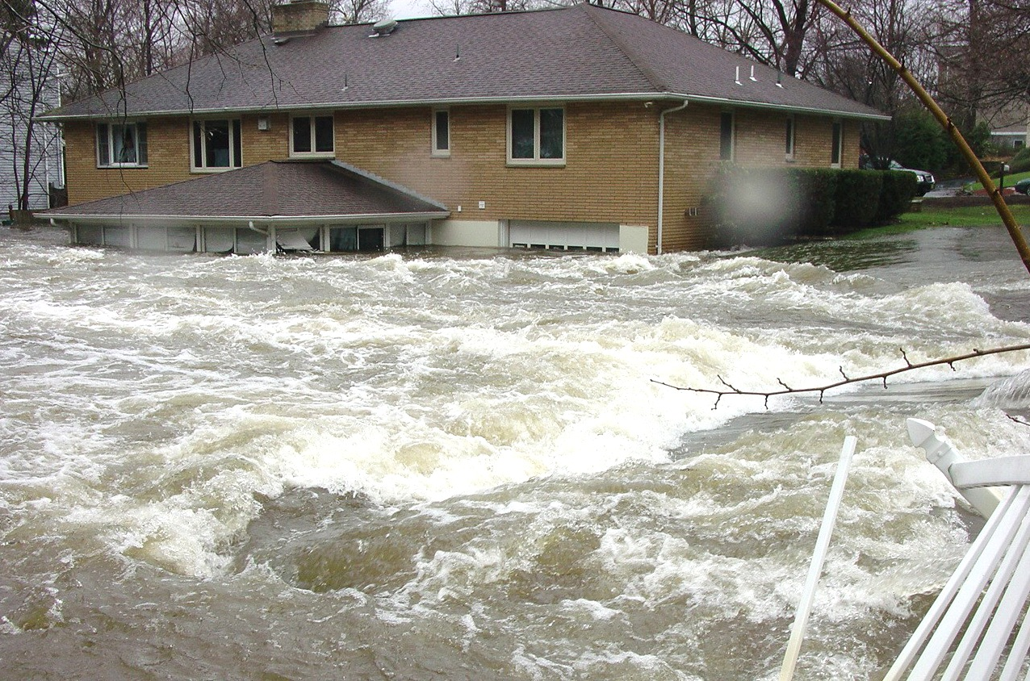
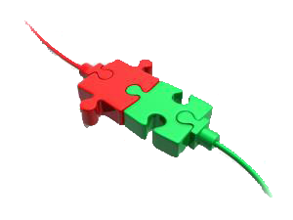


National Flood Interoperability Experiment (NFIE)
Don Cline
Office of Hydrologic Development
National Weather Service, NOAA
CUAHSI WEBINAR
December 10, 2014
National “Street Level” Water Prediction

Slide 3

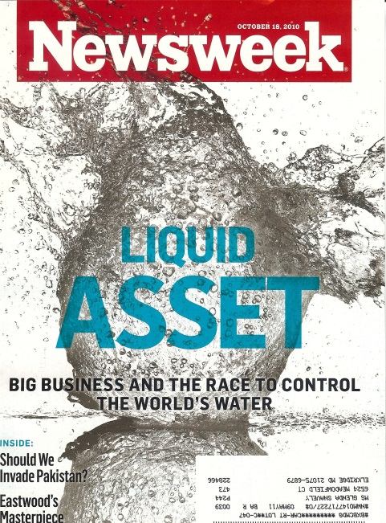

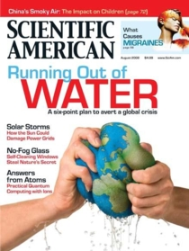






Water Challenges

Slide 4


Stakeholder Priorities
FLOODS TO DROUGHTS - TREETOP TO BEDROCK
Academia
City Planners
Community Councils
Conservation Commissions
Emergency Management Services
Federal Agencies
    NOAA, USGS, USACE,
    FEMA, EPA, NPS, USFWS
Port Authorities
Power and Energy Administrations
Private Sector Companies and NPOs
River Basin Commissions
River Compact Associations
State Climatologists
State, County and City Agencies
    Agriculture
    Environment
    Natural Resources
    Sanitation
    Water Management
    Water Supply
Notes:
Three years ago NOAA joined forces with the USGS and USACE to form IWRSS – Integrated Water Resources Science and Services. We signed an MOU formalizing this agreement in 2011.
Since then, we have conducted extensive outreach with hundreds of stakeholders across the country, representing a wide range of decision makers who need water information
<< CLICK ONCE TO REVEAL LIST >>

Slide 5
Stakeholder Priorities
Flooding
Water Quality
Water Availability
Drought
Climate Change
Need integrated understanding of near- and long-term outlook and risks
Actionable Water Intelligence
Notes:
The message was loud and clear:
While flooding remains a high priority, most stakeholders are concerned about the full gamut of water
They need more, and better integrated water prediction information
They need actionable WATER INTELLIGENCE
<< CLICK ONCE TO REVEAL LIST >>

Slide 6
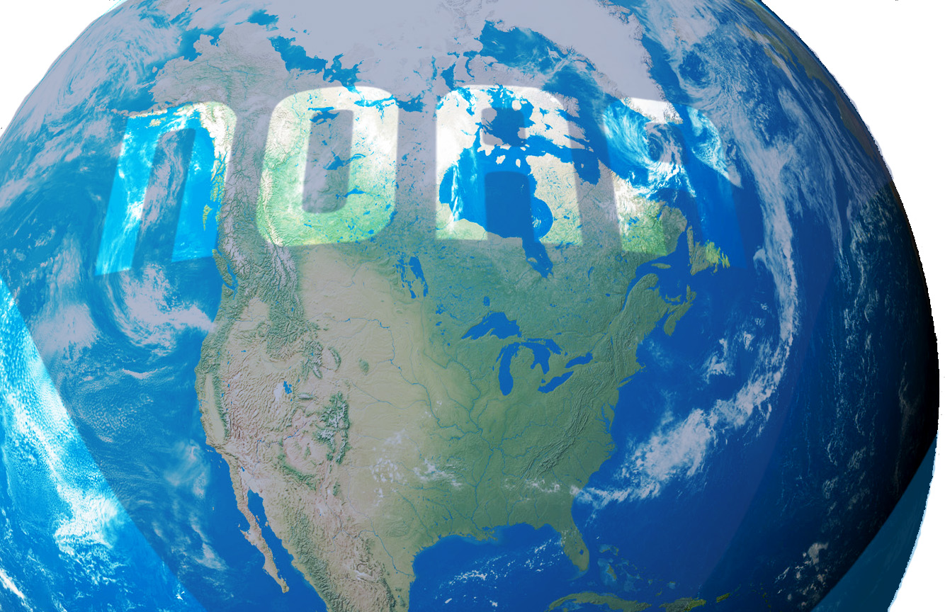
WEATHER
Precipitation
Evaporation
Snowmelt
Runoff
Channel Flow
HYDROLOGY
River Flooding
Water
Prediction
Flash Flooding
Drought
Storm Surge
COASTAL
Tides
Sea Level Rise
Notes:
POINT: THESE ARE FRAGMENTED, DISINTEGRATED TODAY. NEED TO PULL THEM TOGETHER INTO AN INTEGRATIVE FRAMEWORK
MULTIPLE ENTITIES DOING SIMILAR THINGS
Today NOAA provides many types of water prediction information, but it is fragmented across many different line offices and programs.
Moreover, our stakeholders require more comprehensive water prediction information that supports the full gamut of their decision making.
The idea of Earth Intelligence: Water 1.0 is to work towards a unified and improved water prediction capability that complements and expands our overall Earth System Prediction Capability.
NOAA’s new National Water Center is an important catalyst to make this happen.
<< CLICK ONCE TO REVEAL LIST >>

Slide 7
WEATHER
Precipitation
Evaporation
Snowmelt
Runoff
Channel Flow
HYDROLOGY
River Flooding
Water
Prediction
Flash Flooding
Drought
Storm Surge
COASTAL
Tides
Sea Level Rise
Environmental Intelligence:
Total Water Prediction
The National Water Center and the
Transformation of NOAA’s Water Prediction Services
Notes:
POINT: THESE ARE FRAGMENTED, DISINTEGRATED TODAY. NEED TO PULL THEM TOGETHER INTO AN INTEGRATIVE FRAMEWORK
MULTIPLE ENTITIES DOING SIMILAR THINGS
Today NOAA provides many types of water prediction information, but it is fragmented across many different line offices and programs.
Moreover, our stakeholders require more comprehensive water prediction information that supports the full gamut of their decision making.
The idea of Earth Intelligence: Water 1.0 is to work towards a unified and improved water prediction capability that complements and expands our overall Earth System Prediction Capability.
NOAA’s new National Water Center is an important catalyst to make this happen.
<< CLICK ONCE TO REVEAL LIST >>

Slide 8
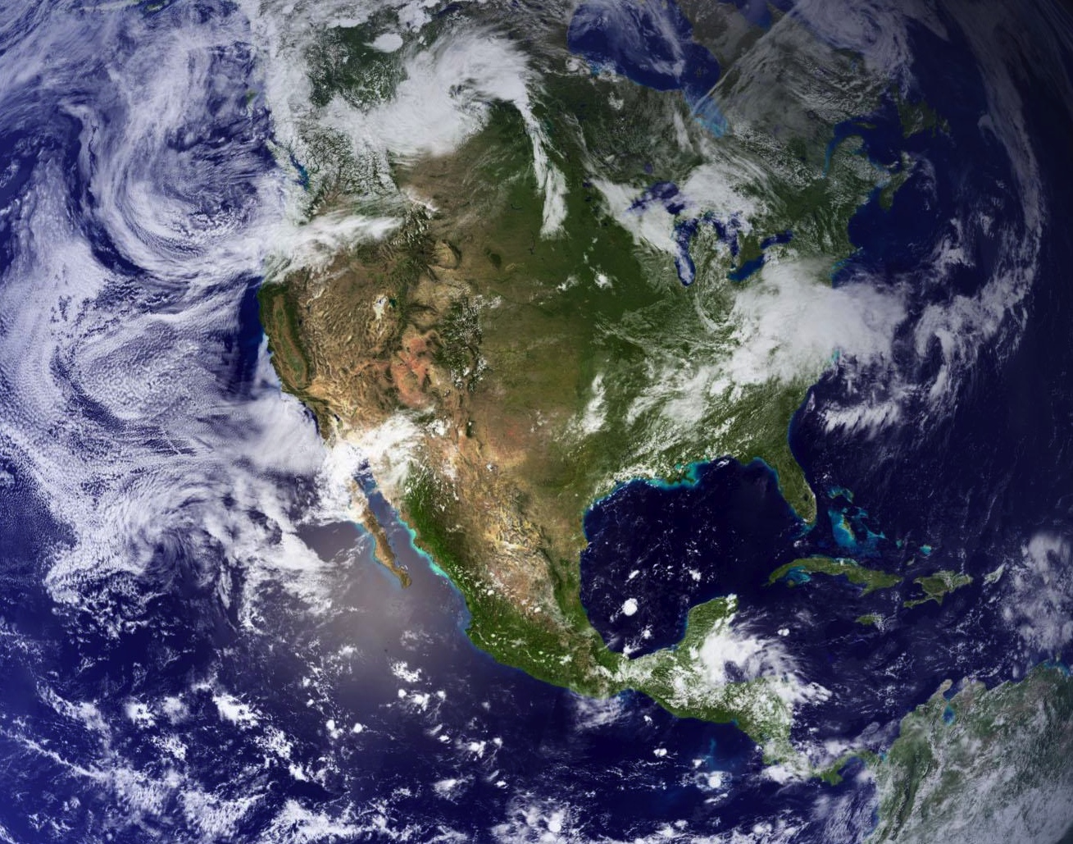

Water – Energy – Food Nexus
Living
Marine
Resources
FOOD
Freshwater Systems
ECOSYSTEM
HEALTH
RECREATION
Total
Water
Prediction
Resilience
HUMAN
HEALTH
INFRA-
STRUCTURE
WATER
ENERGY
Domestic
Availability
Quality
Global
TRANSPOR-
TATION
NATIONAL
SECURITY

Slide 9
WRF-HYDRO System
VISION
Develop and implement the next generation integrated physical earth system prediction capability at weather and longer time scales, to support hours-to-seasonal global prediction including the atmosphere, ocean, land, cryosphere and space.
Notes:
EARTH SYSTEM PREDICTION CAPABILITY is a multi-agency collaboration to provide the global analyses and prediction information needed to support the Nation’s security and economic well-being.
Elements of the National ESPC vision include:
Extend predictive capability to decades using multi-model, multi-agency ensembles
Use ensembles to identify and quantify uncertainty and risk
Advance computational and environmental numerical prediction science and technology
Enhance our understanding of complex interactions of the earth environment

Slide 10
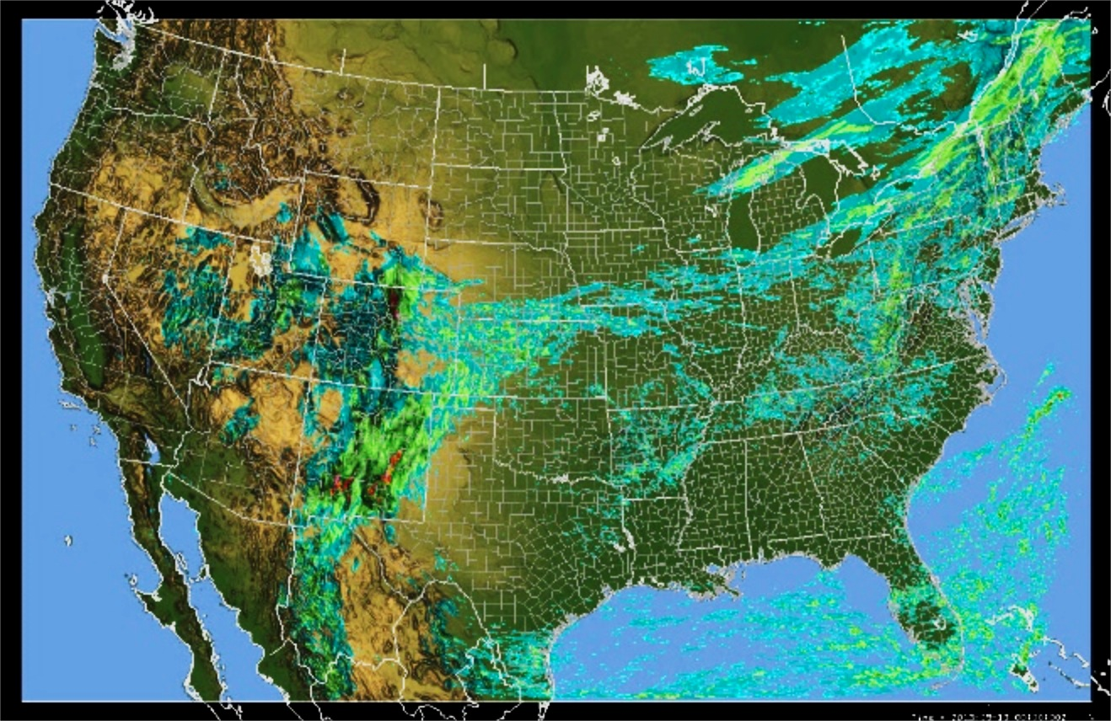
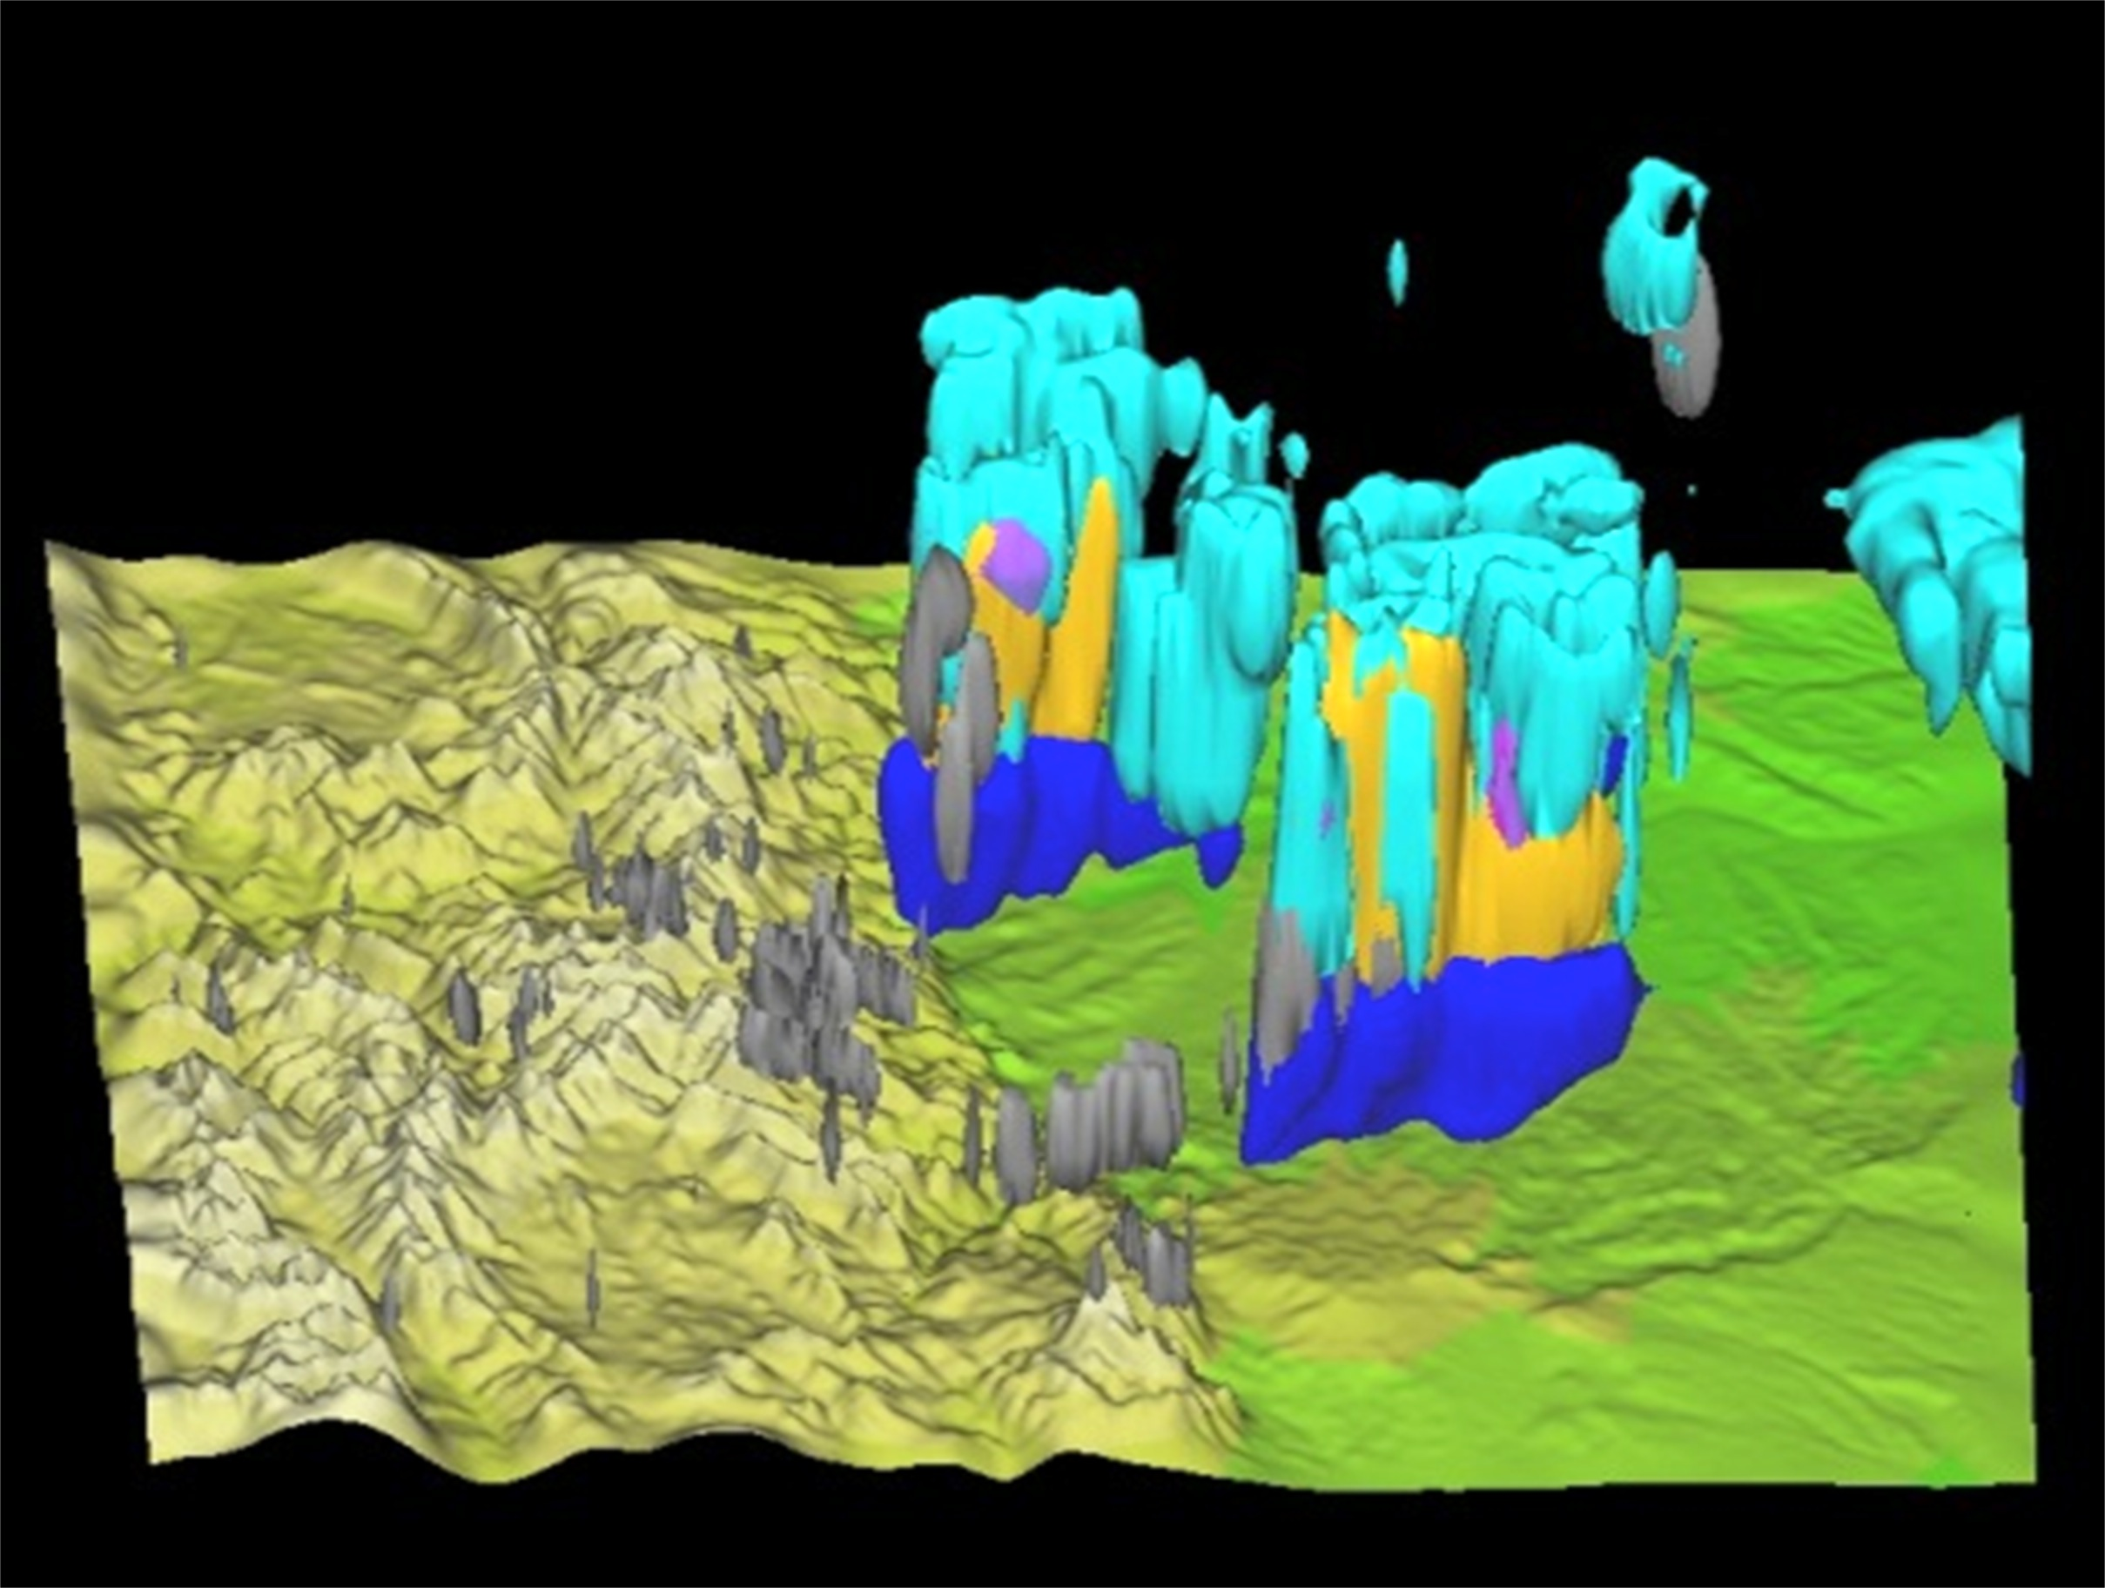
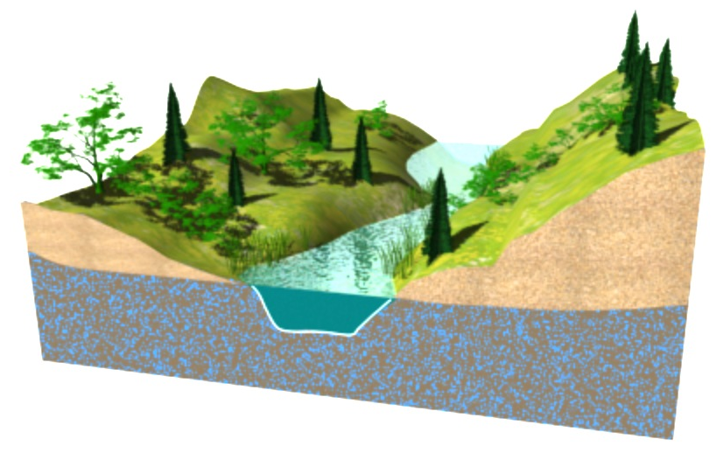
WRF-HYDRO System
Developed by National Center for Atmospheric Research (NCAR)
Community-based and supported
Architecture to couple multi-scale, multi-physics models of the atmosphere and terrestrial hydrology
Support and leveraging of existing ‘Earth System’ modeling enterprise
  WRF, CESM, ESMF
  High performance computing platforms
Modular and extensible
10,000 m
1000 m
100 m
1 m
Notes:
STARTING POINT
To get started in this arena, we’re working with NCAR and their WRF-HYDRO system to develop and test operational capabilities
WRF-HYDRO is designed to handle the wide range of scales important to water prediction

Slide 11
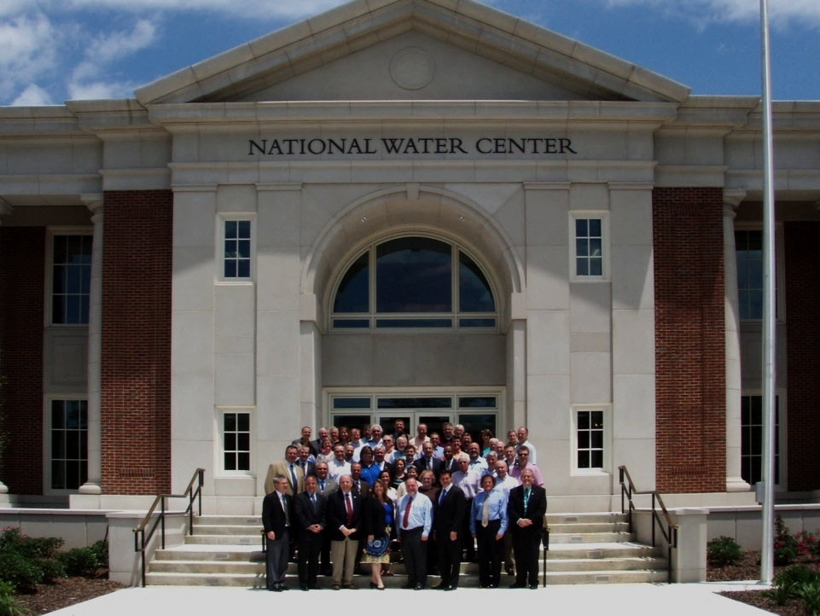
Scientific excellence and innovation driving water prediction and decisions for a water-resilient nation.
Collaborative R&D, Operations
  Support mission-oriented research and development
  Proving Ground Facility
    Science and Technology Transition
  Operations Center
    Socioeconomic Sector Desks
    Regional Desks
    Science Desks
Interagency Staffing
RESEARCH
OPERATIONS
Notes:
Link to NOAA R2O/O2R research funnel

Slide 12
NOAA Research and Development Funnel
All of atmospheric and oceanic science and technology
General Research and Development
Related to NOAA’s Mission
Research Partners
20 Years
Mission-oriented Research and Development to Improve NOAA’s Operational and Information Services
5 Years
NOAA Mission Research and Development
Science and Technology Transition
Test Beds
Requirements and Operational Concepts
Advances in Science and Technology
2 Years
Operational System Development and Implementation
Current Operations
Science and Technology Specific to NOAA Operational and Information Services
Notes:
NOAA Science Advisory Board concept of R2O.
Research structure should enhance the transfer of advances in science and technology into NOAA’s operational and information services.

Slide 13
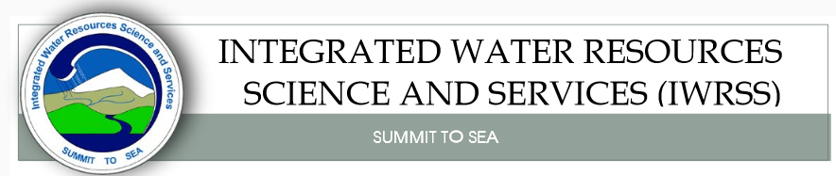
National Water Center
Located on Tuscaloosa Campus of University of Alabama
Operated by National Weather Service to support IWRSS partners (NWS, USGS, Corps of Engineers, with FEMA joining)

Slide 14
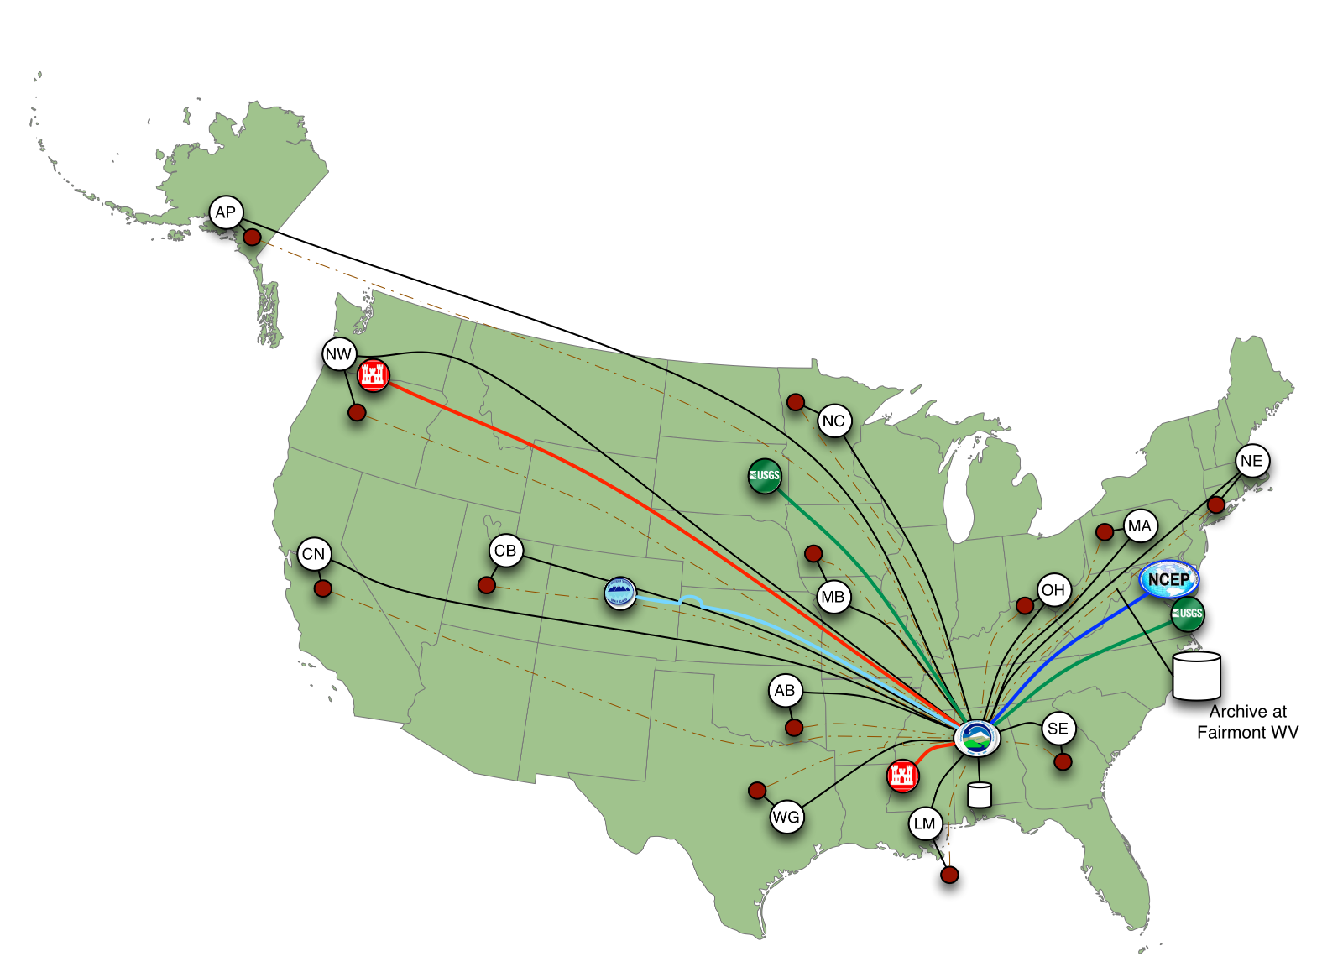
Nationally Synthesize Operations of Regional River Forecast Centers
Creates an opportunity to rethink how hydrology is done
at the national scale for the United States

Slide 15
National Flood Interoperability Experiment
Presented by:
Donald Cline, Acting Director, Office of Hydrologic Development, National Weather Service
David Maidment, University of Texas at Austin
Richard Hooper, President and CEO, CUAHSI
Andrew Ernest, University of Alabama

Slide 16
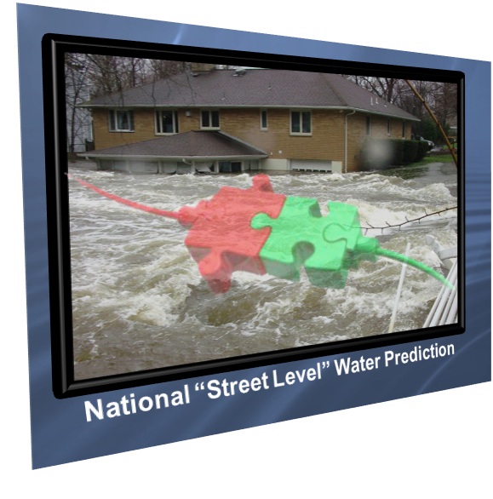
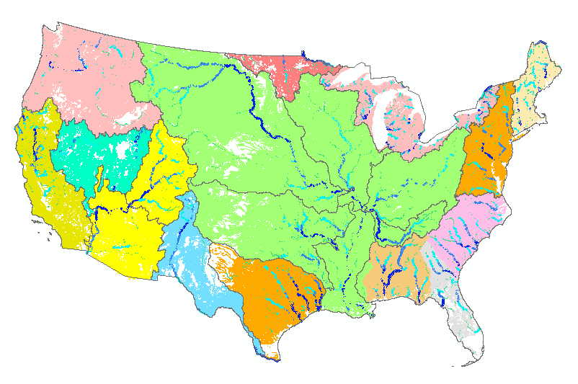
National Flood Interoperability Experiment (NFIE) Research Questions
How can near-real-time hydrologic simulations at high spatial resolution, covering the nation, be carried out?
How can this lead to improved emergency response and community resilience?
How can an improved interoperability framework support the first two goals and lead to sustained innovation in the research to operations process?

Slide 17
















Scope of NFIE
What we are doing: building a national scale research platform for flood data, modeling, forecasting and mapping consistently across the country supported by federal water data and forecasting services, and geospatial information. This is an “interoperability experiment”.
What we are not doing: building an operational flood forecasting system.
The NFIE is an initiative of the academic community in collaboration with government and commercial partners

Slide 18
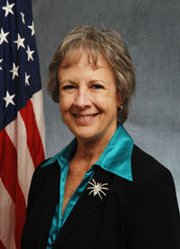

Open Water Data Initiative
Subcommittee on Spatial Water Data leads this effort
This reports to both FGDC and ACWI
Initiated in August 2014
Anne Castle, Asst Secretary for Water and Science, Dept of Interior
Chair

Slide 19
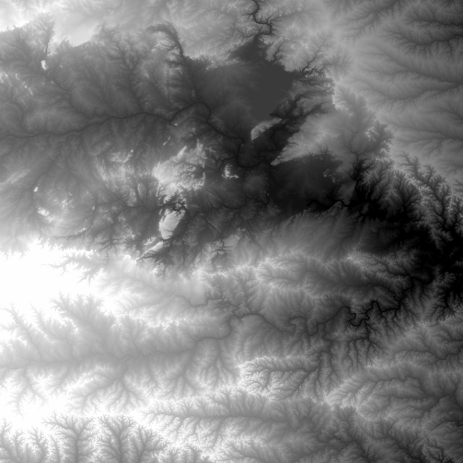
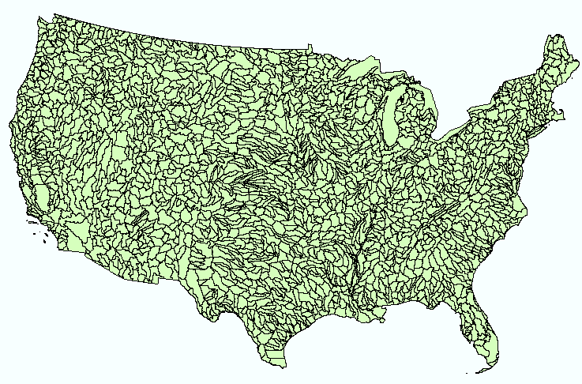
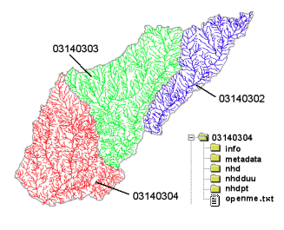
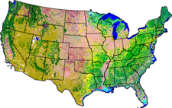
NHDPlus Version 2
Geospatial foundation for a national water data infrastructure
NHDPlus
(built 2004-2014)
National Elevation Dataset
Watershed Boundary Dataset
National Hydrography Dataset
National Land Cover Dataset
2.67 million catchments average area 3 km²,
reach length 2 km

Slide 20
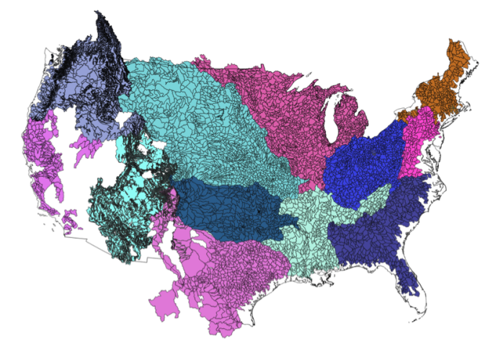

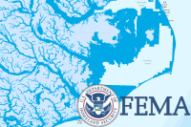
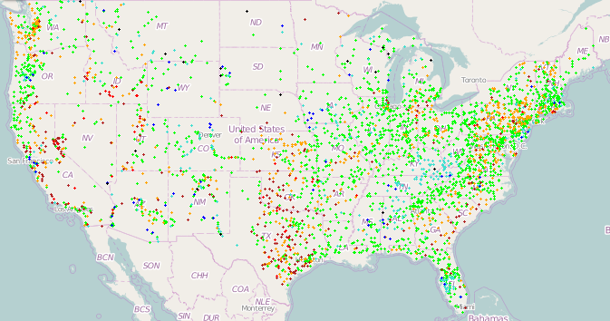
NFIE-Geo for National Flood Interoperability Experiment
Enhanced geospatial database for a national water data infrastructure
NWS Basins and
Forecast Points
USGS Water Watch
Points
National Flood
Hazard Layer
Feature classes:
Subwatershed
Catchment
Flowline
Waterbody
Dam
NFIE-Geo
9 feature classes
5 from NHDPlus
4 from IWRSS
NHDPlus

Slide 21

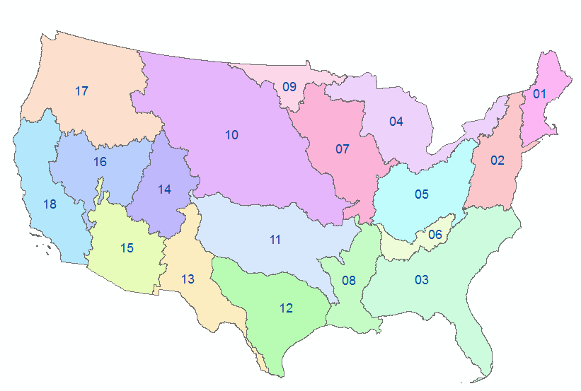


NFIE-Geo as Data Packages in Geoplatform
Enhanced geospatial database for a national water data infrastructure
A data package for each
USGS Water Resource Region
Publish this in the federal Geoplatform
as part of the Open Water Data Initiative
NHDPlus

Slide 22
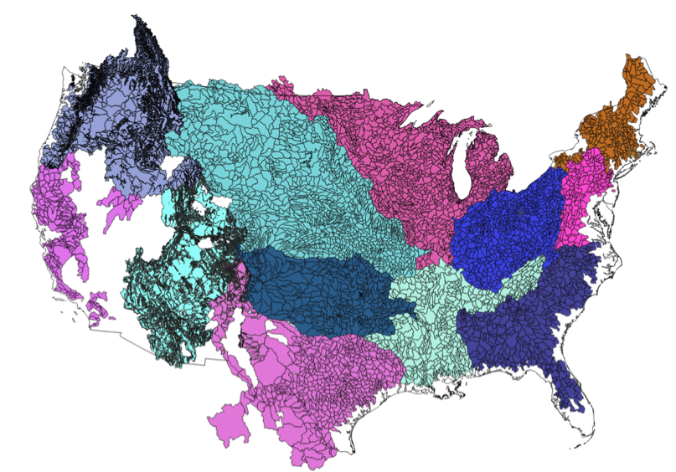
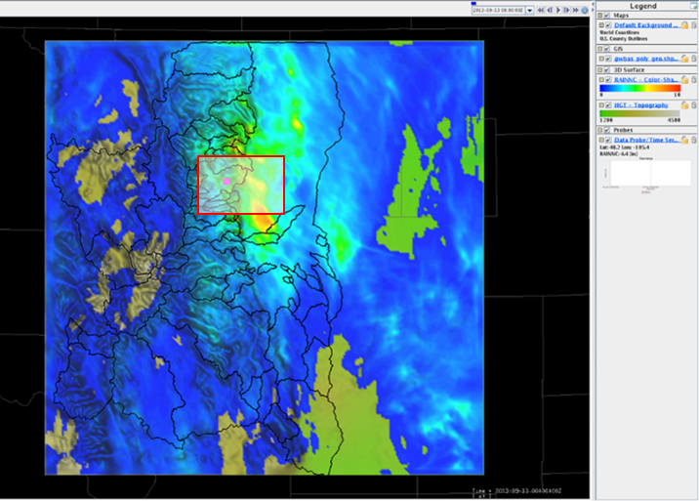
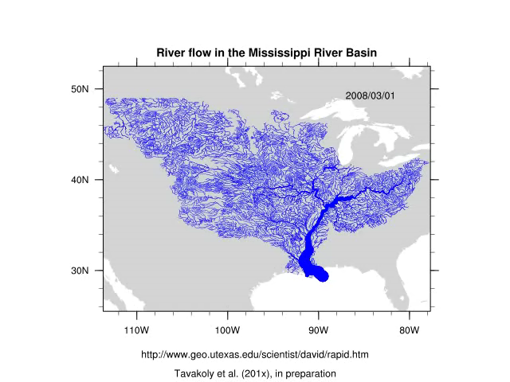
Water Modeling and Forecasting Services
NWS CHPS Modeling Units: 12 CONUS RFCs
Experimental WRF-Hydro
PI-XML to WaterML2
Data Services
RAPID model
flow simulation on NHDPlus
NHDPlus

Slide 23
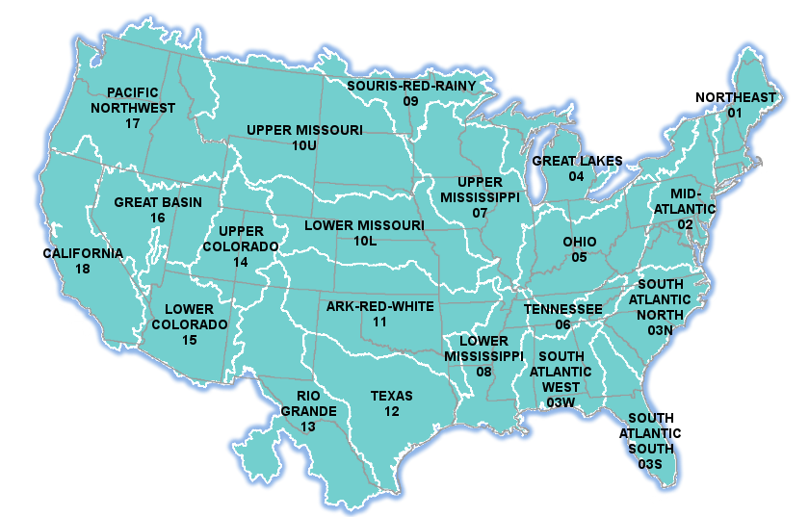
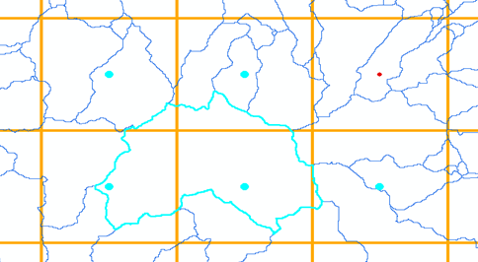
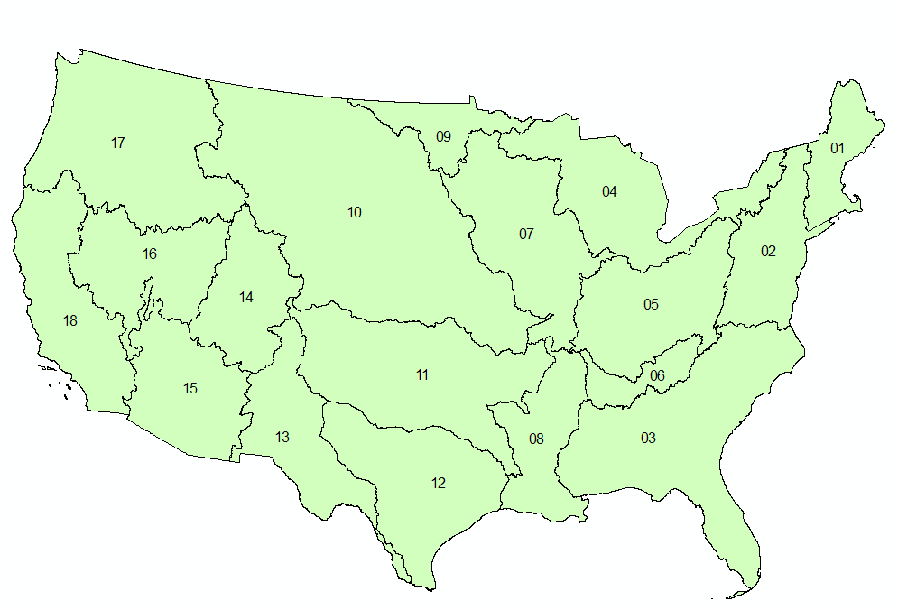
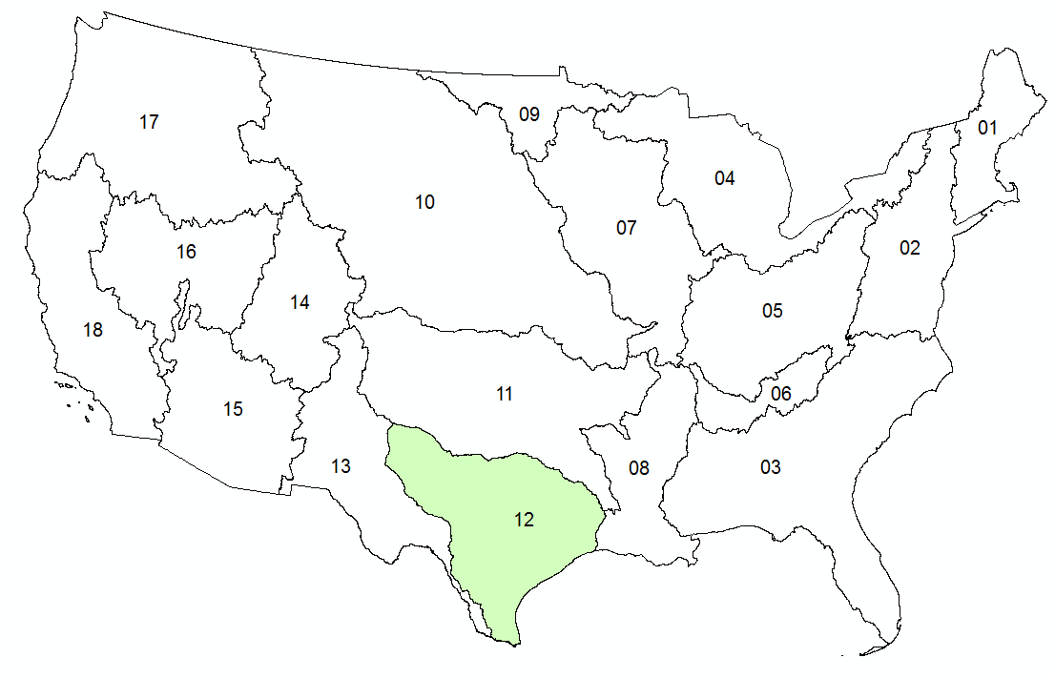

NFIE-Hydro: Computing flows on
2.67 million stream reaches
NWS River Forecasts
WRF-Hydro Model
NHDPlus to
RAPID Conversion
Grid to Catchment Linking
Forecast services
NFIE-Hydro

Slide 24
Four Themes
Science – how can we better connect storm hydrometeorology with flood hydrology?
Technology – how can we create a high spatial resolution, near real-time flood forecasting model for the continental United States?
Decision Support – How is the gap closed between national flood forecasting and local emergency response?
Applications – how can the knowledge and tools created in the first three phases be applied in specific local circumstances to particular flood events?

Slide 25
National Flood Interoperability Experiment
Presented by:
Donald Cline, Acting Director, Office of Hydrologic Development, National Weather Service
David Maidment, University of Texas at Austin
Richard Hooper, President and CEO, CUAHSI
Andrew Ernest, University of Alabama

Slide 26
Timeline for NFIE Student Program
Overview Webinars
Summer Institute Capstone Conference
NFIE Program
Announcement
Technical Webinars
Awards
Announced
Summer Institute Kickoff
Applications Open
Applications Close
Abstracts Due
Dec 2014
Jan 2015
Feb
Mar
Apr
May
Jun
1 – 5
Jul
15 – 17

Slide 27
NFIE Structure
Webinars – Overview of NFIE goals and structure (January) and technical description of resources available (February)
Kick-off Event– Weeklong conference with details of data resources including software carpentry and data carpentry training
Residential Institute– Summer institute at Tuscaloosa with curriculum around four themes
Non-residential Program– Projects performed at students’ home institute
Capstone Event– Projects presented from residential and non-residential students

Slide 28
Application Process
Eligibility– Open to graduate students (including incoming first-year) at US universities; non-US citizens can apply.
Application– One-page statement of interest; letter of support from advisor; brief CV
Award– Travel grant to kick-off and/or room/board/tuition for summer institute. Additional travel grants to Capstone event for non-residential students who submit an abstract to present paper.
Timing– Details finalized in January with awards announced by April.

Slide 29
National Flood Interoperability Experiment
Presented by:
Donald Cline, Acting Director, Office of Hydrologic Development, National Weather Service
David Maidment, University of Texas at Austin
Richard Hooper, President and CEO, CUAHSI
Andrew Ernest, University of Alabama

Slide 30
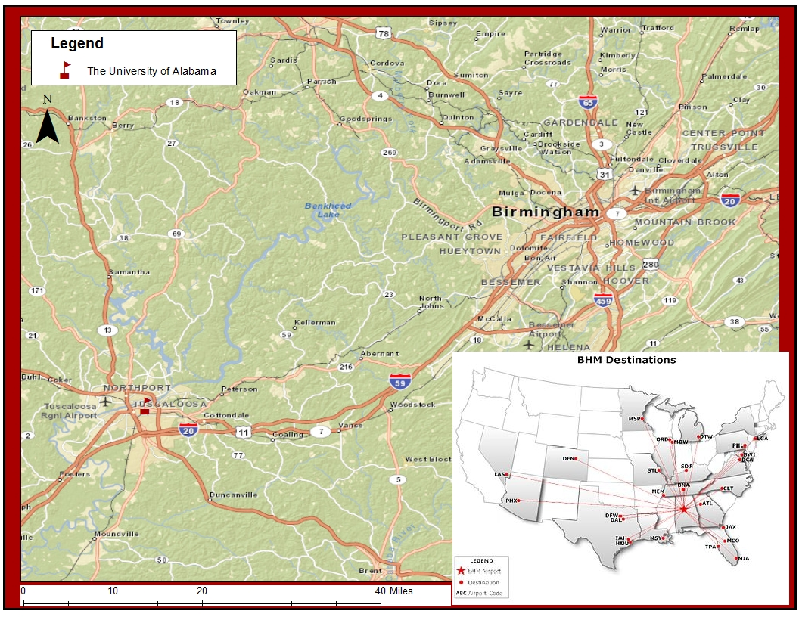
University of Alabama, Tuscaloosa

Slide 31
Conclusions
Goal is to produce national high spatial resolution stream and “street level” water predictions
The National Weather Service is inviting the academic community to be a partner
This is an experiment – what is important are the insights it produces
Everything is open to change and variation. Your ideas, innovation, and contribution are very welcome
Next NFIE Webinar Weds Jan 7

