Slide 1
Statistics in WR: Lecture 12
Key Themes
  Regression y|x and x|y
  Adjusted R²
  Time series and seasonal variations

Slide 2
Regression of Y|X and X|Y

Slide 3
R² and Adjusted R²
SUMMARY OUTPUT
Regression Statistics
Multiple R | 0.950344
R Square | 0.903154 | 0.903154347
Adjusted R Square | 0.898543 | 0.89854265
Standard Error | 159033.1
Observations | 23
ANOVA
 | df | SS | MS | F | Significance F
Regression | 1 | 4.95309E+12 | 4.95309E+12 | 195.8399 | 4.07E-12
Residual (error) | 21 | 5.31122E+11 | 25291521454
Total (y) | 22 | 5.48421E+12

Slide 4
Time Series Trend:
Tide Levels at San Diego
http://tidesandcurrents.noaa.gov/sltrends/sltrends_station.shtml?stnid=9410170%20San%20Diego,%20CA

Slide 5
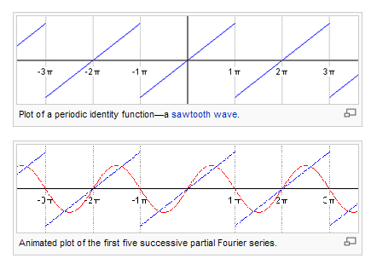
One harmonic

Slide 6
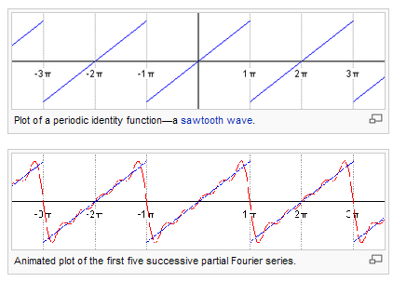
Five harmonics
http://en.wikipedia.org/wiki/Fourier_series

