Slide 1
CE 397 Statistics in Water Resources, Lecture 2, 2009
David R. Maidment
Dept of Civil Engineering
University of Texas at Austin

Slide 2
Key Themes
Statistics
  Parametric and non-parametric approach
Data Visualization
Distribution of data and the distribution of statistics of those data
Reading: Helsel and Hirsch p. 17-51 (Sections 2.1 to 2.3
Slides from Helsel and Hirsch (2002) “Techniques of water resources investigations of the USGS, Book 4, Chapter A3.

Slide 3
Characteristics of Water Resources Data
Lower bound of zero
Presence of “outliers”
Positive skewness
Non-normal distribution of data
Data measured with thresholds (e.g. detection limits)
Seasonal and diurnal patterns
Autocorrelation – consecutive measurements are not independent
Dependence on other uncontrolled variables e.g. chemical concentration is related to discharge

Slide 4
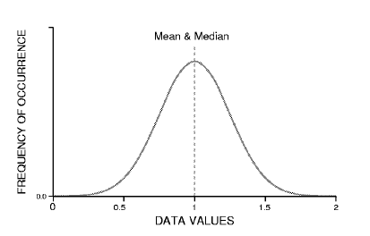
Normal Distribution
From Helsel and Hirsch (2002)

Slide 5
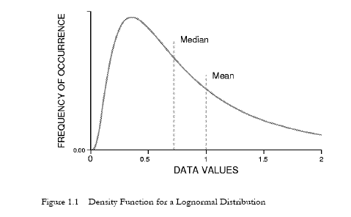
Lognormal Distribution
From Helsel and Hirsch (2002)

Slide 6
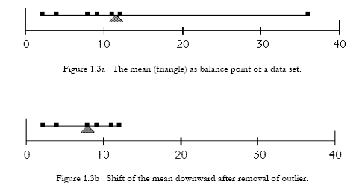
Method of Moments
From Helsel and Hirsch (2002)

Slide 7
Statistical measures
Location (Central Tendency)
  Mean
  Median
  Geometric mean
Spread (Dispersion)
  Variance
  Standard deviation
  Interquartile range
Skewness (Symmetry)
  Coefficient of skewness
Kurtosis (Flatness)
  Coefficient of kurtosis

Slide 8
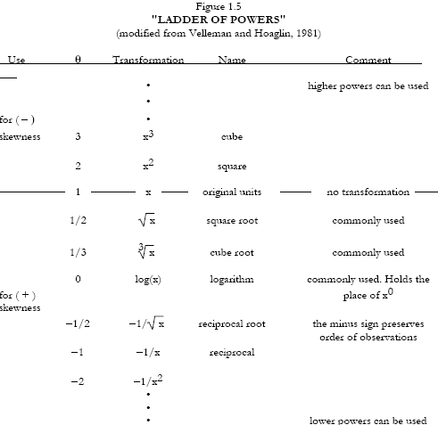
y = x^{θ}
From Helsel and Hirsch (2002)

Slide 9
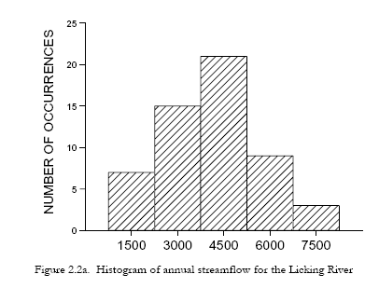
Histogram
From Helsel and Hirsch (2002)
Annual Streamflow for the Licking River at Catawba, Kentucky
03253500

Slide 10
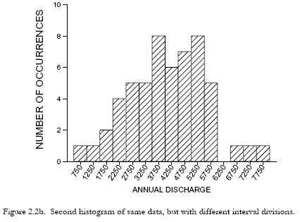
Histogram revised
From Helsel and Hirsch (2002)

Slide 11
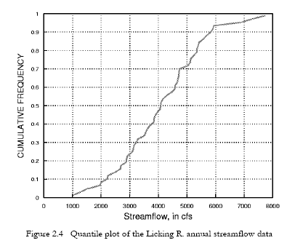
Quantile Plot
From Helsel and Hirsch (2002)

Slide 12
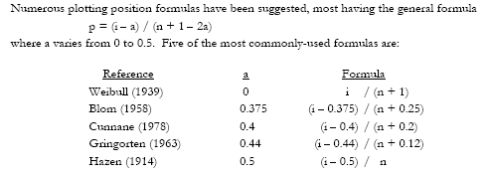
Plotting positions
i = rank of the data with i = 1 is the lowest
n = number of data
p = cumulative probability or “quantile” of the data value (its percentile value)

Slide 13
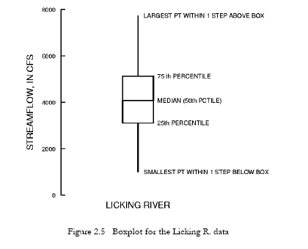
Box and Whisker Plot
(Tukey (1977) “Exploratory data analysis”)
Whisker
Box
Step = 1.5 * IQR
IQR = 75th % – 25th %
From Helsel and Hirsch (2002)

Slide 14
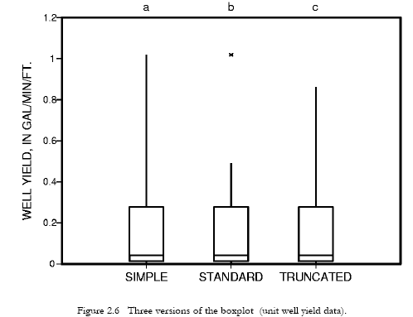
Variants on the Box Plot
Largest value
90th %
Largest value within
“one step”
From Helsel and Hirsch (2002)

Slide 15
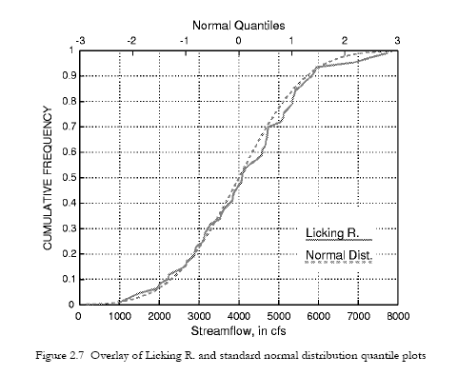
Normal Distribution Quantile Plot
From Helsel and Hirsch (2002)

Slide 16
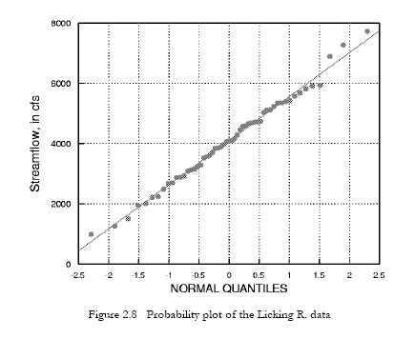
Probability Plot with Normal Quantiles (Z values)
q
z
From Helsel and Hirsch (2002)

Slide 17
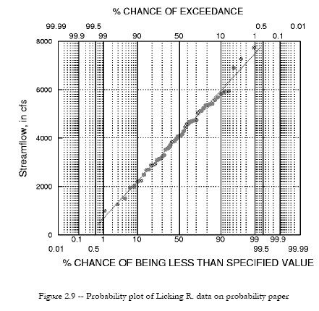
Probabilty Plot on Probability Paper
From Helsel and Hirsch (2002)

Slide 18
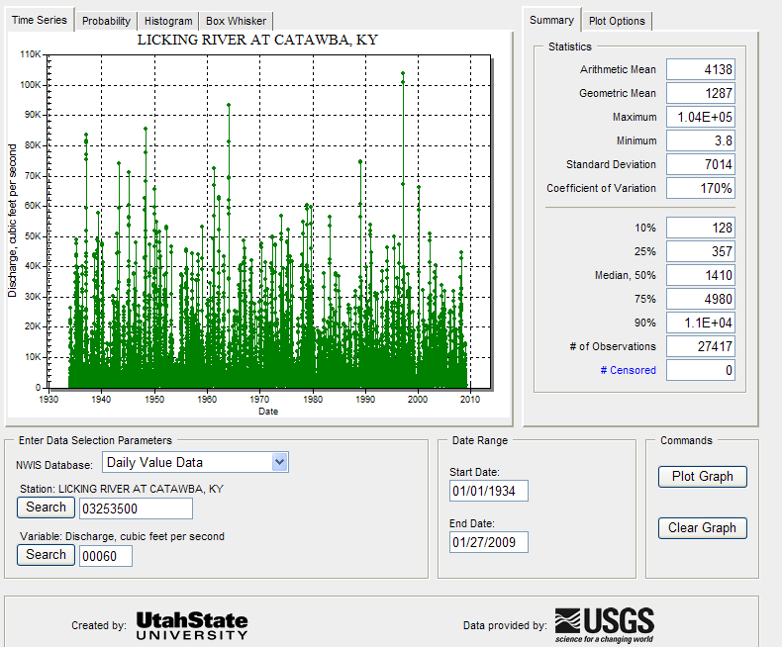
Time Series Analyst for Licking River
http://tsa.usu.edu/nwisanalyst/
Time Series Plot
SiteID
00060 = Daily streamflow

Slide 19
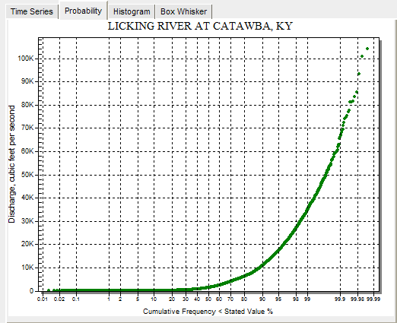
Probability Plot

Slide 20
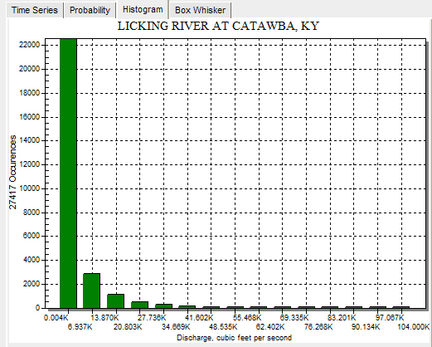
Histogram

Slide 21
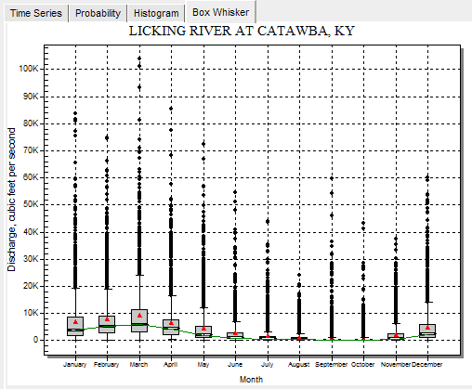
Box and Whisker Plot

Slide 22
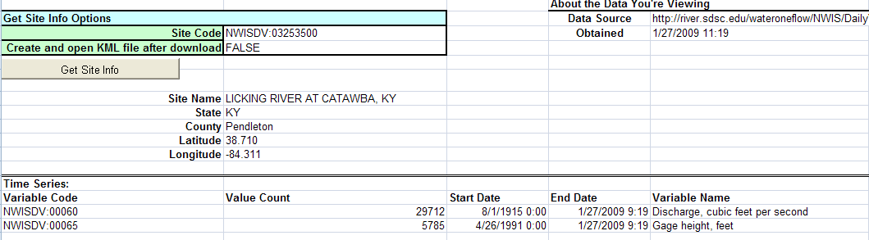
GetSiteInfo in HydroExcel
http://river.sdsc.edu/wateroneflow/NWIS/DailyValues.asmx?WSDL

Slide 23
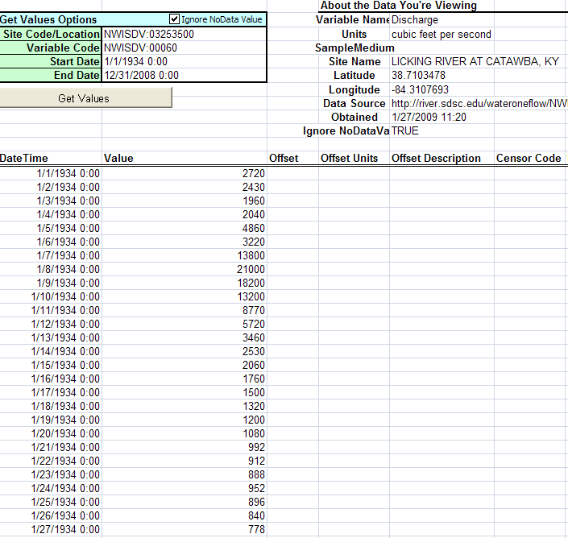
Daily Flows in HydroExcel

Slide 24
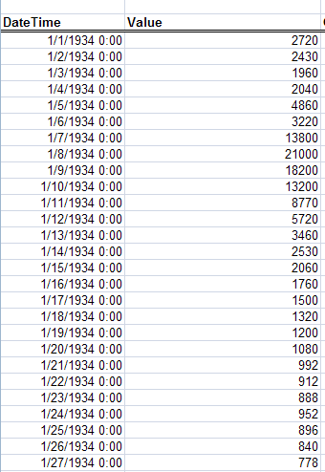
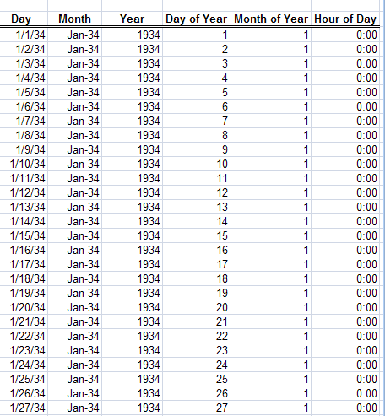
“Dimensions” of Time in HydroExcel

Slide 25
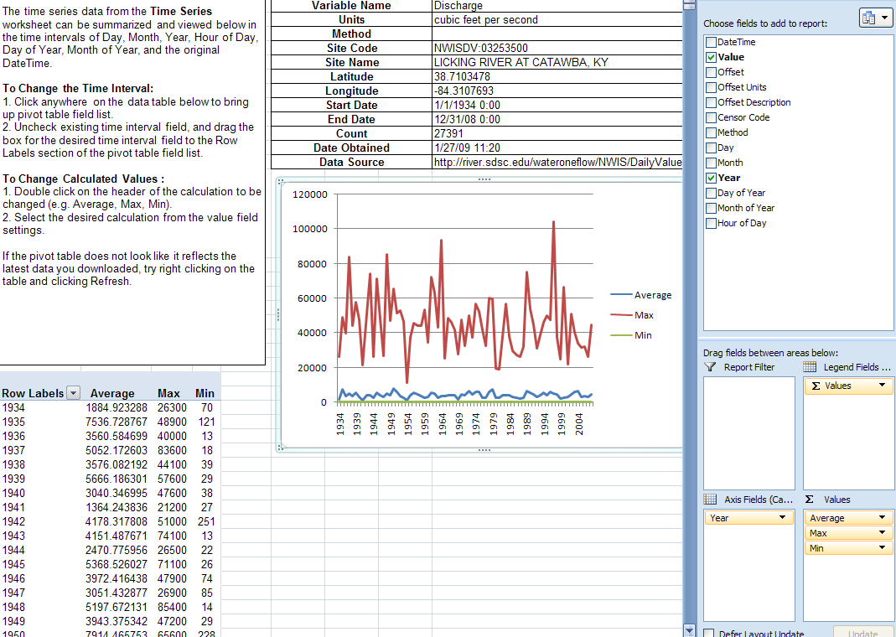
Annual Flows From HydroExcel
Annual Flows produced using Pivot Tables in Excel

