Slide 1
Presentation for TWDB FLOG/FIM Subcommittee, 6/30/2023
Geospatial Representation of Bridge-Class Culverts
Presented by
David Maidment and Tim Whiteaker
Center for Water and the Environment, University of Texas at Austin
Yan Liu, Oak Ridge National Laboratory
Research reported here is supported by TxDOT RTI Project 0-7095
Evaluate Improved Streamflow Measurement at TxDOT Bridges
Acknowledgements: Rose Marie Klee (H&H Director, DES), Trenton Ellis (H&H, DES),
Shelley Pridgen (Project Manager, RTI)

Slide 2
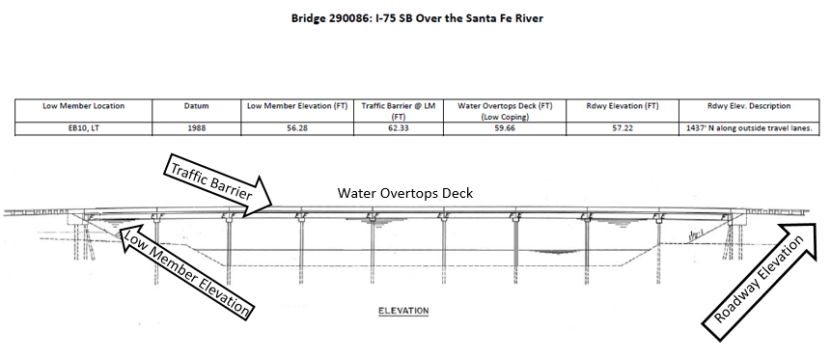
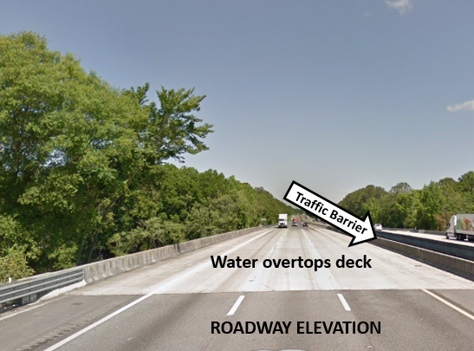
NWS/TXDOT Collaboration
Example NWS/FDOT Collaboration:
In order to provide actionable information to all of partners, FDOT & NWS determined four impacting points on or near a bridge that should be added as impact statements. These are:
Low member - Lowest structural beam across the river
Roadway Elevation - Lowest elevation of travel lane approach to the bridge
Water overtops deck - Elevation of travel lane on bridge
Traffic Barrier - Elevation of top of the guard rail on bridge
When using these four impacting points, common terminology has been developed to describe these impacts that can be implemented across all FDOT regions. The terminology we’ve selected is as follows:
Low Member | Water reaches the base of the <insert roadway name> bridge
Roadway Elevation | Water reaches the approach road surface to the <insert roadway name> bridge.
Water Overtops Deck | Water begins to flood the <insert road name> bridge travel lanes.
Traffic Barrier | Water reaches the top of the <insert road name> bridge railing
Jason Johnson
Hydrologist-in-Charge, WGRFC

Slide 3
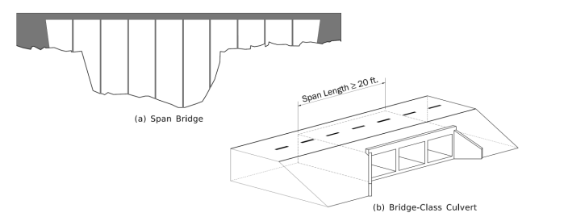
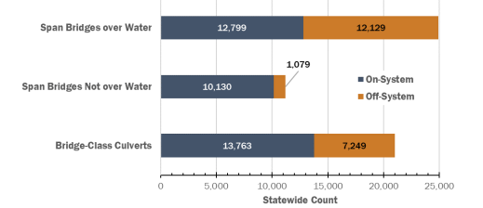
Span Bridges and Bridge-Class Culverts
If more than 20’ in length along the roadway, they have to be inspected every two years – National Bridge Inventory
Total number of NBI Structures Over Water = 45,940 (82%)
24,928
10,309 (18%)
21,012

Slide 4
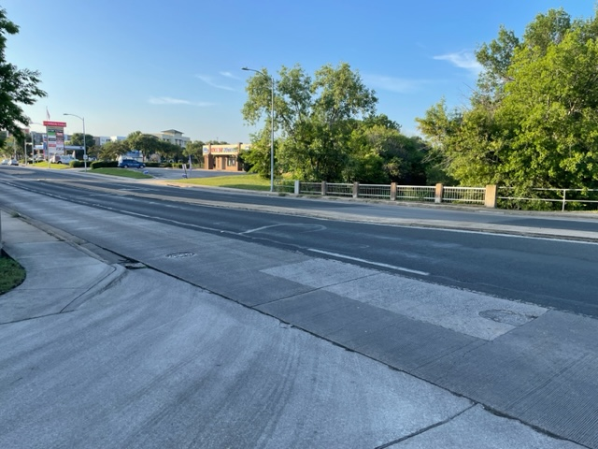
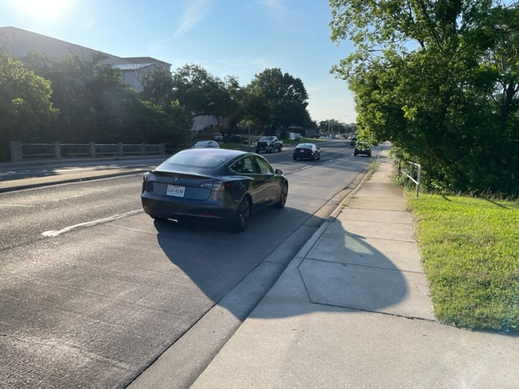
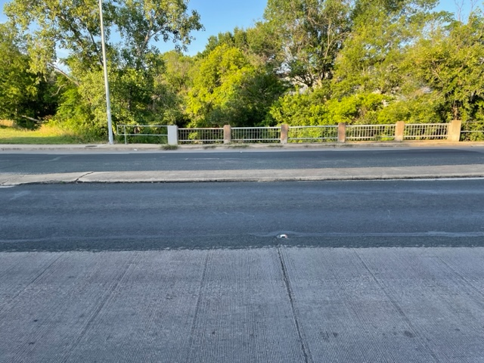
Culvert on Anderson Lane at Shoal Creek in Austin, Tx

Slide 5
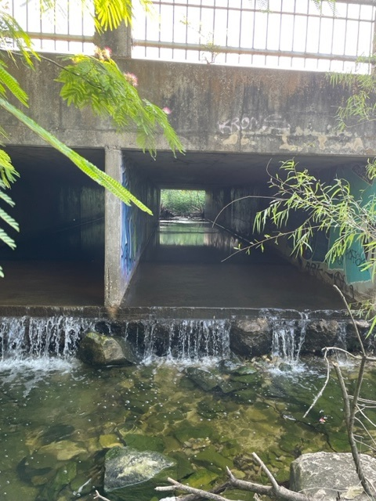
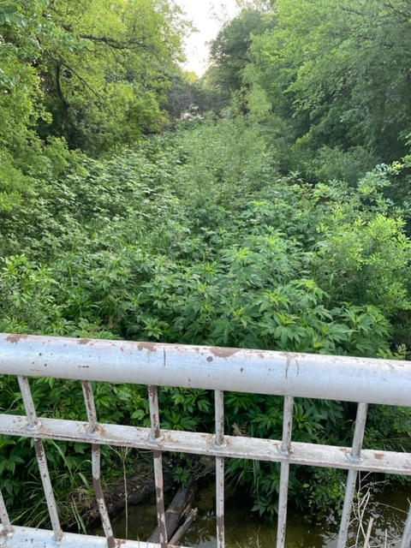
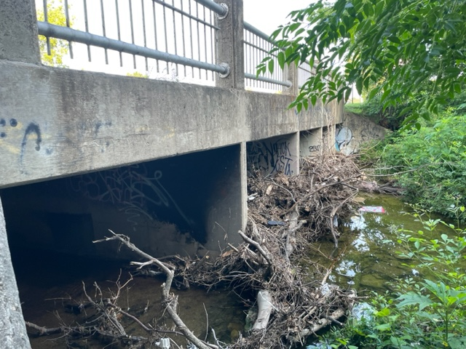
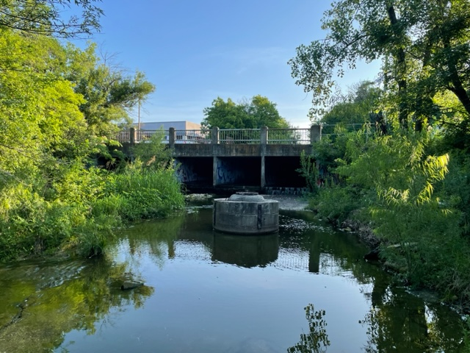
Views from Creek Level
Upstream
Downstream
Bed erosion and overfall
on downstream side
Debris on
upstream side

Slide 6
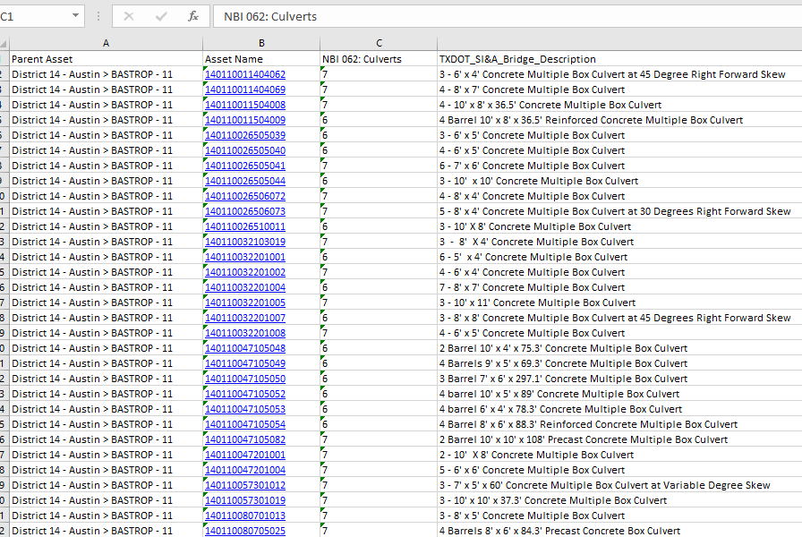
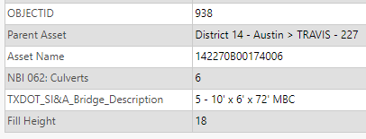
Culvert Information from AssetWise
Internal database of TxDOT bridge and culvert assets
Maintenance
Bridge Number
(Culvert condition 1-9)
(On top of culvert)
10’
6’
Five Box Culverts
72’

Slide 7
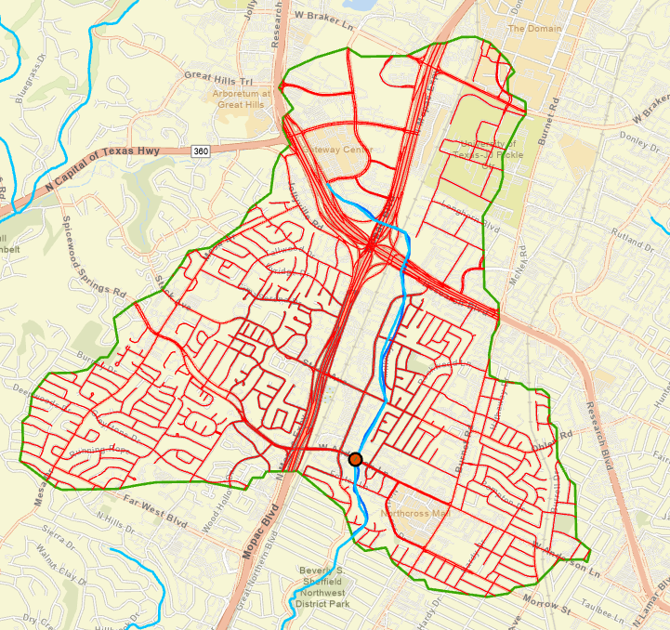
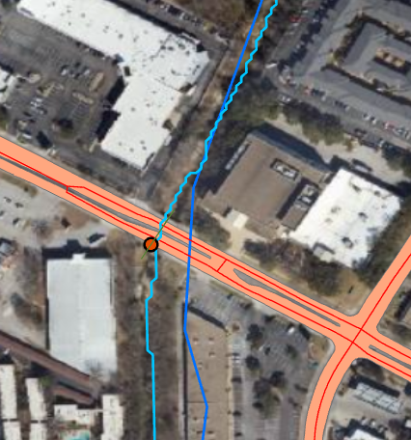
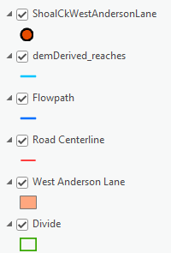
Culvert on Shoal Creek at West Anderson Lane, Austin, Tx

Slide 8
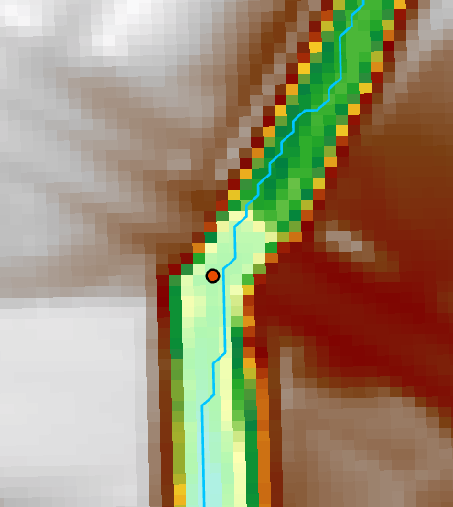
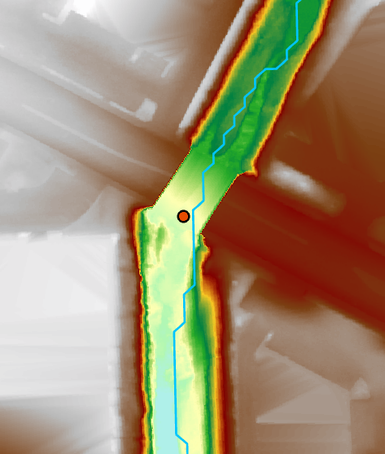
DEM Resolution
Fathom DEM that we used State-wide for Pin2Flood
Current TNRIS standard for individual data tiles
3m DEM
1m DEM

Slide 9
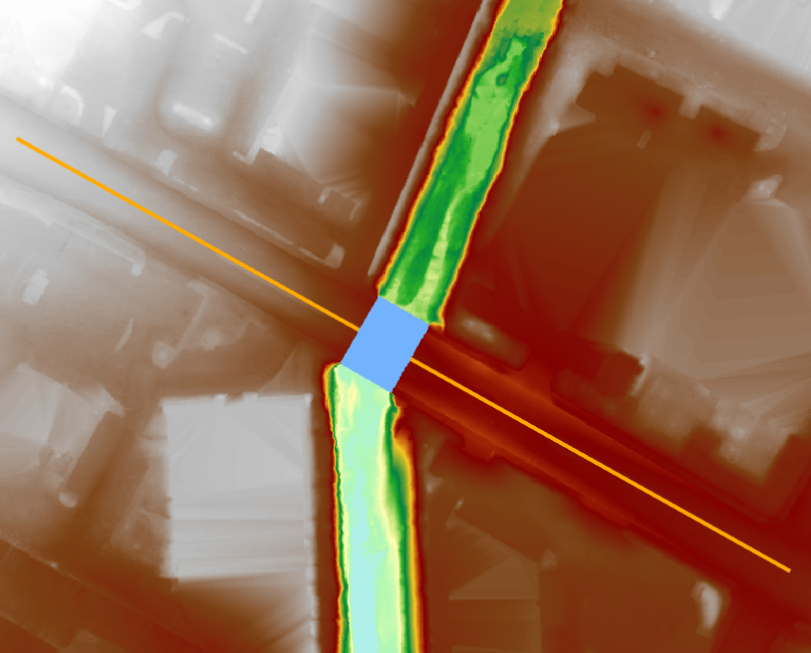
Elevation Profile along Road
Minimum elevation point on approach road is not on the bridge

Slide 10
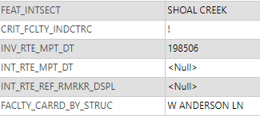
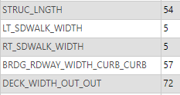
Culvert Template
Streamflow
Stream Centerline
Width_Curb_Curb
Deck_width_Out_Out
Road Centerline
NBI Point
Sidewalk_Width
Struct_Length

Slide 11
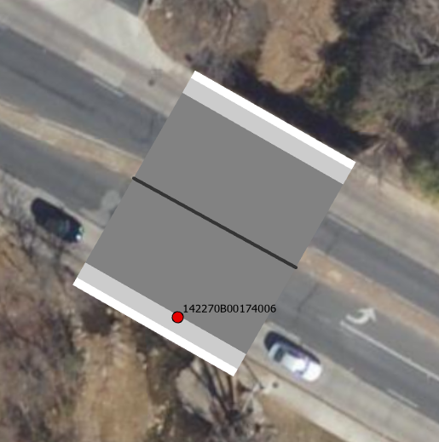
Building Culvert Template
Create centerline of length 54’
Buffer by 36’ to get deck width out to out (72’/2)
Buffer by 28.5’ to get road curb to curb (57’/2)
Buffer by 33.5’ to get side walks (28.5’ + 5’)
Union these three polygons to create road, sidewalk, berm polys

Slide 12
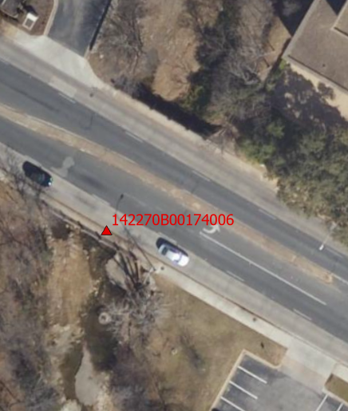
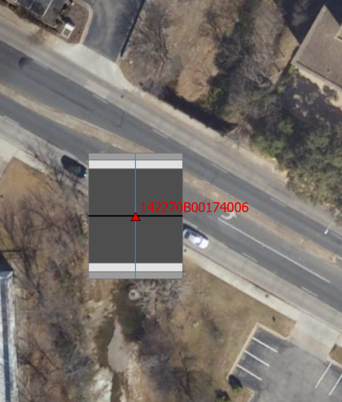
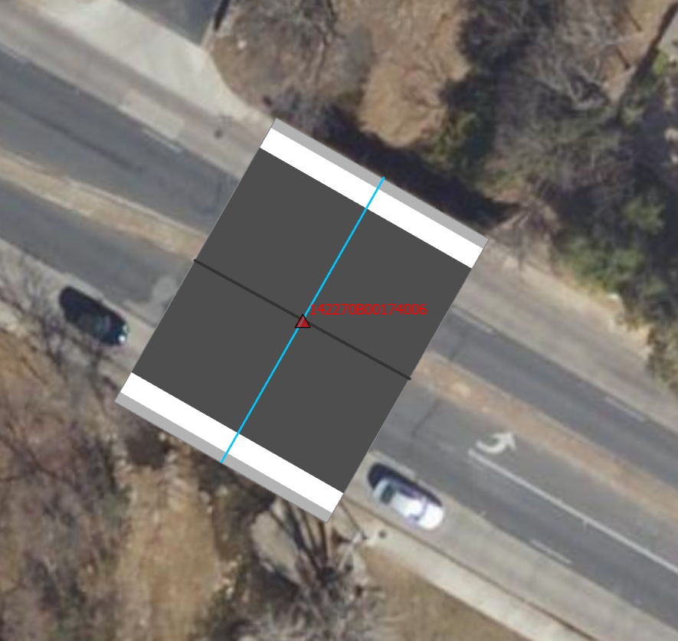
Relocate Culvert Template
Translate and Rotate the Template
Start with the NBI Point
Create the Culvert Template
Correct Position and Orientation

Slide 13
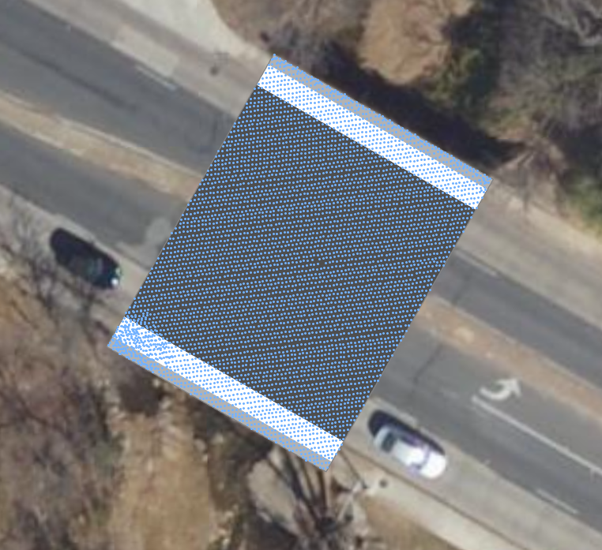
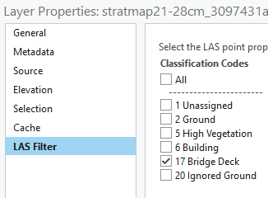
Add LIDAR points Classified as Bridge
Bridge LIDAR points (5237)

Slide 14
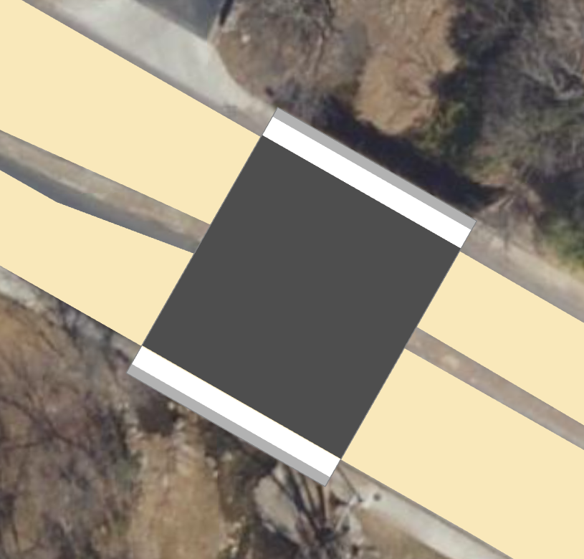
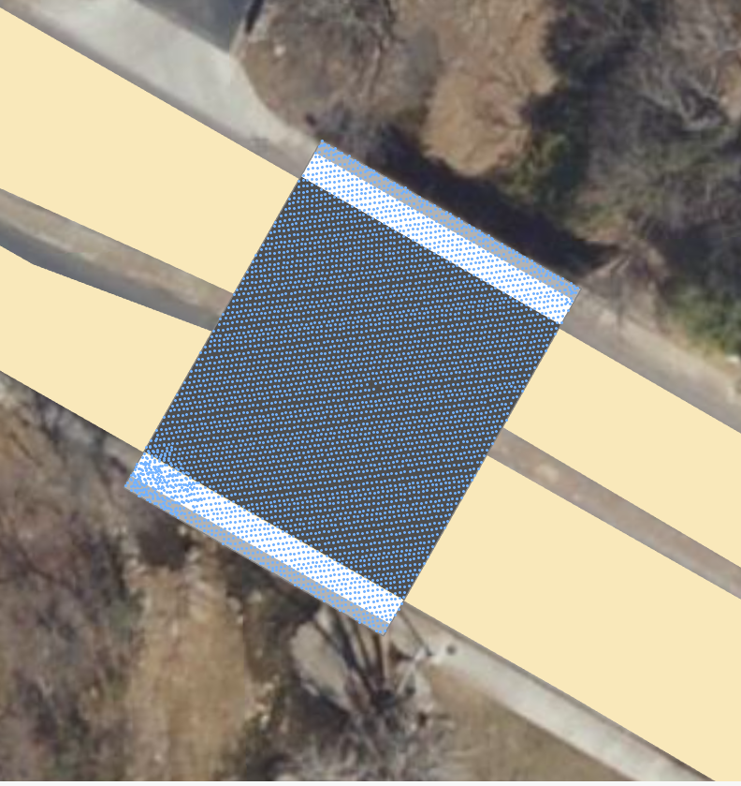
Add Ecopia Road Polygons
They line up very well with the Culvert polygon
Berms
Road on Culvert
Sidewalks
Ecopia Road

Slide 15
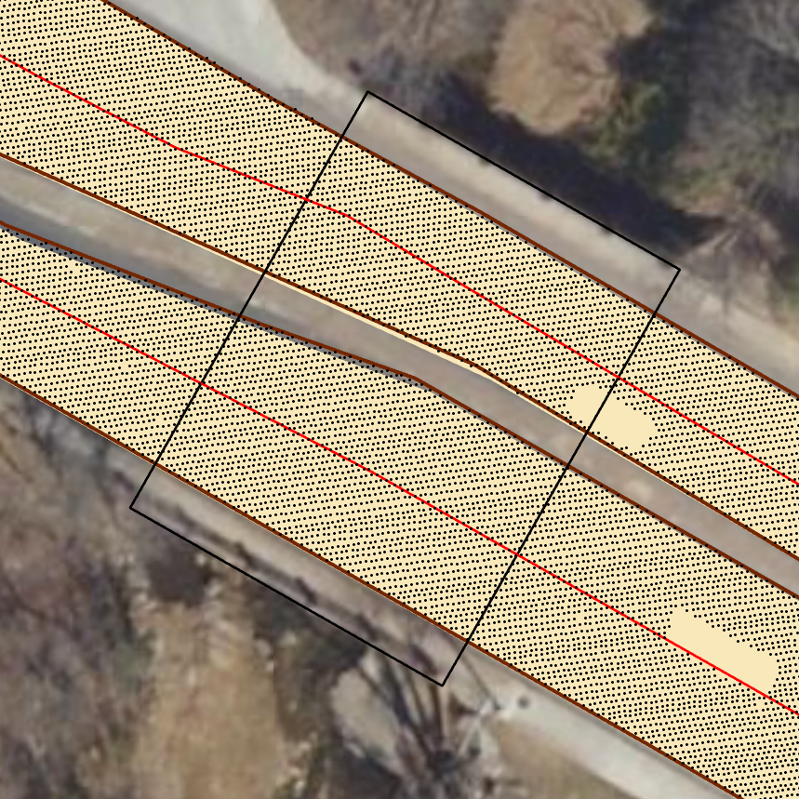
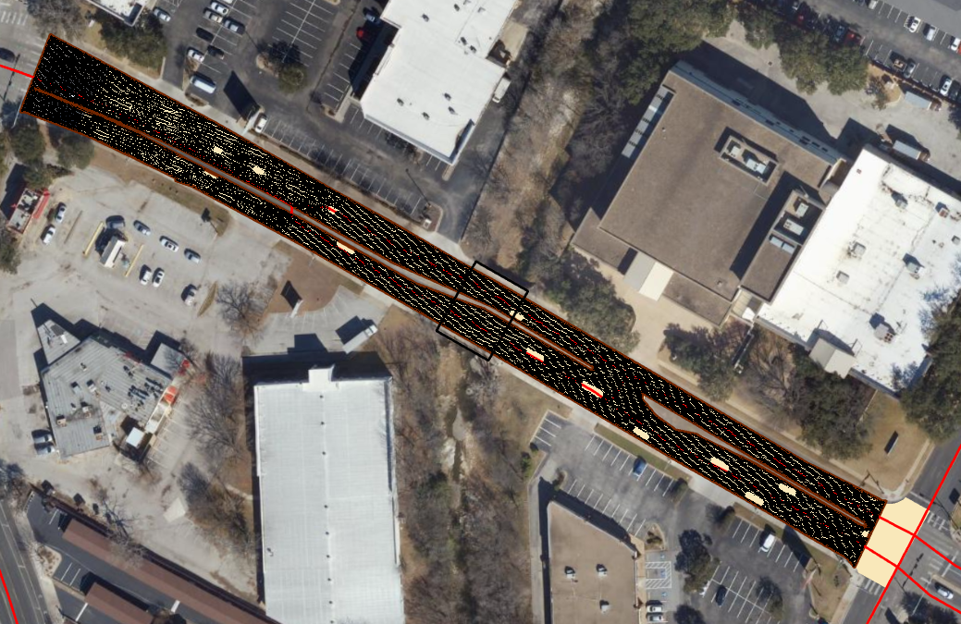
Add all Road LIDAR points

Slide 16
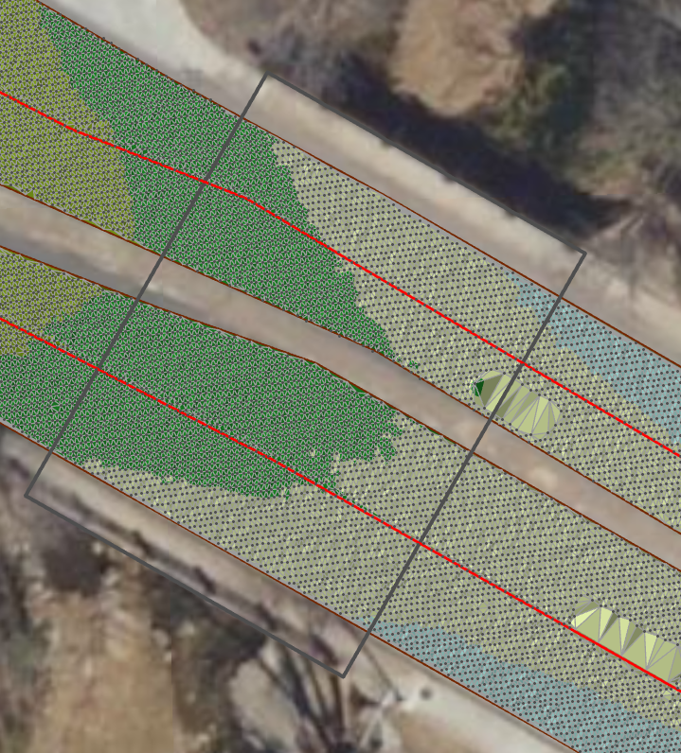
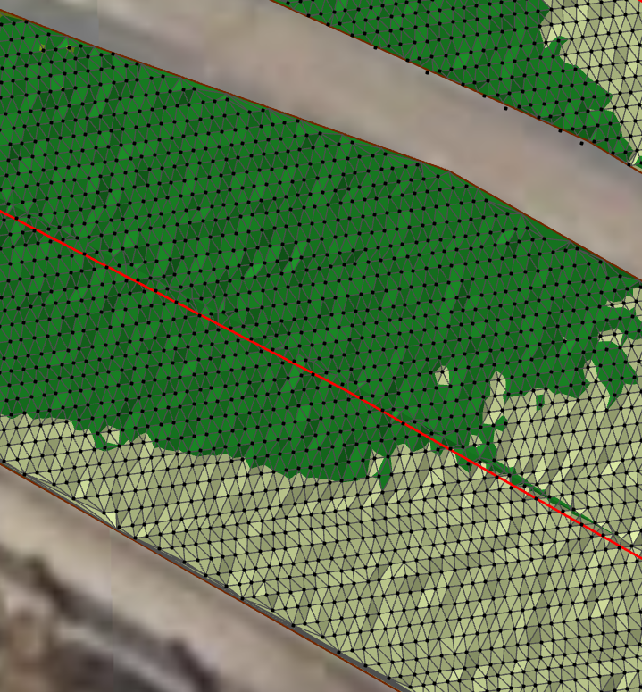
3D Surface as a Triangulated Irregular Network

Slide 17
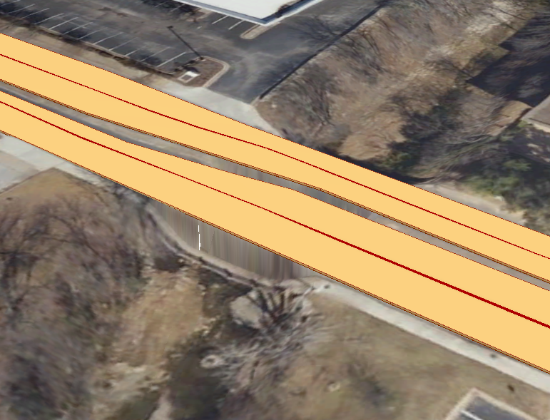
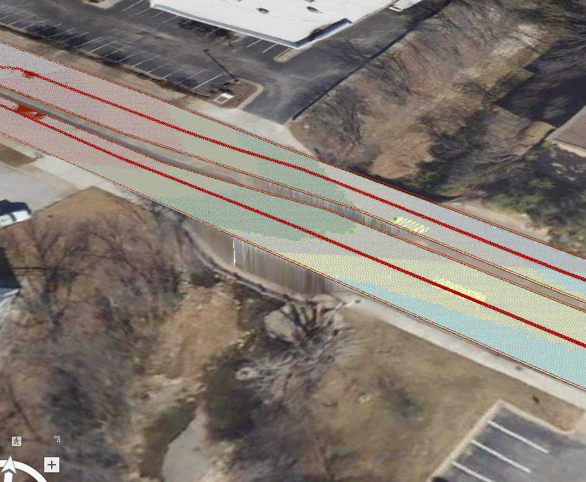
Use LIDAR points to create 3D road centerline and 3D polygon extent and combine with TIN to create a 3D road surface (Yan Liu)
Culvert

Slide 18
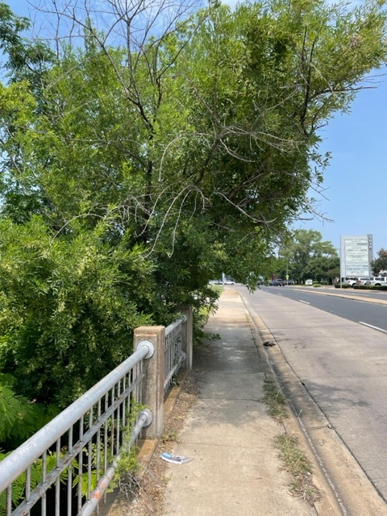
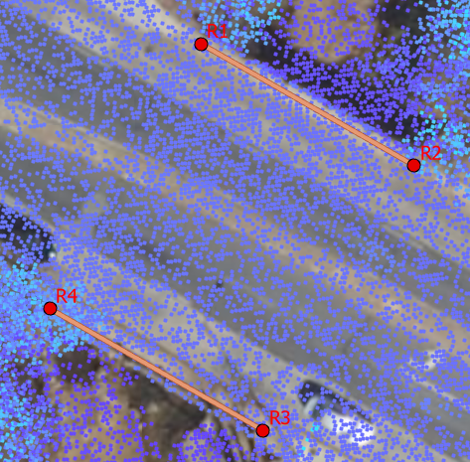
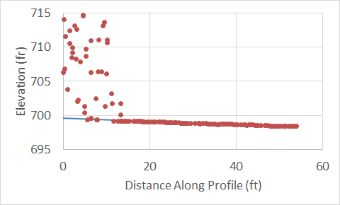
Registration Points at Four Corners of the Box Culvert (R1, R2, R3, R4) Transect along Sidewalk Gives Elevation
Where trees interfere with
LIDAR elevation values
Regression line is used to
estimate elevation at R4
R3
R4

Slide 19
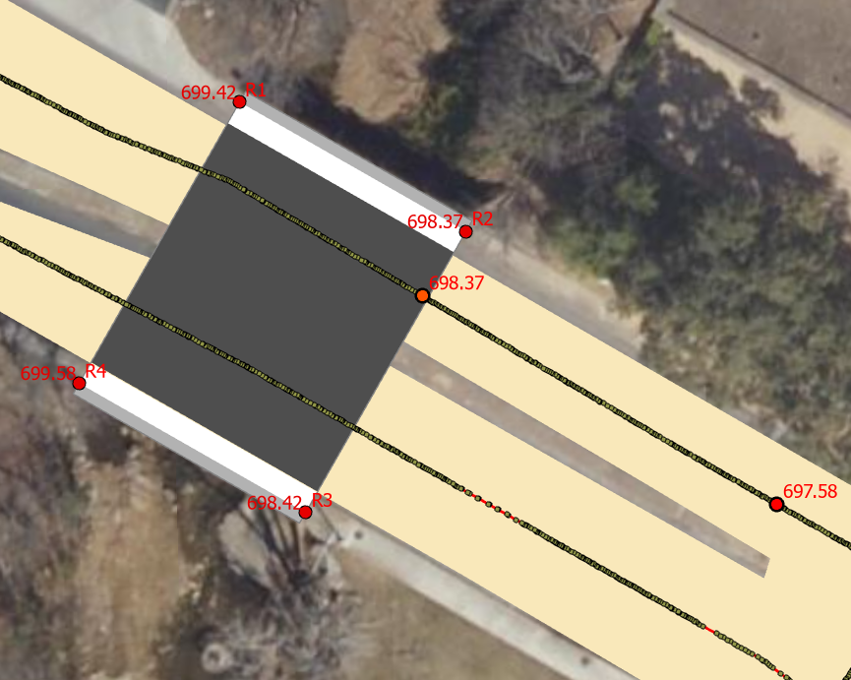
Critical Roadway Elevations on Bridge and Approach Road
Points in (x,y,z)

Slide 20
Tape Down from Road Berm to top of Culvert
701.37’
Rail
Bridge Rail
Offset (3’)
Sidewalk
698.37’
Low
Member
Offset
Sidewalk
Elevation
Tape down
(inches)
Z - Offset
Top – Culvert
Height (6’)
Low Member
696.79’
3 ft

Slide 21
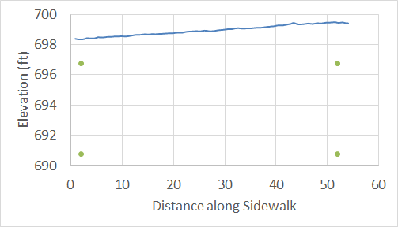
Box Culvert Elevation
Berm
Sidewalk (5’ including berm)
Road
4”
Gutter
5”
Looking left to right from upstream
Sidewalk elevation
Top of Culvert
32”
19”
Culvert pipes (five 10’x6’ box culverts)
Berm supporting the rail is 4” above the sidewalk

Slide 22
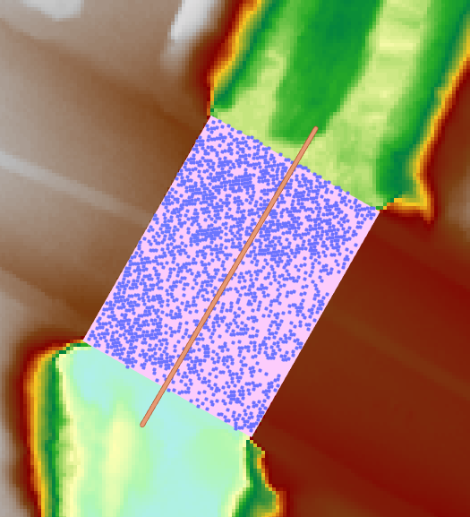
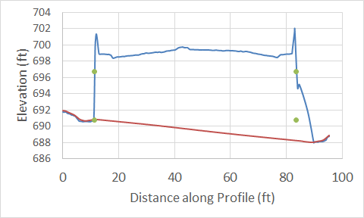
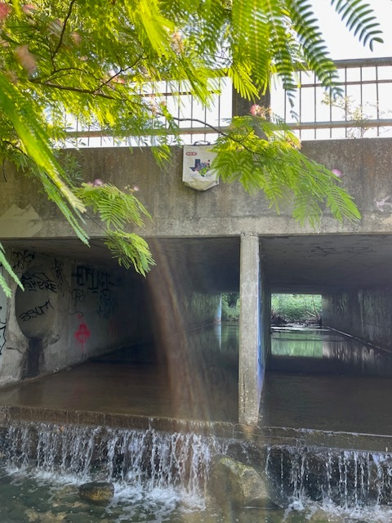
Box Culverts under road
LIDAR points profile over the road
Box culverts 72’ long
and 10’x6’ cross-section
1 m DEM

Slide 23
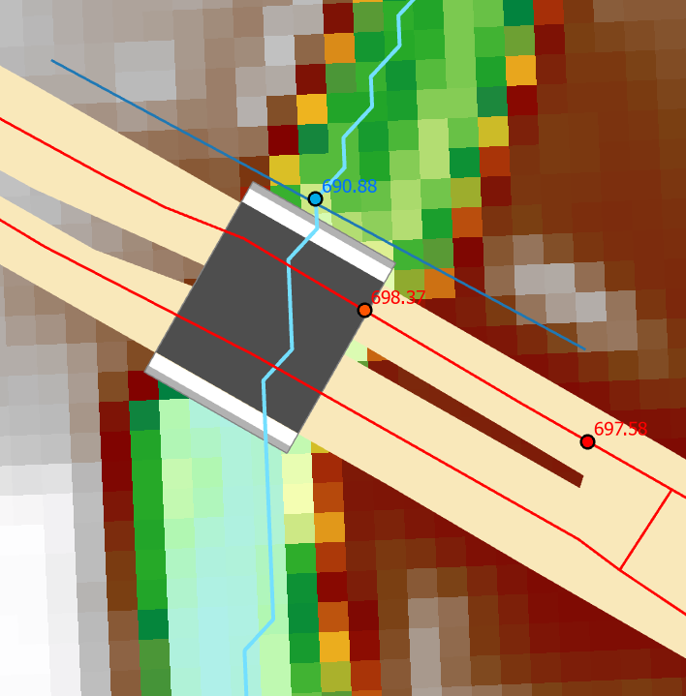
Stream Bed Elevation Upstream of Culvert
Stream Cross-Section Upstream of Culvert
Left to right looking from upstream

Slide 24
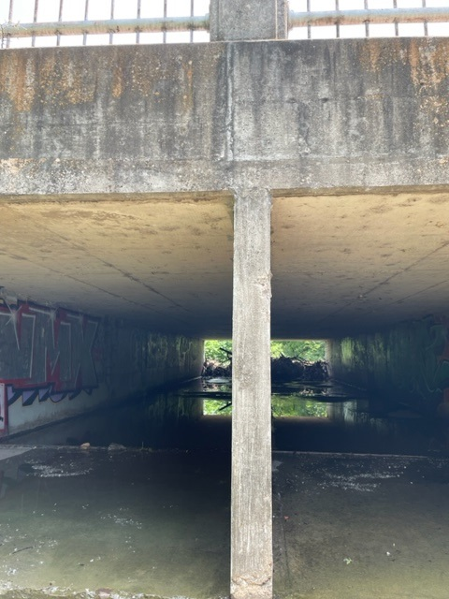
Culvert Wall Thickness
Can be estimated from Structure Length, number and width of culvert pipes
Length = 54’
Openings = 5 * 10’ = 50’
Walls = 54’ – 50’ = 4’ = 48”
4 interior walls + 2 end walls = 6
48” / 6 = 8” wall thickness
End walls are slightly thicker
7” wall
measured

Slide 25
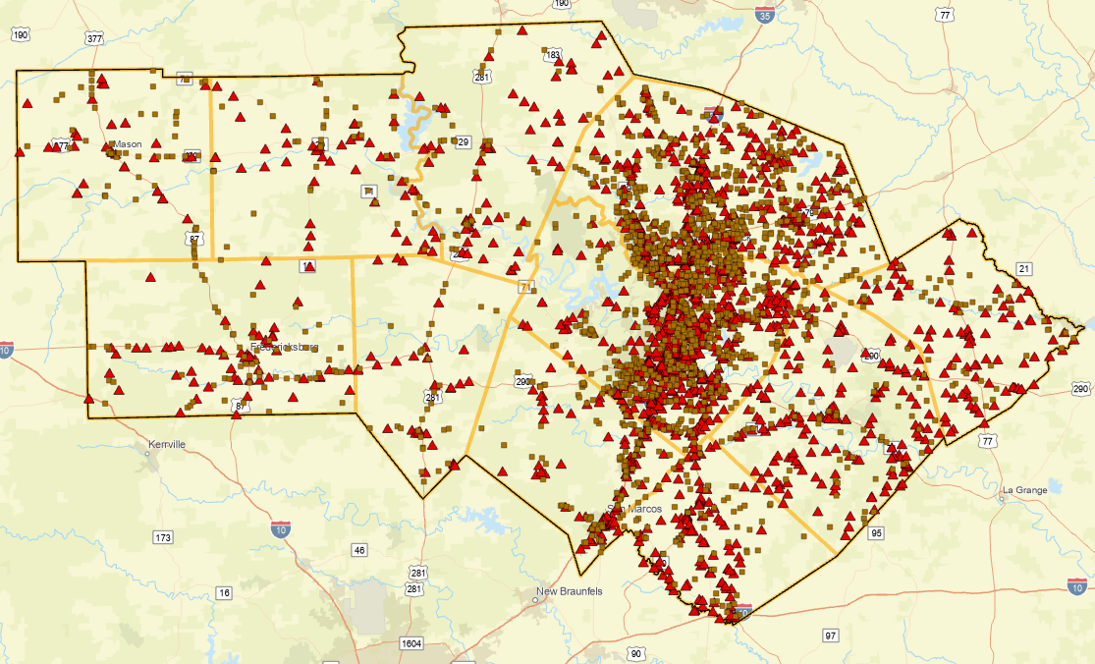
TxDOT Austin District NBI Bridges and Culverts
1684 (43%)
2210 (57%)

Slide 26
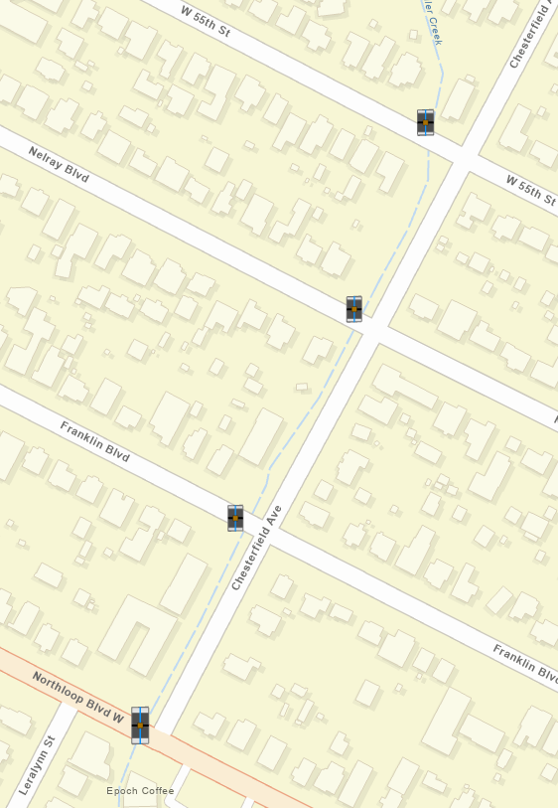
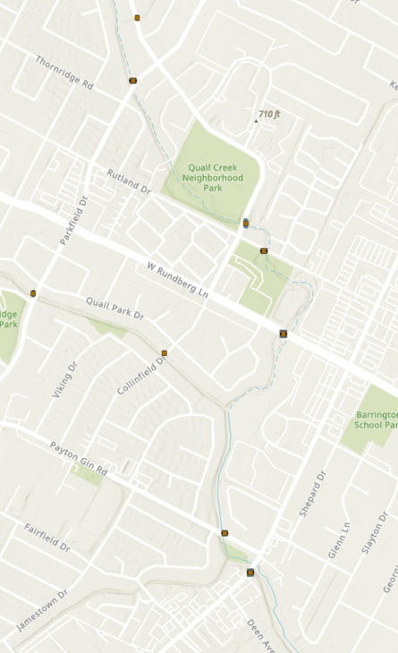
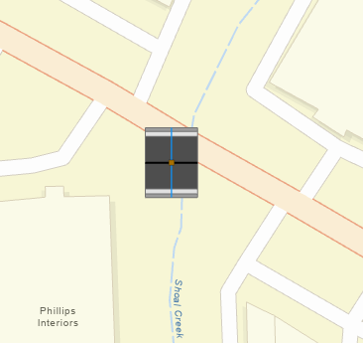
District-Wide Culvert Template Creation (Tim Whiteaker)
Culverts on Waller Creek
Culverts on Little Walnut Creek
Shoal Ck at West Anderson Lane

Slide 27
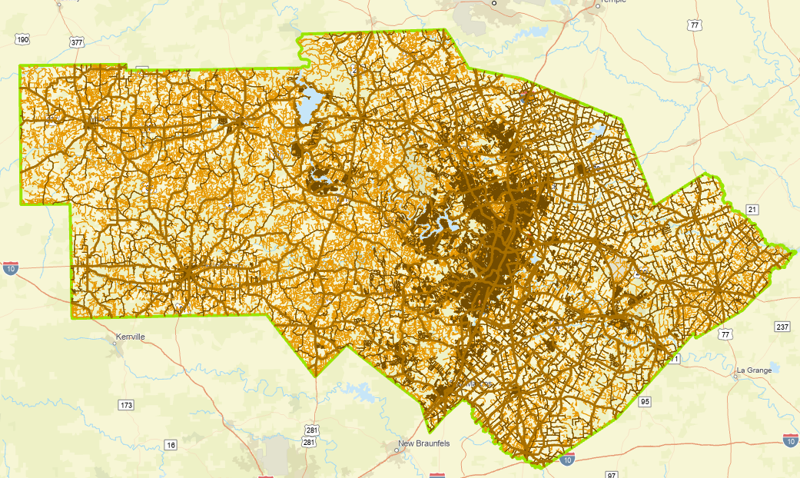
Roads in the TxDOT Austin District
Purchased by TxDOT RTI to support
our Streamflow II research project
Flood Emergency Response Exercise, Jan 2023
4400 miles On-System
38,000 miles Ecopia road coverage
1600 miles of TxDOT Roadway Inventory
are not located on pavement as defined by
Ecopia roads coverage
18,000 miles TxDOT Roadway Inventory

