Slide 1
Real-Time Flood Resilience for TxDOT
Presented by David R. Maidment Center for Water and the Environment University of Texas at Austin
Based on TxDOT RTI Project 0-7095 “Evaluate Streamflow Measurement at TxDOT Bridges” (2021 – 2023)
Project partners: Center for Water and the Environment, US Geological Survey, Kisters, Aqua Strategies
CTR Symposium, University of Texas at Austin, 13 April 2022

Slide 2
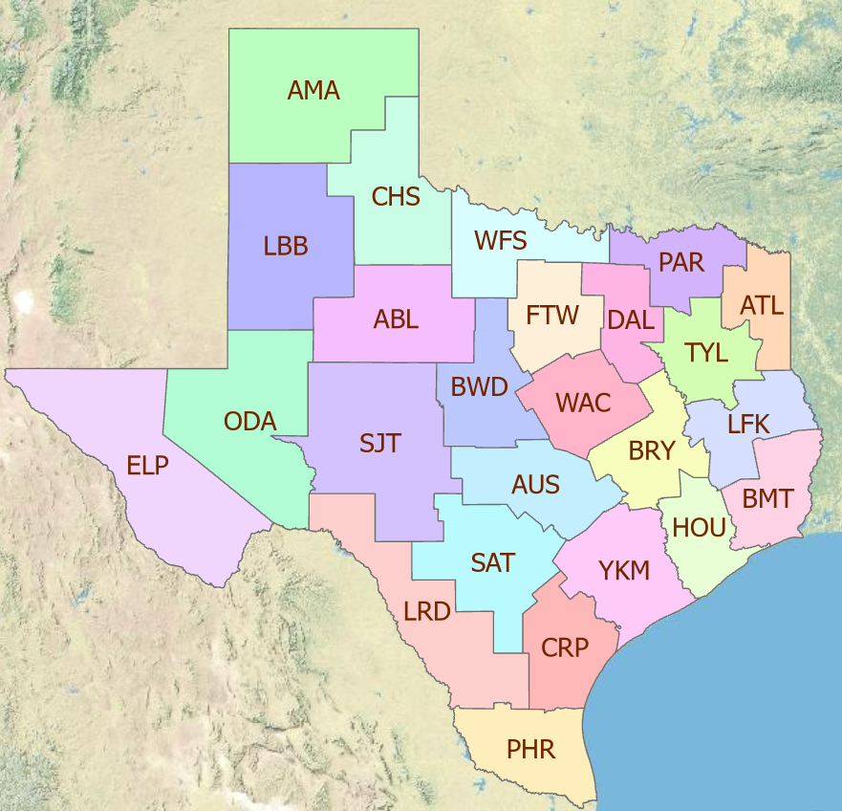
TxDOT Priorities
SAFETY
Our staff, our community
Emergency response
CONNECTIVITY
Reliability of the transportation network
Asset management
*BRIDGES*
Efficiency and efficacy
For TxDOT
For other/all jurisdictions

Slide 3
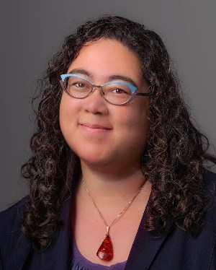
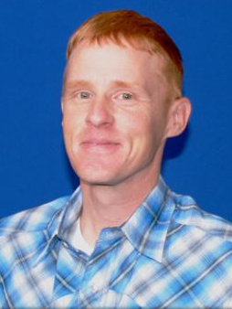
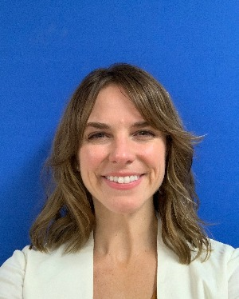
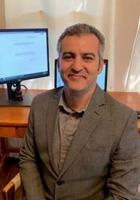
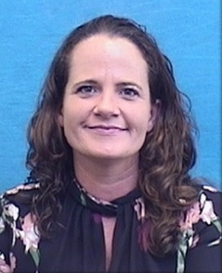
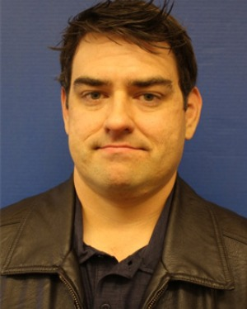
TxDOT Project Management Committee
Rose Marie Klee H&H Section Director DES
Trent Ellis H&H Engineer DES
Shelley Pridgen Research Project Manager RTI
Matthew Heinze TxDOT Emerg Mgmt Coord MNT
Jennifer Lash GIS Program Leader TPP
Abderrahmane Maamar-Tayeb
H&H Section Team Lead DES
Valerie Taylor Transportation Engineer HOU
Adam Jack Dir of Trans Plan & Dev BMT
Andrew Lee District Bridge Engineer BMT
LaDonna Waters Lead Hydraulics Engineer BMT
Jared Browder Maintenance Assess Spec MNT
Joseph Goessling
Lead Hydraulics Engineer
AUS
Ryan Eaves Geotech Brch Mgr BRG
Drake Builta
Bridge Info Grp Lead
BRG

Slide 4
Project Advisory Committee
NOAA National Weather Service | State and Local Agencies
Jason Johnson, West Gulf River Forecast Center | Peter Smith, former TxDOT Director TPP
Paul McKee, Southern Region HQ | Justin Terry, Harris County Flood Control District
Paul Yura, Austin/San Antonio Weather Forecast Office (WFO) | Jorge Urquidi, City of Austin, Flood Early Warning System
Jonathan Brazzell, Lake Charles, LA, WFO | Christina Bryant, City of Austin, Flood Early Warning System
Katie Landry-Guyton, Houston/Galveston WFO | Sam Marie Hermitte, Texas Water Development Board
Amanda Schroeder, Dallas/Fort Worth WFO

Slide 5
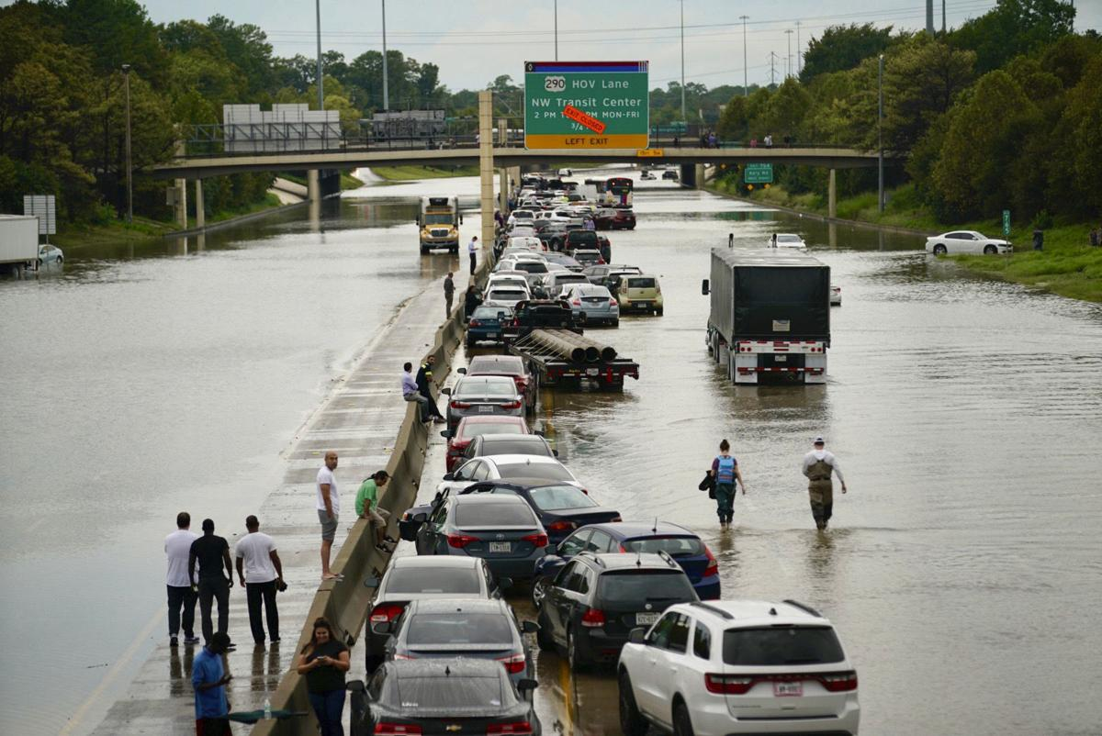
Definition of Resilience
“Ability to anticipate, prepare for, and adapt to changing conditions, and to withstand, respond to, and recover quickly from disruptions.”
Flood Resilience
Real-time (focus of this presentation)
Long-term

Slide 6
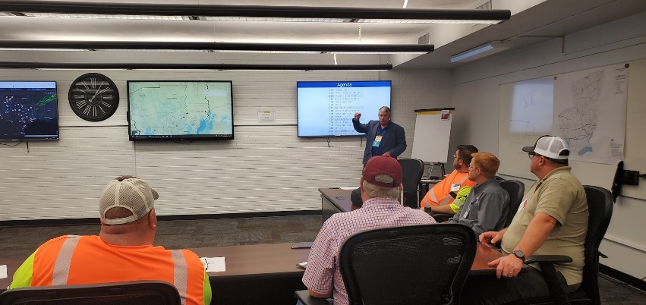
Move from Reactive response to Proactive response
Reactive Response
Maintenance Staff
observing current
flood conditions
EOC staff
Decisions based on
current conditions

Slide 7
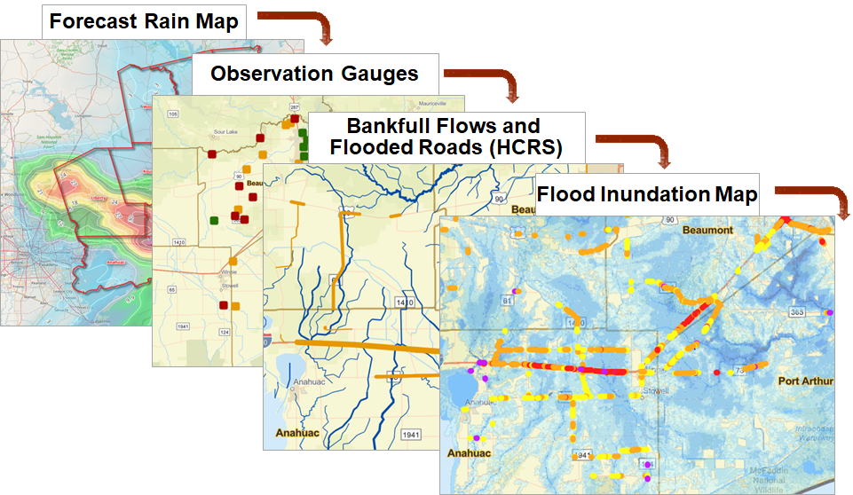
Move from Reactive response to Proactive response
Proactive Response
Maintenance Staff
observing current
flood conditions
Predictive Storm and Flood Maps
EOC staff
Decisions based on
current and predicted conditions
Advance warning of location, extent
and severity of flooding

Slide 8
Real-Time Flood Resilience for TxDOT
Flood Forecasting …

Slide 9
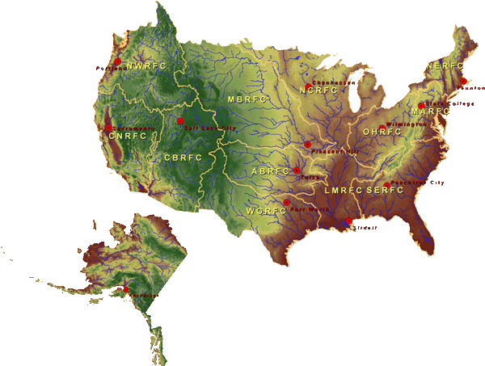
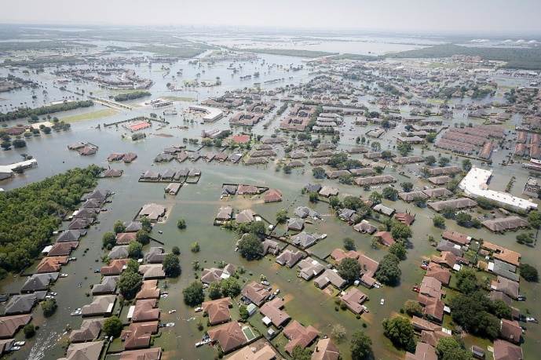
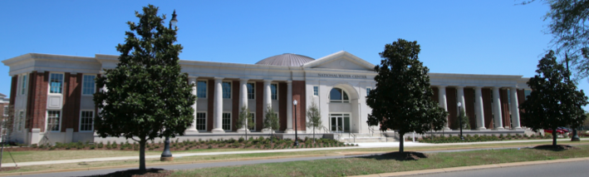
National Flood Forecasting
National Water Center
Established in 2014 in Tuscaloosa, AL

Slide 10
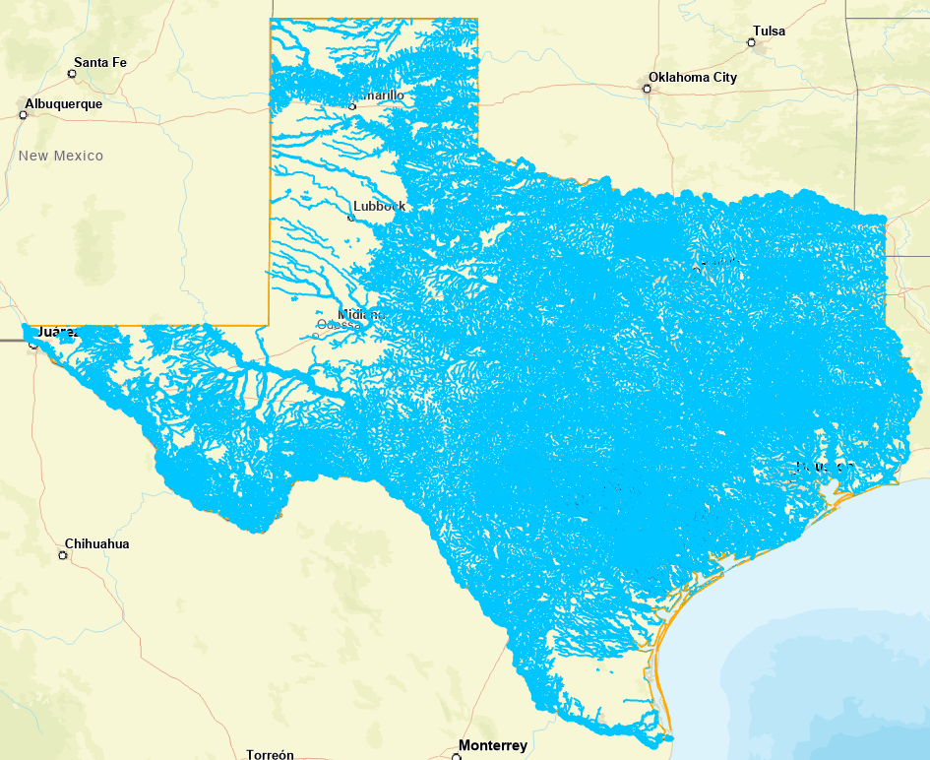
National Water Model
Water forecast like weather 24/7/365
Four model outputs:
Assimilation (Current conditions)
Short Range Forecast (18 hours ahead)
Medium Range (10 days ahead)
Long Range Forecast (30 days ahead)
Water flow forecasts on 190,000 miles
of streams and rivers in Texas

Slide 11
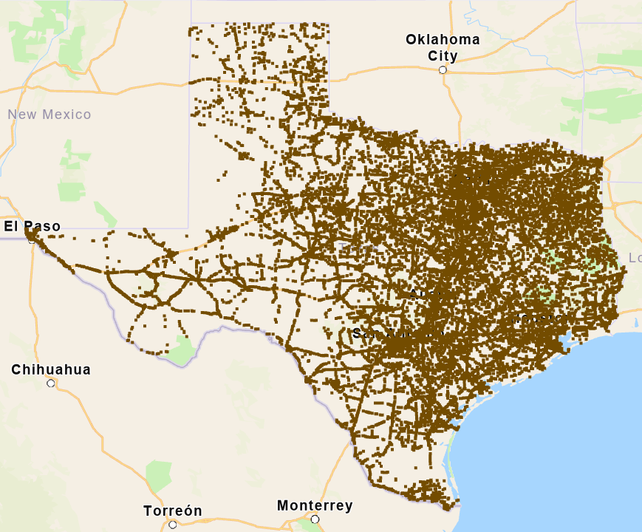
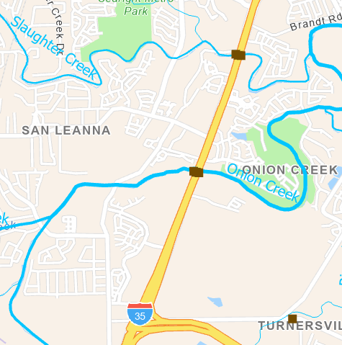
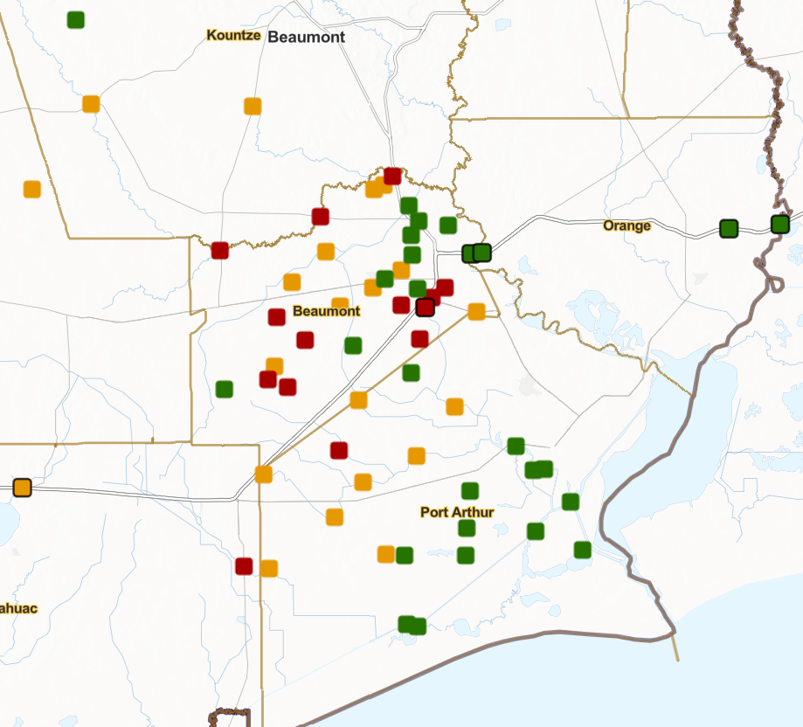
Provide Forecasts for 26,000 TxDOT On-System Bridges
Bridge Warnings
(Low Chord Elevation)

Slide 12
10-day Ahead Forecast
Actual

Slide 13
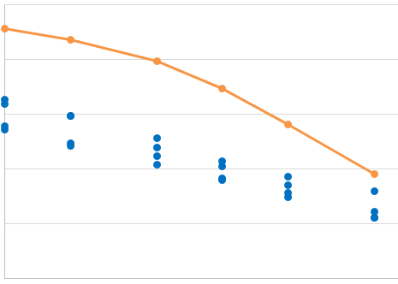
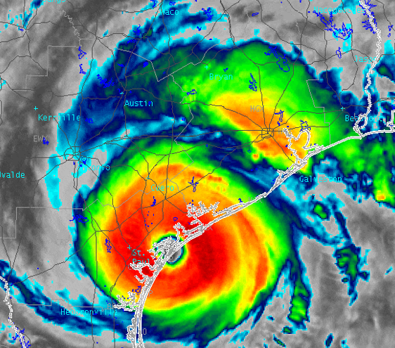
Hurricane Harvey – Record Precipitation
Harvey 2-day precipitation was the worst recorded storm in US history
Harvey 3-day Precipitation averaged 5 inches more than previous worst storms
Harvey 5-day Precipitation averaged 11 inches more than previous worst storms
50
40
30
20
10
0
Precipitation Depth (Inches)
Data Sources: NWS River Forecast Centers;
Applied Weather Associates, Inc., NASA.
Analysis: John Nielsen-Gammon and Brent McRoberts, Texas A&M University
1,000 10,000 50,000
Storm Area (Sq. Miles)

Slide 14
Real-Time Flood Resilience for TxDOT
Flood Forecasting …
Streamflow Measurement…

Slide 15
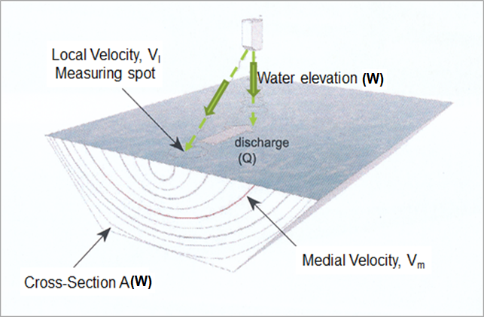
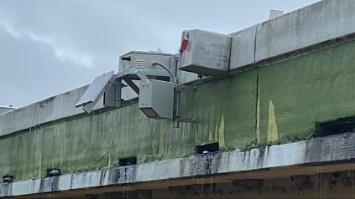
TxDOT Radar Gauges Installed and Maintained by US Geological Survey
Radar gauges measure both
water surface elevation and velocity
Discharge = Cross-Section Area * Medial Velocity
Priority Watersheds and Final Locations for 80 TxDOT Radar Gauges

Slide 16
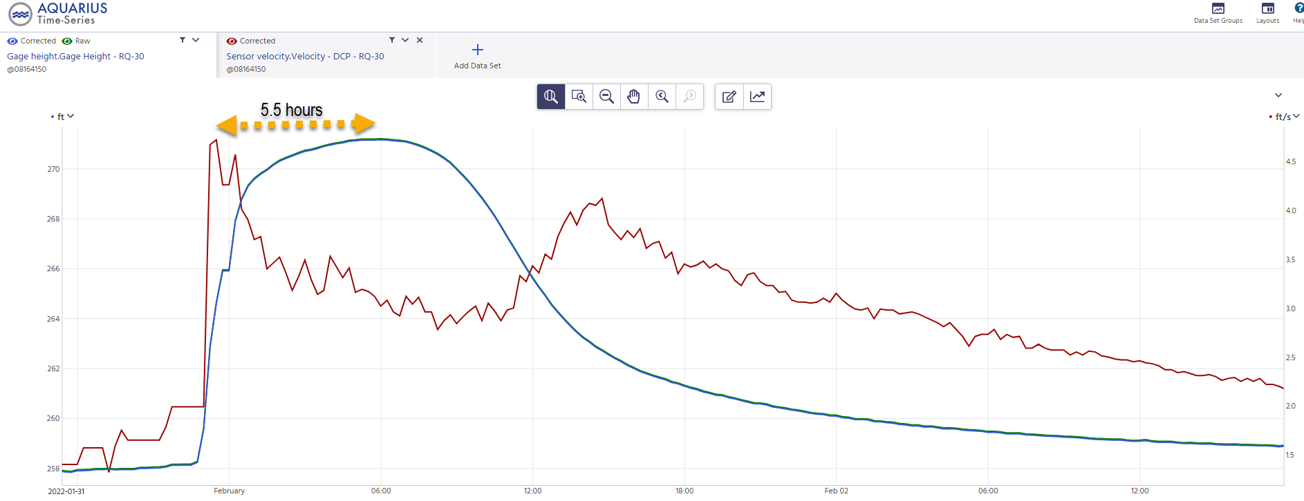
Initial Velocity Wave
Provides advance warning of rising water levels
West Navidad Rv at IH-10 nr Schulenburg, Tx
Water Surface Elevation
Velocity
Time

Slide 17
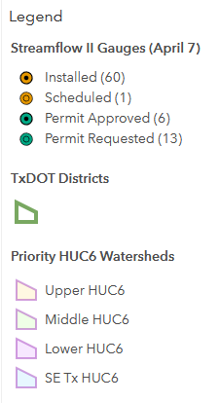
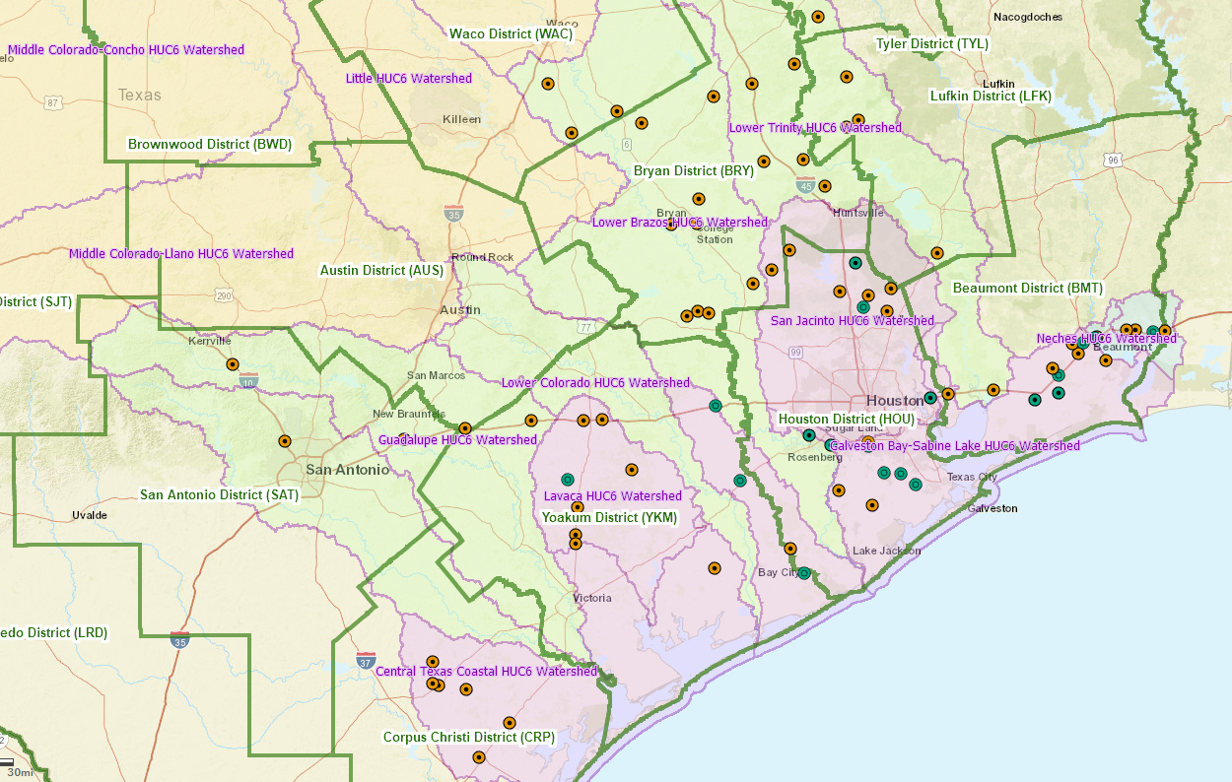
TxDOT Flood Data Network
Main Districts impacted:
Beaumont Bryan Corpus Christi Houston Yoakum Some gauges in:
Austin Lufkin San Antonio Tyler
Waco
Thank you, TxDOT, for your support
of streamflow measurement

Slide 18
Real-Time Flood Resilience for TxDOT
Flood Forecasting …
Streamflow Measurement…
Emergency Response…

Slide 19
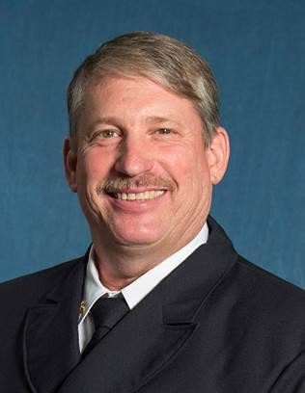
Flood Emergency Response Exercise (22 Feb)
Beaumont District
Maintenance Section
Harry Evans
Christine Thies
Larry Jantzen
UT Austin Flood Emergency Response Team
Notes:
Larry

Slide 20
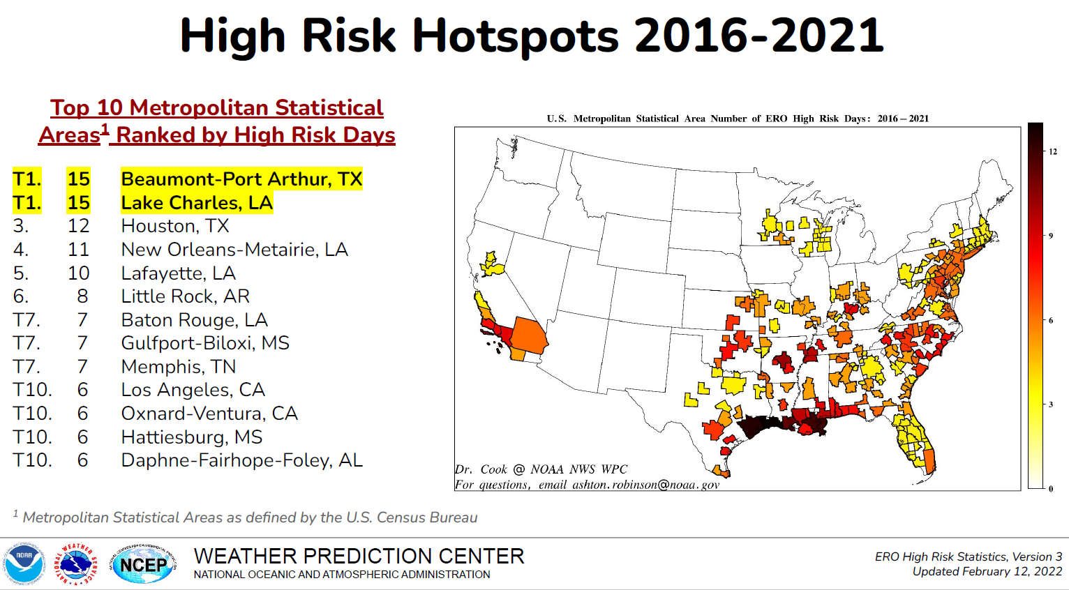
Flood Risk in Beaumont District
High risk of excessive rainfall causing flood deaths and damage
IH-10 closed three times in 2016 – 2021
from “Excessive Rainfall Outlook High Risks (2010-2020)”
Source: Jonathan Brazzell, NWS Lake Charles WFO

Slide 22
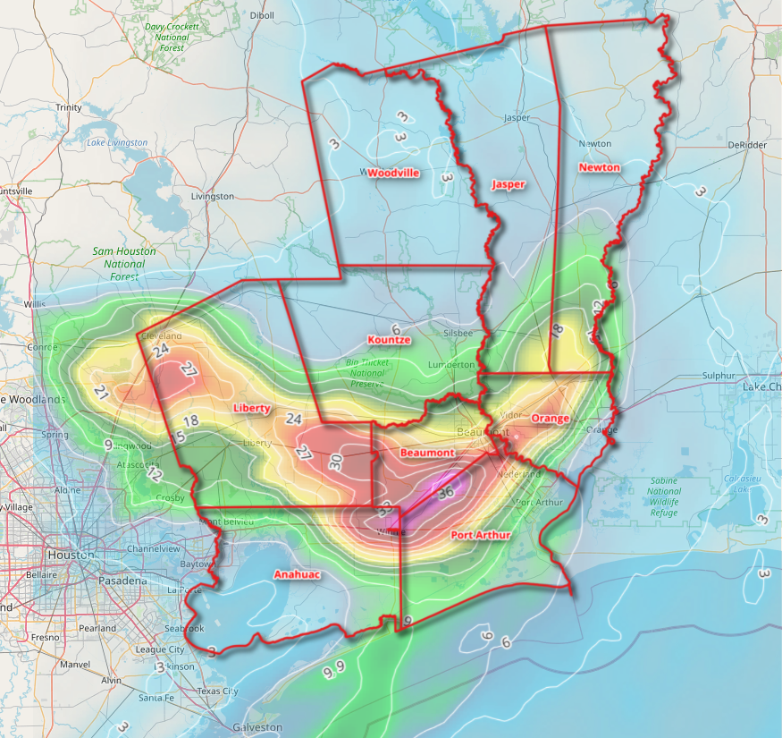
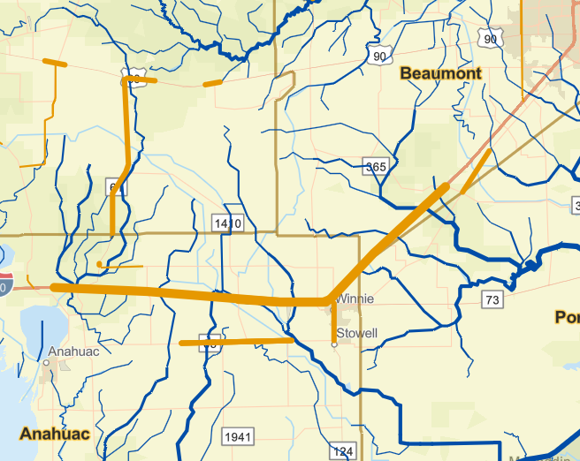
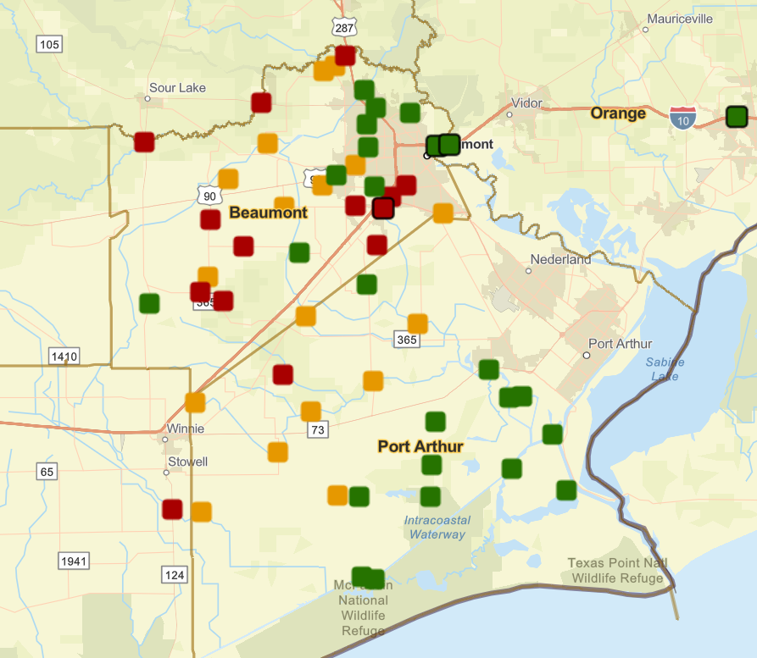
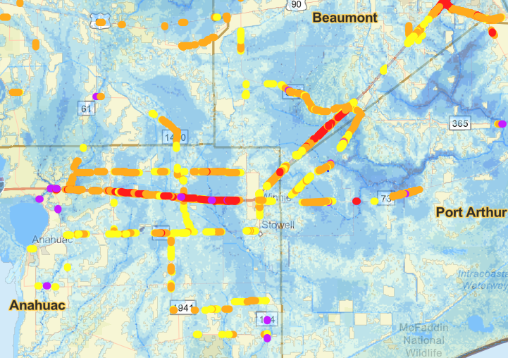
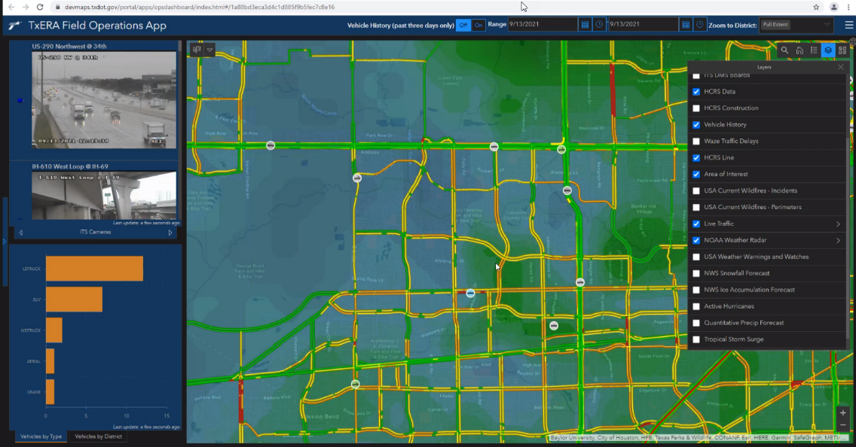
Rainmap in the Sky to Floodmap on the Ground
Forecast Rain Map
Maps accessible through ESRI StoryMap
Bankfull Streams and
Flooded Roads (HCRS-API)
https://arcg.is/0LLLXX
Bridge Warnings
Flood Inundation Map
Web Communication
to TxDOT (TxERA)
Demo by Tim Whiteaker

Slide 23
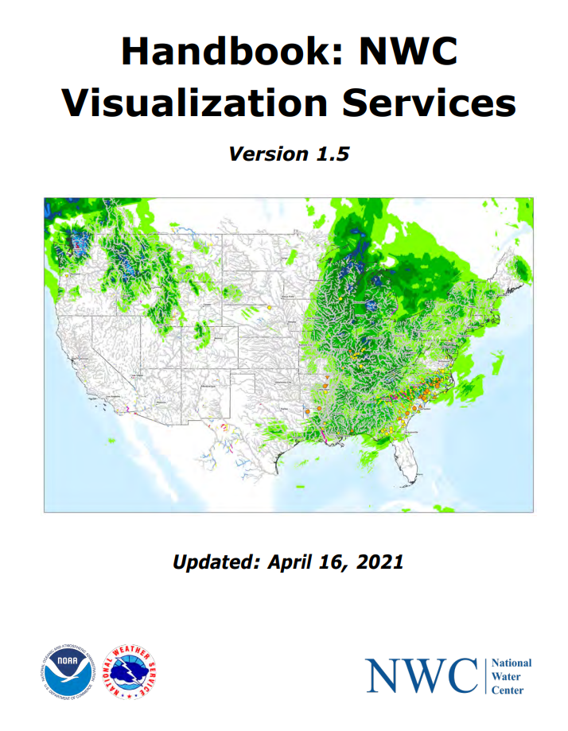
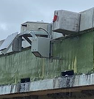
Forthcoming: Real-Time Demonstration Prototype
Goal: A real-time prototype to be tested during the 2022 summer storm season
Forecast Rain Maps
Observations
Forecasting
Field
Observations
HCRS-API
Data and Map
services
Data and Map
services
NWS Public
and Prototype
Map Services
Bridge Warnings
TxDOT Radar
Stream Gauges
Datasphere
Bankfull Streams
and Flooded Roads

Slide 24
Real-Time Flood Resilience for TxDOT
Flood Forecasting …
Streamflow Measurement…
Emergency Response…
Bridge Hydraulics…

Slide 25
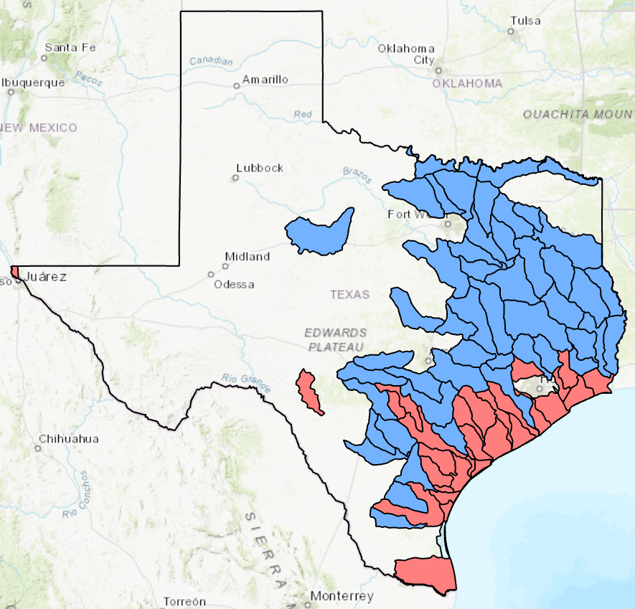
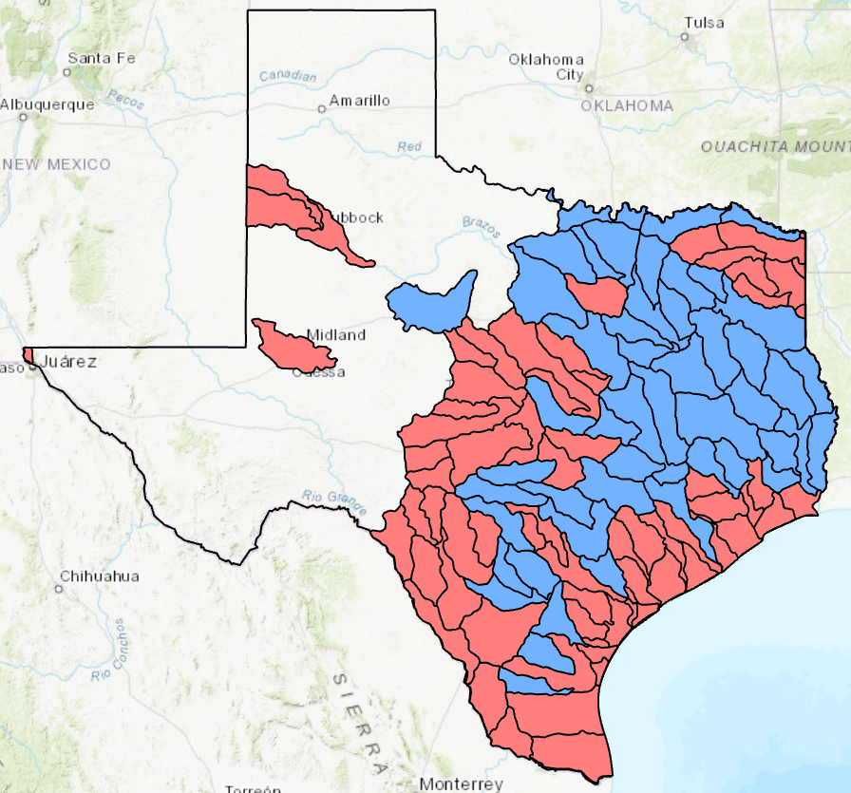
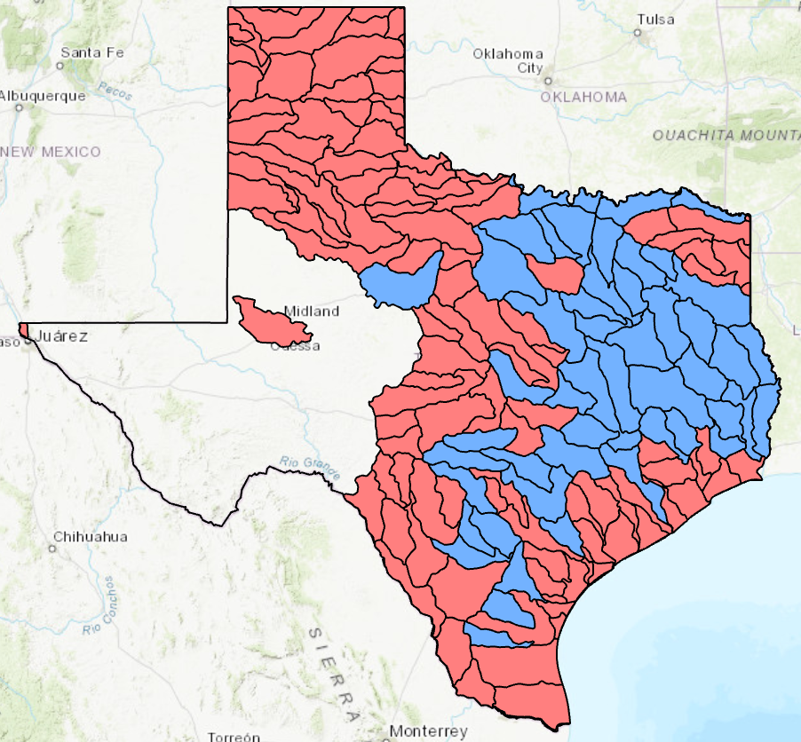
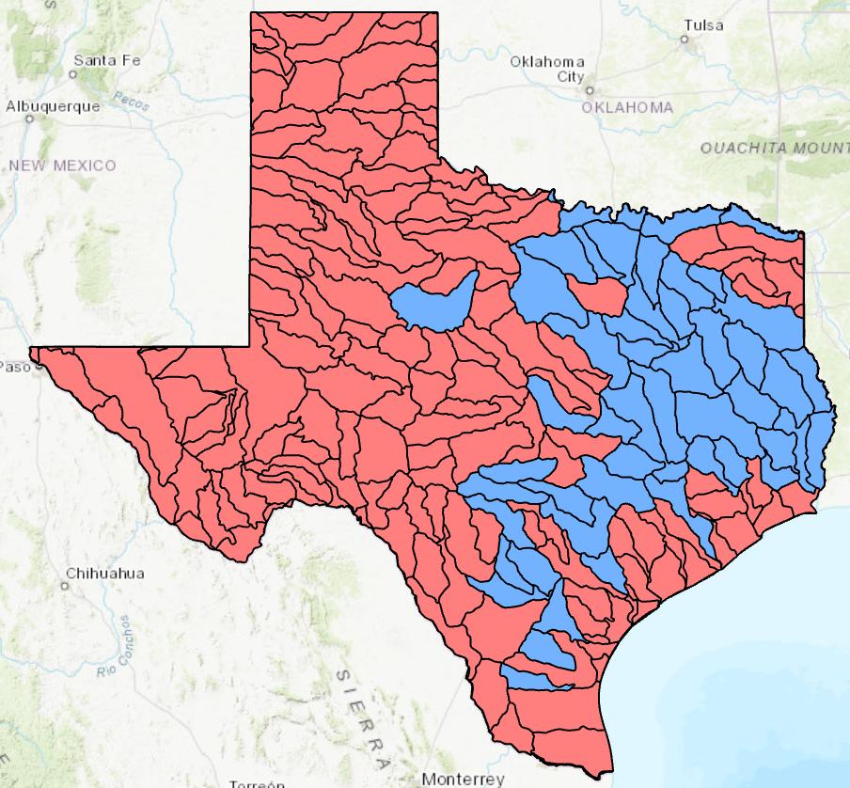
Base Level Engineering Flood Hydraulic Modeling
$40 million investment
Bridges need to be added
2021
2022
2023
2024

Slide 26
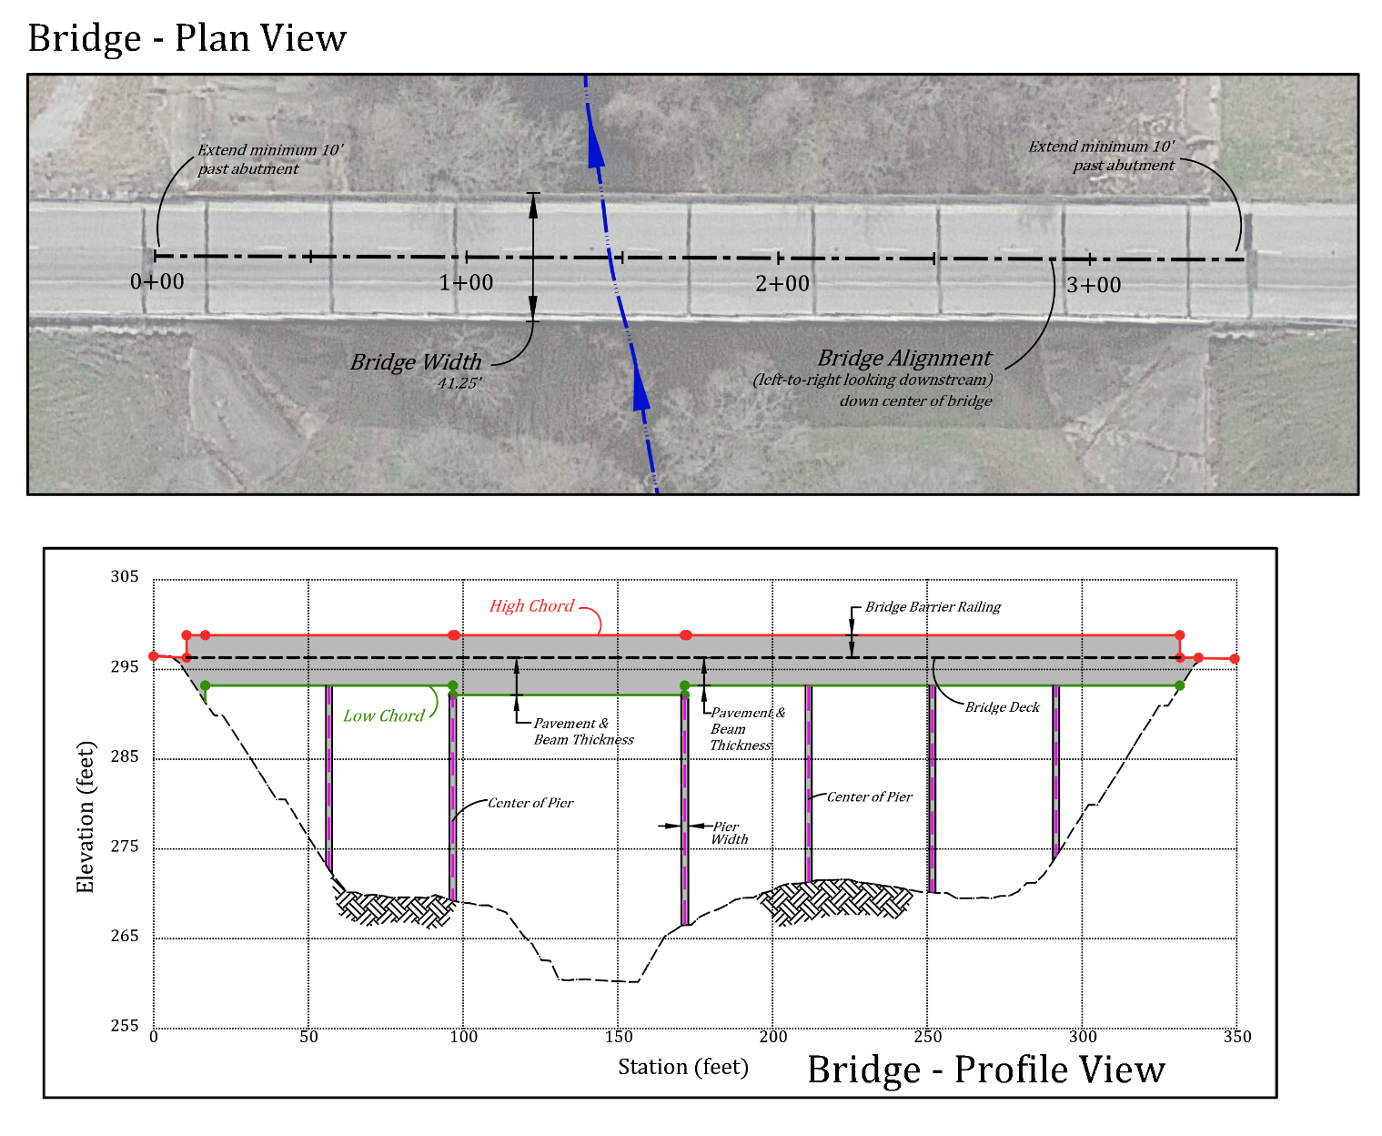
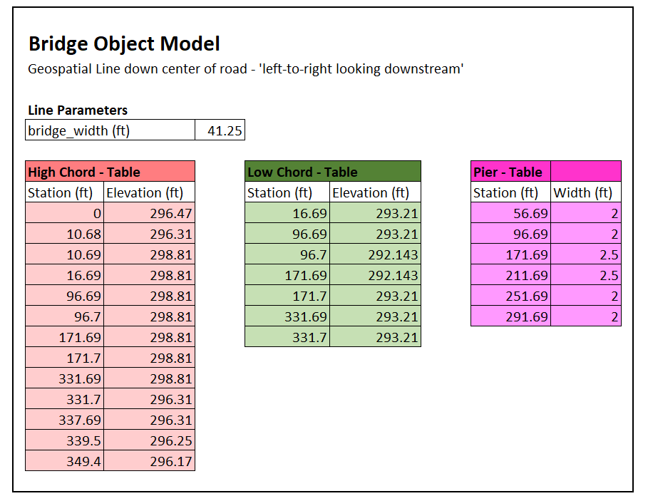
Detailed Bridge Object Model Developed From TxDOT Bridge Plans
Notes:
Larry

Slide 27
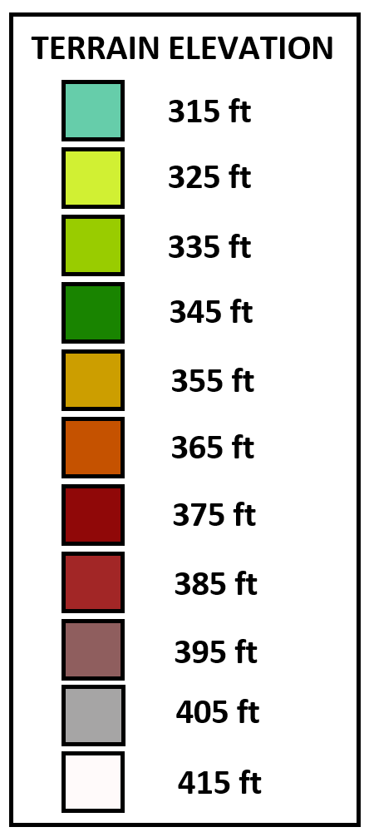
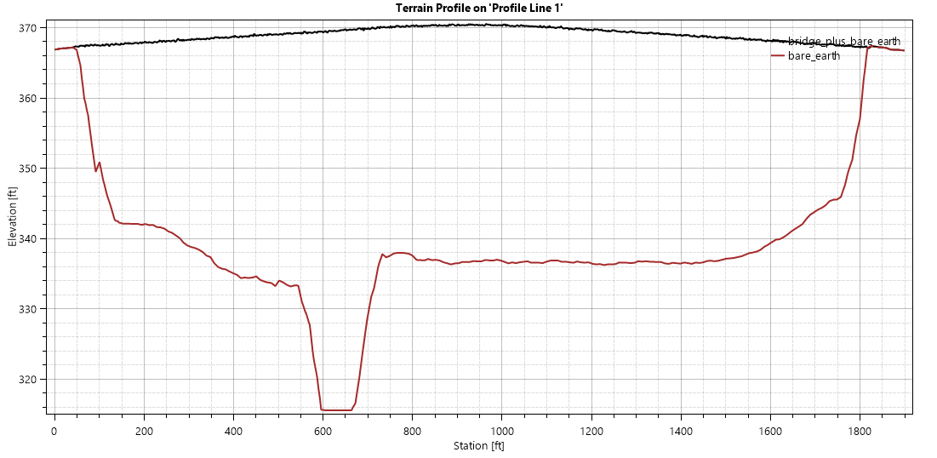
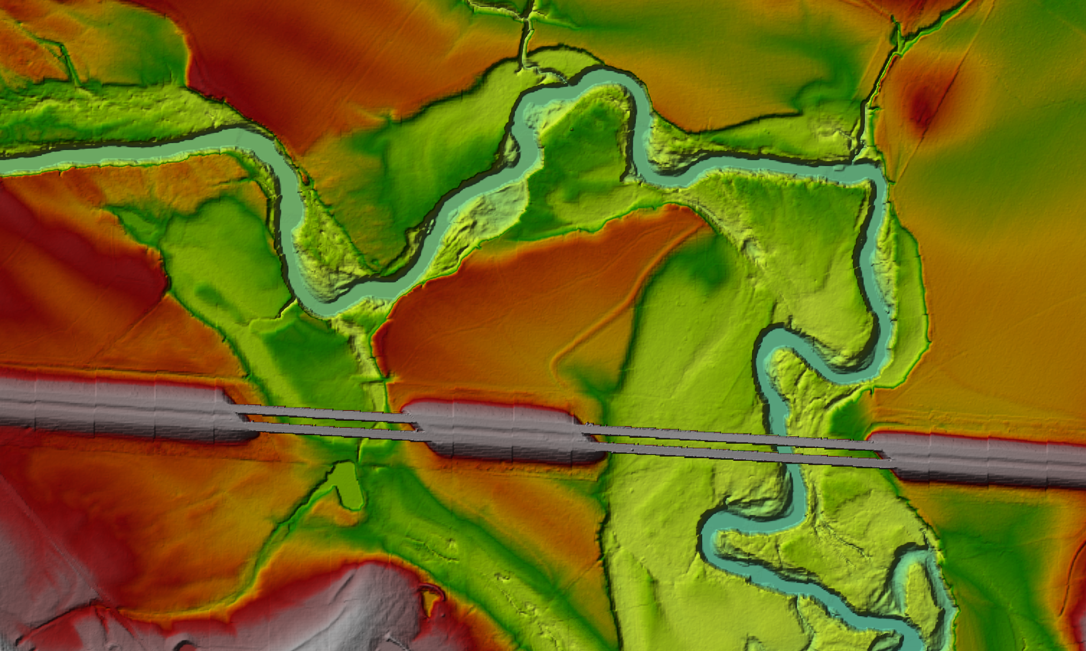
Simplified Bridge Object Model Developed Automatically from LIDAR
Deck
Bridge “envelope”
Stream Cross-section
Add bridge deck thickness
based on bridge type
(with help from BRG Division)

Slide 28
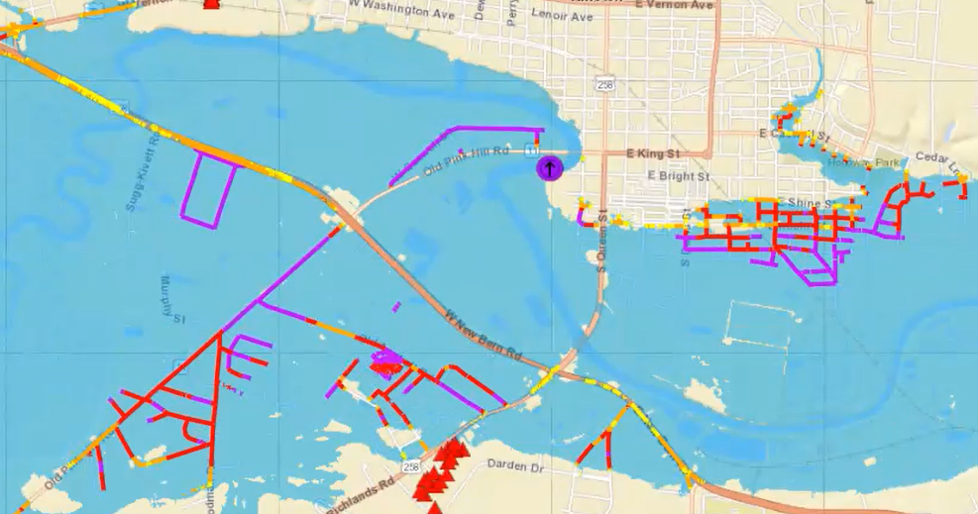
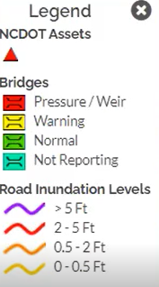
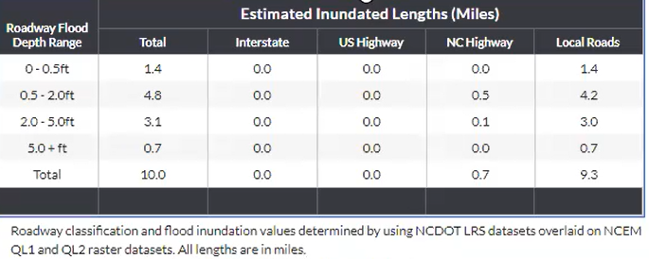
Flood Depth Mapping for Roads
This map and summary table are drawn from the
FIMAN-T system developed by the North Carolina DOT
Source for Images: David Key, ESP Associates

Slide 29
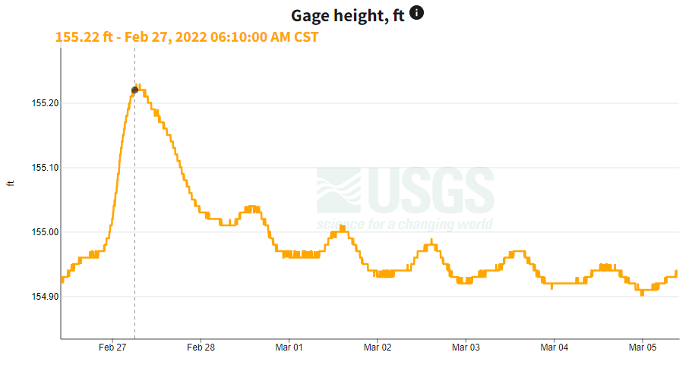
Forthcoming: Measurement, Modeling and Mapping at 80 TxDOT Gauges
Creates accurate measurement of flow conditions at bridges ….
….. and accurate mapping of flooded road depths near bridges

Slide 30
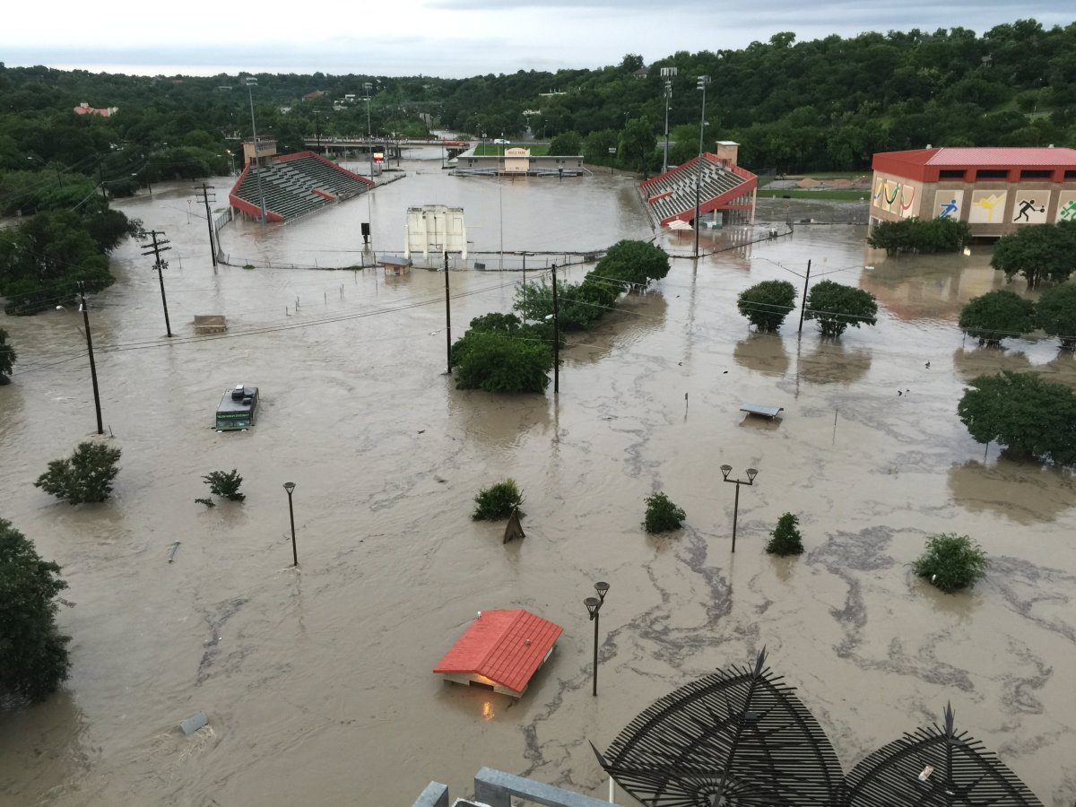
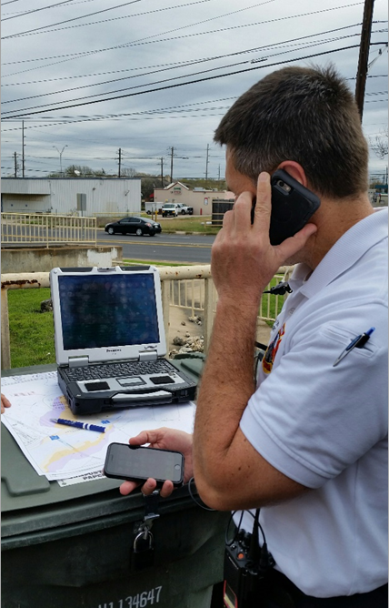
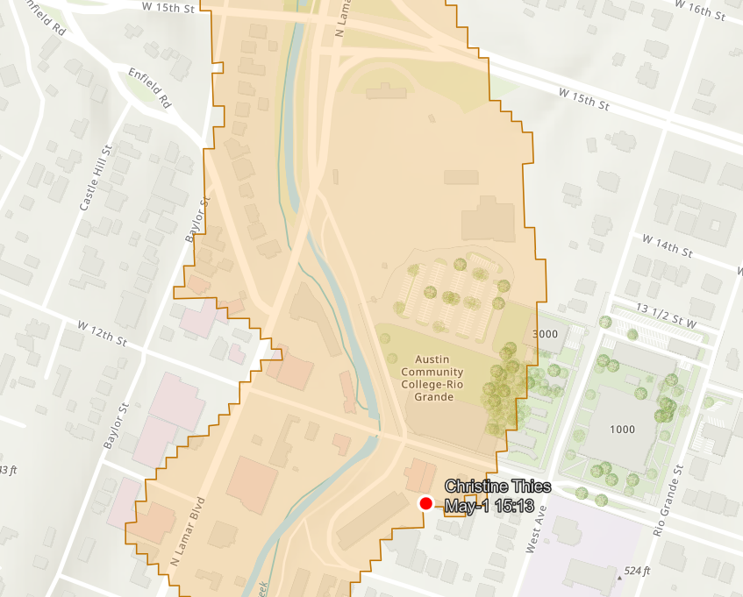
Observational Flood Mapping with a Cell Phone Application

Slide 31
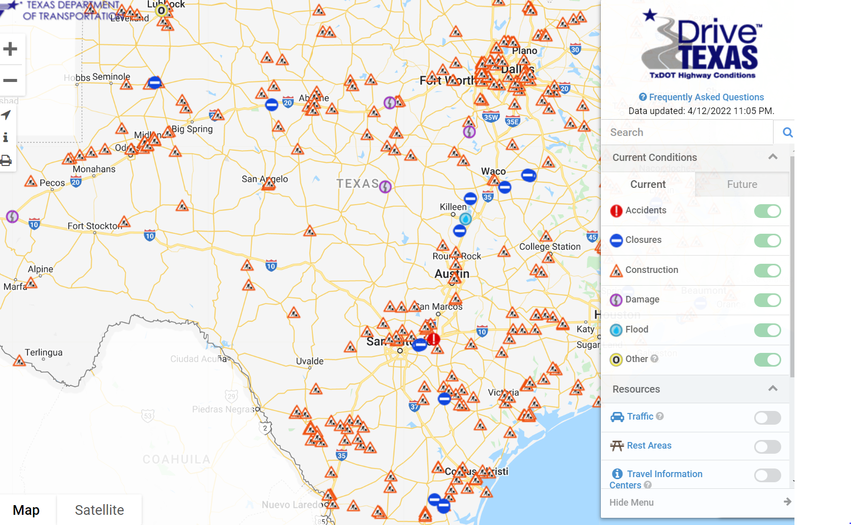
Suggestion 1 for TxDOT: Field Data Collection during Floods
Automated method for field staff to record flood conditions
Possibilities:
Flood Information in Highway Conditions Reporting System (HCRS)
+

Slide 32
Suggestion 2 for TxDOT: Long-Term Flood Resilience
Impact on Transportation System
Large scale storm simulation for historical and possible future storms

Slide 33
Conclusions
Moving from reactive to proactive response to flooding
National Water Model provides continuous forecasting on 190,000 miles of streams and rivers in Texas, including 26,000 on-system bridges
Radar gauges on 80 TxDOT bridges measure water surface elevation and velocity
Flood emergency response with web map overlays in TxERA
Automated hydraulic modeling of bridges using LIDAR and HEC-RAS
Connecting large-scale hydrology with local-scale hydraulics for Texas
We are half-way through a three year project (2021-2023)
We are happy to talk with you about our work: maidment@utexas.edu

