Slide 1
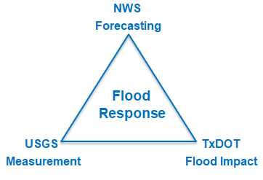
Improved Flood Response at TxDOT
Being Supported by Research Project 0-7095
conducted for TxDOT
by UT Austin and US Geological Survey
with the support of
Kisters North America and Aqua Strategies
September 2020 to August 2023
Presentation to National Weather Service Southern Region Headquarters
18 January 2022
Acknowledgements: Rose Marie Klee (H&H Director, TxDOT), Shelley Pridgen (RTI Project Manager, TxDOT),
Trenton Ellis (H&H, TxDOT), Matthew Heinze (MNT, TxDOT), Keith Horn (BMT, TxDOT), Mark Null (Aqua Strategies)

Slide 2

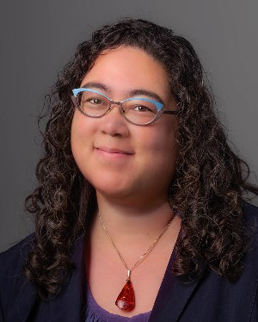

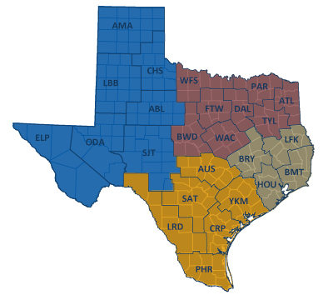


TxDOT Priorities
SAFETY
        Our staff, our community
        Emergency response
CONNECTIVITY
        Reliability of the transportation network
  Asset management
        *BRIDGES*
  Efficiency and efficacy
        For TxDOT
        For other/all jurisdictions
Rose Marie Klee
Hydrology and Hydraulics
Section Director, TxDOT
Matthew Heinze
TxDOT Emergency
Management Coordinator

Slide 3
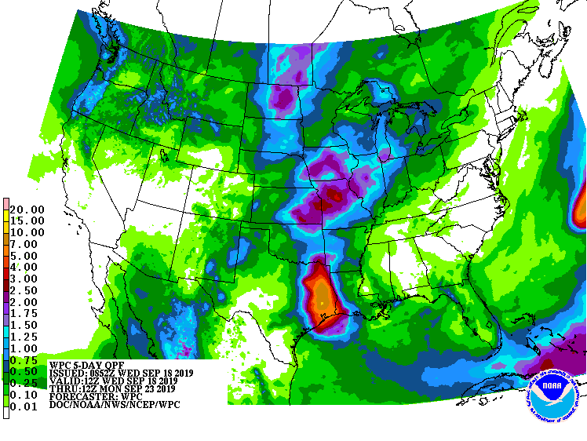
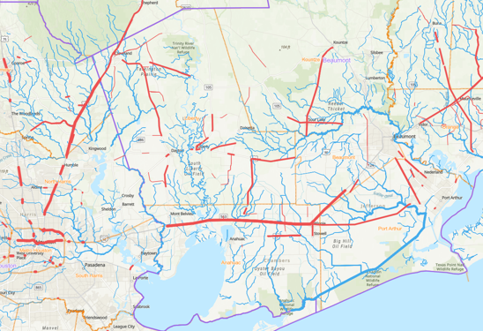
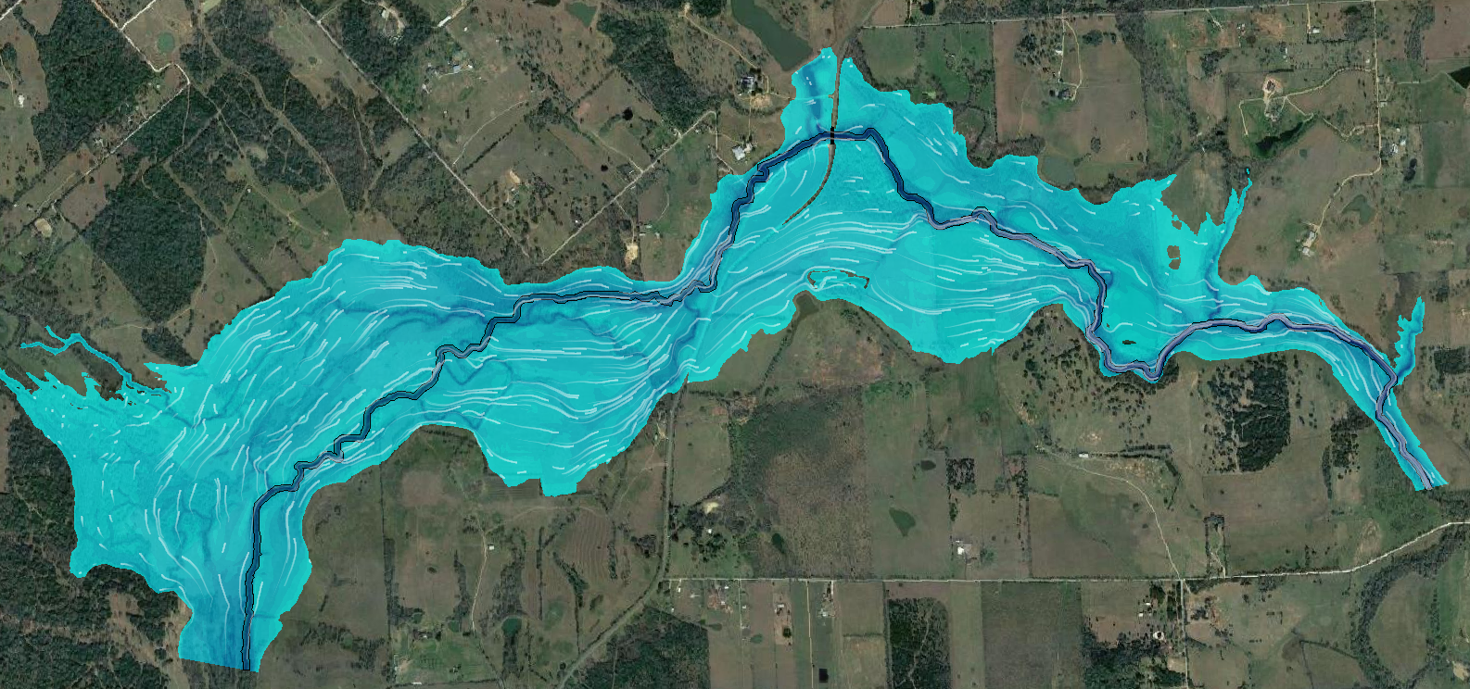
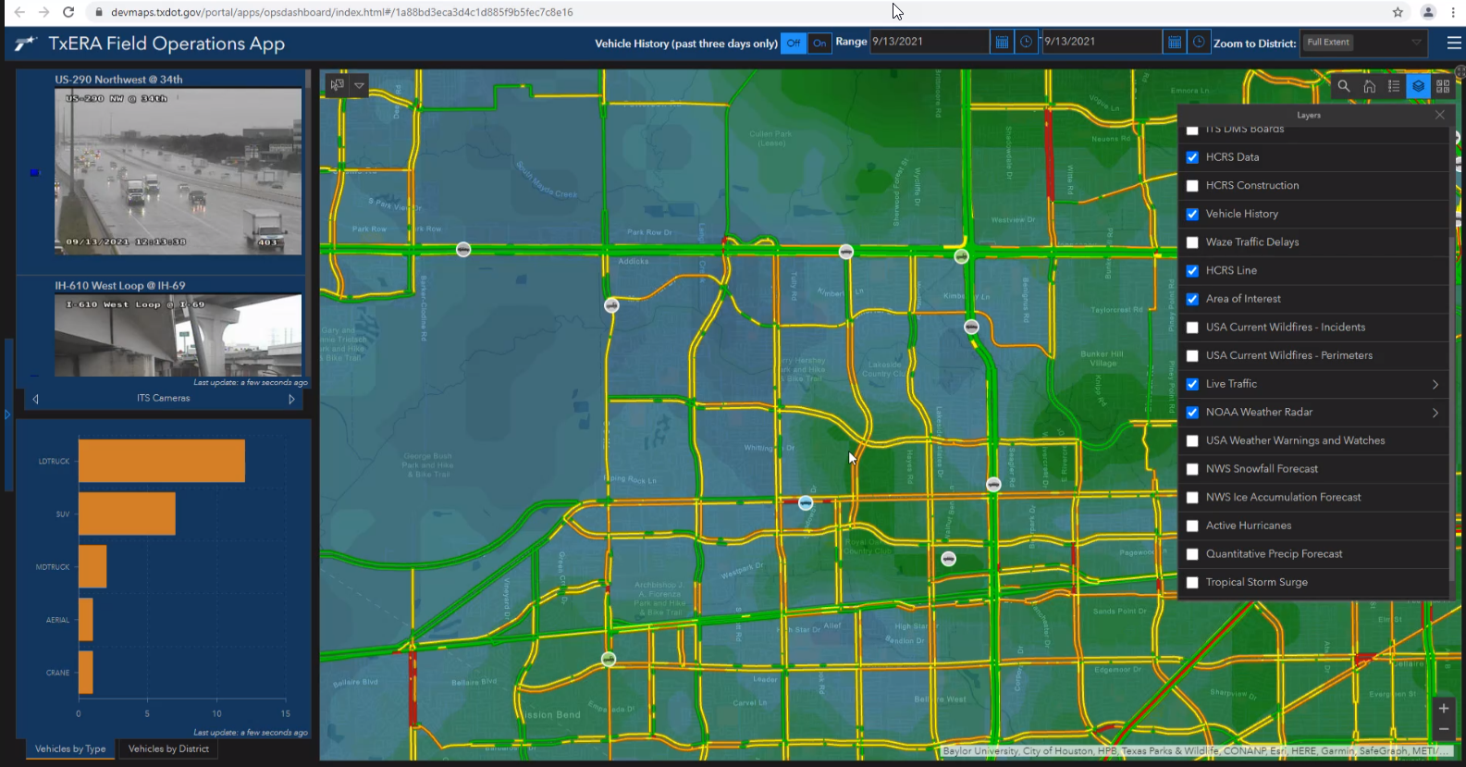
Rain Map in the Sky to Flood Map on the Ground
Forecast Rain Map
Forecast Flood Map: Synoptic Scale
Forecast Flood Map: Detailed Scale
Web Communication to TxDOT

Slide 4
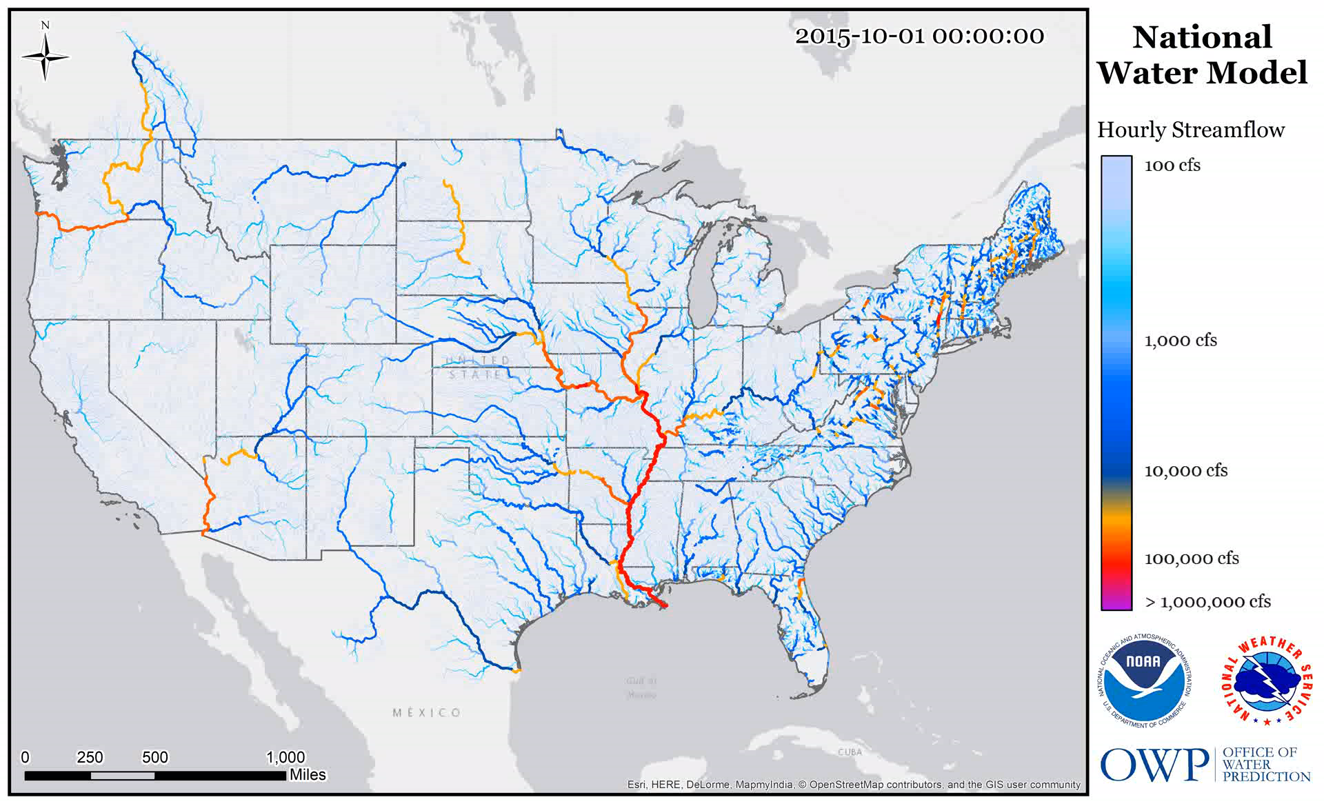
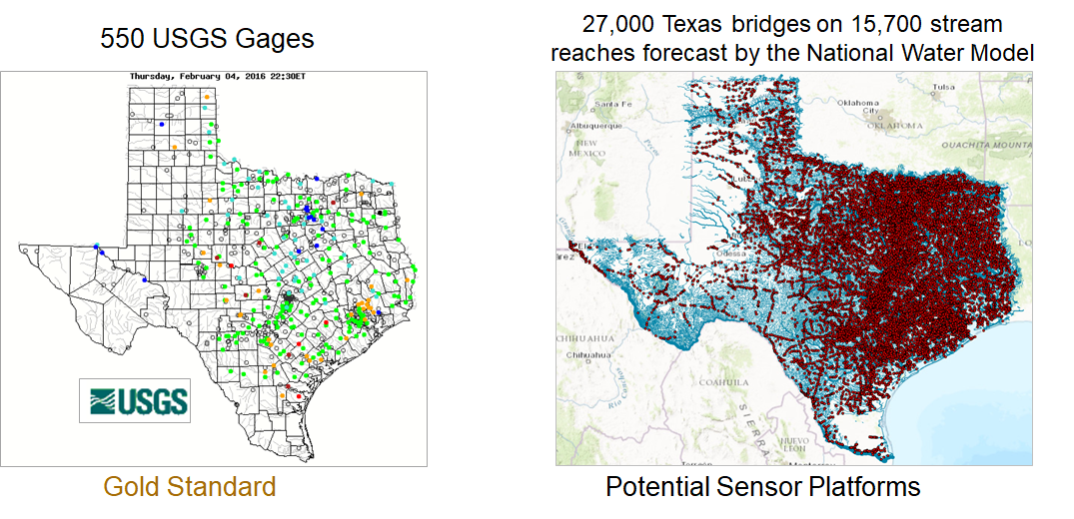
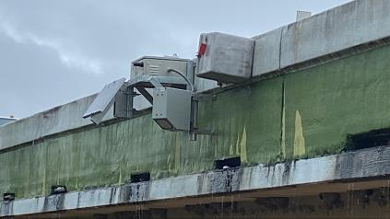
Densifying Stream Gauging … a Slide from 2016
TxDOT Bridges as a Sensor Network
Radar Gauge on Bridge
Then came …
Streamflow I Project (2017 – 2019) – UT Austin installs 20 radar streamflow gauges along IH-10
Streamflow II Project (2020 – 2023) – USGS installs 60 new gauges in watersheds and maintains existing 20 gauges

Slide 5
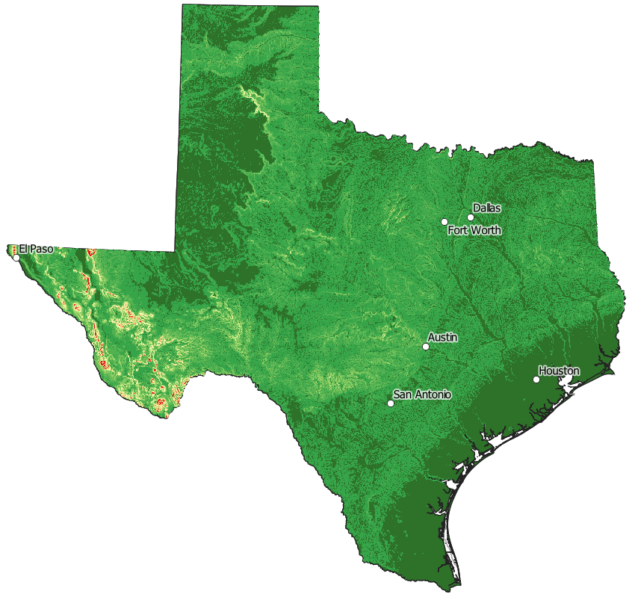
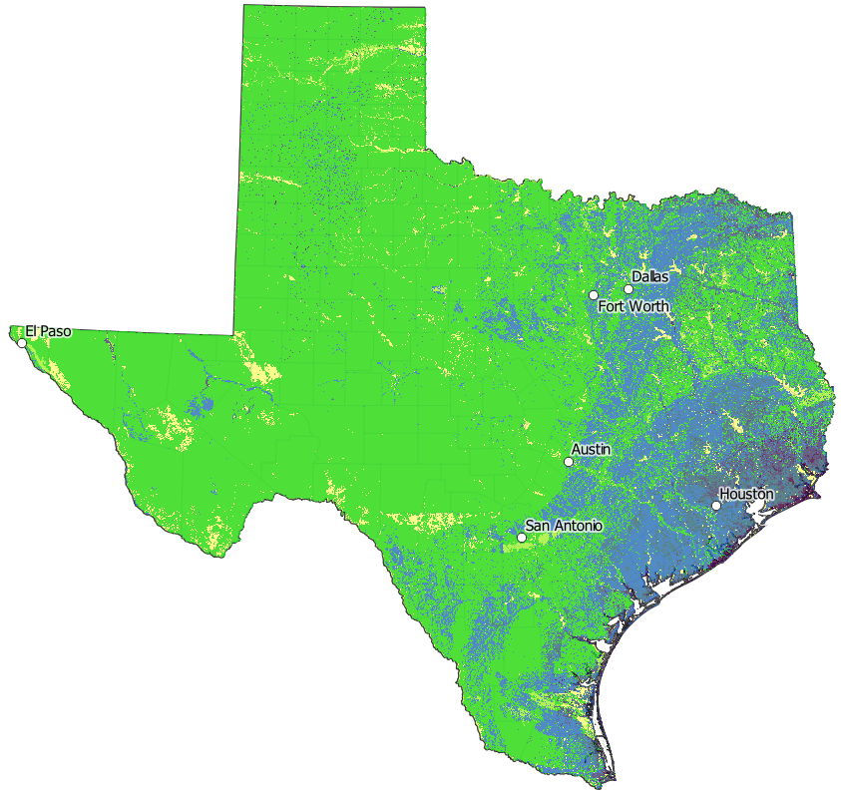
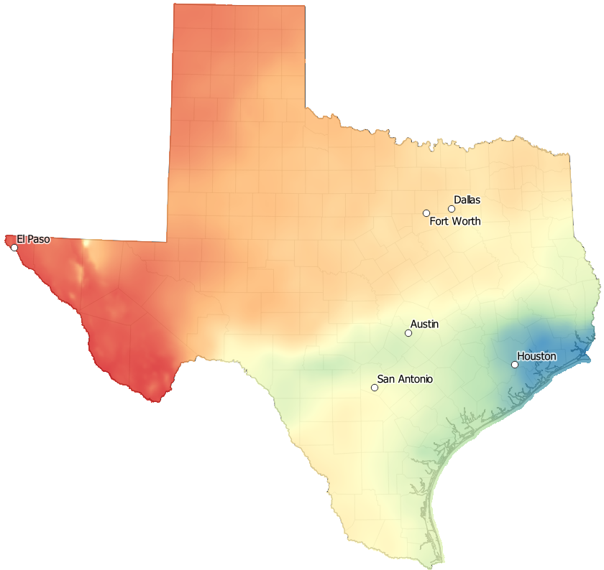

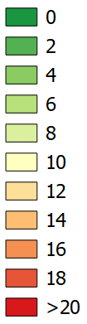

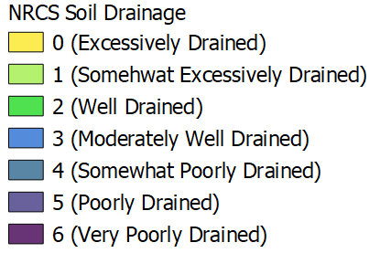
Streamflow II Gauge Siting
Flood Risk Factors have a Combined Gradient from the Coast towards Inland
Flat
Slope
Poor
Drainage
High
Rain

Slide 6
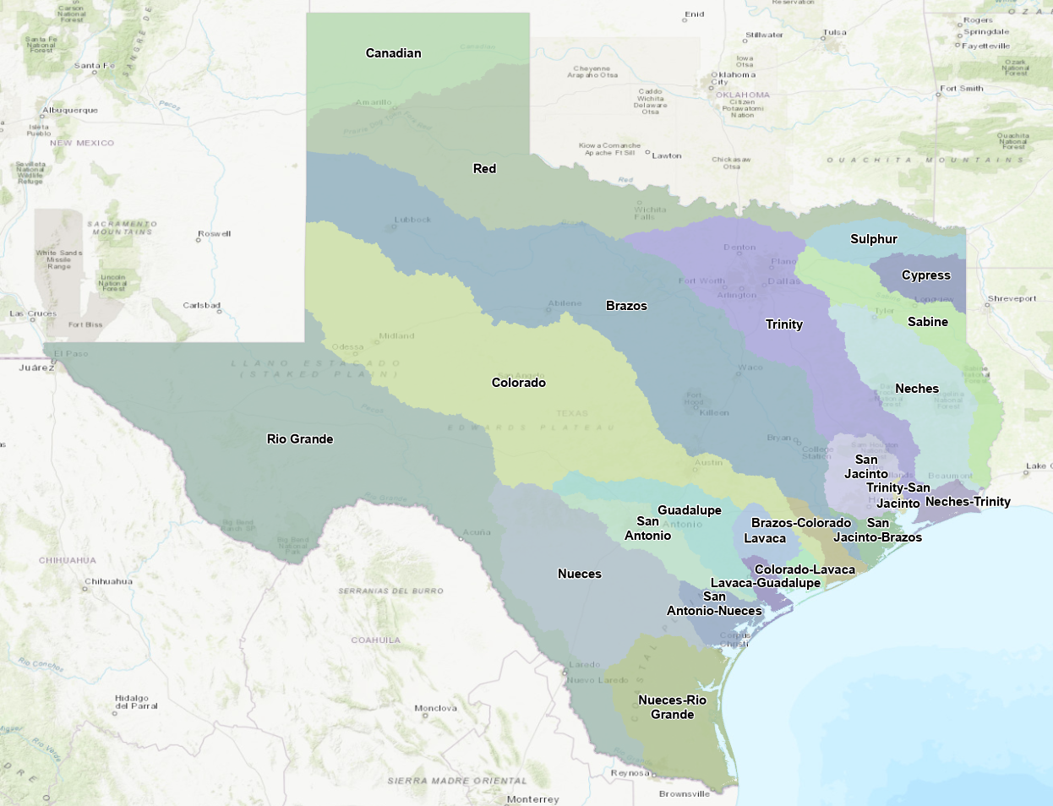
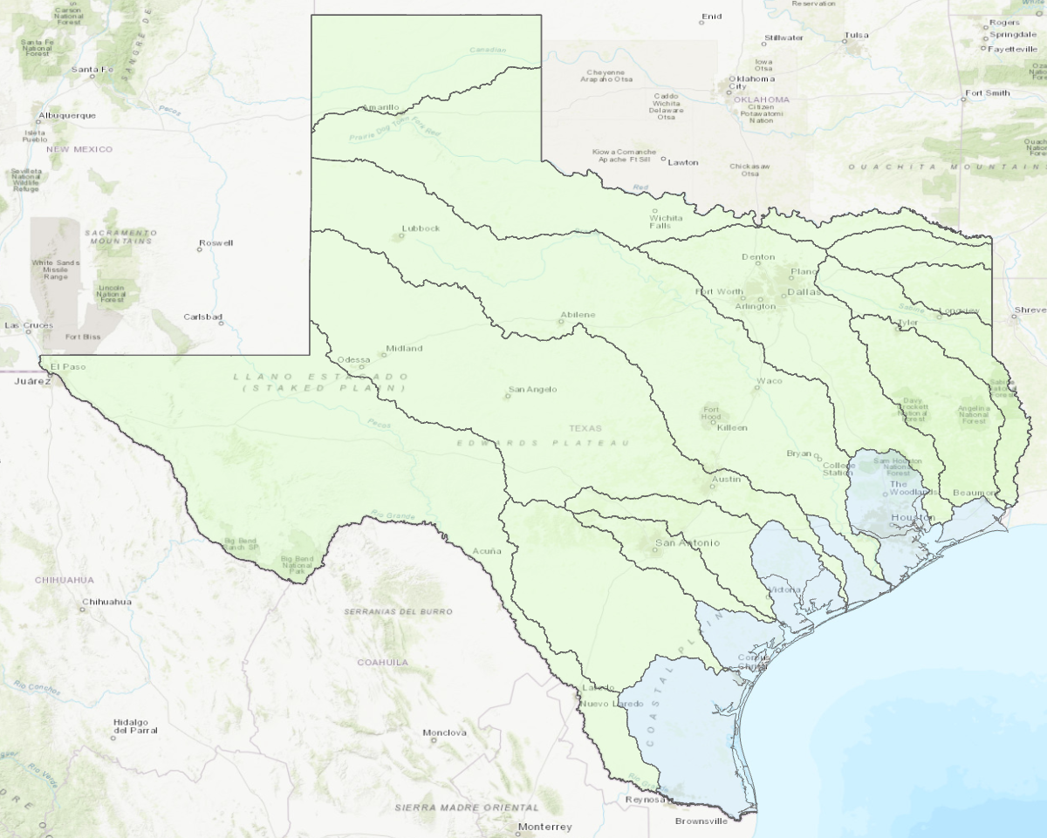
Streamflow II Gauge Siting
Texas Drainage Basins – Two Types, Inland and Coastal Basins
Inland River Basins
Moderate slope
Well drained
Lesser rainfall
Coastal Basins
Low slope
Poor drainage
High rainfall

Slide 7

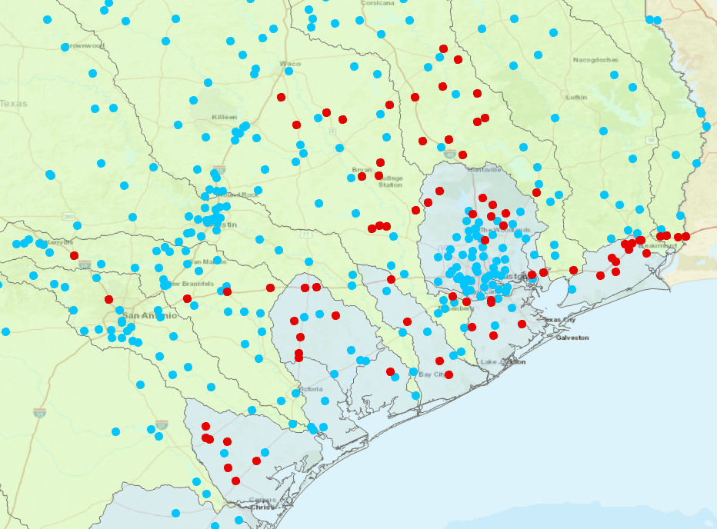
Two clusters of Streamflow II gauge sites
Inland Cluster
Large riverine basins
Approximately doubles
USGS gauge density
in chosen watersheds
Spacing is approximately
one gauge per HUC10
watershed considering
TxDOT and USGS
gauges together
Coastal Cluster
Small coastal basins

Slide 8
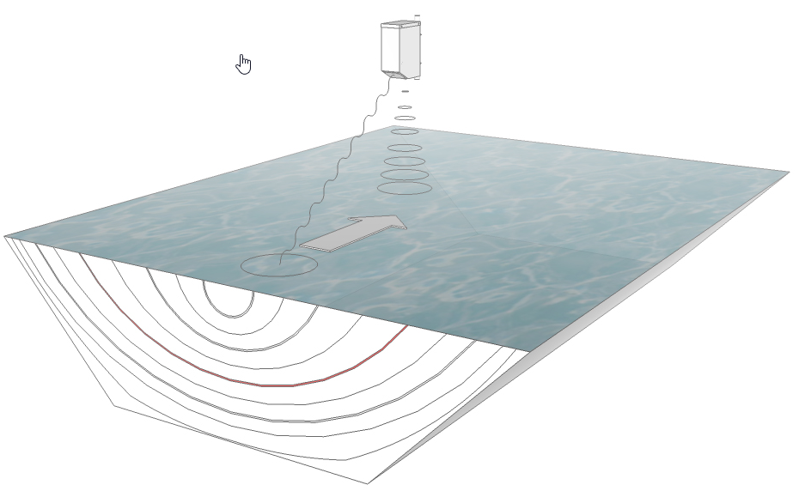
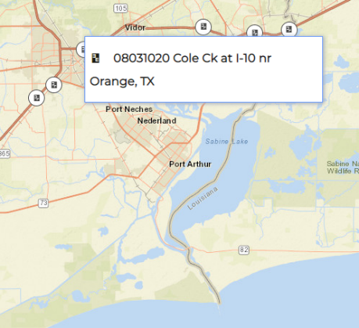
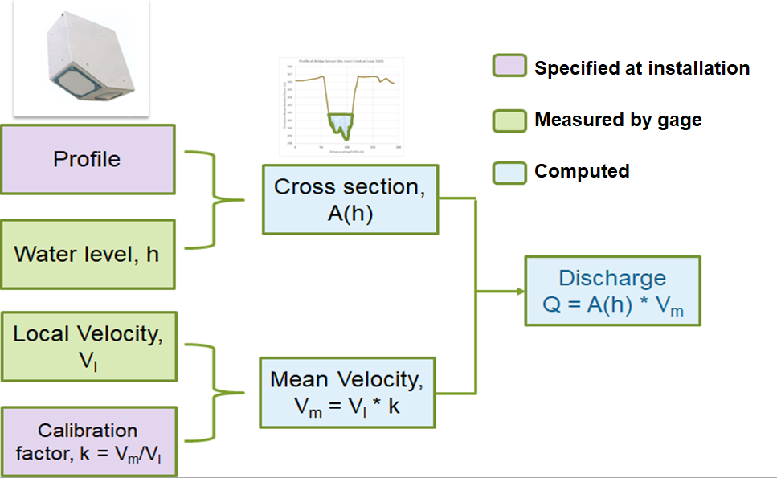
RQ-30 Radar Stream Gauge
08031020 Cole Ck at I-10 nr Orange, TX
Measures water surface elevation h
and local velocity v_{l} by radar
Data Logger
Cell phone comm.
Wire Weight
Solar Panel
Radar Sensor

Slide 9
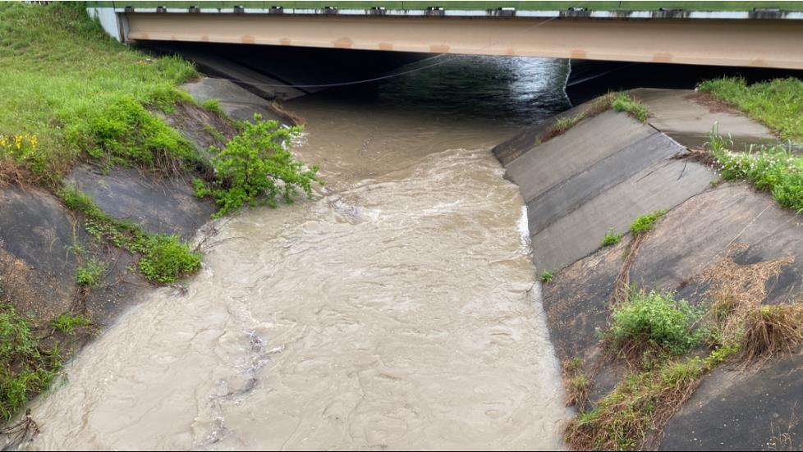
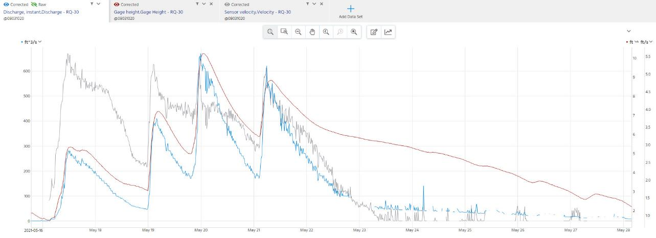
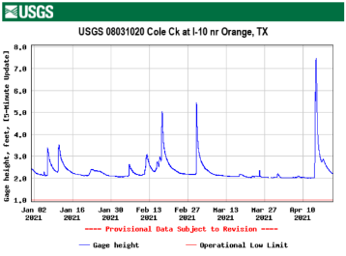

Cole Creek Data with Discharge Pulses for 16-29 May, 2021
Surface Velocity
Stage Height
Discharge

Slide 10

USGS Goals for Streamflow Gauging in this Project
Install and maintain 80 streamflow gauges on TxDOT bridges
Determine uncertainty in computed discharge data to evaluate the Technical Readiness Level (TRL) of the equipment and methods
Tier 1
10 gauges with Traditional USGS methods
Three Levels
of Gauge Support
Tier 2
20 gauges that are Moderately Checked
Tier 3
50 gauges that are Minimally Checked

Slide 11
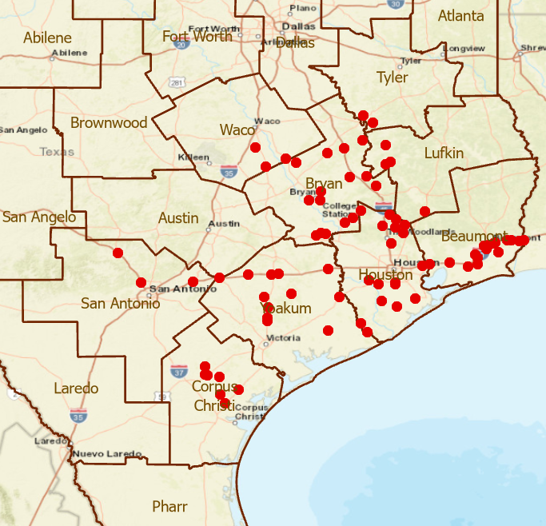
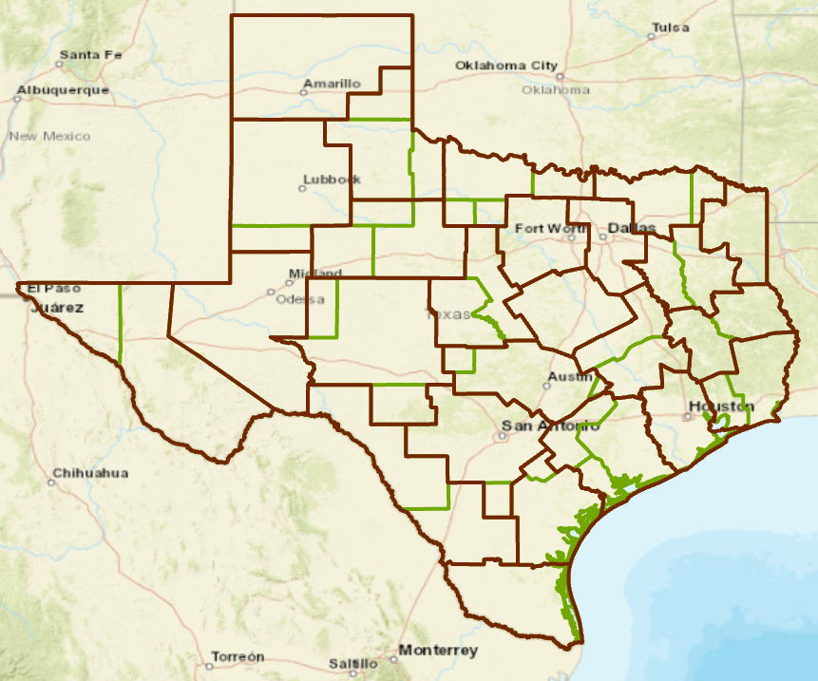
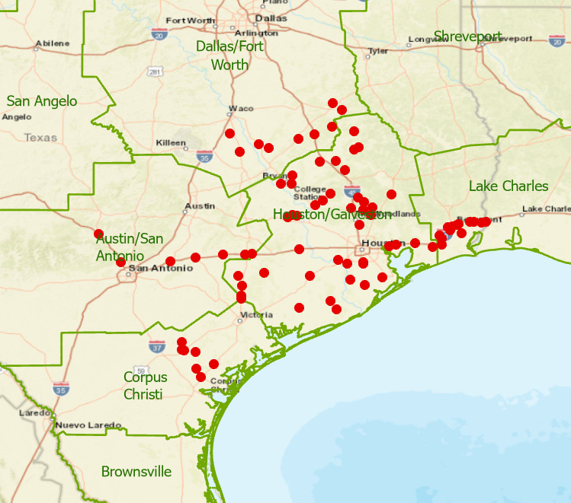
Distribution of 80 New TxDOT Gauges
Largest network of radar stream gauges in US
25 TxDOT Districts
13 Weather Forecast Offices
form 82 distinct intersection areas
Need a Common Operating Picture
TxDOT Districts
NWS Weather Forecast Offices
Jonathan Brazzell
Stage Height Definitions
Bankfull
Action
Flood
Minor
Moderate
Major
for Transportation
Katie Landry-Guyton
Amanda Schroeder
Melissa Huffman, Christina Barron
Paul Yura

Slide 12
Rain Map in the Sky to Flood Map on the Ground
Forecast Rain Map
Forecast Flood Map: Synoptic Scale
Forecast Flood Map: Detailed Scale
Web Communication to TxDOT

Slide 13
Rain Map in the Sky
Forecast Rain Map
WPC 5-Day QPF
Valid: 12Z Wed Sep 18, 2019
Forecast Precipitation for TS Imelda
Flood Emergency Response Exercise
in TxDOT Beaumont District, 22 February 2022
Jonathan Brazzell, LCH, doing weather briefing

Slide 14
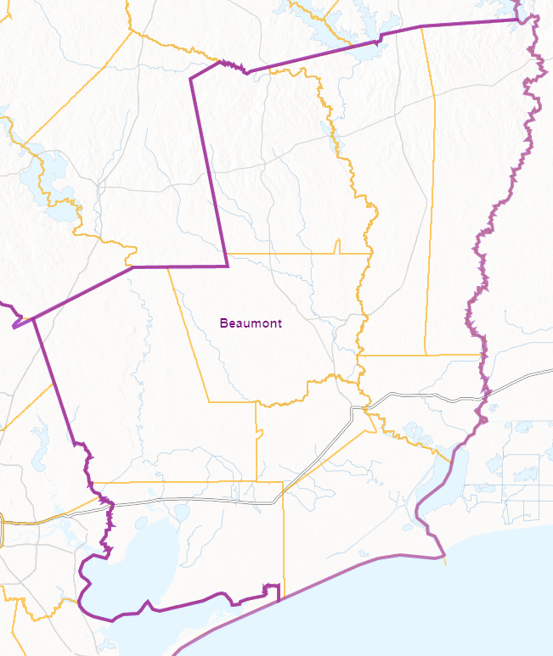


TxDOT Beaumont District Emergency Response Organization
District
(6 people)
Daytime Duty
State
(60 people)
Local
TxDOT Austin
Emergency
Operations Center
(Matthew Heinze)
Requests for
assistance
Maintenance Sections
(Maintenance Supervisor)
District Engineer (Martin Gonzalez)
Newton
(Cecil Wade)
TxDOT Beaumont
Emergency
Operations Center
Incident Command
(Chris Henry /
Kenneth Wiemers)
(Day /
Night)
Jasper
(JoEllen Miller)
Woodville
(Jay Castleberry)
Planning
(Adam Jack)
Logistics
(Keith Horn /
Scott Estes)
Administrative
(Heather Weeks)
Kountze
(Steven Singleton)
Orange
(Jody Hand)
12 hour shifts 7AM – 7PM
Operational briefings 6AM, 6PM
TxDOT Statewide Event (Weather) Call, 8AM
NWS BMT Weather briefings 10AM, 4PM
Liberty
(Tyrone Alexander)
Beaumont
(Kevin Emerson)
Operations
(Brad Murray /
John Sudela)
Port Arthur
(Carl Ray)
Anahuac
(Jake Taylor)
Organized within
Maintenance Sections

Slide 15
TxDOT Emergency Management Questions
Pre-Event
Hydrology Questions
When will the storm arrive?
What is the water level currently and what is the predicted?
What areas or MNT sections will be impacted?
When will roads begin to flood?
How many roads will be flooded?
Operations Questions
Will the Emergency Operations Center be activated?
What is our current resource status?
Do we need to pre-position resources?
Do we need to stage barricades? If so, where?
Do we need to clear culverts/channels of debris prior to flood arrival?
Do we need to call in additional staffing?
Do we need additional resources?
Tropical Storm Imelda, Sept 2019

Slide 16
TxDOT Emergency Management Questions
Response
Maintenance Sections
Newton
Hydrology Questions
Which roads are flooded?
Which bridges are impacted?
Are any high use, critical roads impacted?
Is the flooding concentrated in one area
or across many sections?
How long will the roads be flooded?
Operations Questions
Are evacuations necessary?
Which evacuation routes will be used?
Will we need courtesy patrols?
If so, how many courtesy patrols are needed?
How long will additional staffing be needed?
Jasper
Woodville
Kountze
Orange
Liberty
Beaumont
Port Arthur
Anahuac
TxDOT Beaumont District

Slide 17
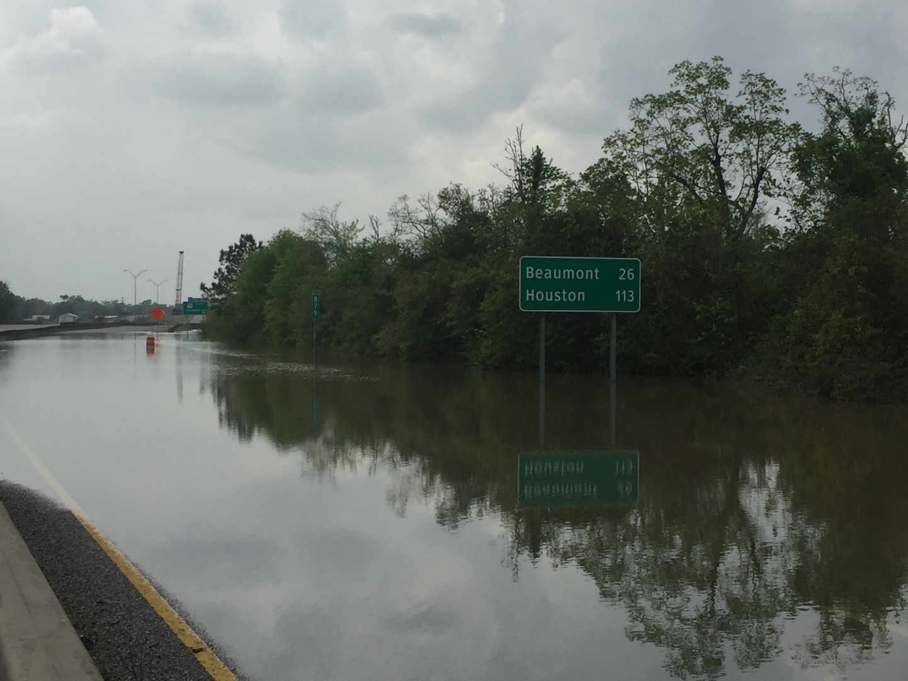
TxDOT Emergency Management Questions
Recovery
Are all Tier 1 and 2 roadways open?
    (IH first and foremost, then US and SH highways will be addressed as these are primary, then look at FM, Loops, etc as the secondary roadways to be opened)
Where do we direct resources to open Tier 1 and/or 2 roadways?
What Tier 3 roadways need work to get opened?
What is the level of storm damage?
Is the damage reimbursable?
Will there be a need for documentation?
What is the estimated time of repair?
Do we need additional repair/recovery resources?

Slide 18
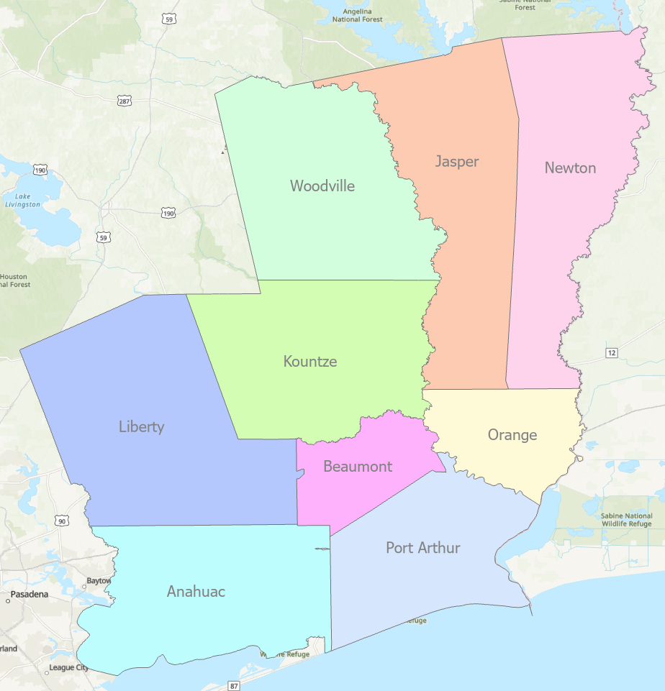
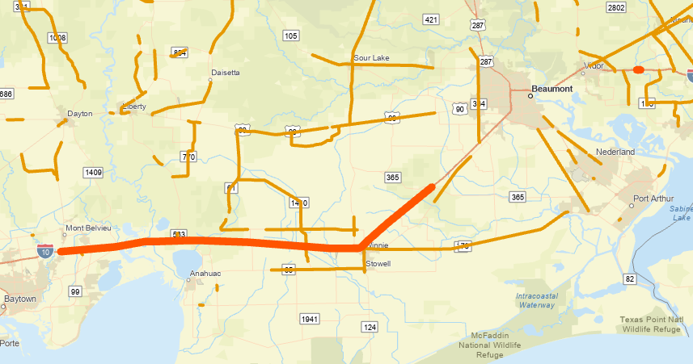
Information Needed for Management of TS Imelda in Beaumont District
Closures of IH-10

Slide 19
Rain Map in the Sky to Flood Map on the Ground
Forecast Rain Map
Forecast Flood Map: Synoptic Scale

Slide 20

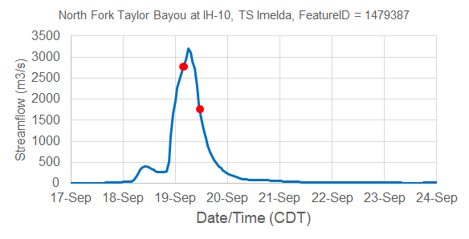
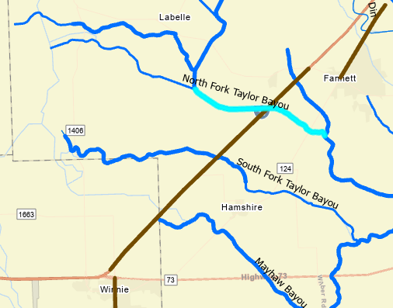
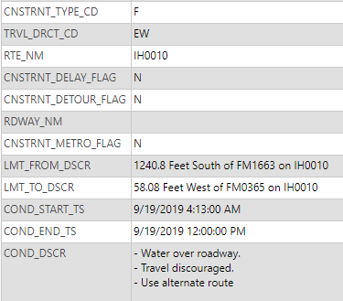
Closure of IH-10 during TS Imelda
National Water Model Retrospective Simulation
Road closure data from TxDOT Highway Conditions Reporting System which underlies “DriveTexas.org”
Streamflow Hydrograph
IH-10 Closure
IH-10 was closed here
from 4:13 AM to 12 noon
on 19 September 2019

Slide 21
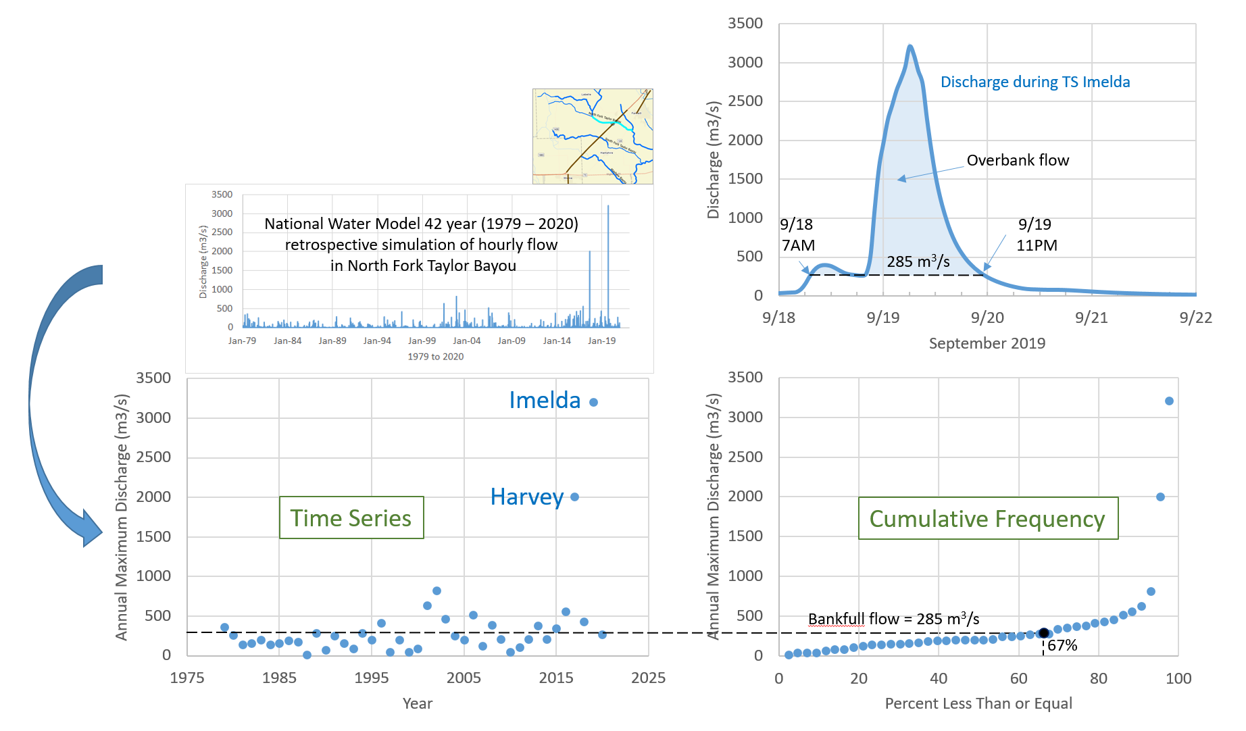
Bankfull Flow
67% Cumulative Frequency of Annual Maximum Flow

Slide 22
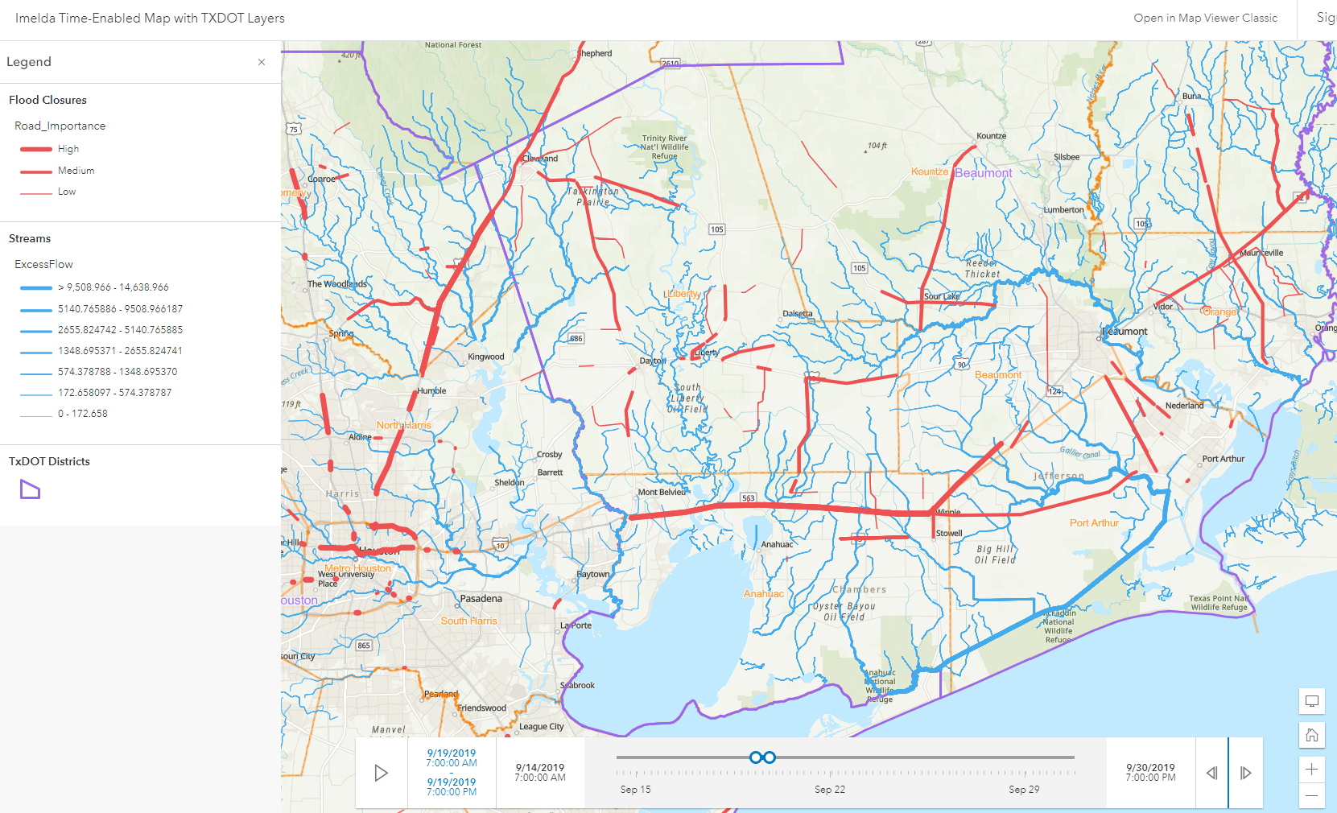
Bankfull Flows and Flooded Road Closures
Spatial Pattern
Tropical Storm Imelda, September 2019
https://arcg.is/1SHC1u

Slide 23
Bankfull Flows and Flooded Road Closures
Time Pattern
Tropical Storm Imelda, September 2019
Flooded Road Closures
Bankfull Flows

Slide 24
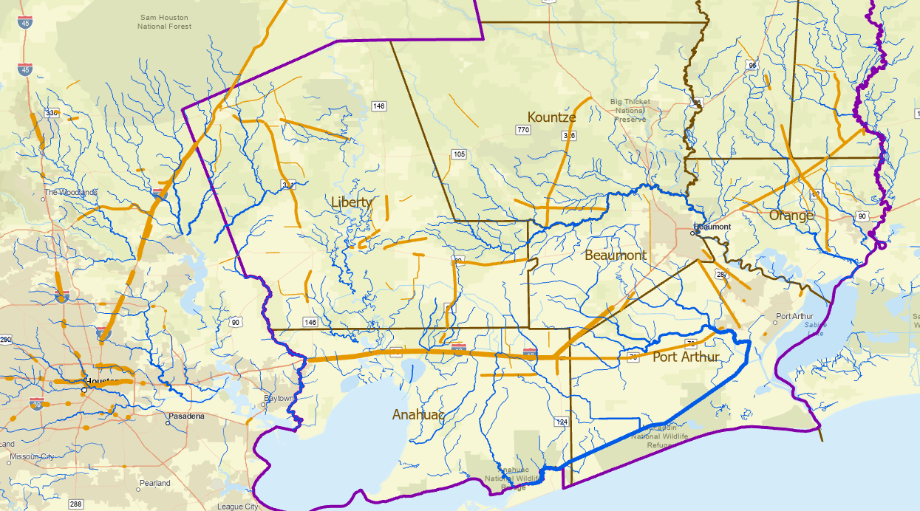
Flooded Roads “Hydrograph”
Sum the length of road closures at each time point
Quantifies the flood threat: How Large is it? Where is it? When is it?
TS Imelda
Total impact = 1412 day-miles
of flooding on TxDOT roads
(area under curve)

Slide 25
Cumulative Road Closures due to Flooding in Texas
March 2014 to November 2021. Data from TxDOT Highway Conditions Reporting System (HCRS)
May, July 2021
South, North Texas
Sept 2019 TS Imelda
Oct 2018 Colorado Flood
Aug 2017 Hurricane Harvey
May 2016 Brazos Flood
Oct 2015 Halloween Flood
Historical flooded roads data that can be
used for forecast calibration
May 2015 (Blanco and Regional Flood)
Sept 2014 (Hill Country Flood)

Slide 26
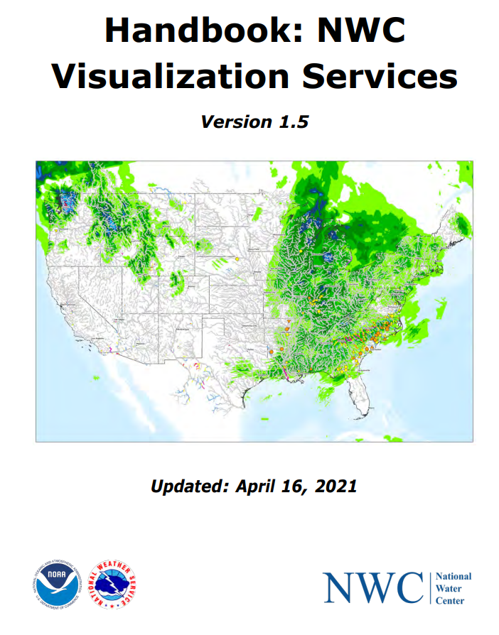
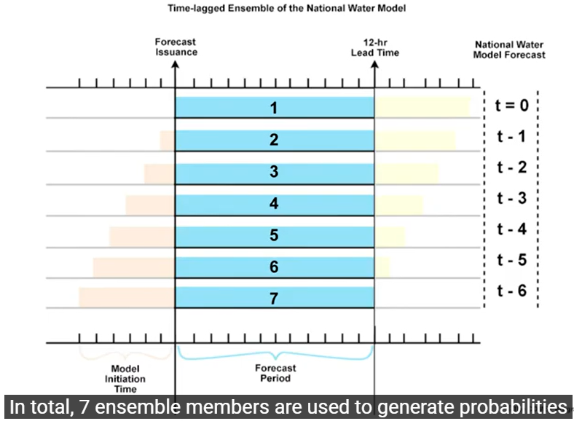
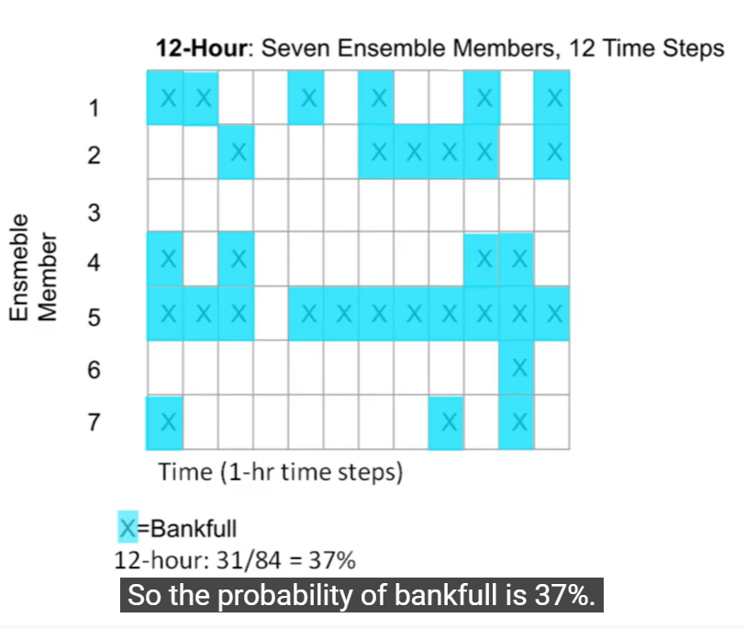
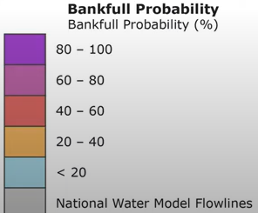
Ensemble Forecasting for Bankfull Flow
Short Range Forecast
12 Hour Bankfull Probability Forecast
  Lagged 7-member ensemble
18 Hour Bankfull Arrival Time Forecast
Medium Range Forecast
5 Day Bankfull Probability Forecast
  7-member ensemble
10 Day Bankfull Arrival Time Forecast
12-Hour Bankfull Probability - YouTube
These are existing NWS Water Visualization Services that I think would be helpful to TxDOT

Slide 27
Rain Map in the Sky to Flood Map on the Ground
Forecast Rain Map
Forecast Flood Map: Synoptic Scale
Forecast Flood Map: Detailed Scale

Slide 28

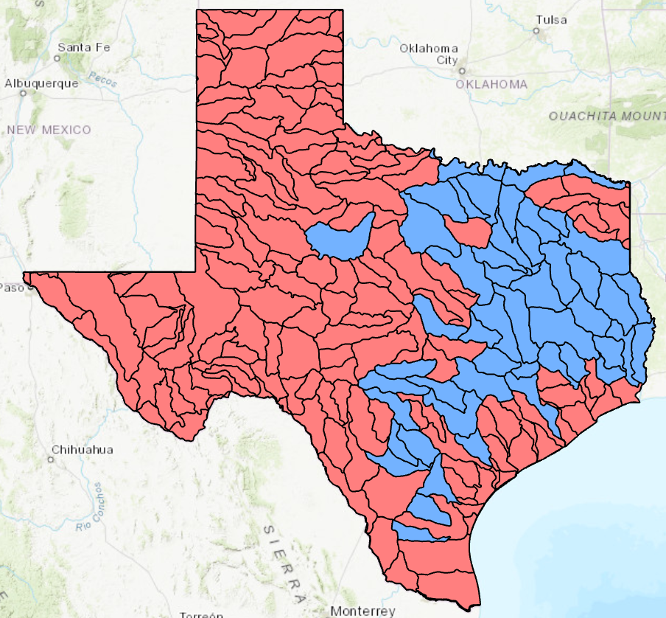
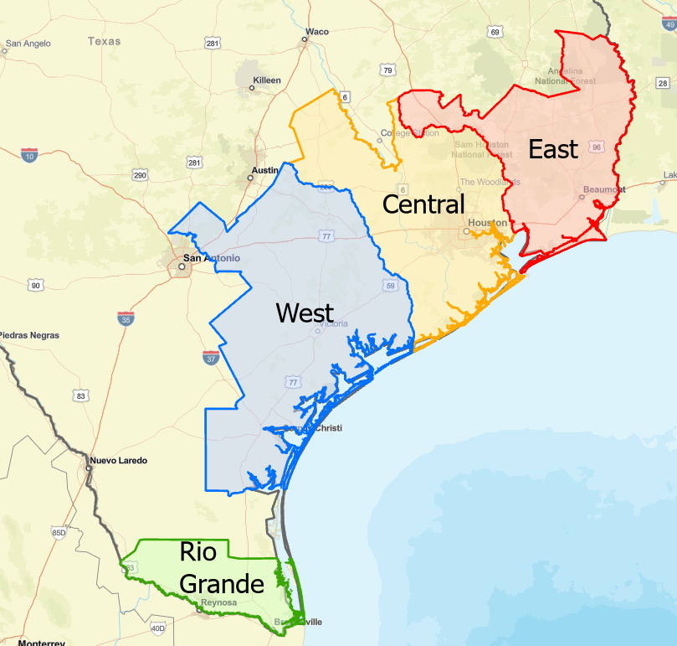




Flood Hydrology and Hydraulic Modeling Studies
Base Level Engineering
Flood Mitigation Areas
Texas Water Development Board & FEMA
Texas General Land Office
HEC-RAS
River Analysis System
How to adapt this modeling effort to support Emergency Response?
$40 million
Notes:
Maidment

Slide 29
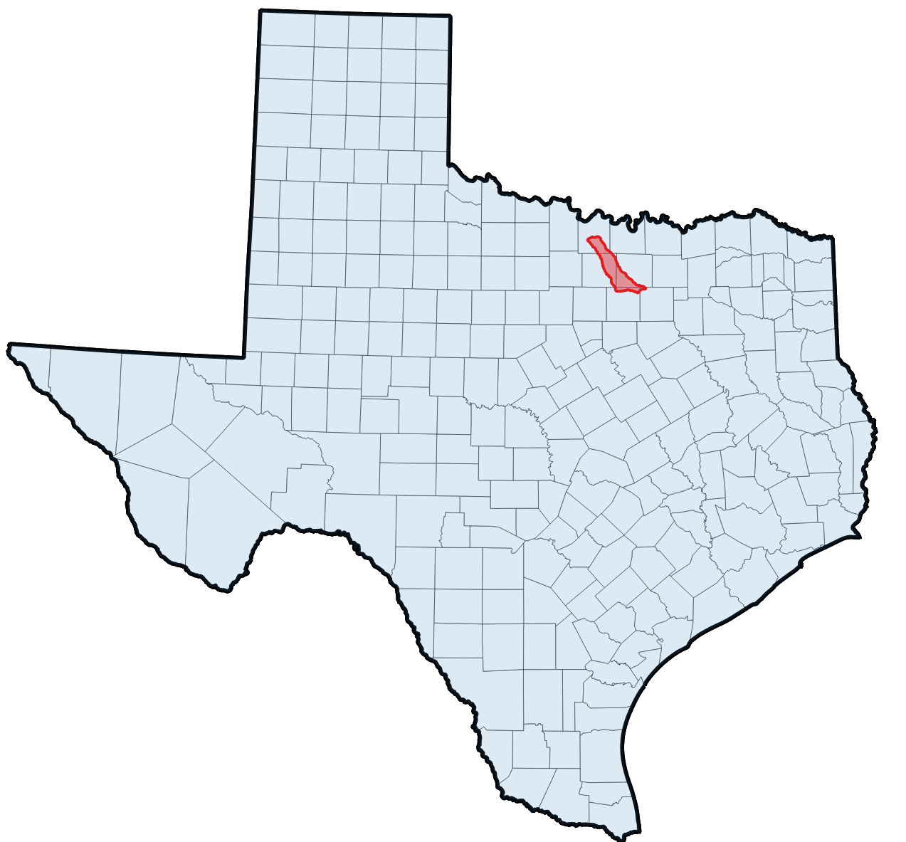
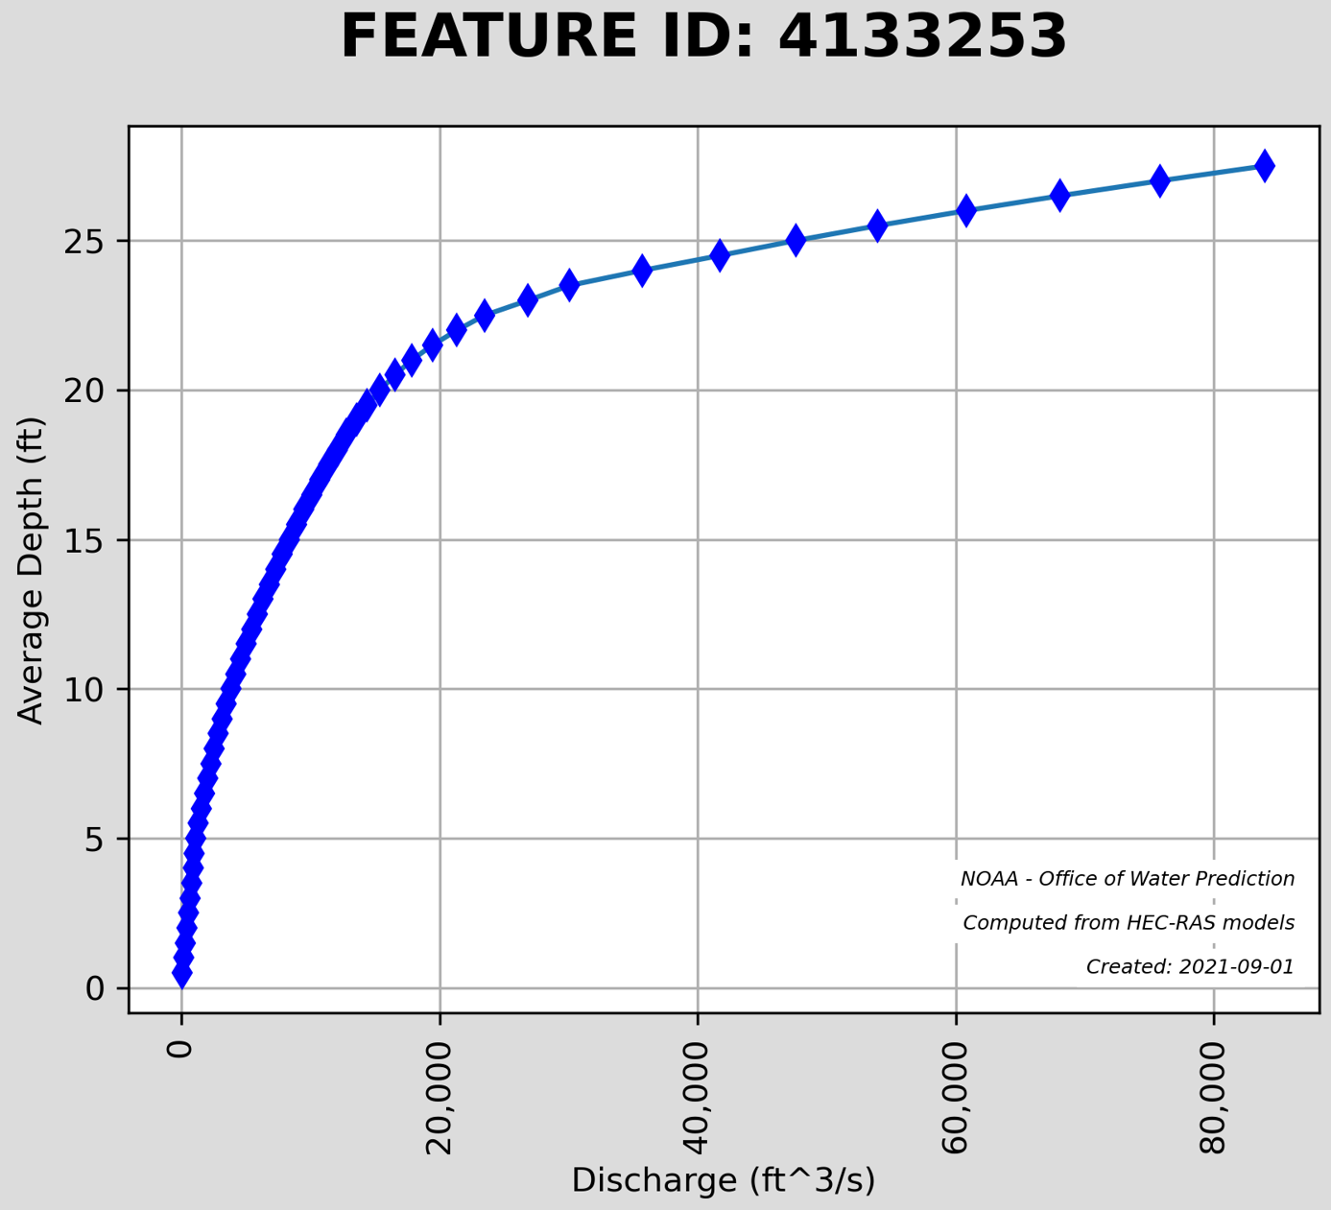
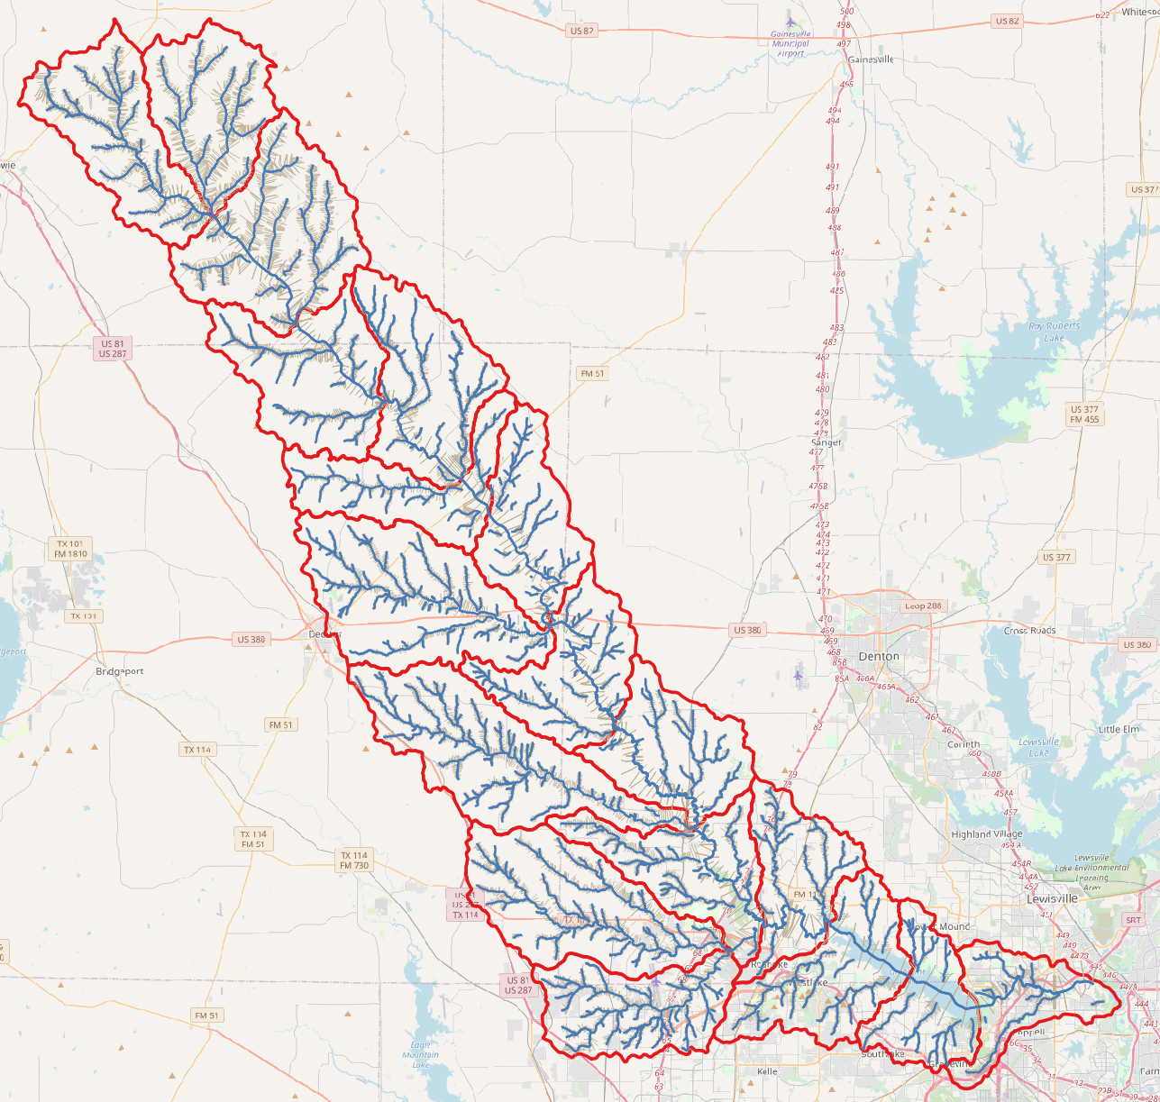

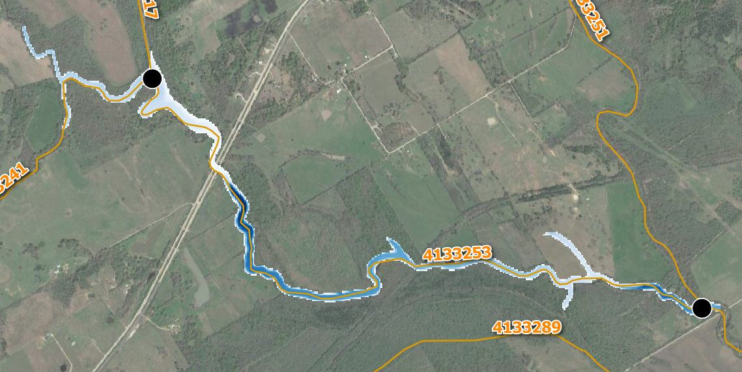
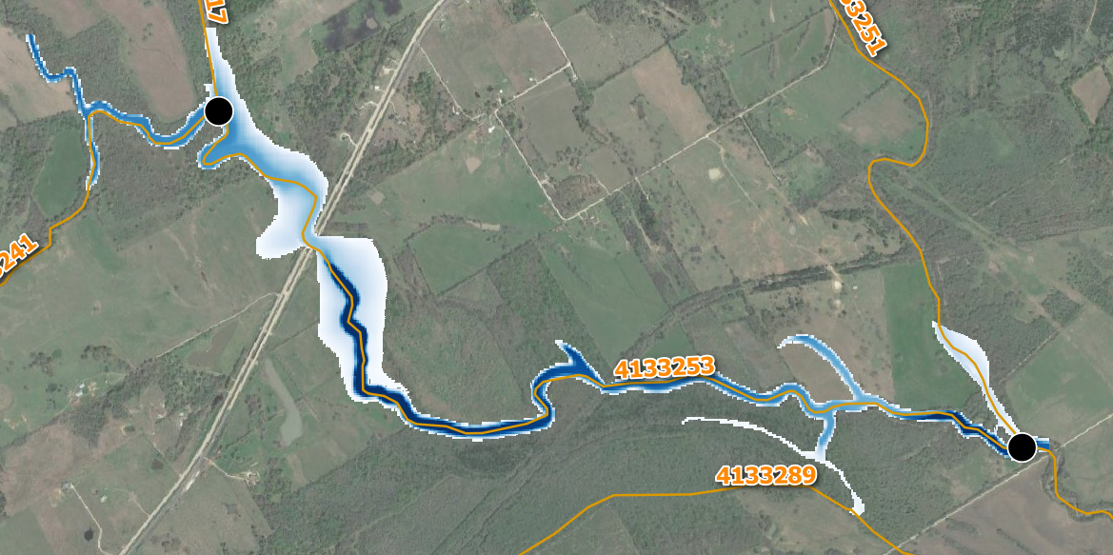
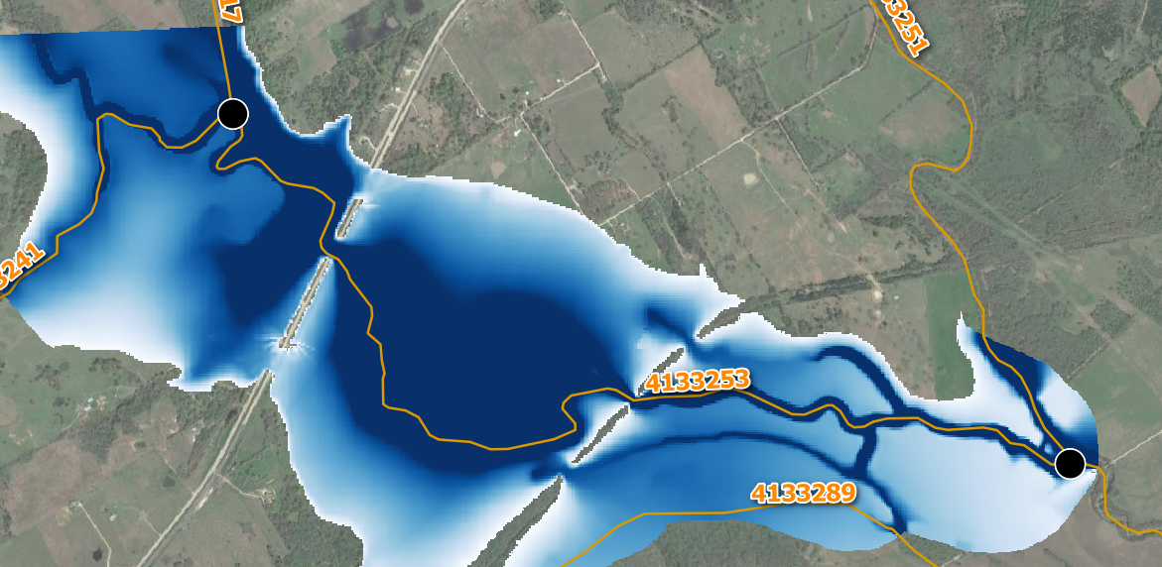
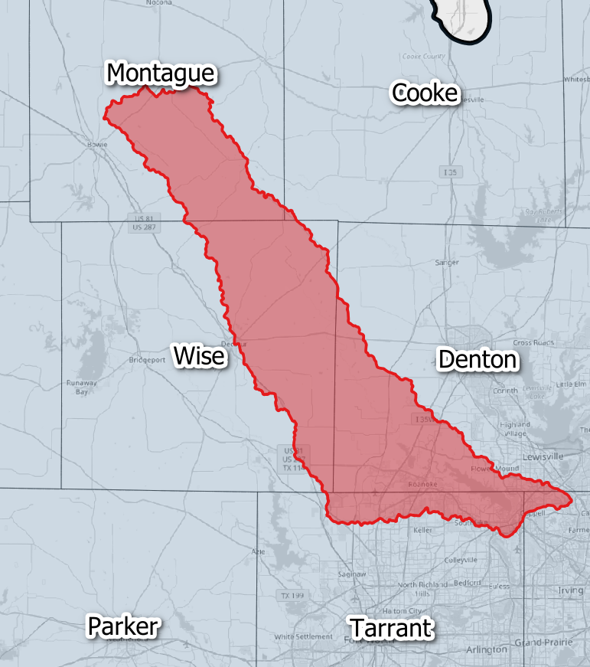




Convert Base Level Engineering 1D Models to Flood Inundation Map Libraries
RAS2FIM
HUC12 units
CSVs
GeoTIFFs
PNGs
Andy Carter
A Flood Inundation Map Library
and set of Rating Curves
A HUC8 unit of Base Level Engineering Models
Done according to InFRM Format
Published on NWS Github site
Notes:
Maidment

Slide 30

2D HEC-RAS Modeling at
a TxDOT Gauge Site
Notes:
Maidment

Slide 31





Flood Information Products
USGS (TxDOT) 08111110 New Year Creek at FM 1155 near Chappel Hill, Tx
Discharge Measurement
HAND
Inundation Extent
Water Depth
Water Velocity

Slide 32





Bridge Characterization from a LIDAR Point Cloud
Andy Carter, UT Austin
3
Plan
Bridge over Shoal Creek at 15th St in Austin, Texas
Deck point density
1 point per 2.6 sq feet
11,078 LiDAR points
on bridge deck
Plan
Profile
Perspective

Slide 33



Updated Set of Flood Inundation Map Guidelines
Critical to know the Low Chord Elevation
of each Bridge

Slide 34
Rain Map in the Sky to Flood Map on the Ground
Forecast Rain Map
Forecast Flood Map: Synoptic Scale
Forecast Flood Map: Detailed Scale
Web Communication to TxDOT

Slide 35

TxERA Field Operations Dashboard
(TxDOT Emergency Response Application)
TS Nicholas, 13 September 2021

Slide 36
Traffic Flow and Vehicle Locations at Local Scale

Slide 37












Geospatial Systems Are Helping Us Understand
Understanding
Sharing and Collaboration
Knowledge
Information
Integration
Mapping
Data
. . . Helping Us Make Better Decisions
Slide: Jack Dangermond, President ESRI

Slide 38
Measurement, Forecasting, Impact, Response
Understanding
Sharing and Collaboration
Knowledge
NWS
Forecasting
Information
Integration
Mapping
Flood
Response
Data
USGS
Measurement
TxDOT
Flood Impact

Slide 39



A Proposal
Shared Services
Flood Response Working Group
Evaluation during 2022 Storm Season
Build on our Quarterly Review Meetings
Arc GIS Online
NWS SRH and WGRFC
Service Hydrologists at
Weather Forecast Offices
NWS
TxDOT (TxERA)
Water
Visualization
Services
DriveTexas.org
Project 0-7095 Research Team

