Slide 1
Evaluate Improved Streamflow Measurement at TxDOT Bridges
Project 0-7095
Being conducted for TxDOT by UT Austin and US Geological Survey with the support of
Kisters North America and Aqua Strategies
September 2020 to August 2023
Presentation for Kickoff Meeting, Wednesday 16 September, 2020
Acknowledgements: Chris Glancy, Rose Marie Klee, Ab Maamar-Tayeb, Andrew Lee, Adam Jack,
Peter Smith, Trent Ellis (TxDOT)

Slide 2

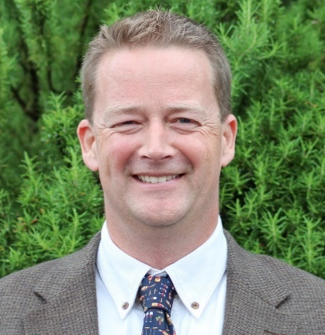
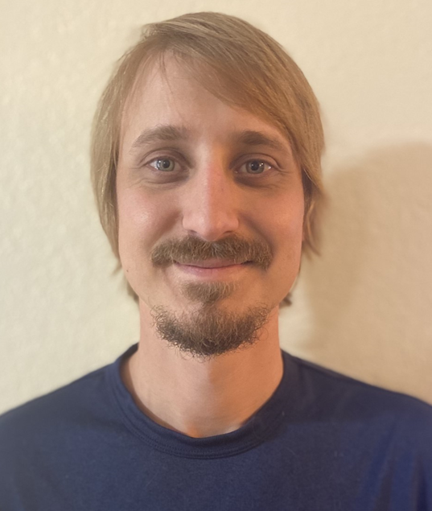
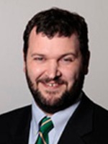

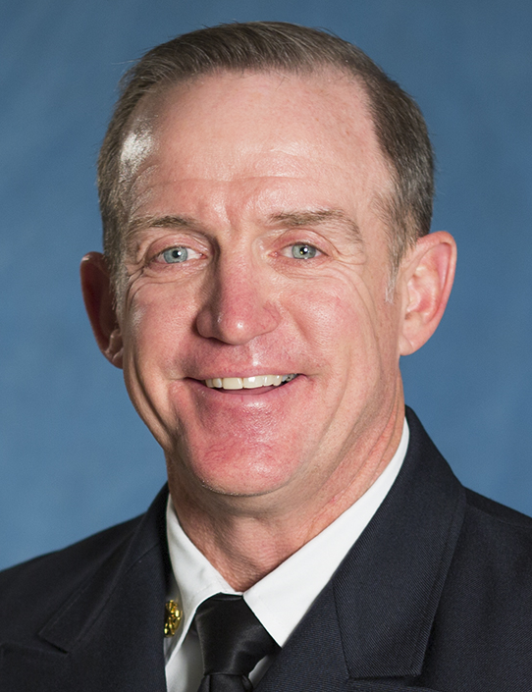
Project Tasks
Task 1 Project Management
(UT Austin, David Maidment)
Task 2 Watershed Selection and Site Evaluation
(Aqua Strategies, Barney Austin)
Task 3 Gauge Installation, Operation and Maintenance
(US Geological Survey (Scott Grzyb)
Task 4 Flood Forecast System Operation
(Kisters North America, Matt Ables)
Task 5 Forecast Model Assessment
(UT Austin, Paola Passalacqua)
Task 6 Flood Manual and Training
(UT Austin, Harry Evans)

Slide 3
Goals of Project
Better information on forecast flood inundation would help anticipate bridge and road flooding, inform decisions before, during, and after flooding, and deploy resources for bridge inspection after flooding is over
Task2: Thoughtful selection of critical watersheds and gauge sites
Task 3: Sound installation and maintenance of 60 new streamflow gauges and 20 existing gauges on TxDOT bridges
Task 4: Accurate, reliable and timely flood forecasting and warning at TxDOT bridges
Task 5: Quantitative and insightful flood model assessment
Task 6: Useful and usable flood manual and training for TxDOT staff
Technical Readiness Level 9: Technology Refined and Adopted by end of three year project in August 2023

Slide 4
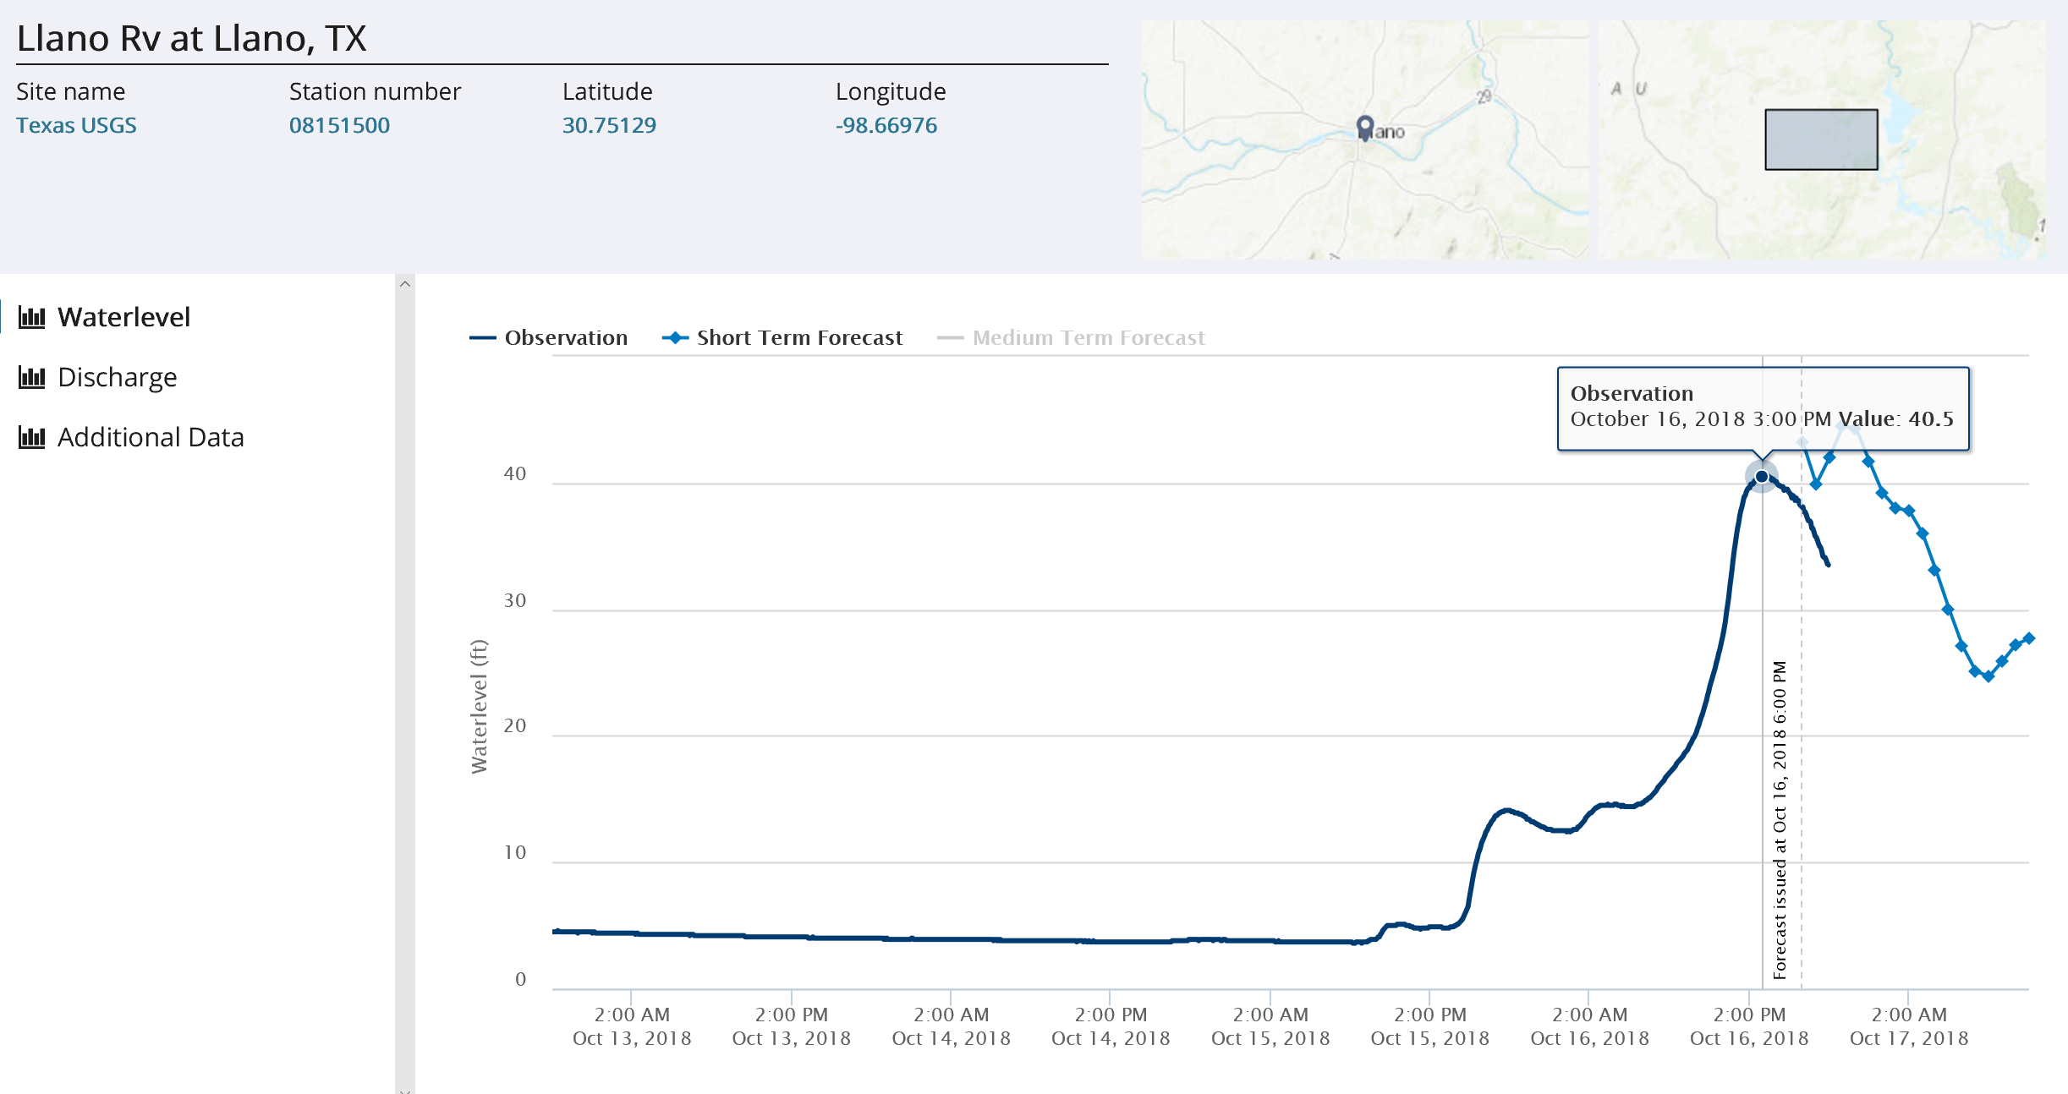
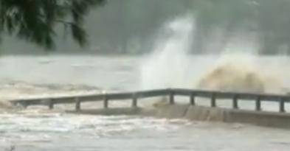
Example from Streamflow I: TxDOT Flood Forecast Portal
Llano River at Llano, 16 October 2018
Largest flood on Llano River since 1939
Llano River at Llano
40
30
Water Level (ft)
USGS Observation
20
National Water Model forecast
and HAND-based rating curve
10
0
Just downstream: bridge failure
on Llano River at Kingsland

Slide 5
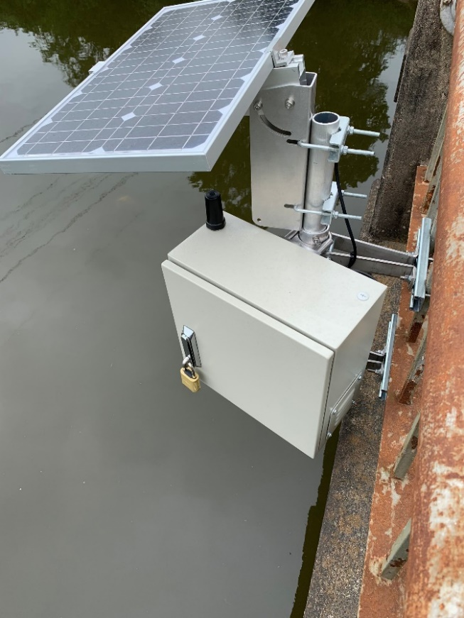
Example from Streamflow I: Radar Stream Gauging

Slide 6





Goal for Streamflow II
National
Flood Forecast
Datasphere
Data
Assimilation
for improved
forecast
in real-time
Local
Observed Data
Flood
Warning
80 Gauges

Slide 7

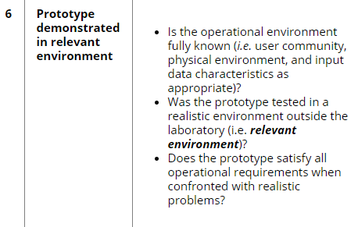
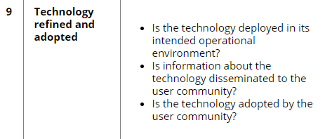
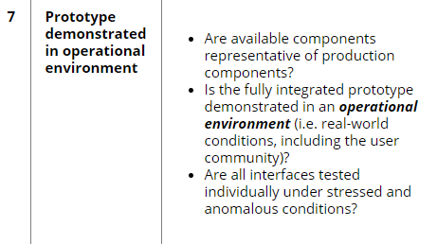
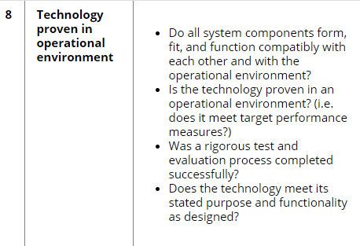
Technical Readiness Levels
From Streamflow I:
Now – Level 6
Prototype demonstrated
in relevant environment
Implementation
9
8
7
6
5
4
3
2
1
August 2023 – Level 9
Technology refined
and adopted
Development
(Field)
Applied
Research
(Laboratory)
August 2021 – Level 7
Prototype demonstrated
in operational environment
August 2022 – Level 8
Prototype proven
in operational environment
Basic
Research
https://cms7.fhwa.dot.gov/research/exploratory-advanced-research/research/technology-readiness-assessment-work-ear-program

Slide 8
Task 1: Project Management
Aim: to achieve project goals and have a well functioning team
How it will be accomplished:
Monthly teleconferences and project report to TxDOT
Quarterly review of project achievements and plans
Discussion with TxDOT Project Committee
Discussion with Research Oversight Group
Project deliverables submitted at periodic intervals
Measures of Success:
Streamflow gauges functioning well
Forecast system accurate, reliable and timely
Flood information and manual useful and usable
Deliverables submitted on time and within budget

Slide 9
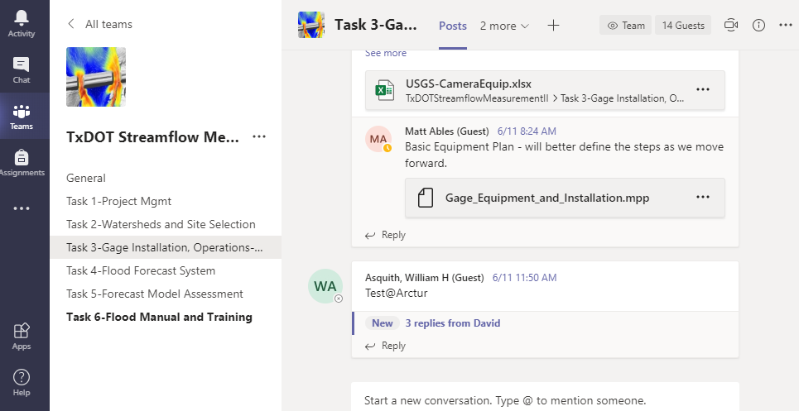
Possible Shared File System (MS Teams)

Slide 10

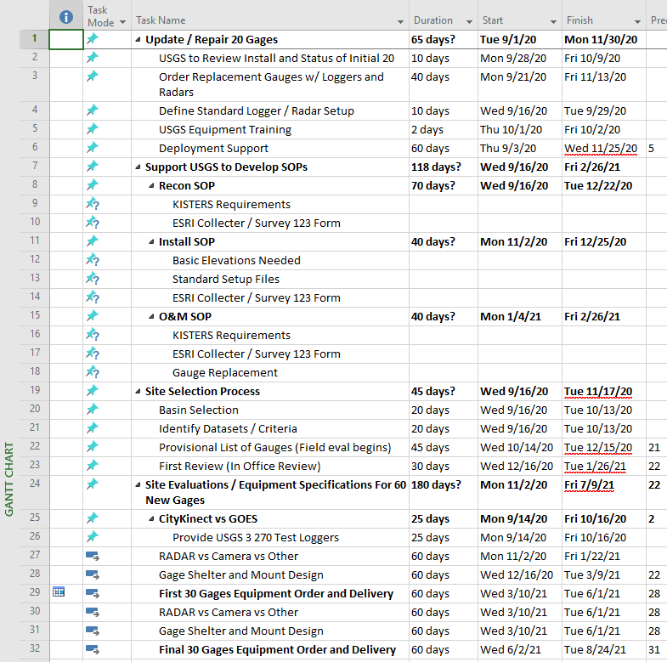
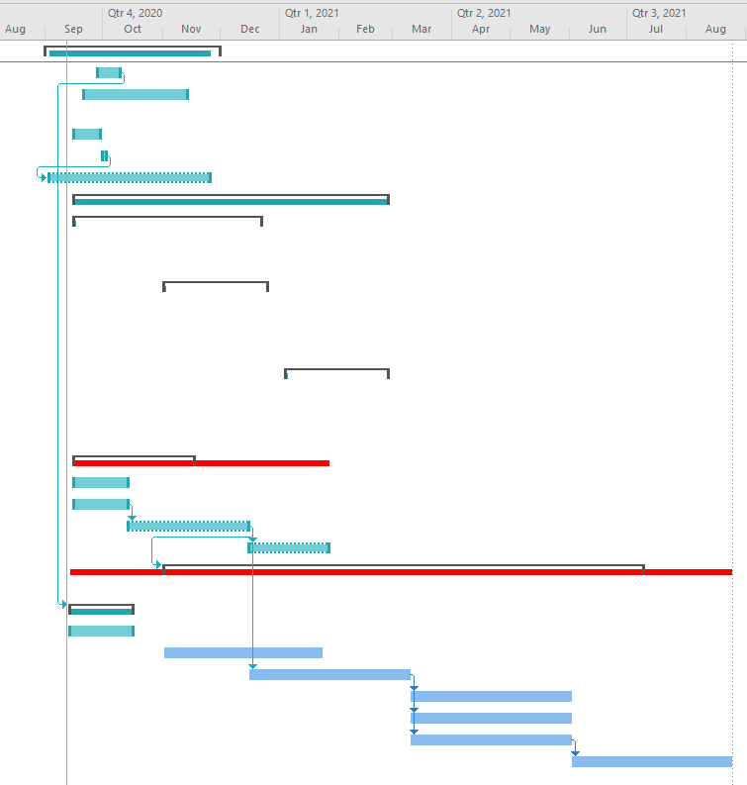
Scheduling using a Gantt Chart (MS Project)
Credit: Matt Ables

Slide 11

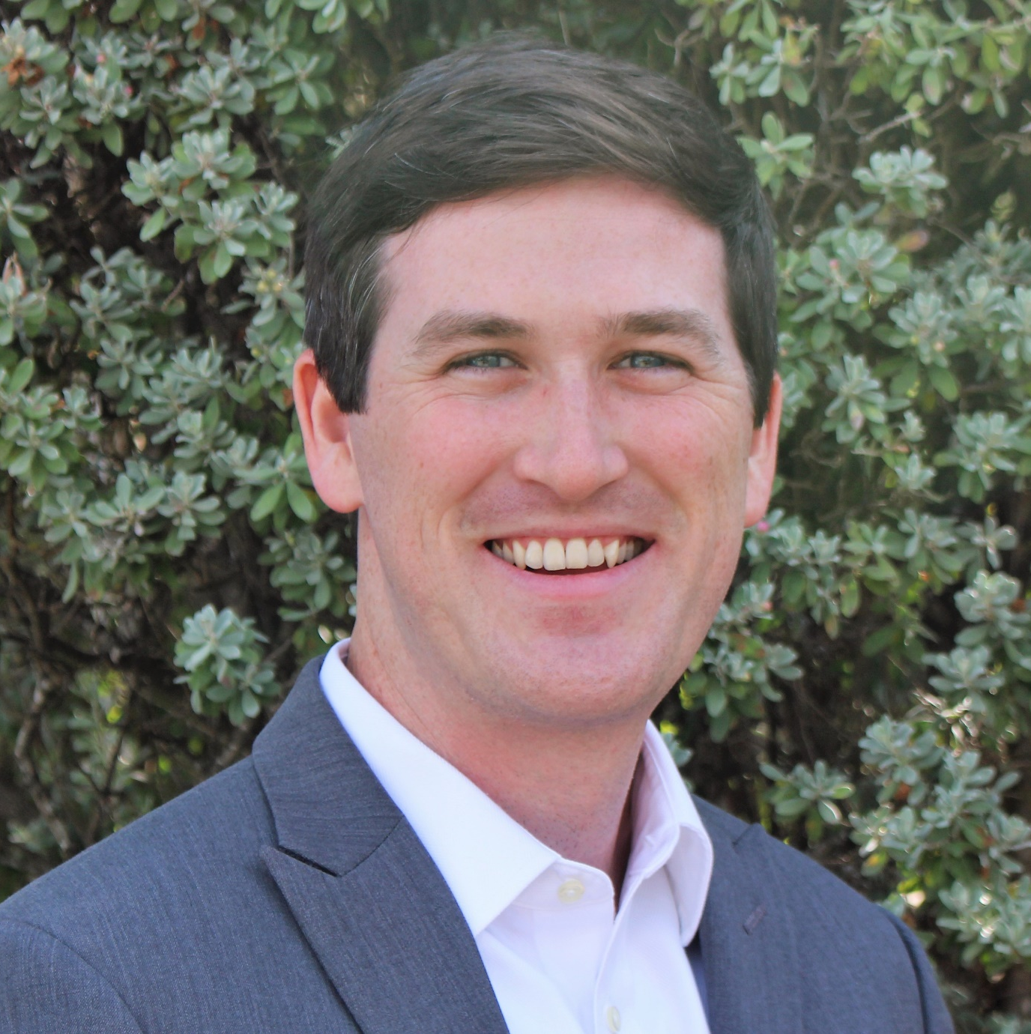

Task 2: Watershed Selection & Site Evaluation
Team Members
Barney Austin, PhD, PE
Frank Schalla, PE

Slide 12
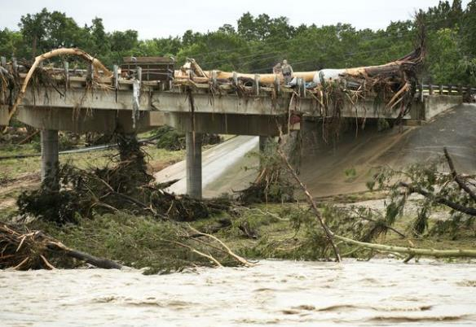
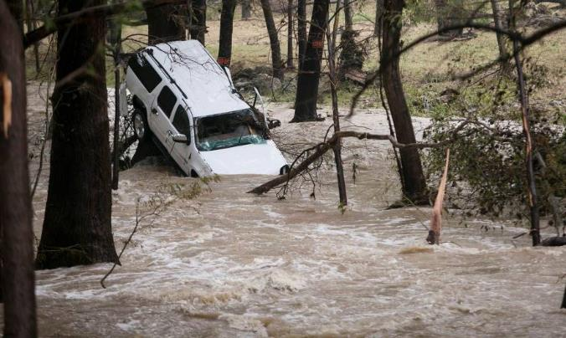
Watershed Selection & Site Evaluation
Task 2
Identify priority watersheds
Prioritize bridges at risk from flooding
Identify and rank potential gauge sites
Recommend sites for field visits
Notes:
New gauges are radar, to measure water stage and surface velocity
Will recommend at least 100, will be installing 60 in Task 3.
New streamgauges costs $50k, plus $17k/yr for O&M. (unsure of these numbers, from our study)

Slide 13
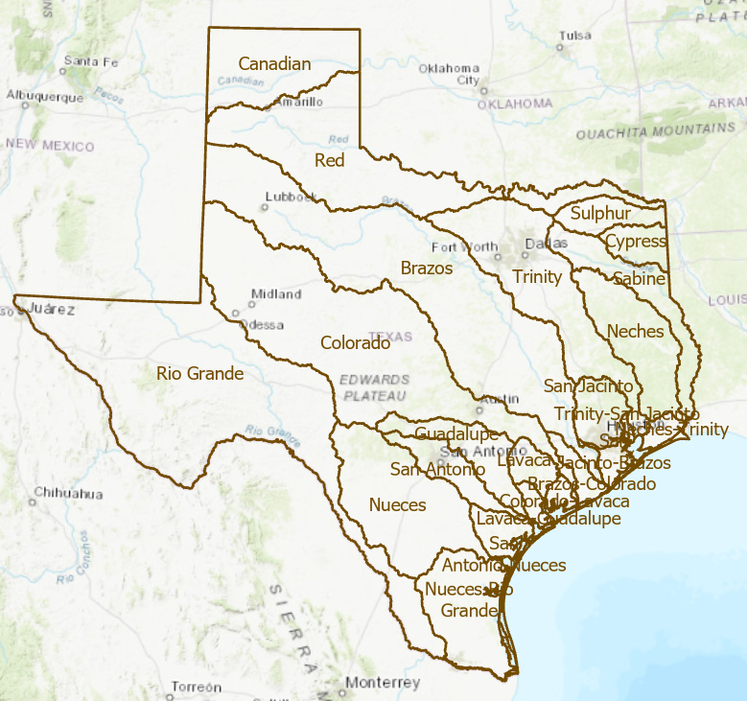
Watershed Selection & Site Evaluation
23 TWDB
Basins
Notes:
Optional slide about watersheds
1st – TWDB basins
2nd – proposed watersheds
3rd – proposed watersheds with bridges over water (without culverts)

Slide 14
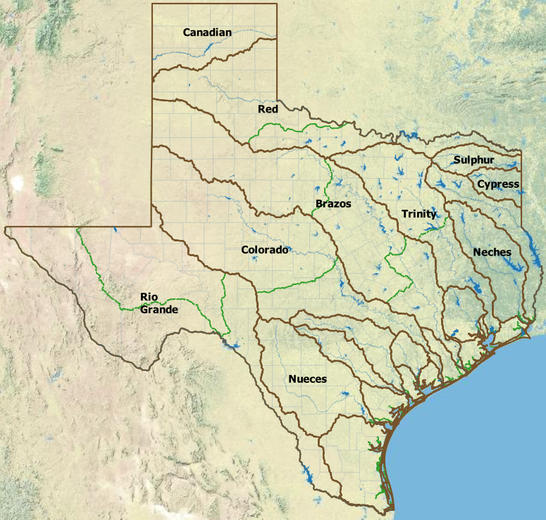
Watershed Selection & Site Evaluation
Combine TWDB and USGS HUC6 watersheds
Divide into two
Divide into two
Divide into three
USGS HUC6 Boundaries
Notes:
Optional slide about watersheds
1st – TWDB basins
2nd – proposed watersheds
3rd – proposed watersheds with bridges over water (without culverts)

Slide 15
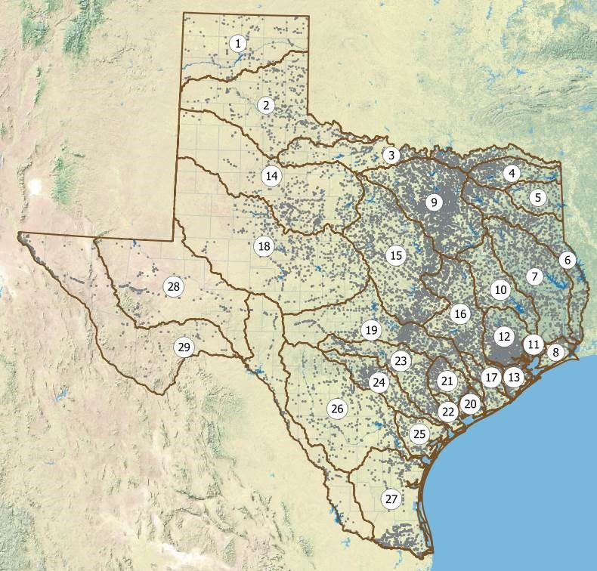
Watershed Selection & Site Evaluation
29 Proposed
TxDOT Watersheds
Notes:
Optional slide about watersheds
1st – TWDB basins
2nd – proposed watersheds
3rd – proposed watersheds with bridges over water (without culverts)

Slide 16
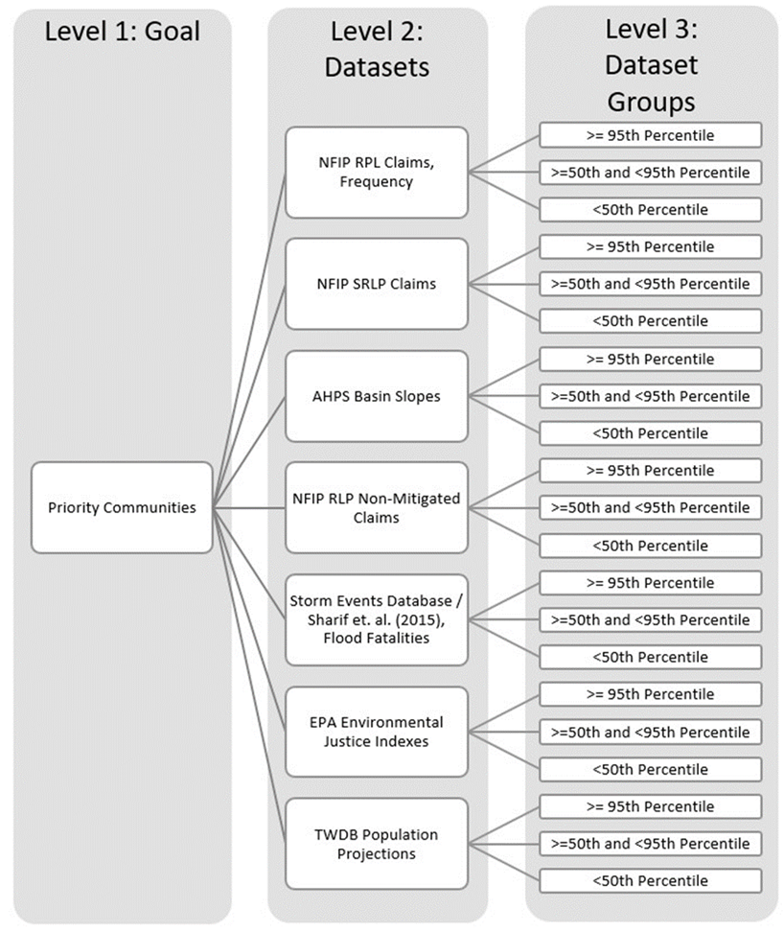
Watershed Selection & Site Evaluation
AHP Process
Analytic Hierarchy Process (AHP)
  Potential datasets
    TxDOT Bridge Inventory
    Road Closures
    Flood fatalities
    FEMA NFIP Claims
  Other factors/datasets?
  Weightings
  Rankings
Further Assessments
Gauge site recommendations (100+)
Notes:
AHP has been used since it’s introduction in 1980 in a wide variety of practical settings to model complex decision problems. Strengths: more transparent and defensible method to determine weights and rankings. It is also useful when datasets are dissimilar, making it unclear how they can be combined to make a rational selection or ranking.
Process: identify applicable datasets, rankings, further assessments outside of AHP (sites compared to existing sites, flood control structures, etc.), and final recommendations to be used for Task 3.
Datasets: bridges dataset can provide types of bridges, class, vehicle counts, risk of being overtopped/flooded, scour critical bridge, channel and channel protection (stable banks?)
- Road closures: records of historical road closures and reasons. Frequency of closures.
- Flood fatalities: 76% of flood related fatalities are vehicle related, and can help identify regions with higher rates of flood related fatalities
- FEMA NFIP claims: dataset identifying properties that are frequently flooded and could have an ancillary benefit from these gauges
Deliverables for this task include a technical memorandum outlining approach/incorporated datasets/selection process/final recommendations.

Slide 17
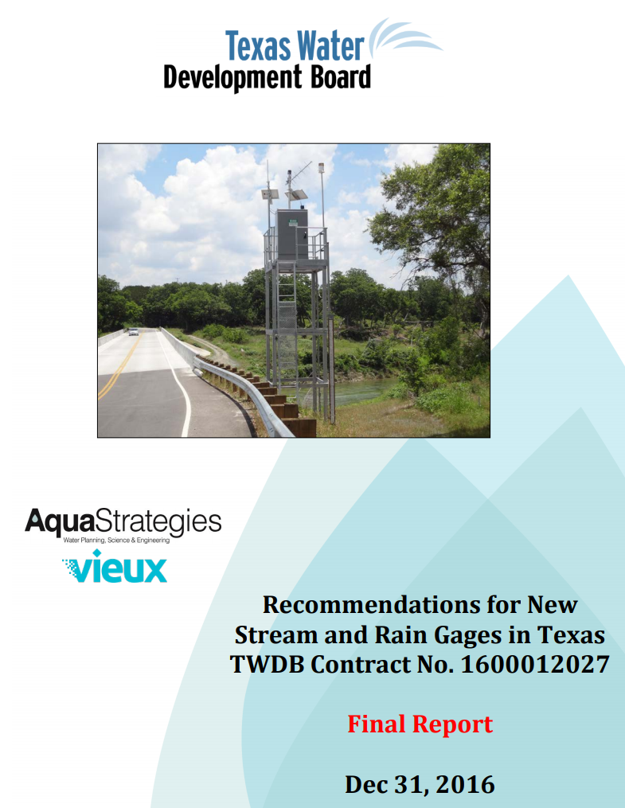
Watershed Selection & Site Evaluation
Measure of
Success
A report on this task for TxDOT that is as authoritative and exhaustive as this report done earlier for the TWDB flood forecasting and warning program
Notes:
AHP has been used since it’s introduction in 1980 in a wide variety of practical settings to model complex decision problems. Strengths: more transparent and defensible method to determine weights and rankings. It is also useful when datasets are dissimilar, making it unclear how they can be combined to make a rational selection or ranking.
Process: identify applicable datasets, rankings, further assessments outside of AHP (sites compared to existing sites, flood control structures, etc.), and final recommendations to be used for Task 3.
Datasets: bridges dataset can provide types of bridges, class, vehicle counts, risk of being overtopped/flooded, scour critical bridge, channel and channel protection (stable banks?)
- Road closures: records of historical road closures and reasons. Frequency of closures.
- Flood fatalities: 76% of flood related fatalities are vehicle related, and can help identify regions with higher rates of flood related fatalities
- FEMA NFIP claims: dataset identifying properties that are frequently flooded and could have an ancillary benefit from these gauges
Deliverables for this task include a technical memorandum outlining approach/incorporated datasets/selection process/final recommendations.

Slide 18
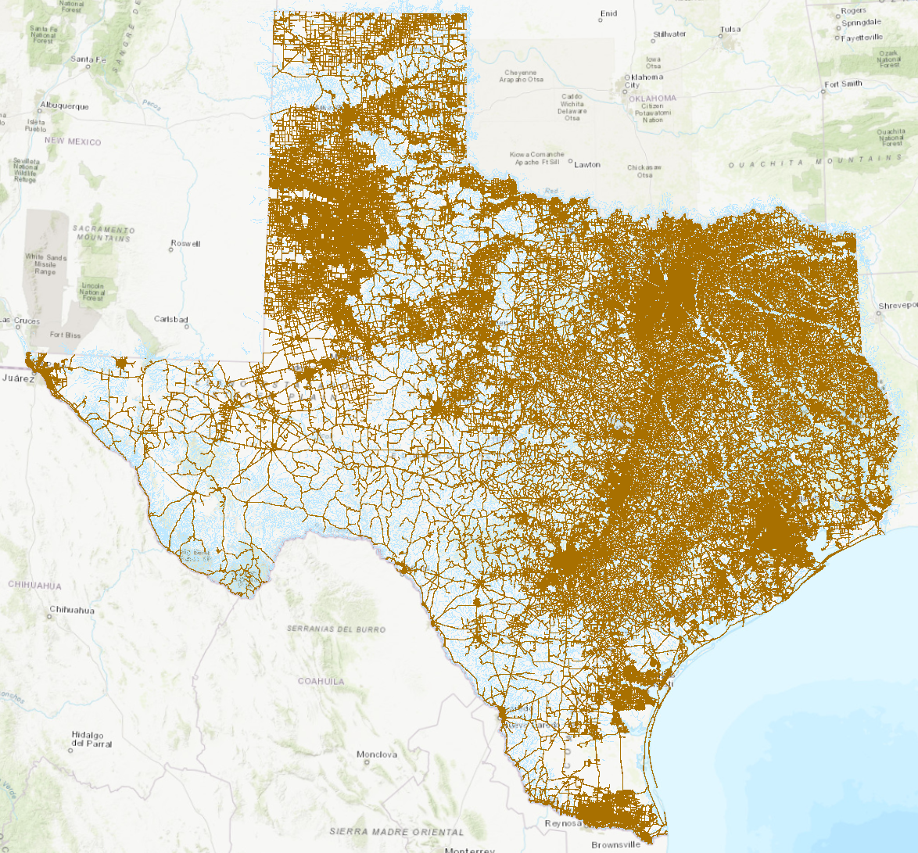
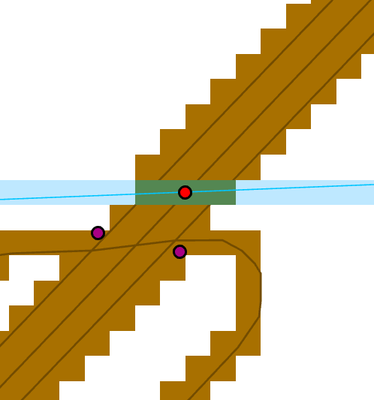
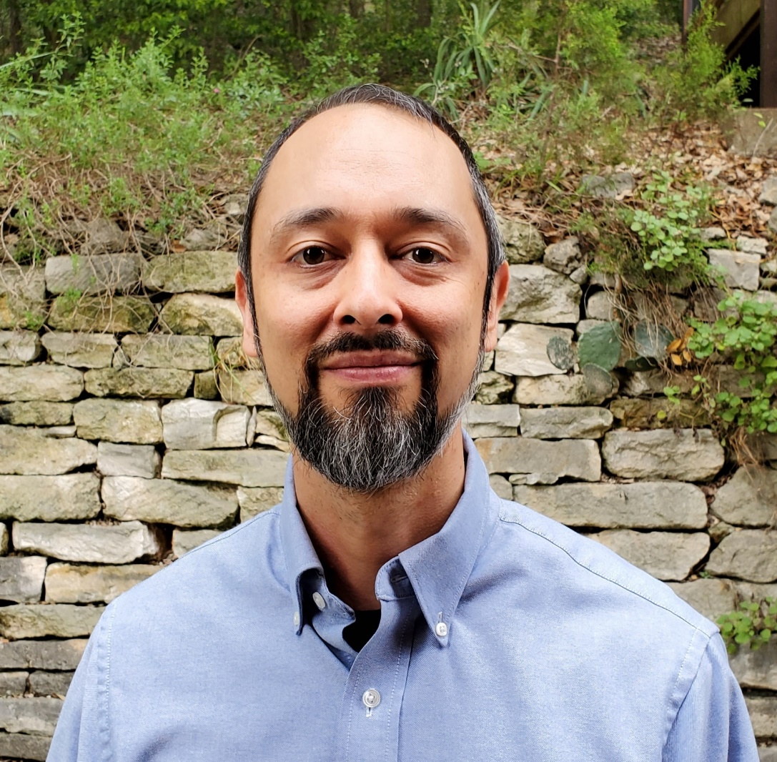
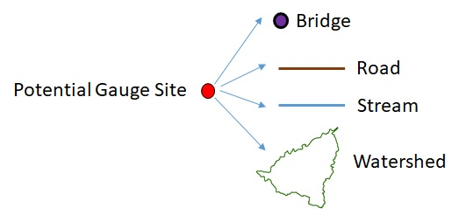
Support from UT Austin for Task 2:
State-wide map of potential gauge sites
Road
Potential
Gauge Site
Stream
Bridges
State-wide road-stream grid
Tim Whiteaker
[he also maintains
TCEQ Water Operations Model]

Slide 19
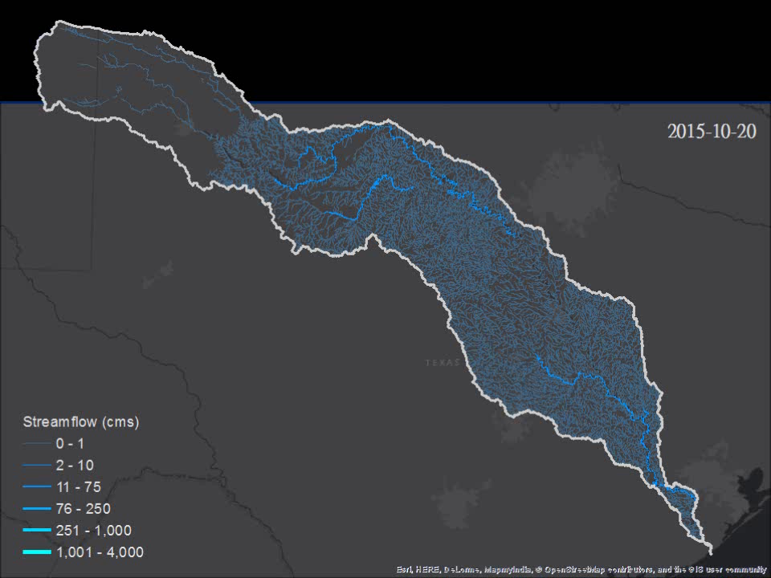

TCEQ Water Operations in Brazos Basin
(now based on the National Water Model)
Notes:
Brazos River pulses south of Lake Whitney in February, 2016:
http://waterdata.usgs.gov/tx/nwis/uv?cb_00060=on&format=gif_default&site_no=08093100&period=&begin_date=2016-02-01&end_date=2016-03-01

Slide 20
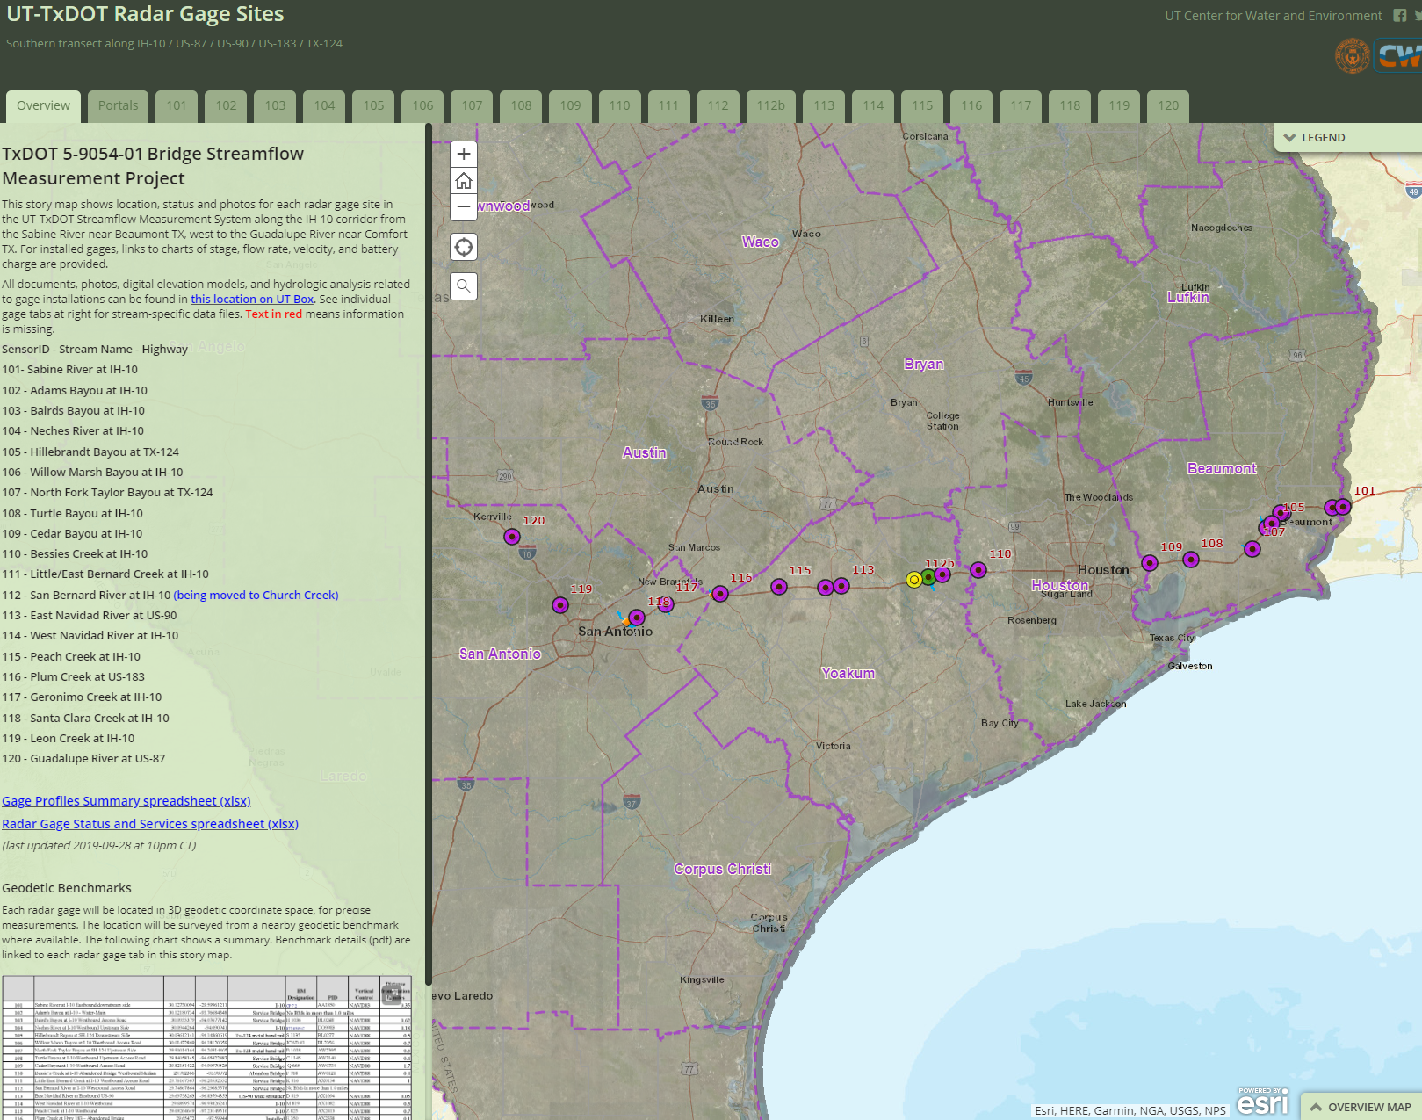
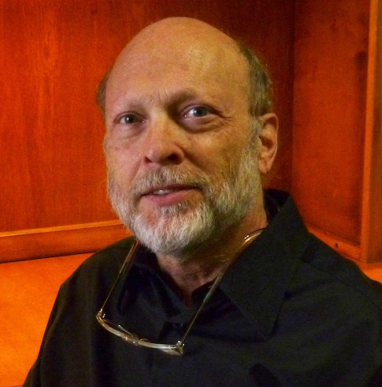
Support from UT Austin and USGS for Task 2:
State-wide map of current water observation networks
David Arctur
[he also schedules
project meetings]
ESRI Story Map of Gauge Sites from TxDOT Streamflow I
USGS field staff will identify local observation networks
and get GIS data for their gauge locations

Slide 21
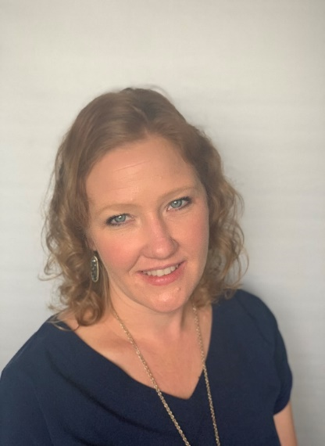
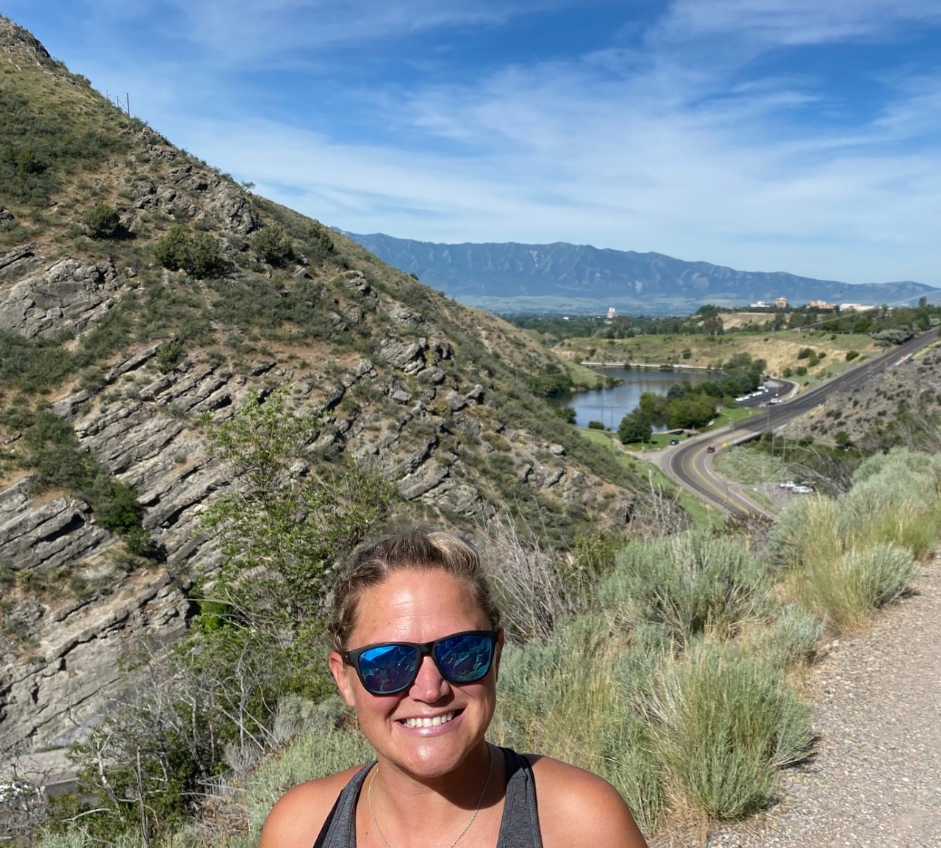
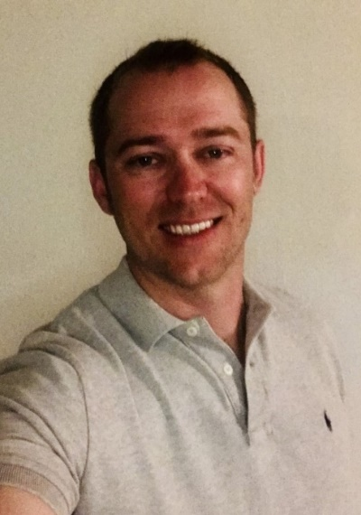

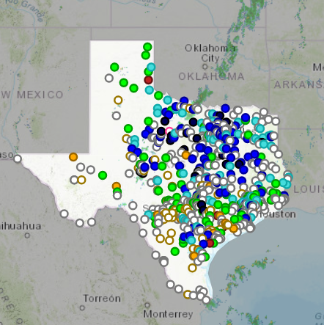
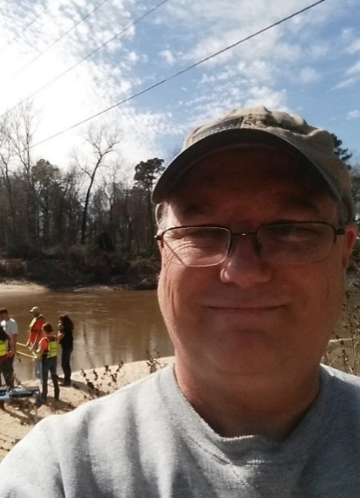
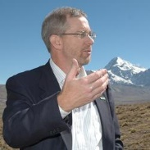
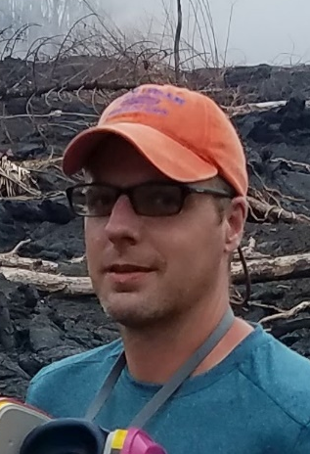
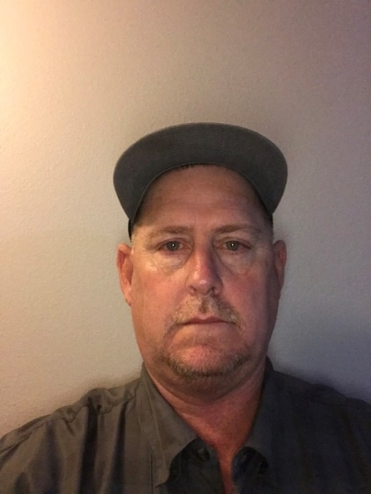
Task 3: Gauge Installation, Operation and Maintenance
Meghan Roussel
Deputy Director
Oklahoma-Texas
Water Science Center
Kristine Blickenstaff, PE
Branch Chief
Integrated Hydrology+
Data Science
Jon Thomas
Studies Chief
IHDS
Hydrology+Hydraulics
Scott Grzyb
Project Chief
IHDS
HH
Jeff East
Surface Water Specialist
OTWSC
Will Asquith, PhD
Research Hydrologist
IHDS
Frank Engel, PhD
Geographer
OTWSC
Milton Sunvison
Construction Specialist
OTWSC

Slide 22
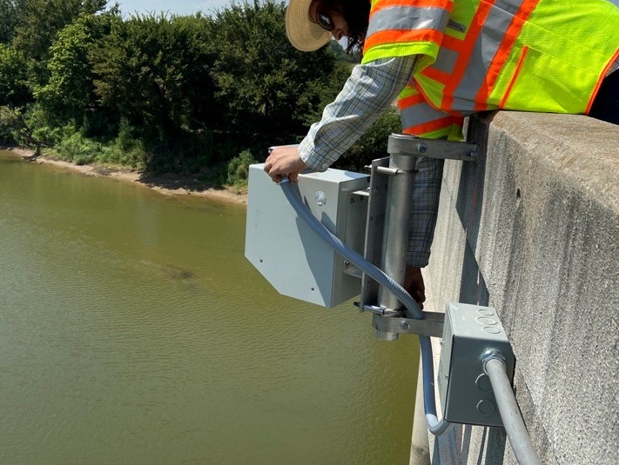

Goals of Task 3
Install and maintain 80 streamflow gauges on TxDOT bridges
Determine uncertainty in computed discharge data to evaluate the Technical Readiness Level (TRL) of the equipment and methods
Secondary goal to evaluate the uncertainty in gauge-height (i.e. water level) data
Tier 1
10 gauges with Traditional USGS methods
Tier 2
20 gauges that are Moderately Checked
Tier 3
50 gauges that are Minimally Checked

Slide 23
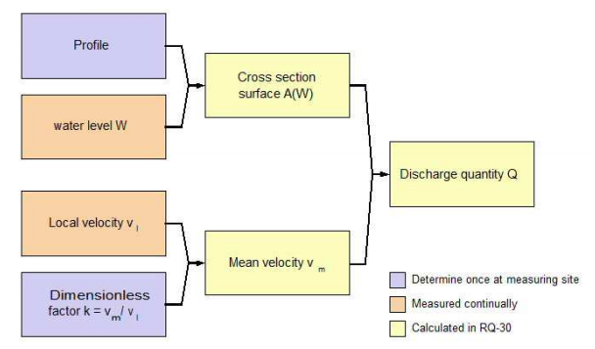
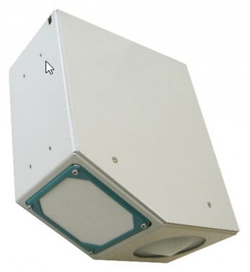
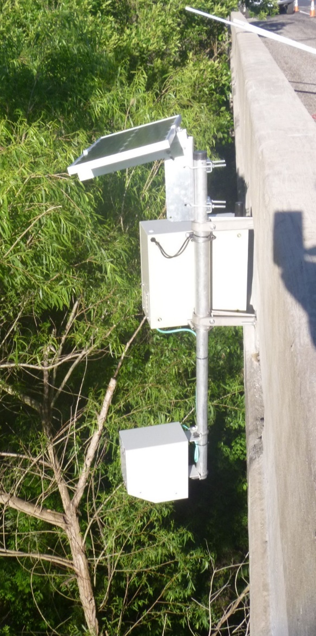
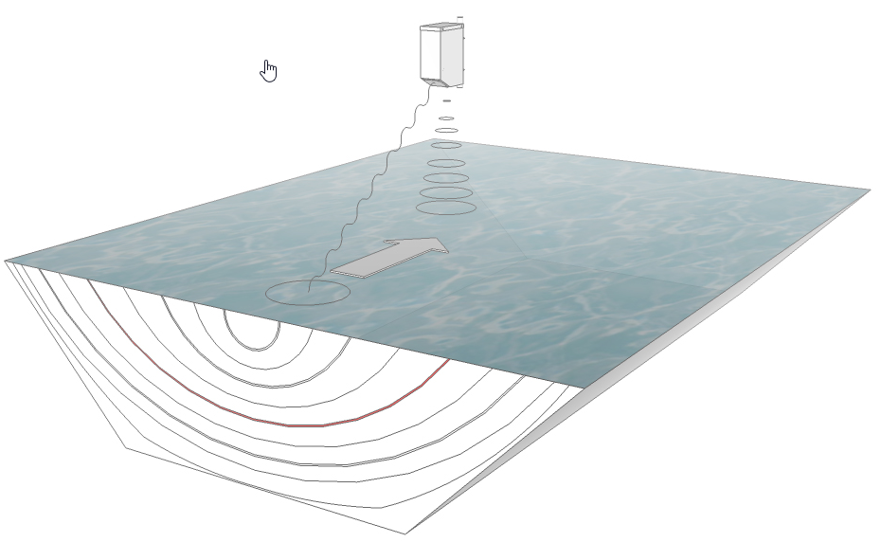
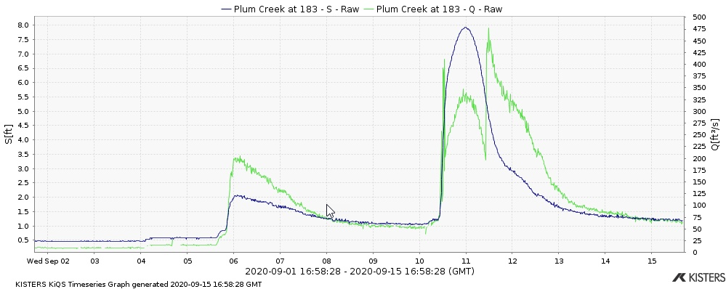
Equipment
RQ-30

Slide 24
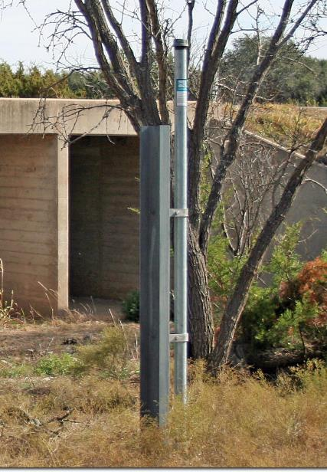
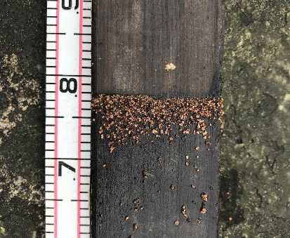
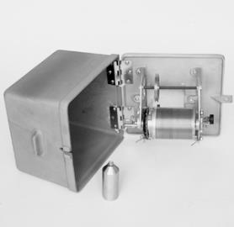
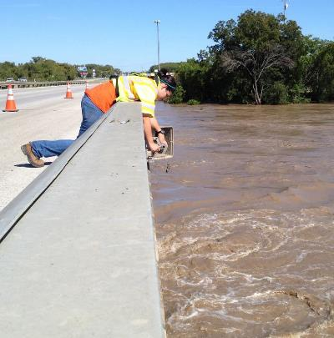
Equipment
Wire-Weight Gauge
Crest-Stage Gauge
Notes:
Wire-weight gage – a fixed calibrated instrument used for verification of water level against a fixed datum
Crest-stage gage –a fixed instrument used to determine peak-stage following a flood event if not on site.

Slide 25
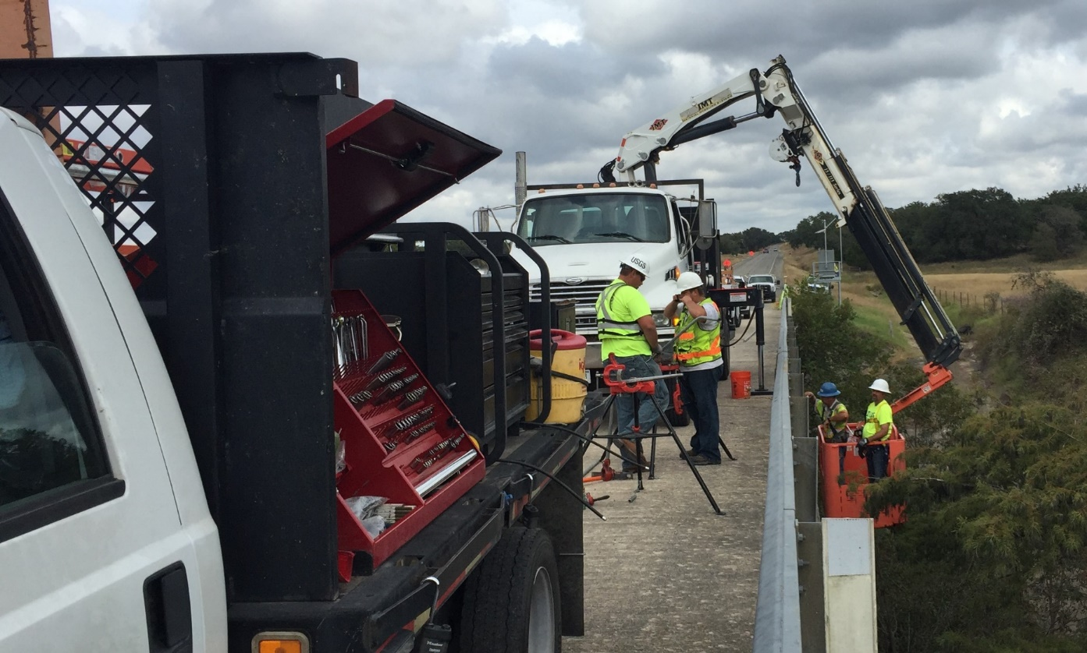
Approach
Sensors will be installed, operated, maintained, and calibrated at select sites and resulting datasets will be statistically evaluated.
Select 60 relevant sites on streams at TxDOT bridges
Evaluate 20 previously installed sites for operational readiness
Install equipment to record and telemeter gauge height and surface velocity to a cloud database.
Notes:
Construction or installation photo

Slide 26
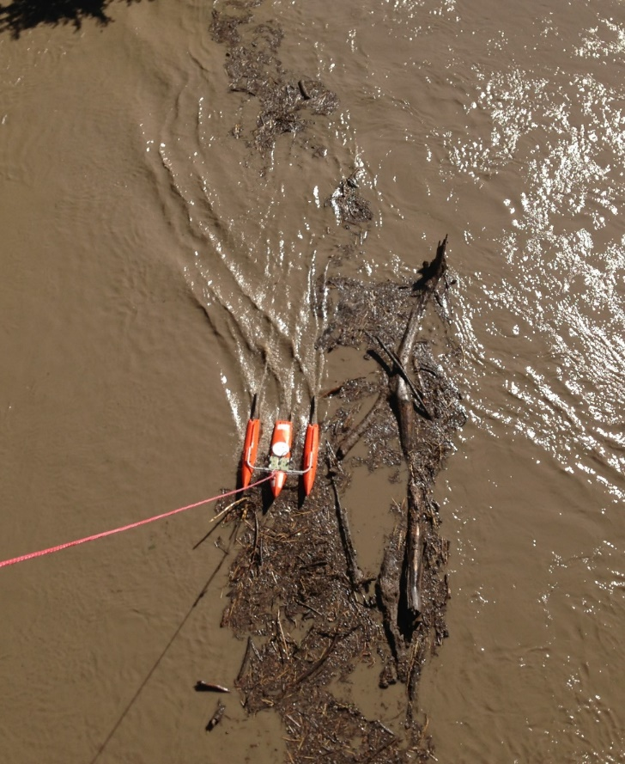
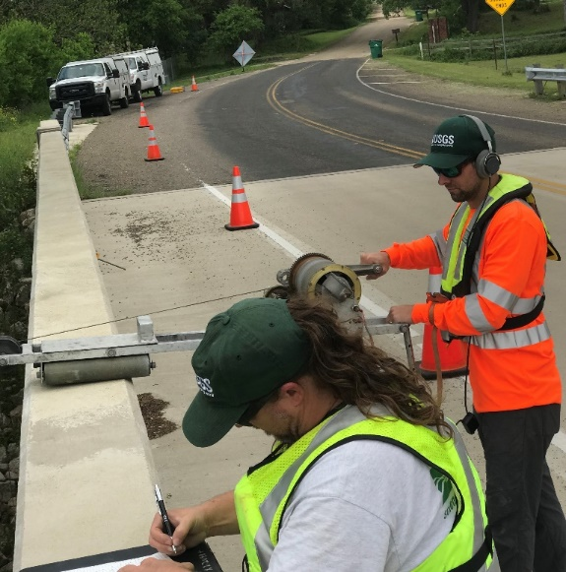

Approach
Operate, maintain, and check instrument calibration
Compute discharge
Determine the level of uncertainty in the discharge and gauge-height data that are computed from each method
Evaluate the use of other non-traditional technology and methods, such as Large-Scale Particle Image Velocimetry (LSPIV) (cameras)
Notes:
Site-visit, or measurement photo

Slide 27


Data Collection – Tier 1
Traditional Methods (10 gauges)
Cross section surveys – as needed
Standard USGS gauge site
Discharge measurements to develop rating curve
Additional site visits during high-flow conditions
Crest-Stage Gauges
Computation of discharge using multiple methods
Notes:
- Explain as needed. Once a year unless extreme storm.

Slide 28

Data Collection – Tier 2
Moderately Checked Methods (20 gauges)
Cross section surveys – extreme changes only
Regularly scheduled (6 to 8 week) visits
One to two high-flow measurements
Crest-Stage Gauges
Computation of discharge using RQ-30

Slide 29

Data Collection – Tier 3
Minimally Checked Methods (50 gauges)
Beginning and ending cross sectional information.
Quarterly visits to check sensor calibration
Crest-Stage Gauges
Computation of discharge using RQ-30
Notes:
No discharge measurements to define calibration. ( out of the box , cross-section, go)
Calibrated reference gages.

Slide 30




Foreseeable Risks
Vandalism
    Construction hardening as needed
Inundation
    Waterproof enclosure
    Elevate equipment when possible

Slide 31



Frank Engel
Dr. Engel conducting Unmanned Aircraft Systems (UAS) work in support of non-contact lava flow discharge measurements, 2018 Kilauea volcanic eruption.
Role
Subject matter expert for non-contact flow methods
Liaison for USGS headquarters on non-contact methods employed
USGS Water Mission Area contributions
Publication of USGS Techniques & Method for Radar derived discharge
Support for Large-Scale Particle Velocity (LSPIV)
DRAFT
Notes:
TAB for this project.
Publication is in draft.. Expected 2021.
Water mission area allowed time to this project.
Bringing a national perspective to this project.
Radar Training for TX USGS and related participants

Slide 32

Will Asquith Contributions
Uncertainty "Coning to Right"
Role
Uncertainty analysis of stage accuracy related to time between visits
Uncertainty analysis of discharge computations
USGS Water Mission Area contributions
Include findings in the National Hydromet Uncertainty Project
Uncertainty band
Notes:
TAB for this project.
Publication is in draft.. Expected 2021.
Water mission area allowed time to this project.
Bringing a national perspective to this project.
Radar Training for TX USGS and related participants

Slide 33





Measures of Success
Collect sufficient data to determine the TRL status of the RQ-30.
Data are available to TxDOT during high-flow conditions and considered useful and reliable.
Notes:
Sufficient data – gage height and discharge for comparison to the rq30 discharge computation.
Sensors maintain adequate calibration
Speak on Uncertainty.
Uncertainty in discharge and gage-height time-series data are determined and provide a suitable means for comparison with traditional USGS methods. These comparisons will be the basis of determining whether the equipment and methods are TRL 9, thus, are appropriate for deployment at any TxDOT bridge location

Slide 34
Questions from USGS
We ask that permission request bundles be expedited by TxDOT to ensure timely installations
Response from TxDOT: Rose Marie Klee will coordinate permission requests
We ask that TxDOT provide traffic control during gauge installations based on the submitted schedule
Notes:
..1. Who will be the direct contacts to make sure this happens.

Slide 35





KISTERS Responsibilities and Requirements
Matt Ables
Project Manager - KNA
Christoph Schweim
Project Manager - KAG
Dirk Schwanenberg
Model and Raster
Integration
Brandon Azvedo
Hardware and Telemetry
Stefan Fuest
Portal Architect
Stefano Vincenzo
Datasphere
Task 3: Support the USGS by providing reliable equipment, training, and telemetry for the 20 existing and 60 new gauges.
Task 4: Provide a reliable Portal to support informed decisions by incorporating all necessary sources of information including gauge data, NWM forecasts, critical bridge elevations, docked 3rd party models, and raster data.

Slide 36

KISTERS Responsibilities and Requirements
Task 3: Support the USGS by providing reliable equipment, training, and telemetry for the 20 existing and 60 new gauges.
Keys to Success:
Support the USGS to develop Standard Operating Procedures for field evaluation, installation, and maintenance.
Provide equipment with a standard configuration that requires the minimum necessary field configurations and adjustments.
Ensure that the USGS has all necessary tools and information from KISTERS.

Slide 37

KISTERS Responsibilities and Requirements
Task 4: Provide a reliable Portal to support informed decisions by incorporating all necessary sources of information including gauge data, NWM forecasts, critical bridge elevations, docked 3rd party models, and raster data.
Keys to Success:
Portal reliability and ease of use for the various user groups.
Provide infrastructure and standard processes to operate and expand the Portal.
Ensure that all necessary persons have the training to properly operate the Portal.

Slide 38

KISTERS Datasphere
Technological Hub of the Project – where everything comes together
Visual interface for TxDOT users

Slide 39


KISTERS Responsibilities and Requirements
Success = Delivery of a stable end to end solution that quickly provides the needed information to make sound decisions.

Slide 40

KISTERS Responsibilities and Requirements
Next Steps - Work with the various groups to define the requirements
Information Gathering
What information does TxDOT need to see in the Portal?
  Bridge data
  GIS layers
  Model evaluation
  Etc.

Slide 41


Task 5: Forecast Model Assessment
Goal: achieve accurate, reliable and timely data assimilation scheme that connects the measurements made at the flood alert gauges and the forecasting coming from the National Water Model.
Paola Passalacqua
Alec Carruthers
(PhD student candidate)
Notes:
In order to see where we are going we have to understand the past.
Lets look at a brief history of flood mapping during an emergency response.

Slide 42

Task 5: Researchers and Schedule
Subtask
FY 2021
FY 2022
FY 2023
Data Assimilation System
Alec Carruthers
Bridge Hydrodynamics
PhD student TBA
Implementation of first version of Data Assimilation in Datasphere in Summer 2021
through collaboration with KISTERS Germany

Slide 43


Task 5: Forecast Model Assessment
Specific objectives from the proposal to achieve main goal:
Determine the spatial distribution between gauge locations with a gauge network that is distributed and spaced to better represent the flow in the system
Perform data assimilation and forecast adjustment of the National Water Model prediction with data acquired at the instrumented locations
Single Channel Network
Branched Network
Study Area Boundary
Contributing stream segment
Missed stream segment

Slide 44
Specific activities from the proposal to achieve main goal:
Identify and define criteria to guide process of improving real-time forecasting models with Receiving Agency
Identify additional data that might improve flood forecasting and best way to use them in real-time forecasting
Improve channel routing for extended flood peaks from NWS forecast points to the new stream gauges
Use 2D hydrodynamic modeling with upstream lidar, as built-drawings, upstream bathymetry, and imagery to predict water levels associated with a range of high flows, determine at what flow the bridge is expected to overtop, to improve water level forecasts and timing/planning of road closures
Assess and compare the forecast accuracy of the West Gulf River Forecast Center’s Advanced Hydrologic Prediction System and the National Water Model
Deliverables:
Tech Memorandum 5A&B, Data Assimilation System (TM5A), Bridge Hydrodynamics (TM5B)
Notes:
In order to see where we are going we have to understand the past.
Lets look at a brief history of flood mapping during an emergency response.

Slide 45


Bridge Hydrodynamics
Example of 2D HEC-RAS model for West Navidad River at I-10
from TxDOT Streamflow I Project
Other local models like this from TxDOT Districts
How can these be used to calibrate discharge measurement at gauge sites?

Slide 46

Mean Water Depths for Water Surface Profile along Stream
71,868 cfs
48,151 cfs
20,425 cfs
8,520 cfs
1,705 cfs
I-10 bridge

Slide 47
Rating Curves for Stream Reach and Bridge

Slide 48

HEC-RAS models in the DataSphere
Andy Carter
[he also converts
Base Level Engineering Models
to Flood Inundation Maps]
HEC-RAS models in the Datasphere

Slide 49


Task 6: Flood Manual and Training
Plus some support
from Aqua Strategies
Harry Evans
(former Chief of Staff
of Austin Fire Department)
Christine Thies
(GIS analyst
and graphic artist)
1. Emergency Management Site Review
Determine what is useful and usable to TxDOT Flood Response (End Users)
    What does TxDOT want to know during a flooding event?
    How will they incorporate the flood information into their emergency management?
2. HSEEP Exercise
Exercise to test product and determine if it meets the Emergency Management needs
    Test Flood Manual with Emergency Managers
    Identify changes / Improvement Plan to meet TxDOT needs

Slide 50

HSEEP Exercises
Scheduled for
Sept 2021 and
Sept 2022

Slide 51

Task 6: Flood Manual and Training
1. Research – Oct / Dec 2020
2. EM Site Review – Jan / Mar 2021
3. Work on Manual V1 – Mar / May 2021
4. P6B1 (Manual V1 Due) – June 1, 2021
5. HSEEP Exercise 1 – Sept 2021
6. P6A1 (HSEEP Exercise Documents) – Oct 1, 2021
7. P6B2 (Manual V2 Due) – Jan 1, 2022
8. HSEEP Exercise 2 – Sept 2022
9. P6A2 (HSEEP Exercise Documents) – Oct 1, 2022
10. P6B3 (Manual V3/Final Due) – Jan 1, 2023
MILESTONES

Slide 52
Conclusions
Solid team with experienced personnel
Good project plan that covers the required components
Previous project (TxDOT Streamflow I) – we know the process
Challenges
  How to merge capabilities at various levels of maturity
    KISTERS DataSphere and full USGS gauging are mature
    Gauging with less than full USGS process is to be developed
    Data assimilation and hydrodynamic modeling are nascent
    How to measure improvement in accuracy, reliability
    and timeliness?
To TxDOT Project Monitoring Team: Can you please help us to
define user requirements and “measures of success”

