Slide 1
Evaluate Improved Streamflow Measurement at TxDOT Bridges
Project 0-7095
Being conducted for TxDOT by UT Austin and US Geological Survey with the support of
Kisters North America and Aqua Strategies
September 2020 to August 2023
Presentation for Project Status Meeting, Monday 14 December, 2020
Acknowledgements: Joanne Steele (Project Manager), Rose Marie Klee, Chris Glancy, Michael Cunningham (TxDOT)

Slide 2
Status Report Agenda
Review of progress in last quarter (David Maidment)
Discussion of Five Topics
Watershed prioritization (Barney Austin)
Gauge Site prioritization (Barney Austin)
National Water Model Accuracy (Paola Passalacqua)
Selecting USGS gauge sites (Scott Grzyb)
Flood Emergency Response Workflow (Harry Evans)
Some future perspectives (David Maidment)
A forecasting system needs forecasters
Building the engineered landscape

Slide 3


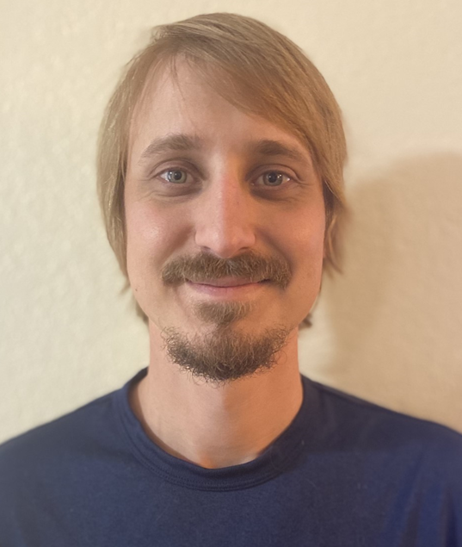


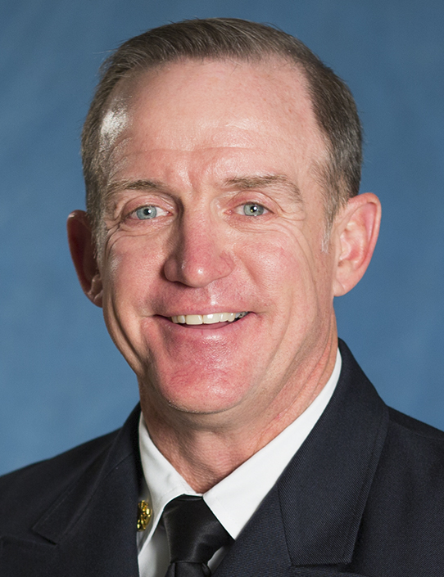
Project Tasks
Task 1 Project Management
(UT Austin, David Maidment)
Task 2 Watershed Selection and Site Evaluation
(Aqua Strategies, Barney Austin)
Task 3 Gauge Installation, Operation and Maintenance
(US Geological Survey (Scott Grzyb)
Task 4 Flood Forecast System Operation
(Kisters North America, Matt Ables)
Task 5 Forecast Model Assessment
(UT Austin, Paola Passalacqua)
Task 6 Flood Manual and Training
(UT Austin, Harry Evans)

Slide 4

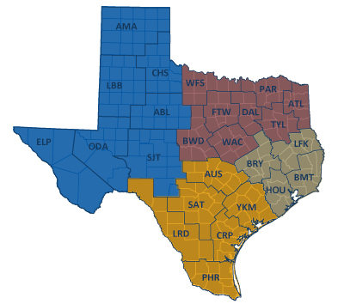


TxDOT Priorities
SAFETY
        Our staff, our community
        Emergency response
CONNECTIVITY
        Reliability of the transportation network
  Asset management
        *BRIDGES*
  Efficiency and efficacy
        For TxDOT
        For other/all jurisdictions
Slide: Rose Marie Klee, TxDOT

Slide 5



Progress this Quarter: Task 1, Project Management
Established regular weekly meetings
Use MS Teams for file sharing, meetings, reporting
On 26 October 2020, established collaboration with NWS
  National Water Center visualization services
  Flood inundation mapping
  Forecast model uncertainty and data assimilation

Slide 6
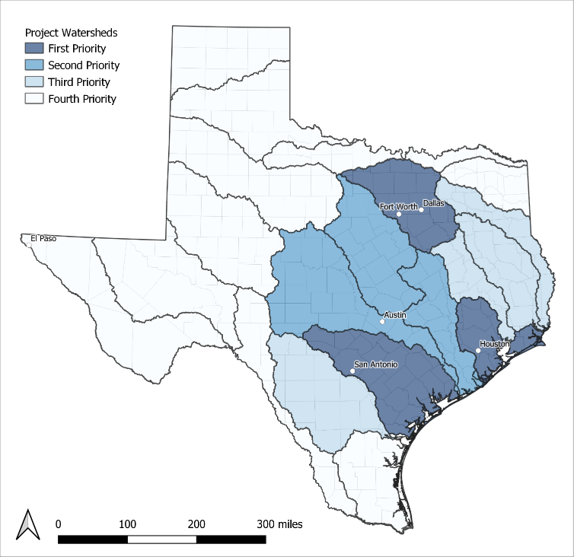
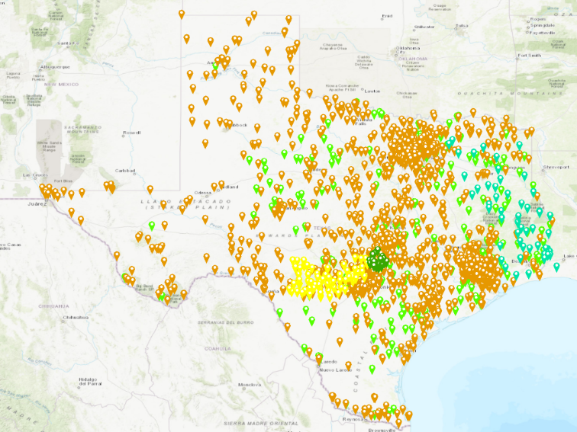
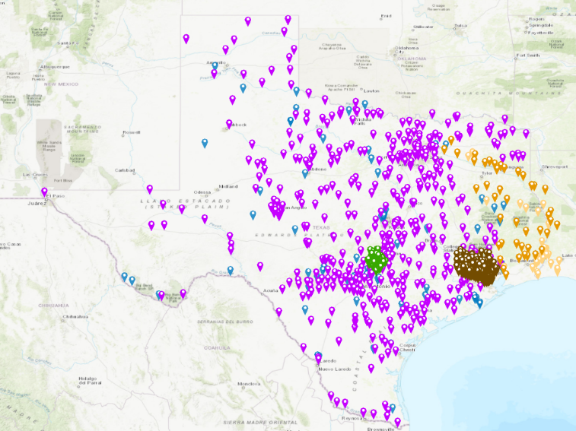
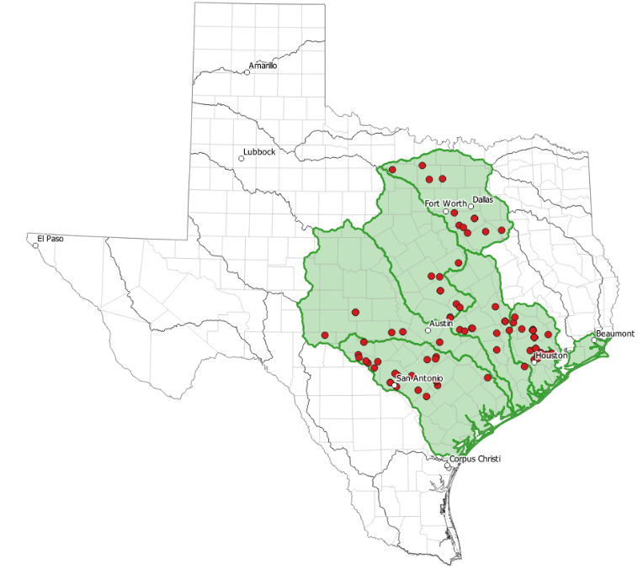
Progress this Quarter: Task 2, Watershed Selection and Site Evaluation
Completed watershed prioritization study
Potential site prioritization in progress
Mapped local observation networks
  2266 rain gauges
  1604 water level and streamflow sensors
Streamflow and Water Level Gauge Networks
(1,604 sensors)
Rain Gauge Networks
(2,266 sensors)

Slide 7
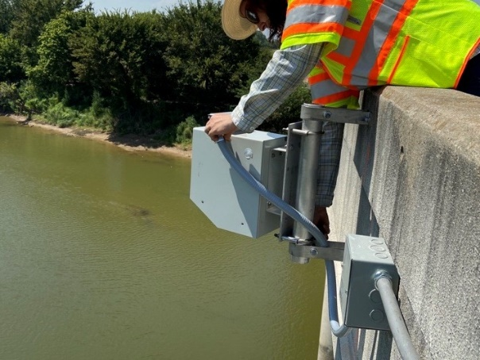
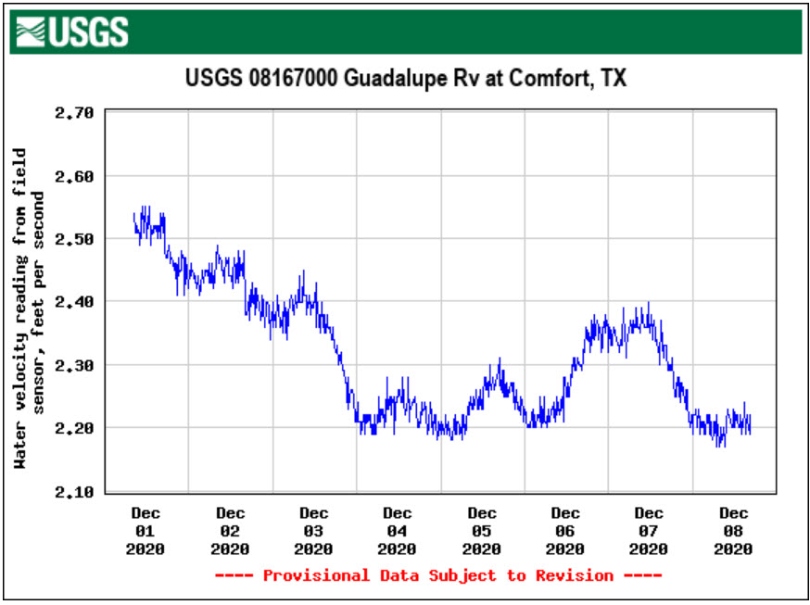
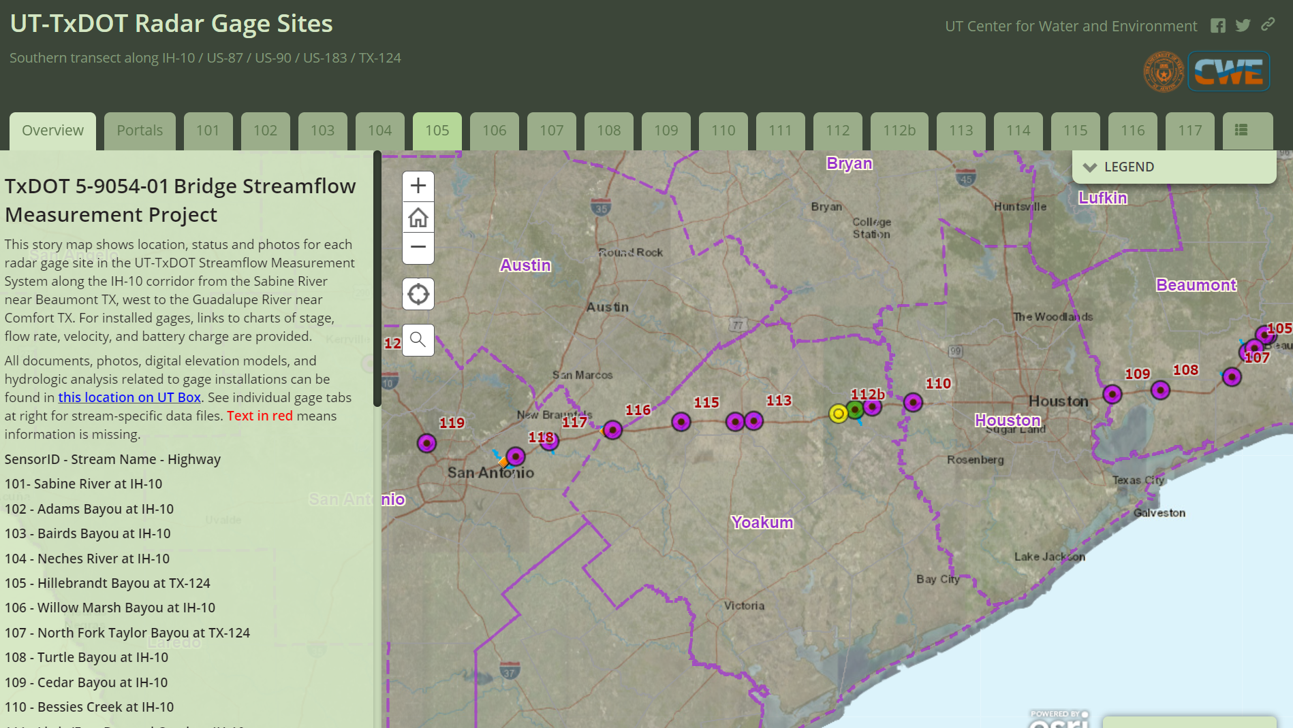
Progress this Quarter: Task 3, Gauge Installation, Operation and Maintenance
Completed reconnaissance of 20 Streamflow I sites
Ordered equipment for upgrades at these sites
Ordered gauges for new installs in 2021
Defined criteria for high quality USGS sites
Incorporated one TxDOT gauge into USGS NWIS
USGS National Water Information System

Slide 8
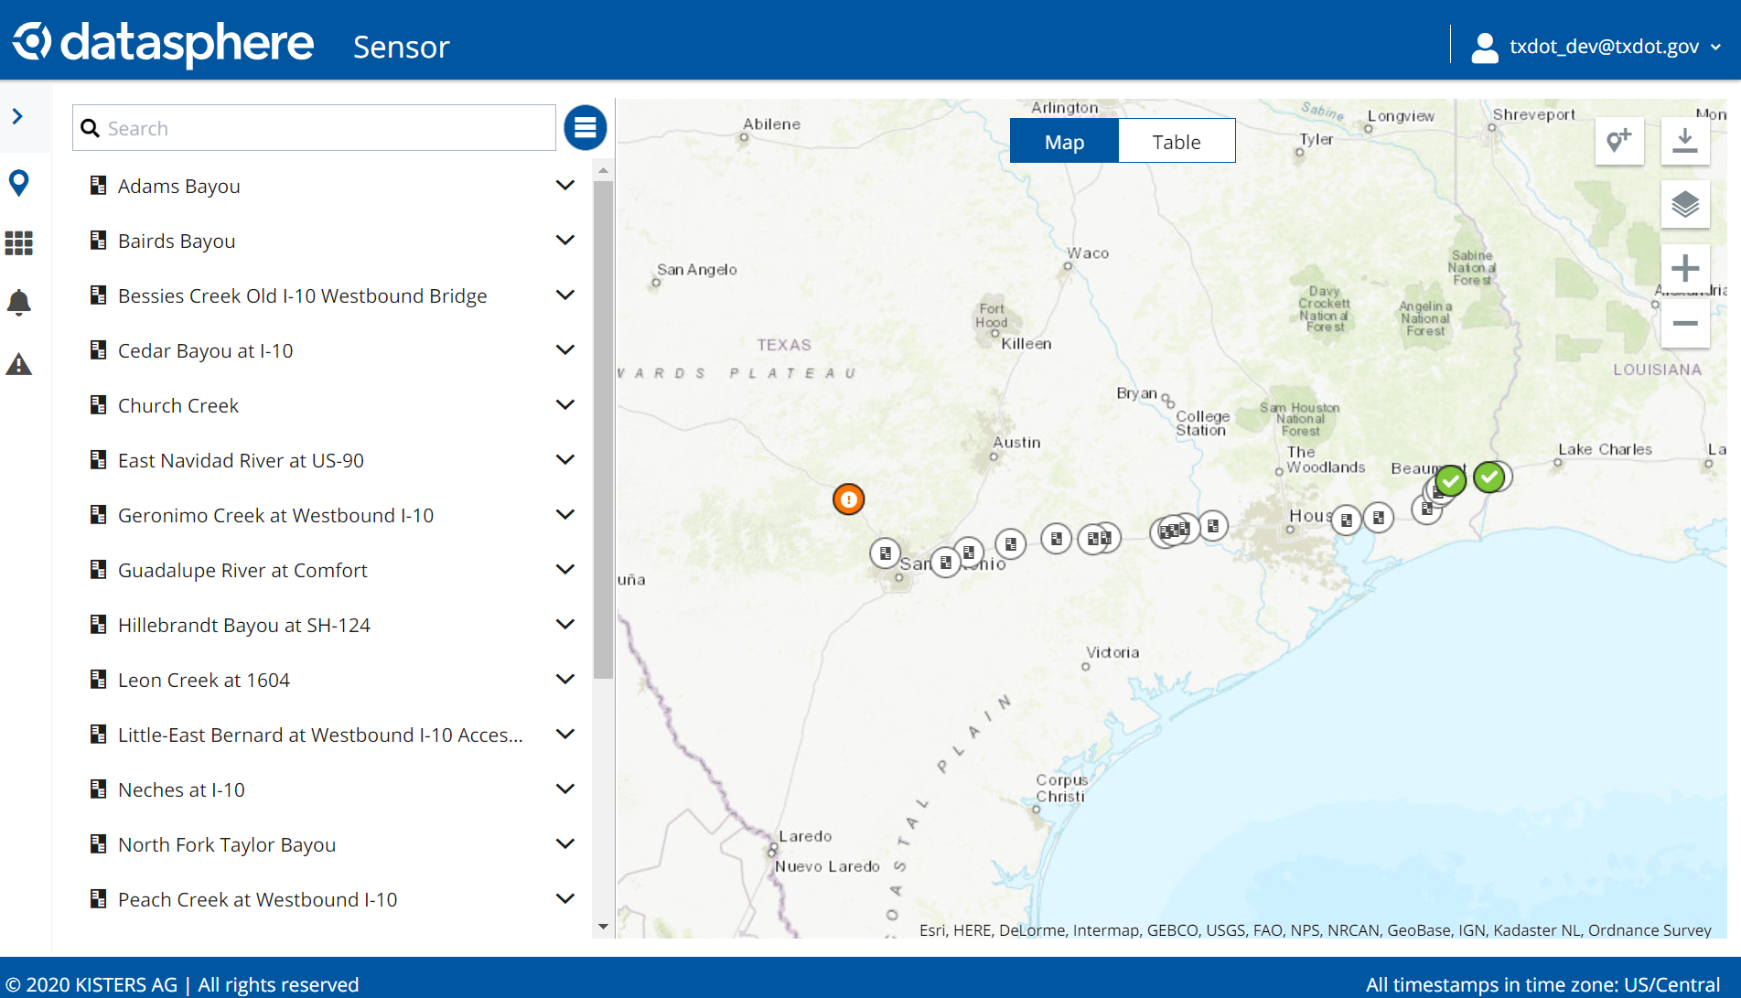
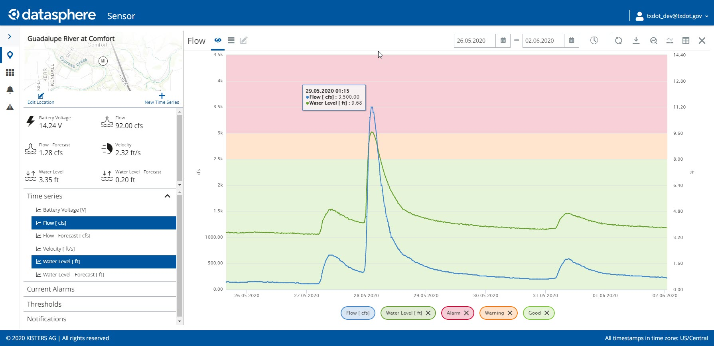
Progress this Quarter: Task 4, Flood Forecast System Operation
Established new TxDOT Flood portal in Amazon Eastern United States
Matt Ables, KISTERS
Discharge and Water Level on Guadalupe River at Comfort

Slide 9
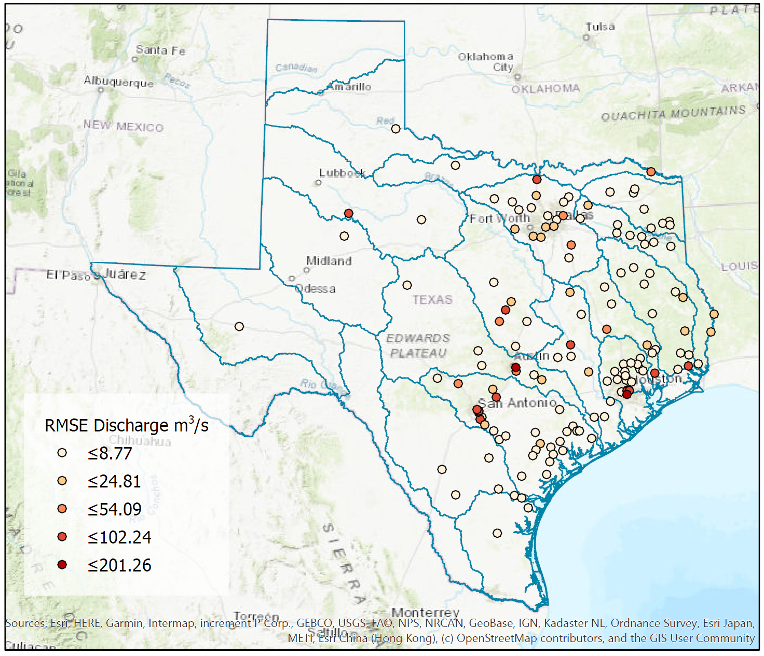
Progress this Quarter: Task 5, Forecast Model Assessment
Completed a first assessment of the National Water Model accuracy

Slide 10
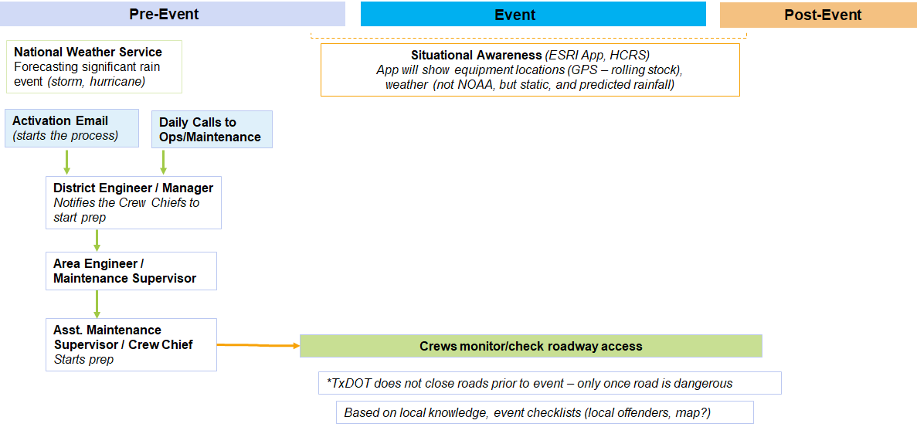
Progress this Quarter: Task 6, Flood Manual and Training
Completed a first draft of the flood emergency response workflow
Many thanks to Jared Browder for help with this!

Slide 11
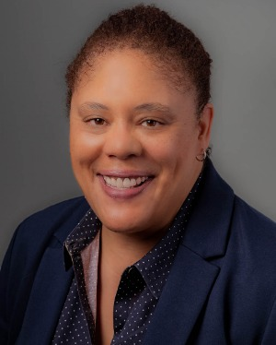
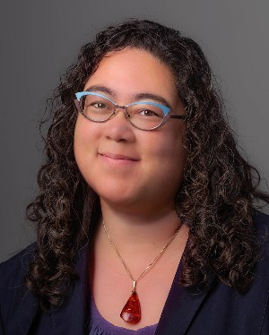



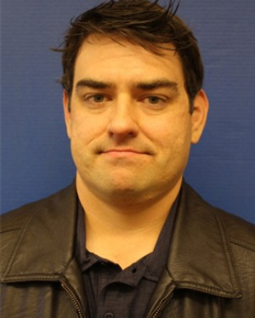
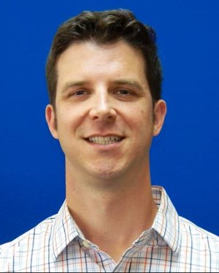

TxDOT Project Management Committee
Joanne Steele
Research Project Manager, RTI
Rose Marie Klee
H&H Section Director, DES
Abderrahmane Maamar-Tayeb
H&H Section Team Lead, DES
Trent Ellis
Bridge Scour Coordinator, BRG
Adam Jack
Dir of Trans Plan & Development, BMT
Andrew Lee
District Bridge Engineer, BMT
Joseph Goessling
Lead Hydraulics Engineer, AUS
Jared Browder
Maintenance Assess Spec, MNT

Slide 12
Research Oversight Committee
Sauda Ahmed, H&H section, TxDOT Design Division
Hiruy Berhe, H&H section, TxDOT Design Division
Lucinda Soto, H&H section, TxDOT Design Division
Jaime Villena-Morales, H&H section, TxDOT Design Division
Fangxin Yu, H&H section, TxDOT Design Division
Mark Lenz, NOAA National Weather Service
Mark Null , NOAA National Weather Service
Paul Yura, NOAA National Weather Service
Sam Marie Hermitte, Texas Water Development Board
Jorge Urquidi, City of Austin, Flood Early Warning System
Randy Charbeneau, UT Professor Emeritus of Civil Engineering Peter Smith, former TxDOT Dir of Trans Planning and Programs
Welcome to
the Discussion!

Slide 13
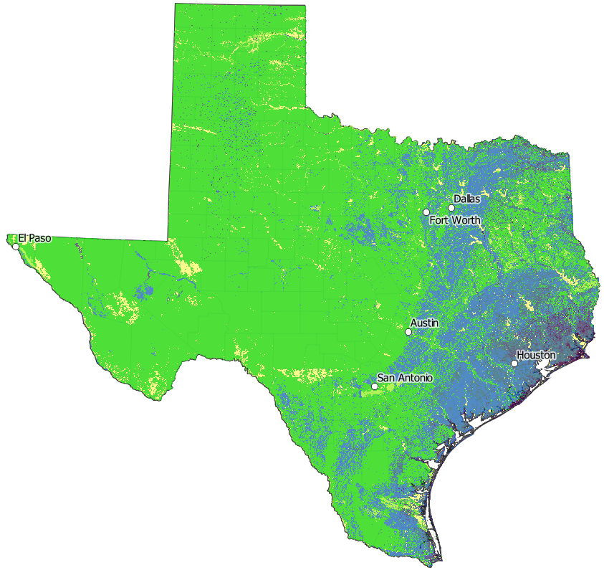
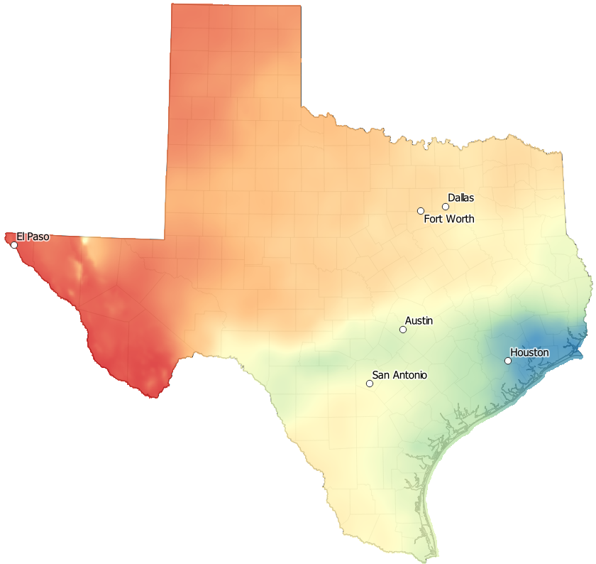
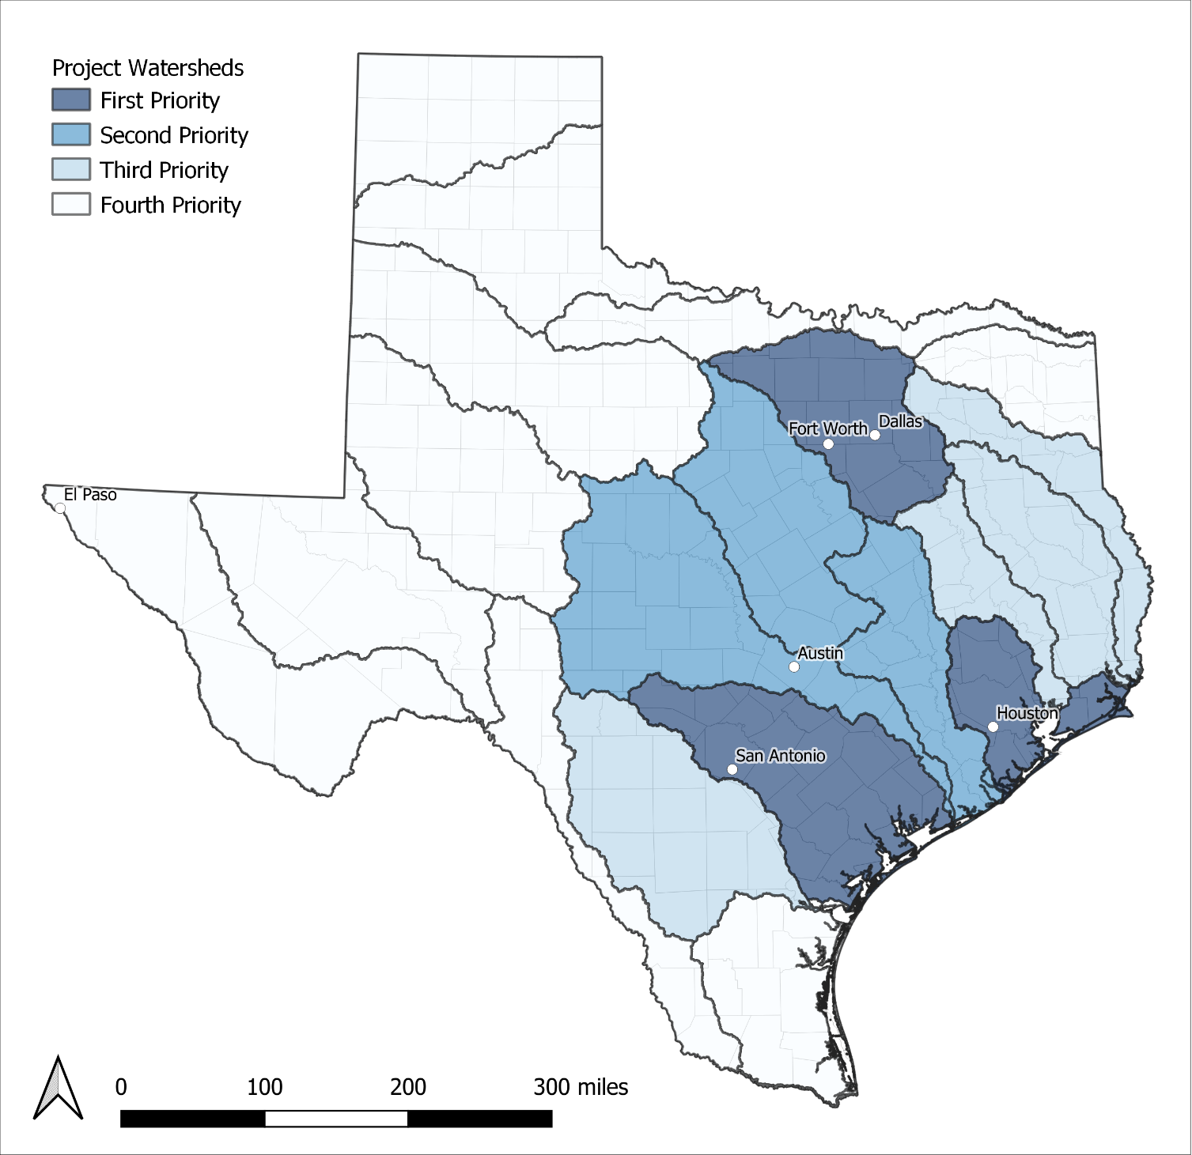
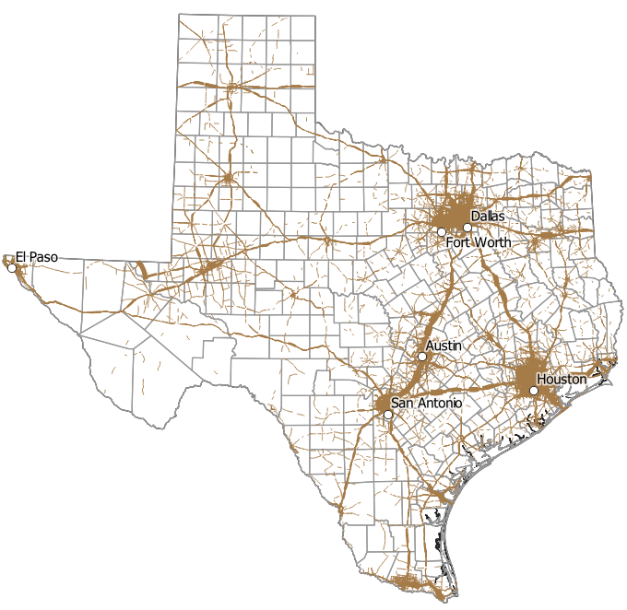
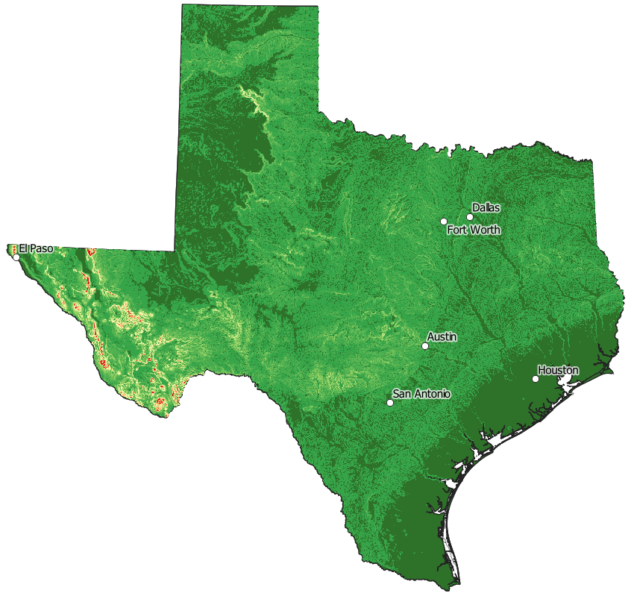

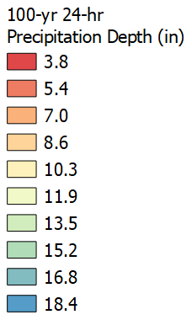
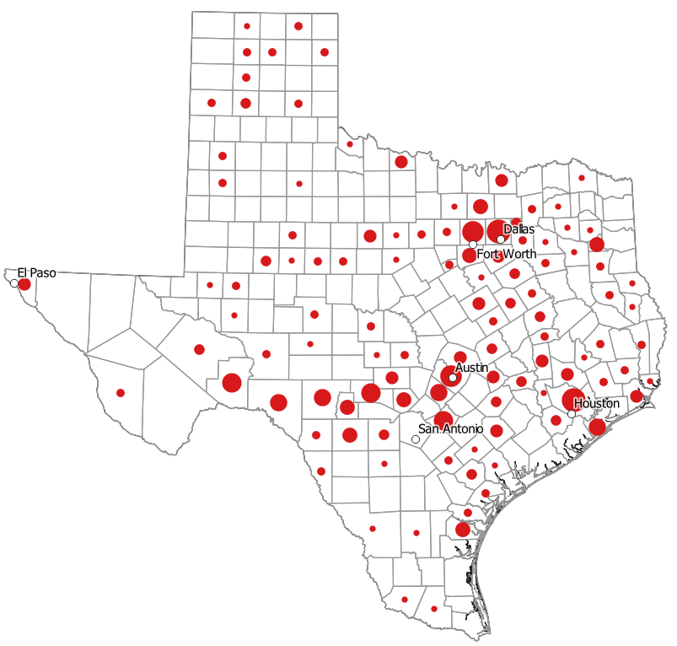
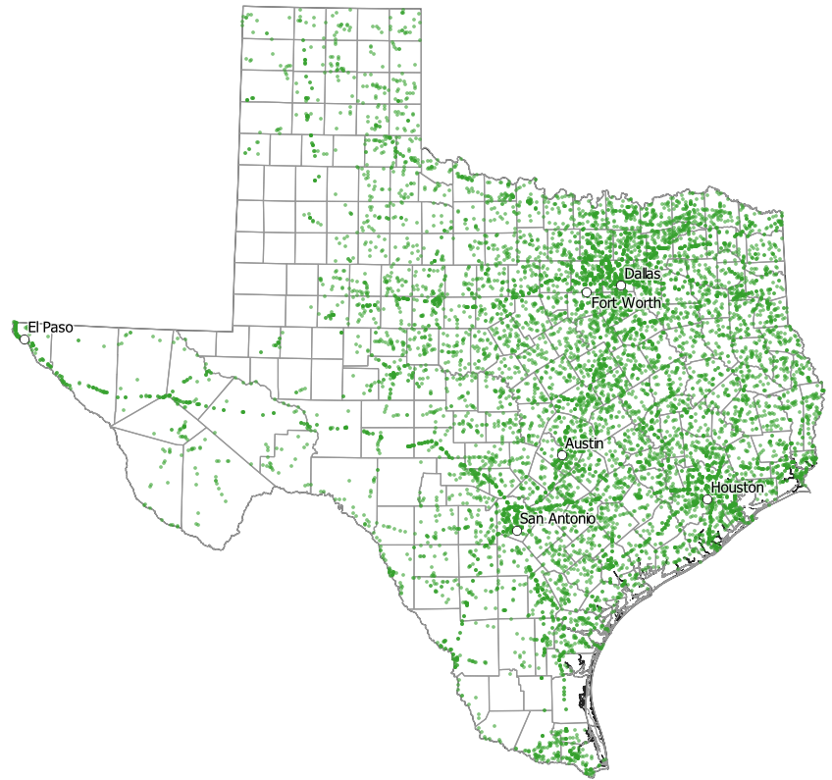
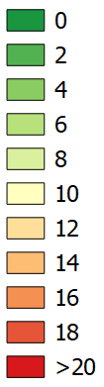

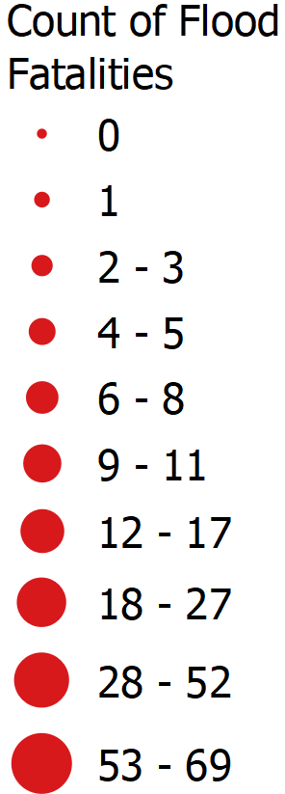

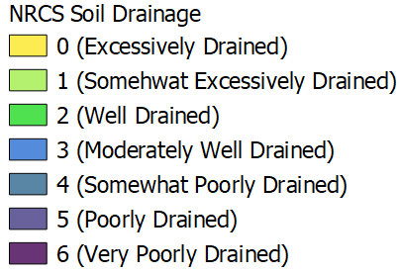
Topic 1: Watershed Prioritization (Barney Austin)
Datasets
  Daily Vehicle Miles of Travel (DVMT)
  Number of Bridges
  Flood Fatalities by county (1959-2016)
  100-year 24-hour precipitation depth
  Terrain Slope
  Soil Drainage
Questions: Is this an appropriate set of watersheds? Is the prioritization appropriate? Should the Priority 1 and Priority 2 watersheds be considered as a single watershed region for gauge site installation?
Notes:
Note we didn’t use AHP
DVMT: daily number of miles traveled by all vehicles, including trucks, is calculated by multiplying a roadway segment’s length by its Annual Average Daily Traffic (AADT)

Slide 14
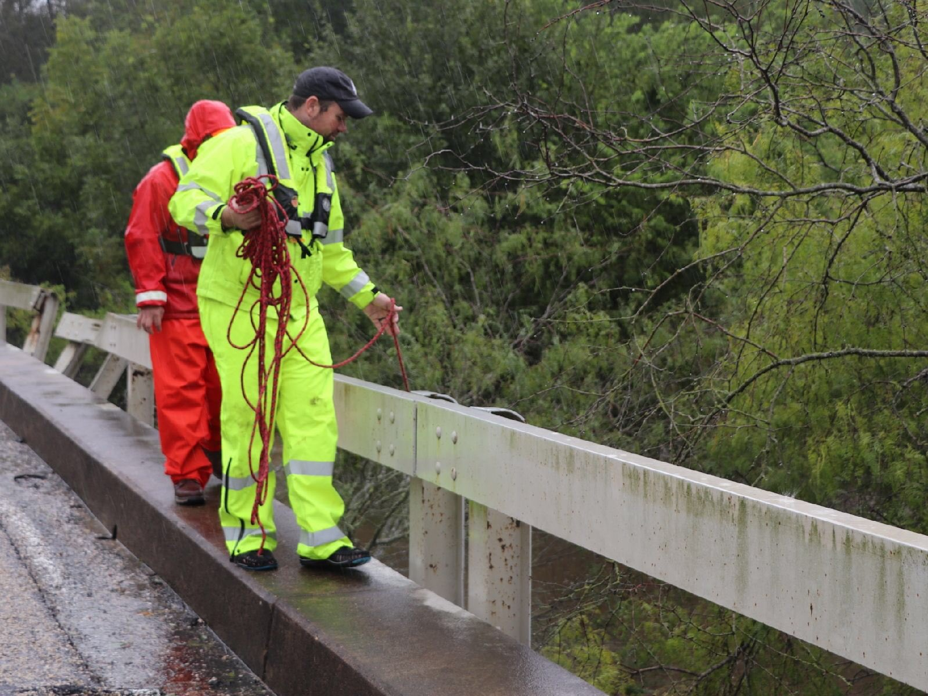
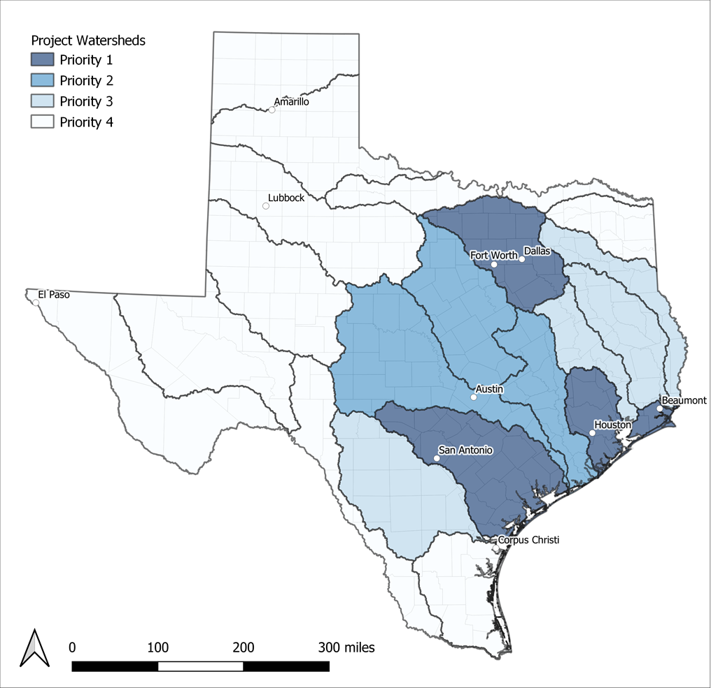
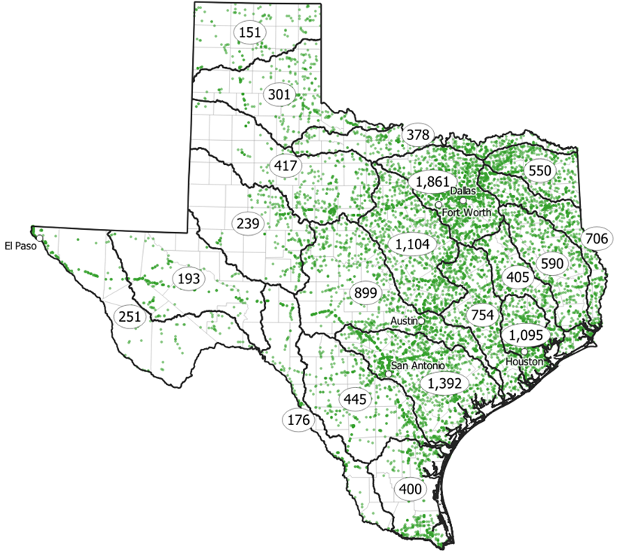
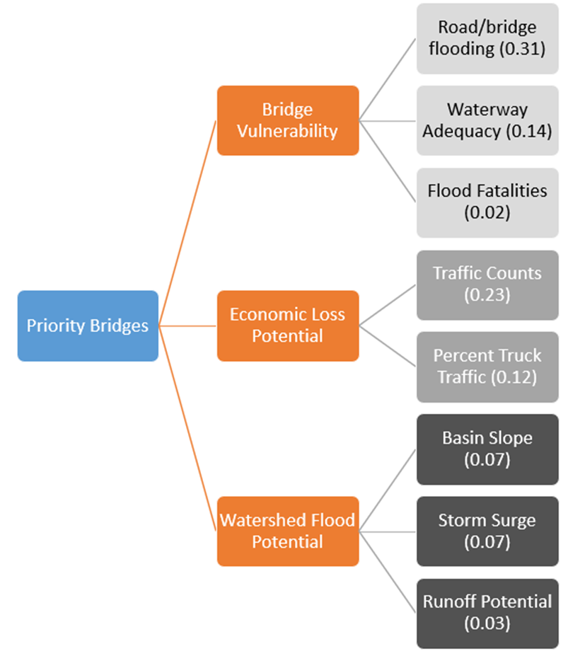

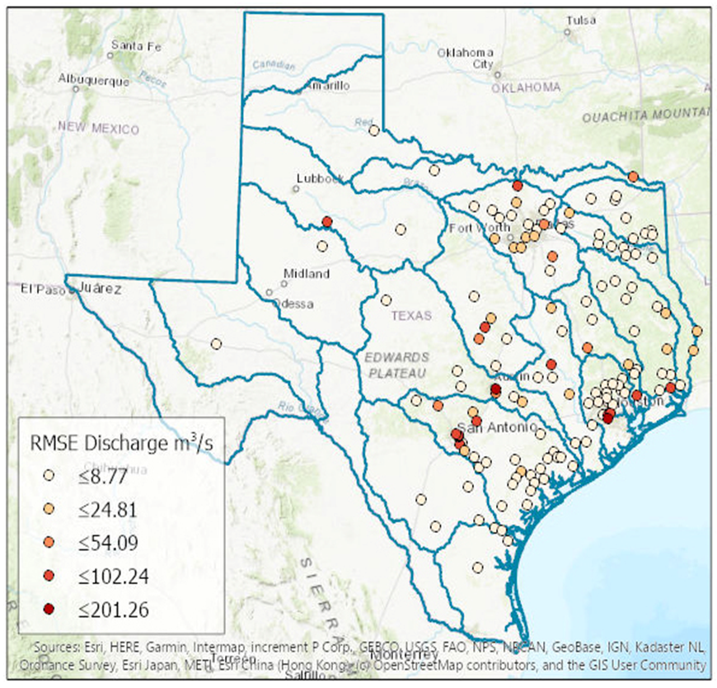
Topic 2: Gauge Site Prioritization (Barney Austin)
Define watershed boundaries and prioritize.
Use attributes in the NBI to reduce number of feasible bridges/sites.
Apply AHP to rank feasible sites and select top 150.
Assessment of sites by USGS, including field visits and quality rating,
and consideration of NWM accuracy.
5. Consultation with TxDOT Districts on sites they favor.

Slide 15
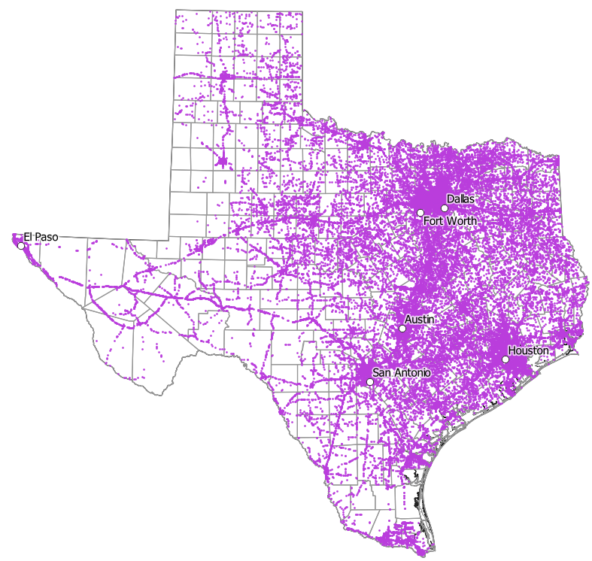
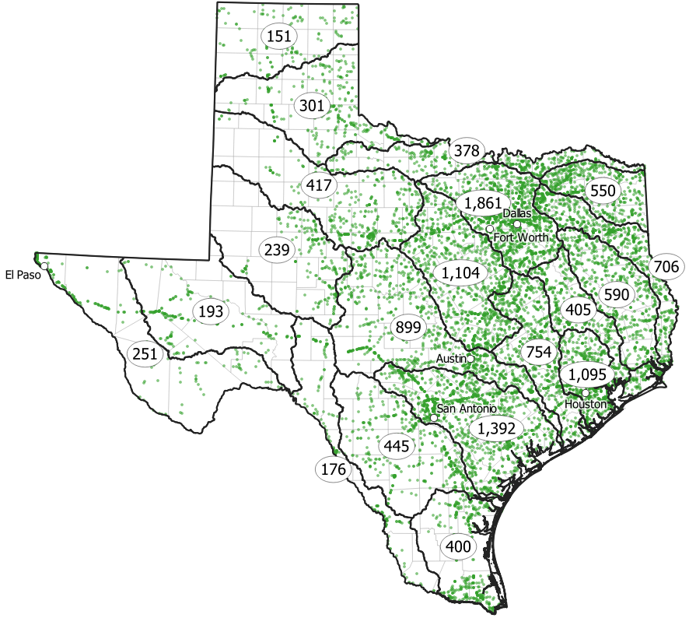
Applying Criteria from the National Bridge Inventory
Inclusionary Criteria from the National Bridge Inventory
  Over waterway
  Not a culvert
  On-System
  Not closed
Number of Bridges
  Full database – 55,574
  Project – 12,309

Slide 16

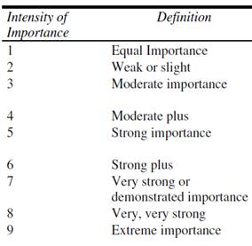

Prioritization using Analytical Hierarchy Process
Preliminary Datasets
Analytic hierarchy process (AHP):
  Model complex decisions
  Objective, transparent
Steps:
  Select datasets
  Develop weights
  Ranking
Results:
  100 to 150 top ranked bridges across priority watershed groups
Considered
TxDOT
  Channel & channel protection
  Scour critical bridge
  National Highway System
  Evacuation Routes
FEMA Claim Payments
Population Projections

Slide 17

Recommendations from Trent Ellis
Included in Prioritization = Yes
USGS = USGS to consider during reconnaissance
Item 26 (Functional Classification) USGS
High-priority structures are more likely to have detailed hydrologic and hydraulic models.
Item 27 (Year Built) USGS
Newer bridges are likely to remain in service longer than older bridges.
Item 41 (Structure Open, Posted, or Closed to Traffic)
Open bridges are likely to remain in service longer than closed or load-posted bridges.
Item 42B (Type of Service)
Screen out bridges not over water. Avoiding railroads as access requirements are different.
Item 61 (Channel and Channel Protection) USGS
Stable banks/channels should be preferable.
Item 62 (Culverts)
Screen out all culverts.
Item 71 (Waterway Adequacy)
Assuming it is favorable for the gauge to remain above water surface.
Item 113 (Scour Critical Bridges) USGS
Avoid scour critical bridges to target a stable channel profile.
Yes
Yes
Yes
Yes

Slide 18
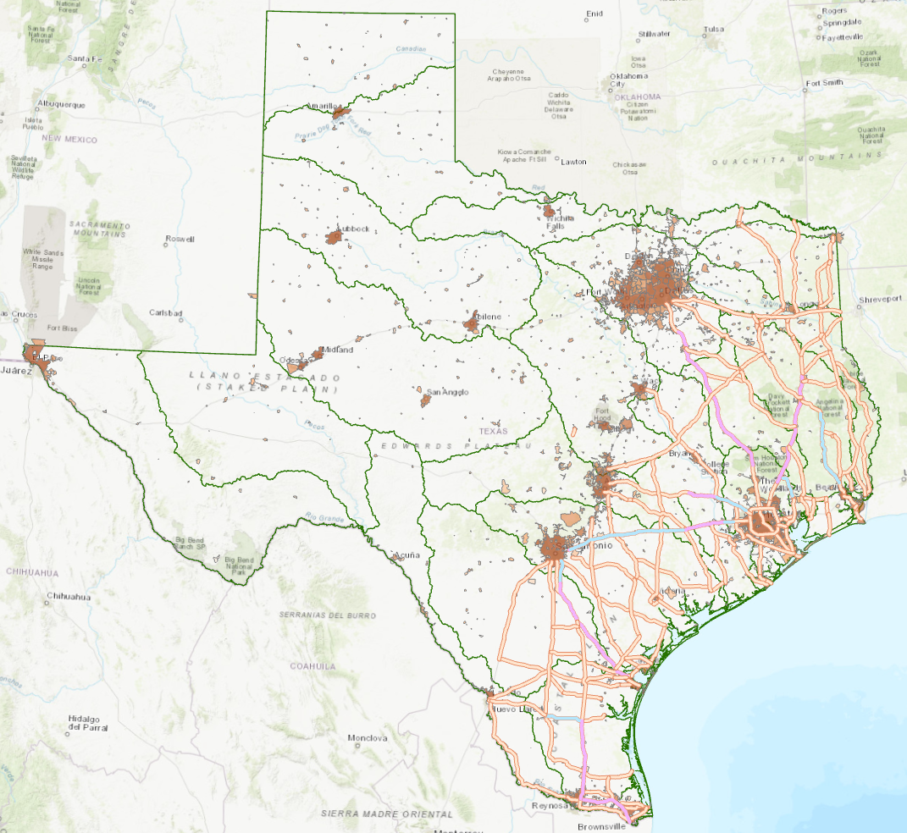
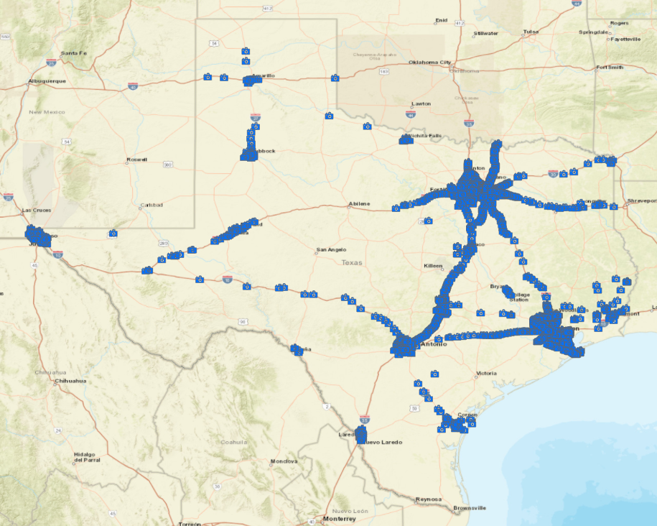
Recommendations from Jared Browder
(after watershed prioritization was completed)
https://www.txdot.gov/inside-txdot/division/traffic/cameras.html
Site gauges on evacuation routes
Do not site gauges where
there are traffic cameras

Slide 19
Topic 2: Summary and Questions
12,309 possible gauge sites
150 priority gauge sites
Questions:
Is the method for potential gauge site prioritization appropriate?
Are there important considerations that have been omitted?
Is there a desired geographic distribution within and between prioritized watersheds?
Are there particular sites where TxDOT would like to have gauges installed?

Slide 20
Topic 3: National Water Model Accuracy (Paola Passalacqua)

Slide 21
Is the National Water Model short term forecast accurate when compared to USGS gauge observations?
The prediction of the NWM at a given reach is compared with the USGS gauge measurement at that time.
Space: All active USGS gauge sites are considered (initial sample size n = 454)
Time: The analysis is performed for events between 04/01/2020 and 09/30/2020
Preliminary conclusions from this first analysis need to be verified with a longer time period analysis
NWM product analyzed: Short term forecast (as no data are assimilated)

Slide 22
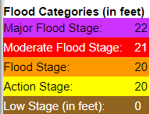
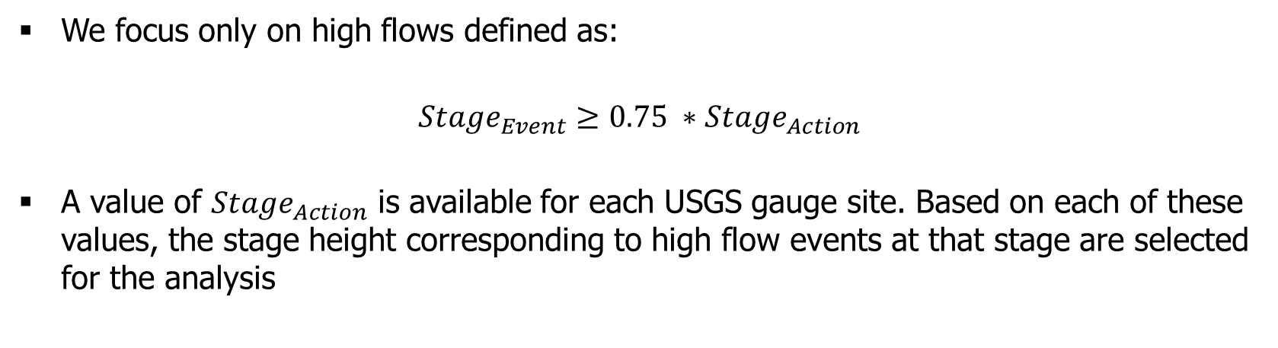

How is an event defined and identified for this analysis?
We focus only on high flows defined as:
$${Stage}_{Event}≥0.75 ∗{Stage}_{Action}$$
A value of ${Stage}_{Action}$ is available for each USGS gauge site. Based on each of these values, the stage height corresponding to high flow events at that stage are selected for the analysis
Example ${Stage}_{Action}$ for a USGS gauge (Big Cypress Creek above Jefferson)

Slide 23
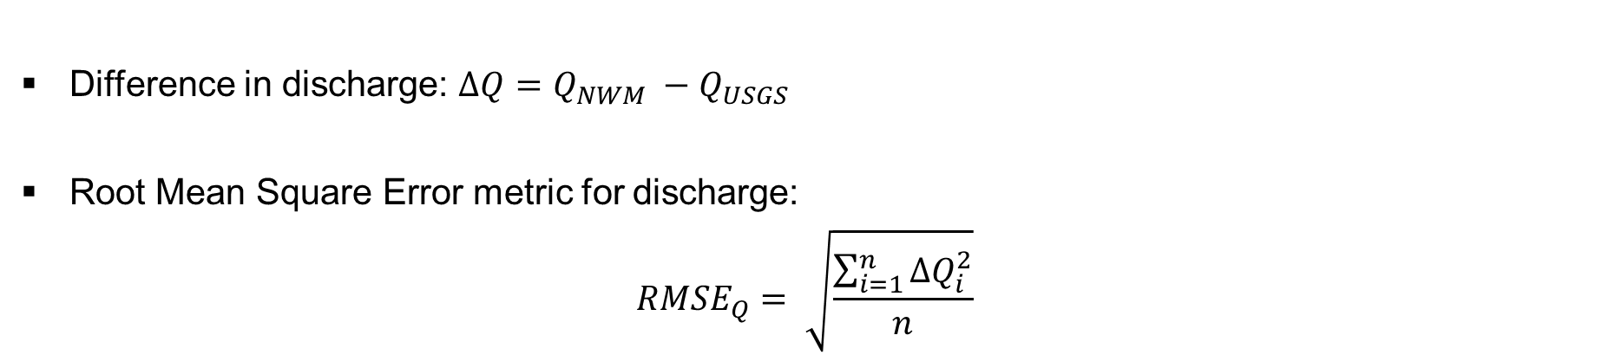
We compute the difference in discharge between the NWM forecast and the USGS observations
Difference in discharge: $∆Q=Q_{NWM} −Q_{USGS}$
Root Mean Square Error metric for discharge:
$${RMSE}_{Q}= \sqrt{\frac{\sum_{i=1}^{n}{{∆Q}_{i}^{2}}}{n}}$$

Slide 24
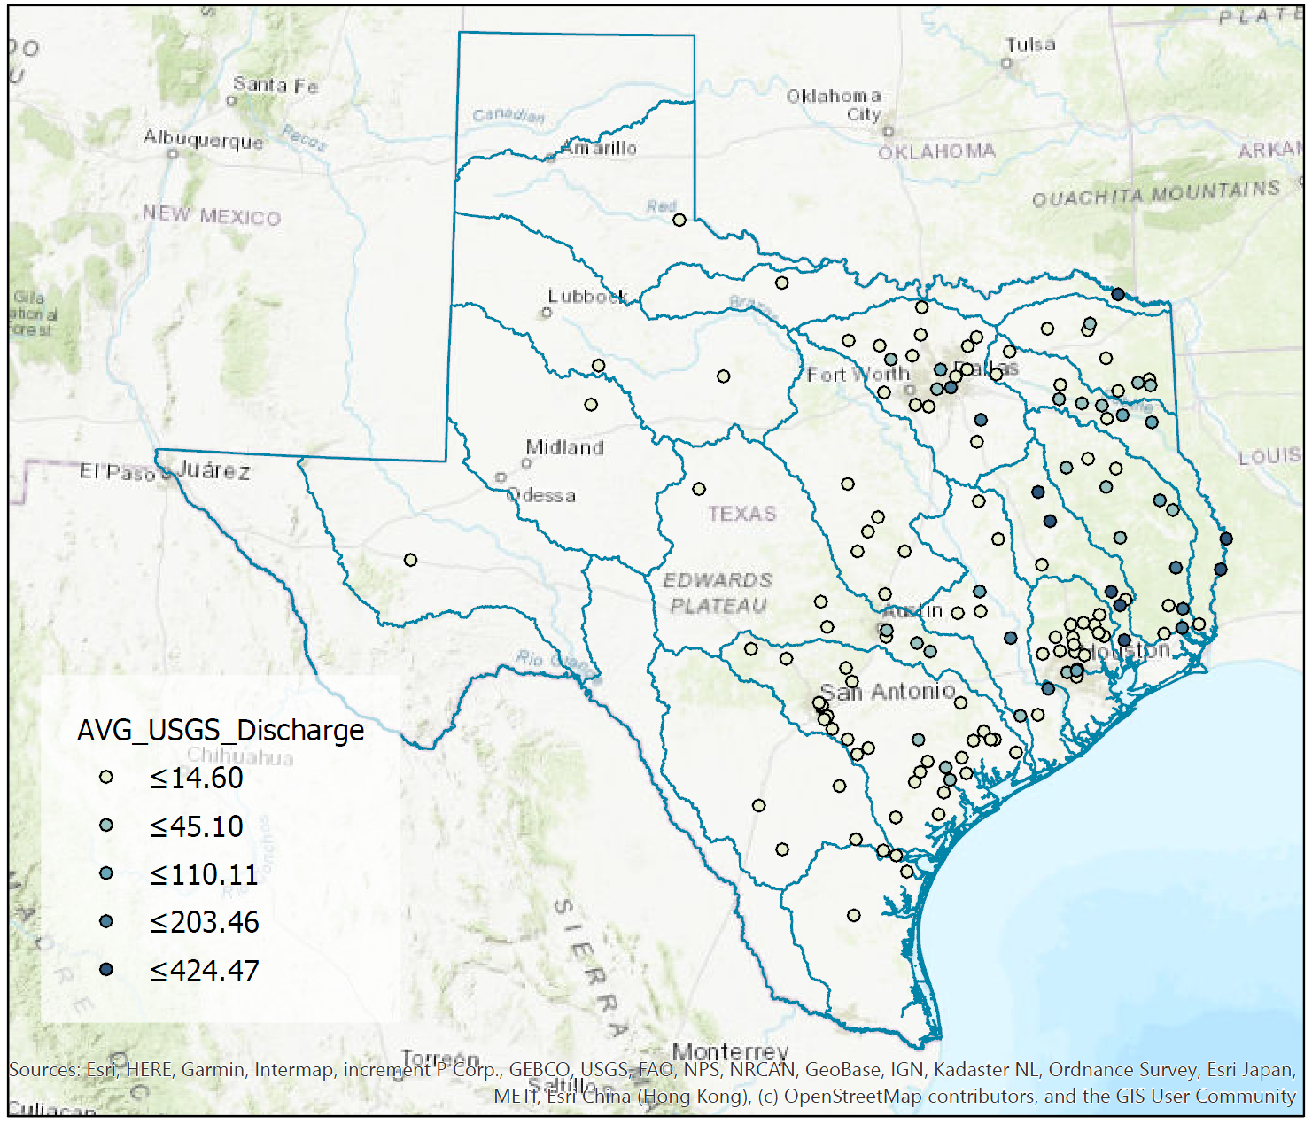
Error (RMSE) in discharge and mean annual discharge

Slide 25
More details and future work
The NWM prediction and the USGS measurement are compared at the exact time of the observation (without any averaging)
Stagnant water bodies were removed; Times with USGS measured discharges equal to zero were removed; Times with NWM forecasted discharges equal to zero were removed; Samples with a NWM forecasted discharge outside the range of discharges defined by the USGS rating curve were removed.
Recall that rating curves are used to transform NWM discharge to stage, but USGS discharge is actual discharge (requirement for the station to have both stage and discharge measurement)
Next: further analysis of the current results (including normalization) and extend period of analysis
Next: Spatial correlation analysis based on NWM results to identify space/time scales of correlation during events.

Slide 26
National Water Model Accuracy
Questions:
Should the new measurement sites be focused in areas where the forecast model is less accurate?
Alternatively, should the project focus on regions where the model already performs well?

Slide 27
Topic 4: USGS Gauge Site Selection (Scott Grzyb)
Goal:
High
Quality
Measurements
Good →
Fair →
Poor →
Quality of USGS measurements is largely independent of AHP ranking
→
→
Highest Ranked
Lowest Ranked
*
Notes:
By trying to specify sites through AHP, we stray from TxDOT’s needs.
Explain to further reasoning for non-AHP approach DO THIS TO GET A DATA SET FOR COMPARISON.
Quality was assessed using all measurements within the last 10 years above 50 CFS for the priority Guadalupe watershed. The Higher the quality, the greater the likelihood of good high-flow measurements.

Slide 28
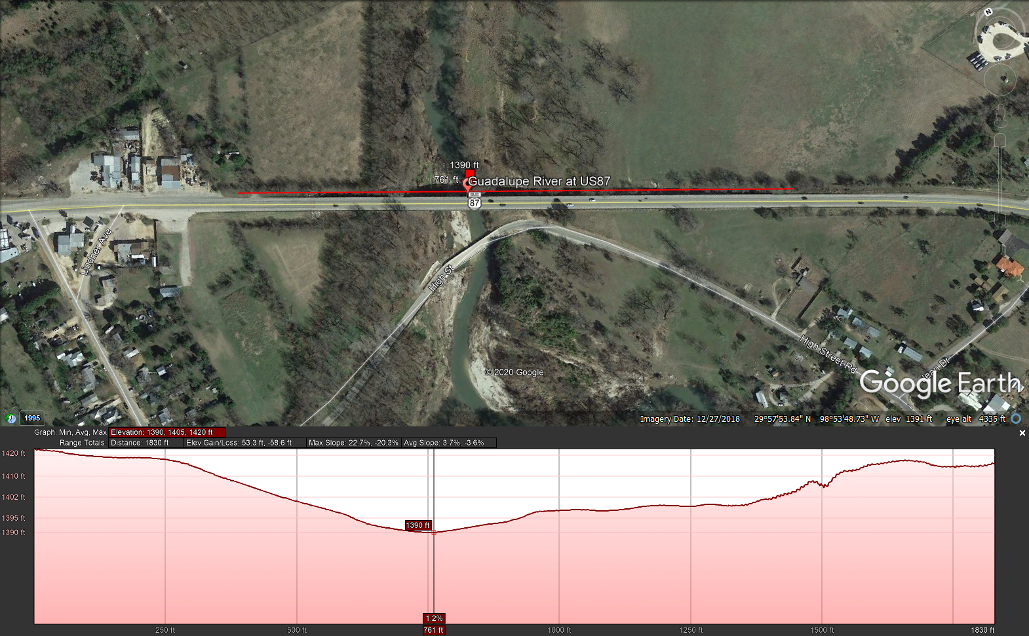
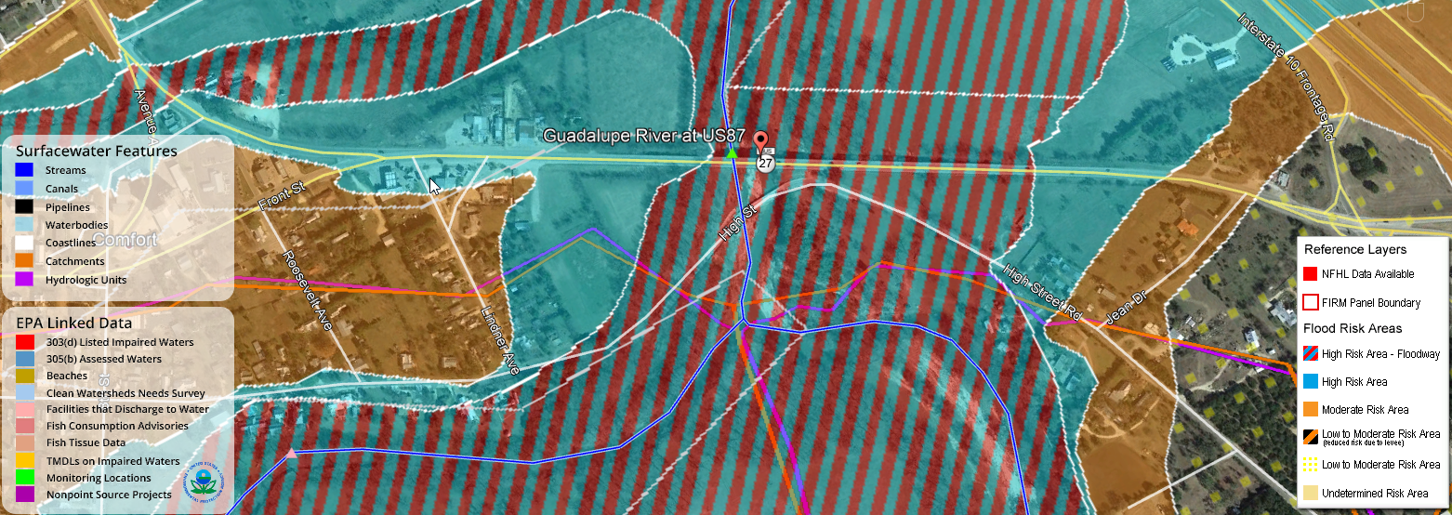
Reconnaissance Considerations
- Bridge Safety
- Multiple Channels / Bridges
- Channel Curvature
- Floodplain Width
- Velocity Distribution
- Density of Vegetation
- Proximity to Established
Stream Gauges
- Channel Stability
Notes:
Explanation of Remote considerations

Slide 29
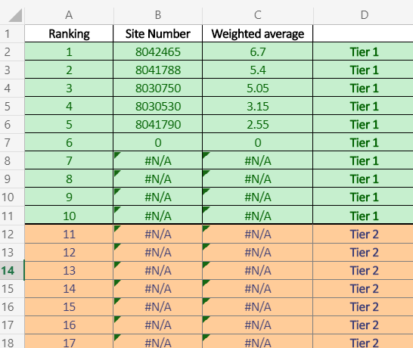
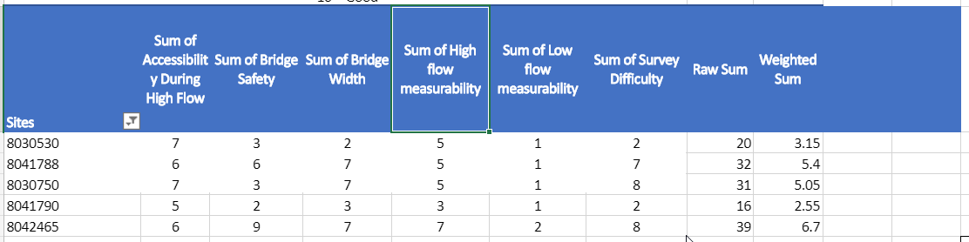
Tier 1: (10 gauges)
  Complete comparison between USGS methods
  and RQ-30.
  Full Range stage-discharge relationship
Tier 2: (20 gauges)
  Additional high flow assessment
  High flow measurements to calibrate RQ-30
Tier 3: (50 gauges)
  Visited Quarterly with no physical measurements
  Basis for statistical determination drift
Notes:
Process for final selection

Slide 30
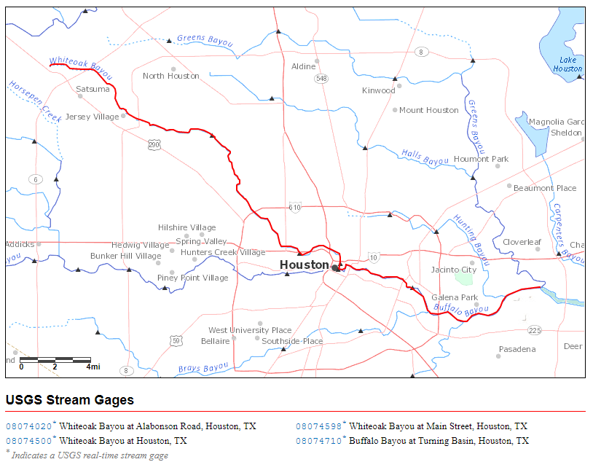
Questions:
Is the separation of potential gauge site prioritization by the AHP method from the application of USGS measurement quality criteria appropriate?
Should RQ-30 gauge locations be located independently of existing USGS sites?
Alternatively, should the sites be located in groups, with Tier 1 sites downstream supported by Tier 2 and Tier 3 sites further upstream?
Tier 3
Tier 3
Tier 3
Tier 2
Tier 2
Tier 1
Notes:
Explain On-site considerations.

Slide 31
Topic 5: Flood Emergency Response Workflow (Harry Evans)
Objective:
Determine what is useful and usable to TxDOT Flood Response (End Users)
    What does TxDOT want to know during a flooding event?
    How will they incorporate the flood information into their emergency management?
To do this, we start with a workflow of how information is used within the organization and who uses it.

Slide 32
Topic 5: Flood Emergency Response Workflow
DRAFT 1
Pre-Event
Event
Post-Event
National Weather Service
Forecasting significant rain event (storm, hurricane)
Situational Awareness (ESRI App, HCRS)
App will show equipment locations (GPS – rolling stock),
weather (not NOAA, but static, and predicted rainfall)
Activation Email
(starts the process)
Daily Calls to Ops/Maintenance
District Engineer / Manager
Notifies the Crew Chiefs to start prep
Area Engineer / Maintenance Supervisor
Asst. Maintenance Supervisor / Crew Chief
Starts prep
Crews monitor/check roadway access
*TxDOT does not close roads prior to event – only once road is dangerous
Based on local knowledge, event checklists (local offenders, map?)

Slide 33
Topic 5: Flood Emergency Response Workflow
Questions:
What is needed to make complete the workflow diagram?
Who consumes flood information to conduct emergency management?
  Who directs emergency operations at TxDOT?
  How many different flood information users are there?
  What are their roles?

Slide 34
Status Report Agenda
Review of progress in last quarter (David Maidment)
Discussion of Five Topics
Watershed prioritization (Barney Austin)
Gauge Site prioritization (Barney Austin)
National Water Model Accuracy (Paola Passalacqua)
Selecting USGS gauge sites (Scott Grzyb)
Flood Emergency Response Workflow (Harry Evans)
Some future perspectives (David Maidment)
A forecasting system needs forecasters
Building the engineered landscape

Slide 35
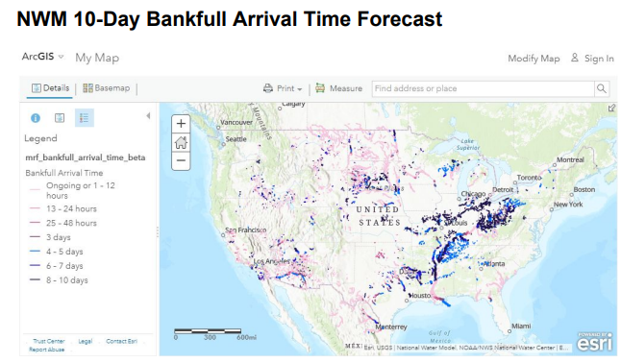






National Water Center Visualization Services
Flood visualization services from National Water Model
Replace and Route Service (Main Rivers)
from West Gulf River Forecast Center for Texas
Medium Range
(up to 10 days ahead)
Short Range
(up to 18 hours ahead)

Slide 36

National Water Center Visualization Services
A comprehensive overview of flow forecasting services from the NWS
https://gis.nwc.nws.noaa.gov/portal
Three Time Frames:
Analysis
(Current conditions)
Short Range
(Up to 18 hours ahead)
Medium Range
(Up to 10 days ahead)
Includes forecasts from
National Water Model
and West Gulf River
Forecast Center model
(for larger rivers)
WGRFC River Flow Forecast
(5 Day Max flow)
NWM 12 hour Bankfull
probability forecast

Slide 37




A Flood Forecasting System Needs Forecasters
13 Weather Forecast Offices
Arkansas-Red
Lower
Mississippi
West Gulf
River Forecast Center
(WGRFC)
25 TxDOT Districts
3 River Forecast Centers
Suggestions:
(1) Use shared NWC Visualization Services
(2) Request a state-wide flood briefing from WGRFC
National Water Center

Slide 38






Building the Engineered Landscape for Flood Modeling
Steps in the process
Begin with Base Level Engineering (FEMA, TWDB, InFRM)
Convert BLE models to support real-time flood inundation mapping (BLE to FIM)
Add Bridge models (Bridge lines and LIDAR)
Translate flood information onto road network (Linear referencing)
Do this at scale for all of Texas

Slide 39

FEMA Base Level Engineering (BLE)
Supported by TWDB and InFRM

Slide 40








Base Level Engineering to Flood Inundation Mapping
BLE to FIM
Andy Carter
Research Fellow, UT Austin
Upper Guadalupe Basin
(one of about 200 HUC8 basins in Texas)
FEMA Base
Level Engineering
NOAA National Water Center
Visualization Services
Supports real-time flood inundation mapping
with non-uniform water surface profile

Slide 41







Modeling the Bridges: Example of Guadalupe River at Comfort
Cross-sections added for bridges
Cross-sections from BLE models
Water cross-section and long. profile

Slide 42




Automating Bridge Model Development
Bridge Line
Bridge deck elevation profile from LIDAR point cloud
“Bridge Envelope”
Stream and floodplain cross-section from bare-earth DEM
OpenStreetMap
Simplified bridge model
LIDAR point cloud and bare-earth DEM

Slide 43


Linear Referencing on Statewide Planning Map
Route event map service
developed by Michael Chamberlain
TxDOT TPP
https://apps3.txdot.gov/eventmap.html?RTE_NM=US0087-KG|609.1|609.9|#0000FF|5|Flooded%20Road
609.1
609.466
Flooding of US 87
at Guadalupe River
as a route event
609.9
Flood information translated into TxDOT statewide planning framework

Slide 44



Building the Engineered Landscape for Flood Modeling in Texas
Use bridge lines as a key connector
between floods, roads, bridges
Struc_ID of Bridge Line
= BridgeID of Bridge Point
US 87 at Guadalupe River
Draft Bridge Lines for Texas
Source: Michael Chamberlain,
TxDOT TPP

Slide 45

Conclusions from the First Quarter
What does TxDOT Want?
What have we learned?
Focusing gauging program on
high quality measurement sites
Supporting relationship between TxDOT
and NWS
Opportunity to help build the engineered
landscape for flood modeling
More flood information …
More often …
More reliable …
More accessible …
What do we need to learn?
More about internal flood operation processes
at TxDOT
How to support existing processes with
better flood information
How to ensure the information is
accurate, reliable and timely

