Slide 1
Evaluate Improved Streamflow Measurement at TxDOT Bridges Project 0-7095 Being conducted for TxDOT by UT Austin and US Geological Survey with the support of Kisters North America and Aqua Strategies September 2020 to August 2023
Presentation for Third Quarterly Review Meeting, Monday 14 June 2021
Acknowledgements: Shelley Pridgen (RTI Project Manager), Rose Marie Klee (H&H Director, TxDOT),
Adam Jack (BMT, TxDOT), Michael Cunningham (TPP, TxDOT)

Slide 2
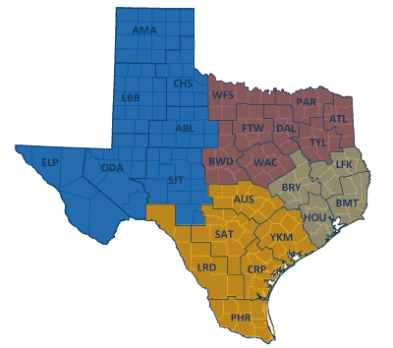
TxDOT Priorities
SAFETY
Our staff, our community
Emergency response
CONNECTIVITY
Reliability of the transportation network
Asset management
*BRIDGES*
Efficiency and efficacy
For TxDOT
For other/all jurisdictions
Slide: Rose Marie Klee, TxDOT

Slide 3
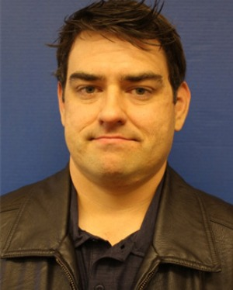
TxDOT Project Management Committee
Shelley Pridgen Research Project Manager, RTI
Rose Marie Klee H&H Section Director, DES
Abderrahmane Maamar-Tayeb
H&H Section Team Lead, DES
Trent Ellis Bridge Scour Coordinator, BRG
Adam Jack Dir of Trans Plan & Development, BMT
Andrew Lee District Bridge Engineer, BMT
Joseph Goessling
Lead Hydraulics Engineer, AUS
Jared Browder Maintenance Assess Spec, MNT

Slide 4
Project Advisory Committee
Jason Johnson, NOAA National Weather Service Mark Lenz, NOAA National Weather Service
Paul Yura, NOAA National Weather Service
Sam Marie Hermitte, Texas Water Development Board
Jorge Urquidi, City of Austin, Flood Early Warning System
Justin Terry, Harris County Flood Control District
Peter Smith, former TxDOT Dir of Trans Planning and Programming
+ other members of the H&H Section, TxDOT Design Division:
Welcome to
the Discussion!
Sauda Ahmed | Ivanna Heigl-Maza
Hiruy Berhe | Lucinda Soto
Zenia De Leon | Jaime Villena-Morales
Tyler DeRose | Sarah Wildenstein

Slide 5
Streamflow II Overview Meeting Agenda
Task 1: Project Management
Task 2: Watershed Selection and Site Evaluation Task 3: Gauge Installation, Operation and Maintenance Task 4: Flood Forecast System Operation Task 5: Forecast Model Assessment
Task 6: Flood Manual and Training

Slide 6
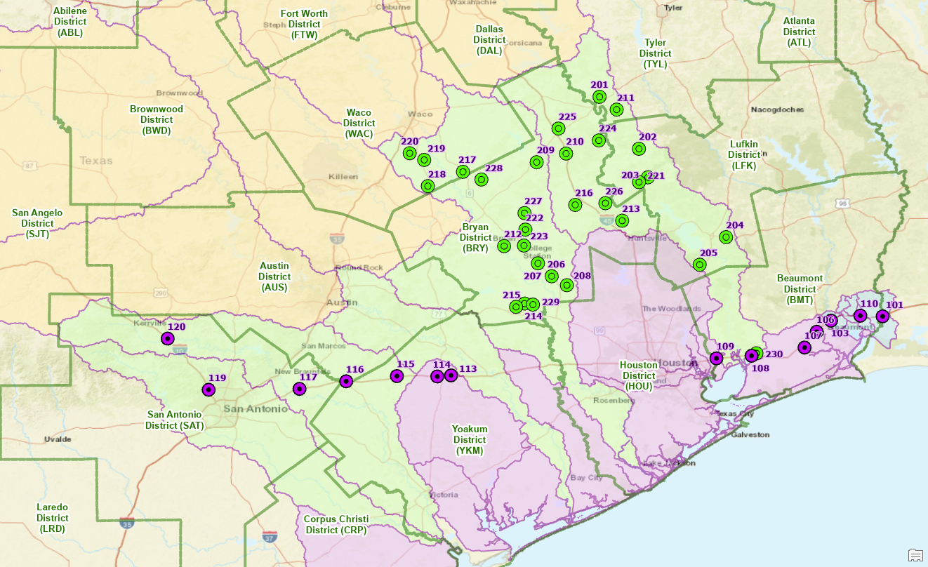
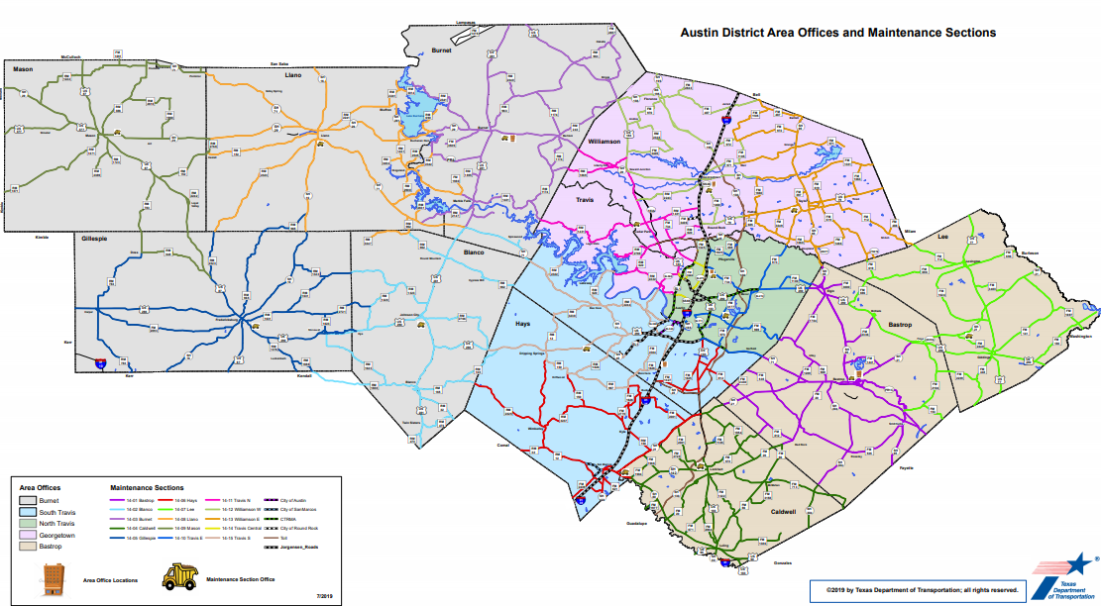
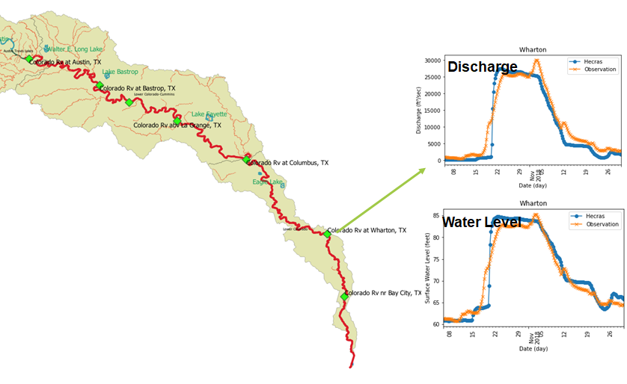
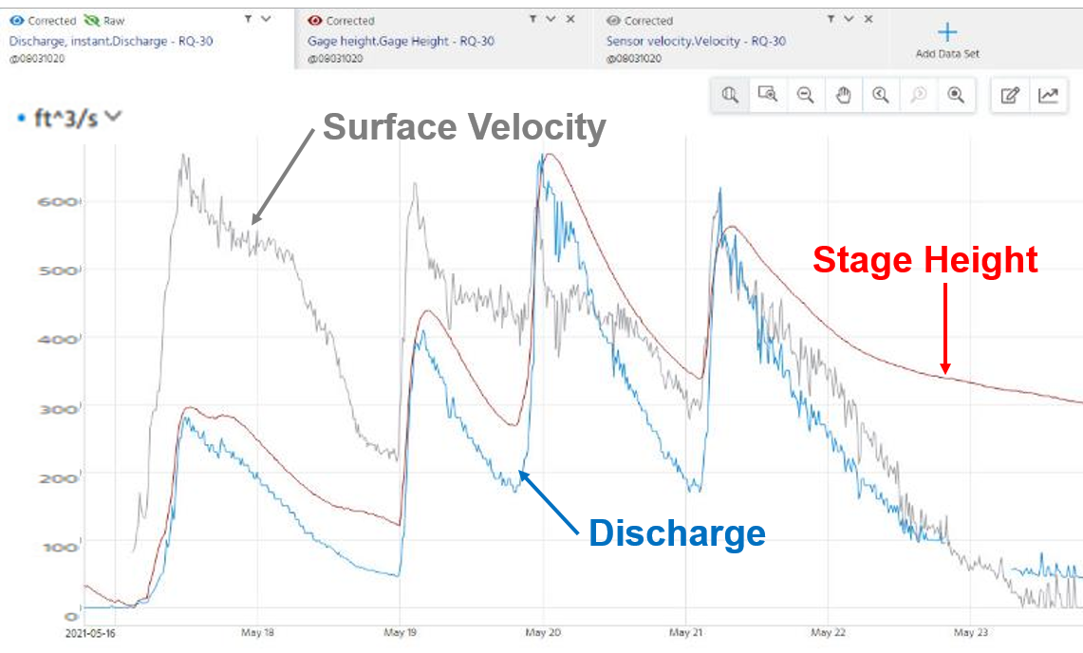
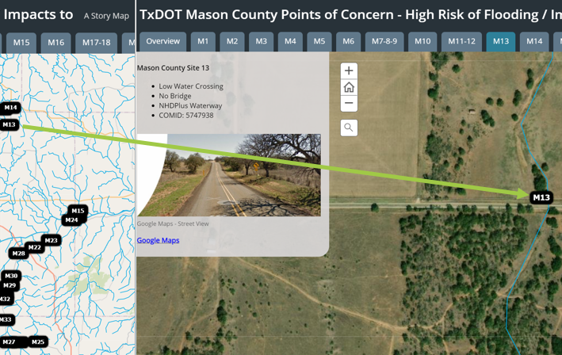
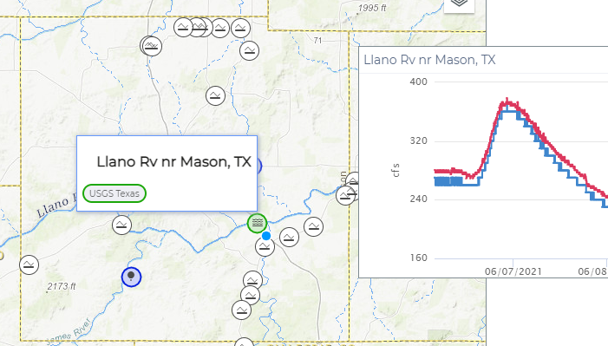
Task 1: Project Management – Some Highlights for this Quarter
Meeting with Project Management
Committee, 5 May 2021
Approval of 30 sites for gauge
installation
Meeting with Austin District Maintenance
Staff, 29 April
Learned about Area Offices and
Maintenance Sections
Live HEC-RAS model
embedded in Datasphere
Lower Colorado River
Excellent data recorded at Cole Ck
during storms, 16 – 24 May
Datasphere Dashboard for Mason County
Concern Point
Low Water Crossing

Slide 7
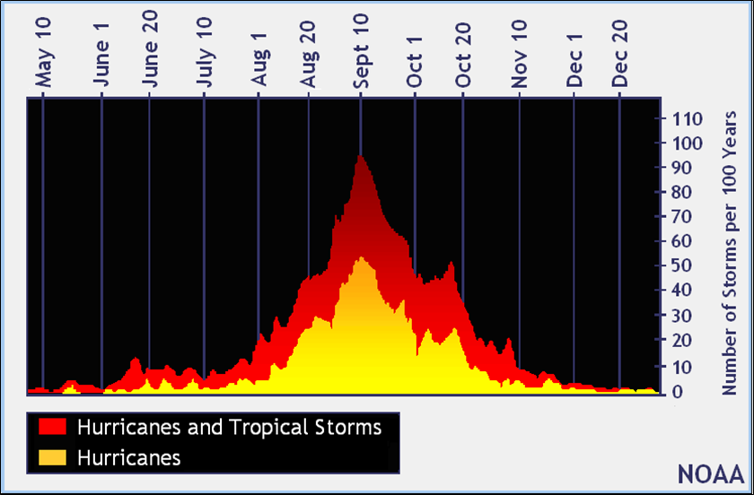
When is Hurricane Season?
Atlantic Hurricane Season: June 1 - November 30
You are here
Peak of season in August and September
Source: Melissa Huffman, NWS Corpus Christi

Slide 8
Task 1: Project Management
Achievements during last Quarter
Selected first 30 gauge sites
Beginning collaboration with Austin District Maintenance
Received first 12 gauge permits
Advancements in Datasphere
Advancements in Bridge Modeling
Challenges for Next Quarter
Selection of second 30 gauge sites
Begin collaboration with Beaumont District
More gauge permits obtained
Advancements in Data Assimilation and 3D road representation
Cope with Hurricane Season!

Slide 9
Streamflow II Overview Meeting Agenda
Task 1: Project Management
Task 2: Watershed Selection and Site Evaluation Task 3: Gauge Installation, Operation and Maintenance Task 4: Flood Forecast System Operation Task 5: Forecast Model Assessment
Task 6: Flood Manual and Training

Slide 10
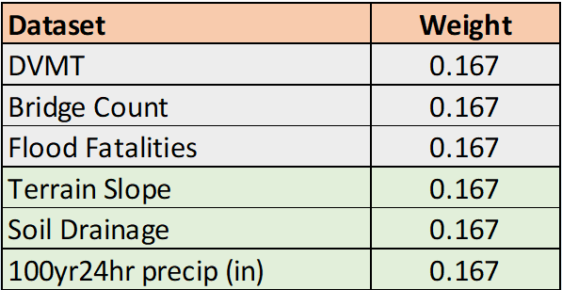
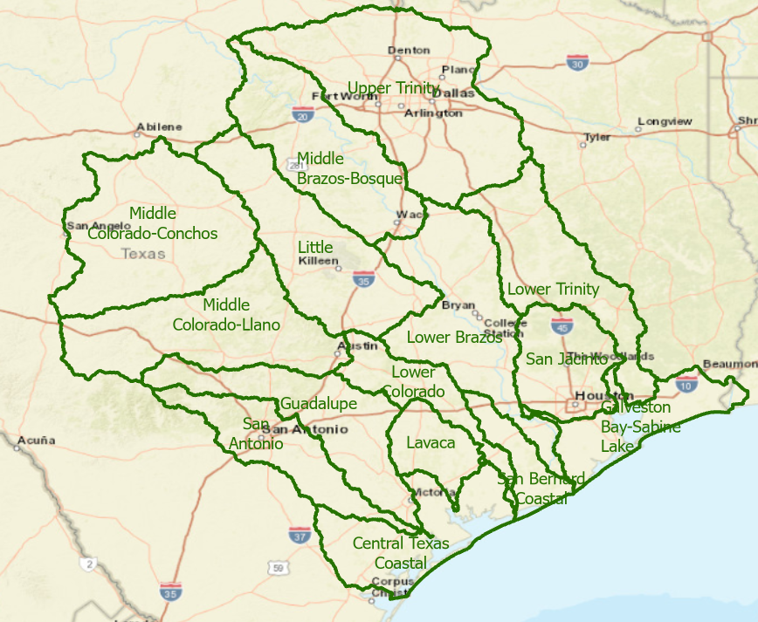
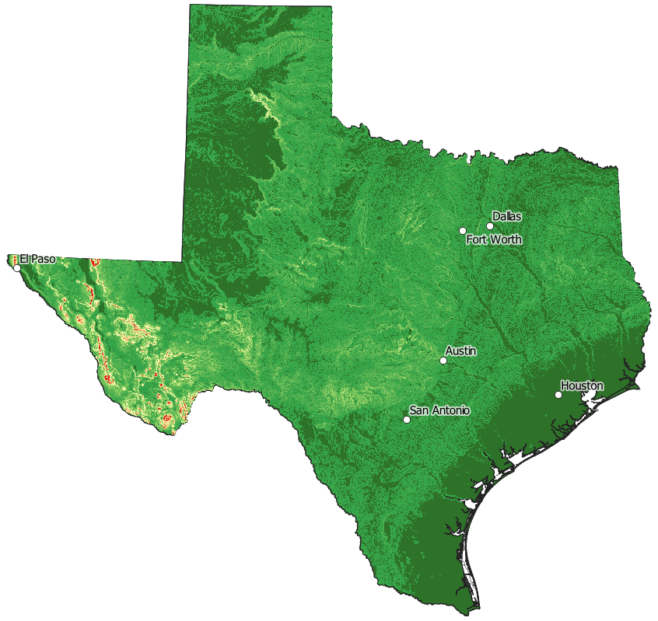
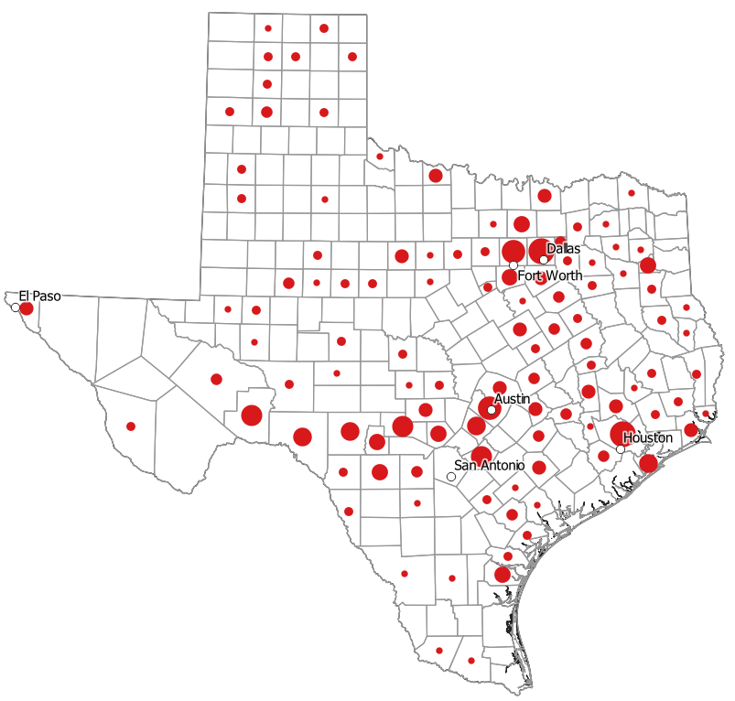
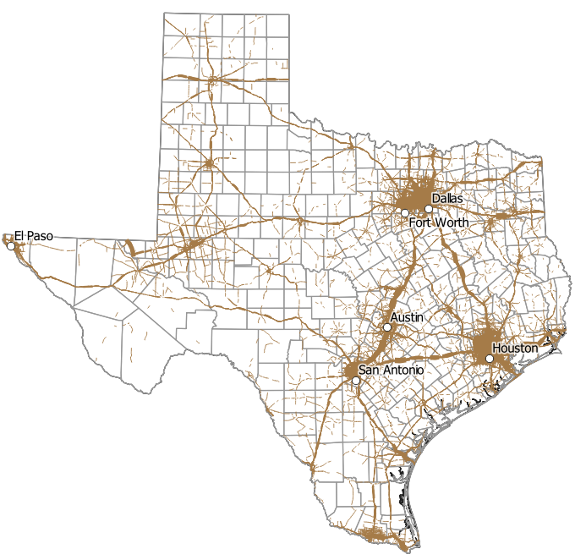
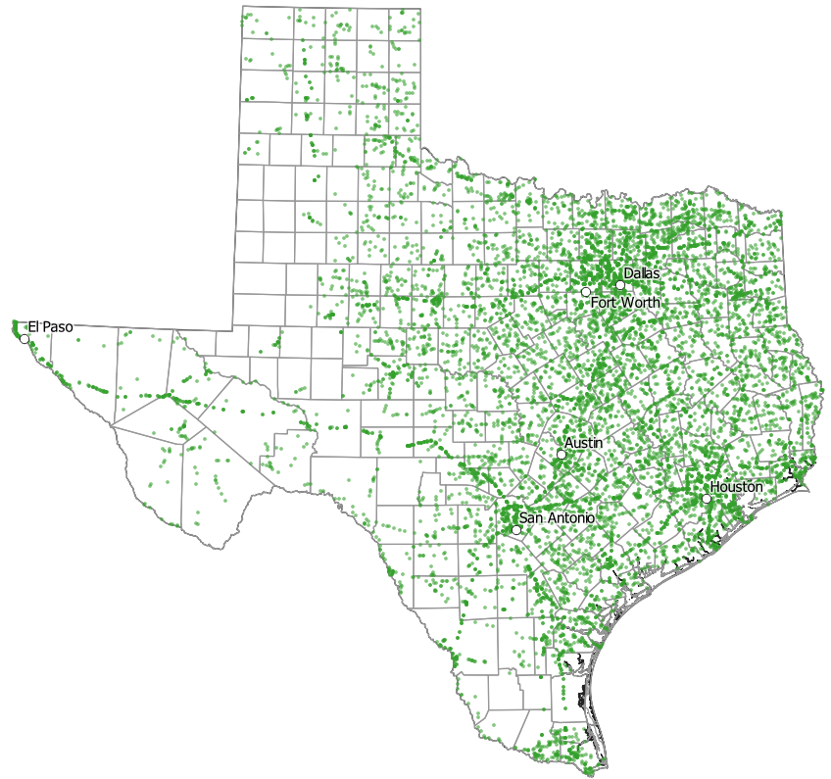
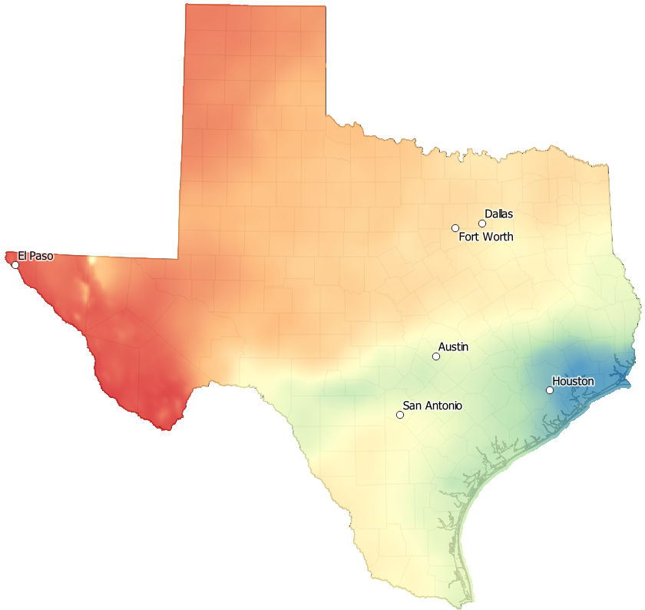
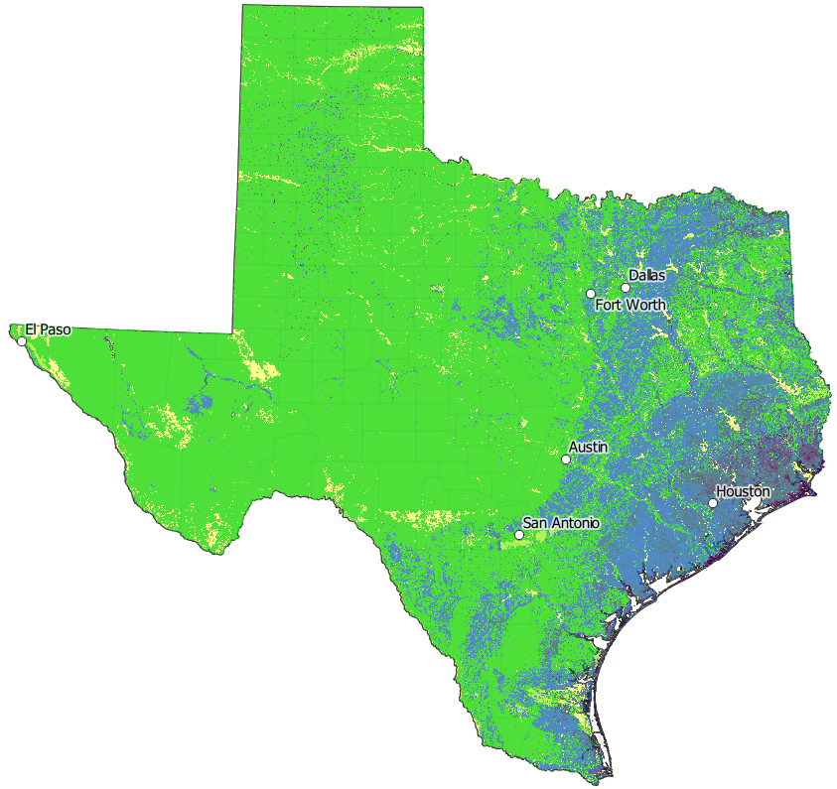
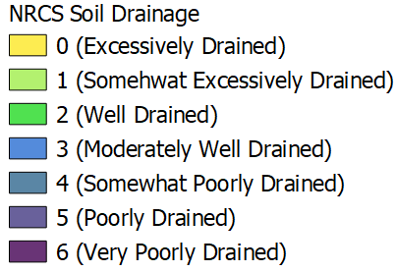
Prioritized Watershed Region Identified using Weighting Factors
Selecting Watersheds
Base set of Bridges
Desktop Assessment
Daily Vehicle
Miles Travelled
DMVT
Field Assessment
Flood Fatalities
Soil Drainage
Site Selection
Bridge Count
Coastal Gauging
Terrain Slope
100yr-24hr Precipitation

Slide 11
Flood Risk Factors have a Combined Gradient from the Coast towards Inland
Flat
Slope
Poor Drainage
High
Rain

Slide 12
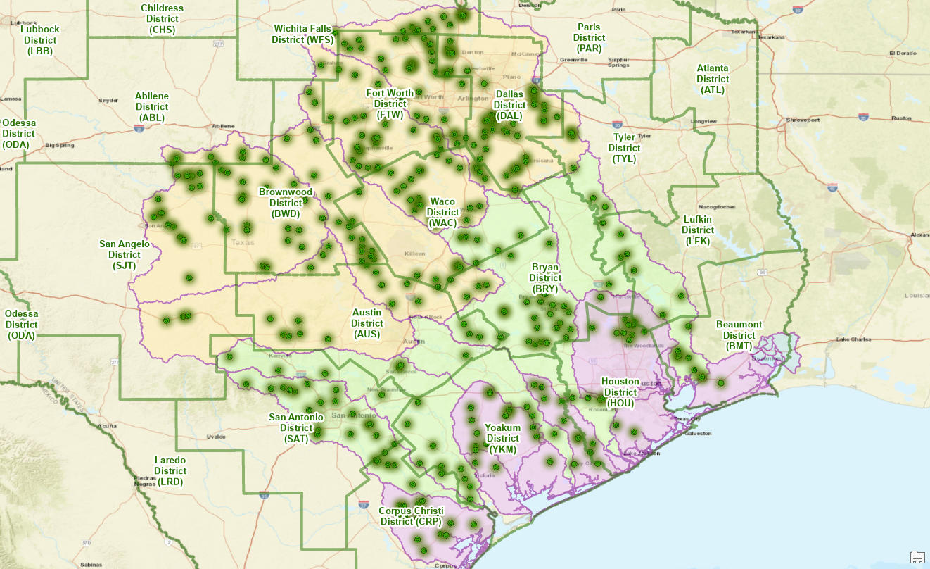
400 Potential Gauge Sites from Office Reconnaissance

Slide 13
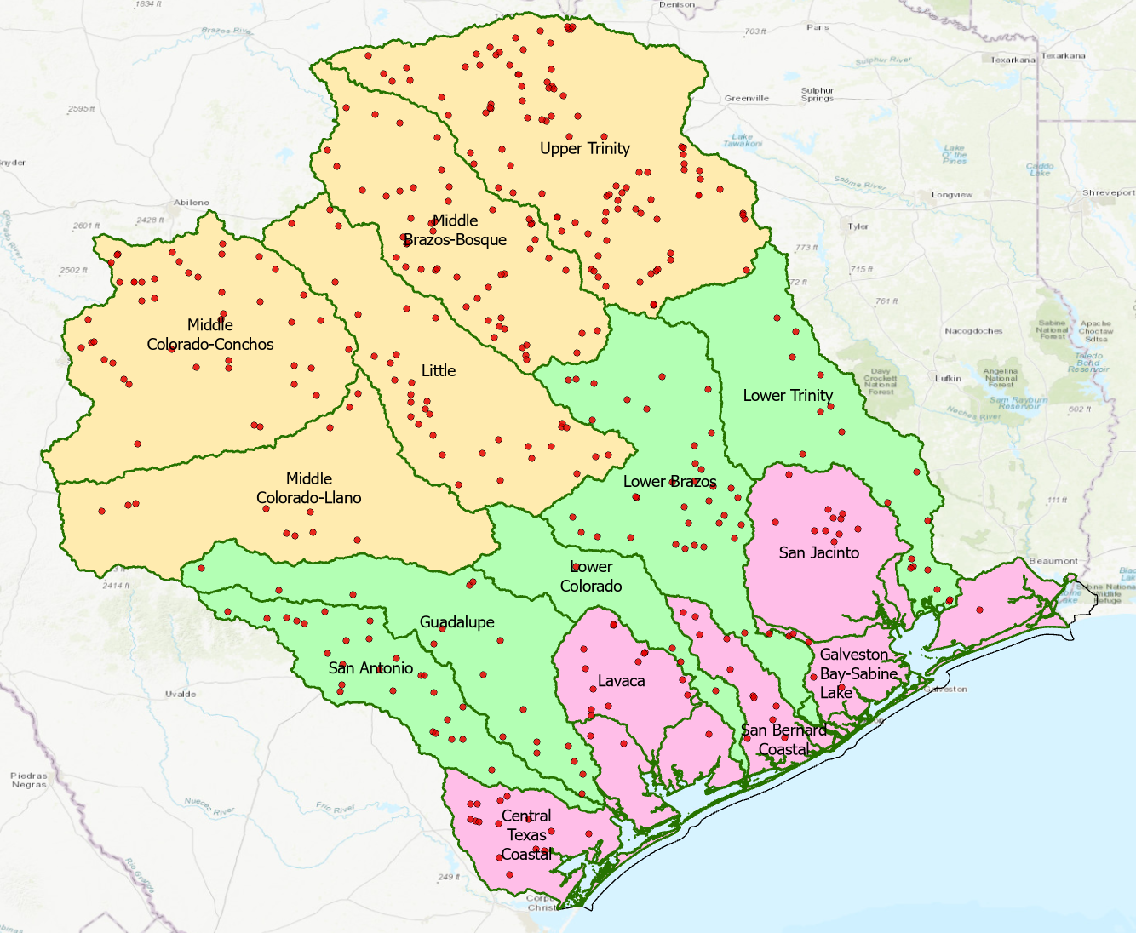
Divide the HUC6 Basins into Three Groups
Potential gauge sites
identified by USGS
Upper
HUC6 Group | Number of Potential Gauge Sites
Lower | 60
Middle | 100
Upper | 240
Total | 400
Middle
Lower

Slide 14
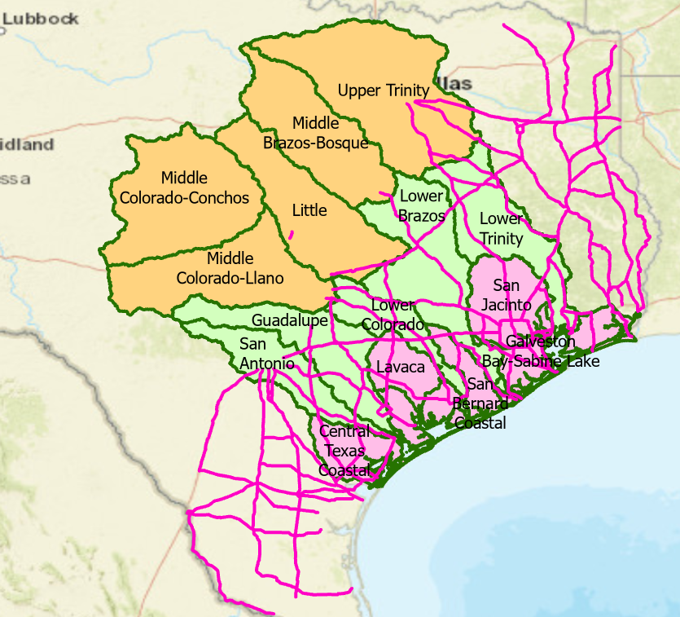
Evacuation Routes
Evacuation Routes are in Lower and Middle basins

Slide 15
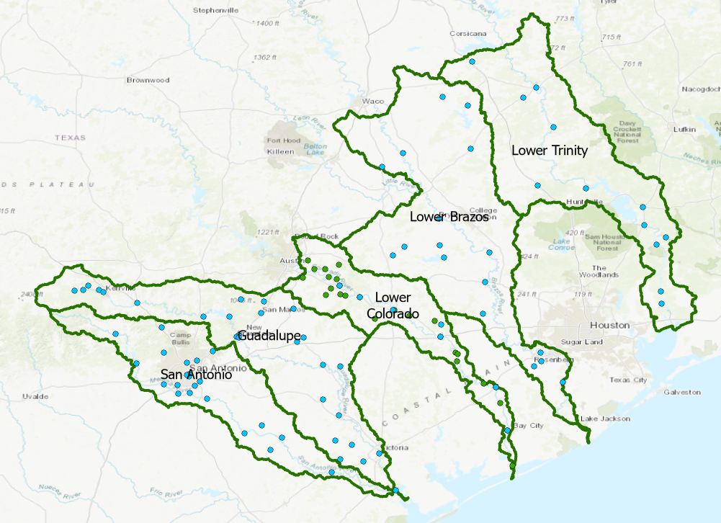
Gauging Density in Middle Basins
Basin | Area SqKm | USGS Gauges | LCRA Gauges | Existing Gauges | Gauges/1000 SqKm
San Antonio | 10863 | 23 |  | 23 | 2.1
Guadalupe | 15378 | 27 |  | 27 | 1.8
Lower Colorado | 7513 | 7 | 26 | 33 | 4.4
Lower Brazos | 20473 | 17 |  | 17 | 0.8
Lower Trinity | 15836 | 12 |  | 12 | 0.8

Slide 16
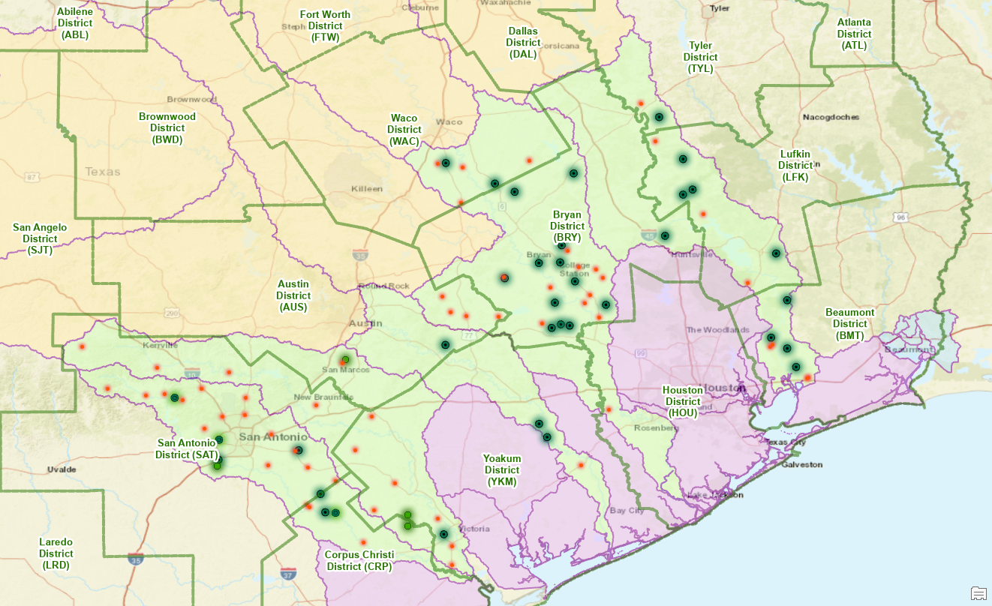
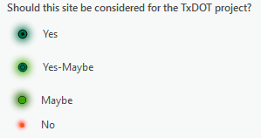
100 Recon Sites After Field Visits

Slide 17
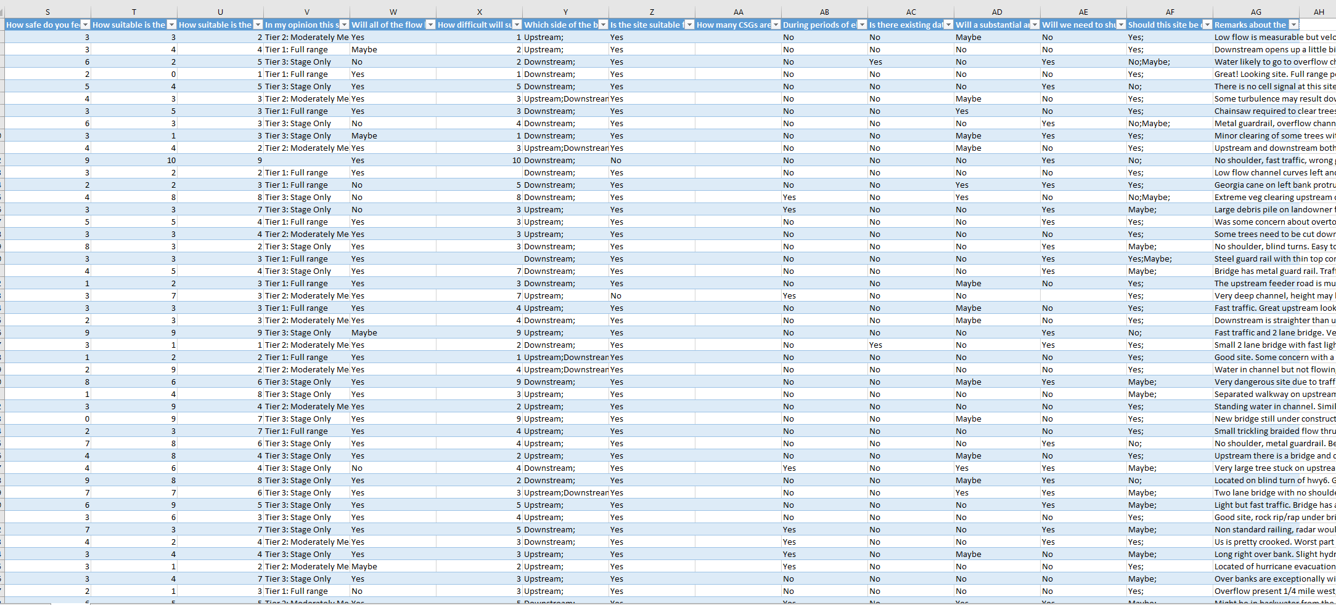
Field Assessment of all Potential Sites in Middle Group

Slide 18
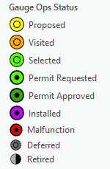
14 Operational Gauges, 30 Selected New Sites
StoryMap Demo by David Arctur
https://arcg.is/veW9T0

Slide 19
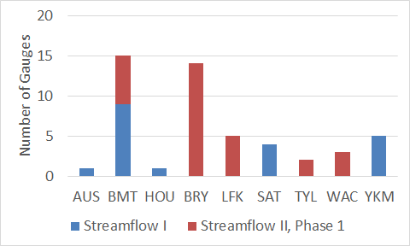
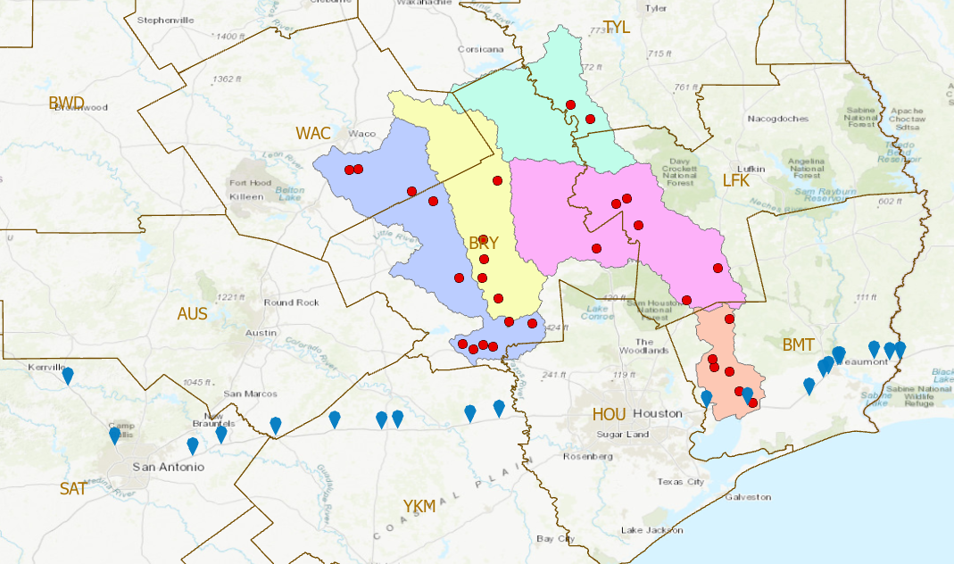
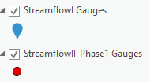
Gauges in TxDOT Districts
Streamflow I 20 Gauges
Streamflow II, Phase 1 30 Gauges

Slide 20
Field Reconnaissance for next 30 sites in Lower Basins
Potential gauge sites
identified by USGS
Upper
HUC6 Group | Number of Potential Gauge Sites
Lower | 60
Middle | 100
Upper | 240
Total | 400
Middle
Lower

Slide 21
Task 2: Watershed Selection and Site Evaluation
Achievements during last Quarter
Completed field reconnaissance of 100 potential sites in Middle Group of basins
Identified first 30 gauging sites
Challenges for Next Quarter
Identify second 30 gauging sites starting with Lower Group of basins
Complete Technical Memorandum 2 by 31 July

Slide 22
Streamflow II Overview Meeting Agenda
Task 1: Project Management
Task 2: Watershed Selection and Site Evaluation Task 3: Gauge Installation, Operation and Maintenance Task 4: Flood Forecast System Operation Task 5: Forecast Model Assessment
Task 6: Flood Manual and Training

Slide 23
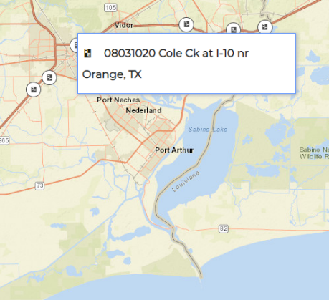
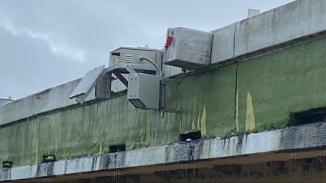
08031020 Cole Ck at I-10 nr Orange, TX
Installation and Lessons Learned
Requested by Beaumont District 31 March 2021
Data flowing
14 April 2021
Relocated Streamflow I Gauge

Slide 24
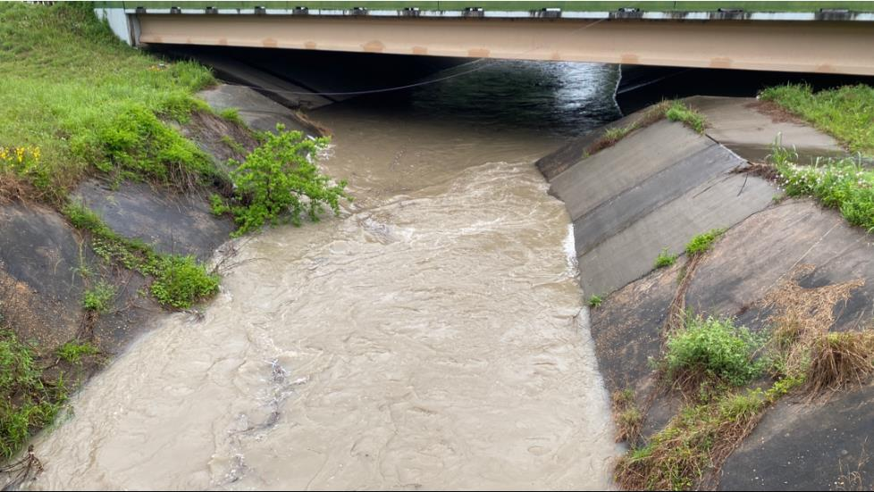
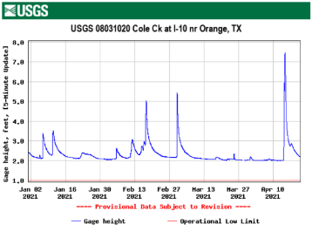
Installation Day (and heaviest rainfall to date as of April 2021)

Slide 25
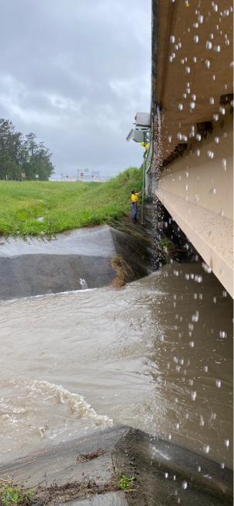
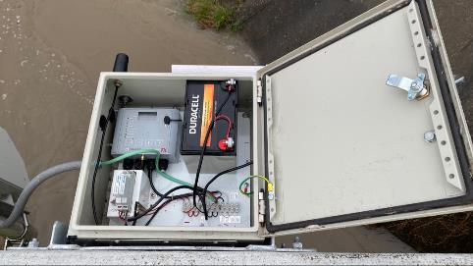
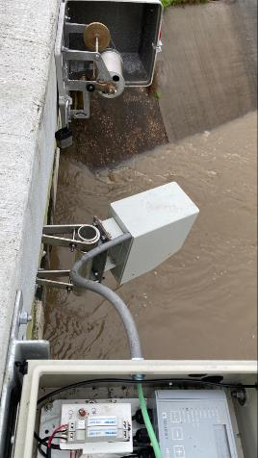
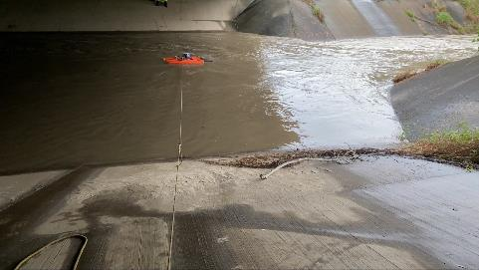
Installation Day

Slide 26
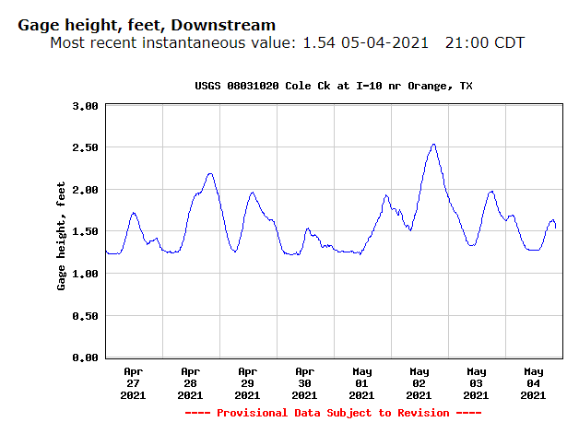
Gage Height is now being reported
through USGS National Water
Information System
Tidal Influence
Notes:
Explain how we learned we could get well defined discharge here even in tidal flows.

Slide 27
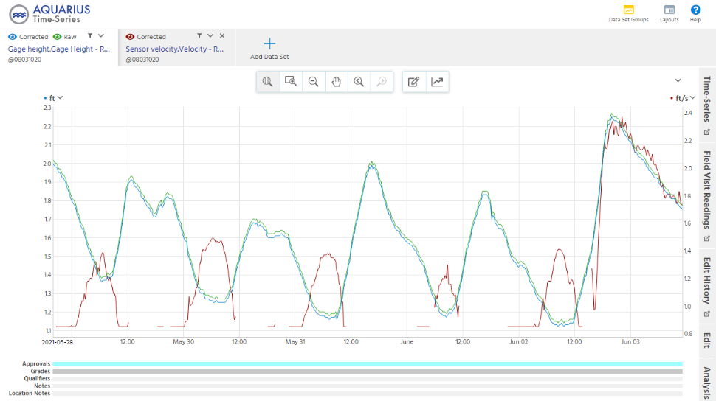
Relation between Stage Height and Velocity
Stage
Height
(ft)
Velocity
(ft/sec)
Flow
pulse
Stage Height
Velocity
Notes:
As water level rises tidally, the velocity decreases and vice versa

Slide 28
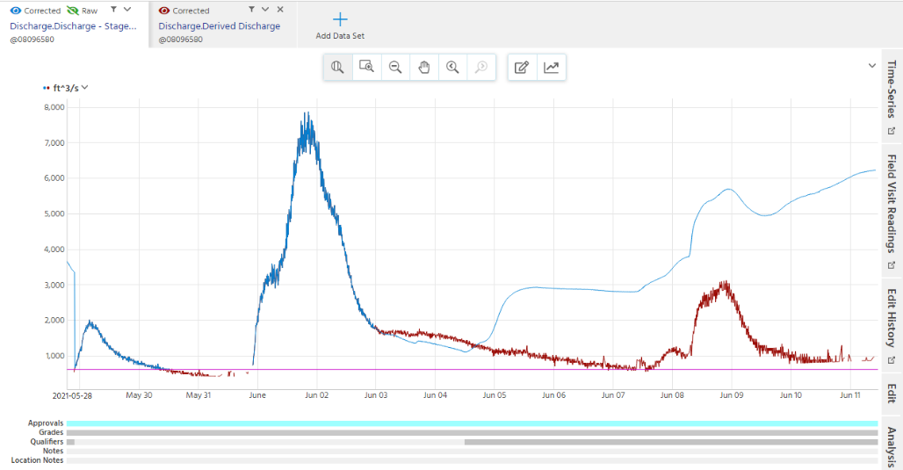
Relation between Stage Height and Velocity (Tehuacana Creek nr Waco)
Discharge Stg/Q
Discharge by velocity
Notes:
As water level rises tidally, the velocity decreases and vice versa

Slide 29
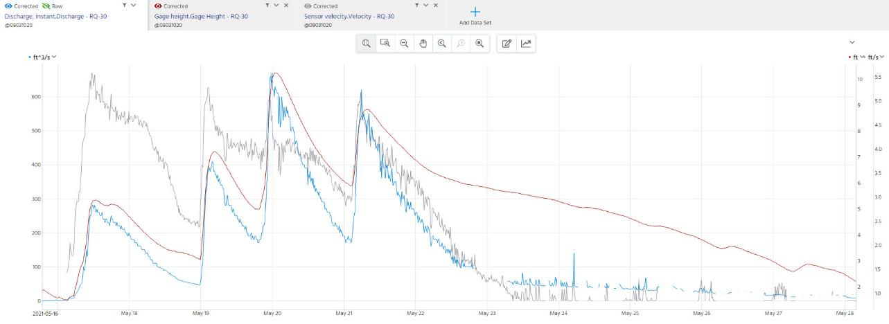
Cole Creek Data with Discharge Pulses for 16-29 May, 2021
Surface Velocity
Stage Height
Discharge

Slide 30
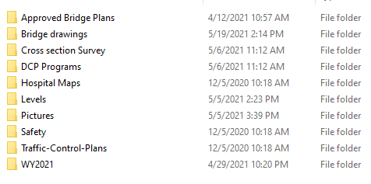
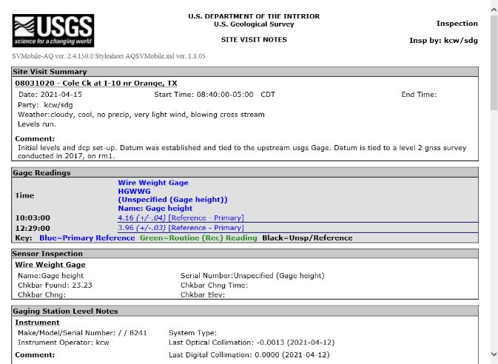
Gauge Documentation

Slide 31
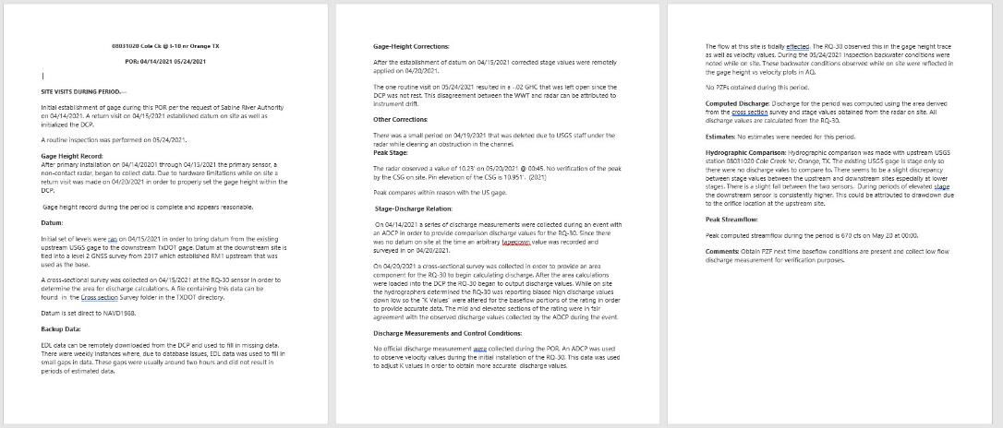
Gauge Documentation
Detailed analysis for each visit-visit period.
Three-step approval process of stage data
- Evaluation of discharge hydrographs
Summary of any corrections or anomalies
- Hydrographic comparisons when available

Slide 32
Task 3: Gauge Installation, Operation and Maintenance
Achievements during last Quarter
-Cole Creek installation
Advance preparation of streamflow II Installation equipment.
Procedures for operations and maintenance outline for thoughtful evaluation of RQ-30.
Challenges for Next Quarter
Efficient installation of 40+ Streamgages
Continued coordination for permitting and traffic control
Operations and Maintenance performed in tandem with installations

Slide 33
Streamflow II Overview Meeting Agenda
Task 1: Project Management
Task 2: Watershed Selection and Site Evaluation Task 3: Gauge Installation, Operation and Maintenance Task 4: Flood Forecast System Operation Task 5: Forecast Model Assessment
Task 6: Flood Manual and Training

Slide 34
KISTERS Datasphere Functions
Data Ingestion and Aggregation
NOAA Weather and Water Forecasting
Observation networks
USGS
TxDOT
Others
Data Analytics
Discharge to water level using rating curves
Time Series at points from raster forecasts (e.g. precipitation)
Probabilistic times series forecasts from ensembles
Data Display and Access
Graphical User Interface
Application Programming Interface
Simulation Modeling
River routing by Muskingum-Cunge
River routing by HEC-RAS
Data Assimilation
Combining observations, modeling and forecasting to provide improved forecasts

Slide 35
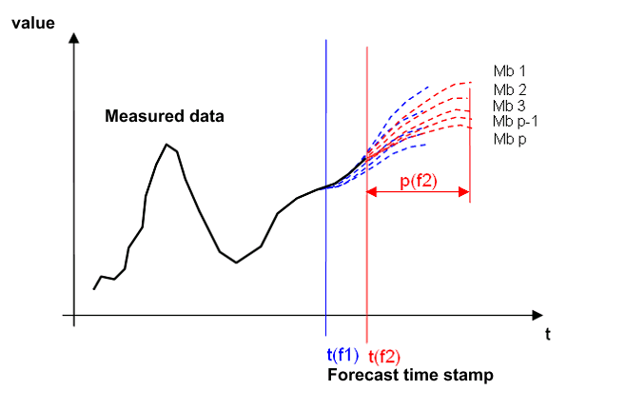
KISTERS Storages
Time Series Storage
Scalar time series in (No)SQL storages
Typically used for gauge observation sites
Time series analytics
Used when users define their own gauge locations
Array storage
Multidimensional storage (space, time, parameter, elevation, modelmember)
Geospatial analytics
Model results like stream forecasts can be supported using the “stationId“ as a dimension

Slide 36
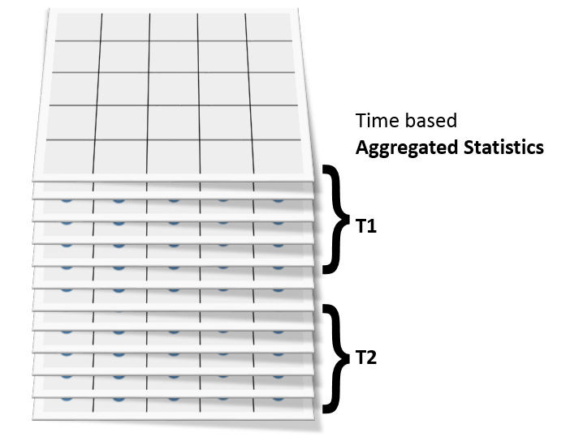
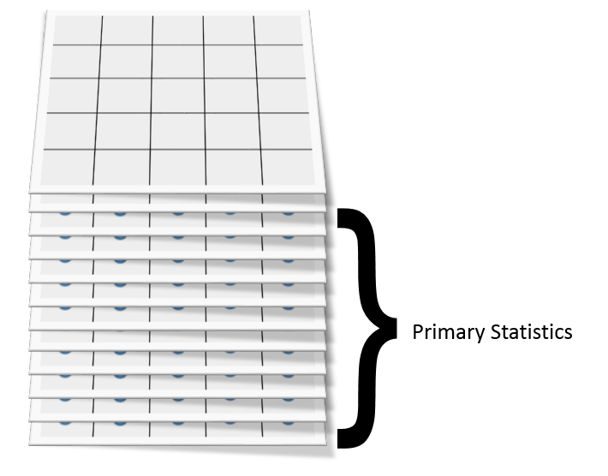
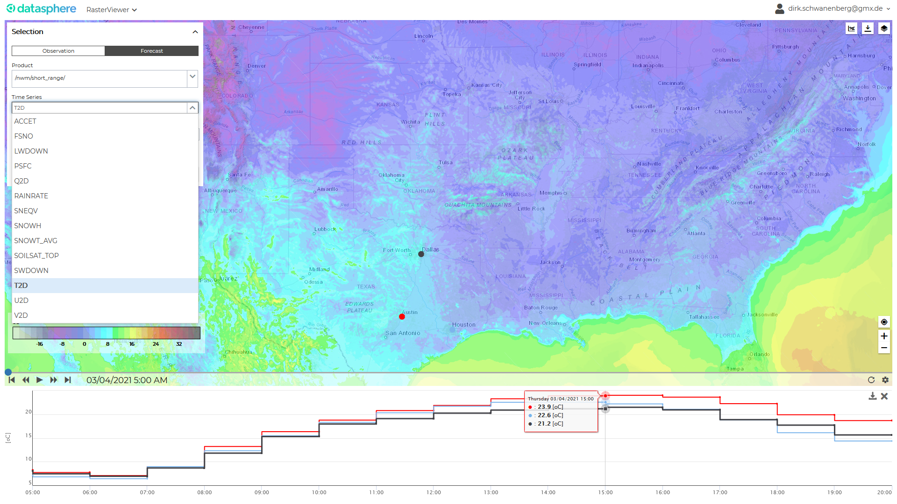
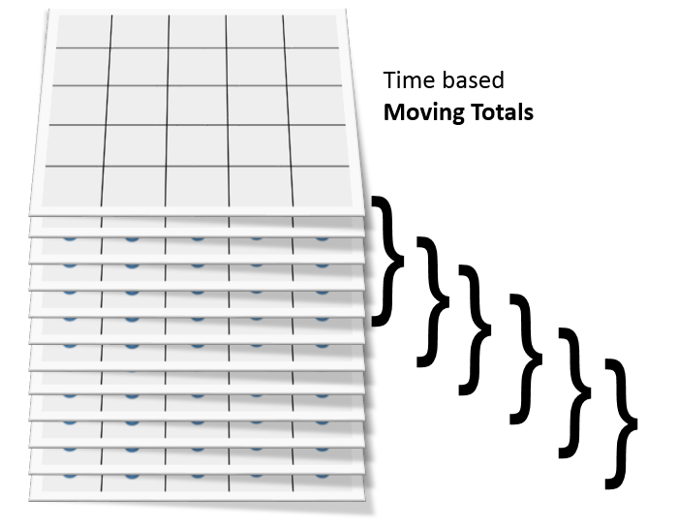
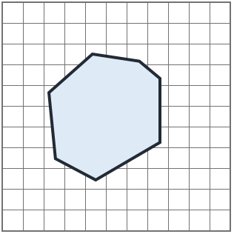
Raster Analytics
Extraction of point time series per pixel
Extraction of polygon statistics as point time series
General in-storage analytics
Aggregations and statistics
e.g. min, max, mean, total, variance
Question: What rainfall is forecast over my District?

Slide 37
Time Series Ensembles (multiple forecasts from a given time point)
Derive probabilistic forecasts (max, min, mean, etc)
Probabilistic forecasting
NWM Medium Range Forecast Ensemble (7 Forecast Traces)
Today

Slide 38
Storages and Data Flow
datasphere spatial GUI
visualization of animated maps, (ensemble) time series at user-selected points / polygons on-the-fly
datasphere sensor GUI
visualization of time series, statistics, alarm levels and notifications
requests to API
maps as png, timeseries as JSON
requests to api
time series as JSON
requests to API
NWM in datasphere spatial (Array Storage)
raster as zarr-CF in AWS S3 or Hadoop HBase with optimized chunking for balanced map and time series extraction use cases
Observations in datasphere sensor
scalar time series data: observations and forecasts at gauges in Hadoop HBase on Amazon Web Services
data by use case:
- forecast archive for individual locations
- aggregated data by shapes / polygons
- time-aggregated data (available soon)
supported formats: netcdf-CF, JSON, png, gif, jpg etc.
meteo: (ensemble x) time x latitude x longitude
derived data for fixed polygon such as HU6 and HU8 as (ensemble x) time x station-id
hydro: (ensemble x) time x station-id
requests to api
Extract Transform, Load (ETL) through API
observations at gauges
for data assimilation
in JSON
Extract Transform, Load (ETL) through API
NWM as forcing
results in NWM reference
Model Integration Framework
Hydraulic model derived from HEC-RAS and Muskingum-Cunge routing in variational data assimilation mode + forecast mode
Observations sources
Time series data ingestion from observation networks (USGS, TxDOT, LCRA, others)
NWM source
netcdf-CF by time step and ensemble member (as the model writes it)

Slide 39
Observation Networks in Datasphere

Slide 40
Medium Range Forecast at Cole Creek

Slide 41
Raster Data Viewer and Time Series at a Selected Point

Slide 42
Global Forecast System (GFS) for Weather

Slide 43
Observed Flows and Forecast Rainfall, Guadalupe River at Comfort

Slide 44
Forecast Flows and Alarms, Pedernales River

Slide 45
Forecasts at Concern Point M1 in Mason County (Demo by Matt Ables)

Slide 46
Task 4: Flood Forecast System Operation
Achievements during last Quarter
Enhancements to Datasphere
Inclusion and dynamic display of NWM Results
Addition of custom layers and map overlays
TxDOT Districts, HUC Basins, Bridges, Streams, etc.
Calculated time series in GUI
Visualization of raster time series with sensor data
Enhancements and alarming on Shared Channel data (LCRA, USGS)
Addition of Concern Point virtual stations
…..
Challenges for Next Quarter
Planned enhancements to Datasphere
Begin development on:
Alarms on forecast data
Visualization of HEC model schema
Display and alarms on HEC results
Visualization of bridge and sensor level alarms
Add current and forecast radar to sensor maps
Add NWM clone forecast

Slide 47
Streamflow II Overview Meeting Agenda
Task 1: Project Management
Task 2: Watershed Selection and Site Evaluation Task 3: Gauge Installation, Operation and Maintenance Task 4: Flood Forecast System Operation Task 5: Forecast Model Assessment - Data Assimilation
Task 6: Flood Manual and Training

Slide 48
Colorado Basin Prediction Testbed
Precipitation Measurement
Streamflow Measurement
247 LCRA rain gauges
Austin
75 USGS Stream gauges
50 LCRA (Lower Colorado River Authority) gauges separate from USGS

Slide 49
HEC-RAS model of Lower Colorado
Consistent unsteady-state model of about 300 km starting upstream of Austin covering the complete Colorado river reach up to Gulf of Mexico
Simulations completed for flood events → HEC-RAS has some stability issues, which require very small time steps resulting in long computations, need for refined calibration for high flows
Integration into KISTERS Operational Planning GUI for online execution and visualization
Next steps:
Real-Time Optimization model conversion and implementation of Data Assimilation mode and workflow for operational forecasting → will get rid of the stability issues
Preparation of roll-out of the concept to other basins and systematic performance assessment

Slide 50
HEC-RAS model of Lower Colorado – October 2018 flood
Austin
Discharge
Wharton
Discharge
Water Level
Water Level

Slide 51
HEC-RAS model of Lower Colorado – HEC-RAS in Operational Planning GUI

Slide 52
NWM model routing clone
Clone can reproduce the results of the NWM routing to a very high degree
Model is available for the complete Colorado basin including the integration of the lakes/reservoirs
NWM data assimilation approach (nudging) is still not in and therefore results in different results downstream of NWM-considered gauges
Next steps:
Operational Planning GUI implementation, completion of Data Assimilation mode and workflow for operational forecasting
Preparation of roll-out of the concept to other basins and systematic performance assessment

Slide 53
Preliminary Data Assimilation Testing
Gap at Forecast Time for reach upstream of streamflow gauge:
NWM - does not consider any data assimilation due to the implemented approach
Clone - assimilation still not implemented
→ very similar results of the models, clone will show significant improvement once data assimilation is implemented
Assimilation impact downstream of streamflow gauges
NWM implements some persistency of the change in its assimilation approach
Clone – assimilation still not implemented
→ significant improvement of clone after implementation of approaching data assimilation approach

Slide 54
Base Level Engineering Model
Guadalupe River at Comfort (Demo by Dirk Schwanenberg)
Guadalupe model (short river reach represented in a single BLE model) as proof-of-concept
Challenge: consolidation of all the individual models
Conclusion: BLE models have significant potential due to state-wide coverage, but exploitation also requires significant effort

Slide 55
Task 5: Data Assimilation
Achievements during last Quarter
Assessment of BLE models (HEC-RAS) → initial work to make them suitable for unsteady state simulations
Assessment of Lower Colorado model → suitable with some caveats and running in OP web GUI
NWM Muskingum-Cunge clone available in simulation mode
Implementation of data assimilation in both models is work in progress
Challenges for Next Quarter
Completion of data assimilation mode in HEC-RAS and NWM clone models
Full operational integration as forecasting models
OP GUI integration of both models for scenario analysis
Roll-out of the approach to other basins in Texas starting with Brazos
Start of systematic performance assessment

Slide 56
Streamflow II Overview Meeting Agenda
Task 1: Project Management
Task 2: Watershed Selection and Site Evaluation Task 3: Gauge Installation, Operation and Maintenance Task 4: Flood Forecast System Operation Task 5: Forecast Model Assessment
Task 6: Flood Manual and Training

Slide 57
Austin District: Area Offices and Maintenance Sections
Area Offices have equivalent lane miles of roads
Maintenance Sections by county in rural areas
Georgetown
Burnet
North Travis
South Travis
Bastrop

Slide 58
StoryMap of Concern Points for Hays County
Hays: https://arcg.is/111Cna1

Slide 59
StoryMap of Concern Points for Mason County
Mason: https://arcg.is/1WWbH8

Slide 60
Roadway Closure Information
DriveTexas.org
Roadway closures due to floodings, 2014-2020
Flooding on IH-10 during Hurricane Harvey
21,261 road closures from flooding

Slide 61
TxDOT Recorded Flooded Roads, 2014 to 2020
Dallas – Fort Worth
San Antonio
Houston
Austin
Large differences in flood records at county lines, missing data in some metropolitan areas

Slide 62
Low Water Crossing Measured by Emergency Services District 11 using Pin2Flood
Low Water Crossing, Normal Conditions
Low Water Crossing, Minor Flooding (ESD 11)

Slide 63
Real-Time Inundation Mapping using Pin2Flood
Flood Inundation Return
Low Water Crossing, Minor Flooding (ESD 11)
Pin Drop by Public Safety

Slide 64
Task 6: Flood Manual and Training
Achievements during last Quarter
Interactions with the Austin District
Discussed past events and how they dealt with them
Discussed steps they take during a flooding event
General staffing
Concern Points established
Austin District provided sites which are a concern in Hays and Mason County
Mainly, these are low water crossings
Create a Story Map
Challenges for Next Quarter
Development of realistic HSEEP exercise
Meetings with the Beaumont District
Identify steps they take during a flooding event
Identify flow of information
Building a Concern Point template

Slide 65
Concluding Remarks by Committee Members
Please introduce yourself and share how this project is relevant to the work that you do. (Is there anything we could do that would make it more valuable?)
Given your awareness of community needs, gaps, and work by others, what is the most strategic way that we can capitalize on the value of this work?
What do you see as the biggest challenges or areas of weakness that we should be considering?
Any additional comments, questions, words of wisdom, observations that you would offer to us?
Jason Johnson – NOAA/NWS
Jorge Urquidi – City of Austin
Justin Terry – HCFCD
Mark Lenz – NOAA/NWS
Paul Yura – NOA/NWS
Peter Smith – TxDOT TPP, ret
Sam Hermitte – TWDB

