Slide 1
Evaluate Improved Streamflow Measurement at TxDOT Bridges
Project 0-7095
Being conducted for TxDOT by UT Austin and US Geological Survey with the support of
Kisters North America and Aqua Strategies
September 2020 to August 2023
Presentation for Eighth Quarterly Review Meeting, Friday 14 October, 2022
Acknowledgements: Rose Marie Klee (H&H Director, TxDOT), Trenton Ellis (H&H, TxDOT), Shelley Pridgen (RTI Project Manager, TxDOT),
Matthew Heinze (MNT, TxDOT), Jared Browder (MNT, TxDOT), Omar de Leon(AUS, TxDOT), Jacob Wells (AUS, TxDOT)

Slide 2
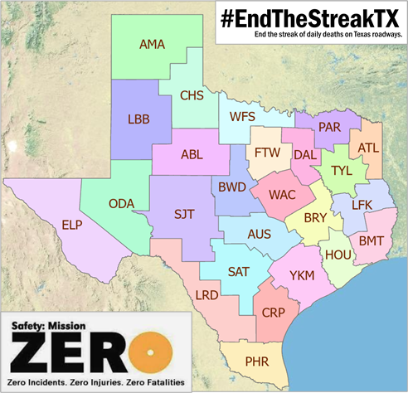

TxDOT Priorities
SAFETY
        Our staff, our community
        Emergency response
CONNECTIVITY
        Reliability of the transportation network
  Asset management
        *BRIDGES*
  Efficiency and efficacy
        For TxDOT
        For other/all jurisdictions
Slide: Rose Marie Klee, TxDOT

Slide 3





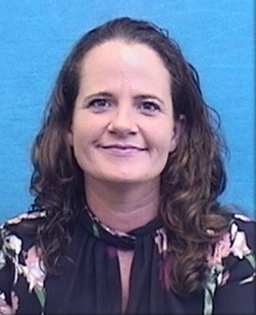


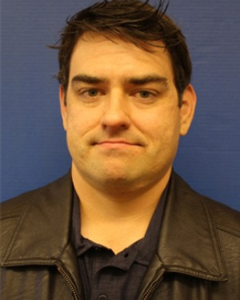



TxDOT Project Management Committee
Rose Marie Klee
H&H Section Director
DES
Abderrahmane Maamar-Tayeb
H&H Section Team Lead
DES
Trent Ellis
H&H Engineer
DES
Matthew Heinze
TxDOT Emerg Mgmt Coord
MNT
Jennifer Lash
GIS Program Leader
TPP
Valerie Taylor
Transportation Engr
HOU
Shelley Pridgen
Research Project Manager
RTI
Adam Jack
Dir of Trans Plan & Dev
BMT
Andrew Lee
District Bridge Engineer
BMT
Joseph Goessling
Lead Hydraulics Engineer
AUS
Jared Browder
Maintenance Assess Spec
MNT
Ryan Eaves
Geotech Brch Mgr
BRG

Slide 4
Project Advisory Committee
NOAA National Weather Service | State and Local Agencies
Jason Johnson, West Gulf River Forecast Center | Sam Marie Hermitte, TWDB
Paul McKee, Southern Region HQ | Jorge Urquidi, City of Austin, Flood Early Warning System
Paul Yura, Austin/San Antonio Weather Forecast Office (WFO) | Christina Bryant, City of Austin, Flood Early Warning System
 | Justin Terry, Harris County Flood Control District
 | Peter Smith, former TxDOT Director TPP
Welcome to
the Discussion!
NOAA Weather Forecast Office Service Hydrologists
Jonathan Brazzell, Lake Charles, LA, WFO
Katie Landry-Guyton, Houston/Galveston WFO
Amanda Schroeder, Dallas/Fort Worth WFO
+ members of the H&H Section,
TxDOT Design Division:
Sauda Ahmed, Edra Brashear, Zenia De Leon, Lucinda Soto, Jaime Villena-Morales, Marissa Williams

Slide 5
Meeting Agenda
Flood Data and Data-Model Integration
  Overview of stream gauge data measurement
  Improved understanding of river flood hydraulics
  Data-Model Integration
    Error analysis at gauges
    Data assimilation at gauge scale
    Data assimilation at network scale
Flood Mapping and Response
  Real-time flood map services
  Flood impact on bridges and roads
  Austin flood emergency response exercise
    Ecopia road and bridge data purchase
    Llano flood of 2018

Slide 6

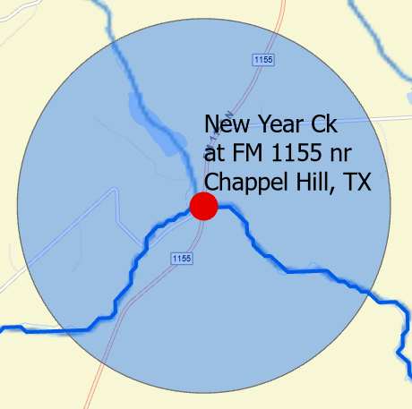
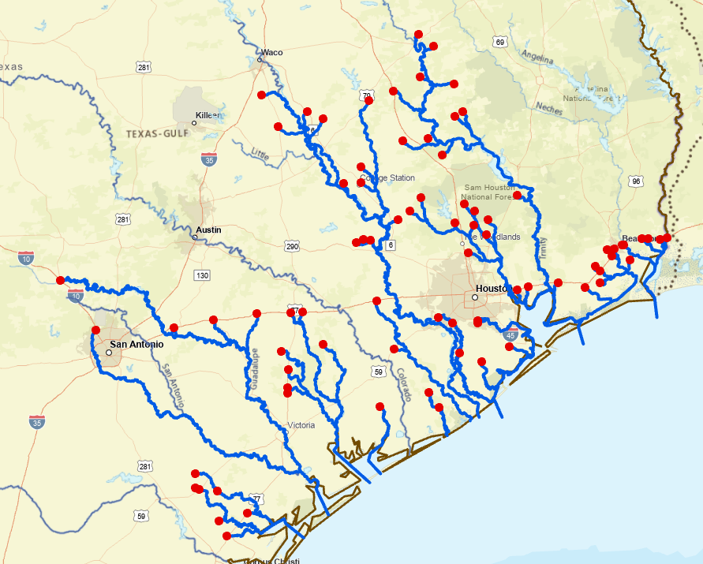
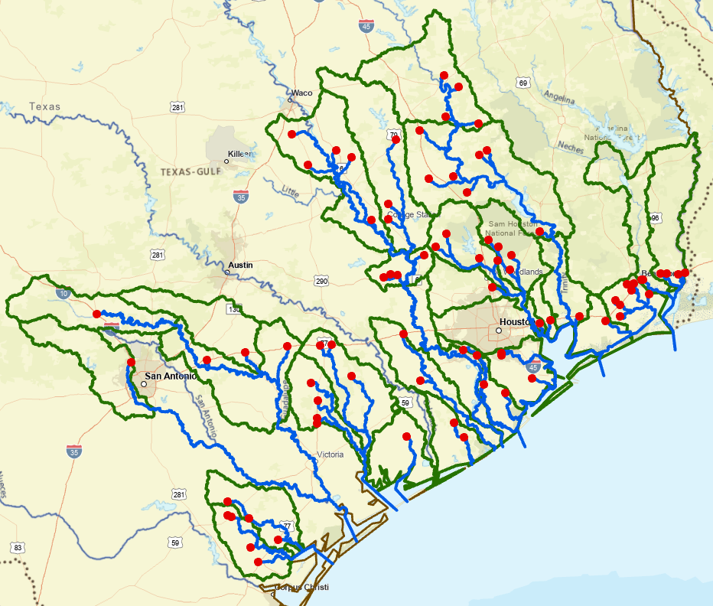
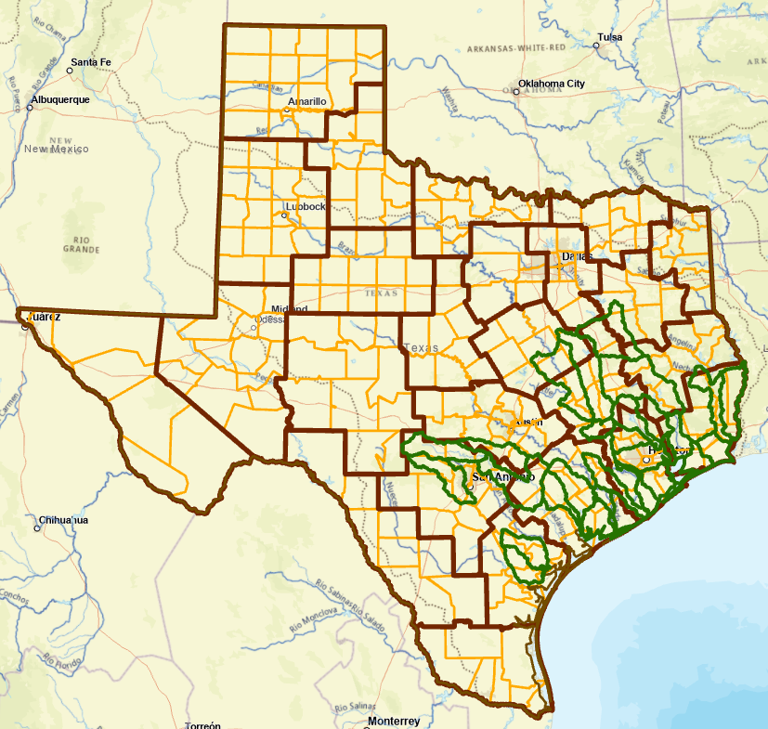
FLOOD DATA AND DATA-MODEL INTEGRATION
Goal: correct measurement, simulation, and forecasting of discharge and water surface elevation across a stream network
Approach: collection and analysis of detailed observations at gauges and integration with numerical modeling across scales; from gauge to district
Around Gauge site
Downstream of Gauge
Gauged Watershed
TxDOT Districts

Slide 7
KEY ADVANCES SINCE LAST QUARTERLY REVIEW
FLOOD DATA
Completion of installation of 77 gauges
Summary of stage height – velocity relationship
Interpretation of stage height – velocity relationship using Saint-Venant equations
Collection of a standard set of bridge measurements at gauge sites
Progress on data assimilation solution at watershed scale by 4DVar
Establishment of 3 gauge test-bed for data assimilation near gauges
Progress on data assimilation solution by Kalman filter
Establishment of error analysis framework on Colorado basin

Slide 8

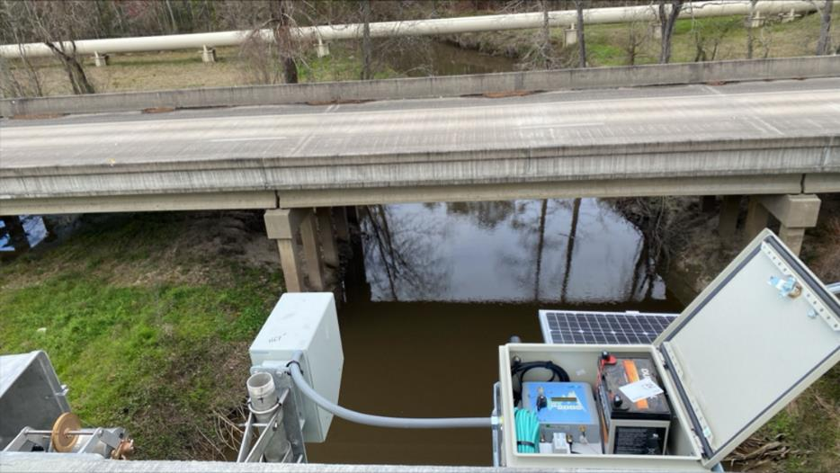

STREAMGAUGE OVERVIEW
    4 gauges installed in June - Q8
    126 recorded visits to installed gauges
    77 total gauges installed
    Final 3 gauge installations to be completed late Q8 – early Q9

Slide 9
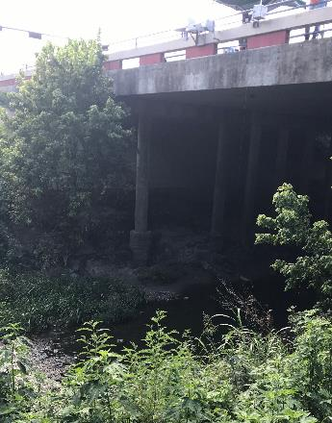
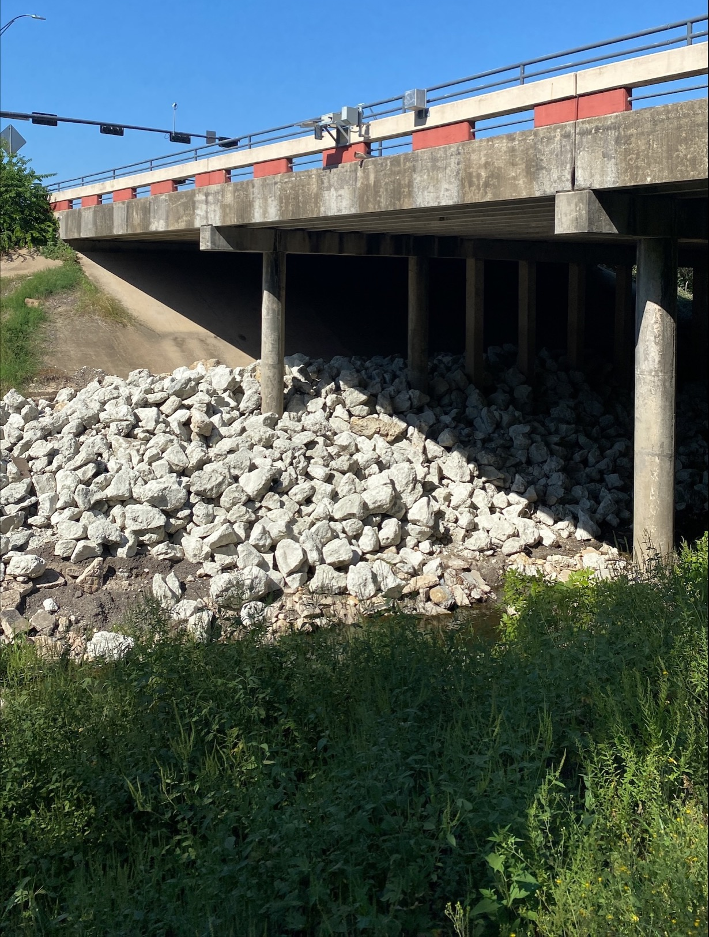
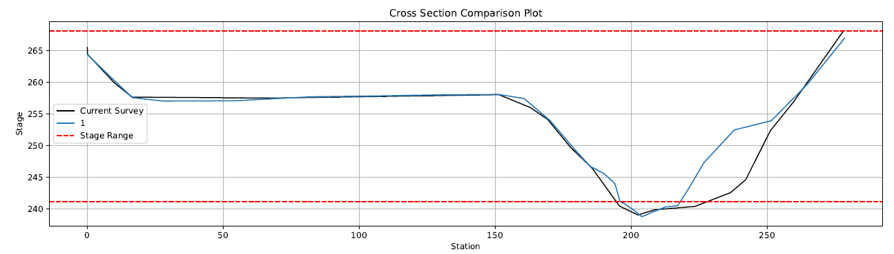
Updated Cross Section Surveys
08111051-Carters Ck at FM 60 nr College Station
Main channel shows approximately 30% reduction in area at low flows following the application of riprap on the right bank.
Before
After

Slide 10
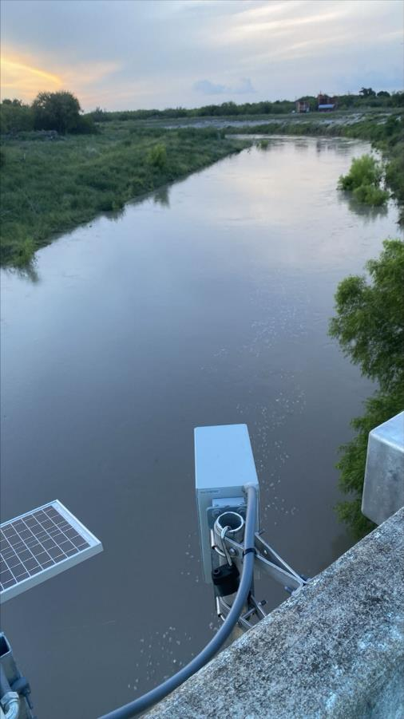
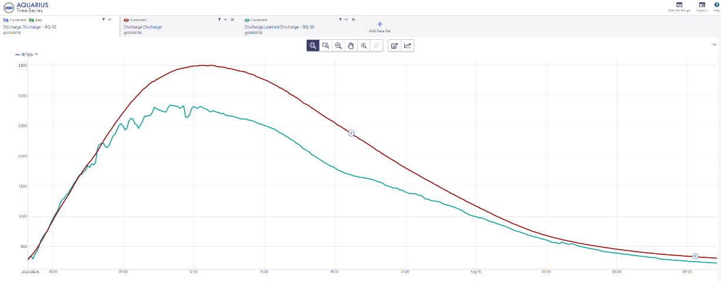
Discharge Measurement Comparisons
Discharge ( cfs )
08189718-Chiltipin ck at us 77 nr Sinton TX
Measurements
USGS Rated Discharge
RQ-30 Learned Discharge
Date/time
Measurements continue to be made to define USGS rated discharges at Tier 1 and Tier 2 comparison sites. Measurements on screen are 29% and 28% lower than USGS rated discharge.

Slide 11
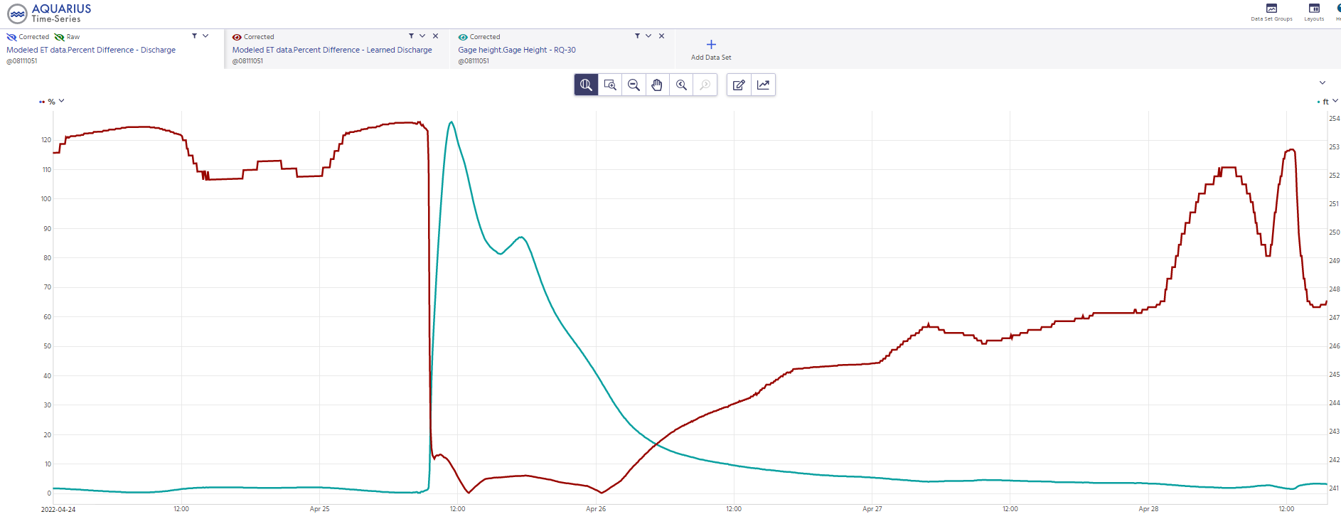
Error Evaluation of Discharge
A plot was created to describe the percent difference between the USGS discharge rating and the RQ-30 computed discharge in real time.
Gauge Height
Percent Difference In Discharge
100%
Percent Difference from USGS Q
Low-flow RQ-30 discharges tend to be less accurate without calibration.
Higher flows tend to increase in accuracy as stage rises.
Gauge Height
0%
Date/time
Date/time

Slide 12
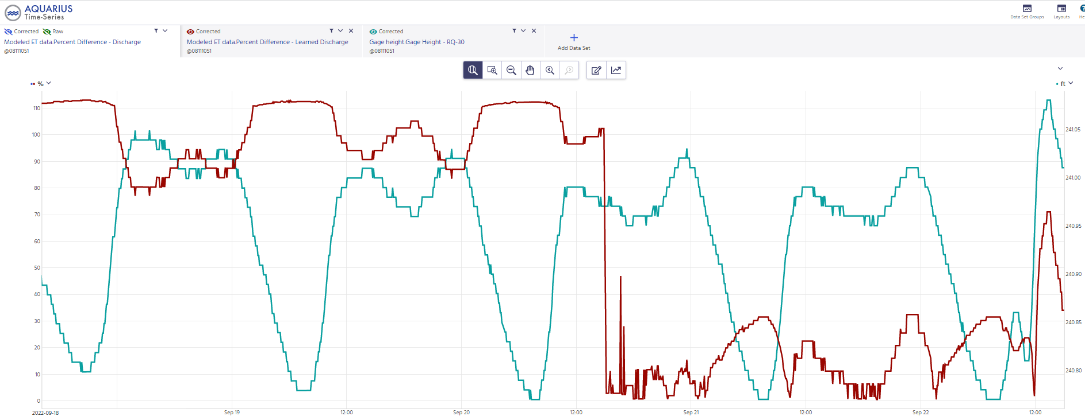
Discharge Error Evaluation
Gauge Height
Errors observed at approximately 6 cubic ft/s
Percent Difference In Discharge
Time of low-flow calibration
100%
0%
Date/time

Slide 13
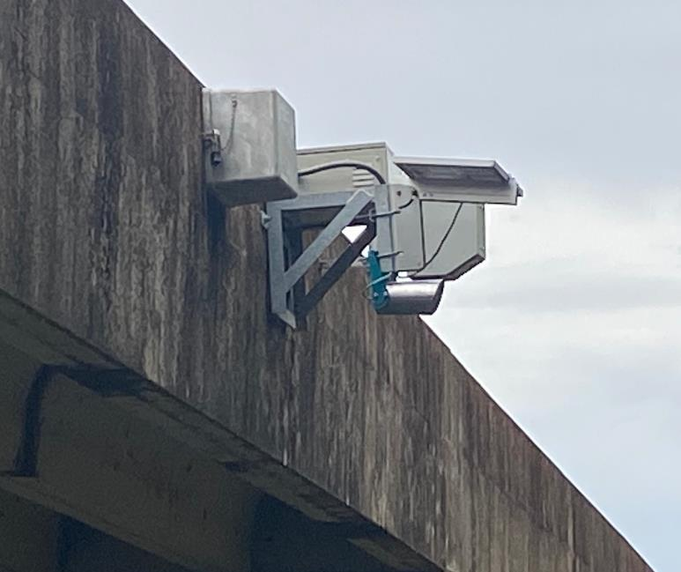
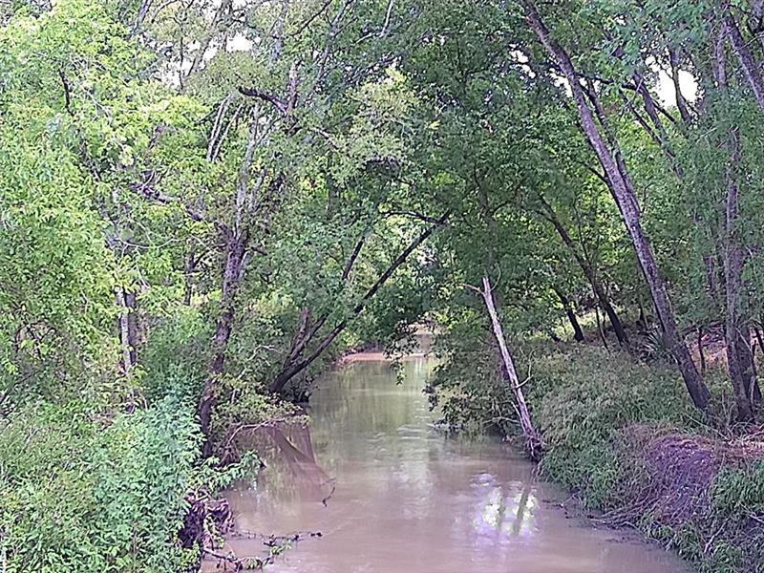
Camera Installation
08111110-New Year Ck at FM 1155 nr Chappel Hill
A fixed camera was installed to observe real-time channel conditions during events.

Slide 14
DATA ANALYSIS AND IMPROVED UNDERSTANDING
OF RIVER (FLOOD) HYDRAULICS
Analysis of stage-velocity relationship highlights hysteresis behavior that can be studied via numerical solution of the Saint-Venant equations.

Slide 15
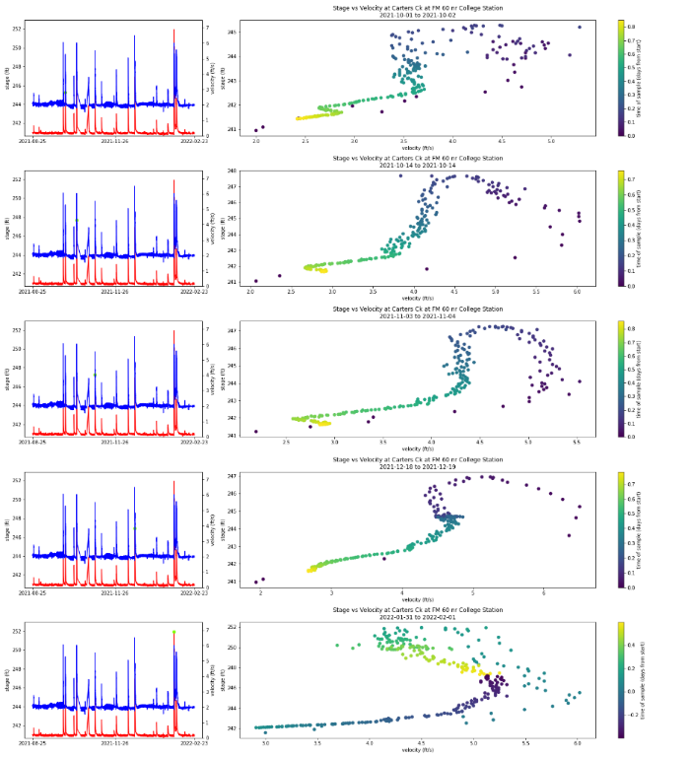
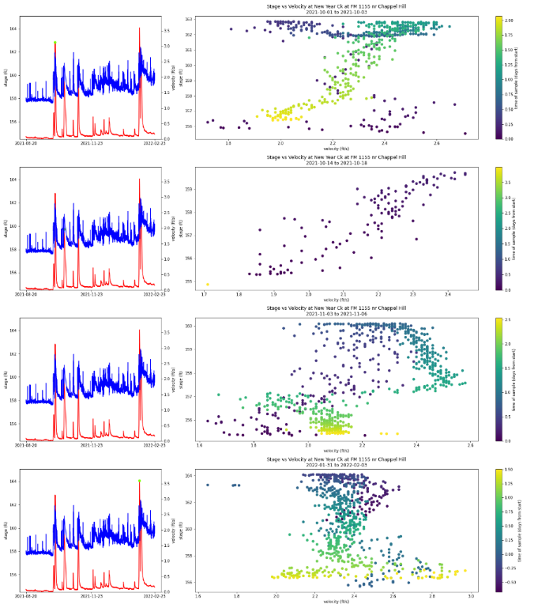
COMPARISON OF HYSTERESIS BEHAVIOR IN TWO CREEKS
Carter’s Ck at FM 60
New Years Ck at FM 1155
Clean, repeated hysteresis pattern
Noisy, complex patterns. Unclear if there is consistent hysteresis

Slide 16

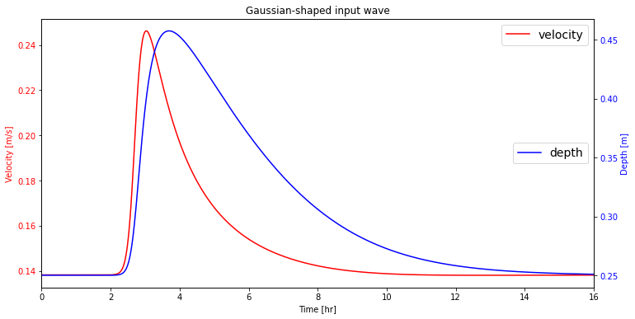
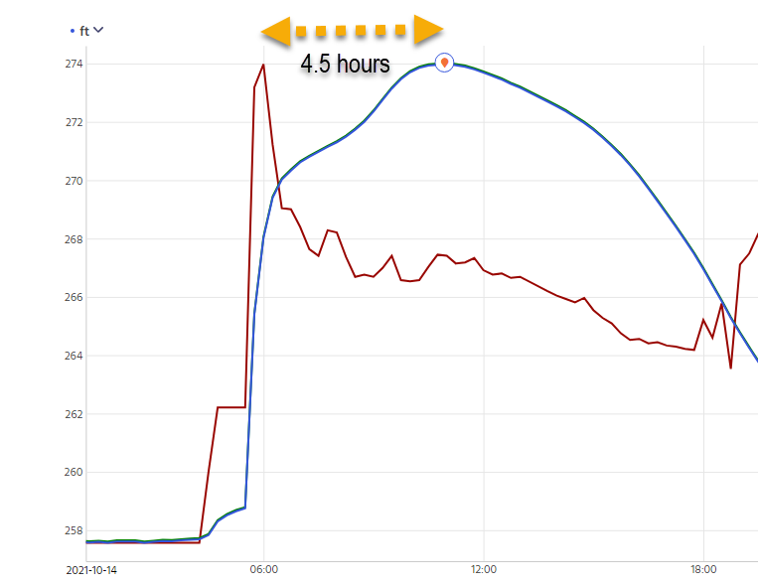
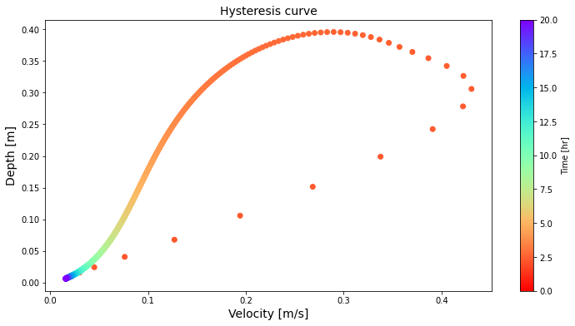
OBSERVED HYSTERESIS BEHAVIOR CAPTURED BY SAINT-VENANT EQUATIONS FOR UNSTEADY FLOW
Potential for new velocity information to serve as an early warning signal
https://github.com/mdbartos/misc/blob/master/notebooks/flow_input_test.ipynb
Modeled depth and velocity in a rectangular channel
Matt Bartos
Depth
Velocity
08164150 - W Navidad Rv at I-10 nr Schulenburg, TX

Slide 17
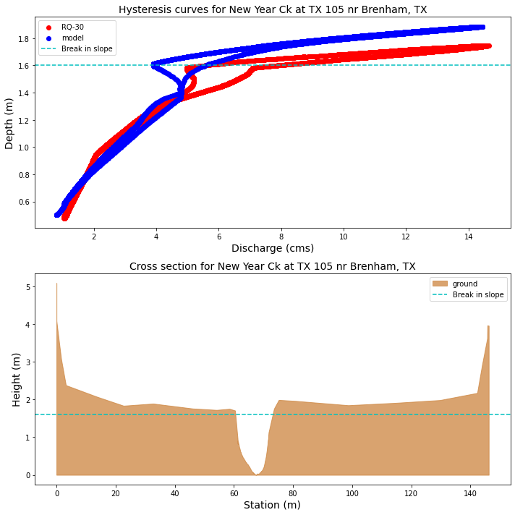
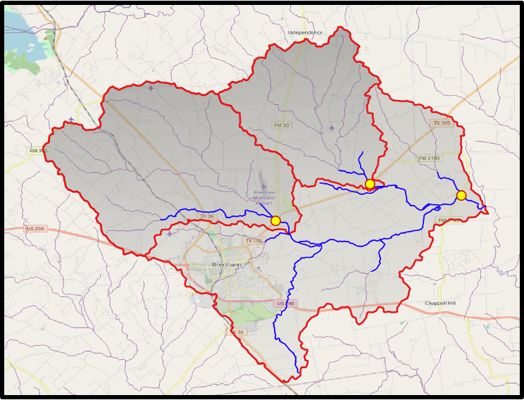
SAINT-VENANT HYDRAULIC MODEL REPRODUCES HYSTERESIS BEHAVIOR AT A REAL-WORLD SITE
Potential to use real-time hydraulic models to more accurately compute depth, velocity and discharge estimates from sensor data.

Slide 18
DATA-MODEL INTEGRATION
Data Assimilation: Modeling across a river network combined with observations at gauge locations to enable improved estimates of water surface elevation and discharge at unmeasured points in the network.

Slide 19

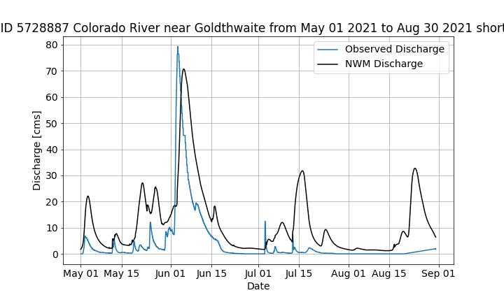
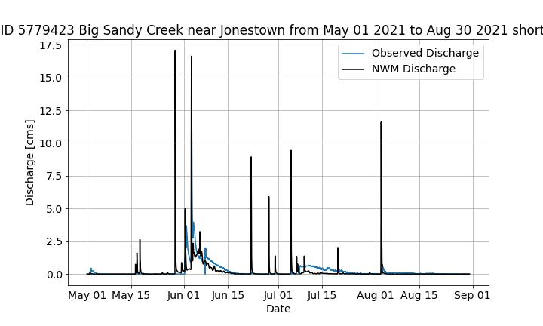
WHY IS THIS NEEDED? ERROR ANALYSIS OF THE NATIONAL WATER MODEL
Sujana Timilsina – PhD student supervised by Paola Passalacqua
Comparison of the NWM discharge to discharge from LCRA gauges, USGS gauges, and DD6 gauges throughout Texas (>600 gauges)
Generation of error map to analyze the performance of NWM
Comparison of NWM short range forecast discharge to LCRA gauges

Slide 20
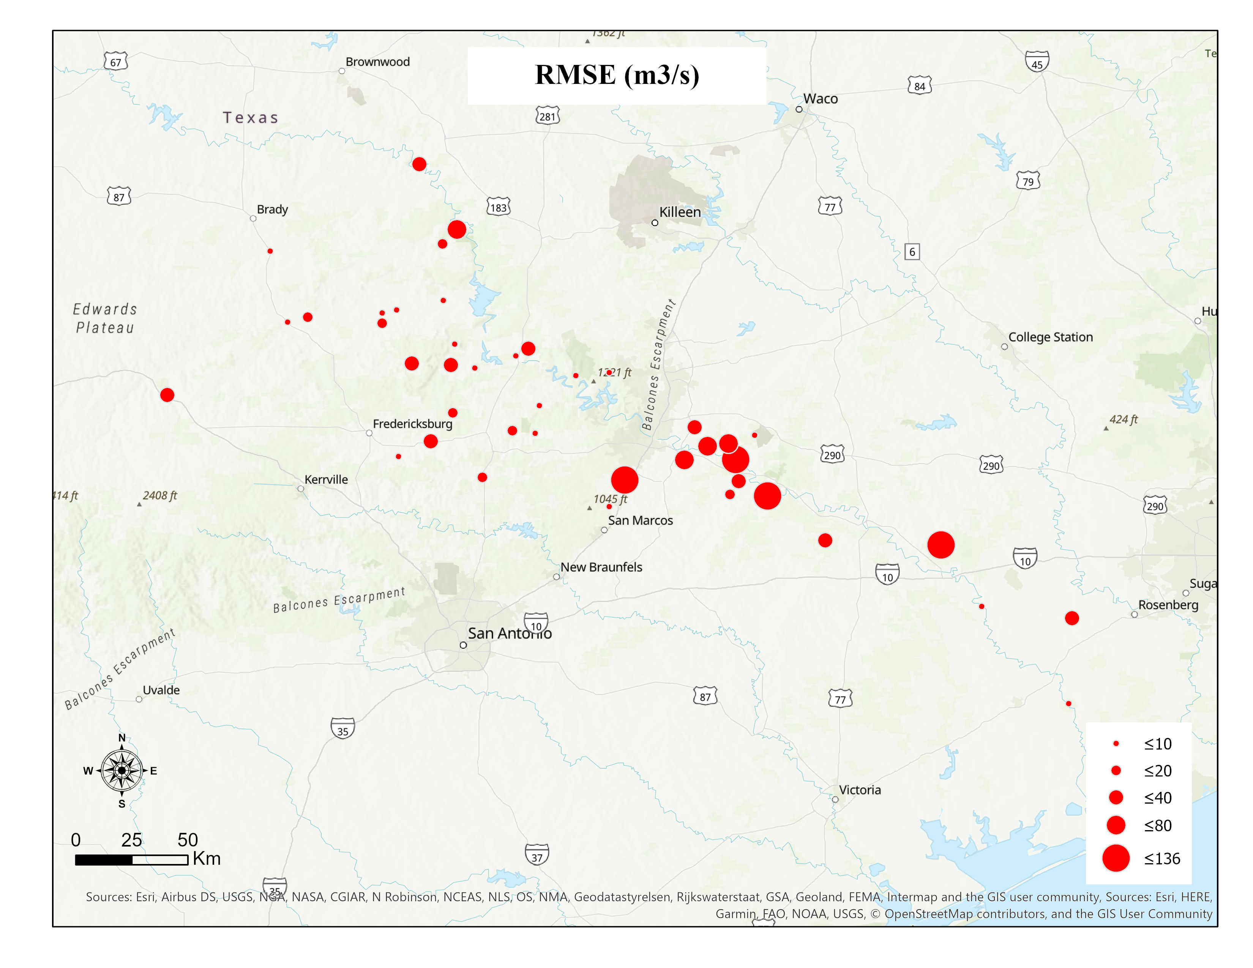
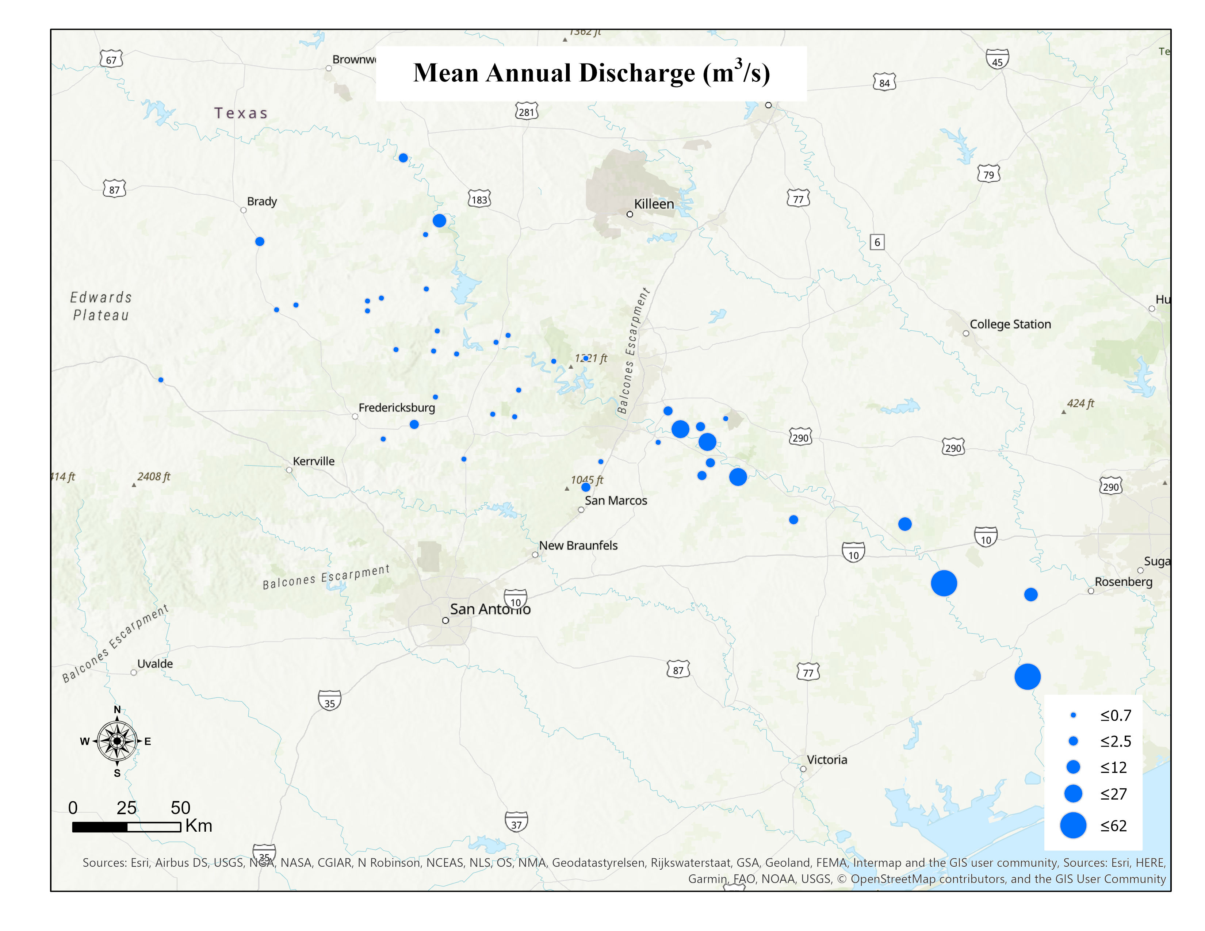
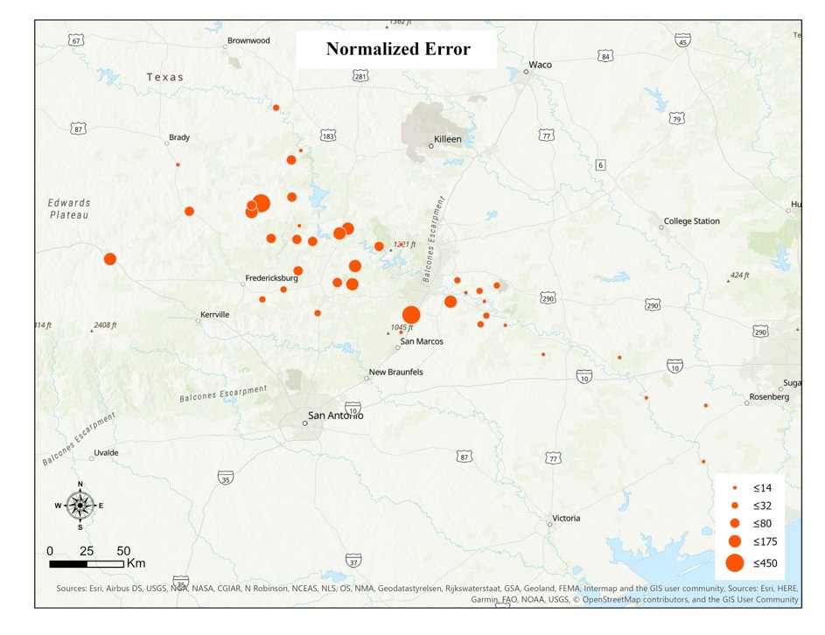
EXAMPLE OF ERROR MAP FROM NWM AND LCRA GAUGES
Storms are selected based on a frequency analysis of the historical record at each location
Normalizing the RMSE by mean annual discharge results in larger normalized errors in streams with low mean annual discharge

Slide 21
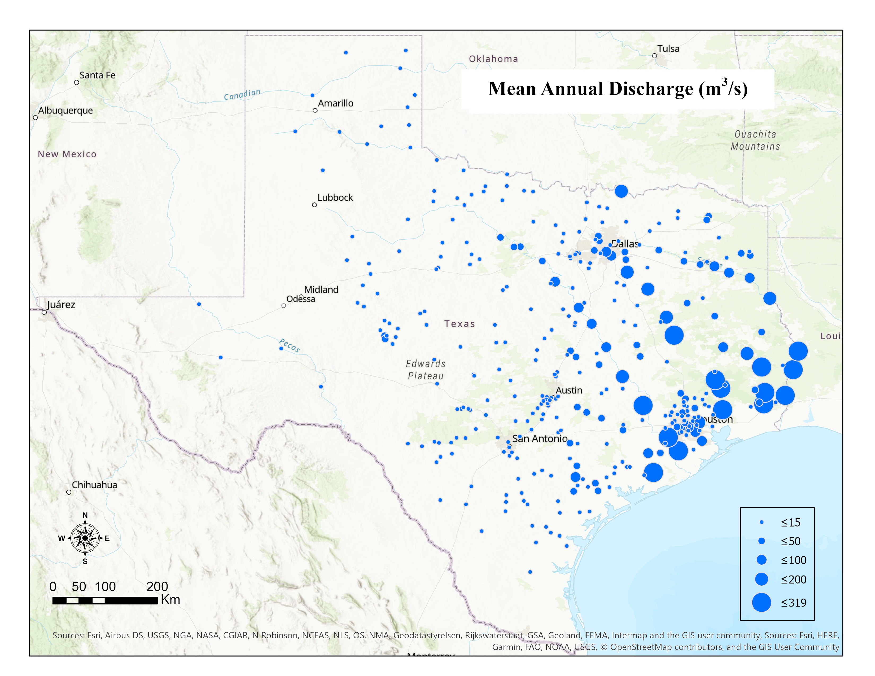
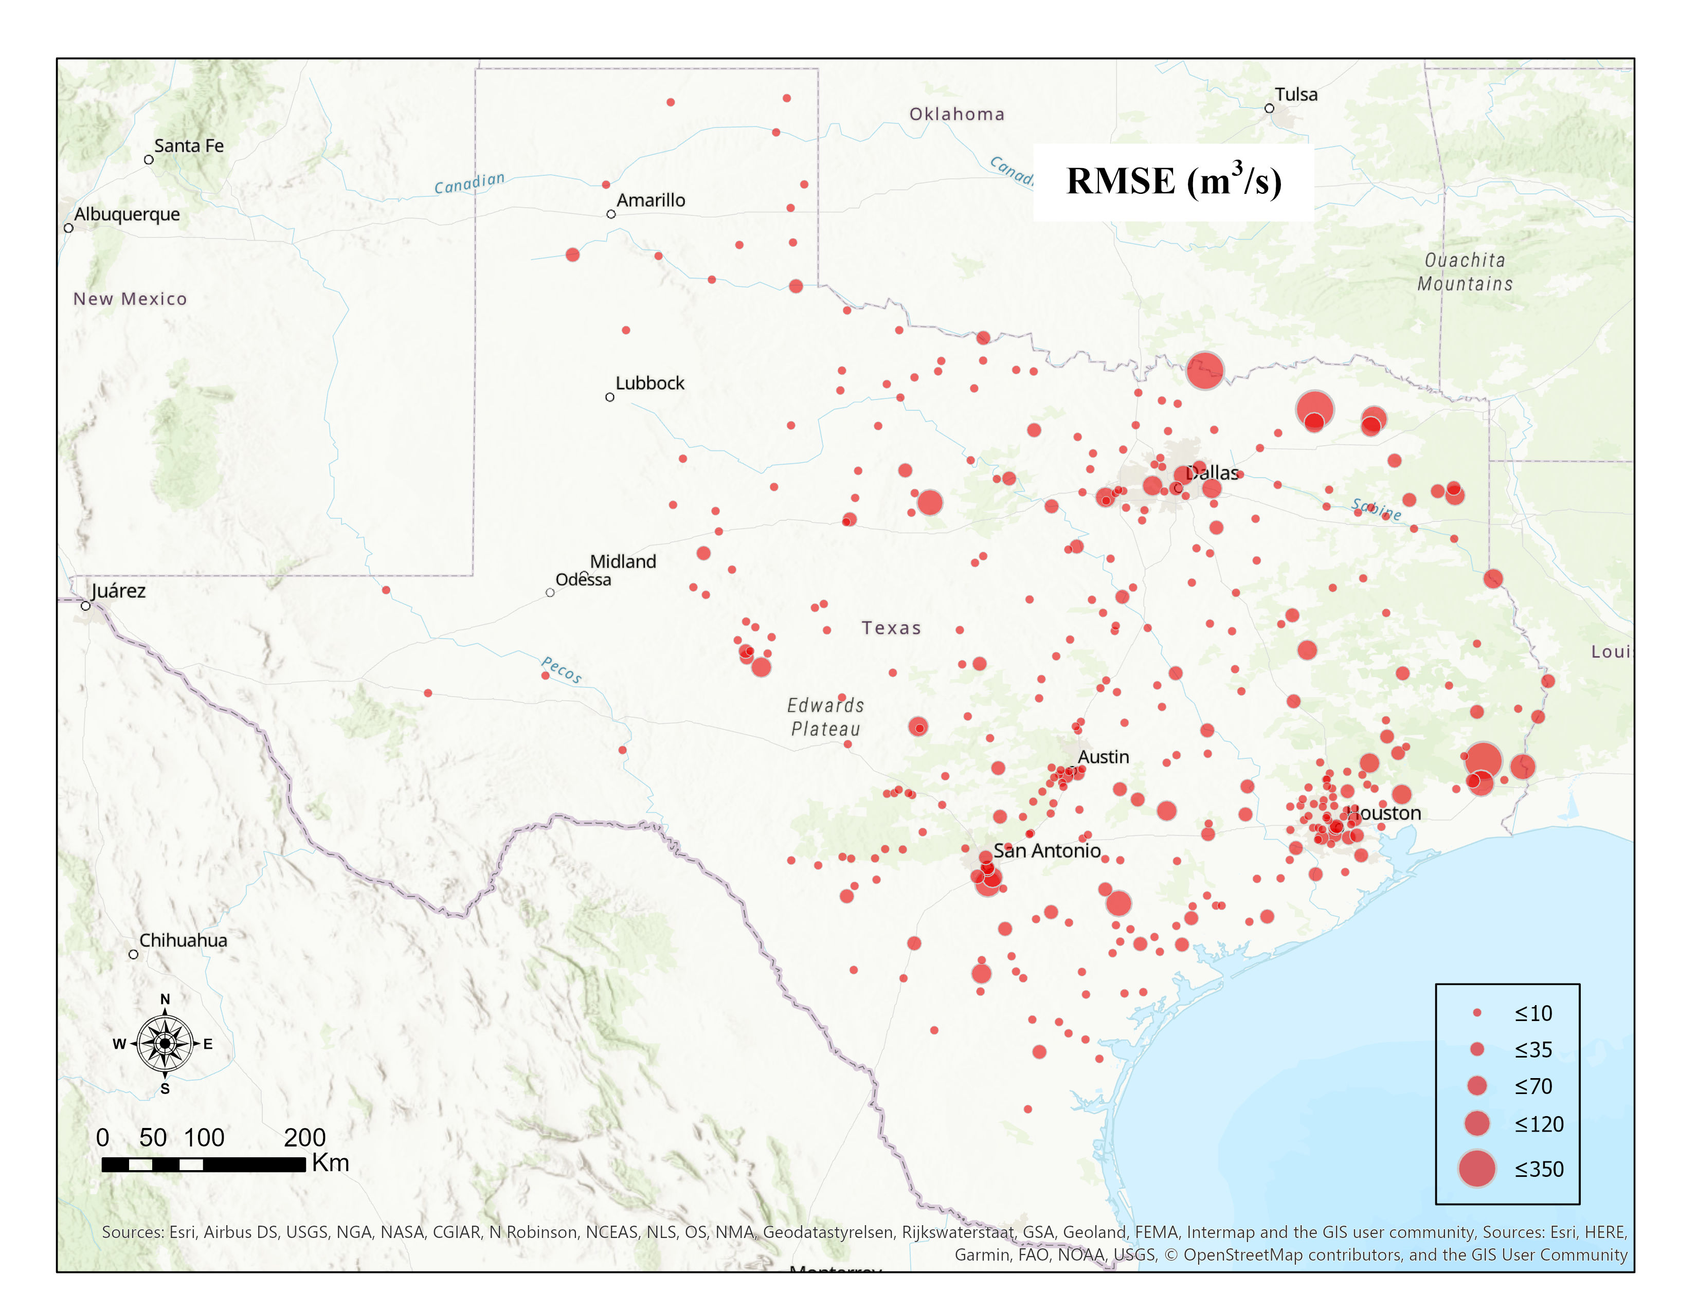
ERROR MAP FOR ALL GAUGES IN TEXAS

Slide 22
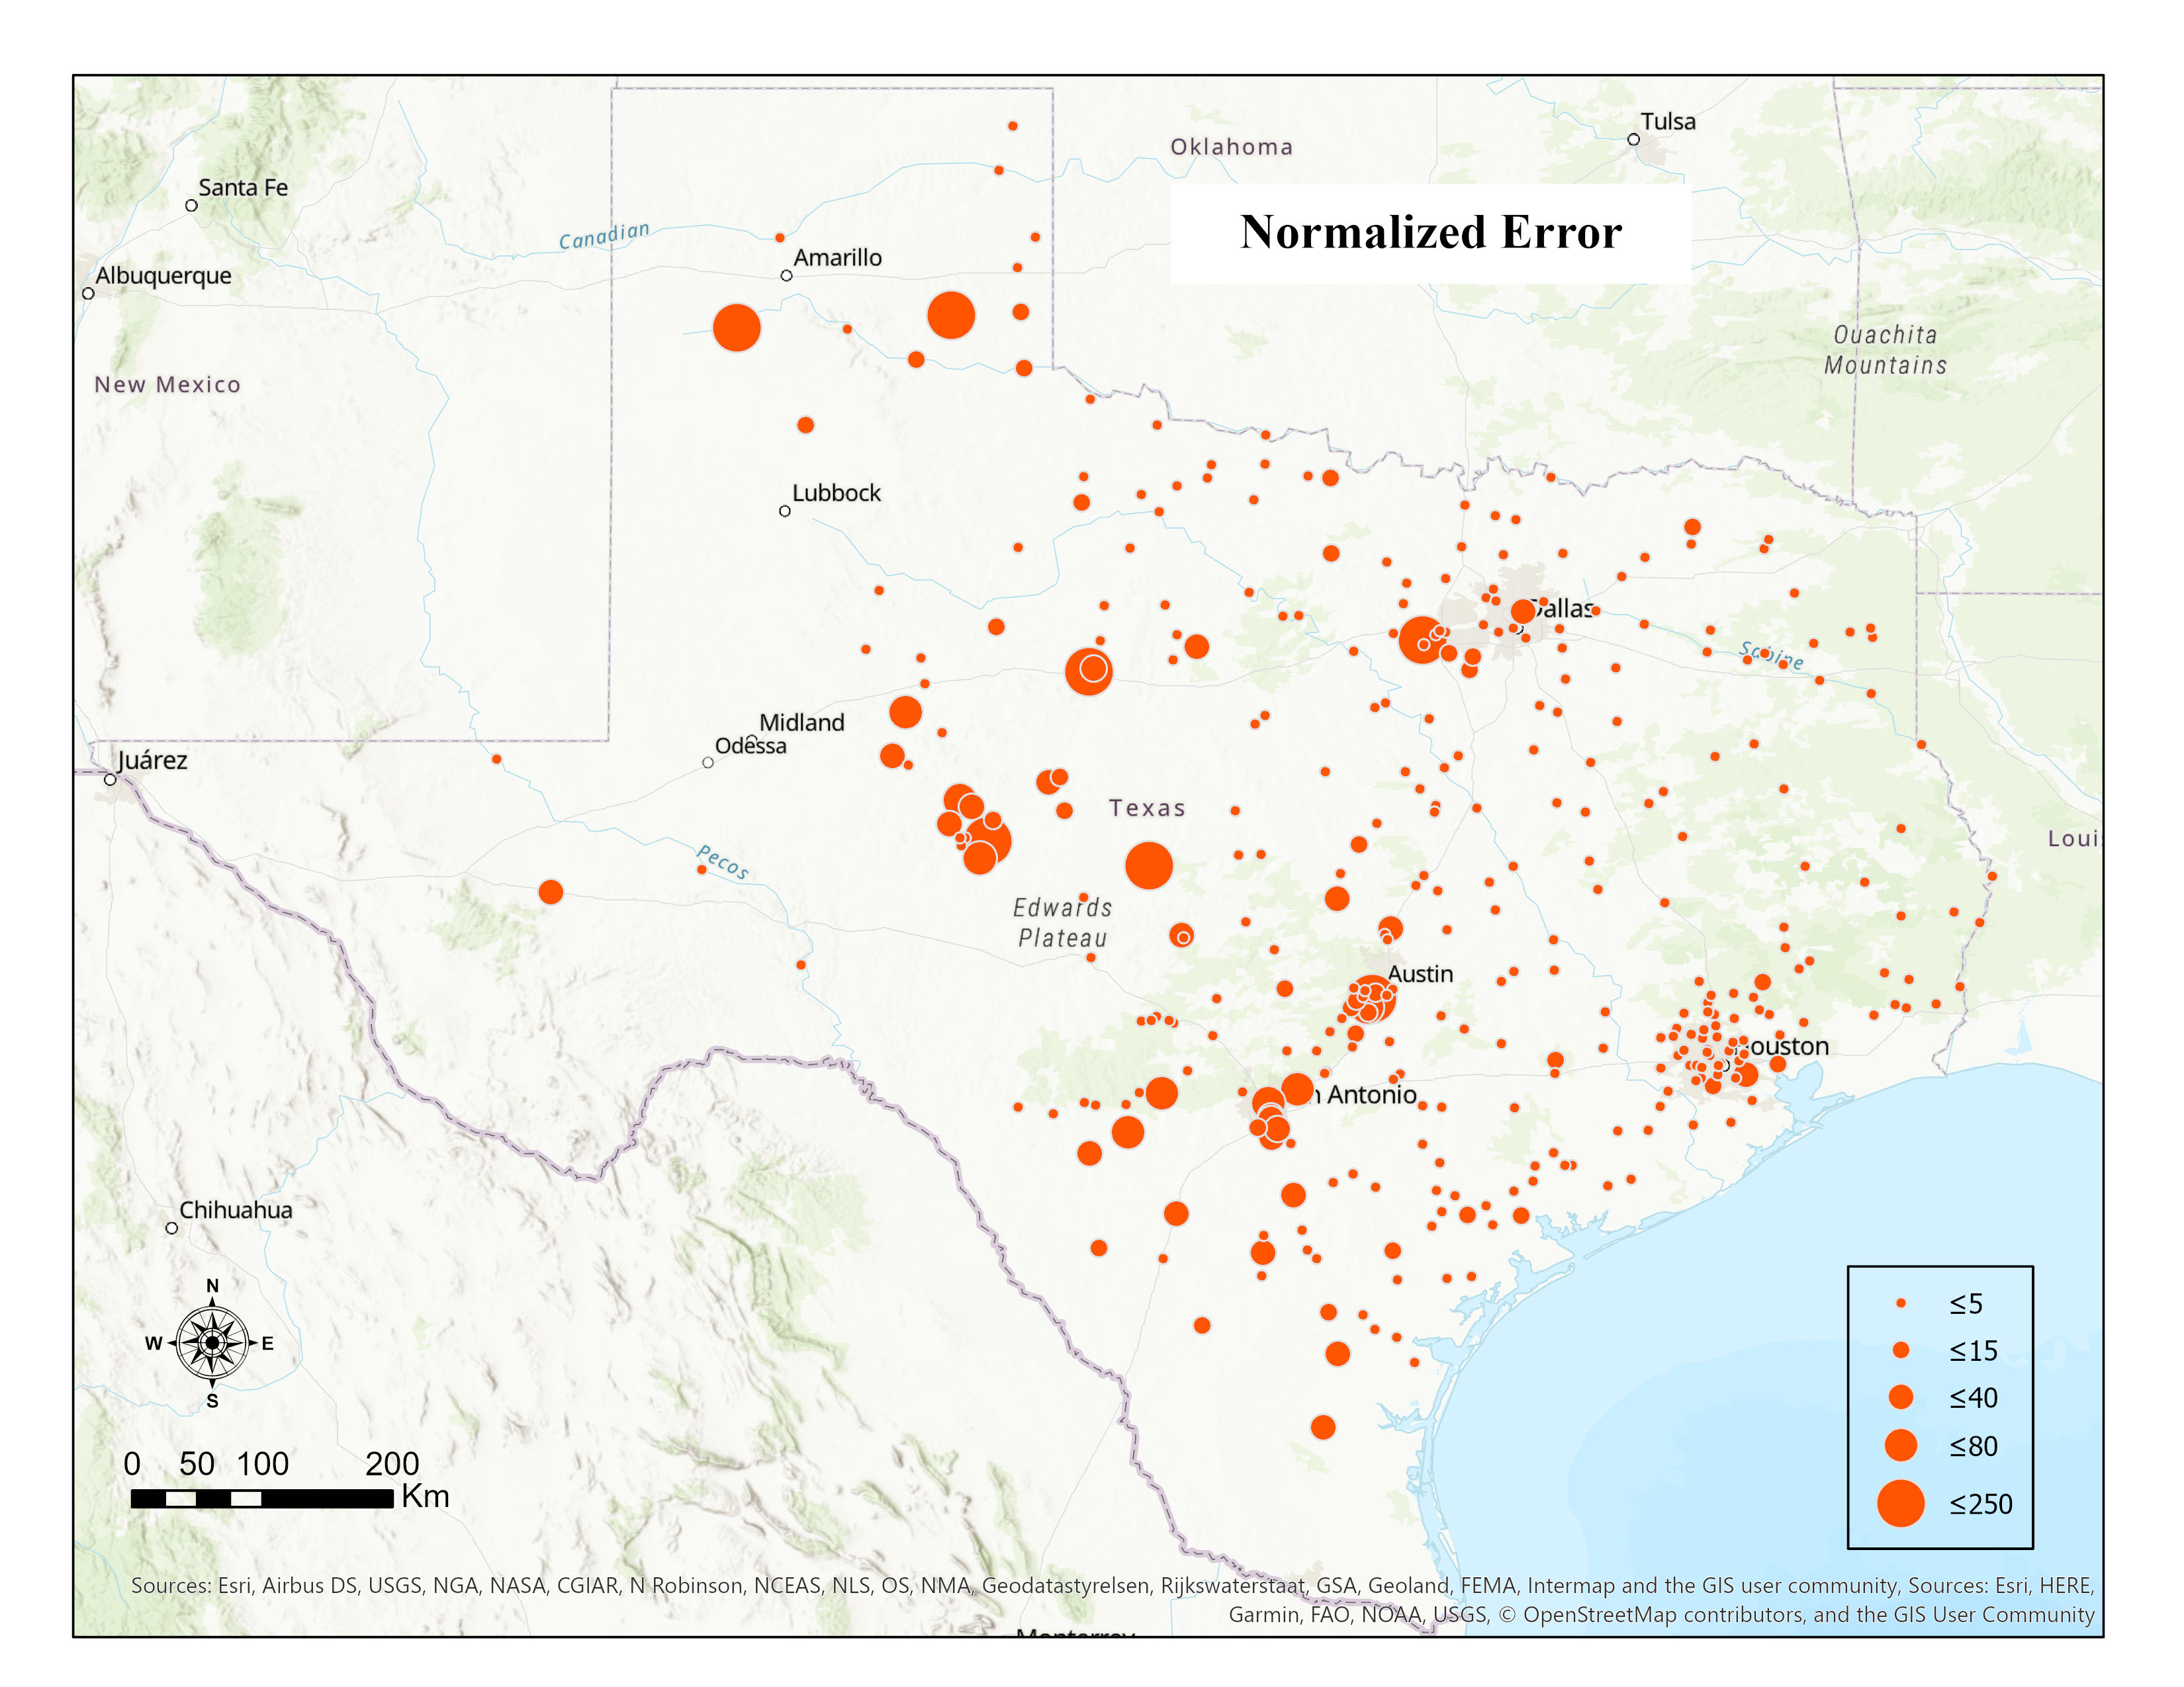
NORMALIZING RMSE BY MEAN ANNUAL DISCHARGE
Normalizing the RMSE by mean annual discharge results in larger normalized errors in streams with low mean annual discharge

Slide 23

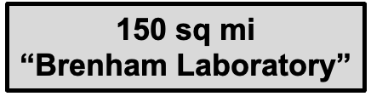
NEW TESTBED FOR IMPROVING ROADWAY FLOODING ESTIMATES USING REAL-TIME DATA ASSIMILATION
Jeil Oh – PhD student supervised by Matt Bartos
Simulation of hydraulics using the full 1D Saint-Venant Equations
Real-time hydrologic forcings from the National Water Model.
Real-time water depth and discharge data from three RQ-30 gages.
Data assimilation via Extended Kalman Filtering.

Slide 24
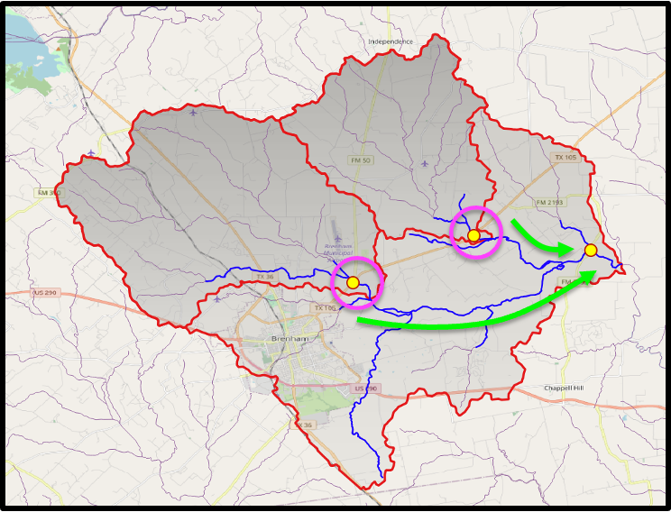
CAN WE PRODUCE BETTER FLOOD FORECAST AT DOWNSTREAM LOCATIONS?
1. Assimilate water stage data at upstream sites
2. Propagate hydraulic model forward in time

Slide 25
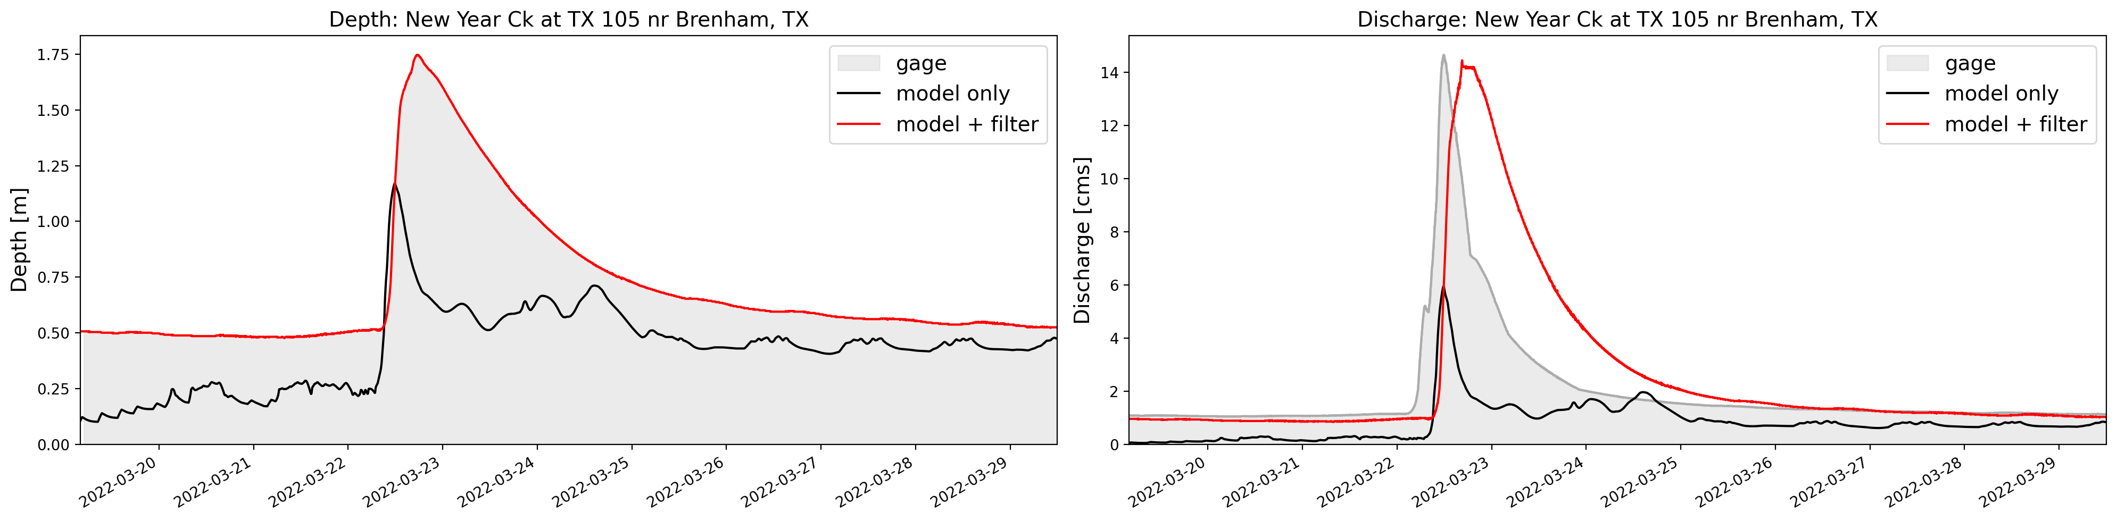
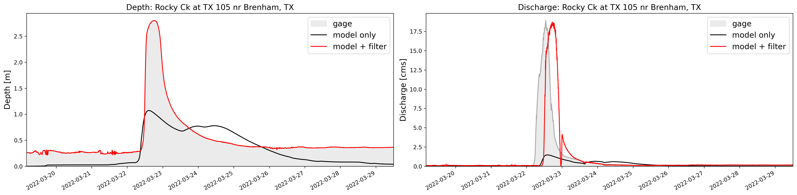
ASSIMILATING DEPTH DATA AT TWO UPSTREAM SITES...

Slide 26
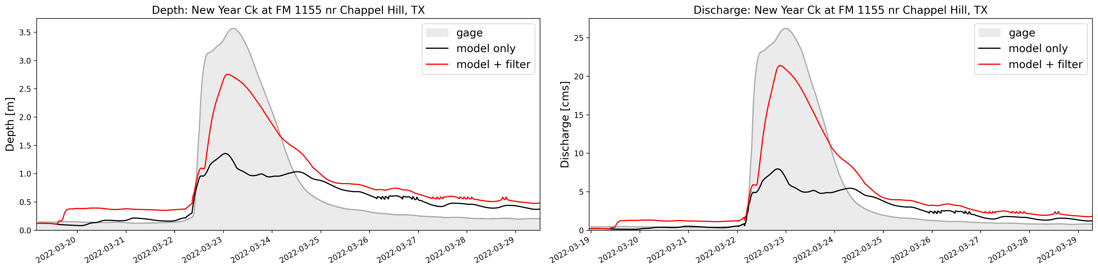
DEPTH AND DISCHARGE ESTIMATES DOWNSTREAM ARE IMPROVED
Depth
Discharge

Slide 27
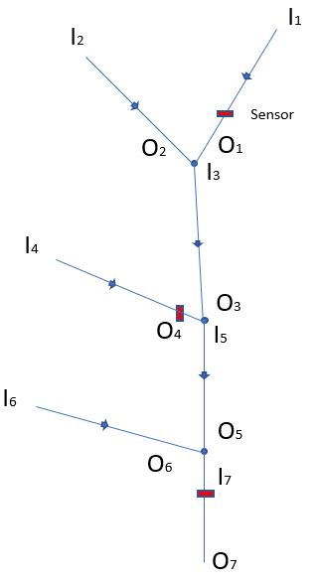
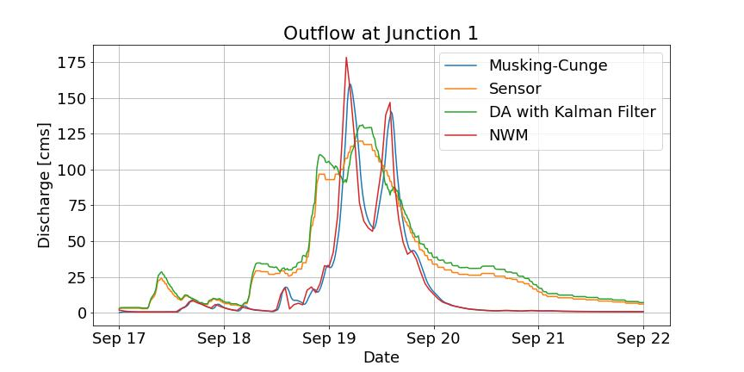
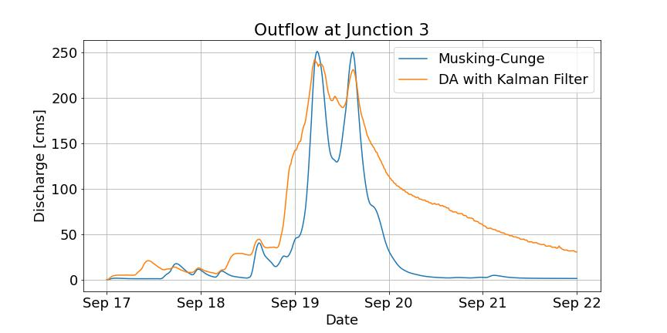
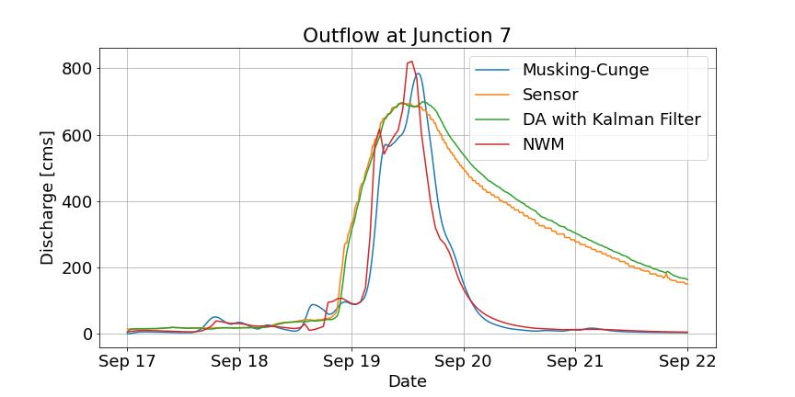
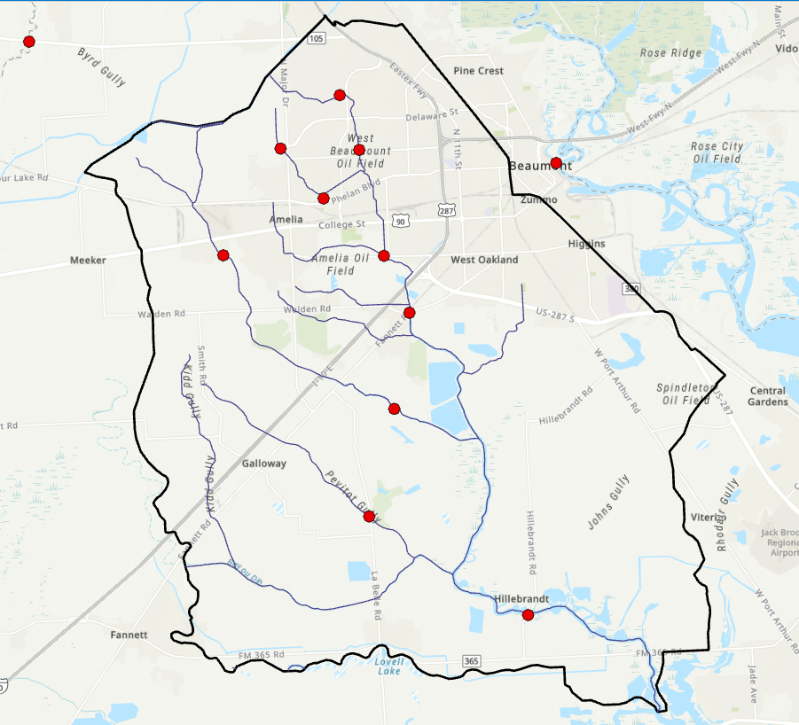
DATA ASSIMILATION WITH KALMAN FILTER AT NETWORK SCALE
Fig: Kalman Filter performance when applied in a small test network in DD6 region
Currently being applied in a sub-watershed of the DD6 region
Challenges:
Scale of the network

Slide 28

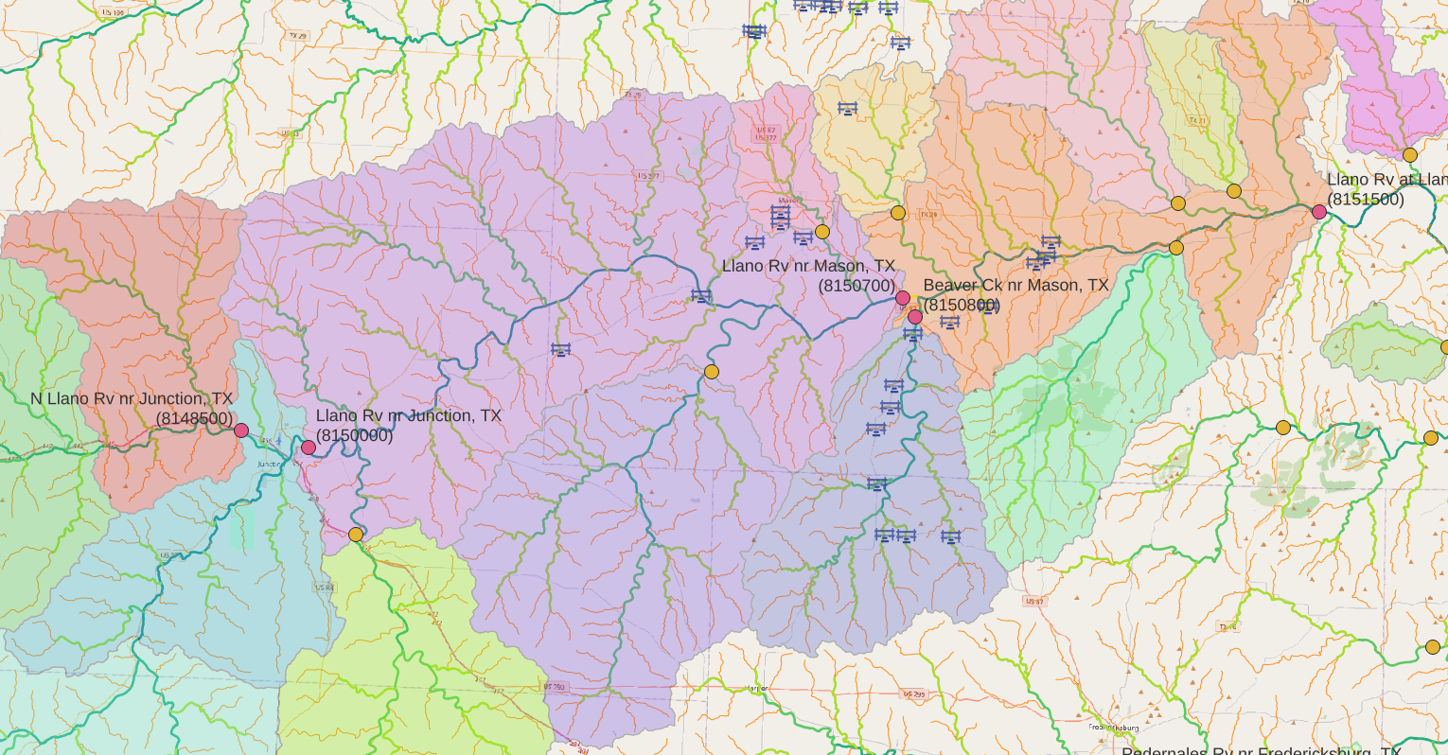

Watershed Scale Data Assimilation
  Accuracy depends on the chosen t0
  Excess rainfall optimization per subcatchments
      Subcatchment layout is dynamically generated based on gauge locations
  Spatial and distribution of excess rainfall based on area or NWM forcings
Llano river watershed
Input and Inline gauges
    In-line gauges are used for DA validation
Attila Bibok

Slide 29
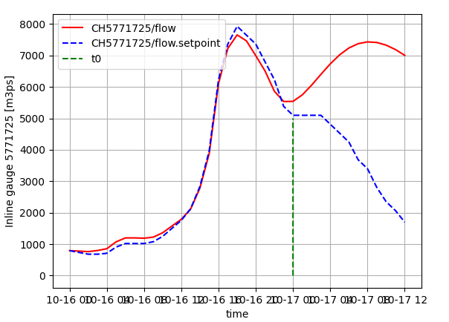
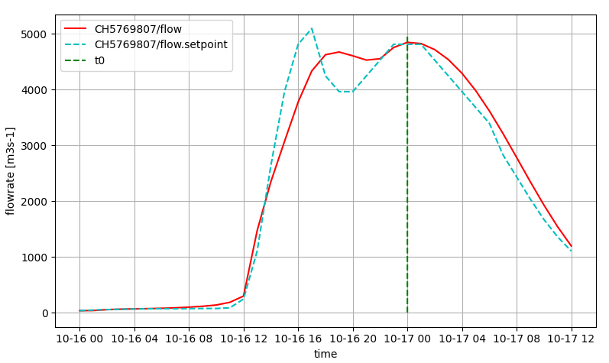
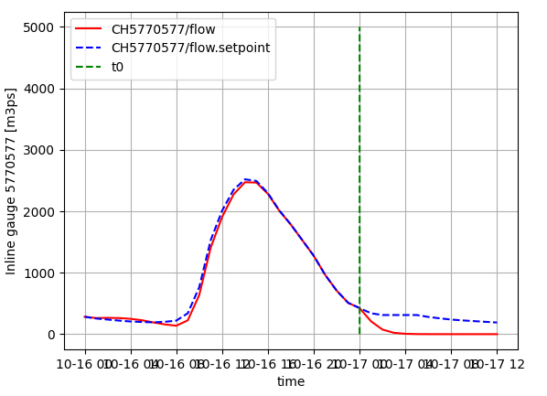
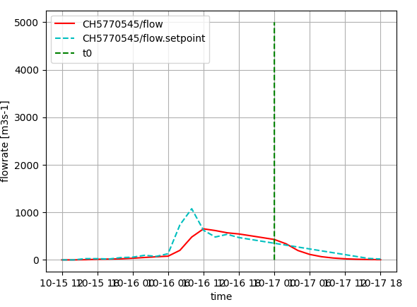
Watershed Scale Data Assimilation
Data-assimilation
Data-assimilation
Data-assimilation
Forecast
Forecast
Forecast
In-line gauge
In-line gauge
In-line gauge
Data-assimilation
Forecast
Artifacts occur at the most upstream and most downstream gauges.

Slide 30
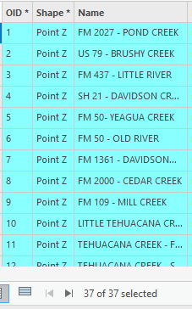
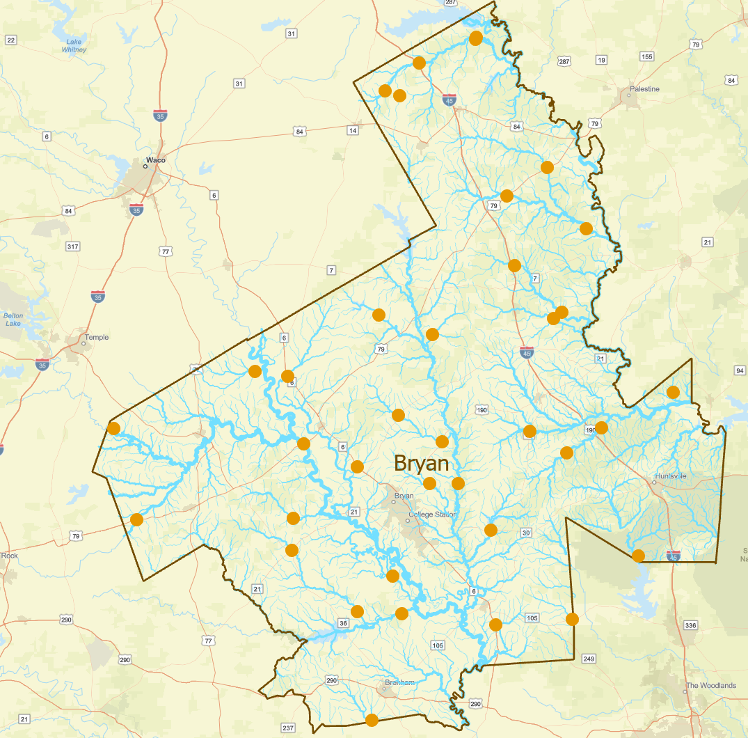
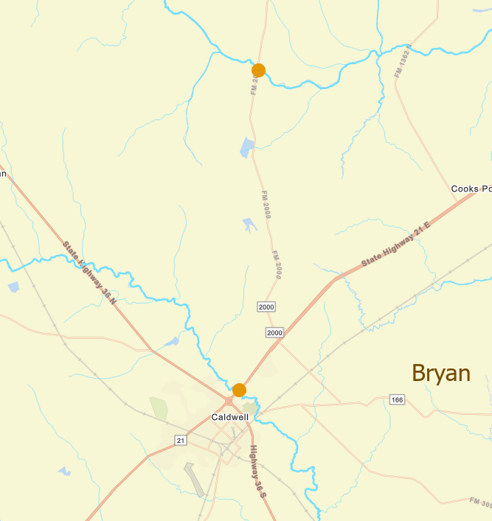
Flood Concern Points in the Bryan District
Source of Data: Paul Ray, TxDOT BRY
37 flood concern points
FM 2000 at Cedar Creek
37/37 Concern Points forecast
by the National Water Model
SH 21 at Davidson Creek

Slide 31



Data Assimilation – Forecasts for Concern Points by Combining Gauged Data with NWS Forecasting

Slide 32


Two Approaches to Data Assimilation
Watershed-Scale Data Assimilation
is needed to synthesize
National Water Model forecasts
and observed data over large areas
Gauge-Scale Data Assimilation
Is needed to get accurate discharge
data at and downstream of radar gauge sites

Slide 33
FLOOD DATA AND DATA-MODEL INTEGRATION
KEY CHALLENGES MOVING FORWARD
Completion of installation of last 3 gauges to make 80 in total
Continue to focus on measurements and rating development
Complete camera installations at useful locations
Continue to process records and approve data
Create a secure replacement for USGS FTP site for data transmission
Create an integrated measurement and flow modeling system at radar gauge sites
Continue progress on data assimilation at gauge site and regional scales
Continue progress on error analysis framework to provide a secure basis for decision making about data and forecasting quality (uncertainty map)

Slide 34
Meeting Agenda
Flood Data and Data-Model Integration
  Overview of stream gauge data measurement
  Improved understanding of river flood hydraulics
  Data-Model Integration
    Error analysis at gauges
    Data assimilation at gauge scale
    Data assimilation at network scale
Flood Mapping and Response
  Real-time flood map services
  Flood impact on bridges and roads
  Austin flood emergency response exercise
    Ecopia road and bridge data purchase
    Llano flood of 2018

Slide 35
REAL-TIME FLOOD MAP SERVICES
Providing real-time flood information for TxDOT Maintenance decision makers using overlaid web maps.

Slide 36












Geospatial Systems Are Helping Us Understand
Understanding
Sharing and Collaboration
Knowledge
Information
Integration
Mapping
Data
. . . Helping Us Make Better Decisions
Slide: Jack Dangermond

Slide 37

Operations Room at the National Water Center, Tuscaloosa, AL

Slide 38



Through open web map services everyone can see …
https://www.weather.gov/owp/operations
… what is seen at the National Water Center

Slide 39

Real-Time Flood Information Services
https://www.arcgis.com/apps/instant/basic/index.html?appid=bb7cb731322d47f4bfee629ca148e053
Web maps are displayed transparently over
TxDOT District and Maintenance Section areas
Map Layers can be accessed by clicking on “Open Layer List”
Lists of maps within a group obtained by toggling on arrow head
Open a map by clicking on its dot symbol

Slide 40


NWS Real-Time Flood Inundation Mapping (FIM) for Texas in 2023
Complete coverage of 12 Districts: BMT, HOU, YMK, CRP, LRD, SAT, BRY, LFK, WAC, TYL, DAL, FTW
Partial coverage of 6 Districts: SJT, AUS, BWD, WFS, PAR, ATL

Slide 41


Base Level Engineering Studies in Texas
TWDB has formed a FIM Subcommittee
to coordinate state efforts on real-time FIM
Comments: Srikanth Koka TWDB
Jason Johnson, NOAA

Slide 42
FLOOD IMPACT ON BRIDGES AND ROADS
3D representation bridges and flood water surface elevation at scale for many bridges and low water crossings in large region

Slide 43

Flood Inundation Mapping with Bare-Earth Digital Elevation Models
The bridges are removed from
bare-earth DEM’s, and roads
appear flooded that may not be
We need a process to “heal”
the DEM’s and put the bridge
decks back into them
Image: Derek Giardino, West Gulf River Forecast Center

Slide 44



Estimating bridge thickness
Dr. Tim Whiteaker
?
bridge deck surface elevation
low chord
?
water surface elevation

Slide 45


Estimating bridge thickness
Trent Ellis
TxDOT provided rubric for approximate
superstructure thickness (NBI)
Function of “Main Span Type” and “Length of Maximum Span”
e.g., for Timber Truss, Thickness (inches) = 1.2 * span length
With TxDOT provided data,
“assumed superstructure thickness”
programmatically assigned
to 57,000+ NBI bridge points
code + bridge data =
Notes:
bridge thickness (beam + slab)

Slide 46




Code in GitHub for Bridge Envelope Development
Andy Carter
https://github.com/andycarter-pe/tx-bridge

Slide 47




Cross-Section Graphic Library for Bridges
Elgin, TX

Slide 48

Bridge Envelope Development using LiDAR point clouds at HUC12 scale
Colorado-Cummins HUC-8: 12090301
- 46 HUC-12 (of 56) processed with ‘Tx-bridge’
- 695 bridge hulls on ‘major axis lines’ found
Bridge hulls found – from point cloud
Has ‘major axis’ – road, railroad, etc..
Conflates to National Water Model reach
Conflates to National Bridge Inventory point
Prediction of flood limits compared to
low chord can be made

Slide 49

Data Extent at Individual Bridges
Colorado-Cummins HUC-8: 12090301
- 46 HUC-12 (of 56) processed with ‘Tx-bridge’
- 695 bridges on ‘major axis line’ found
Bridge hulls found – from point cloud
Has ‘major axis’ – road, railroad, etc..
Conflates to National Water Model reach
Conflates to National Bridge Inventory point
Prediction of flood limits compared to
low chord can be made
Dry Creek and North Fork of Dry Creek @ SH 130
Lat 30.141°, Lon -97.664°

Slide 50


Bridge Envelope and the Associated Inundation Map
‘ras2fim’ depth inundation grid
at ‘reach averaged’ depth
of 26.5 feet
mapped on “healed terrain”

Slide 51

Rating Curves from Different Sources for a Particular Bridge
29.5
28.0
27.0
Discharge of 11,400 cfs

Slide 52


USGS LIDAR Point Cloud Data
USGS 3DEP LiDAR Availability
Data gaps in federally served point clouds
https://raw.githubusercontent.com/hobu/usgs-lidar/master/boundaries/boundaries.topojson
Federal – USGS 3DEP
“cloud encoded” point cloud data

Slide 53


TNRIS LIDAR Point Cloud Data
Best Available LiDAR data in Llano County is
“Hurricane LiDAR” acquired 2019.09.29
Statewide LiDAR
“Best in Time and Space”

Slide 54





Viewing system for real-time web map display and interpretation
Jonathan Thomas
Flood Decision Support Toolbox - Interagency Flood Risk Management (InFRM)
https://webapps.usgs.gov/infrm/fdst/?region=tx
Interagency Flood Risk Management – InFRM
Estimated Base Flood Elevation Viewer
Flood Decision Support Toolbox
Watershed Hydrology Assessments
Watershed Hydrology Assessments Viewer
Atlas 14 Program
Flood Decision Support Toolbox
Utilizes prepositioned flood inundation libraries
Half-foot intervals
Tied to gauge and forecast points
Designed to be used as a planning tool or during events
Incorporates a wide range of data into one tool

Slide 55


Viewing system for real-time web map display and interpretation
Flood Decision Support Toolbox - Interagency Flood Risk Management (InFRM)
https://webapps.usgs.gov/infrm/fdst/?region=tx
Minimum flood stage
Maximum expected flood
Recently added two additional RQ30 sites
08111090 Rocky Ck at TX 105 nr Brenham, TX
08111110 New Year Ck at FM 1155 nr Chappel Hill, TX

Slide 56


Flood Decision Support Toolbox
Interagency Flood Risk Management (InFRM)
https://webapps.usgs.gov/infrm/fdst/?region=tx
First FDST libraries mapped with “healed terrain”… Mapping surface is bare earth plus the bridge

Slide 57



Flood Decision Support Toolbox Maps and Streamflow II Gauges
~ 100
180 Gauges
& FDST maps
80
USGS Gauges with FDST maps
A subset of total USGS gauge coverage
Streamflow II Gauges sited to fill in gaps
in existing USGS gauge coverage
Streamflow II gauges in FDST

Slide 58
AUSTIN FLOOD EMERGENCY RESPONSE EXERCISE
Flood impact on roads, bridges and low water crossings in the Austin District during the Llano flood of 2018

Slide 59




Issues Encountered in Beaumont Flood Emergency Response Exercise
Roads appear flooded because the TxDOT road lines are not correctly positioned in some locations
Road line not on road at all
Road line on edge of road

Slide 60



Geographic Information Model for Roads and Bridges
A bridge is defined in the TxDOT Standard Specifications For Construction and Maintenance of Highways, Streets, and Bridges 2004 as “a structure, including supports, erected over a depression or an obstruction (e.g., water, a highway, or a railway) having a roadway or track for carrying traffic or other moving loads, and having an opening measured along the center of the roadway of more than 20 feet between faces of abutments, spring lines of arches, or extreme ends of the openings for multiple box culverts.”
TxDOT
Hydraulic
Manual
p. 9-2
Bridge on US 281 over Colorado River
Culvert on I-40 access road
Roadway centerline, TxDOT Atlanta District
Road and Bridge Lines: A line coverage along the centerline of the roads, partitioned at the abutments of the bridges

Slide 61




Ecopia Land Cover Data for Roads and Bridges
Being purchased by TxDOT RTI to support Austin Flood Emergency Response exercise
Hexagon 6” aerial imagery used as
a standard by TNRIS and TxDOT
Road and Bridge GIS coverage interpreted by Ecopia
from Hexagon aerial imagery
https://ut-austin.maps.arcgis.com/apps/instant/media/index.html?appid=ccf2b4b0362b46f1b042a41525cf07ae

Slide 62




Road and Bridge Polygons and Centerlines
Abutments

Slide 63



Refinement of HAND-based flood inundation mapping for low water crossings
Dr. Tim Whiteaker
HAND = Height Above Nearest Drainage
Compare HAND to river depth to see what’s flooded
satellite imagery
HAND
where HAND < 10 ft
flooded area
HAND = 14 ft
HAND = 2 ft
Problem

Slide 64



Refinement of HAND-based flood inundation mapping for low water crossings
Solution: Heal HAND. Then compute flooded areas and roads
Healed HAND
Flooded Areas
Flooded Roads

Slide 65

Bulk Processing of Flooded Roads and Low Water Crossings

Slide 66


Flow Depth and Velocity at a Low Water Crossing
Zonal statistics on flood depth values along road line
Sum Depth | 110.6 m
Cell width | 3.06 m
Flow area | 338.2 m²
Discharge | 165.6 m³s
Velocity m/s | 0.490 m/s
Velocity ft/s | 1.6 ft/s
2 m
165.6 m³/s
Max Depth = 5.8 ft, Avg Vel = 1.6 ft/sec

Slide 67

Austin Flood Emergency Response Execise
2018 Central Texas Floods
Participants: Maintenance and EOC Groups
Date/Time: 9:30am - December 12, 2022 (TxDOT Stassney Campus)
Exercise Flood Maps
  Weather Maps
    Weather Service Briefing
    24hr Total Rainfall Forecast by Maintenance Section
  Max Impact over Next 18 hrs
    Flood Inundation
    Flooded Roads
  Bridge Warnings
  HCRS

Slide 68





Top New Products from Beaumont Exercise
Flooded Road Estimates
Precipitation Forecast by Section
Bridge Warnings
Estimated Depth
Warning (< 5ft to bridge)
Concern (5 to 10ft to bridge)
Ok (>10ft to bridge)
X
Out of Service (gauge not working)
Notes:
Larry

Slide 69


Rainfall Mapping for the Austin Flood Emergency Response Exercise
9,522 NWM stream reaches
144 hours (2018-10-14 to 2018-10-19)

Slide 70

Road and Bridge Mapping for the Austin Flood Emergency Response Exercise

Slide 71
Summary Comments
Flood Data, Forecasting and Mapping
Flood Impact on Transportation System
Radar gauge network is operational. Focus is now on data measurement and interpretation
Data assimilation combining flow forecasts and gauge measurements is advancing
Different data assimilation methods across spatial scales (gauge, network, watershed)
Overlaid web maps work well for conveying NWS and TxDOT flood information
NWS flood inundation mapping coming in FY23 for all or part of 18 TxDOT Districts
Collaboration with NWS, InFRM, TWDB, TxDOT to make best maps for Texas
Extracting LIDAR data to define bridge deck elevation and healing bare earth DEM’s
Developing bridge envelopes with bridge thickness at scale for HUC12 watersheds
InFRM has begun incorporating Streamflow II gauges into the Flood Decision Support Tool
Good approach for representing flood depth and velocity at low water crossings
Ecopia land cover data for road and bridge polygons and centerlines in Austin District
Bring this together in Austin flood emergency response exercise on 12 December!

