Slide 1
Evaluate Improved Streamflow Measurement at TxDOT Bridges Project 0-7095 Being conducted for TxDOT by UT Austin and US Geological Survey with the support of Kisters North America and Aqua Strategies September 2020 to August 2023
Presentation for Fourth Quarterly Review Meeting, Friday 24 September 2021
Acknowledgements: Rose Marie Klee (H&H Director, TxDOT), Shelley Pridgen (RTI Project Manager), Matthew Heinze (MNT, TxDOT),
Joe Geossling (AUS, TxDOT); David Key, ESP Associates, NC; Dean Djokic and Chad Jennison, ESRI

Slide 2
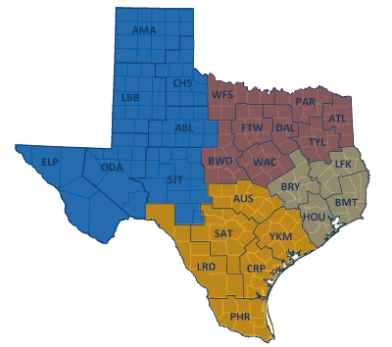
TxDOT Priorities
SAFETY
Our staff, our community
Emergency response
CONNECTIVITY
Reliability of the transportation network
Asset management
*BRIDGES*
Efficiency and efficacy
For TxDOT
For other/all jurisdictions
Slide: Rose Marie Klee, TxDOT

Slide 3
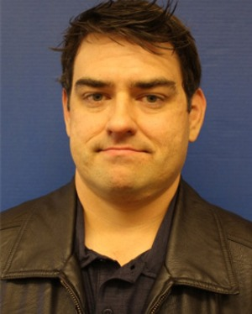
TxDOT Project Management Committee
Welcome to new member, Matthew Heinze!
Rose Marie Klee H&H Section Director, DES
Abderrahmane Maamar-Tayeb
H&H Section Team Lead, DES
Trent Ellis Bridge Scour Coordinator, BRG
Matthew Heinze TxDOT Emergency Mgmt Coordinator, MNT
Shelley Pridgen Research Project Manager, RTI
Adam Jack Dir of Trans Plan & Development, BMT
Andrew Lee District Bridge Engineer, BMT
Joseph Goessling
Lead Hydraulics Engineer, AUS
Jared Browder Maintenance Assess Spec, MNT

Slide 4
Project Advisory Committee
Jason Johnson, NOAA National Weather Service Mark Lenz, NOAA National Weather Service
Paul Yura, NOAA National Weather Service
Sam Marie Hermitte, Texas Water Development Board
Jorge Urquidi, City of Austin, Flood Early Warning System
Justin Terry, Harris County Flood Control District
Peter Smith, former TxDOT Dir of Trans Planning and Programming
+ other members of the H&H Section, TxDOT Design Division:
+ new member of the City of Austin FEWS group Christina Bryant
Welcome to
the Discussion!
Hiruy Berhe | Jaime Villena-Morales
Lucinda Soto | Sauda Ahmed
 | Zenia De Leon

Slide 5
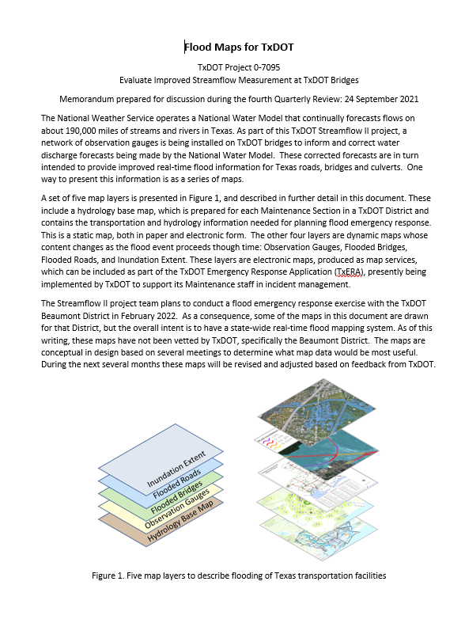
Streamflow II Overview Meeting Agenda
Task 1: Project Management
Task 2: Watershed Selection and Site Evaluation Task 3: Gauge Installation, Operation and Maintenance Task 4: Flood Forecast System Operation Task 5: Forecast Model Assessment
Task 6: Flood Manual and Training
Part 1 – Progress with Tasks
Part 2 – Proposed Flood Maps for TxDOT
Consideration of this proposal:

Slide 6
Task 1: Project Management
David Maidment, UT Austin
Achievements during last Quarter
Visit to Beaumont District on 28-30 July
Developed plan for flood mapping
Advanced collaboration with TxERA (TxDOT Emergency Response Application)
Rapid Assessment process for culverts in Austin District
Challenges for Next Quarter
Complete selection of second 30 gauge sites. Install as many new gauges as possible
Continue collaboration with Beaumont and Austin Districts
Begin flood map development if plan is approved by PMC

Slide 7
Task 2: Watershed Selection and Site Evaluation
Achievements during last Quarter
Completed Technical Memorandum 2 on Watershed Selection and Site Evaluation
Challenges for Next Quarter
Complete field reconnaissance and selection of second 30 gauge sites

Slide 8
Task 3: Gauge Installation, Operation and Maintenance
Scott Gryzb, US Geological Survey
Achievements during last Quarter
Installation of 36 stream gauges
Streamlined site selection and procedures
Reconned more than 40 additional sites for the second round of installation
Challenges for Next Quarter
Continue installation of stream gauges
Continued coordination for permitting and traffic control
Operations and maintenance performed in tandem with installations

Slide 11
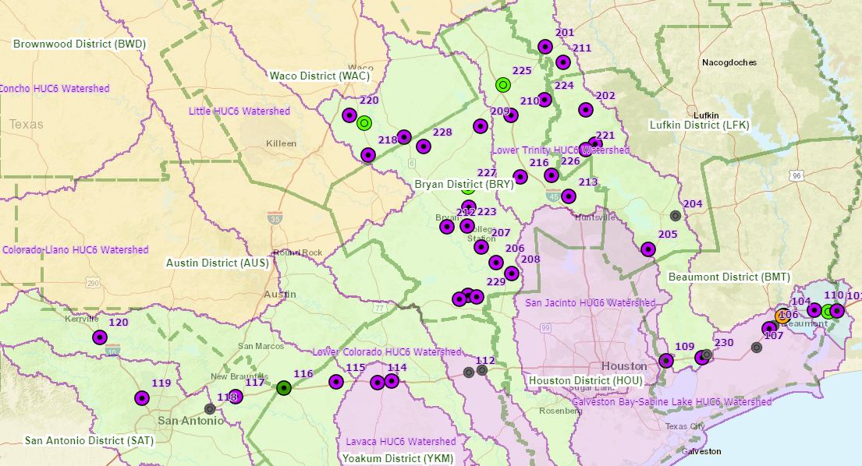
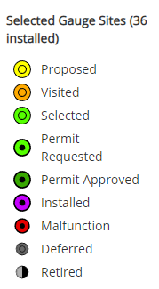
StoryMap for TxDOT RQ-30 Stream Gauging Sites
David Arctur
Streamflow I Refurbished Gauges: 12
Streamflow II New Gauges: 24
Total Gauges: 36
https://arcg.is/veW9T0

Slide 12
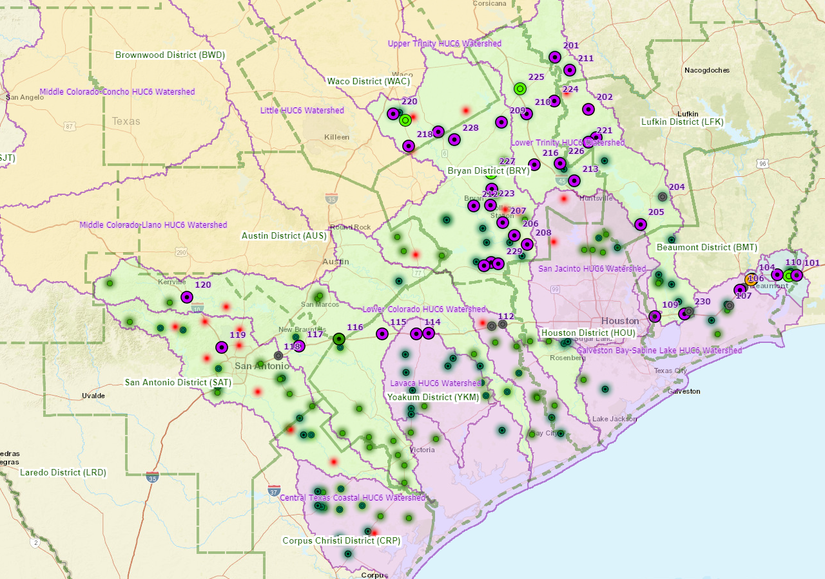
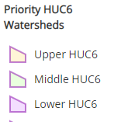
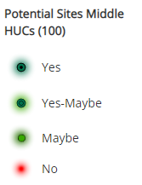
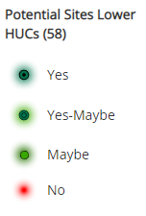
StoryMap for Field Reconnaissance of Potential Sites
https://arcg.is/veW9T0

Slide 13
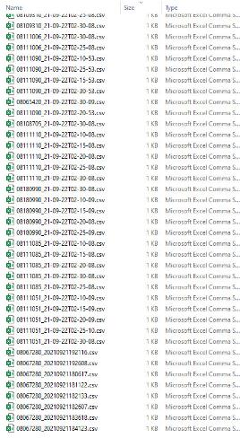
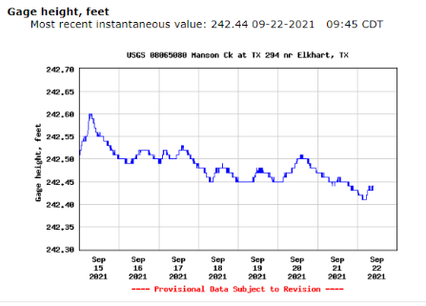
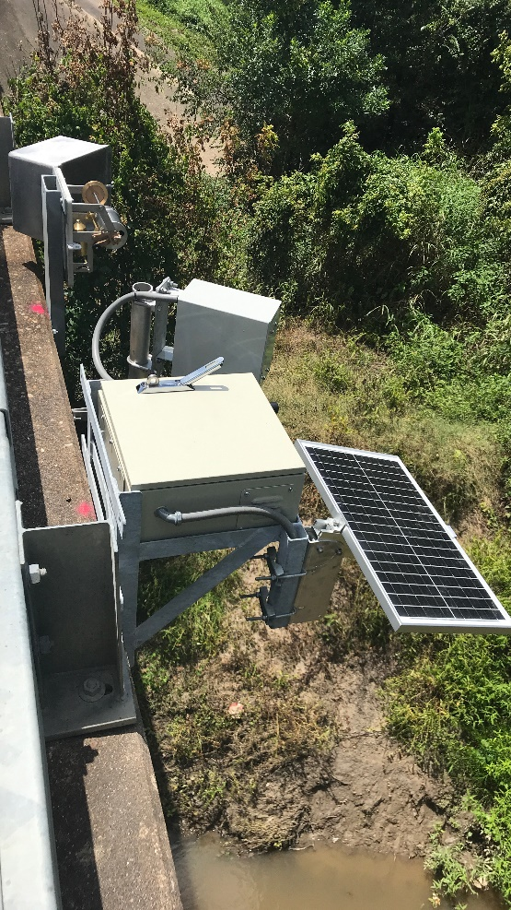
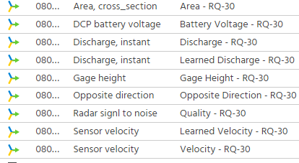
Technical Highlight: How data gets into NWIS (National Water Information System)
Scott Gryzb
NWISWEB Retrieval
R- script
Notes:
Data in FTP location is downloaded and ran through R Script on Virtual Machine creating a file that is then transferred into the Hot sync directory. Once in that directory the file is processed and ran through DECODES in which the file is DECODED for specific Time Series in AQ. Once the data in in AQ NWISWEB retrievals pick up the data and display it on the WEB

Slide 14
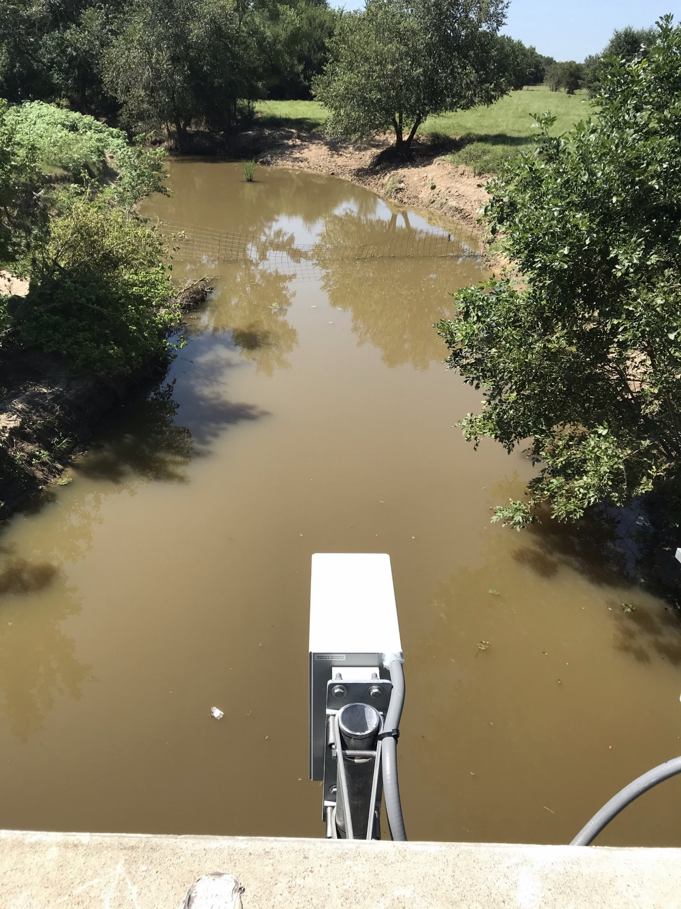
On a Typical Day ….
Check gauges
Preliminary Quality assurance and Quality Control
Field Trips, Measurements, or Records Computation

Slide 15
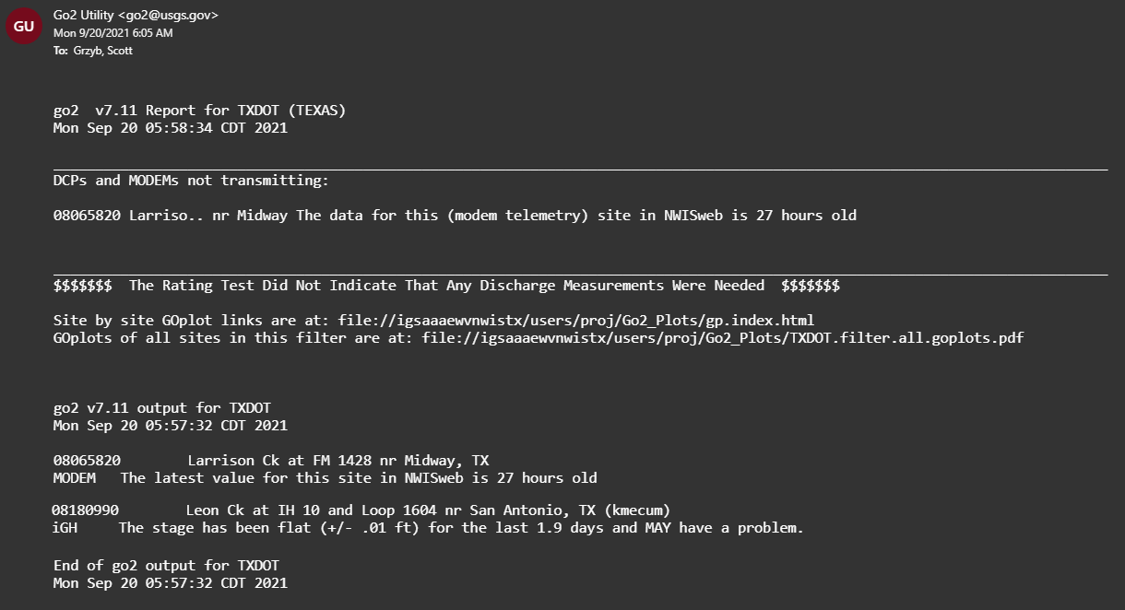
Gauge Checks
Notes:
Automatic fault detections, Look for elevated flows to get measurements.

Slide 16
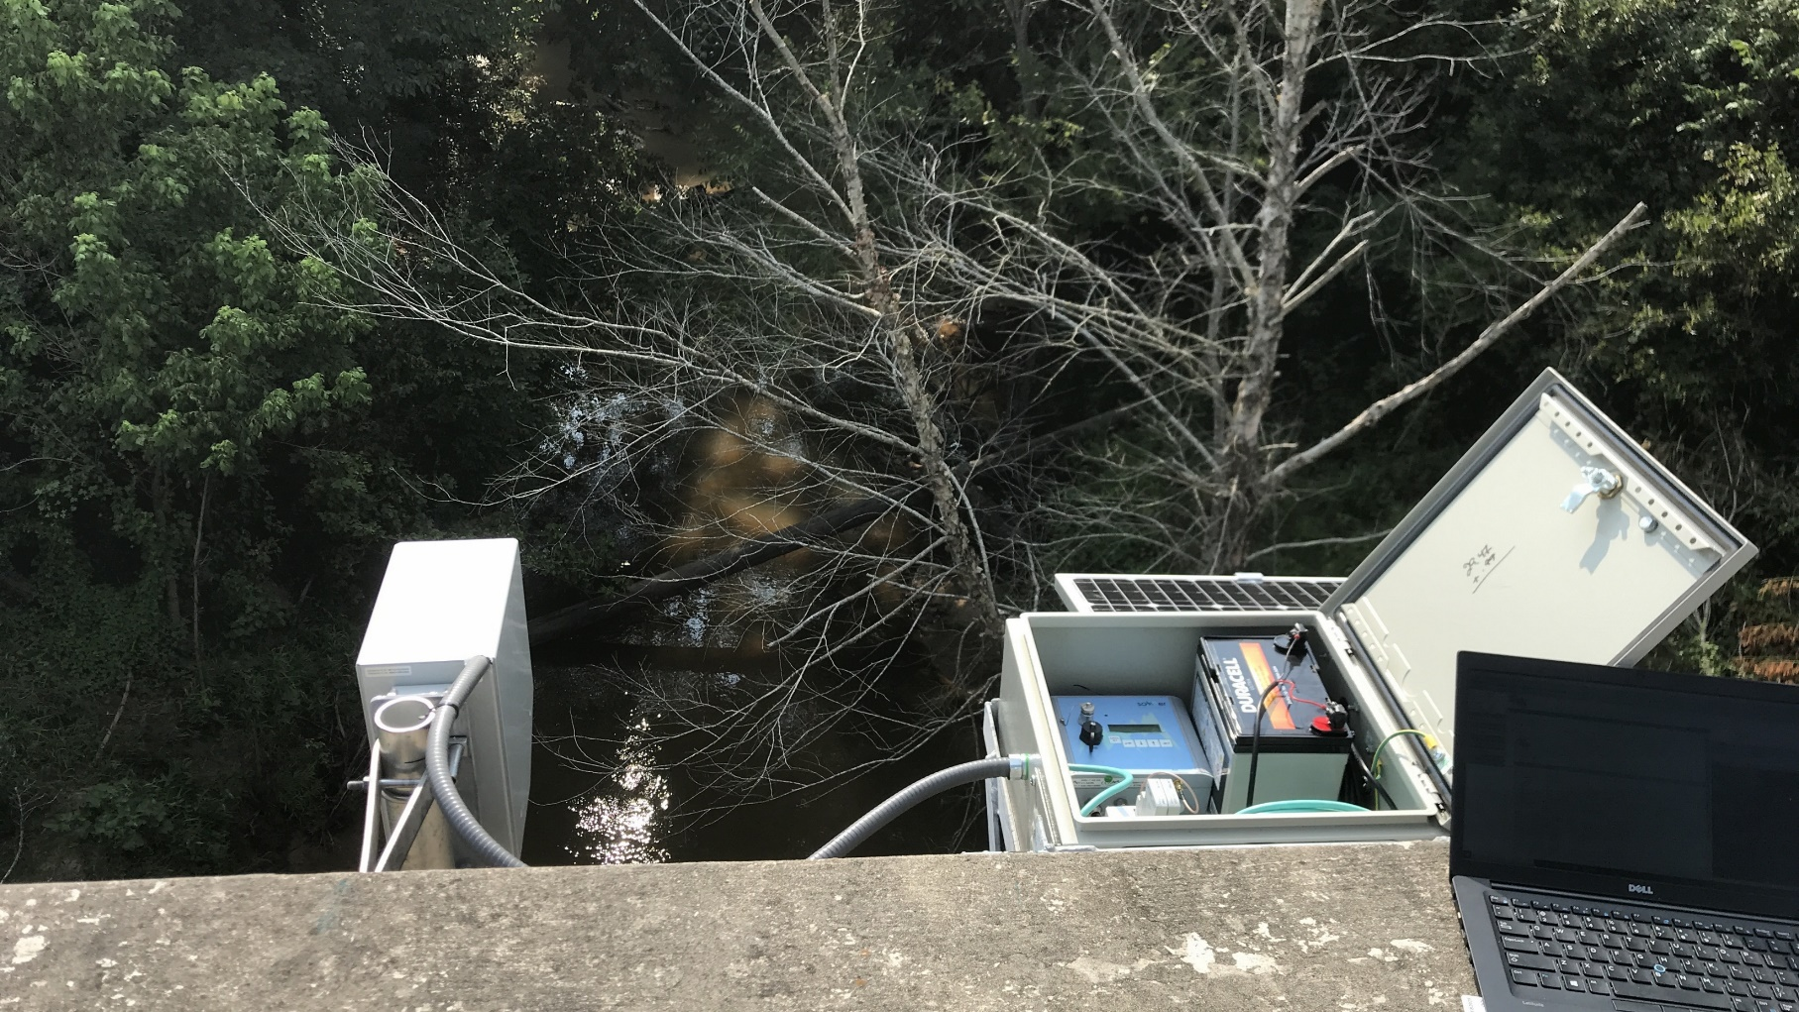
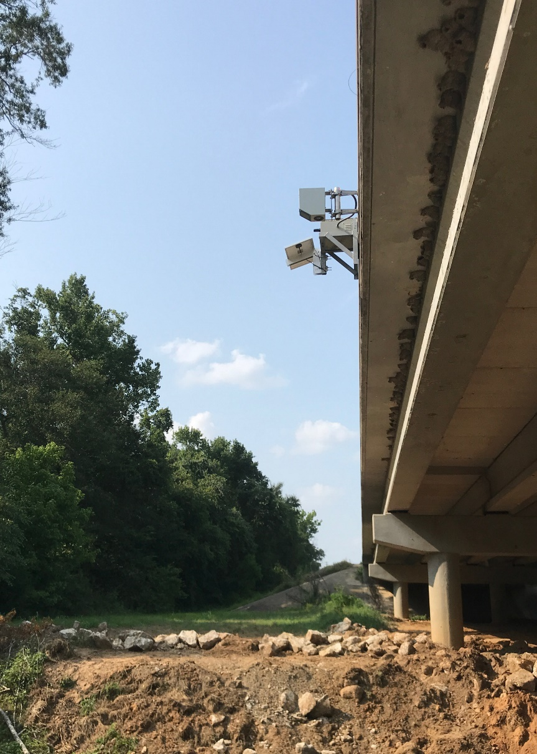
On a Typical Day …
Check gauges
Preliminary Quality Assurance and Quality Control (QA/QC)
Field Trips, Measurements, or Records Computation

Slide 17
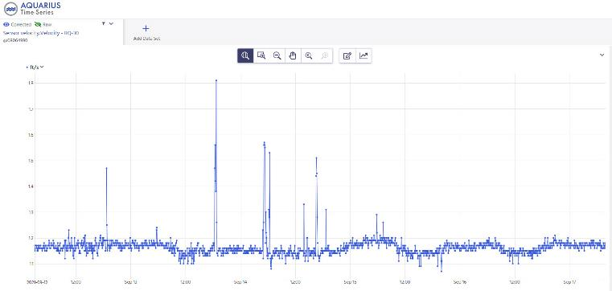
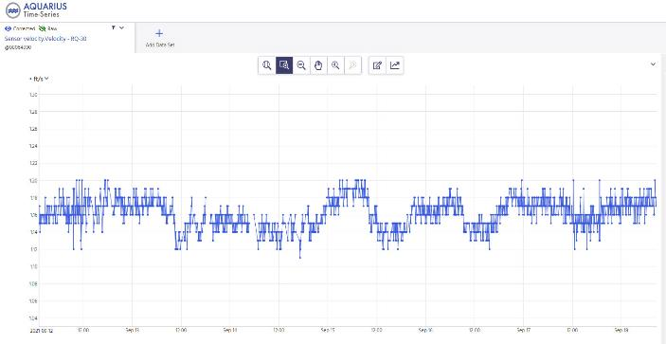
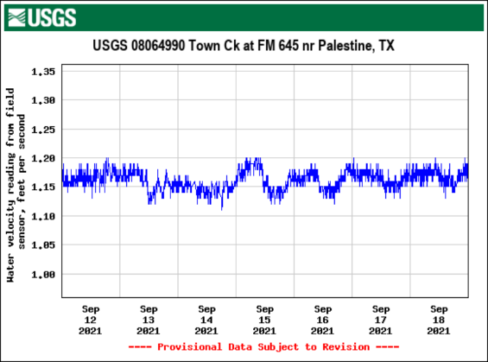
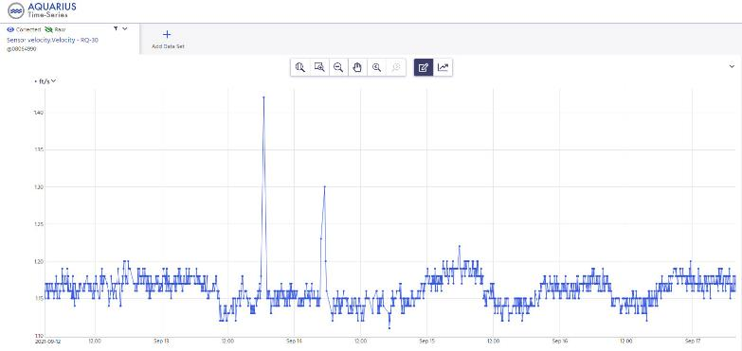
Ongoing Quality Control
Automatic Filtering
Final Checks
Publish to NWIS as Provisional
Manual Filtering
Notes:
Data does not always come in pretty. Wind spikes are common. Automated spike filtering, Manual spike deletion, before going to NWIS

Slide 18
On a Typical Day ….
Check gauges
Preliminary Quality assurance and Quality Control
Field Trips or Records Computation

Slide 19
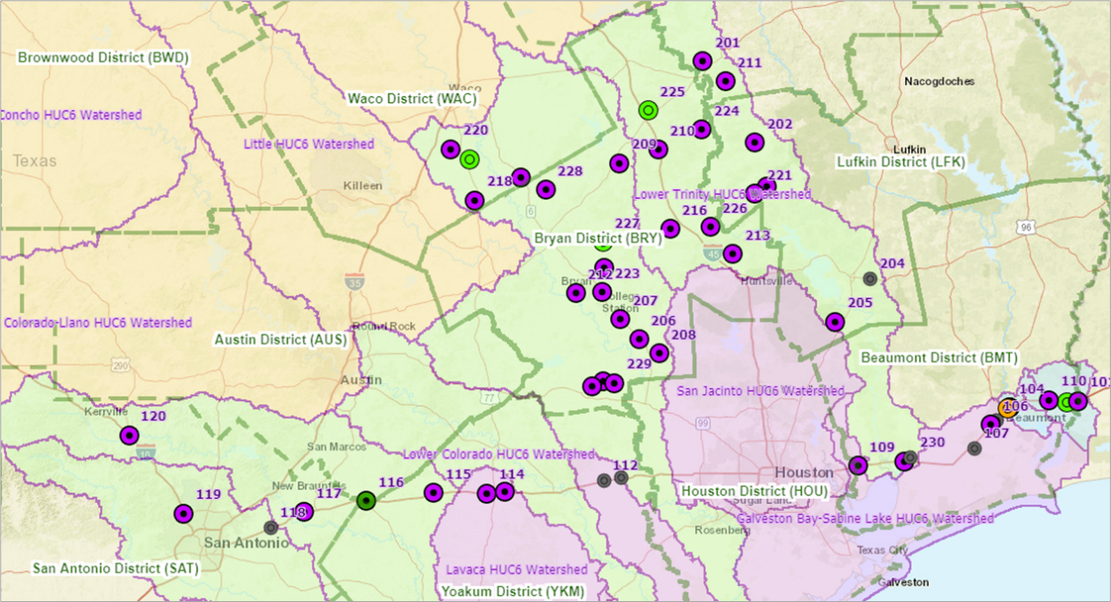
Types of Field Trips
Routine
Operations and Maintenance
Routine gauge height and/or discharge verification
Cross section verification
Special
Gauge repair
Cross sections and Levels
Storm events

Slide 20
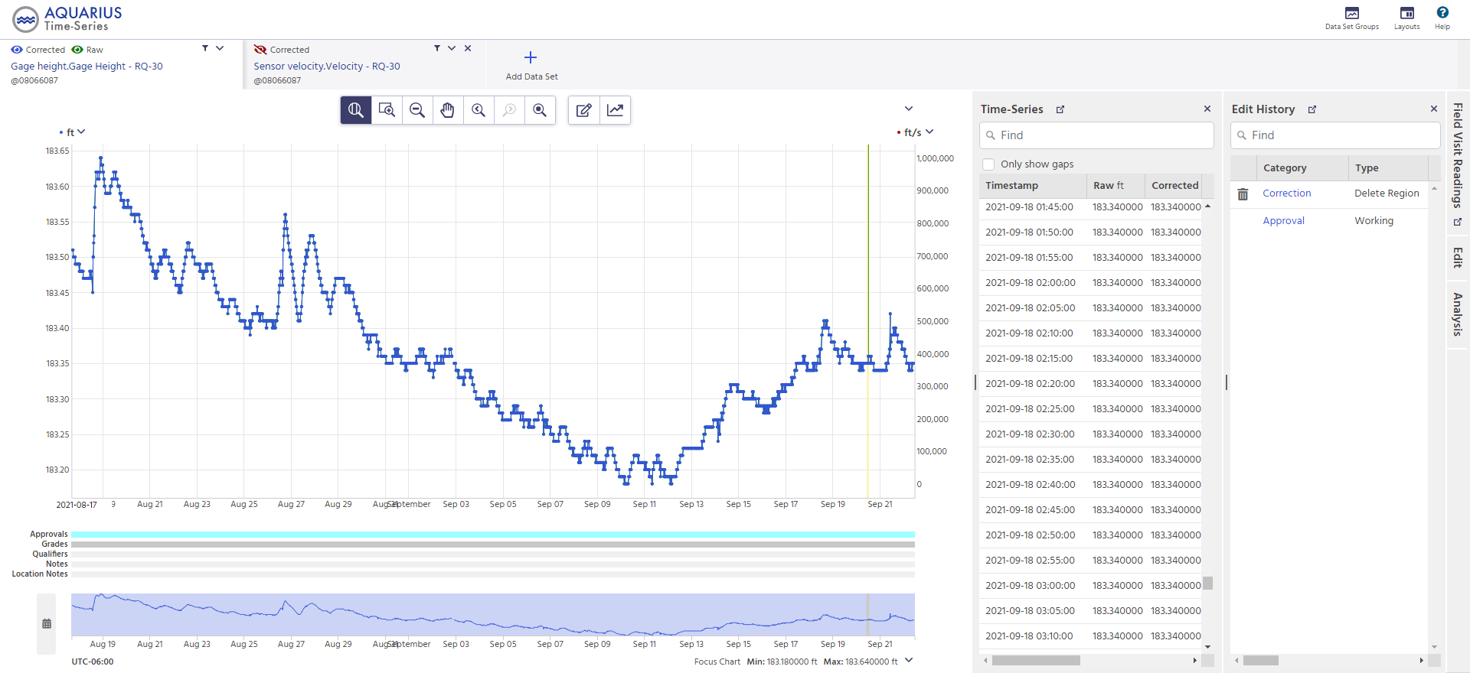
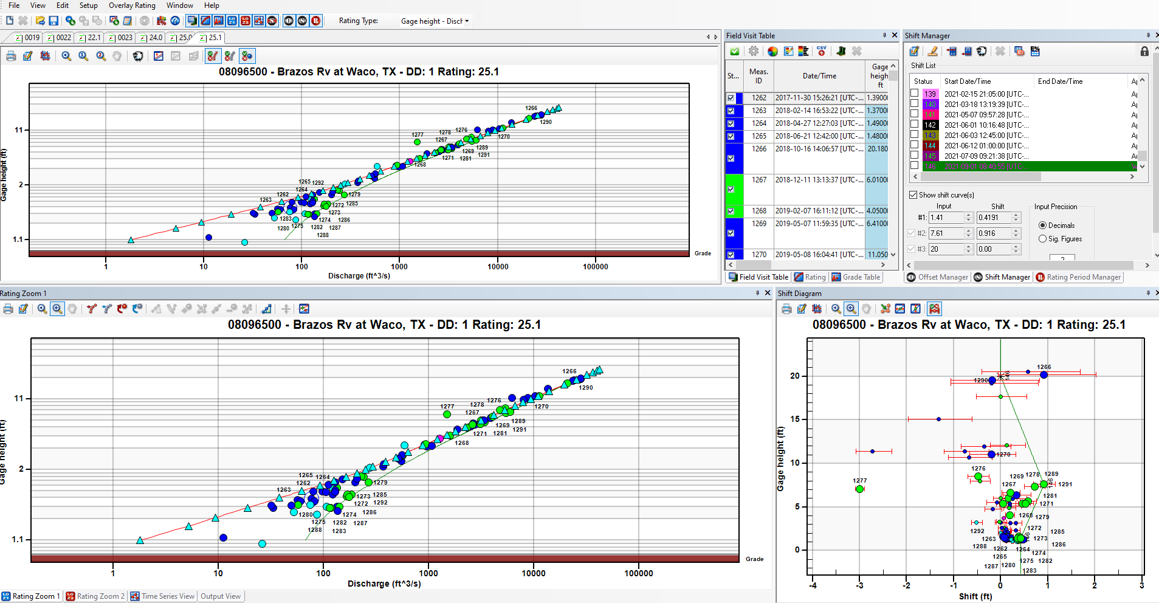
Types of Records Computation
Gauge height corrections
Discharge Rating Development
Comparison of RQ-30 / Standard USGS methods
Period Analysis for each gauge

Slide 21
Task 4: Flood Forecast System Operation
Matt Ables
Achievements during last Quarter
HEC-RAS model integration extended by data visualization of longitudinal and cross sections.
Evaluation of the use of BLE and Lower Colorado model completed (MSc thesis Alp Koyulhisarli). Models not suitable for unsteady flow hydrographs, lessons learned will contribute to future hydraulic modelling activities.
Addition of TxDOT Radar Gauges, JCDD6, and SRA gauges into Datasphere.
NWM Stage and Flow APIs for retrieval of data via COMID or lat/long.
Numerous Datasphere GUI and graph enhancements.
Challenges for Next Quarter
Continue ingestion of observations networks
Complete USGS data for Texas
Begin development of thematic flood maps
Observations map and Bridges map
Prepare data and maps for Beaumont District exercise in Feb 2022

Slide 22
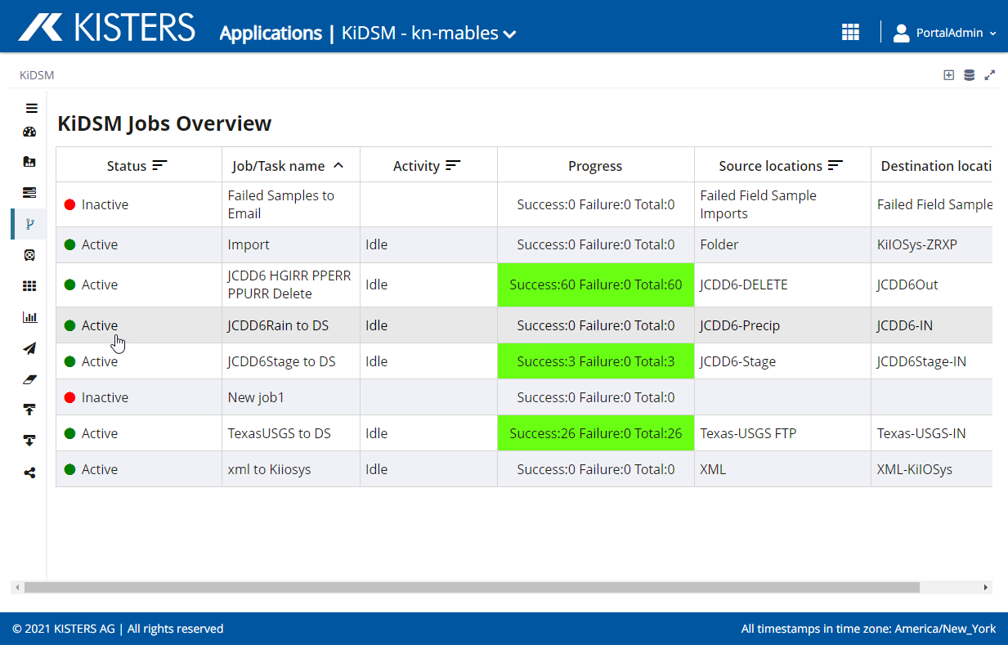
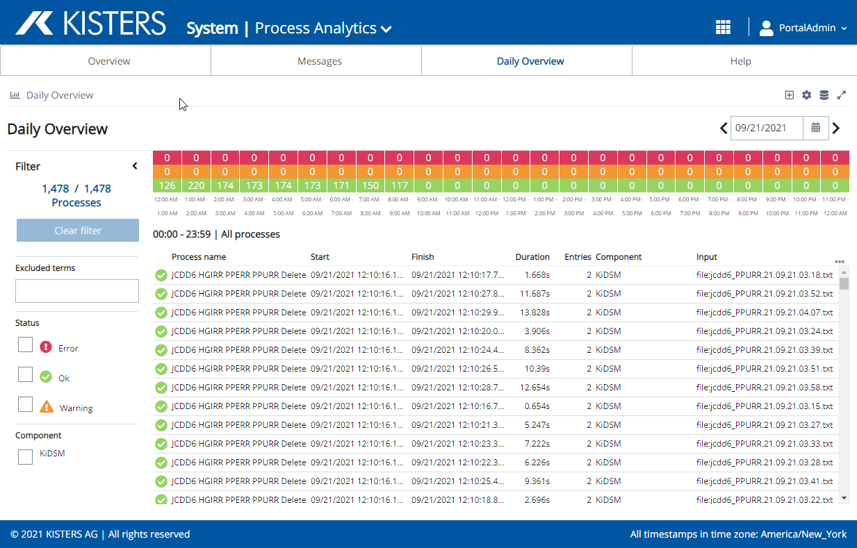
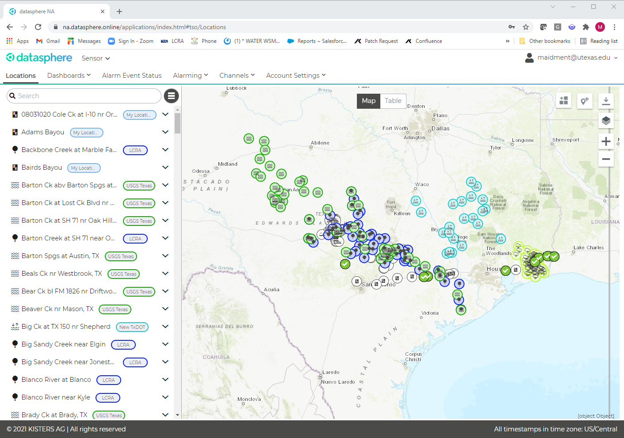
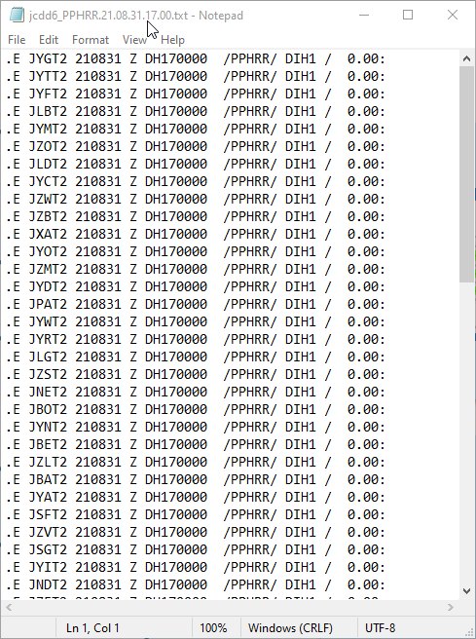
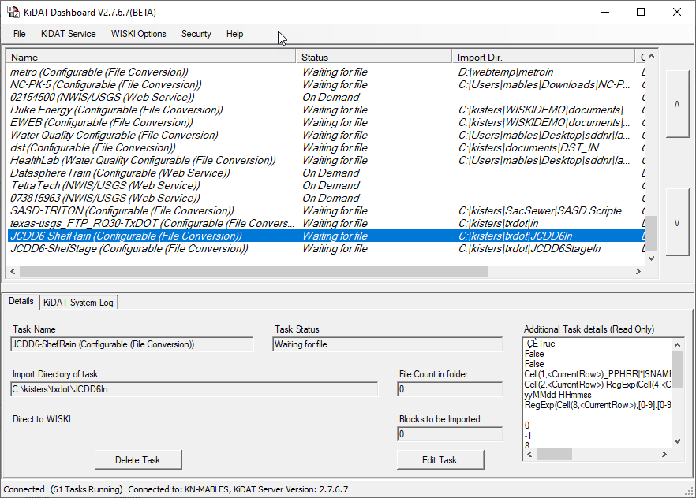
Technical Highlight: Setup and Ingestion of Observation Networks
The Datasphere process to manage, convert, and import observation networks
Jefferson County DD6
SHEF E
FTP
KISTERS Distributed Services Manager (KiDSM)
Datasphere
Datasphere Storage and Services
LCRA Web Service
XML
KISTERS Data Acquisition &
Transformation (KiDAT)
USGS NWIS
Web Service
text

Slide 23
KISTERS Distributed Services Manager (KiDSM)
Monitor and gather data from observation networks
KISTERS Distributed Services Manager (KiDSM)
Jefferson County DD6
SHEF E
FTP
Key Features
Downloads data from Web, FTP, REST, and other APIs.
Source and Target location monitoring and notifications.
Data processing log and monitoring.
LCRA Web Service
XML
USGS NWIS
Web Service
text

Slide 24
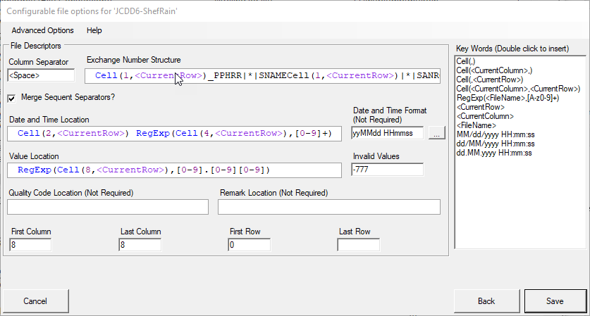
KISTERS Data Acquisition and Transformation (KiDAT)
Convert, clean, and import data from observation networks
KISTERS Data Acquisition &Transformation (KiDAT)
KISTERS Distributed Services Manager (KiDSM)
Key Features
Quickly convert observation network formats and stream to Datasphere.
Automatically builds new stations and sensors in Datasphere on import.
Processes, cleans, and organizes high volumes of data and file formats.

Slide 25
Representation of Multiple Networks in Datasphere
Display data from observation networks
Datasphere
KISTERS Data Acquisition &
Transformation (KiDAT)
Key Features
Each observation network is organized with unique login and account.
Data shared from each observation network account to the TxDOT account.
Allows for better classifications, alarms, and general management of the data based on the observation network data characteristics.

Slide 26
Task 5: Forecast Model Assessment
Paola Passalacqua, UT Austin
Achievements during last Quarter
Completed assessment of HEC-RAS models
Operational integration of HEC-RAS and NWM clone extended by animated longitudinal and cross section views
OP GUI integration of both models for scenario analysis in final stage
Continuation of error analysis of NWM with stage height
Challenges for Next Quarter
Set up Data Assimilation approach with Muskingum-Cunge
Complete error analysis and analyze results (patterns, predictability)
Implement error analysis within Datasphere as well
Initiate river hydraulics analysis (additional student on project started Fall 2021)

Slide 27
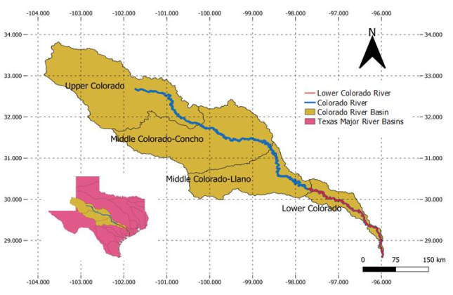
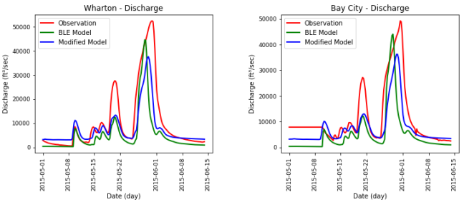
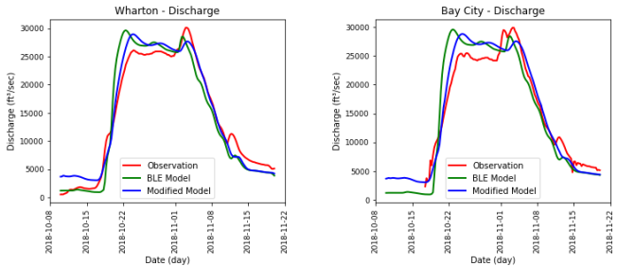
HEC-RAS Model Assessment
Dirk Schwanenberg, KISTERS
- Assessment in MSc project by Alp Koyulhisarli under supervision by KISTERS and University of Texas
- Significant manual work to enable the Lower Colorado model to simulate flood hydrographs
→ various lessons learned, approach not scalable (for the time being)
2015 flood
2018 flood

Slide 28
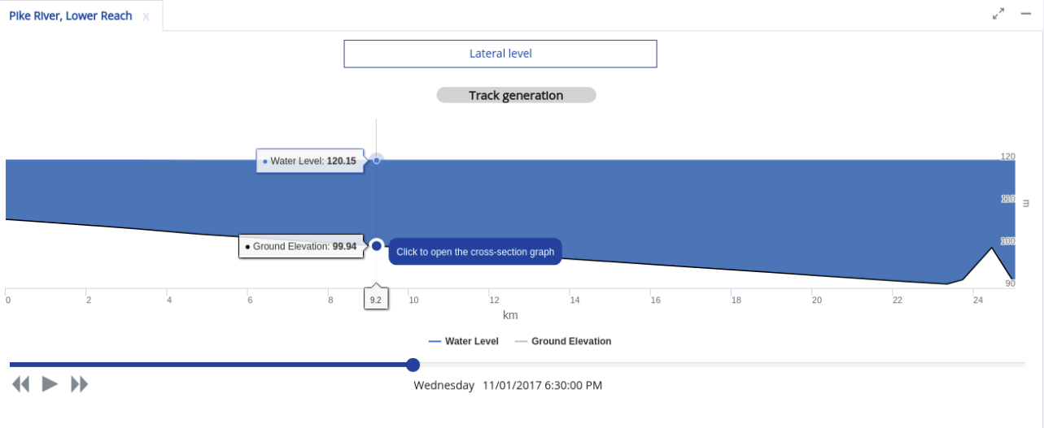
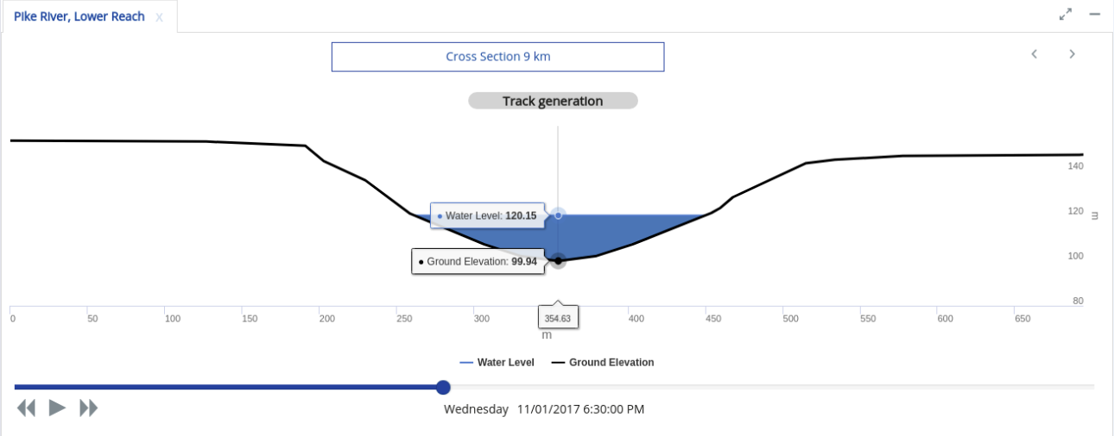
Visualization of Profiles and Cross-Sections
Web-based visualization in Operations Planning GUI
Animated visualization of level and streamflow in longitudinal section
Animated visualization of level in cross section
Future refinement for discussion:
- Definition and visualization of warning/alarm levels

Slide 29
Technical Highlight: RAS2FIM – Creation of Flood Inundation raster libraries and rating curves from HEC-RAS models
Andy Carter, UT Austin
RAS2FIM scripts
Create shapefiles
from directory of
HEC-RAS models
Conflate HEC-RAS
to National Water
Model
Create FIM depth
rasters using
HEC-RAS Mapper +
HEC-RAS API
Get terrain data
for each HUC-12
Real-time mapping
of flooding events
HEC-RAS
Files
Raster
Library
and
Rating
Curves
Cloud served
Terrain data
Cloud served
NWM flow rates
National
Datasets
Watershed Boundary Dataset (WBD)
National Water Model flowlines (NWM)
3DEP Web Coverage Service
(or TNRIS, Fathom, etc..)
BLE, FEMA,
Municipality, USACE,
Etc…
Per API service from the
National Water Model
(coming soon)
Stored per National Water Model
‘feature-id’

Slide 30
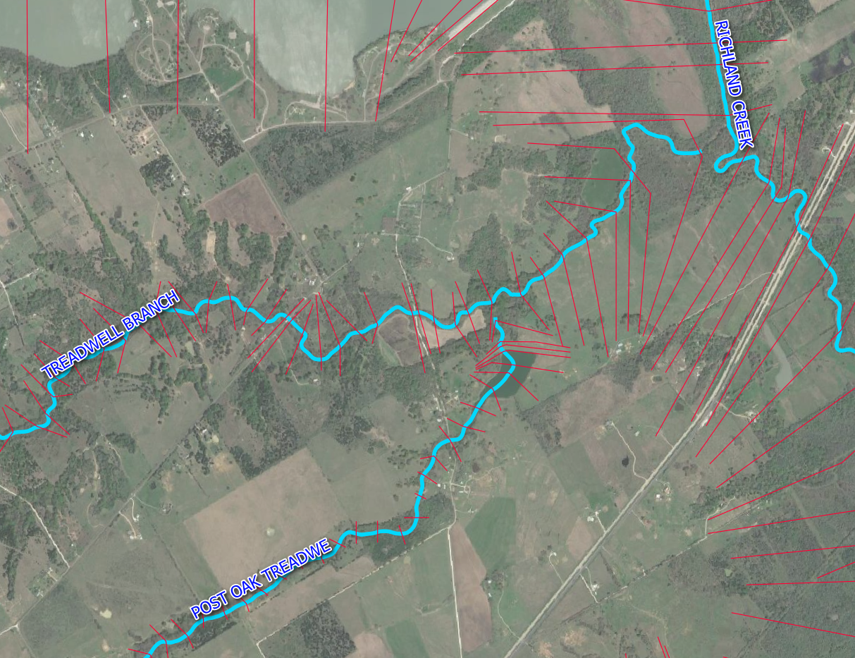
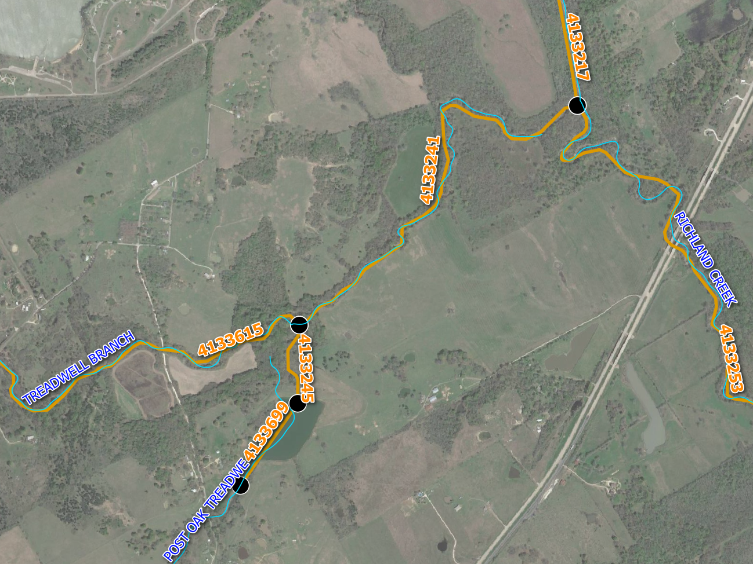
Representation of River Channel in HEC-RAS and National Water Model Hydrofabric
Geospatial HEC-RAS 1D Models
Conflation to the National Water Model Hydro- Fabric

Slide 31
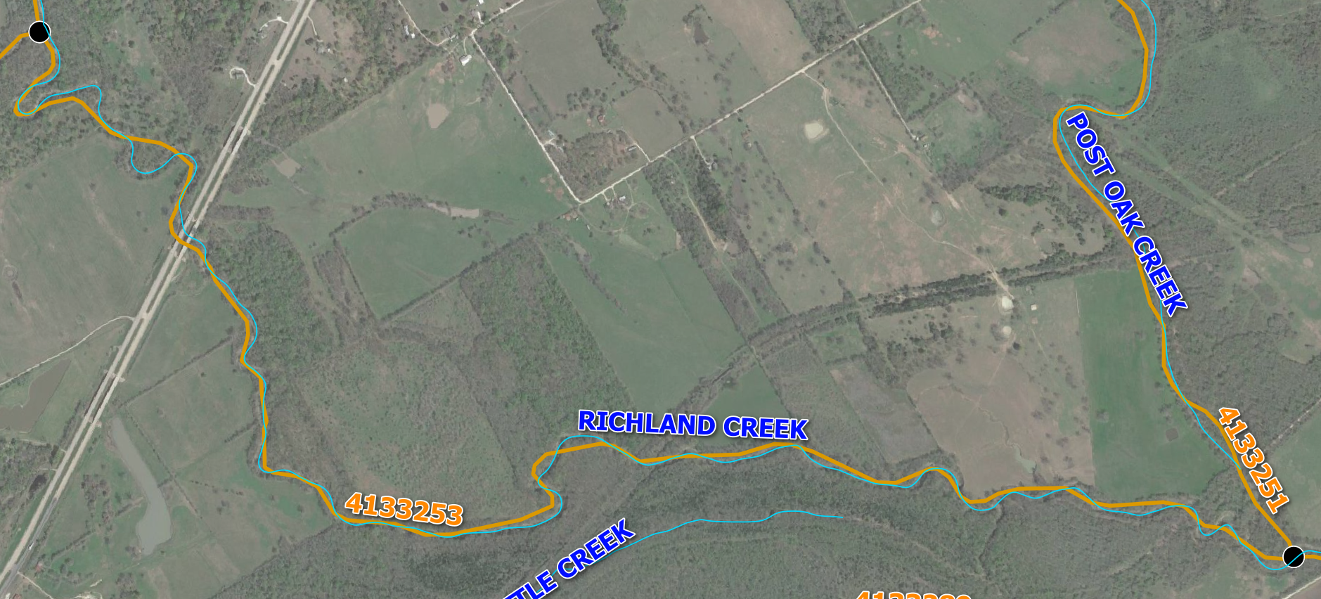
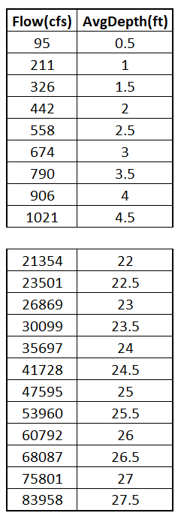
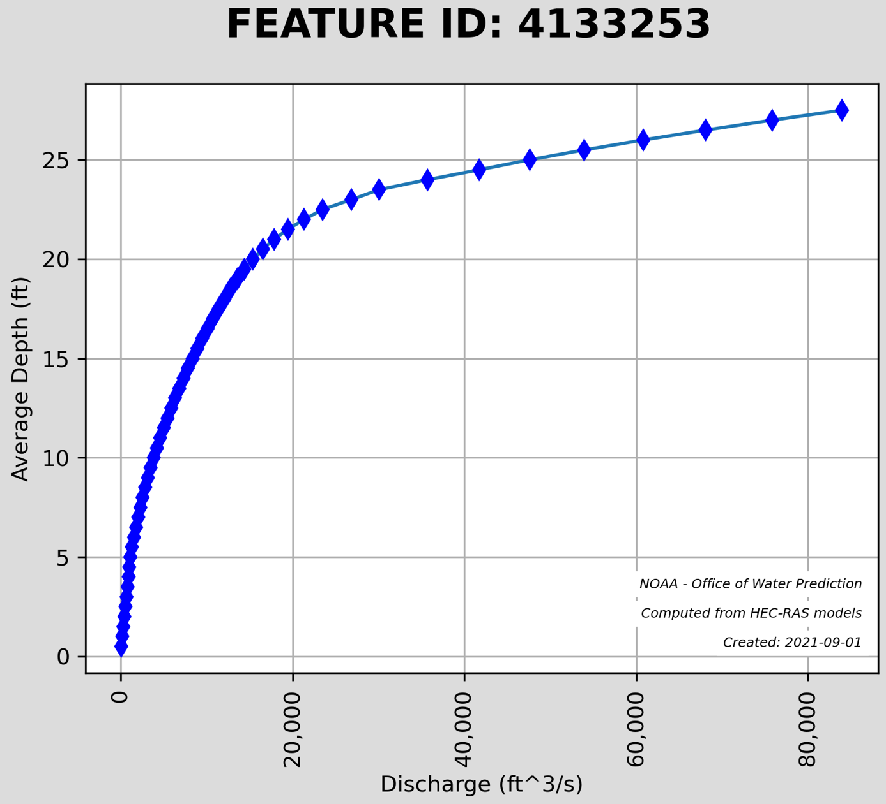
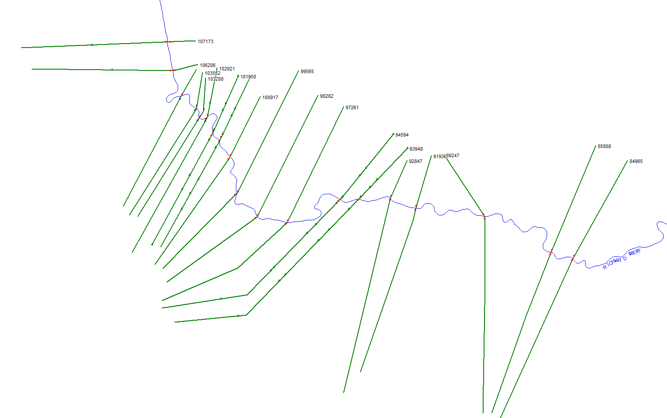
Creating a Rating Curve at Half-ft Vertical Intervals for each Channel Reach
National Water Model ID number for reach
HEC-RAS conflated to National Water Model (NWM) Hydro-fabric
Compute a ‘reach averaged’ depth rating
curve for the ‘Feature-ID’
HEC-RAS Model ‘clipped’ to Corresponding NWM ‘COMID’

Slide 32
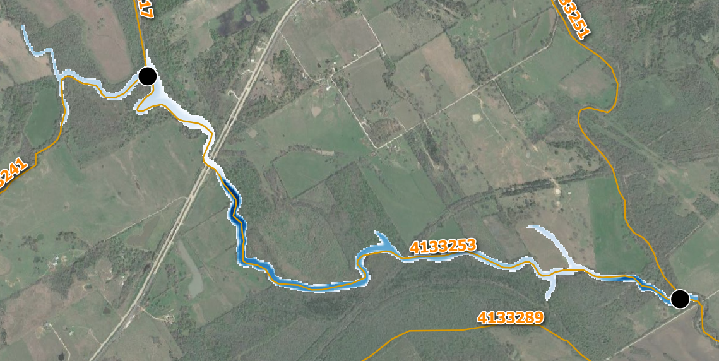
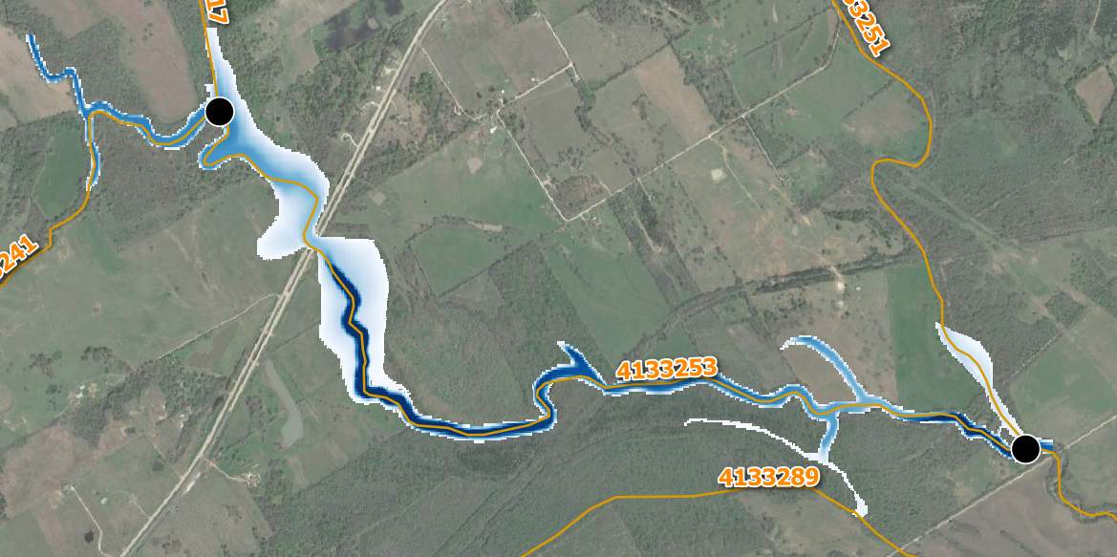
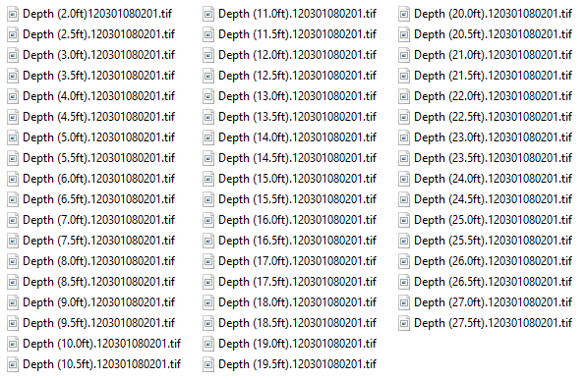
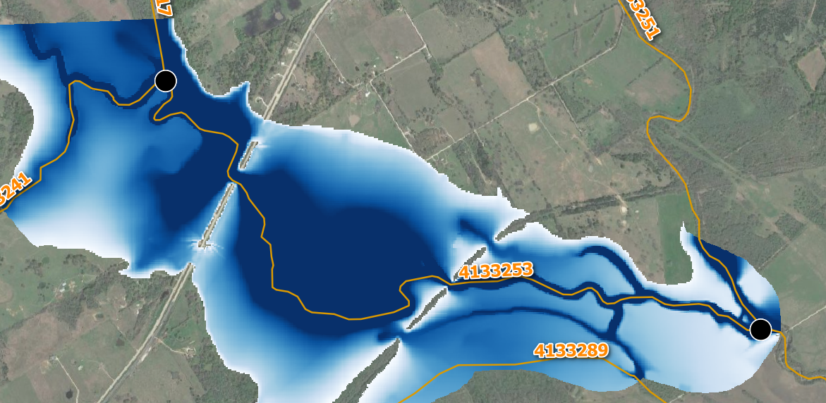
Build an Inundation Map Stack as TIF files
Avg Depth = 12.5ft
Q = 5,867 cfs
Avg Depth = 16.0ft
Q = 9,499 cfs
Avg Depth = 27.5ft
Q = 83,958 cfs
Map library created per ‘feature-id’ with
Corresponding reach averaged
Indirect rating curve

Slide 33
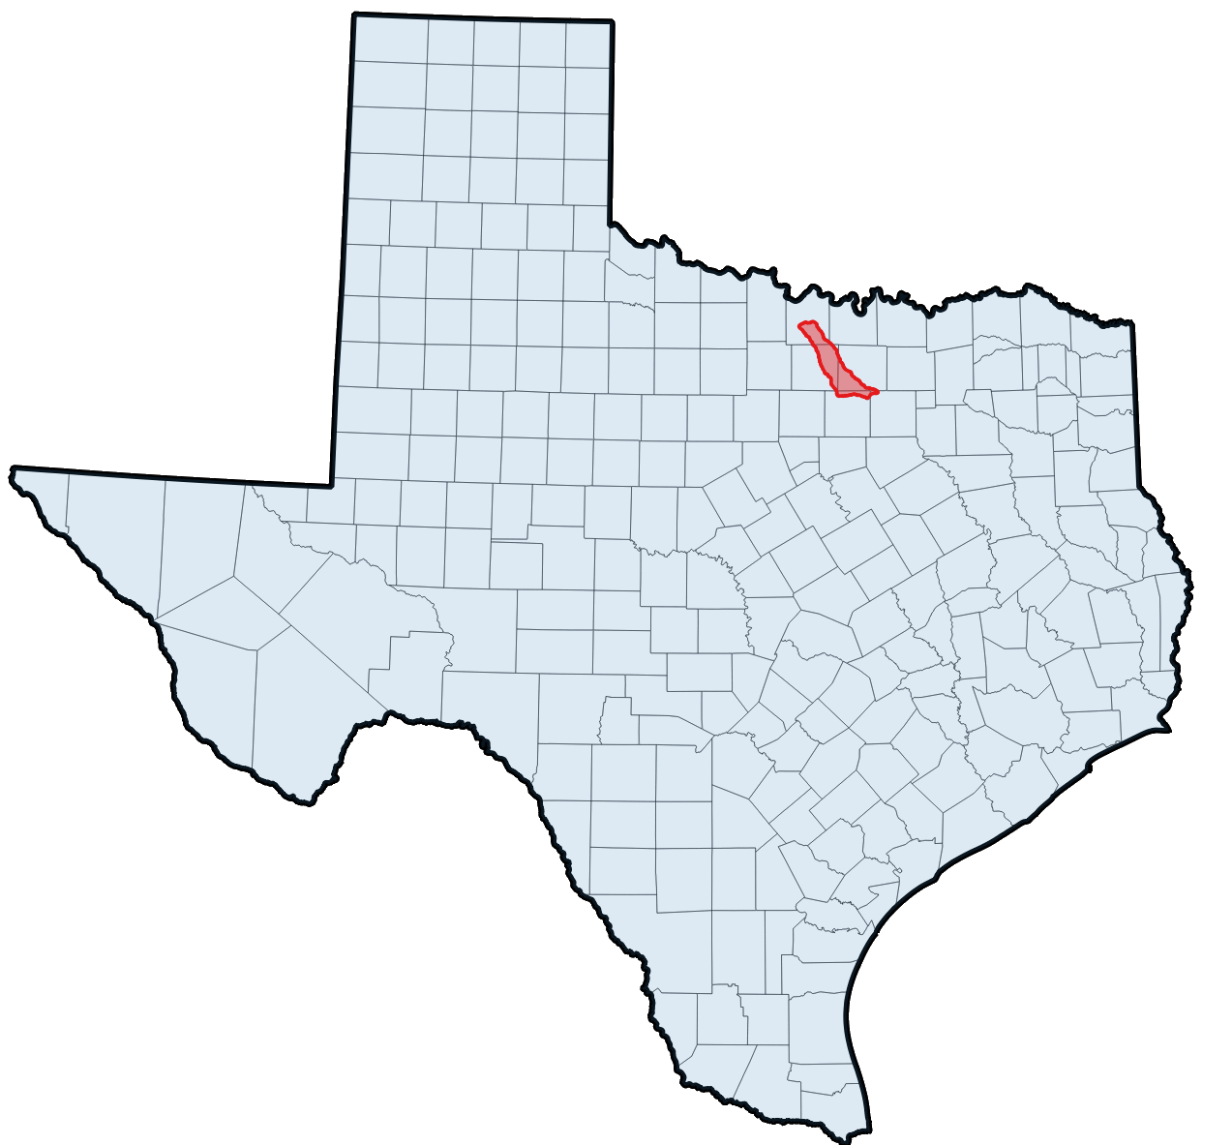
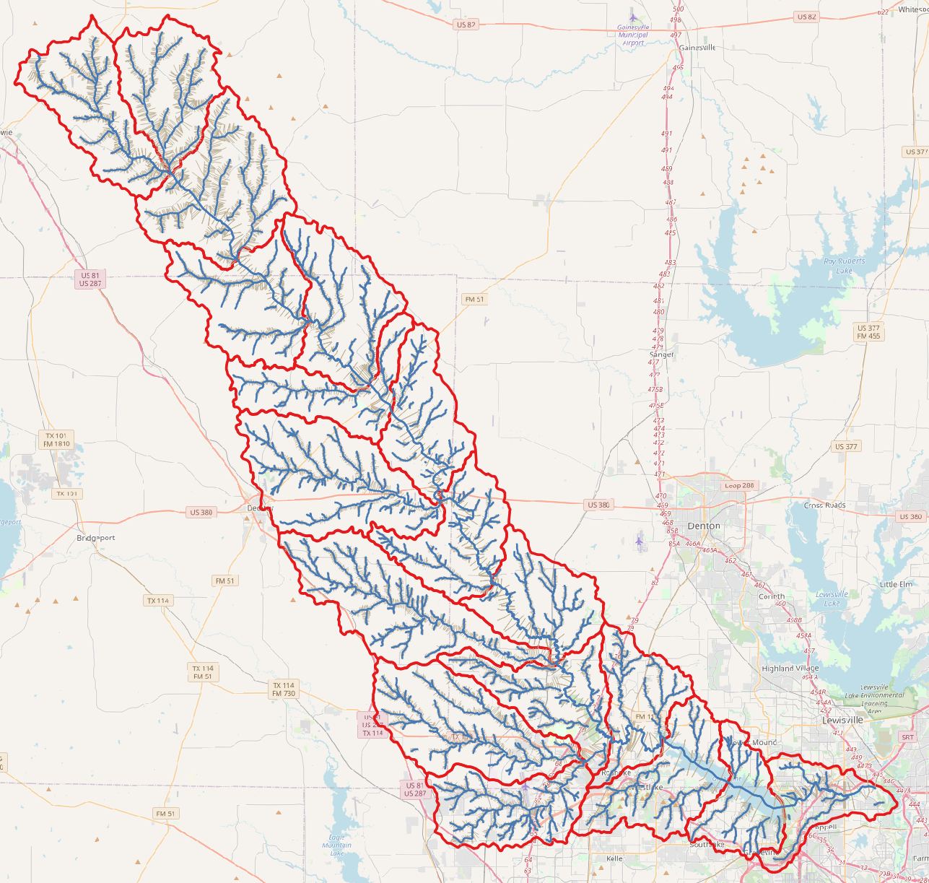
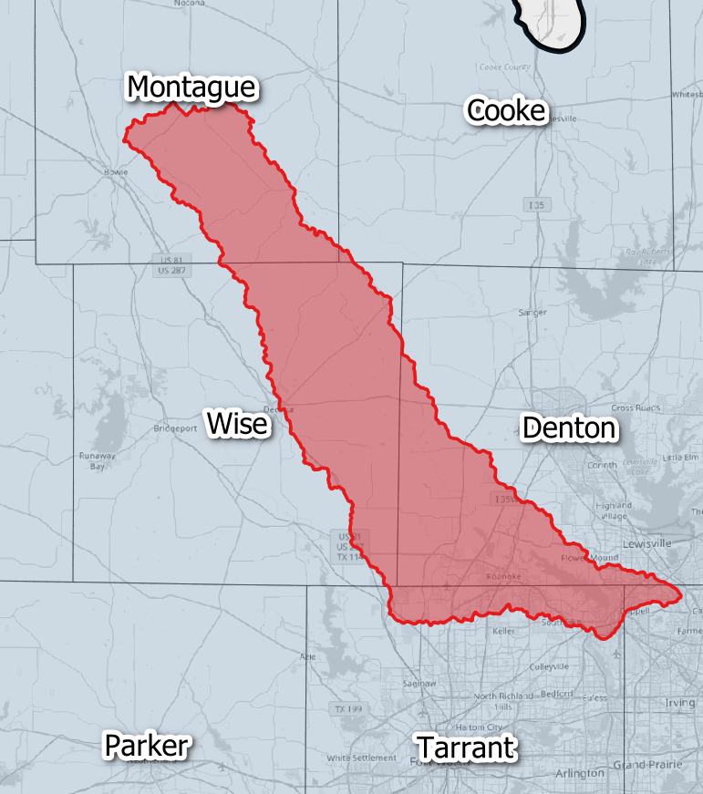
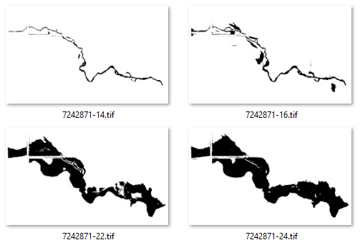
Example of Application of RAS2FIM for Denton Creek, HUC8 = 12030104
HUC12 units
CSVs
GeoTIFFs
PNGs
A Flood Inundation Map Library
and set of Rating Curves
A HUC8 unit of Base Level Engineering Models
519 HEC-RAS Models (611 Mb)
Drainage area = 719 sq miles
National Water Model Streams = 614
HEC-RAS Cross Sections = 13,299
Flood Inundation Library data (1.01 Gb)
Depth Rasters = 12,296
Rating curves PNG and CSV = 521
Depth Interval of GeoTIFFs = 0.5 ft
Processed in 18 HUC12 units

Slide 34
Task 6: Flood Manual and Training
Harry Evans, UT Austin
Achievements during last Quarter
Challenges for Next Quarter
Development of realistic HSEEP exercise
Continue meetings with the Beaumont District
Identify flow of information from the bottom up and the top down
Identify the types of useful maps needed for the BMT District
Continue meetings with TxDOT Statewide Emergency Management
Identify the most important map/data needs that would apply to all TxDOT districts
Collaborate with Esri on TxERA
Collaborate with Veoci on alerts and notifications
Interactions with the Beaumont District
Discussed past events and how they dealt with them
Discussed steps they take during a flooding event
Discussed the data and information needs during a flood event
Field visits to flood prone roads
Interactions with TxDOT Statewide Emergency Management
Discussions with VEOCI for alerts and notifications
Discussions with Esri for TxERA
Concern Points (Flood Points) Surveyed
17 separate site surveys in Travis, Hays, Lee, Williamson, Burnet, Llano, Mason, Gillespie and Blanco Counties.
Mainly, these are low water crossings
Created a story map and Flood Point Template

Slide 35
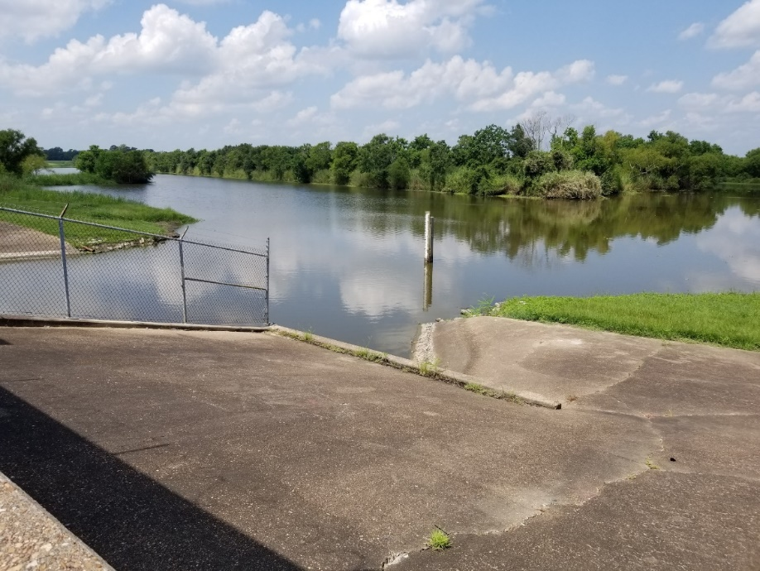
Summary of Lessons Learned from Visit to Beaumont District (28-30 July)
Value of Local Intelligence!
Comprehensive understanding of BMT flood emergency response
Full integration into National Incident Management System (NIMS)
BMT Staffs a 24/7 Emergency Operations Center (EOC) during flood emergencies
Formal and defined lines of communication with Texas Division of Emergency Management (TDEM)
Maintenance Sections are the “tip of the spear” when a flood emergency occurs
What flood information is useful and useable to Maintenance in the EOC and the Field

Slide 36
TxDOT BMT has a Detailed Hurricane Preparedness Plan
Uses National Incident Management System (NIMS) roles

Slide 37
Daily Cycle of Information Development and Decision
Integration with TDEM State Operations Center

Slide 38
Technical Highlight: Rapid Assessment of Low Water Crossings (Austin District)
Christine Thies, UT Austin
Purpose:
Low Water Crossings are flood-prone
National Water Model forecasts flows at many of these sites
Austin District study in 2017 highlighted 153 “flood-points”, of which 20 are highest priority
Rapid Assessment Survey:
Minimizes the ‘time-on-target’ required for a field survey team to obtain the necessary data
Provides ‘just-enough’ appropriately attribute survey points, photos and site measurements to insert the hydraulic structure into HEC-RAS
Written procedure:
We field surveyed 17 sites of the top 20 in Austin District
We developed a written Rapid Assessment Survey for Culvert Crossings

Slide 39
Road Crossing Survey Components
For the test surveys, three classifications of survey points are requested.
They are (1) road edge, (2) pipe information and (3) staff gage [if available].
Road Edge – The field survey team acquires one (1) point on the edge of the roadway. This is used as a check against the site’s LiDAR terrain to determine any datum issues between the survey and the remote sensed data.
Pipe Information – One survey spot is acquired at the bottom center of each pipe/culvert on both the upstream and downstream face. The point data is attributed with the opening dimensions [height, width, radius] and material parameters [Reinforced Concrete Pipe, Corrugated Metal Pipe, etc..].
Staff / Flood Gage – One survey spot is acquired at the staff gage if one is installed at the crossing of concern. This point is recorded at the “zero” elevation of the staff gage.

Slide 40
Documentation
To detail the survey methods and locations, we have created two documents:
“Rapid Assessment Survey for Culvert Crossings”
Background
Survey Point Collection Details
Survey Equipment
Data Collection Software (Collector)
How to Collect Survey Points
Story Map
https://arcg.is/10aXr0
Top 20 Sites
Tab for each site
Pictures, generalized detail about each site

Slide 41
Discussion of Progress and Plans with the Project Management Committee
Your contributions are welcomed and appreciated!

Slide 42
Streamflow II Overview Meeting Agenda
Task 1: Project Management
Task 2: Watershed Selection and Site Evaluation Task 3: Gauge Installation, Operation and Maintenance Task 4: Flood Forecast System Operation Task 5: Forecast Model Assessment
Task 6: Flood Manual and Training
Part 1 – Progress with Tasks
Part 2 – Proposed Flood Maps for TxDOT
Consideration of this proposal:

Slide 43
Five Map Layers
Inundation Extent
Flooded Roads
Flooded Bridges
Observation Gauges
Hydrology Base Map

Slide 44
1. Hydrology Base Map
Inundation Extent
Flooded Roads
Flooded Bridges
Observation Gauges
Hydrology Base Map
One map for each Maintenance Section

Slide 45
State-wide FATHOM 3m DEM of Texas
Inundation Extent
https://web.corral.tacc.utexas.edu/nfiedata/fathom3m/
Flooded Roads
Flooded Bridges
Observation Gauges
Hydrology Base Map
Seamless 3m Digital Elevation Model in 1º x 1º tiles
Built by compositing and resampling Texas 1m
LIDAR coverage, and filling some gaps. Has 11 times
cell density of National Elevation Dataset
Data provided by courtesy of:
Image: Yan Liu, Oak Ridge National Laboratory

Slide 46
FATHOM 3m Topography southeast of Beaumont
Inundation Extent
Flooded Roads
Flooded Bridges
Observation Gauges
Hydrology Base Map
Fathom 3m DEM
Imagery base map with streams
Roads base map with streams

Slide 47
National Water Model Hydrofabric for Texas
Geospatial framework for National Water Model provided by the National Water Center
Adapted from National Hydrography Dataset, Medium and High Resolutions

Slide 48
2. Observations Gauges Map
Inundation Extent
Data from multiple observation networks connected into the KISTERS Datasphere
Each gauge has several time series (water level, precipitation, ...)
Flooded Roads
Flooded Bridges
Observation Gauges
Hydrology Base Map
6
Stage Height (ft)
5
4
3
2
1
Time
Thematic map: shows only data of one type across all networks
For example: the map of water level above geodetic datum ….
Color Code points according to degree of flood risk
Stage Height
(local water level or depth)
Gauge datum
Geodetic datum

Slide 49
Use of Two Water Level Scales (Intellisense Gauges)
Inundation Extent
Flooded Roads
Flooded Bridges
Observation Gauges
Hydrology Base Map
https://flashflood.info:8080
Water Depth
Elevation Above
Geodetic Datum
125 water level sensors being installed
in Beaumont District

Slide 50
Reference Elevations (at Cole Creek Gauge Site)
Inundation Extent
Flooded Roads
Flooded Bridges
Observation Gauges
Hydrology Base Map
Road Elevation = 23.24 ft
Low chord elevation = 15.84 ft
Crest stage gage elevation = 10.95 ft
Channel bottom = 0.71 ft
8
Water Level (ft)
Tropical Storm Nicholas (September, 2021)
Maximum water level 7.5 ft
Maximum Discharge 290 cfs
7
6
5
4
3
2
1
Mon 13-Sep
Tues 14-Sep
Weds 15-Sep
Thurs 16-Sep
Fri, 17-Sep

Slide 51
3. Bridges and Culverts
Inundation Extent
Flooded Roads
Flooded Bridges
Observation Gauges
Hydrology Base Map
These critical bridges and culverts were identified by BMT Maintenance staff
Goal is to provide flood forecasting at all these locations
Source: Sue Tidwell, TxDOT Beaumont District

Slide 52
4. Flooded Roads
Inundation Extent
Flooded Roads
Flooded Bridges
Observation Gauges
Hydrology Base Map
This map and summary table are drawn from the
FIMAN-T system developed by the North Carolina DOT
Source for Images: David Key, ESP Associates

Slide 53
3D Road Map of North Carolina, State-Wide Extent
Inundation Extent
Flooded Roads
Flooded Bridges
Observation Gauges
Hydrology Base Map

Slide 54
3D Road Map of North Carolina, Local Extent
Inundation Extent
Flooded Roads
Flooded Bridges
Observation Gauges
Hydrology Base Map

Slide 55
5. Flood Inundation Mapping
Inundation Extent
Flooded Roads
Flooded Bridges
Observation Gauges
Hydrology Base Map
Inundation Extent map
from NWS Agency Priority Goal exercise in Houston (2019)
Inundation Extent
Flooded Roads Flooded Bridges Observation Gauges
all have to be consistent
Produced by National Water Center
Source of Image: Derek Giardino, West Gulf River Forecast Center, National Weather Service

Slide 56
Technical Highlight: TxERA Field Operations Dashboard (TxDOT Emergency Response Application)
TS Nicholas, 13 September 2021
Source of Image: Chad Jennison, ESRI

Slide 57
TxERA – Traffic Flow and Vehicle Locations at Regional Scale
Source of Image: Chad Jennison, ESRI

Slide 58
Traffic Flow and Vehicle Locations at Local Scale
Source of Image: Chad Jennison, ESRI

Slide 59
Texas Flood Impact Dashboard
Application was live during TS Nicholas, Sept 2021
Developed by UT Austin, ESRI and KISTERS for Texas Division of Emergency Management to measure flood impact by number of flooded Address Points
Address Points
for homes
9.3 million Address Points in Texas
Source of Image: Dean Djokic, ESRI

Slide 60
Conversion to ESRI Dashboard Framework Application (Like TxERA)
Application was live during TS Nicholas, Sept 2021
Source of Image: Dean Djokic, ESRI

Slide 61
Rhode Island DOT Dashboard Example
Source of Image: Dean Djokic, ESRI

Slide 62
Concluding Thoughts
Flood Gauging:
Rapid progress on Field Reconnaissance and
Gauge Installation in last Quarter (June to August)
Need to Get Gauges Done – research team proposes to coordinate with TxDOT biweekly until all gauges
are installed
List of web links for Datasphere and StoryMaps provided to TxDOT
Flood Information:
Meeting with Beaumont District on 28-30 July was critical
TxDOT wants what everyone else wants
with more detail on flooding of roads and bridges
Does Project Management Committee approve in principle the idea
of presenting flood information as map layers?

