Slide 1
Evaluate Improved Streamflow Measurement at TxDOT Bridges Project 0-7095 Being conducted for TxDOT by UT Austin and US Geological Survey with the support of Kisters North America and Aqua Strategies September 2020 to August 2023
Presentation for Fifth Quarterly Review Meeting, Tuesday 7 December, 2021
Acknowledgements: Rose Marie Klee (H&H Director, TxDOT), Shelley Pridgen (RTI Project Manager, TxDOT),
Trenton Ellis (H&H, TxDOT), Matthew Heinze (MNT, TxDOT), Keith Horn (BMT, TxDOT)
Congratulations on his retirement: David Arctur

Slide 2
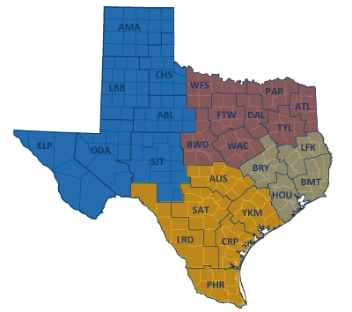
TxDOT Priorities
SAFETY
Our staff, our community
Emergency response
CONNECTIVITY
Reliability of the transportation network
Asset management
*BRIDGES*
Efficiency and efficacy
For TxDOT
For other/all jurisdictions
Slide: Rose Marie Klee, TxDOT

Slide 3
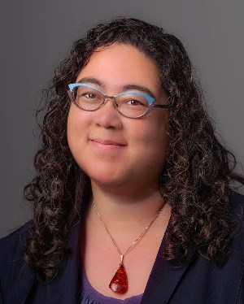
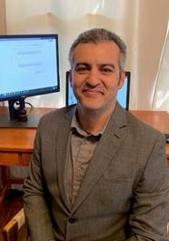
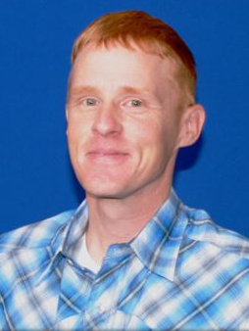
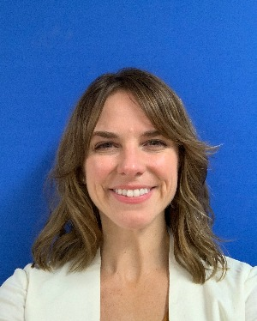
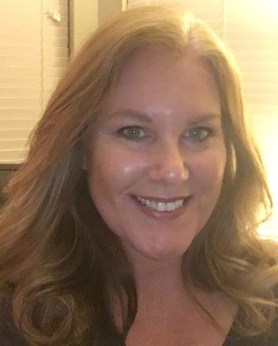
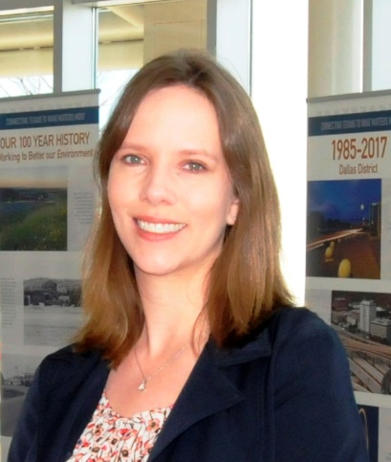
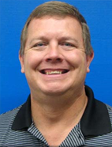
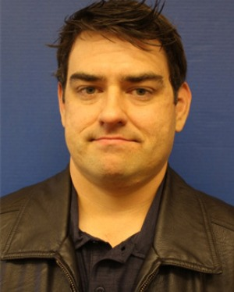
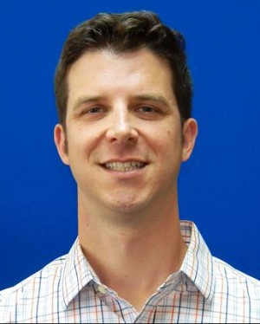
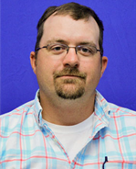
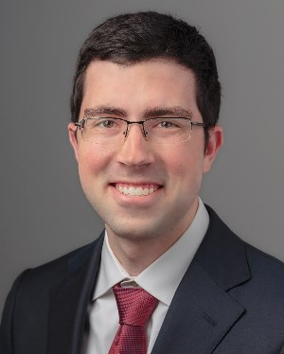
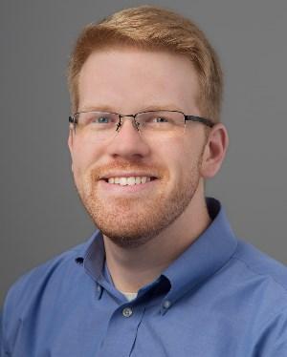
TxDOT Project Management Committee
Welcome to four new members,
Jennifer Lash and LaDonna Waters!
Ryan Eaves and Drake Builta!
Rose Marie Klee H&H Section Director DES
Abderrahmane Maamar-Tayeb
H&H Section Team Lead DES
Trent Ellis H&H Engineer DES
Matthew Heinze TxDOT Emerg Mgmt Coord MNT
Jennifer Lash GIS Program Leader TPP
LaDonna Waters Lead Hydraulics Engineer BMT
Shelley Pridgen Research Project Manager RTI
Adam Jack Dir of Trans Plan & Dev BMT
Andrew Lee District Bridge Engineer BMT
Joseph Goessling
Lead Hydraulics Engineer
AUS
Jared Browder Maintenance Assess Spec MNT
Ryan Eaves Geotech Brch Mgr BRG
Drake Builta
Bridge Info Grp Lead
BRG

Slide 4
Project Advisory Committee
NOAA National Weather Service | State and Local Agencies
Jason Johnson, West Gulf River Forecast Center | Sam Marie Hermitte, TWDB
Paul McKee, Southern Region HQ | Jorge Urquidi, City of Austin, Flood Early Warning System
Paul Yura, Austin/San Antonio Weather Forecast Office (WFO) | Christina Bryant, City of Austin, Flood Early Warning System
Katie Landry-Guyton, Houston/Galveston WFO | Justin Terry, Harris County Flood Control District
Amanda Schroeder, Dallas/Fort Worth WFO | Peter Smith, former TxDOT Director TPP
Welcome to
the Discussion!
NOAA Weather Forecast Office Service Hydrologists*
Jonathan Brazzell, Lake Charles, LA, WFO
Melissa Huffman, Christina Barron, Corpus Christi WFO
+ other members of the H&H Section,
TxDOT Design Division:
Sauda Ahmed | Lucinda Soto
Hiruy Berhe | Jaime Villena-Morales
Zenia De Leon | Marissa Williams
* To discuss gauges in their area

Slide 5
Streamflow II Overview Meeting Agenda
Task 1: Project Management
Task 2: Watershed Selection and Site Evaluation Task 3: Gauge Installation, Operation and Maintenance
Task 4: Flood Forecast System Operation Task 5: Forecast Model Assessment
Task 6: Flood Manual and Training
Part 1 – TxDOT-USGS
Flood Data
Part 2 – TxDOT Flood
Information

Slide 6
Streamflow II Overview Meeting Agenda
Task 1: Project Management
Task 2: Watershed Selection and Site Evaluation Task 3: Gauge Installation, Operation and Maintenance
Task 4: Flood Forecast System Operation Task 5: Forecast Model Assessment
Task 6: Flood Manual and Training
Part 1 – TxDOT-USGS
Flood Data
Part 2 – TxDOT Flood
Information

Slide 7
Task 1: Project Management
David Maidment, UT Austin
Achievements during last Quarter (September to November)
Completed selection of Phase 2 Gauge Sites
Developed Hydrology Base Map
Mapping and charting of flooded roads data from HCRS
Visit to Beaumont District on 16-17 November
Challenges for Next Quarter (December to February)
Complete installations of most Phase 2 Gauges
Complete Flood Maps for TS Imelda in BMT District
Complete Flood Emergency Response Exercise in BMT
Begin planning for September Exercise

Slide 8
Task 2: Watershed Selection and Site Evaluation
Achievements during last Quarter
Completed Phase 2 Gauge Site Selection
Challenges for Next Quarter
Complete Amendment to TM2 that documents selection of Phase 2 Gauge sites

Slide 9
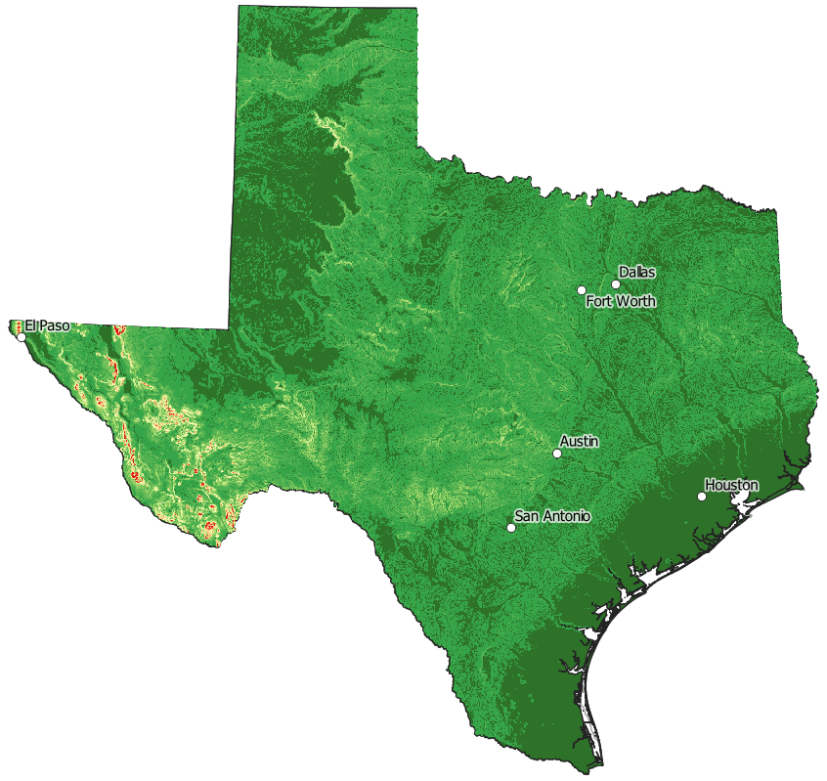
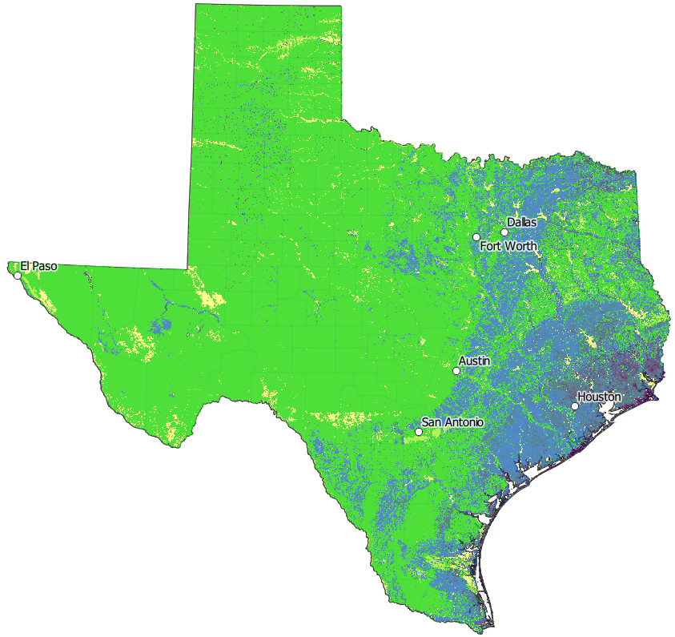
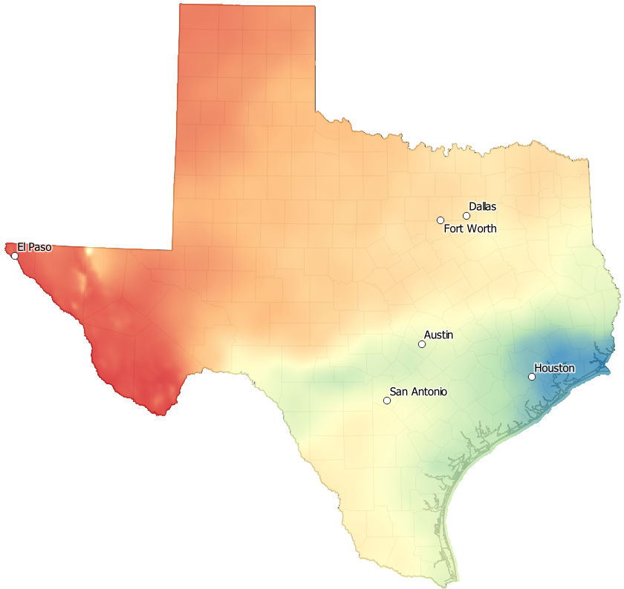
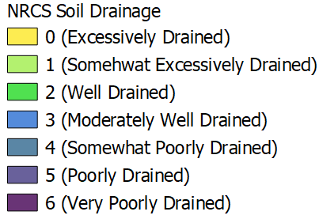
Flood Risk Factors have a Combined Gradient from the Coast towards Inland
Flat
Slope
Poor Drainage
High
Rain

Slide 10
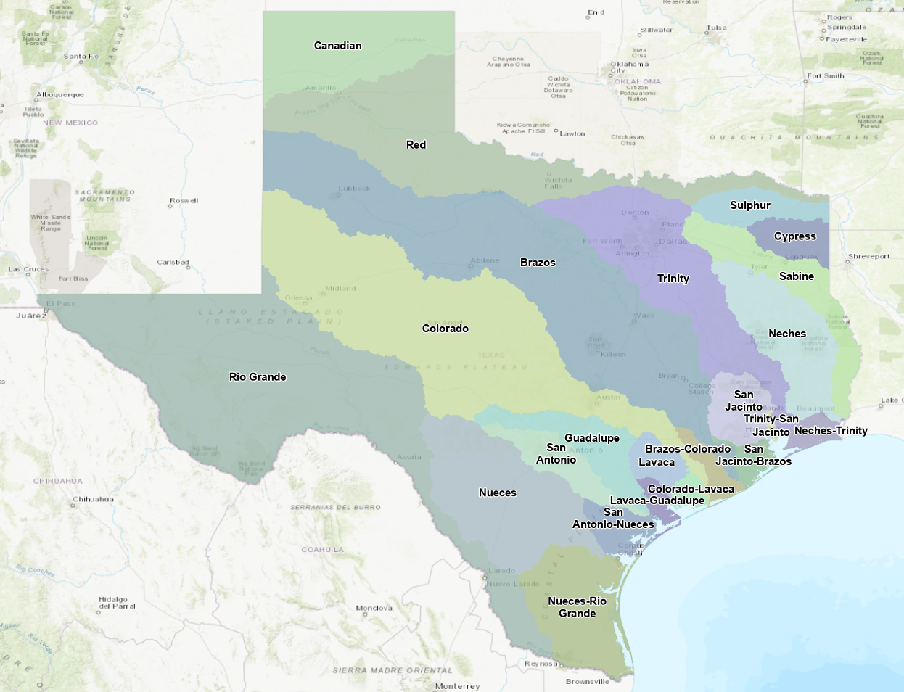
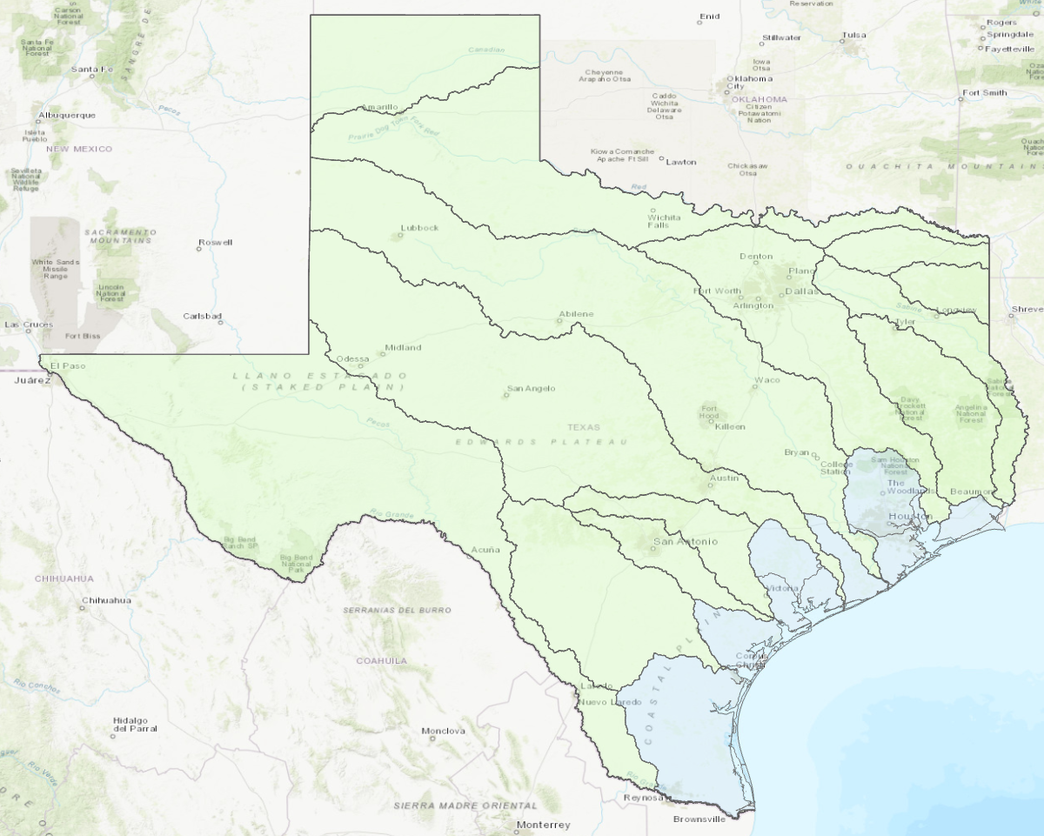
Texas Drainage Basins – Two Types, Inland and Coastal Basins
Inland River Basins
Moderate slope
Well drained
Lesser rainfall
Coastal Basins
Low slope
Poor drainage
High rainfall

Slide 11
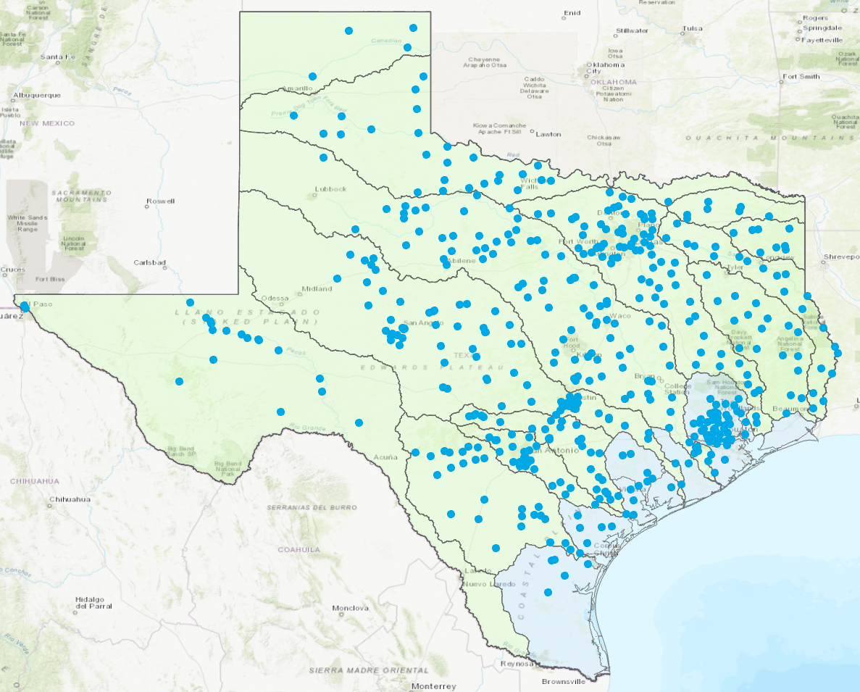
How to Site TxDOT Gauges?
Streamflow II: How do we place 80 gauges
to supplement the current USGS gauge network?
From RFP: “Determine spatial distribution between gauge locations with a gauge network that is distributed and spaced to better represent the flow in the system, which will produce and improve the TxDOT Flood Forecast System. The distribution should be scalable to other watersheds.”
USGS Stream Gauges

Slide 12
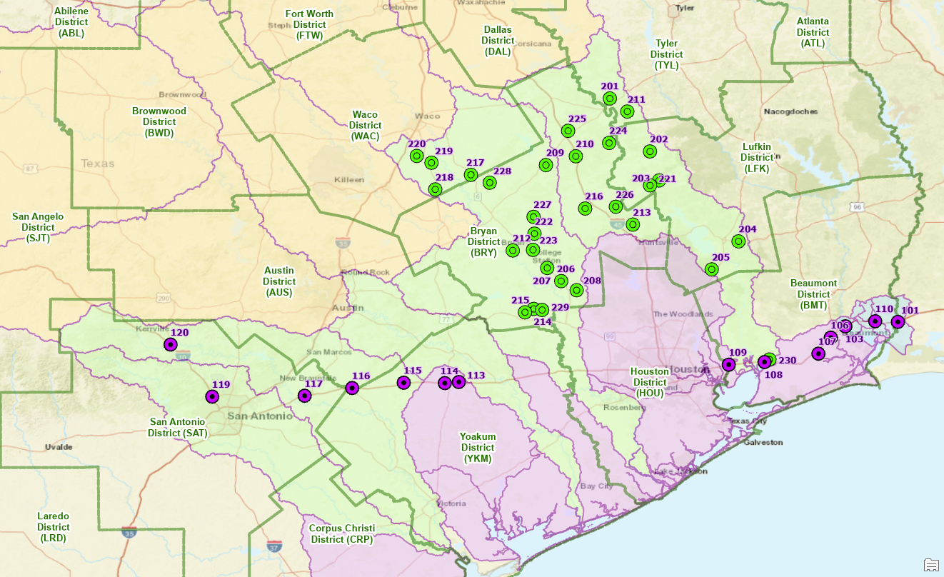
Previous Site Selection (Inland River Basins)
Installed in Streamflow I (2017– 2019)
Installed for Phase 1 of Streamflow II

Slide 13
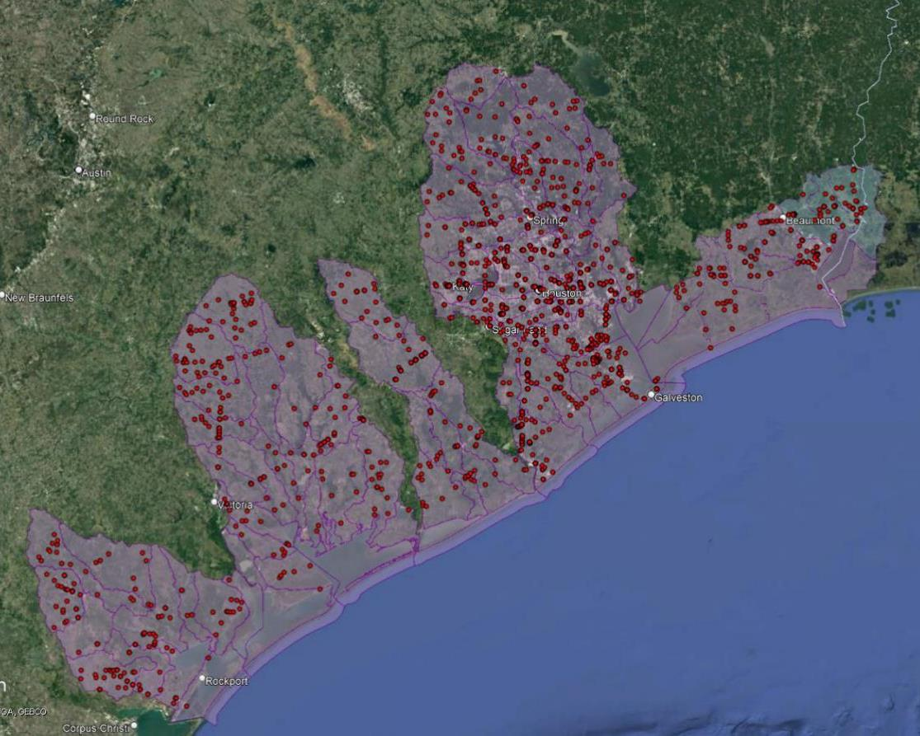
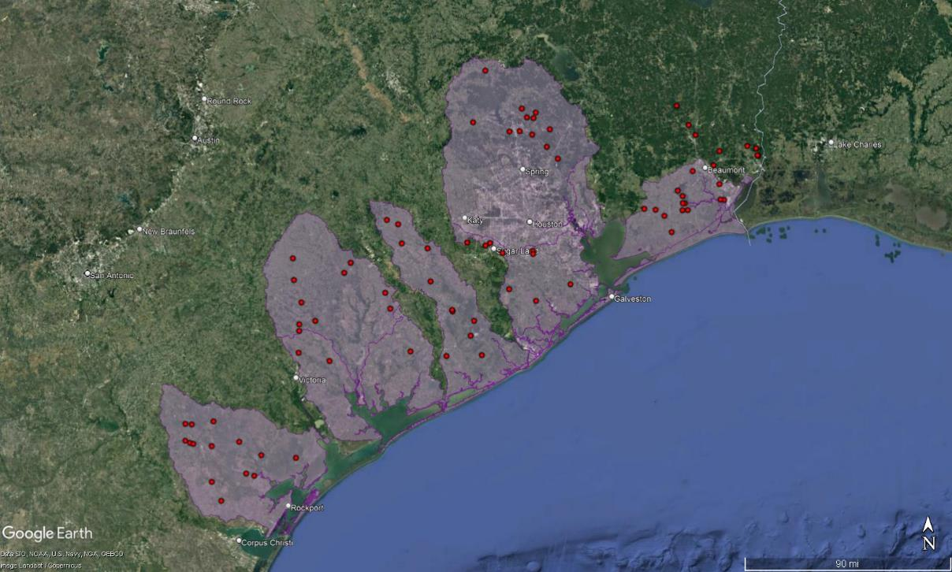
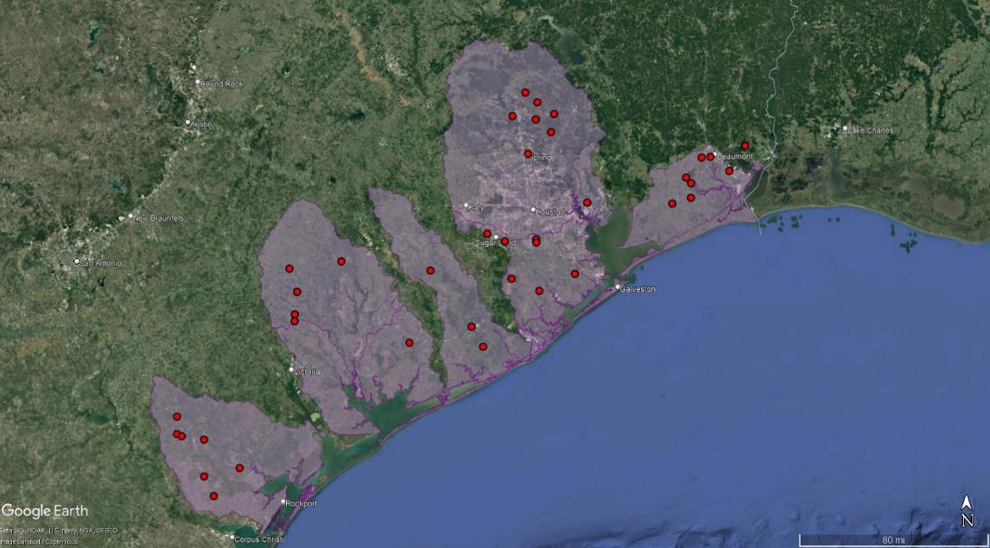
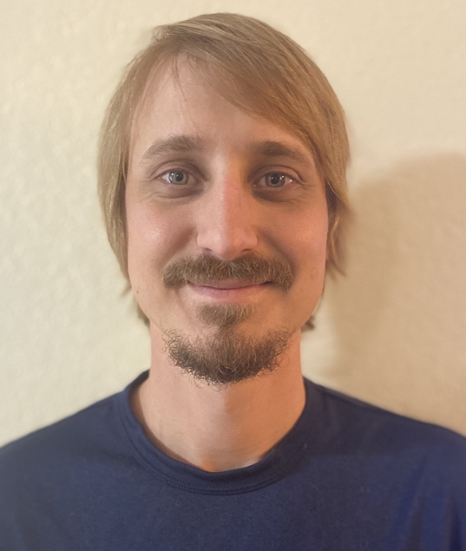
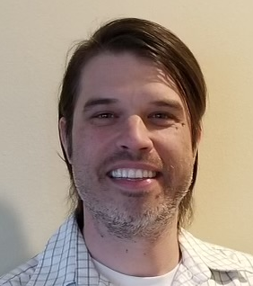
Phase 2 of Streamflow II Site Selection: Bridges Selected for Evaluation
Desktop Reconnaissance | 1402 | Bridges
Field Reconnaissance | 91 | Bridges
Scott Grzyb
Jody Avant
and their colleagues …
… thanks for all your hard work!
Selected Sites | 39 | Bridges
Scott Grzyb

Slide 14
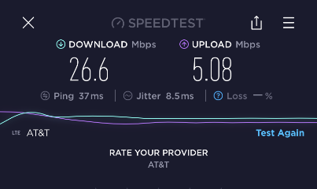
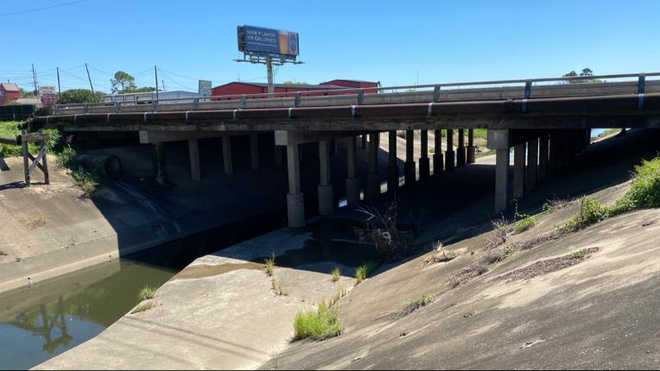
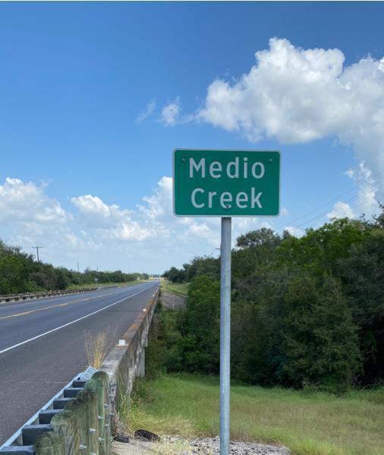
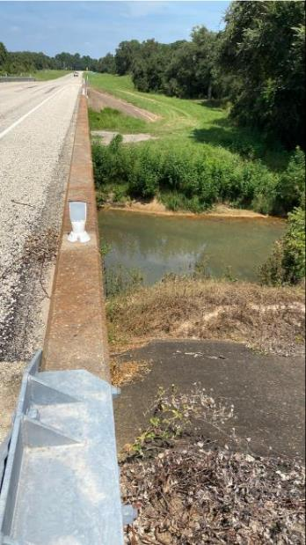
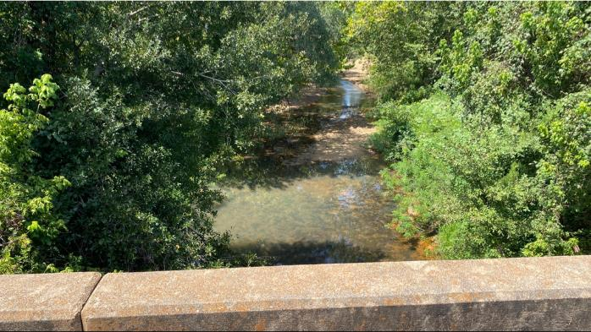
Field Reconnaissance Criteria
Speed tests for modem transmission
Cross-section / bridge deck views and pier configurations
Channel identification
Channel straightness and velocity sensor obstructions
Measurement section view

Slide 15
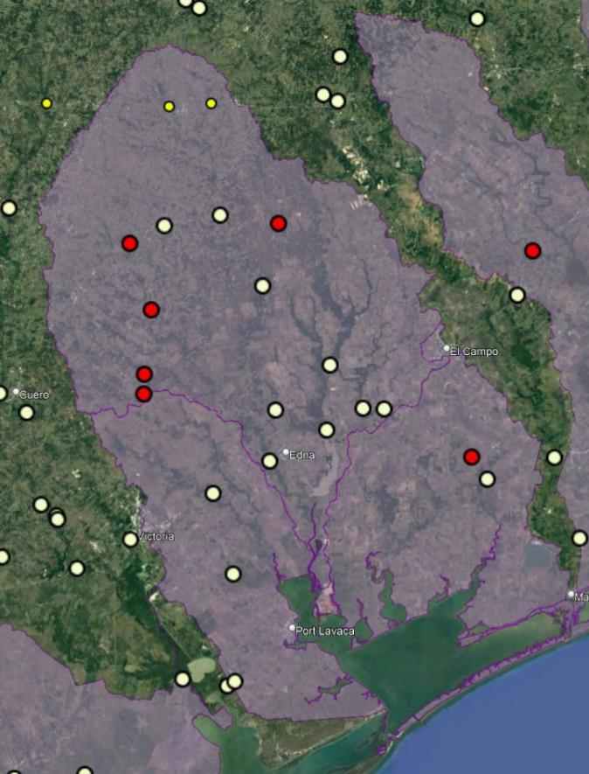
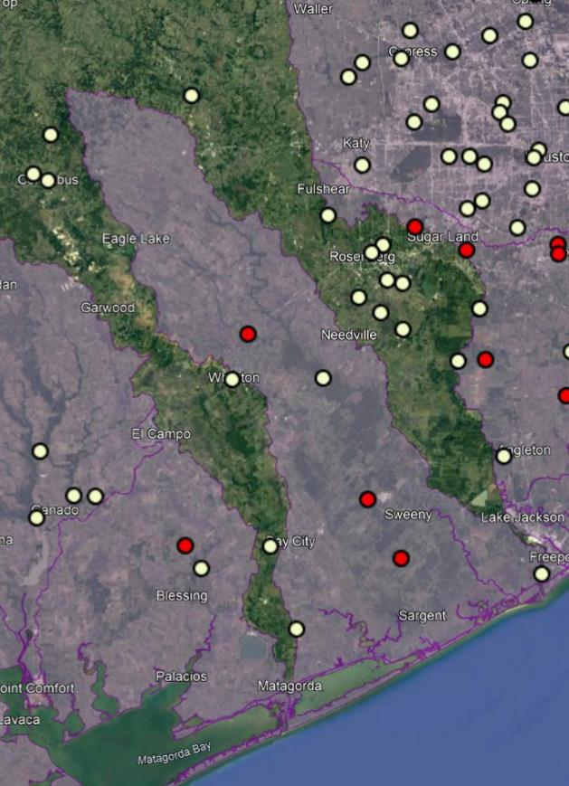
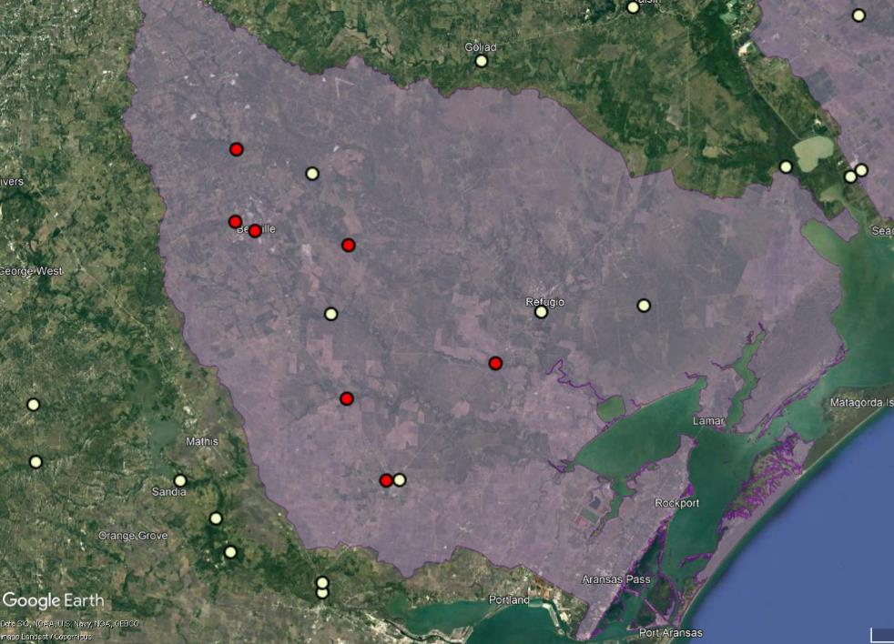
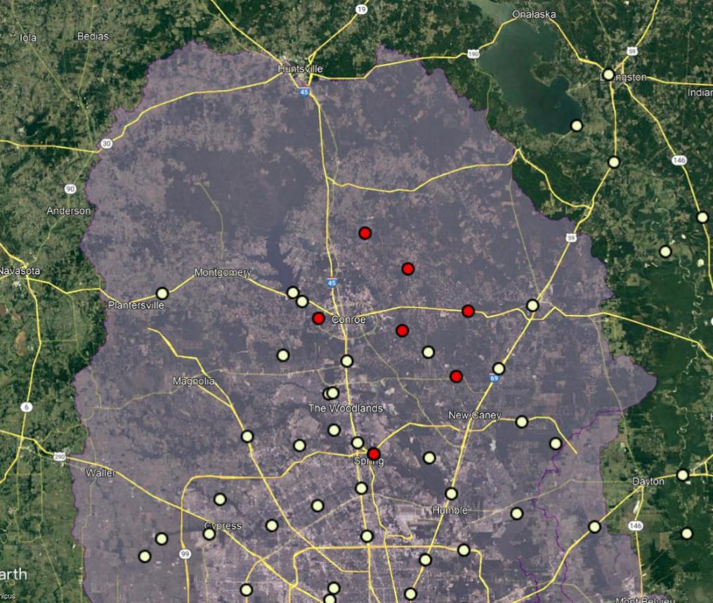
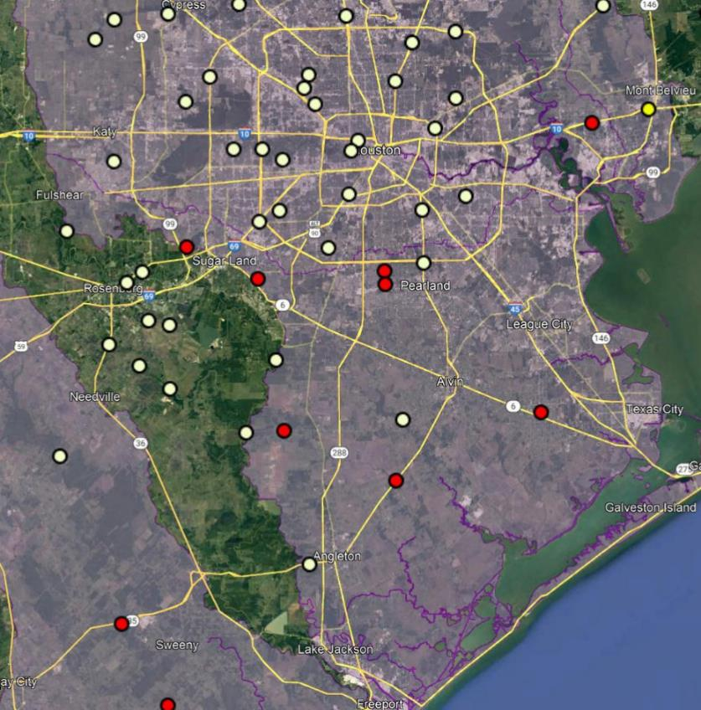
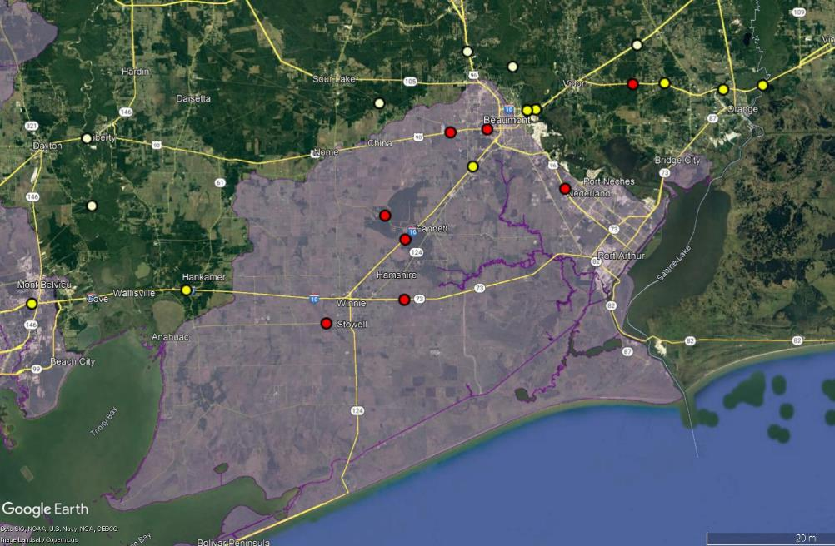
Final Site Selections for Phase 2 of Streamflow II
Corpus Christi
Victoria
Yoakum
USGS Gauges
Phase 2 Installs
Streamflow I Gauges
7 Streamflow II Gauges
6 Streamflow II Gauges
3 Streamflow II Gauges
North Houston
South Houston
Beaumont
7 Streamflow II Gauges
8 Streamflow II Gauges
8 Streamflow II Gauges

Slide 16
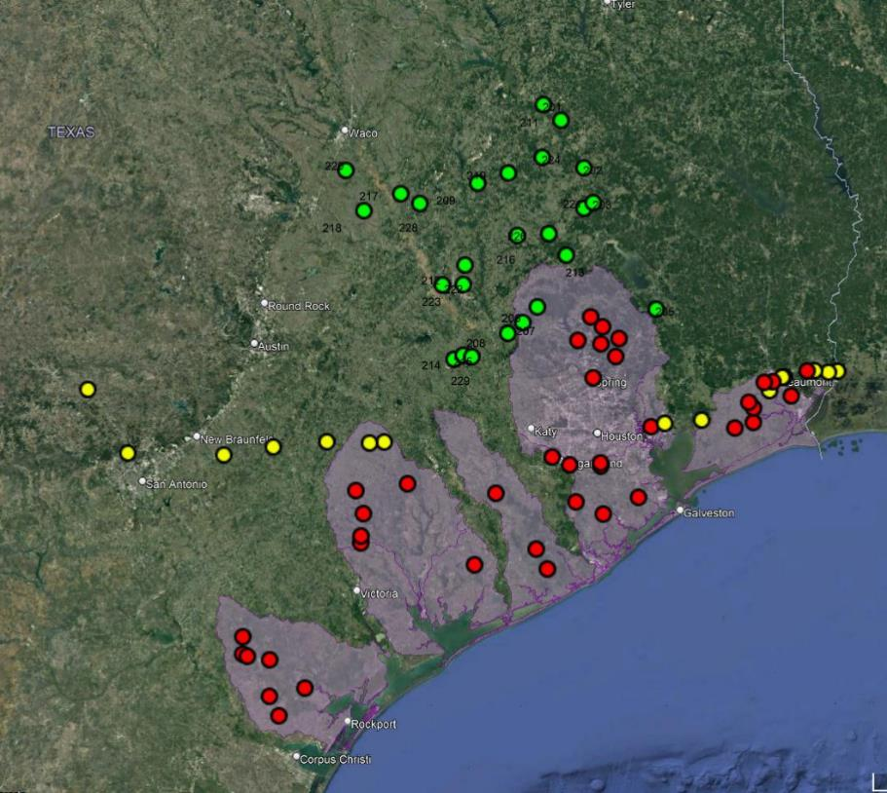
Final Selections – 80 sites
Combined Total of 80 Gauges
Phase 2 Installs
Streamflow I Gauges
Phase I Installs

Slide 17
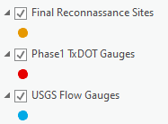
Two clusters of Streamflow II gauge sites
Large riverine basins,
spatially lumped
Inland Cluster
Approximately doubles
USGS gauge density
in chosen watersheds
Provides coastal flow
gauging in Beaumont
District where none
exists now
Spacing is approximately
one gauge per HUC10
watershed considering
TxDOT and USGS
gauges together
Coastal Cluster
Small coastal basins
spatially dispersed

Slide 18
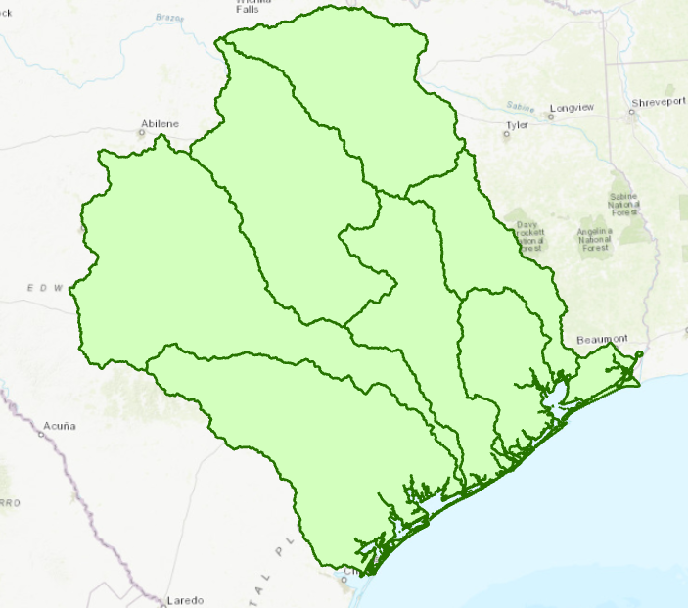
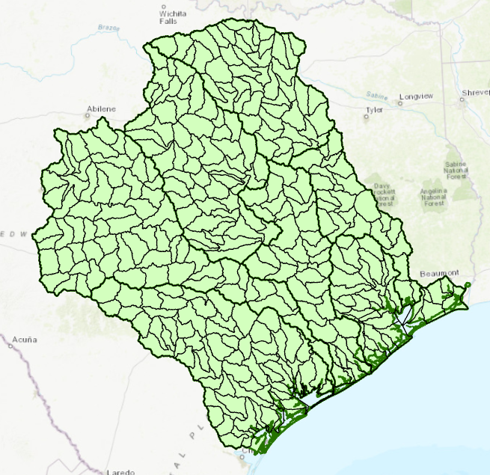
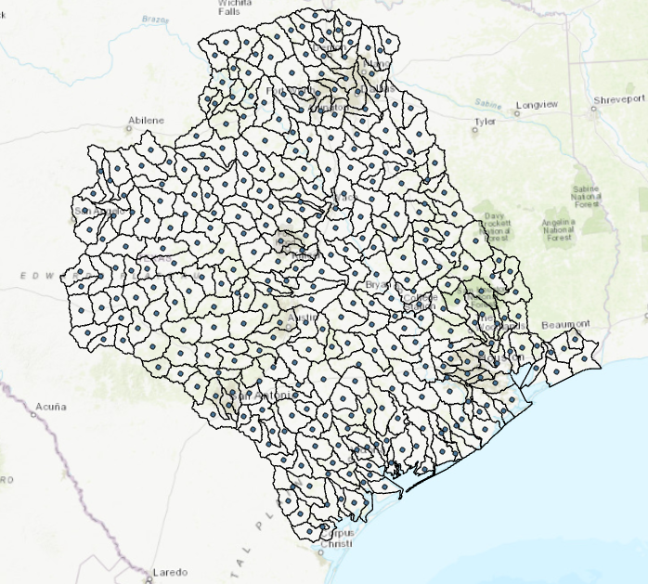
HUC10 Watersheds as Sampling Units
Spacing is approximately
one gauge per HUC10
watershed considering
TxDOT and USGS
gauges together
Priority HUC6 Basins
HUC10 Watersheds
HUC10 Centroids
Mean watershed area = 269 Sq. Mi.
$\sqrt{Watershed area }$ = 16.4 Mi.

Slide 19
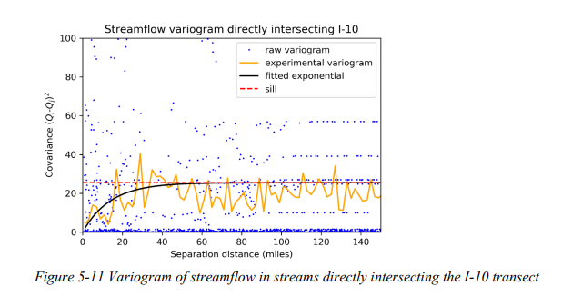
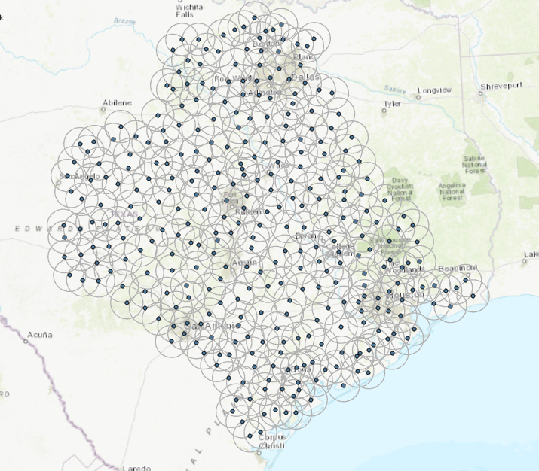
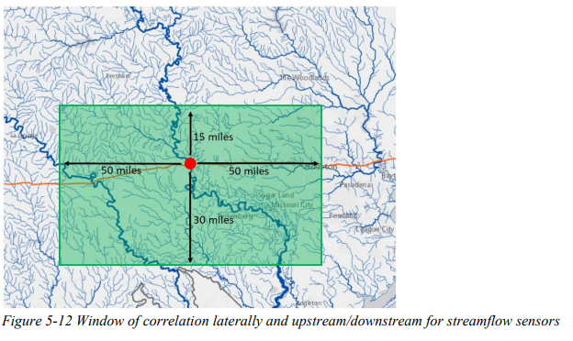
Spatial Correlation of Streamflow
Conclusion: A gauge density of one gauge/HUC10 unit
will show significant flow correlation among gauges
https://library.ctr.utexas.edu/ctr-publications/5-9054-01-1.pdf
HUC10 Centroids with 15 Mile buffer zone

Slide 20
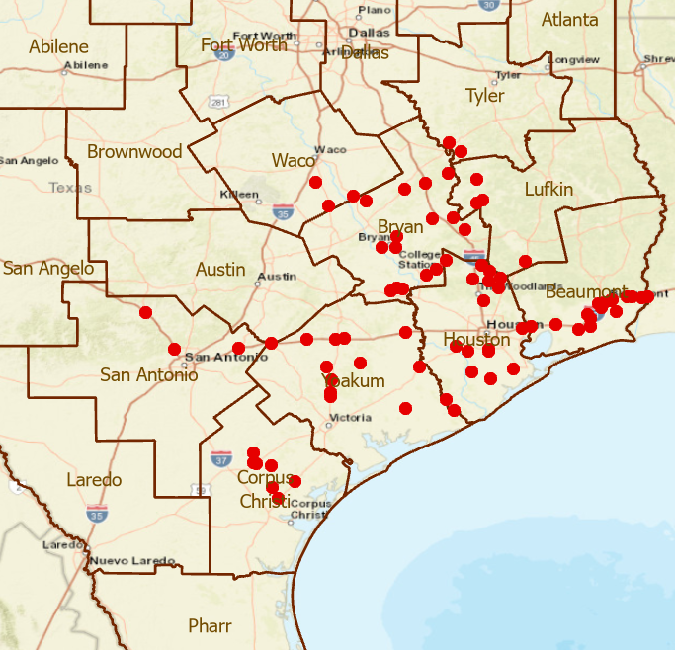
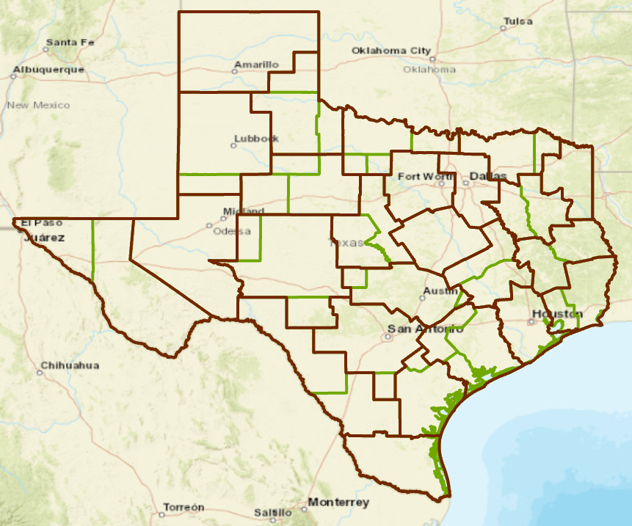
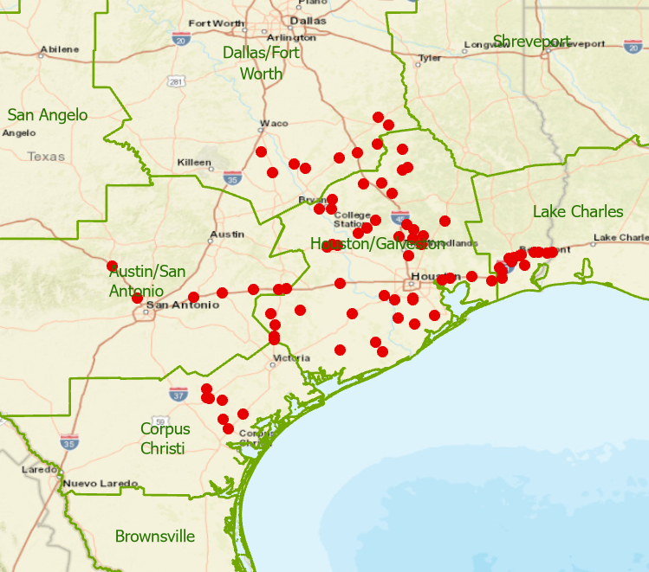
Distribution of 80 New TxDOT Gauges
25 TxDOT Districts 13 Weather Forecast Offices
form 82 distinct intersection areas
Need a Common Operating Picture
TxDOT Districts
NWS Weather Forecast Offices
Jonathan Brazzell
Katie Landry-Guyton
Amanda Schroeder
Melissa Huffman, Christina Barron
Paul Yura

Slide 21
Task 3: Gauge Installation, Operation and Maintenance
Scott Grzyb, US Geological Survey
Achievements during last Quarter
77 recorded visits to installed gauges
39 GNSS surveys performed
Preliminary stage-discharge ratings started
Challenges for Next Quarter
Complete preliminary ratings for all Tier 1 and Tier 2 gauges.
Complete the installation of 43 gauges.

Slide 22
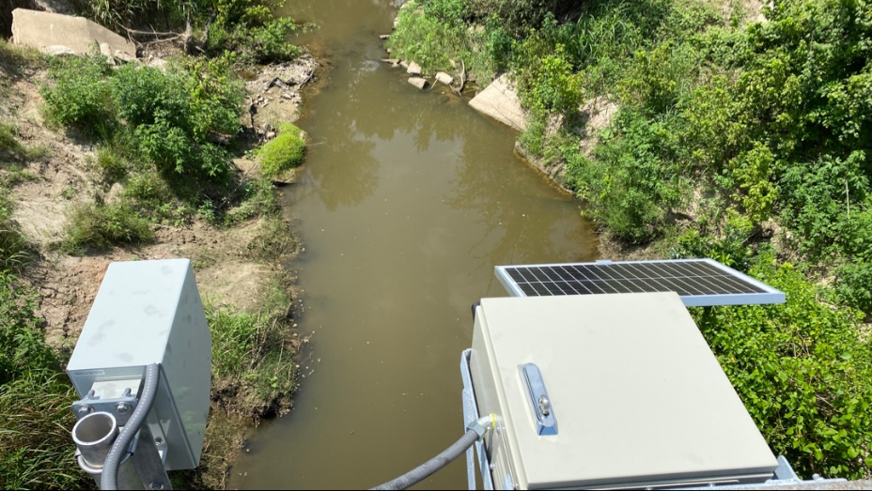
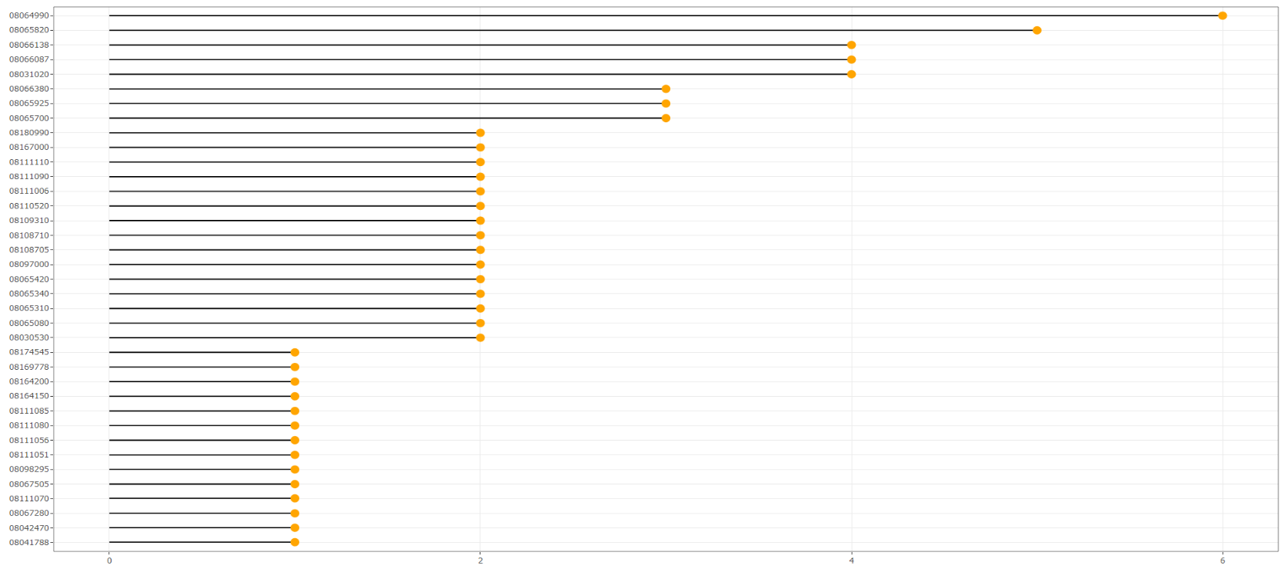
Gauge Visits
Station Number
77 recorded visits to installed gauges
0
1
2
3
4
5
6
Number of Site Visits

Slide 23
Gauge Height Verification
Gauge height (ft)
Date/Time

Slide 24
Peak Verification

Slide 25
Discharge Measurements
Handheld Acoustic Doppler velocimeter
Acoustic Doppler Current Profiler

Slide 26
Preliminary Rating Development
Discharge Measurement
Rating Point

Slide 27
Early discharge observations
July 2021 – Before Reconstruction
USGS Peak Discharge – 665 cfs
RQ-30 Peak Discharge – 680 cfs
November 2021 – Post Reconstruction
USGS Peak Discharge – 1,539 cfs
RQ-30 Peak Discharge – 1,500 cfs
Discharge ( cfs )
Date

Slide 28
Early discharge observations
Discharge ( cfs )
– Before Reconstruction
– Post Reconstruction
USGS Discharge
RQ-30 Discharge
USGS Discharge
RQ-30 Discharge
Date

Slide 29
Part 1: Topics for Discussion
Gauge Siting:
Completed Field Reconnaissance and
for Phase 2 Gauge Sites (September to November)
Need to Get Gauges Done – research team coordinates with TxDOT biweekly until all gauges are installed
Does Project Management Committee approve proposed 42 gauge sites?
Emerging TxDOT Streamflow Data
Could these data be used to improve flood briefings by NWS for TxDOT?

Slide 30
Streamflow II Overview Meeting Agenda
Task 1: Project Management
Task 2: Watershed Selection and Site Evaluation Task 3: Gauge Installation, Operation and Maintenance
Task 4: Flood Forecast System Operation Task 5: Forecast Model Assessment
Task 6: Flood Manual and Training
Part 1 – TxDOT-USGS
Flood Data
Part 2 – TxDOT Flood
Information

Slide 31
Geospatial Systems Are Helping Us Understand
Understanding
Sharing and Collaboration
Knowledge
Information
Integration
Mapping
Data
. . . Helping Us Make Better Decisions
Slide: Jack Dangermond

Slide 32
Observation, Forecasting, Planning, Operations
Understanding
Sharing and Collaboration
Knowledge
TxDOT Maintenance – TxERA
National Weather Service Maps
Information
Integration
TxDOT Flood Maps
Mapping
Data
Kisters Datasphere
TxDOT - USGS Data

Slide 33
TxDOT Flood Forecasting
National Weather Service
Current
conditions
TxERA – TxDOT Emergency
Response Application:
layers of map services
Forecasting
TxDOT Flood Information
VEOCI: text alerts
Inundation Extent
Flooded Roads
Flooded Bridges
Observation Gauges
Hydrology Base Map

Slide 34
Flood Information: Five Map Layers
Inundation Extent
Flooded Roads
Flooded Bridges
Observation Gauges
Hydrology Base Map

Slide 35
Task 4: Flood Forecast System Operation
Matt Ables, KISTERS
Achievements during last Quarter
Multiple enhancements to Datasphere API
Inclusion of runtime calculations (transformations)
Get Last Value csv
Call NWM forecast by gauge, COMID, or Lat/Long
Addition of NWM Forecast vs Gauge data time series
Moved tested import sources and calculations from Dev system to Production
Challenges for Next Quarter
Continue with enhancements to Datasphere API
Allows better integration with TxERA / ESRI
Expansion of NWM Forecast vs Gauge data time series
Continue to move the system into production mode
Add new TxDOT gauges

Slide 36
Observations Map of Water Levels
9:07AM, 7 Dec 2021
Web site of Jefferson County Drainage District 6
Color coded levels for map display
30
25
20
Elevation (ft)
15
10
5
0
Surveyed Elevations
https://dd6.onerain.com/map/?view=46175b76-5b3a-4ea0-bdde-6e8475c64117
Credit: Craig Cormier, Josh Broussard, Jefferson County DD6

Slide 37
Datasphere to TxERA and VEOCI integration
Datasphere API can call each channel and
transform the data as needed
API Enhancements
API Call
To Map
Datasphere Channels allow the desired data
products to be published as a service

Slide 38
Task 5: Forecast Model Assessment
Paola Passalacqua, UT Austin
Achievements during last Quarter
Initiated analysis of stage-velocity relationship at sensors
Getting familiar with ADCP data
Developed HAND-based approach for storm surge inundation
Challenges for Next Quarter
Automate detection of storm and analysis of stage-velocity relationship at sensors
Analysis of ADCP data
Validation of coastal HAND approach and integration with fluvial inundation approach GeoFlood
Data Assimilation
Building an Entwine point cloud at TACC to support 3D Bridges and Roads

Slide 39
Investigating the stage-velocity relationship at radar stations

Slide 40
Storm surge calculation
Coastal HAND approach was used to calculated storm surge
Storm surge was applied to the unfiltered “raw” DEM
Currently implemented in a Jupyter notebook with the rasterio and numpy python libraries

Slide 41
Simulation of compound flooding
Classic GeoFlood riverine inundation map is combined with storm surge inundation
If a cell experiences both riverine and storm surge inundation, the greater value is chosen

Slide 42
Bridge Characterization from a LIDAR Point Cloud
Andy Carter, UT Austin
3
Plan
Bridge over Shoal Creek at 15th St in Austin, Texas
Deck point density
1 point per 2.6 sq feet
11,078 LiDAR points
on bridge deck
Plan
Profile
Perspective

Slide 43
Texas LIDAR Point Cloud Data Seamless point cloud service with consistent classification
Entwine is a data organization library for massive point clouds, designed to conquer datasets of trillions of points.
325,000 tiles in 70 data collections
Some inconsistencies in classification
of types of points

Slide 44
Task 6: Flood Manual and Training
Harry Evans, UT Austin
Achievements during last Quarter
Challenges for Next Quarter
Interactions with the Beaumont District
Continued HSEEP Exercise Planning
Nov 16-17 In-Person Meeting
Discussed logistics for Feb HSEEP
Reviewed Hydrology Base Map for useability
Presented new optional datasets (HCRS)
Interactions with TxDOT Statewide Emergency Management
Discussions with TxDOT Statewide Emergency Management regarding needs and requirements for Hydrology Base Map
Nov 30th In-Person Meeting
Brief on Feb HSEEP Exercise
Brief on what we are developing for Beaumont to make sure it is useful to the State (goal is to create something useful to entire State, not only Beaumont)
Conduct a successful HSEEP Exercise in Beaumont
Objective of exercise is clear and concise Improvement Plan
Harry Evans
Christine Thies
Larry Jantzen
Flood Emergency Response Team

Slide 45
TxDOT Priorities
How to implement these goals
during flood emergency response?
SAFETY
Our staff, our community
Emergency response
CONNECTIVITY
Reliability of the transportation network
Asset management
*BRIDGES*
Efficiency and efficacy
For TxDOT
For other/all jurisdictions
Slide: Rose Marie Klee, TxDOT

Slide 46
Beaumont District Emergency Response Organization
District
(6 people)
Daytime Duty
State
(60 people)
Local
TxDOT Austin
Emergency
Operations Center
(Matthew Heinze)
Requests for
assistance
Maintenance Sections
(Maintenance Supervisor)
District Engineer (Martin Gonzalez)
Newton
(Cecil Wade)
TxDOT Beaumont
Emergency
Operations Center
Incident Command
(Chris Henry /
Kenneth Wiemers)
(Day /
Night)
Jasper
(JoEllen Miller)
Woodville
(Jay Castleberry)
Planning
(Adam Jack)
Logistics
(Keith Horn /
Scott Estes)
Administrative
(Heather Weeks)
Kountze
(Steven Singleton)
Orange
(Jody Hand)
12 hour shifts 7AM – 7PM
Operational briefings 6AM, 6PM
TxDOT Statewide Event (Weather) Call, 8AM
NWS BMT Weather briefings 10AM, 4PM
Liberty
(Tyrone Alexander)
Beaumont
(Kevin Emerson)
Operations
(Brad Murray /
John Sudela)
Port Arthur
(Carl Ray)
Anahuac
(Jake Taylor)
Organized within
Maintenance Sections

Slide 47
HSEEP Exercise Homeland Security Exercise Evaluation Program
HSEEP uses “best practices” to provide guiding principles for a common and professional approach to exercise design and development. This approach provides a format for product evaluation and improvement planning.
These exercises will be the component to evaluate the usefulness of Streamflow II’s gauge data and the presentation of that data.
The HSEEP exercise provides the opportunity to assess and validate the efficacy of the data and address areas for improvement in accessibility and presentation of the data.
Outcome: Improvement Plan
Lists corrective actions based on exercise findings
Lists responsible owner for corrective actions
Provides timeline for completion

Slide 48
February HSEEP Exercise
Date: February 22, 2022
4 hours
Starting at 1:00pm
Storm: TS Imelda
Focus: Maintenance Sections’ data needs during event
Exercise Planning Team: Harry Evans, Larry Jantzen, Christine Thies
Exercise Roles:
Facilitators – Provide exercise facilitation, situation updates, and moderate discussion. Runs the exercise. (Exercise Planning Team)
Observers – Provides support during the exercise. They are TxDOT subject-matter experts and provide insight or questions to support players responses
Players – Role is to use and evaluate product. Active role doing their “Regular Job” (BMT, NWS)
Evaluators – Observe and document the exercise objectives
Computer screens in TxDOT BMT EOC

Slide 49
Demo of Flood Map Overlays by Christine Thies
https://arcg.is/5zX0m0

Slide 50
Exercise Maps
Hydrology Basemap: https://arcg.is/5zX0m0
Paper Maps:

Slide 51
9/19/19
12:00 AM
Minor
Flooding

Slide 52
9/19/19
6:00 PM
Max
Flooding

Slide 53
9/22/19
6:00 PM
Recede

Slide 54
Road Closure due to Flooding -- Visualized in DriveTexas.org
Flood Closure
IH-10 Closure
Road closure data in DriveTexas.org
are stored in the TxDOT Highway
Conditions Reporting System
Duration = 7.83 hours
Length = 9.74 miles
Impact = 7.83 * 9.74 = 76.3 day- miles

Slide 55
Closure of IH-10 during TS Imelda
National Water Model Retrospective Simulation
Road closure data from
TxDOT Highway Conditions Reporting System
which underlies “DriveTexas.org”
Streamflow Hydrograph
IH-10 Closure
IH-10 was closed
From 4:13 AM to 12 noon
on 19 September 2019
National Water Model
retrospective simulation
peaks then.

Slide 56
Flooded Roads “Hydrograph”
Sum the length of road closures at each time point
Quantifies the flood threat: How Large is it? Where is it? When is it?
TS Imelda
total impact = 1576 day-miles
of flooding on TxDOT roads
(area under curve)

Slide 57
Cumulative Road Closures due to Flooding in Texas March 2014 to November 2021. Data from TxDOT Highway Conditions Reporting System (HCRS)
May, July 2021
South, North Texas
Sept 2019 TS Imelda
Oct 2018 Colorado Flood
Aug 2017 Hurricane Harvey
May 2016 Brazos Flood
Oct 2015 Halloween Flood
May 2015 (Blanco and Regional Flood)
Sept 2014 (Hill Country Flood)

Slide 58
Demo by Tim Whiteaker – TxDOT Flooded Roads

Slide 59
Part 2: Topics for Discussion
Shared Map Services
Is a system of sharing map services between NWS and TxDOT feasible?
How best should the content of those services be defined?
Could there be custom map layers defined directly from AssetWise?
Bridge Characterization
LIDAR description of bridges in 3D
How to build a flood hydraulic model for each bridge?
Flooded Roads Hydrograph
Is this a useful concept?
Could it be forecast like a streamflow hydrograph?
Implementation of Observations Map of Water Levels
Datasphere to TxERA and VEOCI?
Test in Beaumont Exercise in Feb 2022?
September 2022 Flood Exercise
First plan was to engage Austin District
Instead, a regional exercise across several TxDOT Districts?
Other Issues …

