Slide 1
Evaluate Improved Streamflow Measurement at TxDOT Bridges Project 0-7095 Being conducted for TxDOT by UT Austin and US Geological Survey with the support of Kisters North America and Aqua Strategies September 2020 to August 2023
Presentation for Second Quarterly Review Meeting, Monday 8 March 2021
Acknowledgements: Shelley Pridgen (RTI Project Manager), Rose Marie Klee (H&H Director, TxDOT),
Trent Ellis (BRG, TxDOT), Michael Cunningham (TPP, TxDOT)

Slide 2
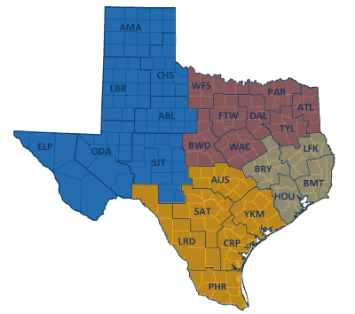
TxDOT Priorities
SAFETY
Our staff, our community
Emergency response
CONNECTIVITY
Reliability of the transportation network
Asset management
*BRIDGES*
Efficiency and efficacy
For TxDOT
For other/all jurisdictions
Slide: Rose Marie Klee, TxDOT

Slide 3
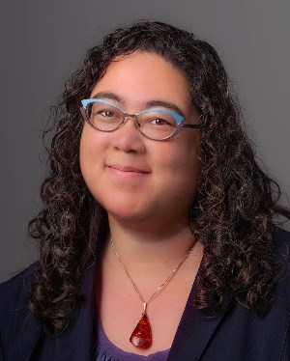
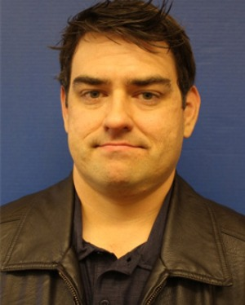
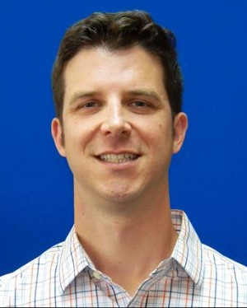
TxDOT Project Management Committee
Shelley Pridgen Research Project Manager, RTI
Rose Marie Klee H&H Section Director, DES
Abderrahmane Maamar-Tayeb
H&H Section Team Lead, DES
Trent Ellis Bridge Scour Coordinator, BRG
Adam Jack Dir of Trans Plan & Development, BMT
Andrew Lee District Bridge Engineer, BMT
Joseph Goessling
Lead Hydraulics Engineer, AUS
Jared Browder Maintenance Assess Spec, MNT

Slide 4
Project Advisory Committee
Jason Johnson, NOAA National Weather Service Mark Lenz, NOAA National Weather Service
Paul Yura, NOAA National Weather Service
Sam Marie Hermitte, Texas Water Development Board
Jorge Urquidi, City of Austin, Flood Early Warning System
Justin Terry, Harris County Flood Control District
Randy Charbeneau, UT Professor Emeritus of Civil Engineering Peter Smith, former TxDOT Dir of Trans Planning and Programs
Sauda Ahmed, H&H section, TxDOT Design Division Hiruy Berhe, H&H section, TxDOT Design Division
Lucinda Soto, H&H section, TxDOT Design Division
Jaime Villena-Morales, H&H section, TxDOT Design Division
Welcome to
the Discussion!

Slide 5
Streamflow II Overview Meeting Agenda
1. Project Concept

Slide 6
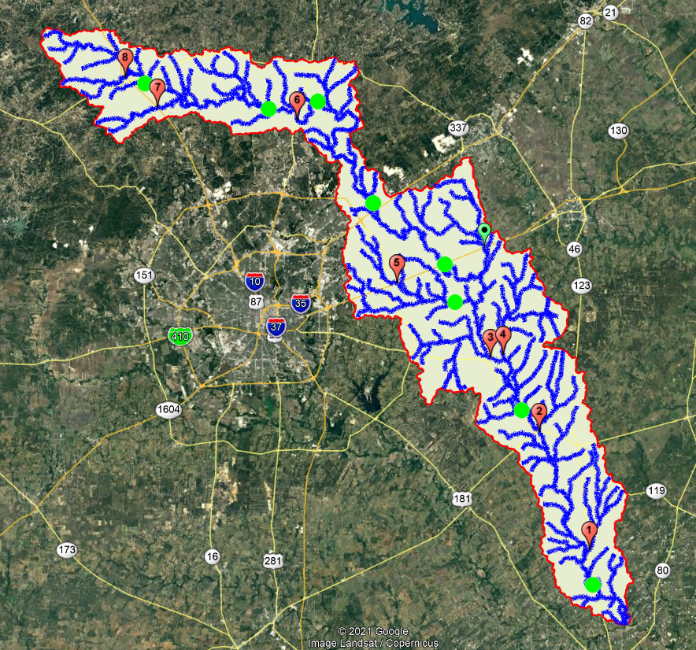
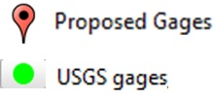
Streamflow II Overview Meeting Agenda
1. Project Concept
2. Site Selection and gauge installation
Scott Grzyb (USGS), David Arctur
and Tim Whiteaker (UT Austin)

Slide 7
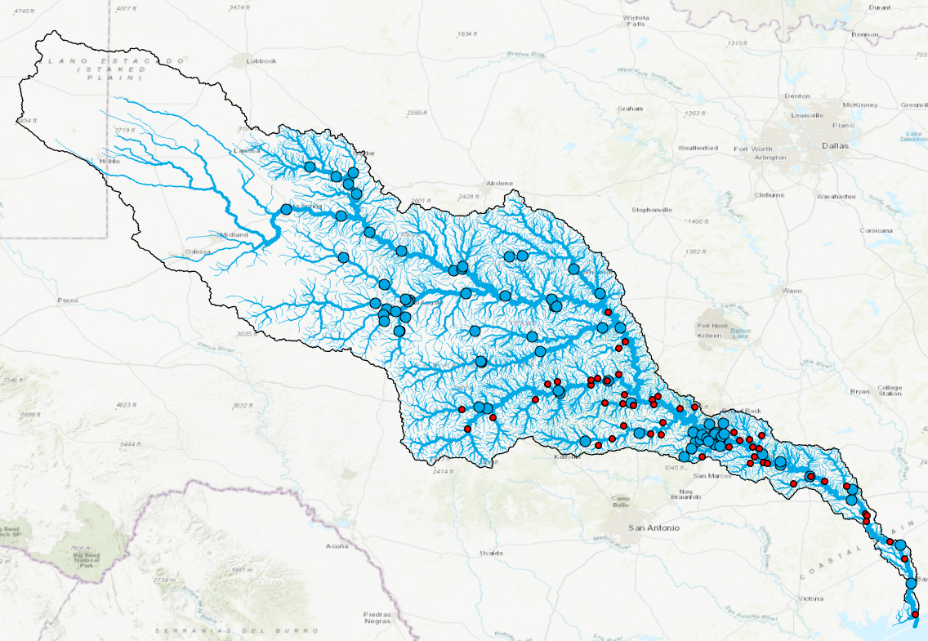
Streamflow II Overview Meeting Agenda
1. Project Concept
2. Site Selection 3. Data Assembly and Prediction Testbed
Scott Grzyb (USGS), David Arctur
and Tim Whiteaker (UT Austin)
Paola Passalacqua (UT Austin)
and Dirk Schwanenberg (Kisters)

Slide 8
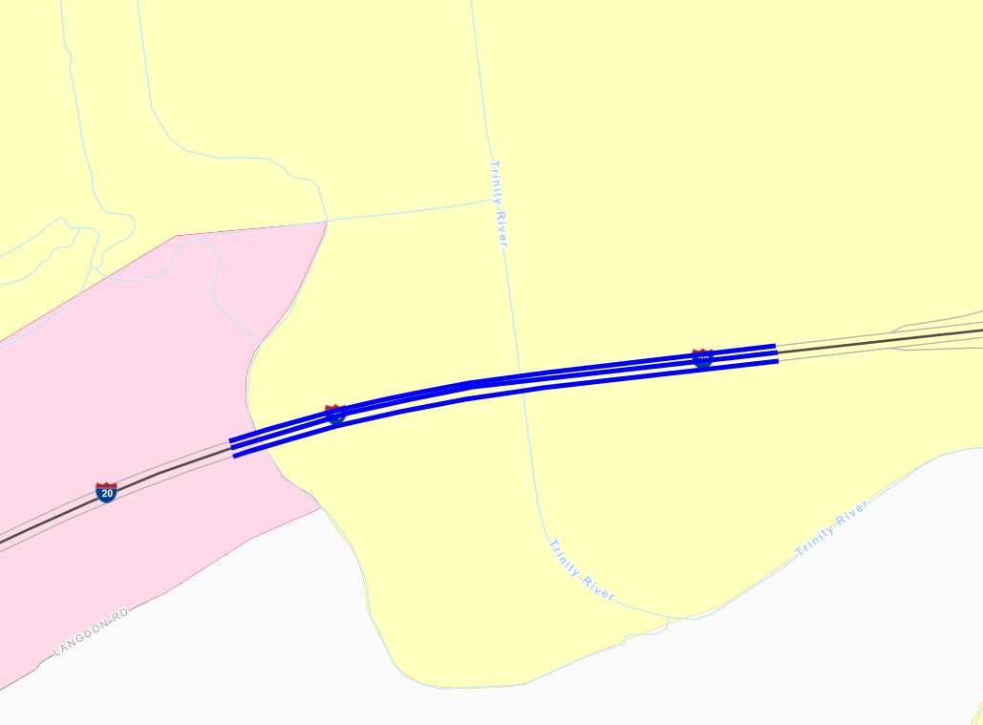
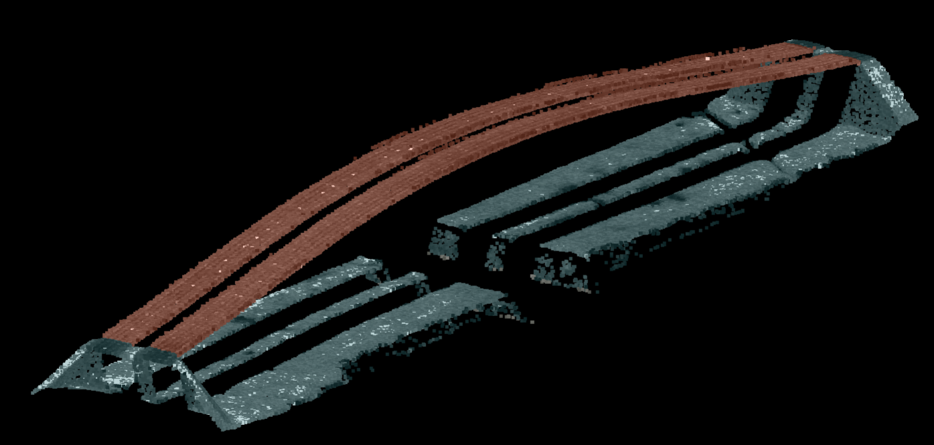
Streamflow II Overview Meeting Agenda
1. Project Concept
2. Site Selection and gauge installation 3. Data Assembly and Prediction Testbed 4. Streams to Roads and Bridges
Andy Carter and
David Maidment (UT Austin)
Scott Grzyb (USGS), David Arctur
and Tim Whiteaker (UT Austin)
Paola Passalacqua (UT Austin)
and Dirk Schwanenberg (Kisters)

Slide 9
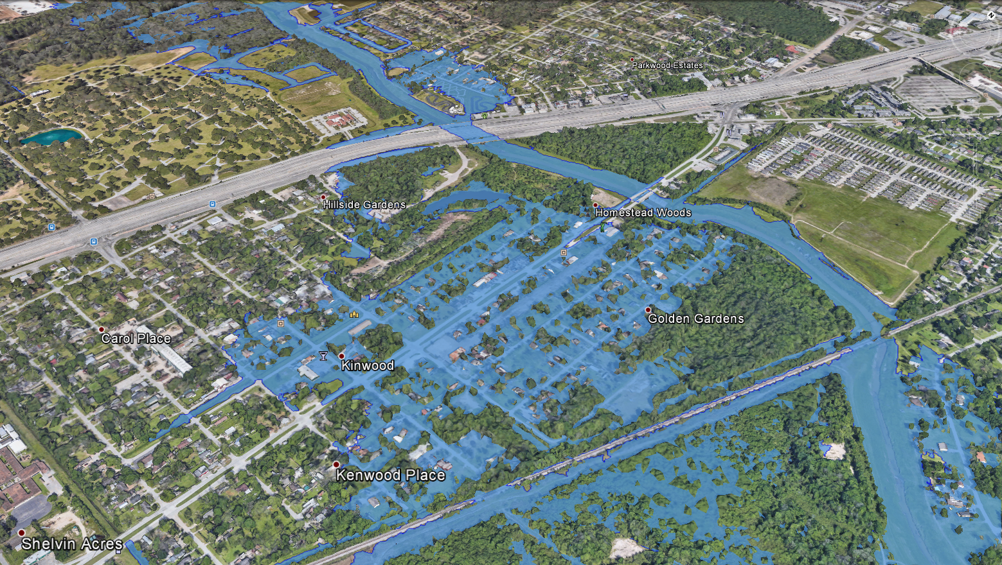
Streamflow II Overview Meeting Agenda
1. Project Concept
2. Site Selection and gage installation 3. Data Assembly and Prediction Testbed 4. Streams to Roads and Bridges
5. NWS Briefings and Flood Maps
Mark Null (Aqua Strategies)
and Harry Evans (UT Austin)
Andy Carter and
David Maidment (UT Austin)
Scott Grzyb (USGS), David Arctur
and Tim Whiteaker (UT Austin)
Paola Passalacqua (UT Austin)
and Dirk Schwanenberg (Kisters)

Slide 10
Streamflow II Overview Meeting Agenda
1. Project Concept
2. Site Selection and gauge installation 3. Data Assembly and Prediction Testbed 4. Streams to Roads and Bridges
5. NWS Briefings and Flood Maps
6. Concluding Comments from Committee
Moderated by Rose Marie Klee (TxDOT)
Mark Null (Aqua Strategies)
and Harry Evans (UT Austin)
Andy Carter and
David Maidment (UT Austin)
Scott Grzyb (USGS), David Arctur
and Tim Whiteaker (UT Austin)
Paola Passalacqua (UT Austin)
and Dirk Schwanenberg (Kisters)

Slide 11
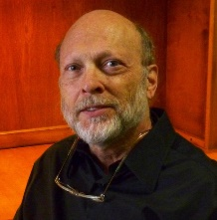
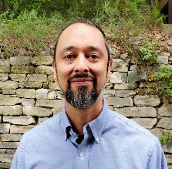
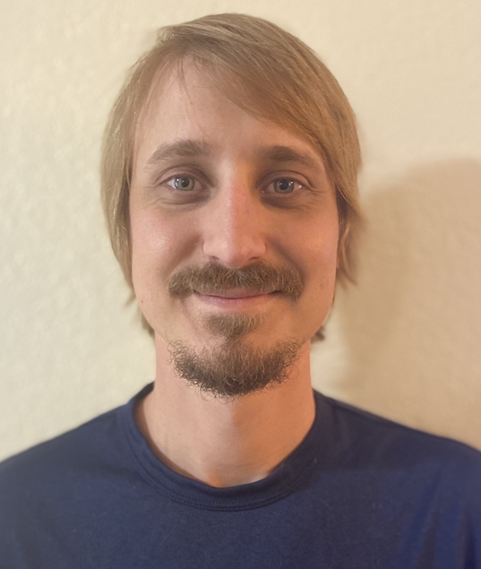
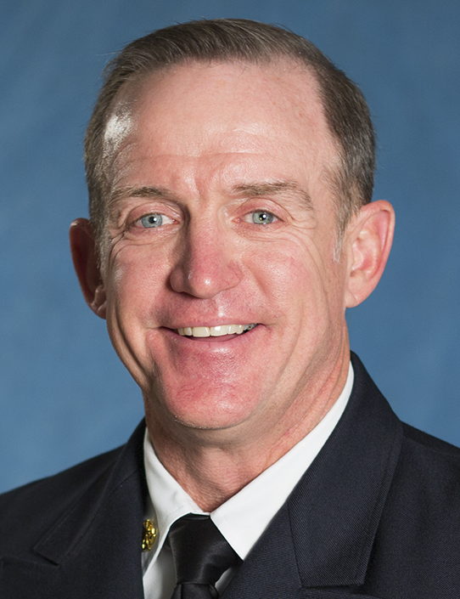
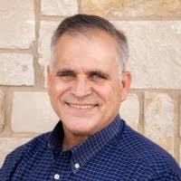
Project Tasks
Topics Reported on during this Review:
Task 1 Project Management
Task 2 Watershed Selection and Site Evaluation
Task 3 Gauge Installation, Operation and Maintenance
Task 4 Flood Forecast System Operation
Task 5 Forecast Model Assessment
Task 6 Flood Manual and Training
Project Concept
Site Selection and gauge installation
Data Assembly and Prediction Testbed
Streams to Roads and Bridges
NWS Briefings and Flood Maps
David Maidment
Scott Grzyb, David Arctur, Tim Whiteaker
Scott Grzyb, …. USGS team
Matt Ables, Dirk Schwanenberg, … Kisters team
Paola Passalacqua, Andy Carter, David Maidment
Harry Evans, Christine Thies, Mark Null

Slide 12
Streamflow II Overview Meeting Agenda
1. Project Concept
2. Site Selection and gauge installation
Scott Grzyb (USGS)
David Arctur and Tim Whiteaker (UT Austin)

Slide 13
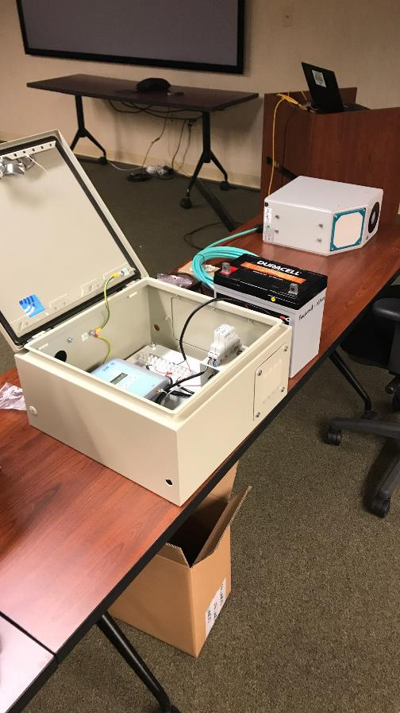
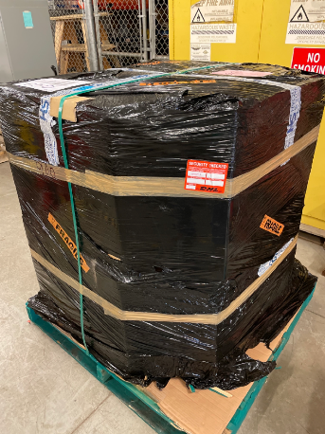
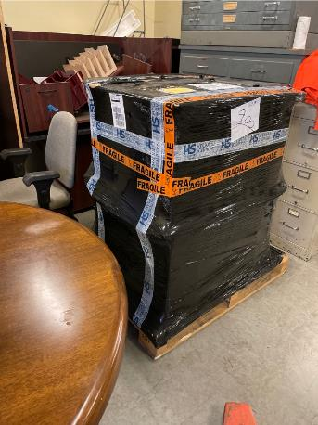
Progress Updates
January - Equipment starts arriving
February - Equipment set-up training
Now - Data Collector Set-up for installations

Slide 14
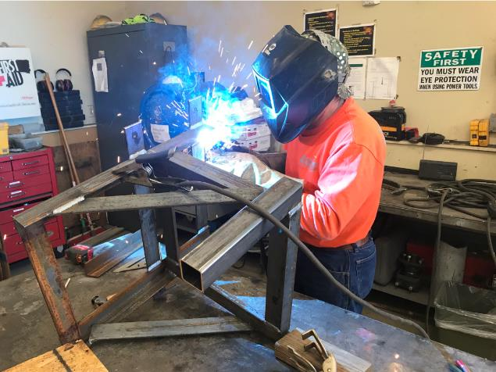
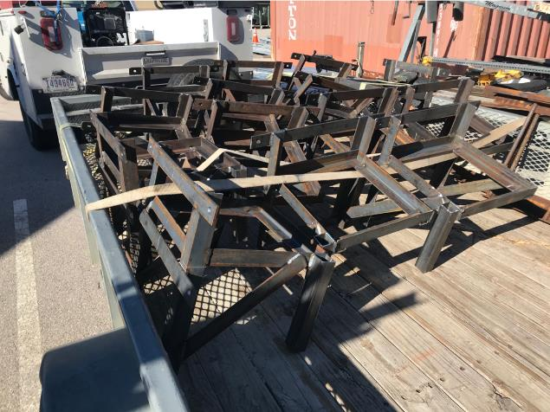
Progress Updates
Structures for enclosure were designed and are being manufactured.
Redesigned for safer access and more robust attachments.
14 stands completed and sent for galvanizing.

Slide 15
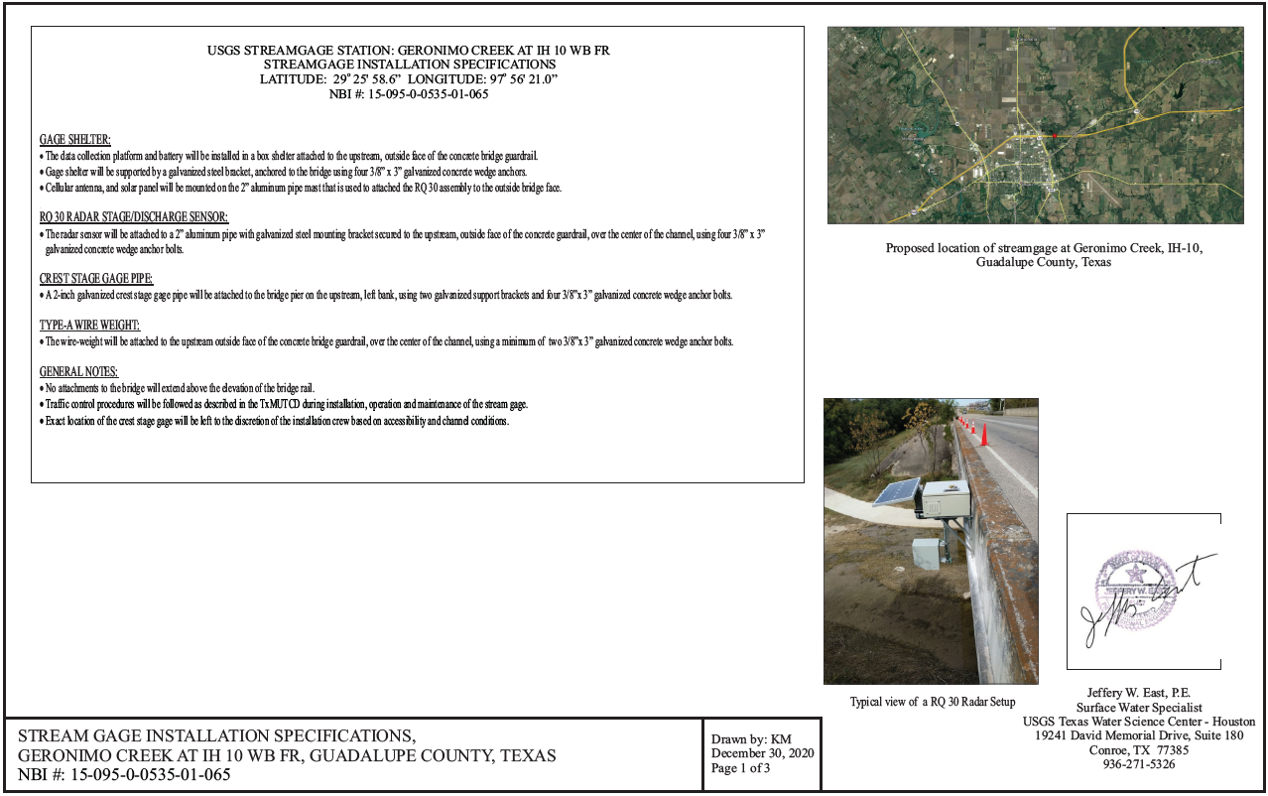
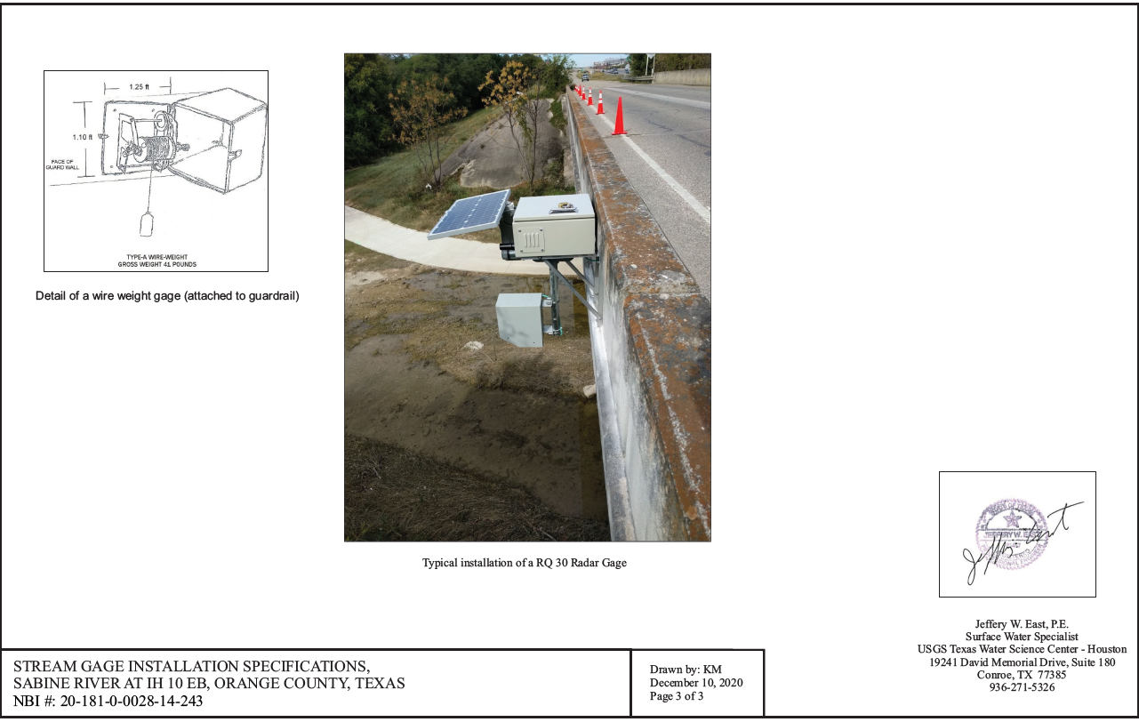
Progress Updates
Initial bridge permit package (10 Sites) sent in early February
Remaining Streamflow I permits nearing completion

Slide 16
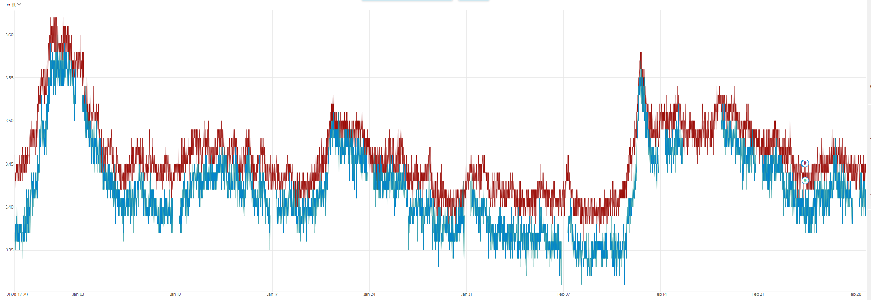
Progress Updates
13 sites set up in Aquarius program for USGS assessment.
Automated entry developed to expedite remaining project sites.
TxDOT Project Data
USGS Data

Slide 17
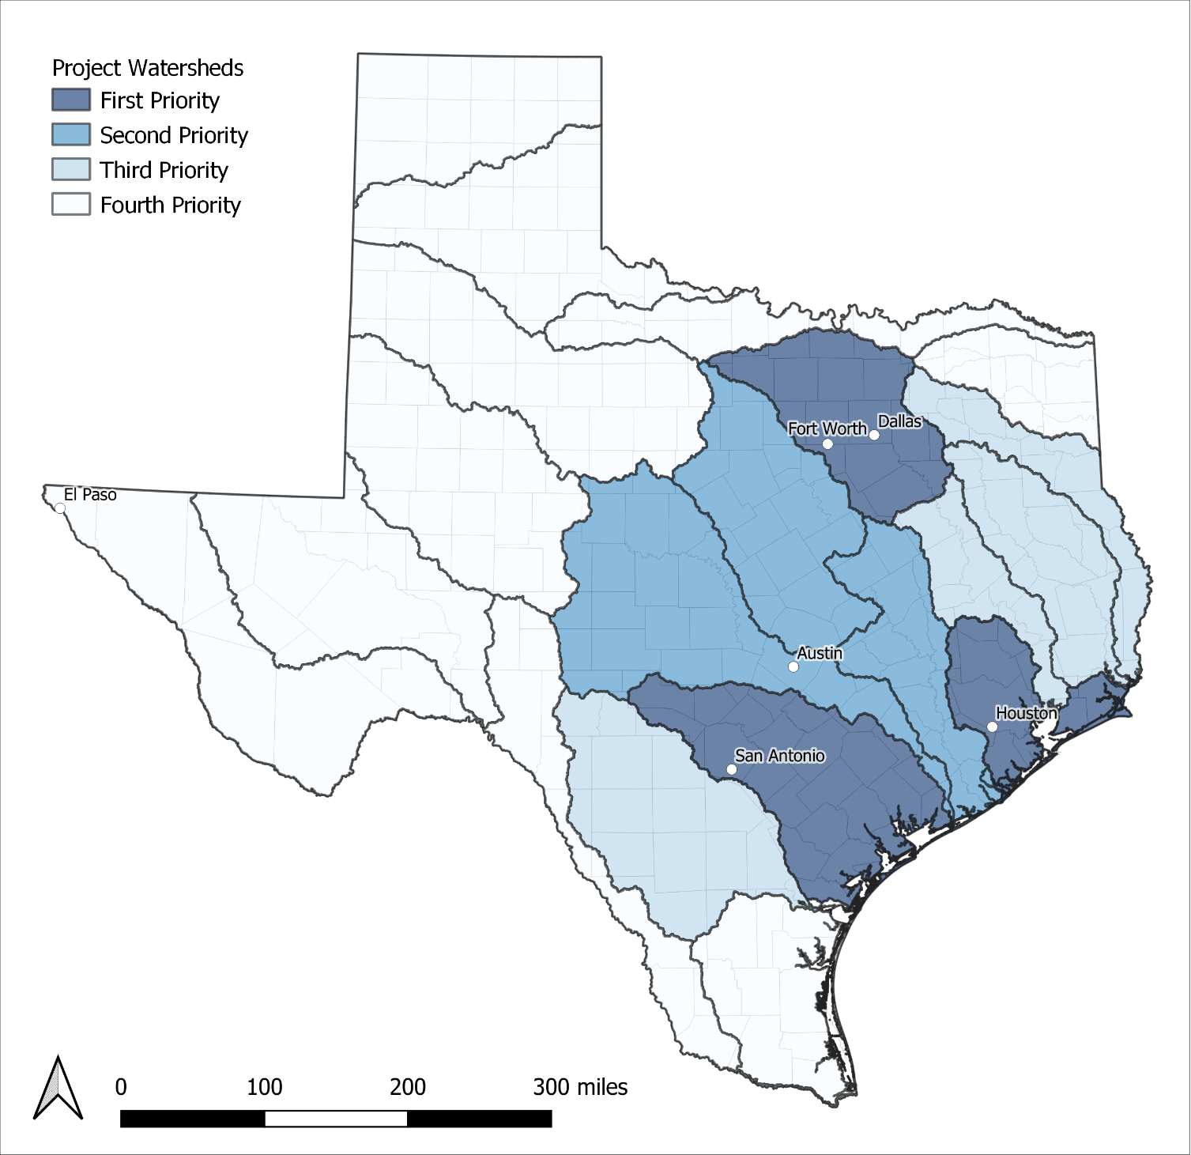
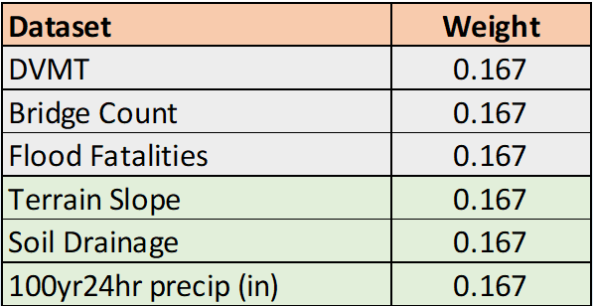
Review: In Q1, we had prioritized watersheds for site selection

Slide 18
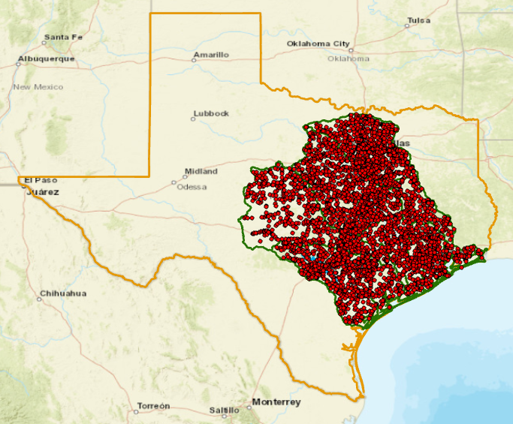
On-System Bridges in Priority Watersheds with NBI and NHD attributes
5,355 bridges
National Bridge Inventory Criteria
National Hydrography Dataset Criteria

Slide 19
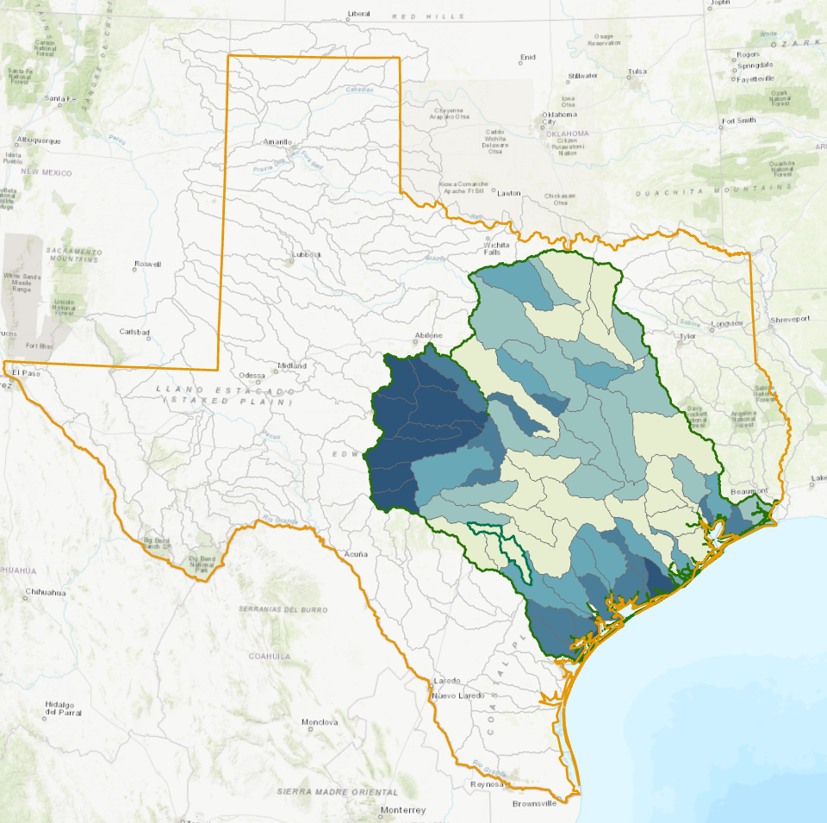
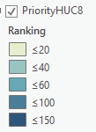
Ranking of USGS HUC8 Subwatersheds in Priority Zone
Same weighting
scheme applied to
HUC8 subwatersheds

Slide 20
Information Needs
TxDOT Needs
UT needs
USGS / RQ-30 needs
Early Warning
and Actionable Notification
Data For Forecast Model
Assimilation
Ideal Measurement
Location
Bridge and
Roadway
Inundation
Bridge
Inspection
Stream Network
Representation
Higher Bridge,
no Inundation
Generally
Straight
Reach
Mostly
Contained
channel
Velocity
>1 ft/s

Slide 21
Information Needs
Ideal Measurement
Location
Data For Forecast Model
Assimilation
Early Warning
and Actionable Notification
Higher Bridge,
no Inundation
Stream Network
Representation
Bridge
Inspection
Bridge and
Roadway
Inundation
Generally
Straight
Reach
Mostly
Contained
channel
Velocity
>1 ft/s

Slide 22
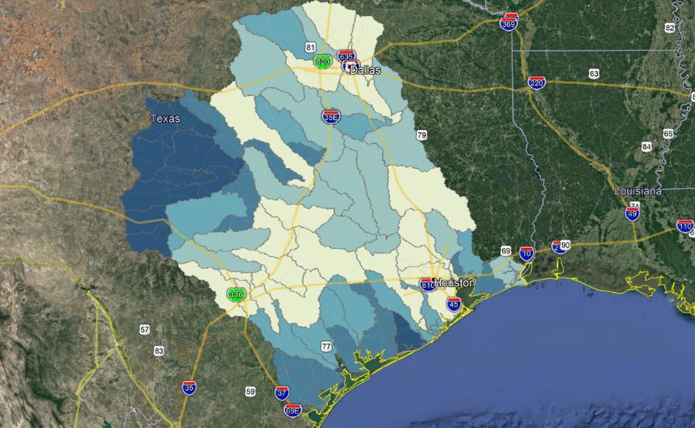
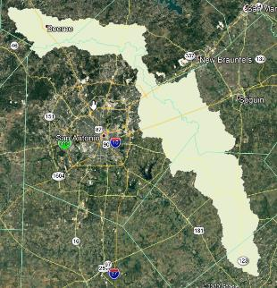

Slide 23
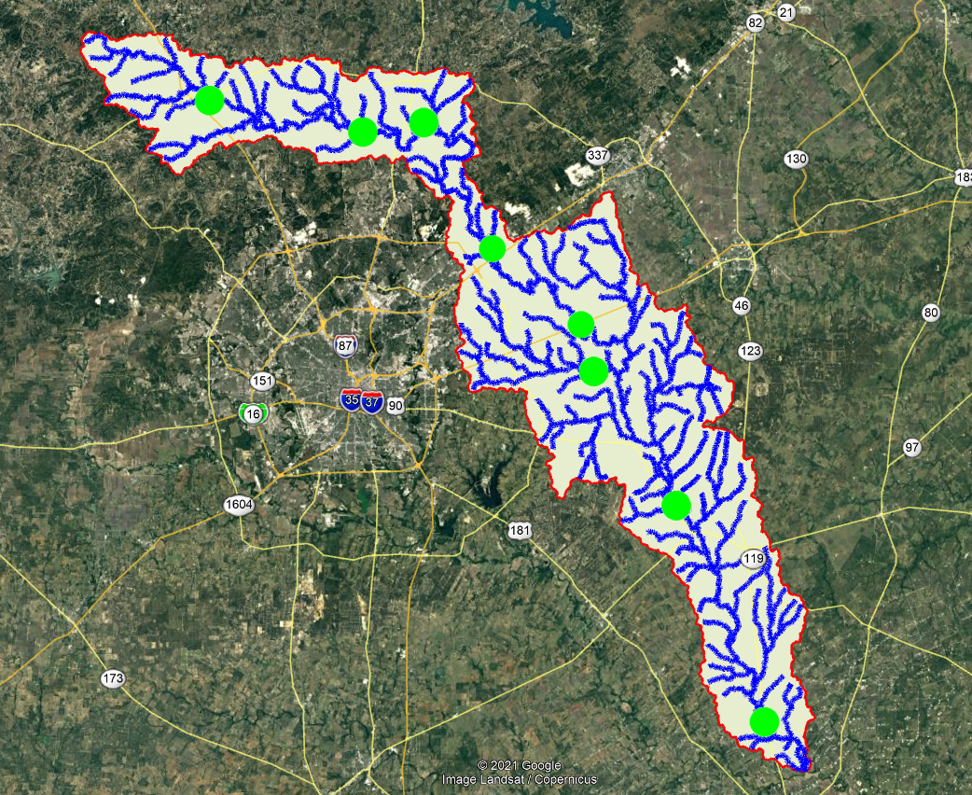

Slide 24
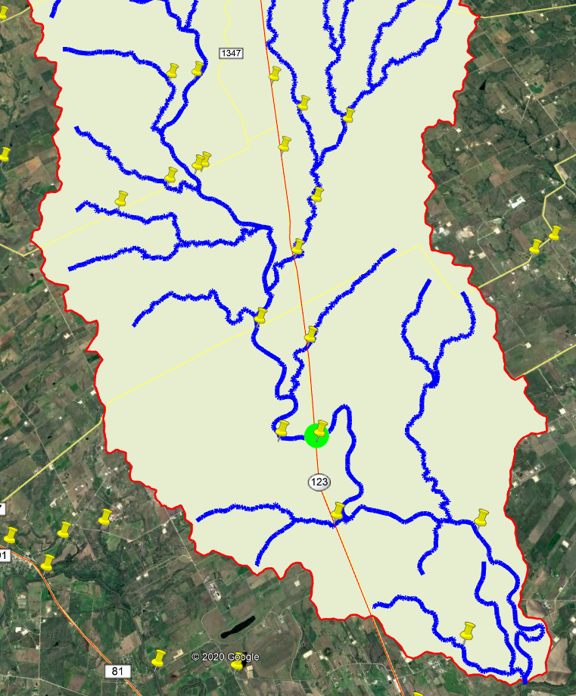
Notes:
Fix legend.

Slide 25
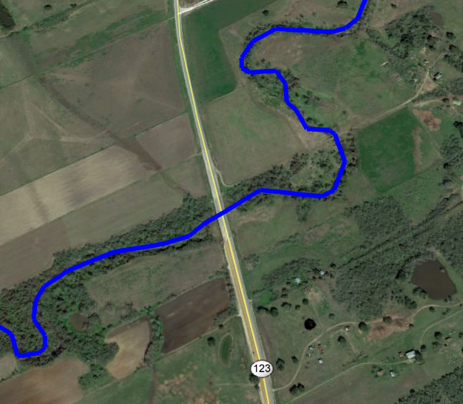
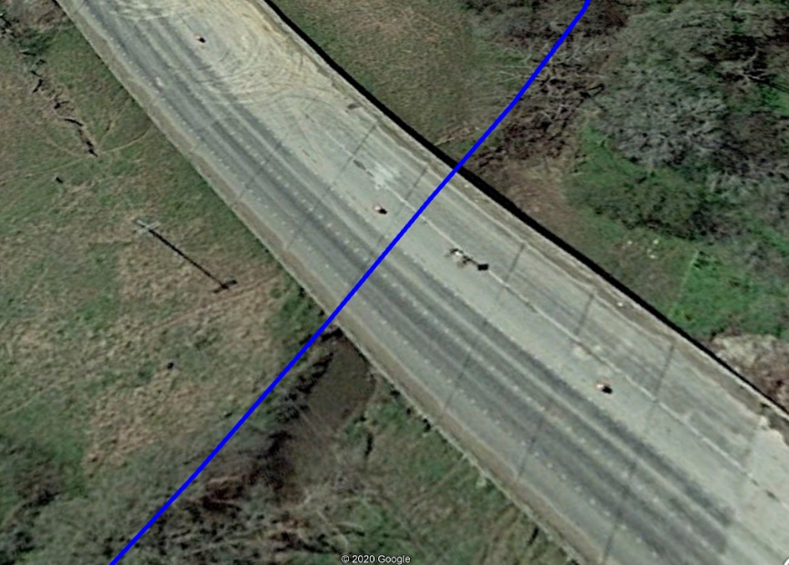
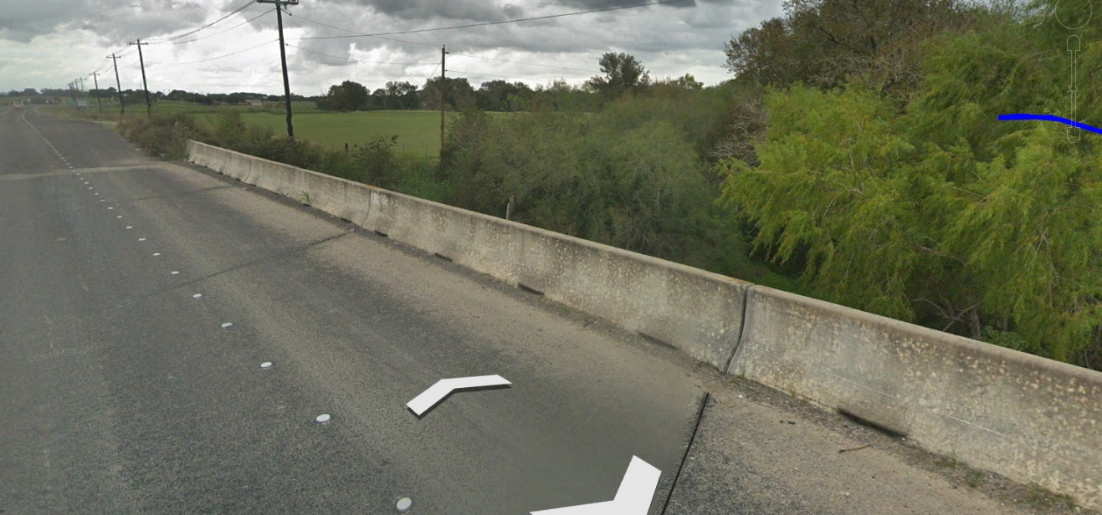

Slide 26
Proposed gauge locations for field recon
Notes:
Add a legend. Change symbols.

Slide 27
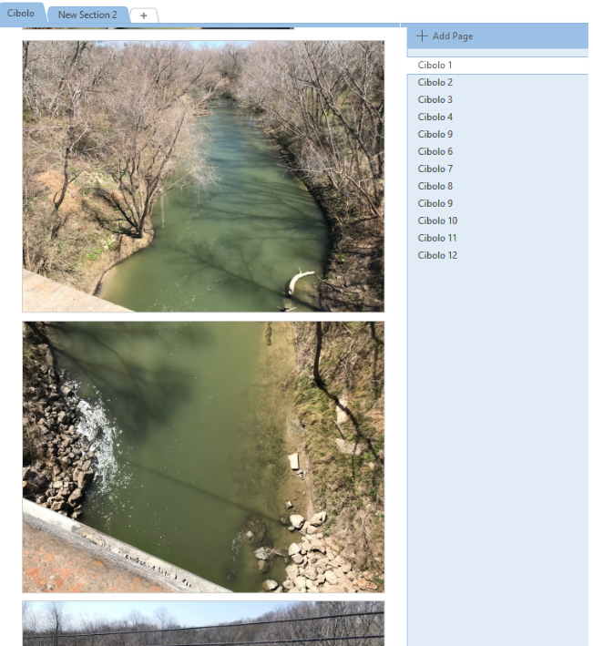
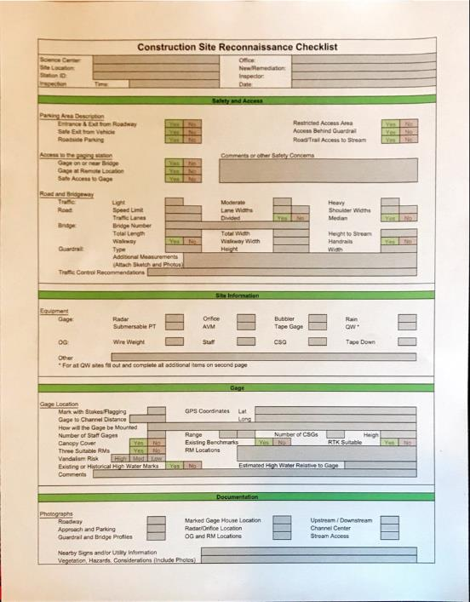
Field Recon Pilot
Proved usefulness of office recon Procedures

Slide 28
Sharing the site selection process using a StoryMap
Demo by Tim Whiteaker
Credit: StoryMap prepared by David Arctur (UT Austin)

Slide 29
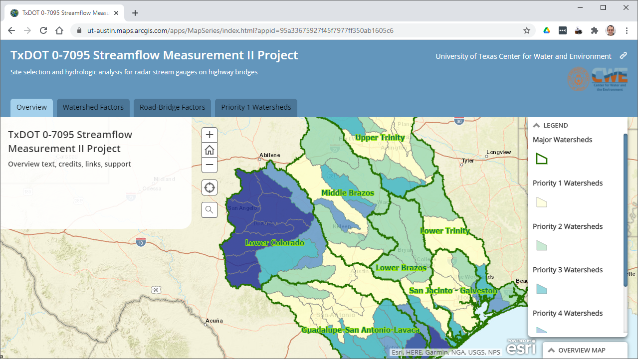
Notes:
To give TxDOT a view into our site selection process, we could create an interactive story map like this one.

Slide 30
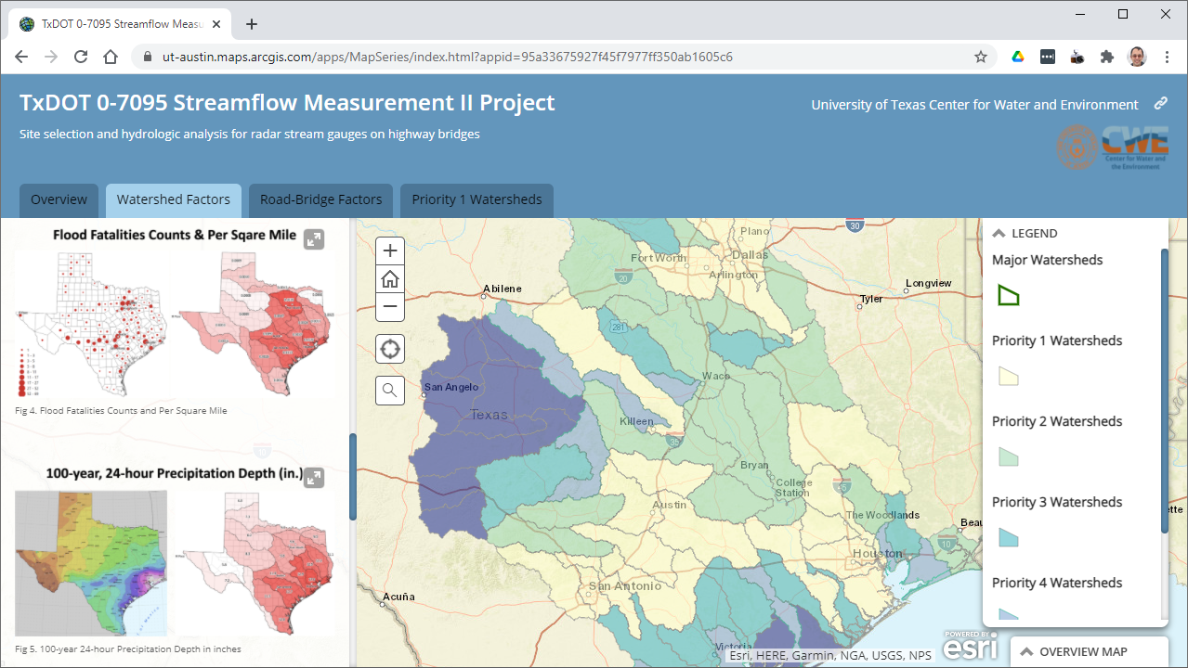
Notes:
Tabs on the map focus on phase of the site selection process, such as watershed prioritization and identification of candidate bridges.

Slide 31
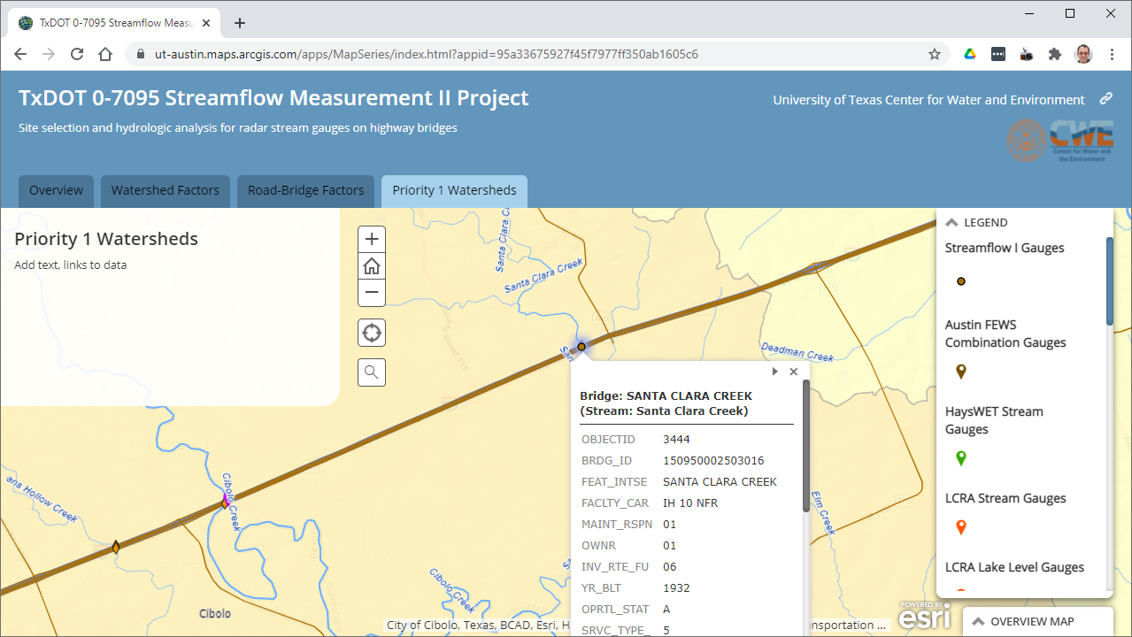
Notes:
You can zoom around and click features in the map to see details on existing and proposed gauges, bridges, streams, and more.

Slide 32
Discussion
Is this process reasonable?
Is the format of the permit applications appropriate or could it be improved?
How does TxDOT want to be involved in site selection?

Slide 33
Streamflow II Overview Meeting Agenda
1. Project Concept
2. Site Selection and gauge installation 3. Data Assembly and Prediction Testbed
Paola Passalacqua (UT Austin)
and Dirk Schwanenberg (KISTERS)

Slide 34
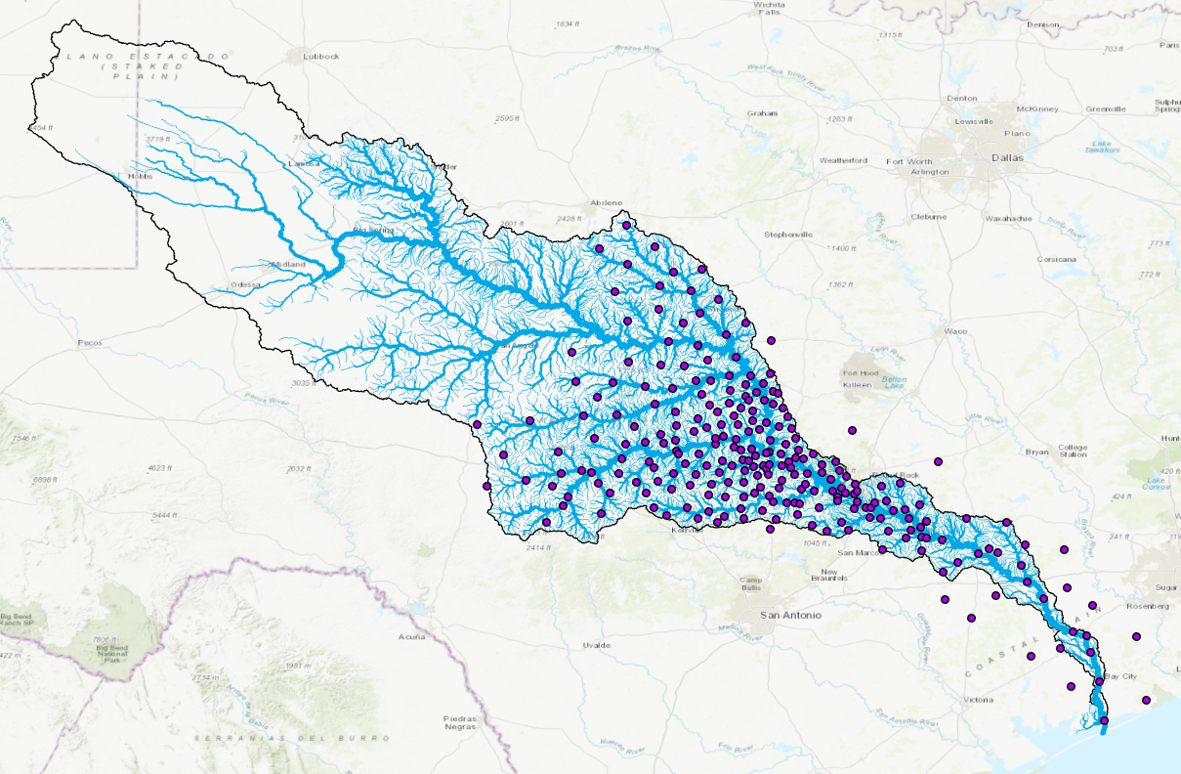
Colorado Basin Prediction Testbed
247 LCRA rain gauges
Austin
75 USGS Stream gauges
50 LCRA (Lower Colorado River Authority) gauges separate from USGS

Slide 35
Data Assembly and Prediction Testbed
UT Austin and KISTERS team
UT Austin
KISTERS
is an international IT company with about 600 employees and its head office in Aachen, Germany
KISTERS North America has been founded in 2004 and is the 2nd largest water entity
The KISTERS TxDOT team supplied the hydromet tech stack for various international organizations including the European Flood Awareness System, national hydromet systems for UK, Sweden, Spain, Germany, among others
Lower Colorado River Authority, City of Austin, Harris County Flood Control District, ...
Research collaboration initiated in Streamflow I

Slide 36
Data Assembly and Prediction Testbed
Improve forecasts on local scale based on NWM input
Baseline:
NWM is an excellent start, but national scale. On local scale we may improve it in several ways:
Acquire and collect local data
Make use of local/regional models with higher degree of detail (nested into the NWM), e.g. the approaching HEC-RAS models for Texas
Make use of more enhanced data assimilation techniques (you cannot afford on national scale) to improve the skill of forecasts
Run models more frequently, more real-time (model execution cycle for local models in the order of 2-5 min instead of 1-1.5 hours for the national NWM)
→ more accurate, more timely forecasts with higher spatial resolution

Slide 37
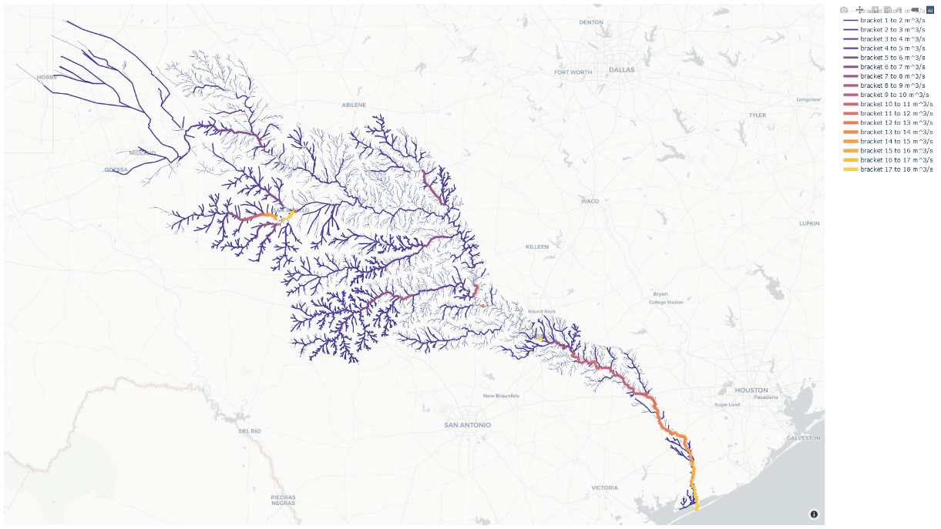
Data Assembly and Prediction Testbed
Technology Stack / Approach
Clone of the NWM routing scheme + enhanced data assimilation → model schematization comes for free from NWM, highly scalable approach → pilot model available for Colorado River, setup of DA and integration in progress
HEC-RAS model integration → pilot model for Guadalupe River
datasphere as next generation cloud platform to
integrate all scalar and raster data products
structure and share data, provide alarming and notification features
disseminate data through API and web widgets, e.g. for integration into inundation mapping or ESRI products
Credit: Wilken Steiner, KISTERS

Slide 38
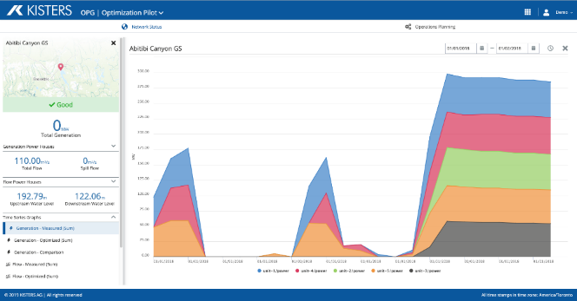
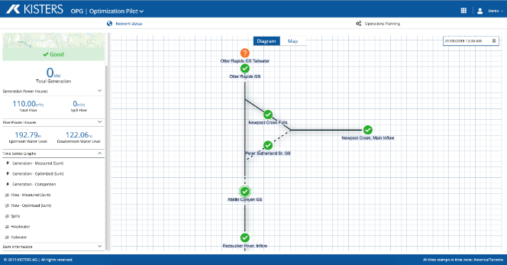
Assimilation of local data into regional models (NWM clone, HEC-RAS) to improve forecasts
Data Assimilation (Muskingum-Cunge)
NWM (Muskingum-Cunge routing)
datasphere
Time series storage
Raster storage
Network Store
Model schematization
Data Assimilation (Hydraulic)
HEC-RAS (Hydraulic routing)
National and regional modelling
datasphere
(cloud platform)
Out-of-the-box visualization of (forecast) time series and model schematization

Slide 39
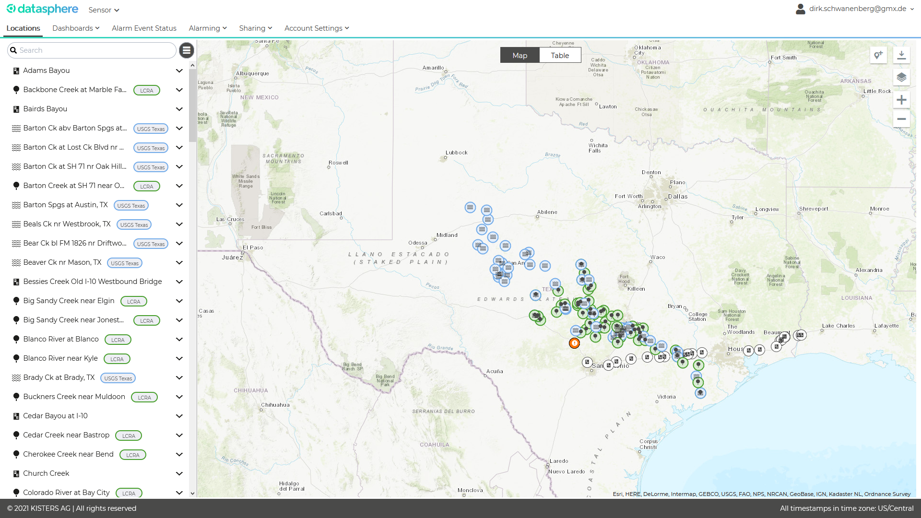
datasphere for visualization of time series data, alarming and notifications
Sharing concept for private and public data, e.g.
- USGS
- LCRA

Slide 40
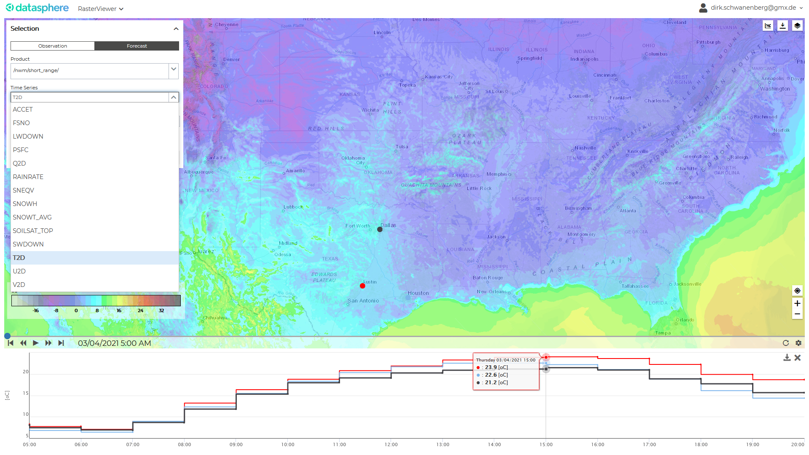
datasphere for visualization of time-varying raster data
Raster data including the full extend of the NWM forcing and results
→ live demonstration

Slide 41
Data Assembly and Prediction Testbed
Roadmap
next 1-2 months:
remaining data integration tasks
NWM streamflow reaches integrated as separate layer, all NWM forecasts (short-range, medium-range ensemble) fully supported in the cloud app
NWM routing clone and HEC-RAS pilot models both integrated (without data assimilation)
discussion of TxDOT user experience, setup and customization options
until June/July 2021:
NWM routing clone operational including data assimilation
customization such as the integration of the TxDOT Statewide Planning Map as map layer
various other fine-tuning tasks regarding usability

Slide 42
Data Assembly and Prediction Testbed
Questions for discussion
What expectations does TxDOT have for a flood data visualization system?
Should the TxDOT state planning map be used as the background?
Does TxDOT want this system to have “District-level” views or is one state-wide view sufficient?
How should alarms be set and to whom should the messages be directed?
Which data are most needed: current conditions, short-range forecast (18 hrs), medium range forecast (10 days)?

Slide 43
Streamflow II Overview Meeting Agenda
1. Project Concept
2. Site Selection and gauge installation 3. Data Assembly and Prediction Testbed 4. Streams to Roads and Bridges
Andy Carter and
David Maidment(UT Austin)

Slide 44
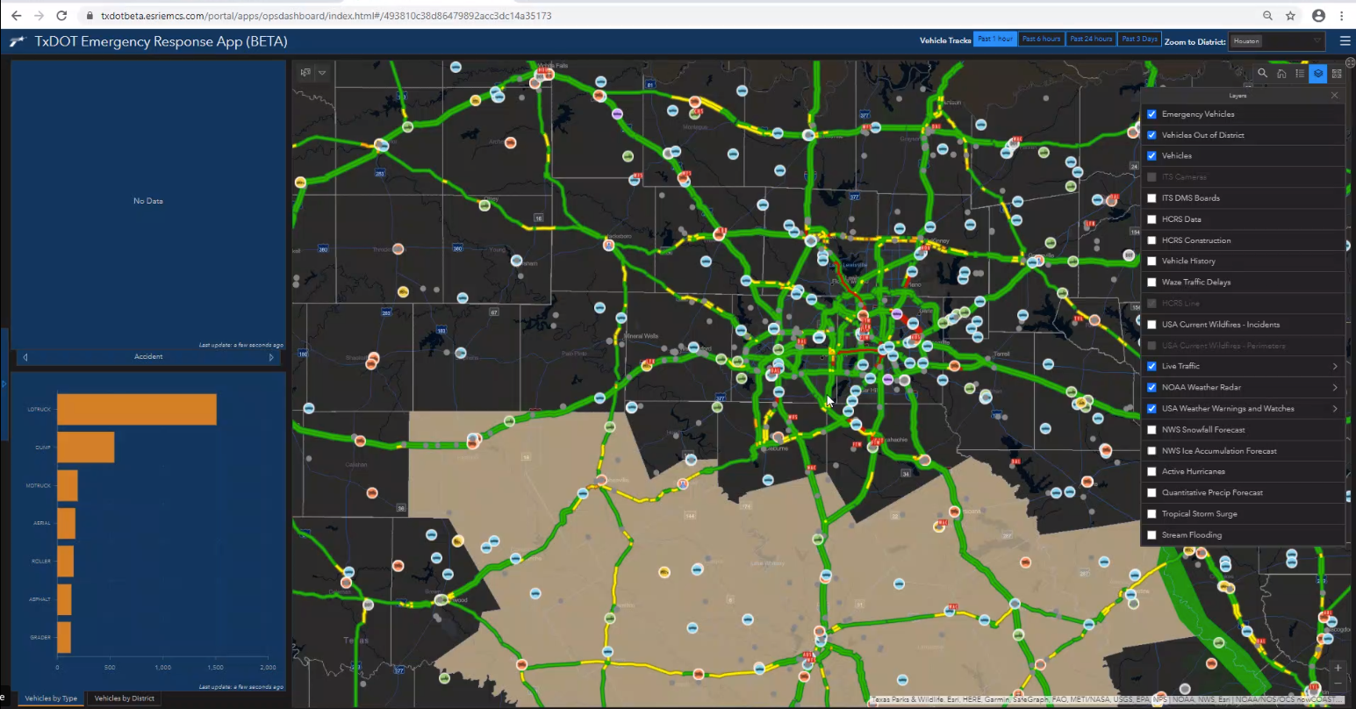
TxDOT Emergency Response Application (TxERA)
Traffic Flow Chart

Slide 45
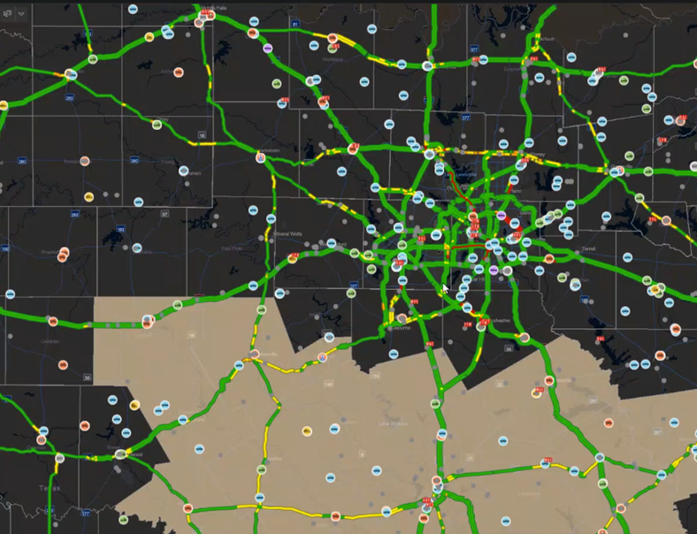
Streams to Roads and Bridges
Hydrology: Lines are streams and rivers
Flows are water
Transportation: Lines are roads and highways
Flows are traffic
Flood Information

Slide 46
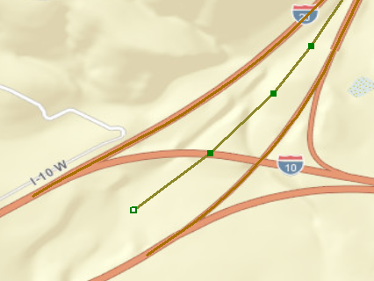
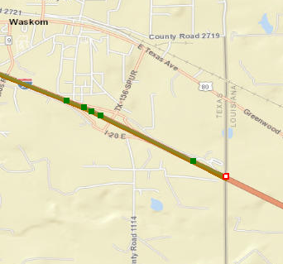
Linear Referencing using Measures for IH-20
4,746 vertices on IH-20 in Texas
Distance from Origin (DFO) ranges from :
M = 0.00 miles in West Texas to
M = 634.692 miles at TX/LA border
634.692
0.000
Long.
Lat.
Measure (M)
Long.
Lat.
Measure (M)

Slide 47
Measure Values Near Trinity River
This is feature type PolylineM in GIS.
We would like to use PolylineMZ, which
also has a z-coordinate for each vertex
474.998
474.731
474.648
M = Distance from Origin (DFO) in miles
Measure increases going Eastwards

Slide 48
Linear Referencing Demo
Route
Measure
RIA_RTE_ID=IH0020-KG|474.404|475.13|#0000FF|5|Flooded%20Road
https://apps3.txdot.gov/eventmap.html?RIA_RTE_ID=IH0020-LG|474.637|475.363|#0000FF|5|Flooded%20Road&RIA_RTE_ID=IH0020-RG|474.467|475.191|#0000FF|5|Flooded%20Road&RIA_RTE_ID=IH0020-KG|474.404|475.13|#0000FF|5|Flooded%20Road
An arbitrary flood polygon on IH-20 ….
…. is translated by route and measure
values in a TxDOT web app ….
475.13
…. to be depicted on the TxDOT state planning map
474.404
Credits: Michael Chamberlain, TxDOT TPP, Tim Whiteaker, UT Austin

Slide 49
Flood Inundation Mapping (FIM)
Current Discharge
Forward Looking Discharge
National Water Model

Slide 50
USGS Entwine LIDAR point cloud data service
https://usgs.entwine.io/
3.77 trillion LIDAR points for Texas
Only USGS 3DEP elevation data
Data Gaps
Source: https://raw.githubusercontent.com/hobu/usgs-lidar/master/boundaries/boundaries.topojson
Date pulled: 5 March 2021

Slide 51
LIDAR Points for LBJ Freeway at Trinity River
Bridge limits can be spatially queried
Point Cloud - Plan View
This bridge envelope is composed of
258,000 points
[of the 3.77 trillion points in Texas]
Point Cloud - Profile View
Extraction of DEMs and LAS Point Clouds via Entwine pipeline (JSON) request
Point Cloud
Orthographic View

Slide 52
Bridge Envelope for LBJ Freeway at Trinity River
NBI Structure Length = 2400 ft (732m)

Slide 53
Profile along Trinity River at LBJ Freeway
NBI Attributes
Width = 21.6m
Width = 21.6m
Bridge Deck Width
Left = 70.9 ft
Right = 70.9 ft
LIDAR measured width
is close to that stored
in National Bridge Inventory

Slide 54
Streams to Roads and Bridges
Questions:
Is the linear referencing approach appropriate for relating flood inundation to the road network?
Should we try to represent the road network in 3D?
Is this an appropriate way of characterizing bridges? What additional information about the bridge could be added to the Bridge Envelope?
How best can we present this information for flood decision-making at TxDOT? Create a flood water elevation line?

Slide 55
Streamflow II Overview Meeting Agenda
1. Project Concept
2. Site Selection and gage installation 3. Data Assembly and Prediction Testbed 4. Streams to Roads and Bridges
5. NWS Briefings and Flood Maps
Mark Null (Aqua Strategies)
and Harry Evans (UT Austin)

Slide 56
National Weather Service Offices
122 Weather Forecast Offices (WFO)
Responsible for issuing Flood Watches, Flash Flood Watches, Flood Warnings, Flash Flood Warnings, and Flood Advisories for their local County Warning Area
13 River Forecast Centers (RFC)
Provides hydrologic forecasting, hydrometeorologic analysis and support (HAS) functions and products.

Slide 57
Emergency Management Decision Making
STRATEGIC
(State-wide EM Planning, Resource Allocation, Routing)
OPERATIONAL (Hydrologic Warning Area / Watershed Coordination)
TACTICAL (Neighborhood Level)
Weather Forecast Office

Slide 58
Engagement With Emergency Managers
State/Regional Level:
NWS ROC / WGRFC
Local Level:
Weather Forecast Offices (WFOs)
Deployments to the State Operations Center
Morning Briefings (Technical and Executive)
State → Governor, TDEM
FEMA
“Deep” Core Partners
USACE, USGS, River Authorities
Assist WFO’s with local EM briefings and discussions
Outreach and training opportunities (i.e FloodAware)

Slide 59
NWS Coordination with Texas Division of Emergency Management
TDEM State Operations Center
Austin, TX
NWS Southern Region Headquarters
Regional Operations Center (Fort Worth)
Situational Weather Briefings
Daily high-level weather/hydro briefings to TDEM once SOC becomes activated.
Consolidated message across NWS offices. (One Forecast)
Deployments to the SOC as required
Meteorology Message
Hydrology Message
SRH ROC coordinates weather messaging across all impacted WFOs
WGRFC coordinates Hydro messaging across all impacted RFCs

Slide 60
Flood Messaging (Current and Future Services)
“This is a tool we just can’t afford to wait another 5 to 10 years to have…”
– Houston Office of Emergency Management

Slide 61
Significant Finding #1: This is an Improvement and is Needed Now
Inundation maps are more useful than a hydrograph
Gaps are problematic
Hatch areas that are not modeled

Slide 62
Homeland Security Exercise and Evaluation Program (HSEEP) Exercises
Scheduled for Sept 2021 and Sept 2022
What is HSEEP?
What will we be testing?
HSEEP is an exercise to test a product or procedure. It provides a set of guiding principles to create an exercise which will evaluate, validate, and identify areas for improvement for preparedness.
We propose that Exercise 1 will involve collaboration with the National Weather and build on previous NWS flood inundation mapping exercises by adding TxDOT data and transportation information. The scope with be defined in consultation with the Project Management Committee.
What will Exercise tell us?
The Exercise outcomes will allow us to document what worked, what needs improvements, and develop an improvement plan. The improvement plan could be as simple as adding … to Datasphere or to the TxDOT Emergency Response Application, or as complex as updating operational guidelines within TxDOT’s emergency response.
We will present a more detailed plan for consideration at the June Quarterly Review

Slide 63
Homeland Security Exercise and Evaluation Program (HSEEP) Exercises
Scheduled for Sept 2021 and Sept 2022
Create HSEEP Exercise
Set
Exercise Date / Send out Invites
Test Exercise
(2-4 tests)
Hold Exercise (2-4 hrs)
Document Improvement Plan
Implement changes/
improvements

Slide 64
NWS Briefings and Flood Mapping
Questions:
Could TxDOT personnel be more fully engaged in the state-wide flood briefings that NWS presents to TDEM?
How best could the bridge hydraulics work being done in this project be connected with the NWS flood inundation mapping services?
We have a flood exercise scheduled for September 2021. Could this be focused on a joint effort between NWS and TxDOT for forecasting flood impact on the transportation system?

Slide 65
Streamflow II Overview Meeting Agenda
1. Project Concept
2. Site Selection and gauge installation 3. Data Assembly and Prediction Testbed 4. Streams to Roads and Bridges
5. NWS Briefings and Flood Maps
6. Concluding Comments from Committee
Moderated by Rose Marie Klee (TxDOT)

Slide 66
Concluding Remarks by Committee Members
Please introduce yourself and share how this project is relevant to the work that you do.
What excites you most about the potential value?
Are there any particular aspects of this project that you would like to be more involved with?
Any comments, questions, words of wisdom, observations that you would offer to us?
AN ASK (not for discussion): would you be willing to share a headshot that we could include in future presentations and a brief bio? (if so, please email!)
Randy Charbeneau – UT Professor Emeritus Sam Hermitte – TWDB
Jason Johnson – NOAA/NWS
Mark Lenz – NOAA/NWS
Paul McKee* – NOAA/NWS
Peter Smith – TxDOT TPP, ret
Justin Terry – HCFCD
Jorge Urquidi – City of Austin
Paul Yura – NOA/NWS
*special guest

