Slide 1
Evaluate Improved Streamflow Measurement at TxDOT Bridges Project 0-7095 Being conducted for TxDOT by UT Austin and US Geological Survey with the support of Kisters North America and Aqua Strategies September 2020 to August 2023
Presentation for Sixth Quarterly Review Meeting, Tuesday 8 March, 2022
Acknowledgements: Rose Marie Klee (H&H Director, TxDOT), Trenton Ellis (H&H, TxDOT), Shelley Pridgen (RTI Project Manager, TxDOT),
Matthew Heinze (MNT, TxDOT), Jared Browder (MNT, TxDOT), Chris Henry (BMT, TxDOT), Keith Horn (BMT, TxDOT)

Slide 2
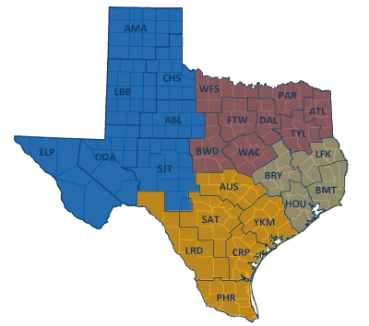
TxDOT Priorities
SAFETY
Our staff, our community
Emergency response
CONNECTIVITY
Reliability of the transportation network
Asset management
*BRIDGES*
Efficiency and efficacy
For TxDOT
For other/all jurisdictions
Slide: Rose Marie Klee, TxDOT

Slide 3
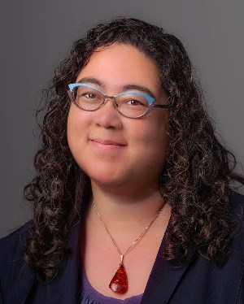
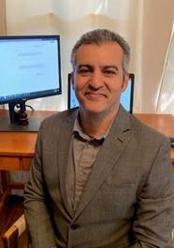
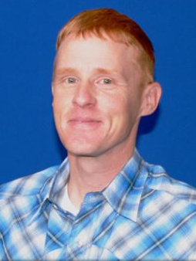
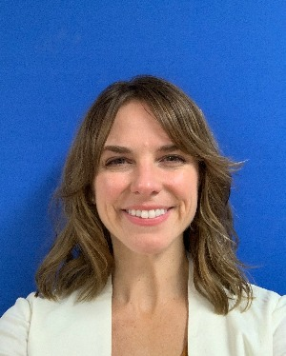
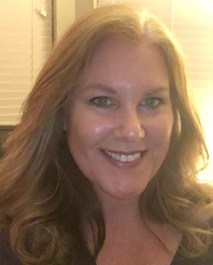
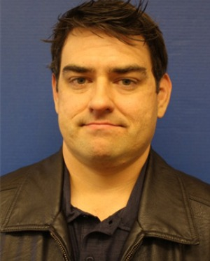
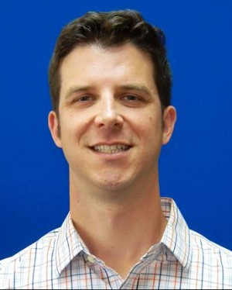
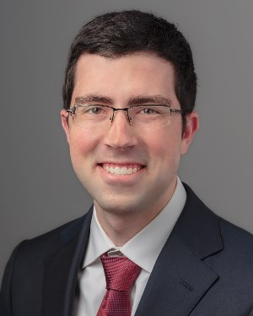
TxDOT Project Management Committee
Rose Marie Klee H&H Section Director DES
Abderrahmane Maamar-Tayeb
H&H Section Team Lead DES
Trent Ellis H&H Engineer DES
Matthew Heinze TxDOT Emerg Mgmt Coord MNT
Jennifer Lash GIS Program Leader TPP
LaDonna Waters Lead Hydraulics Engineer BMT
Shelley Pridgen Research Project Manager RTI
Adam Jack Dir of Trans Plan & Dev BMT
Andrew Lee District Bridge Engineer BMT
Joseph Goessling
Lead Hydraulics Engineer
AUS
Jared Browder Maintenance Assess Spec MNT
Ryan Eaves Geotech Brch Mgr BRG
Drake Builta
Bridge Info Grp Lead
BRG

Slide 4
Project Advisory Committee
NOAA National Weather Service | State and Local Agencies
Jason Johnson, West Gulf River Forecast Center | Sam Marie Hermitte, TWDB
Paul McKee, Southern Region HQ | Jorge Urquidi, City of Austin, Flood Early Warning System
Paul Yura, Austin/San Antonio Weather Forecast Office (WFO) | Christina Bryant, City of Austin, Flood Early Warning System
 | Justin Terry, Harris County Flood Control District
 | Peter Smith, former TxDOT Director TPP
Welcome to
the Discussion!
NOAA Weather Forecast Office Service Hydrologists*
Jonathan Brazzell, Lake Charles, LA, WFO
Katie Landry-Guyton, Houston/Galveston WFO
Amanda Schroeder, Dallas/Fort Worth WFO
+ other members of the H&H Section,
TxDOT Design Division:
Sauda Ahmed | Lucinda Soto
Hiruy Berhe | Jaime Villena-Morales
Zenia De Leon | Marissa Williams

Slide 5
Meeting Agenda
Beaumont Flood Emergency Response Exercise
Introduction and overview
Review of maps presented
Results of the exercise evaluation
Proposed plan
Discussion
Progress and Plans
Gauge installation, operation and maintenance
Flood forecast system operation
Forecast model assessment
Flood emergency response and flood manual
Discussion

Slide 6
Meeting Agenda
Beaumont Flood Emergency Response Exercise
Introduction and overview
Review of maps presented
Results of the exercise evaluation
Proposed plan
Discussion
Progress and Plans
Gauge installation, operation and maintenance
Flood forecast system operation
Forecast model assessment
Flood emergency response and flood manual
Discussion

Slide 7
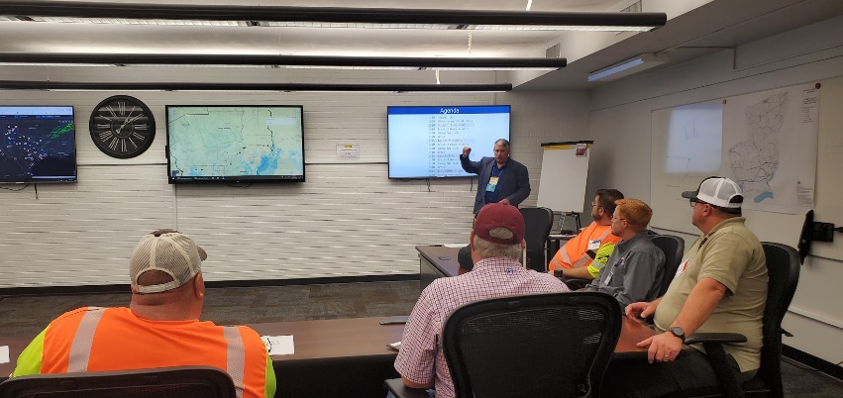
TxDOT BMT wants to move from Reactive response to Proactive response
Reactive Response
Maintenance Staff
observing current
flood conditions
EOC staff
Decisions based on
current conditions

Slide 8
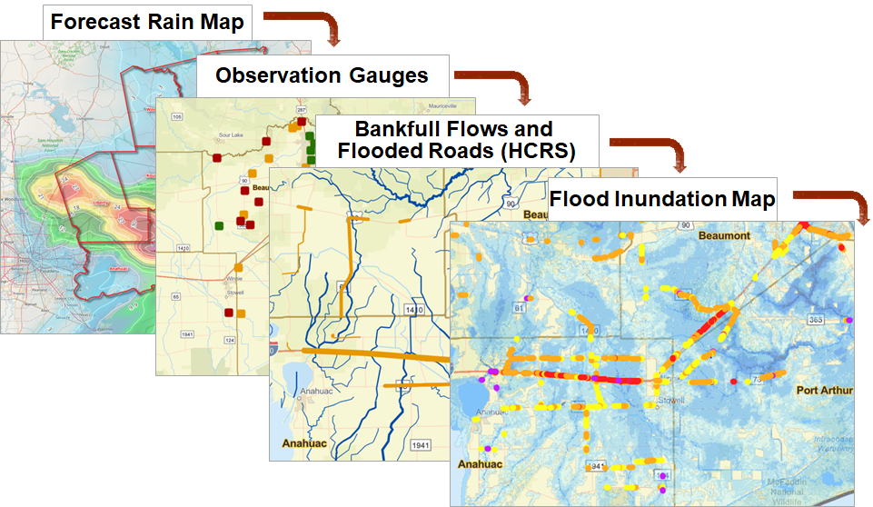
TxDOT BMT wants to move from Reactive response to Proactive response
Proactive Response
Maintenance Staff
observing current
flood conditions
Predictive Storm and Flood Maps
EOC staff
Decisions based on
current and predicted conditions
Advance warning of location, extent
and severity of flooding

Slide 9
Some Thoughts I have Heard
“It’s the guys in the field who tell us what’s going on”
Keith Horn, Logistics Coordinator, BMT
“I want technology to be my eyes on the landscape”
Martin Gonzalez, District Engineer, BMT
“We want to move from being reactive to being proactive”
Chris Henry, Director of Maintenance, BMT
“We need all the data in one place”
Eliza Paul, District Engineer, HOU
“I want to know if there’s going be another Harvey”
Eliza Paul, District Engineer, HOU
“We could close IH-10 in 3-6 hours”
Chris Henry, Director of Maintenance, BMT
“At the SOC, we need warning 24-48 hours in advance”
Jared Browder, Maintenance Assessment Specialist, MNT

Slide 10
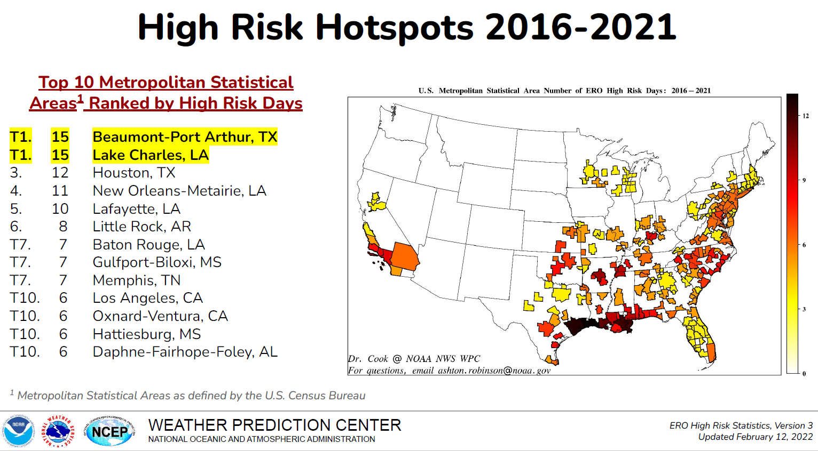
Why so much about Beaumont?
High risk of excessive rainfall causing flood deaths and damage
IH-10 closed three times in 2016 – 2021
from “Excessive Rainfall Outlook High Risks (2010-2020)”
Source: Jonathan Brazzell, NWS Lake Charles WFO

Slide 11
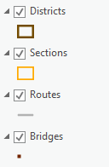
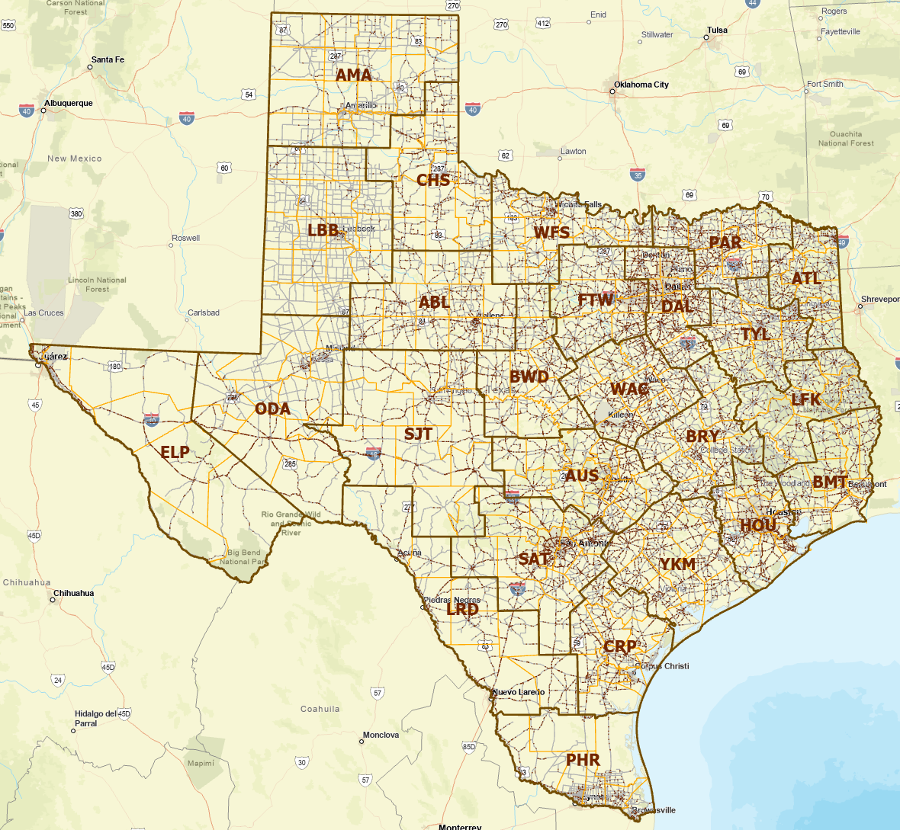
Districts, Maintenance Sections, Routes and Bridges
25 Districts
265 Maintenance Sections
13,784 Maintenance Routes
25,874 On-System Bridges over Water
101,187 miles of On-System Roads 268,820 square miles of Area
An average Maintenance Section
is responsible for approximately:
50 Routes
100 Bridges
400 miles of Roads
1000 square miles in Area

Slide 12
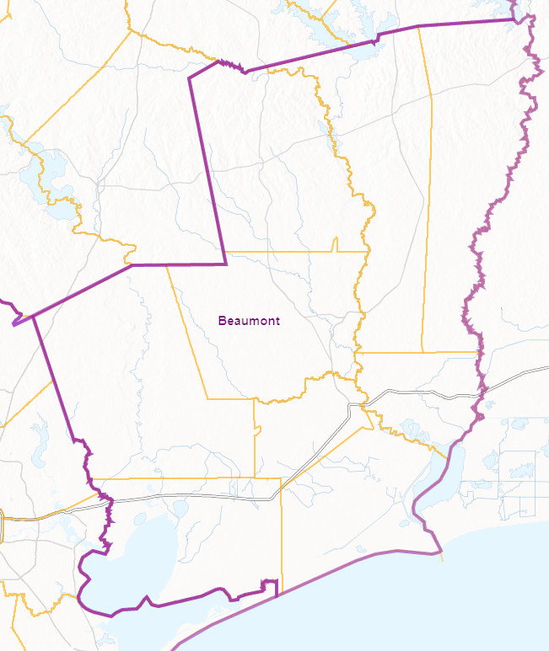
TxDOT Beaumont District Emergency Response Organization
District
(6 people)
Daytime Duty
State
(60 people)
Local
TxDOT Austin
Emergency
Operations Center
(Matthew Heinze)
Requests for
assistance
Maintenance Sections
(Maintenance Supervisor)
District Engineer (Martin Gonzalez)
Newton
(Cecil Wade)
TxDOT Beaumont
Emergency
Operations Center
Incident Command
(Chris Henry /
Kenneth Wiemers)
(Day /
Night)
Jasper
(JoEllen Miller)
Woodville
(Jay Castleberry)
Planning
(Adam Jack)
Logistics
(Keith Horn /
Scott Estes)
Administrative
(Heather Weeks)
Kountze
(Steven Singleton)
Orange
(Jody Hand)
12 hour shifts 7AM – 7PM
Operational briefings 6AM, 6PM
TxDOT Statewide Event (Weather) Call, 8AM
NWS BMT Weather briefings 10AM, 4PM
Liberty
(Tyrone Alexander)
Beaumont
(Kevin Emerson)
Operations
(Brad Murray /
John Sudela)
Port Arthur
(Carl Ray)
Anahuac
(Jake Taylor)
Organized within
Maintenance Sections

Slide 13
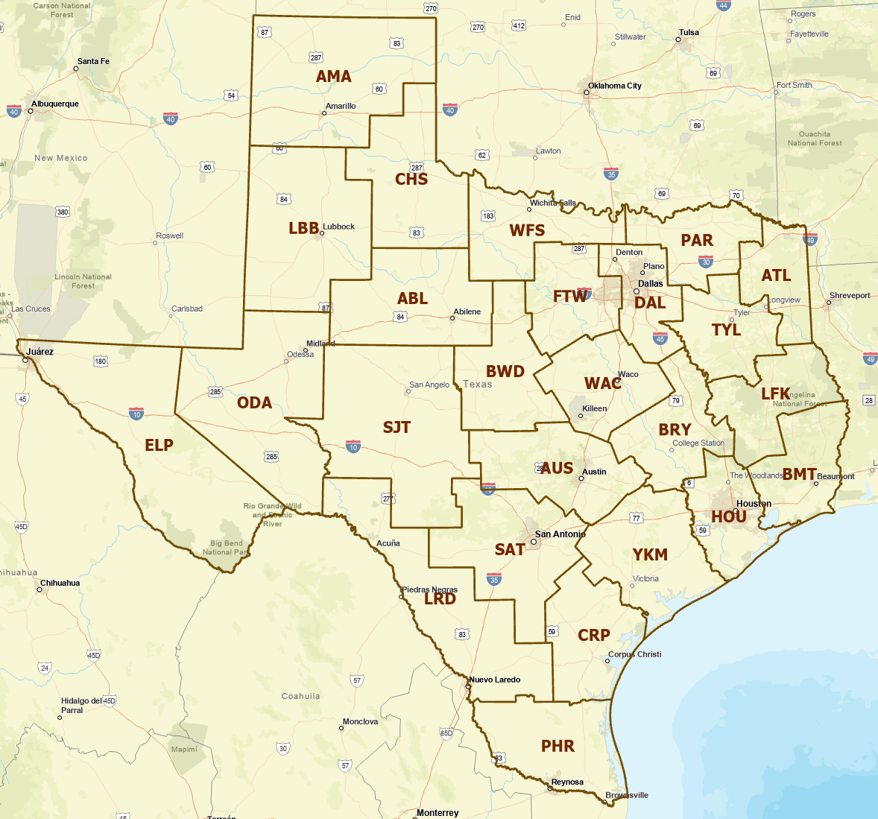
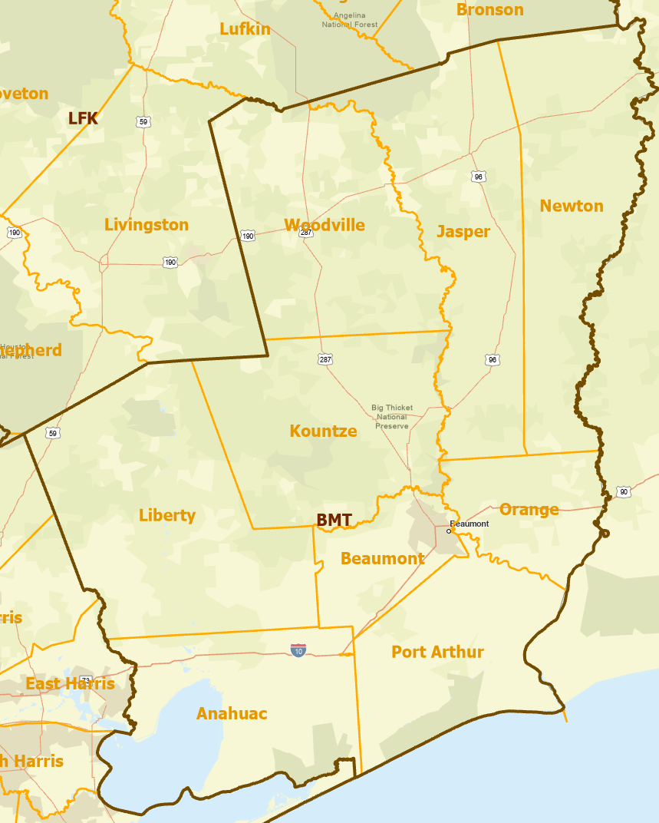
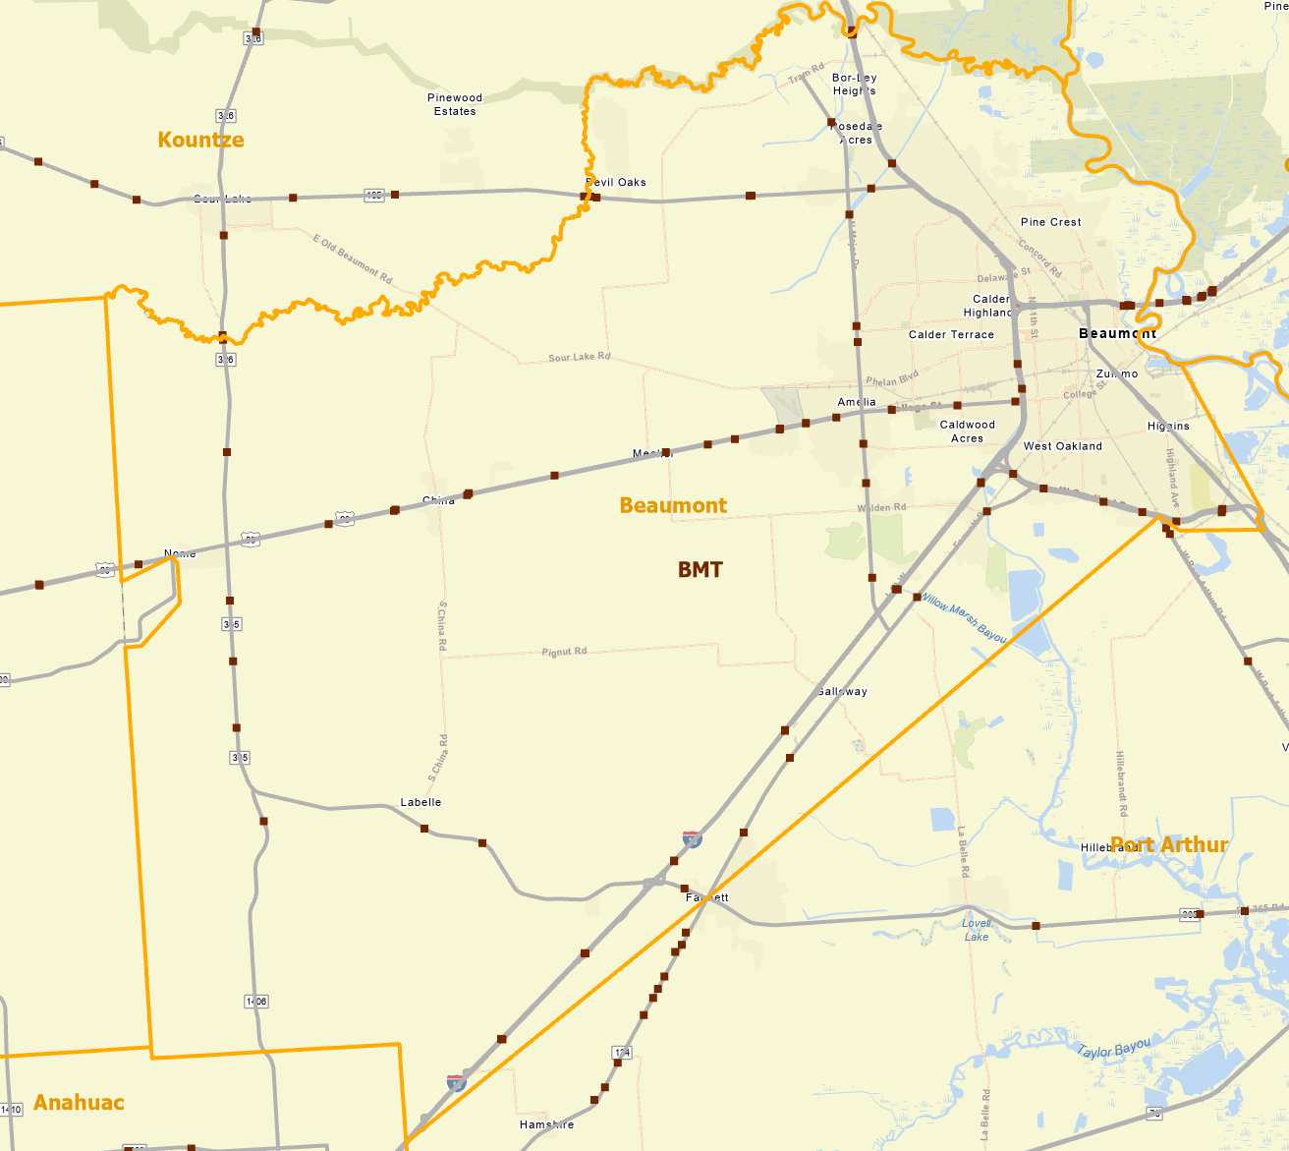
Spatial Scales and Forecast Lead Times
State scale
24-48 hours in advance
District scale
12-24 hours in advance
Section scale
3-6 hours in advance
Decision units are Districts
Decision units are Sections
Decision units are Routes and Bridges
Flood Risk: Local Transportation Infrastructure
Flood Risk: Regional Transportation System

Slide 14
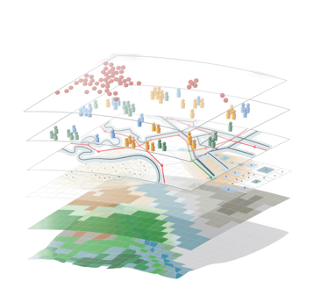
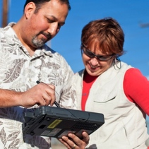
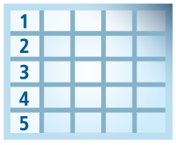
Geospatial Systems Are Helping Us Understand
Understanding
Sharing and Collaboration
Knowledge
Information
Integration
Mapping
Data
. . . Helping Us Make Better Decisions
Slide: Jack Dangermond

Slide 15
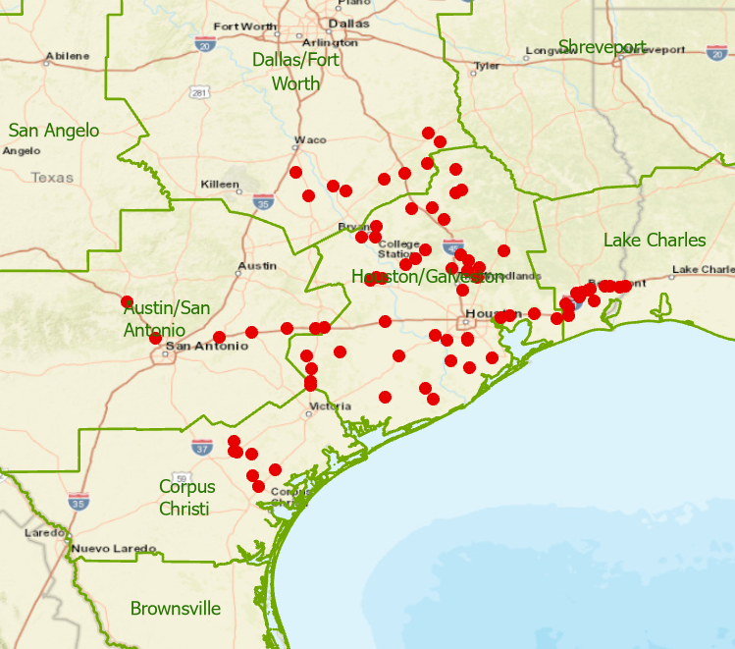
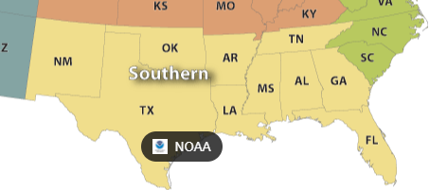
A Proposal Discussed with NWS Southern Region Leadership on 18 Jan 2022
Shared Services
Flood Response Working Group
Evaluation during 2022 Storm Season
Build on our Quarterly Review Meetings
Arc GIS Online
NWS SRH and WGRFC
Service Hydrologists at
Weather Forecast Offices
TxDOT
NWS
DriveTexas.org
Radar gauge data
Forecast
Map
Services
Project 0-7095 Research Team
“I can’t see any downsides to this.”
Mike Coyne, Director NWS SRH

Slide 16
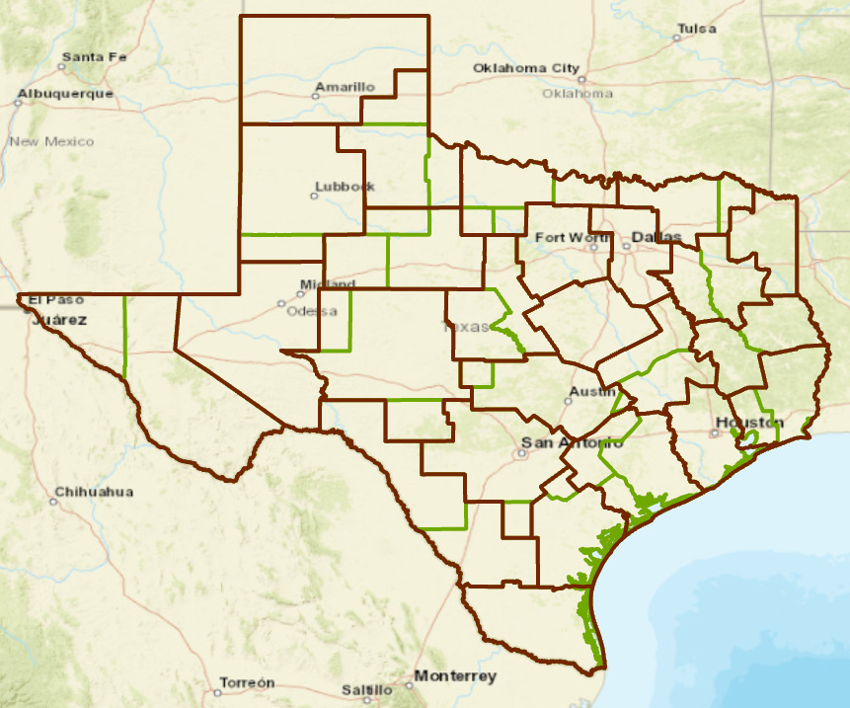
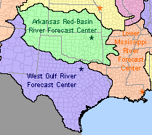
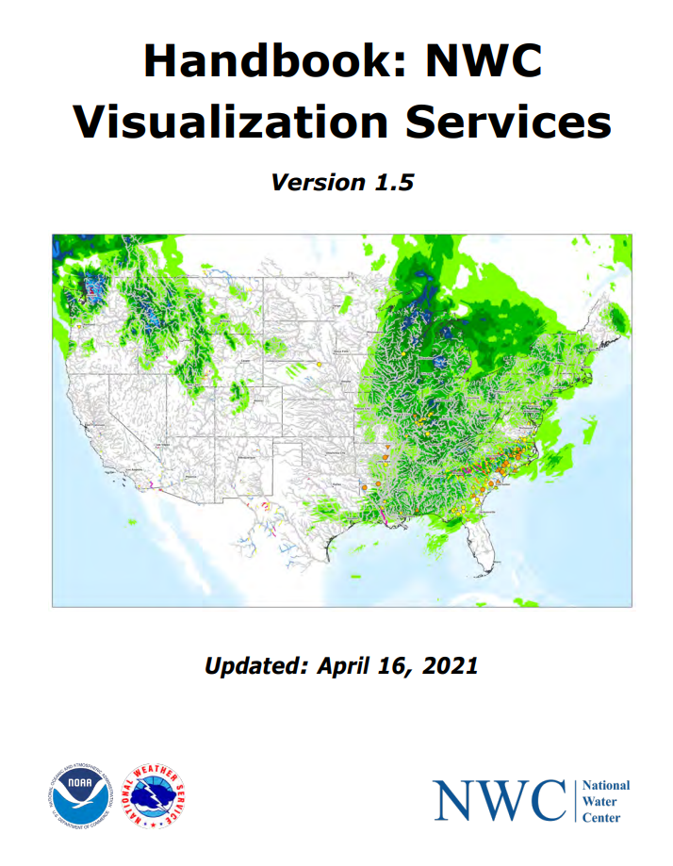
Shared Map Services between NWS and TxDOT
25 TxDOT Districts
13 Weather Forecast Offices
3 River Forecast Centers
EOC Staff and
Maintenance Supervisors
Forecast briefings
Forecasters at
WFO’s and RFC’s
Common
Operating
Picture
Staff
Field observations
of flooded roads
TxERA
(TxDOT Emergency Response Application)
ArcGIS applications for IDSS
(Impact-Based Decision Support Services)
Applications
Map services for weather
and water forecasting at TxDOT
Services Infrastructure
KISTERS Datasphere
TxERA Map Server
(customized maps
for TxDOT)
NWS Map Server
(Public and Prototype
Map Services)
Flood
data
services
Forecast map services
DriveTexas.org service

Slide 17
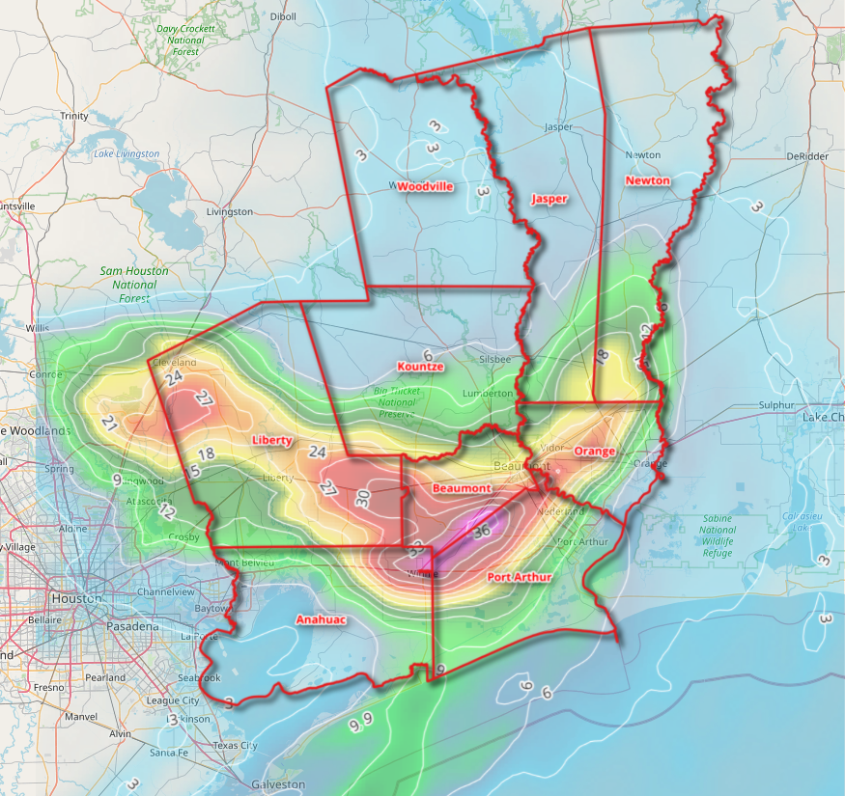
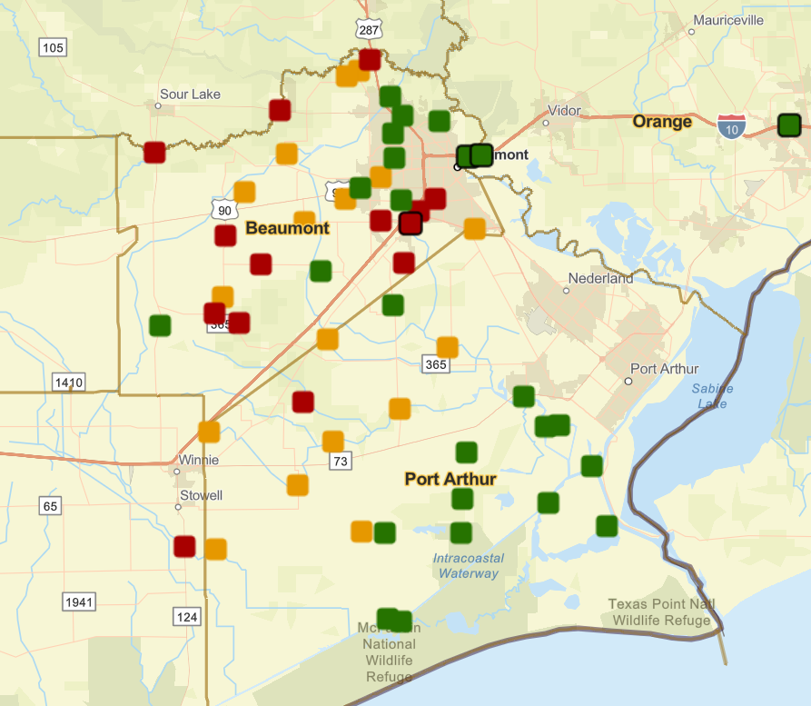
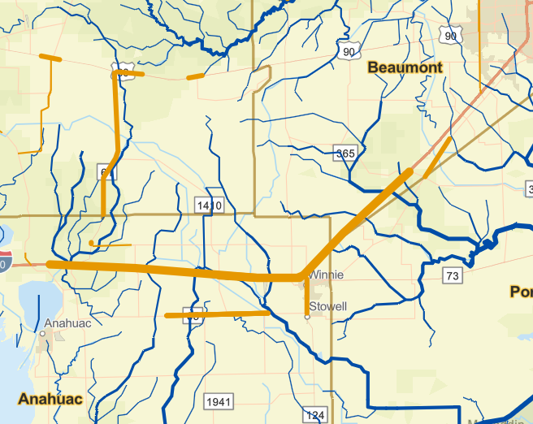
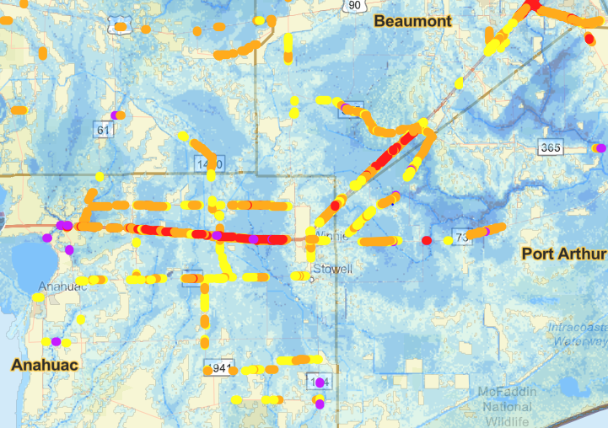
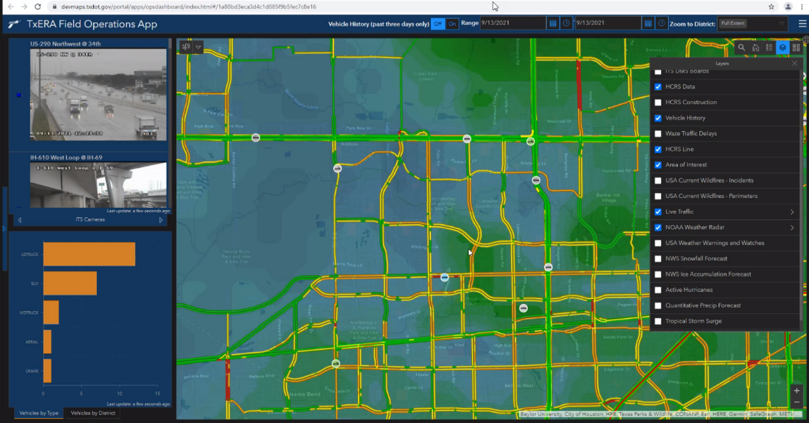
Rainmap in the Sky to Floodmap on the Ground
Forecast Rain Map
Maps accessible through ESRI StoryMap
Observation Gauges
https://arcg.is/0LLLXX
Bankfull Streams and
Flooded Roads (HCRS)
Flood Inundation Map
Web Communication
to TxDOT (TxERA)

Slide 18
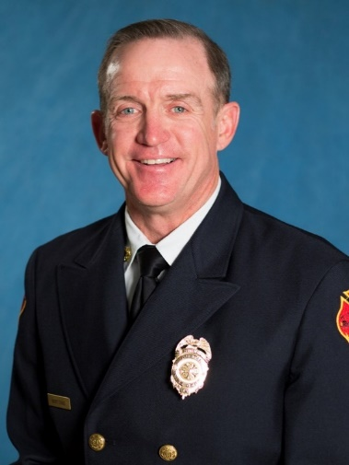
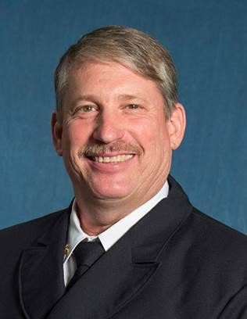
Streamflow II 0-7095
HSEEP Exercise Outcomes
Beaumont District
Maintenance Section
Harry Evans
Christine Thies
Larry Jantzen
Flood Emergency Response Team
Center for Water and the Environment
Notes:
Larry

Slide 19
Purpose
The Streamflow II Project Team have created several new products which we tested with the TxDOT Beaumont Maintenance District. The objectives of this exercise are to evaluate the effectiveness and access of these products.
The new products are:
Flooded Road Estimates (based on flood depth map)
Flood Inundation (flood depth map)
Gauge Water Level using Streamflow I and Drainage District 6 gauges
Bridge Warnings using Streamflow I and Drainage District 6 gauges
Bankfull Rivers (National Weather Service Product)
Precipitation Forecast by Section (National Weather Service Product)
Notes:
Larry

Slide 20
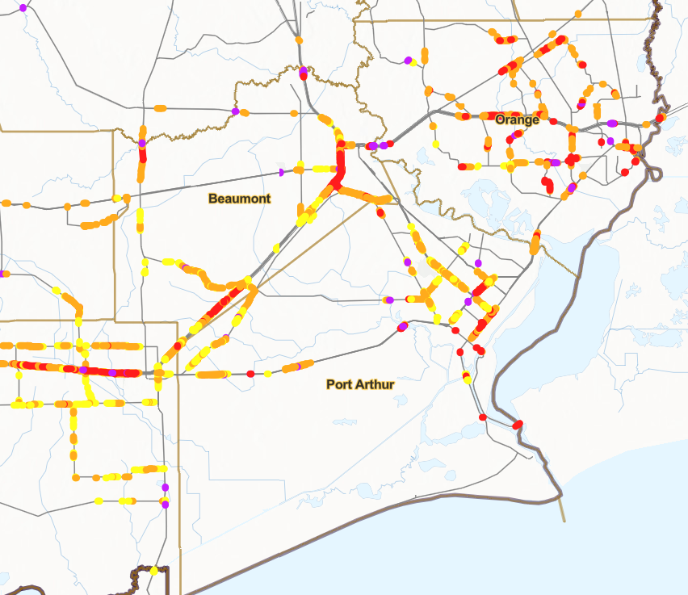
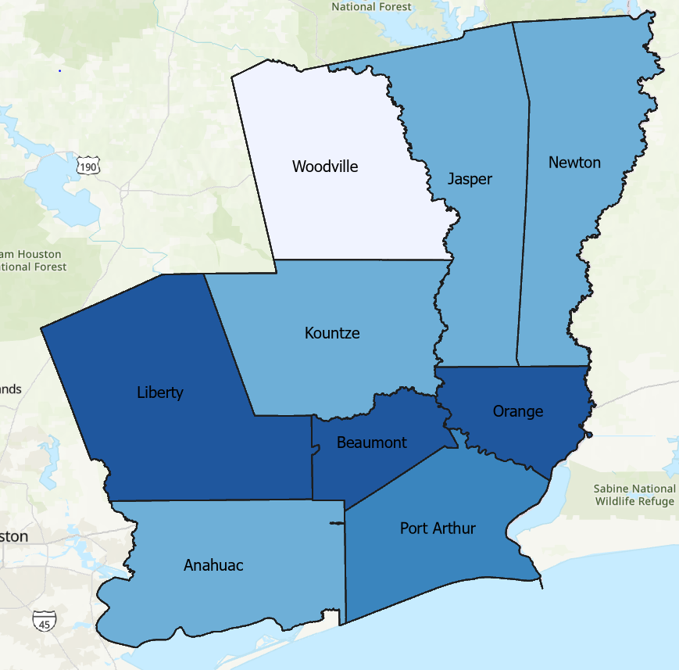
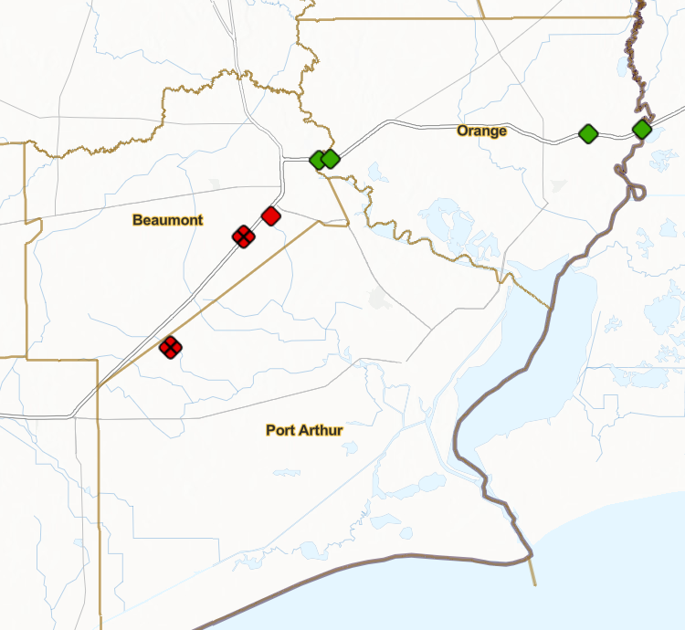
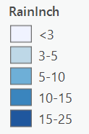
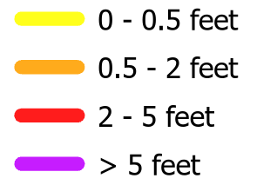
Top New Products
Flooded Road Estimates
Precipitation Forecast by Section
Bridge Warnings
Estimated Depth
Warning (< 5ft to bridge)
Concern (5 to 10ft to bridge)
Ok (>10ft to bridge)
X
Out of Service (gauge not working)
Notes:
Larry

Slide 21
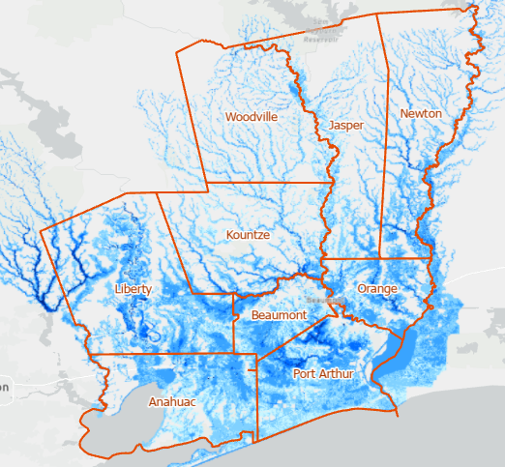
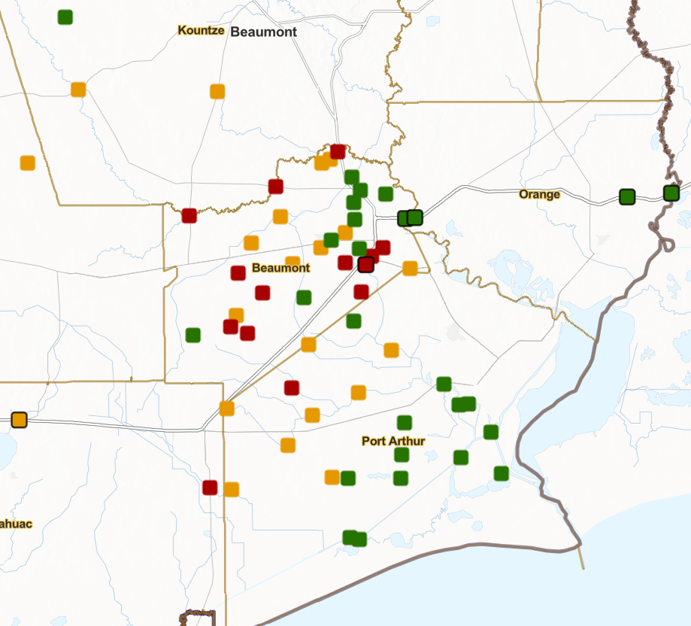
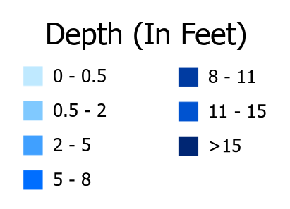
Top Reference Products
Flooded Inundation
Bankfull Rivers
Gauge Water Level
Flooded Roads (HCRS)
Warning (>10ft of water over normal level)
Concern (5-10ft of water over normal level)
Ok (<5ft of water over normal level)
Notes:
Larry

Slide 22
Exercise Feedback
The exercise was very well received in the Beaumont District
Participant Role | Assessment Factor
 | The exercise was well structured and organized. | The multimedia presentation helped the participants understand and become engaged in the scenario. | The facilitators were knowledgeable about the material, kept the exercise on target, and were sensitive to group dynamics. | Participation in the exercise was appropriate for someone in my position. | The participants included the right people in terms of level and mix of disciplines.
Observer | 5 | 5 | 5 | 5 | 5
Player | 5 | 5 | 5 | 5 | 5
Player | 5 | 5 | 5 | 5 | 5
Player | 5 | 4 | 5 | 4 | 5
Evaluator | 5 | 5 | 5 | 3 | 5
Player | 5 | 5 | 5 | 5 | 5
Player | 5 | 4 | 5 | 5 | 4
Player | 5 | 5 | 5 | 5 | 5
Evaluator | 5 | 5 | 5 | 5 | 5
Observer | 5 | 5 | 5 | 5 | 5
Player | 4 | 5 | 5 | 5 | 5
Player | 5 | 4 | 5 | 5 | 5
Average | 4.9 | 4.8 | 5.0 | 4.8 | 4.9
Notes:
Larry

Slide 23
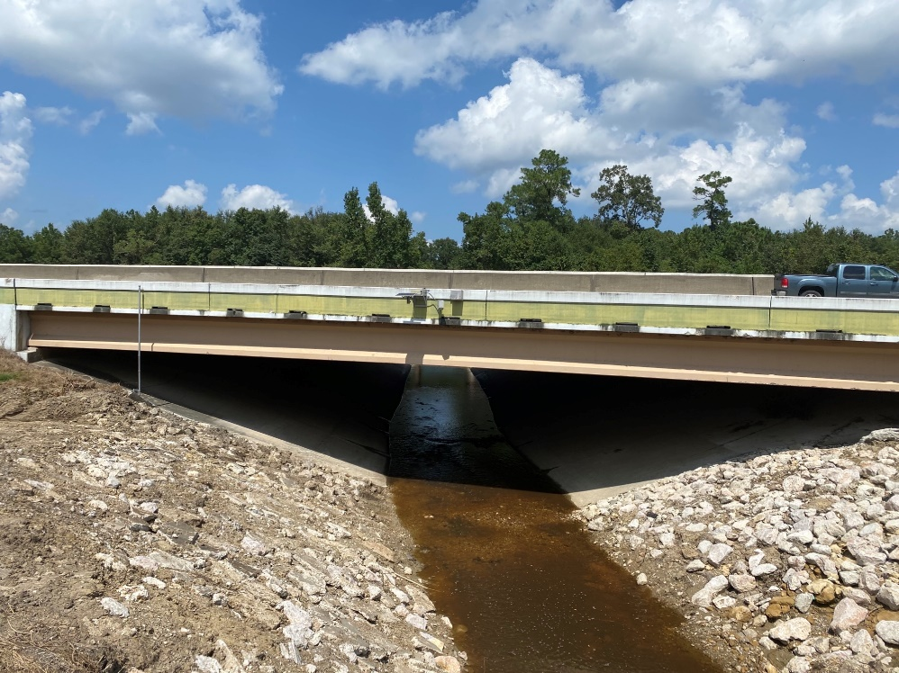
Recommendations to TxDOT
Field Data Collection During Floods
An automated method for field staff to record flood conditions is needed
Possibilities:
Low Chord Elevation on Bridges
Creating a bridge warning system requires a surveyed low chord elevation to serve as a reference point in (x,y,z)
+

Slide 24
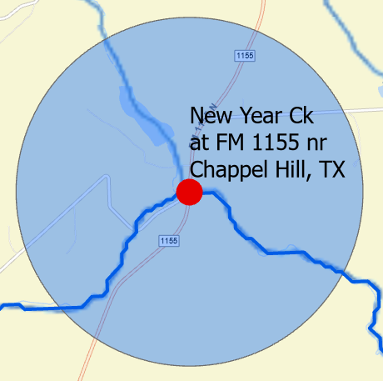
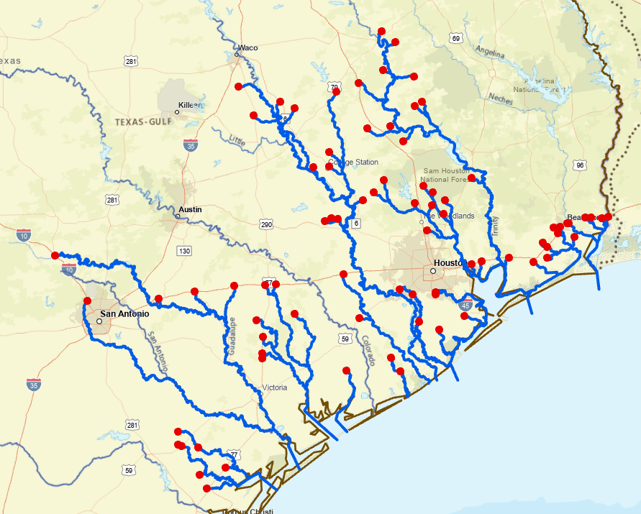
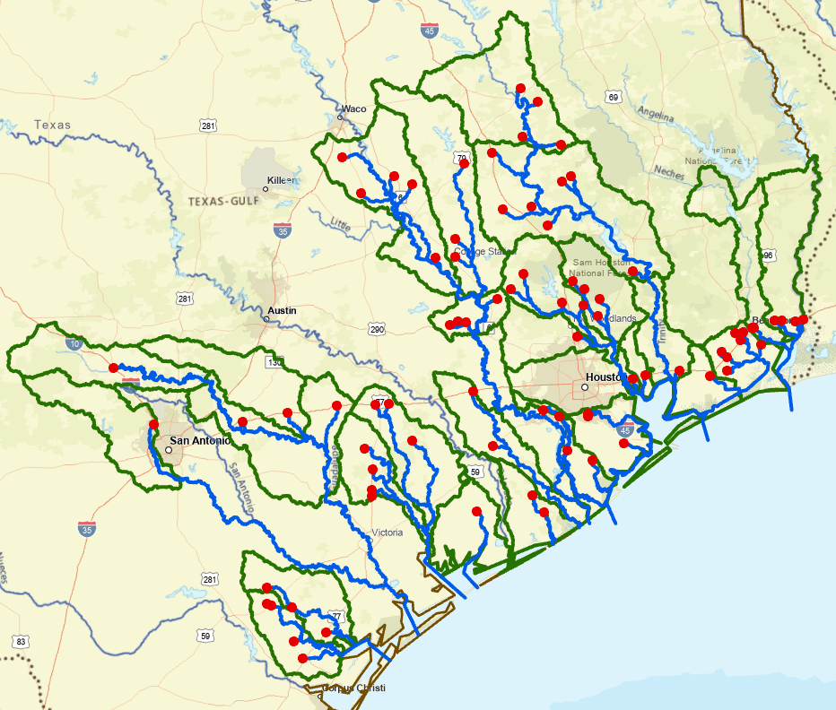
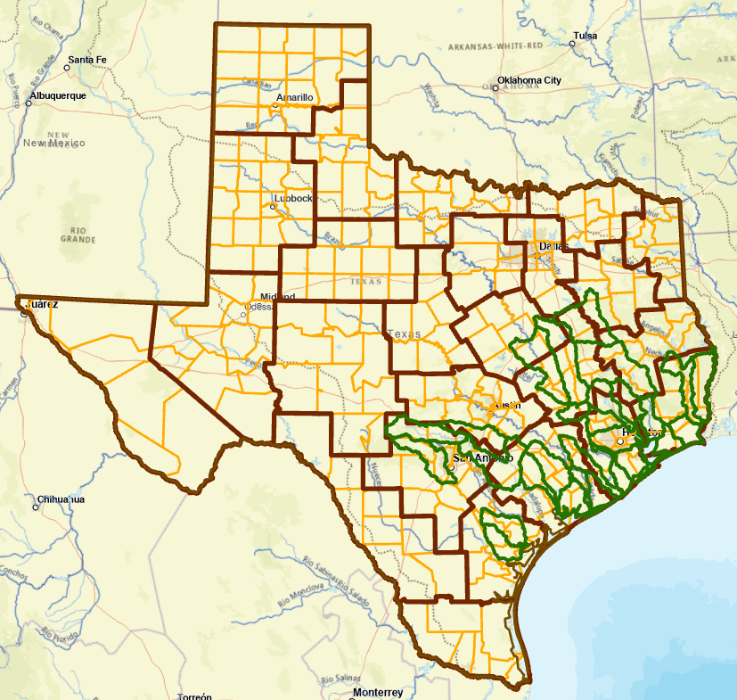
Spatial Scales of Flood Information
Around Gauge site
Downstream of Gauge
Gauged Watershed
TxDOT Districts

Slide 25
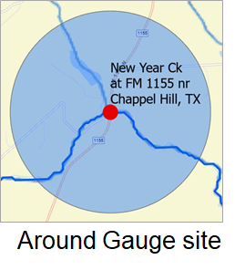
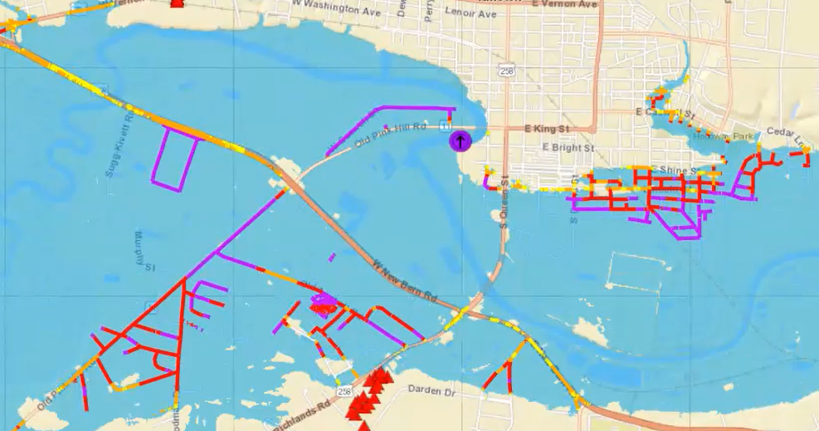
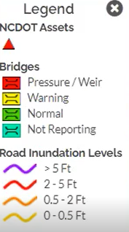
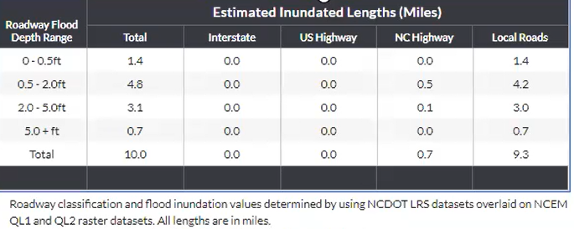
FIMAN-T system from NCDOT
This map and summary table are drawn from the
FIMAN-T system developed by the North Carolina DOT
Source for Images: David Key, ESP Associates

Slide 26
Proposed Plan
Prototype Map Products | At TxDOT Gauges | Downstream of TxDOT Gauges¹ | Gauged Watersheds² | Texas State-Wide
Flooded Road Estimate | 6 mo.³ | 12 mo. | 18 mo. | N. A.
Precipitation Forecast by Section | -- | -- | -- | 3 mo.
Bridge Warnings | 3 mo.⁴ | 6 mo.⁵ | 12 mo.⁵ | N. A.
Flood Inundation | 6 mo.³ | 12 mo. | 18 mo. | N. A.
Bankfull Rivers | -- | -- | -- | 3 mo.
Gauge Water Level | 3 mo. | -- | -- | N. A.
Notes:
Requires forecast adjustment and downstream routing
Requires forecast adjustment from routed reaches to all reaches
Requires hydraulic modeling of gauged bridge and its approach roads
Requires completion of gauge installation and a preliminary rating curve
Requires point cloud representation of bridge deck
Shared Services
Demonstration Prototype

Slide 27
Shared Services Demonstration Prototype
Goal: A research prototype to be tested during the 2022 summer storm season
Forecast Rain Maps
Observations
Forecasting
Field
Observations
Data and Map
services
Data and Map
services
NWS Public
and Prototype
Map Services
Observation Gauges
TxDOT Radar
Stream Gauges
Datasphere
Bankfull Streams
and Flooded Roads

Slide 28
Streamflow Measurement and Bridge Modeling at 80 TxDOT Gauges
“FIMAN-T for Texas”
Creates accurate measurement of flow conditions at bridges ….
….. and accurate mapping of flooded road depths near bridges

Slide 29
Proposed Activities by Quarter
Beaumont
Exercise
Austin
Exercise
Measurement and Modeling
at TxDOT Gauges
Shared Services
Demonstration Prototype
Prep all products for
Beaumont exercise
Prep all products for
Austin exercise
Second Quarter
Third Quarter
Fourth Quarter
Dec 2021
Mar 2022
Jun 2022
Sept 2022
Fifth Quarterly Review
Sixth Quarterly Review
Seventh Quarterly Review
Eighth Quarterly Review
We are here now

Slide 30
Discussion
We are asking for your approval of the proposed plan
Shared services demonstration prototype
Streamflow Measurement and Bridge Modeling at 80 TxDOT gauges

Slide 31
Meeting Agenda
Beaumont Flood Emergency Response Exercise
Introduction and overview
Review of maps presented
Results of the exercise evaluation
Proposed plan
Discussion
Progress and Plans
Gauge installation, operation and maintenance
Flood forecast system operation
Forecast model assessment
Flood emergency response and flood manual
Discussion

Slide 32
Task 3: Gauge Installation, Operation and Maintenance
Scott Grzyb, US Geological Survey
Achievements during last Quarter
55 recorded visits to installed gauges
Finished site selection and permitting
- Meaningful discharge verifications
45 gauges installed and operating
Challenges for next Quarter
Complete gage installations and documentation
Continue developing and refining USGS rating models
- 77 gauges installed and operating

Slide 33
Bridge permits, approvals, installations and visits
December 3, 2021
36 bridge permit requests sent
December 16, 2021
4 bridge permit requests sent
February 9, 2022
28 permits returned approved
February 23, 2022
Installation of new stream gauges begins
Station Number
55 recorded visits to installed gauges
0
1
2
3
4
Number of Site Visits
7 new stream gauges installed since February 23, 2022

Slide 34
Gauge Visits - Observations
Corrections in gauge height

Slide 35
Gauge Visits - Observations
Changes in vegetation in the channel
July 2021
February 2022

Slide 36
Data Observations – Initial Velocity Wave
W Navidad Rv at I-10 nr Schulenburg, TX
Stage Height (ft)
Velocity (ft/s)
Date/time

Slide 37
Data Observations – Initial Velocity Wave
W Navidad Rv at I-10 nr Schulenburg, TX
Stage Height (ft)
Velocity (ft/s)
Date/time

Slide 38
Data Observations – Initial Velocity Wave
New Year Ck at FM 1155 nr Chappel Hill, TX

Slide 39
Rating 2.0 Development
Tier 1 Site: New Year Ck at FM 1155 nr Chappel Hill, TX
Discharge Rating 2.0
Discharge Measurements
Rating Point

Slide 40
Discharge observations
Discharge ( cfs )
Tier 1 Site: New Year Ck at FM 1155 nr Chappel Hill, TX
Measurements
USGS Discharge
RQ-30 Discharge
(uncalibrated)
Date/time

Slide 41
Task 4: Flood Forecast System Operation
Matt Ables, KISTERS
Achievements during last Quarter
Released the first versions of the Datasphere Command Line Interface (CLI) to research staff
Provided CLI training and support to research staff
Prepared Web Services for Beaumont Flood Emergency Response Exercise
Imported and configured Llano Basin stations and data for Data Assimilation
Challenges for next Quarter
Add new TxDOT Radar gauges to the system
Establish TxDOT specific scheduling and data processing services in AWS / ArcGIS Online
Enhance Datasphere APIs as needed
Further develop the Operations vs Research and Planning environments
Data Assimilation in the Llano River basin

Slide 42
Task 4: Flood Forecast System Operation
Operations Engine
Research & Planning Tools
Datasphere will work as an Operations Engine by collecting, processing, and distributing data directly to other TxDOT applications like TxERA. This allows for the datasphere products to be presented to Operations Staff through existing and familiar tool and eliminates the need to learn / use additional software.
Researchers, planners, and other users in need of additional tools and data are able to use the Datasphere interface to perform detailed graphing and analysis. Additional tools like the Cmd Line Interface all for easy bulk data retrieval and analysis.

Slide 43
Operations Engine
Datasphere APIs will supply time series data and graphs to TxERA or other TxDOT systems as needed.
Datasphere
TxERA
Scheduler / Data Processor
ArcGIS Online Services
The Scheduler / Data Processor is an AWS VM and collection of services used to analyze, build, and update feature services and layers in ArcGIS Online that are ultimately consumed by TxERA.

Slide 44
Research & Planning Tools
Datasphere APIs will supply time series data and graphs to the KISTERS Water Information System which will allow greater access to historical data and statistics through web services and the ArcPro Extension.
Scheduler / Data Processor
Datasphere
KISTERS
Water Information System
Research Tools & Prototypes
Data products and procedures designed by the Research Team could be operationalized if necessary once they pass the proof of concept stage.
Web services
Python
Tools
Statistics &
time series
ArcPro
Extension

Slide 45
Task 5: Forecast Model Assessment
Paola Passalacqua, UT Austin
Achievements during last Quarter
Challenges for next Quarter
Automated detection of storm and analysis of stage-velocity relationship at sensors from NWM retrospective data
Analyzing ADCP data and comparing to RQ30
Validating coastal HAND approach with ADCIRC model results
Error analysis of NWM in SETx
Identify patterns of stage-velocity relationships in space and time
Analyzing ADCP data and comparing to RQ30
Complete validation of coastal HAND approach, integrate with GeoFlood and finalize paper for submission
Identify patterns in NWM errors and create uncertainty map

Slide 46
Radar Measurements and River Hydraulics
Julia Ho – senior undergraduate student supervised by Paola Passalacqua on this project
Stage Height (ft)
Velocity (ft/s)
What do stage-velocity relationships look like in the Texas streams where radar sensors are installed?
Do these relationships change through time?
How do the velocity measurements at radar sensors compare with ADCP measurements?

Slide 47
ADCP measurement and Isovel Contours
Isovel
Contour of
Point velocity
Mean velocity
Smoothed contours created with USGS Velocity Measurement Tool and visualized with Python

Slide 48
RQ-30 Cross-Section Profile and K-Factor
Q = A*V_{m}= A*k*V_{l}
Cross-Section, A
k-factor
Can a predictive model for the
k-factor relationship with depth
be developed?
Stage Height (ft)
Stage Height (ft)

Slide 49
Coastal HAND Approach
Mark Wang – MS/PhD student supervised by
Paola Passalacqua on a NOAA project
Wang et al, in preparation
Coastal flooding plays a major role in SETx and coastal Texas in general – at this time, our flood inundation modeling approach does not account for this type of flooding
Currently performing comparison of our coastal HAND approach with ADCIRC model results for TS Imelda

Slide 50
Error Analysis and Validation of Data Assimilation Approach
Sujana Timilsina – PhD student supervised by Paola Passalacqua on this project
How do the predictions of the National Water Model compare to water level/discharge observations (at DD6 gauges and over the whole area?
Are there spatial patterns in the error and are those related to river network properties?
How to integrate this uncertainty into the flooded road maps?
Do DA techniques improve model forecasts? Does the operational DA approach improve the NWM performance on the Llano River?
Are there regions/watersheds or reaches that are more sensitive to model adjustments than others? Can we identify critical links of the network?

Slide 51
Flood Inundation – 2D Hydraulic Modeling Andy Carter
80 TxDOT Radar
Stream Gauges
USGS Gage 08111110
New Year Ck at FM 1155 nr Chappel Hill, TX
30.21231, -96.24295
NBI #172390140504004
Goals:
Create “flood depth raster stacks” from HEC-RAS 2D models in compliance with FDST (Flood Decision Support Toolbox) criteria for each gauge location.
Main stem (1 mile +/- upstream and downstream)
Create rating curve from 2D model and composite / compare with USGS ADCP data.
From raster stacks, determine limits of flooded roads.

Slide 52
Flood Inundation – Rating Curves (USGS ADCP Integration)
USGS Gage 08111110
New Year Ck at FM 1155 nr Chappel Hill, TX
30.21231, -96.24295
NBI #172390140504004

Slide 53
Flood Inundation – 2D Hydraulic Modeling
Bridge Modeling from Plans
In 2D grid mesh

Slide 54
Flood Inundation – “Healing” Terrain with Bridges
Model on hydro-enforced
and map on “healed” terrain

Slide 55
Flood Decision Support Toolbox (FDST) Compliant Products
Guadalupe River at Comfort, Tx
A Flood Inundation Map Library
and set of Rating Curves
Draft 2D – FDST Guidance
Source: Jonathan Thomas (USGS)

Slide 56
Estimated Road Flooding Tim Whiteaker
Inputs:
Road network

Slide 57
Estimated Road Flooding
Inputs:
Road network
Flooded area

Slide 58
Estimated Road Flooding
Inputs:
Road network
Flooded area
Outputs:
Flooded road extent

Slide 59
Estimated Road Flooding
Inputs:
Road network
Flooded area
Outputs:
Flooded road extent
Flooded road depth

Slide 60
Task 6: Flood Emergency Response and Flood Manual
Harry Evans
Achievements during last Quarter
Completion of Beaumont Flood Emergency Response Exercise
Challenges for next Quarter
Improvement plan arising from Beaumont exercise
Report P6A due 31 March
Preparation for Austin exercise (September 2022)
Harry Evans
Christine Thies
Larry Jantzen
Flood Emergency Response Team

Slide 61
Discussion
Comments from all Committee members are encouraged
Questions for Discussion:
Does TxDOT want to participate in the Flood Decision Support Toolbox?
What survey measurements are needed at TxDOT bridges to support flood warning?
How to connect flow measurements and hydraulic modeling at gauged bridges?
How to connect inundation mapping done around bridges with regional scale inundation mapping?
How to define “bankfull flow”?
How to describe uncertainty in forecast information on the flood maps?
….

