Slide 1
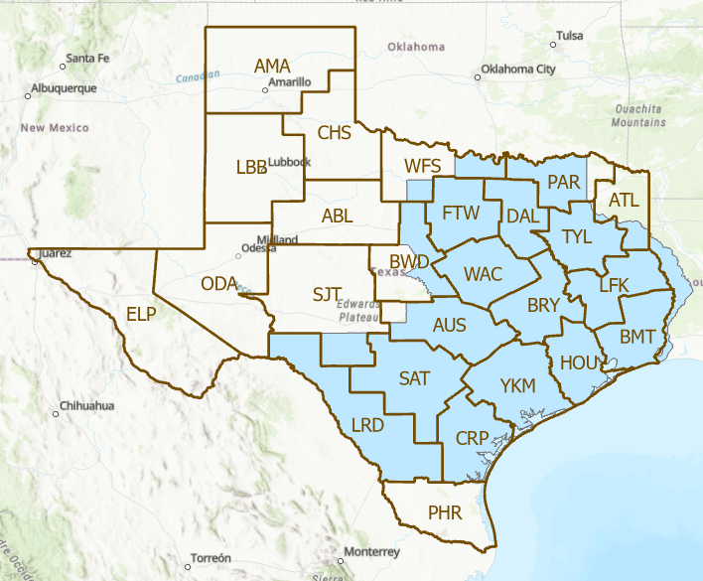
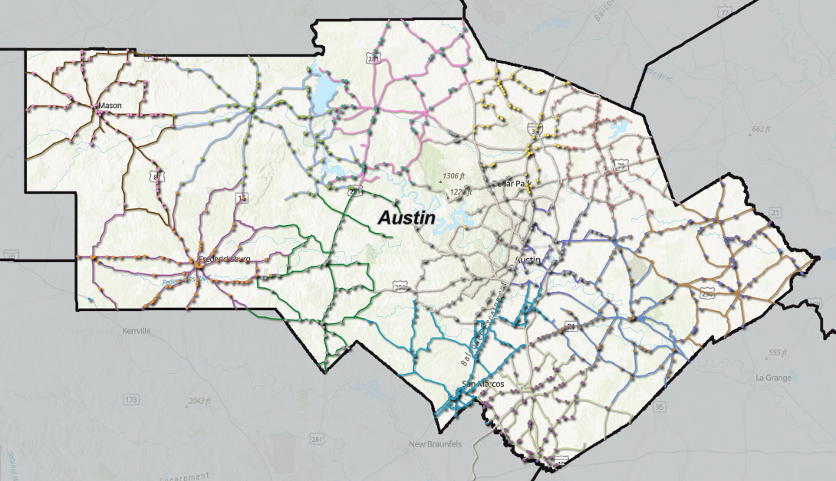
Looking to the Future
Flood Assessment System for TxDOT
David R. Maidment, Center for Water and the Environment, University of Texas at Austin
Presented to Austin Flood Emergency Response Exercise, Tuesday 17 January 2023
How can we apply FAST concepts
to other TxDOT Districts?
How can we improve FAST for the Austin District?
Real-time flood inundation
map services, October 2023

Slide 2
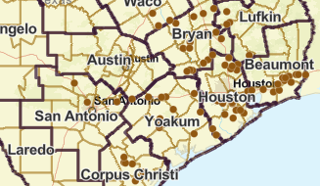
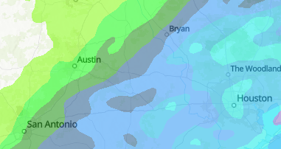
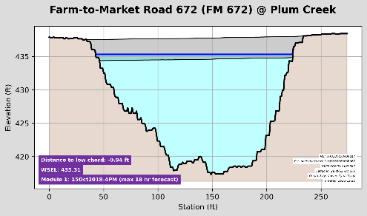
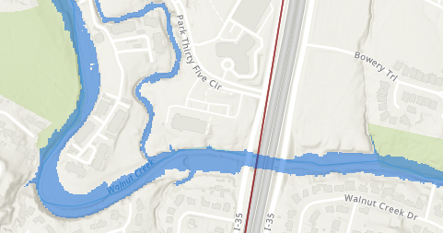
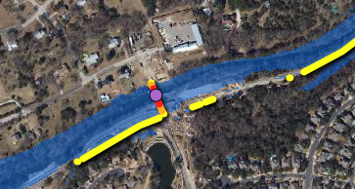
Real-Time Map Services
Asset Inventory
Streamflow Measurement
Precipitation
Bridge Warnings
Flood Inundation
Flooded Roads

Slide 3
Asset Inventory
How can we best summarize flood impacts on the inventory?
For Maintenance Section Supervisors?
For Austin District Operations Staff?
For TxDOT Statewide EOC?
Can you please contribute suggestions about this during
the feedback phase of this exercise?
MAINT_SEC_NBR | MAINT_SEC_NM | Bridge Count | Culvert Count | Route Count | Road Miles
1 | Bastrop County | 58 | 36 | 40 | 321
2 | Blanco County | 27 | 27 | 21 | 211
3 | Burnet County | 36 | 28 | 19 | 250
4 | Caldwell County | 49 | 39 | 38 | 274
5 | Gillespie County | 42 | 34 | 17 | 256
6 | Hays County | 61 | 47 | 64 | 345
7 | Lee County | 42 | 33 | 23 | 260
8 | Llano County | 41 | 39 | 23 | 252
9 | Mason County | 25 | 52 | 20 | 226
10 | Travis County East | 36 | 24 | 34 | 176
11 | Travis County North | 31 | 24 | 24 | 172
12 | Williamson County West | 50 | 57 | 40 | 302
13 | Williamson County East | 60 | 50 | 31 | 237
14 | Travis County Central | 23 | 18 | 34 | 178
15 | Travis County South | 43 | 24 | 40 | 222
25 | Austin Toll Roads | 64 | 35 | 21 | 316
 | Total | 688 | 567 | 489 | 3998
This inventory needs to be
checked and updated

Slide 4
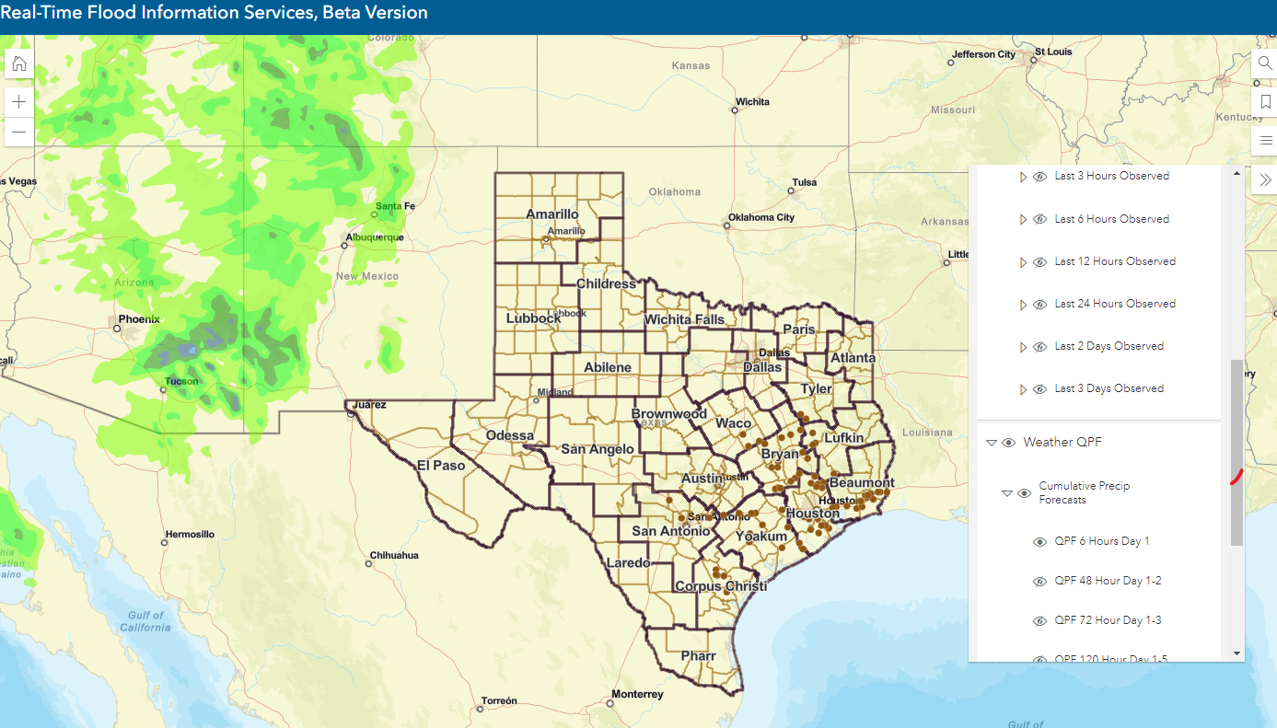
Real-Time Estimated and Forecast Precipitation
Provided by NOAA-NWS and already available in the Austin Real-Time Flood Viewer

Slide 5
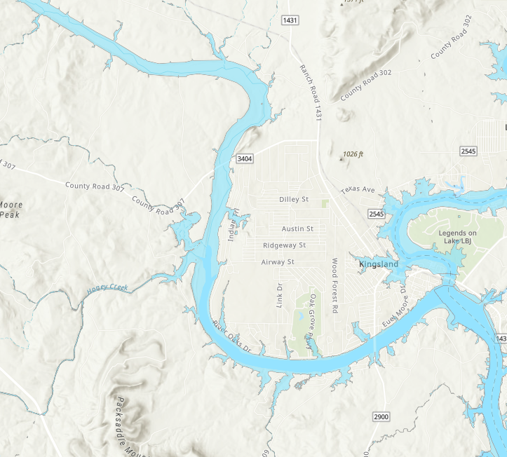
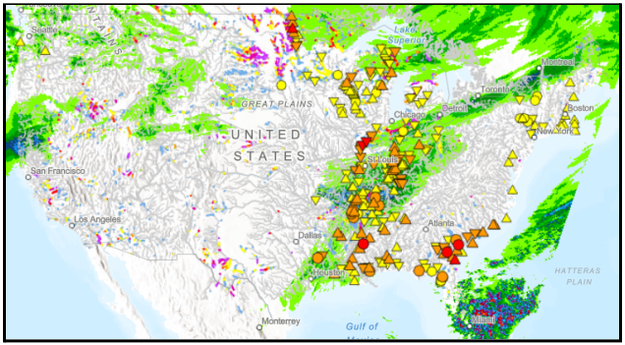
Real-Time Flood Inundation Maps
To be provided by NOAA-NWS and will become available in the
Austin Real-Time Flood Viewer in October 2023

Slide 7
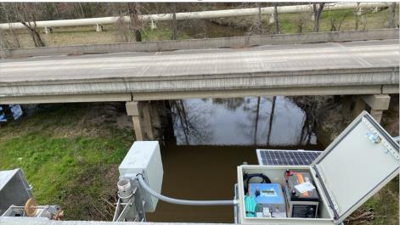
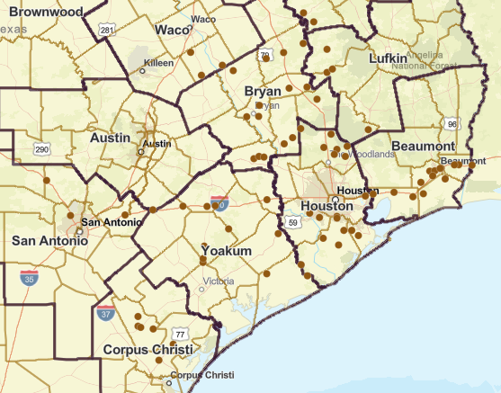
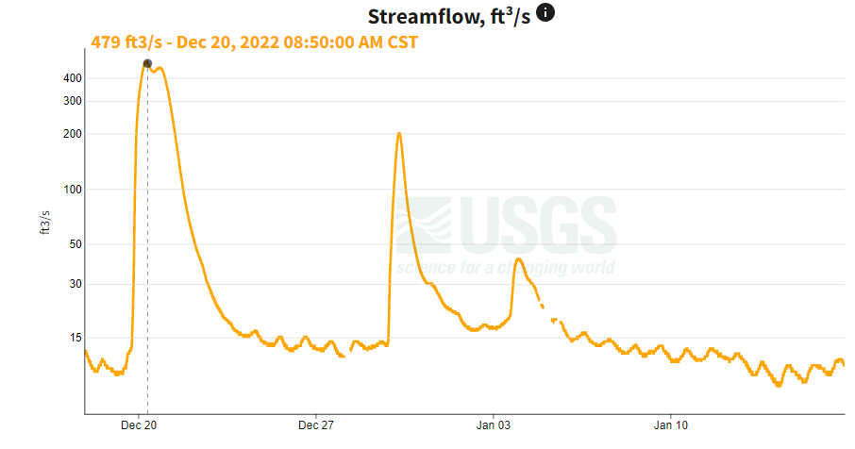
Streamflow Measurement
80 radar gauges installed and operational
Measure water surface elevation, velocity and discharge
Scott Grzyb

Slide 8
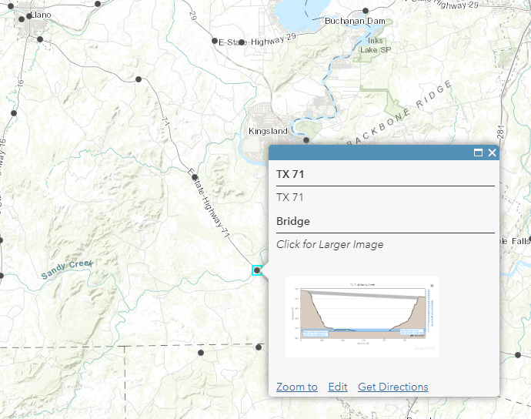
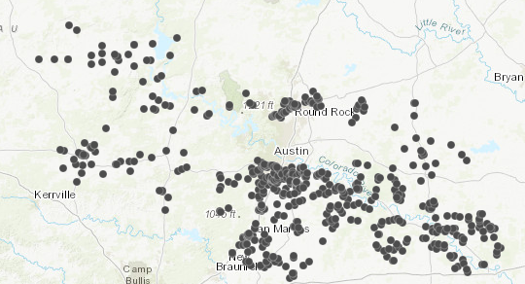
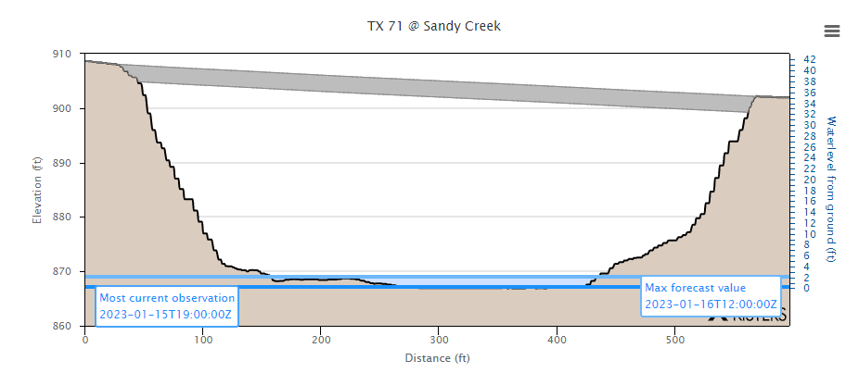
Bridge Warnings
https://arcg.is/098zGu0
Matt Ables
A working real-time system at 600 Austin District bridges
supported by this project and operated by KISTERS

Slide 9
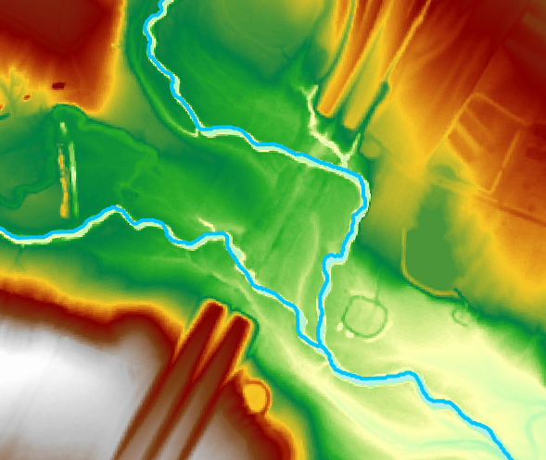
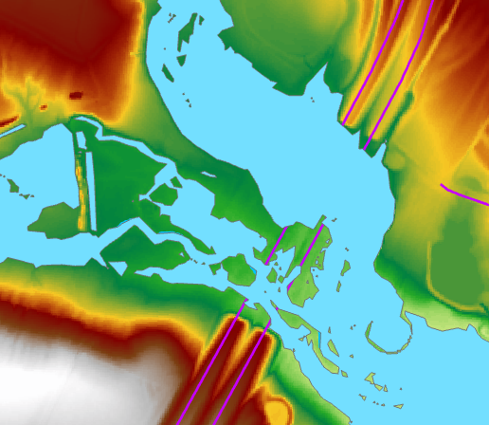
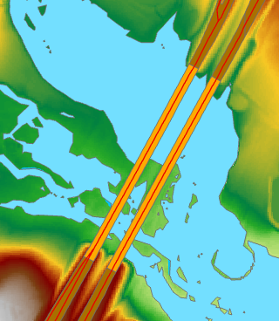
Flooded Roads
(1) Flood Inundation maps are prepared using “bare-earth Digital Elevation
Models with no bridges included
(2) Road appears flooded using
TxDOT Roadway Inventory
(3) Ecopia road and bridge data used to
“mask out” false road flooding
SH 130 at Gillieland Creek

Slide 10
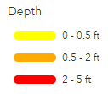
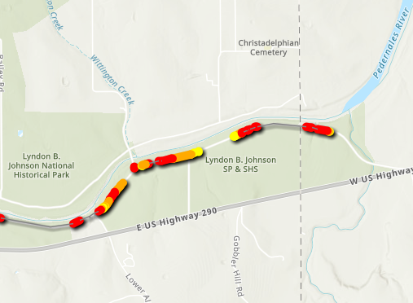
Flooded Roads
Lesson learned in preparing for this exercise:
Get the roads and bridges right first
On average 72% of flooded segments
covered by bridges

Slide 11
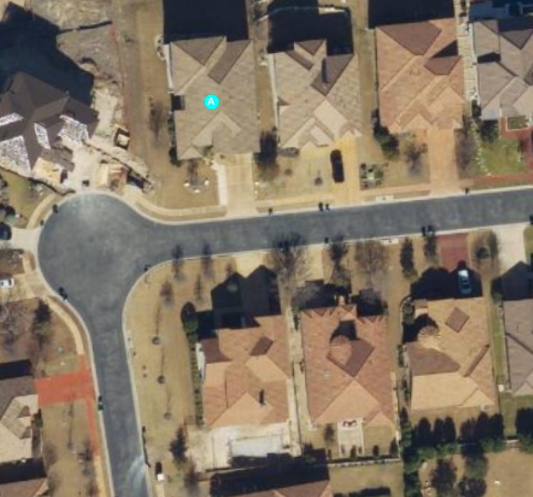
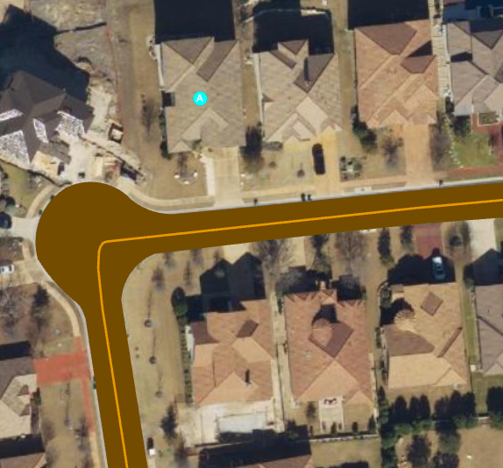
Ecopia Roads at my Home
TNRIS 6” Imagery licensed by TxDOT
Ecopia Polygons and Centerlines

Slide 12
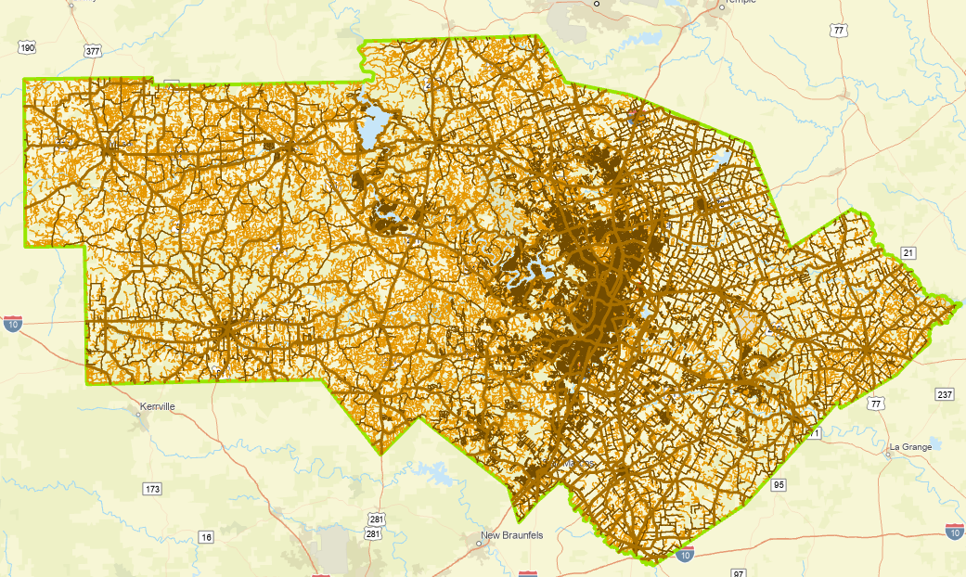
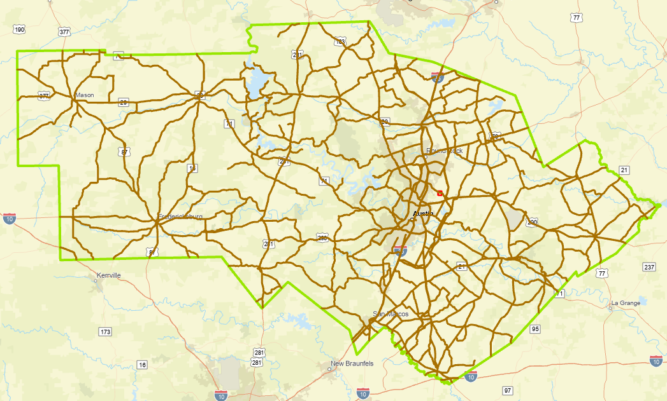
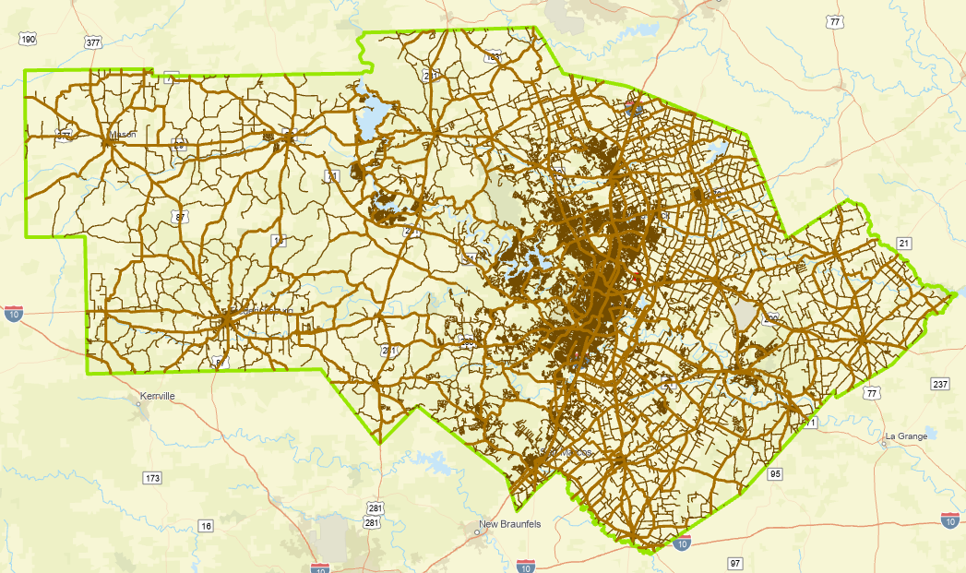
Roads in the TxDOT Austin District
Purchased by TxDOT RTI to support
our Streamflow II research project
Flood Emergency Response Exercise, Jan 2023
4400 miles On-System
38,000 miles Ecopia road coverage
1600 miles of TxDOT Roadway Inventory
are not located on pavement as defined by
Ecopia roads coverage
18,000 miles TxDOT Roadway Inventory

Slide 13
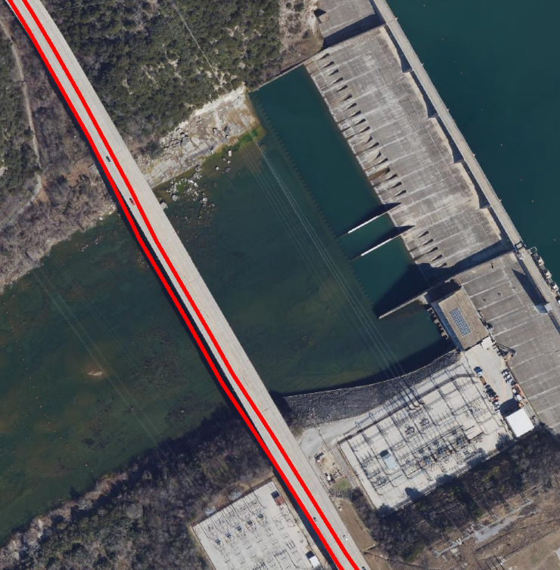
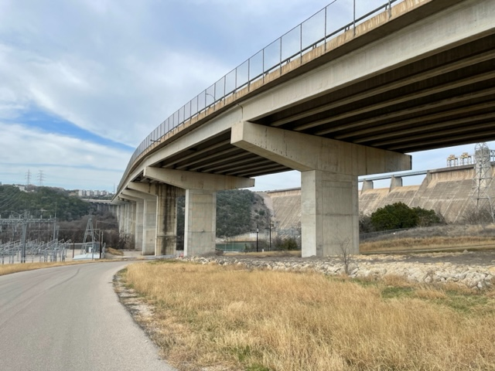
RM 620 over Colorado River at Mansfield Dam
West bound RM 620 is where East bound RM 620 should be
East bound RM 620 is in the Colorado River in TxDOT Roadway Inventory

Slide 14
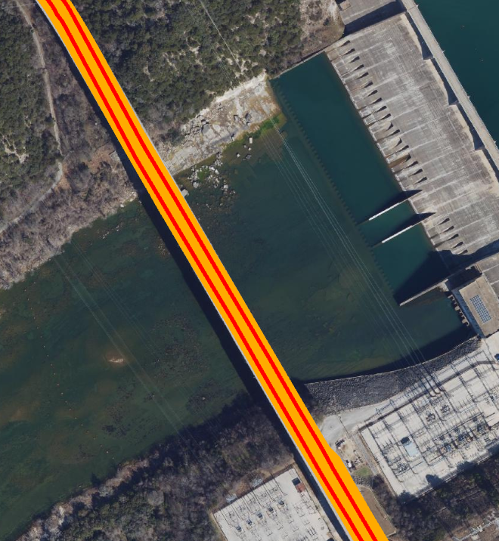
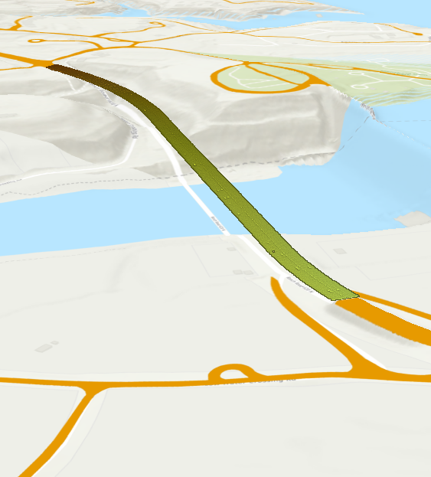
RM 620 over Colorado River at Mansfield Dam
Road polygons and centerlines are correctly positioned in (x,y) and have correct elevation (z)
Ecopia Road and Centerlines
LIDAR point cloud for bridge deck elevation
129,649 (x,y,z) points
on bridge

Slide 15
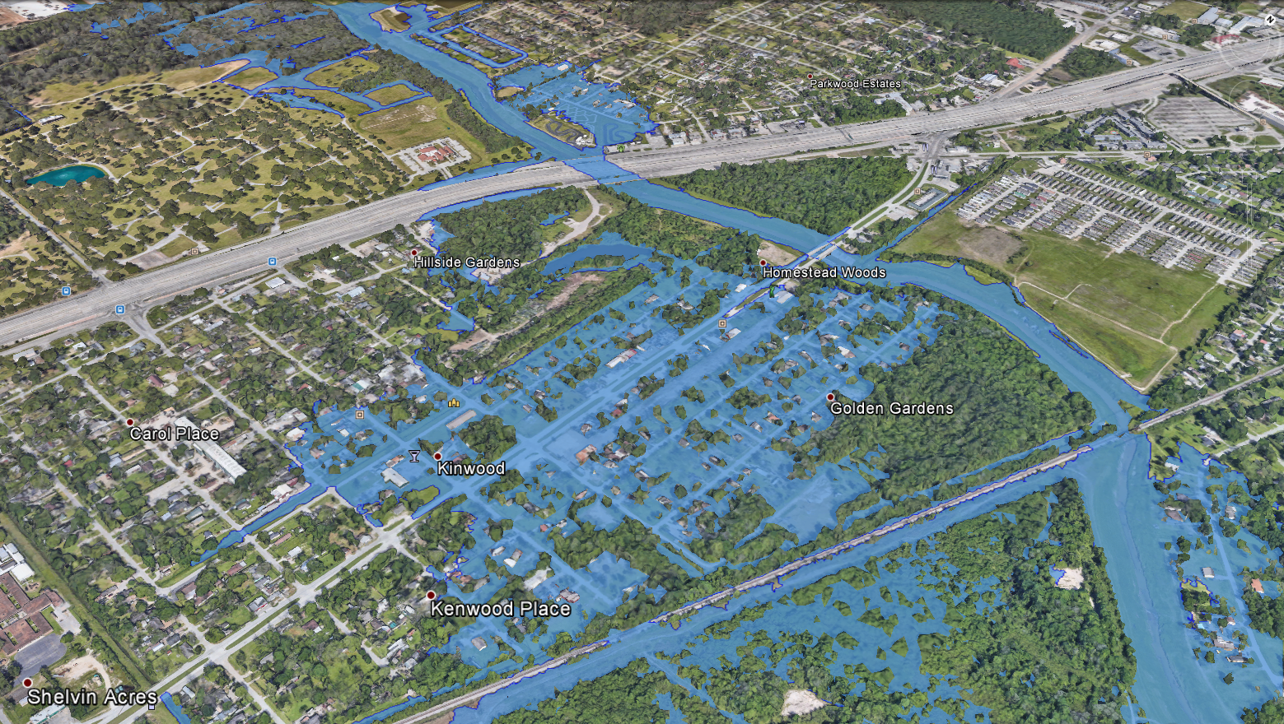
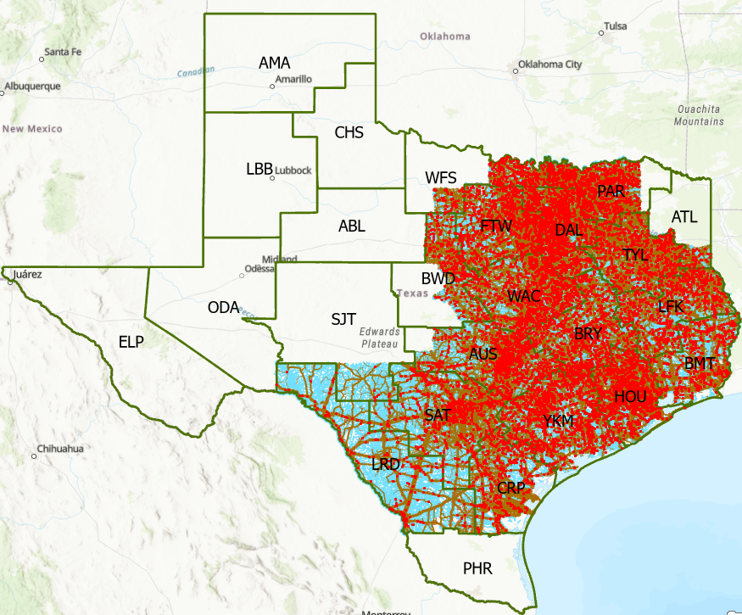
A Challenge: Real-Time Flood Inundation Mapping in October 2023
Inundation of a major highway
How can we use insights from FAST to include
the 16,500 bridges over water in these Districts?
Source: Derek Giardino, National Weather Service
Coverage of NWS Flood Inundation Mapping

