Slide 1
Texas FLOG/FIM Subcommittee, Friday 27 Jan 2023
Agenda
Summary of completion of FIM3 processing on 3m DEM for Texas (Yan Liu – ORNL)
FAST– Flood Assessment System for TxDOT and its roads and bridges representation (David Maidment – CWE)
Approaches to filling in 16,500 bridges in proposed NWC FIM4 coverage of Texas (Andy Carter – CWE)
Discussion

Slide 2
Computing 3-Meter HAND for the State of Texas
Yan Liu
Computational Scientist
Computational Sciences & Engineering Division
Oak Ridge National Laboratory
January 27, 2023

Slide 3
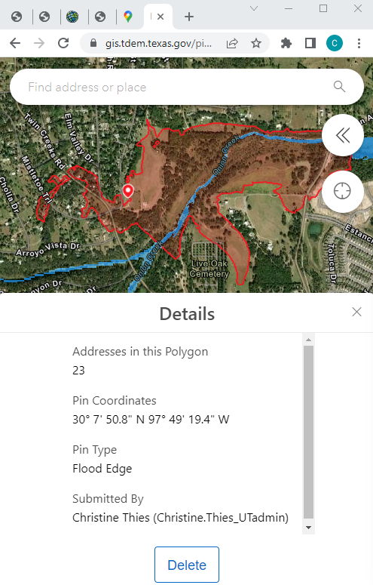
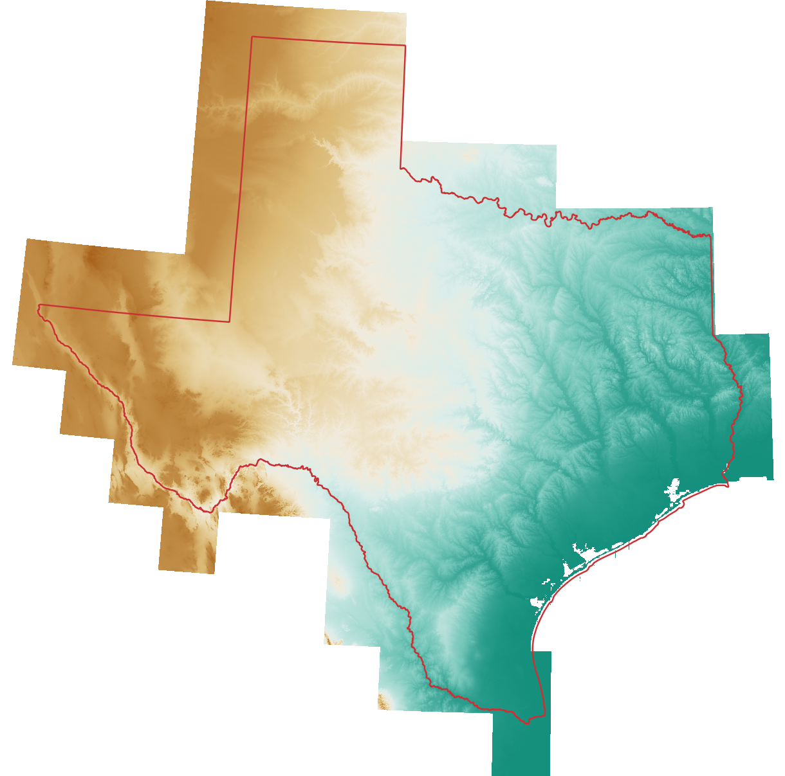
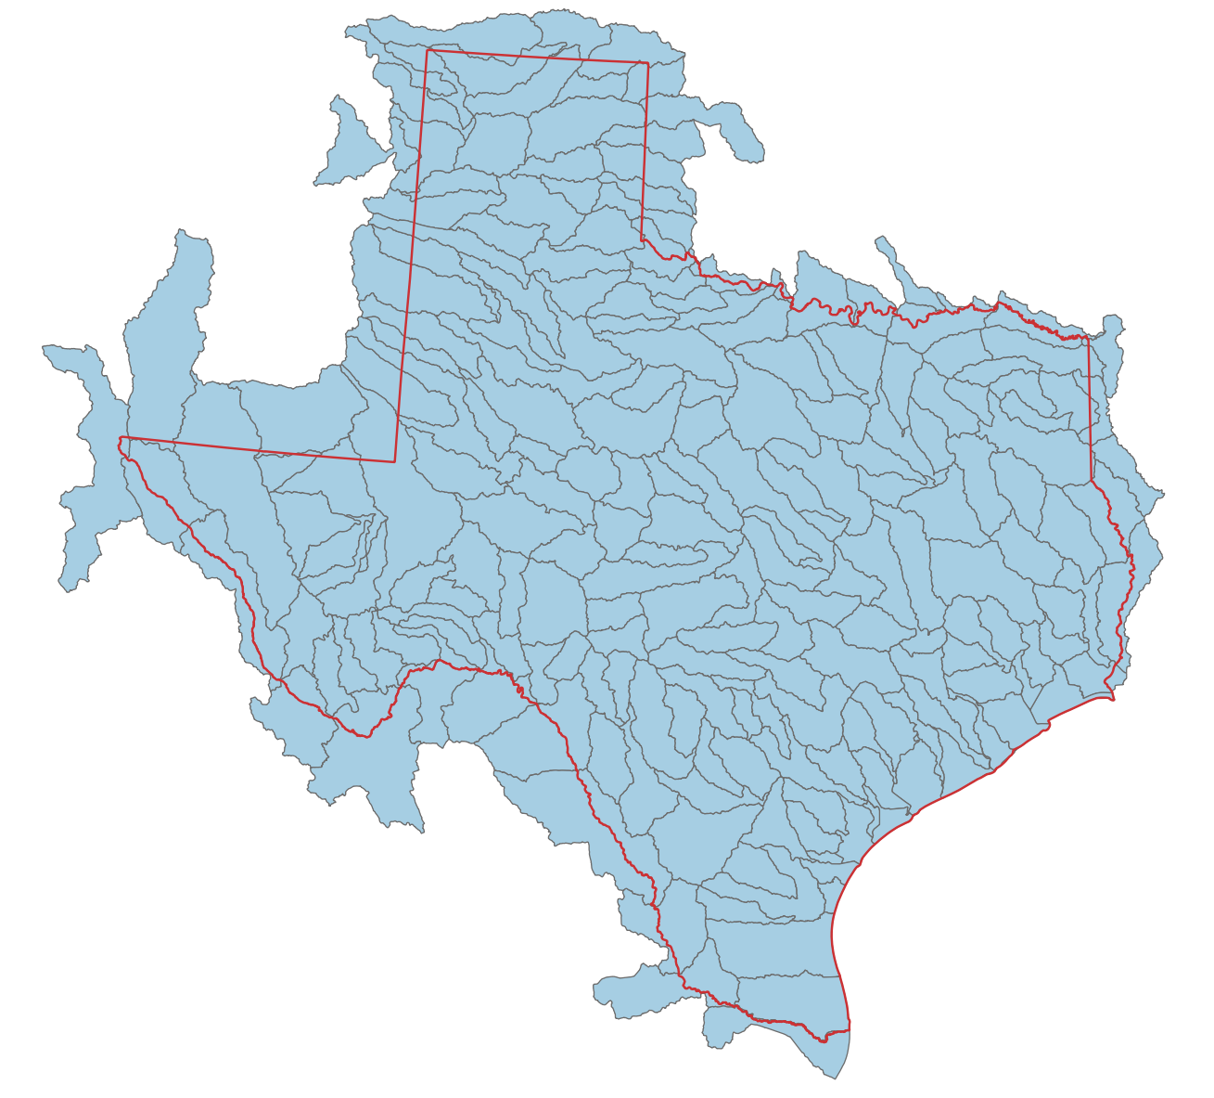
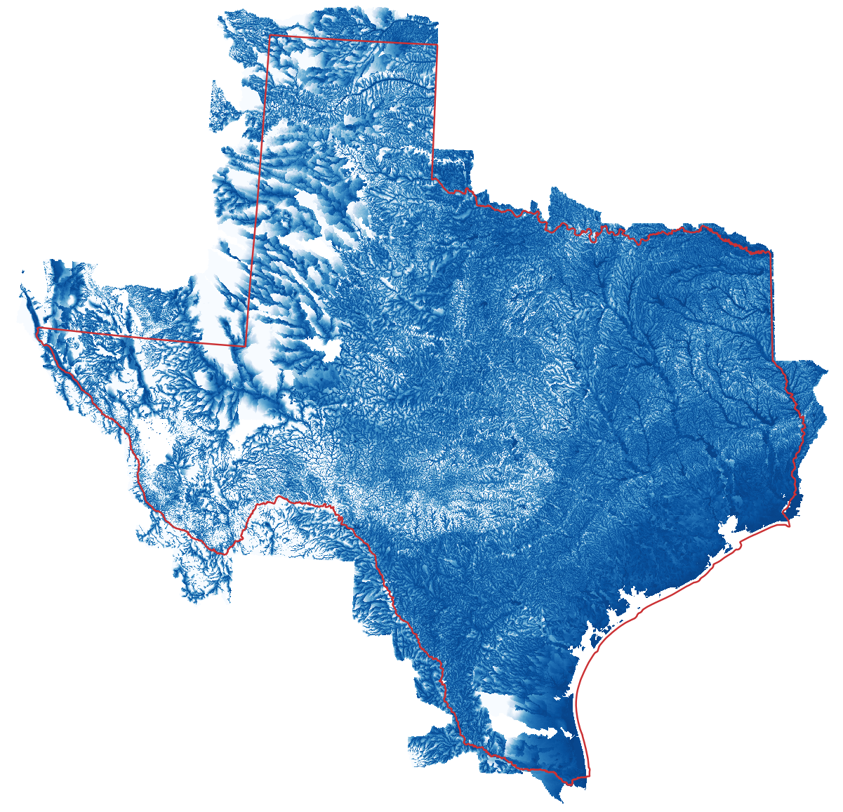
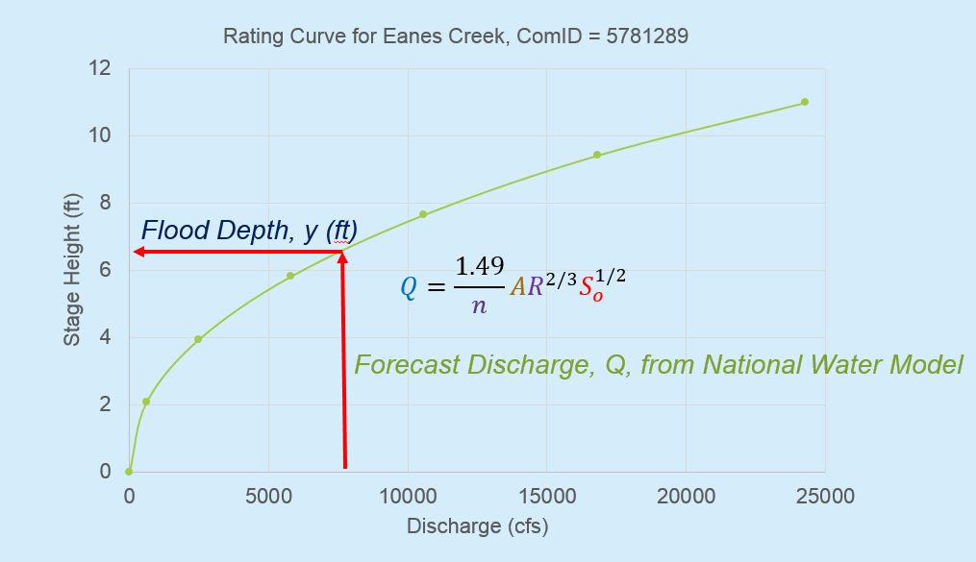
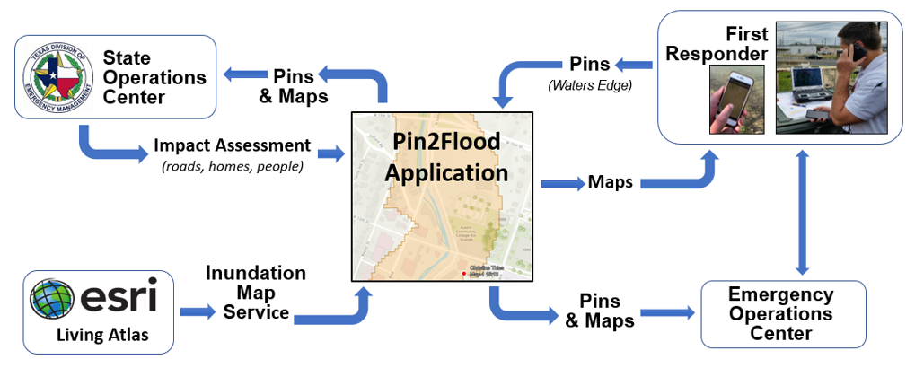
Pin2Flood Data Production Workflow
Watershed-based decomposition
NOAA NWC FIM3 workflow (full resolution mode)
ESRI flood slicing
App
Application Environment
Fathom 3m DEM
Full coverage of Texas
Projection: EPSG:4326
Size: 321GB
93 tiles, 176.36 billion raster cells
HUC8 hydrofabric
209 HUC8 units
Projection: EPSG:5070
For each HUC8:
DEM: Fathom 3m
NWM hydrofabric: NOAA NWC FIM3
3m HAND
Healed HAND raster
Stream network:
287,535 streams
~1.5km/stream
Synthetic rating curve
Other byproducts
Size: 1.8TB
Full package: 1.5TB
Production package: 284GB

Slide 4
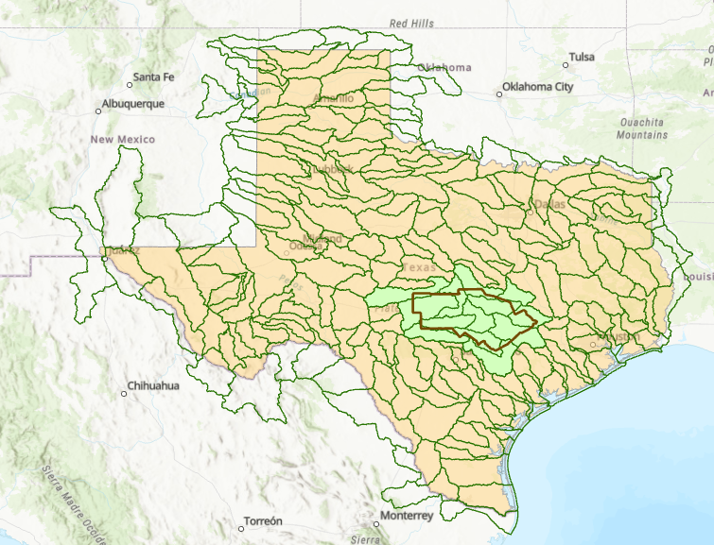
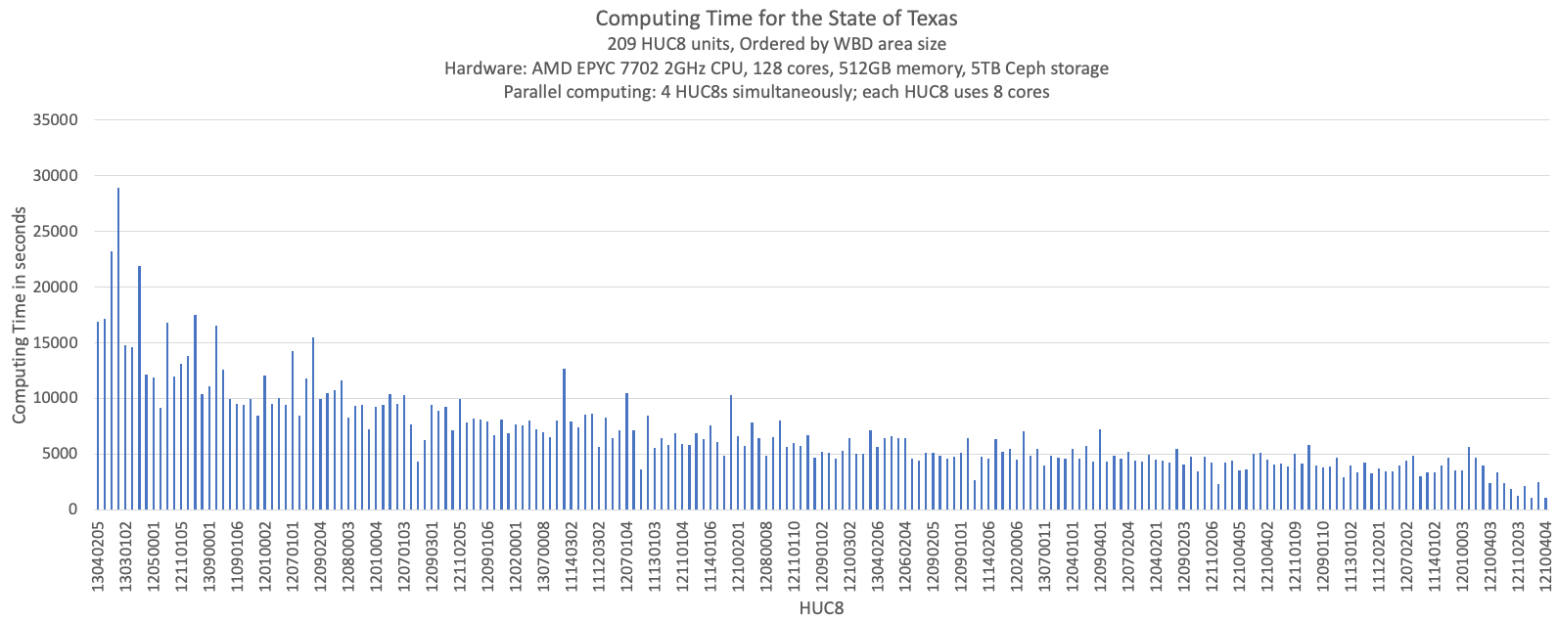
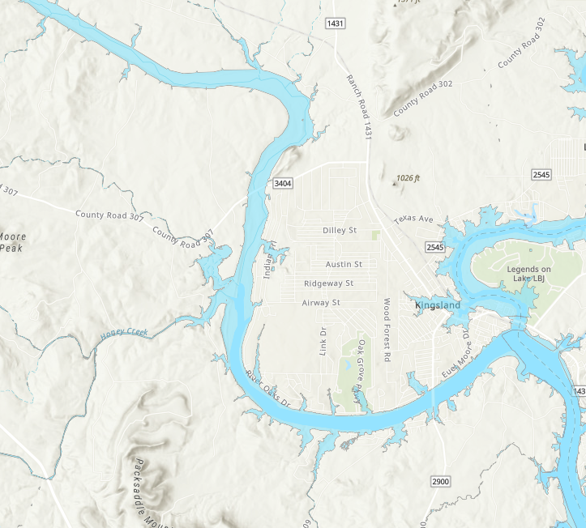
FIM3 Terrain Processing, Catchment and Stream Network Development for Texas
209 HUC8 units processed by Yan Liu at Oak Ridge National Laboratory in 4.28 days
Supports Pin2Flood inundation map library development being done for TDEM
This enables flood inundation map layers produced for the TxDOT Austin District
to be replicated across Texas when connected to forecasting from the
National Water Model
13 HUC8 units
processed for
Austin exercise

Slide 5
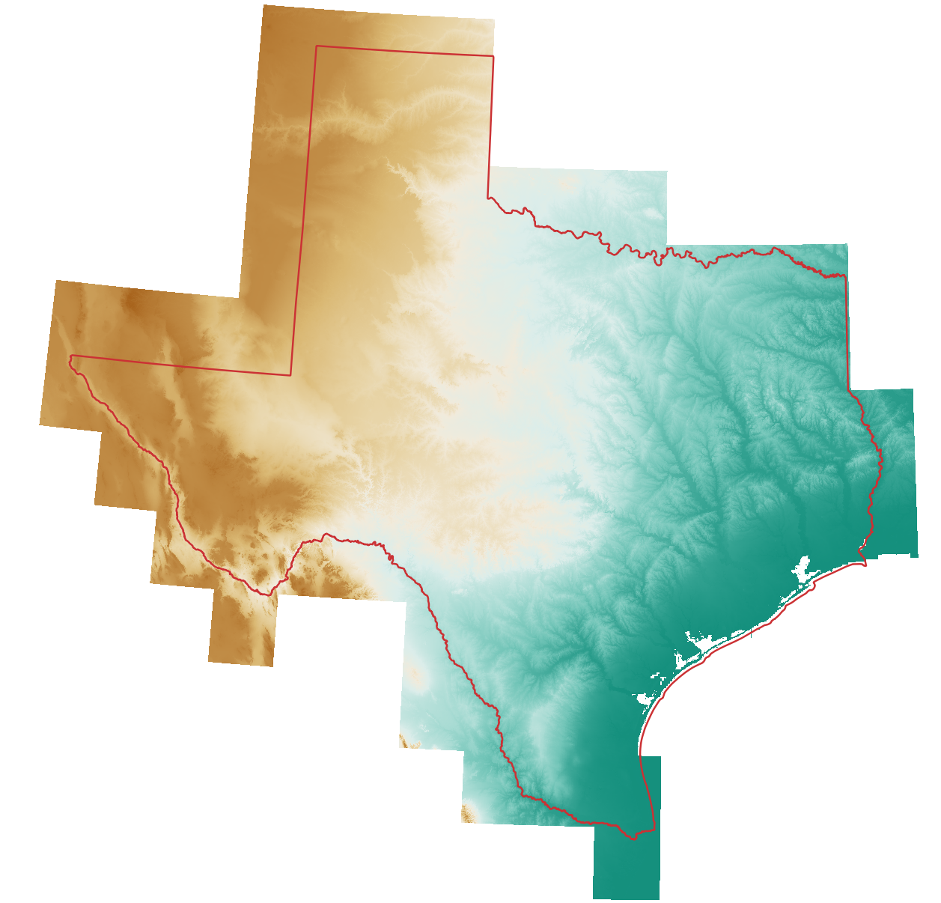
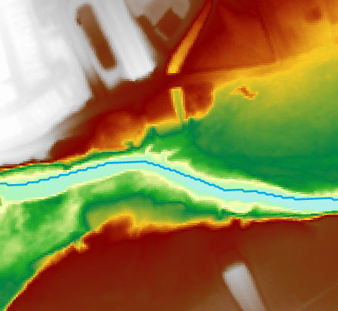
Processing Bare-EarthDEM
Fathom 3m DEM for Texas (TWDB)
DEM-derived streams for Texas (TDEM)
(best elevation-derived stream hydrography that we have ever had)

Slide 6
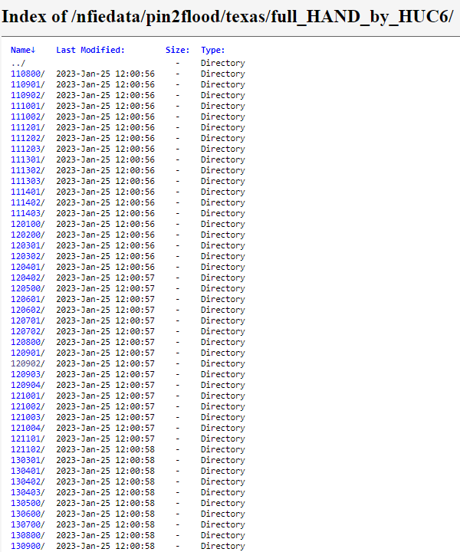
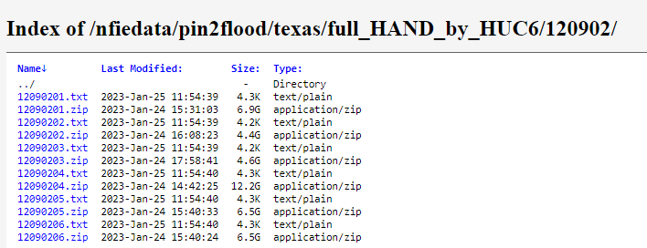
Texas FIM3 Results are Publicly Accessible
https://web.corral.tacc.utexas.edu/nfiedata/pin2flood/texas/
Results by HUC6 Units
Results by HUC8 Units
Metadata and Data

Slide 7
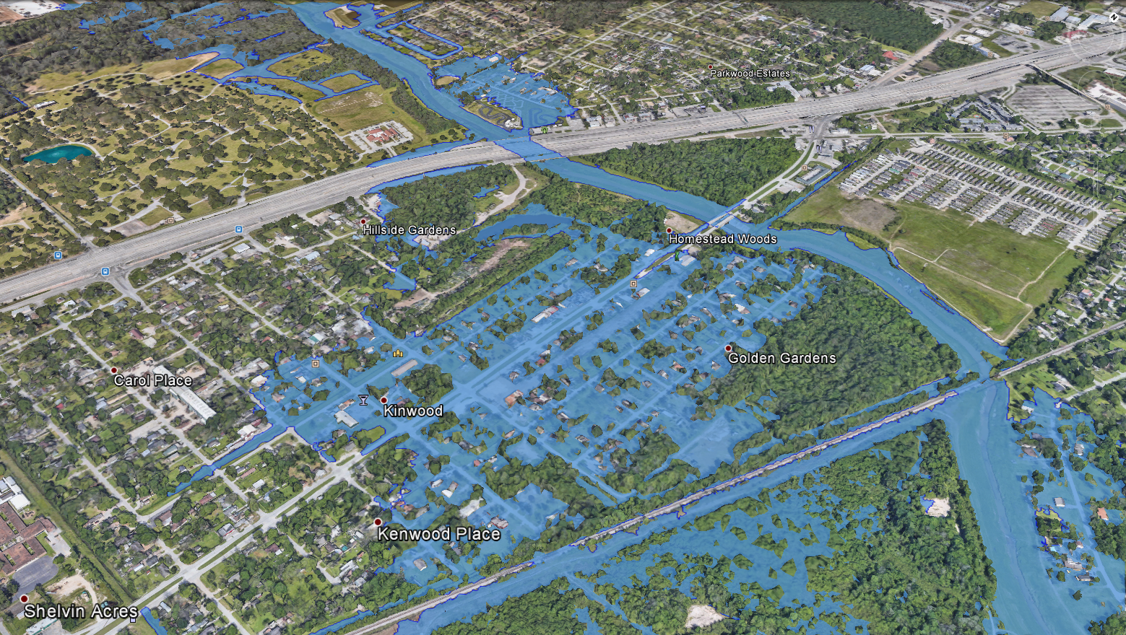
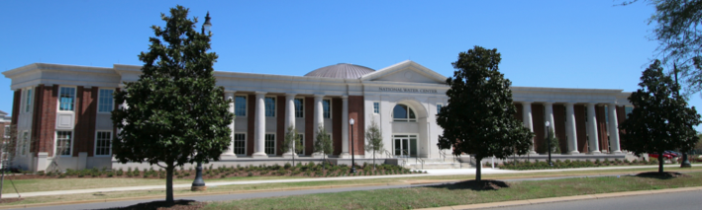
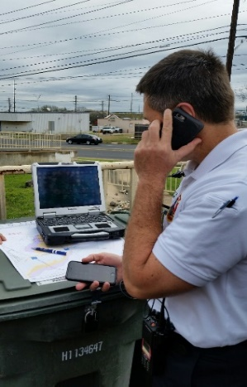
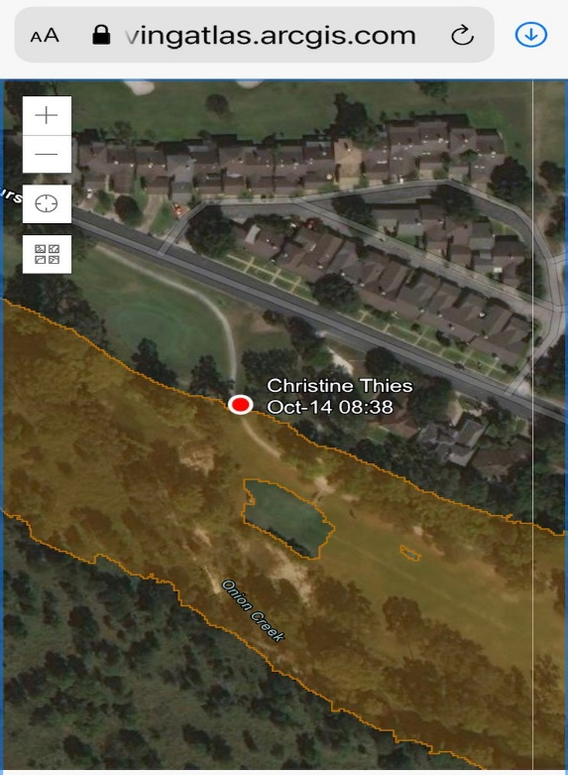
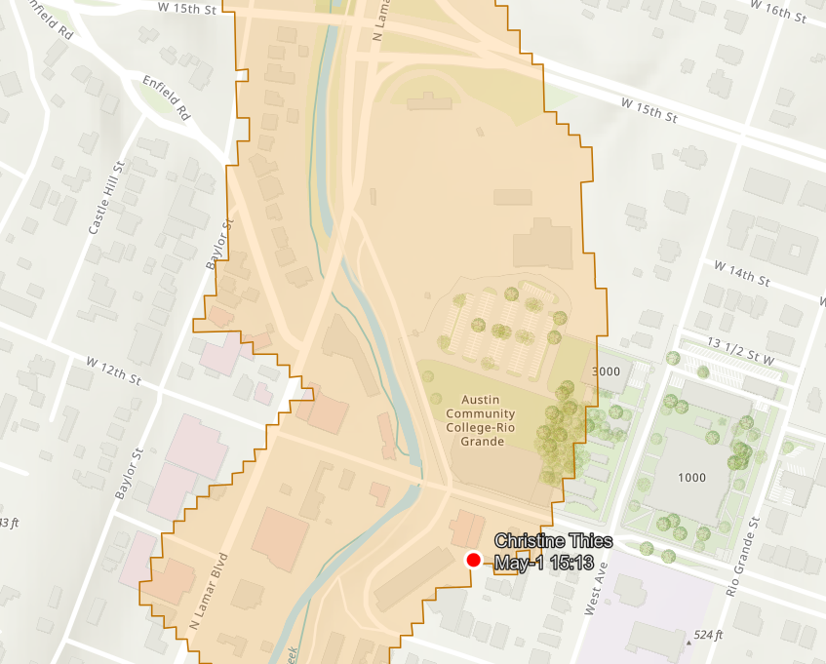
Flood Response with Maps at the State Operations Center
State Operations Center
West Gulf River
Forecast Center
Predictive Flood
Mapping
A common dataset for
predictive and
observational mapping
State Operations Center
Local EOC
First responders in field
Observational
Flood Mapping

Slide 8
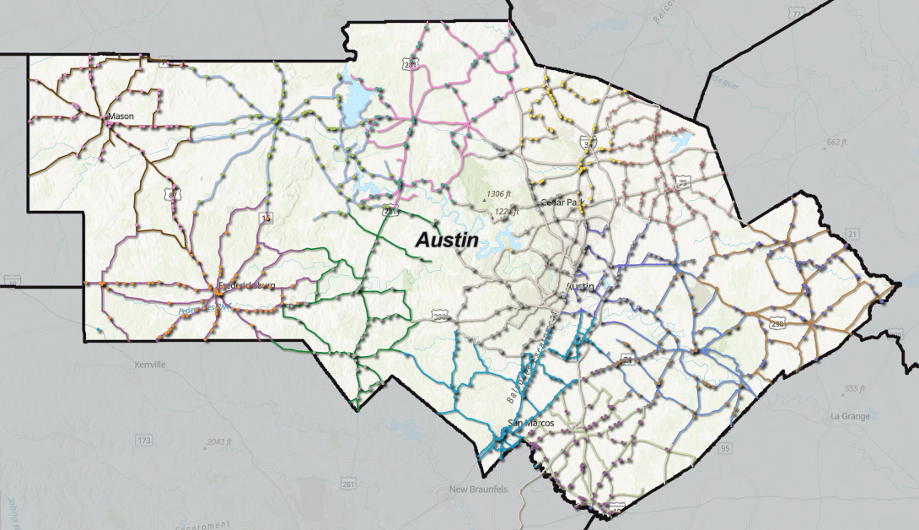
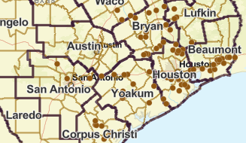
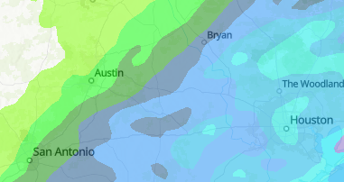
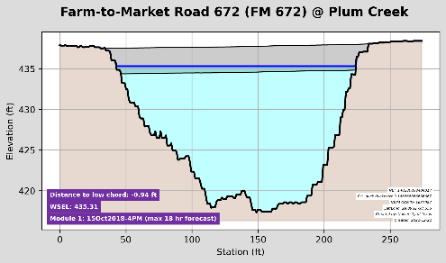
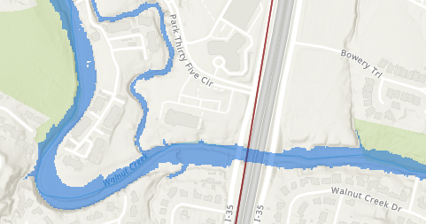
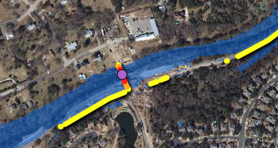
FAST: Flood Assessment System for TxDOT
Asset Inventory
Streamflow Measurement
Precipitation
Bridge Warnings
Flood Inundation
Flooded Roads

Slide 9
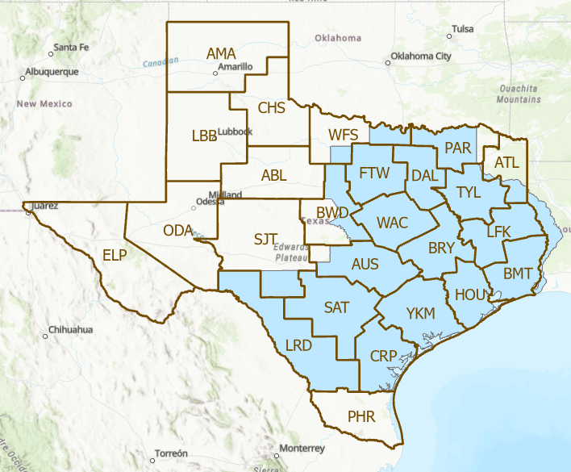
How to Move Forward: Two Challenges
How can we improve FAST for the Austin District?
How do we deal with lack of bridges in FIM
derived from bare-earth elevation models?
Real-time flood inundation
map services in 20 TxDOT Districts,
October 2023
Develop a comprehensive solution starting with
“get the roads and bridges right first”
Develop a quick solution based on tools
and data we have now

Slide 10
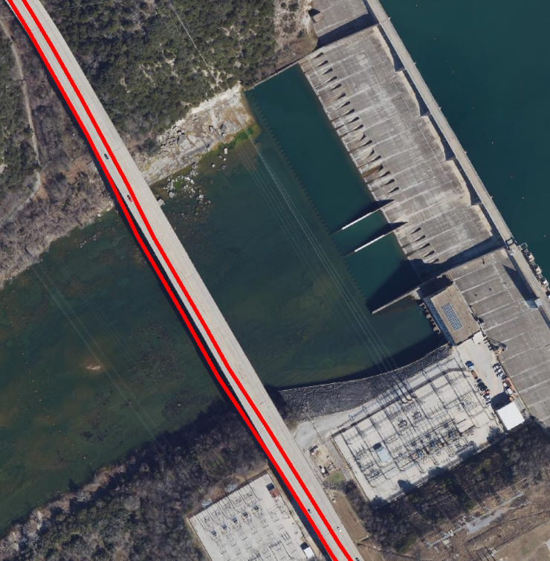
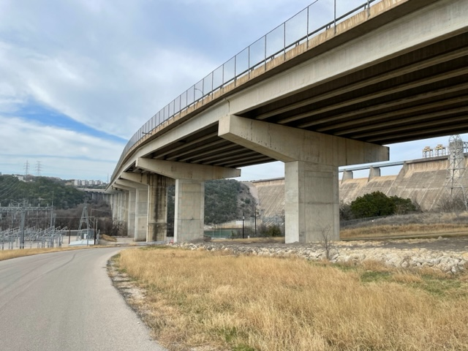
RM 620 over Colorado River at Mansfield Dam
West bound RM 620 is where East bound RM 620 should be
East bound RM 620 is in the Colorado River in TxDOT Roadway Inventory

Slide 11
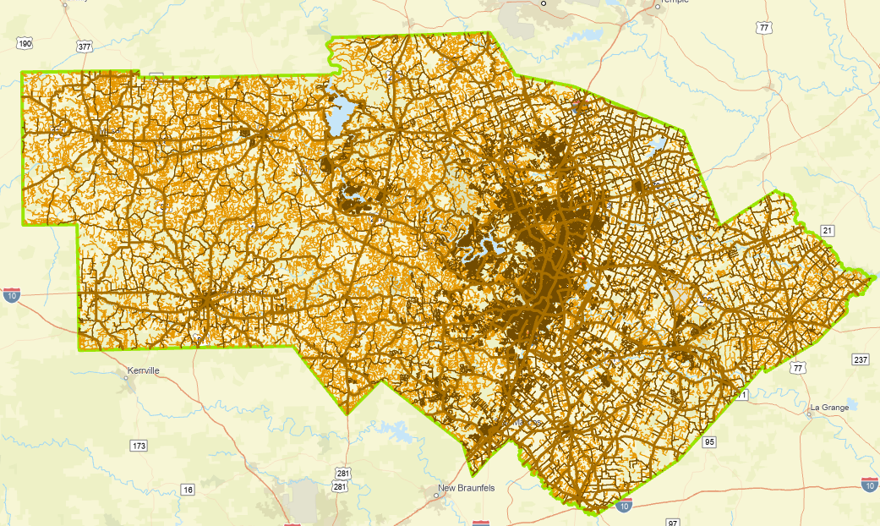
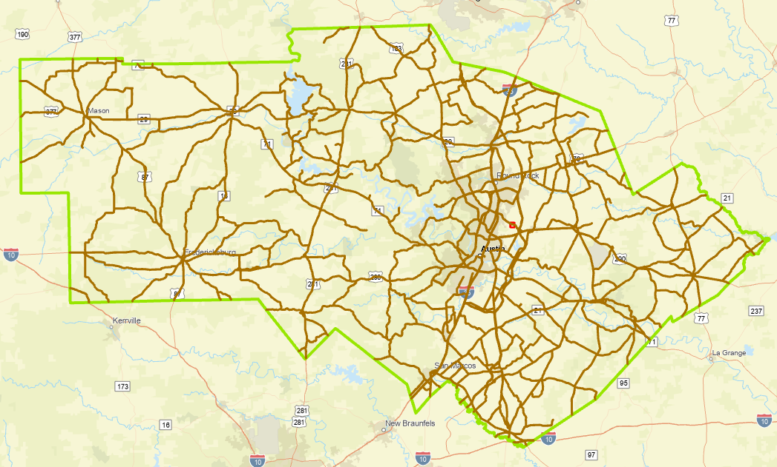
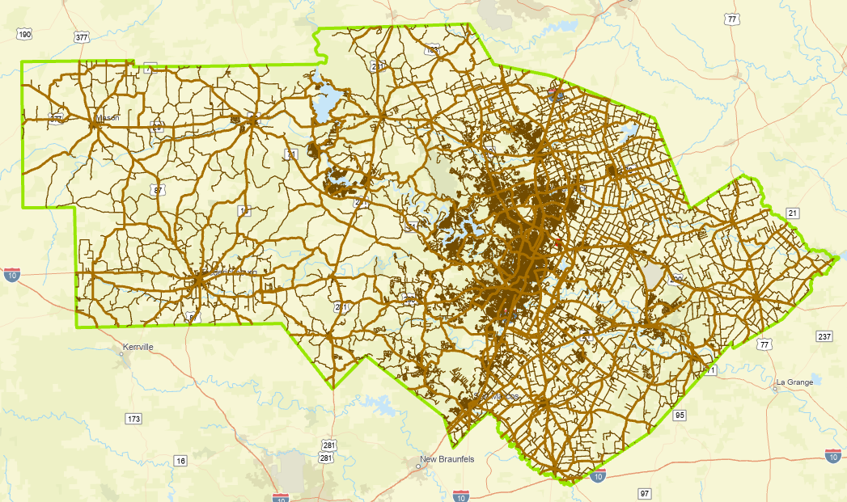
Roads in the TxDOT Austin District
Purchased by TxDOT RTI to support
our Streamflow II research project
Flood Emergency Response Exercise, Jan 2023
4400 miles On-System
38,000 miles Ecopia road coverage
1600 miles of TxDOT Roadway Inventory
are not located on pavement as defined by
Ecopia roads coverage
18,000 miles TxDOT Roadway Inventory

Slide 12
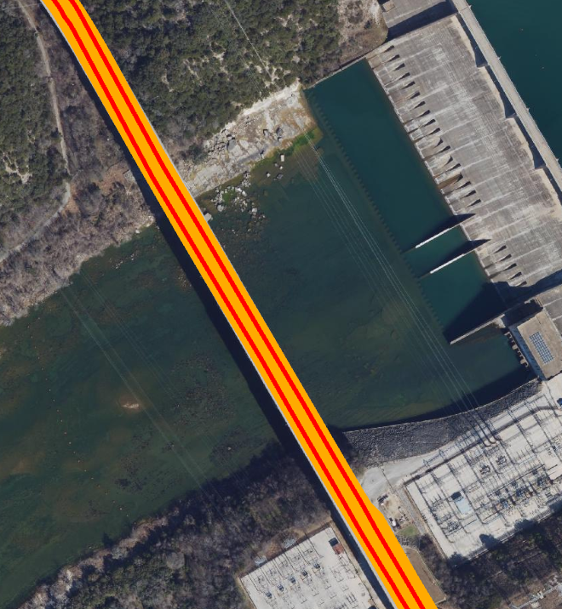
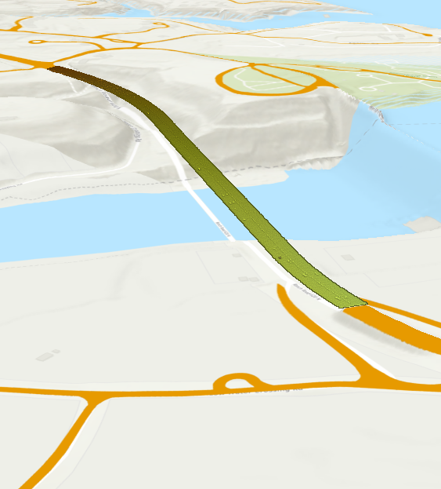
RM 620 over Colorado River at Mansfield Dam
Road polygons and centerlines are correctly positioned in (x,y) and have correct elevation (z)
Ecopia Road and Centerlines
LIDAR point cloud for bridge deck elevation
129,649 (x,y,z) points
on bridge

Slide 13
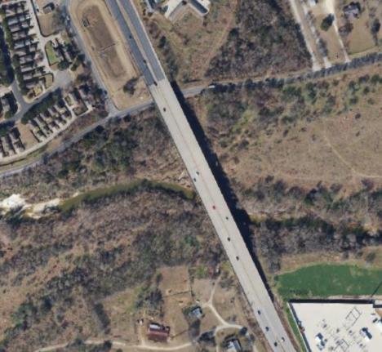
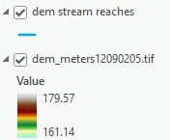
Data Inputs for Road and Bridge Representation
Aerial Imagery (licensed from TNRIS)
Terrain from TWDB and Reaches from Pin2Flood (TDEM)

Slide 14
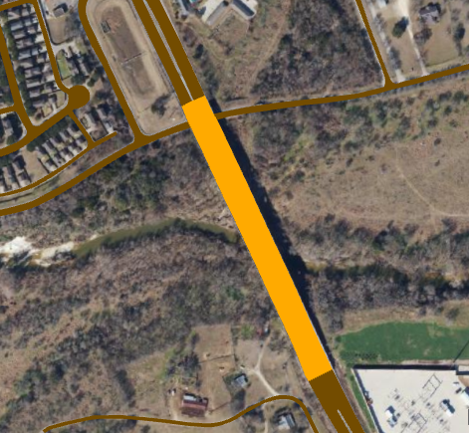
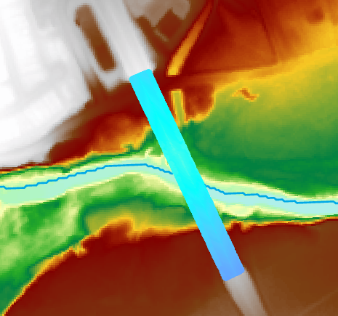
Representation of East Slaughter Lane at Onion Creek
Ecopia Roads and Bridges (2D)
(interpreted by AI from TNRIS imagery)
LIDAR point cloud of bridge (3D)
(from TNRIS LIDAR data stored at TACC)

Slide 15
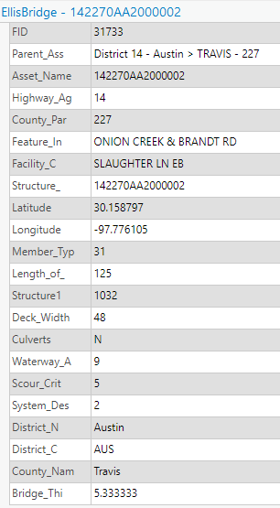
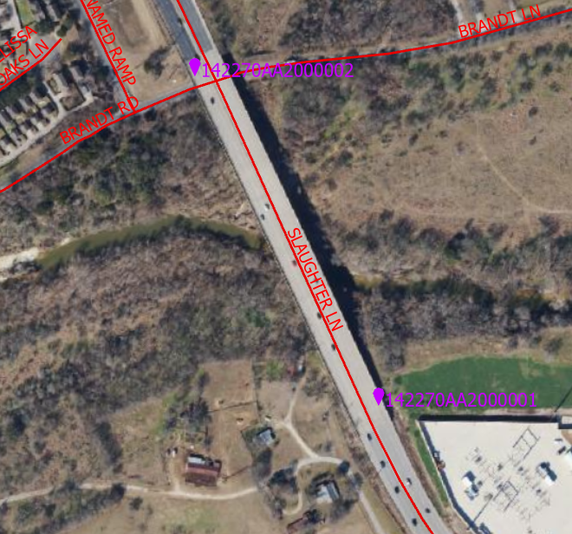
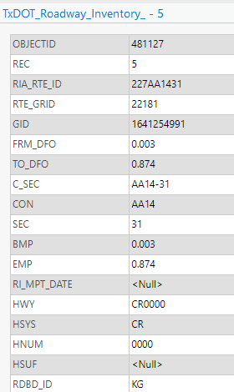
Adding Attributes to a Geometrically Strong Roads and Bridges Dataset
AssetWise for Bridges
TxDOT Roadway Inventory for Roads

Slide 16
How to Move Forward: Two Challenges
How can we improve FAST for the Austin District?
How do we deal with lack of bridges in FIM
derived from bare-earth elevation models?
Real-time flood inundation
map services in 20 TxDOT Districts,
October 2023
Develop a comprehensive solution starting with
“get the roads and bridges right first”
Develop a quick solution based on tools
and data we have now

Slide 17
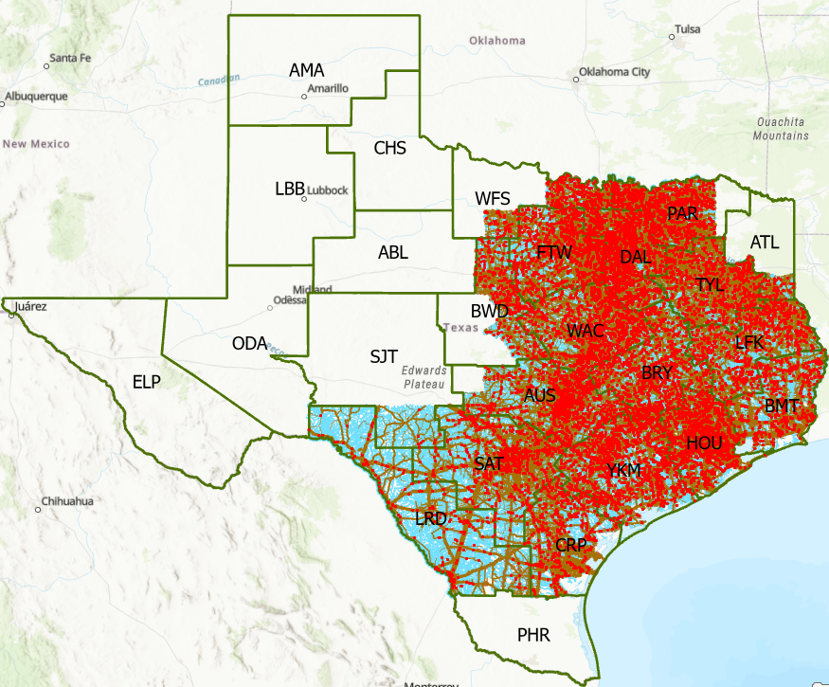
A Challenge: Real-Time Flood Inundation Mapping in October 2023
Inundation of a major highway
How can we use insights from FAST to include
the 16,500 bridges over water in these Districts?
Source: Derek Giardino, National Weather Service
Coverage of NWS Flood Inundation Mapping

Slide 18
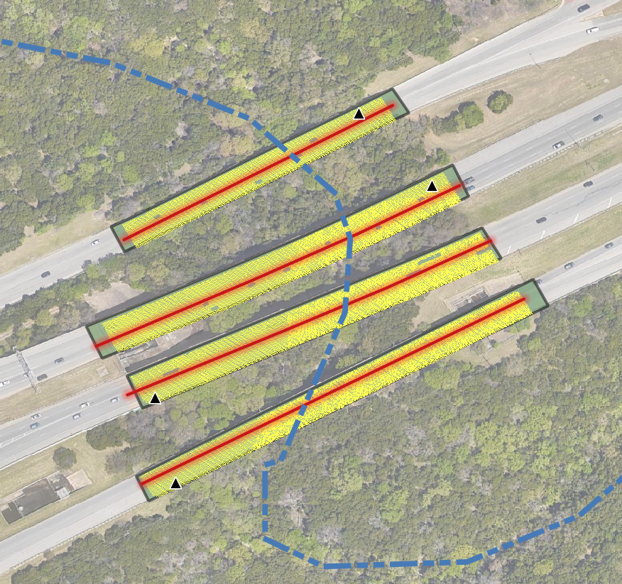
Getting the bridges back in National Weather Service’s real-time flood mapping products
GOAL: Create georeferenced bridge deck DEM’s from LiDAR point clouds to ‘correct’ the NWS‘ “relative elevation model” (REM) used in real-time flood mapping.
Sources of Bridge locations
Crowd sourced bridge lines
National Bridge Inventory (NBI)
governmental dataset of points
Artificial intelligence polygons
extracted from 2D imagery
Classified LiDAR point clouds
Linearly referenced bridge lines

Slide 19
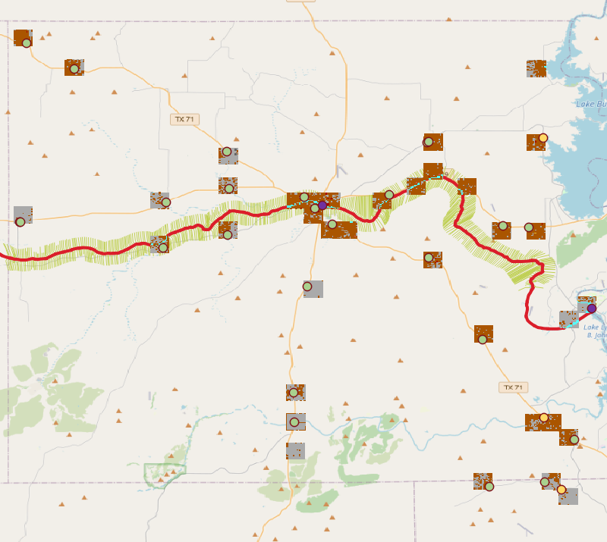
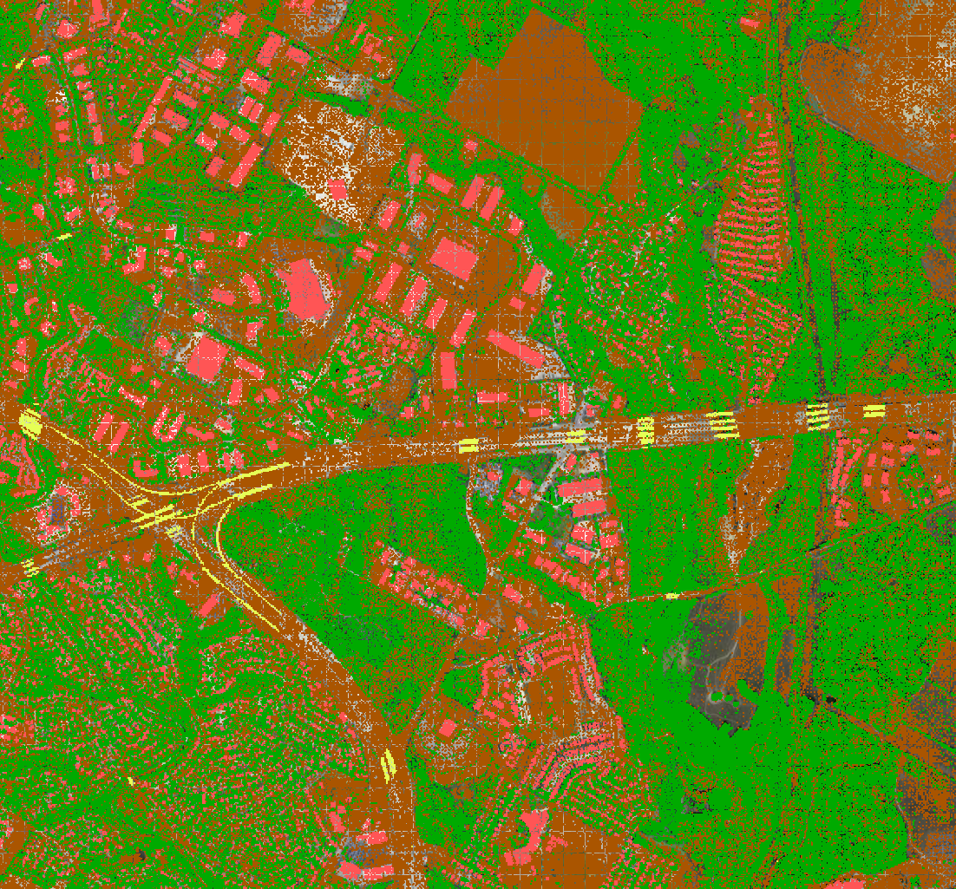
Creating bridge deck DEM’s
GOAL: Create georeferenced bridge deck DEM’s from LiDAR point clouds to ‘correct’ the NWS‘ “relative elevation model” (REM) used in real-time flood mapping.
Method #1
Provided points, lines and polygons of expected bridge locations, examine the point clouds only at these locations.
Method #2
From cloud optimized point clouds (COPC), search the entire domain for classified bridges.

Slide 20
Bridge DEM from bulk LiDAR processing
Road pavement polygons
extracted from 2D imagery
Terrain DEM from point clouds
No infill of missing data
No “bridge” classifications used
Terrain DEM from points clouds
Infill of missing data
Use “bridge” classifications
Comparing ground w/o bridges
to ground w/ bridges
(assuming infill of both)
Detect differences
(Likely bridges with large clustering)

