Slide 1
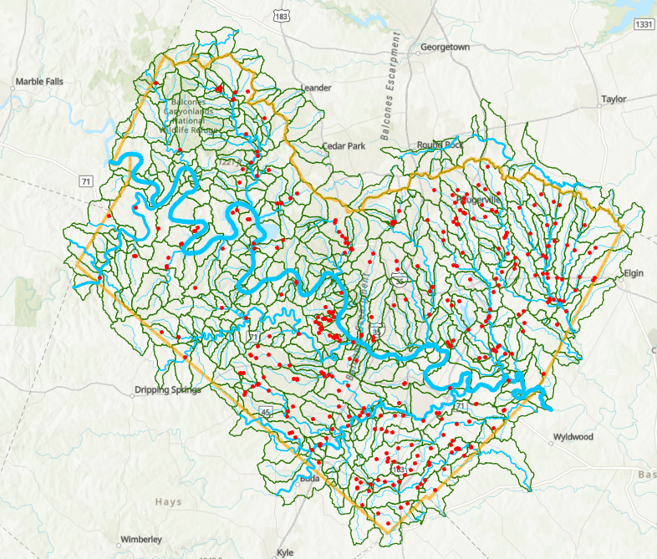
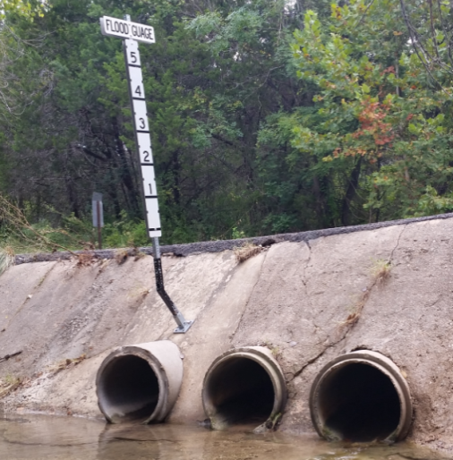
Flood Emergency Response at TCSO
Presented by David Maidment, Harry Evans and Christine Thies
Center for Water and the Environment, University of Texas at Austin
Travis County Sheriff’s Office
9 December 2024

Slide 2
Why the death of Deputy Hollis means so much to me
Deputy Hollis was 35 years old. I have two daughters, aged 34 and 36 at that time, each with a son.
Deputy Hollis had a son. I know from the death of my aunty Eva how devastating this was and is for my cousin Rex.
Pictures from 2014
Daughter Linda (34)
Wife Helen
Daughter Amy (36)
My cousin, Rex
Daughter, Amy
with son Matthew (8)
Rex’s mother, who died of breast cancer at age 36 in 1959
Me as a teenager.
Rex and I grew up
together
Daughter, Linda
with son David (3)

Slide 4
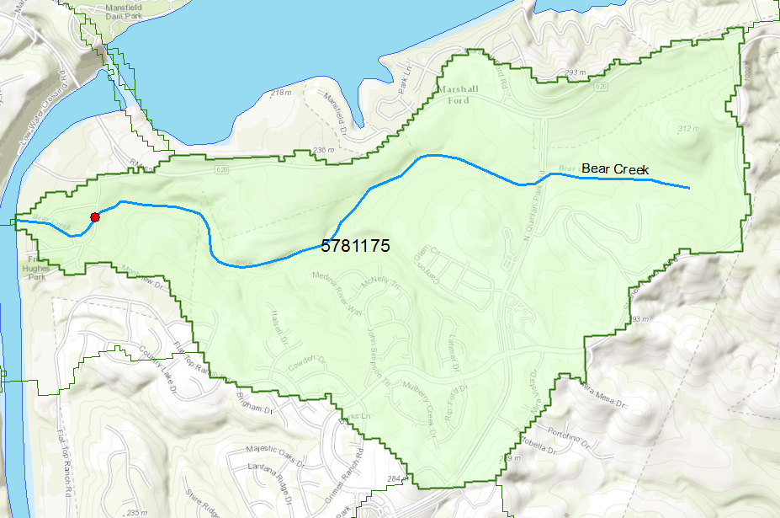
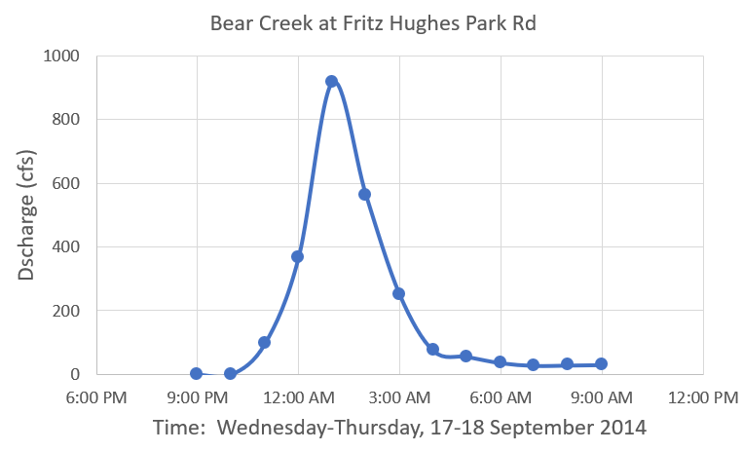
Flood Information for Bear Creek at Fritz Hughes Park Rd
There are 590 of these catchments and streams forecast by the National Water Model in Travis County
Flood discharge at this location,
18 September 2014
Deputy Hollis arrived here
at 1:51 AM
Bear Creek watershed
in the National Water Model
Water on road
Low water crossing at
3400 Fritz Hughes Park Rd
Retrospective simulation using the
National Water Model
This model was just being developed in 2014

Slide 5
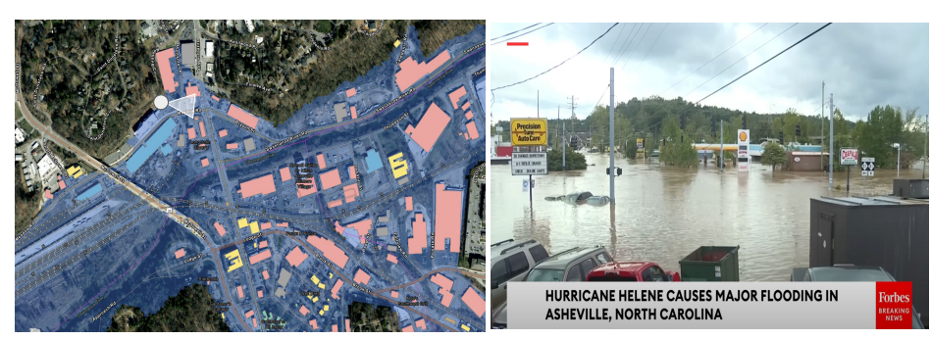
Real-Time Flood Inundation Mapping
Hurricane Helene, Asheville, NC
27 September 2024
NWS real-time flood inundation mapping is available for Travis County
Water flow is now like weather, forecast everywhere, all the time

Slide 6
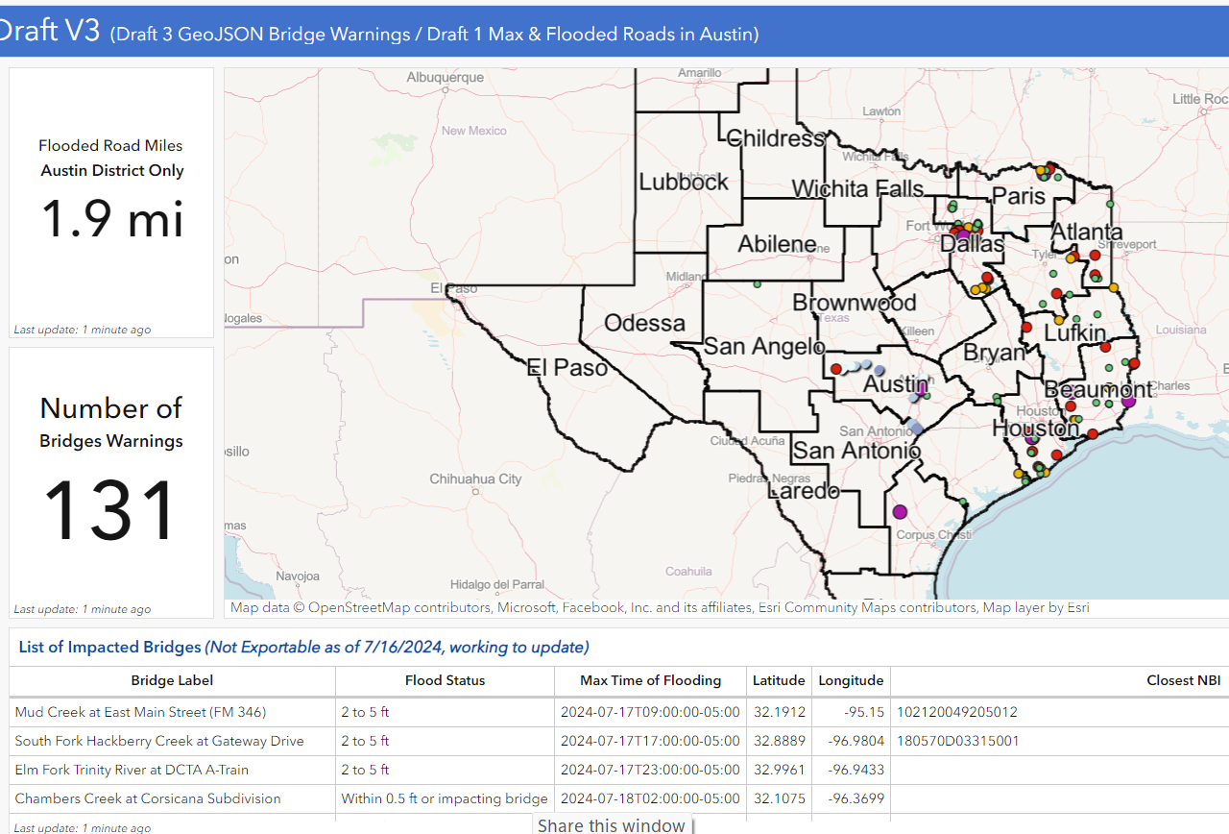
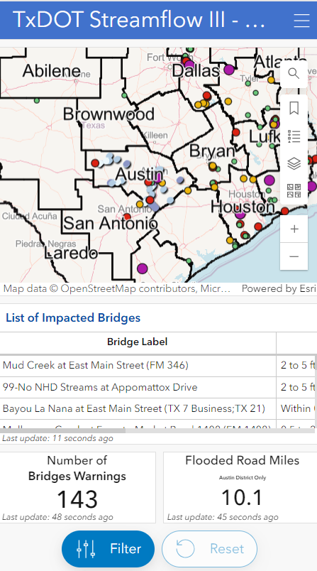
Possibilities and Probabilities
Possible
What if a deputy could see flooded roads on the MDC in same way as slow traffic?
What if CAD could re-route responders based on flooded roads or alert them to the danger?
Probable
TxDOT will have an operational system showing flooded roads and bridges
TDEM has a Pin2Flood a real-time flood impact app showing inundation based of observations of first responders

Slide 7
Key Insights
UT has created GIS layers/services which identify flooded roads and bridge impacts
Layers could be integrated with ATXFlood.com, CAD, MDC, or internal GIS dashboards
Prediction capabilities for flooded roads and bridges are being developed in collaboration with NWS and TxDOT
TxDOT approval is required for broader application of these layers/services
*

