Slide 1
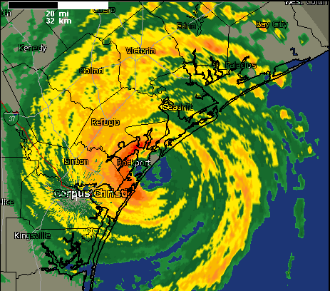
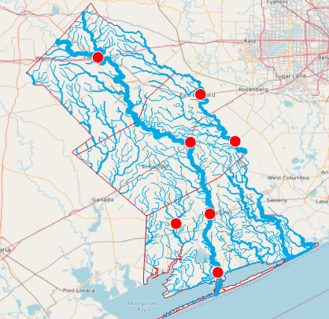
Flood Inundation Mapping for Colorado, Wharton and Matagorda Counties
David R. Maidment
Center for Water and Environment University of Texas at Austin
Prepared for presentation at Wharton County Commissioners Court, 13 June 2018
Acknowledgements: National Weather Service, Texas Division of Emergency Management,
Wharton County, USGS, Kisters, ESRI, FishView, Xing Zheng, David Arctur, Harry Evans.

Slide 2
Flood Inundation Mapping for Colorado, Wharton and Matagorda Counties
Three questions:
What has been done?
What needs to be done?
Enhanced inundation mapping
Flood impact assessment
Densified Water Measurement
How much will it cost per county?

Slide 3
Flood Inundation Mapping for Colorado, Wharton and Matagorda Counties
Three questions:
What has been done?
What needs to be done?
Enhanced inundation mapping
Flood impact assessment
Densified Water Measurement
How much will it cost per county?

Slide 4
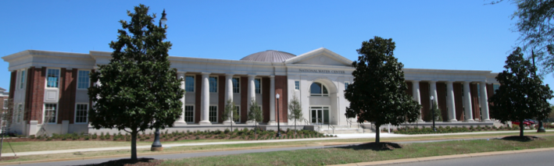
Continuously forecasts flows over continental US

Slide 5
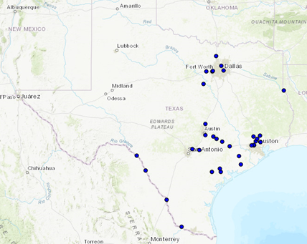
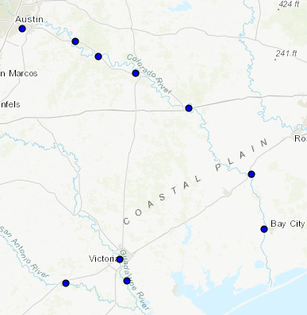
Current Flood Inundation Maps in Texas
Colorado River
at Columbus
Maps at forecast points

Slide 6
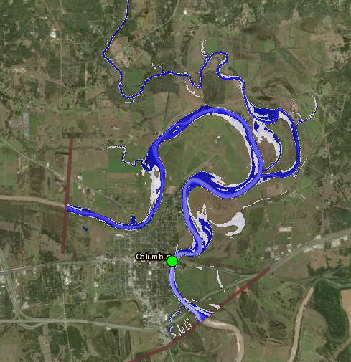
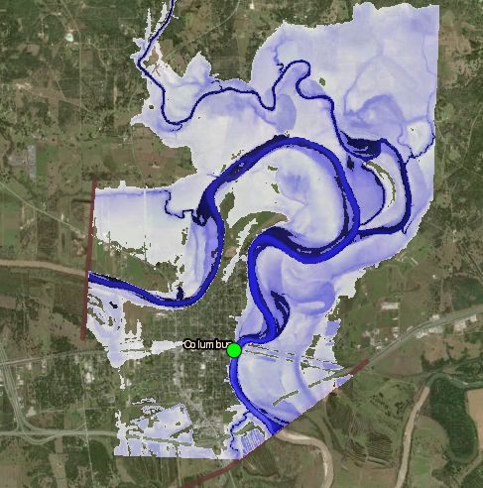
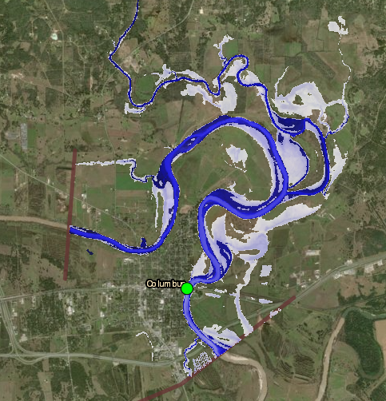
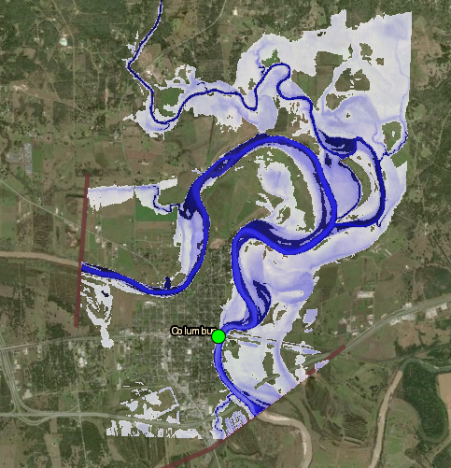
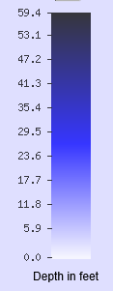
Moderate Flooding (Stage Height 39 ft)
Minor Flooding (Stage Height 34 ft)
Highest Flooding (Stage Height 46.5 ft)
Major Flooding (Stage Height 43 ft)

Slide 7
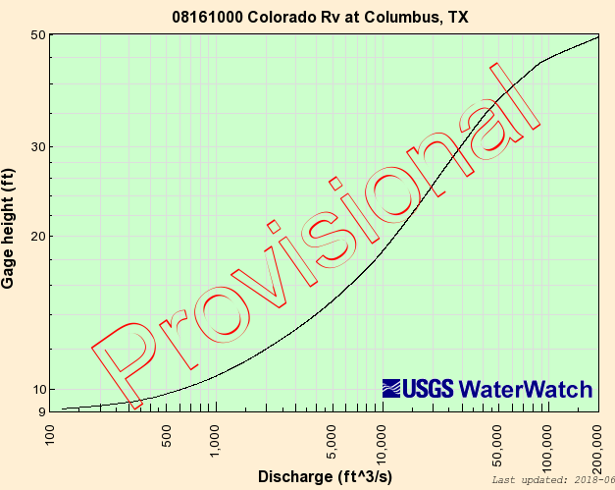
Rating Curve: Relates Depth to Discharge
Stream Depth
Forecasting
Stream
Depth
(ft)
Streamflow
Measurement
Discharge (cubic feet per second)

Slide 8
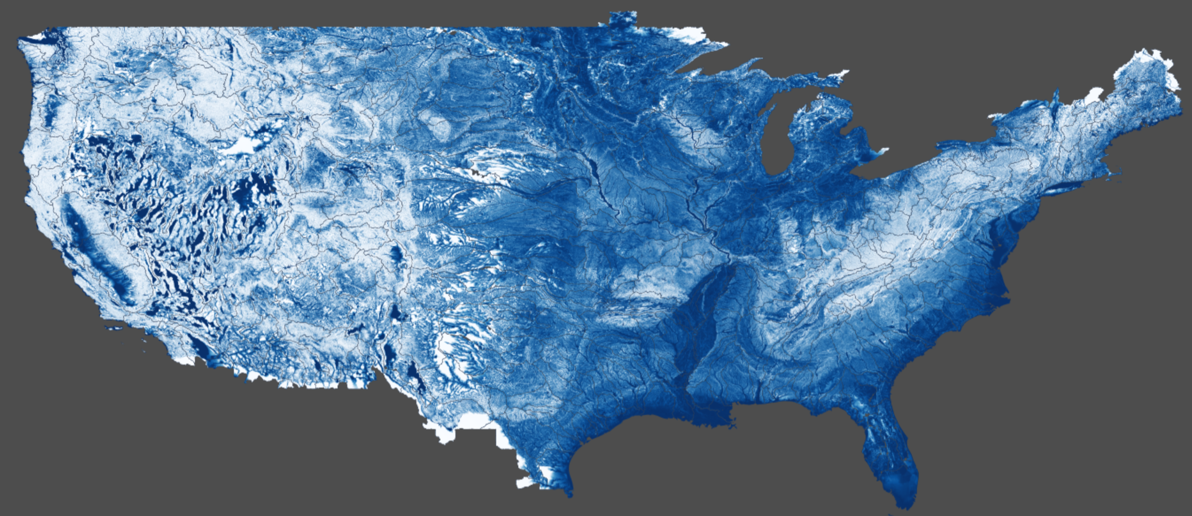
Method for Determining Flood Risk: Height Above Nearest Drainage (HAND)
Flooding occurs when Water Depth is greater than HAND
Address Point
Flood
HAND
Normal
Computed for continental US
Notes:
How do we answer the question of how many people are going to be impacted, especially if large areas of the state are not covered by LIDAR or National Flood Hazard Layer? The researchers developed a process called Height Above Nearest Drainage or HAND.

Slide 9
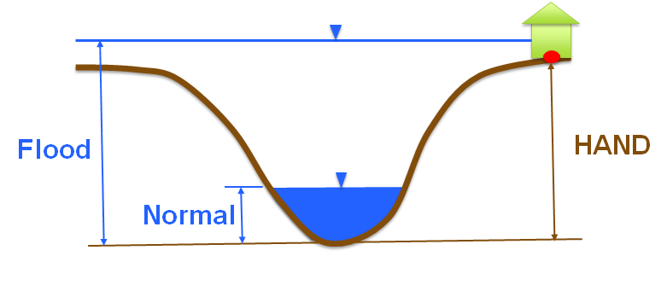
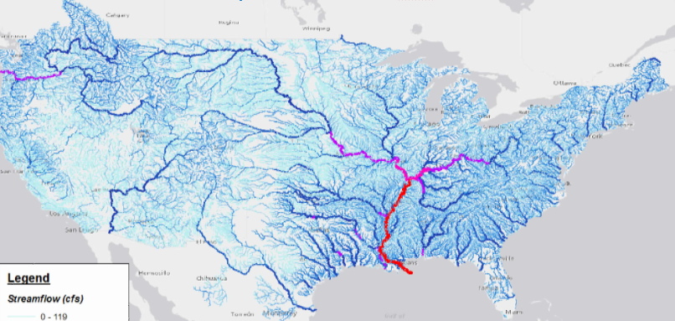
Modeled Rating Curves from HAND Data
2.7 million stream reaches in continental US
Stream Depth (ft)
$$Q=\frac{1.49}{n}AR^{2/3}S_{o}^{1/2}$$
Forecast Discharge
from National Water Model

Slide 10
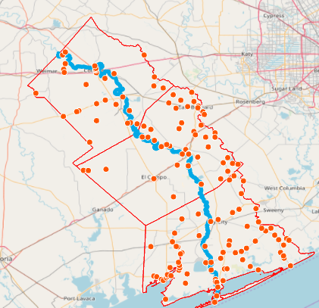
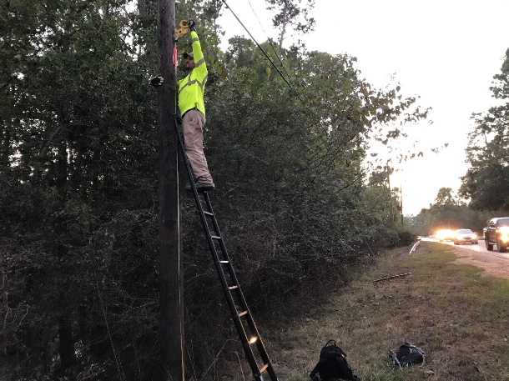
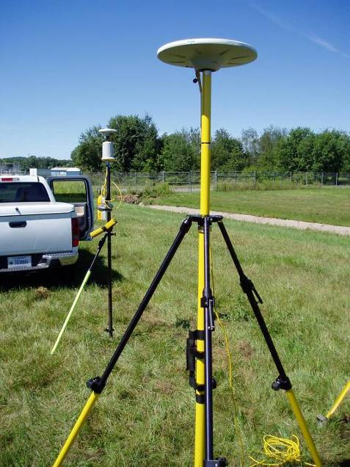
USGS Peak Stage Points from Harvey
Images: Kristine Blickenstaff, USGS
$$Q=\frac{1.49}{n}AR^{2/3}S_{o}^{1/2}$$
152 peak stage points
used to calibrate
Manning roughness for
flood inundation mapping

Slide 11
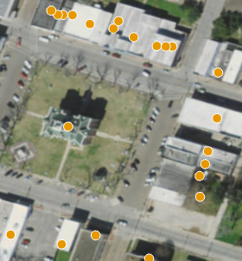
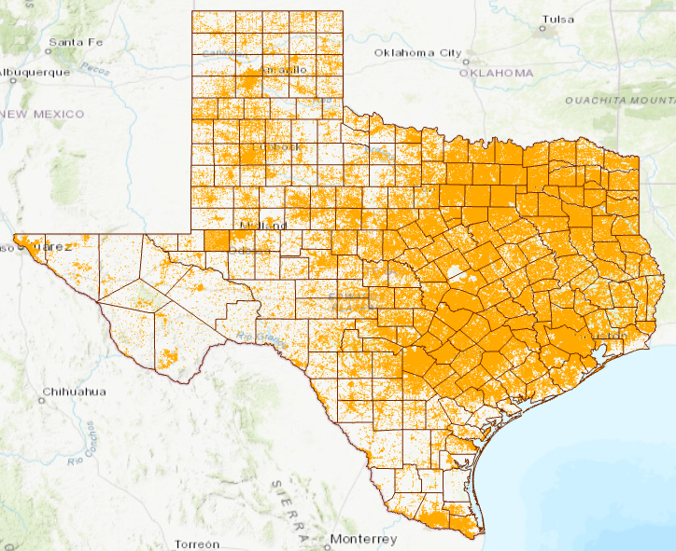
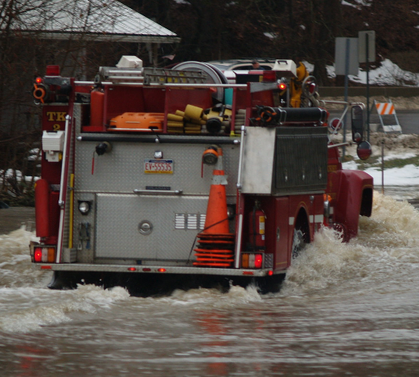
Texas Address Points Use for Flood Impact Assessment
Point on every building
for dispatching emergency
response vehicles by
911 systems
9.28 million points
Notes:
Over the summer we collected all 8.7million address points across Texas. Dr. David Arctur has assembled all the data and done some quality checks. When you have this much data from hundreds of sources, there are always some inconsistencies. However, in my opinion, for public safety this strategic snapshot is a good starting point for describing overall impact to a region or district.

Slide 12
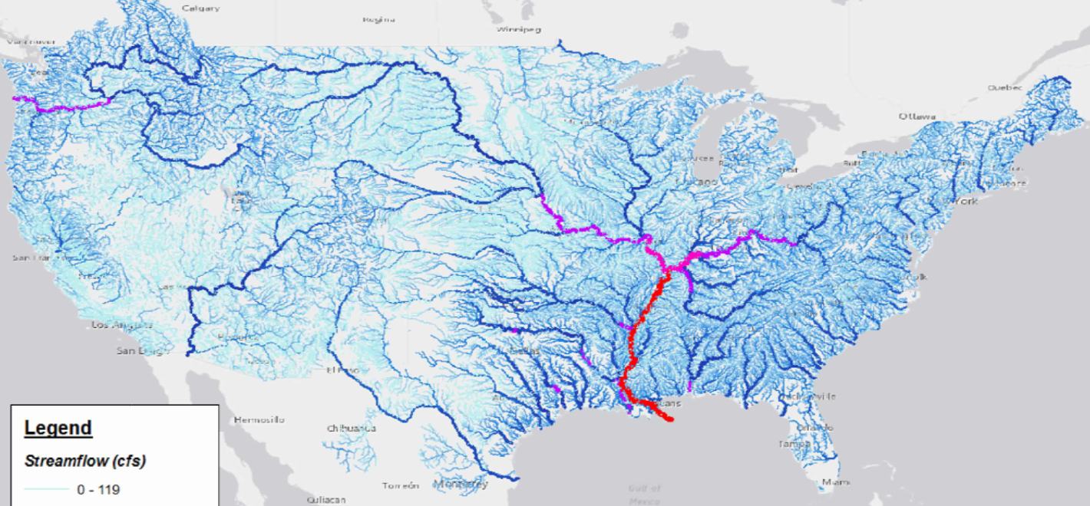
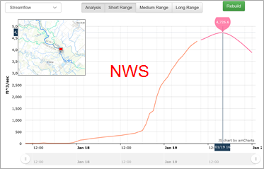
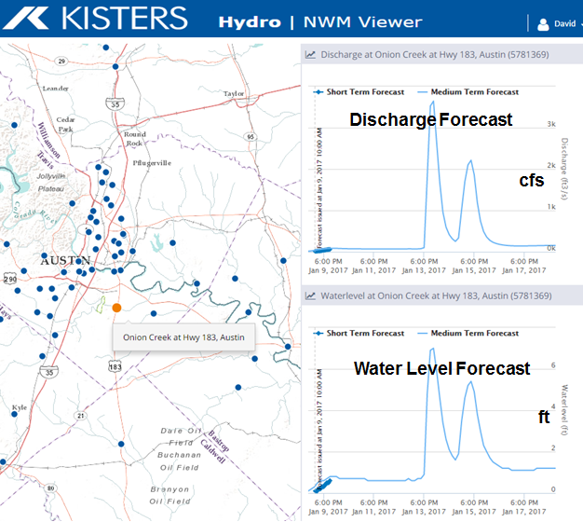
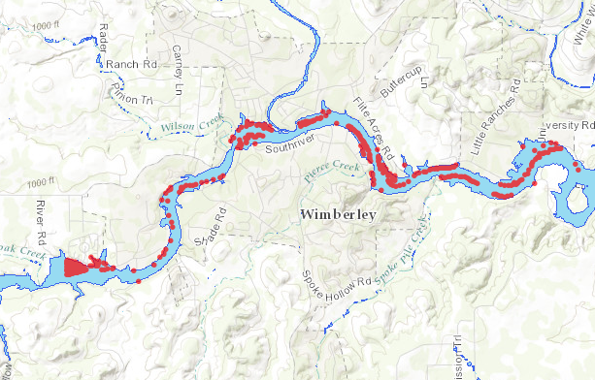
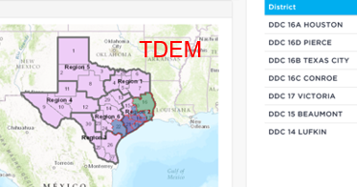
Flood Inundation and Impact
Take discharge forecast from the National Water Model
Discharge
Transform discharge to depth by rating curve
or hydraulic model
Depth
Create flood inundation map from water depth
Inundation
Assess impact on people and property
Impact
Flood emergency response depends on assessment of impact

Slide 13
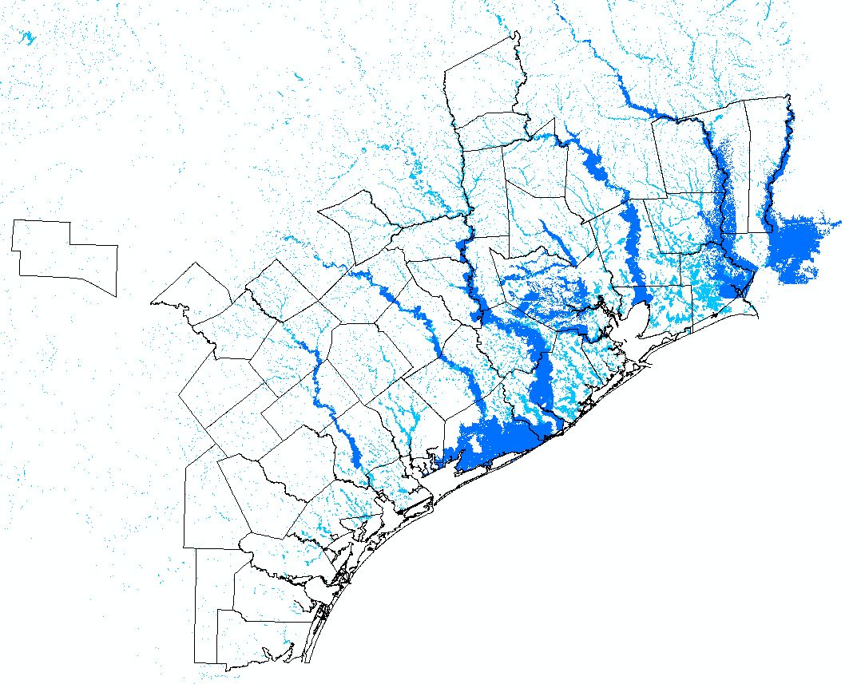
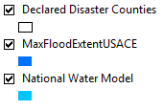
Inundation Map Produced After Harvey for Governor’s Office
Observations from the U.S. Geological Survey
Forecasting by NWS West Gulf River Forecast Center
Inundation Mapping by USACE, National Water Center and UT Austin
Map Synthesis by Texas Division of Emergency Management

Slide 14
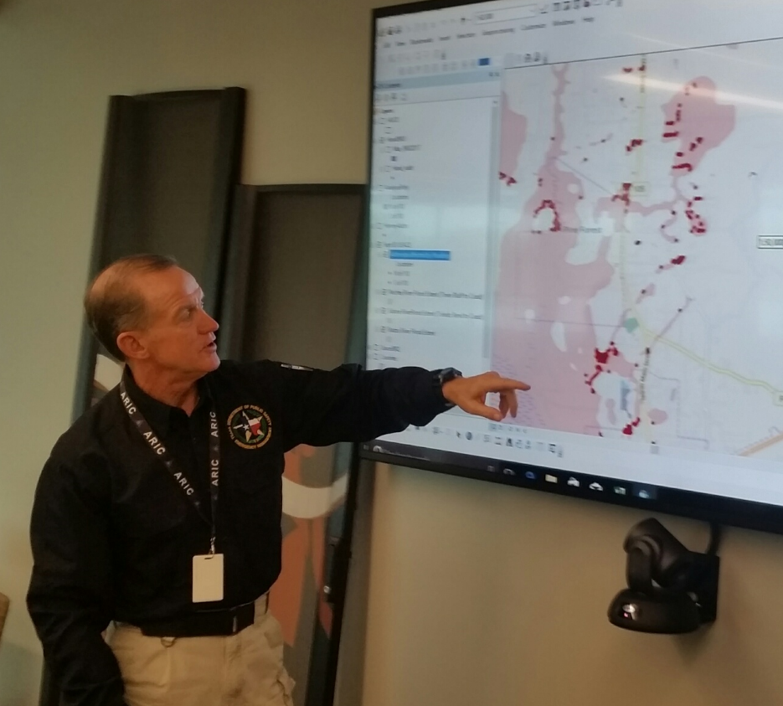
Goal: Real-Time Flood Inundation Mapping for Texas at Local Scale

Slide 15
Flood Inundation Mapping for Colorado, Wharton and Matagorda Counties
Three questions:
What has been done?
What needs to be done?
Enhanced inundation mapping
Flood impact assessment
Densified Water Measurement
How much will it cost per county?

Slide 16
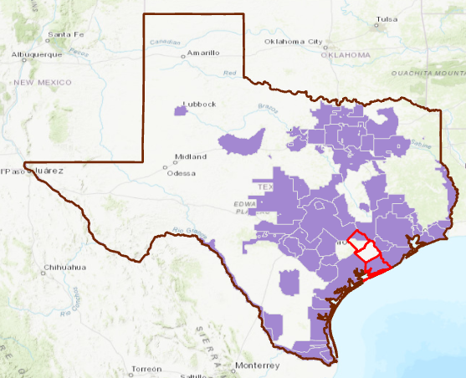
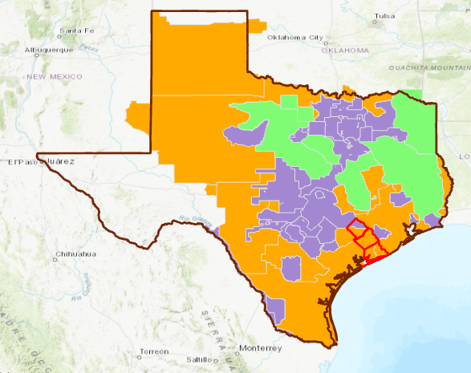
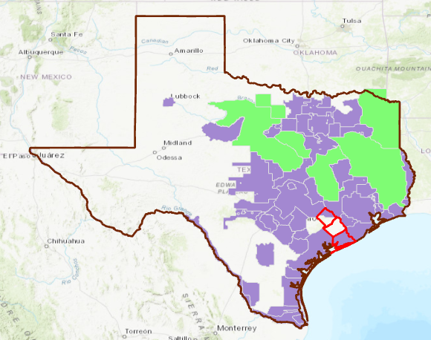
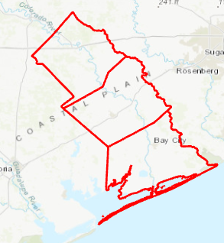
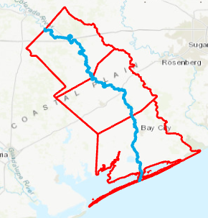
Lidar Data Collection in Texas
2/3 of Texas is getting new LIDAR data over the period, 2017-2019!
Collected in 2018
Available in 2019
Available now
Colorado
Wharton
Matagorda
Collected in 2017
Available in 2018
Colorado River
(154 miles)
Counties

Slide 17
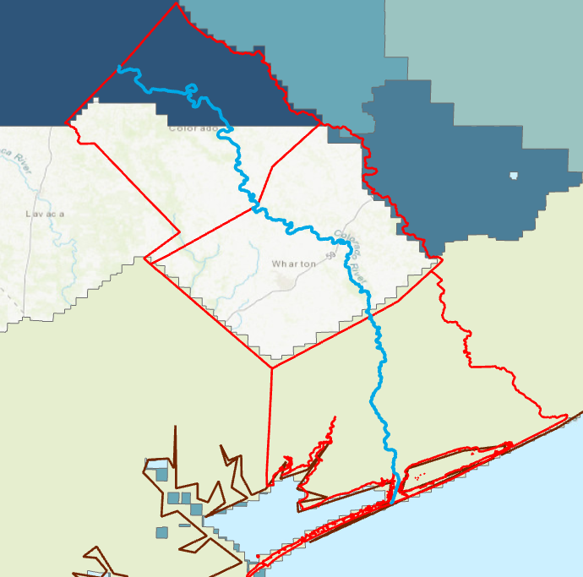
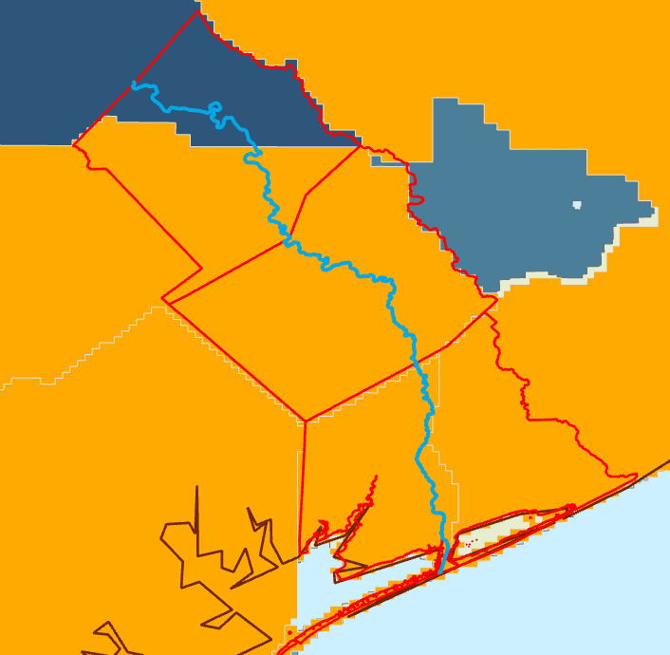
LIDAR Data in Three Counties
Use northern Colorado County as a testbed
Flight Year
Collected in 2018
Available in 2019
Available now

Slide 18
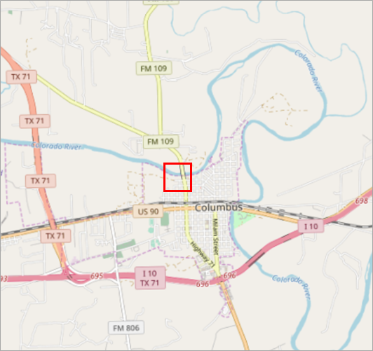
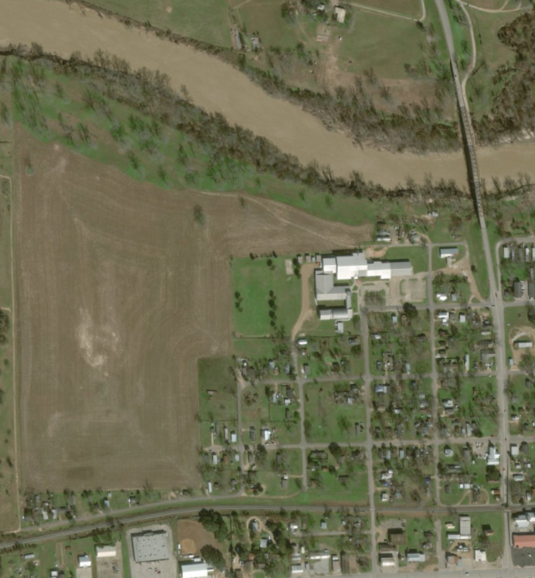
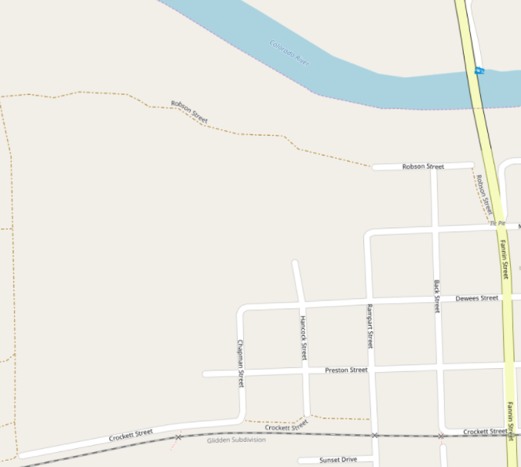
An area of Columbus, Tx
(in Colorado County)
Colorado River
Fannin St

Slide 19
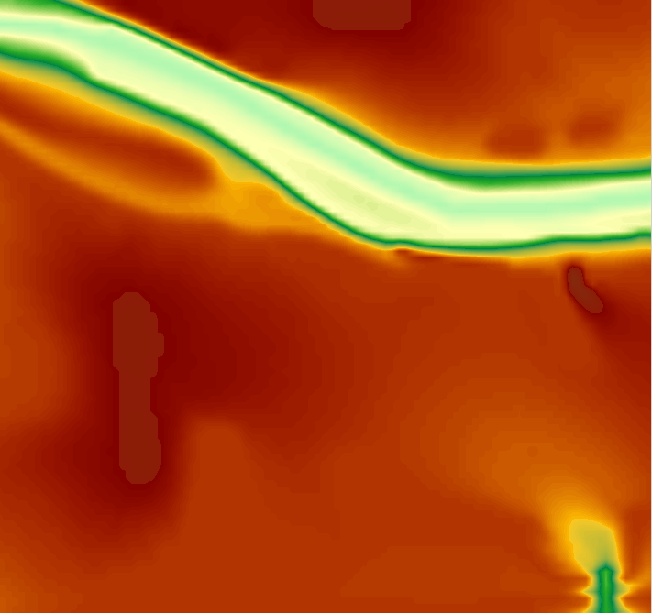
National Elevation Dataset (10m cells)
used for existing flood inundation mapping

Slide 20
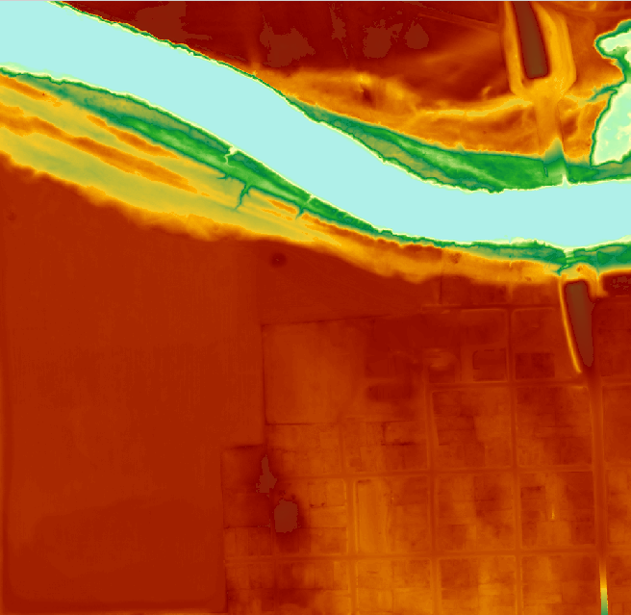
New LIDAR data (1m cells)
Makes much better inundation maps

Slide 21
New LIDAR data is 100 times denser
National Elevation
Dataset
1 cell
10m x 10m
New LIDAR for
Columbus
100 cells
1m x 1m
LIDAR is critical for accurate terrain description

Slide 22
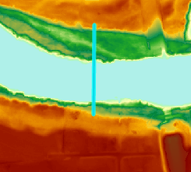
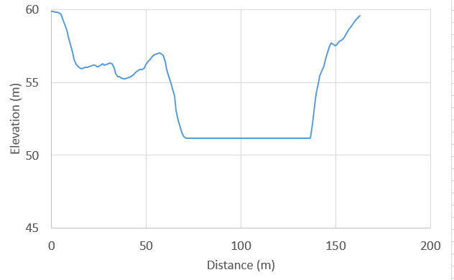
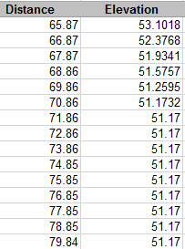
Surface Profile using LIDAR
This LIDAR cannot see under water
Water Surface
Where is the
channel bed?
We need a survey of Colorado river bathymetry

Slide 23
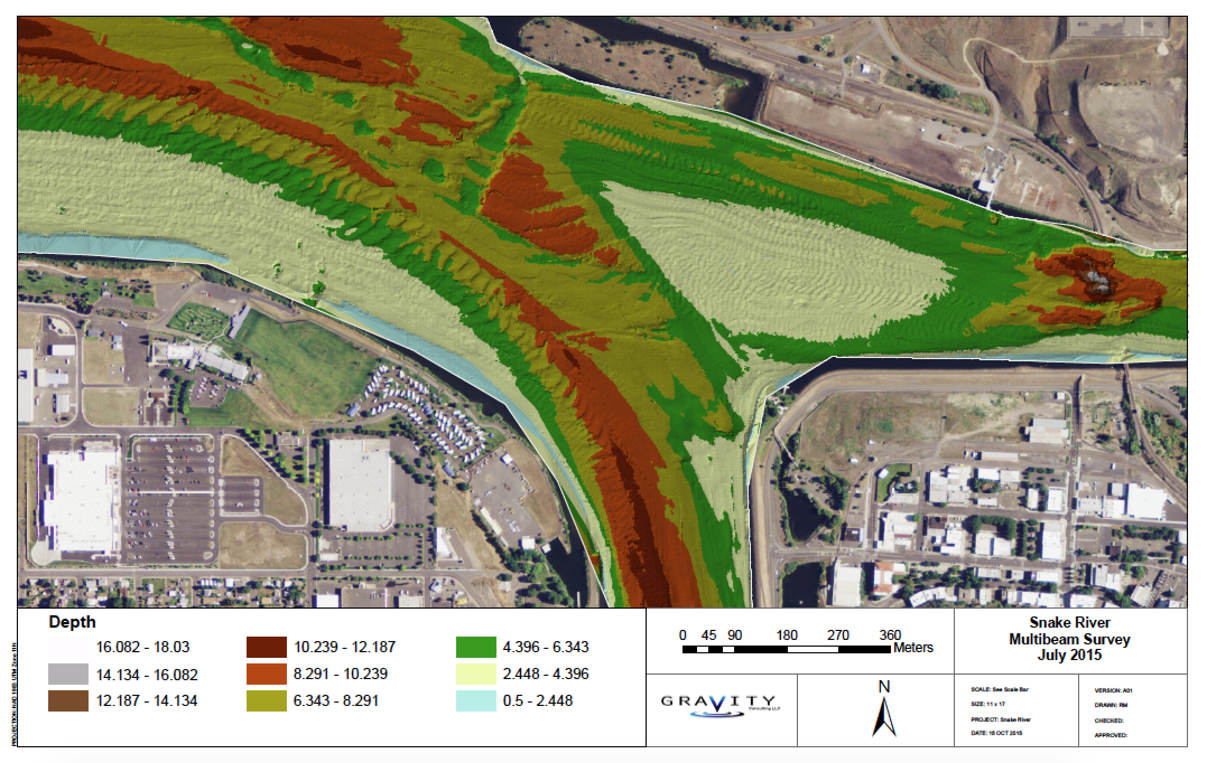
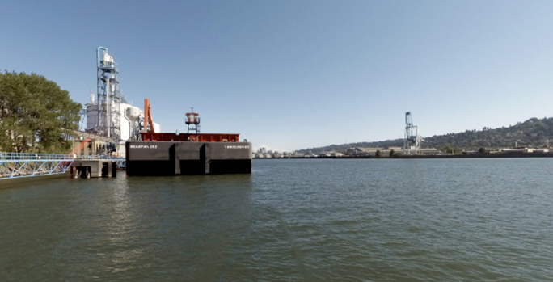
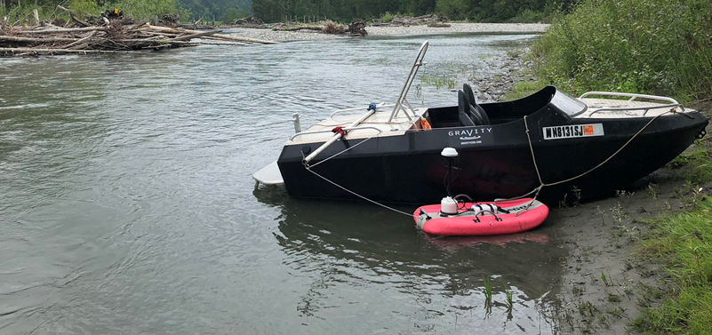
Detailed Bathymetry Data Collected using Boats
Survey using sonar and couple with surface imagery

Slide 24
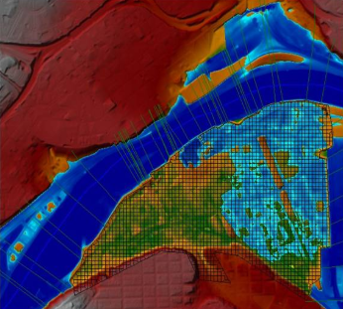
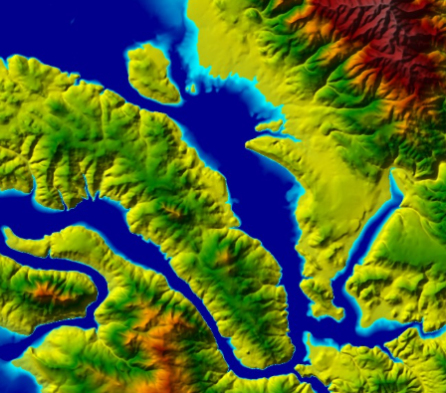
HEC River Analysis System
1-D and 2-D Steady and
Unsteady Flow Analysis
Inundation Mapping
Apply at critical overflow locations on main rivers

Slide 25
Flood Inundation Mapping for Colorado, Wharton and Matagorda Counties
Three questions:
What has been done?
What needs to be done?
Enhanced inundation mapping
Flood impact assessment
Densified Water Measurement
How much will it cost per county?

Slide 26
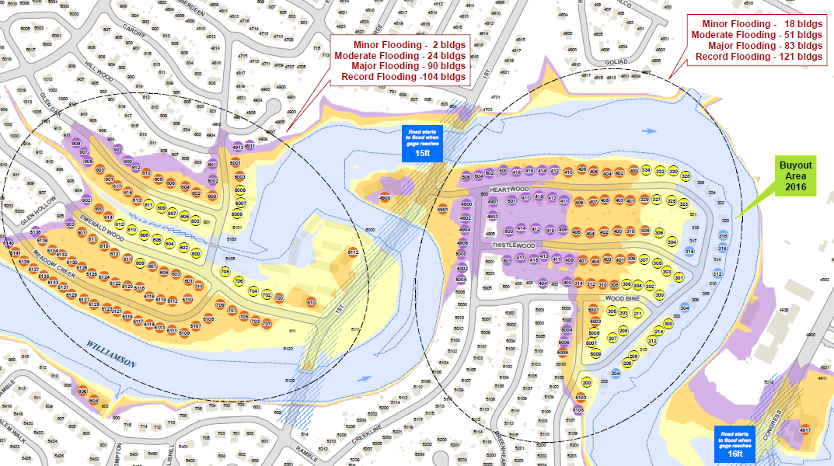
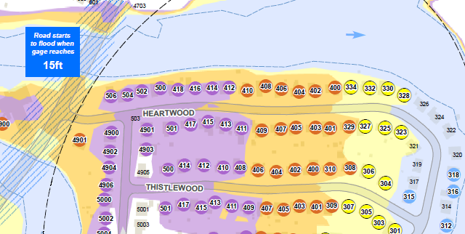
Flood Operational Maps
Potentially flooded
neighborhoods
Flood depth in houses
3ft
6” – 3 ft
< 6”

Slide 27
Common Operating Picture for each County
Summarize information for
urban counties
Prepare information for
rural counties
Travis
Wharton
Identify neighborhoods at risk from flooding
using FEMA flood maps and interaction
with county Emergency Management Coordinator
… Buildings

Slide 28
Wharton County Map
under glass:
Used for incident location, road closures, field notes…

Slide 30
Strategic Flood Base Map for Wharton County

Slide 31
Pin to Flood Map Application (for first responders)
Rock on road at current water level
Point location sent in by text
Inundation map
Local Impact in this area
Chief Todd Pomroy, Austin Fire Department

Slide 32
Flood Inundation Mapping for Colorado, Wharton and Matagorda Counties
Three questions:
What has been done?
What needs to be done?
Enhanced inundation mapping
Flood impact assessment
Densified Water Measurement
How much will it cost?

Slide 33
Current and Forthcoming River Forecast Systems
Densified Forecasting Requires Densified Measurement
Current
7 forecast points
3 inundation maps covering 35 river miles
Updated 6-hourly
Forthcoming
Forecasting and inundation mapping
covering 3274 river miles
Short-term forecast updated hourly
Medium-term forecast updated 6-hourly

Slide 34
Three Tier Water Measurement Plan
Tier 1: Gold Standard USGS Gages
– measure everything
Cost
Tier 2: Radar Sensors on Bridges (TxDOT)
– medium and high flows
Tier 3: Water Level Sensors
– low water crossings

Slide 35
27,000 Texas bridges on 15,700 stream reaches forecast by the National Water Model
Flood forecasting system
for Texas Bridges

Slide 36
Radar Measurement Technologies
Measures surface velocity
Measures water level
Densified forecasting requires densified measurement

Slide 37
Radar Measurement of Discharge
Combine with Acoustic Doppler Current Profiler
velocity profile
to get discharge
Measure velocity at one
point on water surface

Slide 38
Radar Streamflow Measurement on I-10
20 Sensors from San Antonio
to LA border

Slide 39
Real-Time Water Level Measurement in Hays County

Slide 40
Flood Inundation Mapping for Colorado, Wharton and Matagorda Counties
Three questions:
What has been done?
What needs to be done?
Enhanced inundation mapping
Flood impact assessment
Densified Water Measurement
How much will it cost per county?
Low 6-figures
High 6-figures
to low 7 figures

