Slide 1
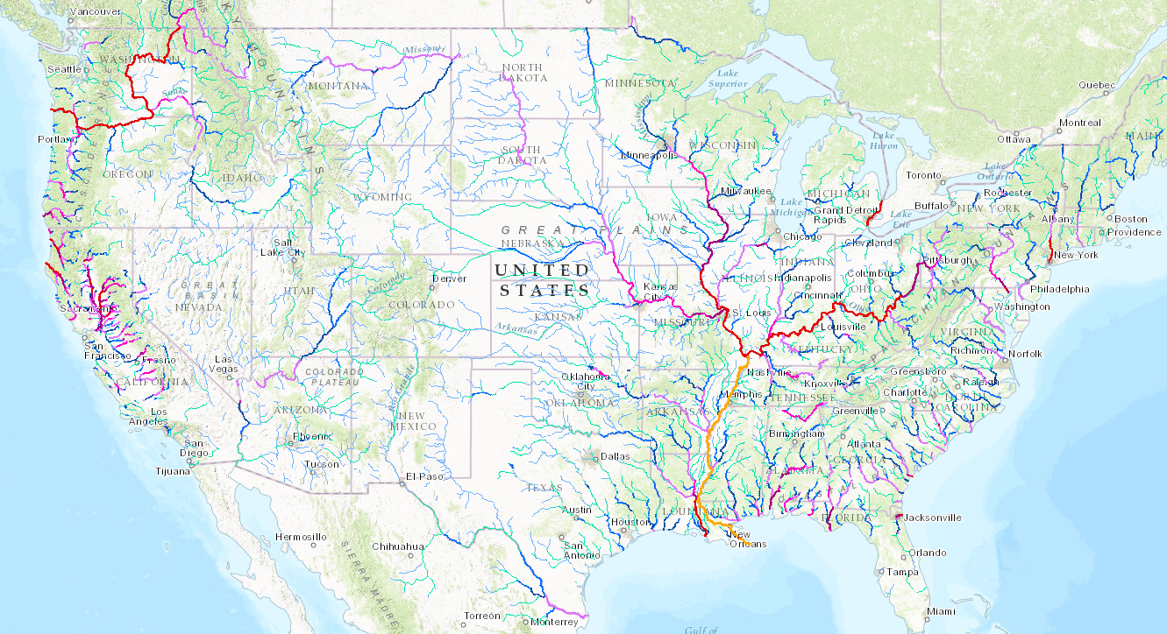
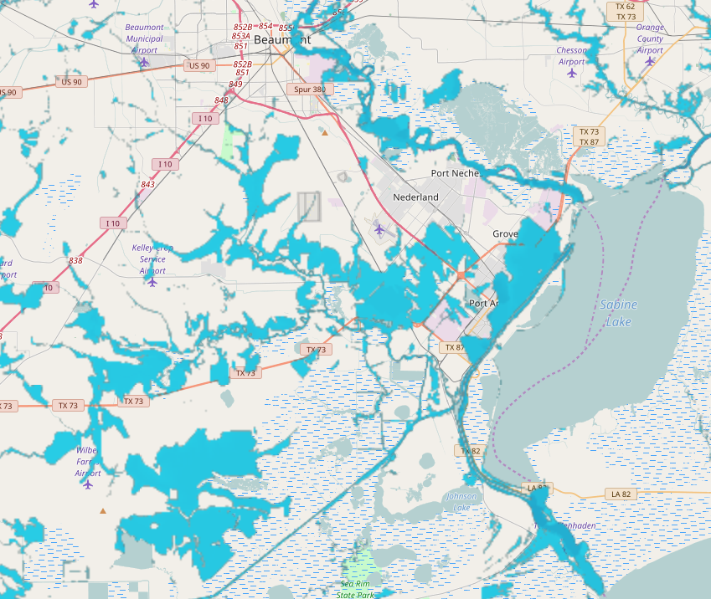
Flood Inundation Mapping using Height Above Nearest Drainage Method
David R. Maidment
Center for Research in Water Resources
University of Texas at Austin
Presentation for National Weather Service Leadership Team, 9 January 2016
Acknowledgments: Yan Liu, University of Illinois; David Tarboton, Utah State University;
Xing Zheng, University of Texas at Austin; City of Austin, National Weather Service, NCAR,
Texas Division of Emergency Management, ESRI, Kisters, National Science Foundation,
colleagues and students at UT Austin.

Slide 2
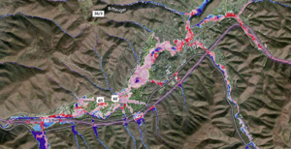
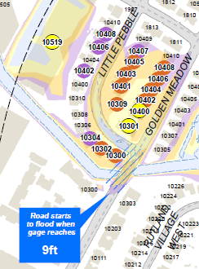
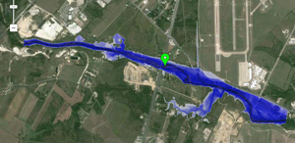
Flood Mapping Levels
Level 1 – approximate inundation mapping
Level 2 – approximate impact mapping
Level 3 – detailed inundation mapping
Level 4 – detailed impact mapping
Uses National Elevation Dataset
and rating curves
Impact at County scale
Uses LIDAR and
detailed hydraulic modeling
Impact at Stream Reach scale

Slide 3
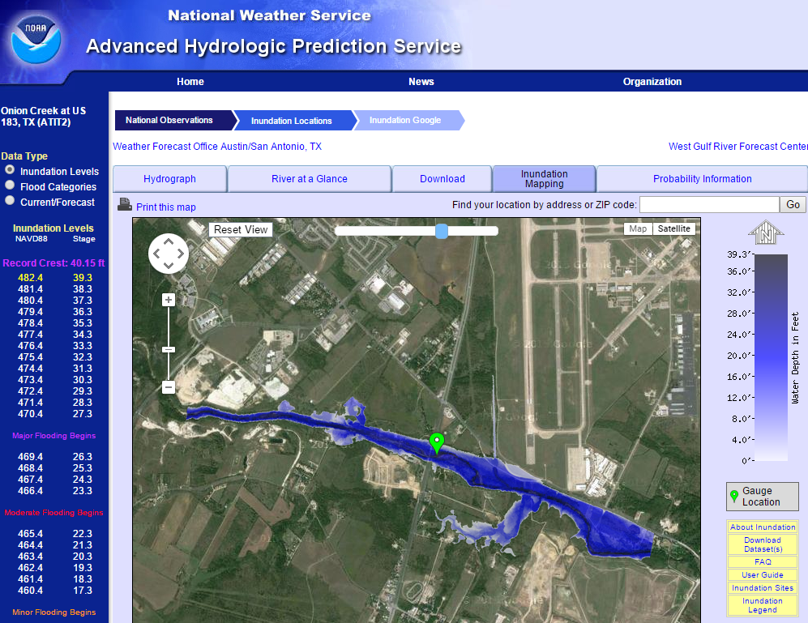
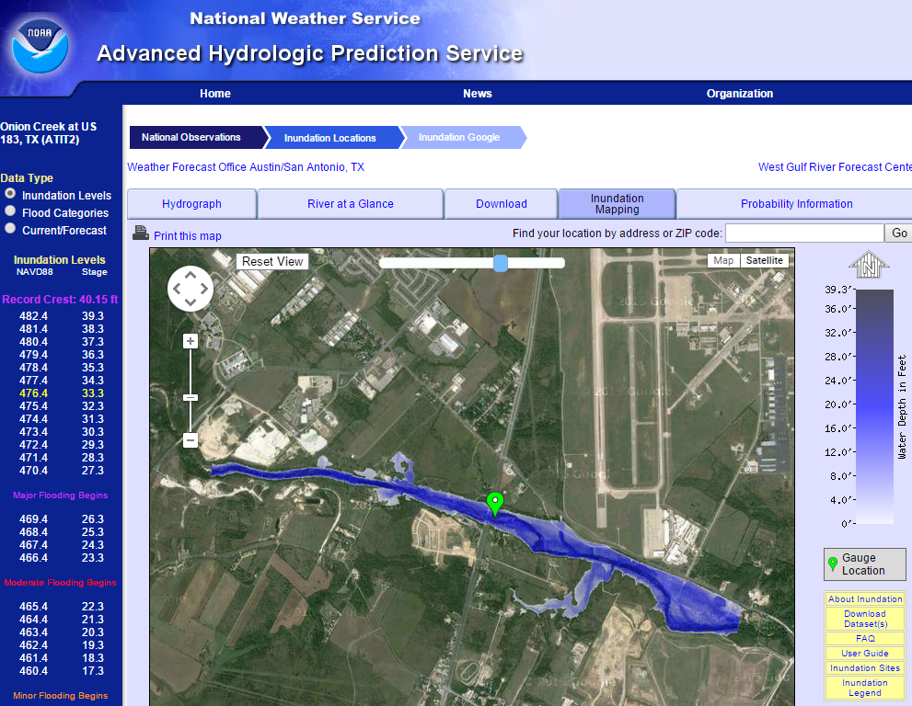
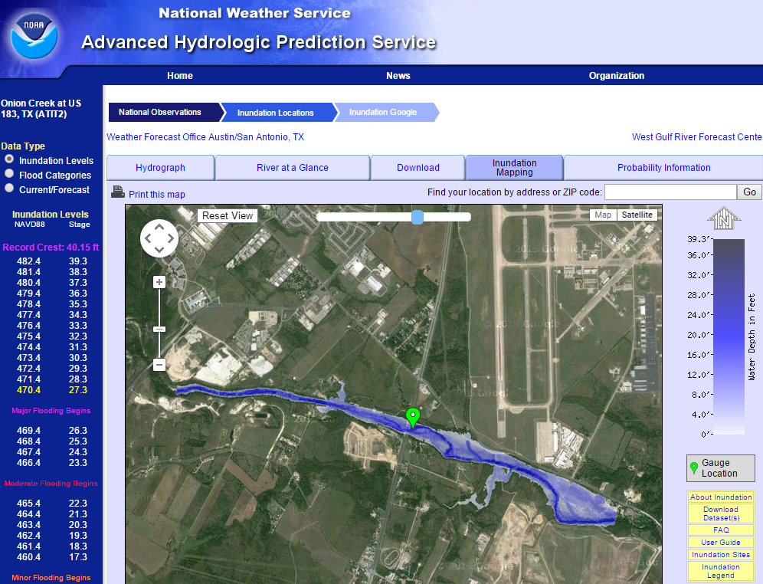
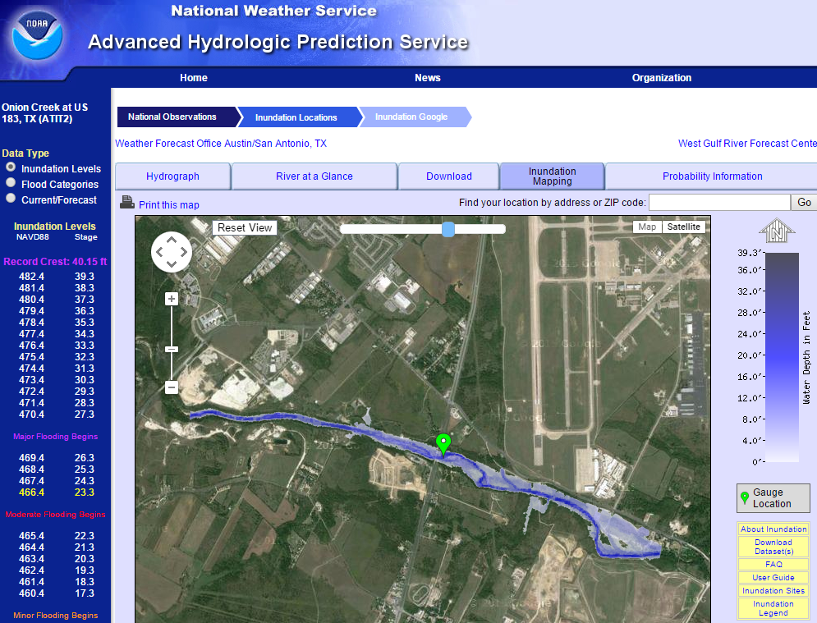
Real-Time Flood Inundation Mapping Onion Creek at Highway 183
http://water.weather.gov/ahps2/inundation/inundation_google.php?gage=atit2

Slide 4
Method for Determining Flood Risk: Height Above Nearest Drainage (HAND)
Flooding occurs when Water Depth is greater than HAND
Flood
HAND
Normal

Slide 5
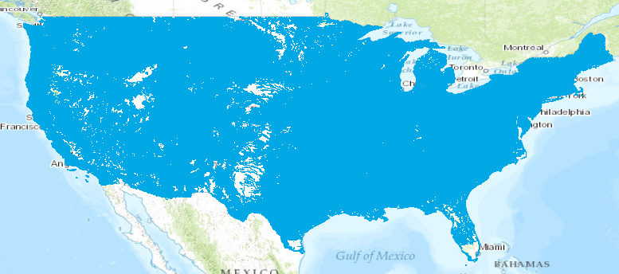
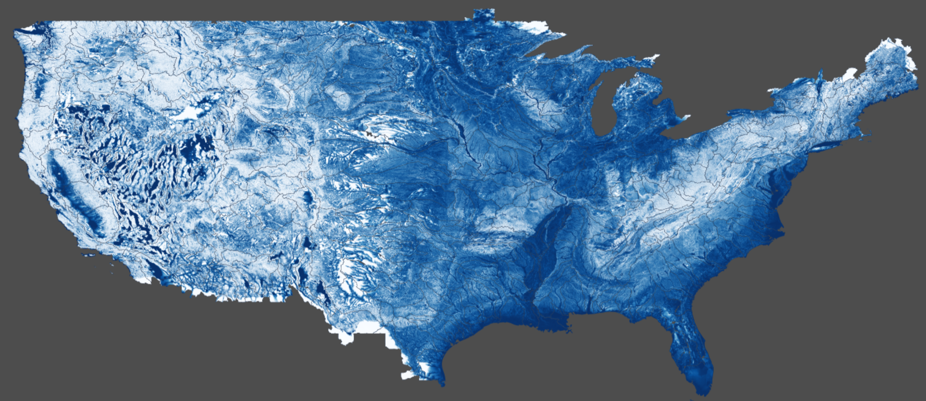
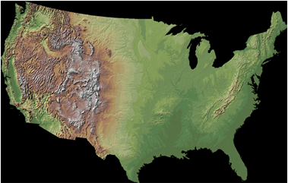
Continental-Scale Flood Inundation Mapping
Catchments and Flowlines
Height Above Nearest
Drainage (HAND) (relative elevation of land
surface cell above cell in
stream to which it flows)
Digital Elevation Model

Slide 6
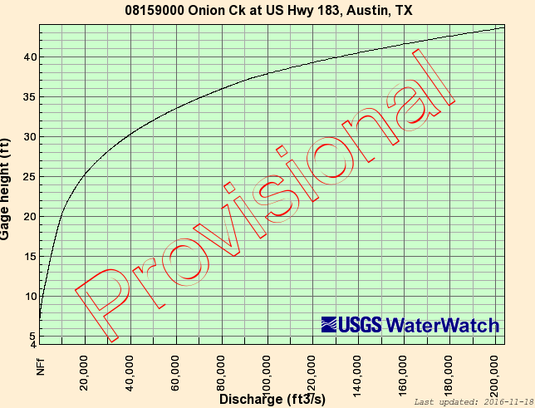
USGS Rating Curve at a Stream Gage
Onion Creek at Highway 183
Measure
Water Level
Determine Discharge

Slide 7
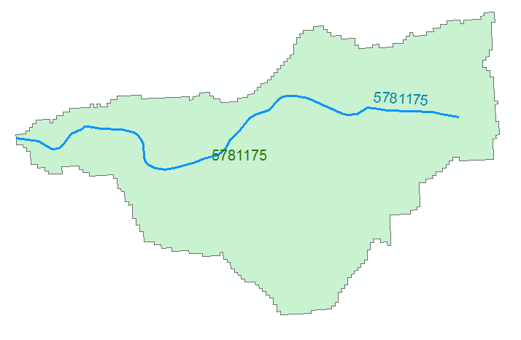
Reach Hydraulic Parameters
Comid | y | A | R | P | T | V | Ab | As
5781175 | 3
5781175 | 4
A_{s}
Surface Area
Wetted Bed Area
L
V
Volume
A_{b}
T
$$A=\frac{V}{L}$$
Cross Section Area
Depth
y
A
P
P$=\frac{Ab}{L}$
Wetted Perimeter
T$=\frac{As}{L}$
Top Width
R$=\frac{A}{P}$
Hydraulic Radius

Slide 8
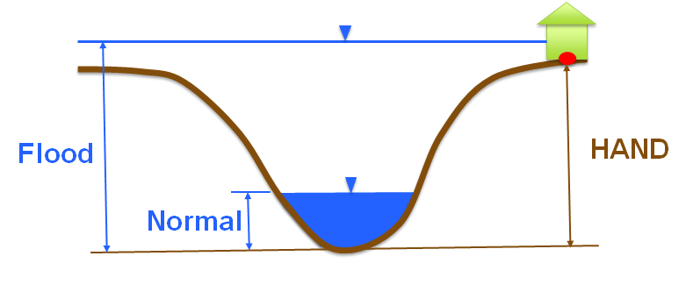
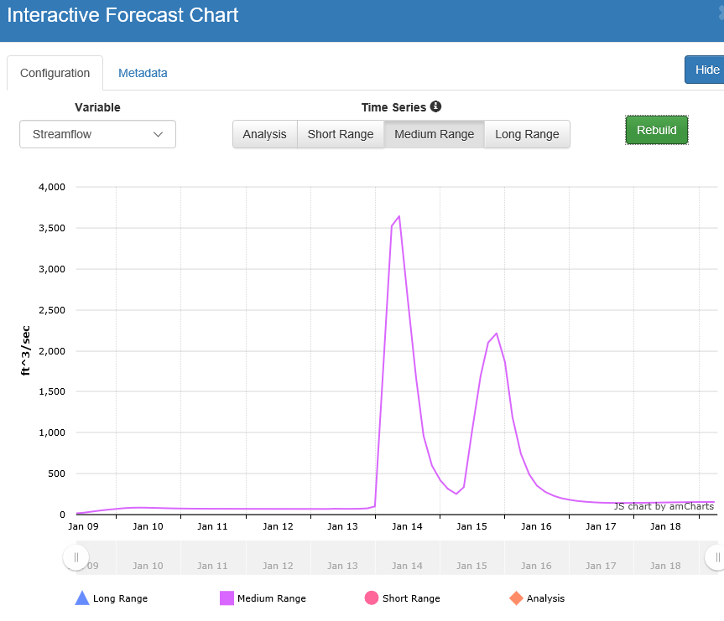
Rating Curve – Connects Discharge with Depth
Flood Depth, y (ft)
$$Q=\frac{1.49}{n}AR^{2/3}S_{o}^{1/2}$$
Forecast Discharge, Q,
from National Water Model

Slide 9
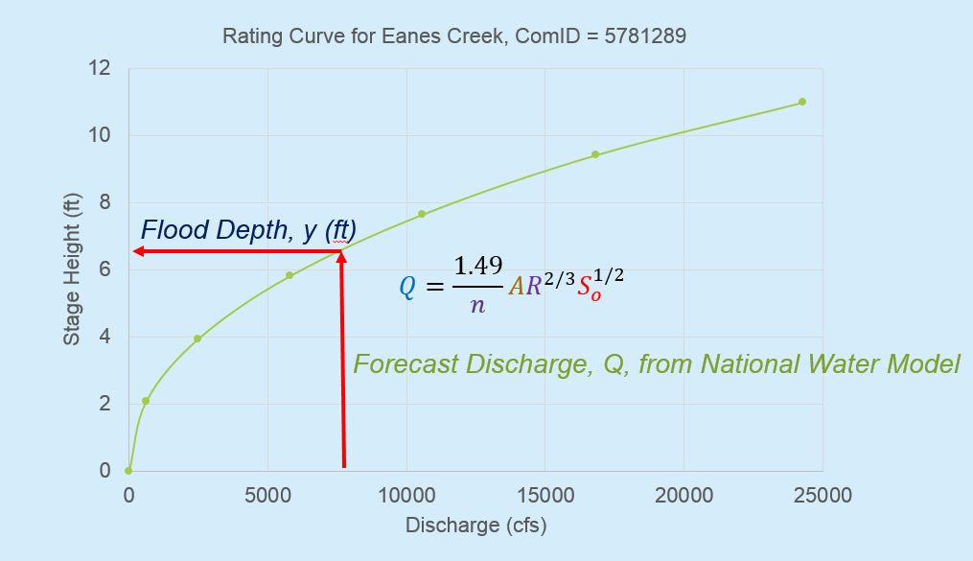
Continental-Scale Flood Inundation Mapping
1. Forecast discharge with National Water Model
2. Convert discharge to depth using rating curve
3. Convert depth to inundation using HAND
1
2
3

Slide 10
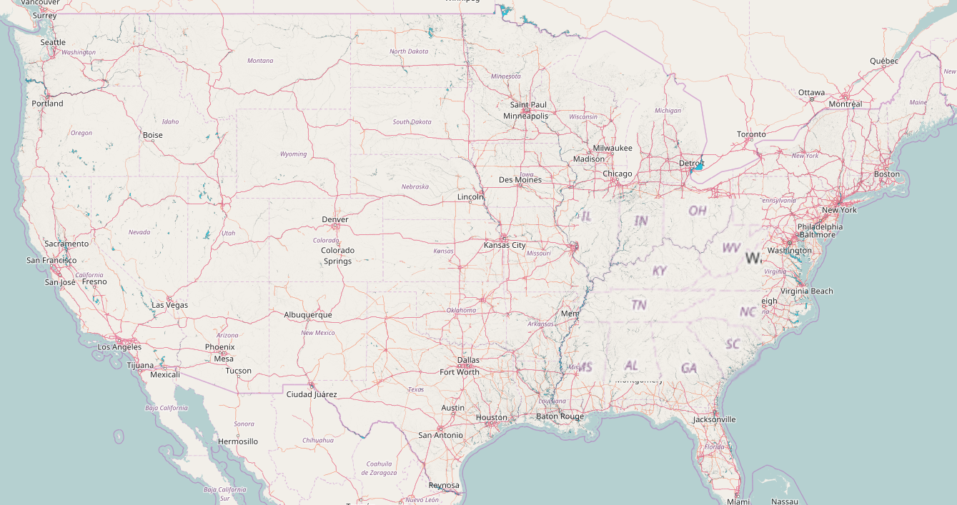
Continental-Scale Flood Inundation Mapping Process, Version 1 Alpha
South Texas and Louisiana
Source of Map: Yan Liu, University of Illinois at Urbana-Champaign

Slide 11
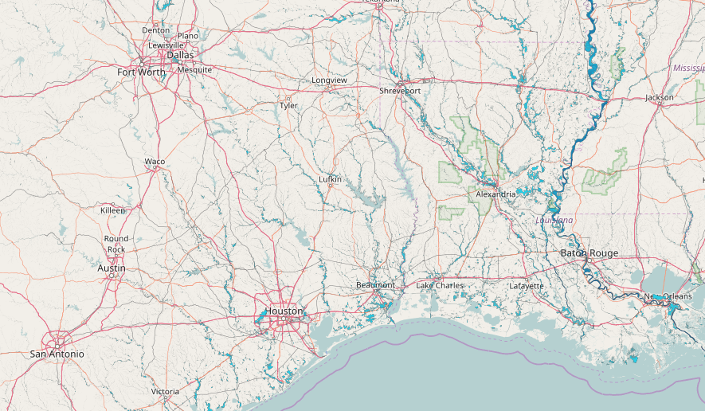
South Texas and Louisiana
Sabine Lake

Slide 12
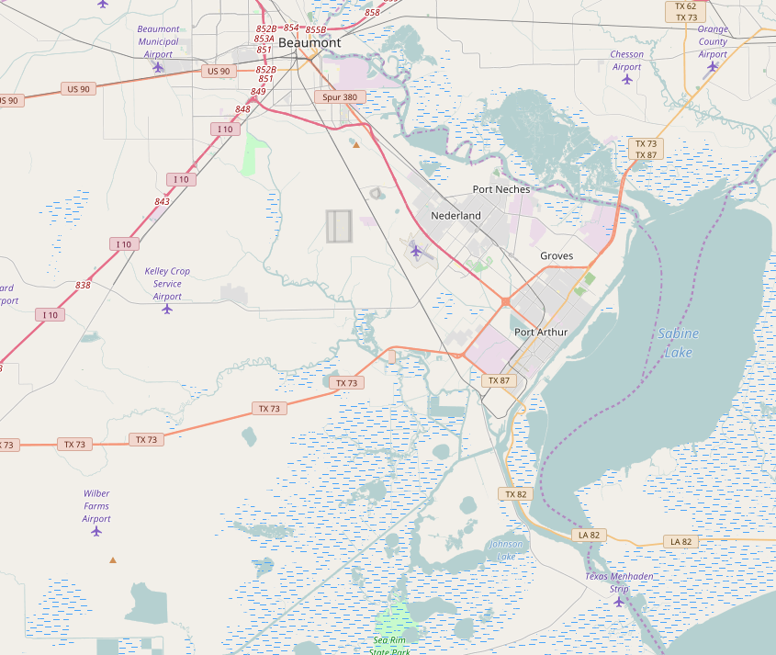
Water Map Under Normal Flow Conditions
Sabine Lake
Swamp
and
Marsh

Slide 13
Water Map with Flood Inundation

Slide 14
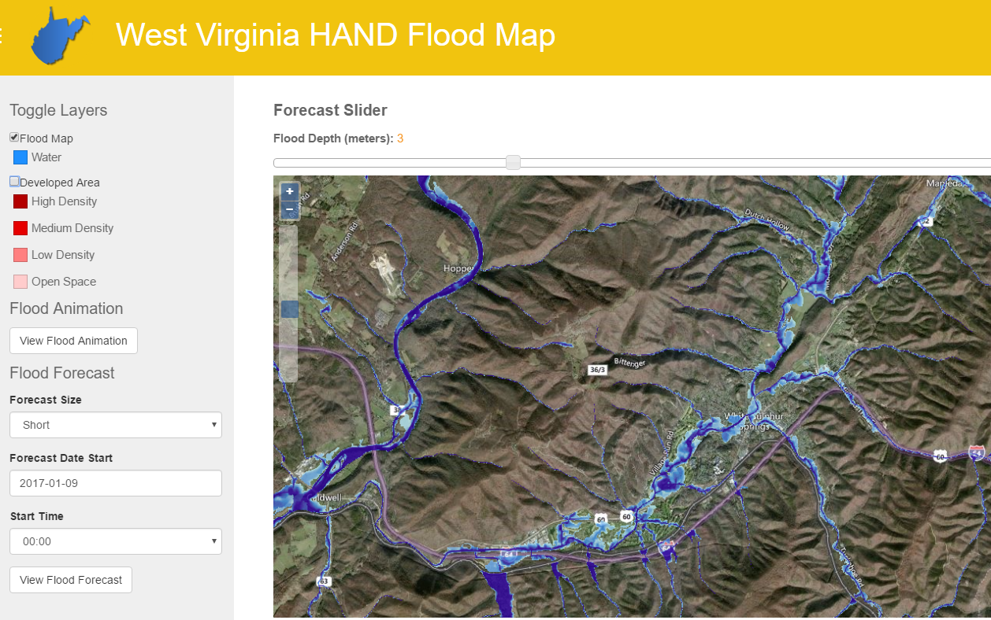
Regional Flood Inundation
Source of Map: Christian Kessler, Brigham Young University

Slide 15
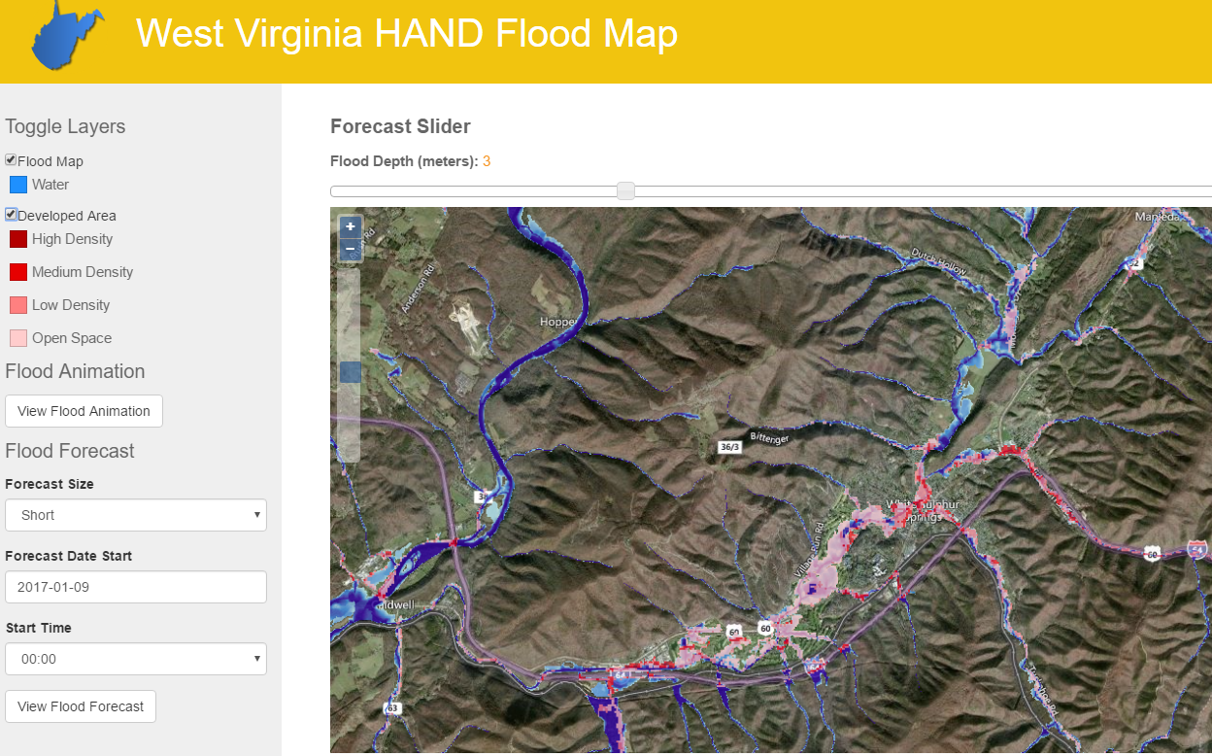
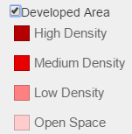
Regional Flood Impact
National Land Cover Dataset
Source of Map: Christian Kessler, Brigham Young University

Slide 16
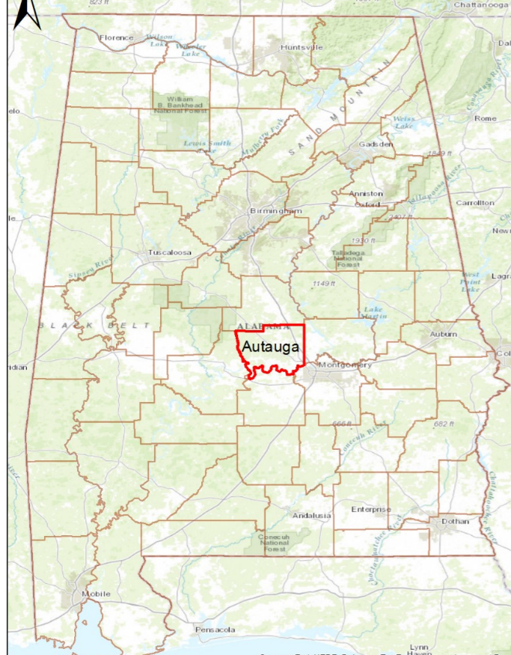
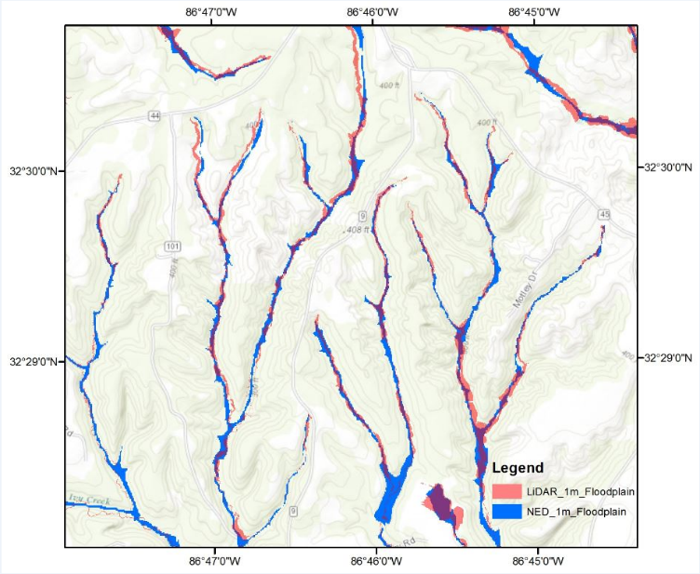
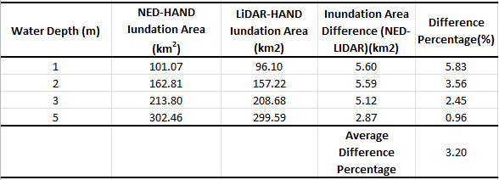
HAND comparison between LIDAR and NED
Inundated Area in Autauga County, AL
Source of Data: Xing Zheng, University of Texas at Austin

Slide 17
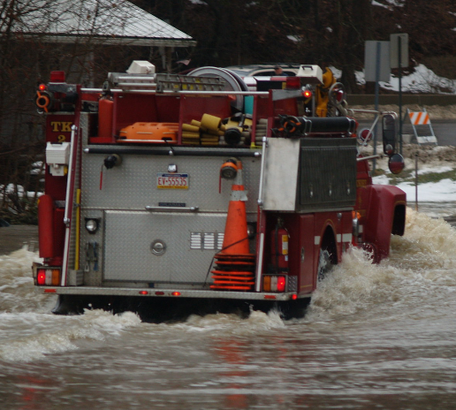
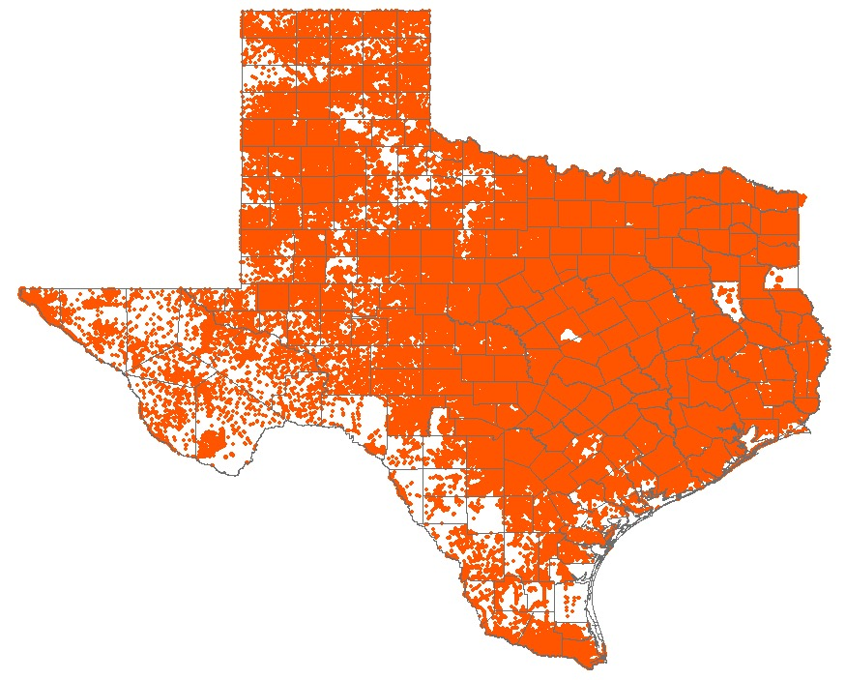
Texas Address Points
8.6 million points
Used for dispatching emergency
response vehicles in e-911 systems

Slide 18
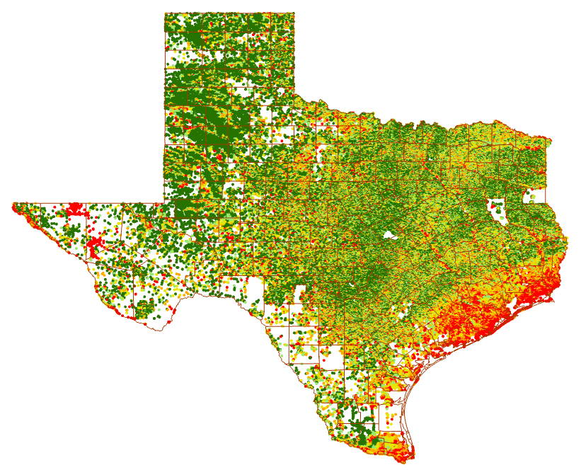
Statewide Addresses with HAND
Notes:
237 counties mapped
16 CSEC counties geocoded
1 non-CSEC county geocoded

Slide 19
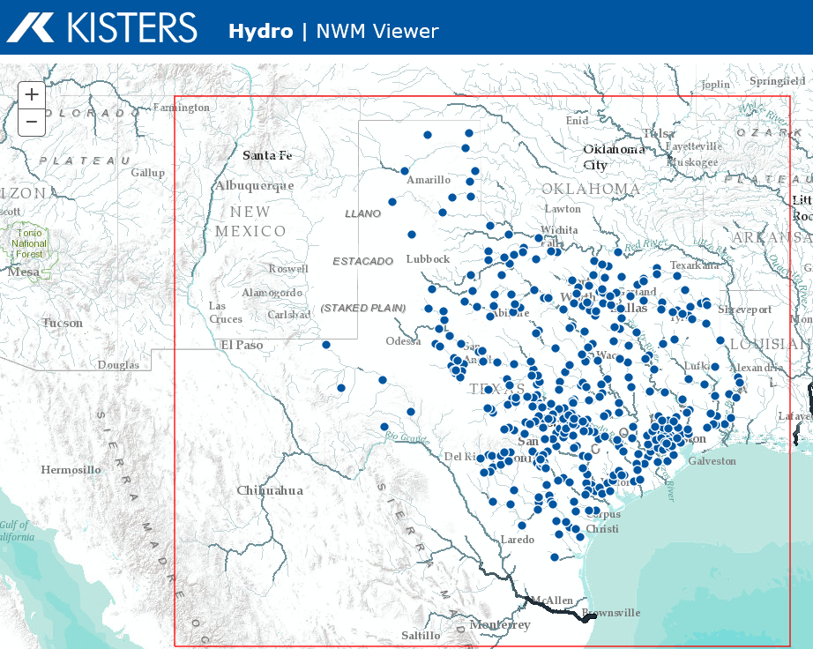
Flood Inundation Mapping in Texas (Texas Division of Emergency Management)
Provides real-time access to National Water Model forecasts
Discharge converted to Depth using Rating Curves for all 100,000 reaches
Built using Kisters Big Data system (KiBiD) in Aachen, Germany

Slide 20
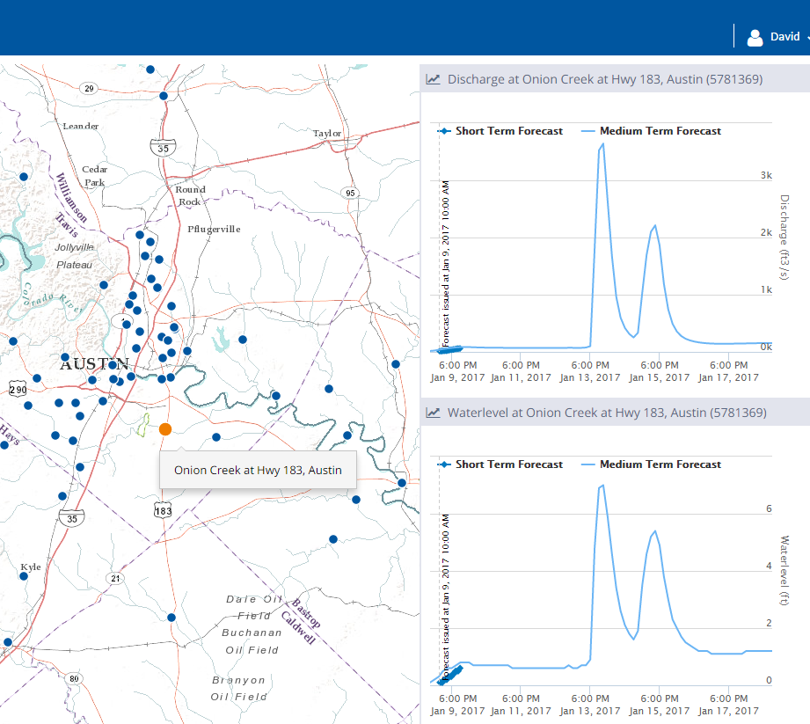
Real Time Charts for Discharge and Depth
Discharge Forecast
cfs
Water Level Forecast
ft

Slide 21
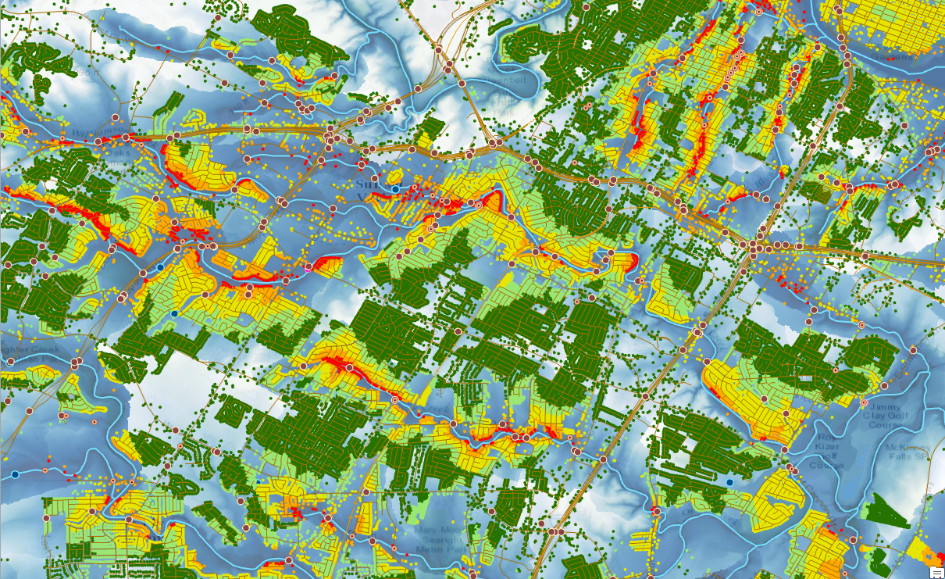
Williamson Creek, South Austin: address points attributed with HAND

Slide 22
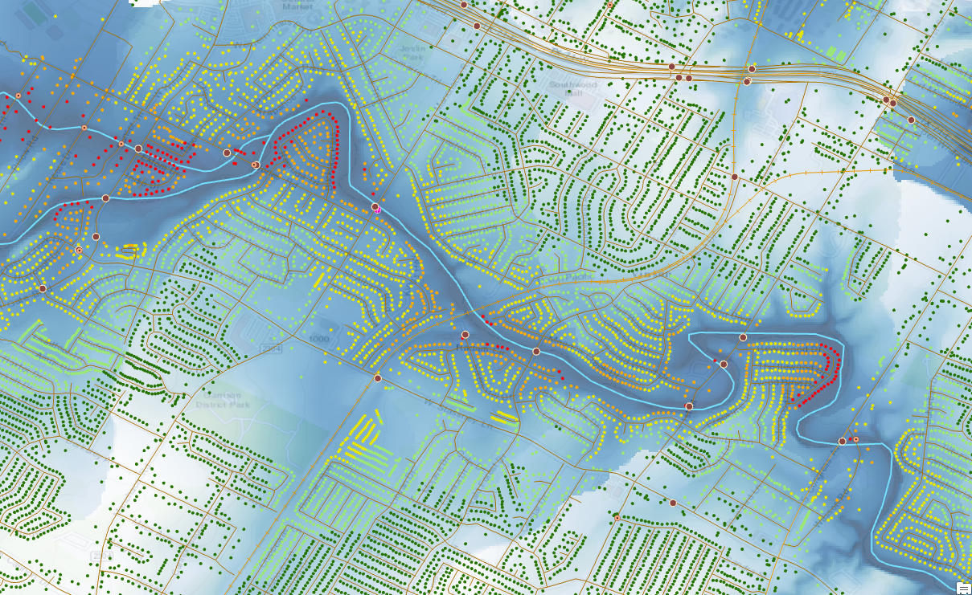
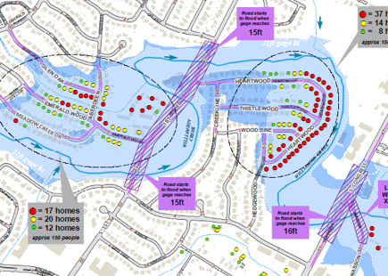
Williamson Creek, South Austin: Comparison with detailed engineering modeling

Slide 23
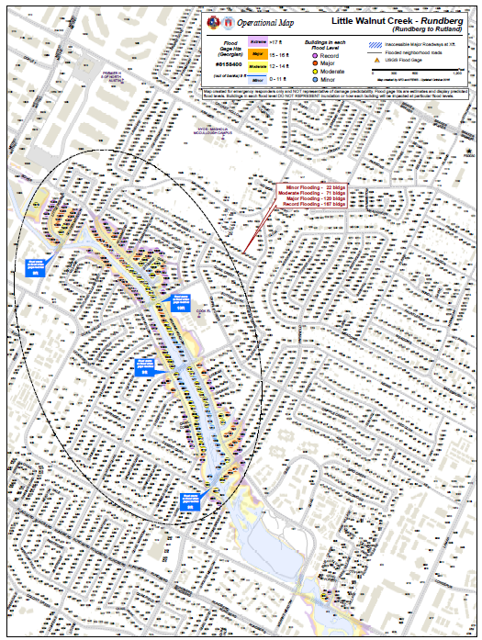
Collaboration between Austin Fire Dept and Flood Early Warning System
Flood operational maps for 21 Austin creeks
Tested in table top exercises
Being deployed in fire trucks in paper and pdf format in Jan-Feb 2017

Slide 24
Flood Operational Maps

Slide 25
Flood Mapping Levels
Level 1 – approximate inundation mapping
Level 2 – approximate impact mapping
Level 3 – detailed inundation mapping
Level 4 – detailed impact mapping
Uses National Elevation Dataset
and rating curves
Impact at County scale
Uses LIDAR and
detailed hydraulic modeling
Impact at Stream Reach scale

Slide 26
Summary
A Continental-Scale Flood Inundation Mapping Process, Version 1 Alpha exists
We hope to have a Version 1 Beta for external testing at 2017 Summer Institute
Need to connect with existing National Water Model map outputs
Should we do a presentation at White House Conference Center later in the Spring as we did at the beginning of the National Flood Interoperability Experiment?

