Slide 1
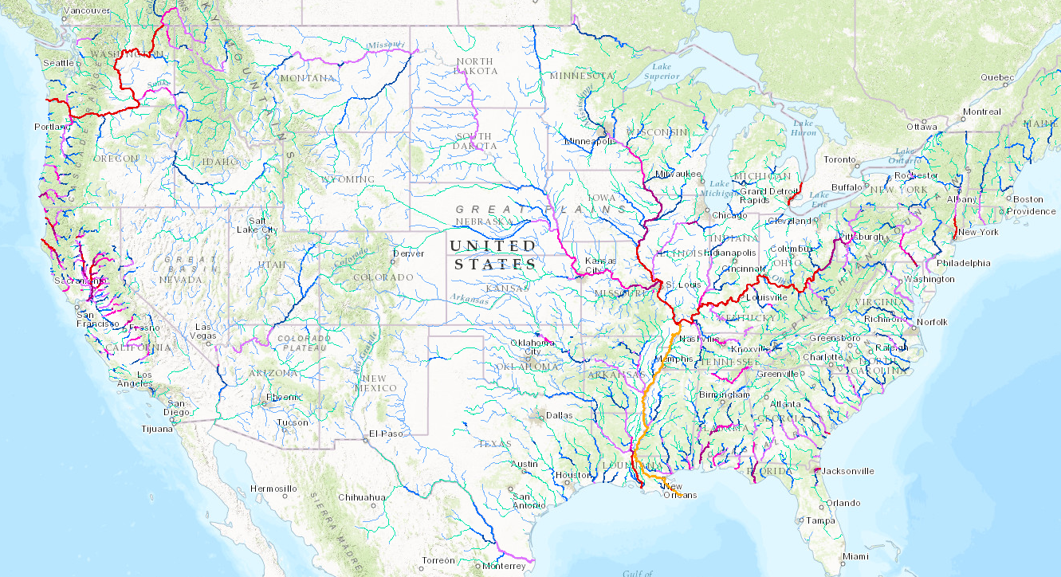
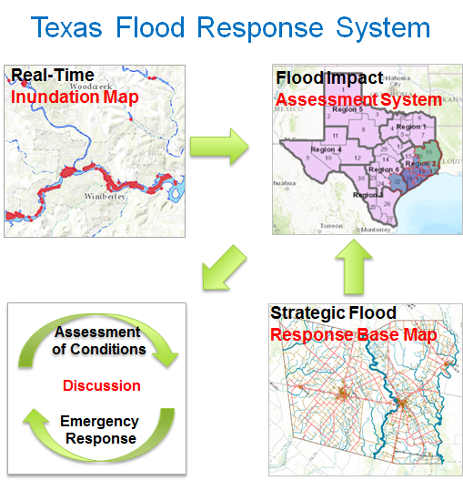

Texas Flood Response System:
Incorporating Predictions and Observations for Inundation Mapping
National Water Model
Dr. David Maidment, Harry Evans, Dr. David Arctur, University of Texas at Austin
Center for Water and the Environment (CWE)
Presentation to TDEM, 3 August 2017
Acknowledgments: Texas Division of Emergency Management, City of Austin, Austin Fire Dept,
National Weather Service, West Gulf River Forecast Center, University of Texas at Austin

Slide 2
Texas Flood Response System
August 3rd Briefing
0900 – Opening and Introductions – Mike Ouimet
0905 – Review of Project status and directions – David Maidment
0910 – Ed Clark, Director National Water Center
0920 – WGRFC
0930 – Real-time Flood App “Point to Flood”
0945 – Best Available Flood Inundation Mapping for Texas
0955 – Questions/Comments
1000 – Discussion on Workflow NWS & TDEM CIS
1030 – Close Out

Slide 3
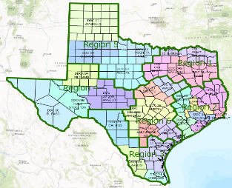
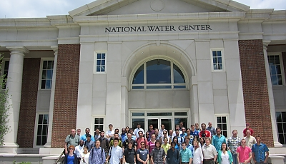
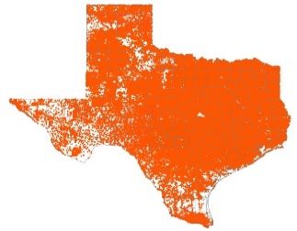
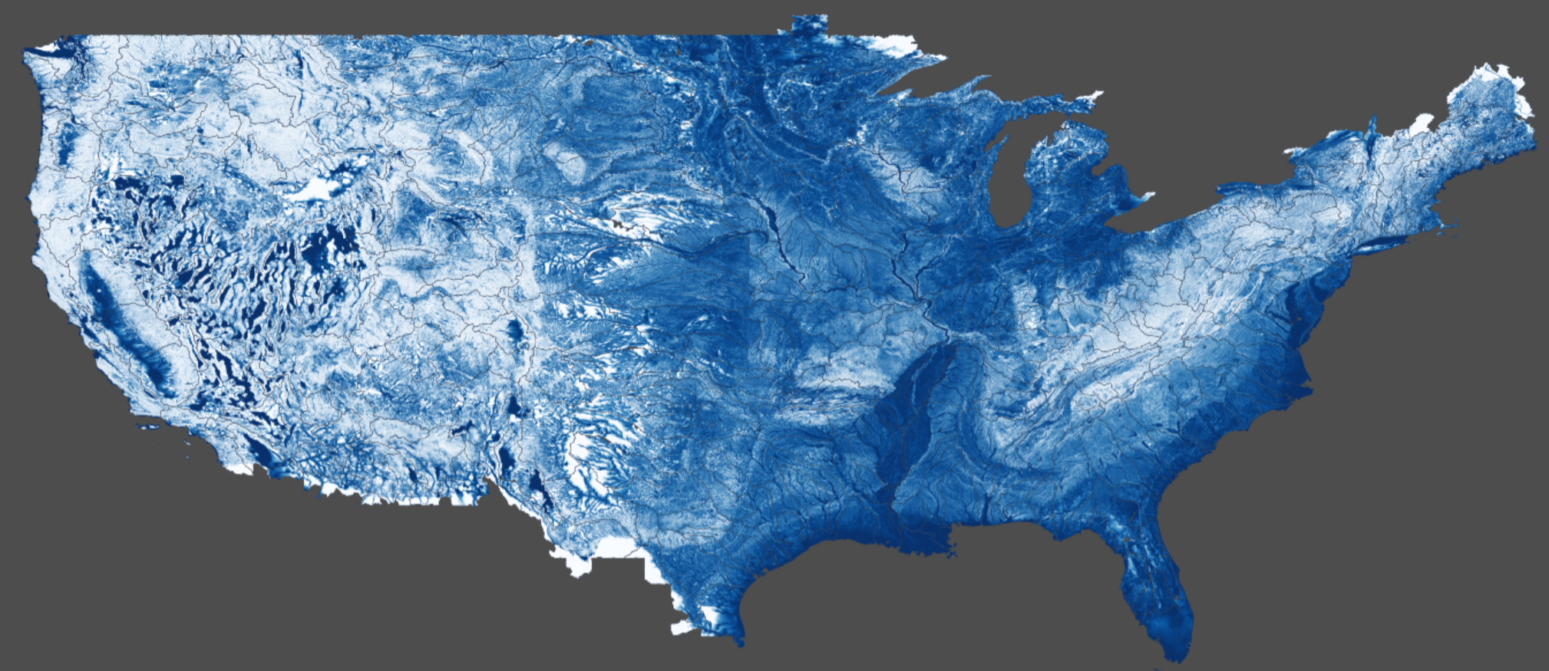

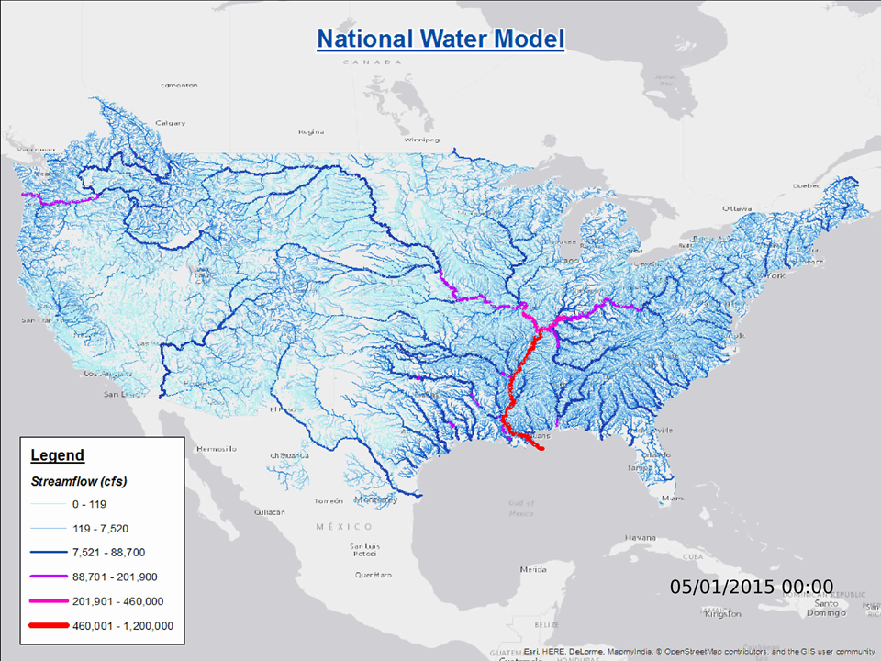

Texas Flood Response System
Demonstration
May 2019
Research and Development
May 2018
May 2017
May 2016
Deployment
May 2015
Services
May 2014
Impact
Inundation
Discharge

Slide 4
Recent Accomplishments
9.1 million Address Points statewide collected for impact assessment
TNRIS adoption of the Address Point Database
Process Review during 2017 Summer Institute at the NWC
Flood inundation mapping services from the NWC (in process)
Real-Time Point to Flood Map app created
Agency Collaboration – Over 40 different stakeholders
    6 Federal agencies / 8 State agencies / 10 Texas Counties /
    12 Fire Departments / 5 City agencies … and others
TxDOT gage/sensor network (pending)
DHS Flood Apex Program – Texas Flood Response Testbed (pending)

Slide 5
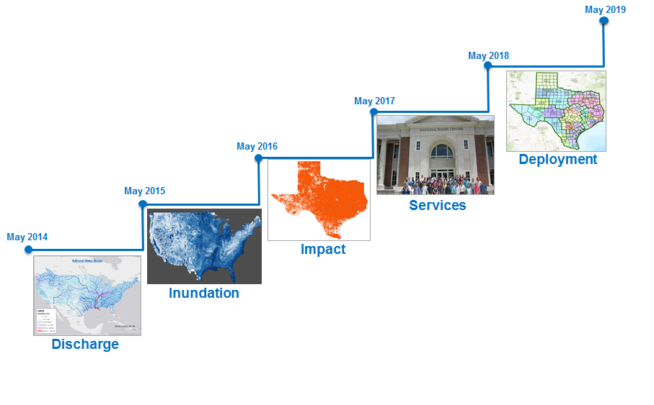
Three Themes for this Meeting:
Predictive flood mapping from the National Water Center
  Collaboration with WGRFC and TDEM
  What maps are needed?
  How will they be delivered?
Observational flood mapping at TDEM
  Point to Flood Map application
  Testing with first responders
  Building the mapping infrastructure at TDEM
Best available flood inundation maps for Texas
  Use engineering scale models where available, HAND elsewhere
  River Hydraulic Framework for combining maps from different sources

Slide 6
Three Themes for this Meeting:
Predictive flood mapping from the National Water Center
  Collaboration with WGRFC and TDEM
  What maps are needed?
  How will they be delivered?
Observational flood mapping at TDEM
  Point to Flood Map application
  Testing with first responders
  Building the mapping infrastructure at TDEM
Best available flood inundation maps for Texas
  Use engineering scale models where available, HAND elsewhere
  River Hydraulic Framework for combining maps from different sources
Ed Clark leads discussion

Slide 7
Three Themes for this Meeting:
Predictive flood mapping from the National Water Center
  Collaboration with WGRFC and TDEM
  What maps are needed?
  How will they be delivered?
Observational flood mapping at TDEM
  Point to Flood Map application
  Testing with first responders
  Building the mapping infrastructure at TDEM
Best available flood inundation maps for Texas
  Use engineering scale models where available, HAND elsewhere
  River Hydraulic Framework for combining maps from different sources

Slide 8

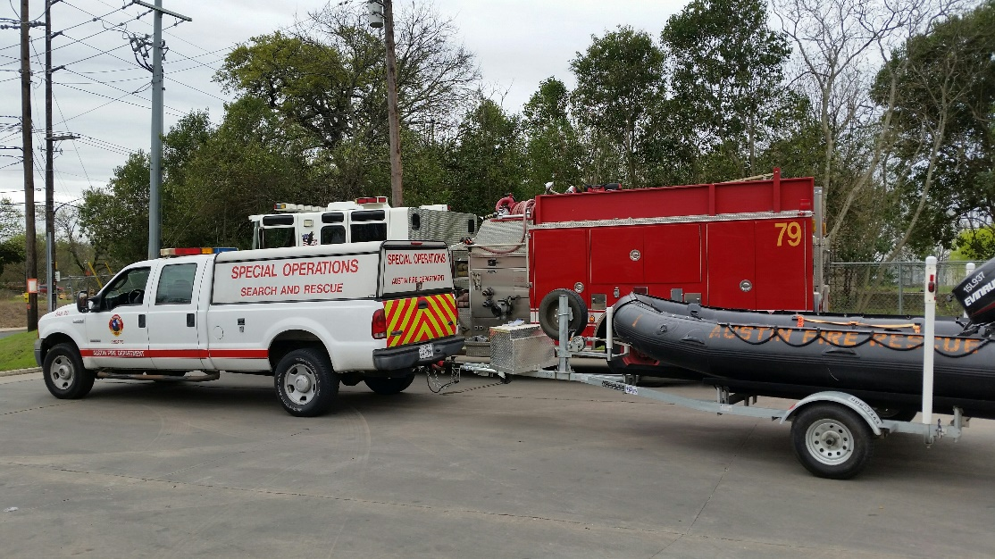
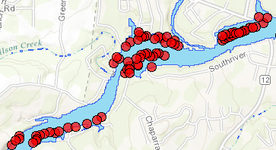
First Responder Input to Inundation Mapping
Rock on road at current water level
Point location sent in by text
Inundation map
Local Impact in this area
Chief Todd Pomroy, Austin Fire Department

Slide 9
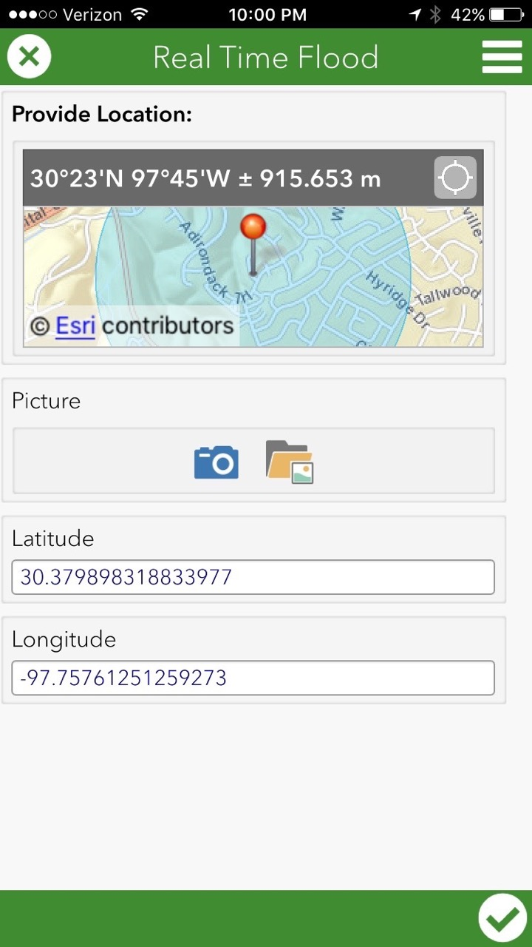
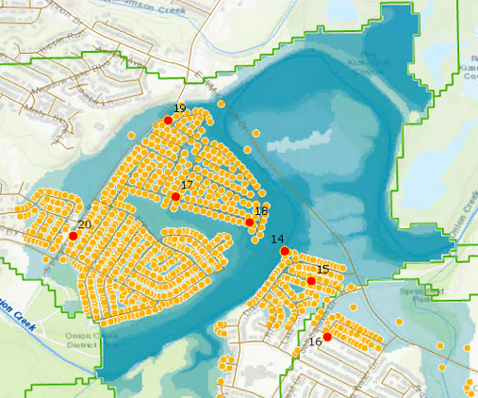
Texas Flood Response System:
Incorporating Observations for Real-Time Inundation Mapping
Prepared for TFRS Status Briefing, Aug 3, 2017
Harry Evans, David Arctur, University of Texas at Austin
Jeanette Chamorro, TDEM Critical Information Systems
Acknowledgements:
David Maidment, Xing Zheng, University of Texas at Austin; Michael Ouimet, TDEM; Austin Fire Dept.

Slide 10
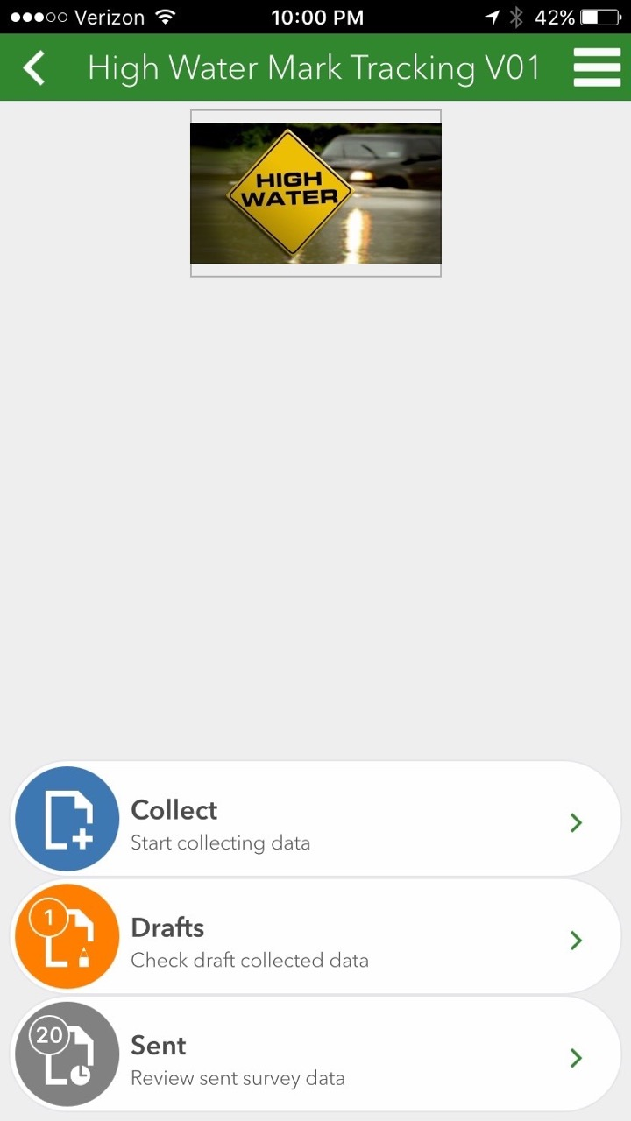
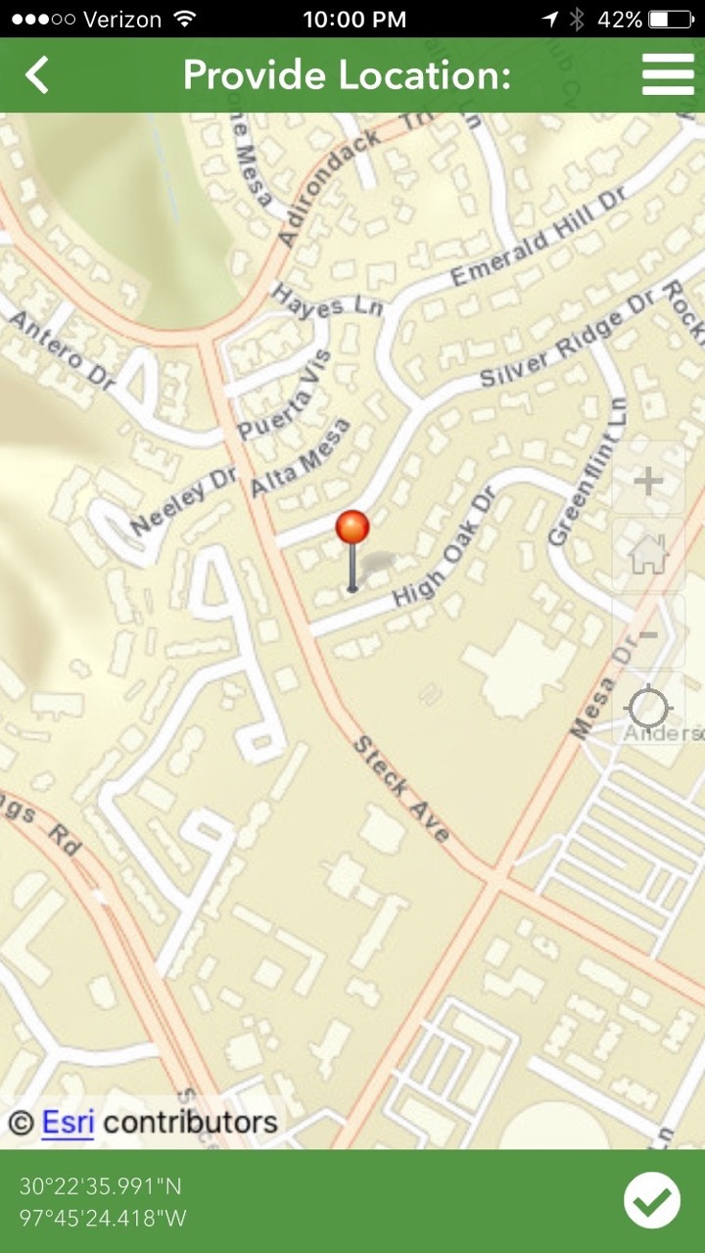
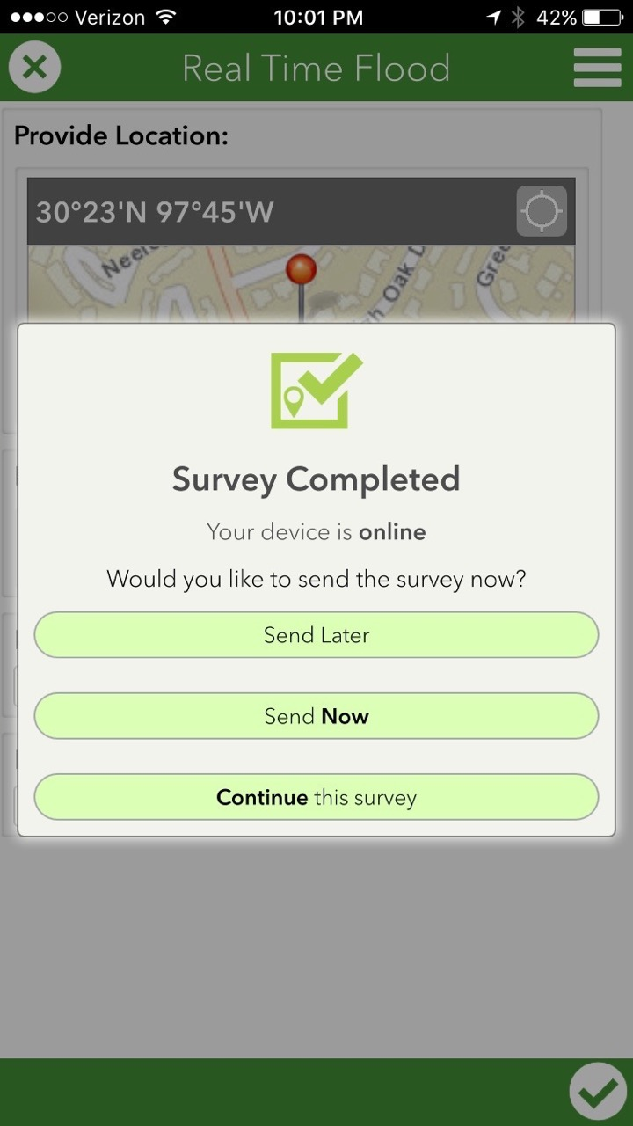
Run mobile app on a phone or tablet in the field

Slide 11
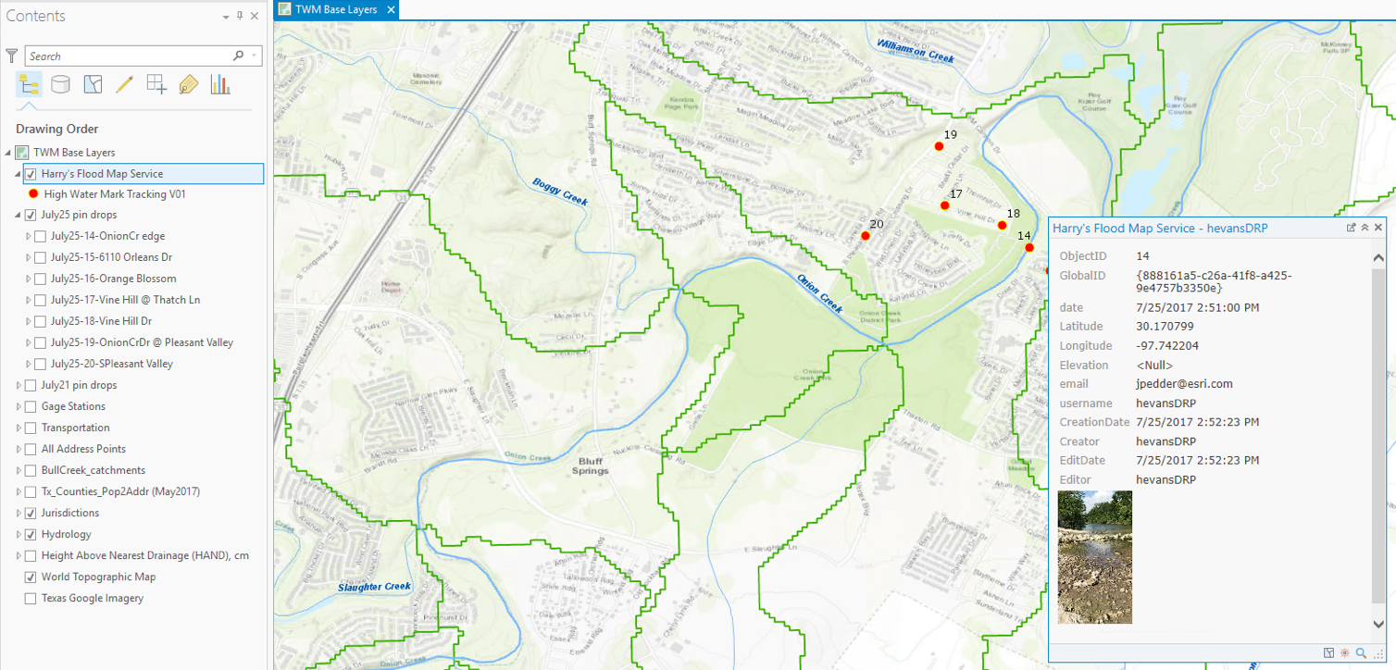
Map the mobile app photo & coordinates at TDEM CIS

Slide 12
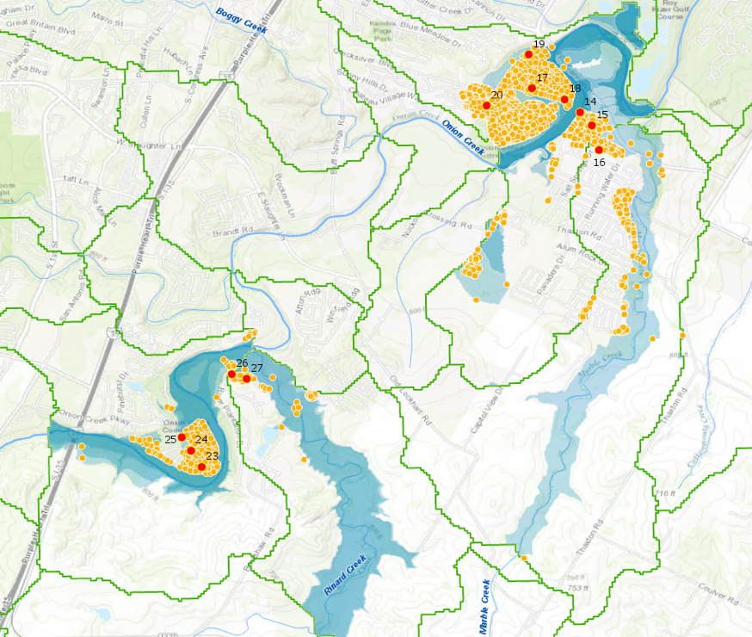
July 25 Testing
Test areas in
Onion Creek Basin
July 28 Testing

Slide 13
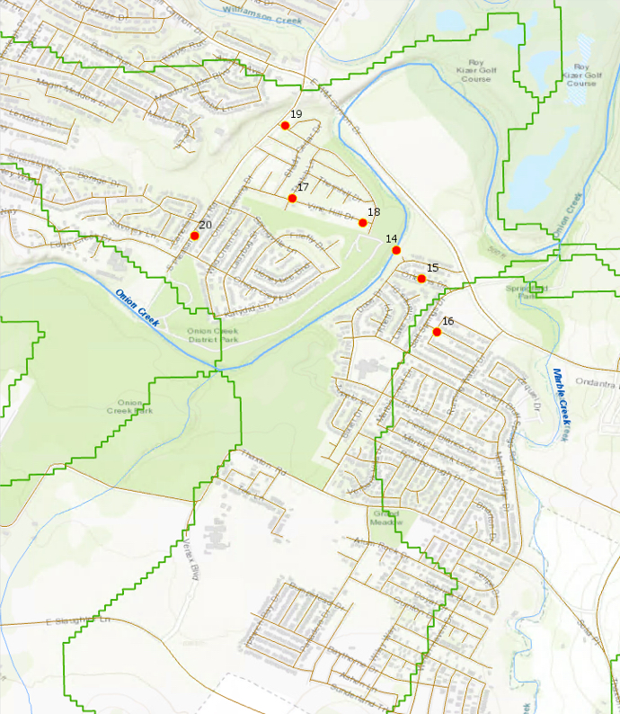
July 25 Testing: Topo basemap

Slide 14

14 – Onion Creek’s edge
Pin – (lat,long) – potential addrs impacted
14 – (30.170799, -97.742204) – 0 addrs

Slide 15
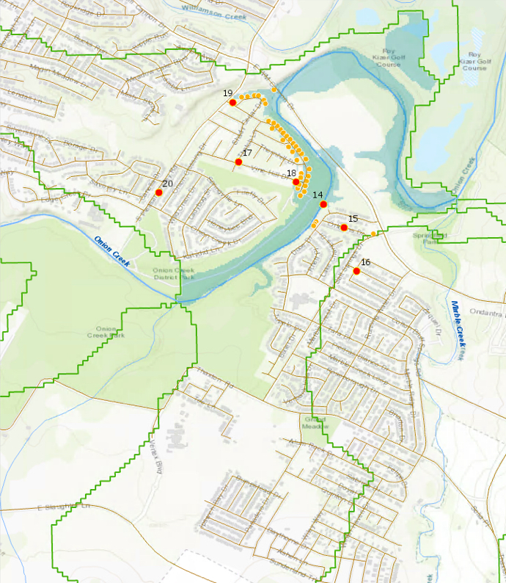
18 – Vine Hill Dr near creek
Pin – (lat,long) – potential addrs impacted
18 – (30.172203, -97.743922) – 38 addrs

Slide 16
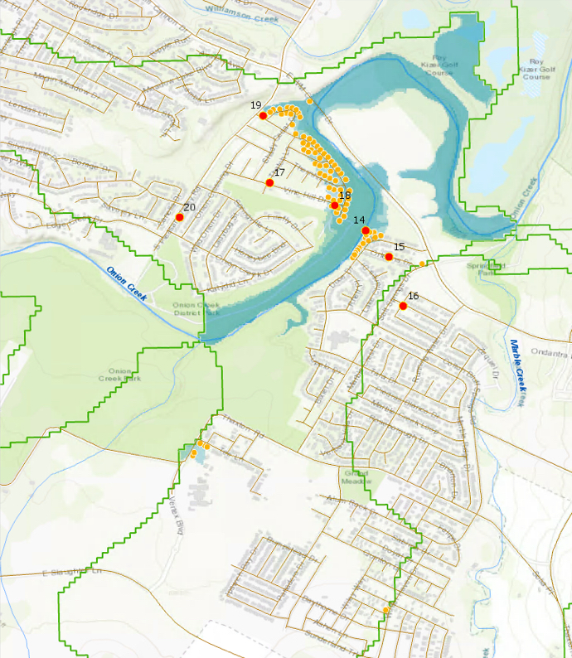
19 – Onion Cr Dr & Pleasant Valley Rd
Pin – (lat,long) – potential addrs impacted
19 – (30.177183, -97.747903) – 79 addrs

Slide 17
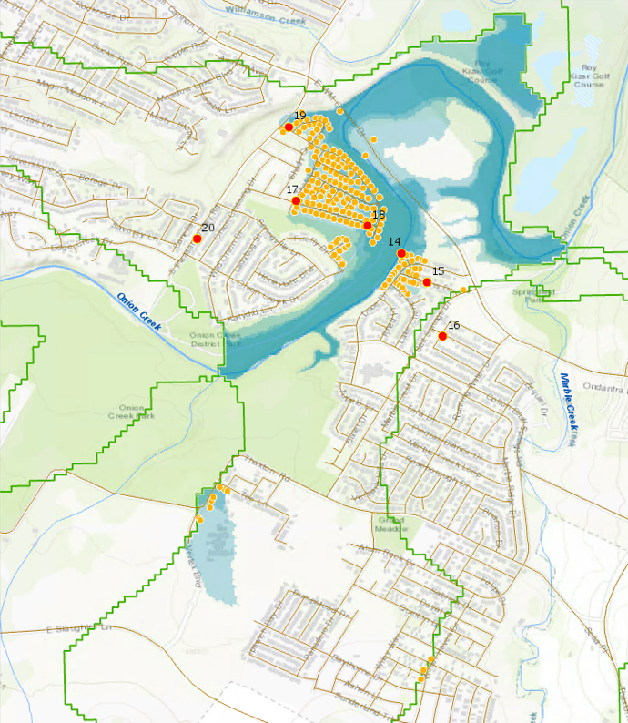
17 – Vine Hill Dr at Thatch Ln
Pin – (lat,long) – potential addrs impacted
17 – (30.173456, -97.747538) – 196 addrs

Slide 18
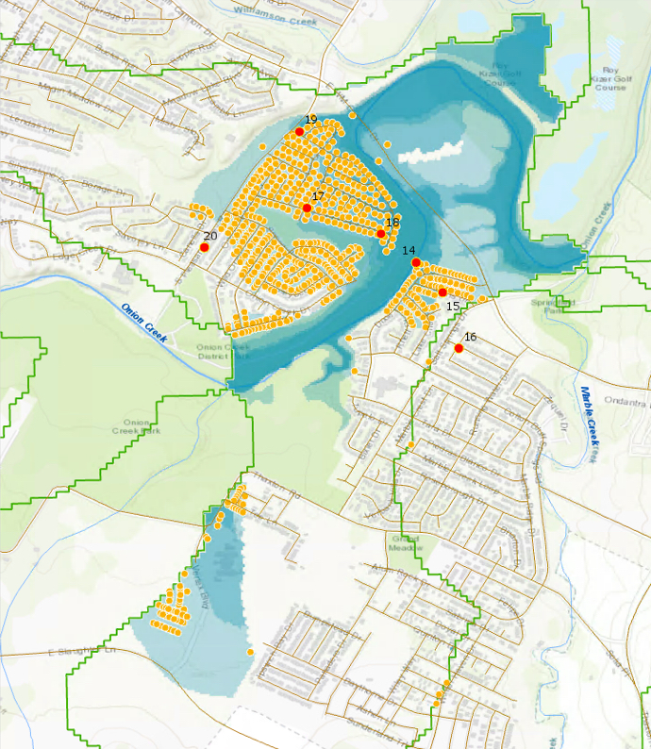
15 – 6114 Orleans Dr
Pin – (lat,long) – potential addrs impacted
15 – (30.169338, -97.740908) – 677 addrs

Slide 19
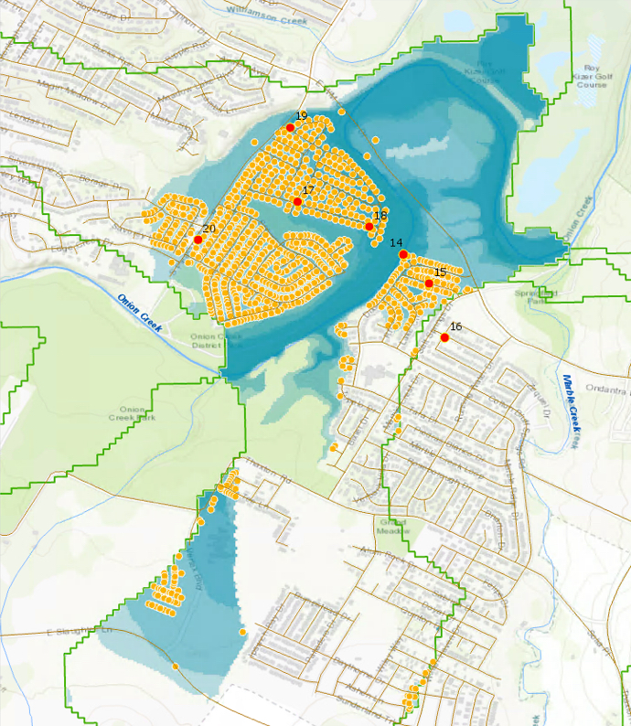
20 – 7313 S Pleasant Valley Rd
Pin – (lat,long) – potential addrs impacted
20 – (30.17156, -97.752547) – 959 addrs

Slide 20
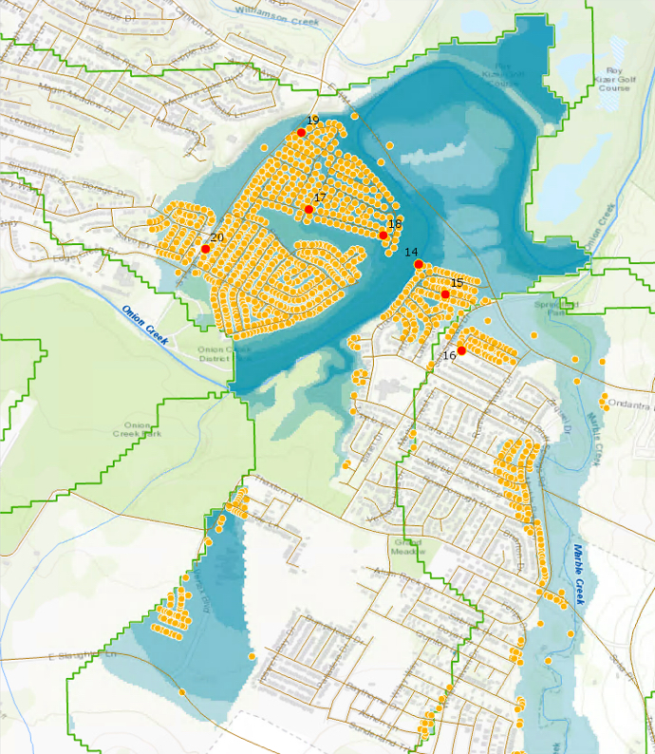
16 – Orange Blossom Way at Green Grass Trail
Pin – (lat,long) – potential addrs impacted
20 – (30.17156, -97.752547) – 959 addrs
16 – (30.166610, -97.740116) – 202 addrs

Slide 21
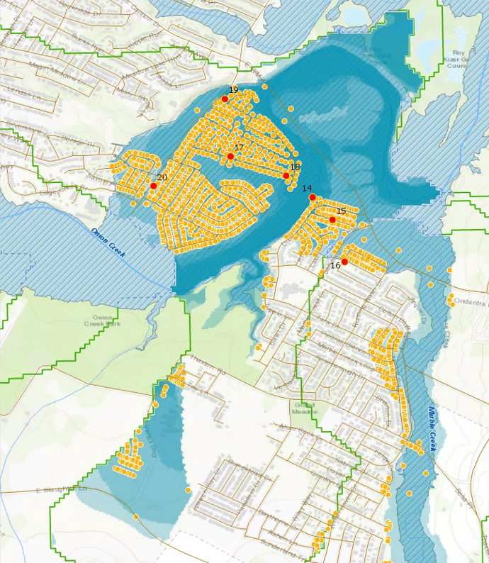
Comparison with FEMA National Flood Hazard Layer

Slide 22
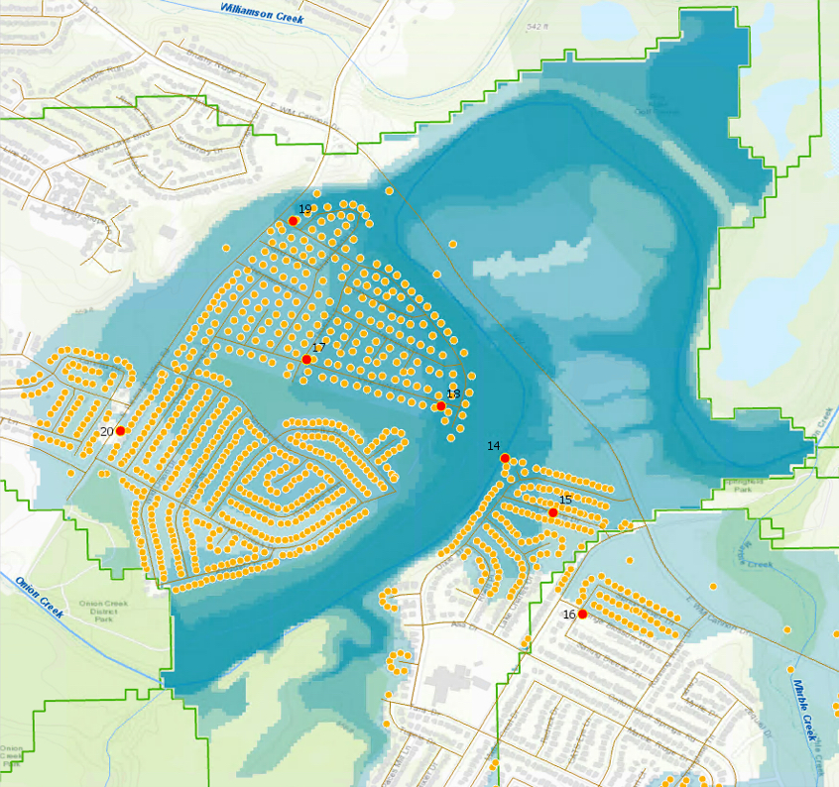
Comparison with AFD Operational Map

Slide 23
July 25 Testing
Test Areas in
Onion Creek Basin
July 28 Testing

Slide 24
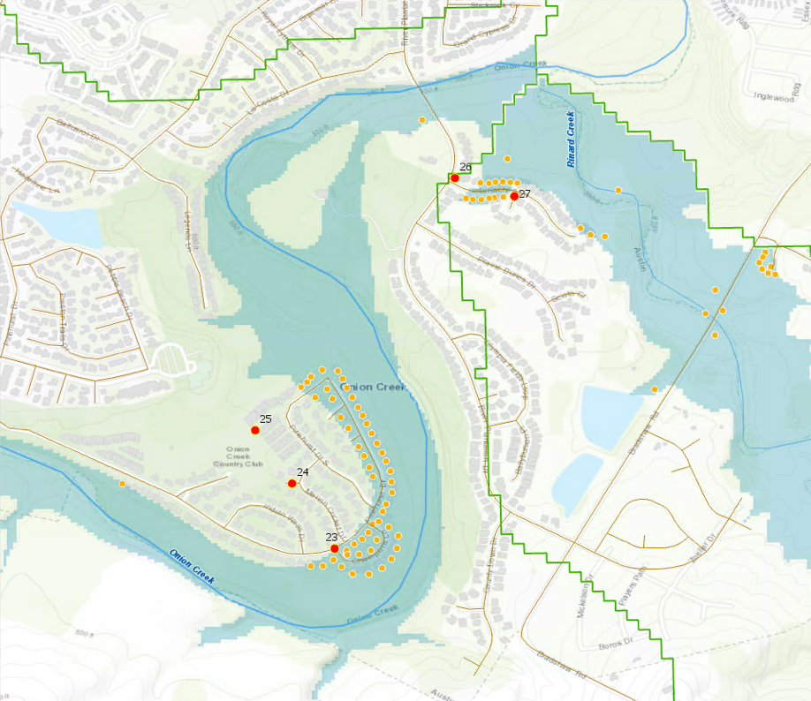
23 – Pinehurst Dr
& Champions Ln
27 – Port Rush Ct
Pin – (lat,long) – potential addrs impacted
23 – (30.131581, -97.784074) – 53 addrs
27 – (30.141330, -97.779103) – 30 addrs

Slide 25
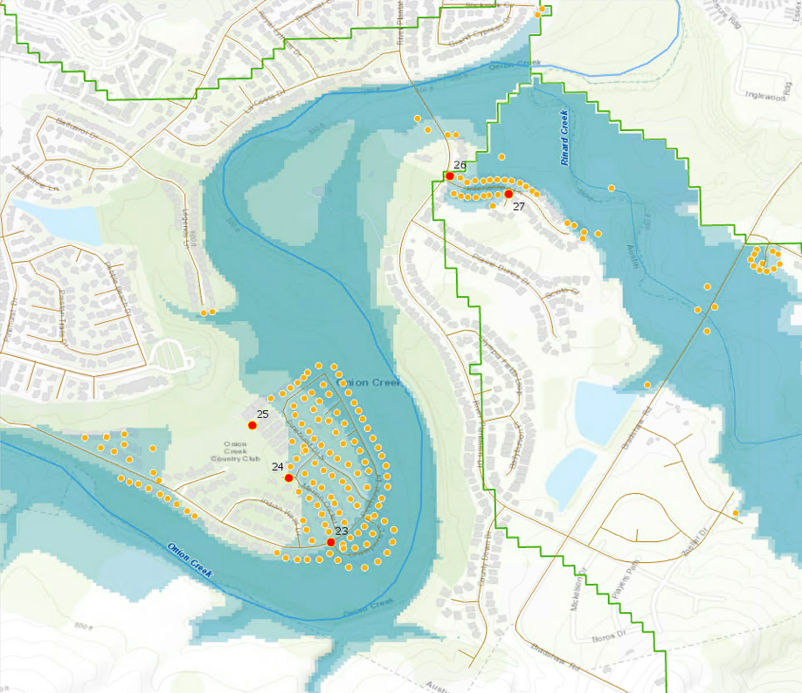
24 – Merion Cricket Ct
26 – River Plantation at Interlachen
Pin – (lat,long) – potential addrs impacted
24 – (30.133381, -97.785252) – 132 addrs
26 – (30.141835, -97.780748) – 45 addrs

Slide 26
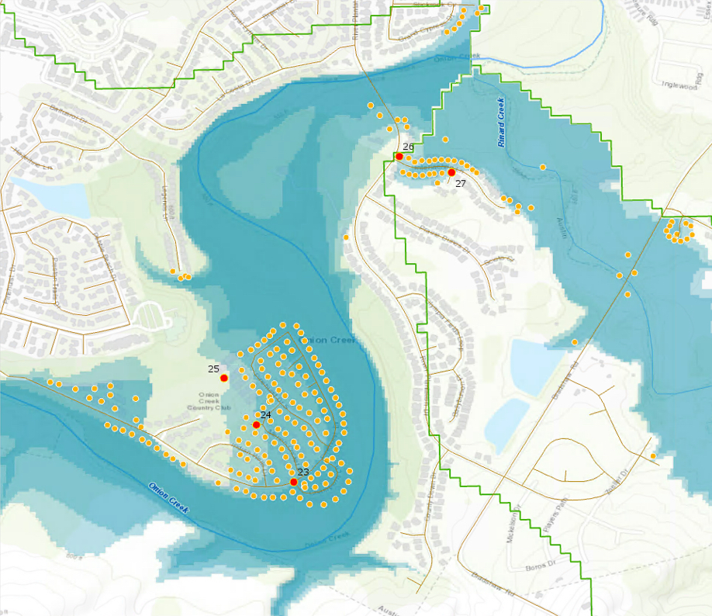
25 – 4621 Pinehurst Dr S
26 – River Plantation
at Interlachen
Pin – (lat,long) – potential addrs impacted
25 – (30.134856, -97.786274) – 166 addrs
26 – (30.141835, -97.780748) – 45 addrs

Slide 27
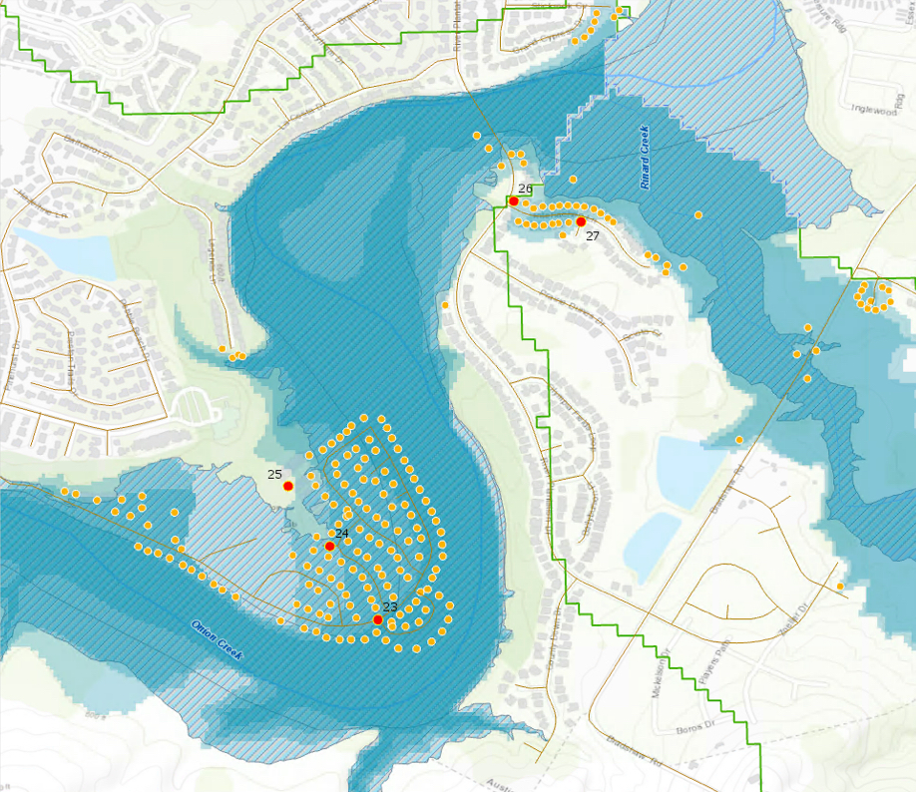
Comparison with FEMA National Flood Hazard Layer

Slide 28
Comparison with AFD Operational Map

Slide 29
Live Demonstration:
Collecting Observations for Real-Time Inundation Mapping

Slide 30
Pin to Flood Summary
This testing was done in areas well understood, engineered and mapped
Some flood test mapping was over/under actual flooded extent due to differences in resolution between 10m NED and 30m NHDPlus
Flood test mapping from HAND calculation was bounded by NHD medium resolution catchments; this fragmented the result
Future stream reach delineation will use 10m (or better) catchments and river geometry, and will consider longer reaches than NHD, for greater usefulness in emergency response

Slide 31
Three Themes for this Meeting:
Predictive flood mapping from the National Water Center
  Collaboration with WGRFC and TDEM
  What maps are needed?
  How will they be delivered?
Observational flood mapping at TDEM
  Point to Flood Map application
  Testing with first responders
  Building the mapping infrastructure at TDEM
Best available flood inundation maps for Texas
  Use engineering scale models where available, HAND elsewhere
  River Hydraulic Framework for combining maps from different sources

Slide 32
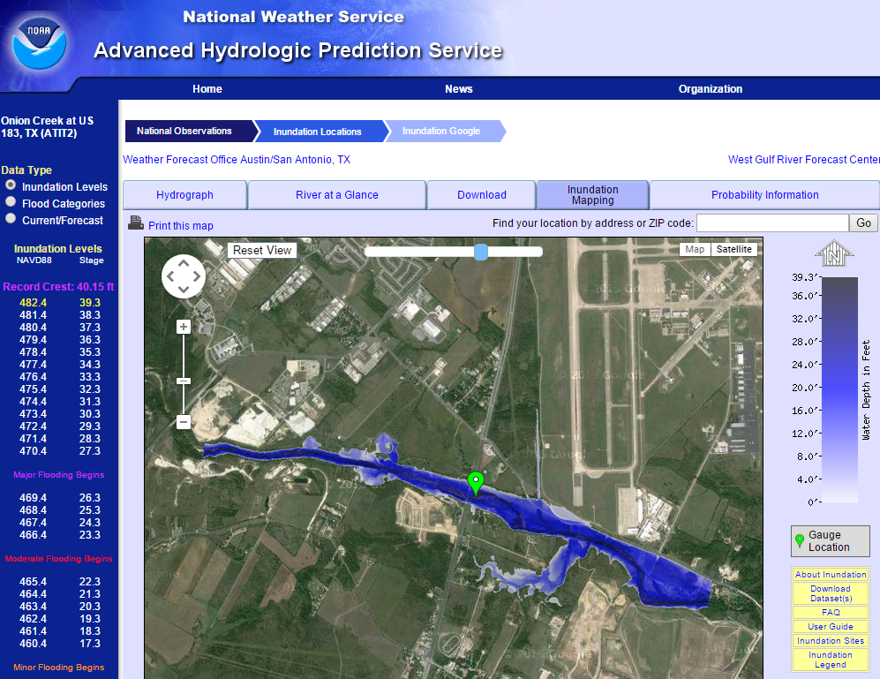
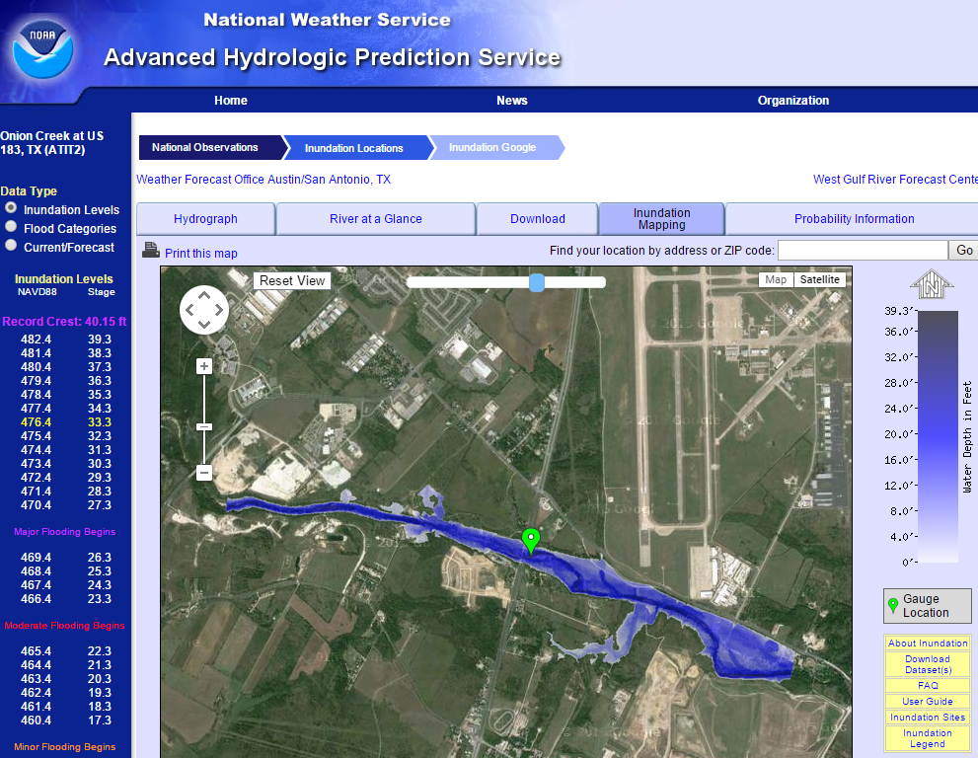
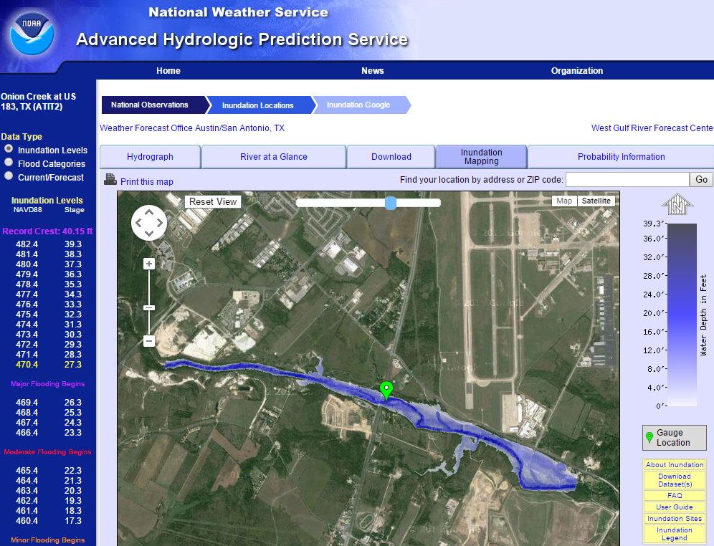

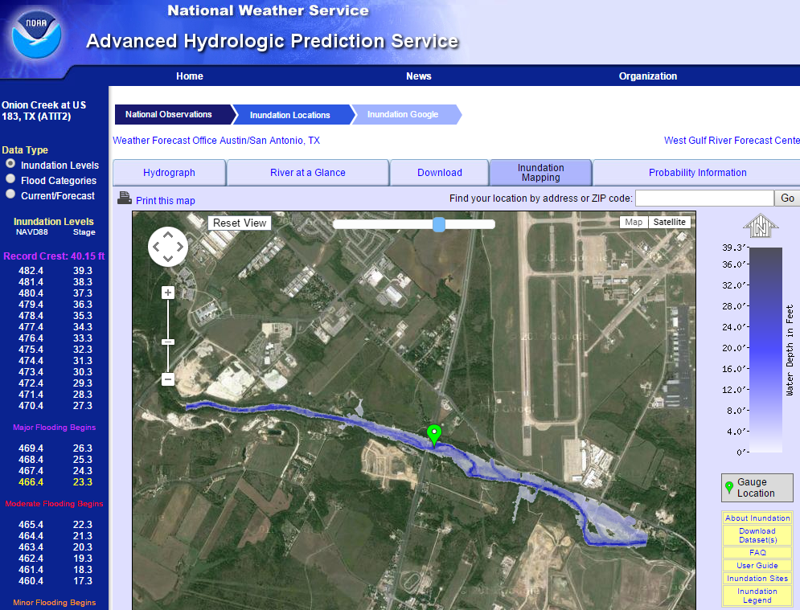
Existing Flood Maps from National Weather Service
http://water.weather.gov/ahps2/inundation/inundation_google.php?gage=atit2

Slide 33
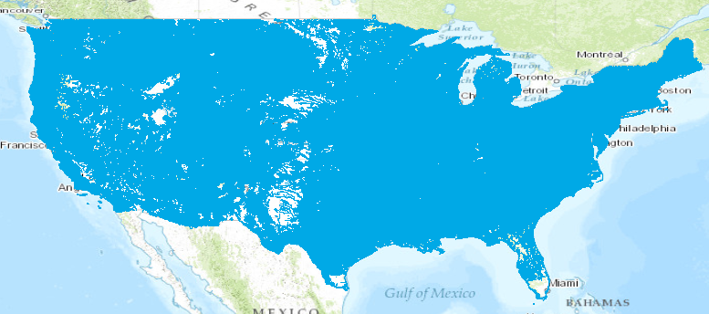
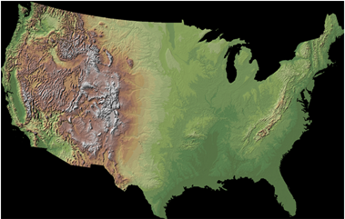

Continental-Scale Flood Inundation Mapping
Catchments and Flowlines
Height Above Nearest
Drainage (HAND)
(relative elevation of land
surface cell above cell in
stream to which it flows)
Digital Elevation Model

Slide 34
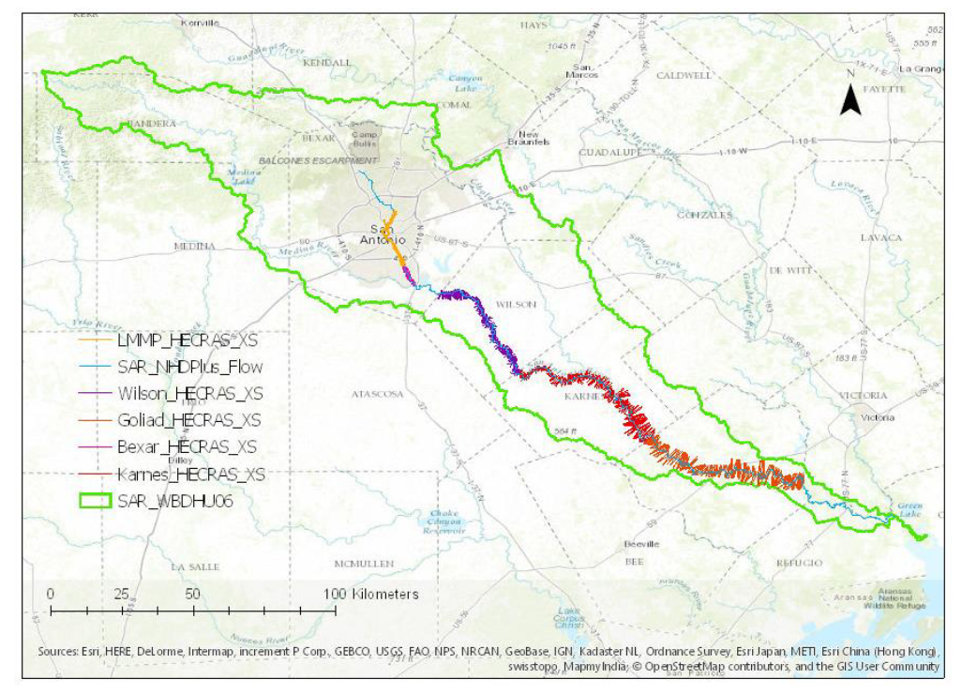
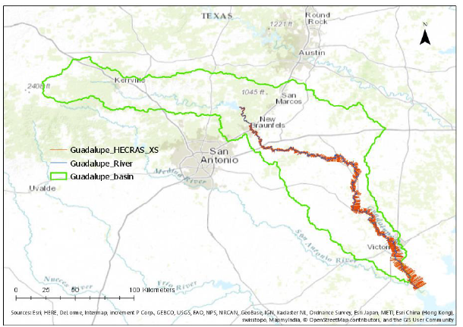
Detailed Flood Models of Main Stem Rivers
San Antonio River
(from San Antonio River Authority)
Guadalupe River
(from US Army Corps of Engineers,
Fort Worth District)

Slide 35
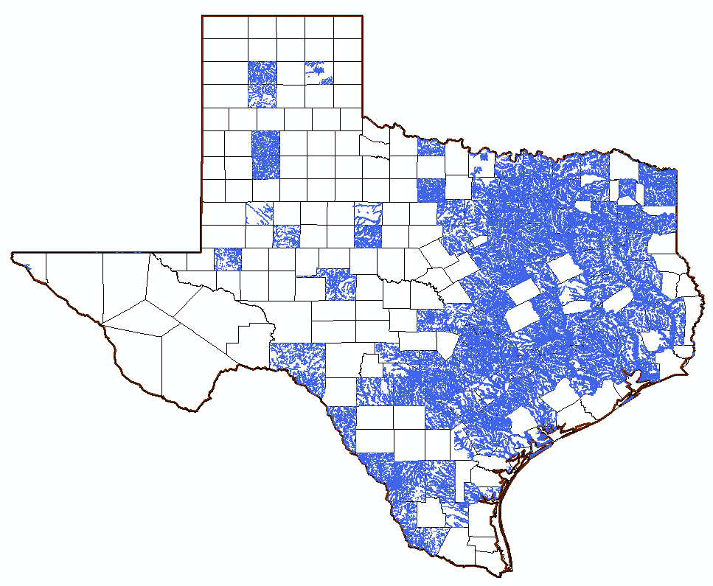
Flood Models from FEMA Flood Mapping Studies
Harris County
Notes:
Of the 254 counties in Texas about 120 have the FEMA Flood Hazard Layer. The National Flood Hazard Layer (NFHL) dataset represents the current effective flood data for the country, where maps have been modernized. The default base map is from a USGS service and conforms to FEMA's specification for horizontal accuracy. This is used by homeowners, engineers, architects, surveyors, insurance professionals, lenders, floodplain managers.

Slide 36
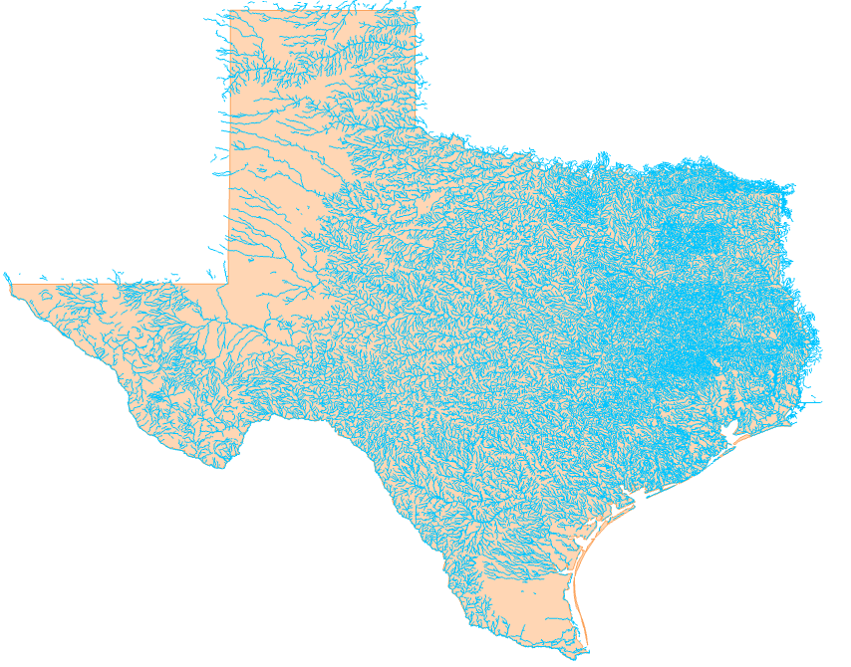
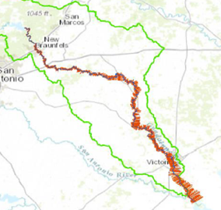
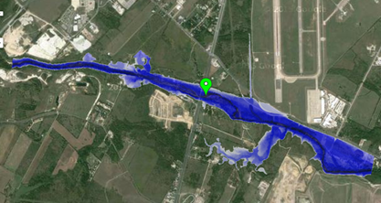
Best Available Flood Inundation Mapping
Use mapping from
engineering scale models
where available,
HAND elsewhere
190,000 miles of
streams and rivers
in Texas
National River Hydraulic Framework for Flood Inundation Mapping

Slide 37
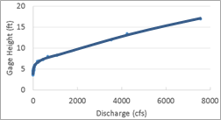
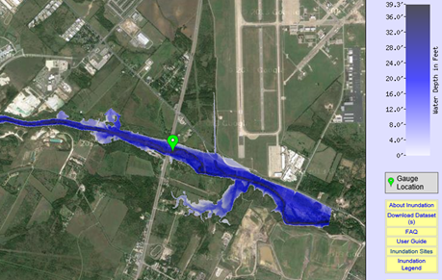
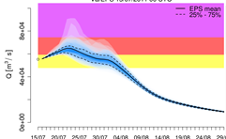
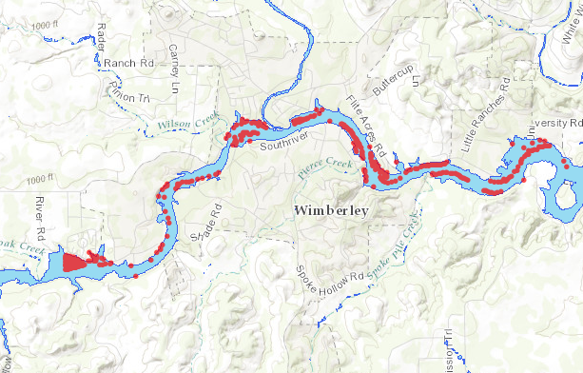
Uncertainty Assessment
Uncertainty in discharge – uncertainty in depth – uncertainty in inundation – uncertainty in impact (Monte Carlo simulation derived from USACE risk assessment procedure)
Depth
Rating curve
Depth
Discharge
Discharge
Inundation
Discharge
Flooded
Structures
Time
Impact
Uncertainty in discharge
Uncertainty in impact

Slide 38
Three Themes for this Meeting:
Predictive flood mapping from the National Water Center
  Collaboration with WGRFC and TDEM
  What maps are needed?
  How will they be delivered?
Observational flood mapping at TDEM
  Point to Flood Map application
  Testing with first responders
  Building the mapping infrastructure at TDEM
Best available flood inundation maps for Texas
  Use engineering scale models where available, HAND elsewhere
  River Hydraulic Framework for combining maps from different sources

