Slide 1
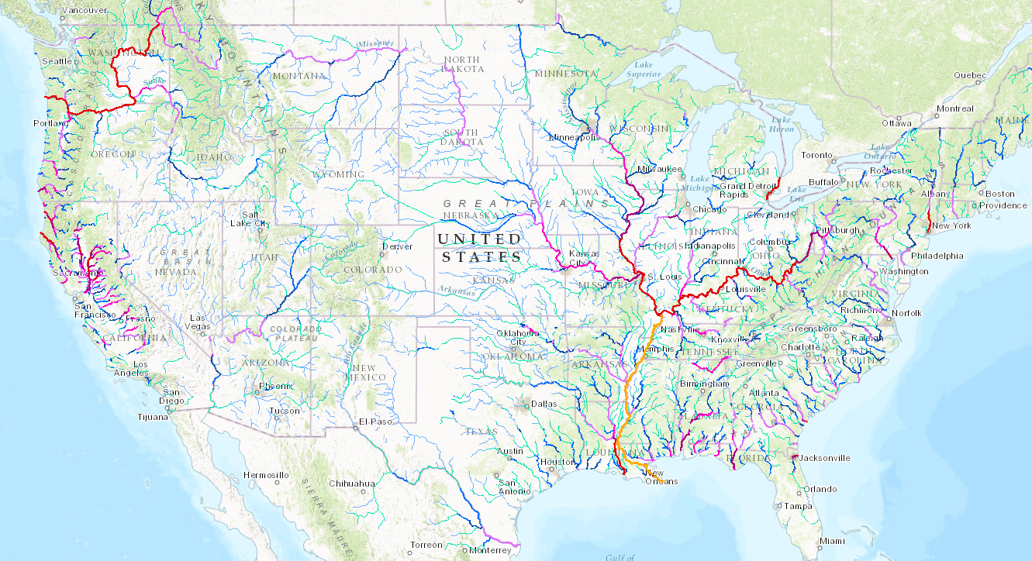
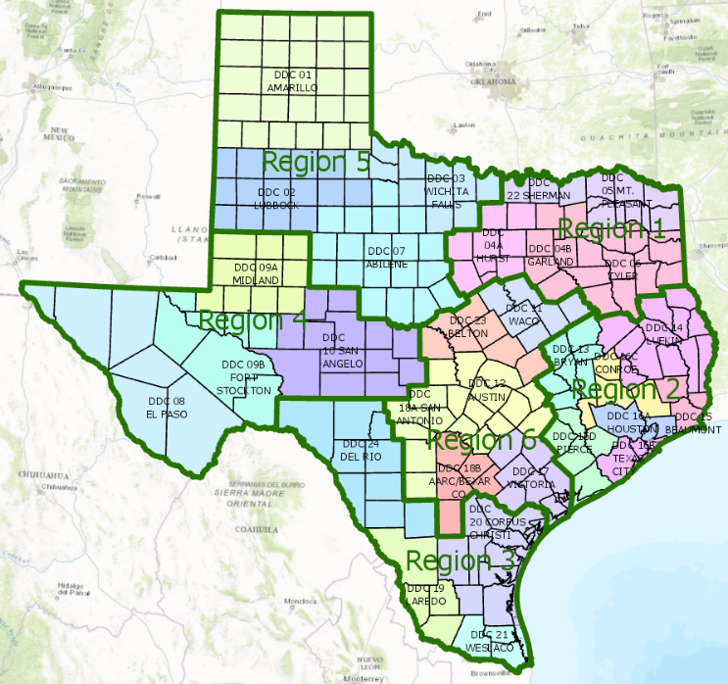
Applying the National Water Model in Texas
David R. Maidment
Center for Research in Water Resources
University of Texas at Austin
Presentation for TWDB Water for Texas Conference, Austin,Texas, 22 January 2017
Acknowledgments: Ed Clark, National Weather Service; Yan Liu, University of Illinois;
David Tarboton, Utah State University; David Arctur, Harry Evans, Xing Zheng, University of Texas
at Austin; City of Austin, National Weather Service, NCAR, CSEC, Texas Division of Emergency
Management, ESRI, Kisters, National Science Foundation, colleagues and students at UT Austin.

Slide 2
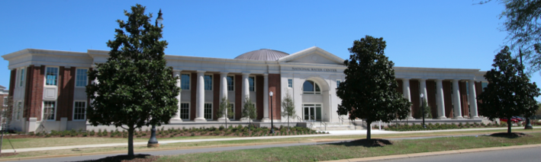
The Opportunity
New National Water Center established on the Tuscaloosa campus of University of Alabama by the National Weather Service and federal agency partners
Has a mission to assess hydrology in a new way at the continental scale for the United States

Slide 3
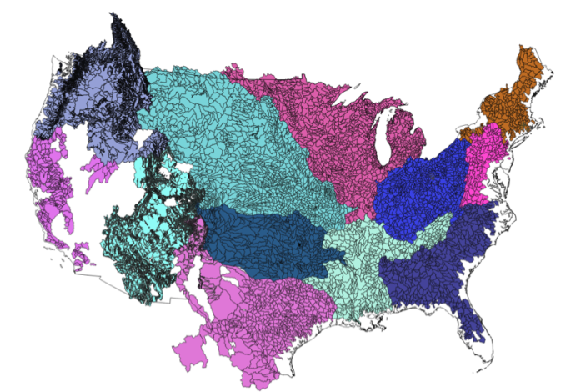
NWS River Forecast Centers (RFCs)
Prepare river and flood forecasts using models based on average basin characteristics
Provide forecast guidance to Weather Forecast Offices (WFOs)
Issue daily stage and streamflow forecasts, rainfall and drought data and information, and flash flood guidance
Work with water managers and other Federal Agencies
6600 sub-basins in continental US
3
Notes:
RFC Summary

Slide 4
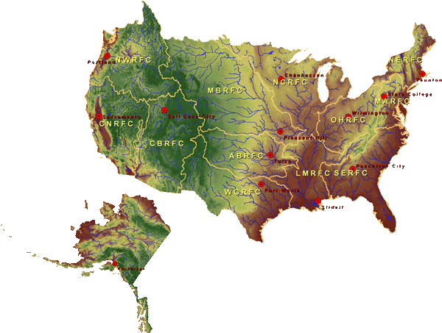
Centralized Water Forecasting
National Water Center
Notes:
TRANSITION INTO METHODS
FY15 PROJECT HAS FOUR CORE COMPONENTS
RFC archive
Model evaluation service
Modeling testbed
Centralized modeling demonstration

Slide 5
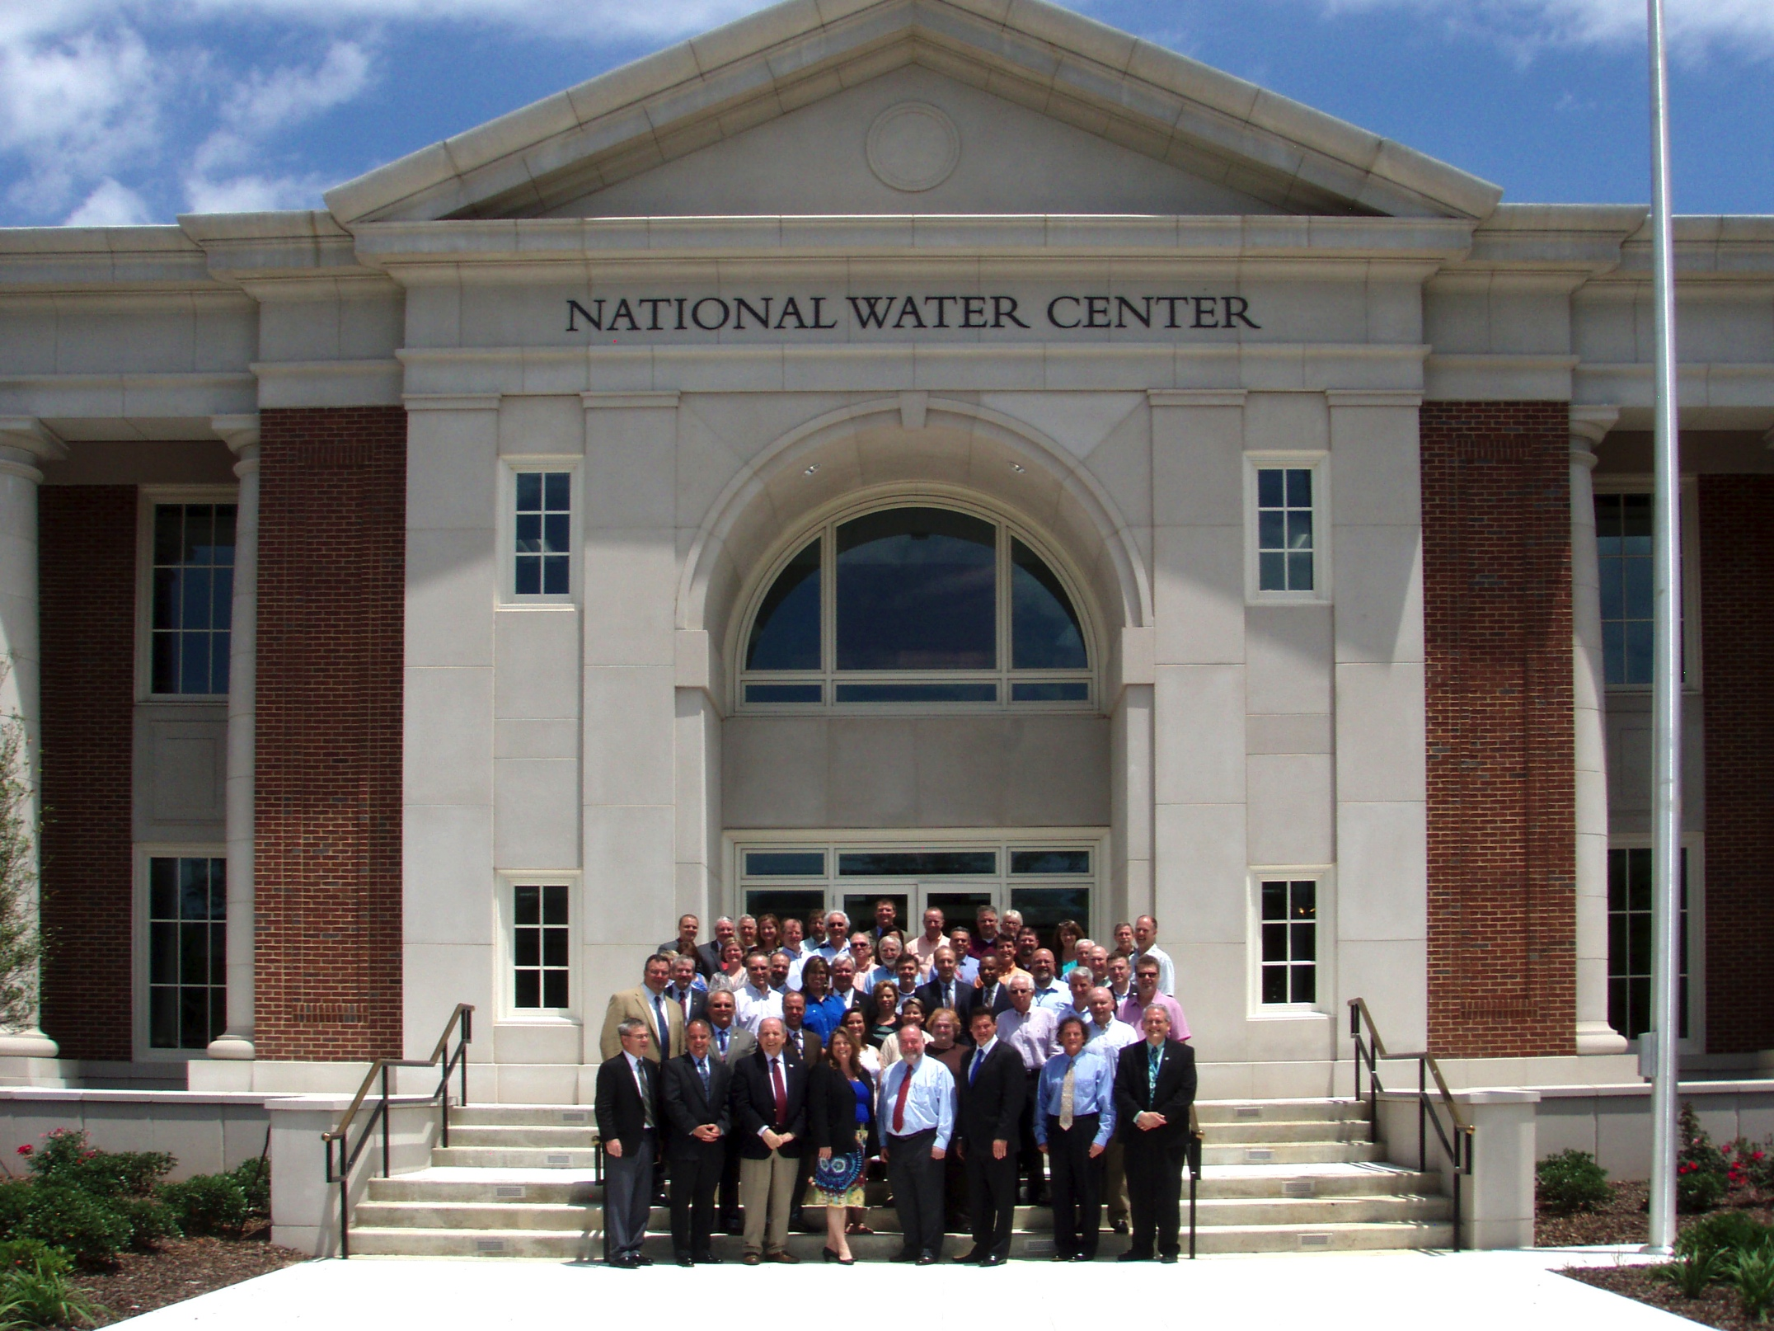
This meeting led to an engagement between the academic community of the United States and the National Weather Service to help build the National Water Model
Inaugural Meeting – May, 2014

Slide 6
National Water Prediction Model Configurations
Operational on 16 August 2016
Four Forecasting Horizons for National Water Model
Analysis & Assimilation
Short-Range
‘Flood Prediction’
Medium Range
‘Flow Prediction’
Long Range
‘Water Resources’
Cycling Frequency
Hourly
3-Hourly
Daily
~Daily (x16)
Forecast Duration
- 3 hrs
0-2 days
0-10 days
0-30 days
Spatial Discretization & Routing
1km/250m/NHDPlus Reach
1km/250m/NHDPlus Reach
1km/250m/NHDPlus Reach
1 km/catchment /NHDPlus Reach
Meteorological Forcing
MRMS blend/ HRRR-NAM bkgnd.
Downscaled HRRR /RAP/NAM blend
Short-range + Downscaled GFS
Downscaled & bias-corrected CFS

Slide 7
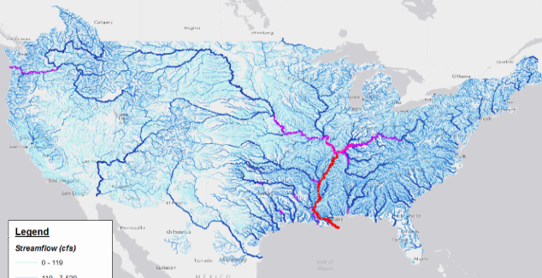
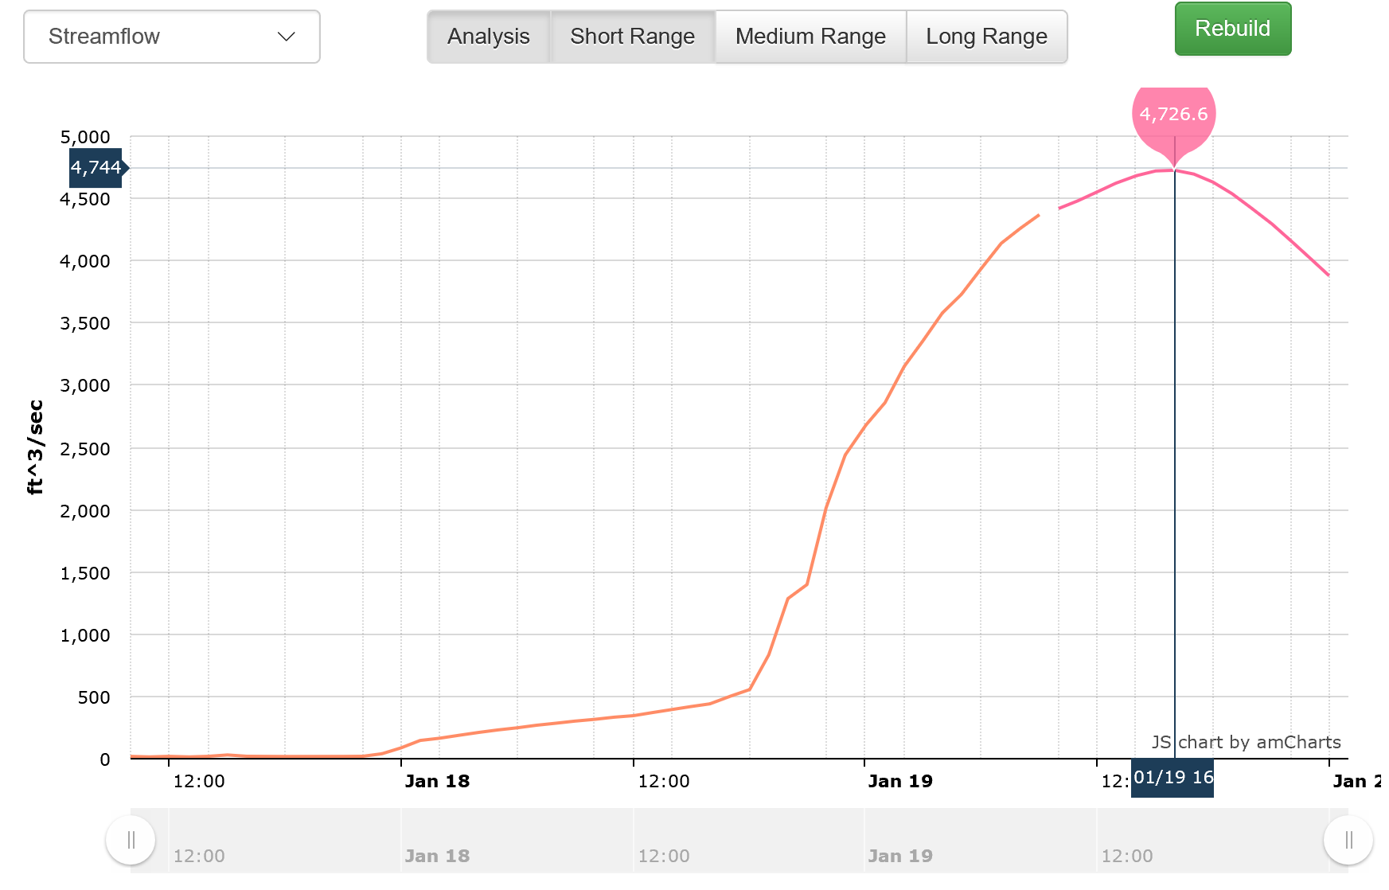
Forecasts from National Water Model
2.7 million
stream reaches
San Bernard River near Boling, Texas
10AM 19 Jan 2017
Now
Analysis
Best estimate of current conditions
Hourly for 15 hours ahead
Short Range
3 Hourly for 10 days ahead
Medium Range
Daily for 30 days ahead
Ensemble of 4 forecasts each 6 hours (16 forecasts total)
Long Range
(5 TB of forecast information per day)

Slide 8
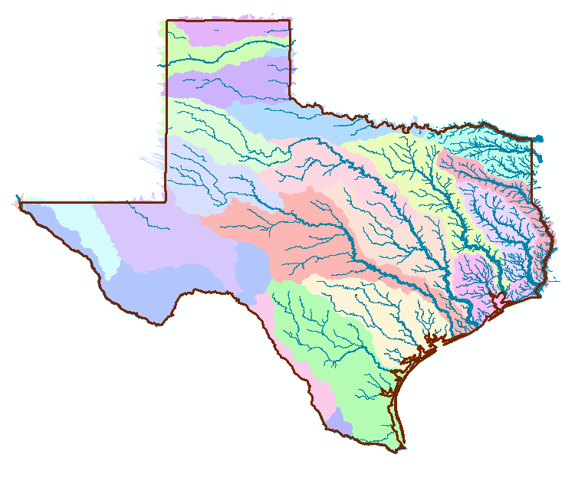
NOAA National Water Model in Texas
Continuous real-time water forecasting
on 190,000 miles of streams and rivers
divided into 98,000 reaches. Data are
publicly accessible now
San Bernard River near Boling, Texas
10AM 19 Jan 2017
A transformative improvement for flood resilience in our state!

Slide 9
Texas Division of Emergency Management
State Operations Center
Regional Coordinators
Disaster Districts
Counties
Chief Nim Kidd Director, TDEM

Slide 10
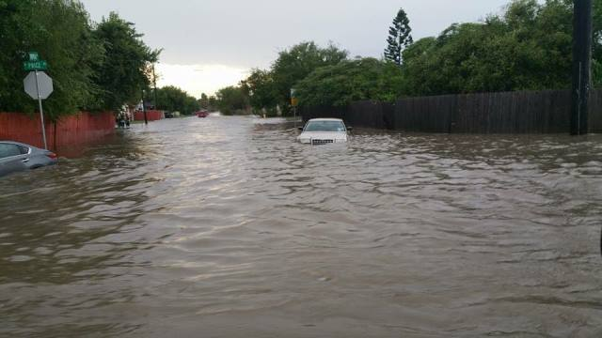
Flood Emergency Response in Texas
Local governments (counties, cities, or towns) respond to emergencies daily using their own resources
They rely on mutual aid and assistance agreements with neighboring jurisdictions
When local jurisdictions cannot meet incident response resource needs, they may ask the state for assistance

Slide 11
Information Flow During a Flood Emergency
Weather and
Flood Forecasting
Flood Impacts
Assessment of
Conditions
Communications
cycle
Emergency
Response

Slide 12
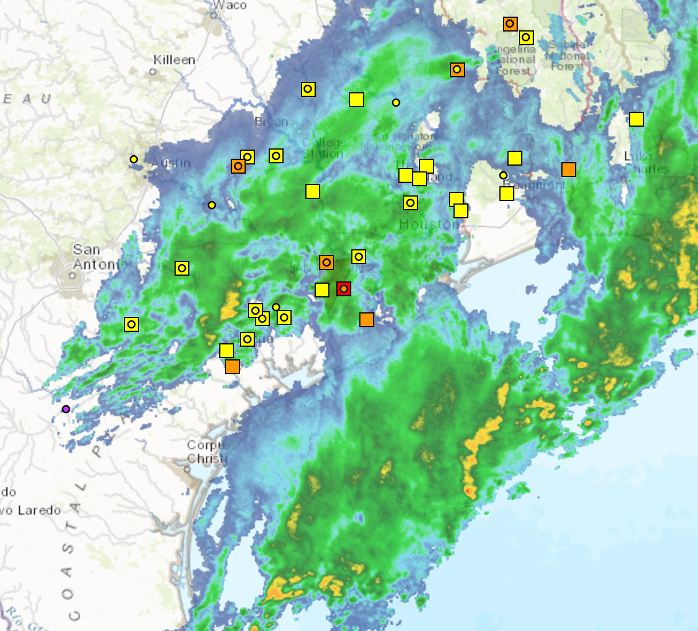
Storm in San Bernard Basin, 18 Jan 2017
San Bernard River near Boling
http://gisdev.srh.noaa.gov/rfcdss2.html

Slide 13
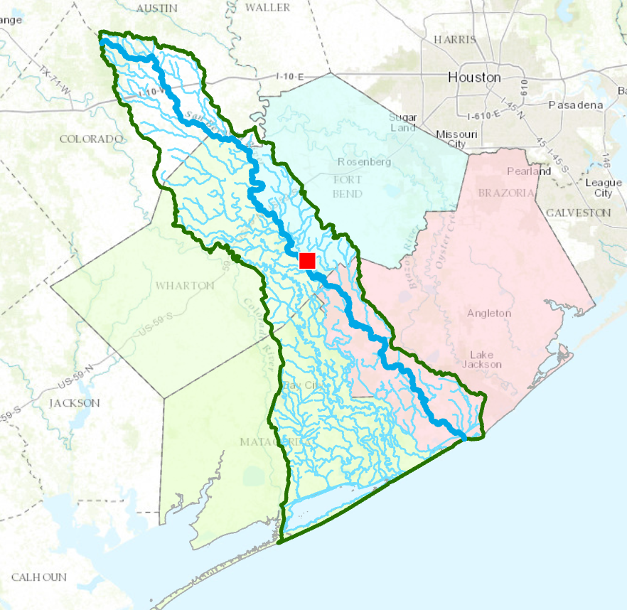
Area of Concern: San Bernard Basin in Brazoria, Fort Bend, Wharton and Matagorda Counties in Texas
San Bernard River
Fort Bend
San Bernard River near Boling
Wharton
Brazoria
Matagorda
San Bernard Basin
NWS Forecast Point BOLT2

Slide 14
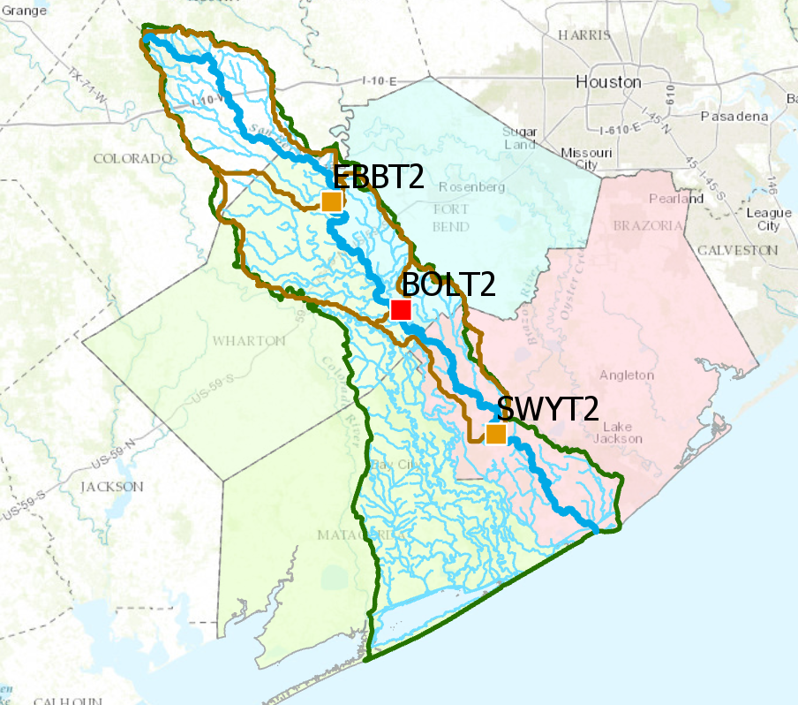
NWS Forecast Points and Basins in San Bernard Basin

Slide 15
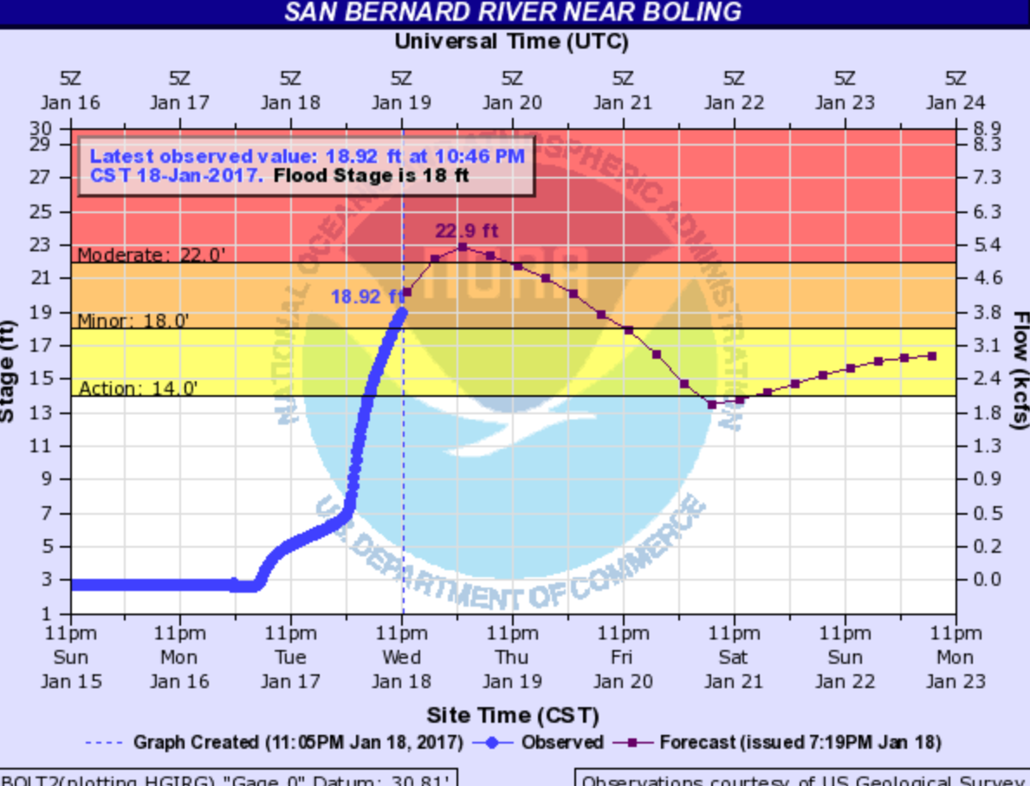
West Gulf River Forecast Center Largest Impact: Forecast of Moderate Flooding (at BOLT2) (made at 7:19PM 18 Jan 2017)
http://water.weather.gov/ahps2/hydrograph.php?wfo=hgx&gage=bolt2

Slide 16
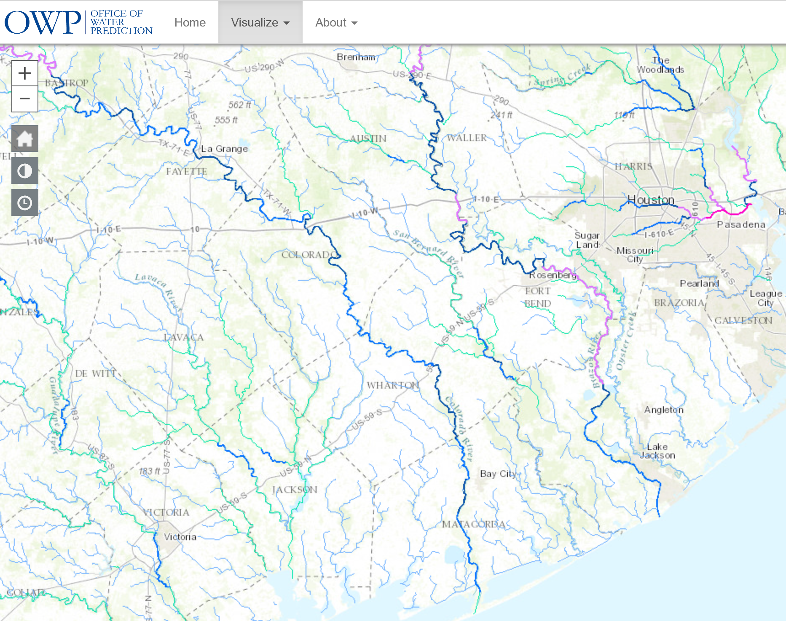
National Water Model Forecast Map
San
Bernard
River
Fort
Bend
Wharton
Brazoria
Matagorda
http://water.noaa.gov/map

Slide 17
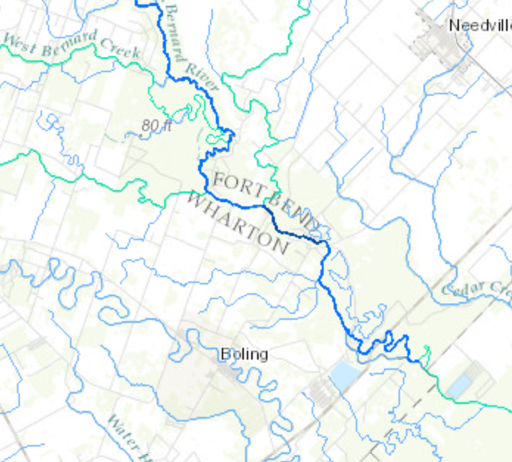
Forecast of National Water Model for San Bernard River at Boling (peak of 4727 cfs at 10AM) (made at 3 AM Central Time, accessed at 5:30AM 18 Jan 2017)

Slide 18
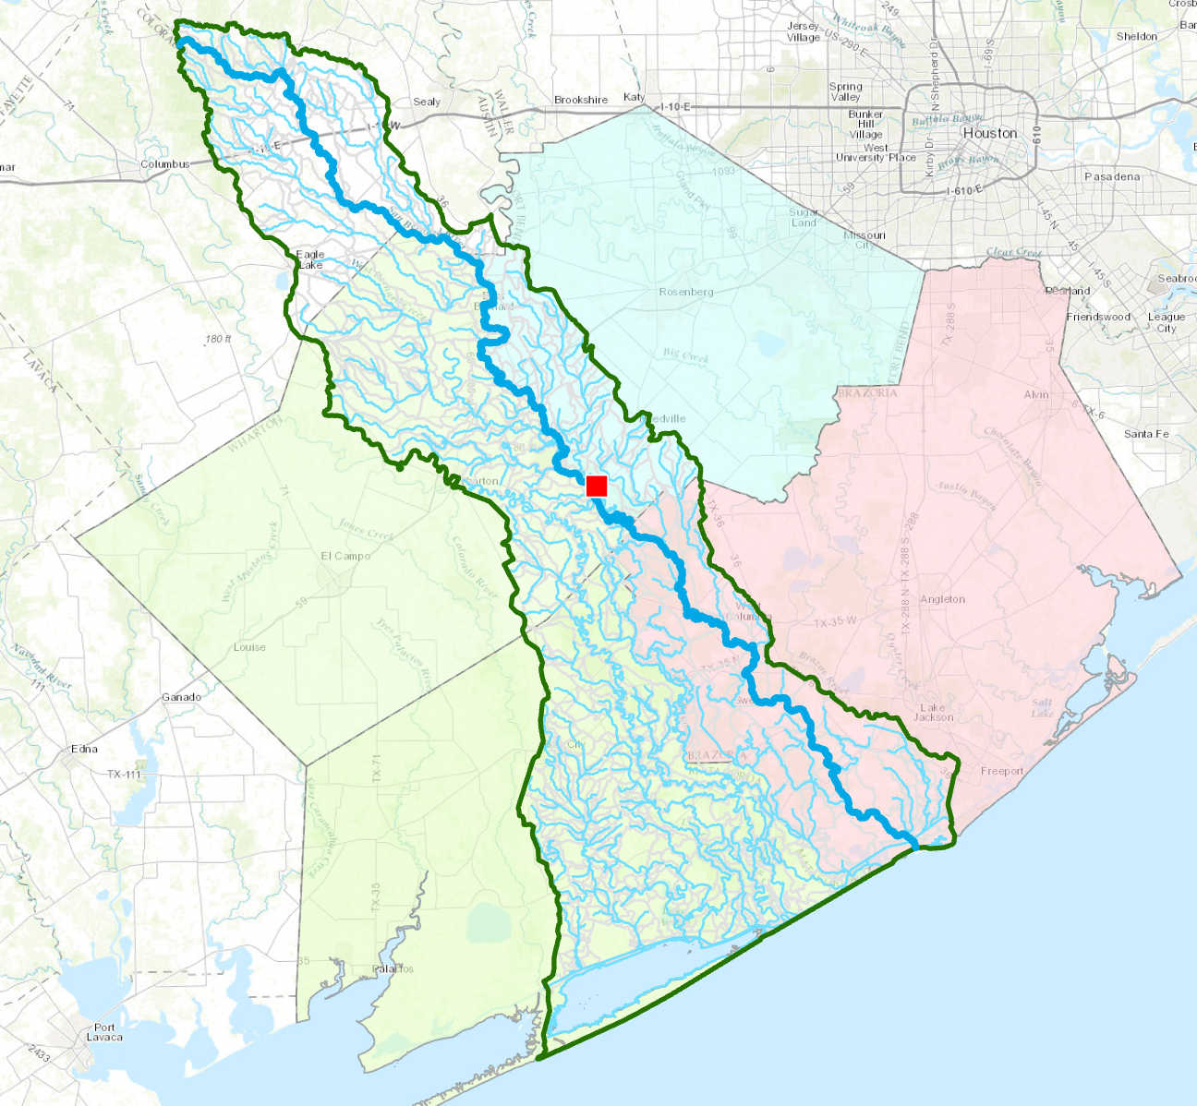
National Water Model in San Bernard Basin (800 catchments and stream reaches)
Forecasts are available
for each individual stream

Slide 19
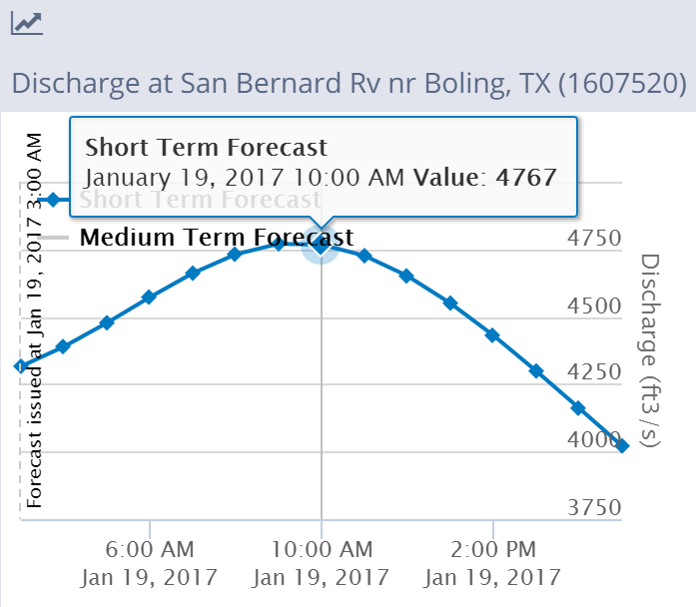
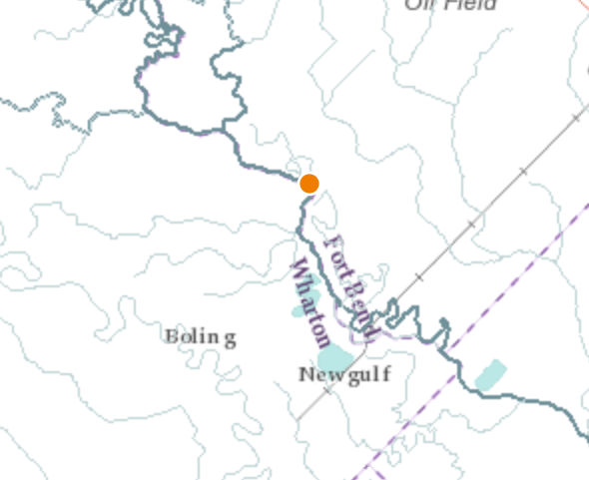
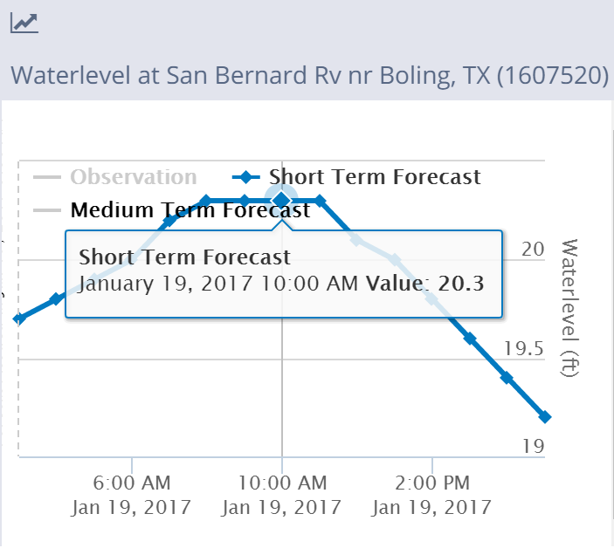
TDEM Flood Inundation Mapping System
Forecast of discharge from National Water Model
Converted to depth using a synthetic rating curve
Discharge = 4767 cfs (from National Water Model)
San Bernard River near Boling, TX
Water Depth = 20.3 ft
(from synthetic rating curve)
(these data are from the 2AM NWM forecast because
of the time lag to do the conversion to depth)

Slide 20
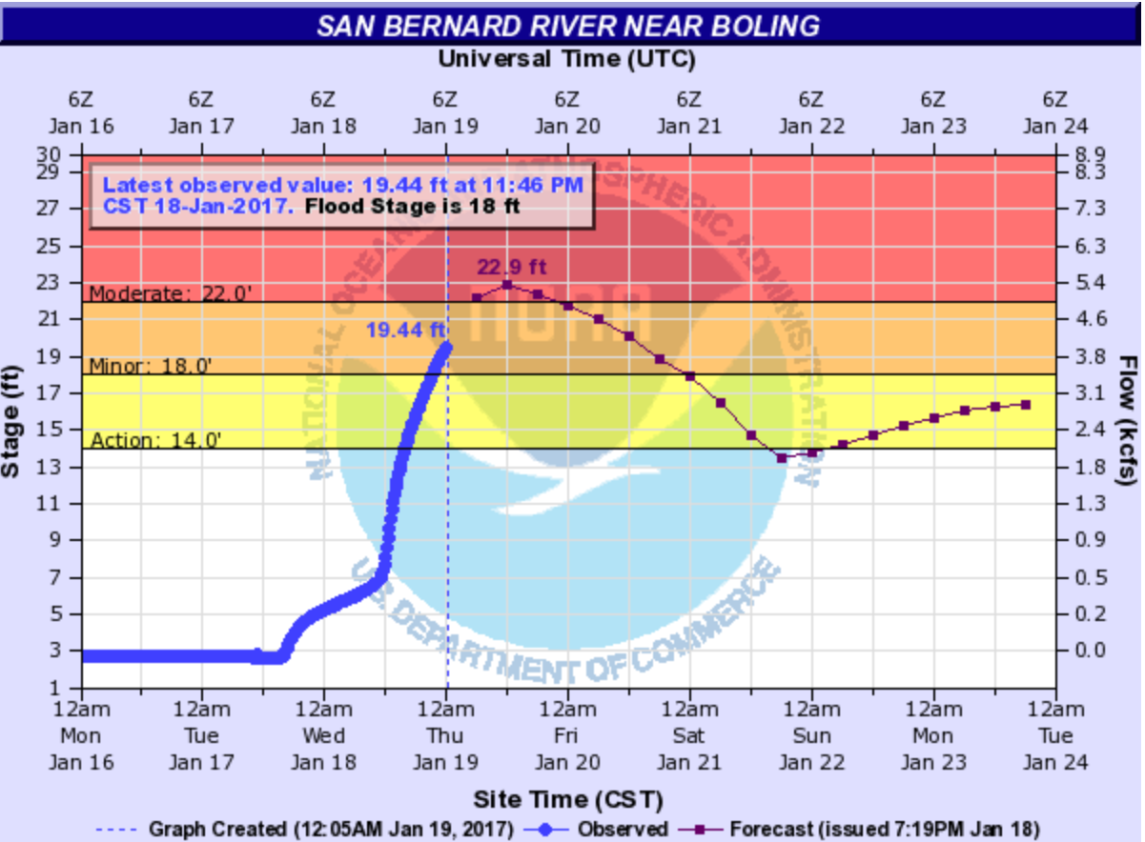
Comparison of WGRFC and NWM/TDEM forecast of Water Depth on San Bernard River near Boling, TX
Water Depth = 20.3 ft
(from synthetic rating curve)
Water Depth in Stream from
synthetic rating Curve applied to
National Water Model forecast = 20.3 ft
Stage Height of Forecast = 22.9 ft
Minus Stage Height at Zero Discharge ~ 2.8 ft
Equals Water Depth in Stream of 20.1 ft from WGRFC Forecast
There is less than 1 foot difference between these two forecast depths!

Slide 21
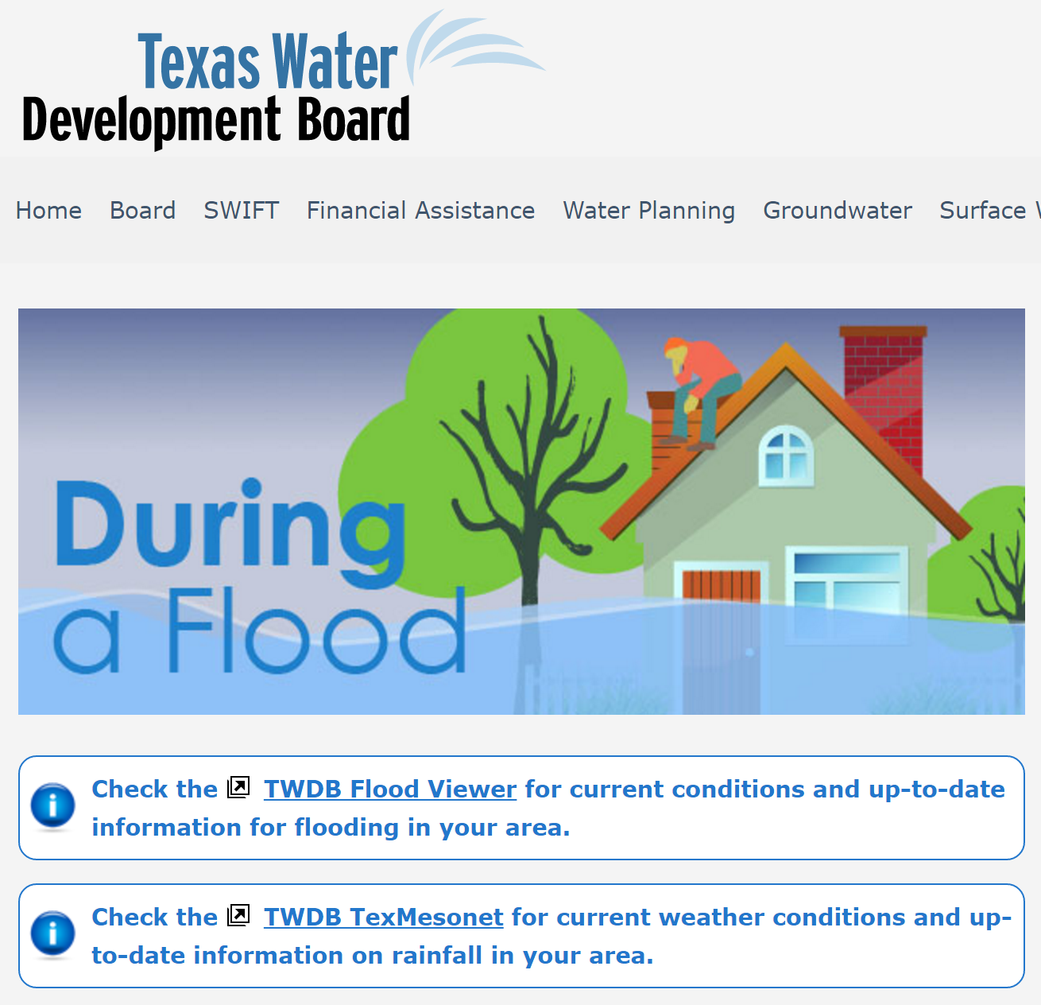
Lesson Learned: Need Local Intelligence
800
stream
reaches
Need for information
from impacted areas
during floods
Crowd sourcing
Twitter
Send a photo or video
Georeference this info
Use it to update
predictions

Slide 22
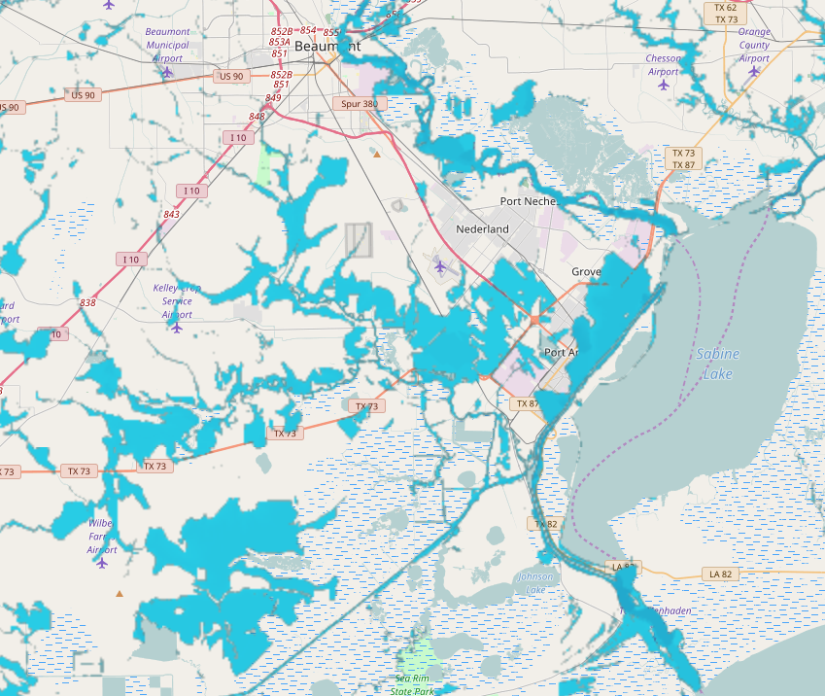
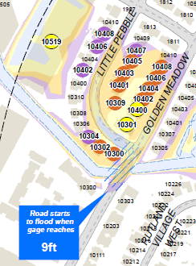
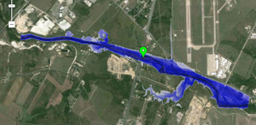
Flood Response Mapping
Level 1 – approximate inundation mapping
Level 2 – approximate impact mapping
Level 3 – detailed inundation mapping
Level 4 – detailed impact mapping
Uses National Elevation Dataset
and rating curves
Impact at County scale
Uses LIDAR and
detailed hydraulic modeling
Impact at Stream Reach scale

Slide 23
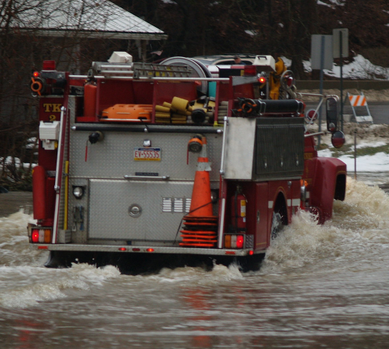
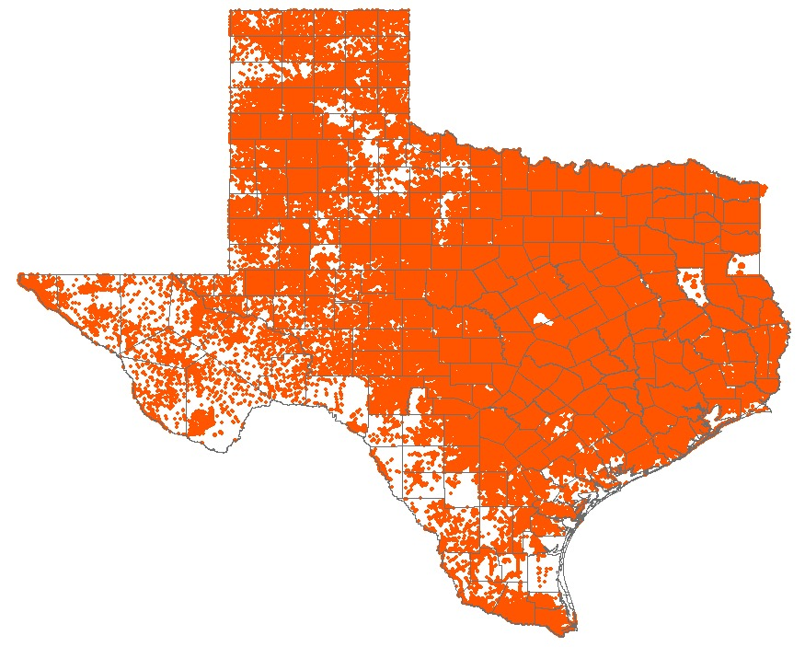
Texas Address Points
8.6 million points
Can TNRIS help to
maintain these data?
Used for dispatching emergency
response vehicles in 911 systems

Slide 24
What is a Floodplain?

Slide 25
Method for Determining Flood Risk: Height Above Nearest Drainage (HAND)
Flooding occurs when Water Depth is greater than HAND
Address Point at a home
Flood
HAND
Normal

Slide 26
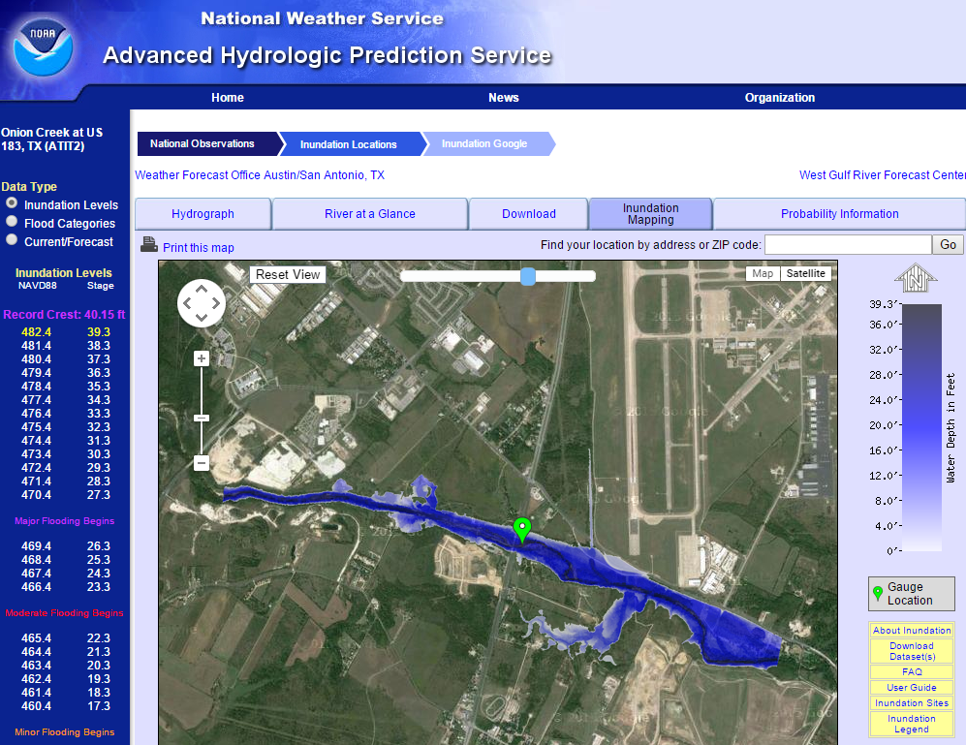
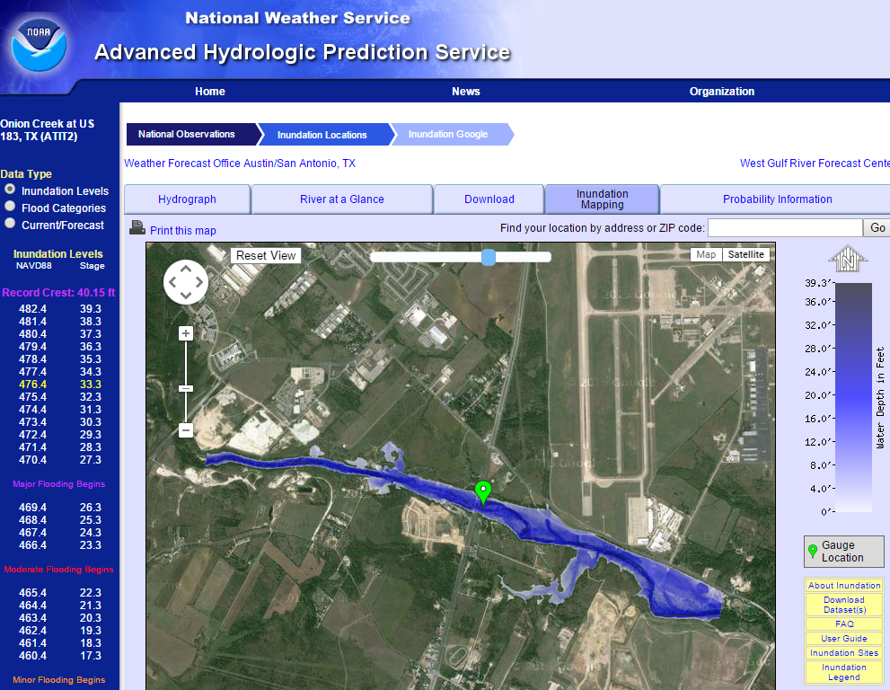
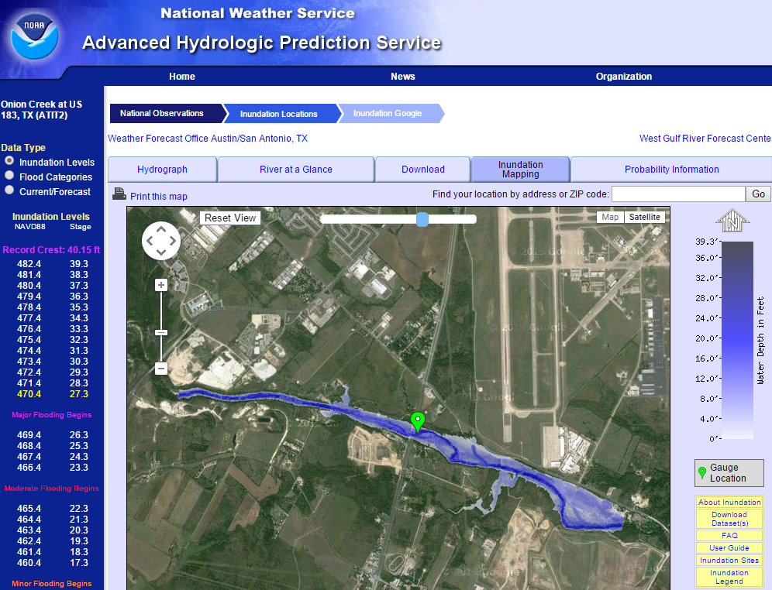
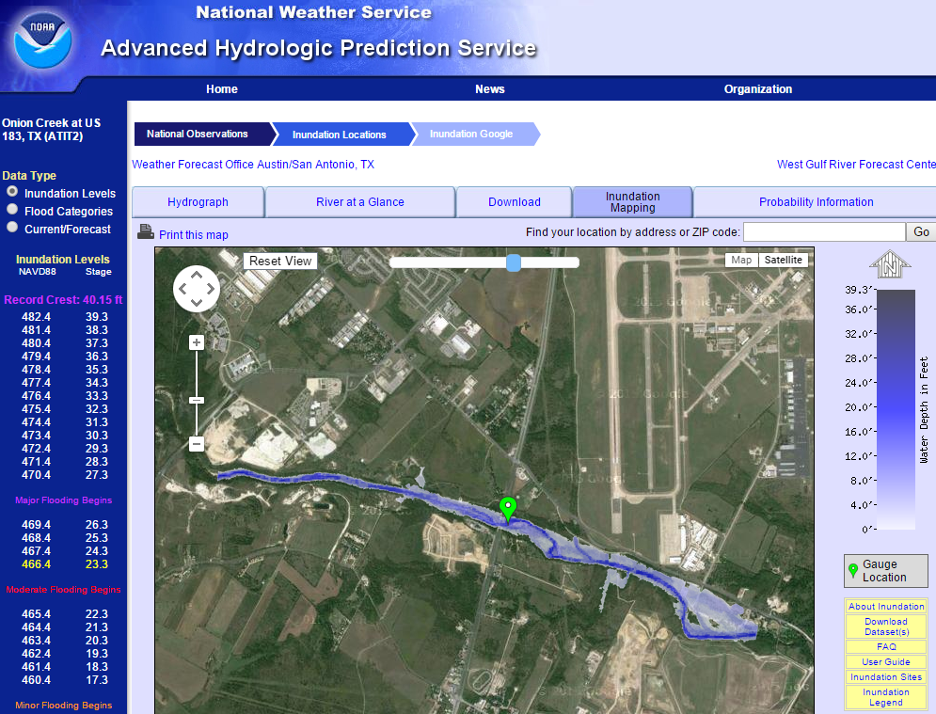
Real-Time Flood Inundation Mapping Onion Creek at Highway 183
http://water.weather.gov/ahps2/inundation/inundation_google.php?gage=atit2

Slide 27
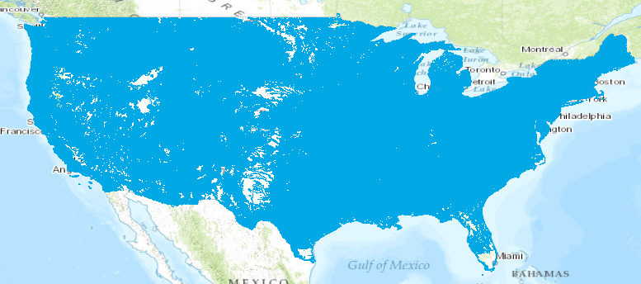
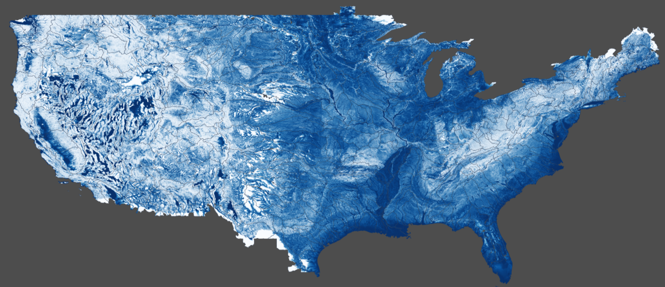
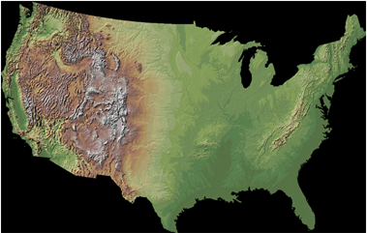
Continental-Scale Flood Inundation Mapping
Catchments and Flowlines
Height Above Nearest
Drainage (HAND) (relative elevation of land
surface cell above cell in
stream to which it flows)
Digital Elevation Model

Slide 28
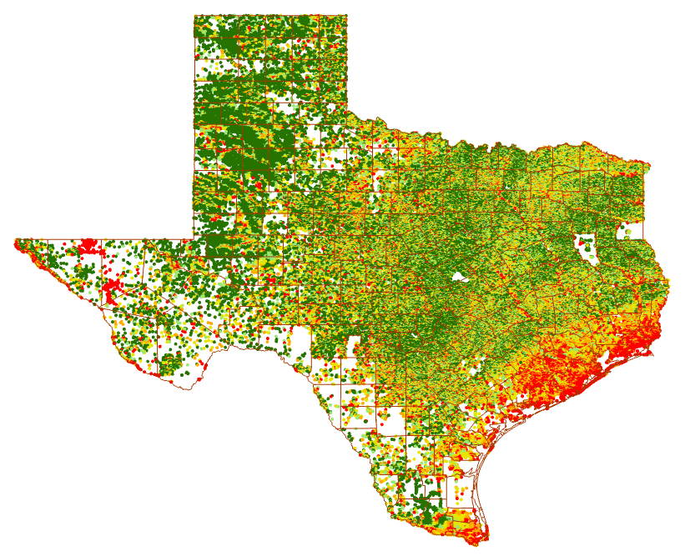
Height Above Nearest Drainage for Texas

Slide 29
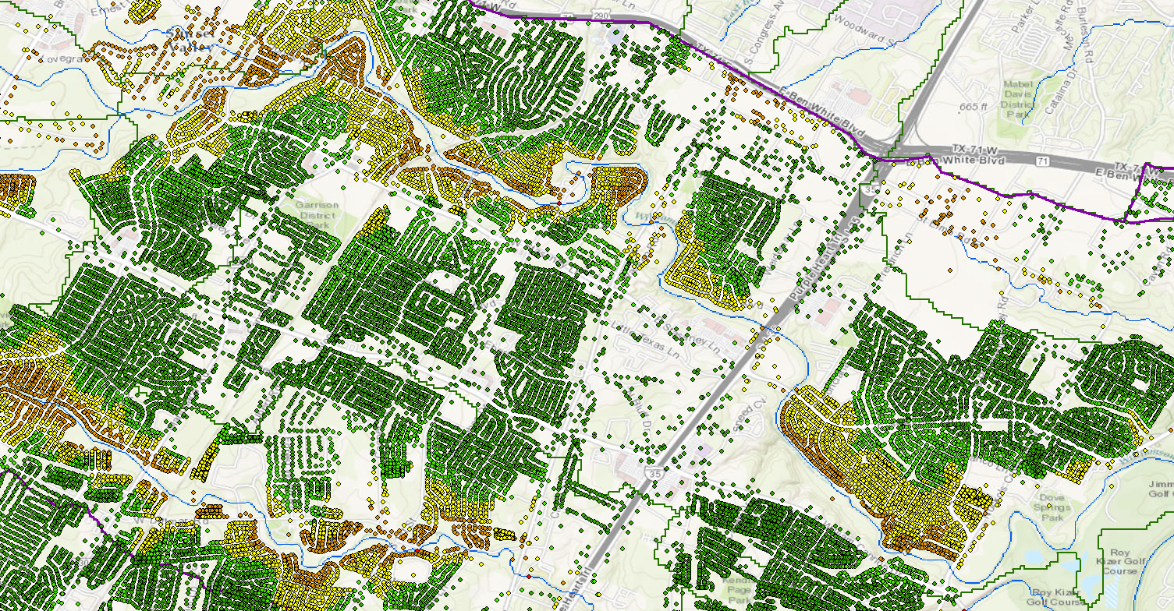
Height Above Nearest Drainage for Address Points in Williamson Creek

Slide 30
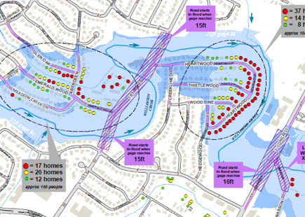
This Information Can be Used for Detailed Flood Response Planning by First Responders

Slide 31
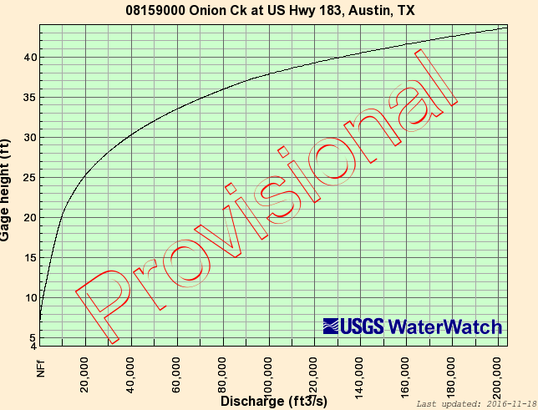
USGS Rating Curve at a Stream Gage
Onion Creek at Highway 183
Measure
Water Level
Determine Discharge

Slide 32
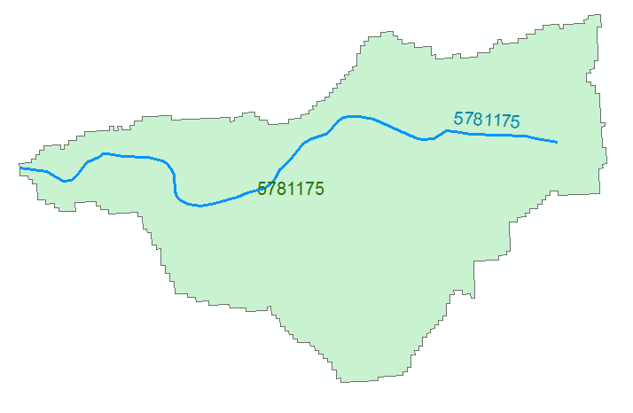
Reach Hydraulic Parameters
Comid | y | A | R | P | T | V | Ab | As
5781175 | 3
5781175 | 4
A_{s}
Surface Area
Wetted Bed Area
L
V
Volume
A_{b}
T
$$A=\frac{V}{L}$$
Cross Section Area
Depth
y
A
P
P$=\frac{Ab}{L}$
Wetted Perimeter
T$=\frac{As}{L}$
Top Width
R$=\frac{A}{P}$
Hydraulic Radius

Slide 33
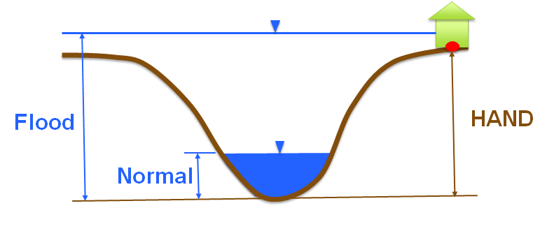
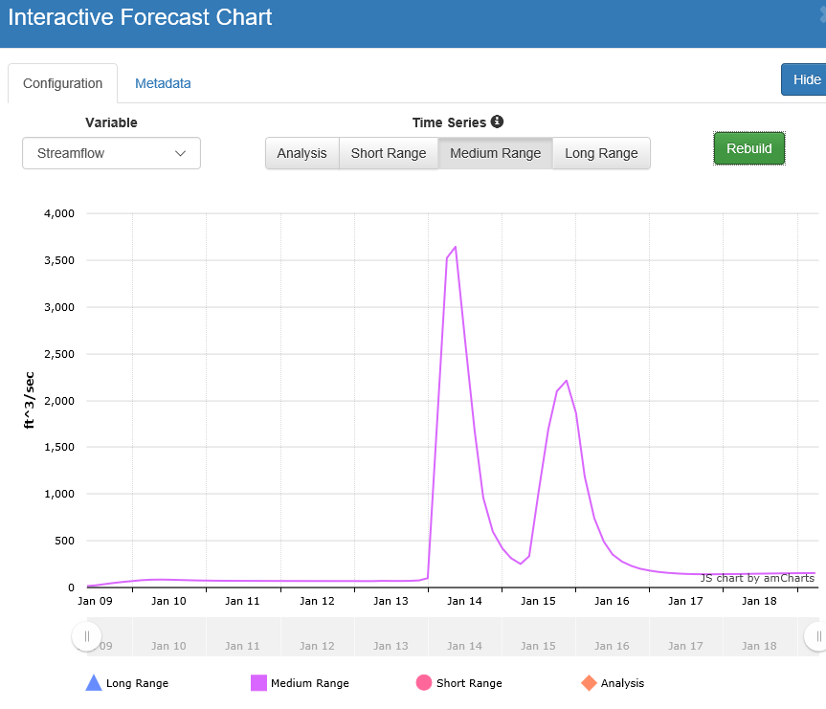
Rating Curve – Connects Discharge with Depth
Flood Depth, y (ft)
$$Q=\frac{1.49}{n}AR^{2/3}S_{o}^{1/2}$$
Forecast Discharge, Q,
from National Water Model

Slide 34
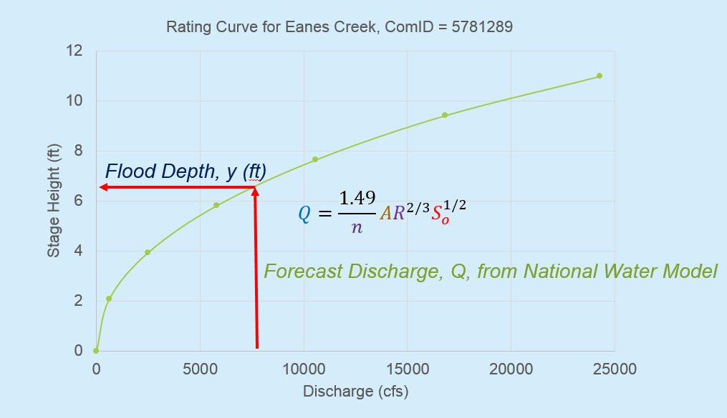
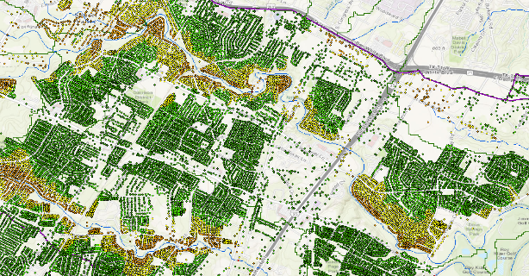
Continental-Scale Flood Inundation Mapping
1. Forecast discharge with National Water Model
2. Convert discharge to depth using rating curve
3. Convert depth to inundation using HAND
4. Add Address Points to assess impact
1
2
3
4

Slide 35
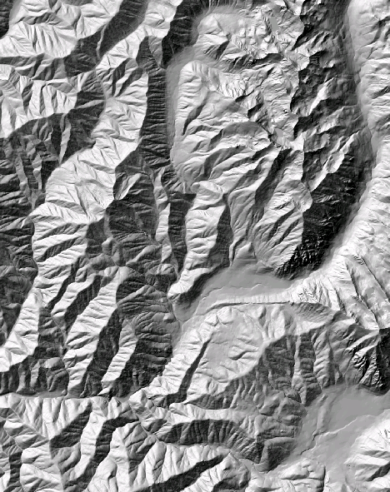
The challenge of increasing Digital Elevation Model (DEM) resolution
1980’s DMA 90 m
10² cells/km²
1990’s USGS DEM 30 m
10³ cells/km²
National Elevation Dataset
2000’s NED 10-30 m
10⁴ cells/km²
LIDAR
2010’s LIDAR ~1 m
10⁶ cells/km²

Slide 36
Flood Response Mapping
Level 1 – approximate inundation mapping
Level 2 – approximate impact mapping
Level 3 – detailed inundation mapping
Level 4 – detailed impact mapping
Uses National Elevation Dataset
and rating curves
Impact at County scale
Uses LIDAR and
detailed hydraulic modeling
Impact at Stream Reach scale

