Slide 1
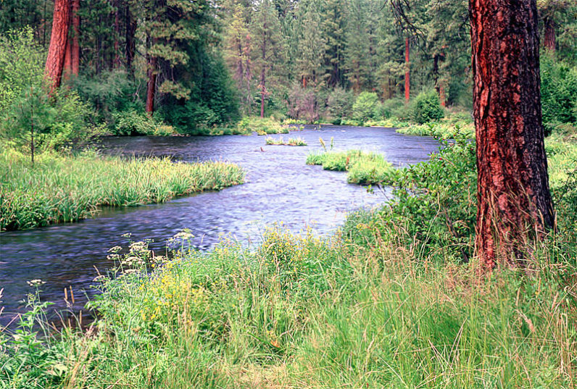
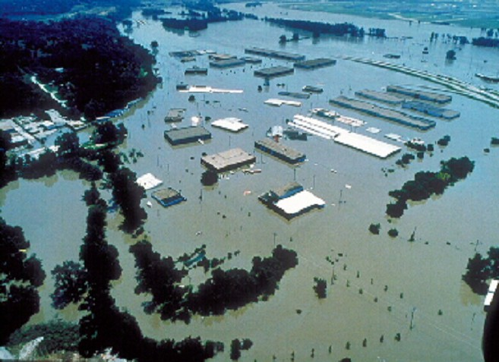
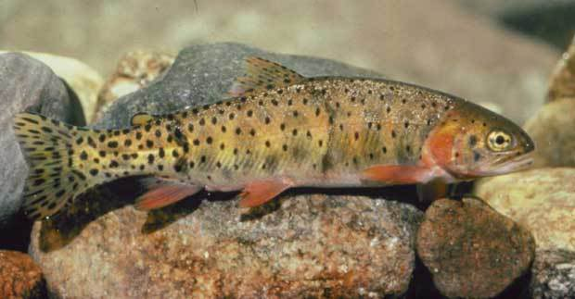
Arc Hydro River
Here is what I was thinking at the start of this meeting
River Network
Channel Shape
Geography
Flooding
Aquatic Biology
Applications

Slide 2
Is Global Geospatial Consciousness Possible?
We’ve discussed this a lot over the past couple of days
Billions
Society
Millions
Application
Users
100’s of Thousands
GIS Professionals
Thousands
Research
There are lots of things that could be done ……
……. we need a thoughtful plan

Slide 3
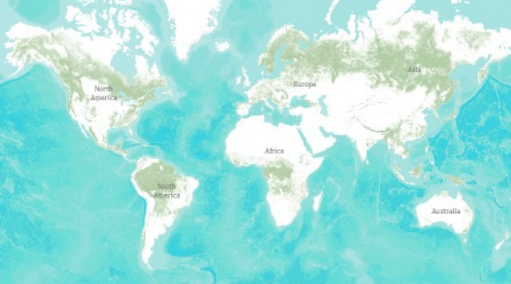
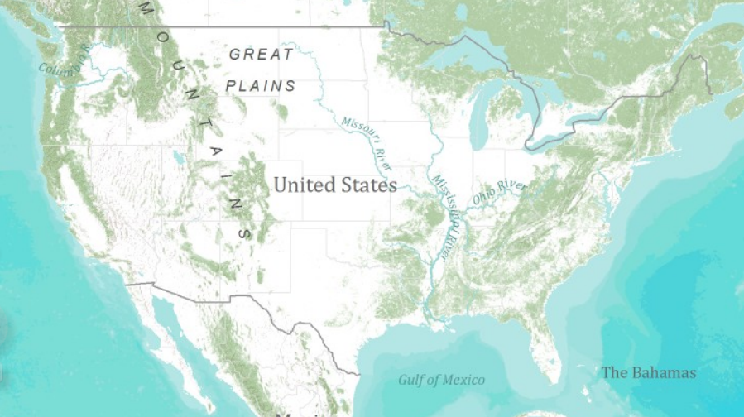
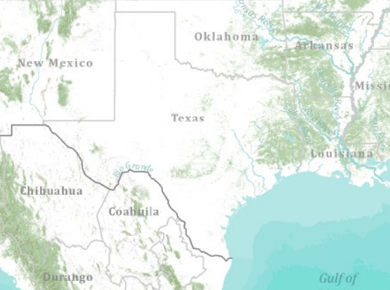
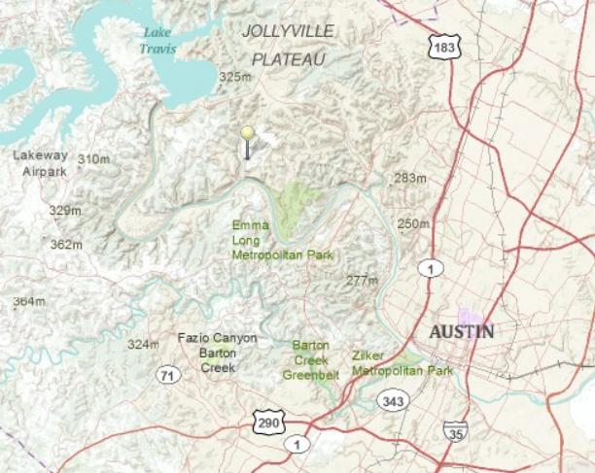
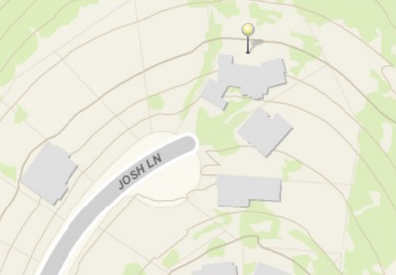
Global Topographic Basemap in ArcGIS.com
Tiled base map synthesizing information across map scales
World
United States
Texas
Austin
Home
How do we do this for hydro?

Slide 4
Arc Hydro on the Web
A vision has emerged at this meeting …..
Modeling Layers
Descriptive Layers
Observations Layers
Operational Layer
(Key Hydro Functions)
Display Layer
(Base Map)

Slide 5
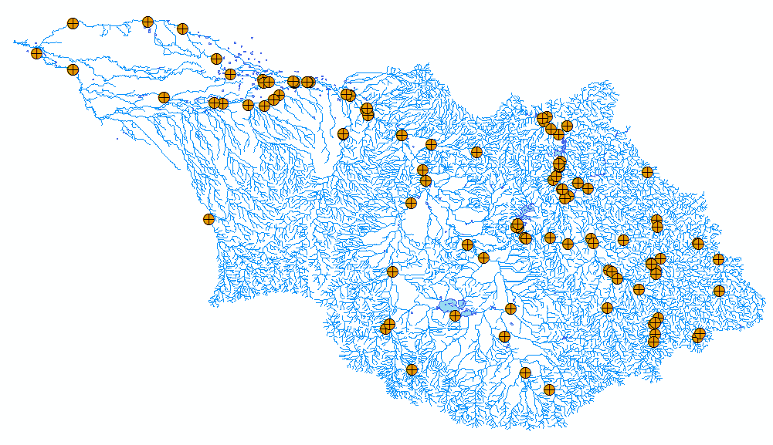
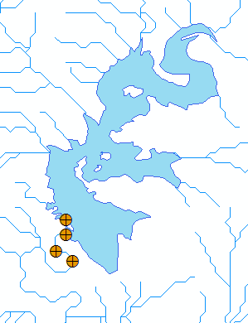
Hydro BaseMap Display Layer
The Hydrography or “blue line” component of a topographic map

Slide 6
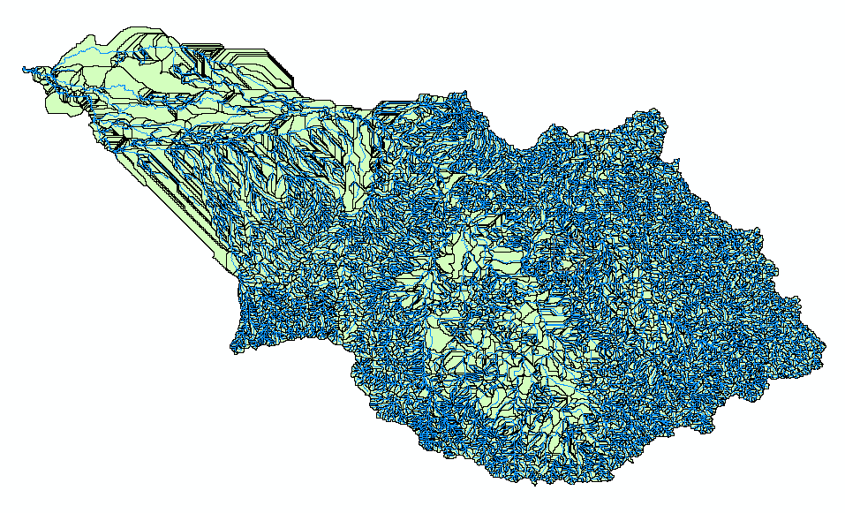
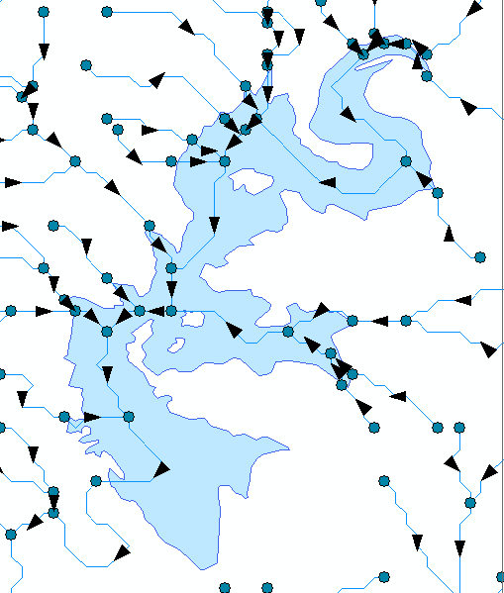
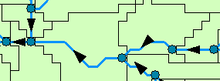
Hydro Operational Layer
A geometric network with a local catchment for each network edge

Slide 7
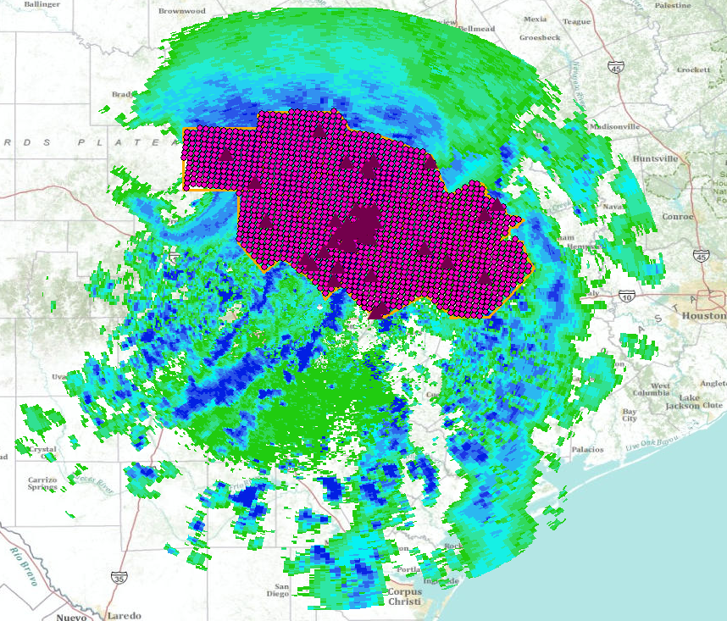
Hydro Observation Layers
Time-enabled feature layers of observations data

Slide 8
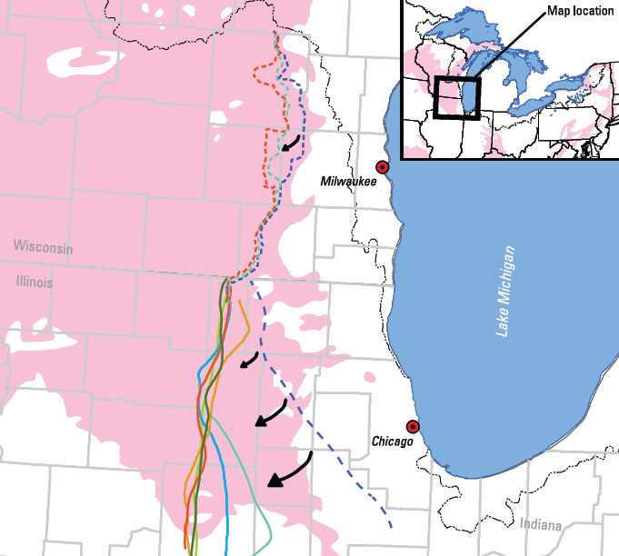
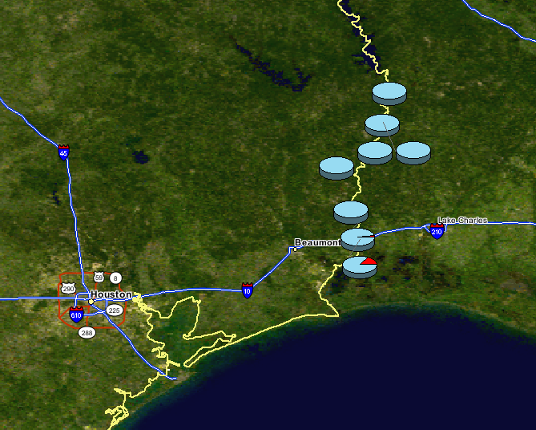
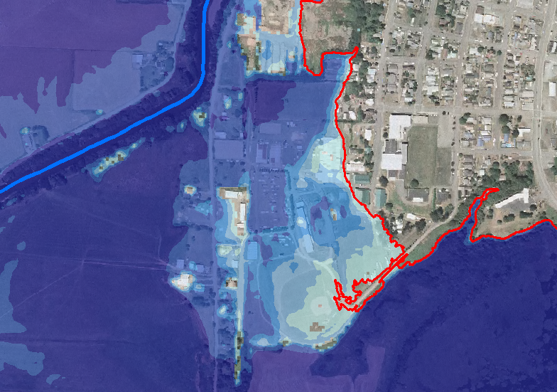
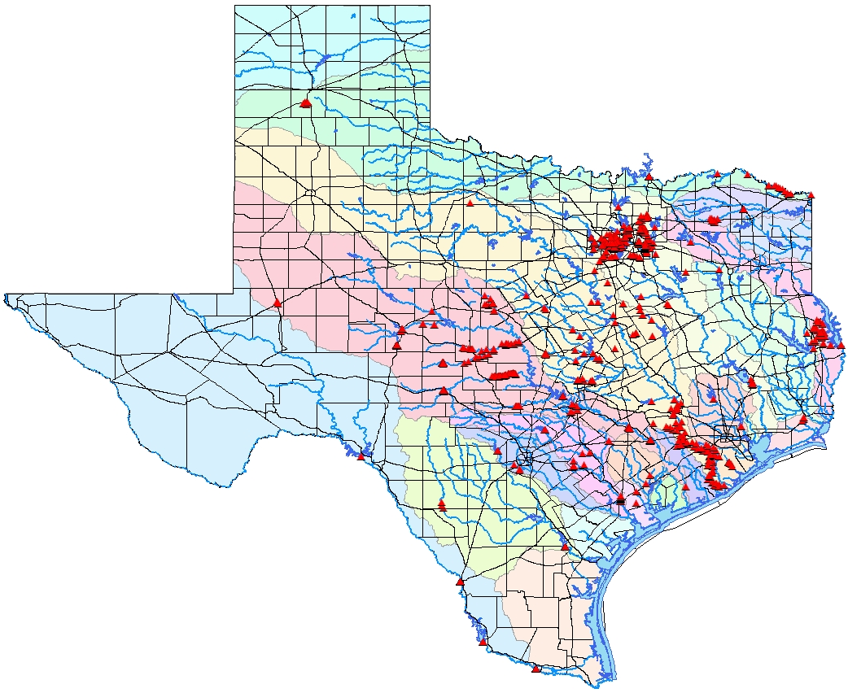
Hydro Descriptive Layers
Static information about hydro features
Watershed divide
Groundwater divides
Groundwater divide
Fish species distributions
100 year flood depth
High Water Marks
……Linked to the Operational Layer by “Virtual Referencing”

Slide 9
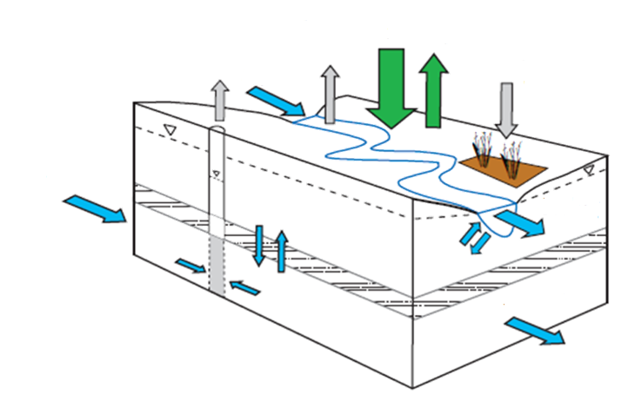
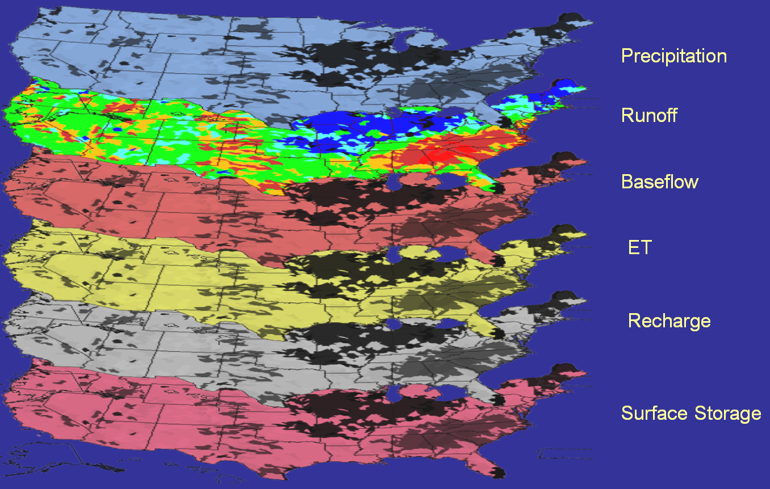
Hydro Modeling Layers
Models that connect maps
Source: USGS Water Census

Slide 10
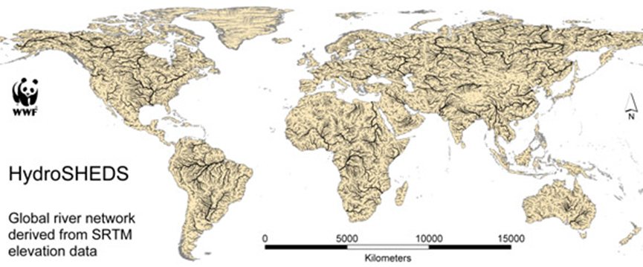
Global HydroBase Map and Operational Layer
Build from HydroSheds
Start Global and use this to define the template

Slide 11
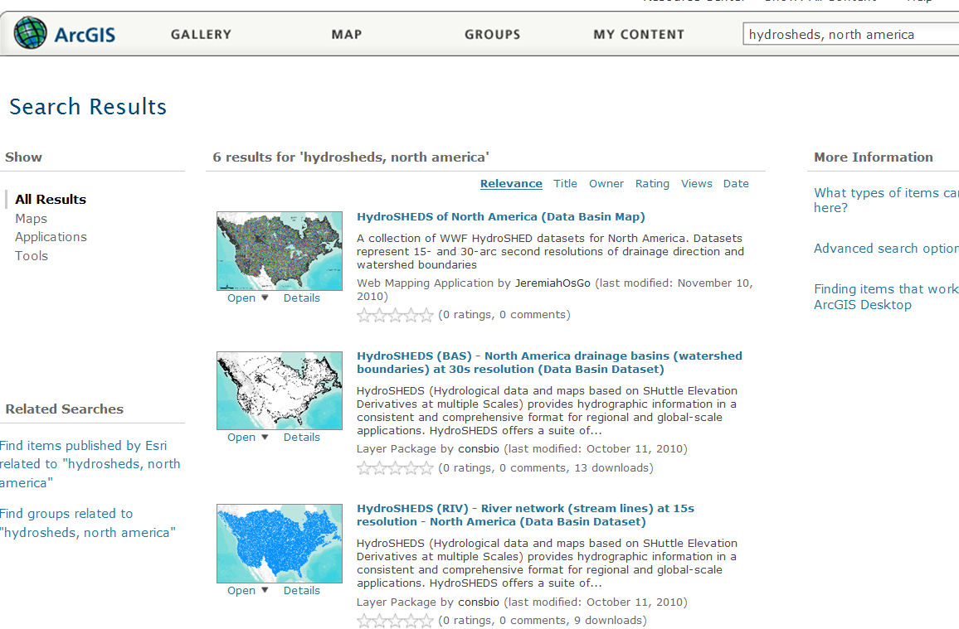
HydroSheds for the World
The data is already presented in ArcGIS.com

Slide 12
Arc Hydro on the Web
Within the US, lets explore a “Map Sandwich” as a stack of services
Modeling Layer Services
Descriptive Layer Services
Observations Layer Services
Operational Layer Services
(Key Hydro Functions)
Display Layer Services
(Base Map)

Slide 13
Is Global Geospatial Consciousness Possible?
How to make this work for Hydro
Billions
Society
Millions
Application
Users
Dream Big
100’s of Thousands
GIS Professionals
Key Expansion
Thousands
Research
Arc Hydro Today
Make geospatial understanding of water relevant by making it accessible and easy.
Think of the questions people might want of ask of the data.

Slide 14
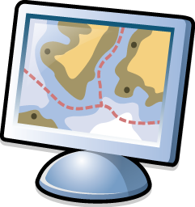
New LiDAR Workflow
Direct use of LAS files
On the fly mosaicking and rendering (hillshade, slope, etc)
Input to analytic tools as a raster or terrain
Editing
Research hydrologic derivatives from high resolution triangulated elevation
LAS
LAS
LAS
LAS
LAS
LAS
LAS
LAS
LAS
LAS
LAS
LAS
LAS
LAS

