Slide 1
Communicating Critical Information
During Flood Events Using
WebEOC® and the
CAPCOG Emergency Notification System

Slide 2
Communicating Critical Information During Flood Events
Who is CAPCOG?
CAPCOG is the Capital Area Council of Governments.
Councils of Governments are voluntary associations of counties, cities, and special districts formed under Texas law. These associations deal with the problems and planning needs that cross the boundaries of individual local governments or that require regional attention.
The primary focus of CAPCOG is to serve as advocate, planner and coordinator of initiatives that, when undertaken on a regional basis, can be more effective and efficient, including emergency communications services, elderly assistance, law enforcement training, criminal justice planning, solid waste reduction, homeland security planning, infrastructure development, land use and transportation planning, and economic development.
The 10-county CAPCOG area covers Bastrop, Blanco, Burnet, Caldwell, Fayette, Hays, Lee, Llano, Travis and Williamson counties.

Slide 3
Communicating Critical Information During Flood Events
Who is CAPCOG?

Slide 4
Communicating Critical Information During Flood Events
Two Target Audiences
There are two groups of people that need to have critical information.
Persons at risk– It is a simple truth, “If you’re not in the water, you won’t drown.” Persons in the area that is expected to flood need advance warning to move out of harm’s way.
Public safety personnel – It is another simple truth, “We work better when we work together.” Coordination of the activities of emergency response agencies is critical to ensure that life-saving activities are conducted in a timely, safe and comprehensive manner. These agencies need to have an up-to-the-minute assessment of what is happening, what actions are being taken to respond to the threat, and who continues to be at risk.

Slide 5
Communicating Critical Information During Flood Events
Two Information Sharing Systems
CAPCOG has implemented two systems to meet these needs.
CAPCOG Emergency Notification System (ENS)– This is a telephone-based notification system with the capability of notifying large numbers of persons at any time. Unlike other forms of warning, the person is not required to be “tuned-in” to receive the notification– they only have to answer the telephone.
WebEOC® – As implemented in the CAPCOG region, this web-based incident management software tool allows emergency management personnel across the region to share up-to-the-minute information about the situation, their response actions and any unmet needs, aka “Common Operating Picture.”

Slide 6
Communicating Critical Information During Flood Events
Two Components of ENS
CAPCOG’s ENS consists of two web-based applications.
Communicator! NXT – A database-driven application currently being used by the LCRA for its Floodgate Operations Notification Service (FONS). The City of Austin is considering its use for “heads up” messages.
GeoCast - A geographic information system (GIS)-based application used to notify persons within a specific geographic area of an imminent threat. Telephone numbers come from the 9-1-1 database and voluntary registration of cellular phones.

Slide 7
Communicating Critical Information During Flood Events
Communicator NXT: LCRA’s FONS
From the LCRA website: “LCRA offers a free service to notify residents and property owners of anticipated floodgate operations, which can cause higher, faster water flows. This Floodgate Operations Notification Service (FONS) allows people to specify how they are notified: by e-mail, land line and/or cell phone. This is not a flood warning system.”
Currently has over 1,100 subscribers.
Notification can be made for floodgate operations at any of LCRA’s dams (Buchanan, Wirtz, Starcke, Mansfield, Tom Miller).
The message can be delivered by telephone and e-mail to any location– not confined to the local area.
Message is intended to be a “heads-up” of the potential threat.

Slide 8
Communicating Critical Information During Flood Events
Use of GeoCast ® Web for Flood Warning
Allows emergency personnel to outline an area on a GIS-generated map and send a telephone notification to every land-line telephone within the area, including unlisted numbers.
Notification can also be sent to cellular phones that have been registered on the system.
Bi-lingual (English and Spanish) messages can be delivered, as well as messages to TDD devices.
Recently used by Williamson County in September, 2010 to warn of early morning flooding resulting from Tropical Storm Hermine. Extensively used by Burnet County and Marble Falls during the 2007 “rain bomb”.
Warning areas can be defined during the event or pre-defined.

Slide 9
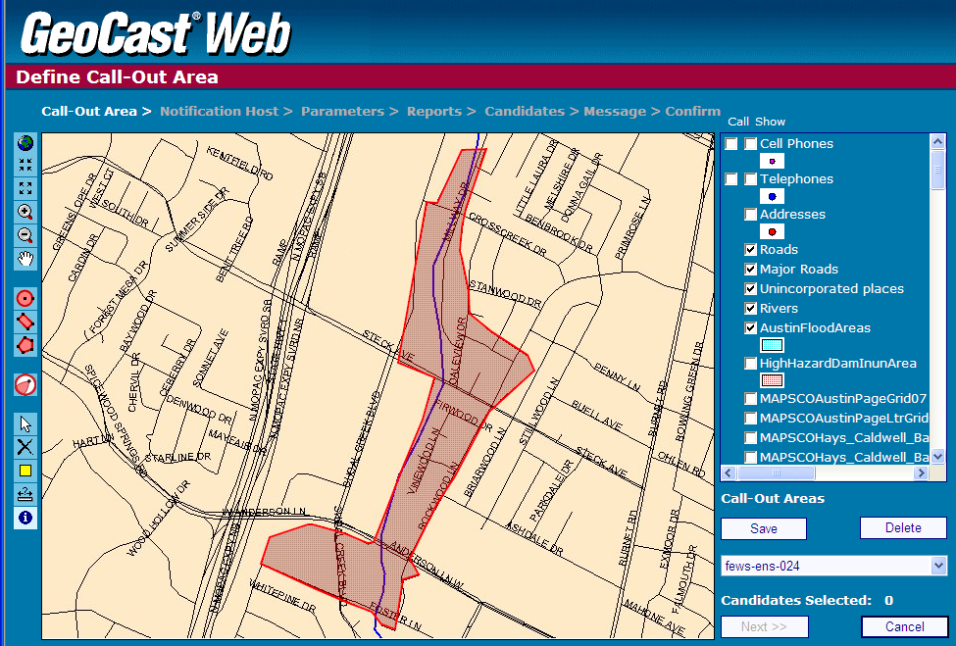
Communicating Critical Information During Flood Events
GeoCast Web Predefined Area

Slide 10
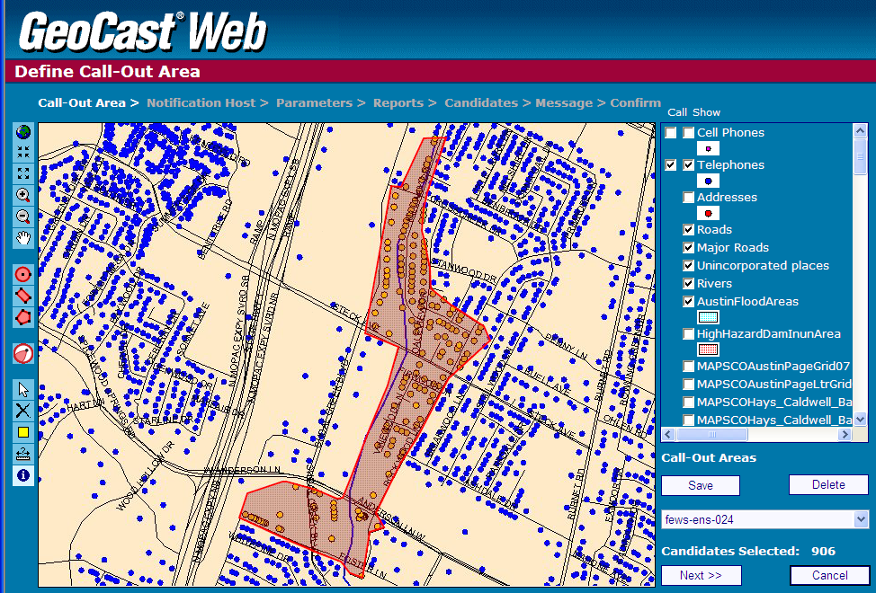
Communicating Critical Information During Flood Events
GeoCast Web Predefined Area (with telephones)

Slide 11
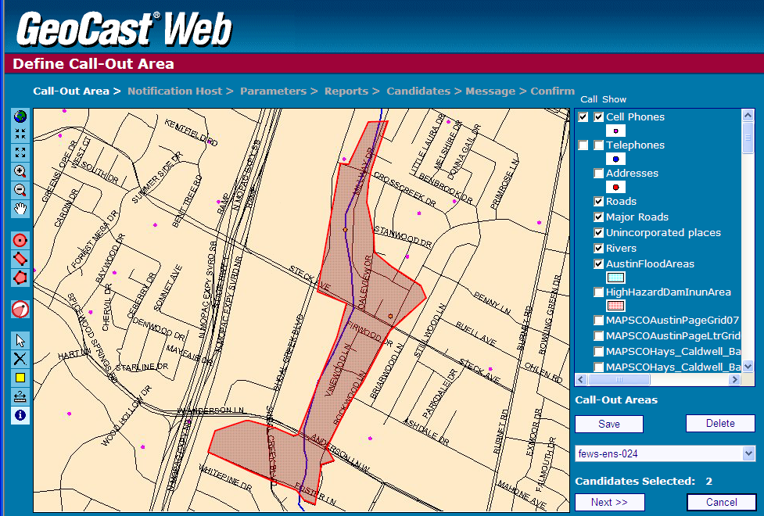
Communicating Critical Information During Flood Events
GeoCast Web Predefined Area (with cell phones)

Slide 12
Communicating Critical Information During Flood Events
Use of GeoCast Web® for Flood Warning
Sixty-nine (69) calls can be made simultaneously from the primary system. All phones in the selected area would be notified in less than ten (10) minutes.
The “Mass Call” system has access to five hundred (500) lines.
The system has had no downtime since February, 2008.

Slide 13
Communicating Critical Information During Flood Events
WebEOC®–Maintaining a Common Operating Picture
WebEOC® has been deployed on three servers in the CAPCOG region:
CAPCOG;
Austin/Travis County Emergency Operations Center;
Williamson County.
All counties, cities, schools and hospitals have access to the system.
Essential information can be shared in real time across all servers.
Key information can be shared with the State Operations Center.
Map-based display capabilities are being enhanced, allowing emergency personnel to see what is happening, where it is happening and what resources have been deployed.

Slide 14
Communicating Critical Information During Flood Events
Contact Information – Web Links
Ed Schaefer, CAPCOG Director of Homeland Security
Office: 512-916-6026
E-mail: eschaefer@capcog.org
LCRA Floodgate Operations Notification Service (FONS)
http://www.lcra.org/water/flood/fons.html
CAPCOG Emergency Notification System
Information: http://www.capcog.org/divisions/homeland-security/ens/
Cell phone registration: http://wireless.capcog.org
CAPCOG WebEOC Information:
http://www.capcog.org/divisions/homeland-security/web-eoc/

Slide 15
Communicating Critical Information During Flood Events
Questions?
?

