Slide 1
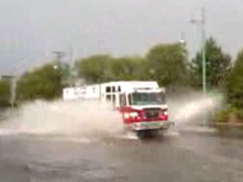
Situational Awareness for Flash Flooding
Presented to the TFFC Flood Technology Workshop
Austin, Tx, Dec 10, 2010
By David R. Maidment
Director, Center for Research in Water Resources
Cockrell School of Engineering
University of Texas at Austin

Slide 2
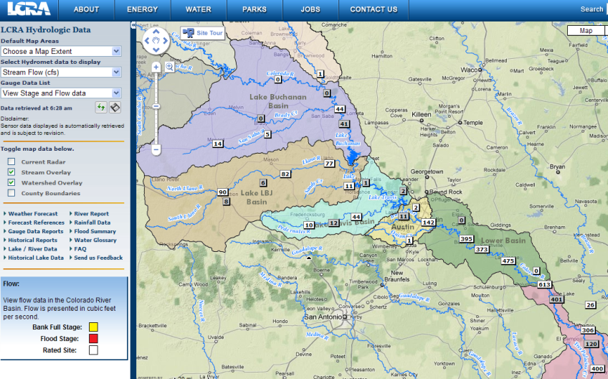
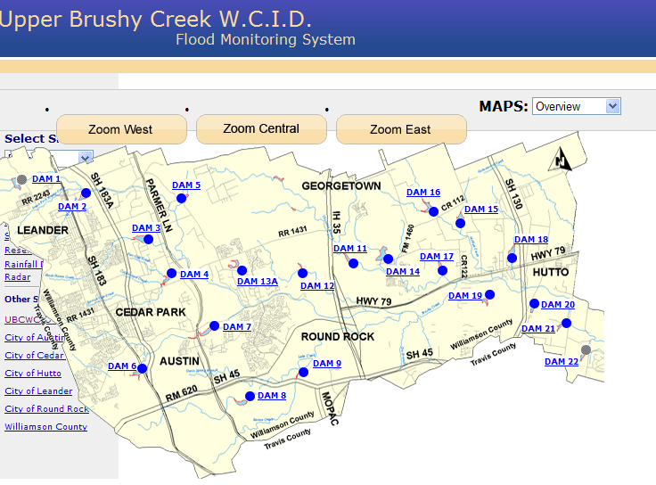
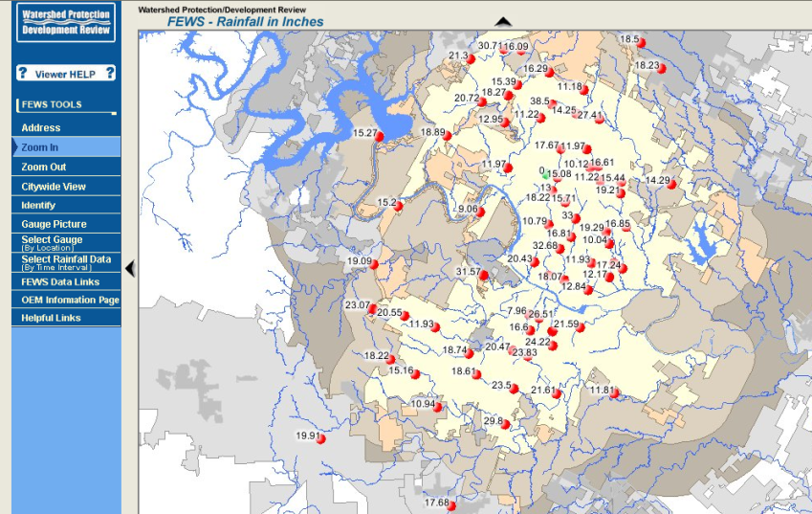
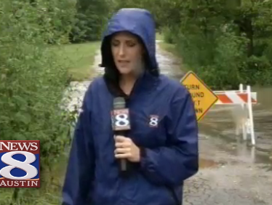
Local Information during Tropical Storm Hermine (8 Sept 2010)
Upper Brushy Creek (Round Rock)
LCRA
http://hydromet.lcra.org
http://ubcwcid.org/Overview/Overview.aspx?id=1
TV
City of Austin
http://coagis1.ci.austin.tx.us/website/COAViewer_fews/viewer.htm

Slide 3
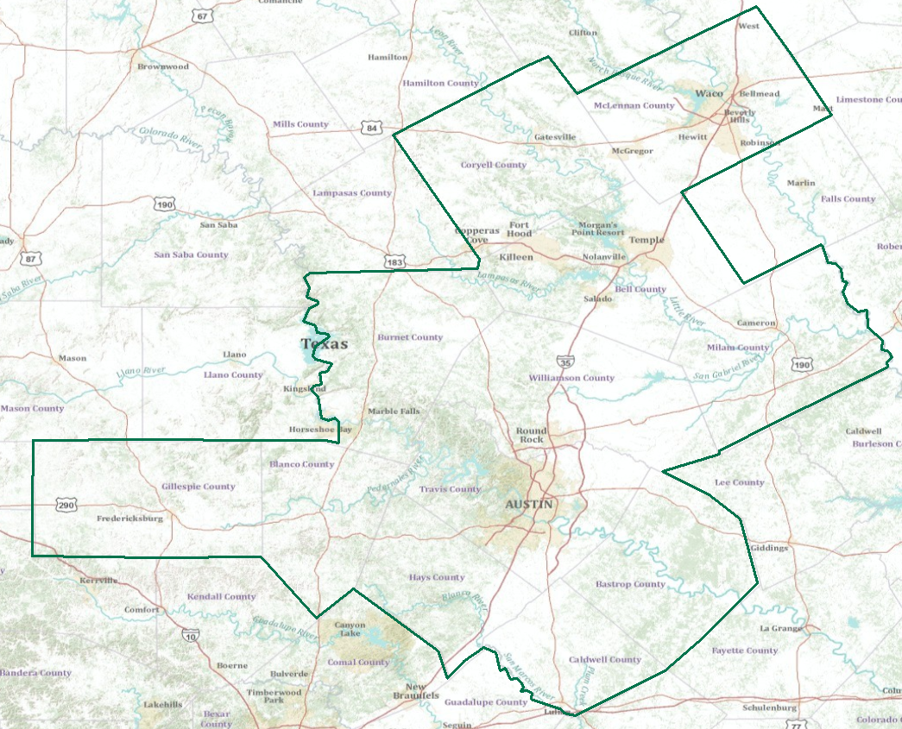
Real-Time Flood Information for Television
Maureen McCann, Meteorologist with News8 Austin
Develop a prototype of space-time mapping for television meteorologists

Slide 4
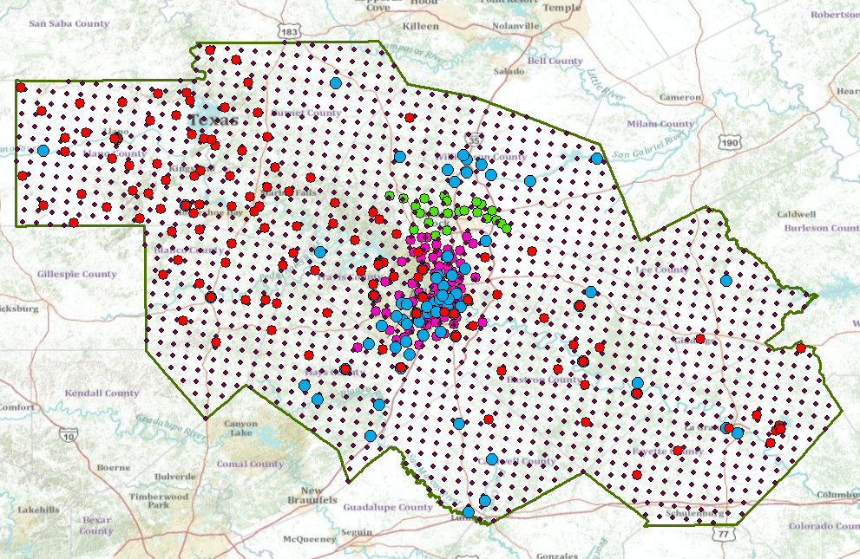
A Single Virtual Flood Observation Network for the CAPCOG region
Combines NWS, USGS, LCRA, City of Austin, UBCWCID, …. data

Slide 5
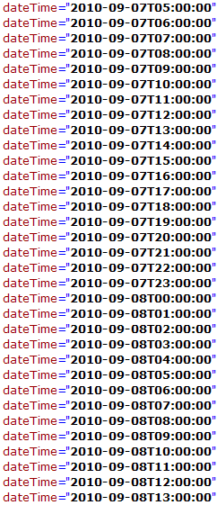
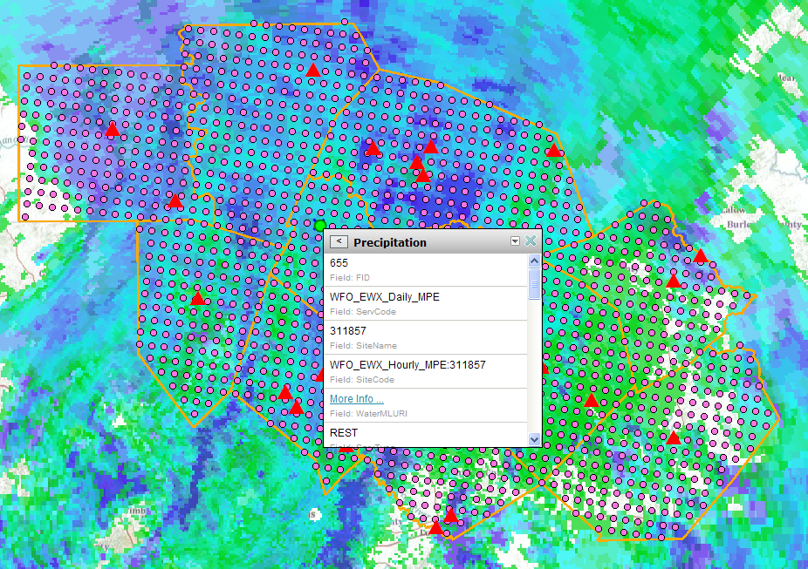
Hourly Precipitation in Hermine
ArcGIS.com Map Service
WGRFC MPE Service at UT Arlington
A WaterML observations service in time

Slide 6
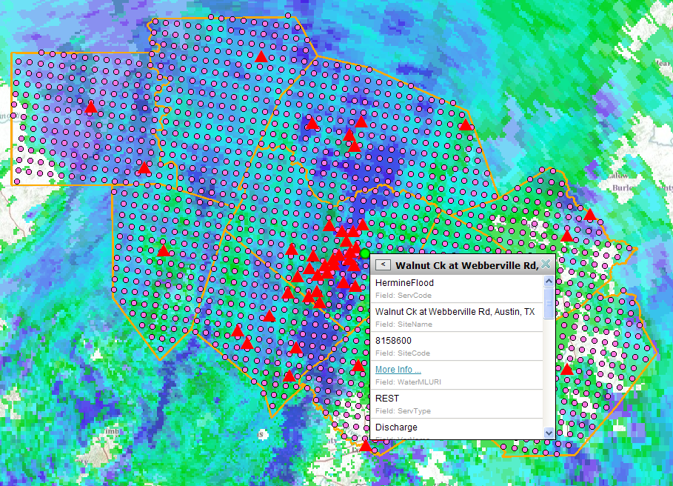
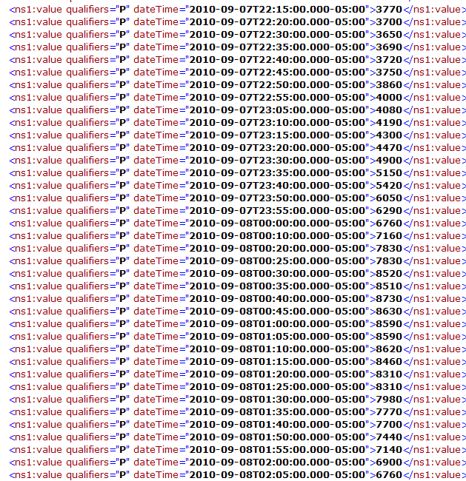
USGS Streamflow fromHermine
USGS Real-Time Streamflow Service
ArcGIS.com Map Service
A WaterML observations service in time

