Slide 1
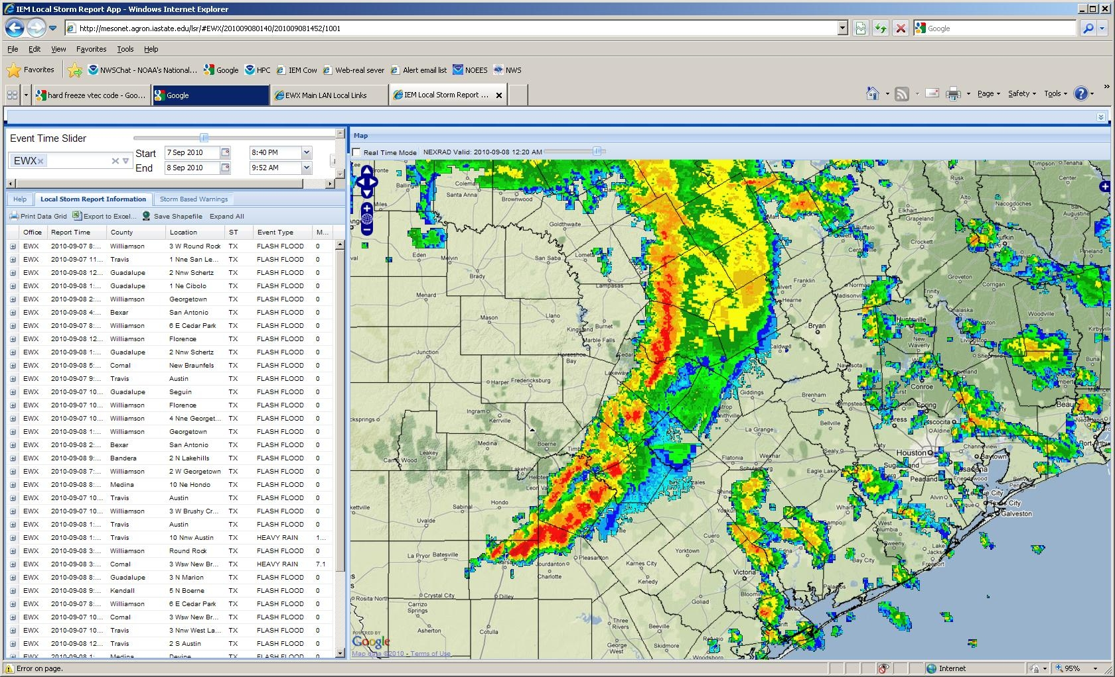

Williamson County
T.S. Hermine Flood Response
Jarred Thomas
Williamson County OEM

Slide 2
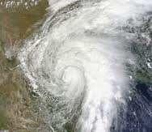
Incident- Overview
Pre-incident
Incident Response
Post-incident
Lessons Learned

Slide 3
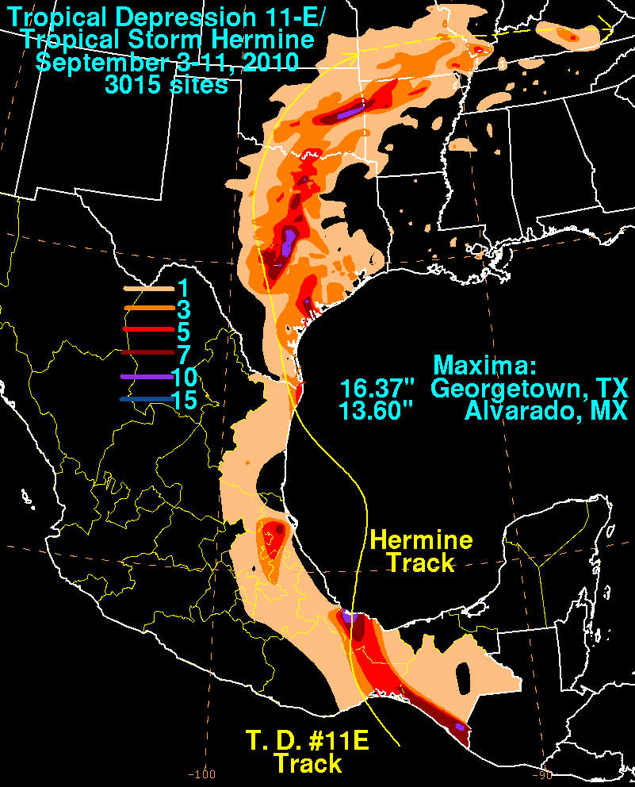
Pre-Incident
State Conference Calls
National Weather Service Forecast
Monitored Storm Track and Activity
Monitored local rainfall totals and water levels at local flood control dams.
Communicated with local emergency managers.

Slide 4

Incident Response
Localized Widespread
Simultaneous Evacuations and Rescues
  By Land
  By Boat
  By Helo
Agencies Engaged (primary rescue)
Florence FD, Cedar Park FD, Leander FD, Sam Bass FD, Round Rock FD, Georgetown FD, Williamson County EMS, HazMat, and Sheriff’s Office, Austin FD (TTF-1) (x2), StarFlight (x3), Texas Parks and Wildlife.

Slide 5
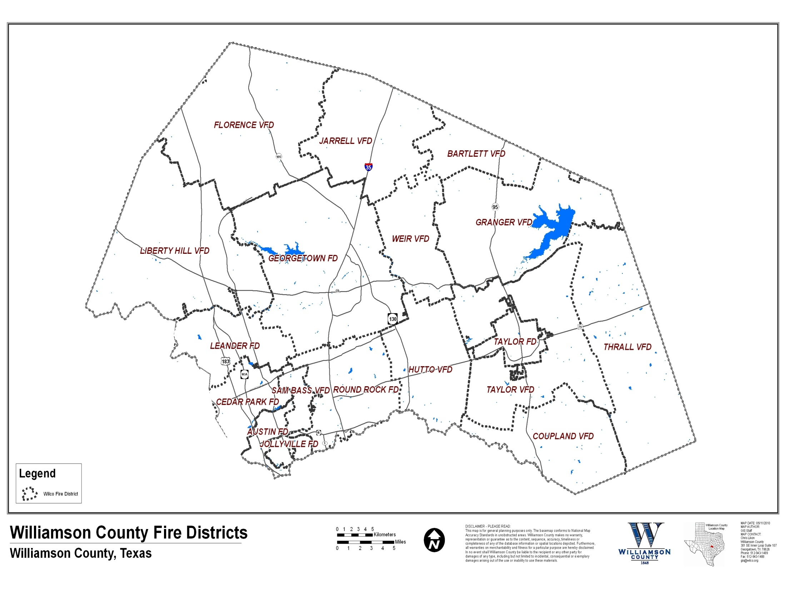
Watersheds and Rescues

Slide 6
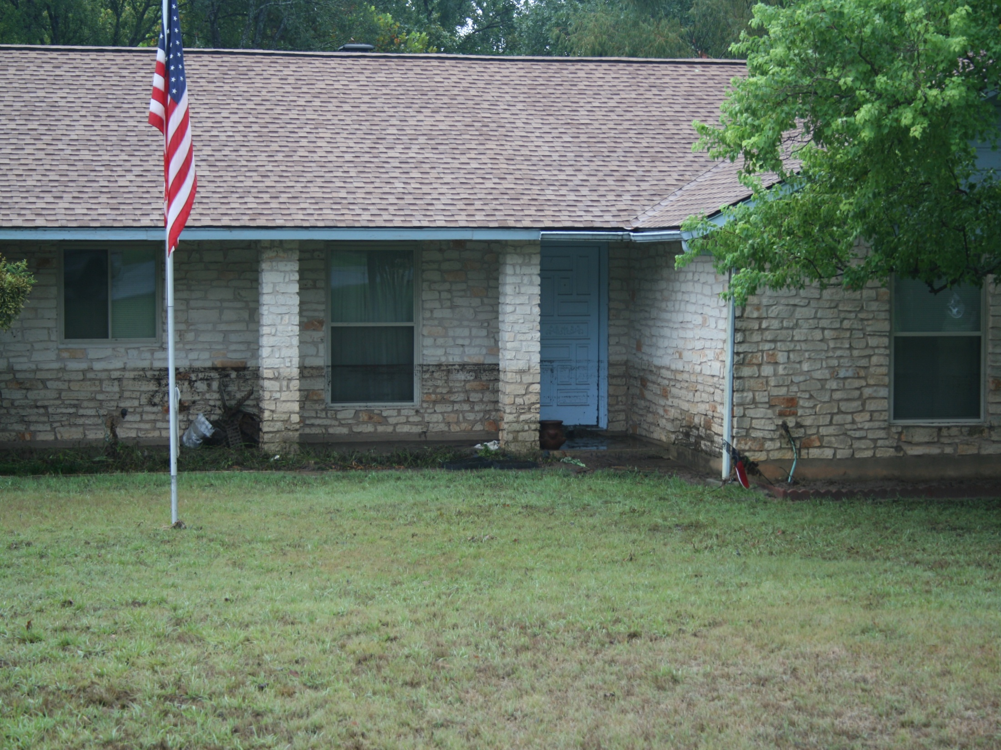
Post-incident

Slide 7
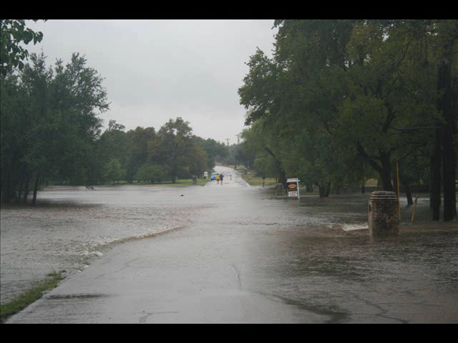

Slide 8
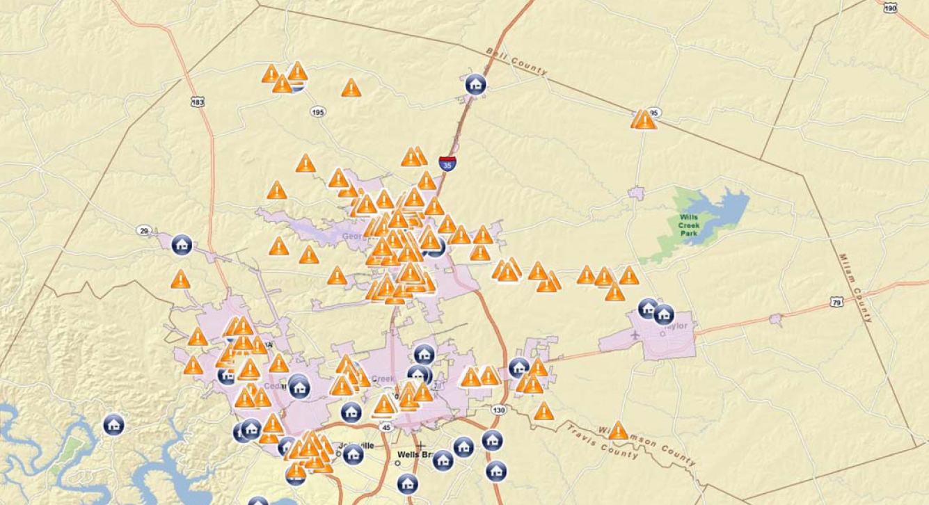
Collaboration and Cooperation

Slide 9
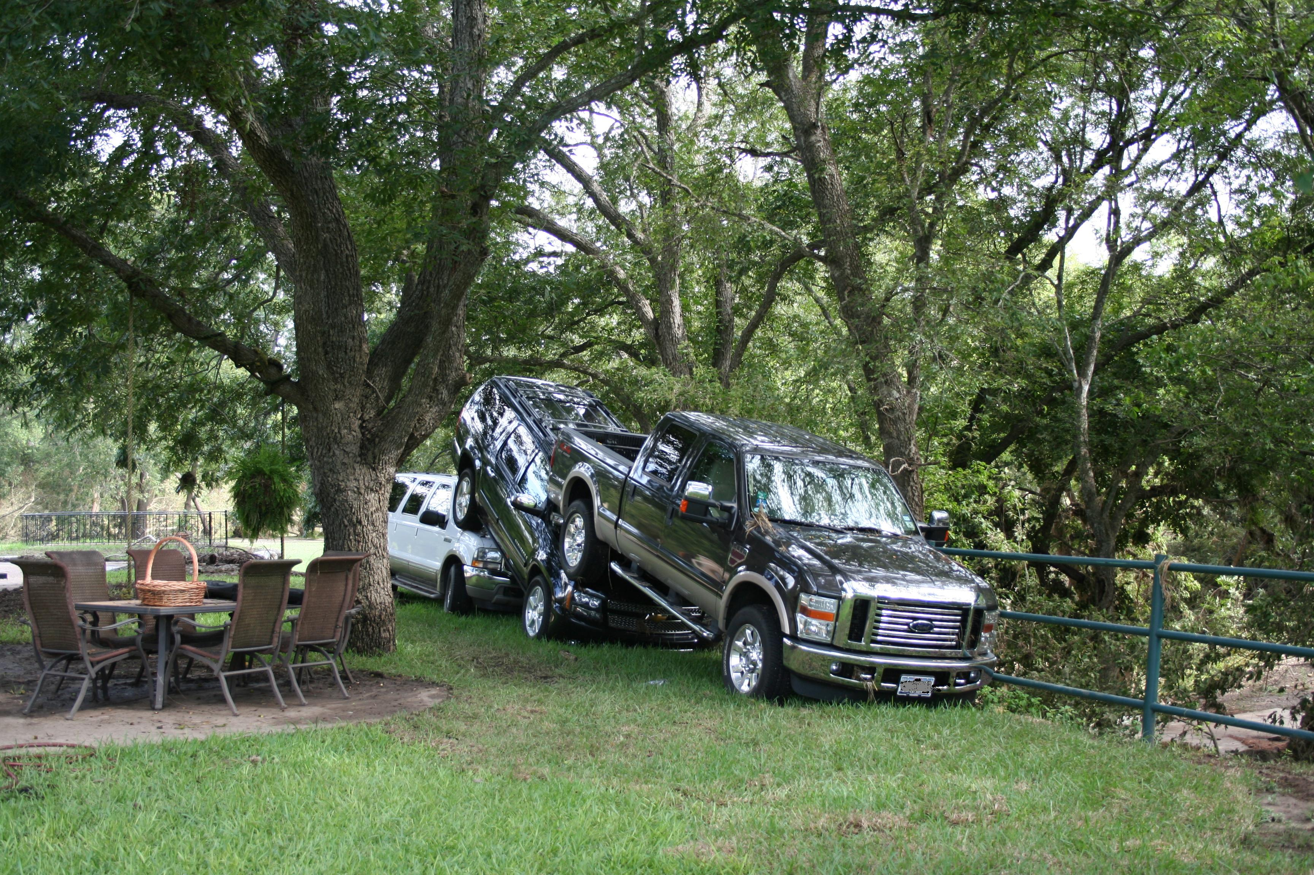
Lessons Learned
Disasters don’t follow the plan and Storms don’t listen to the forecast.
Water is Mightier than the Phone.
Relationships are Key.
  Before and After
You can only monitor so many websites and process so much data.
What You’ve Got is What You’ve Got.

Slide 10
Contact Info
Jarred Thomas, EMC
Williamson County OEM
512-943-3747
jthomas@wilco.org

