Slide 1
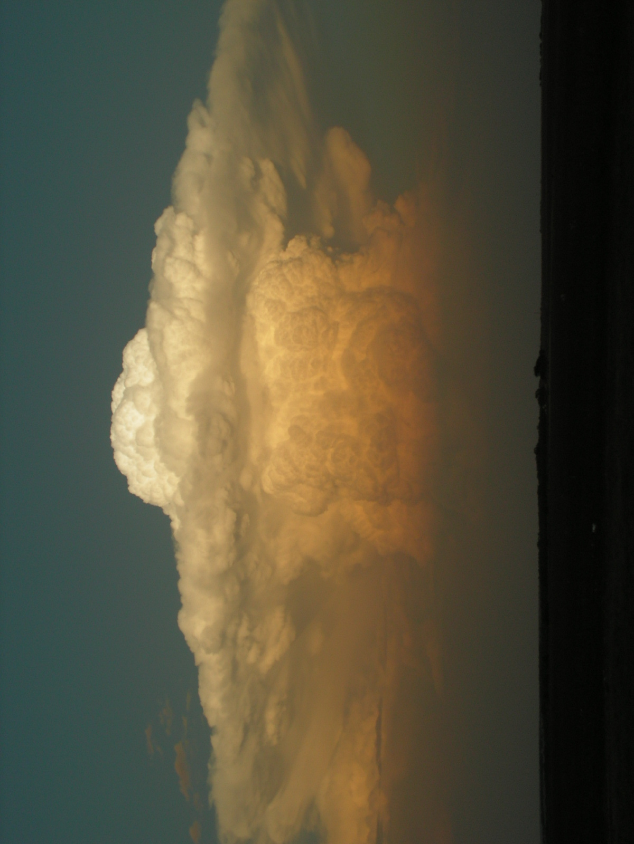


National Weather Service Flash Flood Program
Overview
By Hector Guerrero
Warning and Coordination Meteorologist,
NWS San Angelo, TX
and
Chair of The Texas Flash Flood Coalition
l

Slide 2
National Weather Service Flash Flood Program
Overview
Current NWS Flash Flood Situational Awareness /Decision Support Tools
NWS Rainfall Data Sources
How NWS Creates Flash Flood Watches and Warnings

Slide 3
Flash Flood Situational Awareness Tools
Collaborate with decision makers using hotline, telephone, text messaging, NAWAS, NWS Chat (Austin Flood Warning Alert and media), Conference Calls, iNWS, email alerts, multimedia brief, graphicast, private sector systems, and amateur radios.

Slide 4
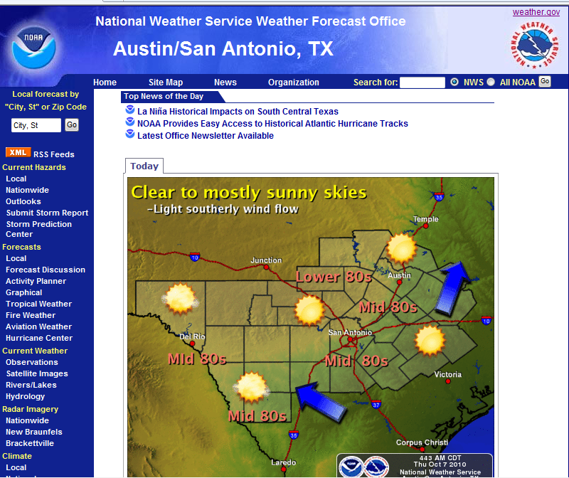

Slide 5
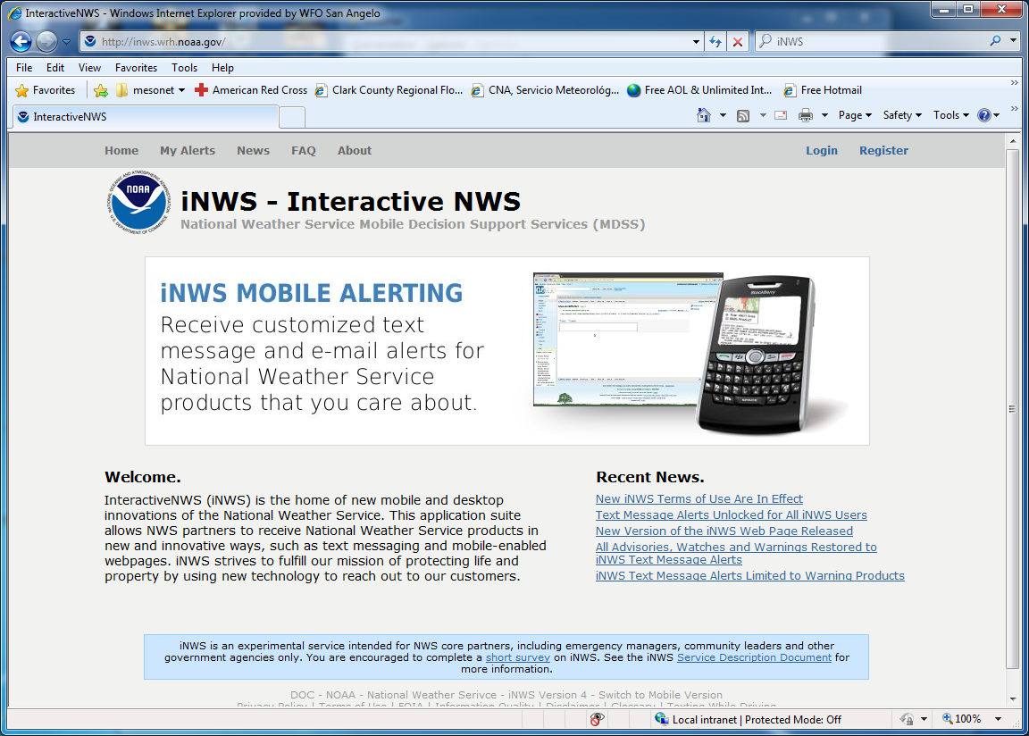

Slide 6
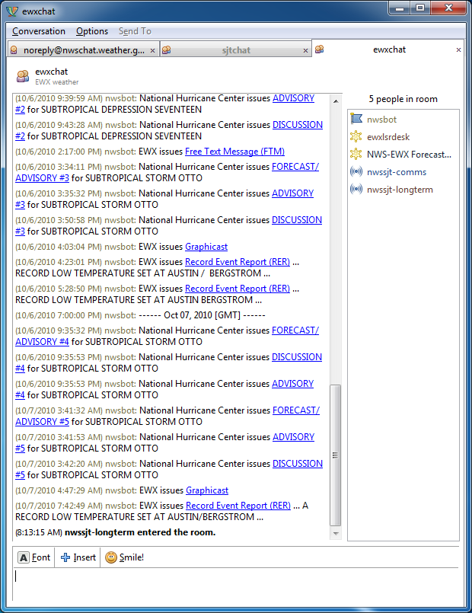

Slide 7
Rainfall Data Sources
LCRA Hydromet Data every 15 min.
City of Austin Rainfall Gauges every 15 min.
Federal (U.S.G.S.) Data Via Satellite
Spotter Reports
CoCoRahs- Collaborative Rain, Hail and Snow Network.

Slide 8
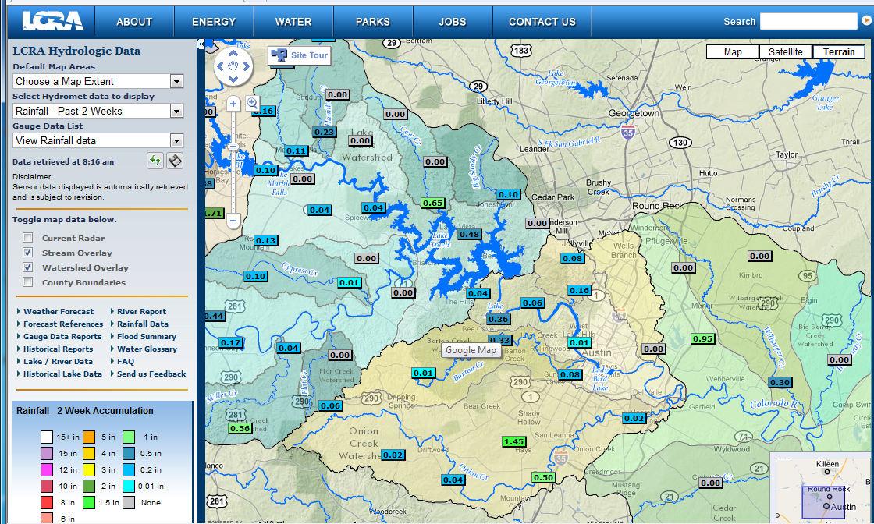

Slide 9
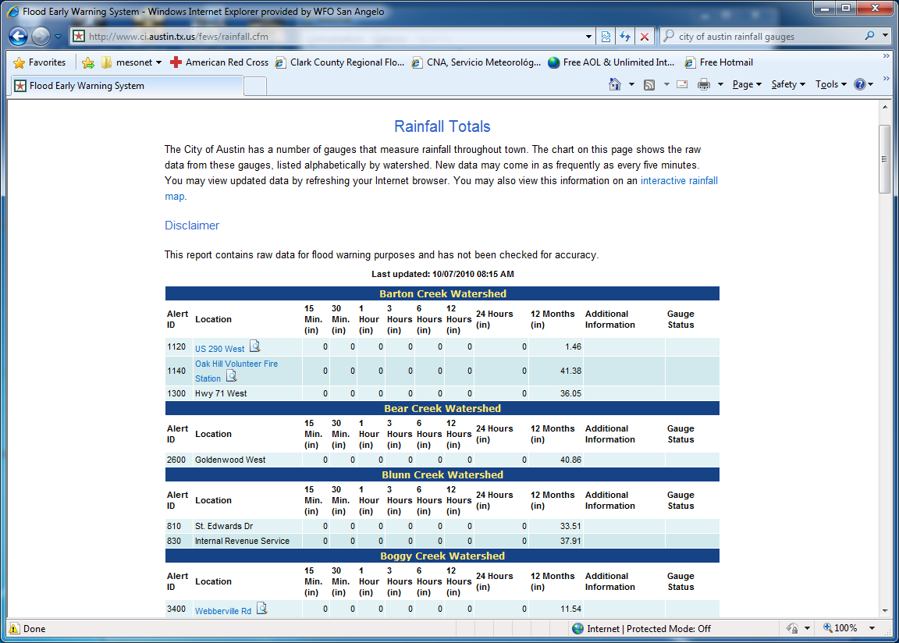

Slide 10
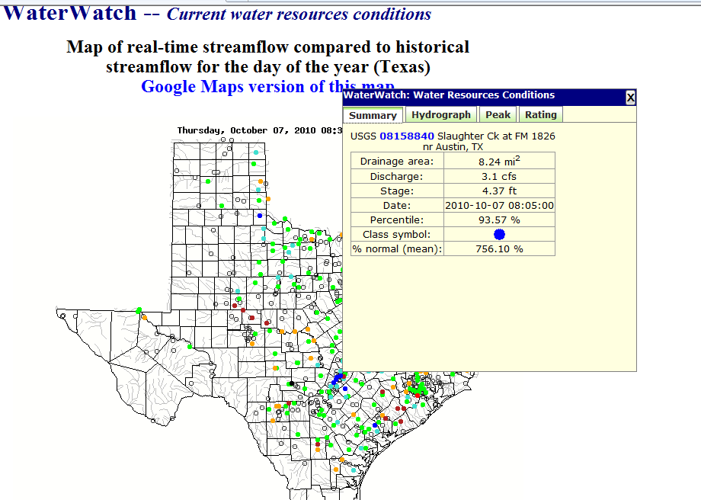

Slide 11
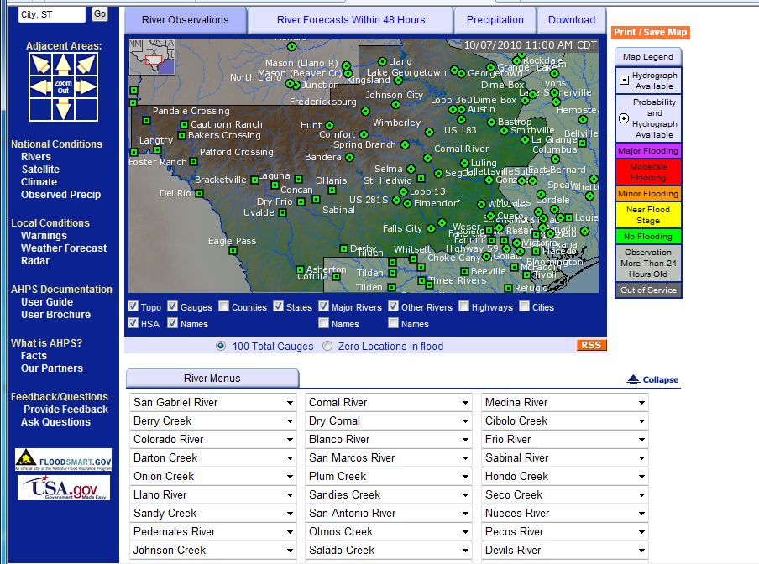

Slide 12
Creating Flash Flood Watches and Warnings
Definition: Flash flood warnings are issued when flooding is imminent or likely. This product will be reserved for those short-term events which require immediate action to protect life and property, such as dangerous small stream or urban flooding and dam or levee failures.

Slide 13
ZCZC LBBFFASJT
WGUS64 KSJT 081013
FLOOD WATCH
NATIONAL WEATHER SERVICE SAN ANGELO TX
513 AM CDT WED SEP 8 2010
...HEAVY RAINFALL AND FLOODING POSSIBLE TODAY...
.THE REMNANTS OF HERMINE WILL CONTINUE TO TRACK NORTH ACROSS THE BIG COUNTRY TODAY. UNTIL IT EXITS THE AREA THIS AFTERNOON …MODERATE TO HEAVY RAINFALL WILL BE POSSIBLE...MAINLY ALONG AND EAST OF A HASKELL TO ABILENE TO EDEN TO JUNCTION LINE. SOME AREAS OF THE HEARTLAND HAVE ALREADY SEEN 3 TO 5 INCHES OF RAIN SINCE
TUESDAY MORNING...WITH 1 TO 3 INCHES ACROSS THE EASTERN BIG
COUNTRY.
TXZ066-073-098-099-113-114-127-128-139-140-154-155-168>170-081800-
/O.CON.KSJT.FF.A.0008.000000T0000Z-100909T0000Z/
/00000.0.ER.000000T0000Z.000000T0000Z.000000T0000Z.OO/
RUNNELS-CONCHO-HASKELL-THROCKMORTON-JONES-SHACKELFORD-TAYLOR-
CALLAHAN-COLEMAN-BROWN-MCCULLOCH-SAN SABA-MENARD-KIMBLE-MASON-
INCLUDING THE CITIES OF... BALLINGER... WINTERS... EDEN...HASKELL…THROCKMORTON... WOODSON... STAMFORD...ANSON...HAMLIN...ALBANY...
ABILENE...CLYDE...BAIRD...CROSS
513 AM CDT WED SEP 8 2010
...FLASH FLOOD WATCH REMAINS IN EFFECT THROUGH THIS EVENING...
THE FLASH FLOOD WATCH CONTINUES FOR
* A PORTION OF WEST CENTRAL TEXAS...INCLUDING THE FOLLOWING
AREAS...BROWN...CALLAHAN...COLEMAN...CONCHO...HASKELL...
JONES...KIMBLE...MASON...MCCULLOCH...MENARD...RUNNELS...SAN
SABA...SHACKELFORD...TAYLOR AND THROCKMORTON.
* THROUGH THIS EVENING
* THE REMNANTS OF HERMINE WILL CONTINUE MOVING ACROSS PORTIONS OF WEST CENTRAL TEXAS TODAY. THE THREAT OF MODERATE TO HEAVY RAINFALL WILL CONTINUE NEAR THE CENTER OF THE SYSTEM ACROSS THE BIG COUNTRY...AND ALONG A BAND OF SHOWERS AND STORMS THAT MAY DRIFT NORTH BACK INTO THE NORTHWEST HILL COUNTRY AND THE HEARTLAND. IN BOTH OF THESE AREAS...ADDITIONAL RAINFALL TOTALS TODAY OF 1 TO 2 INCHES WILL BE POSSIBLE...AT LEAST OVER ISOLATED AREAS. SINCE THESE AREAS HAVE SEEN SIGNIFICANT RAINFALL...AND SOILS ARE ALREADY SATURATED...ANY ADDITIONAL RAINFALL MAY QUICKLY PRODUCE FLASH FLOODING.
* FLOODING OF LOW LYING AREAS AND LOW WATER CROSSINGS IS
POSSIBLE. THERE IS THE POTENTIAL FOR FLOODING OF SMALL STREAMS
AND ARROYOS...AND RISES ON RIVERS.
PRECAUTIONARY/PREPAREDNESS ACTIONS...
A FLASH FLOOD WATCH MEANS THAT CONDITIONS MAY DEVELOP THAT LEAD TO FLASH FLOODING. FLASH FLOODING IS A VERY DANGEROUS SITUATION.
YOU SHOULD MONITOR LATER FORECASTS AND BE PREPARED
TO TAKE ACTION SHOULD FLASH FLOOD WARNINGS BE ISSUED.
&&
$$

Slide 14
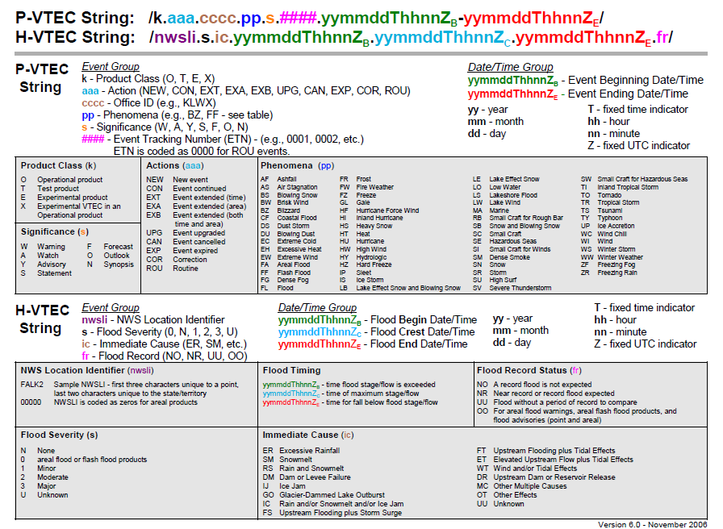

Slide 15
WGUS54 KEWX 080155
FFWEWX
TXC053-055-091-187-209-453-491-080445-
/O.NEW.KEWX.FF.W.0063.100908T0155Z-100908T0445Z/
/00000.0.ER.000000T0000Z.000000T0000Z.000000T0000Z.OO/
BULLETIN - EAS ACTIVATION REQUESTED
FLASH FLOOD WARNING
NATIONAL WEATHER SERVICE AUSTIN/SAN ANTONIO TX
855 PM CDT TUE SEP 7 2010
THE NATIONAL WEATHER SERVICE IN AUSTIN SAN ANTONIO HAS ISSUED A
* FLASH FLOOD WARNING FOR...
EASTERN BURNET COUNTY...
NORTHWESTERN CALDWELL COUNTY...
EASTERN HAYS COUNTY...
TRAVIS COUNTY...
WESTERN WILLIAMSON COUNTY...
* UNTIL 1145 PM CDT.
* AT 848 PM CDT...NATIONAL WEATHER SERVICE METEOROLOGISTS
HAVE DETERMINED THAT VERY HEAVY DOWNPOURS FROM SHOWERS MOVING
NORTH BETWEEN NEW BRAUNFELS...AUSTIN AND BERTRAM WILL RESULT IN
LIFE THREATENING FLASH FLOODING. ADDITIONAL RAINFALL AMOUNTS WILL
RANGE FROM ONE TO THREE INCHES AND WILL FALL OVER ALREADY
SATURATED GROUND.
LOCATIONS IN THE WARNING INCLUDE BUT ARE NOT LIMITED TO MAHOMET...
HILL...LEANDER...LAGO VISTA...FLORENCE...CEDAR PARK...BRIGGS...
PRECAUTIONARY/PREPAREDNESS ACTIONS...
IT IS HARD TO RECOGNIZE THE DANGERS OF FLOODING AT NIGHT. IF FLOOD
WATERS RISE ACT QUICKLY. DO NOT STAY IN FLOOD PRONE AREAS.
&&
LAT...LON 3092 9783 3091 9778 3011 9762 3007 9765
3003 9760 2992 9758 2975 9806 3104 9816
3105 9791
$$
Plots lat/lon using KML

Slide 16
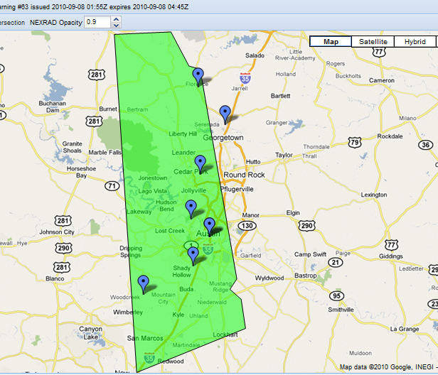
Notes:
Changed text from “Polygon Eliminates Area False Alarmed” to “Polygon Eliminates False Alarm for Area”

Slide 17
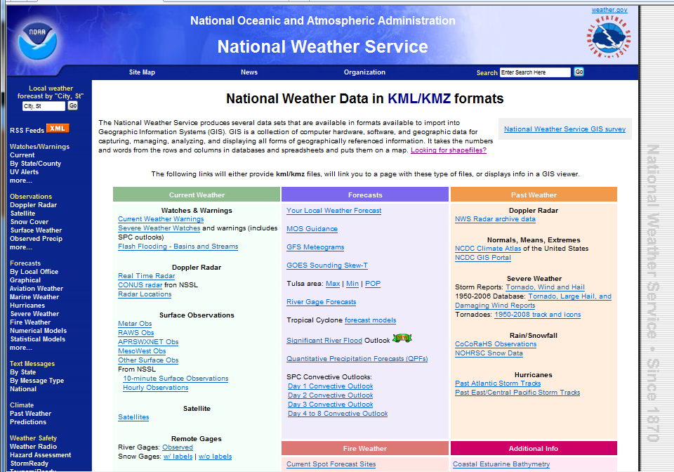

Slide 18
