Slide 1
City of Austin Flood Early Warning System Situational Awareness
Susan Janek
October 8, 2010

Slide 2
What is Flood Warning?
Flood
Flow
Duration of
Flooding
Time
MONITOR
MONITOR
DETECT
DETECT
MOBILIZE
MOBILIZE
ACTION
ACTION
The GOAL is to DECREASE detect time to INCREASE time for action and response
Notes:
Most important slide of the presentation – tells you why we are here, what our GOAL is
Main thing to remember is TIME is everything to us in Flood Warning
Hydrograph represents the duration of a storm event
The single most important point is where the flood stage is surpassed
The gray block represents the duration of flooding – we need to respond to the threat before then
Four Steps: Monitor (Is it a threat?), Detect (How do we respond?), Mobilize (The time it takes to get boots on the ground), and Action (Actual response to the threat).
GOAL is to reduce Monitor/Detect time in order to increase Mobilize/Action time – since we cannot control the duration of the hydrograph, we must shrink one to grow the other

Slide 3


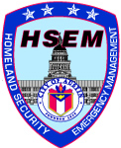
The FEWS Family Tree
Field Operations
Duty Officer
Notes:
Field Ops closes roads and asseses field conditions
FEWS makes recommendations to the Duty Officer

Slide 4

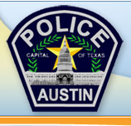

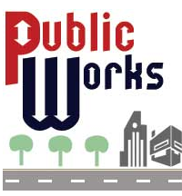
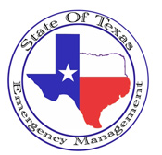


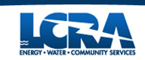
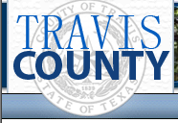

The FEWS Family Tree
Duty Officer
Field Operations
Notes:
The Duty Officer is responsible for coordination with other entities – this leaves FEWS out of emergency management decision making

Slide 5
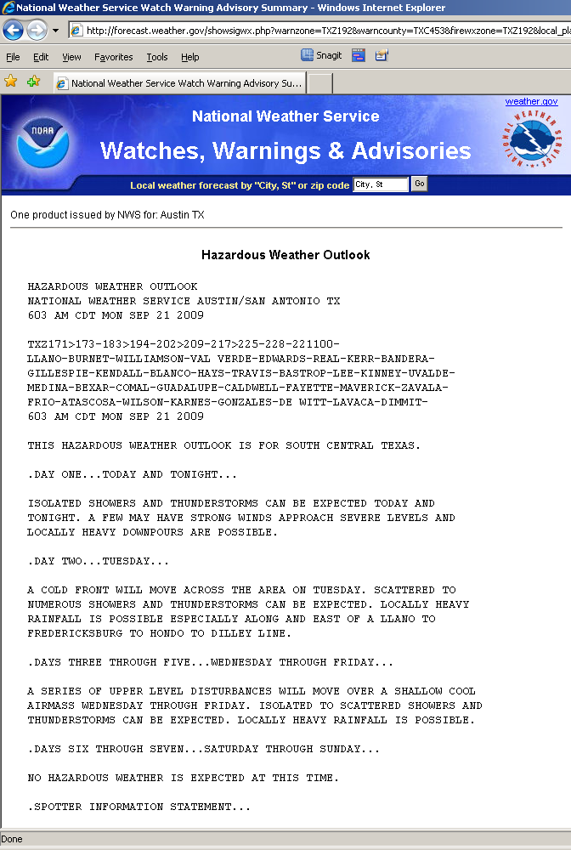
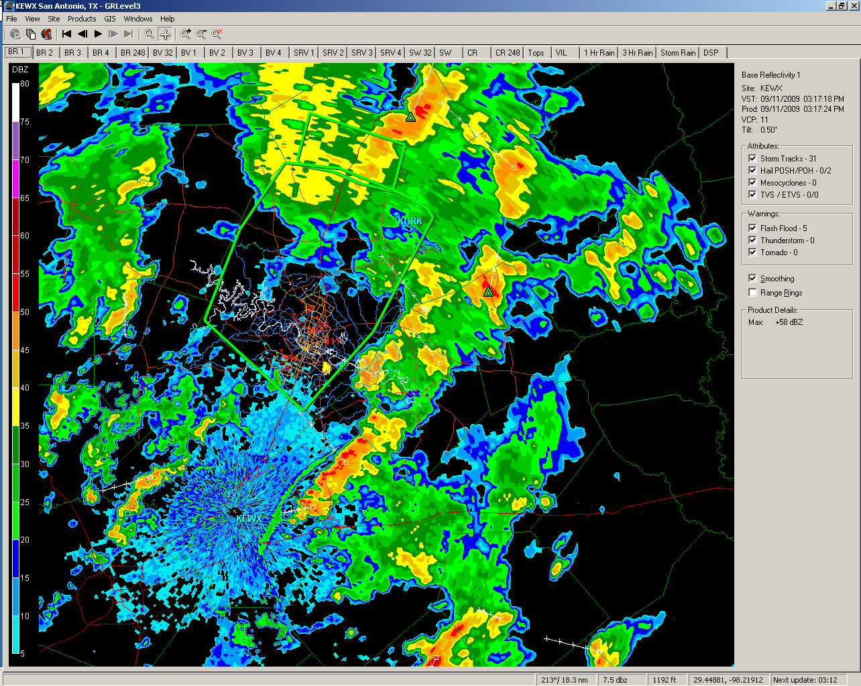
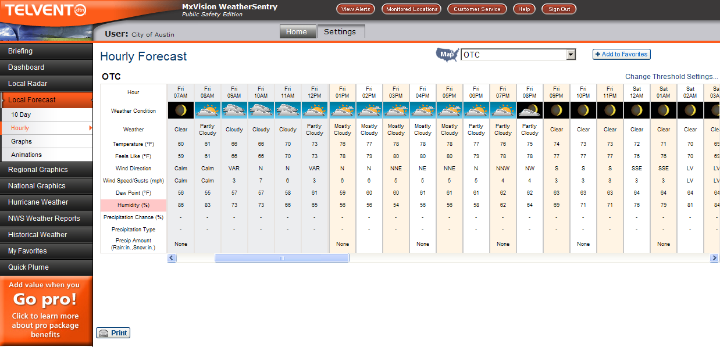
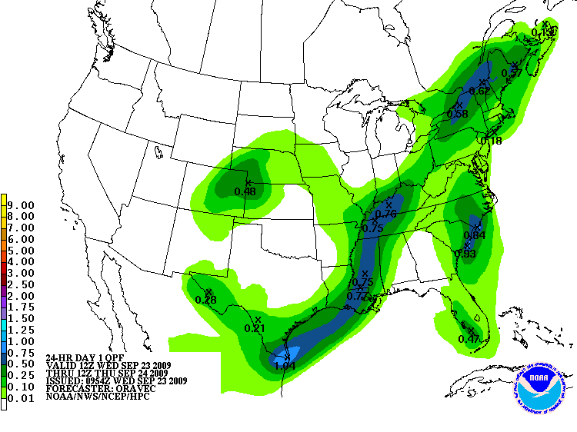
24/7 Monitoring
24/7/365 on-call schedule
4 primary operators
NWS Forecast Products
Doppler Radar
DTN WeatherSentry and Pager Alerts and “Jean” pages

Slide 6
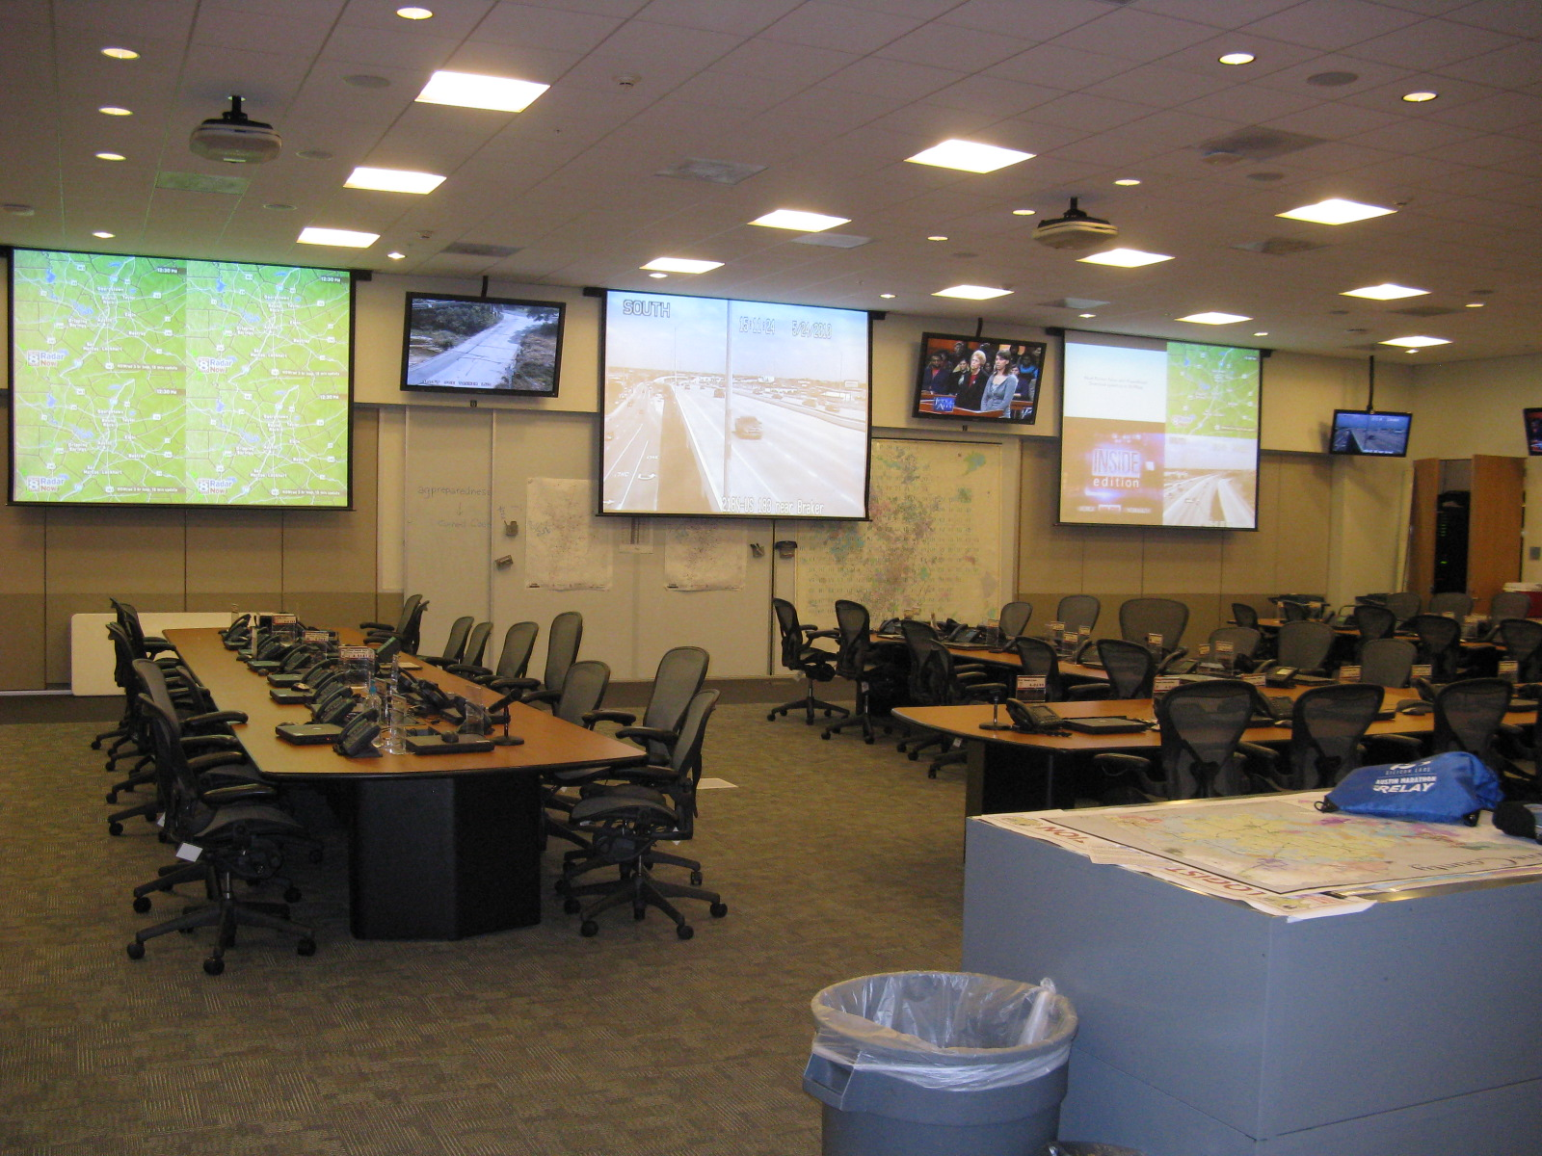
Mission Control

Slide 7
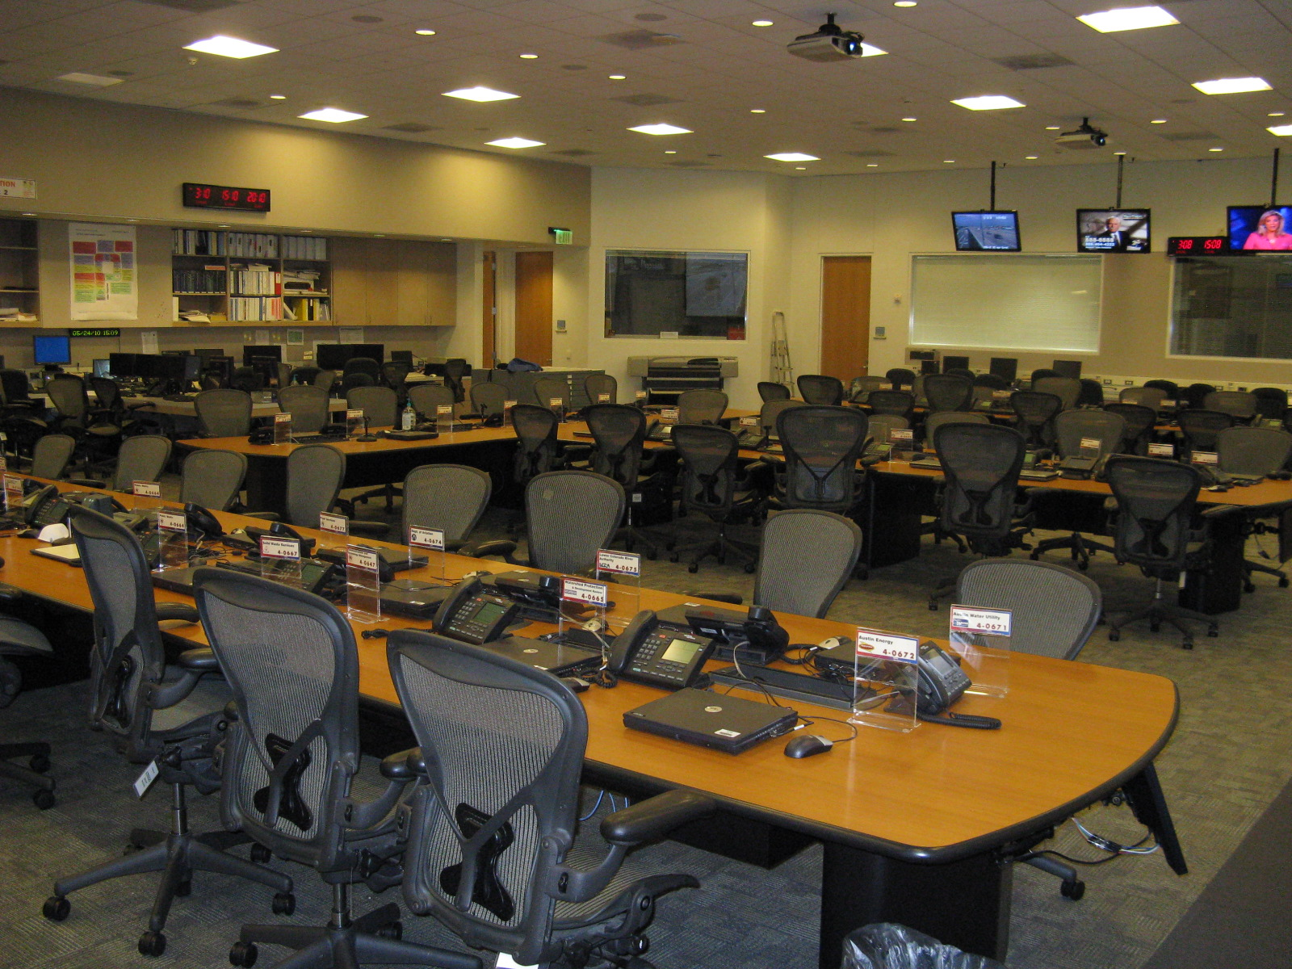
Mission Control

Slide 8
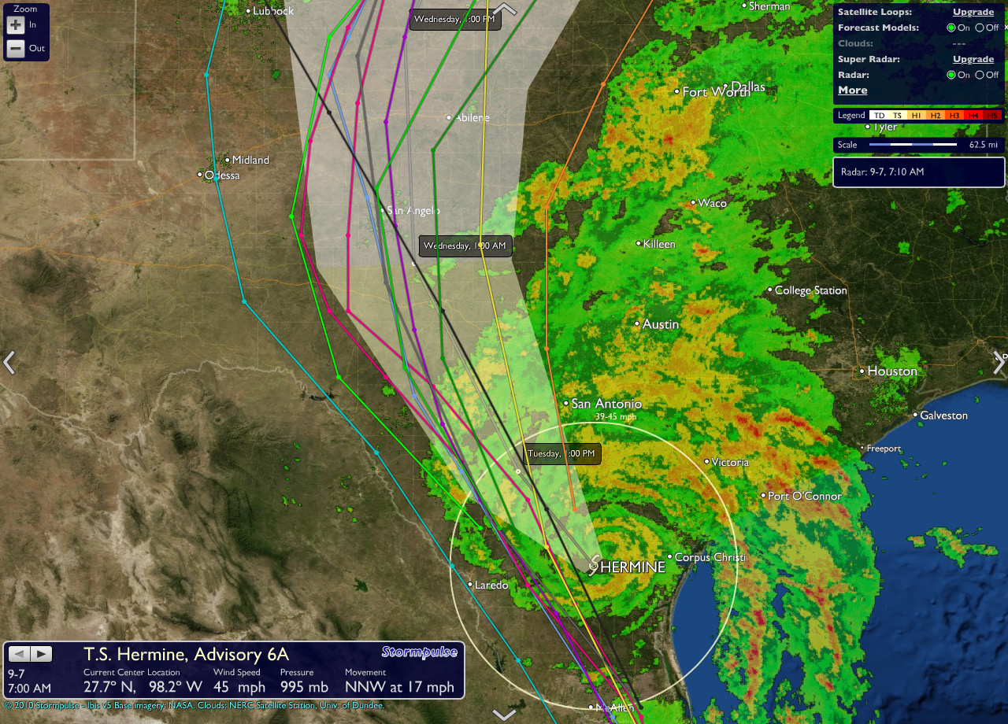
Situational Awareness

Slide 9
Before the storm….

Slide 10
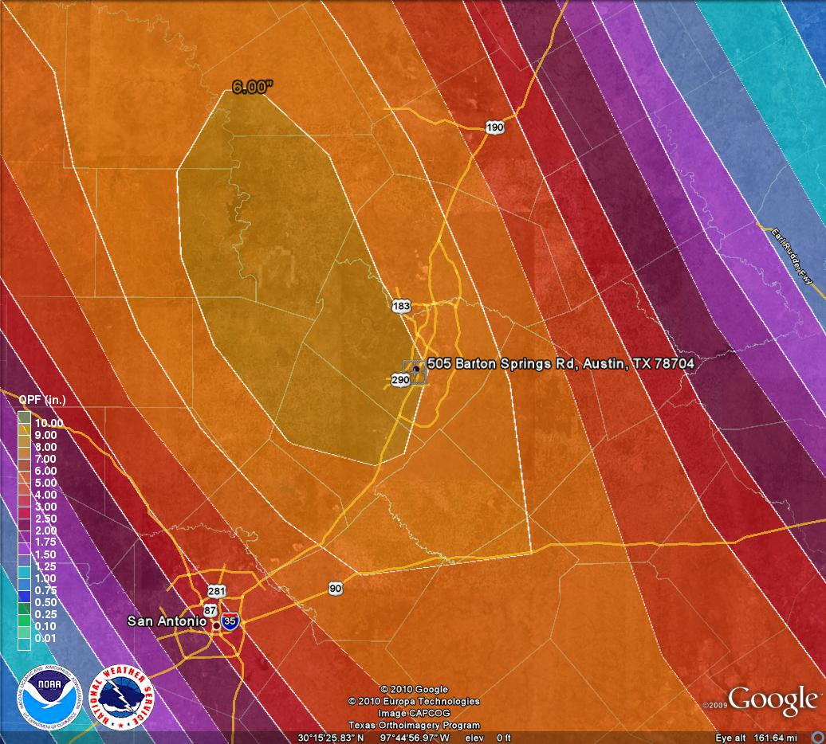
NWS QPF for Day 1

Slide 11
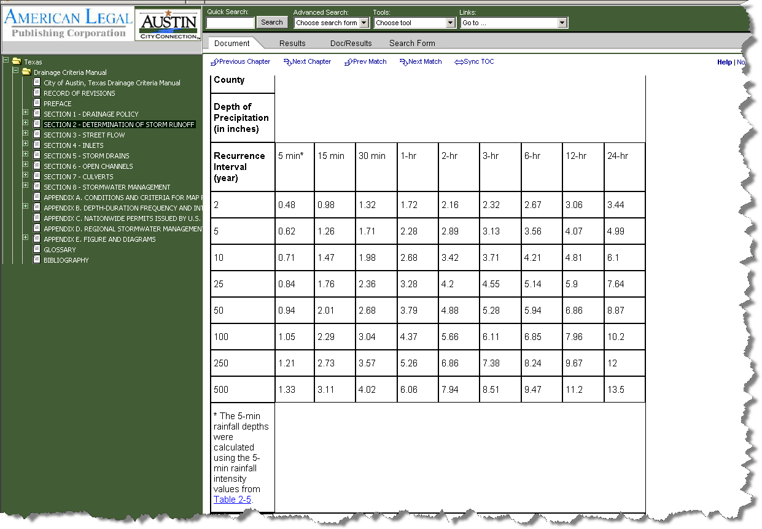

Slide 12
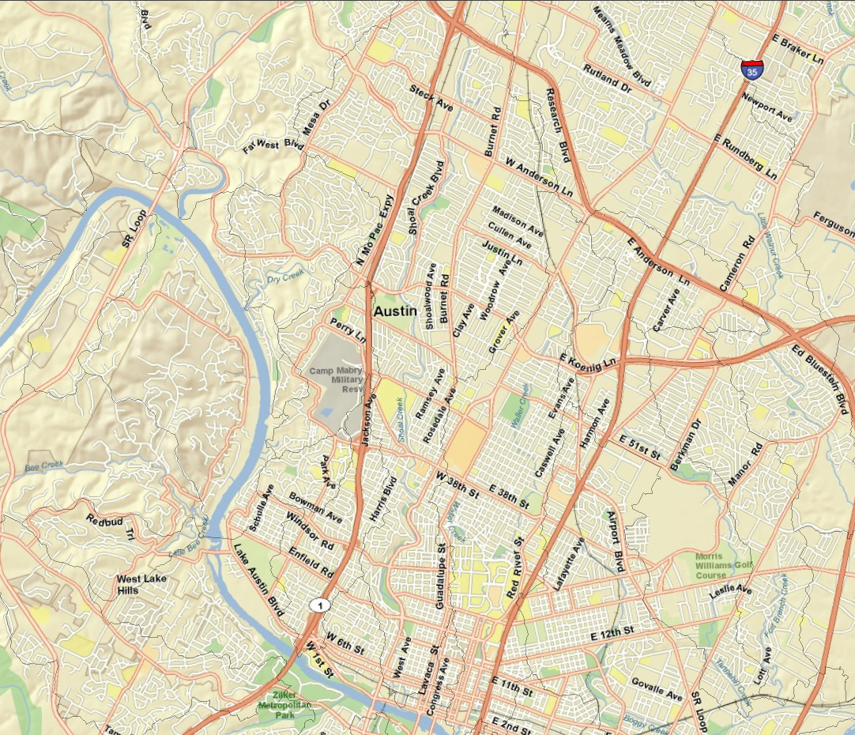

Slide 13
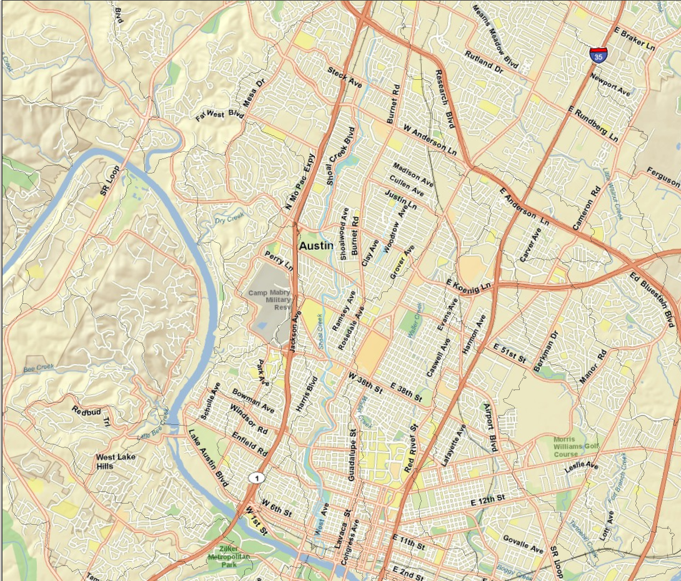

Slide 14
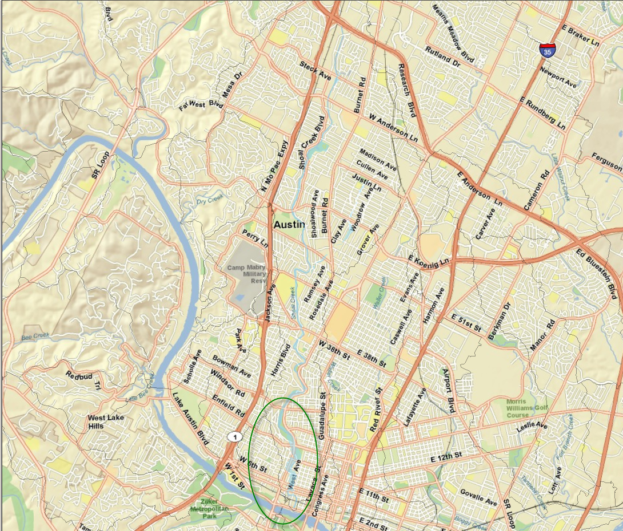

Slide 15
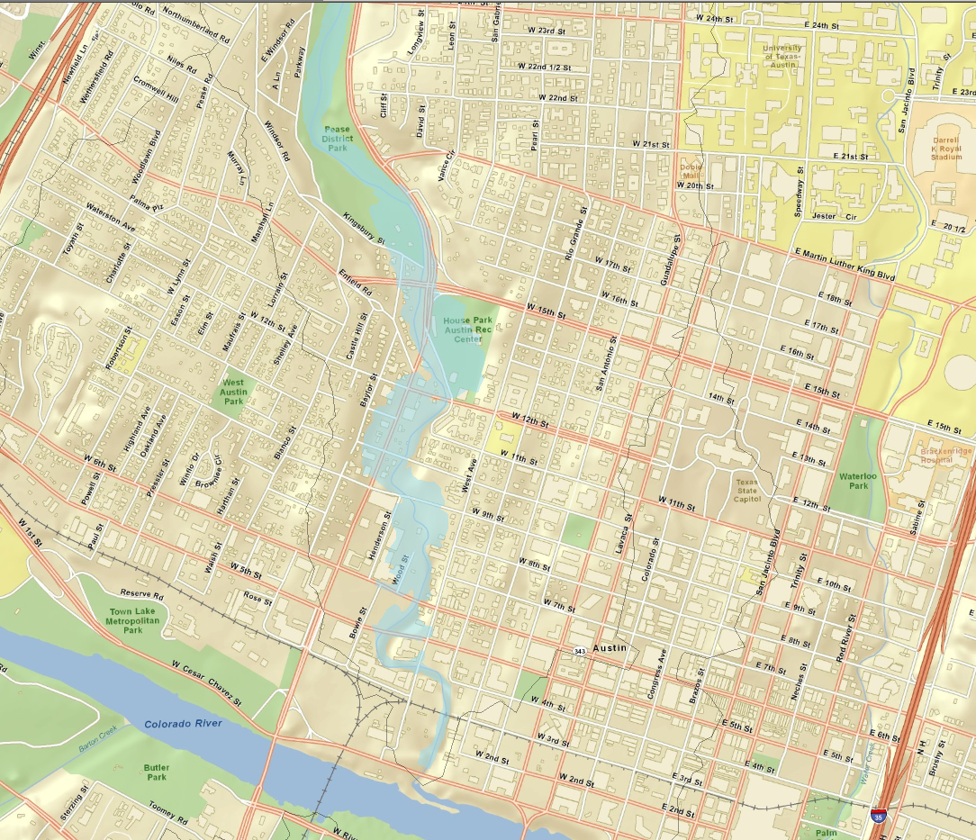

Slide 16
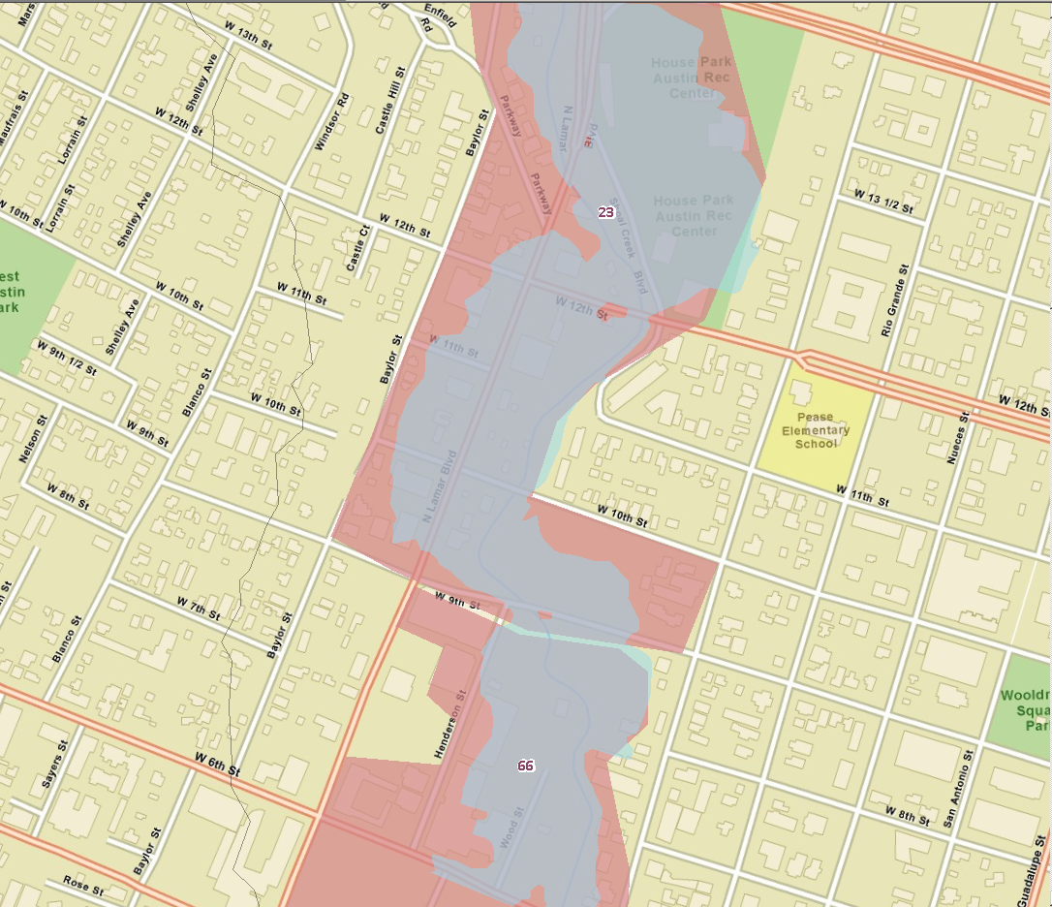

Slide 17
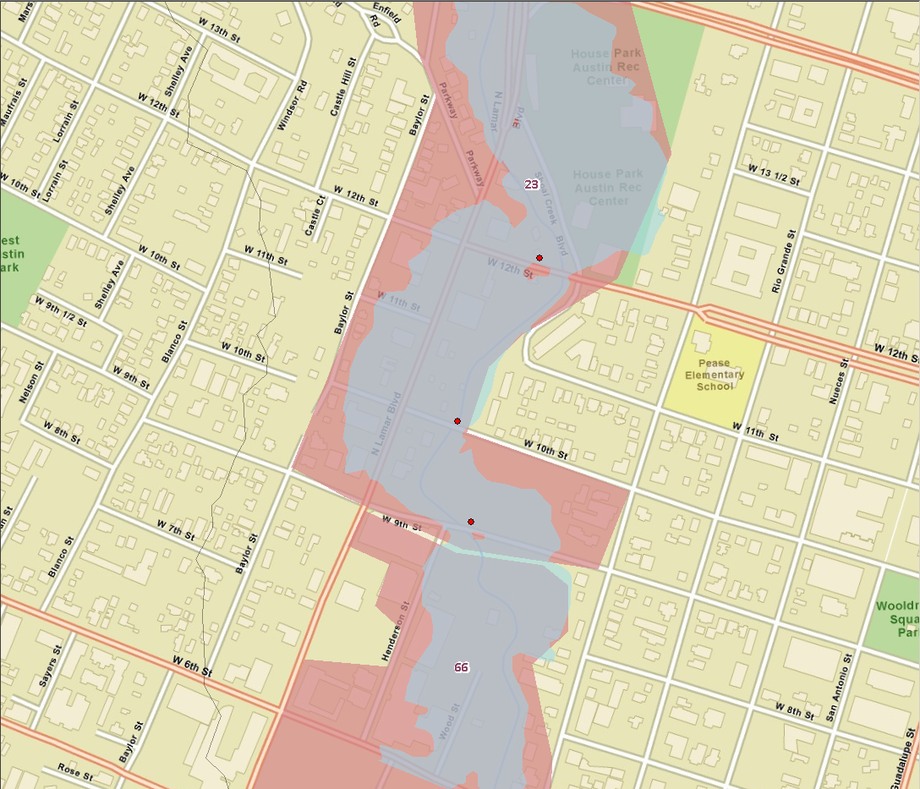

Slide 18
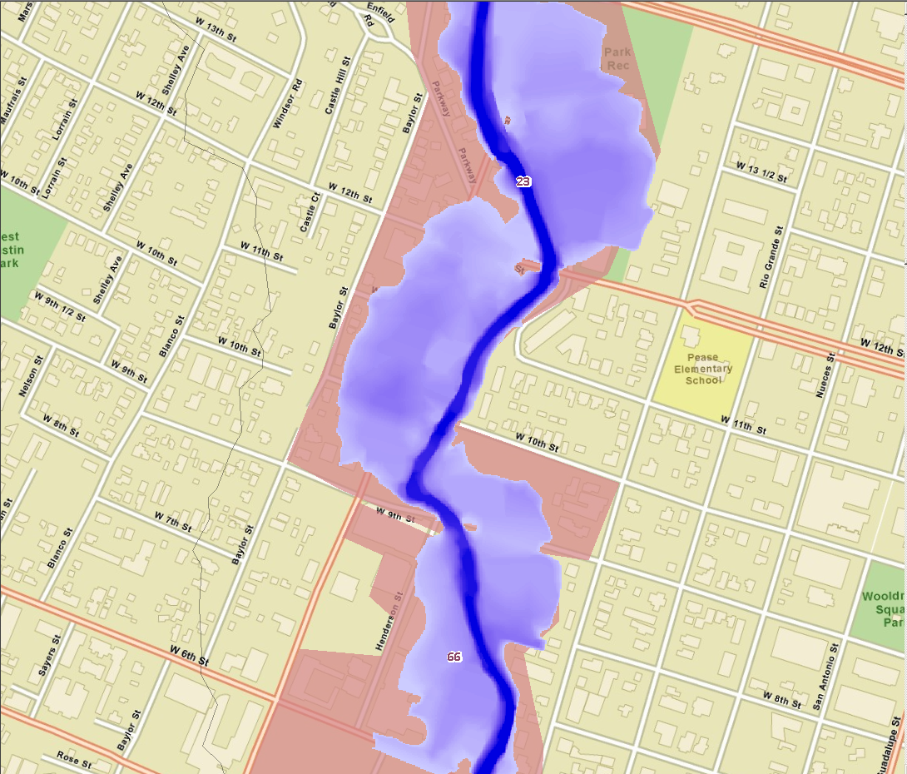

Slide 19
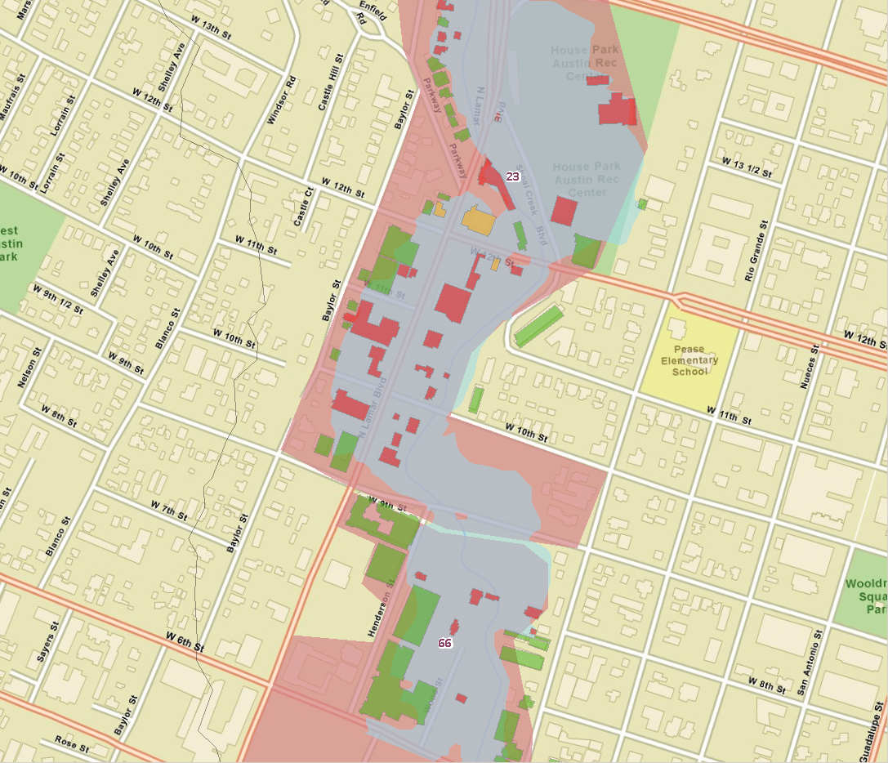

Slide 20
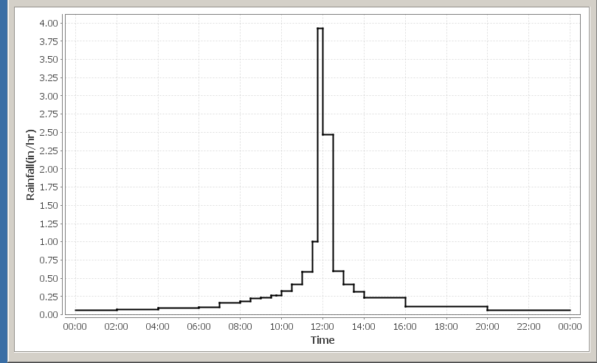
Type III SCS 24 Hour 10 year storm (total depth of 6.1 inches for Austin, TX)

Slide 21
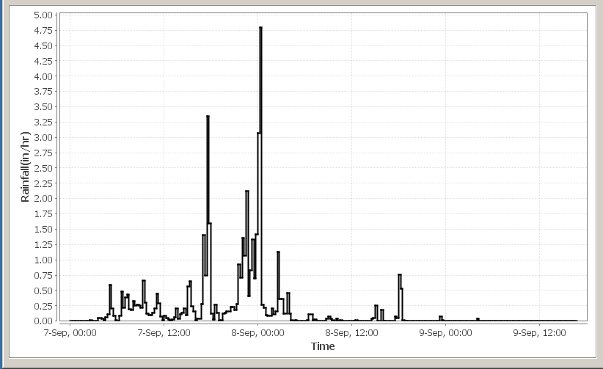
Actual Basin Hyetograph for Bull Creek Watershed (Tropical Storm Hermine)

Slide 22
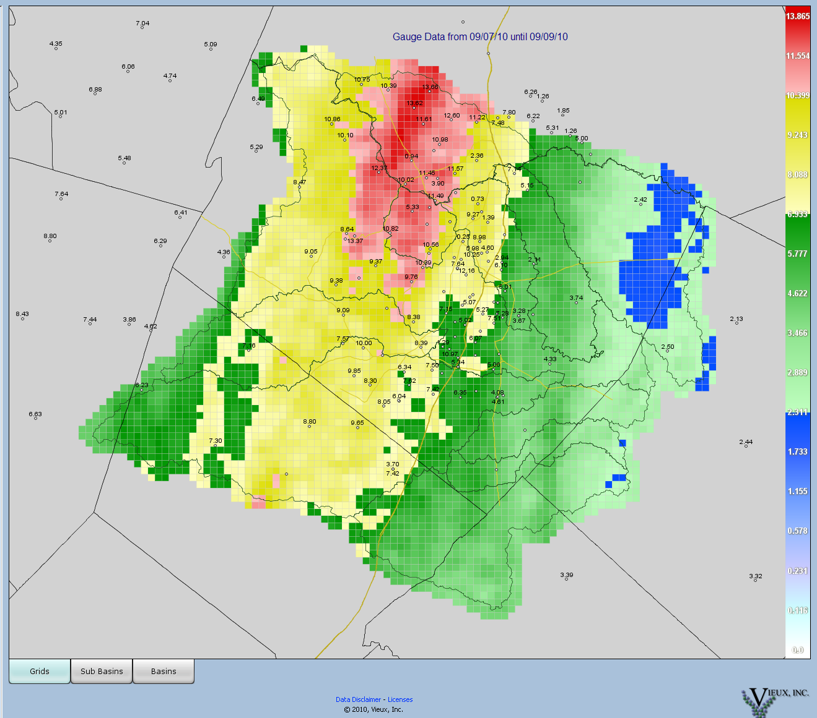

Slide 23
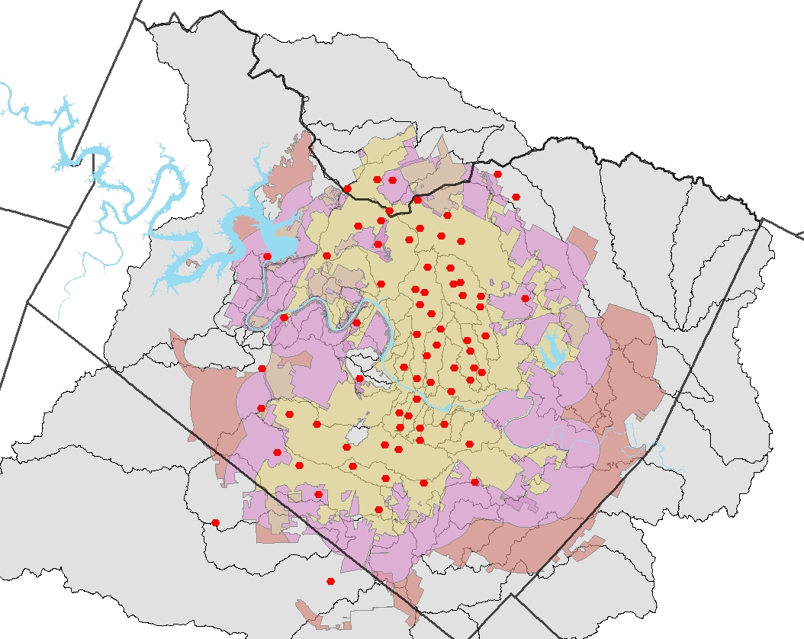
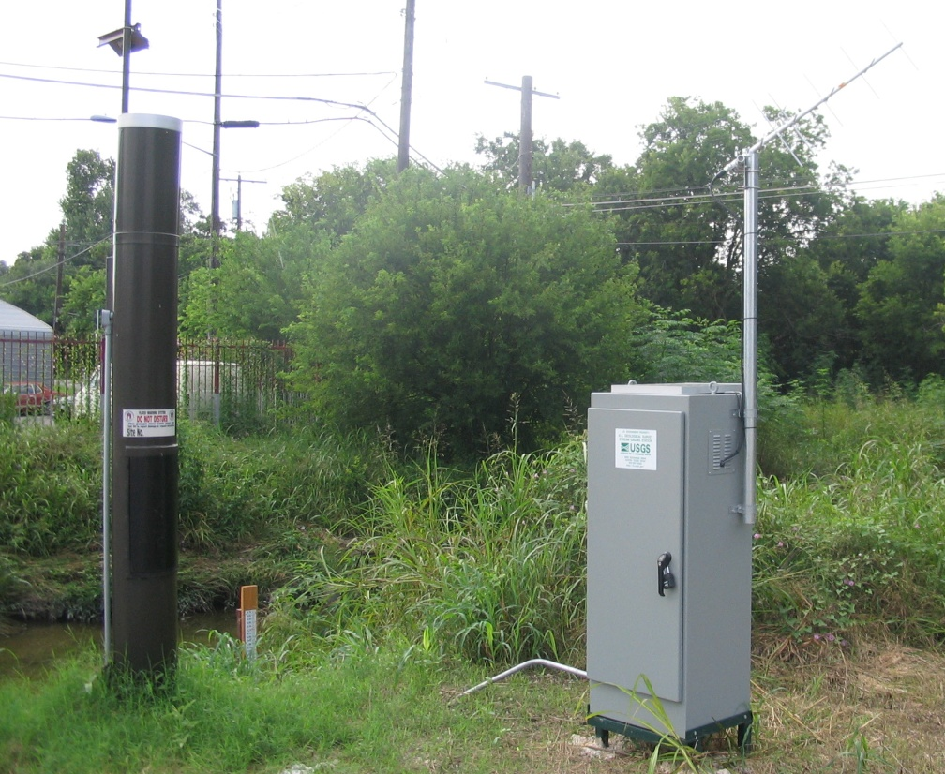
Field Gauge Network
90 precipitation gauges
40 stream level gauges
28 USGS-maintained stream gauges
Notes:
MODBUS – allows us to control gate arms and flashing lights and allows us to poll our gauges, politeness provides better reporting (no missing data)
Waller at Koenig – COA gauge and USGS gauge

Slide 24
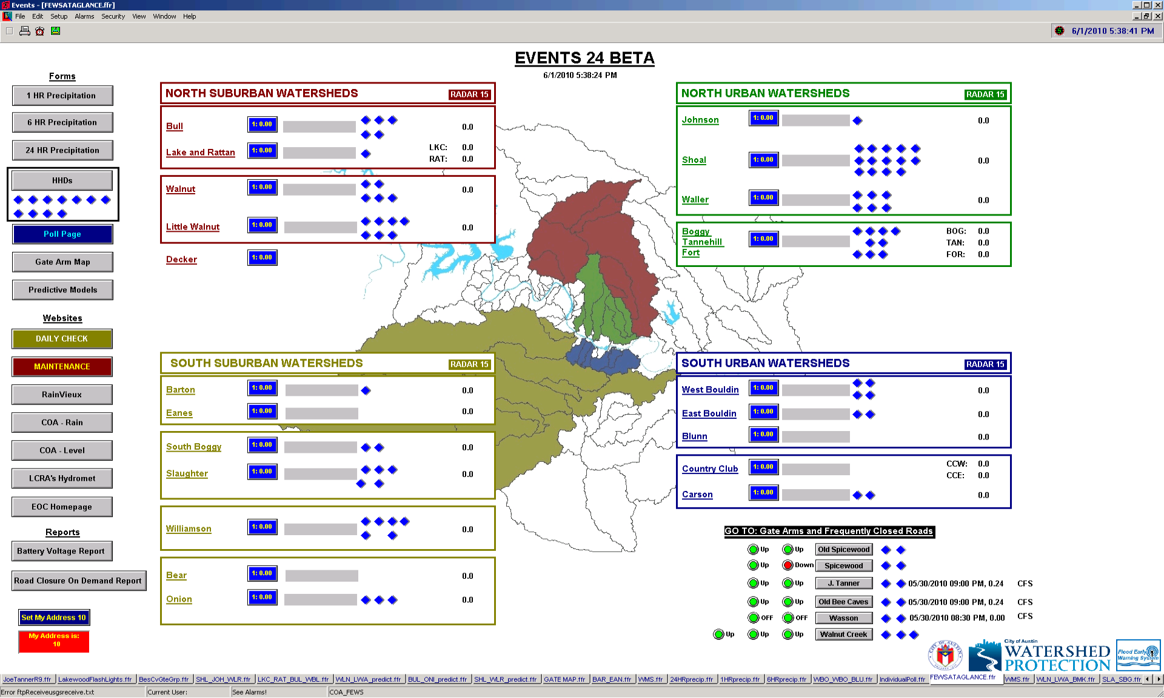
Events SCADA System
Notes:
Pages linked together like a website
Ingests radio information as well as any information from our FTP site (USGS, Vflo)
EVENTS costs approximately $2500 for bare bones software. Configuration and maintenance is an additional cost.
Mirrored systems (2)
Remote access

Slide 26
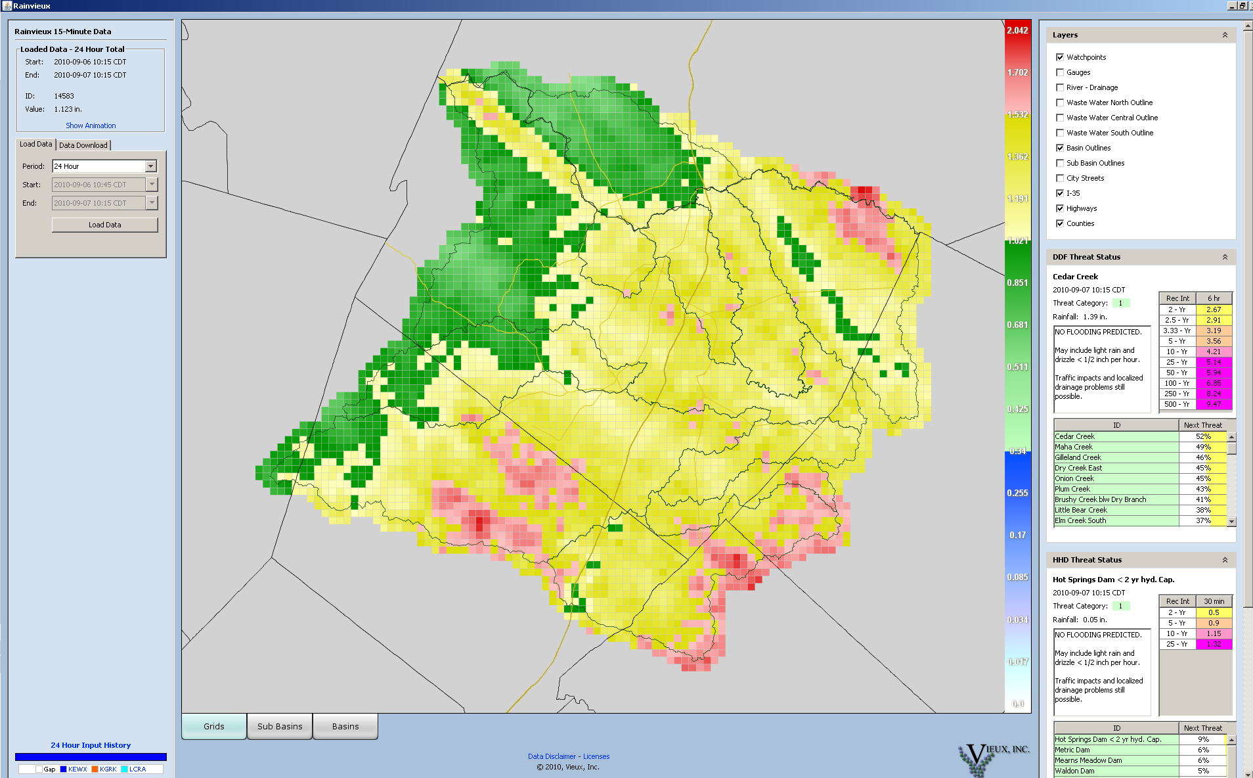
RainVieux™
RainVieux™: Ground-Truthed Radar Rainfall in 1-km² grids
Uses ground gauge information from USGS, LCRA, Brushy Creek WCID as well as COA
Notes:
RainVieux/PreVieux costs approx $3000 per month for basic services – we pay closer to $5800
15 minute updates
1 hr, 3hr, 6hr totals/animation
Ad Hoc Query for totals/animation

Slide 27
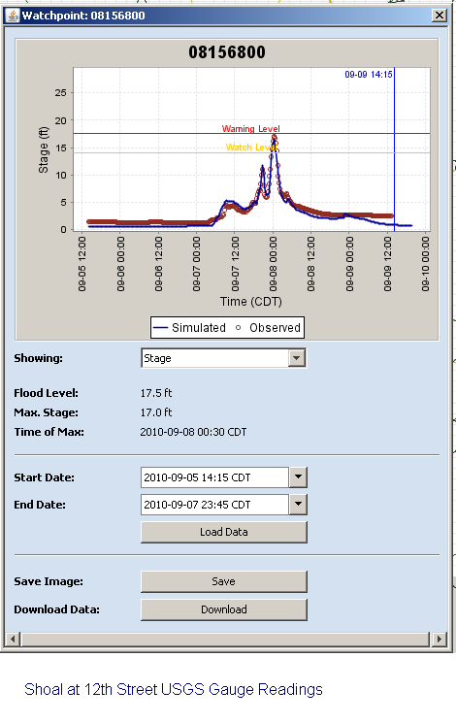

Slide 28
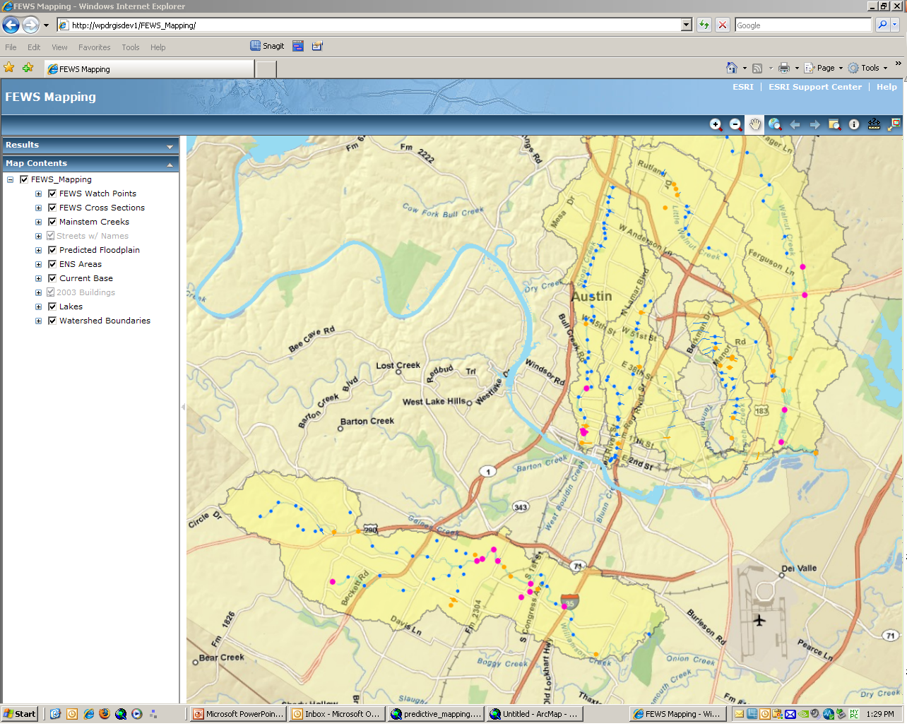
Internal Web Viewer
Notes:
Shows predicted floodplain, watchpoints, and cross-sections at bridge faces
Watchpoints and cross-sections are coded to change color and size as they move from normal to watch to flood status
Area wide view allows us to focus in on problem areas
GIS process knows when to run based on when XML being updated (i.e. when it’s raining) – doesn’t waste computation time

Slide 29
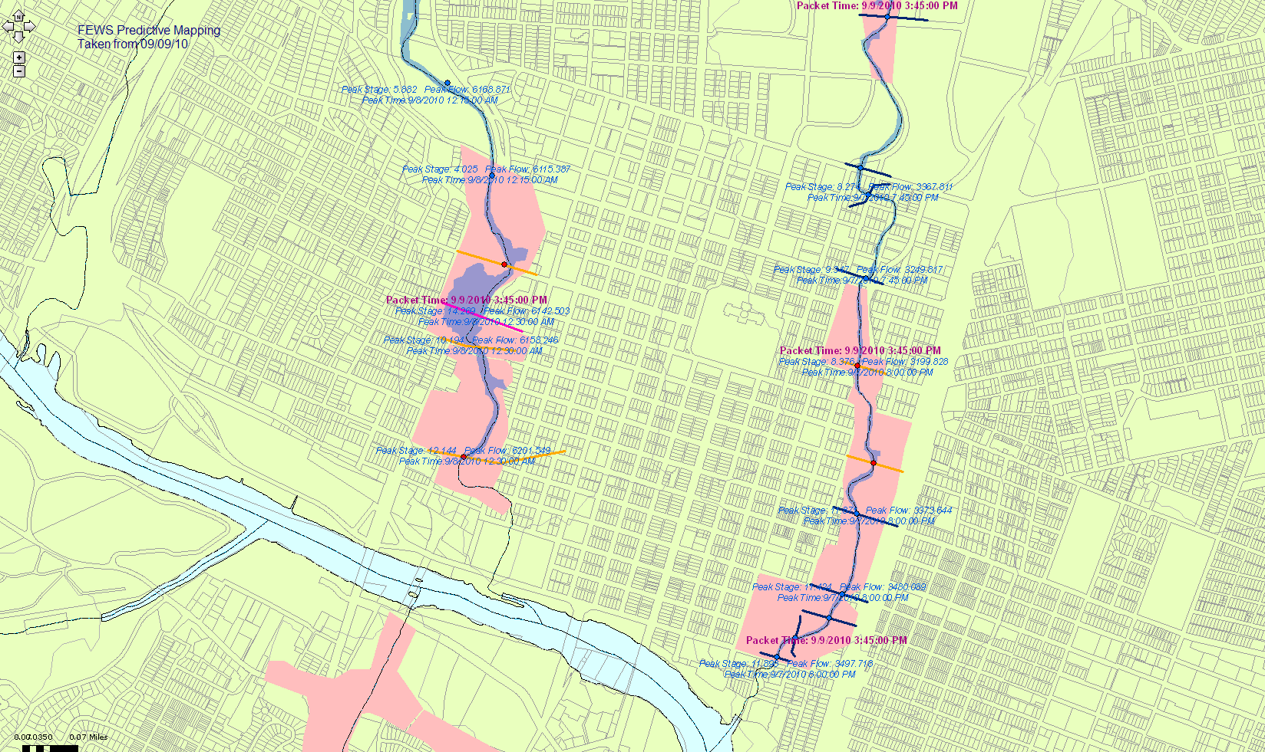
Internal Web Viewer

Slide 30
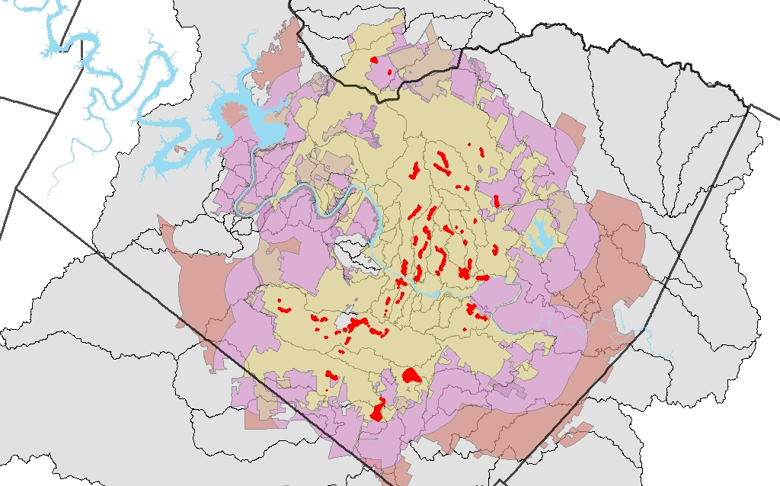
ENS Areas
Notes:
74 ENS areas
Represent Austin’s flooding hotspots: areas that flood bad, flood fast, and flood often
Located mostly throughout urban core

Slide 31
Other tools
Flashing lights
Gate arms
Field Observations
Traffic cameras

Slide 32
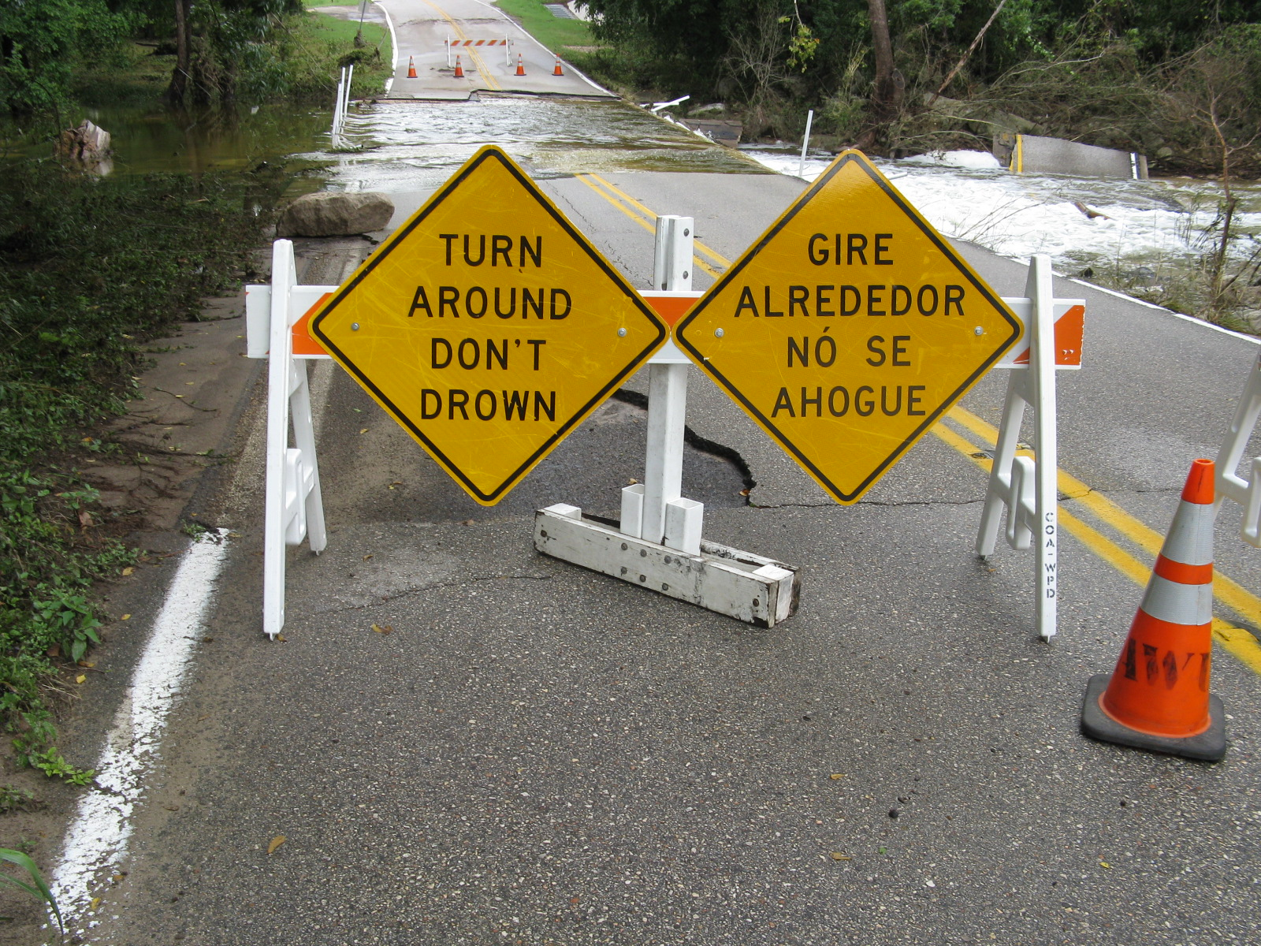

Slide 33
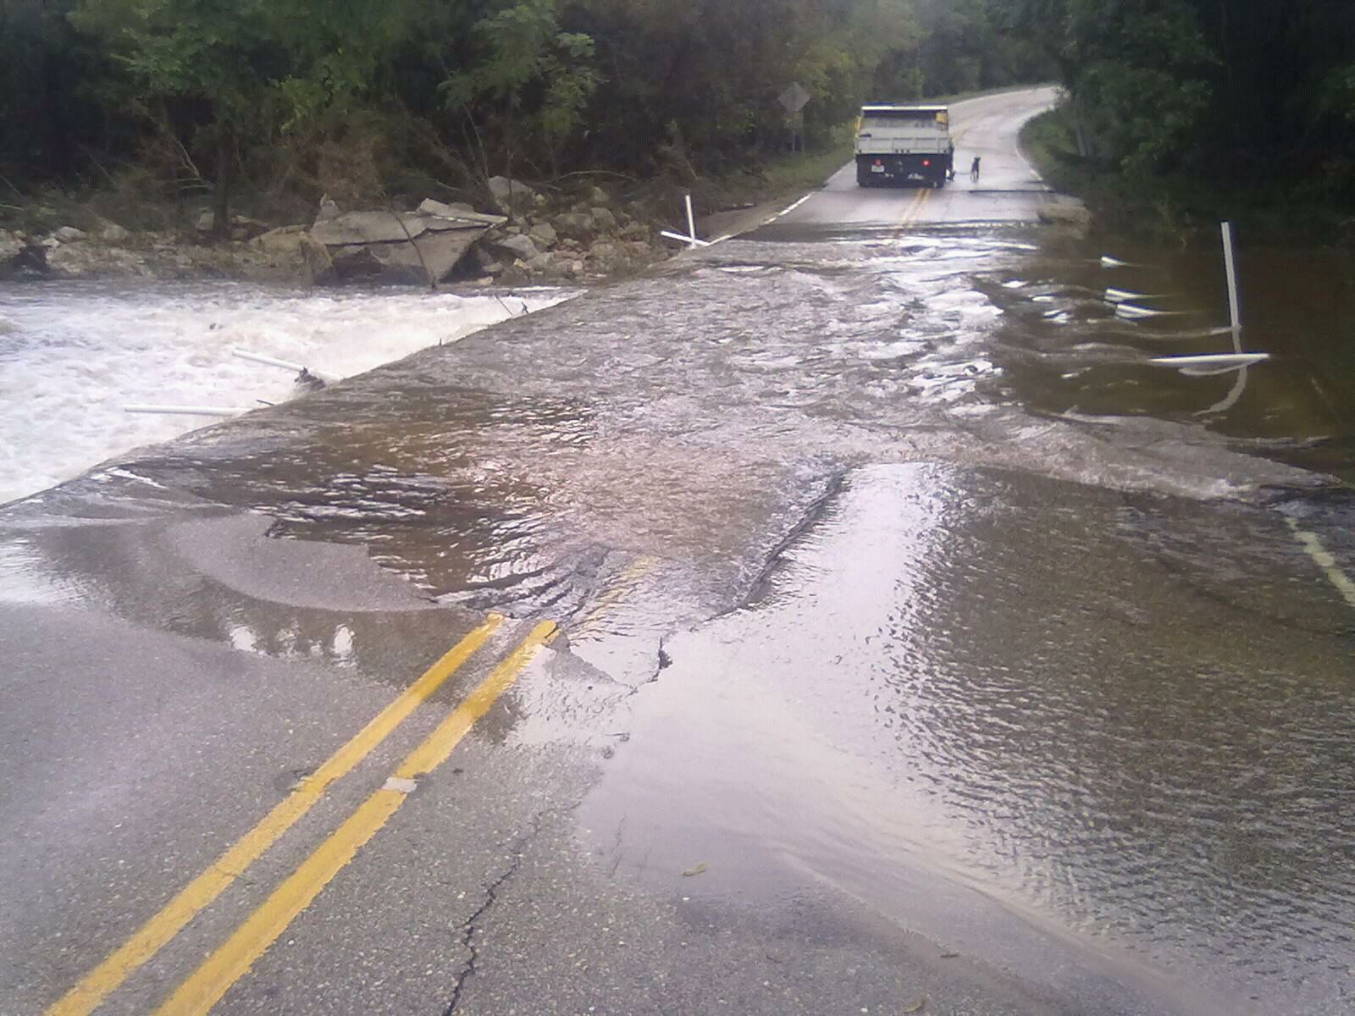

Slide 34
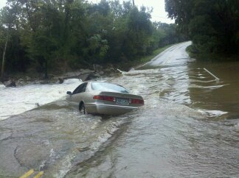

Slide 35
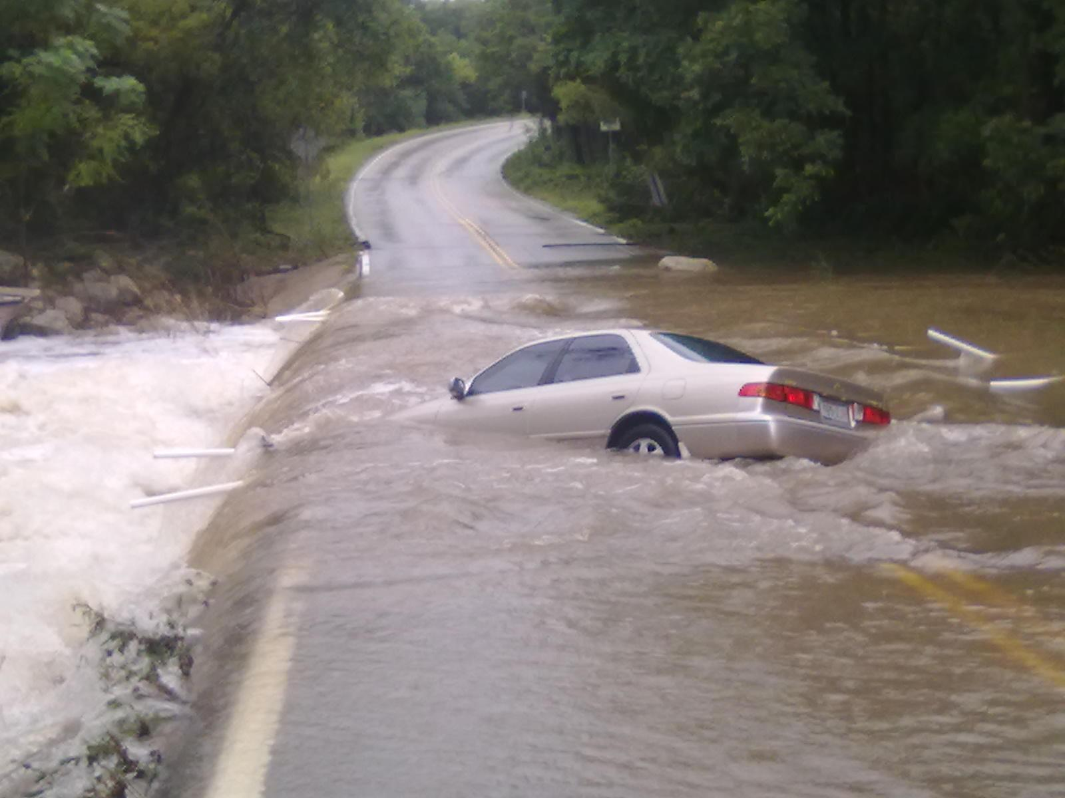

Slide 36
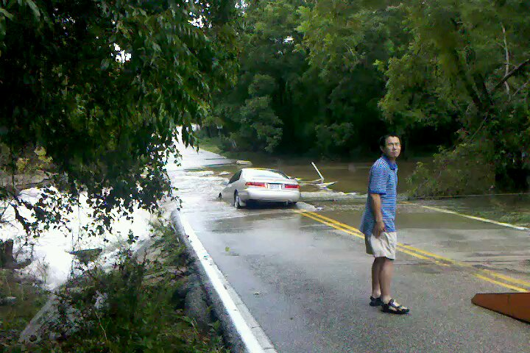

Slide 37
