Slide 1
TxDOT’s Role in Flood Management
Jack Kayser, P.E., Ph.D., CFM
TxDOT – Austin District – Hydraulics Team
Flash Flood Awareness Meeting
October 8, 2010
Texas Department of Transportation

Slide 2
Outline of Presentation
TxDOT’s Organizational Structure
Jurisdiction and Responsibilities
Emergency Flood Response Procedures
Contributions to Floodplain Management
Process of Hydrology and Hydraulic Design
Example of Cross Drainage Culvert Design
Summary and Conclusions
References
Texas Department of Transportation

Slide 3
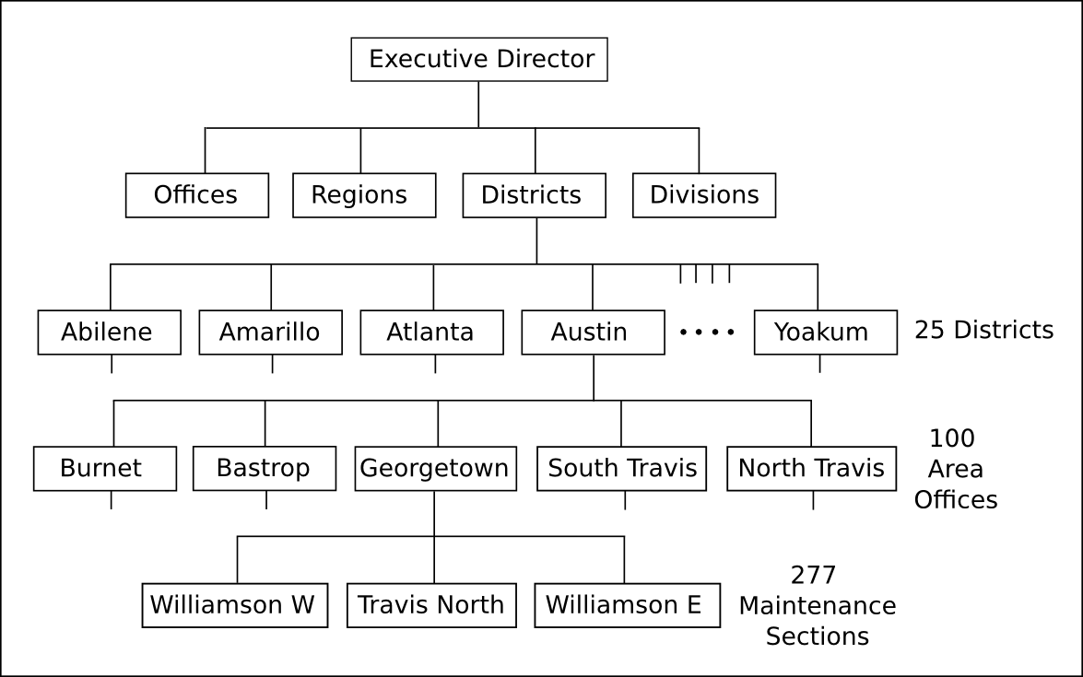
TxDOT’s Organizational Structure
As of August 2009 there are 13,015 TxDOT employees, 11.7% of which are P.E.s or E.I.T.s [1].
Texas Department of Transportation

Slide 4
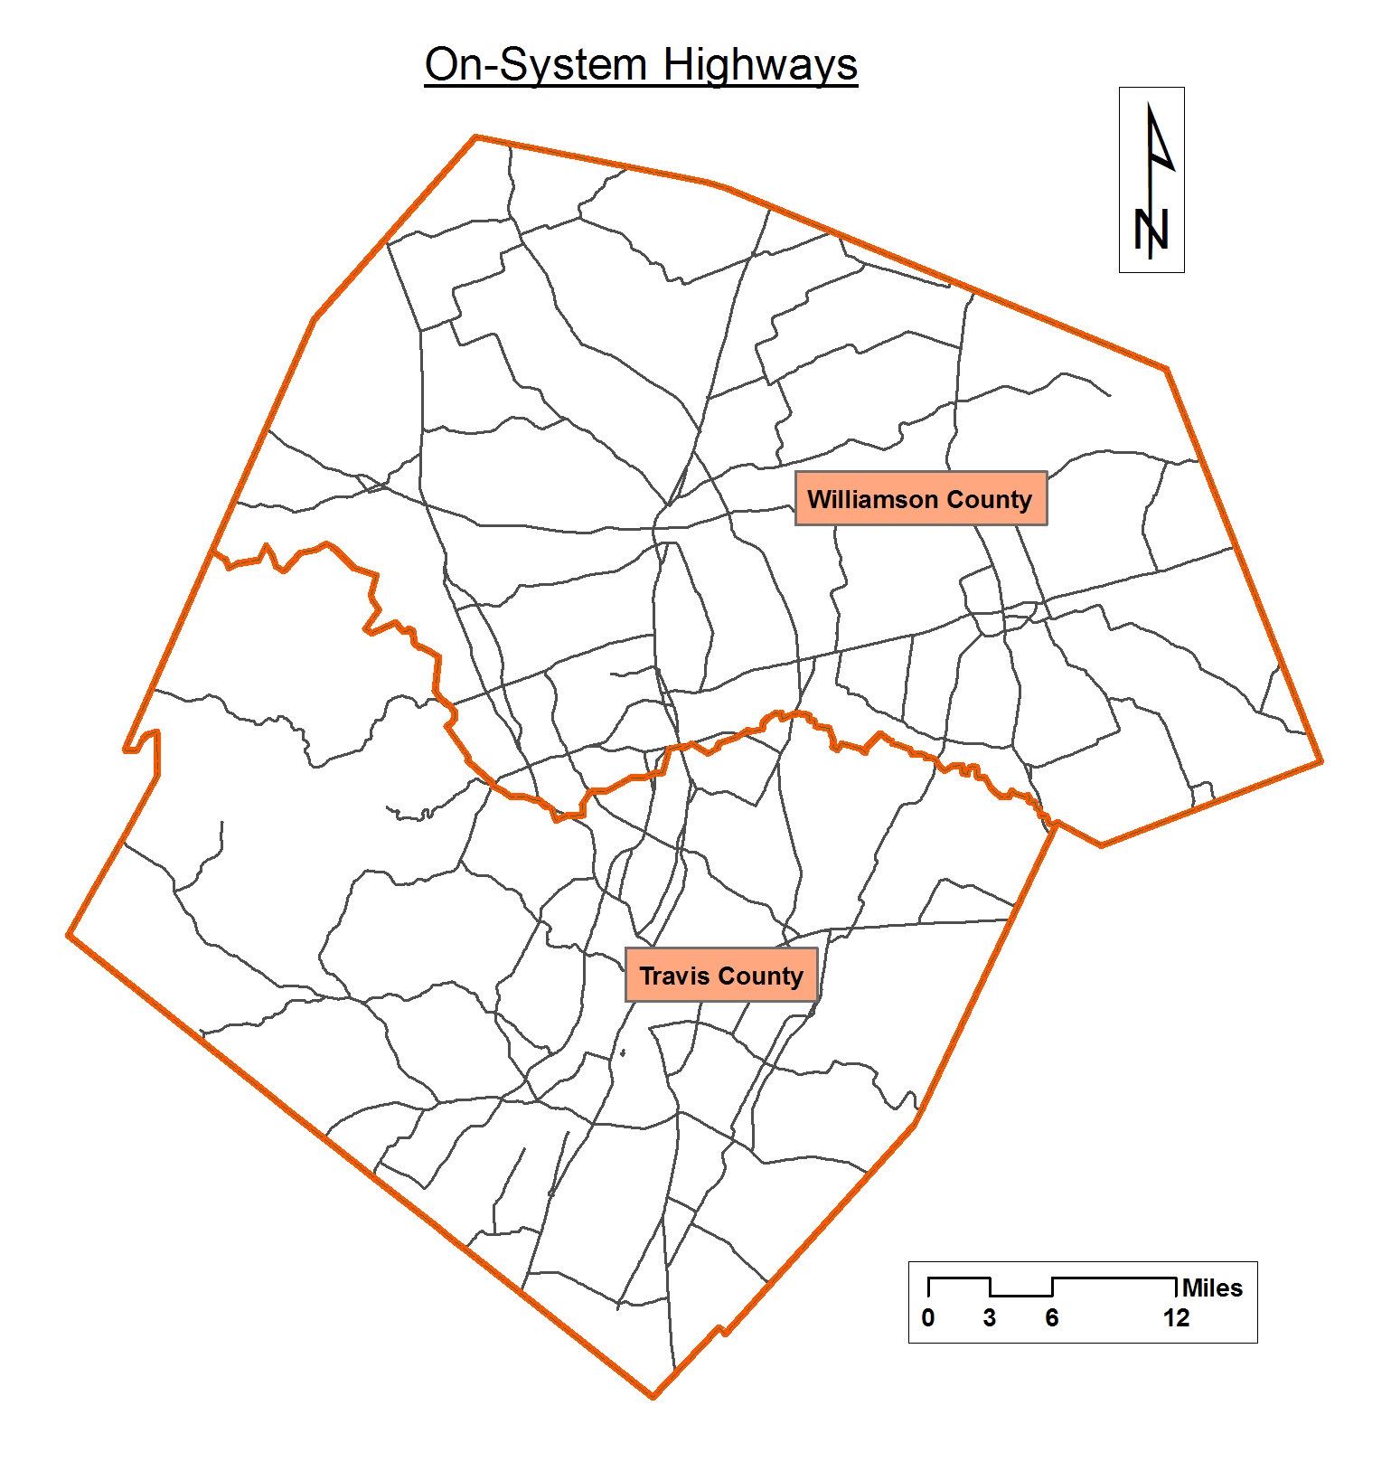
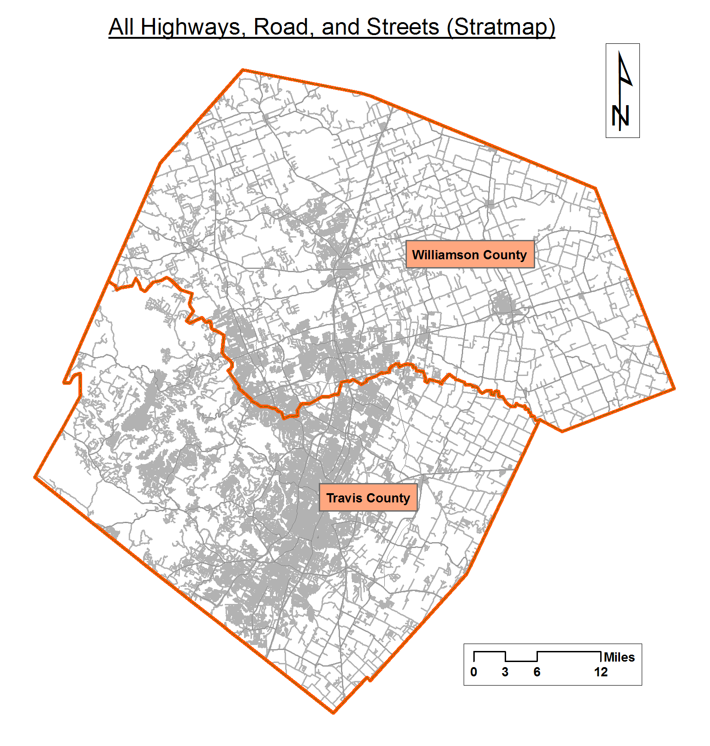
Jurisdiction and Responsibilities
For Travis and Williamson Counties there are 1,170 On-System miles and 7,205 Stratmap miles,
statewide there are 80,067 On-System miles and 306,403 Stratmap miles (centerline miles) [2].
Texas Department of Transportation

Slide 5
Jurisdiction and Responsibilities
On-System:
Plan, Design, Build, Operate, and Maintain
Emergency Response per internal and external request
Off-System:
Inspect All Public Bridges and Bridge Class Culverts
Oversight of Federal Transportation Funds
Emergency Response per Governor’s Office of Emergency Management
Texas Department of Transportation

Slide 6
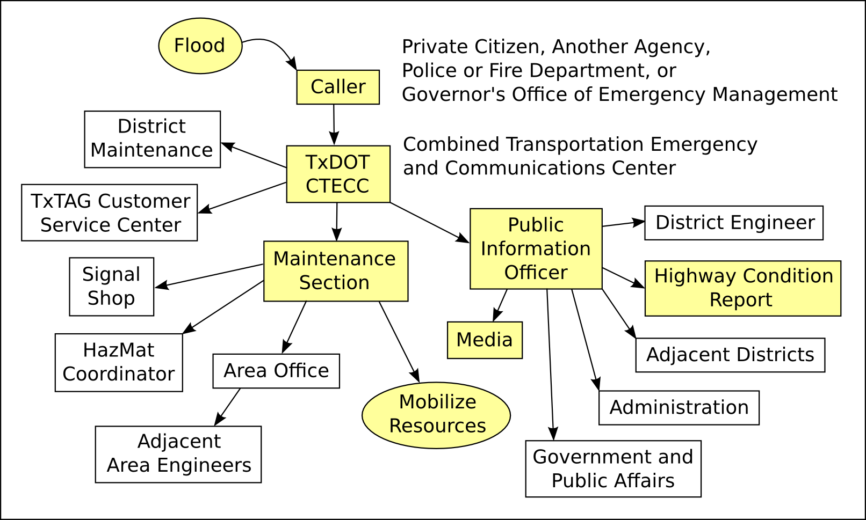
Emergency Flood Response Procedures [3]
Maintenance personnel are encouraged to use their own judgment, eliminating chain of
command delays. Such personnel often personally know local DPS, Fire and EMS personnel.
73% of TxDOT staff are over 40 years of age and 53% have 11 or more years with the agency [4].
Texas Department of Transportation

Slide 7
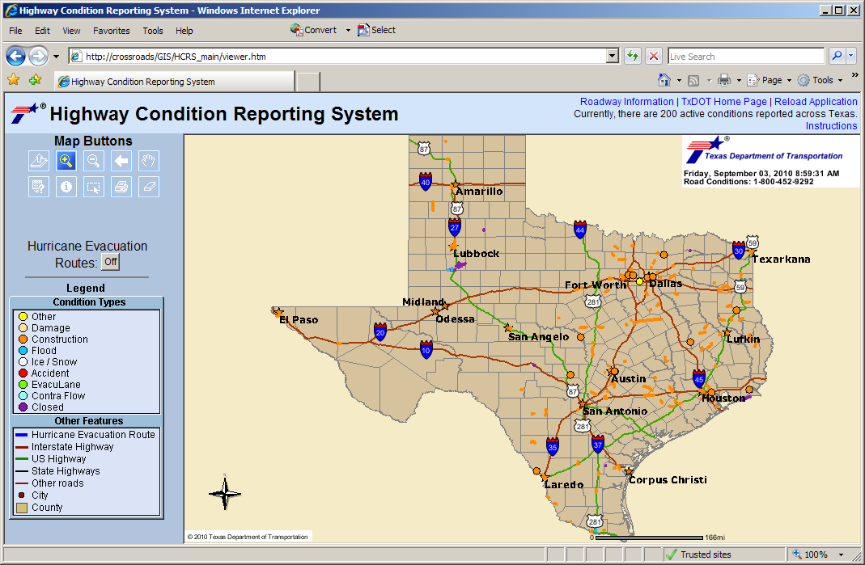
Highway Condition Reporting System
Texas Department of Transportation

Slide 8
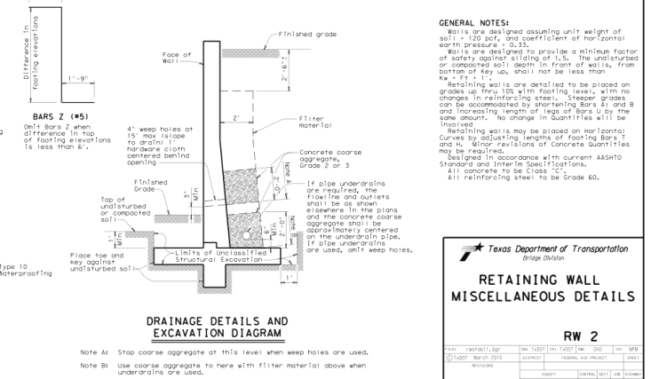
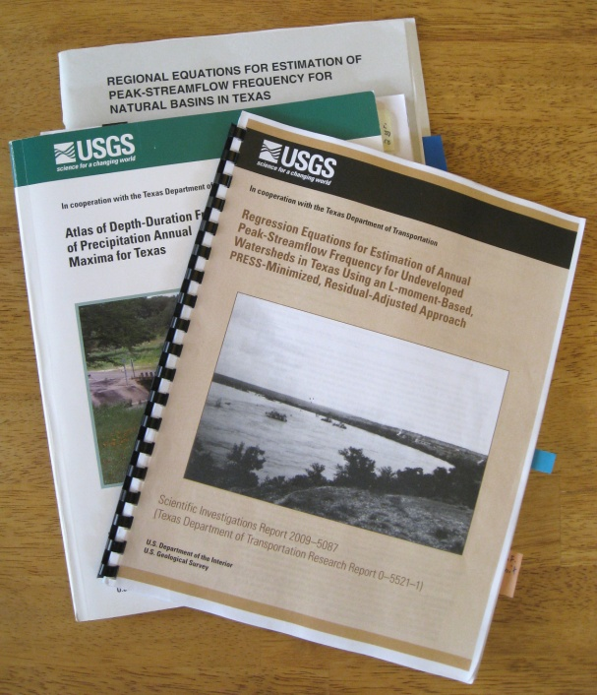
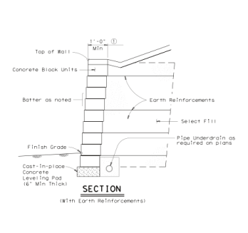
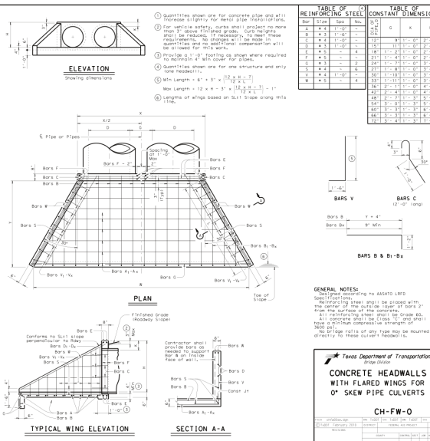
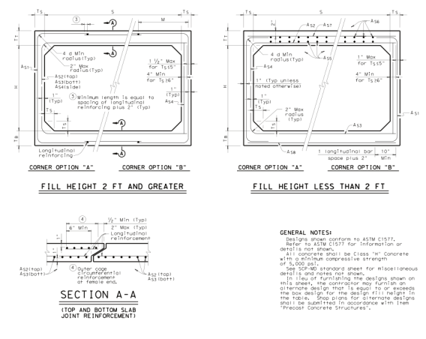
Contributions to Floodplain Management
Sponsored USGS and
university hydrology and
hydraulic research and
publications, used in
engineering practice.
Standard hydraulic structure
designs and specifications,
used throughout the industry.
Hosting and supporting the
TFMA – NFIP training
program from 2004 to 2008.
Texas Department of Transportation

Slide 9
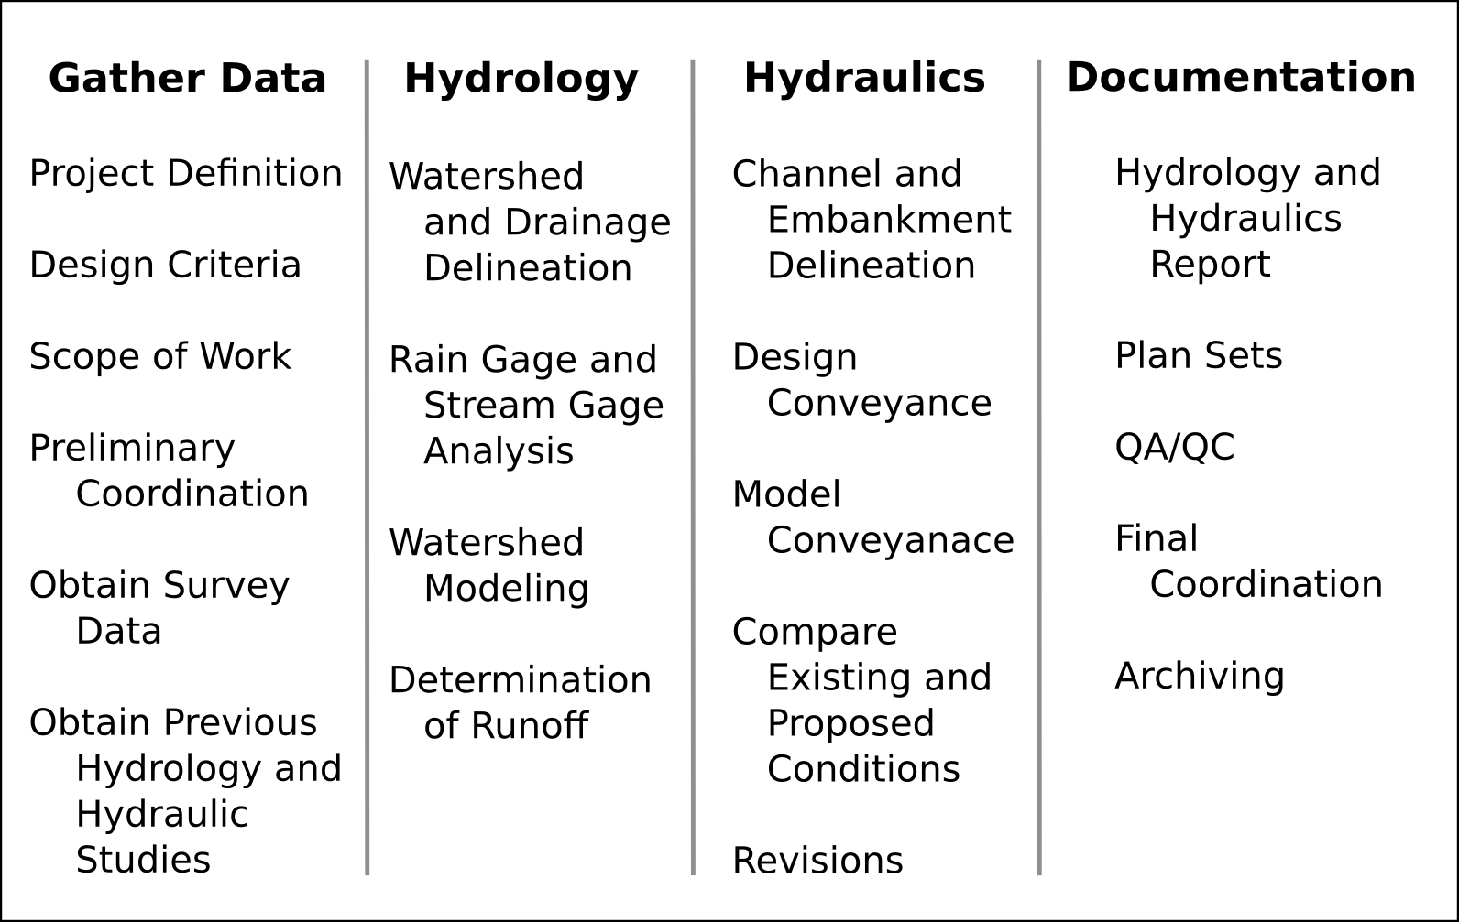
Process of Hydrology and Hydraulic Design [5]
Texas Department of Transportation

Slide 10
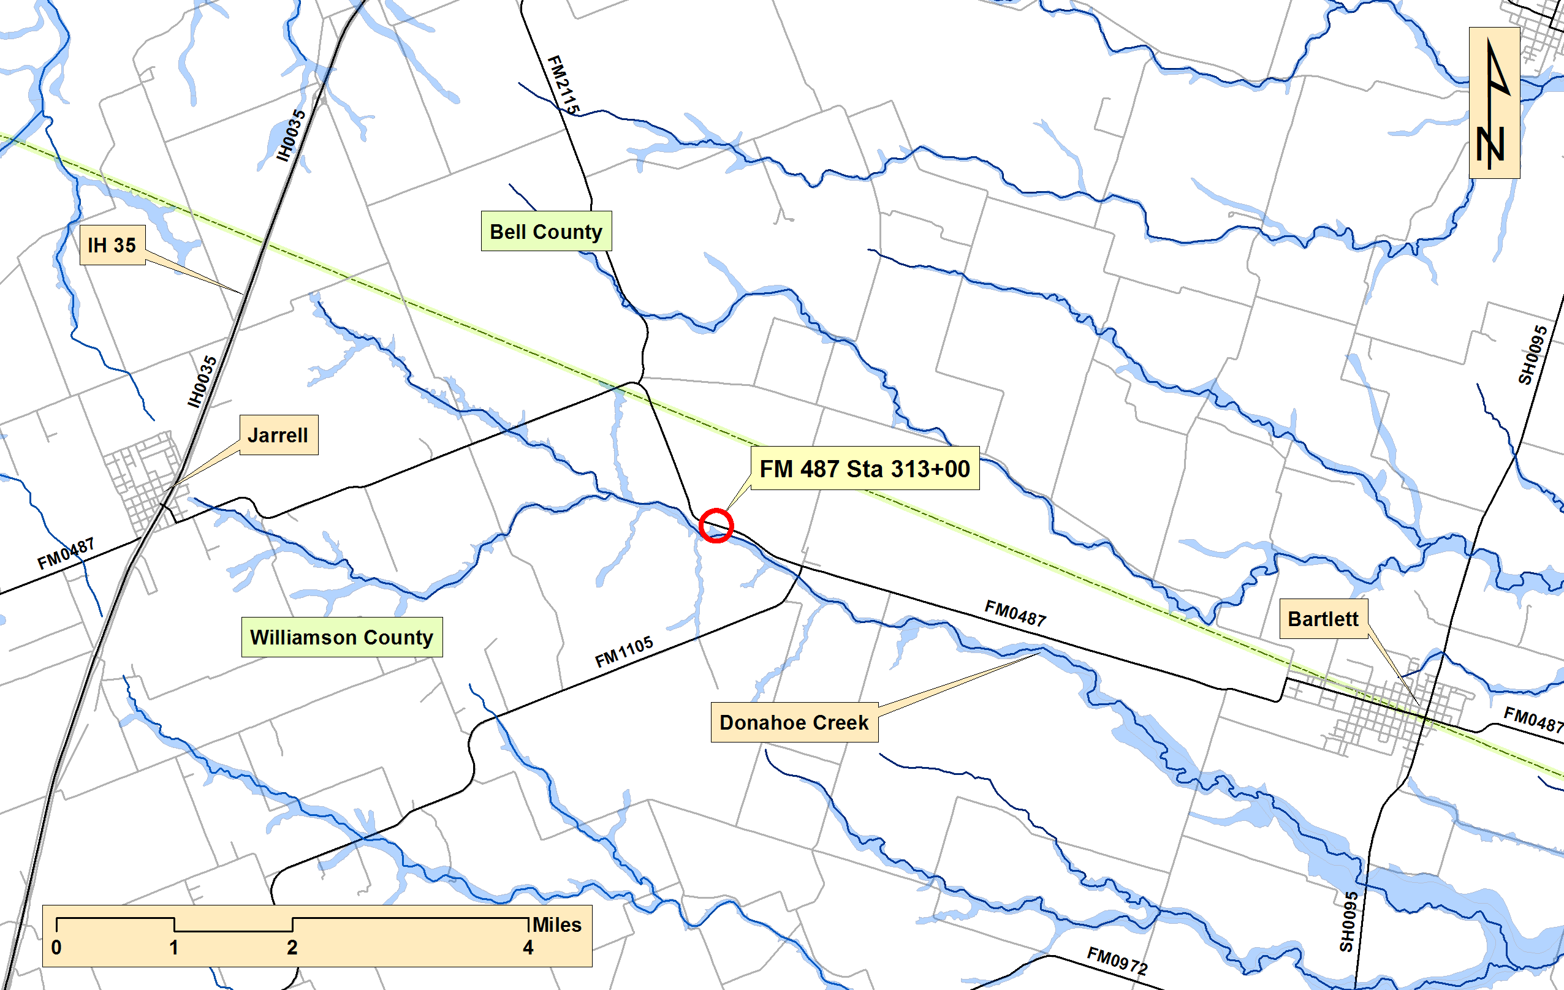
Example of Cross Drainage Culvert Design
Texas Department of Transportation

Slide 11
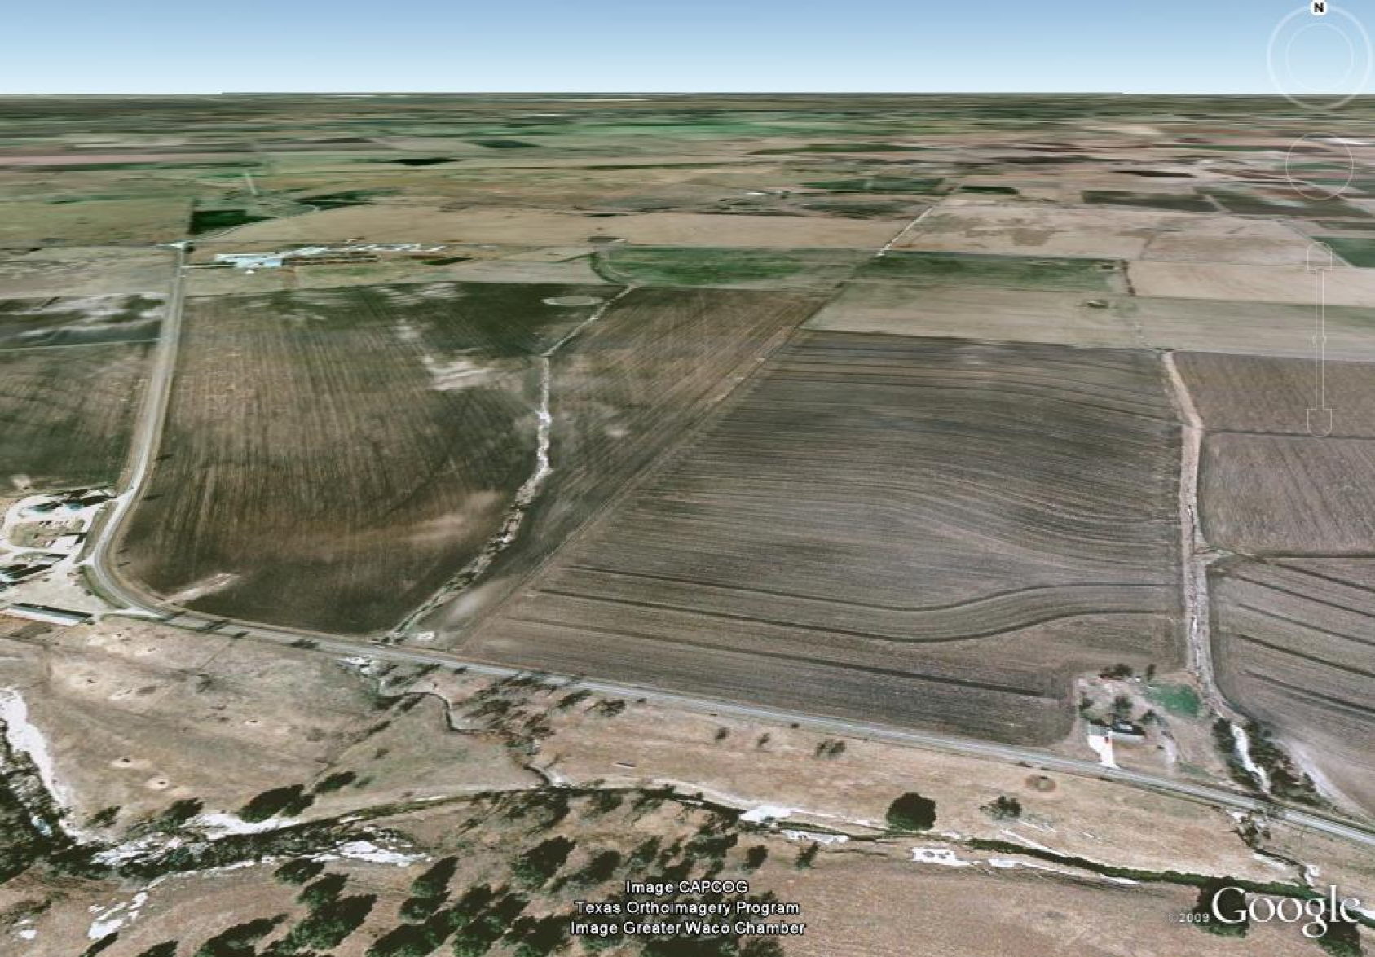
Where is Structure - What is Scope of Work
Texas Department of Transportation

Slide 12
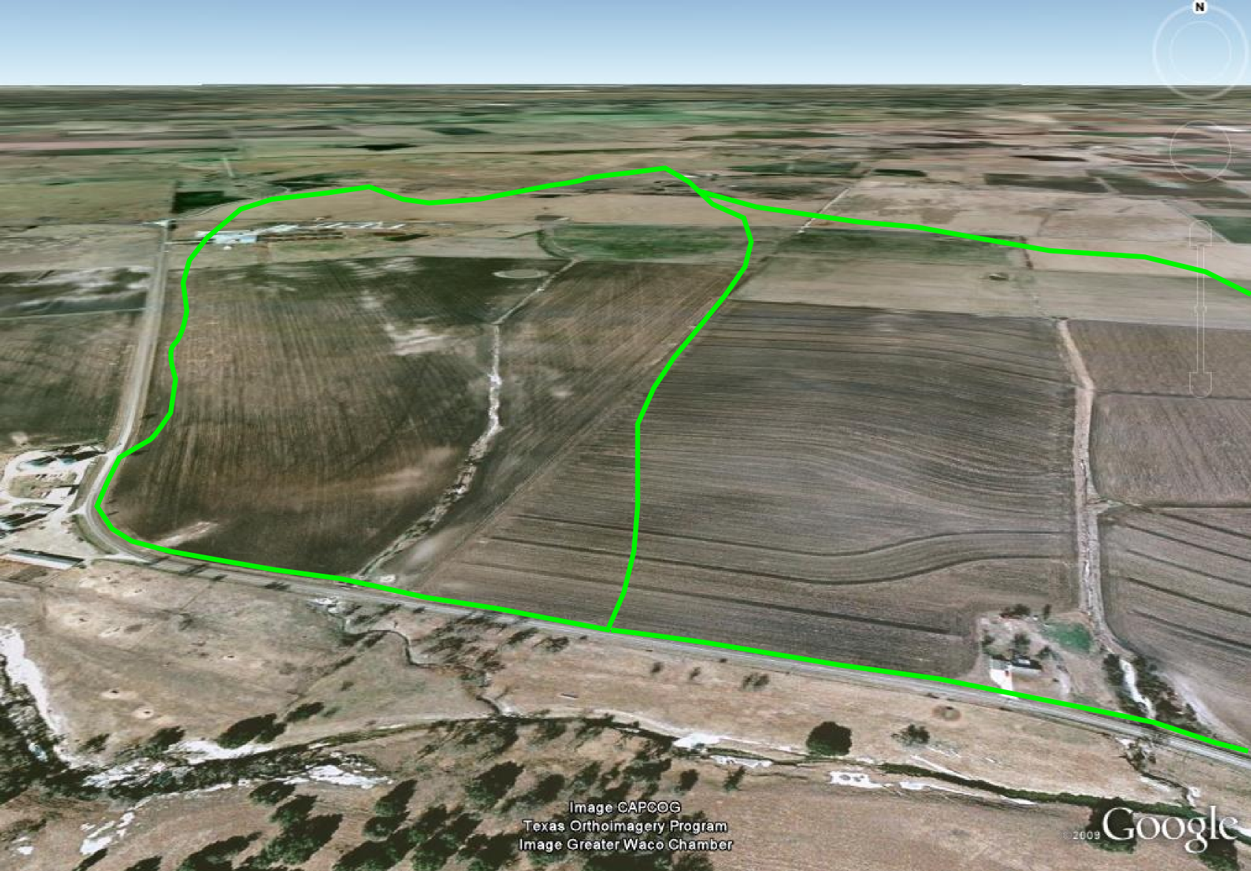
Delineation of Watershed
Texas Department of Transportation

Slide 13
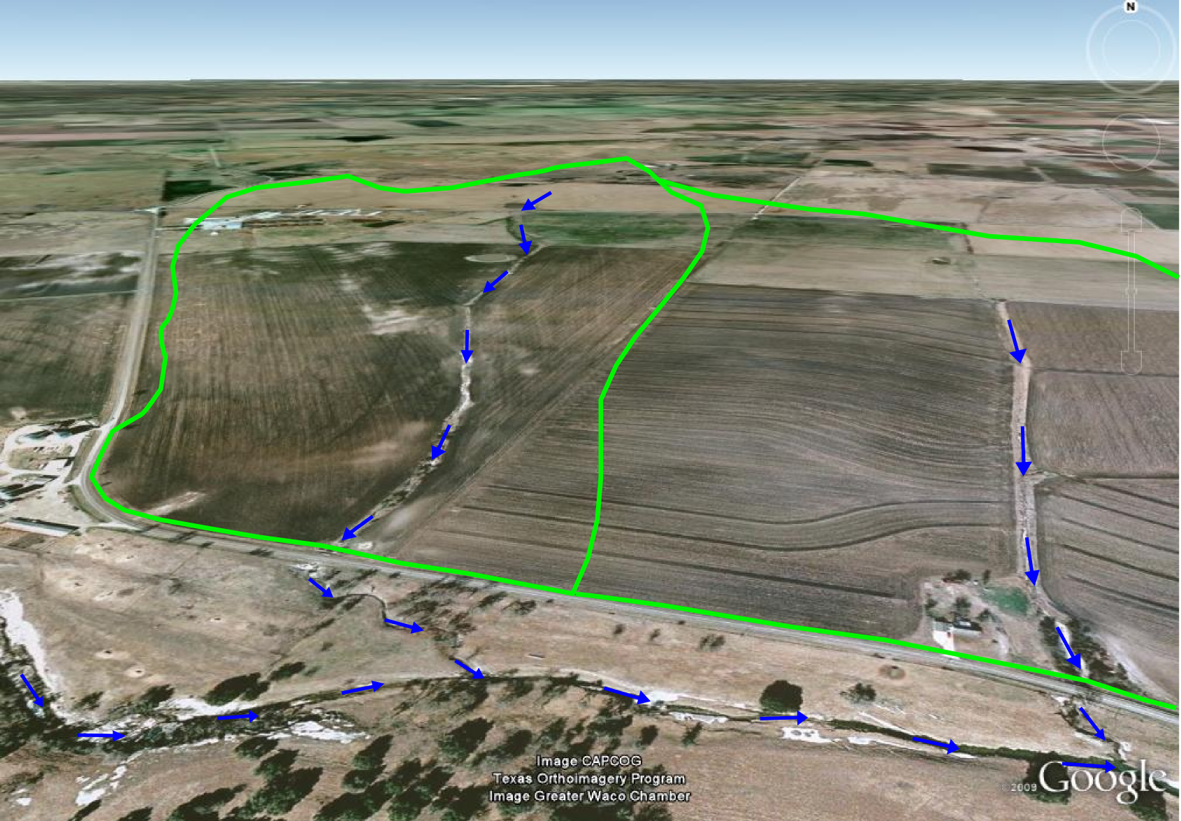
Delineation of Channel
Texas Department of Transportation

Slide 14
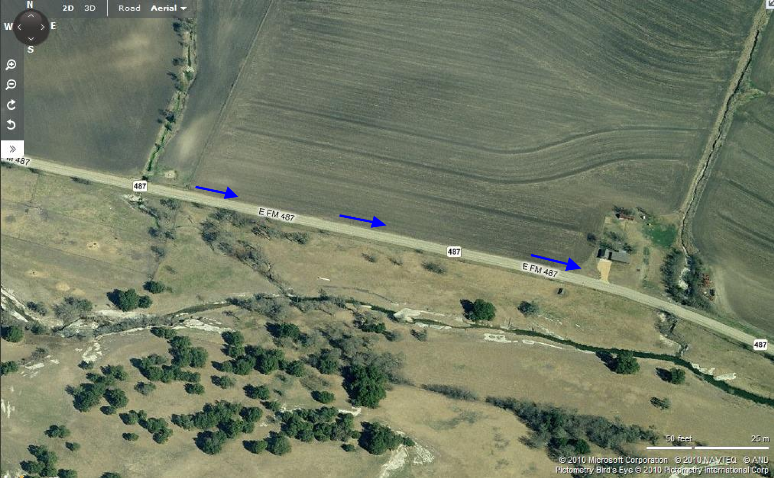
Revision of Conveyance Due to Ditch Carryover
Texas Department of Transportation

Slide 15
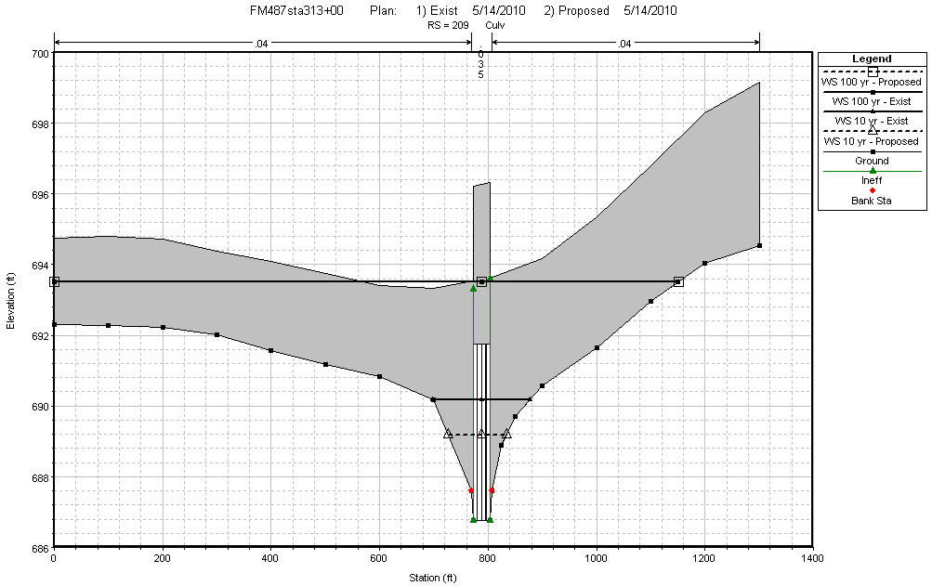
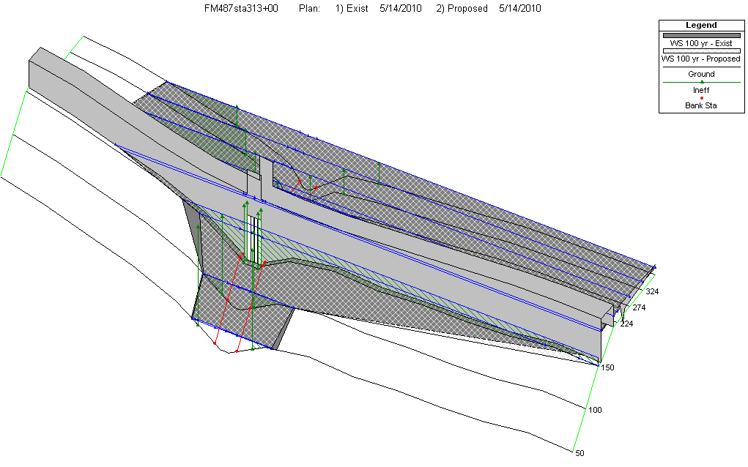
Hydraulic Analysis of Culvert and Ditch
Texas Department of Transportation

Slide 16
Summary and Conclusion
Two central aspects of dealing with floods:
a. Responding
b. Mitigation
Nature of TxDOT’s response depends on the situation:
a. On-System versus Off-System
b. How the request reaches Maintenance
c. Decisions Made On-Site
Mitigation is made up of two parts:
a. Identifying the Risks
b. Avoiding Adverse Impacts
Texas Department of Transportation

Slide 17
References
Highway Engineer Staffing Analysis, Texas Comptroller of Public Accounts, January 2010, page 7.
Annual Report – Highway Status Open to Traffic Only, Texas Department of Transportation, Transportation Planning and Programming Division, August 17, 2009.
Information Sharing Plan – Austin District, June 8, 2010
Survey of Organizational Excellence Data Report, Texas Department of Transportation, 2008, pages 2 and 3.
Hydraulic Design Manual, Texas Department of Transportation, March 2009.
Texas Department of Transportation

Slide 18
Questions?
Texas Department of Transportation

