Slide 1
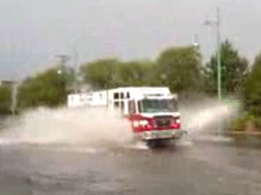
Situational Awareness for Flash Flooding
Texas Flash Flood Coalition, Flood Technology Committee, October 7, 2010
By David R. Maidment
Director, Center for Research in Water Resources
Cockrell School of Engineering
University of Texas at Austin

Slide 2
Slide: Hector Guerrero, NWS, San Angelo

Slide 3
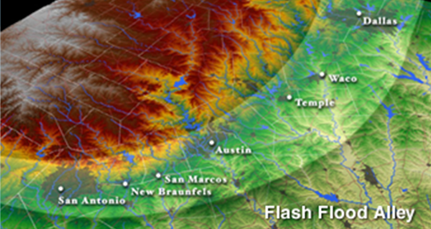
Flash Flood Alley
Slide: Hector Guerrero, NWS, San Angelo

Slide 4
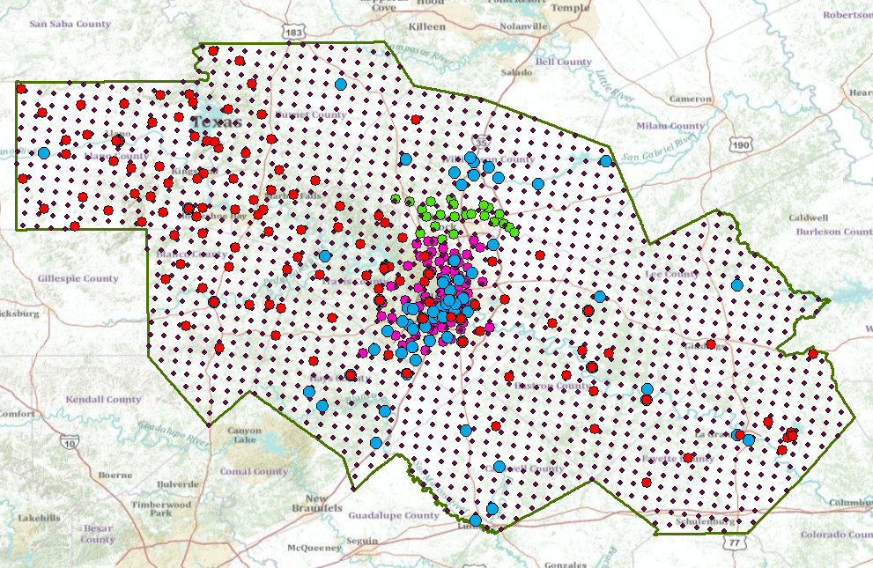
A Single Virtual Flood Observation Network for the CAPCOG region

Slide 6
How to Communicate Information to Emergency Responders?

Slide 7
Hand-Held Devices
Give information to them?
Obtain information from them?
Twitter feeds to ArcGIS .com

Slide 8
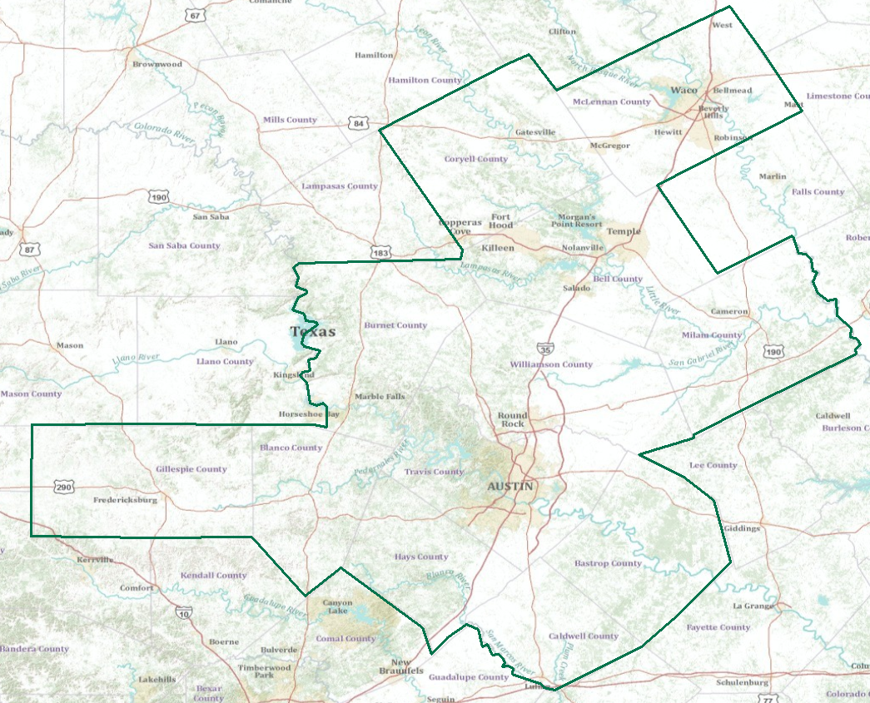
Real-Time Flood Information for Television
Maureen McCann, Meteorologist with News8 Austin
Develop a prototype of space-time mapping for television meteorologists

Slide 9
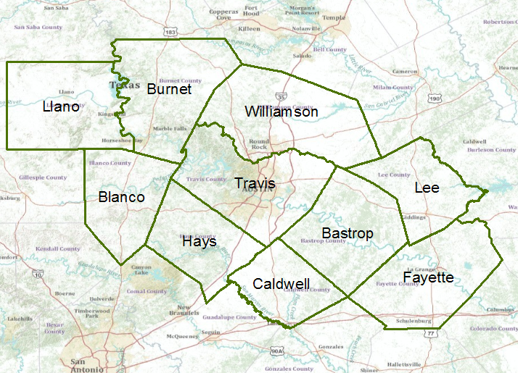
Capital Area Council of Governments (CAPCOG)

Slide 10
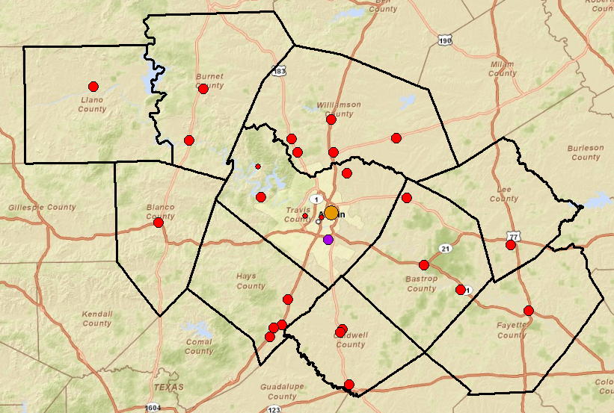
Public Safety Answering Points in the CAPCOG region

Slide 11
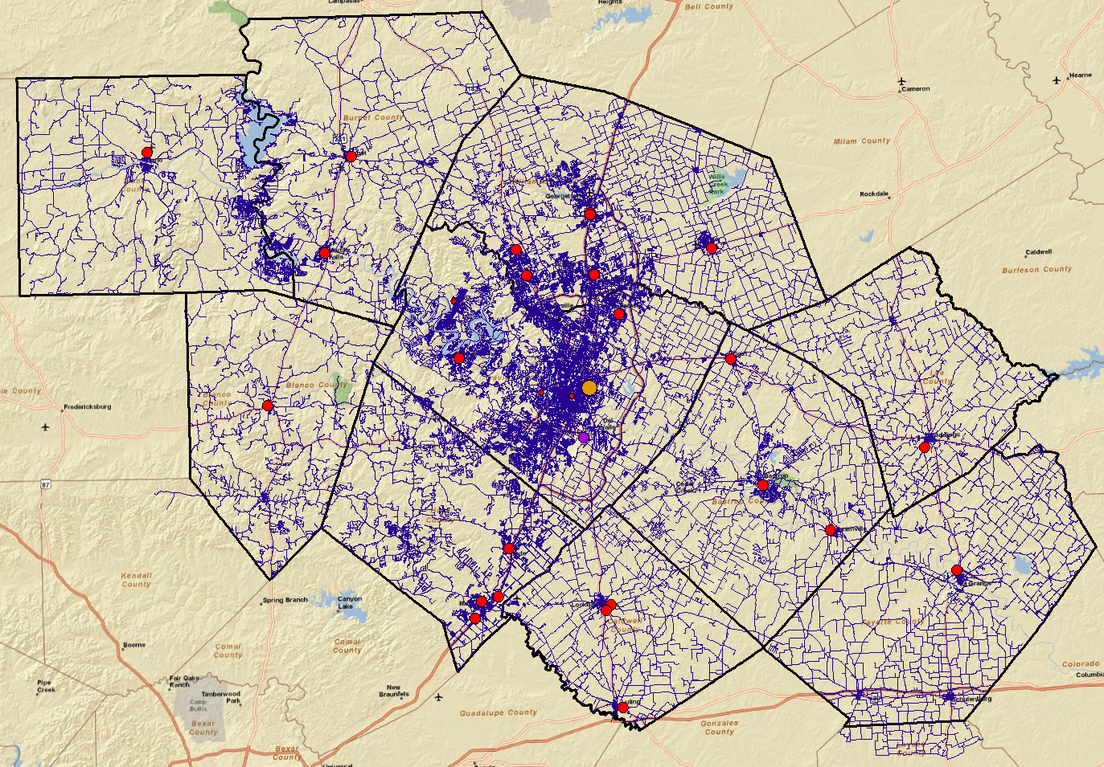
Emergency calls are referenced on the road and street network

Slide 12
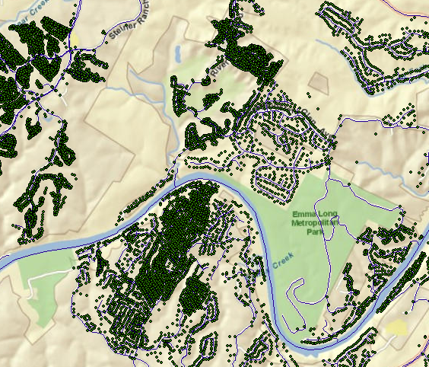
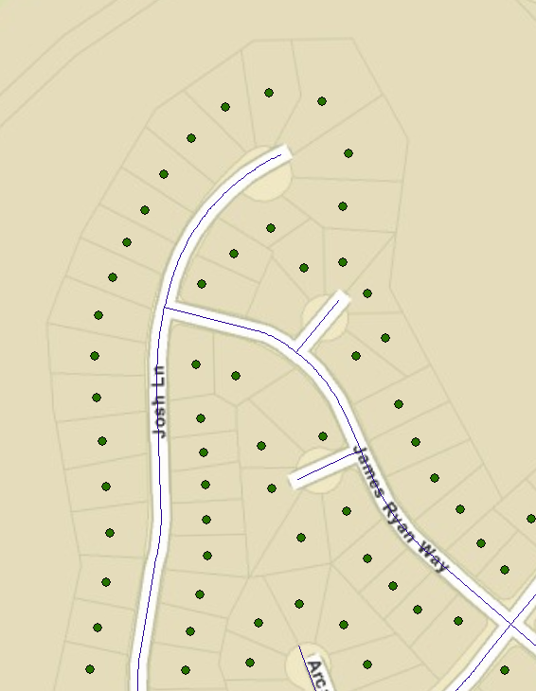
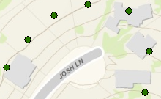
Address points locate individual homes and buildings
Address points and building footprints
There are 687,000 address points in the CAPCOG region
Address point is the center of a legal lot and is referenced to a location on the road network

Slide 13
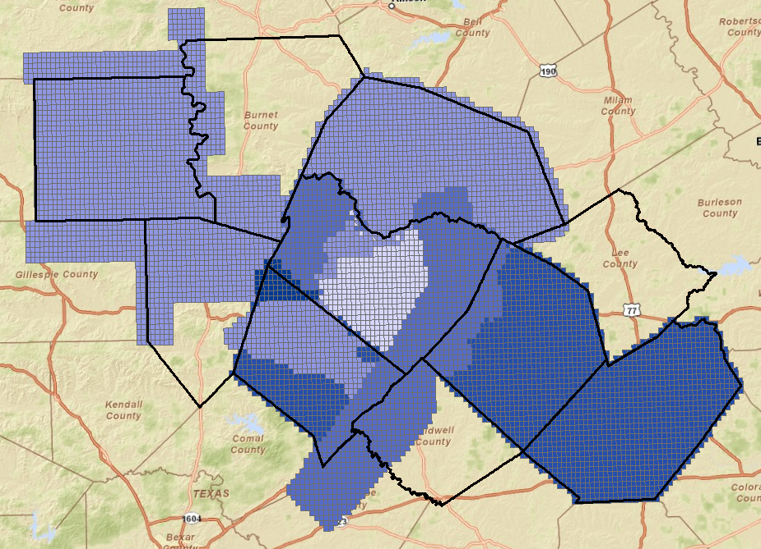
CAPCOG LIDAR Coverage
In Process
Collected

Slide 14
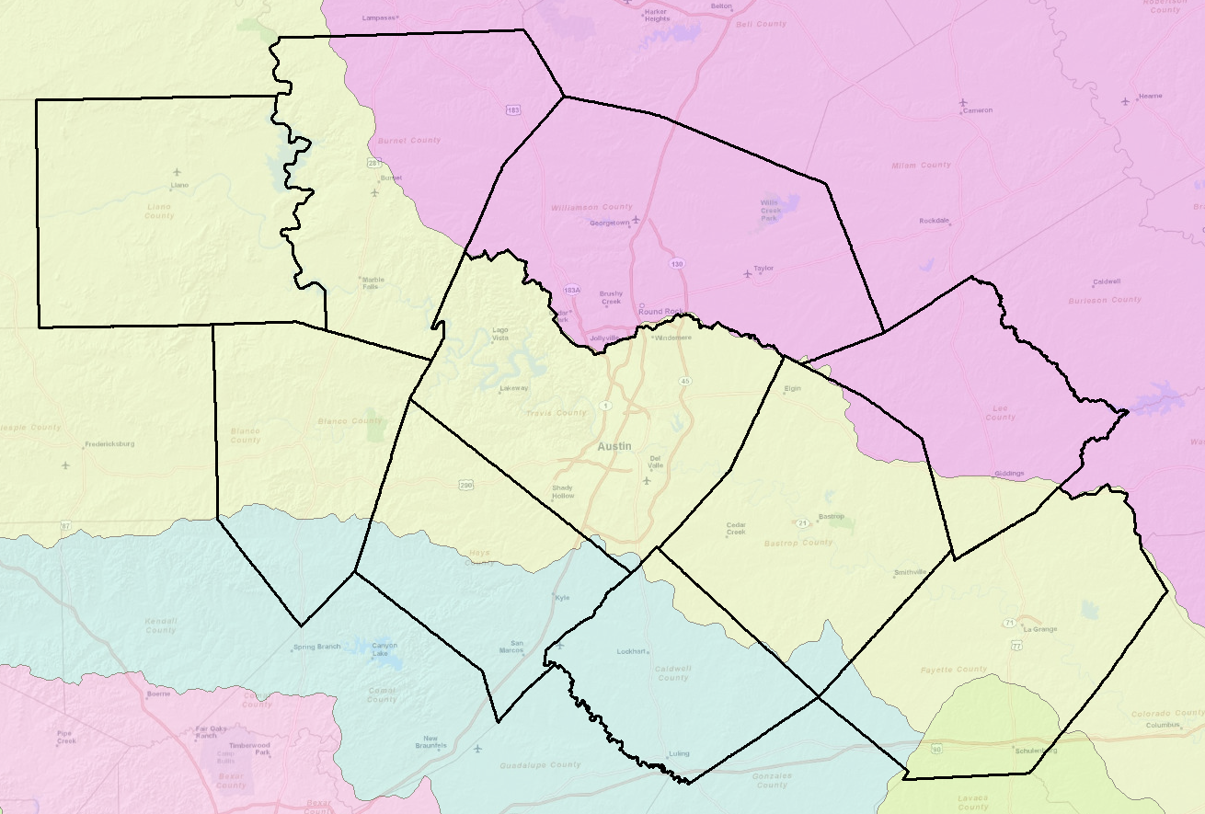
River Basins of CAPCOG region
Colorado
Brazos
Guadalupe
Lavaca

Slide 15
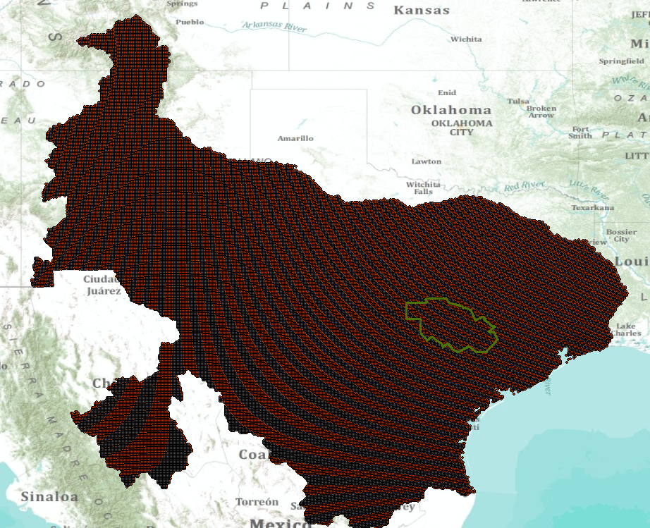
WGRFC MPE Nexrad rainfall

Slide 16
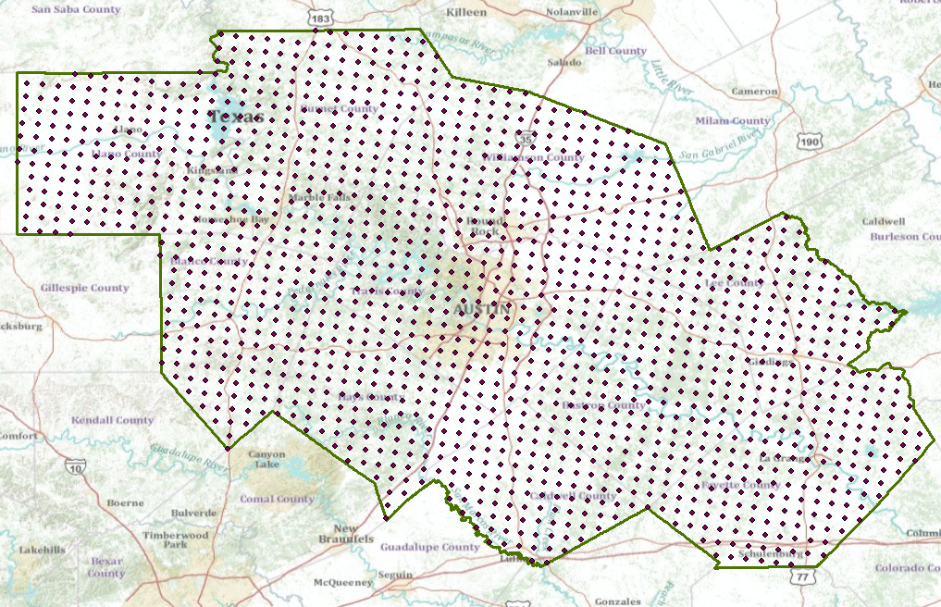
Nexrad Radar Rainfall in CAPCOG

Slide 17
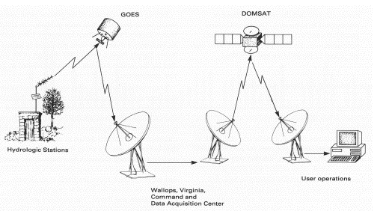
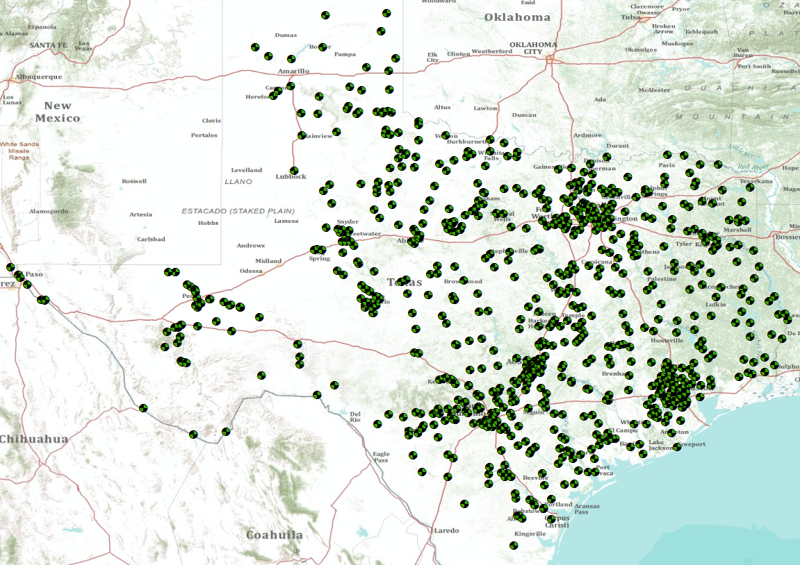
USGS Streamflow gages in Texas
Real-time data acquisition through satellites

Slide 18
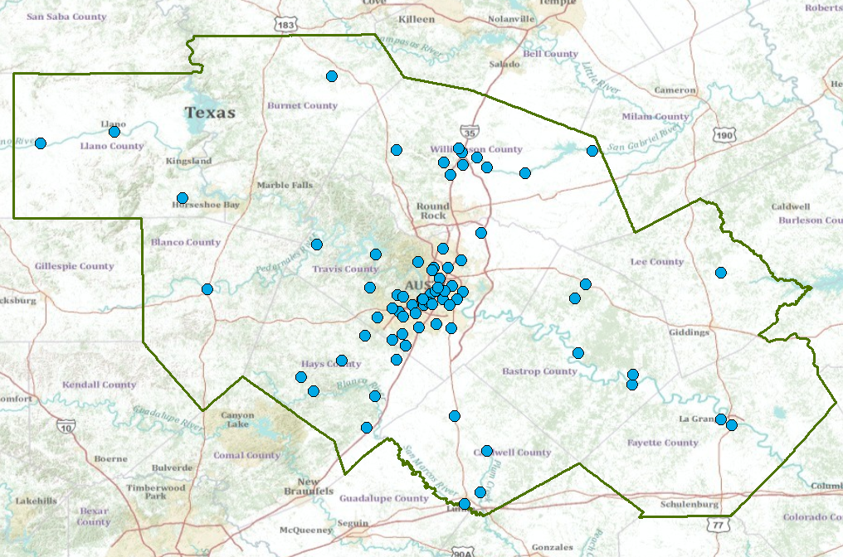
USGS Streamflow gages in CAPCOG

Slide 19
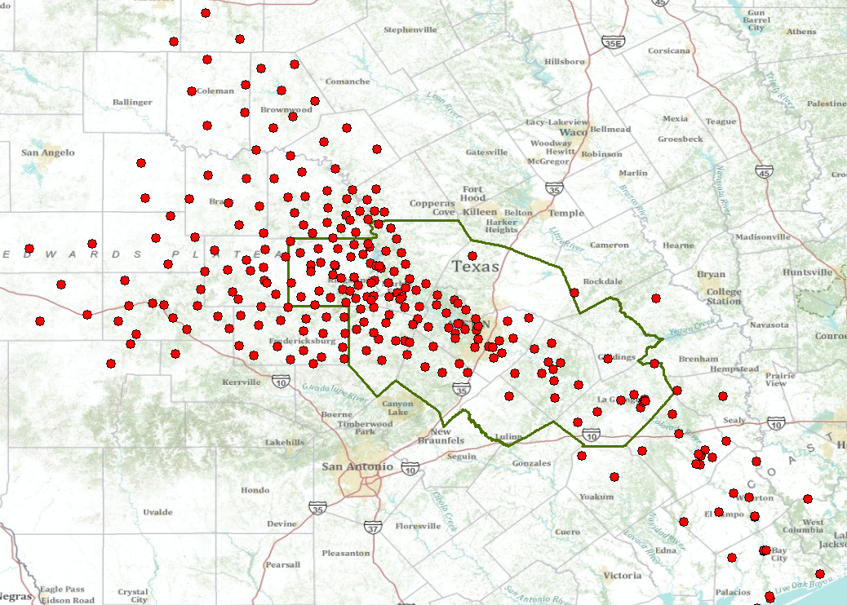
LCRA HydroMet Network

Slide 20
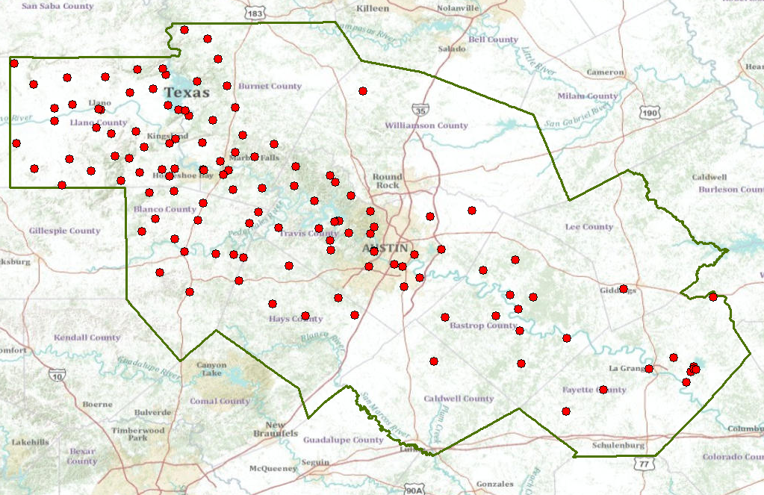
LCRA HydroMet in CAPCOG

Slide 21
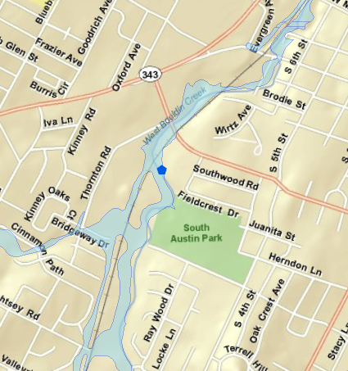
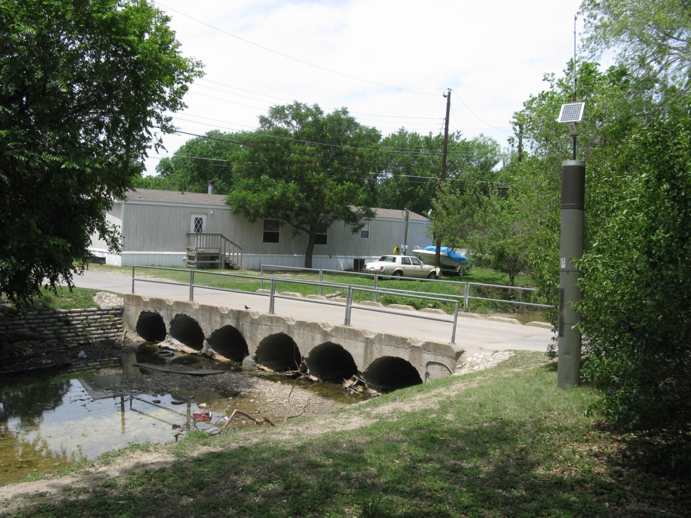
Austin’s Flood Early Warning System
Gage measuring water level and rainfall at a low water crossing
Image: Susan Janek, City of Austin
Citizens living near here are in the 5-year floodplain….
……their only escape is along a railroad line

Slide 22
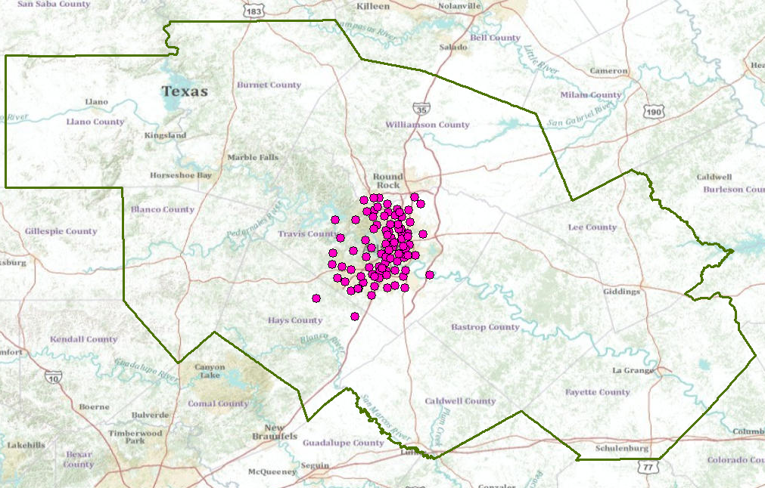
City of Austin FEWS

Slide 23
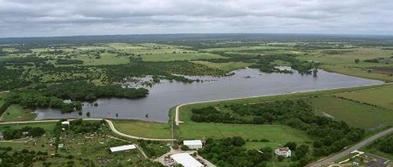
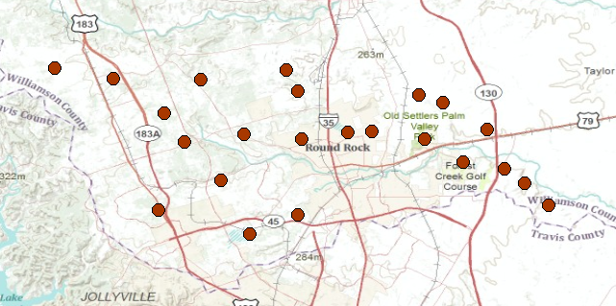
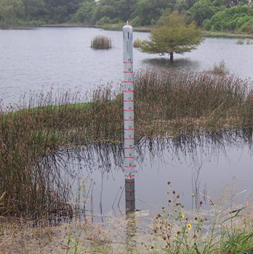
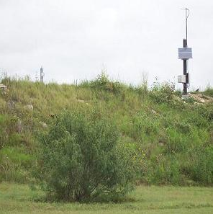
21 Flood Control Dams in Williamson County
Water Level
Precipitation
15 min data

Slide 24
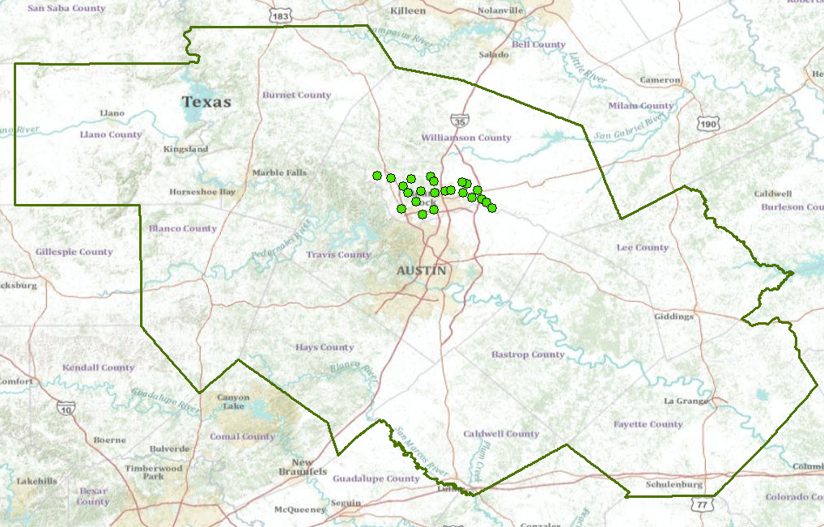
Upper Brushy Creek WCID

Slide 25
A Single Virtual Flood Observation Network for the CAPCOG region

