Slide 1
Flash Flood Awareness for Central Texas
Bob Rose, LCRA
October 8, 2010

Slide 2
A Look Back at Tropical Storm Hermine
Bob Rose, LCRA Meteorologist
October 8, 2010

Slide 3
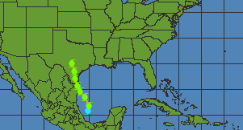
Track of Tropical Storm Hermine
10 pm, Tuesday, 9/7
10 pm, Sunday, 9/5

Slide 4
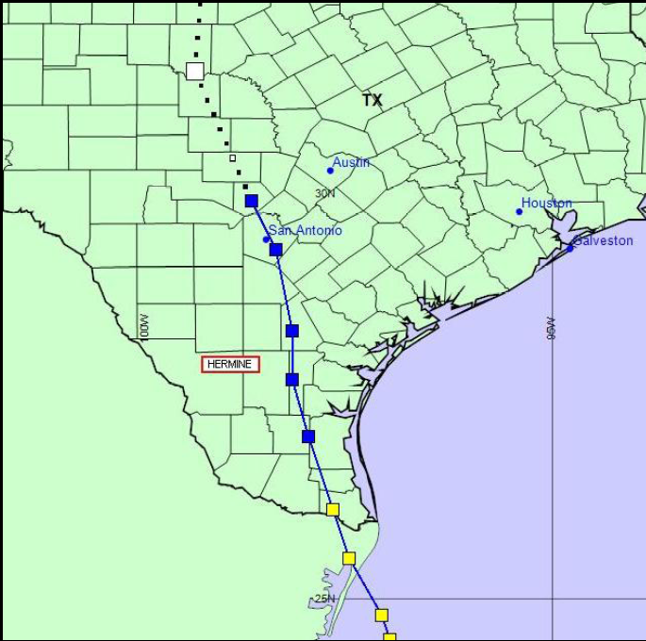
Track of Tropical Storm Hermine
Midnight, Wed.
9/8
10 pm Tuesday
9/7
8:30 pm, Monday
Sep. 6th

Slide 5
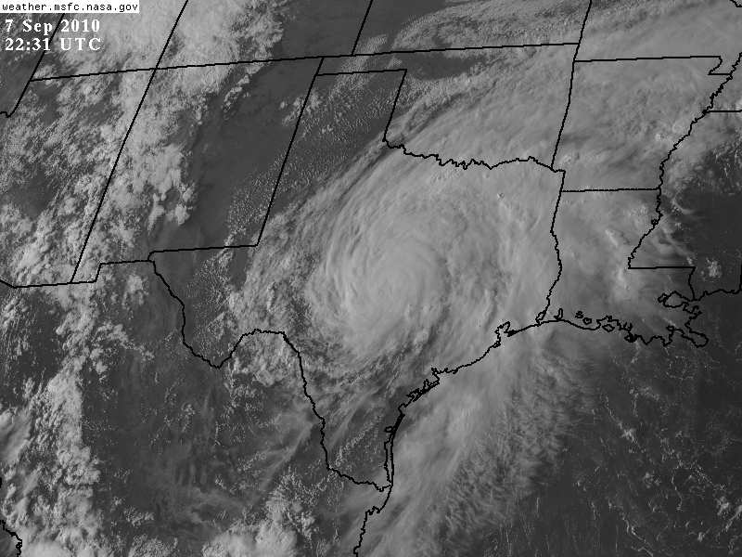
Visible Satellite Image, 5:31 pm, 9/7

Slide 6
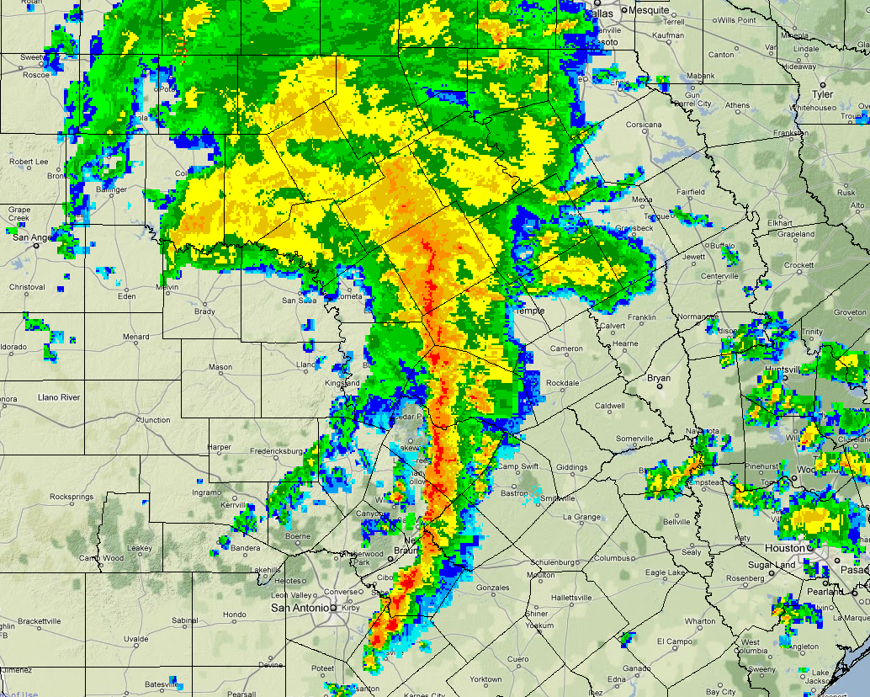
9 PM

Slide 7
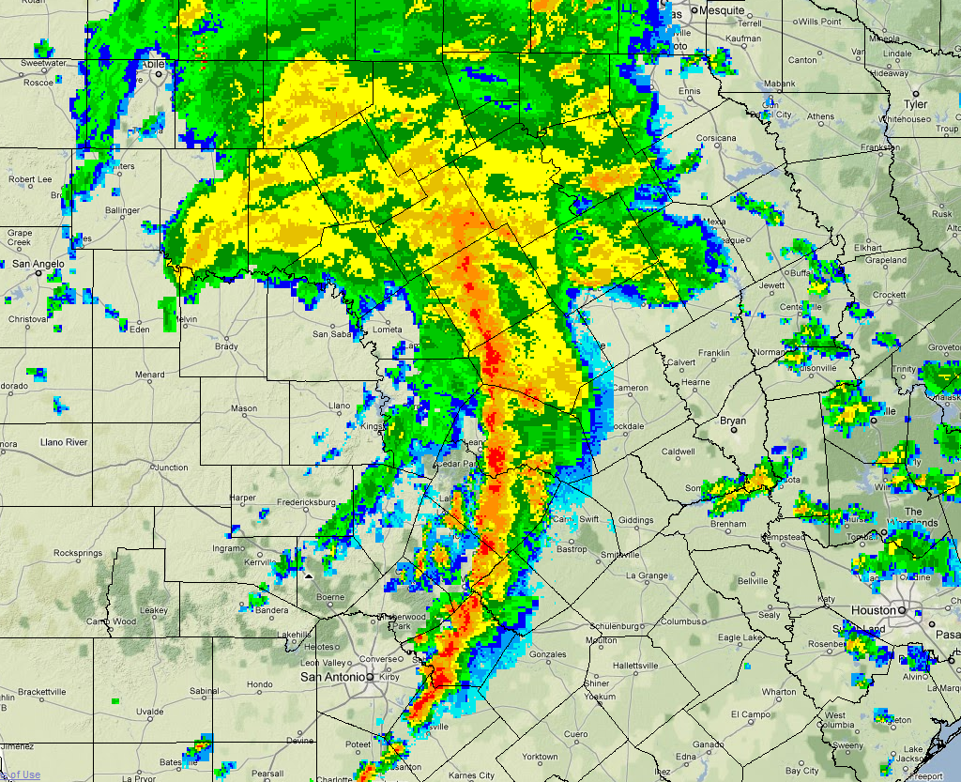
10 pm

Slide 8
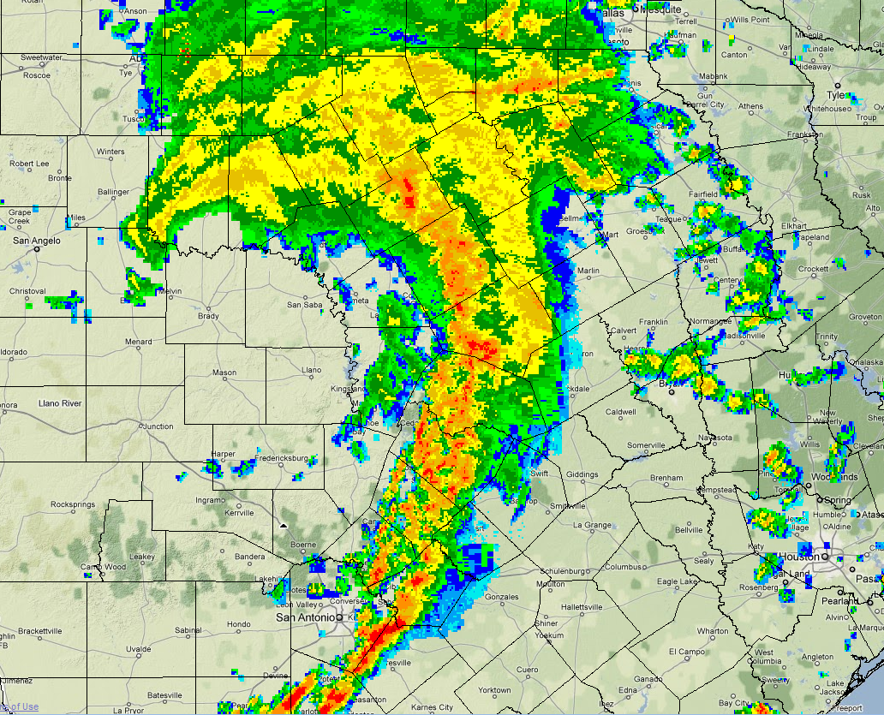
11 pm

Slide 9
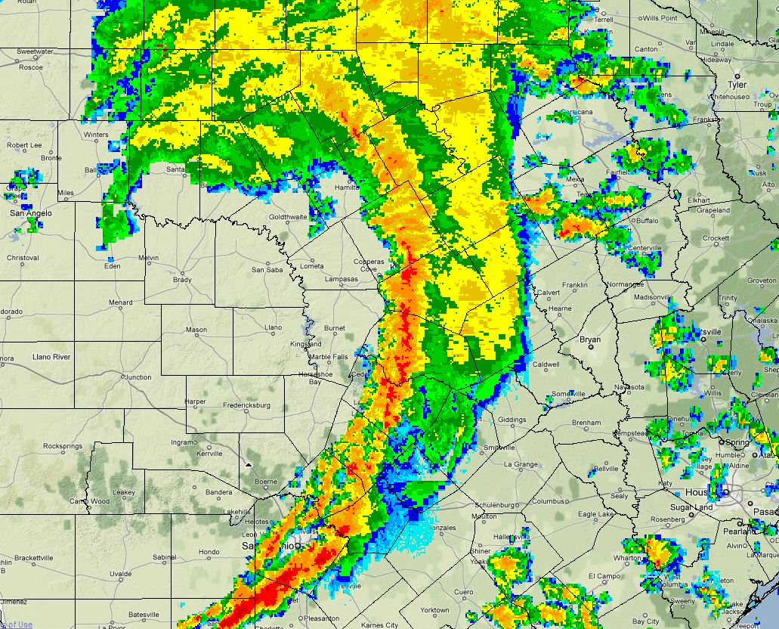
Midnight

Slide 10
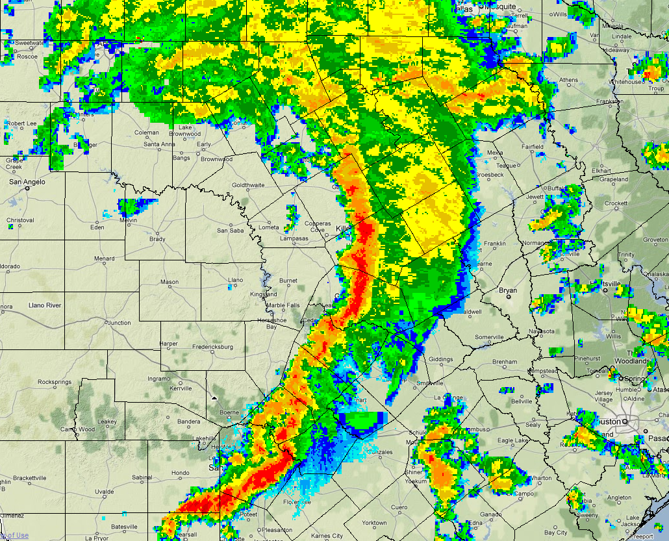
1 am

Slide 11
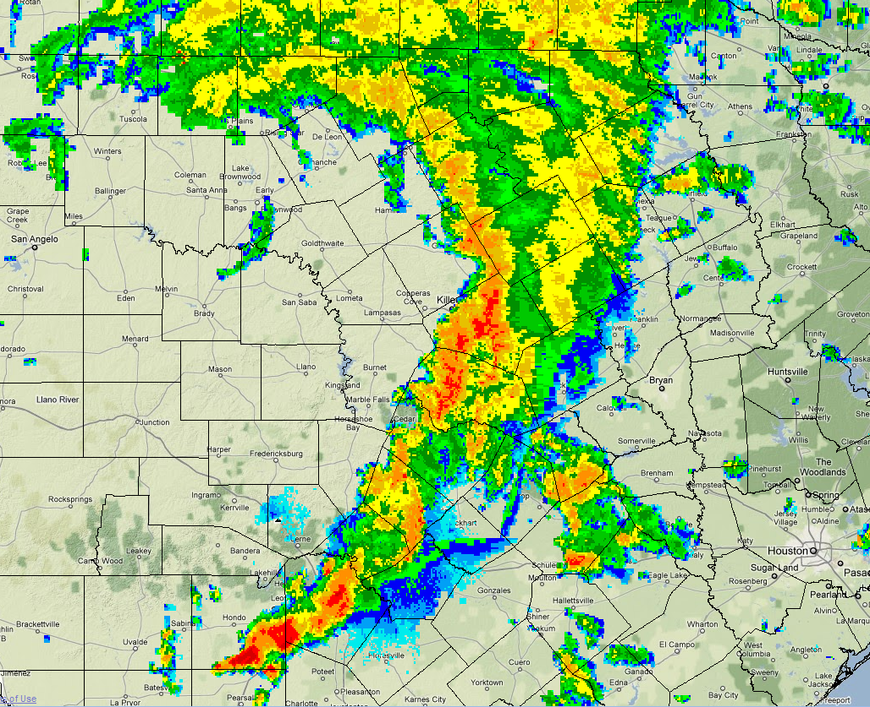
2 am

Slide 12
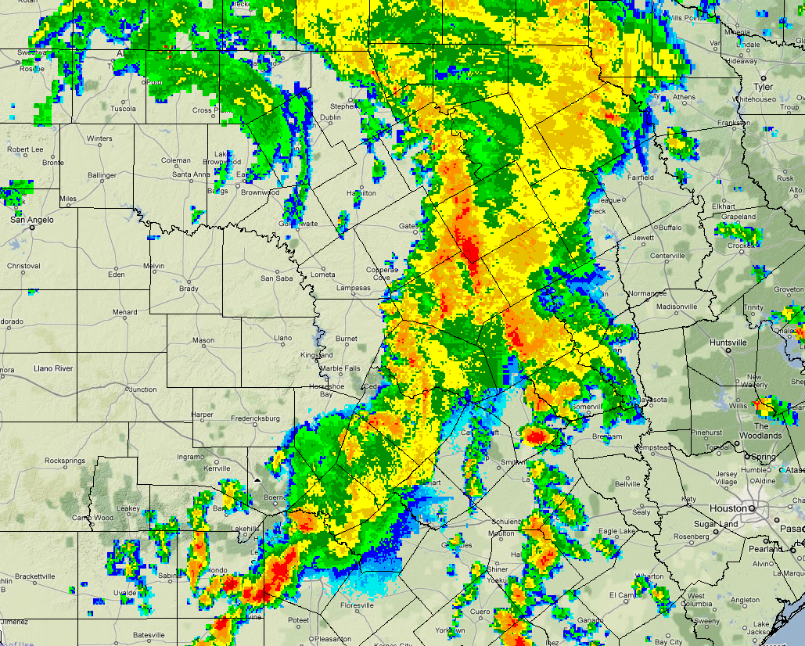
3 am

Slide 13
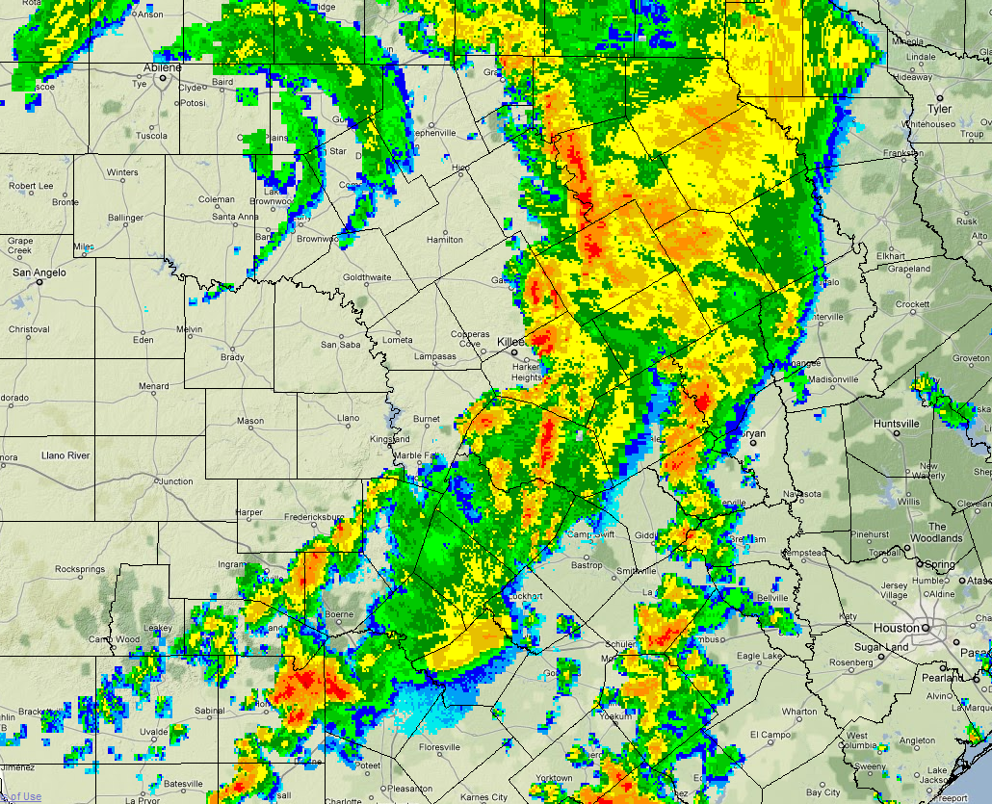
4 am

Slide 14
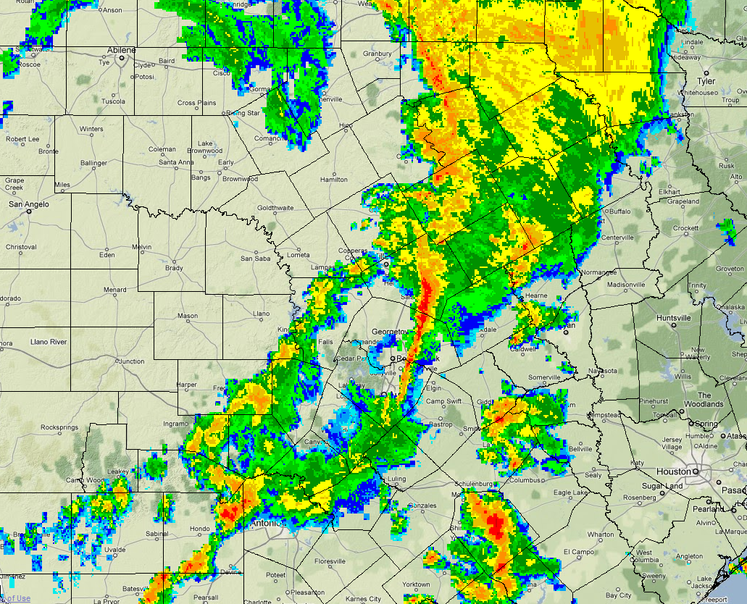
5 am

Slide 15
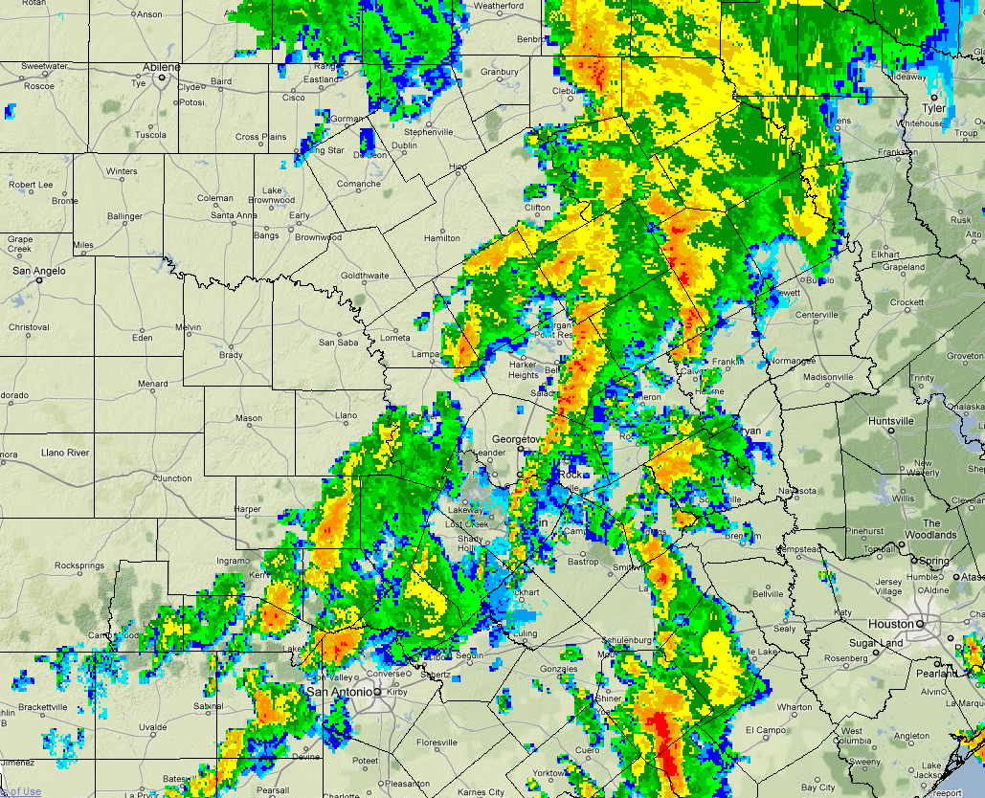
6 am

Slide 16
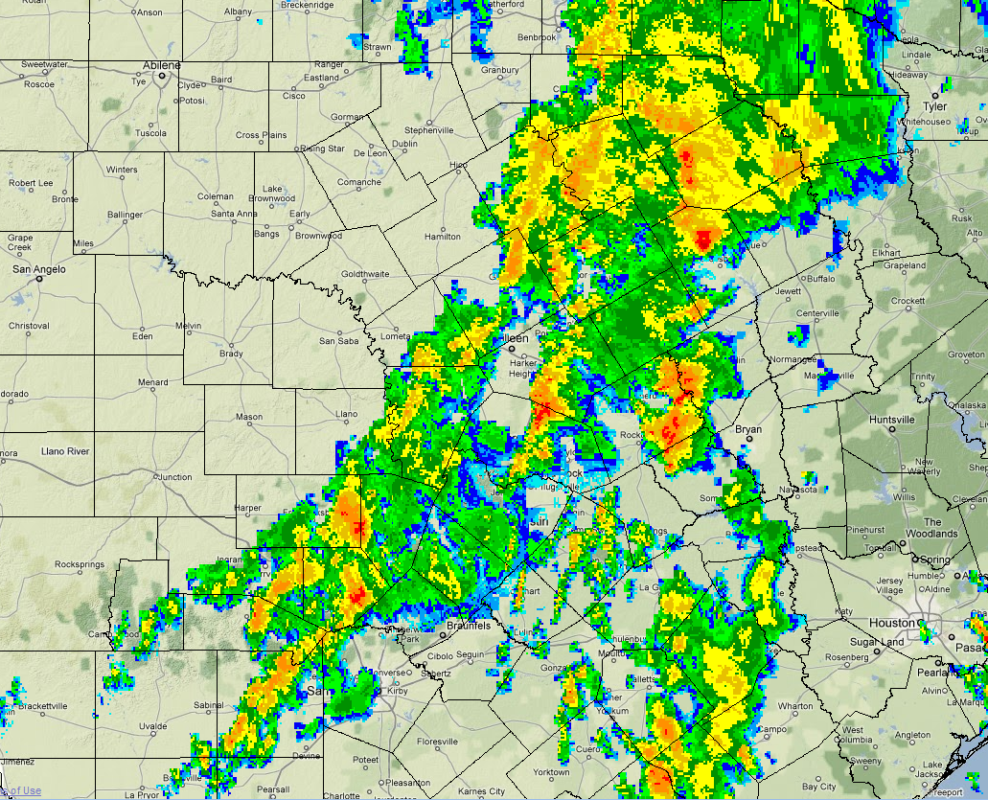
7 am

Slide 17
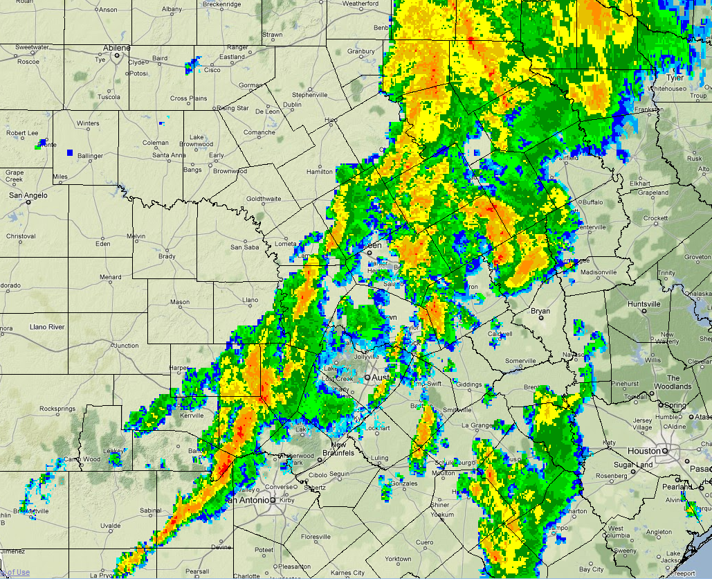
8 am

Slide 18
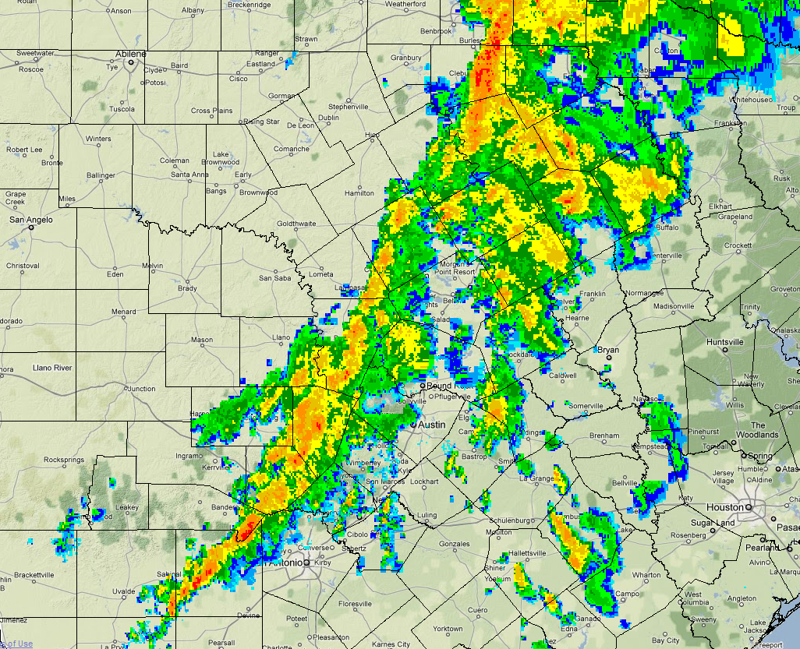
9 am

Slide 19
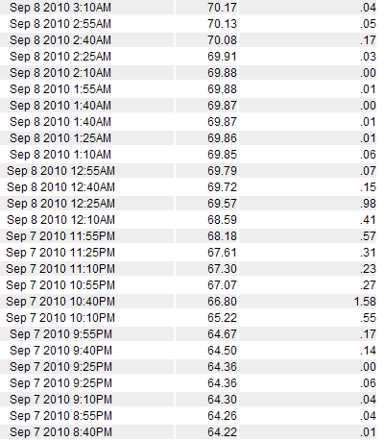
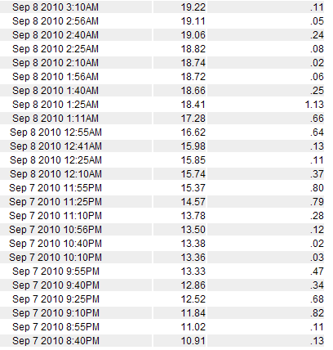
Rainfall Rates of 4 to 6 Inches per Hour
Lake Austin at
Davenport Ranch
Mansfield Dam

Slide 20
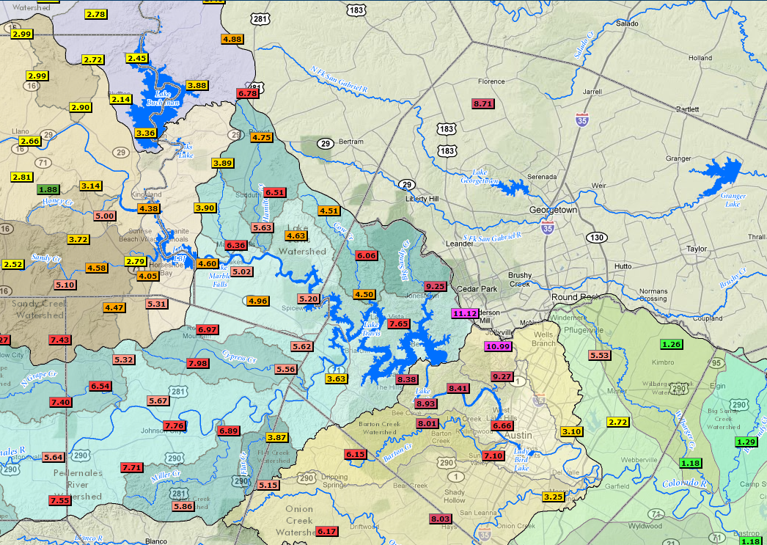
LCRA Hydromet, 9/6-9/10

Slide 21
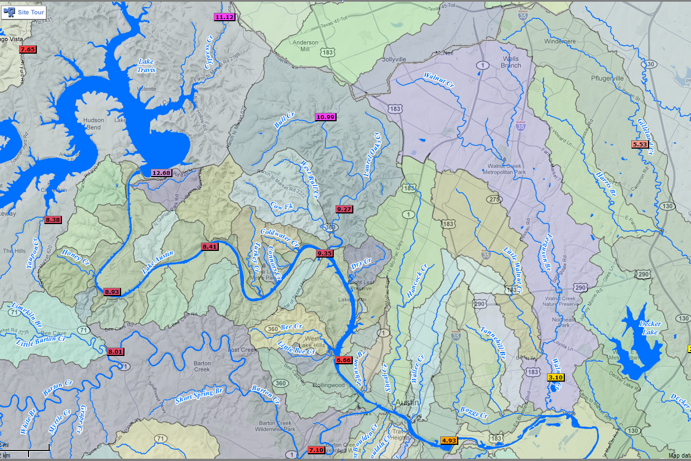
LCRA Hydromet, 9/6-9/10

Slide 22
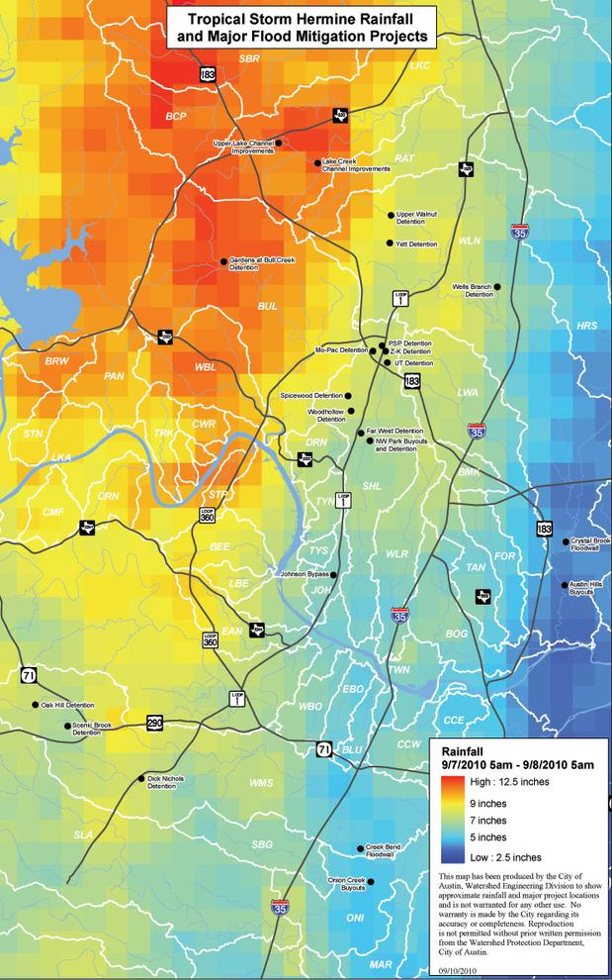
City of Austin
Watershed
Protection
Department
5 am, 9/7-9/8

Slide 23
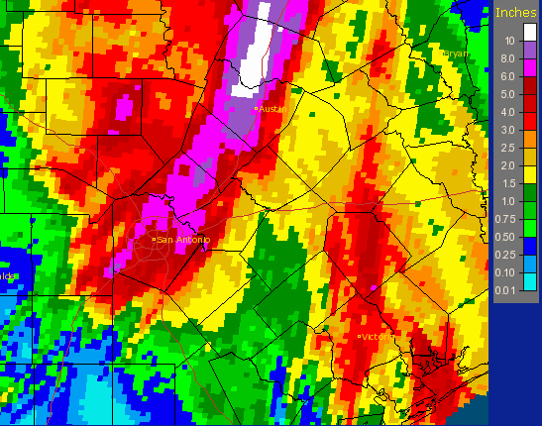
National Weather Service “MPE” 7 am, 9/7-9/8

Slide 24
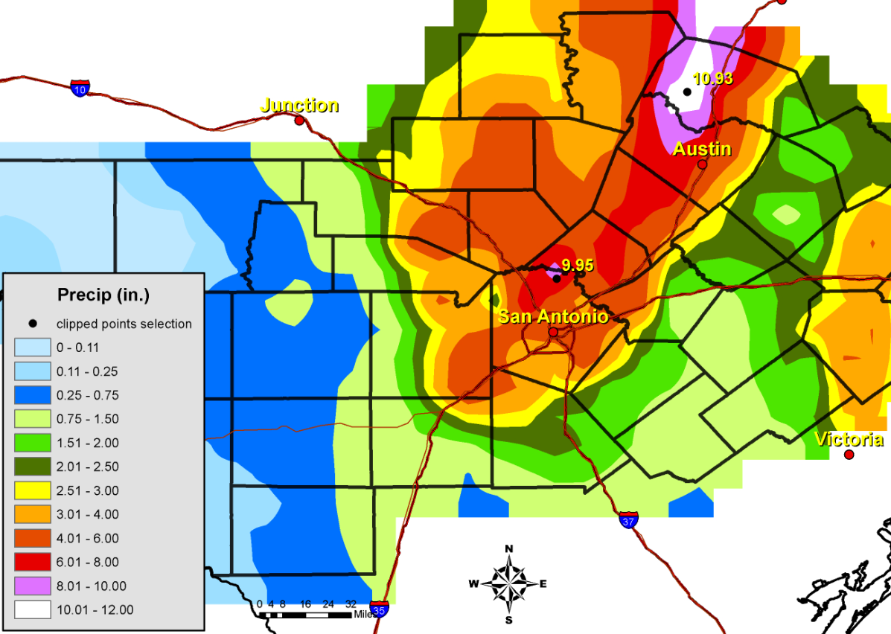
CoCoRaHS Rainfall, 7am, 9/7-9/8

Slide 25
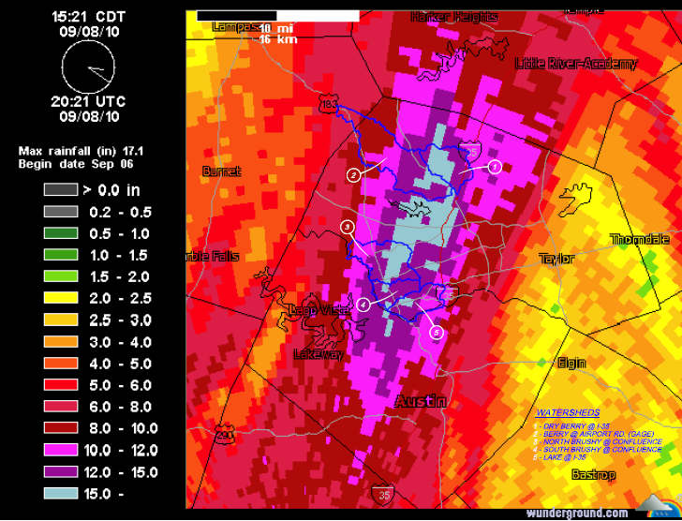
GRK Radar Estimate, 9/6-9/8

Slide 26
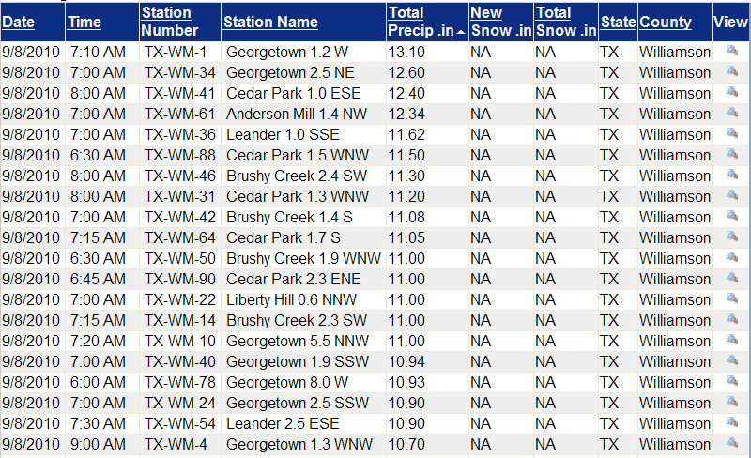
Other Rain Gauge Amounts Williamson County
Maximum gauged 24 hour total (7 am-7am) was 14.57 inches, at Lake Georgetown. (16.37 inches 9/7-9/9) NWS Coop location

Slide 27
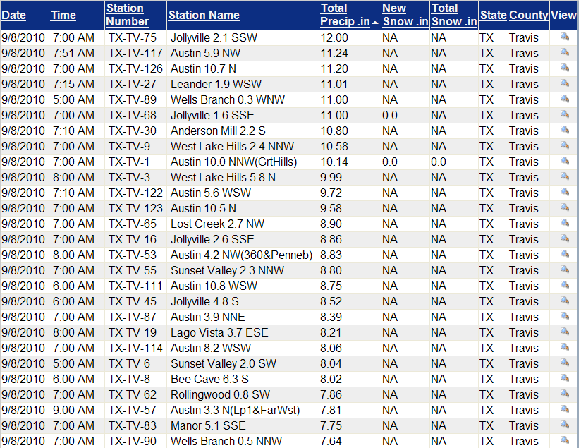
Other Rain Gauge Amounts Travis County

Slide 28
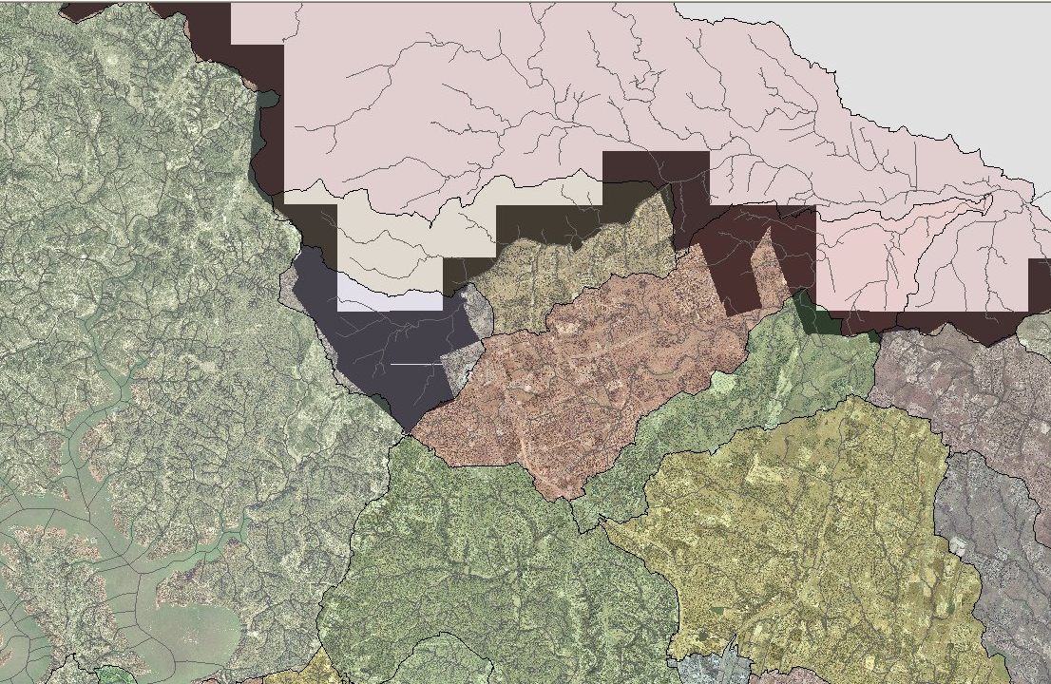
Most Impacted Watersheds
North Brushy Creek
Round Rock
South Brushy Creek
Buttercup
Creek
Lake Creek
Rattan Creek
Walnut Creek
Bull Creek

Slide 29
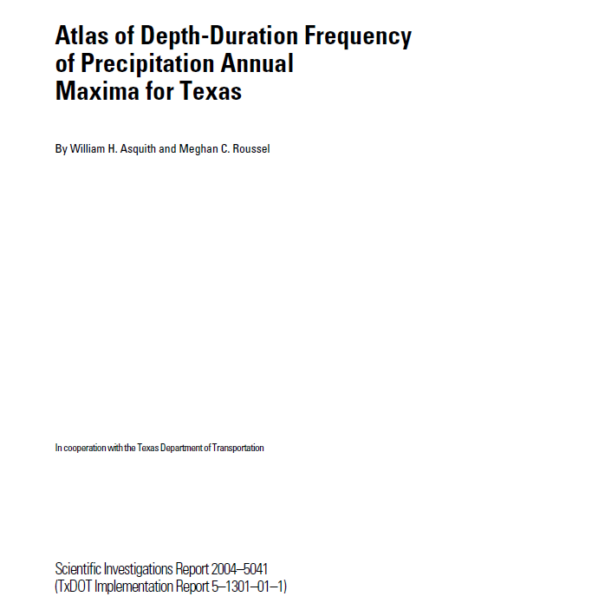
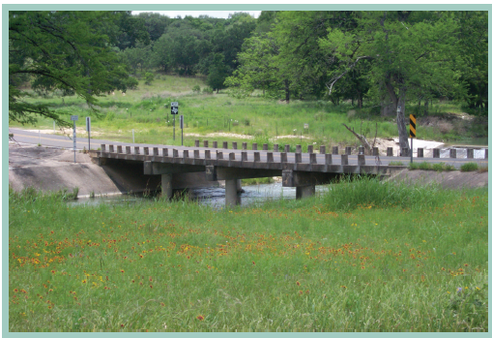

Slide 30
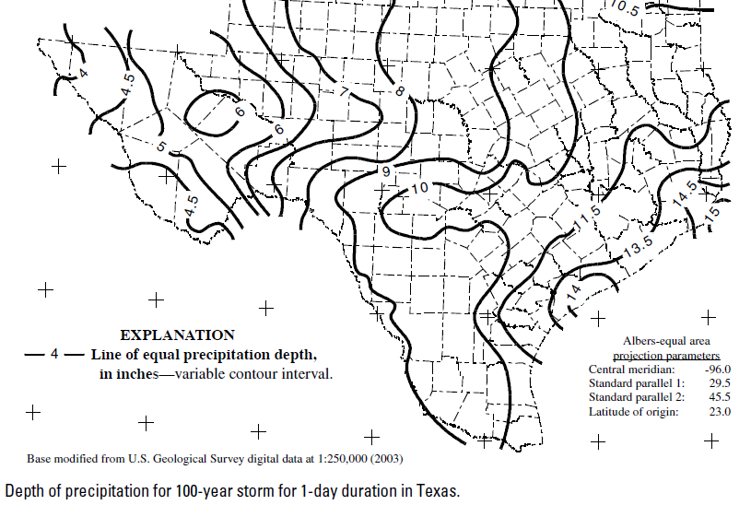
100-Year Storm, 1-day Duration

Slide 31
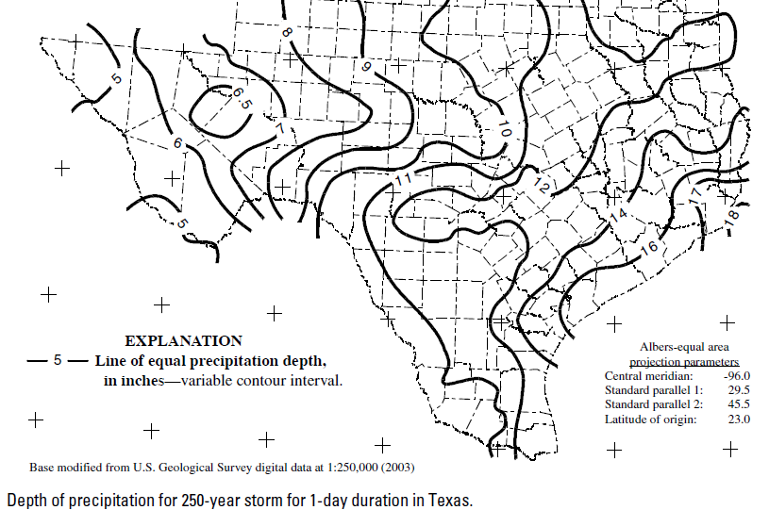
250-Year Storm, 1-day Duration

Slide 32
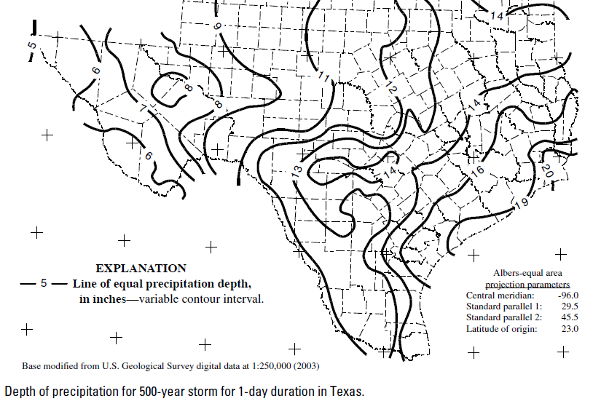
500-Year Storm, 1-day Duration

Slide 33
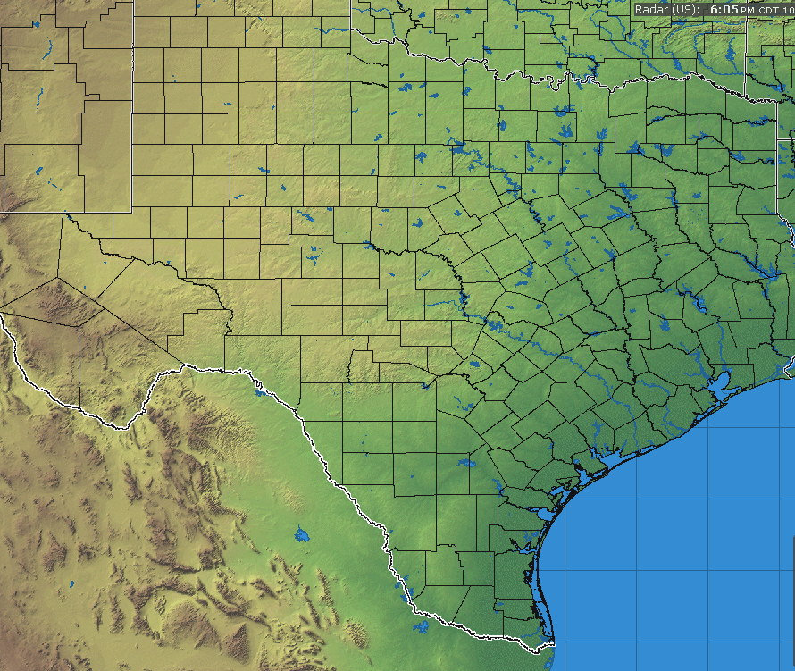
7 Flash Flood Fatalities from Hermine
1
1
1
2
1

Slide 34
Bob Rose
Meteorologist, LCRA
bob.rose@lcra.org
512-473-3350

