Slide 1
Using Twitter and ArcGIS.com to Gather Information
Traci Tracey, ESRI, San Antonio
Flood Technology Committee Workshop
Texas Flash Flood Coalition
LCRA, Austin, 8 October 2010

Slide 2
…she had me @ incremental autospatial correlation…
Spatialcomfort tweeting from 2010 Esri User Conference

Slide 3
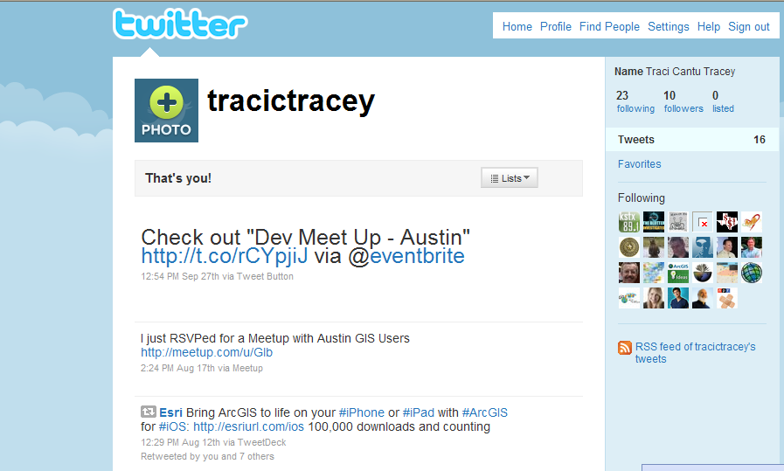
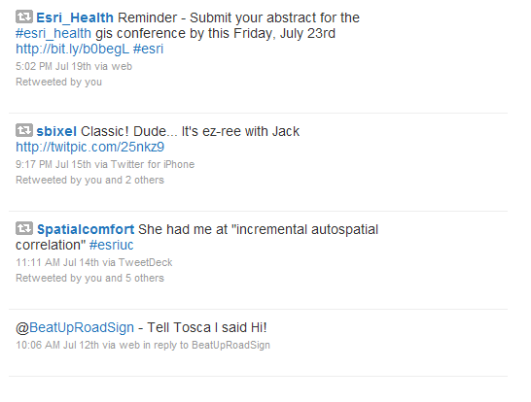

Slide 4
Social Media aka VGI
Twitter
  Users send and read other users' messages called tweets.
  Tweets:
    Text-based posts
    Up to 140 characters
    Displayed on the user's profile page.
    Tweets are publicly visible by default
    Can add photos - Twitpic
  Users may subscribe to other author tweets—known as following and subscribers are known as followers. http://twitter.com/garysco
Ushahidi
YouTube
Flickr

Slide 5
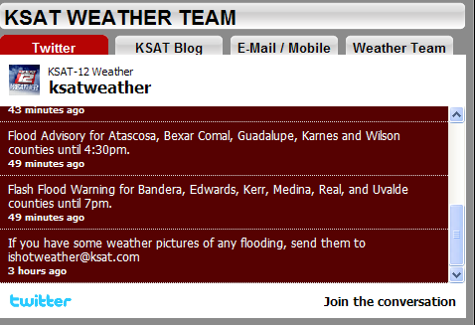
San Antonio Flood – 4/10

Slide 6
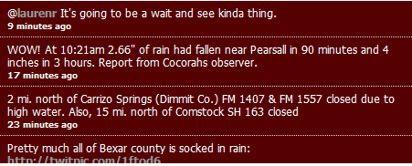
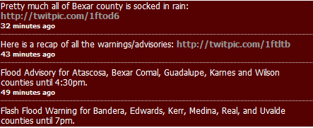
San Antonio Flood – 4/10

Slide 7
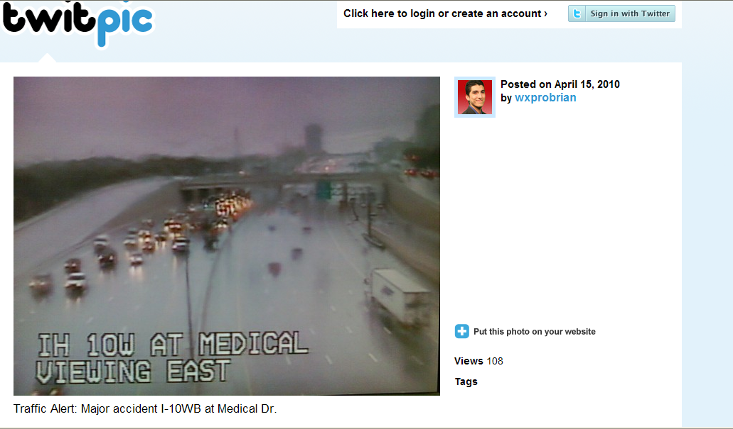
San Antonio Flood – 4/10

Slide 8
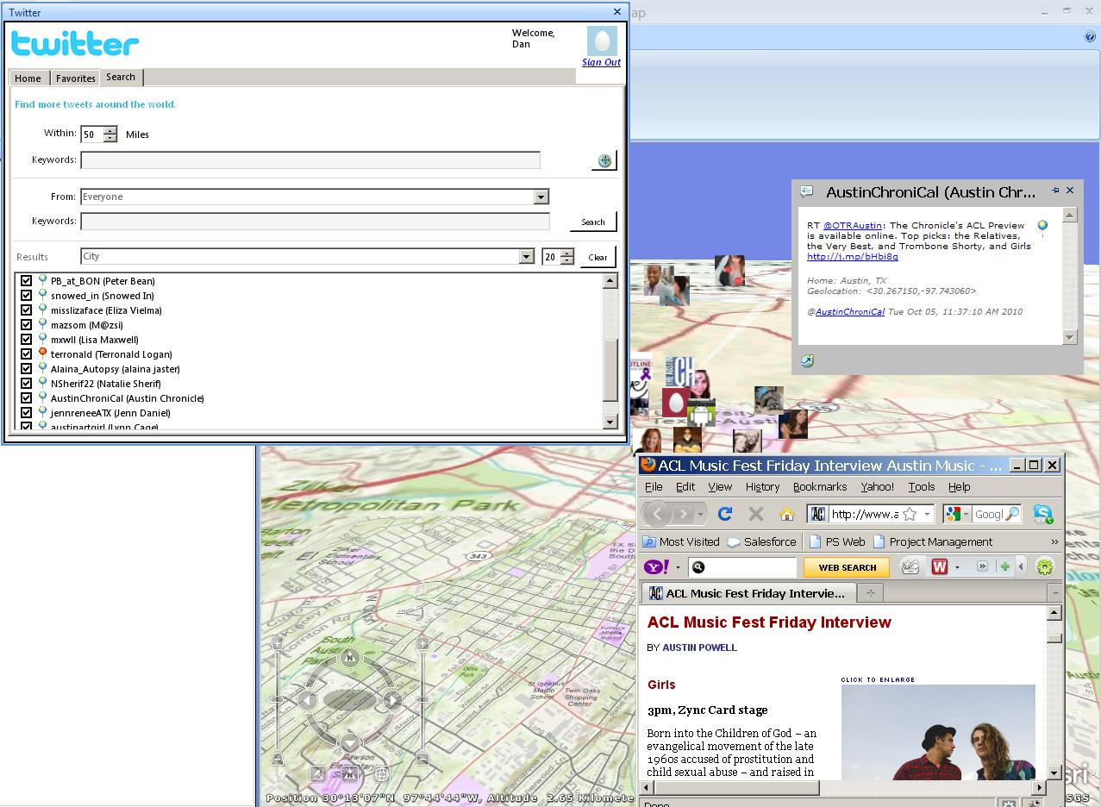
#KeepAustinWeird
Screen shot twitter in austin

Slide 9
Ushahidi
Swahili for “testimony”
2007 elections in Kenya
Provides mechanism for local observers to submit reports using mobile phones or internet during a crisis
Esri and Ushahidi now working together to make this information available to more people, including those using Esri geographic information system (GIS) technology

Slide 10
Ushahidi – Haiti
Ushahidi-Haiti – set up within 2 hours of earthquake by Tufts volunteers
Code (4636) created for incoming texts
  Virally spread via radio stations
Actionable texts (people trapped) - then volunteers mapped GPS coordinates and fed to rescue team
Over 2500 text messages received in 25 days
Texts often in Creole – 10,000 Haitian-American volunteers translated every message w/in 10 minutes

Slide 11
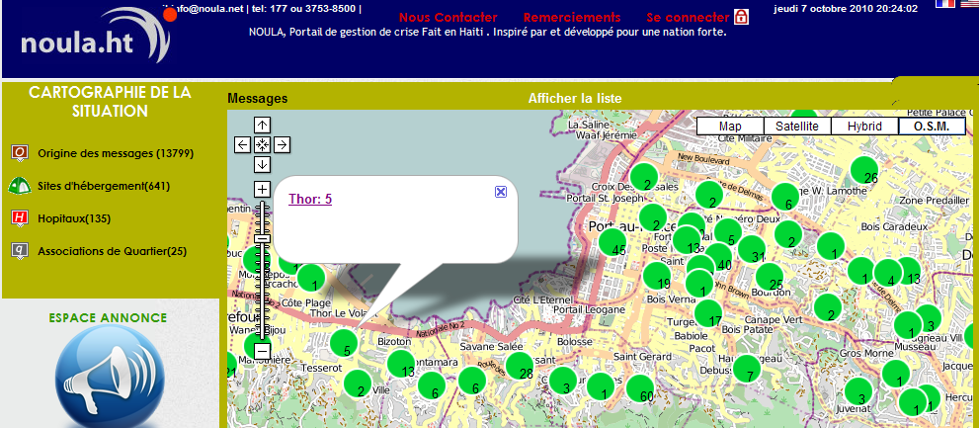
Ushahidi – Haiti

Slide 12
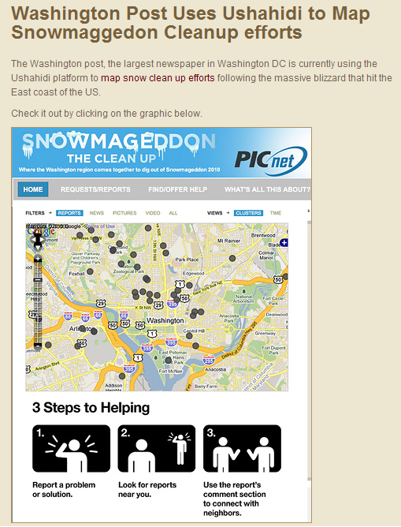
Ushahidi – Washington DC Snowmageddon

Slide 13
Demonstration
Interactive Social Media Map
http://www.esri.com/services/disaster-response/gulf-oil-spill-2010/index.html
http://www.kdvr.com/videobeta/a1e0fead-66d7-4e6b-95dc-a8a8f2e3305e/News/Social-media-emergency-test-conducted
Notes:
So rather than just show you slides, <demo presenter’s name> will show us how 3D GIS is not only practical, and it’s something you can start doing very quickly.
[After the demo]
So as you saw, 3D GIS is something that's achievable. You know, you don't have to go out and try to do it all at one time; you can start by doing the first thing shown: download the 3D model template. Then, you can start to take your existing building footprints and you can extrude them. So what did he really do there? He really assigned a value to every building polygon saying its height. And then he used that to give it an elevation and give it volume. And that's really the first major step. Once you have that, you can start performing all the calculations that he showed. So you could go ahead and calculate shadow, you could calculate viewshed, and do all the other kinds of analysis capabilities. This analysis combined with the use of 3D models will really transform how you communicate information to citizens, to decision makers, and other constituents that you have to engage in order to explain complex spatial analysis or even make simple impact statements about what's the city going to look like in the future if we do this or if we do that. So 3D is well within your grasp in order to be able to leverage and do something with it, and ArcGIS has all the tools you need to build your 3D city, analyze your 3D city, and leverage your 3D city to better communicate with the people around you.

Slide 14
