Slide 1
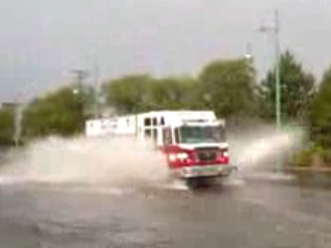
Situational Awareness for Flash Flooding
Presented to the Capital Area Council of Governments
Austin, 15 October 2010
By David R. Maidment
Director, Center for Research in Water Resources
Cockrell School of Engineering
University of Texas at Austin

Slide 2
Slide: Hector Guerrero, NWS, San Angelo

Slide 3
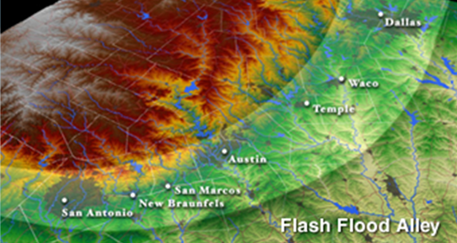
Flash Flood Alley
Slide: Hector Guerrero, NWS, San Angelo

Slide 4
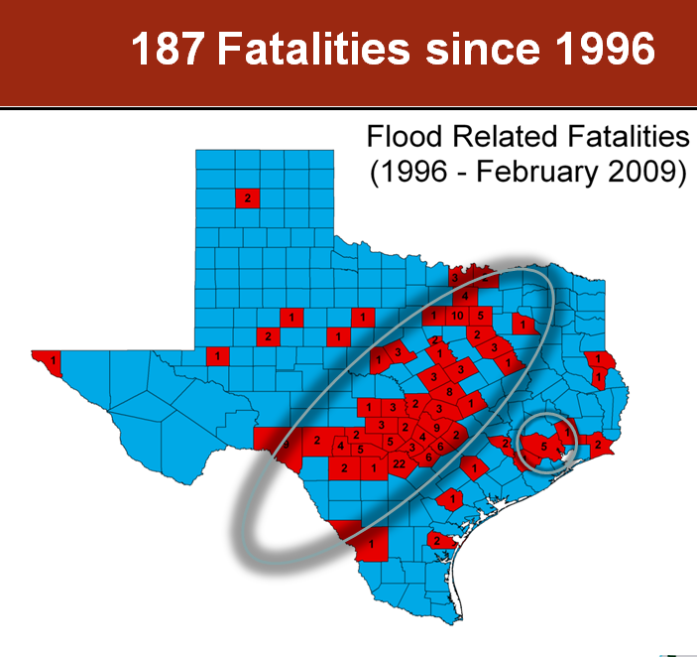
Slide: Hector Guerrero, NWS, San Angelo
Texas is No. 1 state in flood depths per year in the US – three times more than No. 2

Slide 5
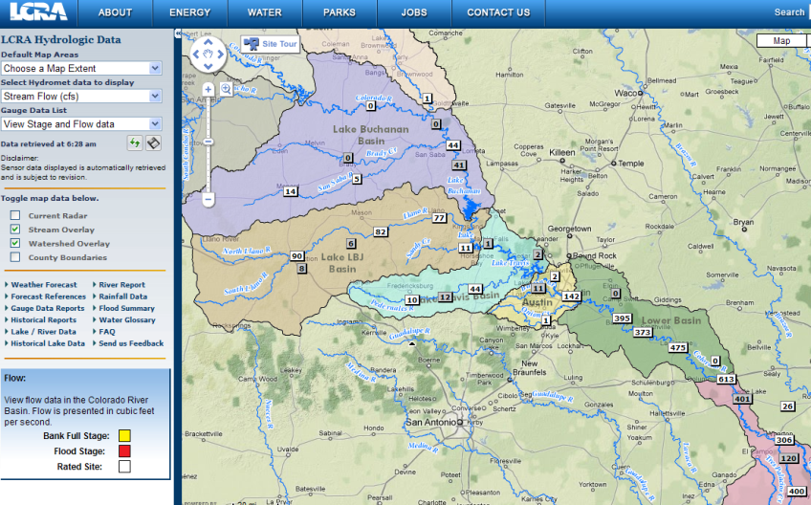
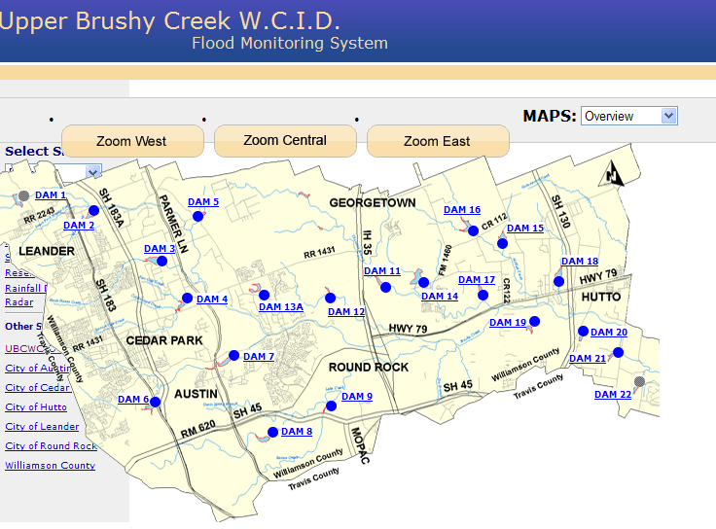
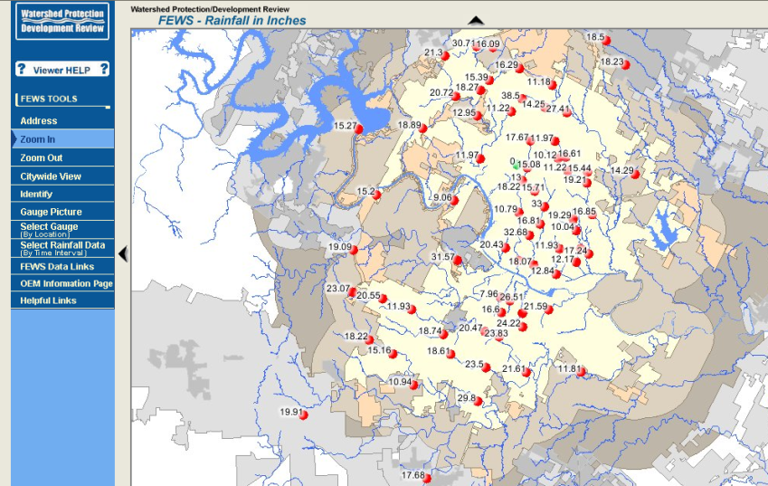
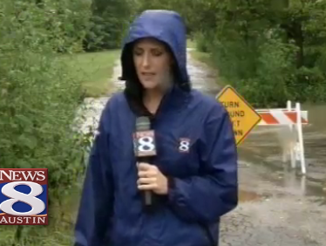
Local Information during Tropical Storm Hermine (8 Sept 2010)
Upper Brushy Creek (Round Rock)
LCRA
http://hydromet.lcra.org
http://ubcwcid.org/Overview/Overview.aspx?id=1
TV
City of Austin
http://coagis1.ci.austin.tx.us/website/COAViewer_fews/viewer.htm

Slide 6
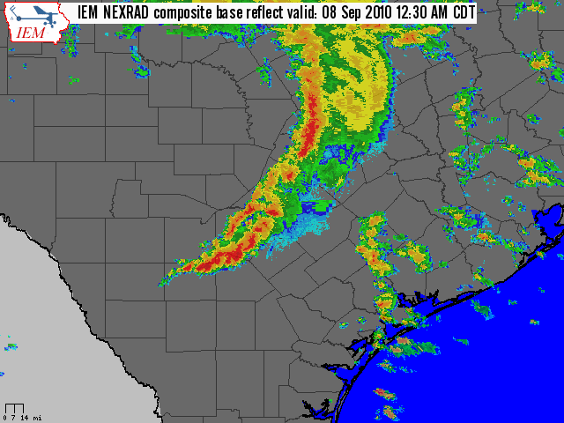
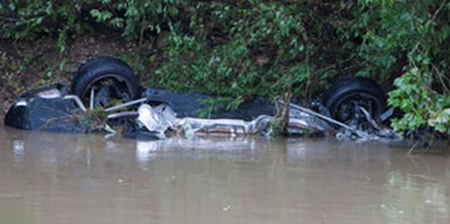
Lessons Learned from Hermine
People will drive through flood barriers!
A flash flood has about 2 hours advance warning and lasts for about 2 hours
During the crisis period emergency managers are busy and “chat” goes silent
Need automated systems that keep providing information regardless of the crisis
Image: Mark Lenz, NWS
Photo: Larry Kolvoord – American Statesman

Slide 7
Situational Awareness for Flash Flooding
“All disasters are local”
News Media
People
TV
Radio
Warnings
Emergency Response
Federal Government
Local Government
Information
Internet

Slide 8
How to Communicate with Emergency Responders?
Frisco, Tx: SAFER http://www.crwr.utexas.edu/gis/gishydro10/SAFER-Frisco.wmv
Shows how school information is communicated to emergency responders

Slide 9
Hand-Held Devices
Give information to them?
Obtain information from them?
Harvesting and filtering twitter feeds
Posting information to online maps

Slide 10
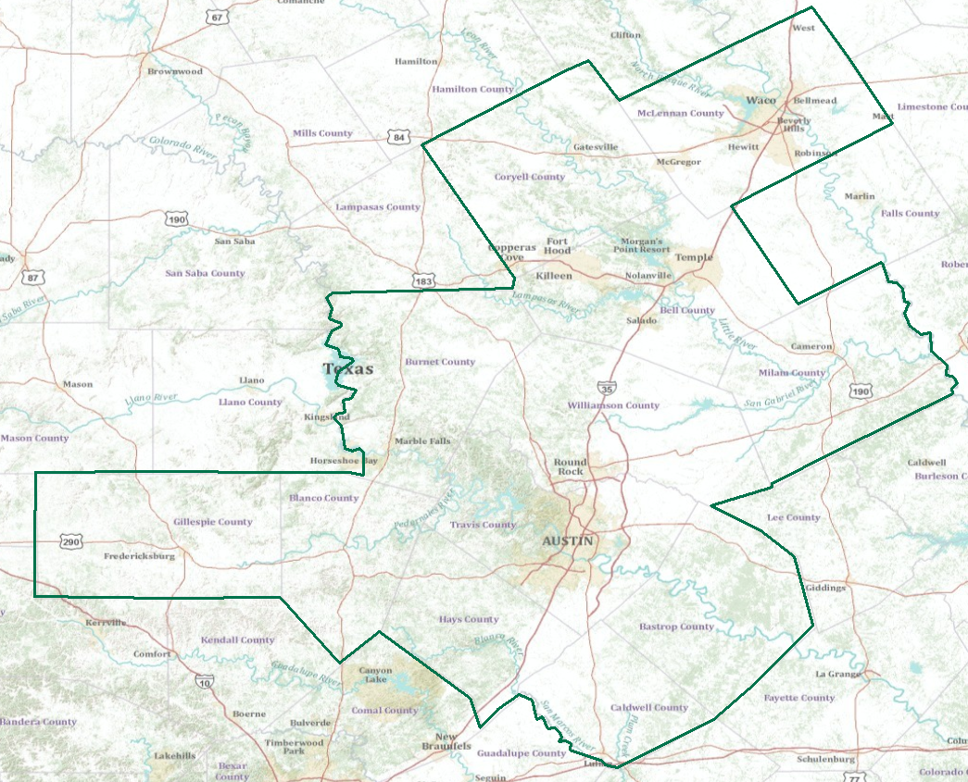
Real-Time Flood Information for Television
Maureen McCann, Meteorologist with News8 Austin
Develop a prototype of space-time mapping for television meteorologists

Slide 11
Internet Communications
We are all connected
Information Consumers
 | People | Media | Local Government | Federal Government
People
Media
Local Government
Federal Government
Information Producers
Web services can play an important role in this……

Slide 12
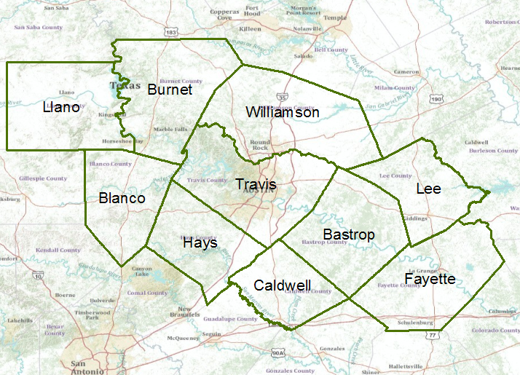
Capital Area Council of Governments (CAPCOG)
Emergency response is organized within COG’s (24 in Texas)

Slide 13
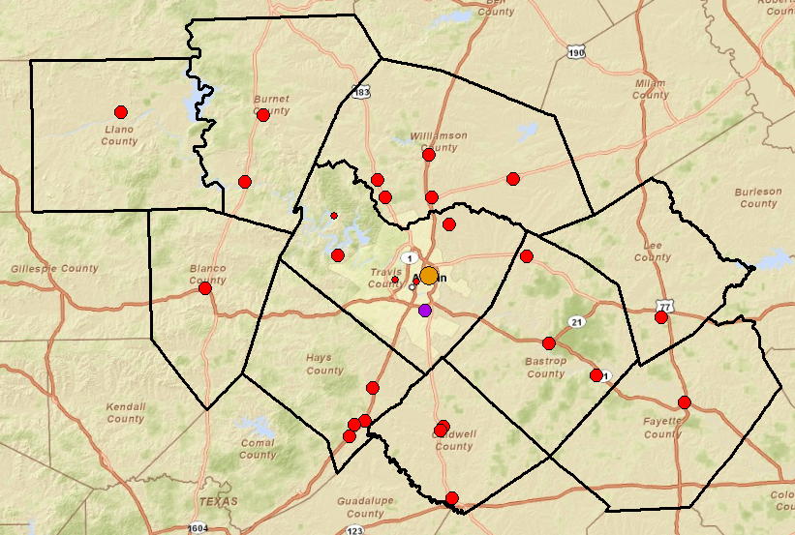
Public Safety Answering Points in the CAPCOG region

Slide 14
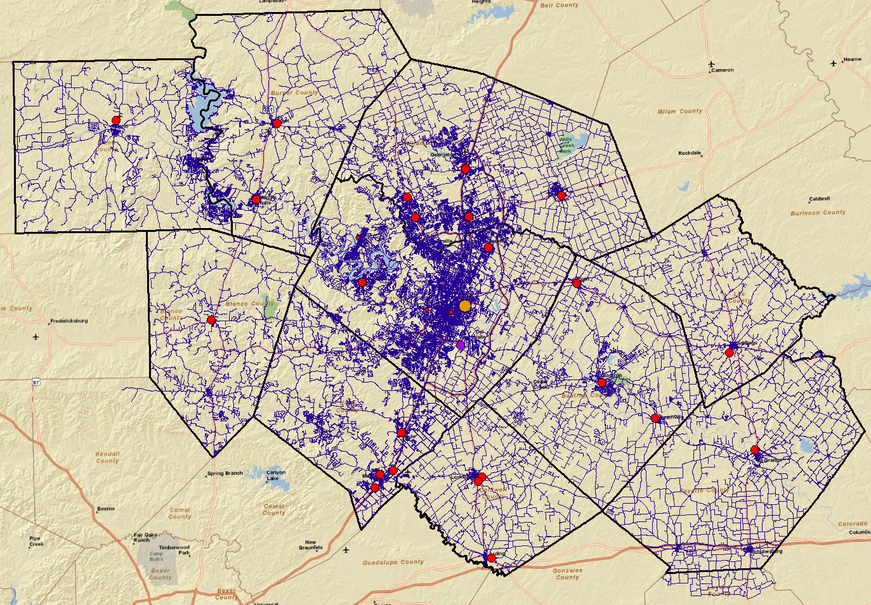
Emergency calls are referenced on the road and street network

Slide 15
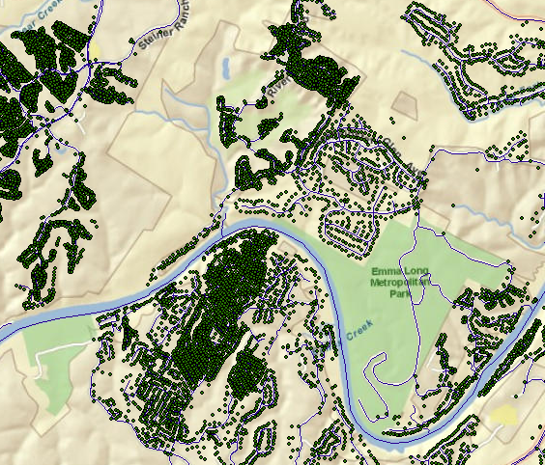
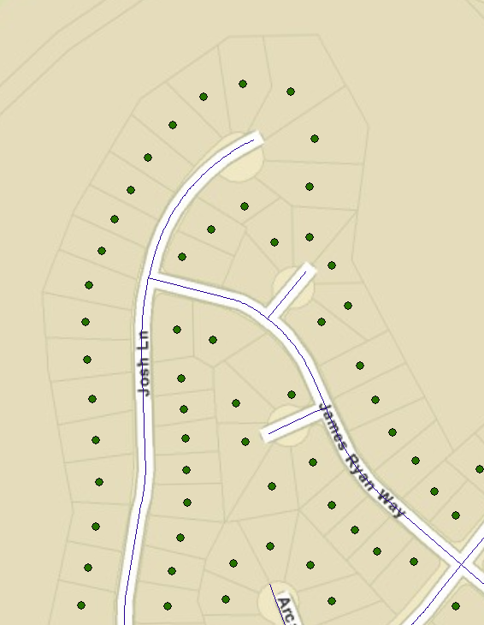
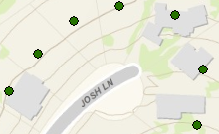
Address points locate individual homes and buildings
Address points and building footprints
There are 687,000 address points in the CAPCOG region
Address point is referenced to a location on the road network

Slide 16
How 911 calls are handled now
71% of emergency calls are made from cell phones
CAPCOG Public Service
Access Points
PSAP = Public Safety Answering Point
Slide adapted from: John Brosowsky Product Development Director, GeoComm

Slide 17
ESInet – Emergency Services Internet Network IP Enabled – each device has an IP address
Next Generation 911
Geographic location by coordinates
Public Service Access Points
Location on Maps
Slide adapted from: John Brosowsky Product Development Director, GeoComm

Slide 18
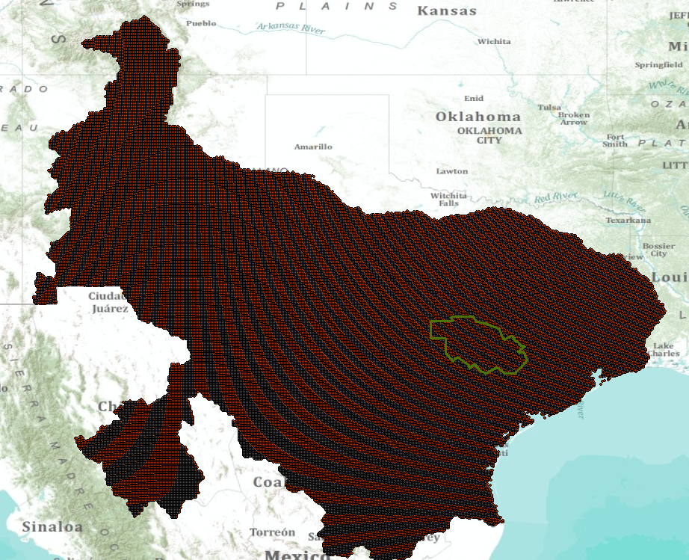
Multisensor Precipitation Estimate (MPE) West Gulf River Forecast Center

Slide 19
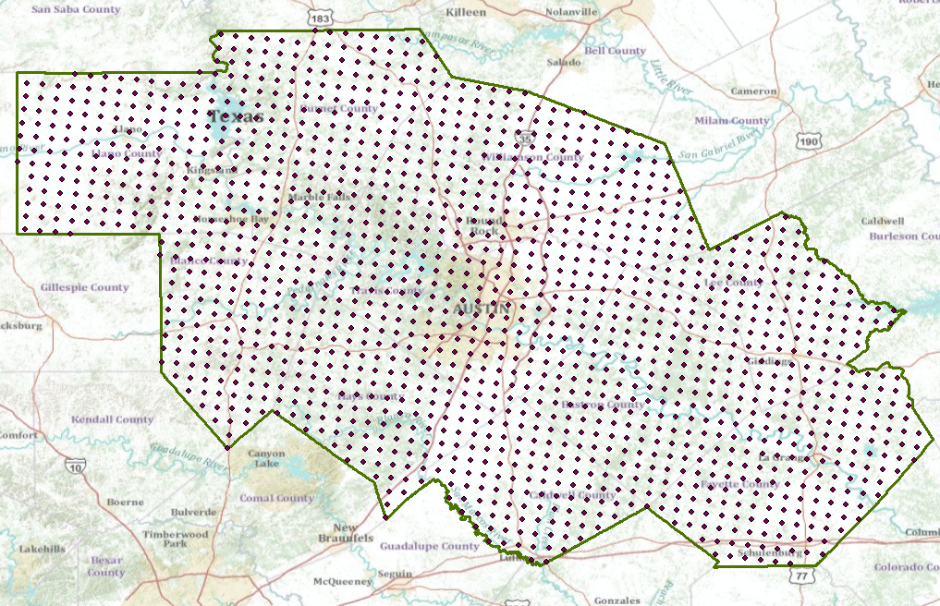
MPE Rainfall Points in CAPCOG

Slide 20
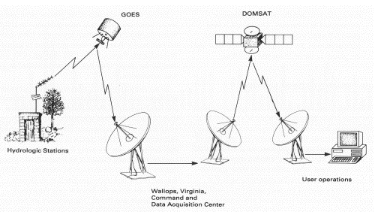
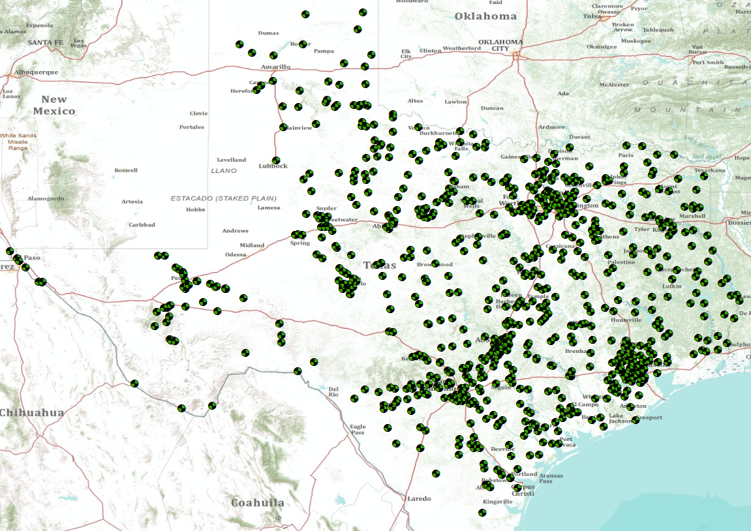
USGS Streamflow gages in Texas
Real-time data acquisition through satellites

Slide 21
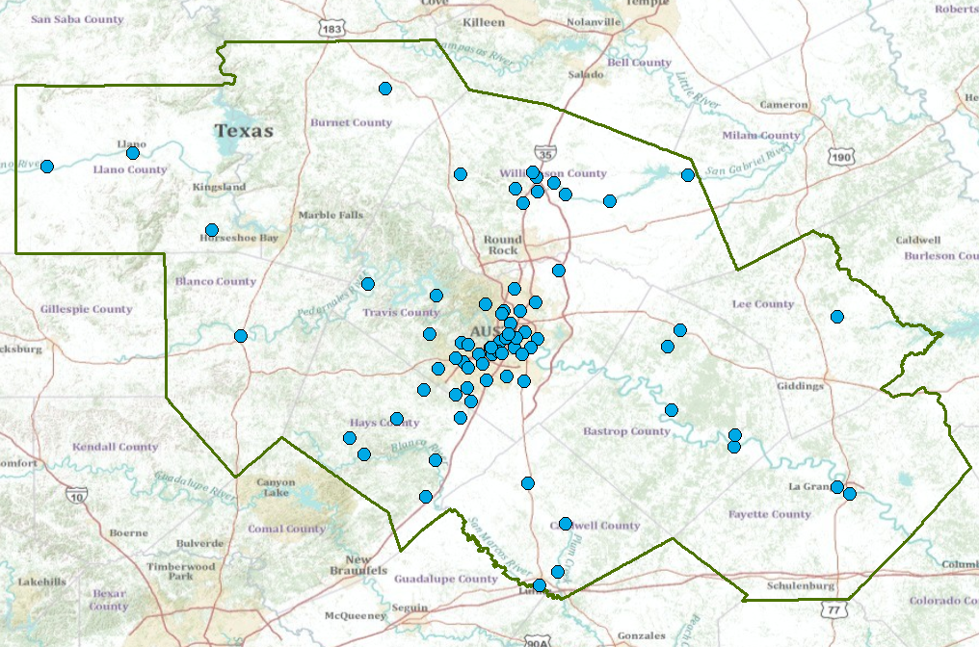
USGS Streamflow gages in CAPCOG

Slide 22
USGS Streamflow gages in CAPCOG

Slide 23
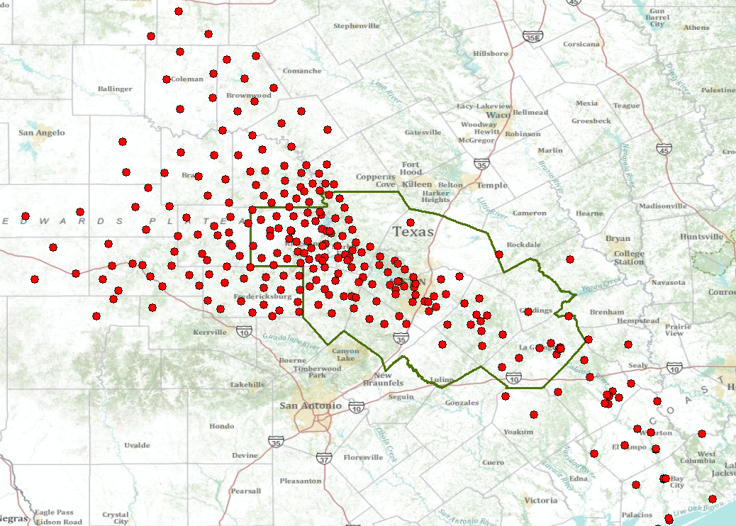
LCRA HydroMet Network

Slide 24
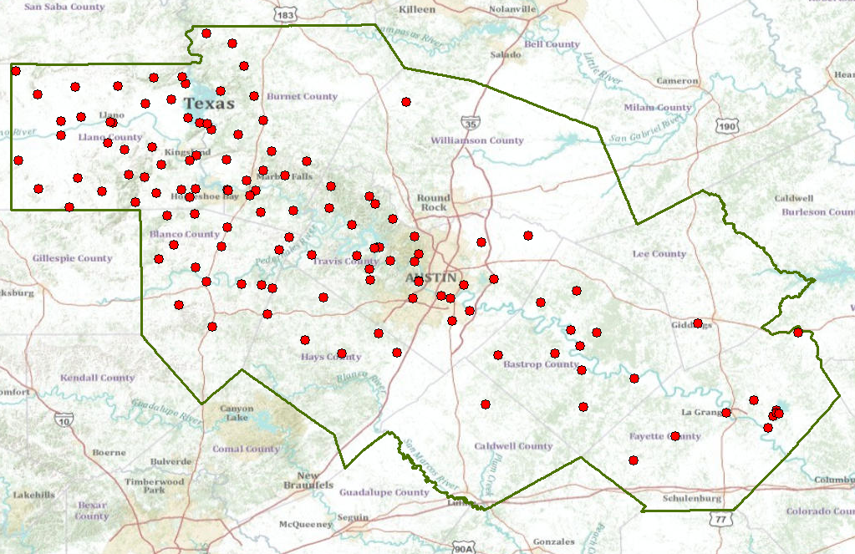
LCRA HydroMet in CAPCOG

Slide 25
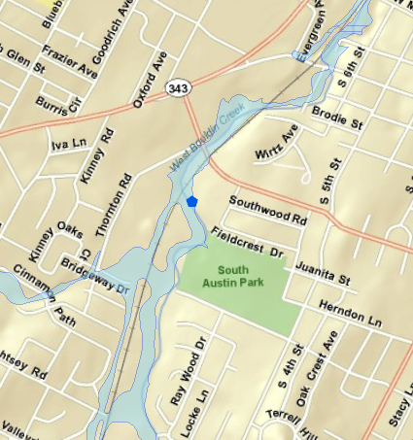
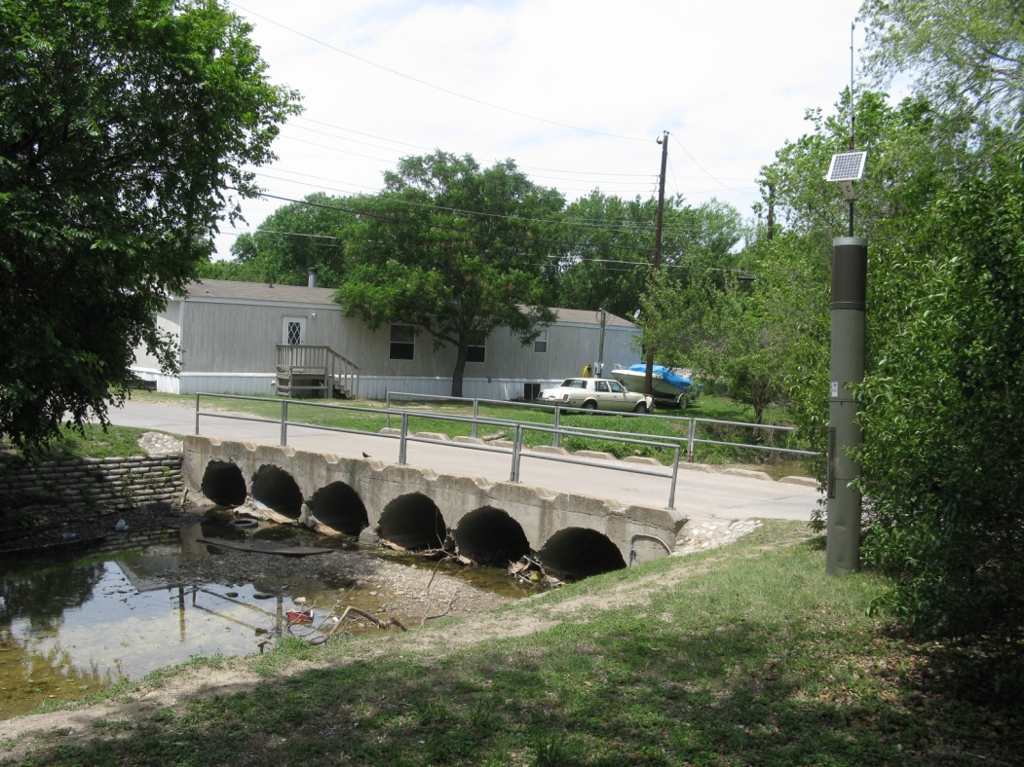
Austin’s Flood Early Warning System (FEWS)
FEWS Gage measuring water level and rainfall at a low water crossing
Image: Susan Janek, City of Austin
Citizens living near here are in the 5-year floodplain….
……their only escape is along a railroad line

Slide 26
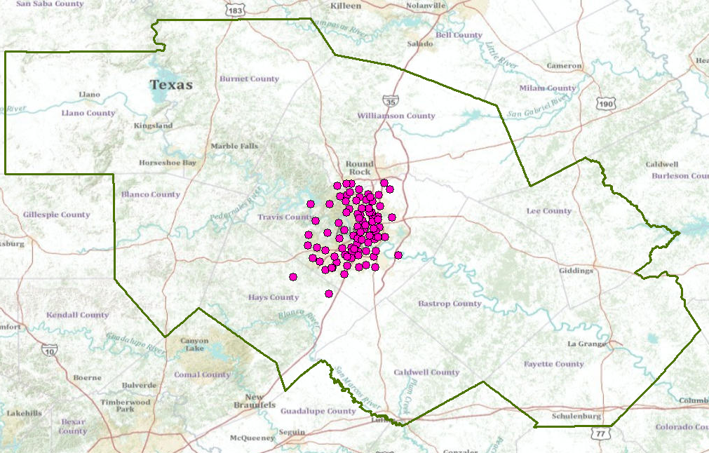
City of Austin FEWS in CAPCOG

Slide 27
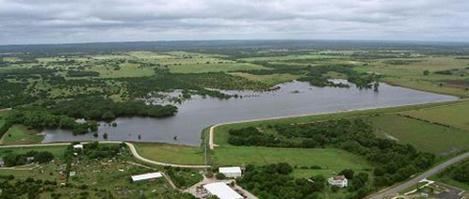
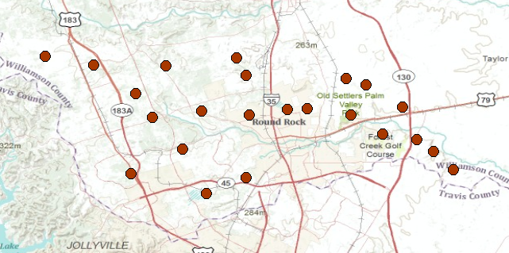
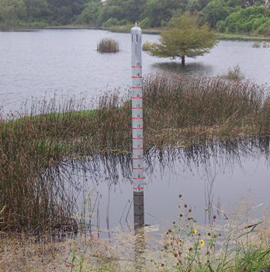
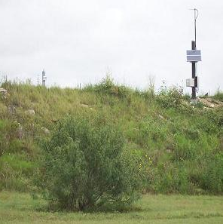
21 Flood Control Dams in Williamson County
Water Level
Precipitation
15 min data

Slide 28
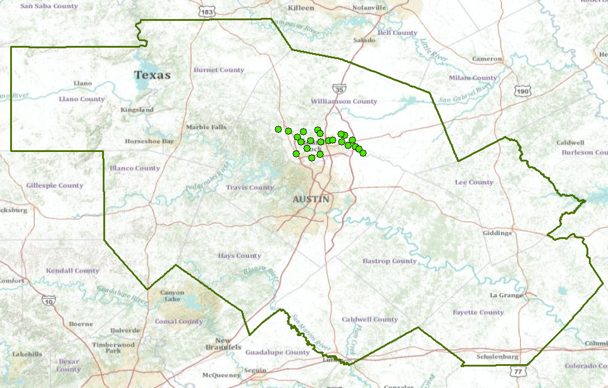
Upper Brushy Creek Sites in CAPCOG

Slide 29
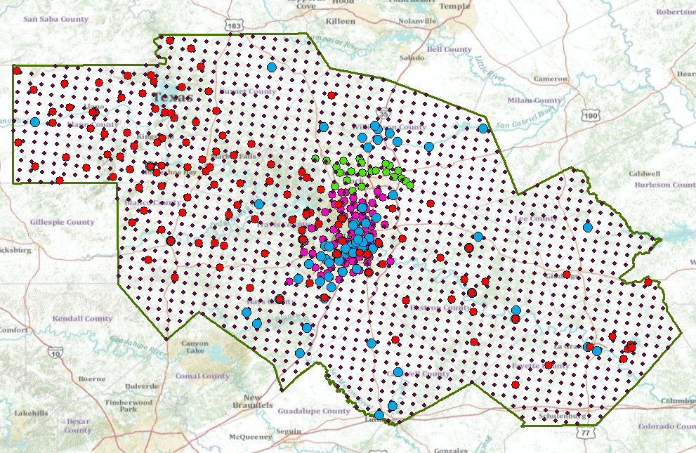
A Single Virtual Flood Observation Network for the CAPCOG region
Combines NWS, USGS, LCRA, City of Austin, UBCWCID, …. data

Slide 31
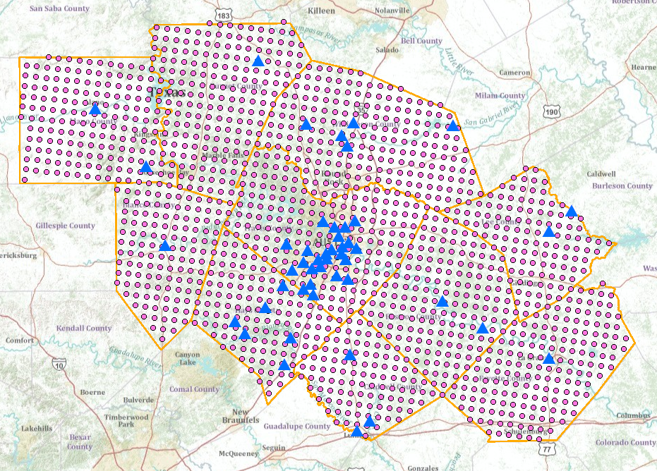
Nexrad Rainfall and USGS gages in the CAPCOG region
http://129.116.104.176/ArcGIS/rest/services/capcogaustin/capcog/MapServer
A map service in space
Accessible through ArcGIS.com

Slide 32
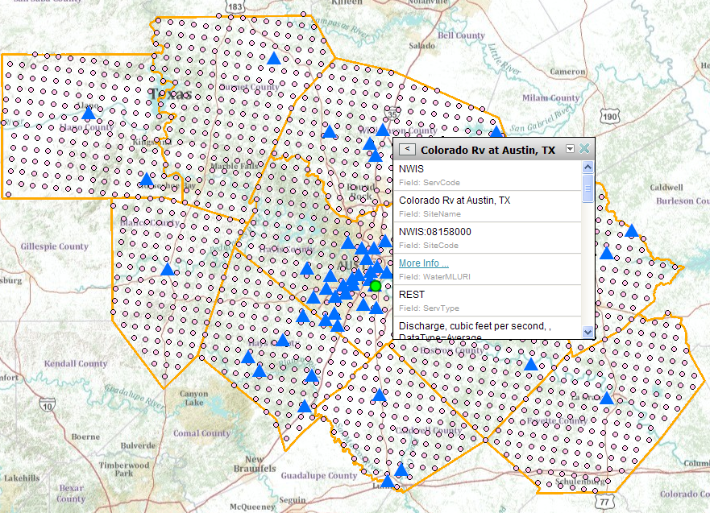
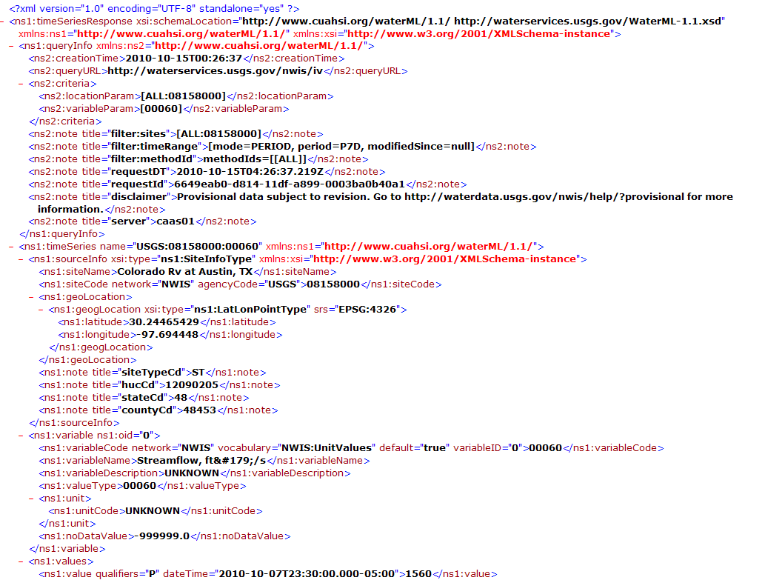
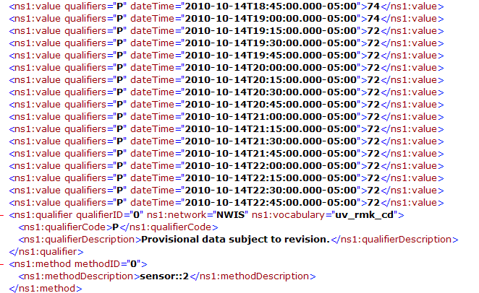
USGS REST service
http://waterservices.usgs.gov/nwis/iv?sites=08158000&period=P7D&parameterCd=00060
An observations service in time

Slide 33
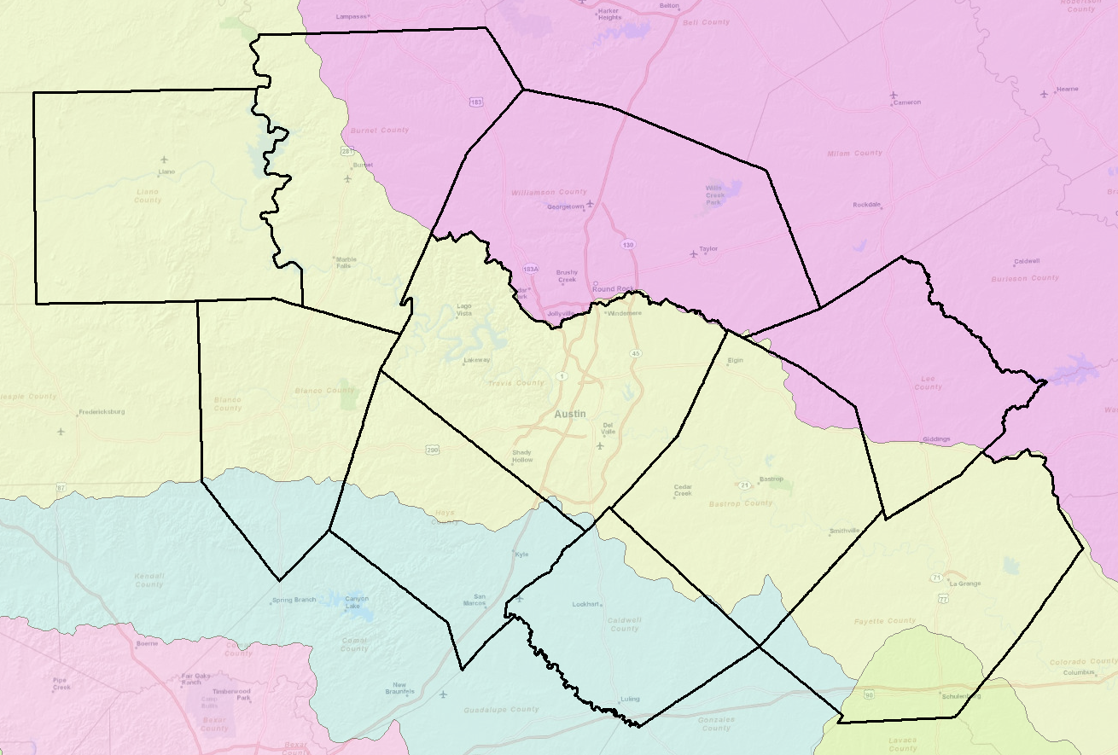
River Basins of CAPCOG region
Colorado
Brazos
Guadalupe
Lavaca

Slide 34
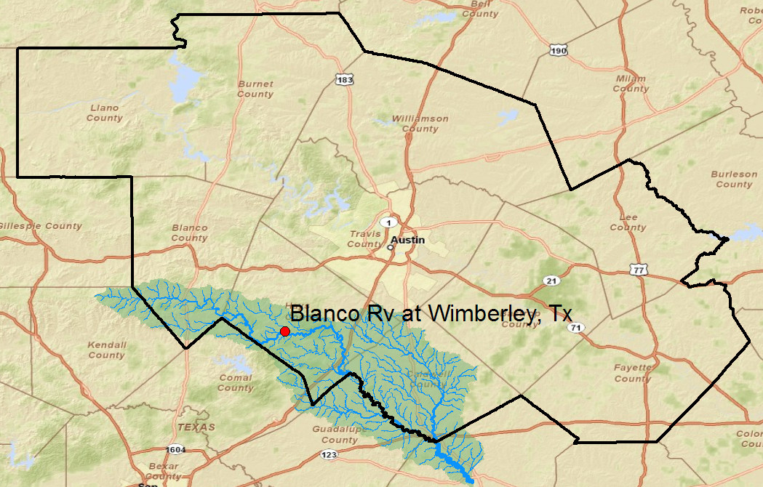
Example for Wimberley, Texas
San Marcos Basin

Slide 35
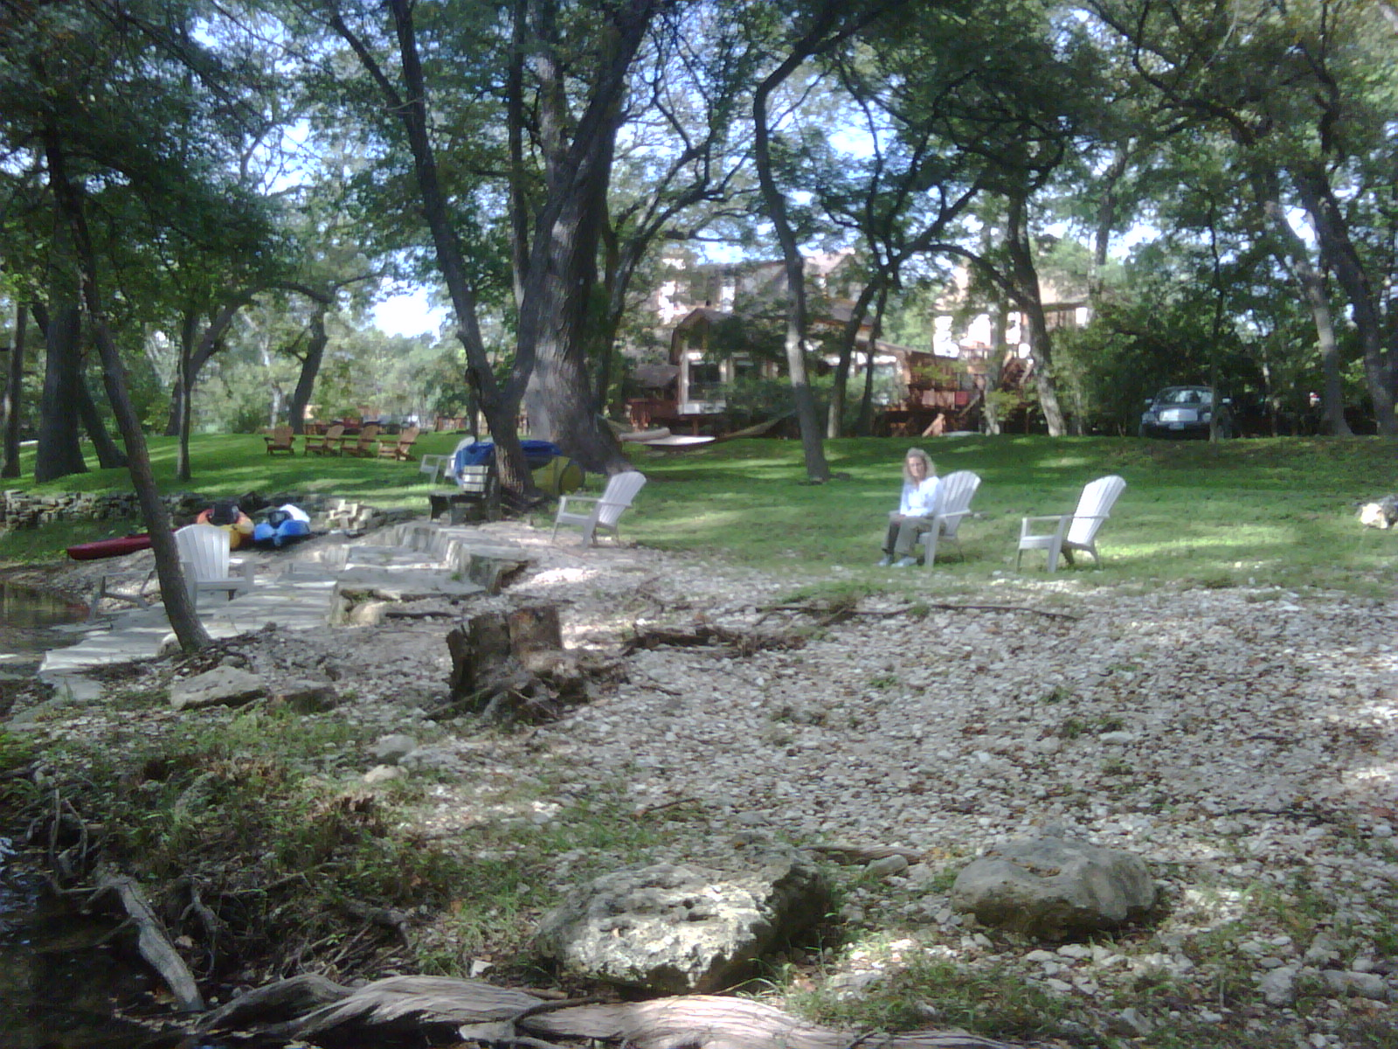
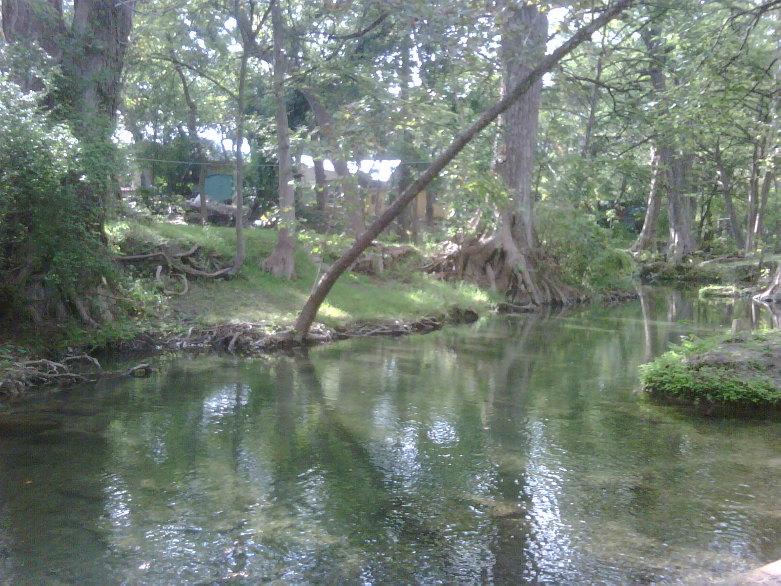
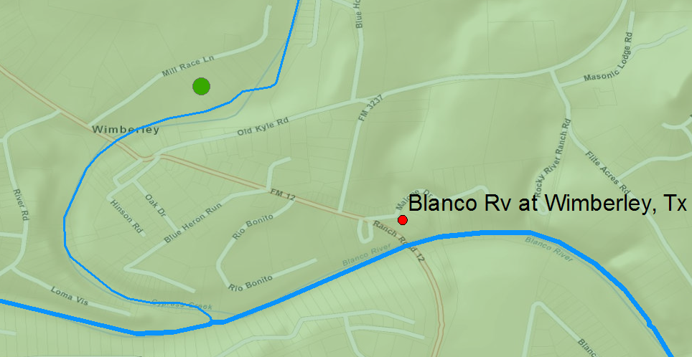
Cypress Creek, Wimberley
Cypress Creek
Creekhaven Inn
Wimberley
Blanco River

Slide 36
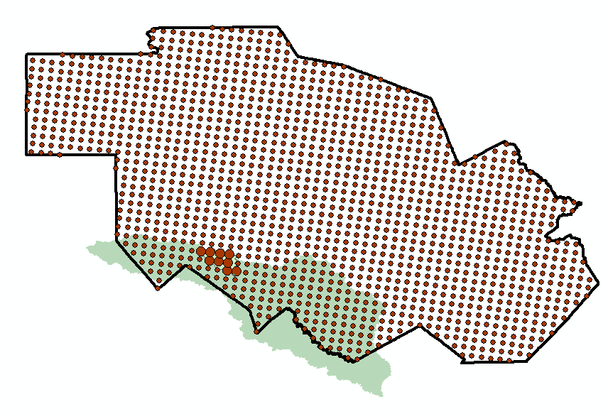
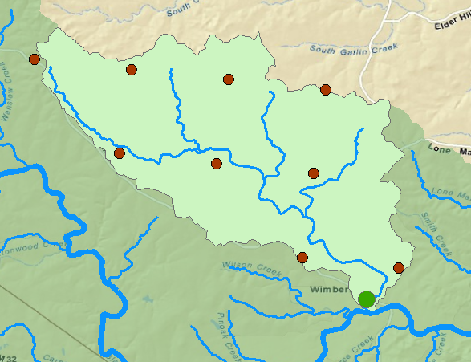
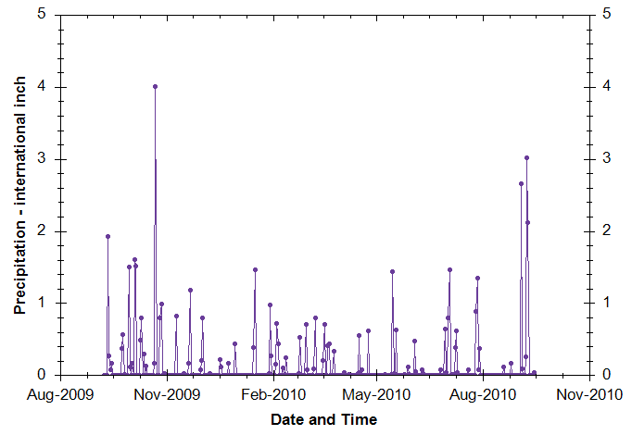
Rainfall in Cypress Creek Watershed Drainage area – 38 Sq. Mi.
“Virtual Rain Gages”— Nexrad Radar Rainfall points
Time Series of Rainfall
Data obtained via WaterML web service from NWS and UT Arlington

Slide 37
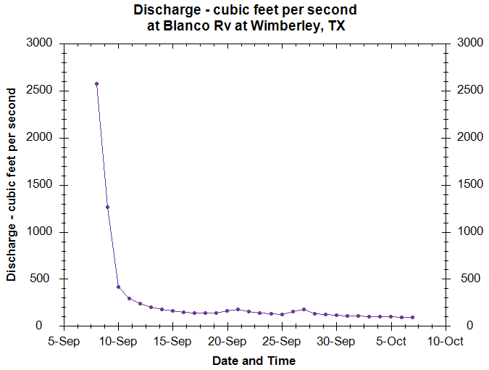
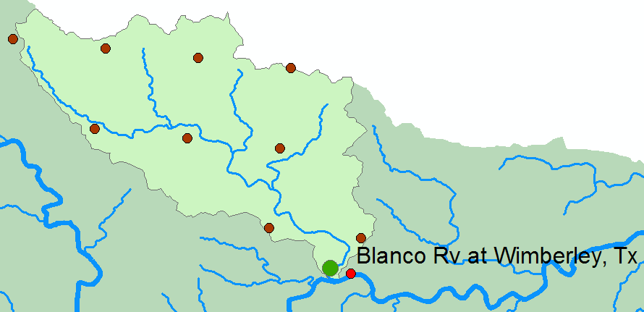
Discharge in the Blanco River
Data obtained via USGS WaterML
web service
Time Series of Discharge

Slide 38
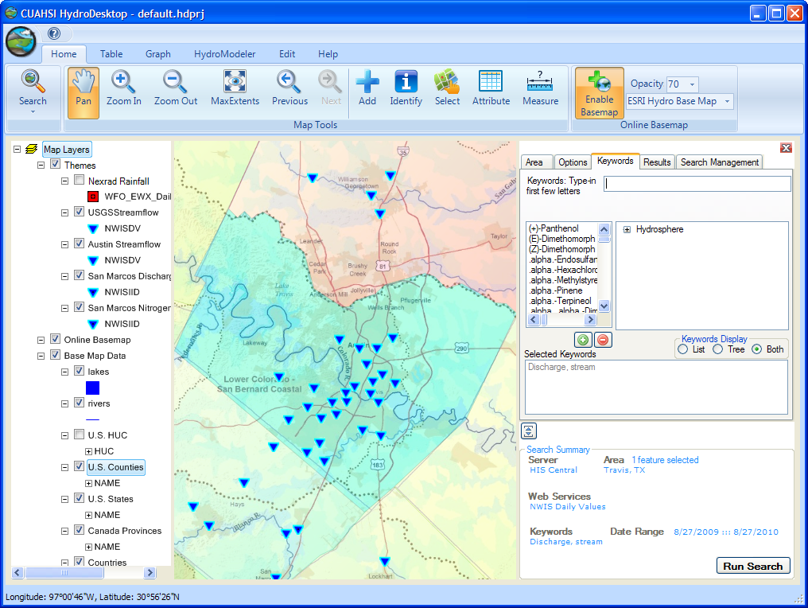
CUAHSI HydroDesktop http://www.hydrodesktop.org

Slide 39
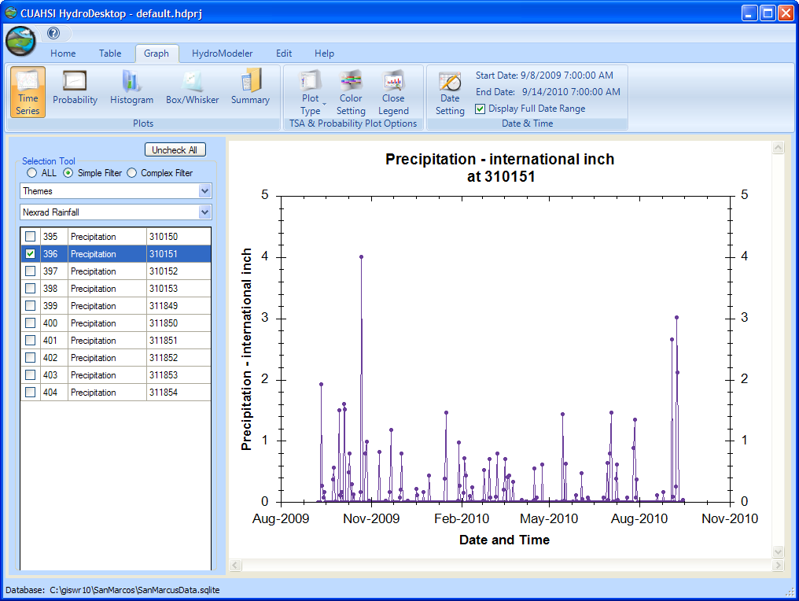
A Hydrologic Information System Searching and Graphing Time Series

Slide 40
Local Water Level Sensors operated by homeowners
Wireless Transmission to Nearby Building
Creekhaven Inn
Cypress Creek
Internet Transmission to ESINet
A pressure sensor

Slide 41
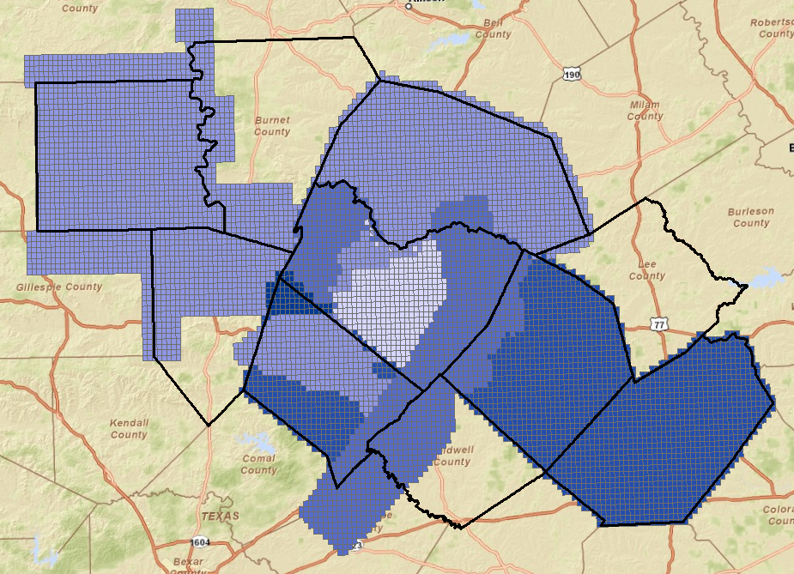
CAPCOG LIDAR Coverage
In Process
Address points can be given elevation
so they have (x,y,z), not just (x,y)
Collected
How high is the water?
How high am I?

Slide 42
Conclusions
We are building a community with shared interests in situational awareness for flash flooding
Can create a virtual flood observation network and access it through WaterML web services
Map services in space that index observations services in time
Next workshop in early December focusing on information for TV stations

