Slide 1
FLOG/FIM Subcommittee Meeting, 2 August 2024
Agenda Items:
Geo-Intelligence Division FIM Development Updates (Carson Pruitt, NWC)
Federal and state agency updates
Transportation Stormwater Overview by Matthew Lepinski, USACE, Fort Worth

Slide 2


Slide 3
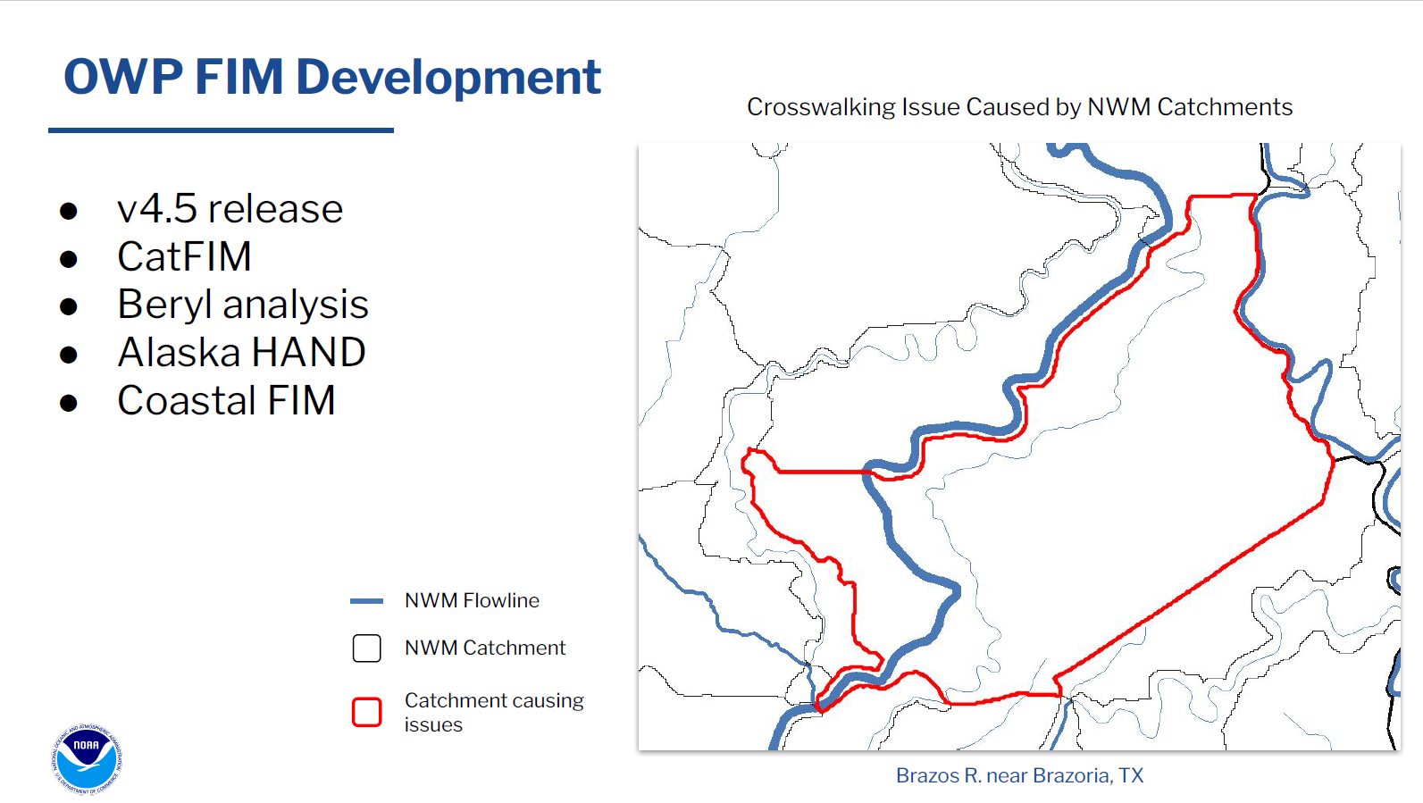

Slide 4



TSI Overview for FLOG/FIM Small Group
Matt Lepinski, P.E.
U.S. Army Corps of Engineers, Fort Worth District
August 2, 2024

Slide 5
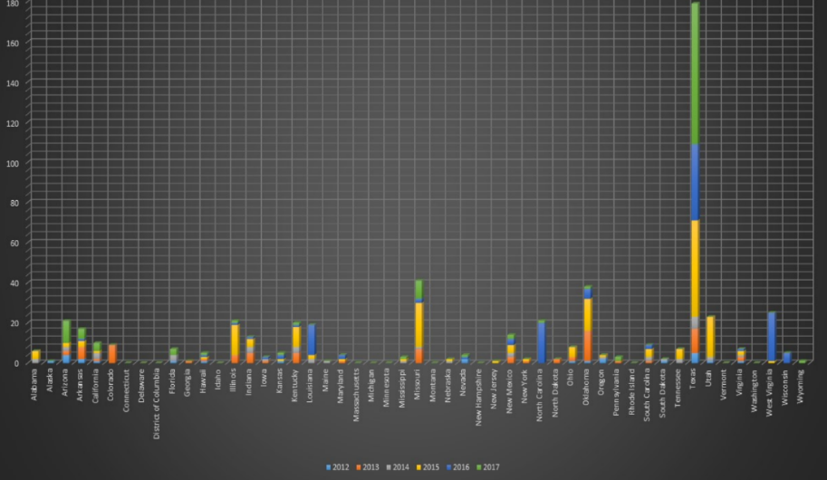

Flooding Fatalities and Damages
Fatalities by State for 2012 – 2017
Texas far outpaces other states in flood-related fatalities and flood-related damages
2017
$100+ billion 70 fatalities
156 fatalities 2015 – 2017
2016
38 fatalities
2015
$850 million 48 fatalities
Source: Gregory Waller, Service Coordination Hydrologist, NWS – West Gulf River Forecast Center, http://www.nws.noaa.gov/om/hazstats.shtml, 11/18 TFMA

Slide 6
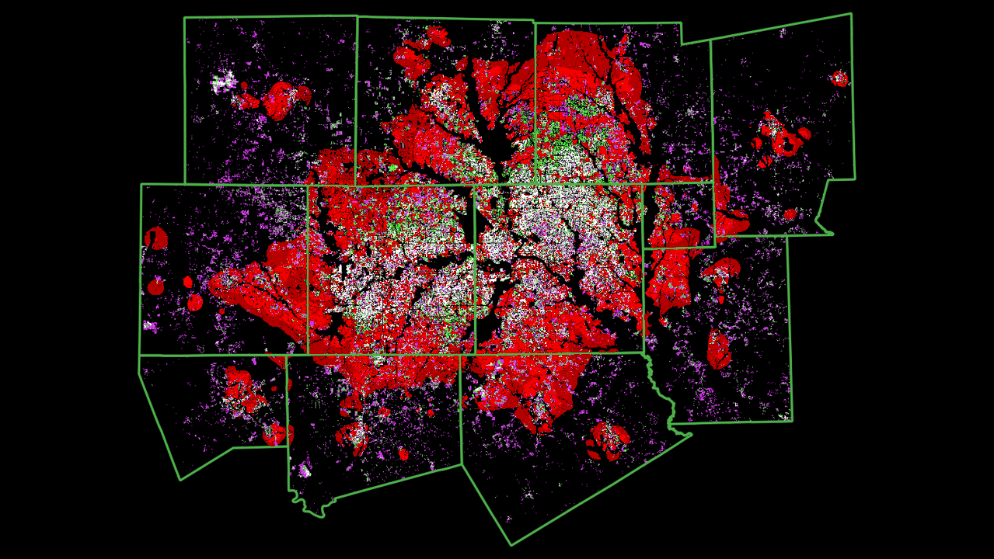
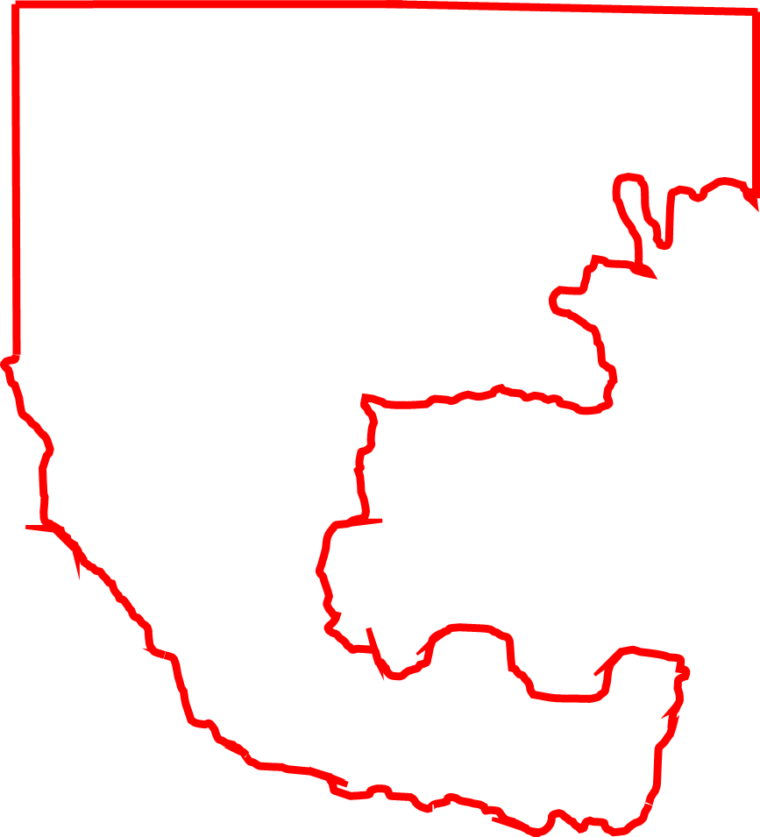
Projected Growth
1986
2000
2015
2015 – 2045
TSI Study Area

Slide 7
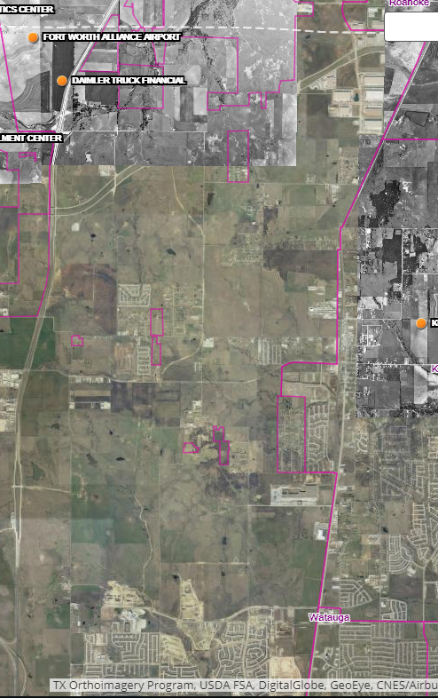
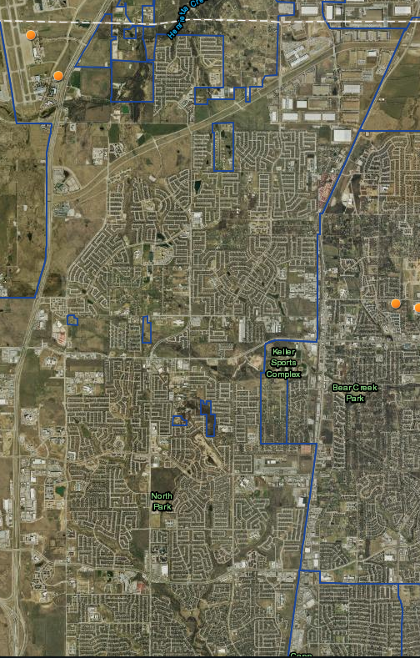
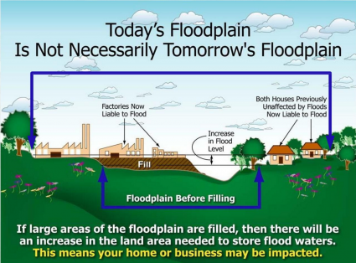
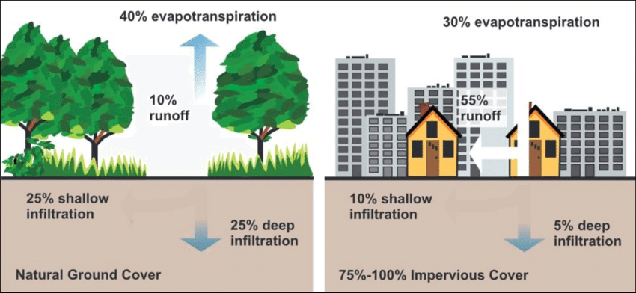
Urbanization Challenges
Case Study: Development in Fort Worth, TX (North)
BEFORE
AFTER

Slide 8

Stormwater Challenges
No regionwide data
Piece-meal/lacks connectivity
Updated rainfall estimates
  Precipitation data required for infrastructure design, planning, and delineation of flood risk
  NOAA Atlas 14 published for Texas in 2018
    The 2022 FLOODS Act requires updates to this every 10 years

Slide 9
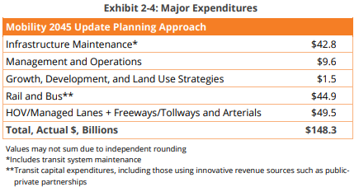
Transportation Challenges
Transportation spending is high and growing
Rate of deterioration for transportation infrastructure increasing
Needs far outweigh resources
Source: Dallas 2017 Bond Program – http://www.dallasbond.com/
Source: NCTCOG, Mobility 2045 Update

Slide 10
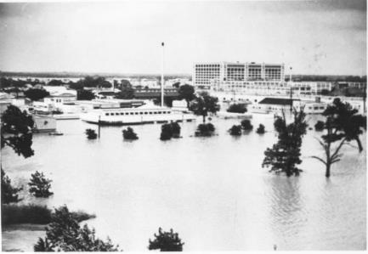
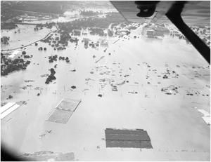
Response vs. Prevention?
Sources: Flooded Area of Stores and Homes Near Downtown Fort Worth During Flood of 1949; https://texashistory.unt.edu/ark:/67531/metapth27965/: University of North Texas Libraries, The Portal to Texas History, https://texashistory.unt.edu; Tarrant County College NE, Heritage Room
Fort Worth – May 1949 (~11 inches of rain overnight):
Levees breached, 10 deaths & $11M+ in damages
Resulted in extensive improvements to flood control infrastructure
  Water District (established in 1924)
  USACE Fort Worth District (established in 1950)
Sources: Aerial View of Flood in Fort Worth in 1949, photograph, May 17, 1949; (https://texashistory.unt.edu/ark:/67531/metapth40670/: University of North Texas Libraries, The Portal to Texas History, https://texashistory.unt.edu ; Lockheed Martin Aeronautics Company, Fort Worth.

Slide 11
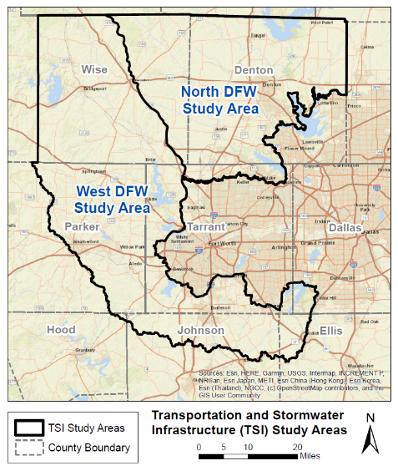
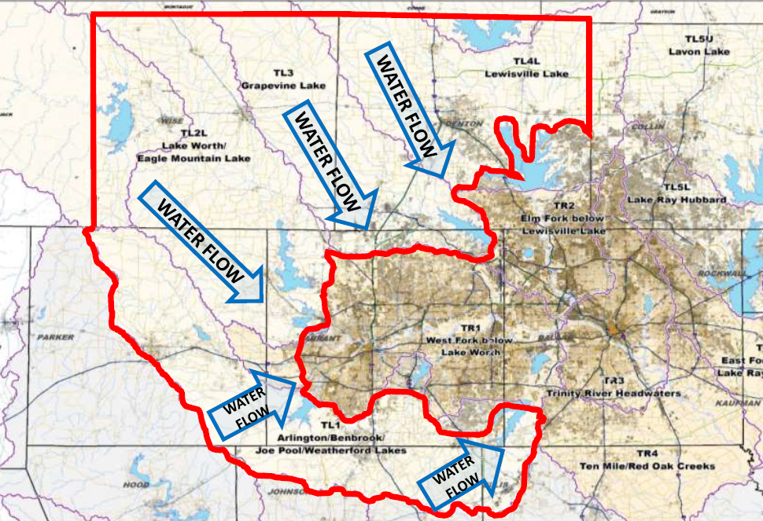
Integrated Transportation and Stormwater Infrastructure (TSI) Study Overview
Intent:
Integrate regional planning for transportation, stormwater management, urban development, and environmental features
Proactively vs. Reactively reduce flood risk
Minimize overall life cycle costs of infrastructure
Reduce impacts to the natural environment in the rapidly developing study area
Objective: a ‘roadmap’ for communities
www.nctcog.org/tsi

Slide 12
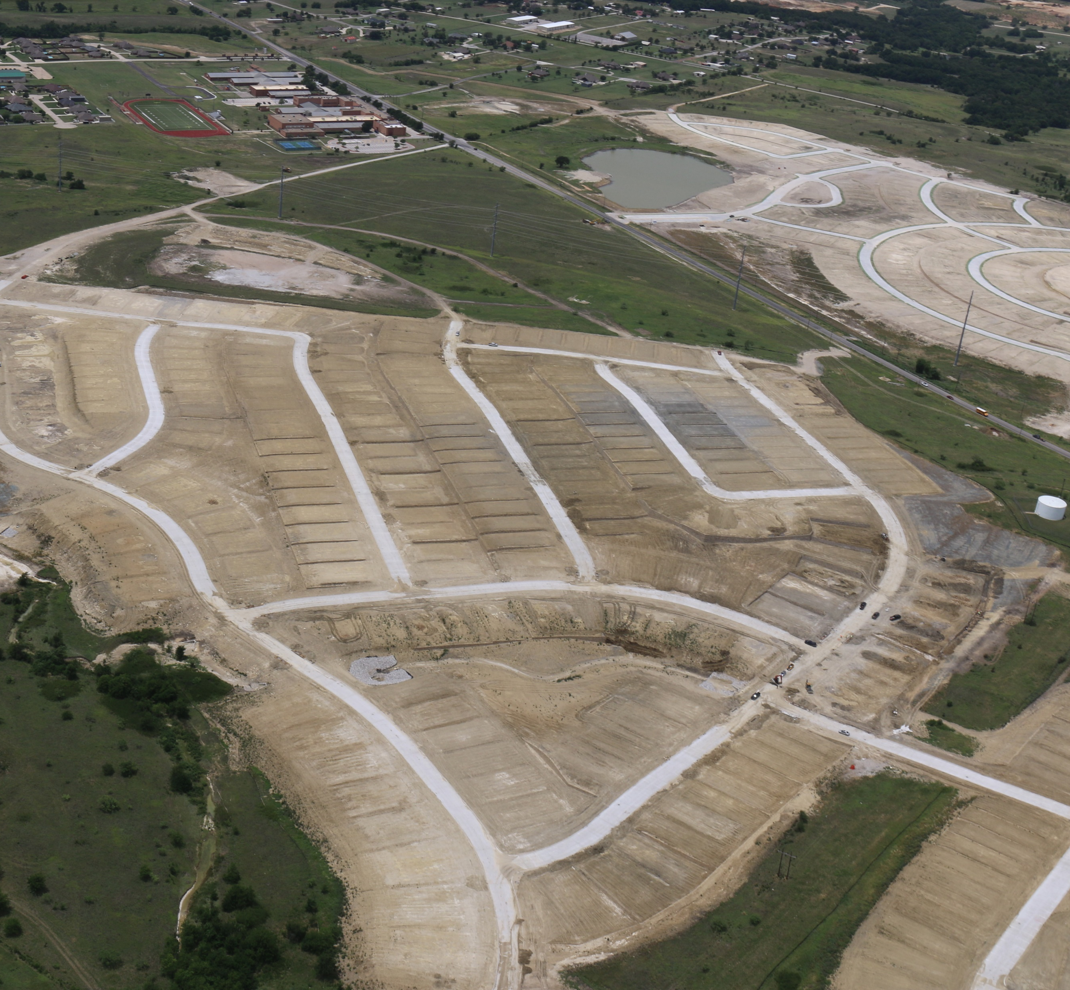
Project Area Details
85 cities and portions of 8 counties
126% increase in population (2020 – 2045)
60% undeveloped (2015)
19% growth in impervious surface (2006 – 2016)
> 7,000 miles of streams and > 274,000 acres of 100-year floodplain
Photo courtesy of City of Newark

Slide 13
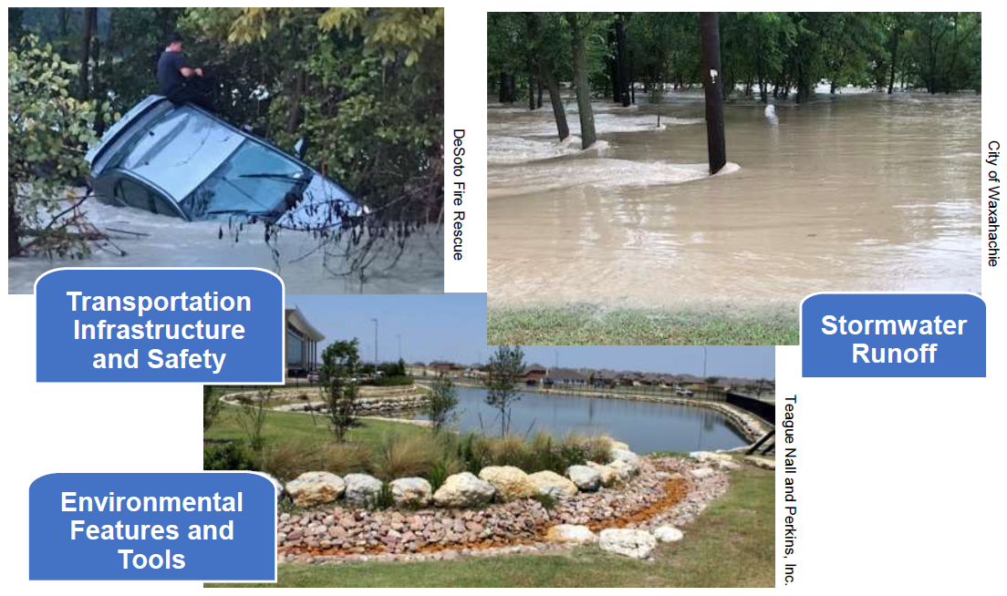
Why Collaboration is Important
Dissolve silos
Improve delivery of consolidated, adaptive infrastructure
Get ahead of growth
Reduce costs

Slide 14
Stakeholder Involvement
Collect & Analyze Data
Document Processes
Assess Hydrology & Hydraulics & Scenarios
Mapping, Modeling, and Policy Recommendations
Identify Transportation Infrastructure Impacts &
Develop Decision-Making Tools
Conduct Environmental Planning
Evaluate a Real-Time Flood Warning System
Support & Empower Communities

Slide 15
TSI Goals and Outcomes
Proactive Planning
Reduce Flooding
Tools/ Resources
Local-Scale Innovation
Community Roadmap
Reimagine transportation design to integrate stormwater, environmental, and flood reduction benefits
Protect current and future infrastructure
Develop model for replication
  Reduce flooding downstream of rapidly growing upstream communities
  Increase resiliency to flooding disasters
  Inform decision-making
  Implement stormwater infrastructure with transportation infrastructure
  Empower communities to adopt higher floodplain management standards
  Develop GIS based tools and resources
  Emergency management & flood warning recommendations
  Enhance Trinity River Watershed Hydrology Assessment
  Enhance existing hydraulic models such as BLE
  Optimization study for drainage/flood control structures
  Develop flood susceptibility map
  Produce planning-level designs for transportation, stormwater detention, and environmental
  Integrate these layers to identify what needs to be built and achieved benefits
  Establish ways to fund planned infrastructure

Slide 16


Result: A menu of options & integration where it makes sense
Open Space
Preservation
Transportation Integration
Stormwater Management
Nature Based Solutions
Green Infrastructure
Aquifer Recharge
Note that these images are AI generated

Slide 17
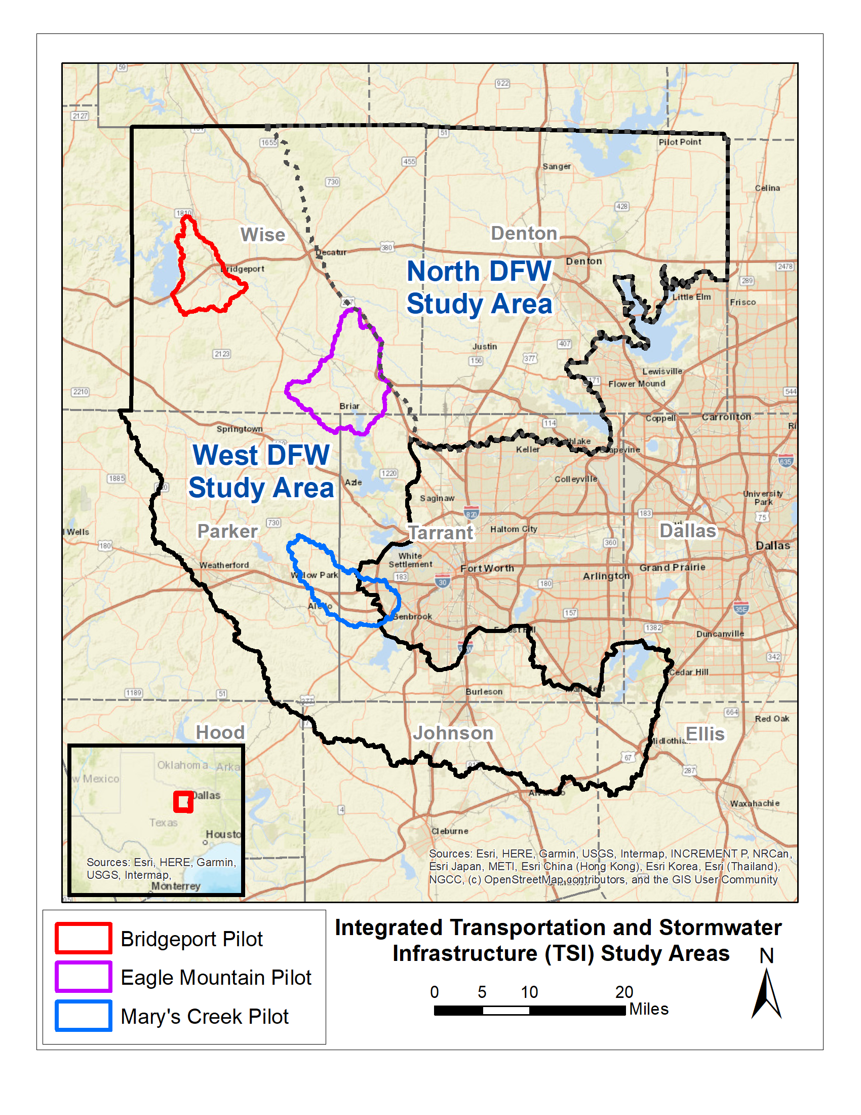
TSI Pilot Study Overview
Pilot Study Locations and Updates:
  Intent: to develop and test approach for larger effort
  Bridgeport:
    Completed initial H&H pilot study in late 2023
  Eagle Mountain and Mary’s Creek:
    Completing more comprehensive H&H pilot studies, including:
      Establishing current/future land use
      Hydrology approach development and technical enhancements to WHA
      Hydraulics approach development and technical enhancements to BLE
      Optimization study and urban drainage methodology refinement
      Identify flood-prone areas and model Green Stormwater Infrastructure (GSI)

Slide 18
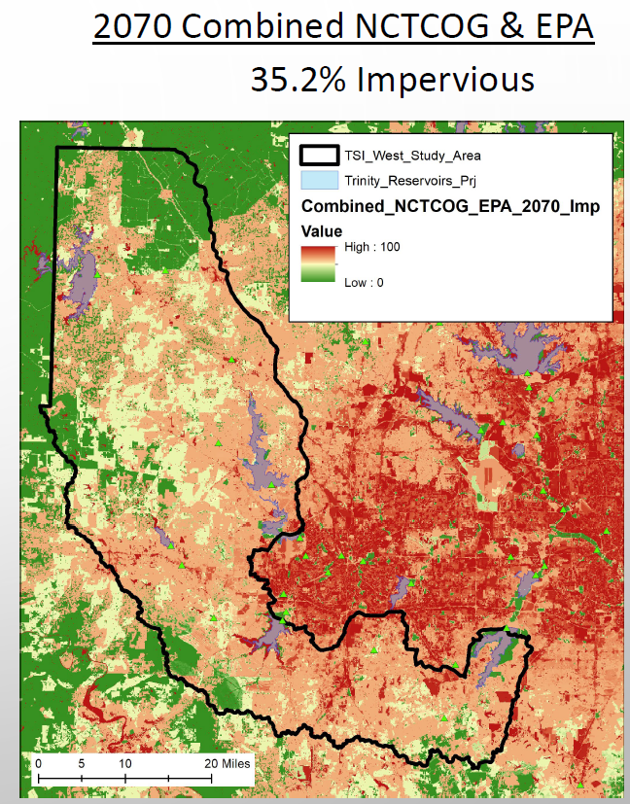
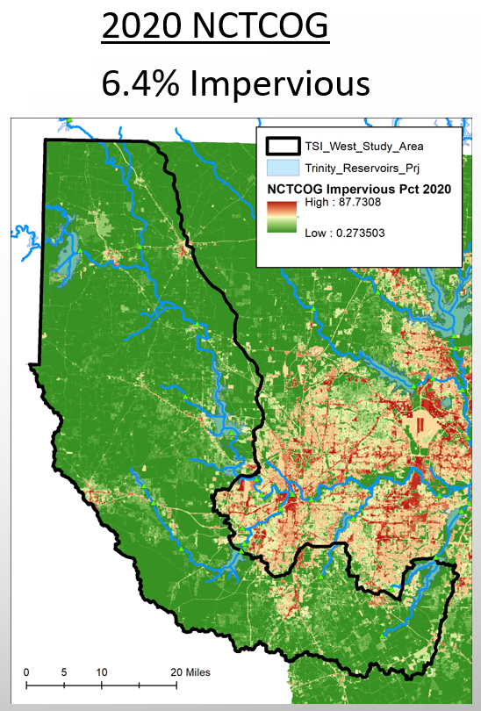
TSI Land Use Approach
  Leverage available current (2020) and future (2070) land use data to inform:
    Current conditions flooding
    Future conditions flooding
    Future conditions flooding with TSI

Slide 19
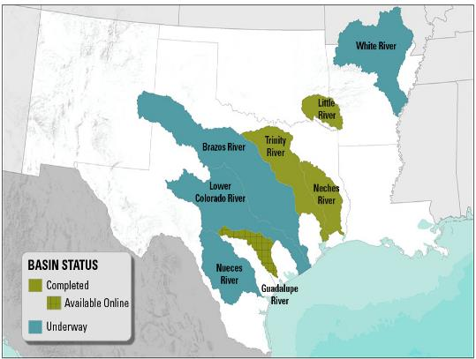
Hydrology Data Source: Watershed Hydrology Assessment (WHA)
What? State of the art estimate for the potential of flooding
  Hydrology study (i.e., determines how much water) for large rivers and streams
  Multi-method analysis to reduce uncertainty
  Statistical data & numerical data is incorporated into larger modeling efforts
  Incorporates NOAA Atlas 14 point-precipitation rainfall totals
  Accounts for regulated flow from dams
Why?
  Hydrology remains the single largest source of uncertainty in our understanding of flood risk
  Available hydrology information is generally dated and obsolete
Outcome:
  WHA produce consistent 100-yr and other frequency flows across the river basin, based on all available hydrologic information
  Provides design data and suggests areas where flood hazard information may need to be updated
  Trinity River Watershed Hydrology Assessment
    Objective: Recently completed high quality hydrology study of 700-mile-long Trinity River Basin (18,000 square miles)
    Outcome: Innovative and quality information for use in regional flood studies
https://webapps.usgs.gov/infrm/whav/

Slide 20
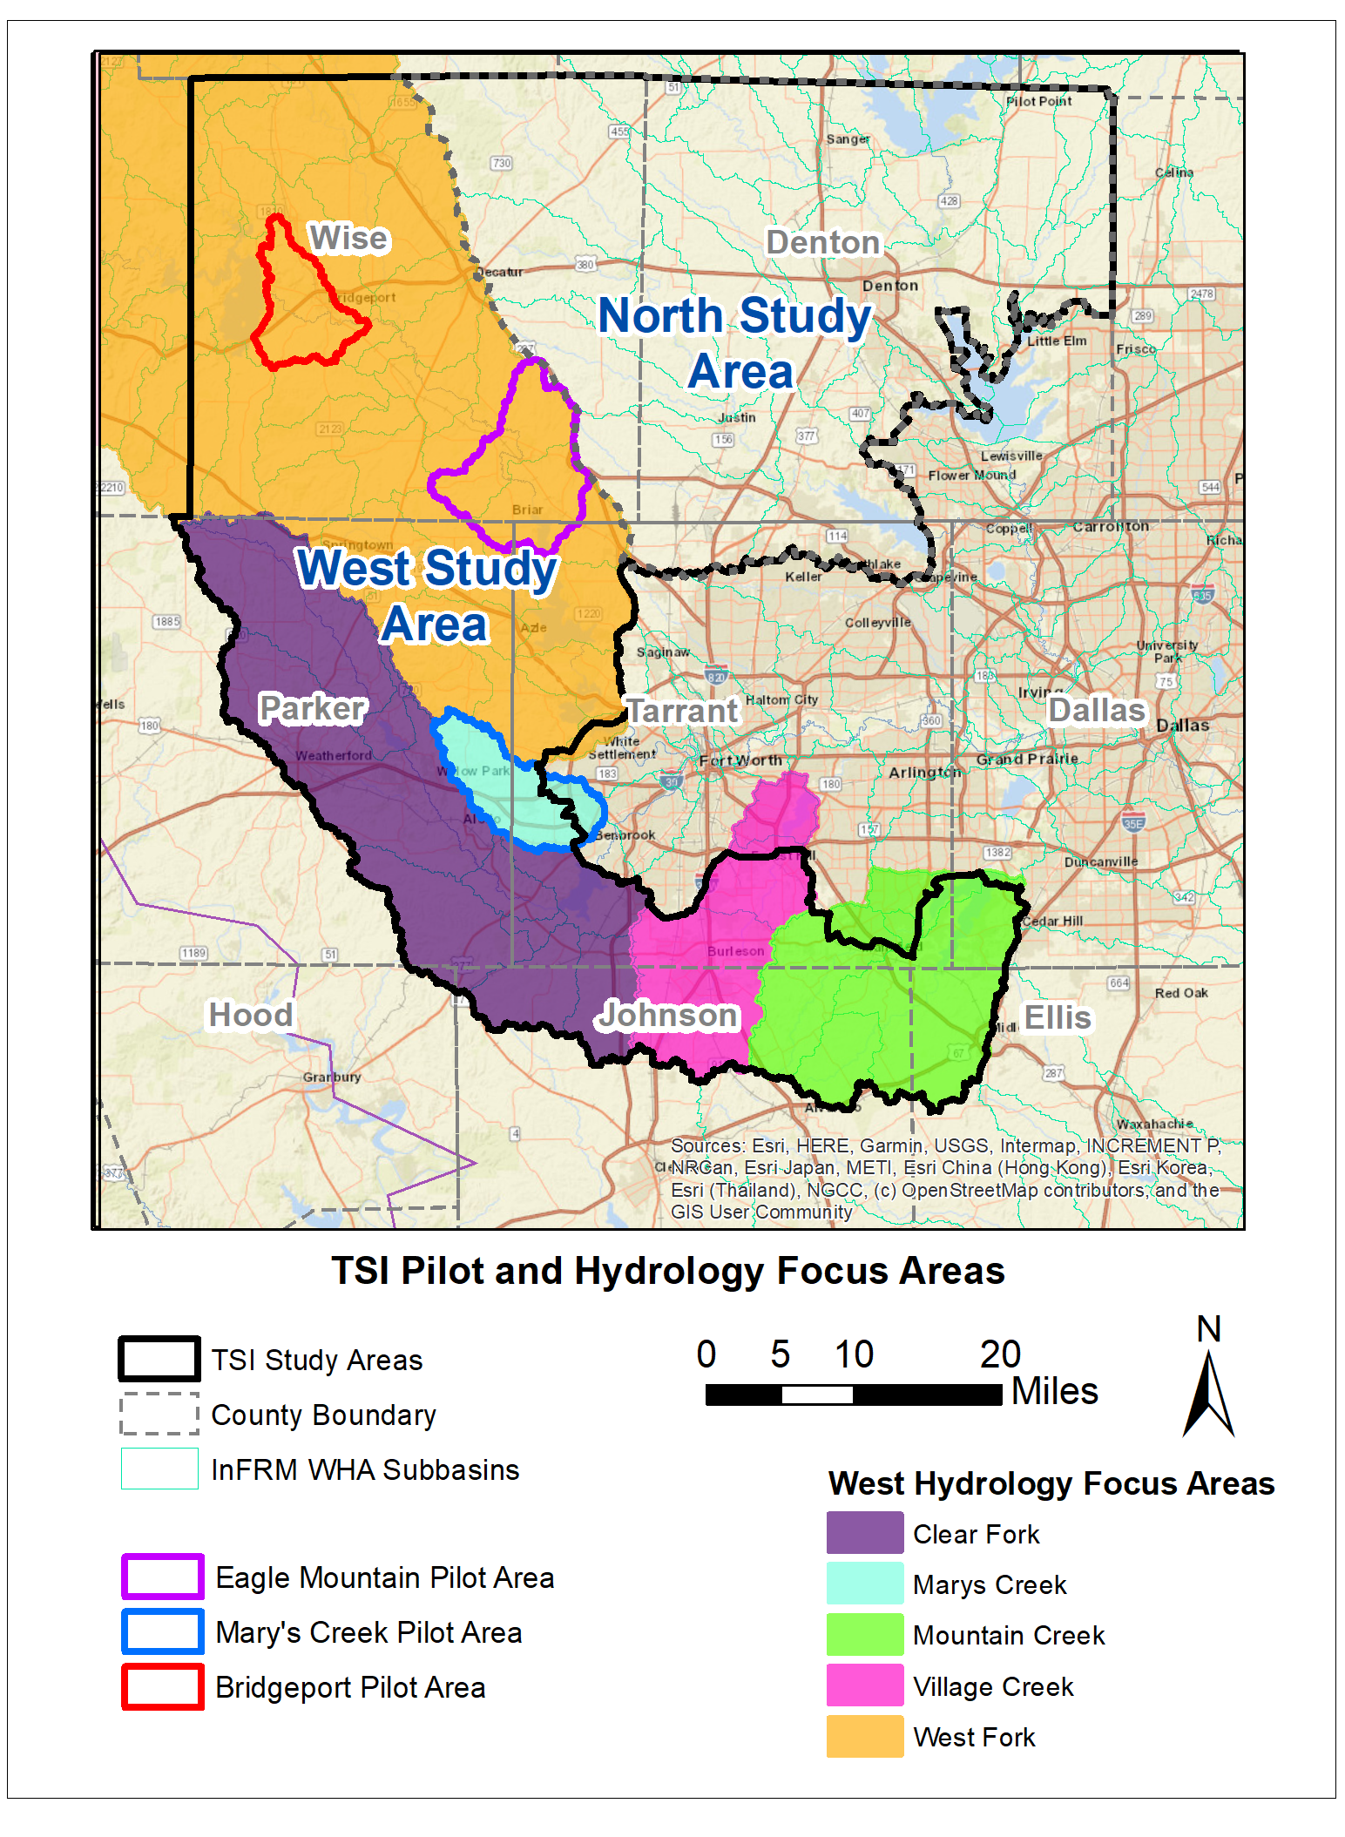
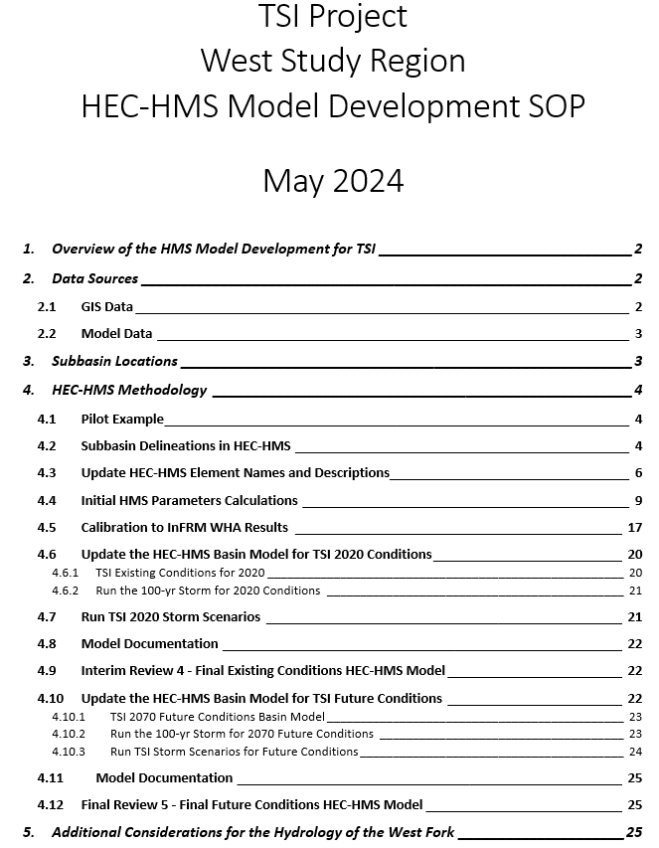
Hydrology Approach
Developed SOP and enhancing hydrology (including new flow locations) in pilot areas and larger West area:
  Mary’s Creek
  Village Creek
  Mountain Creek
  Clear Fork
  West Fork
  Delineate additional subbasins in HEC-HMS
  Update HMS element names and descriptions
  Calculate initial HMS parameters
  Calibrate to InFRM WHA results
  Update the HMS basin model for TSI current and future conditions
  Run TSI storm scenarios
  Model documentation
  Submit final HMS model for review and use for team members

Slide 21
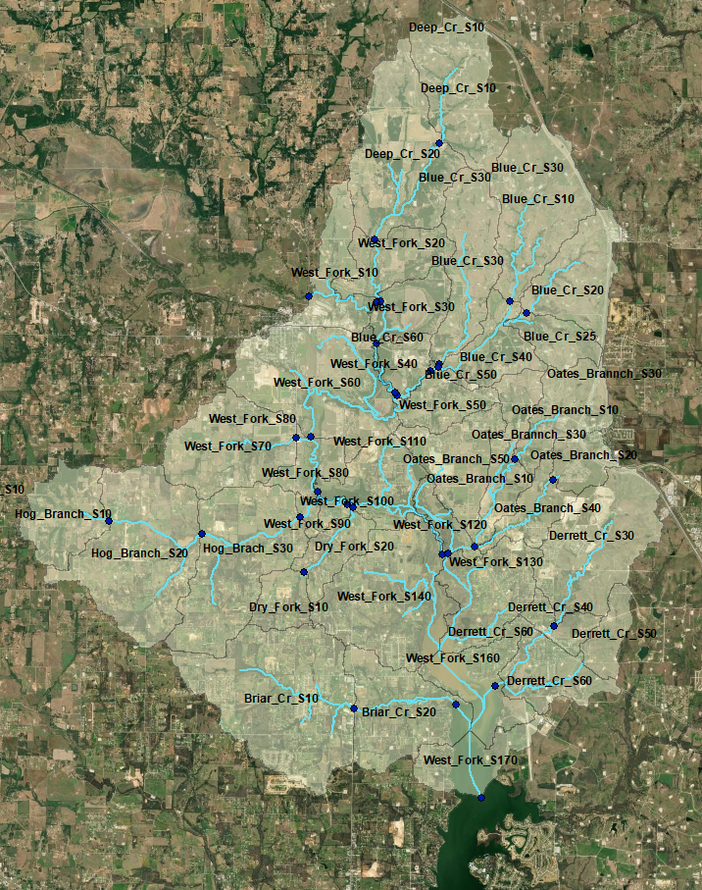
Hydrology enhancement example: Eagle Mountain Pilot
Final hydrology delineation for TSI Eagle Mountain Pilot Area

Slide 22
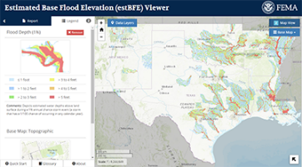
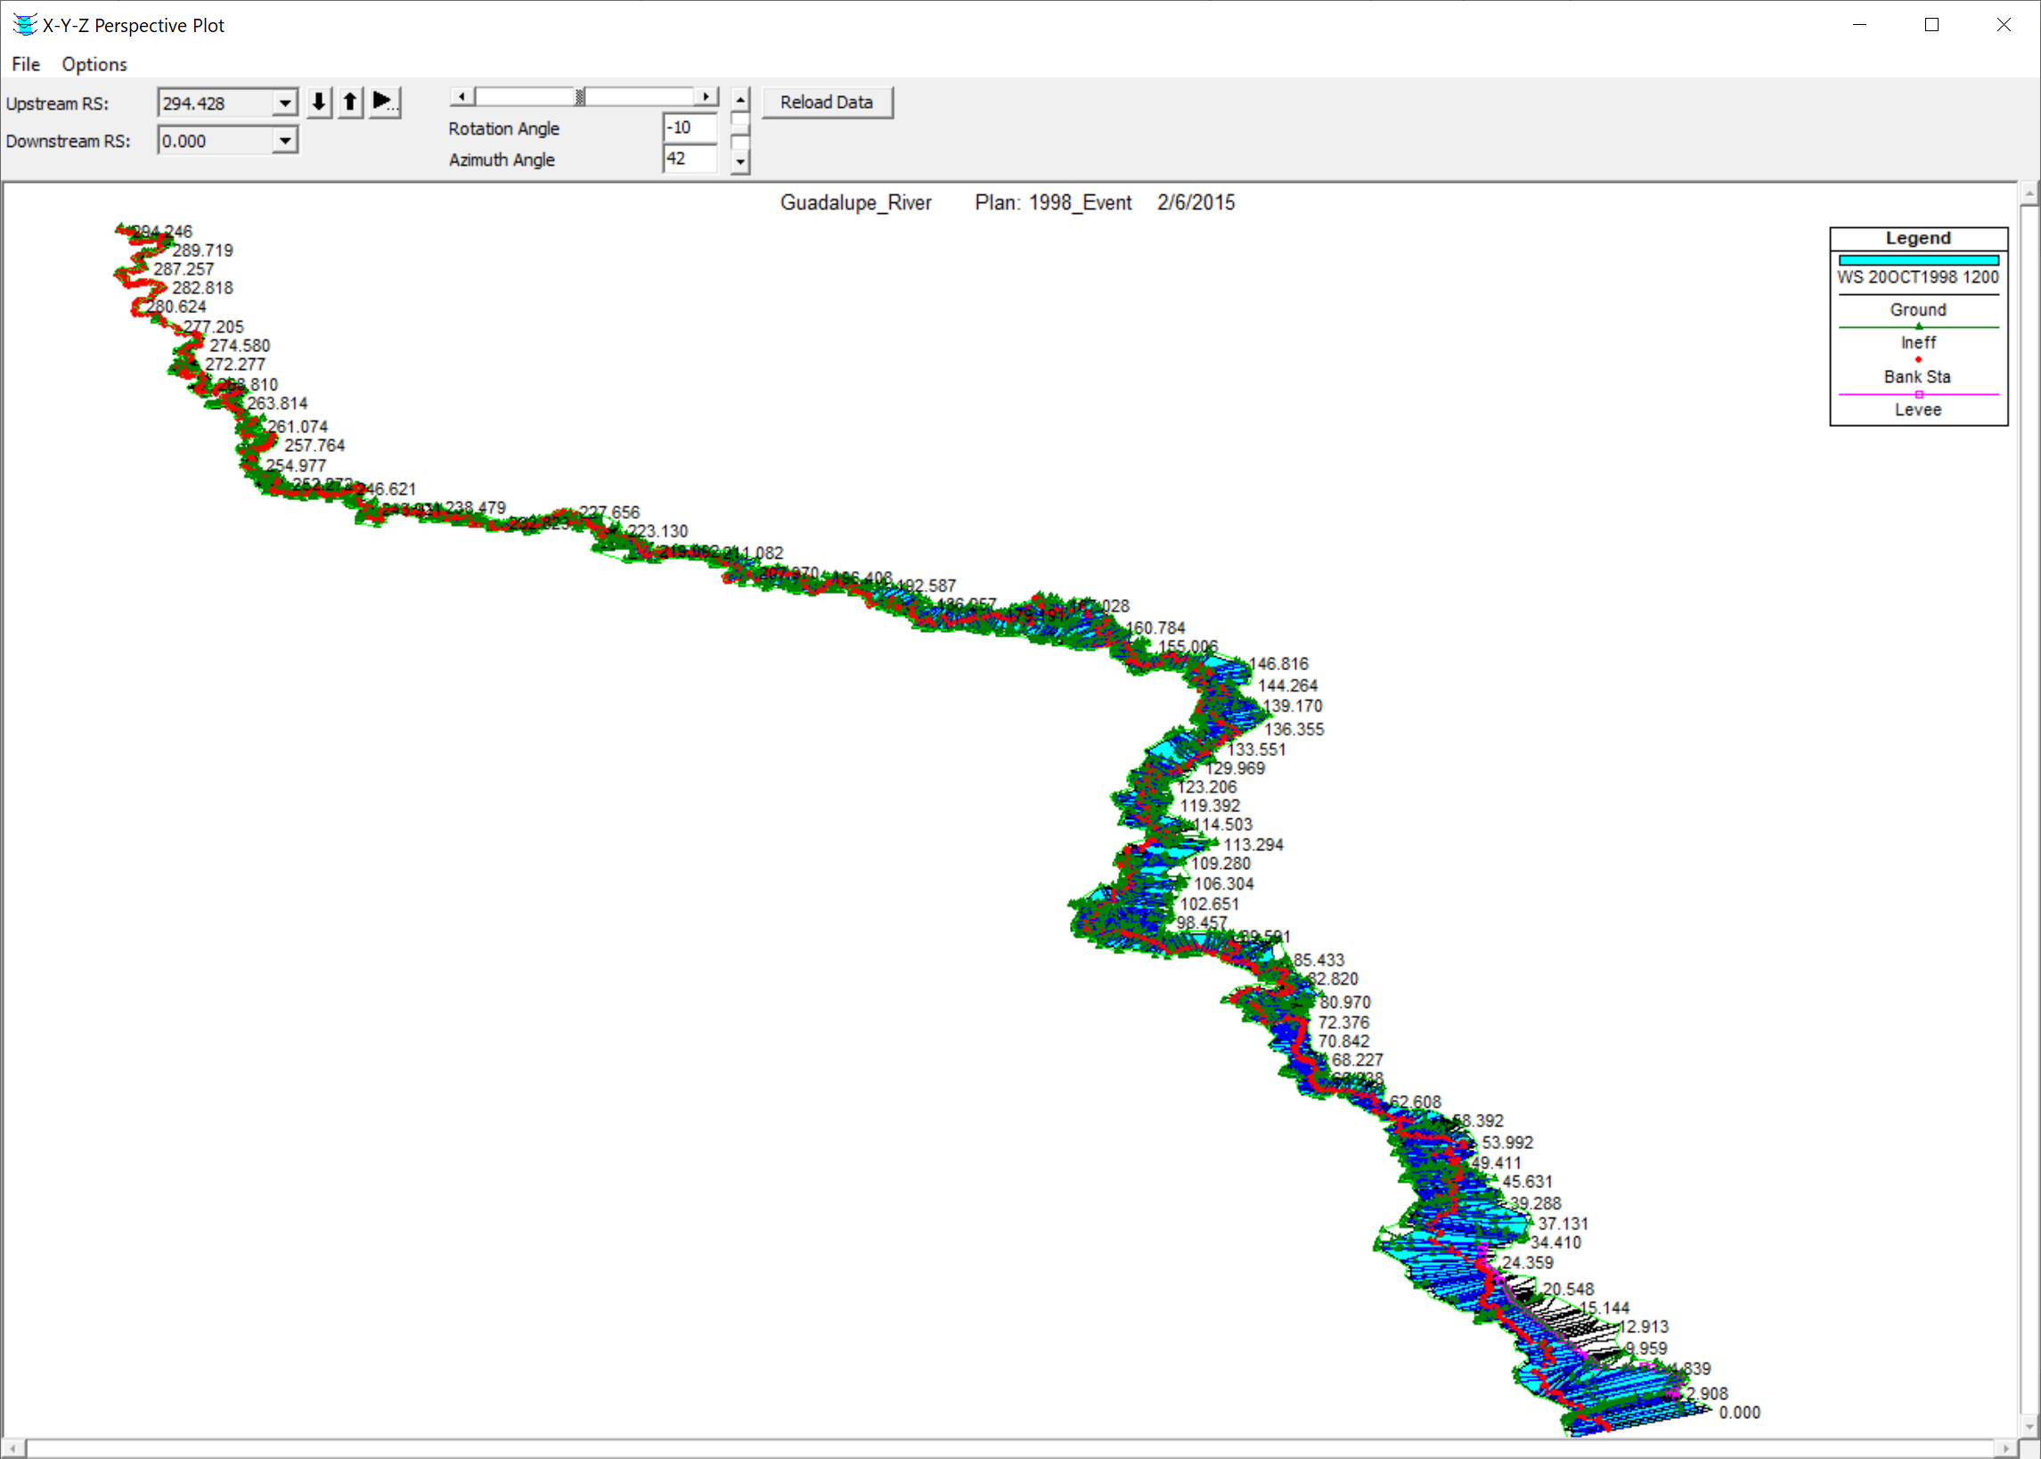
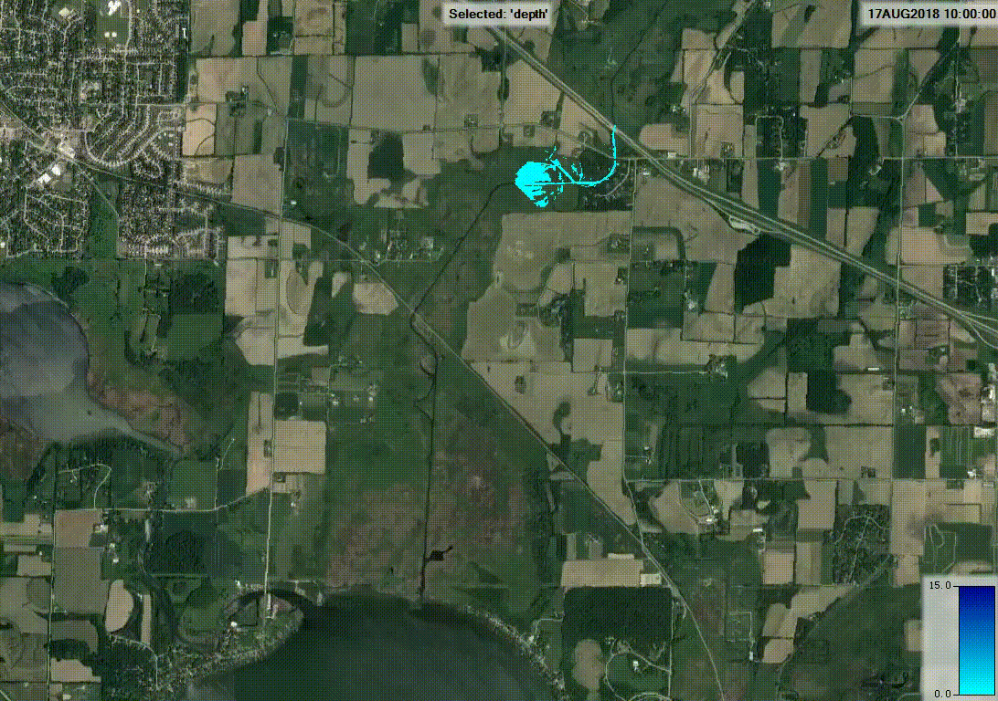
Hydraulics Data Source: Base Level Engineering (BLE)
What?
Watershed-wide engineering modeling method that leverages high resolution ground elevation, automated model building techniques, and manual model review to prepare broad and accurate flood risk information.
Why?
Centralized and available flood hazard analysis to support floodplain management activities and development review, while increasing risk awareness for individuals.
Outcome:
Quickly determine the flood risk for various events throughout multiple watersheds at various recurrence intervals (i.e., 10yr, 100yr, 500yr).
Allows Federal, State, and local governments, as well as individuals, to access and use flood risk information.
https://webapps.usgs.gov/infrm/estBFE/

Slide 23
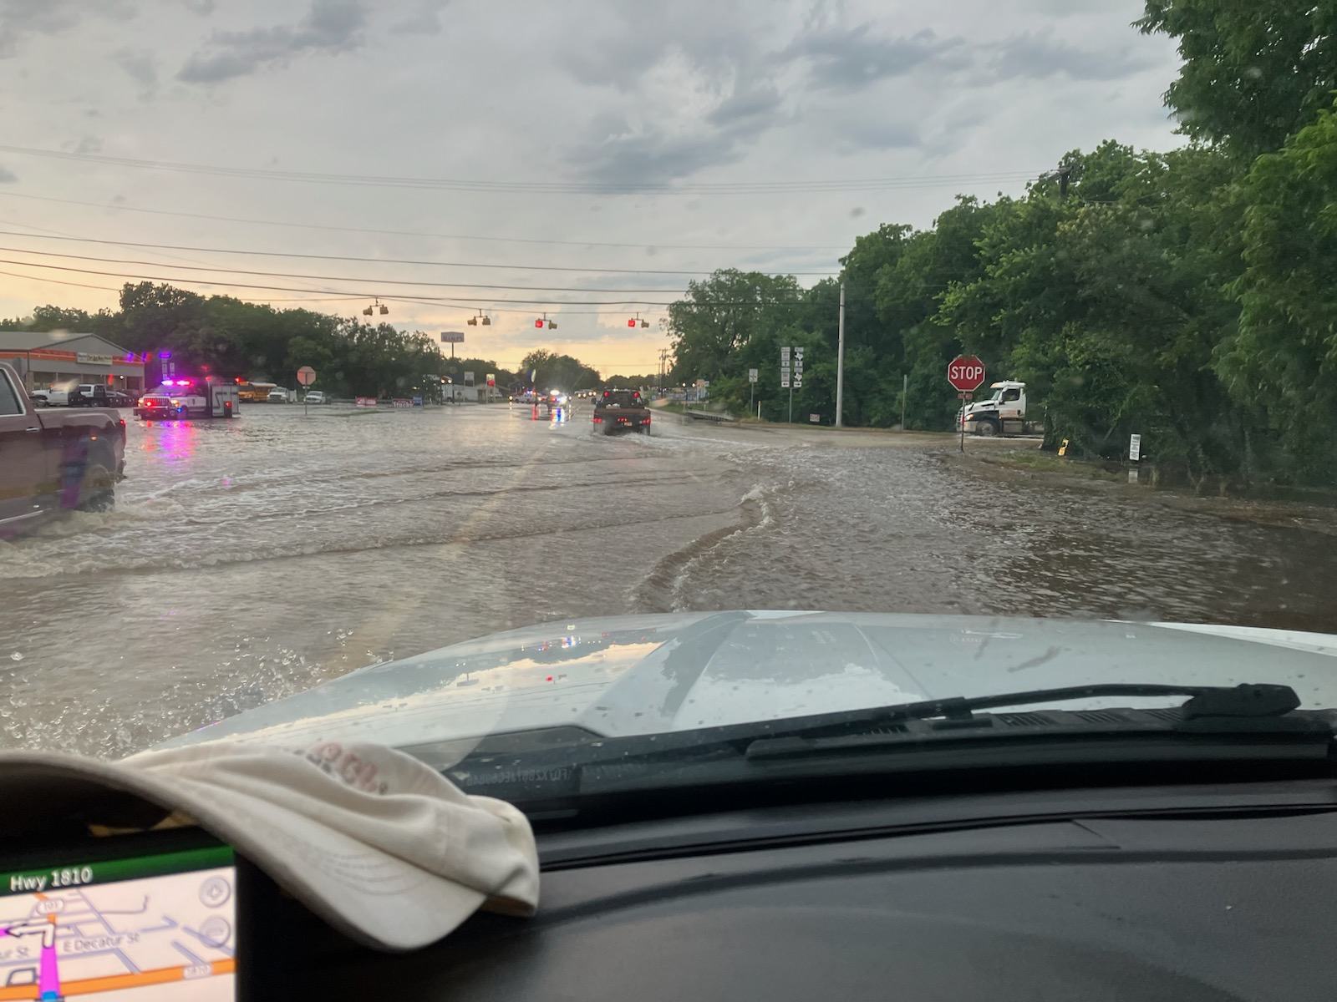
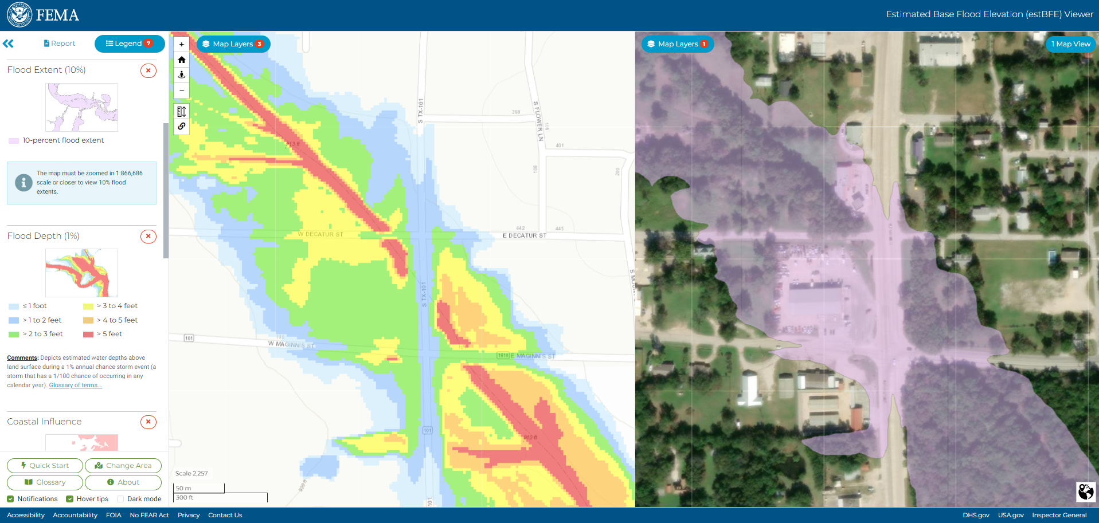
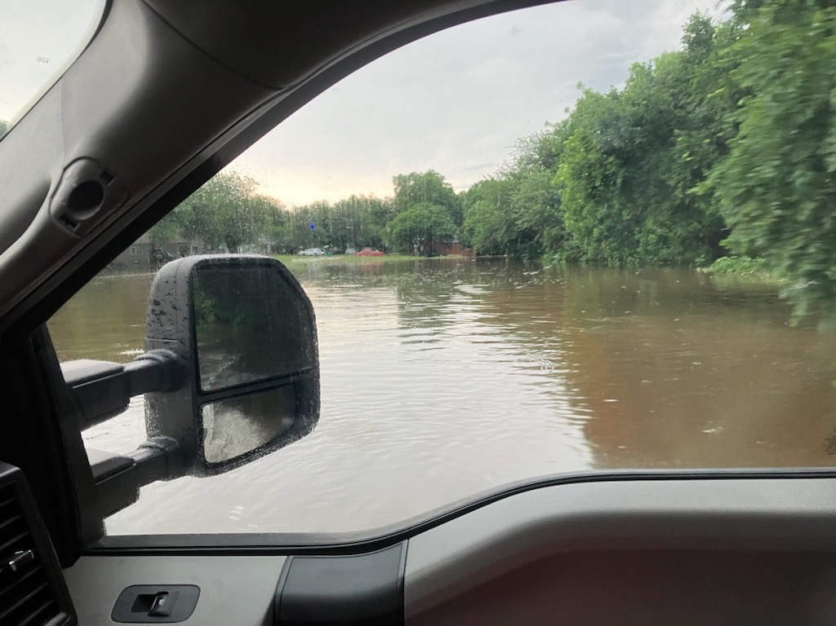
Hydraulics Example: TSI-Area Flooding with BLE (Chico, Texas)
Dry Creek: May 28, 2024

Slide 24
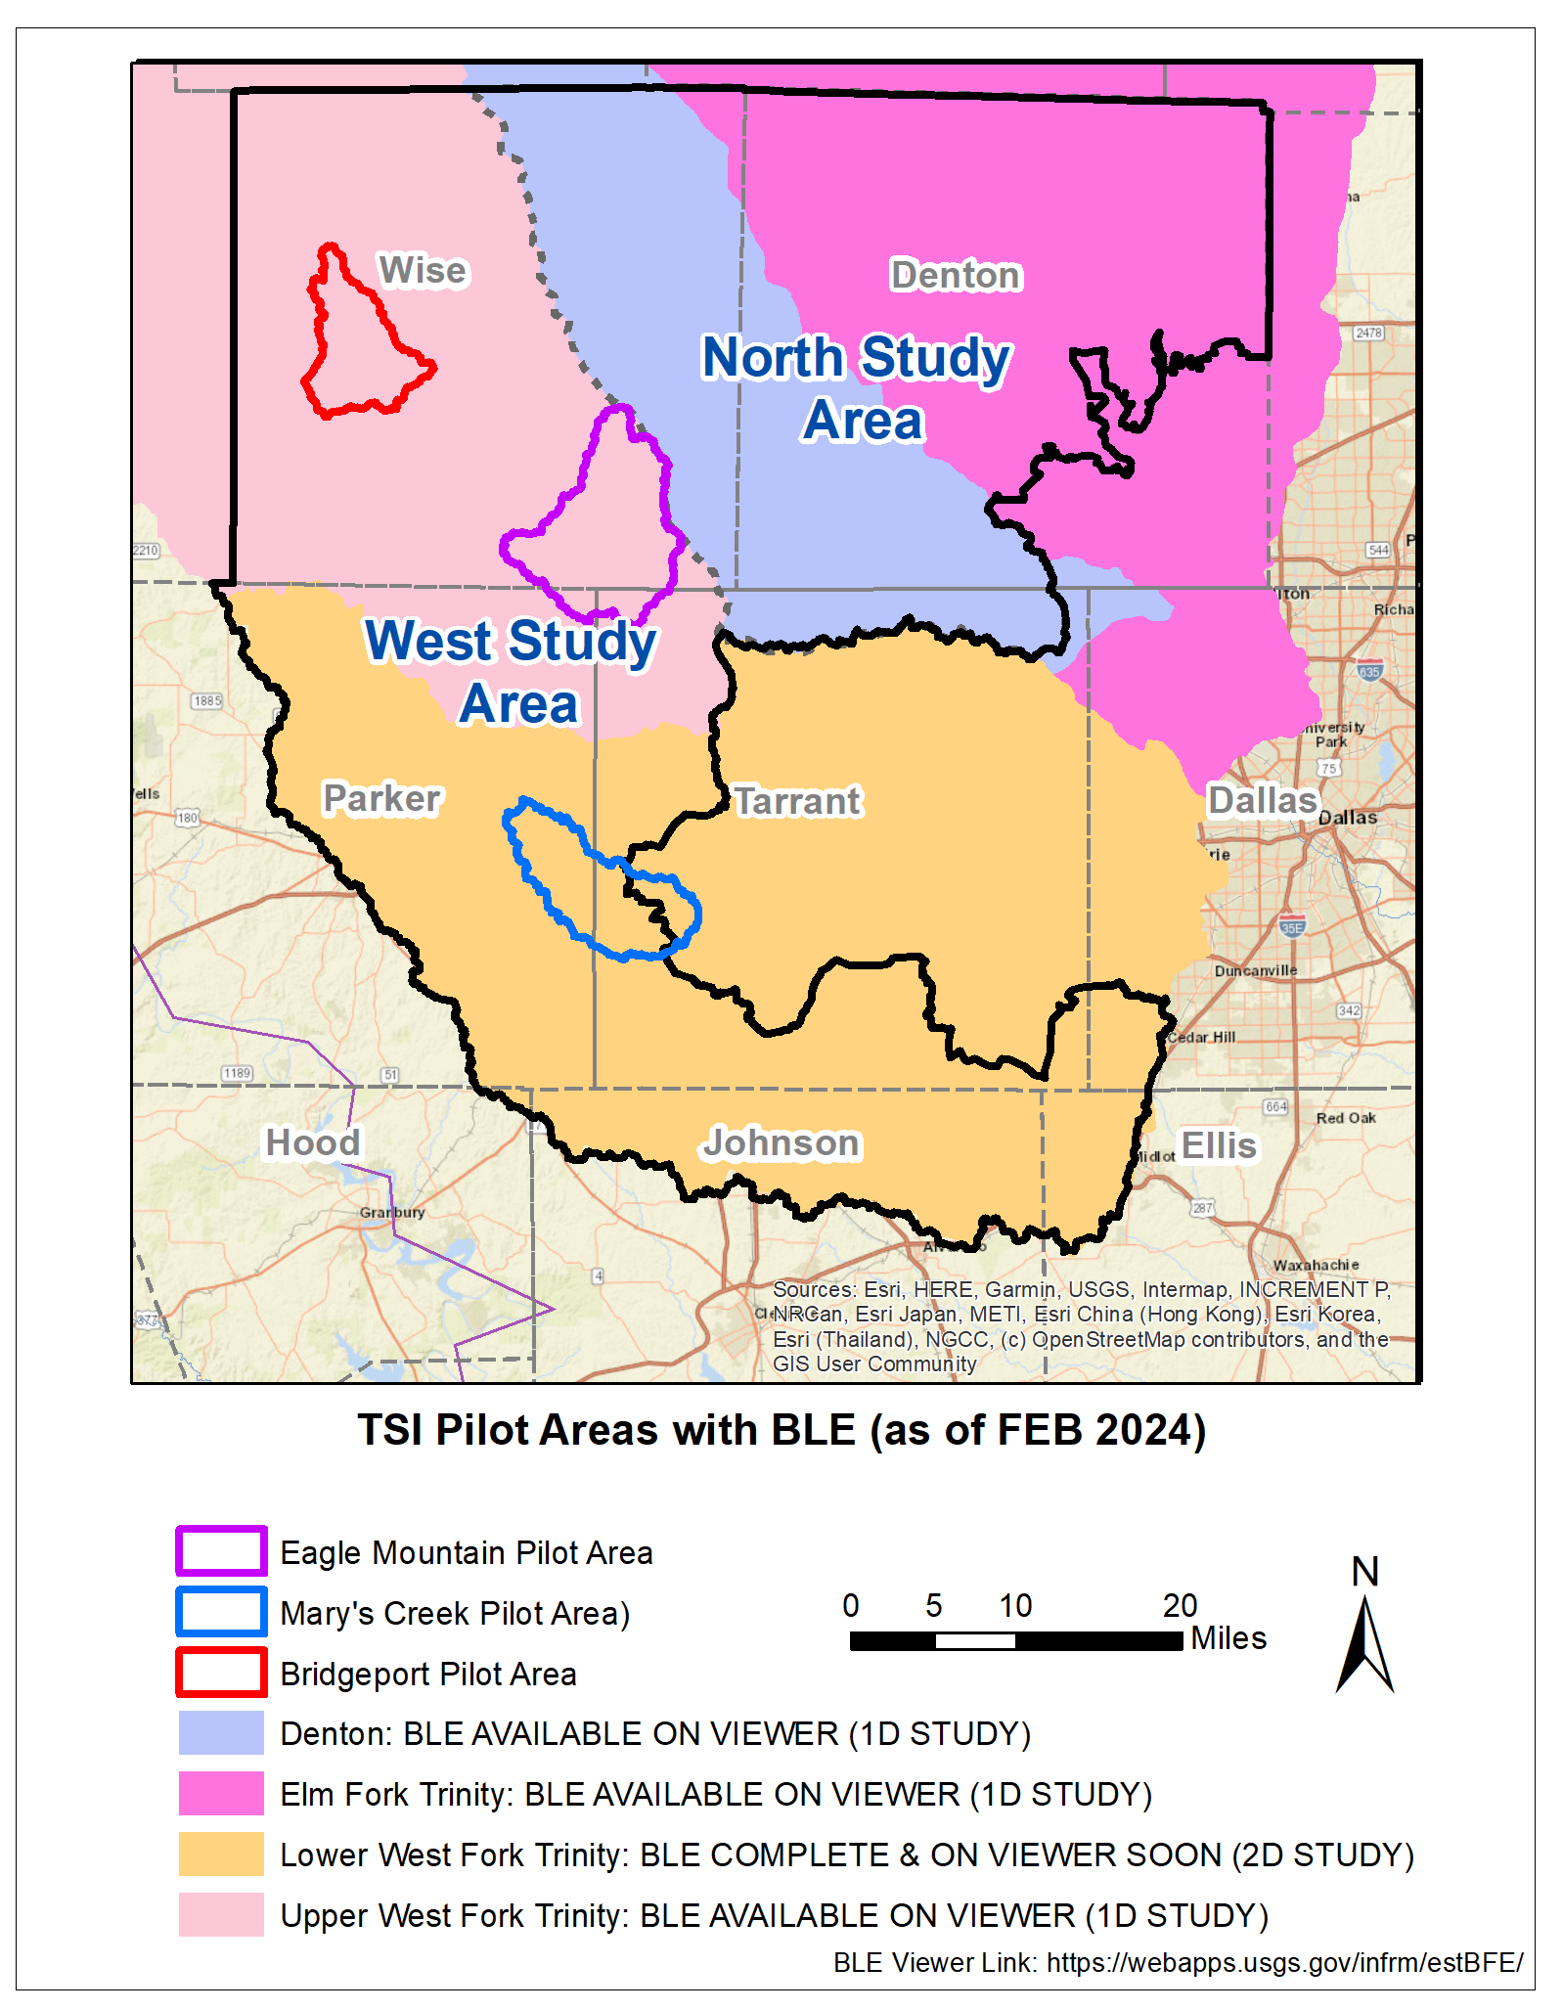
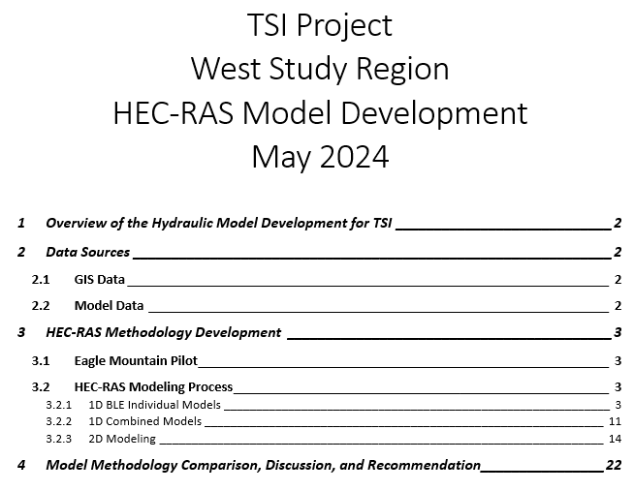
Hydraulics Approach
Developed SOP and enhancing hydraulic models to inform flooding considerations:
  Defining approach for enhancing Base Level Engineering (BLE) & potentially other hydraulic models
    Exploring 1D vs 2D model considerations
    Testing approaches, adding detail, urban drainage, determining environmental constraints, establish recurrence intervals, incorporate current/future flows, optimization scripting, etc.
  Defining TSI HEC-RAS Modeling Process for:
  1D Individual Models
  1D Combined Models
  2D Modeling

Slide 25
TSI Optimization Study
The optimization study aims to model ideal location and sizing for detention ponds and consider potential alternatives (e.g., GSI/NBS) to reduce downstream flows.
Utilizes the enhanced hydrology (HEC-HMS) models as a starting point.
May incorporate transportation facilities at risk, regulatory tools, green infrastructure applications, scenario options, vulnerable areas, infrastructure integration options, and flood-prone and ideal GSI/NBS implementation areas where possible.
Relies on the results of GSI and NBS suitability index based on geological, social, and environmental parameters and ranking of project types and locations.

Slide 26
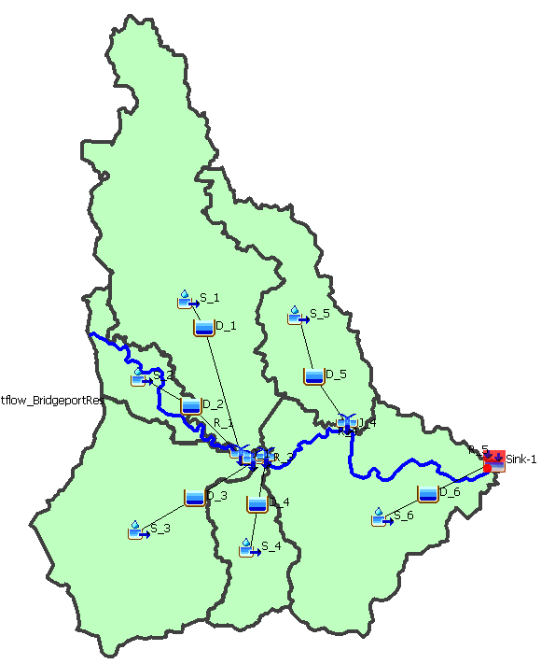
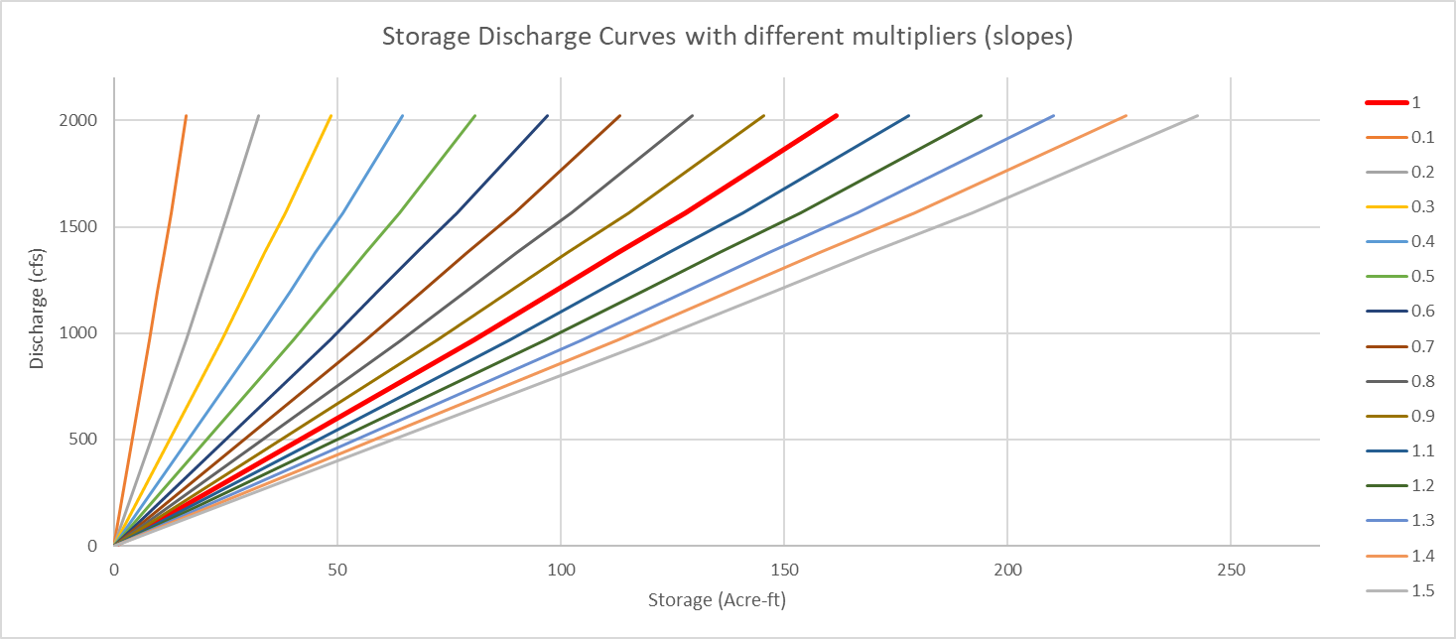
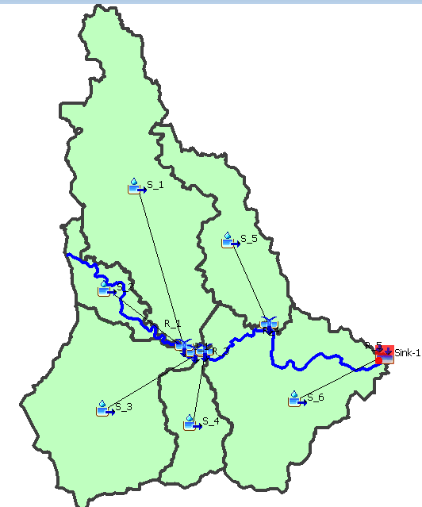
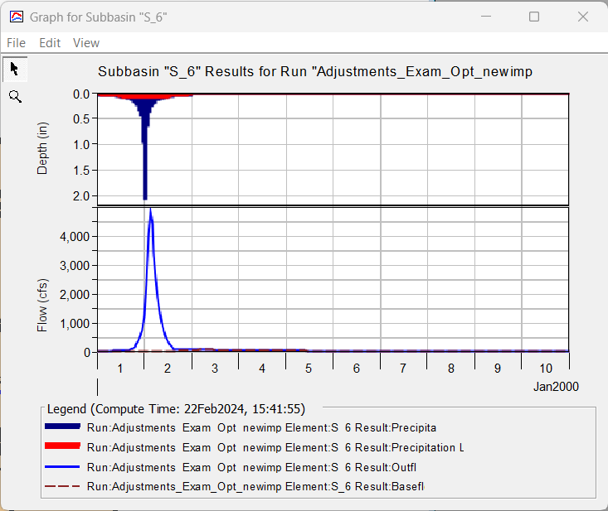
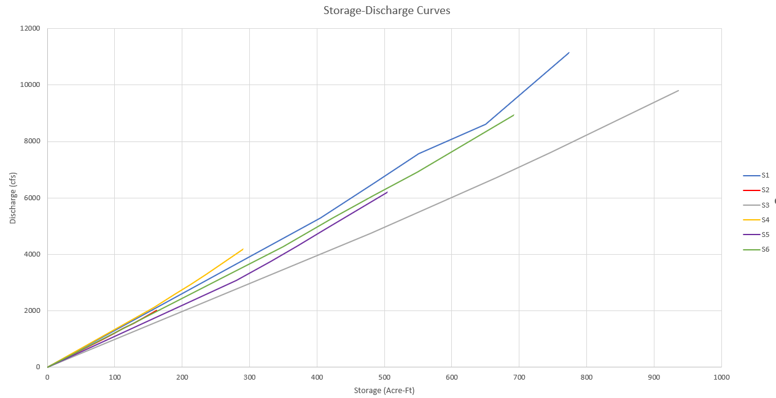
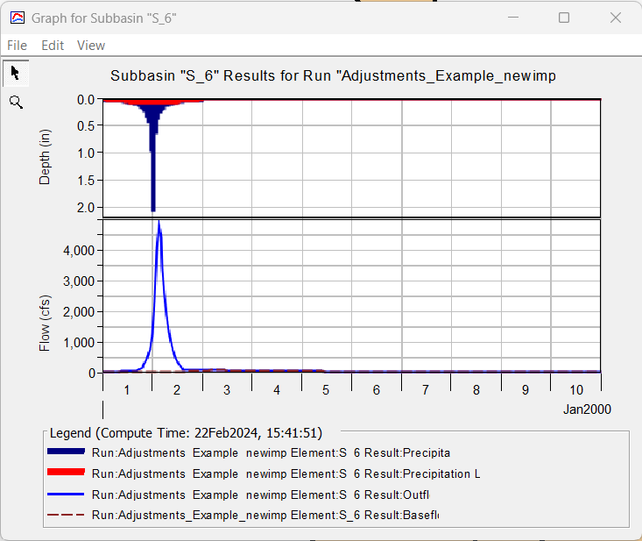
TSI Optimization – Pilot Study Workflow
Obtain HEC-HMS models (“current conditions” and “future conditions”) for all pilot study areas.
Compare results from the “current conditions” and “future conditions” HEC-HMS models to identify subbasins with significant changes in peak flow and/or volume.
Modify the “future conditions” basin model by creating Reservoir elements downstream of each subbasin with associated Storage-Discharge Curves.
Develop a library of Storage-Discharge Curves (1) for detention ponds by generating per-subbasin ideal curves based on frequency storm results and (2) for GSI/NBS (from AgriLife).
Develop a python script to automate HEC-HMS and optimize, minimizing the change in peak discharge and/or volume by applying multipliers to the Storage-Discharge Curves.
Run the optimization script to minimize the impact of future conditions while considering constraints.

Slide 27
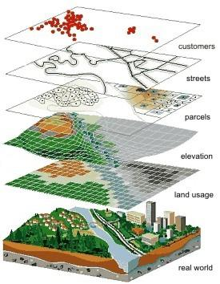
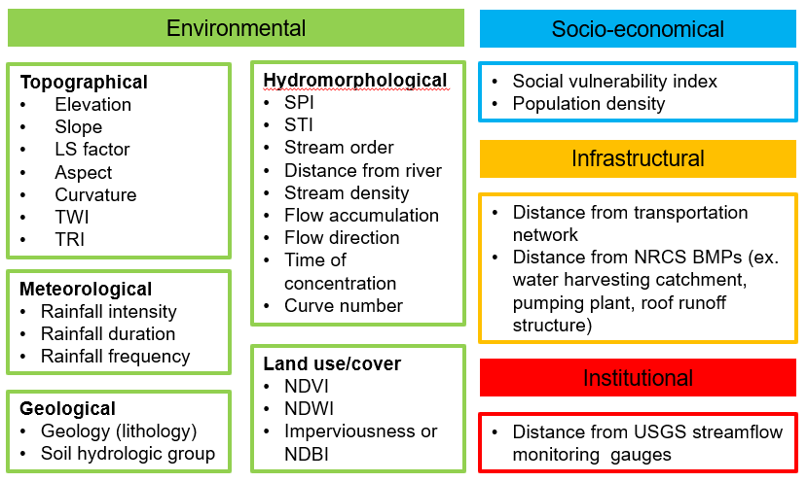
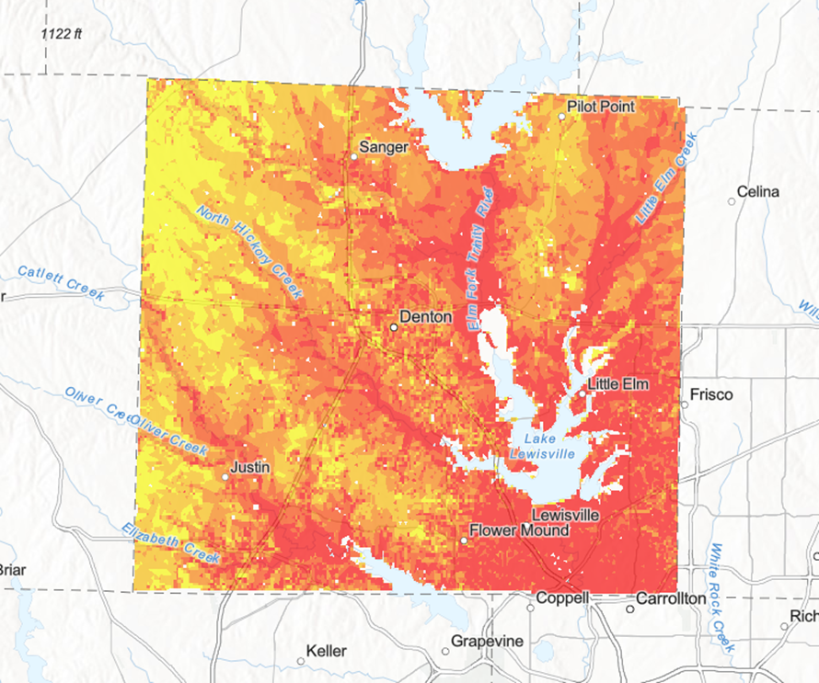
Approach to Flood Risk Reduction
Flood susceptibility mapping
Indicator method: Develop a flood susceptibility map using a GIS stacking model that includes four categories of conditioning factors: Environmental, Socio-economical, Infrastructural, and Institutional
Note: Factors are summarized based on a literature review from 30 peer-reviewed journal articles over the past three years. All these factors could be considered in TSI study according to the data availability.

Slide 28
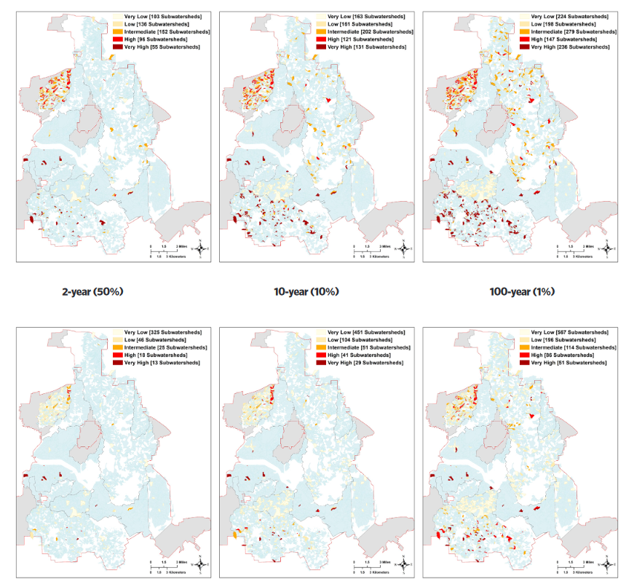
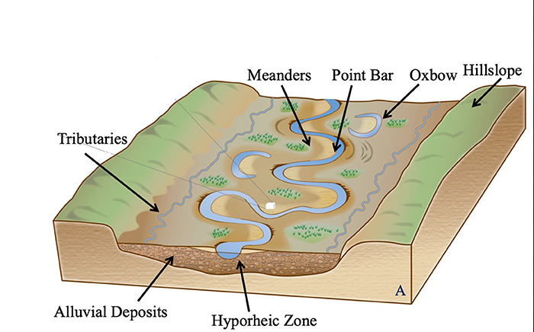
Modeling GSI for Flood Control
In high-risk flooded area, investigate hydrological response of incorporating GSI by running some watershed model (SWMM and/or SWAT)
Watershed model will be linked to H&H Model
Coupled model will be used for environmental constraints (e.g. minimum flows)
Before GSI
Dallas city study as an example
After GSI
https://www.nature.org/dallasgsi

Slide 29
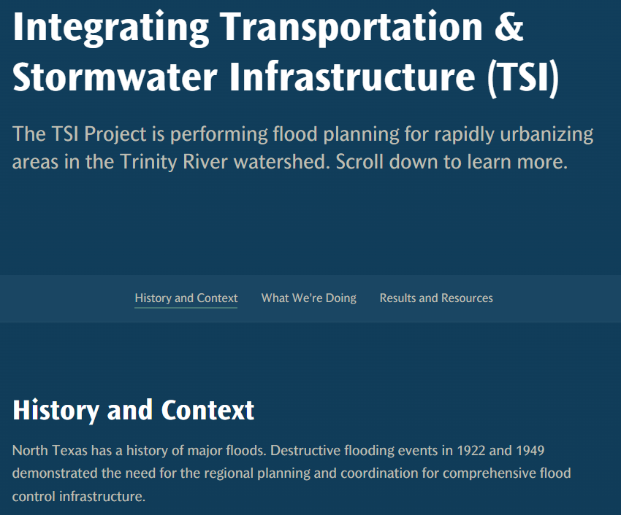
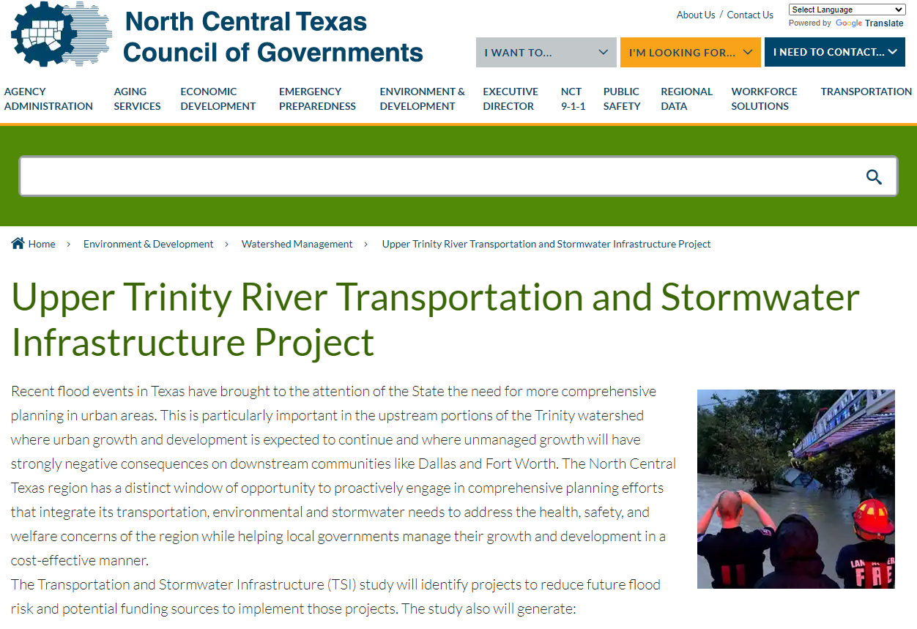
TSI Website and Story Map Demonstration
Summary:
  The team developed a website and story map to assist in communicating and visualizing study results
https://geospatial.nctcog.org/portal/apps/storymaps/stories/6b73437fc69643cb9b6f239831706191
https://nctcog.org/tsi

Slide 30

Today’s Presenter
Funding Partners
Texas Water Development Board
Federal Highway Administration
Texas Department of Transportation
Federal Emergency Management Agency
U.S. Army Corps of Engineers
Matthew Lepinski, P.E.
Lead Hydraulic Engineer
US Army Corps of Engineers
817.886.1683
Matthew.T.Lepinski@usace.army.mil
Study Partners
North Central Texas Council of Governments
U.S. Army Corps of Engineers
University of Texas at Arlington
Texas A&M AgriLife
Tarrant Regional Water District

