Slide 1
FLOG/FIM Subcommittee Meeting, 3 May 2024
Agenda Items:
1 - Update on Developments on FIM at the National Water Center
2 - 3D representation of channel geometry over CONUS via Machine Learning
3 - Comments from USGS on their work on Synthetic Rating Curves

Slide 2
FLOG/FIM Subcommittee Meeting, 3 May 2024
Agenda Items:
1 - Update on Developments on FIM at the National Water Center – Presented by Jim Coll and Laura Keys
2 - 3D representation of channel geometry over CONUS via Machine Learning
3 - Comments from USGS on their work on Synthetic Rating Curves

Slide 3
National Water Center
FLOG/FIM Subcommittee Update
May 3, 2024

Slide 4
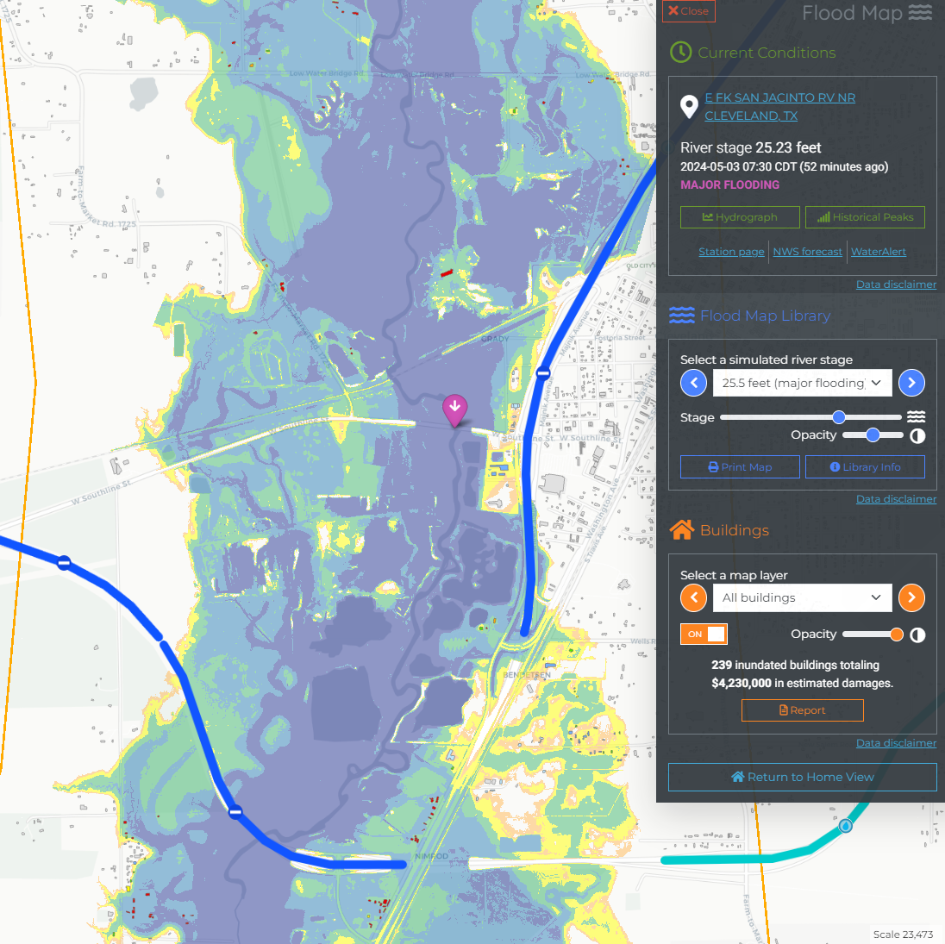
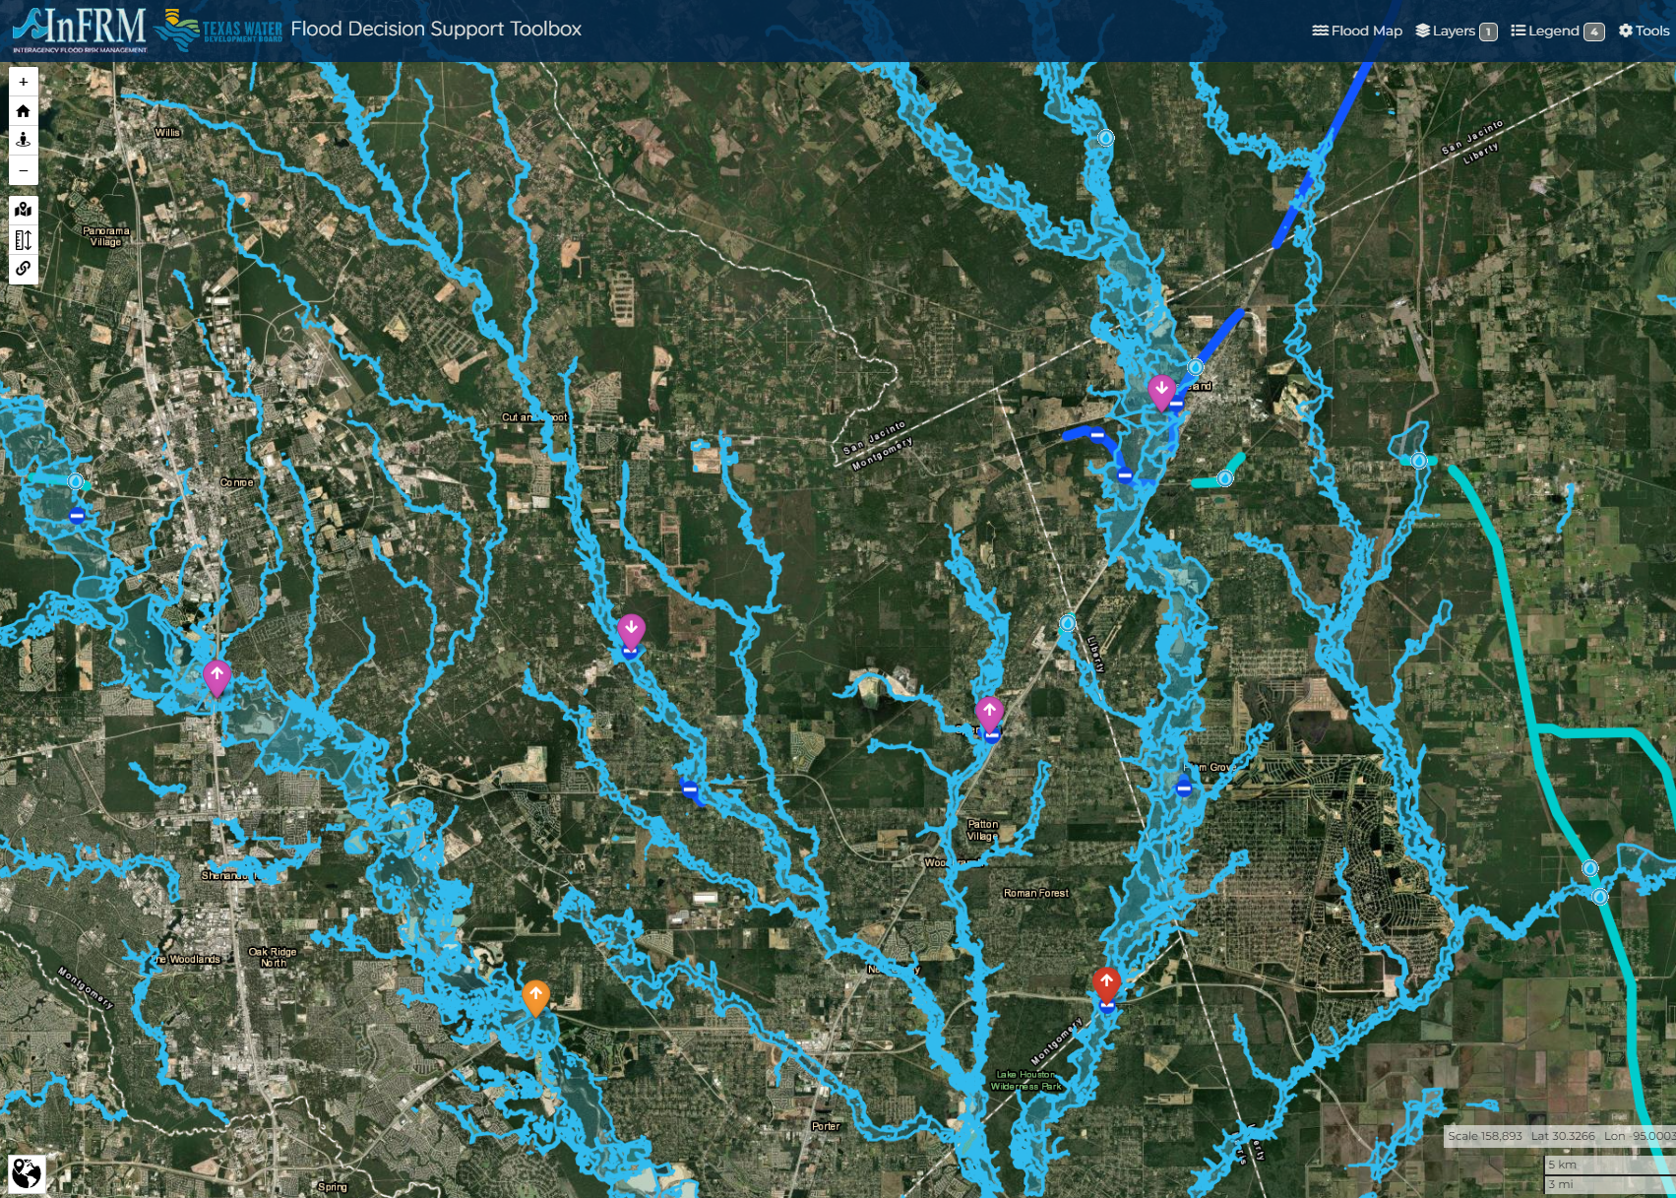
Busy Week in Texas

Slide 5
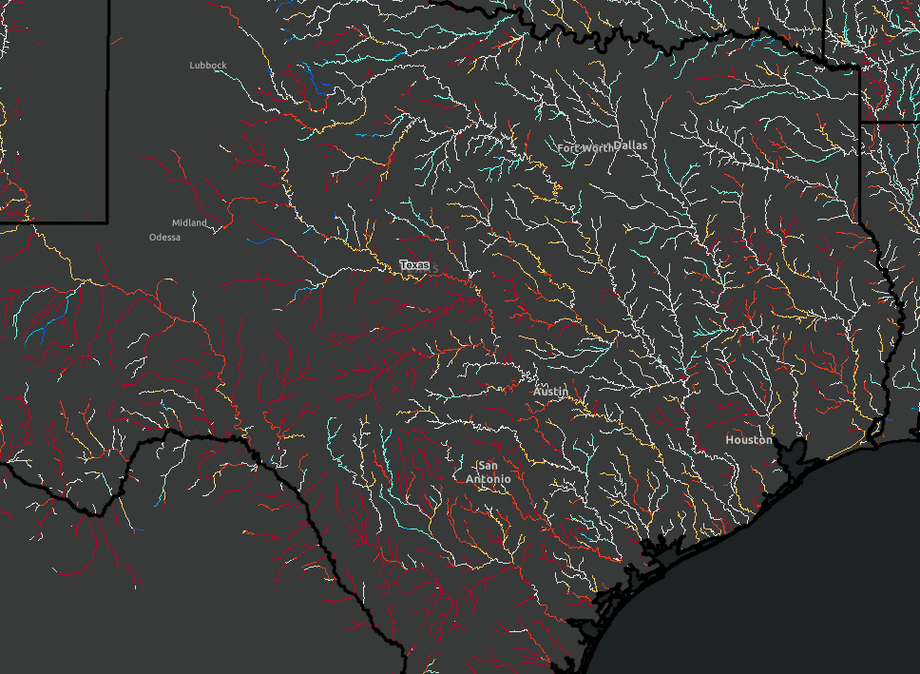
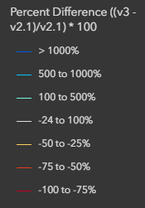
GeoIntelligence Division Update
Items in Testing
Update to the High Water Thresholds that triggers Flood Mapping to be generated
Moving to a cache flood stack visualization method - Important point is we will move generating FIM from every ½ foot to every foot

Slide 6
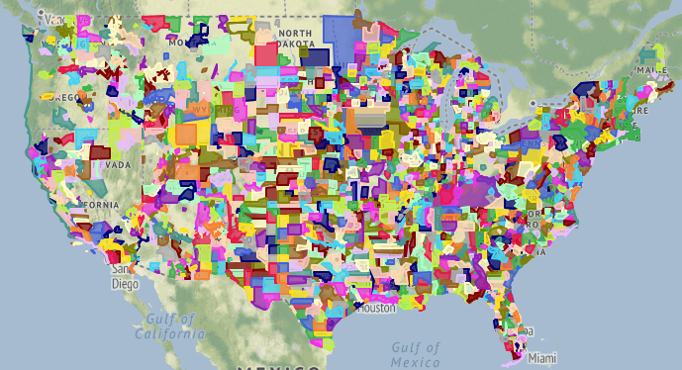
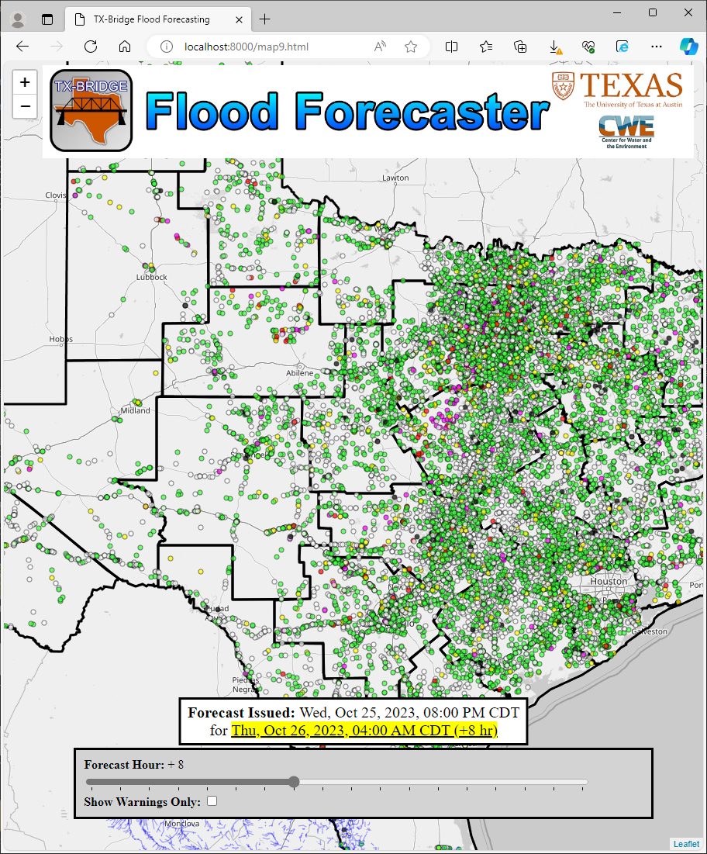
Phased Bridge Healing Plan
OSM Guided HAND Healing
OSM Guided, LIDAR Enhanced Heal
Bulk Classified LIDAR Healing
Prototype Deployment & Feedback
Bridge Impact Prototyping
Using OSM bridge-classified street lines to buffer and capture the maximum HAND value to heal into the mapping surface
Using the OSM derived polygon to define the shape to extract LIDAR elevations to heal into the mapping surface
Using well classified 3DEP point clouds (bridge class 17) to bulk heal the HAND surface
Heal HAND surfaces across CONUS and deploy in FIM visualization services, collect field feedback (targeted - May 2024)
Use forecast and bridge attributes to flag potentially impacted bridges as scaffolded by Andy Carter and https://bridgeflood.com/
1
2
3
4
5
Notes:
From our last update: touching on the status of OSM-based bridge healing and its prototyping and deployment

Slide 7
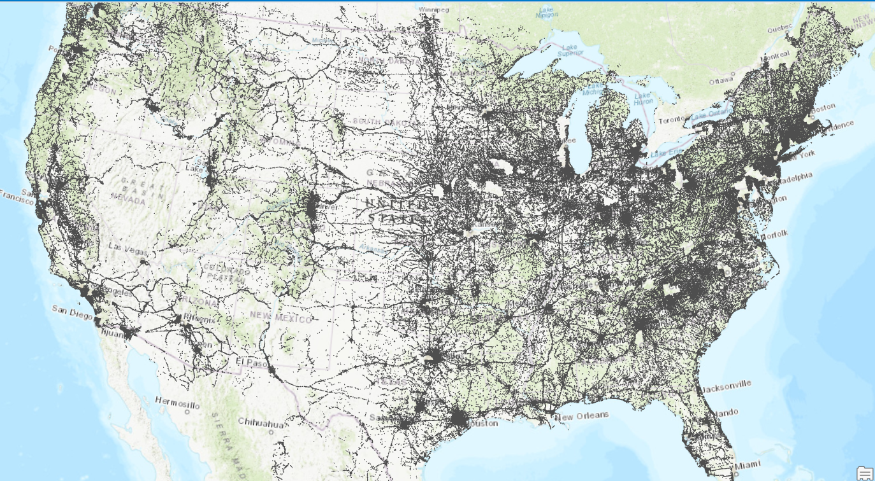
OSM Coverage for initial deployment
OSM bridges successfully downloaded nationwide: 669,358 (Texas: 50,819)
Currently being incorporated into FIM pipeline
Notes:
Last time, we showed off some examples of the OSM bridge healing working, now we’re expanding it out as part of the FIM workflow for further field evaluation

Slide 8
Phased Bridge Healing Plan
OSM Guided HAND Healing
OSM Guided, LIDAR Enhanced Heal
Bulk Classified LIDAR Healing
Prototype Deployment & Feedback
Bridge Impact Prototyping
Using OSM bridge-classified street lines to buffer and capture the maximum HAND value to heal into the mapping surface
Using the OSM derived polygon to define the shape to extract LIDAR elevations to heal into the mapping surface
Using well classified 3DEP point clouds (bridge class 17) to bulk heal the HAND surface
Heal HAND surfaces across CONUS and deploy in FIM visualization services, collect field feedback (targeted - May 2024)
Use forecast and bridge attributes to flag potentially impacted bridges as scaffolded by Andy Carter and https://bridgeflood.com/
1
2
3
4
5

Slide 9
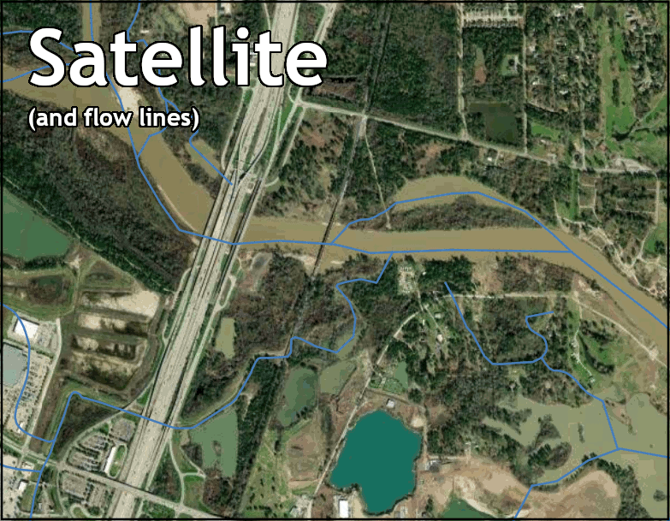
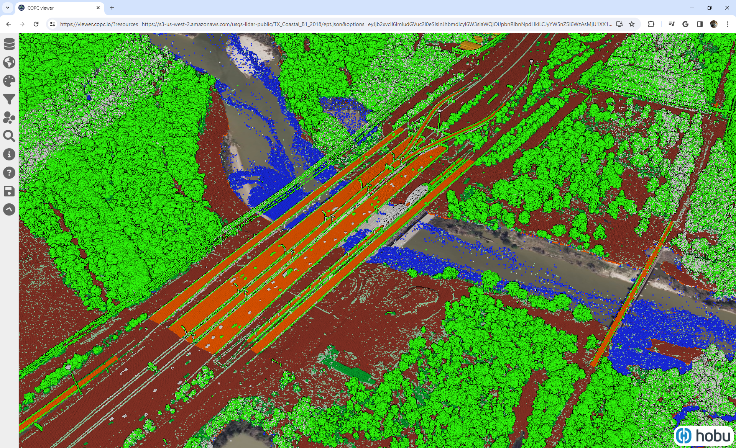
Last time: https://www.caee.utexas.edu/prof/maidment/TWDB/FLOGFIM/Meetings
Bulk Classified LIDAR Healing
3

Slide 10
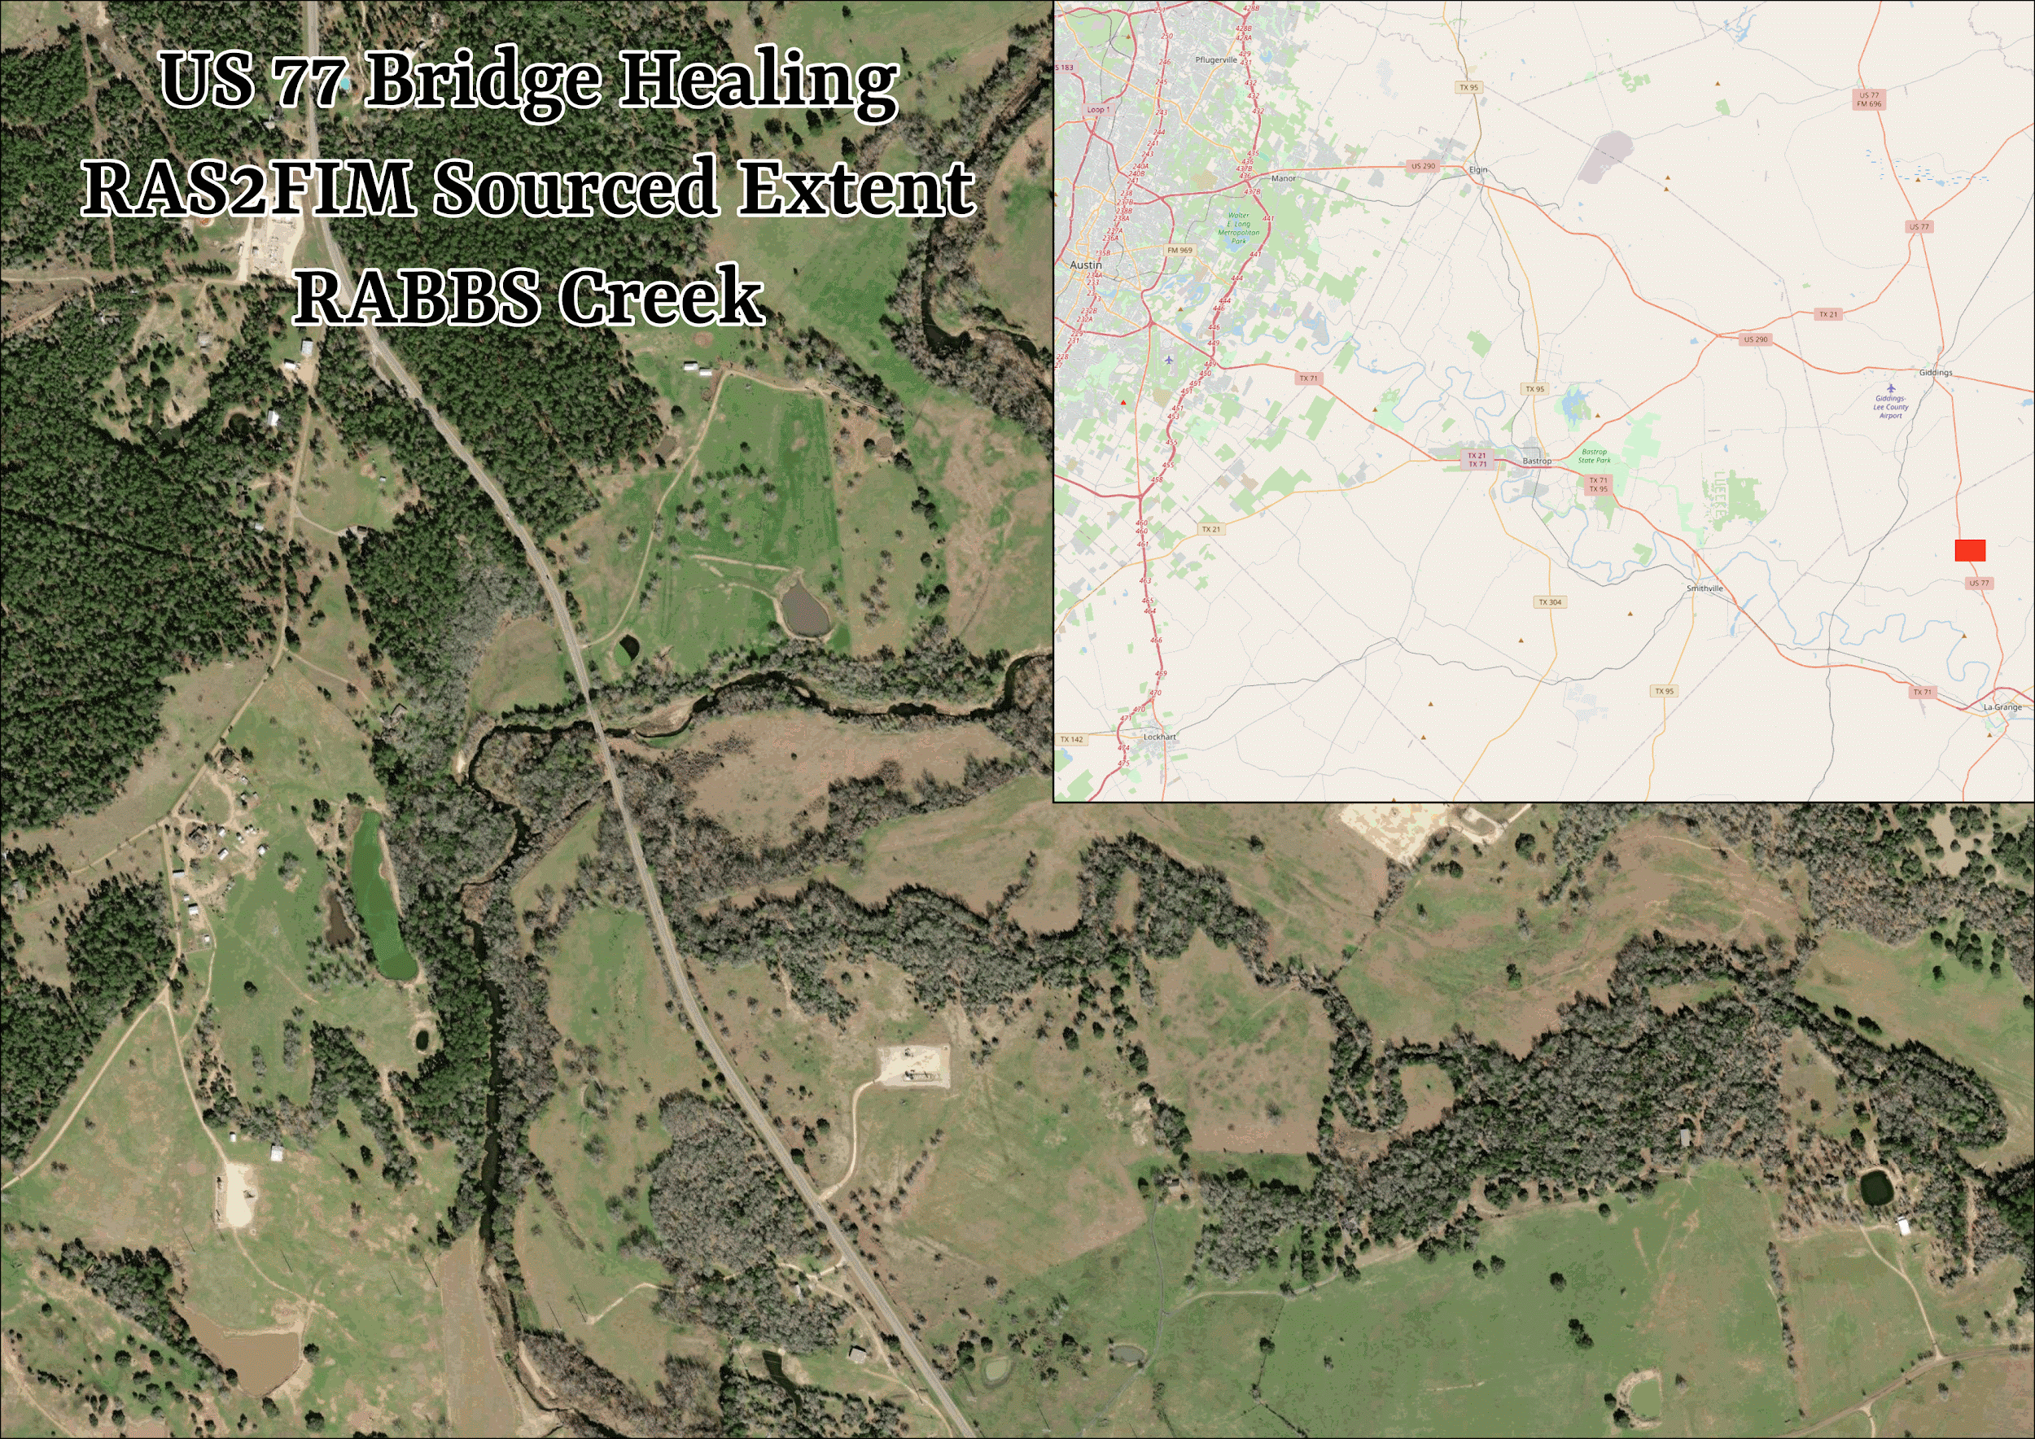
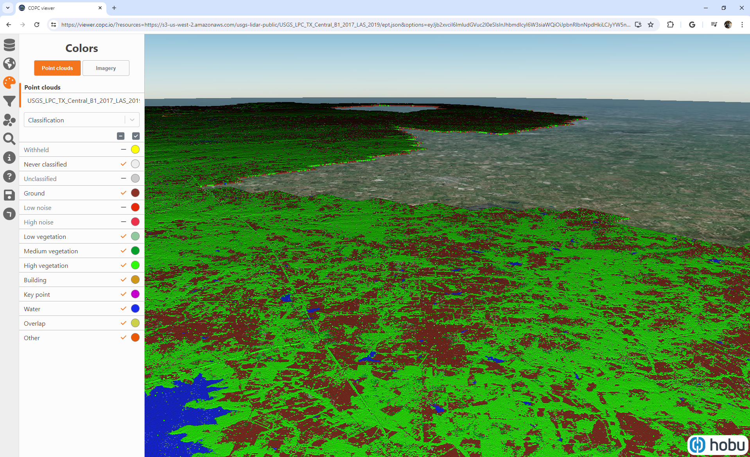
Bulk Classified LIDAR Healing
3

Slide 11
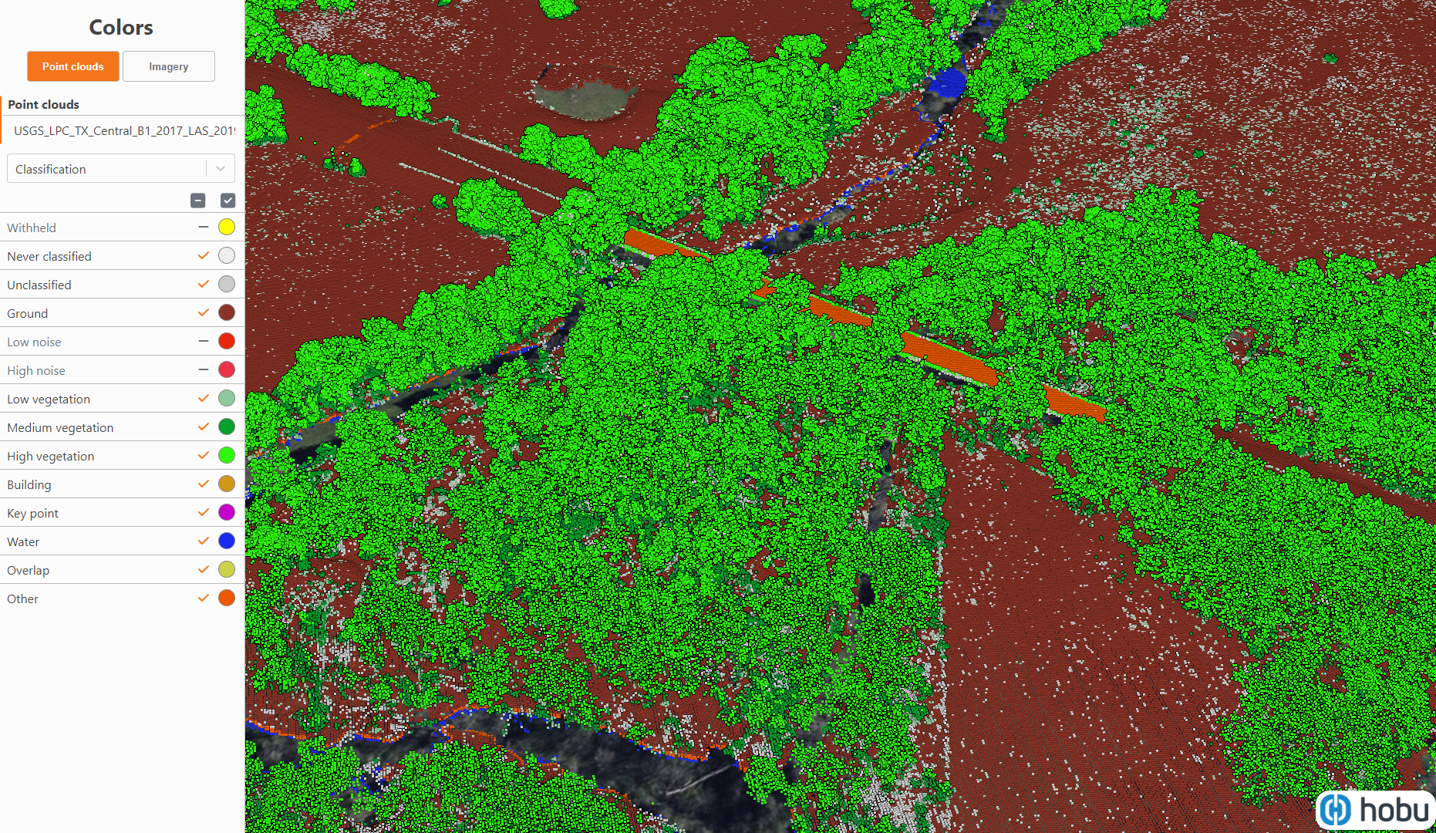
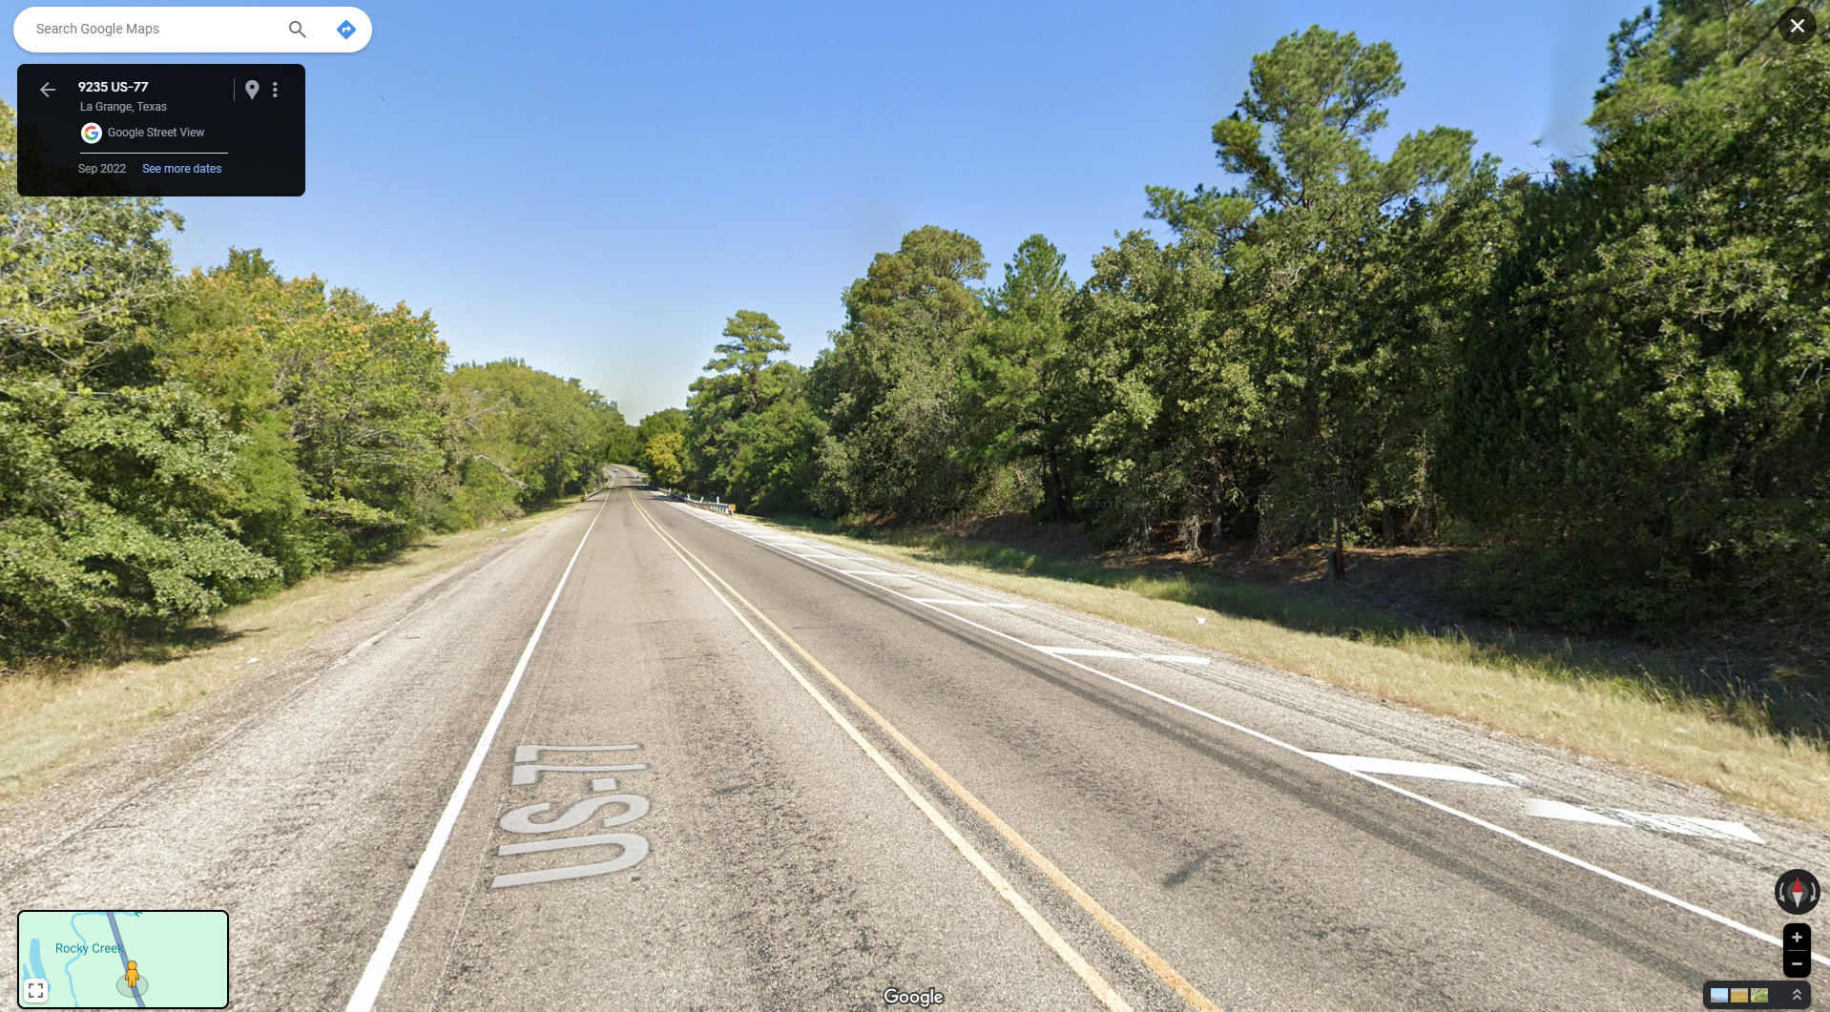
Bulk Classified LIDAR Healing
Inundating a healed surface
3

Slide 12
FLOG/FIM Subcommittee Meeting, 3 May 2024
Agenda Items:
1 - Update on Developments on FIM at the National Water Center
2 - 3D representation of channel geometry over CONUS via Machine Learning – Presented by Arash Rad,
3 - Comments from USGS on their work on Synthetic Rating Curves

Slide 13
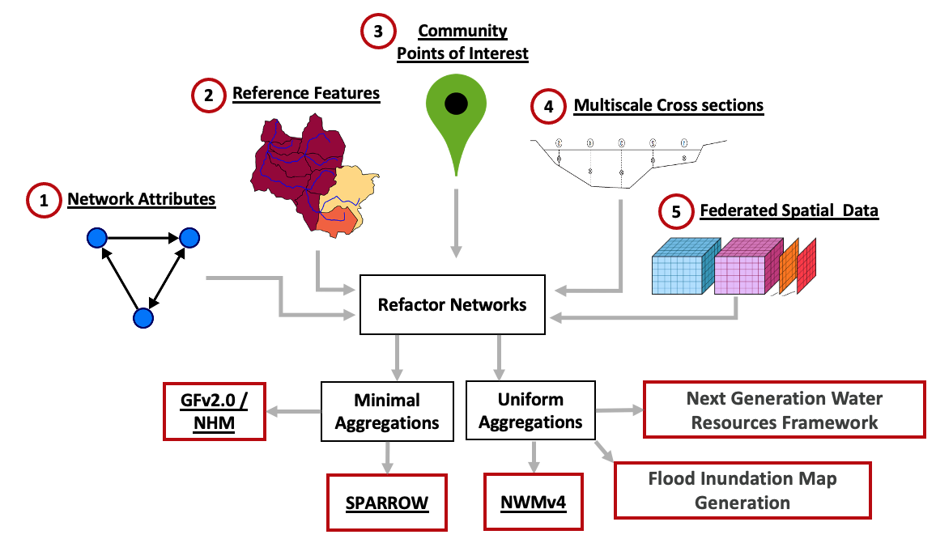
The 3D river channel geometry

Slide 14
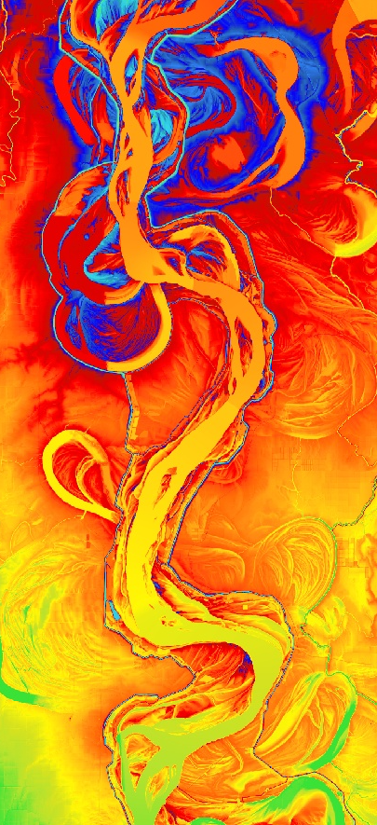
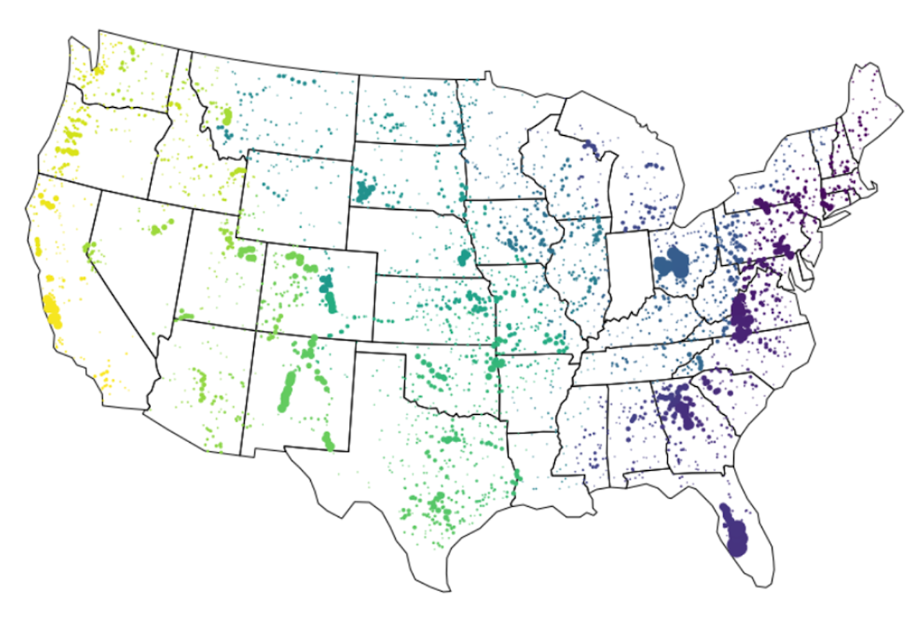
Training ML models to learn channel geometry of CONUS
DEM is missing the channel bathymetry (flat river bed)
Survey data is sparse
HYDRoSWOT locations used for training and testing
Elevation
25m
50m

Slide 15
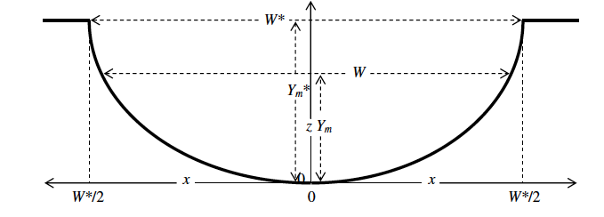
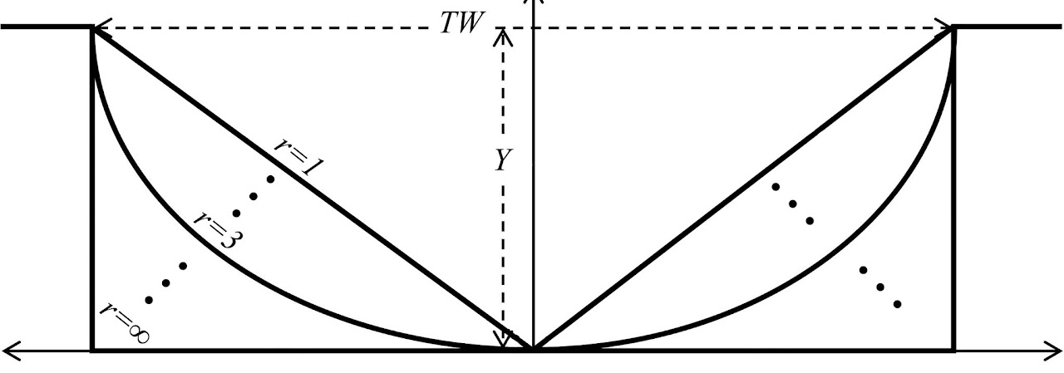
At Station Hydraulic Geometry
Dingman’s r coefficient

Slide 16
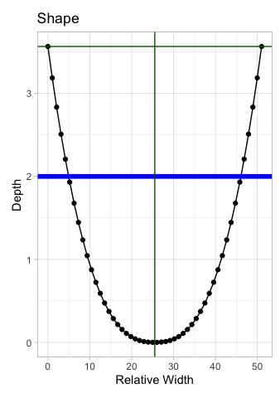
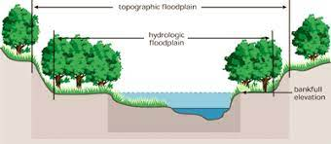
AHG Software and Bathymetry Problem
1 year = in-channel 2 year = bankfull
Width
Depth
Missing bathymetry from DEM

Slide 17
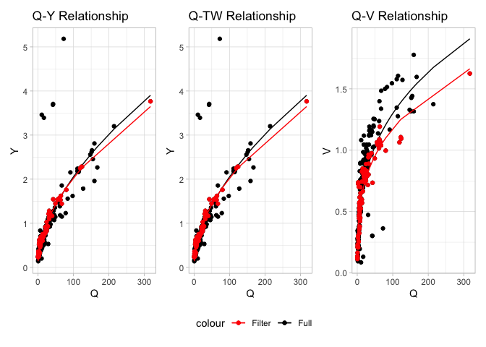
At a Station Hydraulic Geometry
Robust fits while preserving mass AHGestimation package
Software
Data filtering:
1- Median Absolute Deviation mad_filter()
2- Temporal date_filter()
3- Mass conserving qva_filter()
4- NLS nls_filter()

Slide 18
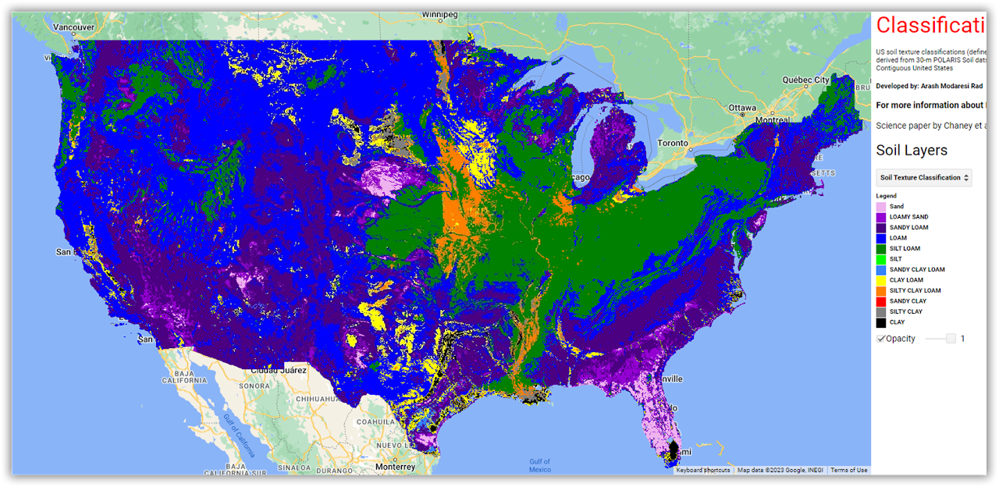
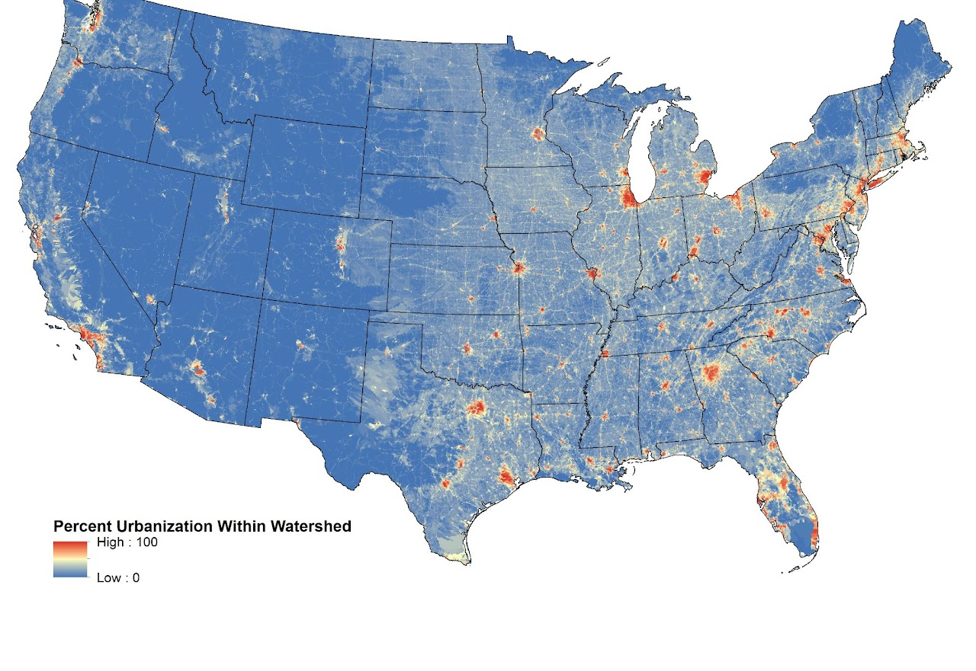
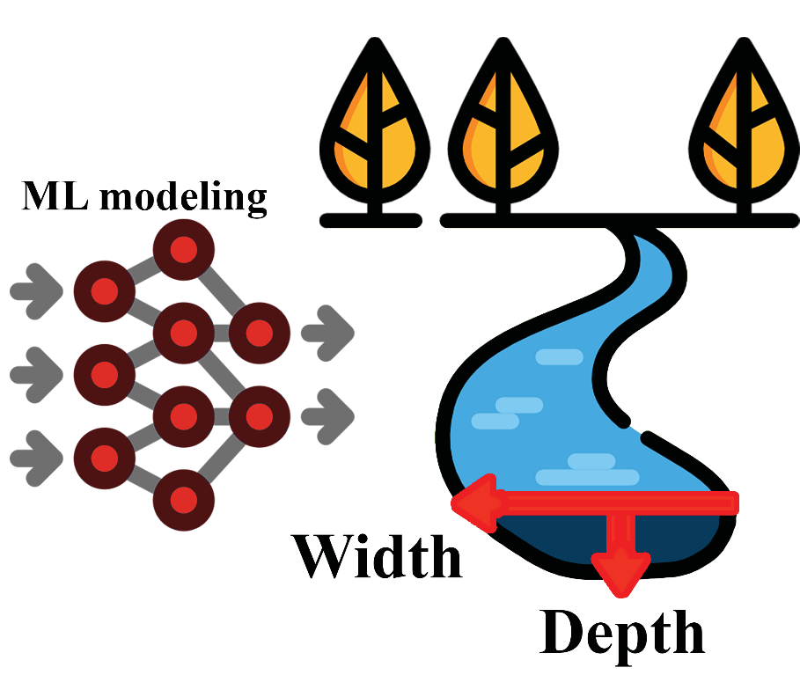
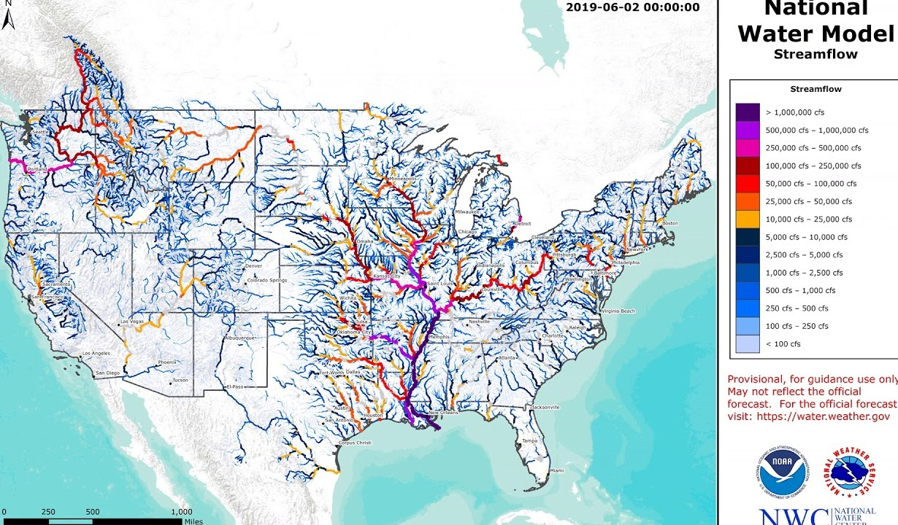
POLARIS
HYDRoSWOT
Reference Fabric
StreamCat
NWM Flood Frequencies
3-
Dingman r
1-
2-

Slide 19
Channel Shape
Plot of ML model predictions of Dingman’s r that determine channel shape for all NHDPlus reaches corresponding to HydroSWOT data

Slide 20
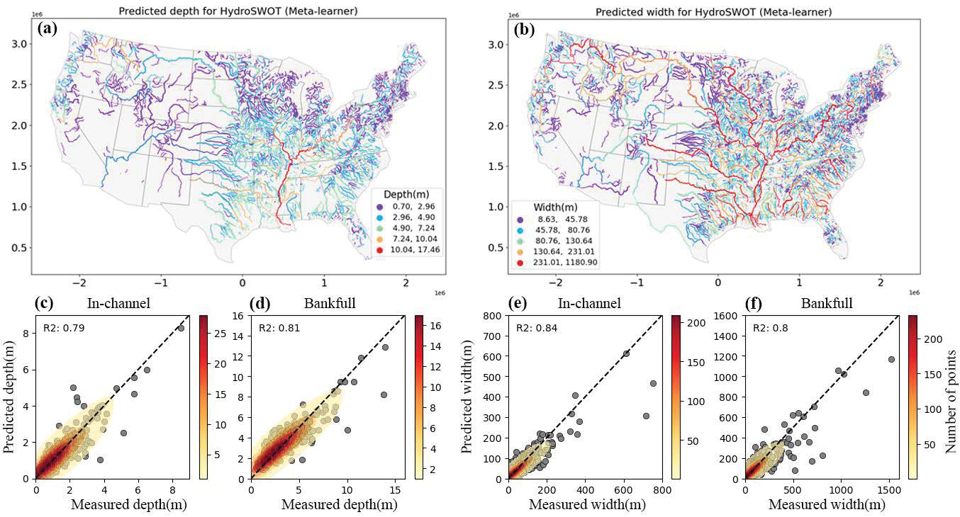
Channel Depth
Channel Width

Slide 21
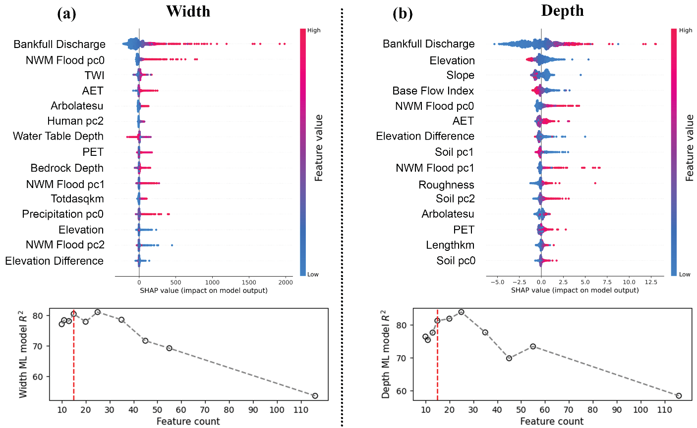

Slide 22
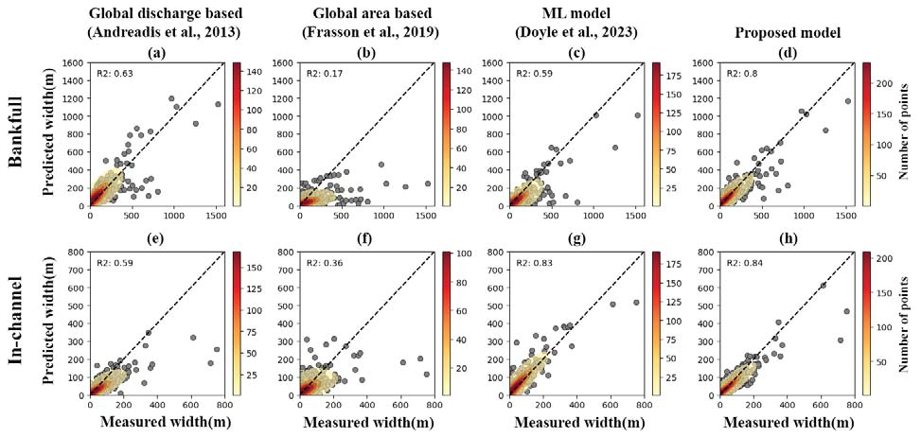
Evaluation with Literature

Slide 23
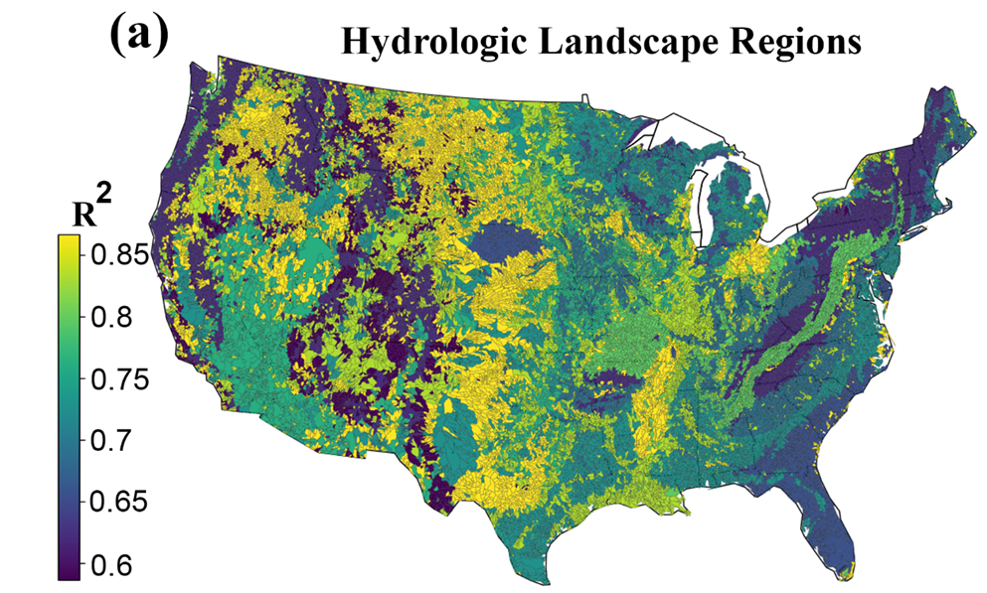
Evaluation with Literature
Depth Model comparison to Blackburn-lynch
Black dots are reported Blackburn-lynch regional equations goodness of fit (R2)
Bar plots are ML goodness of fit (R2)

Slide 24
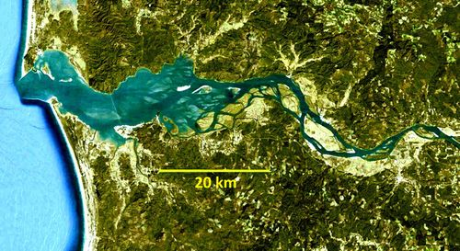
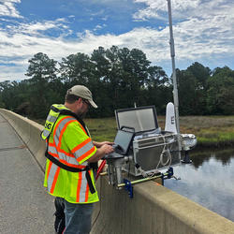
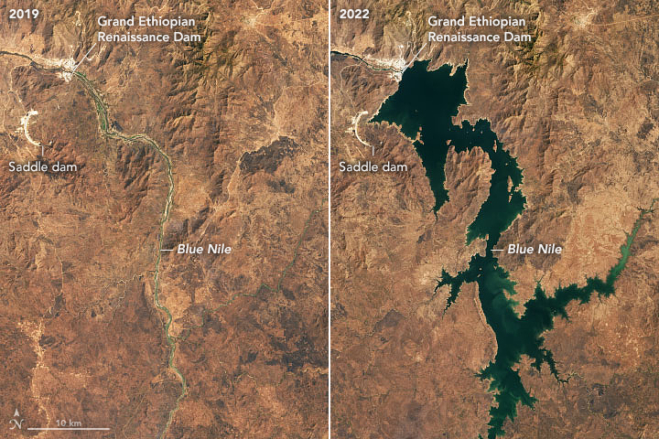
Coastal regions
Shortcomings
USGS monitoring
Dams and other man made structures

Slide 25
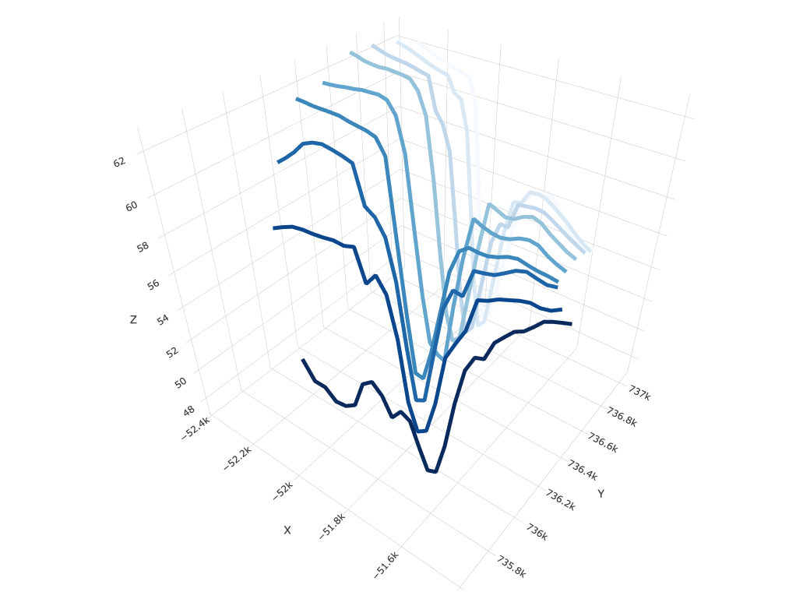
Providing data for width, depth and shape (and all AHG coefficients) ~2.7 million catchments
Can be infused with DEM derived cross sections to represent entire river geometry
The dataset indexes bathymetry-related data resources into the National Hydrologic Geospatial Reference Fabric, enabling exhaustive watershed-level queries.
Potential to enhance routing within hydrological models, improves representation of river bathymetry in Flood Inundation Mapping (FIM), and facilitates numerous comprehensive scientific analyses.
ML drived channel geometry Paper currently
under revision submitted to JGR ML
Paper on AHG software published at JOSS Paper

Slide 26
FLOG/FIM Subcommittee Meeting, 3 May 2024
Agenda Items:
1 - Update on Developments on FIM at the National Water Center
2 - 3D representation of channel geometry over CONUS via Machine Learning
3 - Comments from USGS on their work on Synthetic Rating Curves – Presented by Nam Jeong Choi

Slide 27
Synthetic Rating Curve for Flood Inundation Mapping in Ungaged Streams ______________________________________________________ Discharge Estimate Using Generalized Additive Regression Model Bigger studies: Interagency Flood Risk Management (InFRM) Flood Decision Support Toolbox (FDST) Trinity San Jacinto River Basin Integrated Water Availability Assessment
Namjeong Choi nchoi@usgs.gov

Slide 28
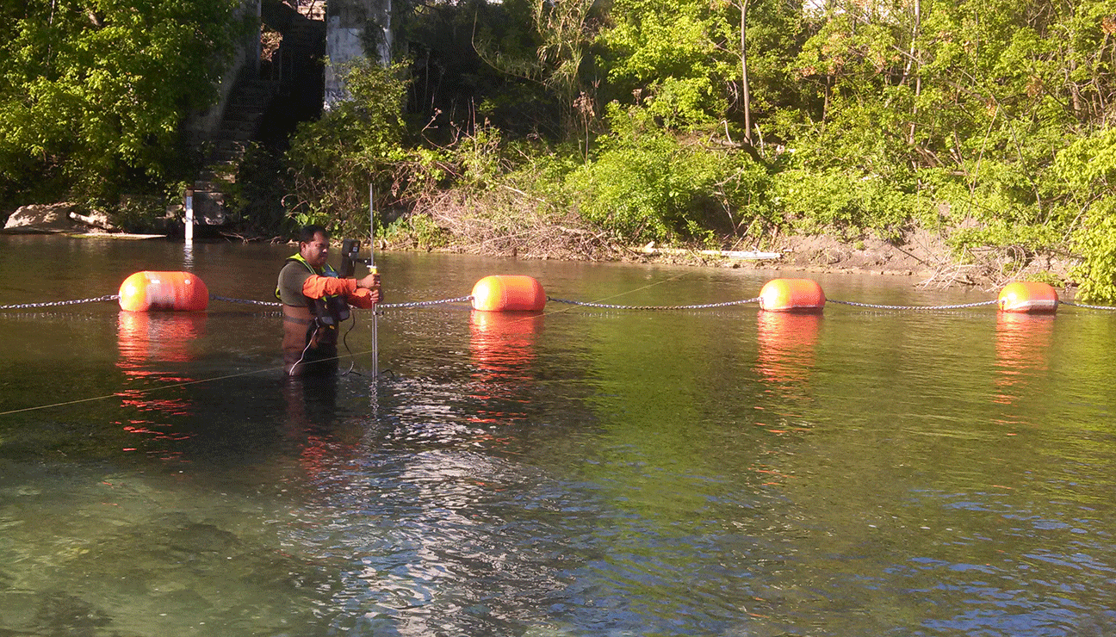
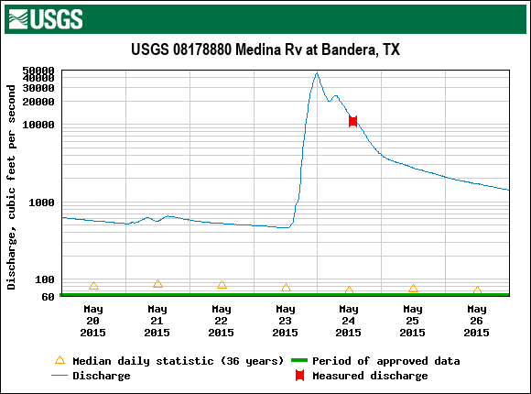
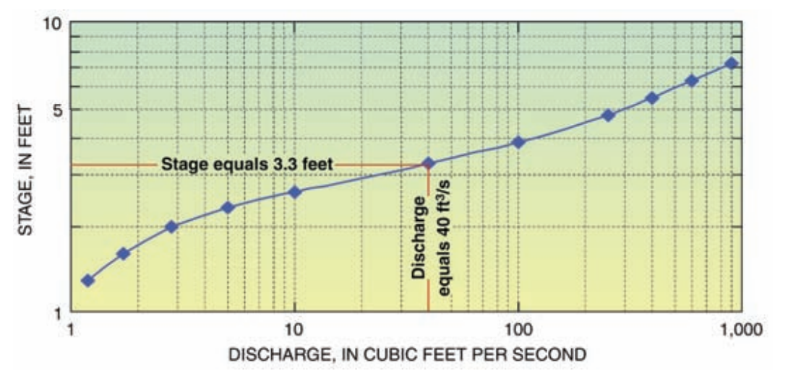
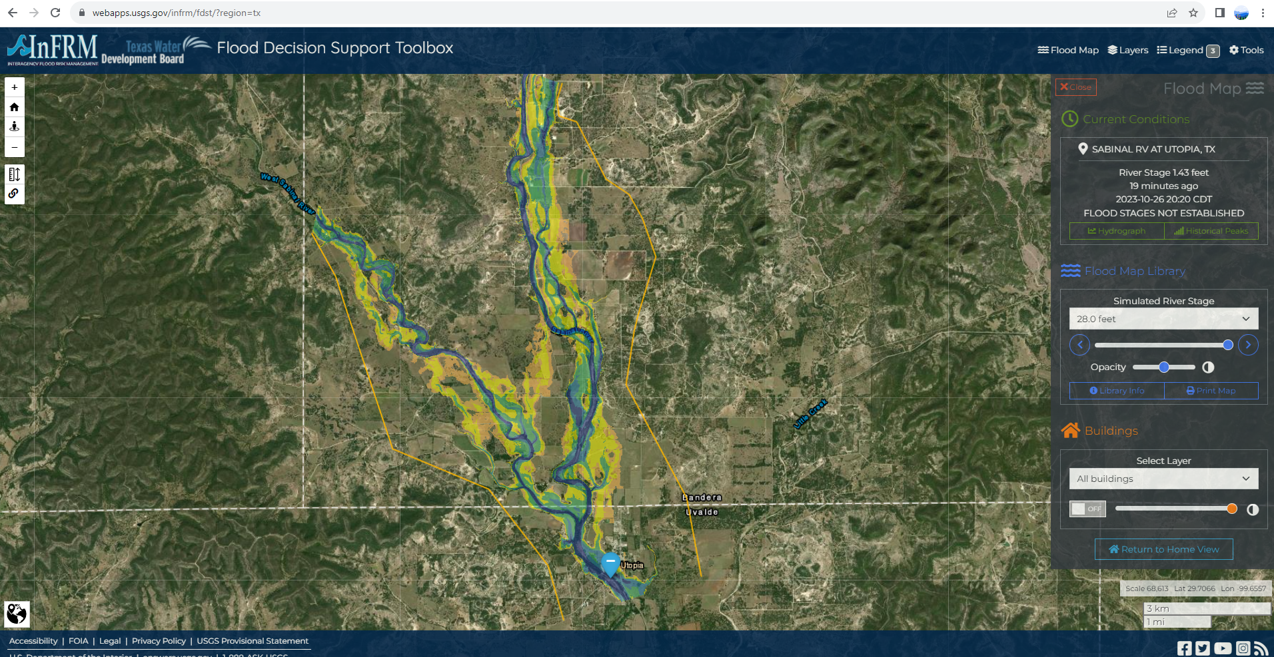
Synthetic rating curve for flood inundation mapping
Conventional rating curve takes years of flow measurements that covers wide range of hydrologic conditions
Statistics-based synthetic rating curve proposed for ungagged streams
Input Data
Hydraulic Model
Model Calibration Using Stage-Discharge Rating
Curve
× N
$$\log\left(Q\right)=−0.2896+1.269\log\left(A\right)−0.2247\log\left(B\right)$$
$$+0.2865Ω+f_{5}\left(longitude, latitude\right)+f_{6}\left(P\right)$$
Geoprocessing
Flood-Inundation Maps
Flood Decision Support Toolbox
(https://infrm.us/fdst)
Notes:
Floods are the main cause of natural-disaster economic and life losses in the USA. It’s in the USGS mission to provide science which enable timely information about earth processes to protect lives and livelihoods. We are completing this mission in cooperation with BCRAGD by:

Slide 29
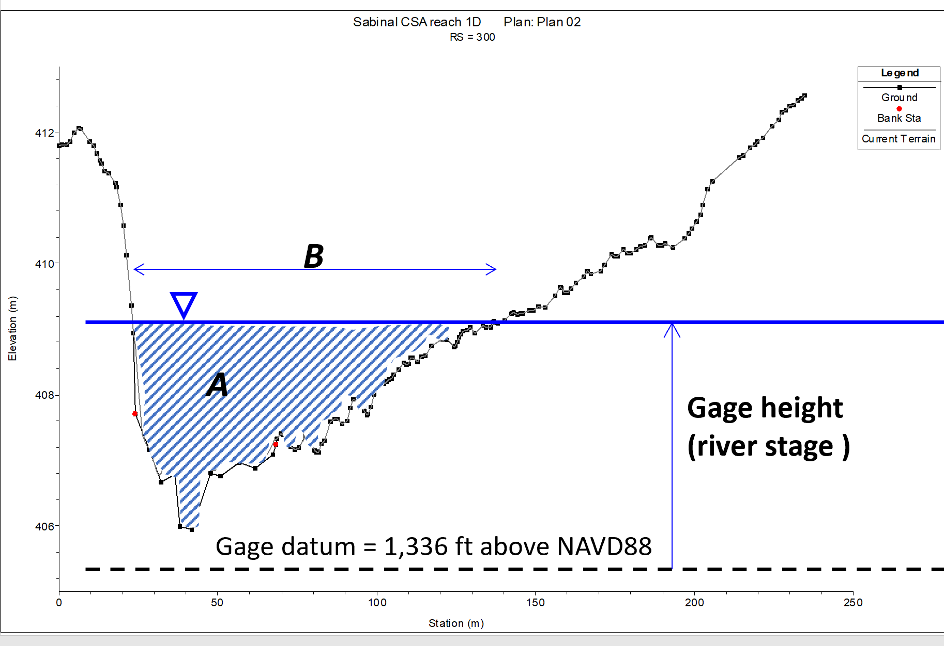
Existing direct discharge estimate equation
Asquith et al. (2013)* developed a regionalized streamflow discharge equation based on 17,700 discharge values from 424 USGS streamgages using Generalized Additive Regression Model (GAM) in Texas.
$$\log\left(Q\right)=−0.2896+1.269\log\left(A\right)−0.2247\log\left(B\right)$$
$$+0.2865Ω+f_{5}\left(longitude, latitude\right)+f_{6}\left(P\right)$$
where log = base-10 logarithm, Q = discharge in m³/s, A = cross-sectional flow area in m², B = top width in m, Ω = the OmegaEM parameter (Asquith and Roussel, 2009), P = mean annual precipitation in mm, and f₅ and f₆ are smooth functions of the indicated predictor variables.
* https://doi.org/10.1061/(ASCE)HE.1943-5584.0000635

