Slide 1
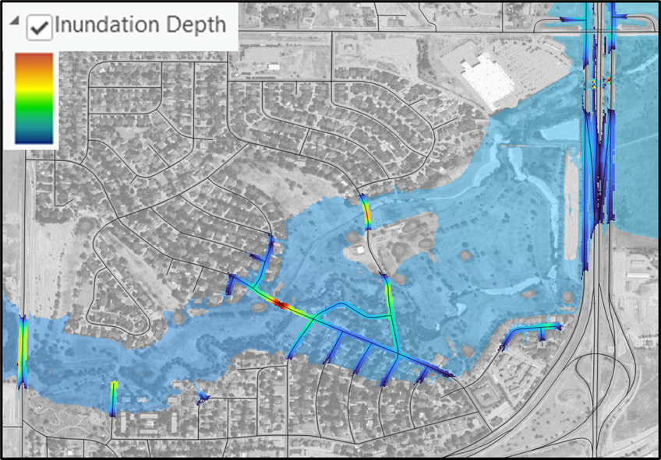
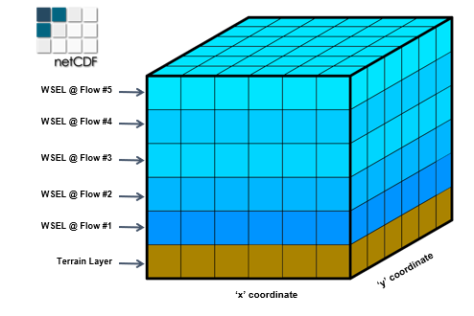
FLOG/FIM 4 April 2025
Agenda
Updates from the National Water Center
Updates from state and federal agencies
Discussion on forming a Flood Inundation Map library for Texas from RAS2FIM

Slide 2
Flood Response
Flood Mitigation
Flood Preparedness, Response and Recovery
Flood Planning and Design
Based on historical and design storms
We have about $100 million invested in HEC-RAS hydraulic models across Texas for this purpose
Flood Operations
Based on real-time flood forecasting and inundation mapping
Can we leverage the investment in hydraulic modeling to create flood inundation map libraries for real-time use?

Slide 3
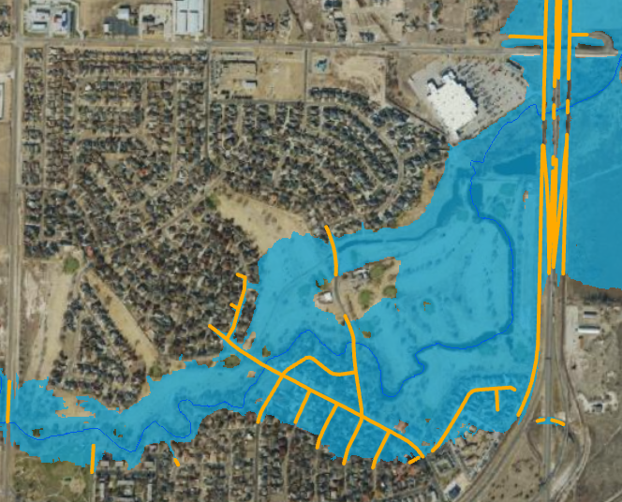


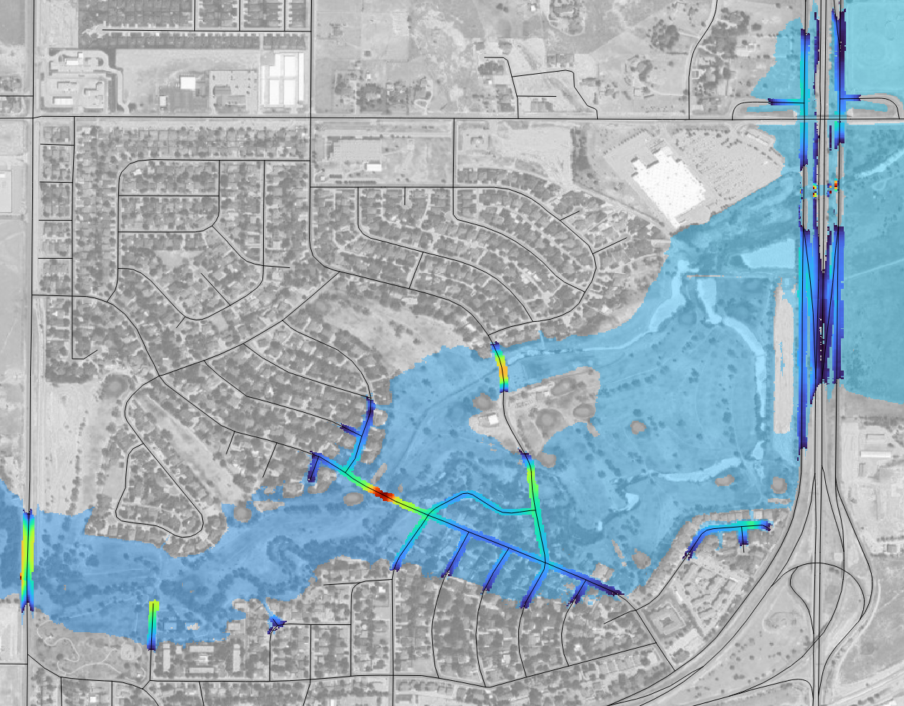
HAND and RAS2FIM
More accurate and reliable
HAND – flood extent only
2D RAS2FIM – flood extent and depth

Slide 4
Questions
National Water Center has some 1-D RAS2FIM maps operating in Texas for some HUC8 units. How many? Where are they?
How is implementing RAS2FIM maps different than for HAND maps in the NWC flood inundation map system?
2D RAS2FIM is being implemented for BLE modeling across Texas and Andy Carter at UT Austin has developed a 2D RAS2FIM methodology for creating a FIM map dataset from a 2D HEC-RAS model.
How can 2D RAS2FIM be scaled out across Texas? Who does that? National Water Center? Texas Water Development Board? InFRM group?
How is the resulting library stored and kept up to date?
How are the newly completed flood models for coastal communities created by the GLO River Basin Flood Studies included in this process?

Slide 5
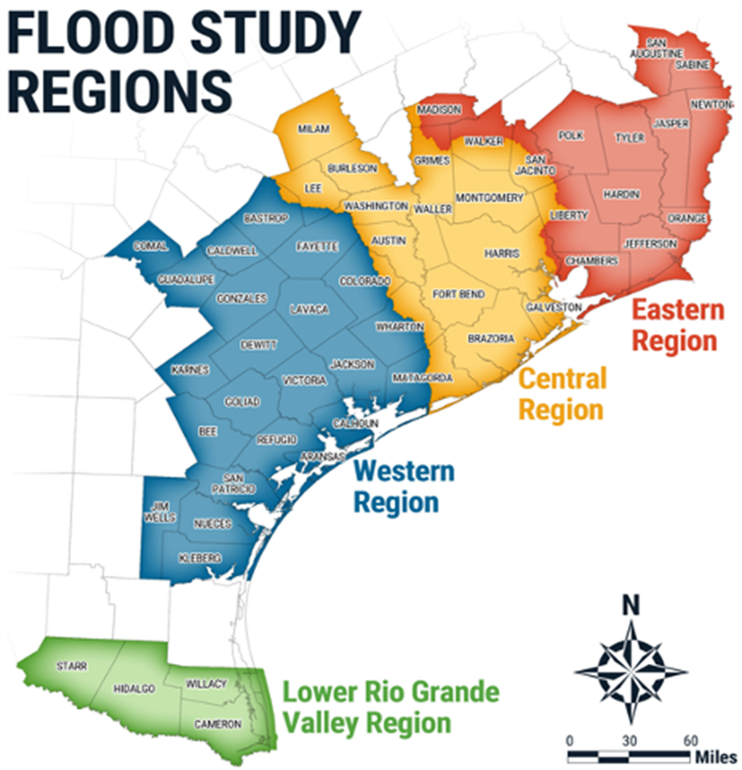
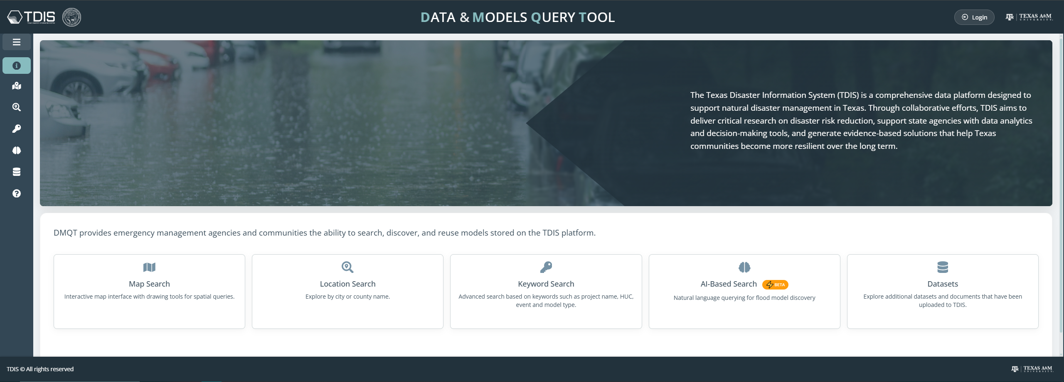




Next Meeting (Friday 2 May 2025) :
GLO and TDIS with a River Basin Flood Study (RBFS) Update
GLO - RBFS Update
                Baseline Modeling nearly complete; models available
                Beginning alternatives analysis
TDIS - Data & Models Query Tool (DMQT)
Demo of DMQT and how RBFS models can be accessed
Texas General Land Office
@glotx
Texas General Land Office | CDR
@txglo
Commissioner Dawn Buckingham, M.D.
Notes:
PHOTO W TITLE SLIDE

