Slide 1
FLOG/FIM Subcommittee Meeting, 5 April 2024
Agenda Items:
Introduction to the National Water Prediction System (Fernando Salas and Derek Giardino, NWC)
Update on working with bridges in NWC FIM (Jim Coll and Laura Keys, NWC)
Any state agency updates
RQ-30 Stream gauging program (Scott Grzyb, USGS)

Slide 2


Slide 3

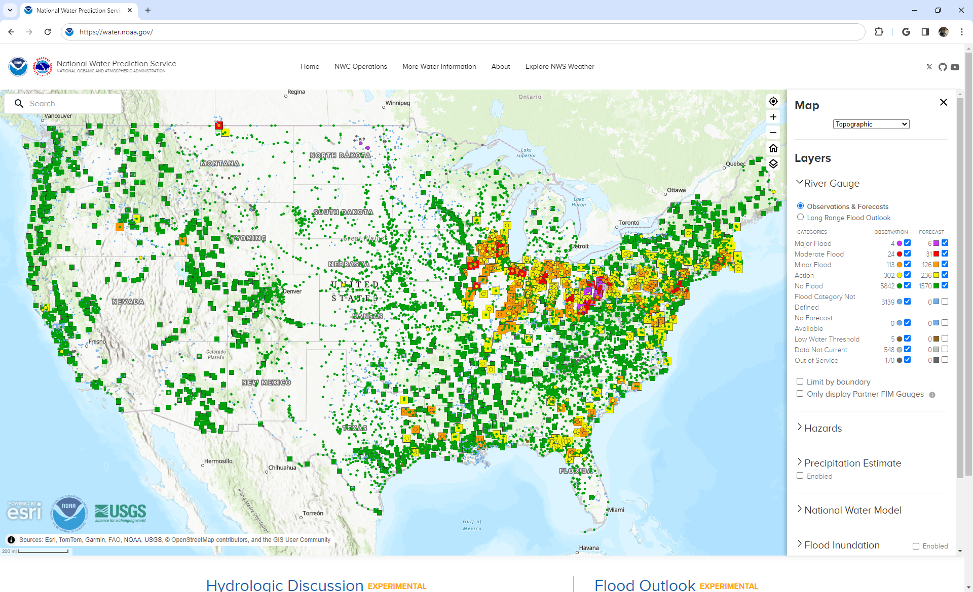
Bridges
water.noaa.gov

Slide 4

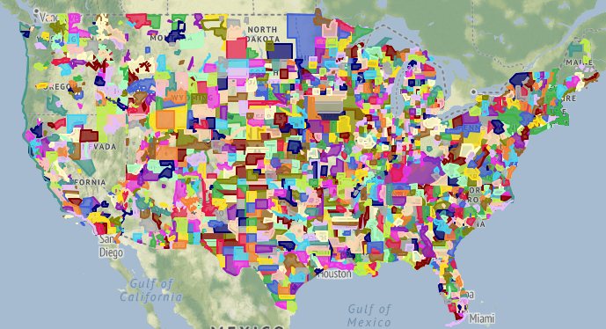
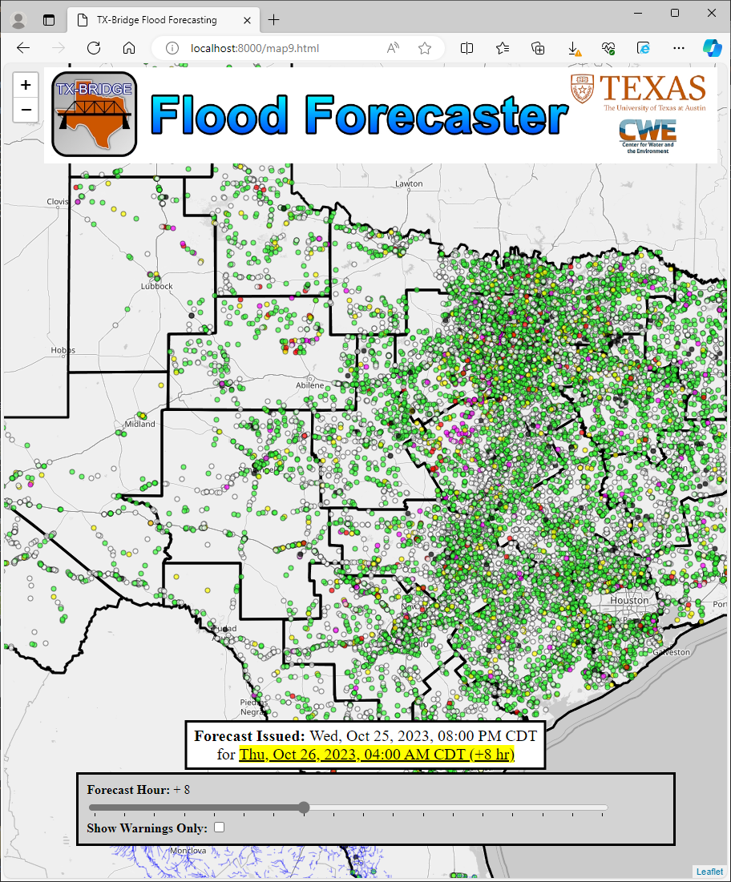

Phased Bridge Healing Plan
OSM Guided HAND Healing
OSM Guided, LIDAR Enhanced Heal
Bulk Classified LIDAR Healing
Prototype Deployment & Feedback
Bridge Impact Prototyping
Using OSM bridge-classified street lines to buffer and capture the maximum HAND value to heal into the mapping surface
Using the OSM derived polygon to define the shape to extract LIDAR elevations to heal into the mapping surface
Using well classified 3DEP point clouds (bridge class 17) to bulk heal the HAND surface
Heal HAND surfaces across CONUS and deploy in FIM visualization services, collect field feedback
(targeted - May 2024)
Use forecast and bridge attributes to flag potentially impacted bridges as scaffolded by Andy Carter and https://bridgeflood.com/
1
2
3
4
5

Slide 5
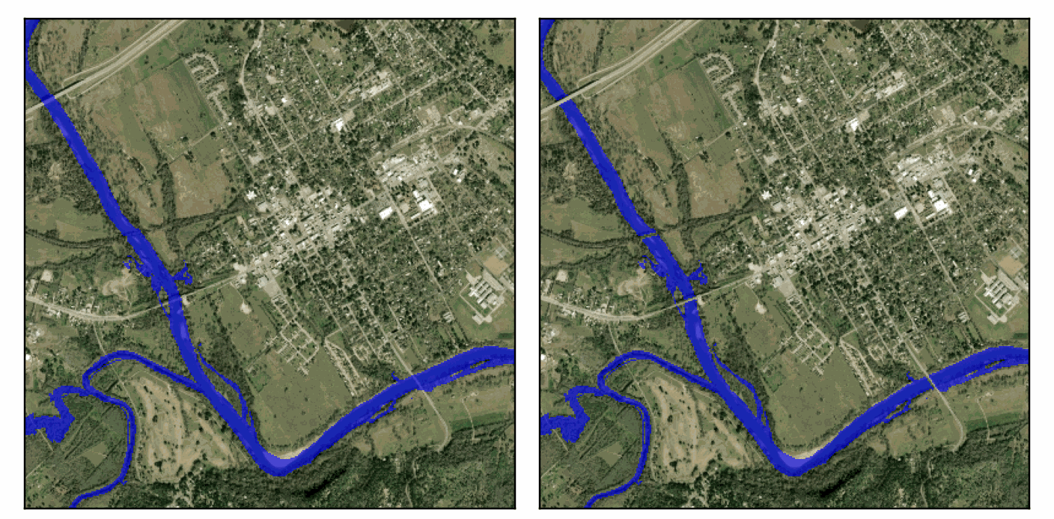
OSM Guided HAND Healing
Before
After
1

Slide 6
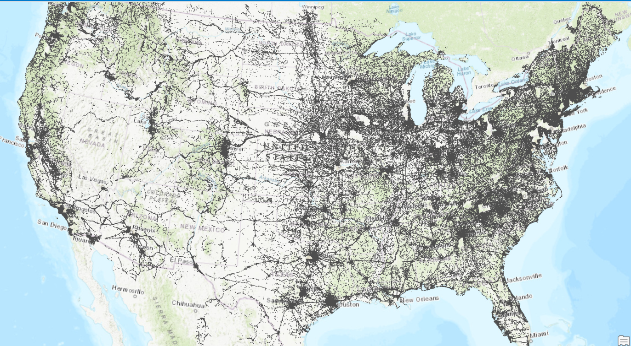
OSM bridge data
OSM Guided, LIDAR Enhanced Heal
Lidar-based bridge forecasting | Open Street Map HAND Healing (non-lidar)
Relatively heavy lift to prepare for HAND FIM (HPC processing, storage, etc.) | Relatively easy to deploy as pre-processing step to modify HAND grid
TX only (based on Andy Carter work); heavy lift to expand beyond TX | Data already available to deploy for all of CONUS
Offers potential heterogeneous deck elevations | Heals single value across bridge deck polygon
2
Use OSM bridge polygons as hulls for lidar points
Notes:
Under 7GB to save out all OSM bridge features across CONUS; 40GB for lidar-based TX DB

Slide 7
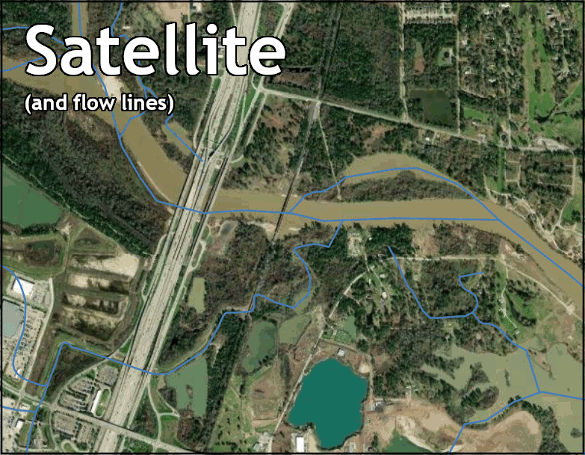
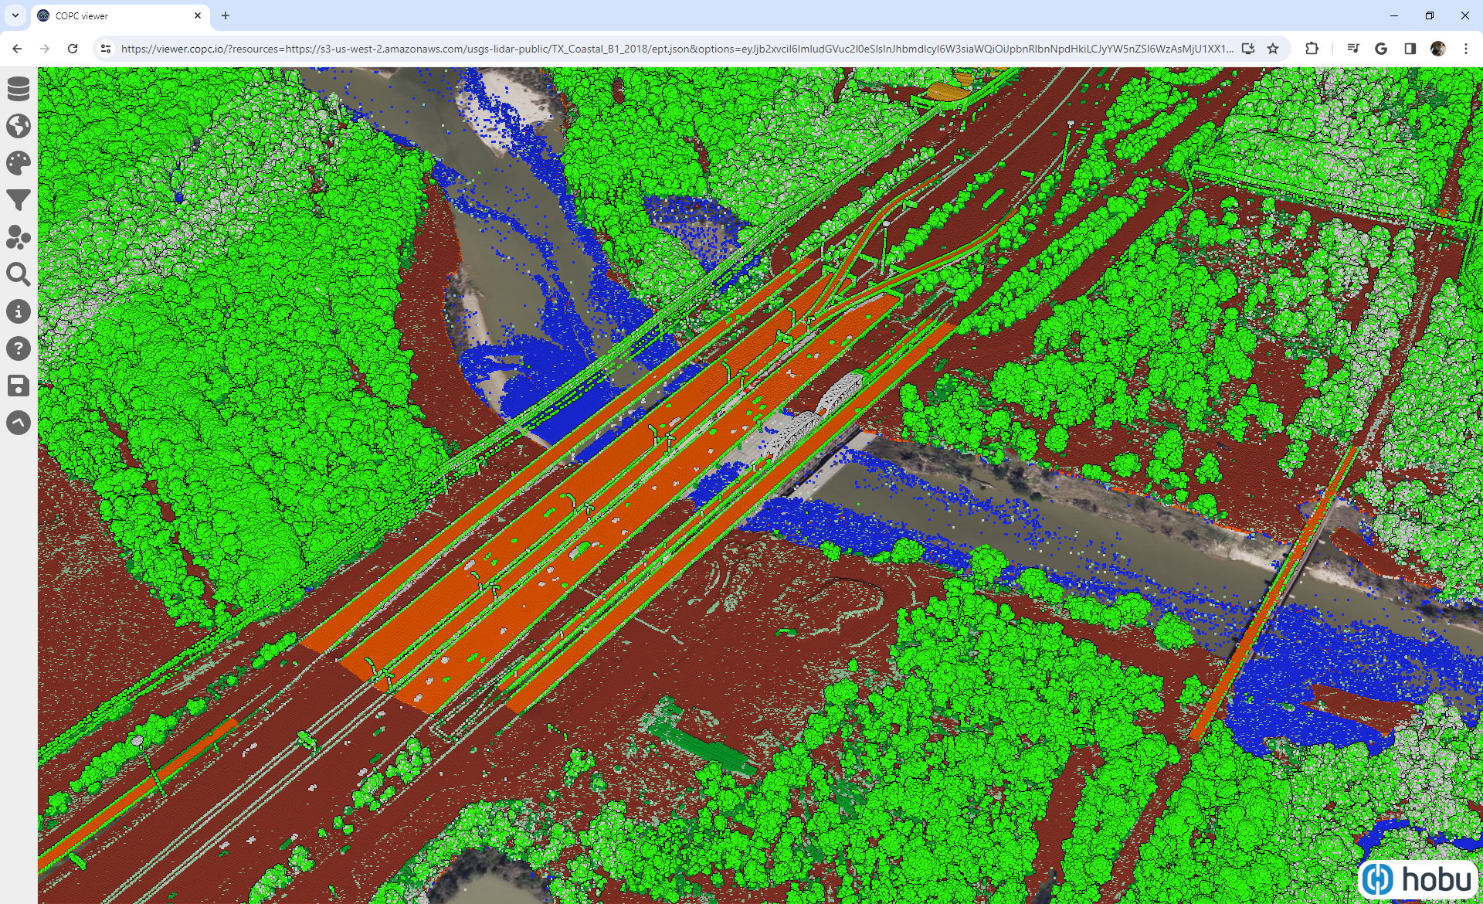
Bulk Classified LIDAR Healing
3

Slide 8

Streamgaging using surface-velocity sensors
(RQ-30s)
Presented by Scott Grzyb, USGS to the TWDB FLOG/FIM Subcommittee
5 April 2024
U.S. Department of the Interior
U.S. Geological Survey

Slide 9
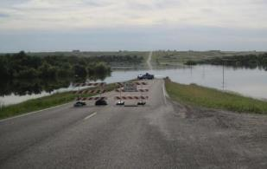
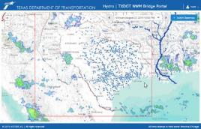
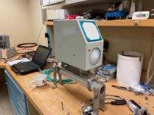
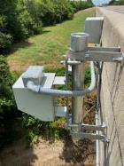
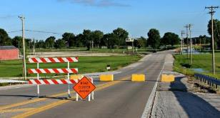

Objectives
Densified forecasting requires densification of stream gaging
Assess if newer technology can achieve comparable results with less effort

Slide 10
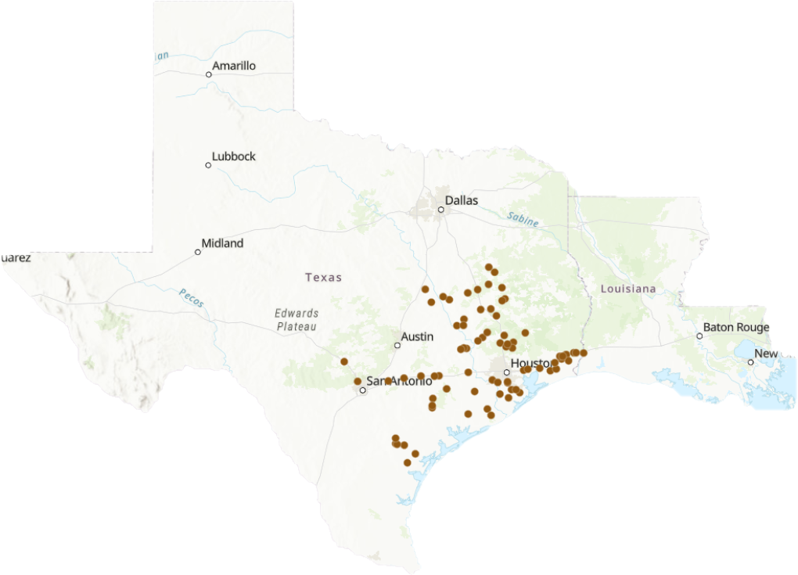
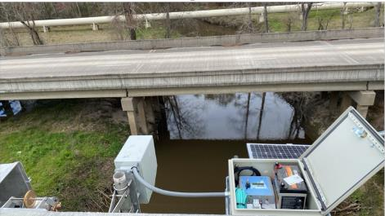
Study Area
80 TxDOT gages with
RQ-30 radar sensors

Slide 11
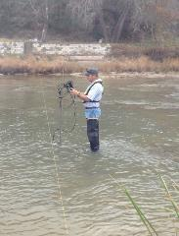
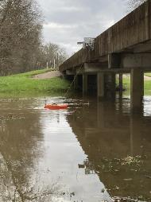
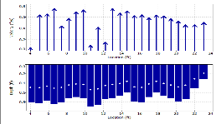
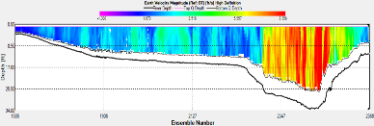
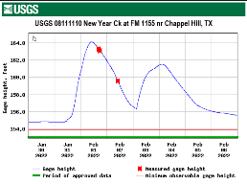
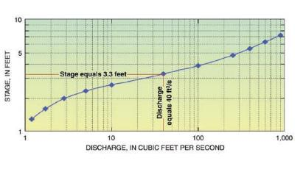
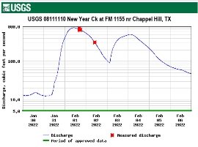
Traditional USGS Discharge Determination
Flowtracker Handheld ADCP
Acoustic Doppler Current Profiler
Measure Stage Height
Use Rating Curve to
get Discharge
USGS Stage-Discharge Rating

Slide 12
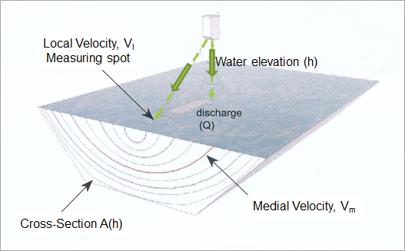
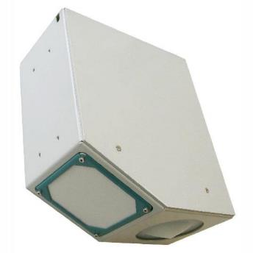
Measurement of Water Elevation and Velocity using RQ-30 Radar Gage
Discharge = Area * Mean Velocity

Slide 13
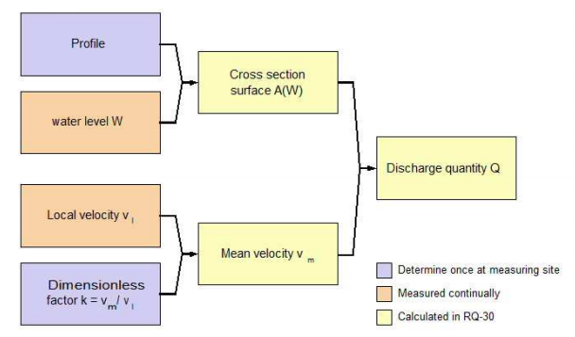
Computation of Discharge using RQ-30 Radar Gauge
A
Q
V

Slide 14

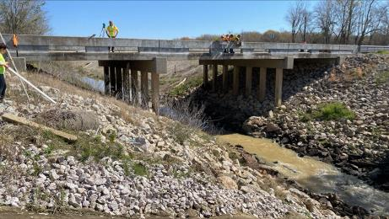
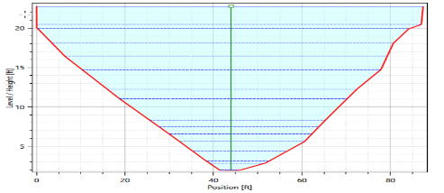
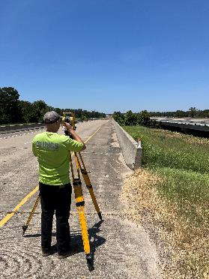
Cross Section Surveying
08041940-Green Pond Gully at FM 365 nr Fannett, TX
Channel geometry in-line with the velocity sensor
Low chord
Upper bridge deck / road elevation
Sensor elevation

Slide 15
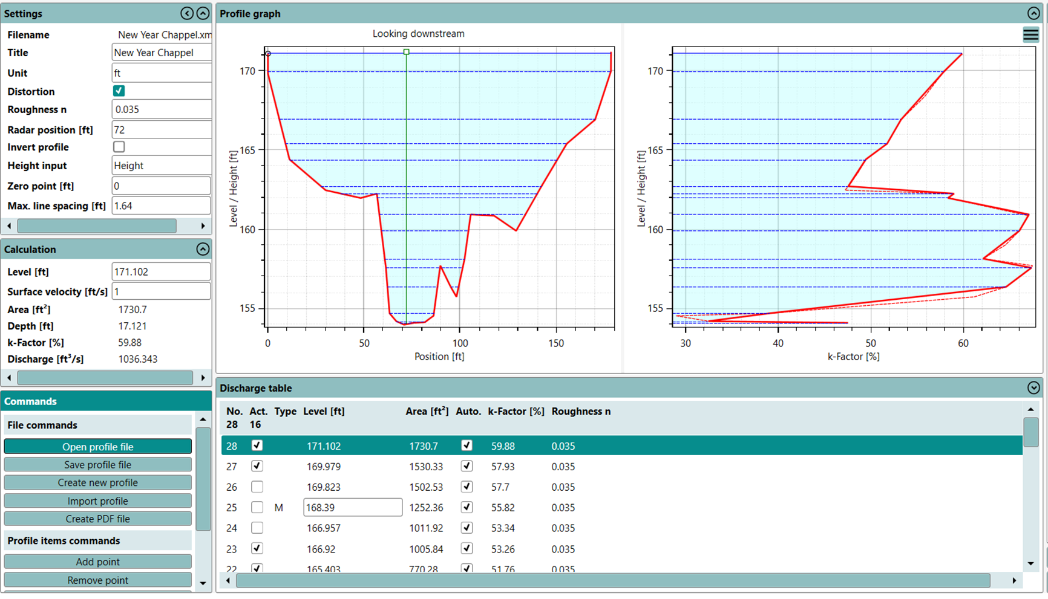

Slide 16
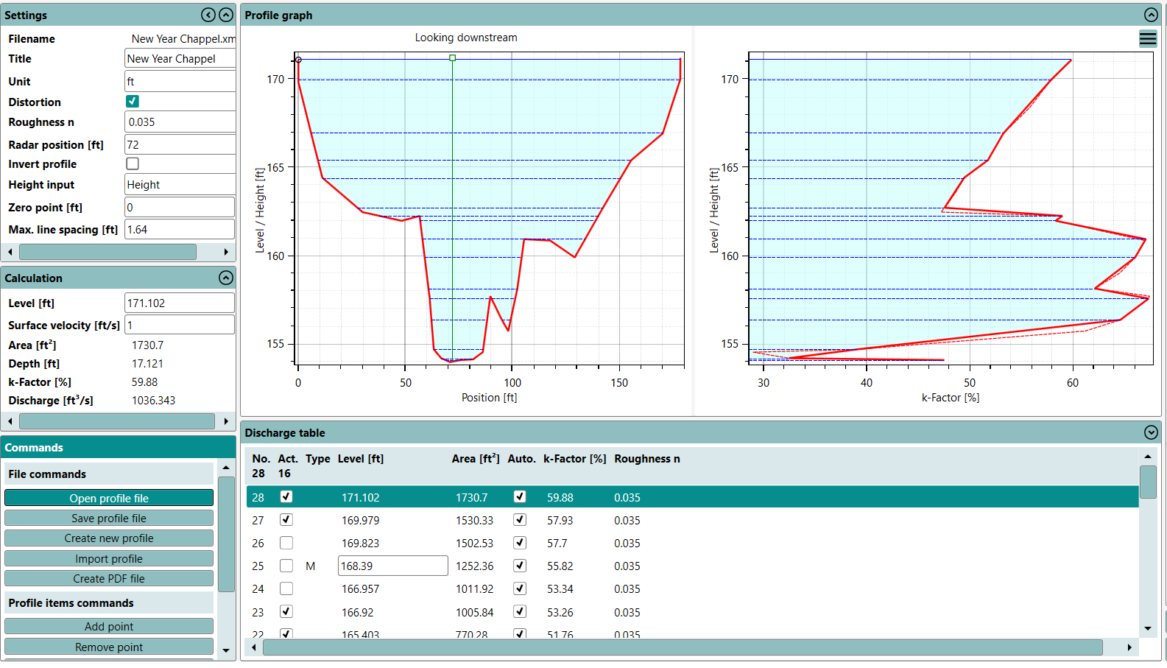
Cross-section
K-Factor Profile

Slide 17
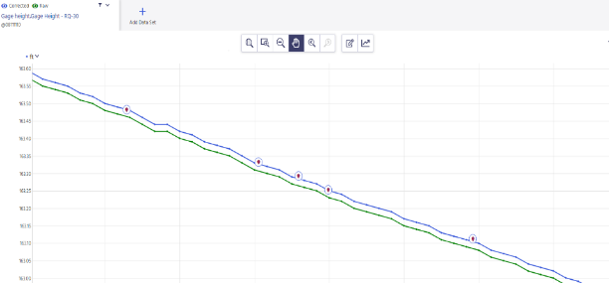
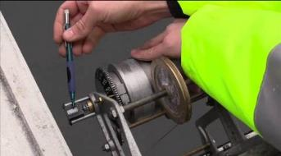
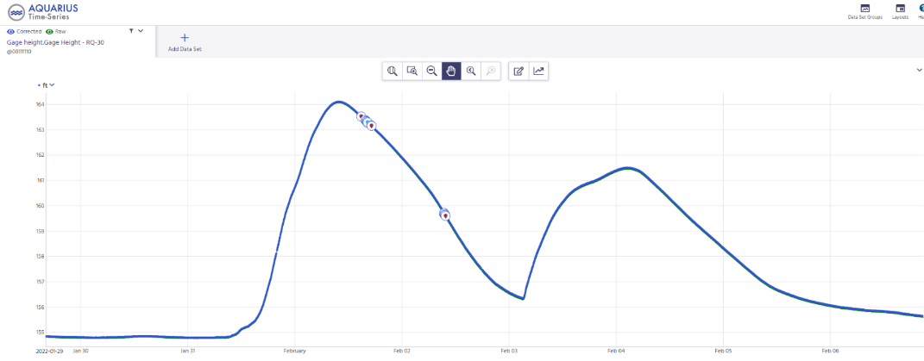
Gage Height Accuracy

Slide 18
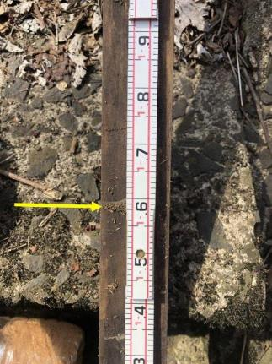
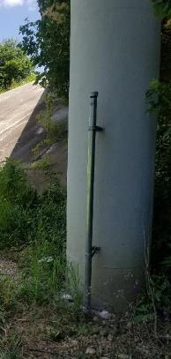
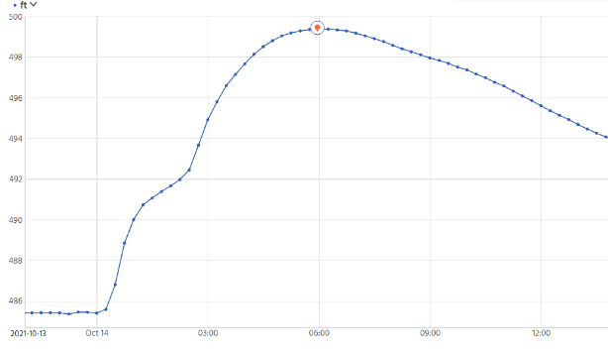
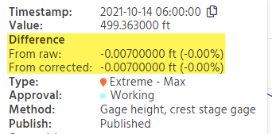
Gage Height Peak Verification

Slide 19

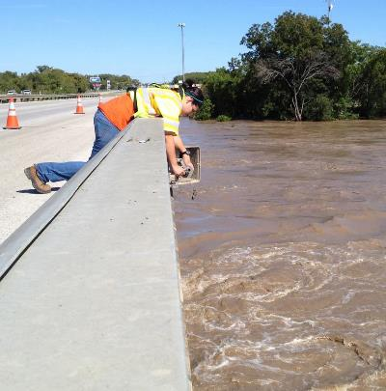
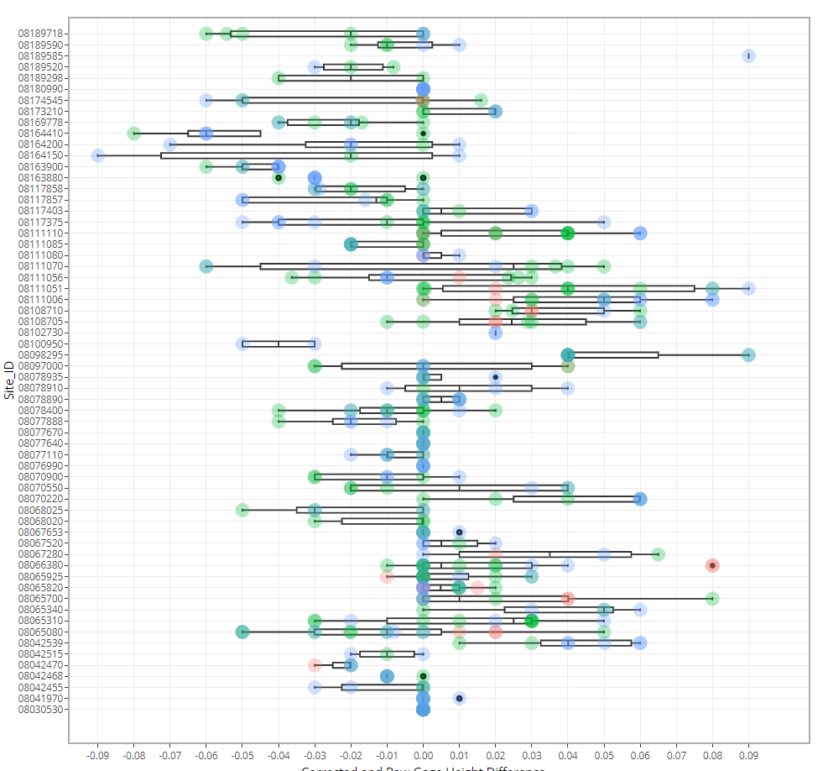

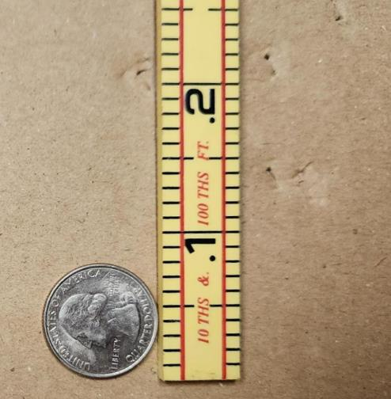
Gage Height Assessment
Gage Heights for 53 stations
No resets made for the life of the gage
+/- .05 ft accuracy
+/- 0.05 ft

Slide 20
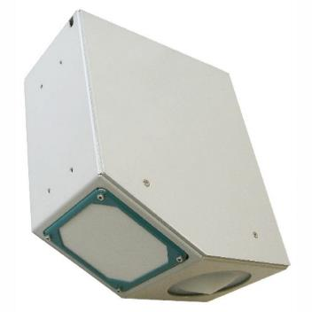
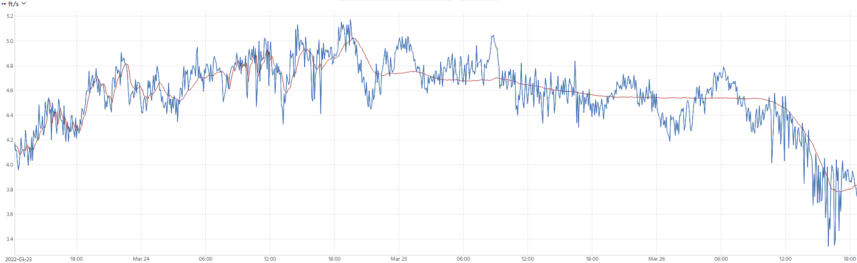

Velocity vs Learned Velocity
Velocity ( ft/s)
Date/time

Slide 21
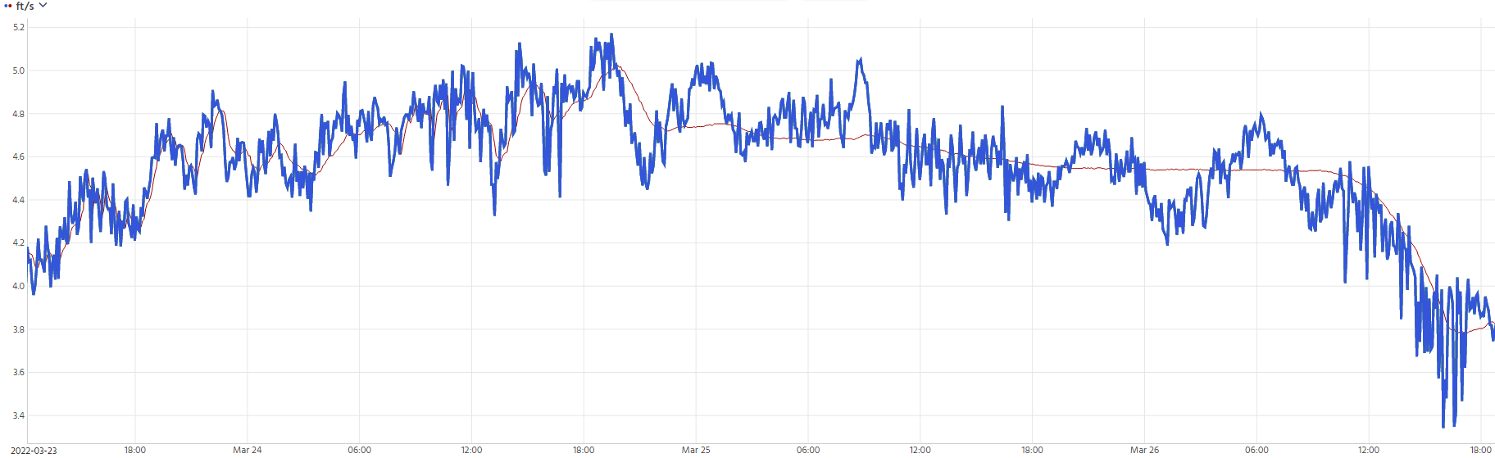
Point Velocity (surface)
Velocity ( ft/s)
Date/time

Slide 22
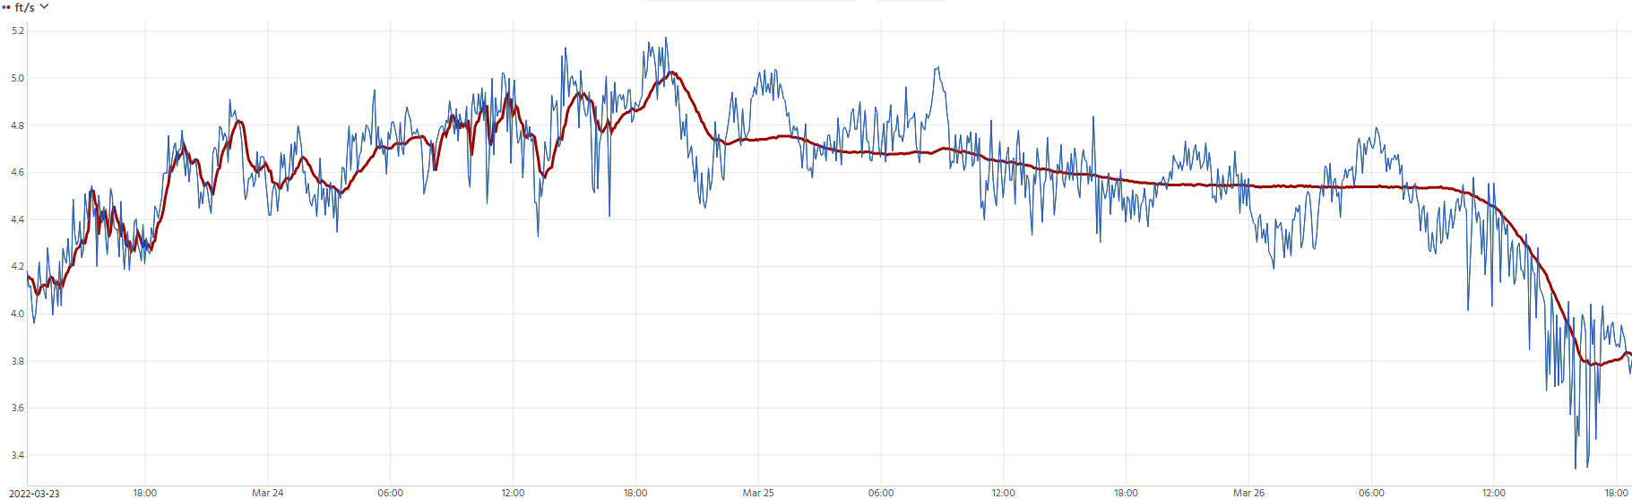
Learned Point Velocity (surface)
Velocity ( ft/s)
Date/time

Slide 23
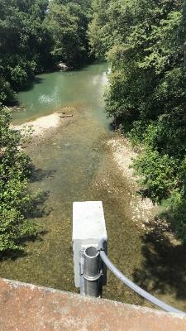
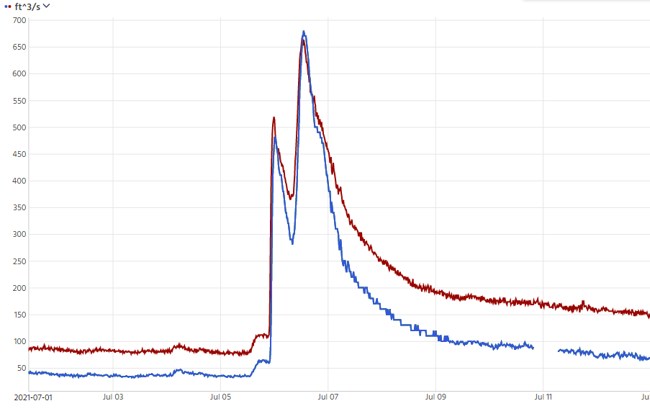
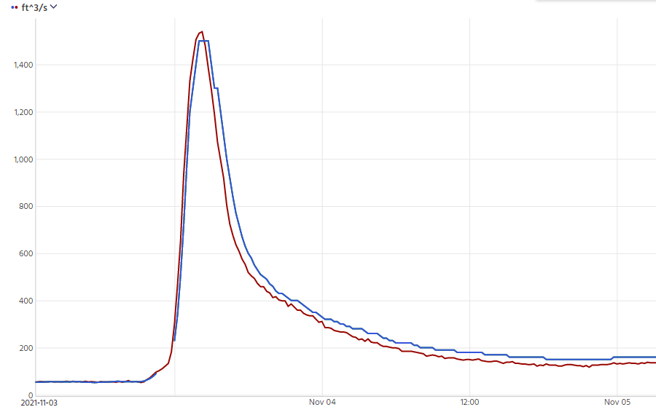
Early discharge observations
08167000 – Guadalupe Rv at Comfort, TX
July 2021
USGS Peak Discharge – 665 cfs
RQ-30 Peak Discharge – 680 cfs
November 2021
USGS Peak Discharge – 1,539 cfs
RQ-30 Peak Discharge – 1,500 cfs
Discharge ( cfs )
Date

Slide 24
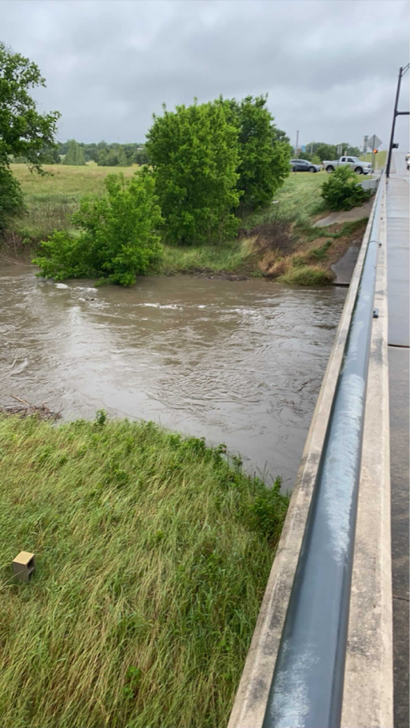
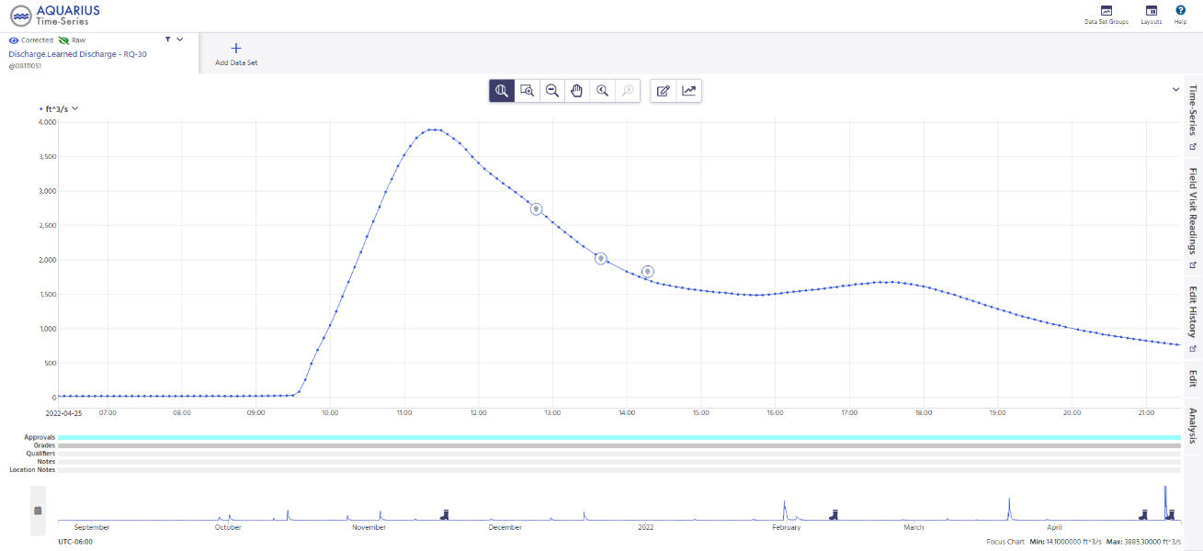
Discharge observations
Discharge ( cfs )
08111051 - Carters Ck nr College Station, TX
Measurements
RQ-30 Discharge
Date/time

Slide 25

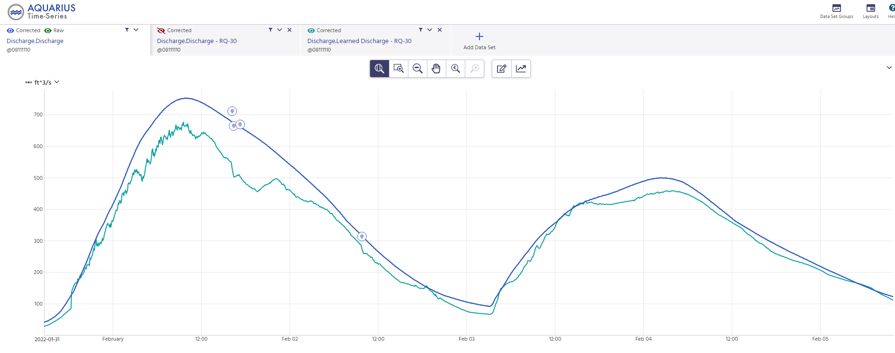
Discharge observations
Discharge ( cfs )
08111110 - New Year Ck at FM 1155 nr Chappell Hill, TX
Measurements
USGS Discharge
RQ-30 Discharge
Date/time

Slide 26
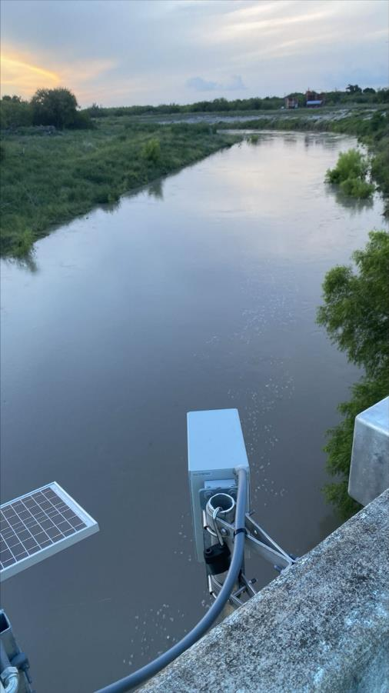

Discharge Measurement Comparisons
Discharge ( cfs )
08189718-Chiltipin ck at us 77 nr Sinton TX
Measurements
USGS Rated Discharge
RQ-30 Learned Discharge
Date/time
Measurements are 29% and 28% lower than USGS rated discharge.

Slide 27

Q-Commander Calibration

Slide 28


081111110 – New Year Ck at FM 1155 nr Chappel Hill, TX
Number of Calibration Points

Slide 29


Targeted Approach
Measure a minimum of 2 discharges at different channel geometries.
Calibrate the RQ-30
Once calibrated, make minimal measurements to verify accuracy

Slide 30
Discharge observations – Pre-Calibration
Discharge ( cfs )
08111110 - New Year Ck at FM 1155 nr Chappell Hill, TX
Peak 700 cfs
Measurements
USGS Discharge
RQ-30 Discharge
Date/time

Slide 31

Discharge observations – Post Calibration
Discharge ( cfs )
08111110 - New Year Ck at FM 1155 nr Chappell Hill, TX
Peak 600 cfs
Measurement
USGS Discharge
RQ-30 Discharge
Date/time

Slide 32

081111110 – New Year Ck at FM 1155 nr Chappel Hill, TX
Measurement Number

Slide 33


Targeted Measurement Approach Exercise
(from USGS Velocimetry training class)
Students independently select 2 measurements they think represents channel geometry
Calibration is performed through Q-commander (RQ-30 software)
Results are compared with classmates

Slide 34





Externalizing K-Factor Calculation
Existing USGS app Area Comp 3 Is being modified to calculate K-factor - the coefficient to convert surface velocity to mean channel velocity

Slide 35


Externalizing Learned Velocity
Learned velocity is determined within the RQ-30
Currently no way to transfer learned velocity
Future learned velocity profile calculation being developed for integration into Area Comp 3

Slide 36


Relationship between averaged cells
Depth
Distance from Left Bank

Slide 37
Relationship between averaged cells
Depth
Distance from Left Bank

Slide 38




K-Factor Methods Compared
Q-Commander
ADCP Deconstruction

Slide 39


Q-Commander
ADCP Deconstruction
USGS Stage-Discharge Rating
Numerous Measurements
2 - 4 Measurements
(Using Targeted Approach)
1 - 2 Measurements
No need for roughness

Slide 40


Effectiveness in dynamic channel conditions
Seasonal changes
July 2021
February 2022

Slide 41


Effectiveness in dynamic channel conditions cont.

Slide 42



Cross Section Surveys
08111051-Carters Ck at FM 60 nr College Station
Main channel shows approximately 30% reduction in area at low flows following the application of riprap on the right bank.

Slide 43



Observations After Rectification

Slide 44



Tidally Affected Gages
08031020 – Cole Ck at I-10 nr Orange, TX
Stage
Velocity

Slide 45

Backwater Conditions Cont.
Relation between Stage Height and Velocity (Tehuacana Creek nr Waco)
Discharge
Stg/Q
Discharge
by velocity

Slide 46


Data Observations – Velocity
08164150 - W Navidad Rv at I-10 nr Schulenburg, TX
Stage ( ft )
Date/time

Slide 47


Data Observations – Velocity
08164150 - W Navidad Rv at I-10 nr Schulenburg, TX
Stage ( ft )
Date/time

Slide 48


Data Observations – Initial Velocity Wave
Stage (ft)
08111110 - New Year Ck at FM 1155 nr Chappell Hill, TX
Peak velocity of initial pulse

Slide 49



Data Observations – Initial Velocity Wave
08111110 - New Year Ck at FM 1155 nr Chappell Hill, TX
19 hours
6 hours
Subsequent rain events

Slide 50
 | Questions?

