Slide 1
FLOG/FIM Meeting Agenda, 5 September
Report from Derek Giardino on the FIM60 flood map release and NOAA’s Kerr County flooding post assessment; https://www.weather.gov/media/owp/operations/nws_fim_faqs.pdf
Report from Jon Thomas on USGS data gathering and assessment of Hill Country flooding; https://apps.usgs.gov/fev/event/2025-july-tx-flood
Report from Srikanth Koka on TWDB’s plan for assessing the Hill Country flooding;
Review of Senate Bill 5 passed by the Texas House and Senate
Any other updates that people would like to contribute.

Slide 2
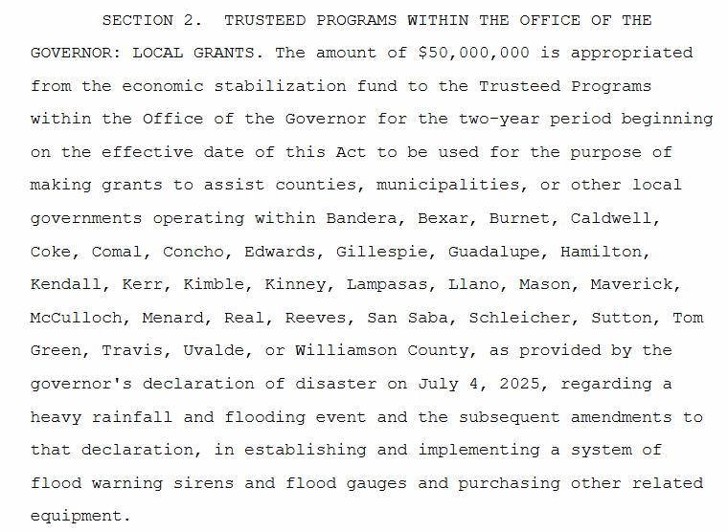
Senate Bill 5, passed by House and Senate
$50 million for flood warning sirens and flood gauges

Slide 3
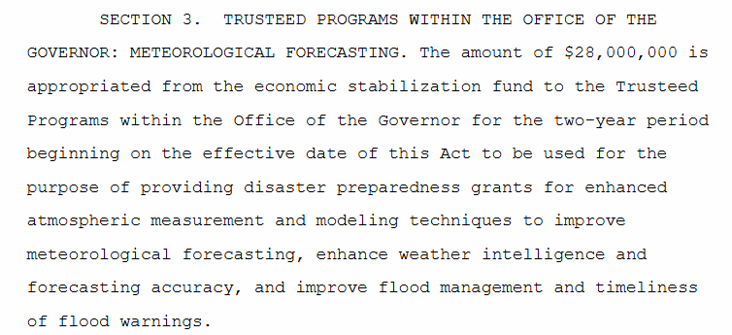
Senate Bill 5, passed by House and Senate
$28 million for improved meteorological forecasting and flood management
https://legiscan.com/TX/text/SB5/2025/X2

