Slide 1
FLOG/FIM Subcommittee Meeting, 7 June 2024
Agenda Items:
Geo-Intelligence Division FIM Development Updates (Derek Giardino and Jim Coll NWC)
Federal and state agency updates
RAS2FIM-2D (Andy Carter, UT Austin)

Slide 2
FLOG Meeting
Geo-Intelligence Division FIM Development Updates
June 7 2024

Slide 3
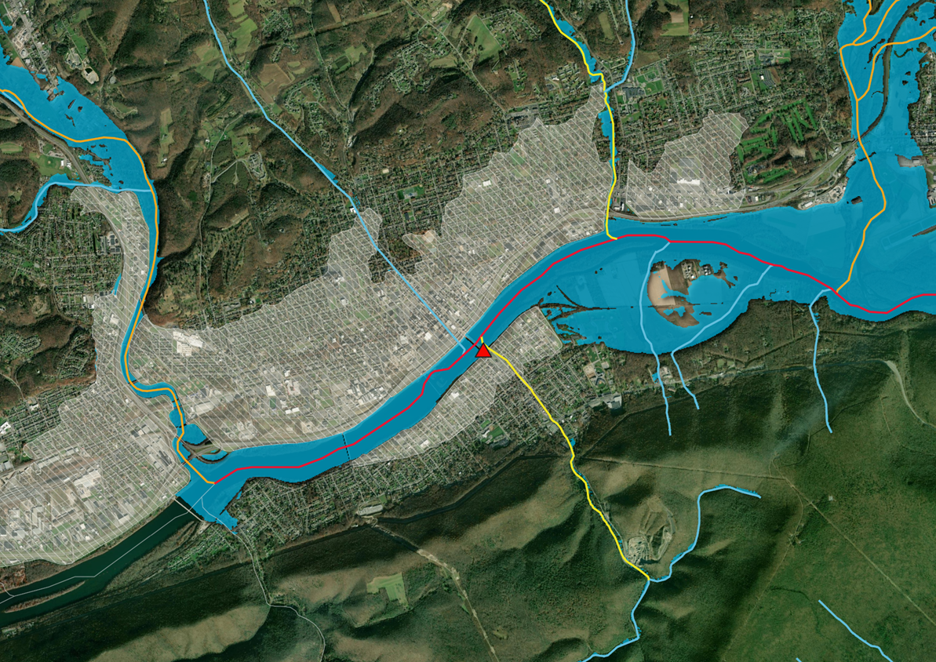
FIM v4.5
Levee-protected Areas
Tributary
Backpooling
Levee-protected area
Gages
Flow Direction
Bridges
Burned-in Streamlines
West Branch Susquehanna River at Williamsport (WILP1)

Slide 4
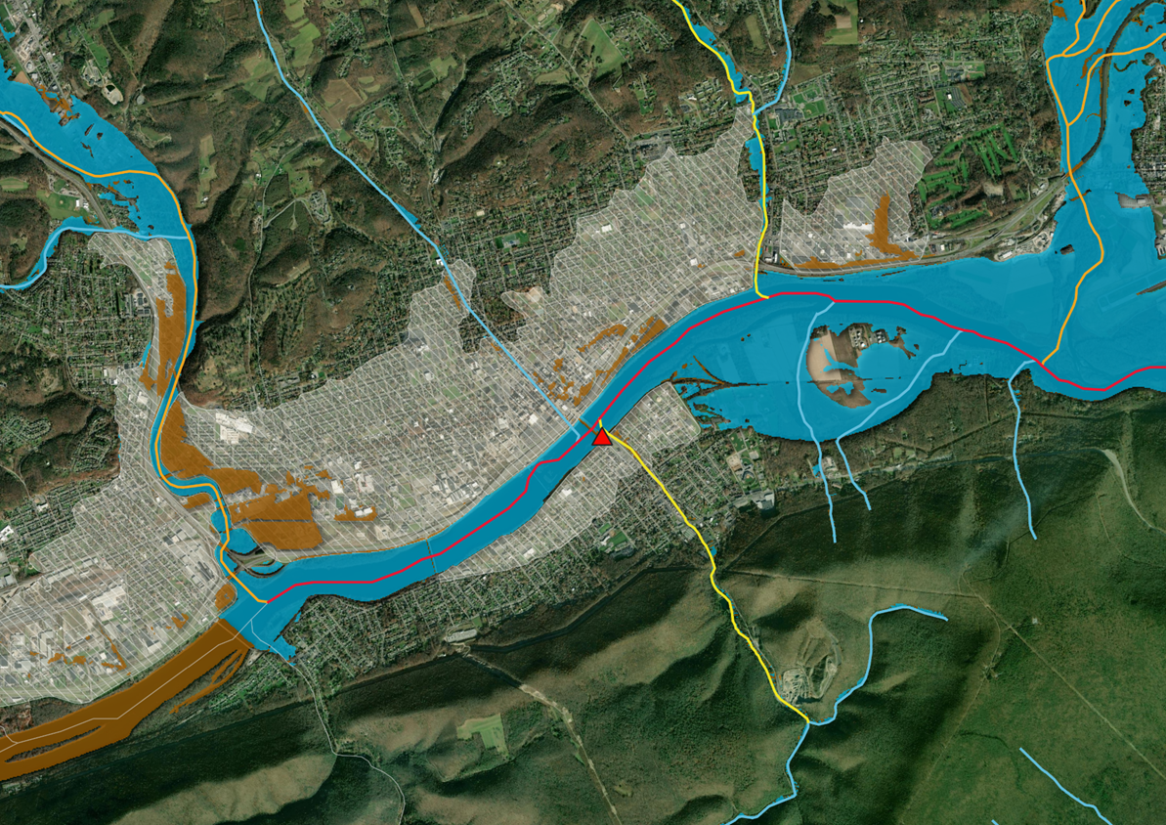
FIM v4.5
Levee-protected Areas
v4.4 inundation
Tributary
Backpooling
Levee-protected area
Gages
Bridges
Better levee-to-river assignment process means less inundation behind levees
Burned-in Streamlines

Slide 5
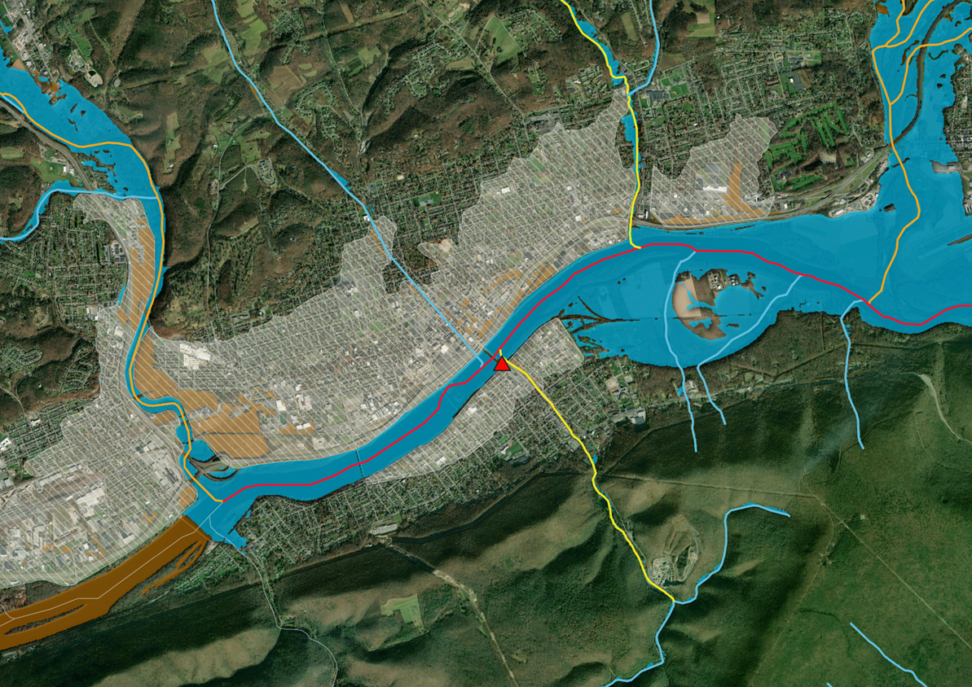
FIM v4.5
Levee-protected Areas
Tributary
Backpooling
Tributaries above High Water can longer produce FIM in mainstems that are not above High Water
Gages
Bridges
Flow Direction
Burned-in Streamlines
v4.4 inundation

Slide 6
FIM v4.5
SRC calibration now extends 5 miles* up-/down-stream from USGS gages instead of only in the gaged catchment
Levee-protected Areas
Tributary
Backpooling
Levee-protected area
Gages
Bridges
Burned-in Streamlines
* Calibration will stop before 5 mi if there is a stream order change

Slide 7
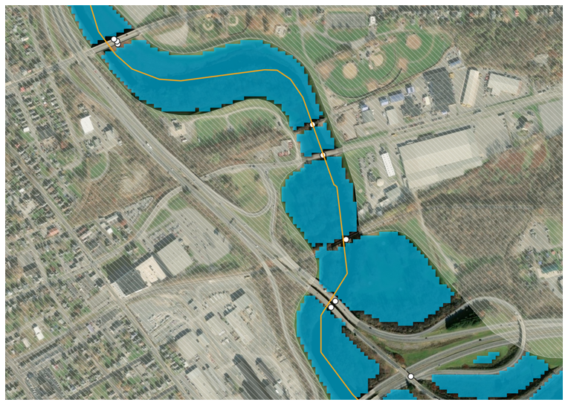
FIM v4.5
Levee-protected Areas
Crowd-sourced bridge lines from OpenStreetMap are being used to better represent bridges
Tributary
Backpooling
Levee-protected area
Gages
Bridges
Burned-in Streamlines

Slide 8
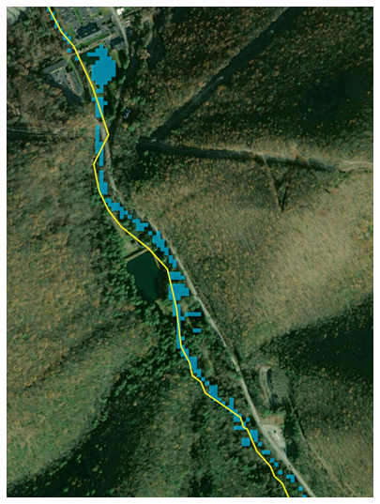
FIM v4.5
Levee-protected Areas
Tributary
Backpooling
Levee-protected area
Gages
Healing hydro-conditioning artifacts removes the burned-in effect for inaccurate channel placement and culverts
Bridges
Burned-in Streamlines

Slide 9
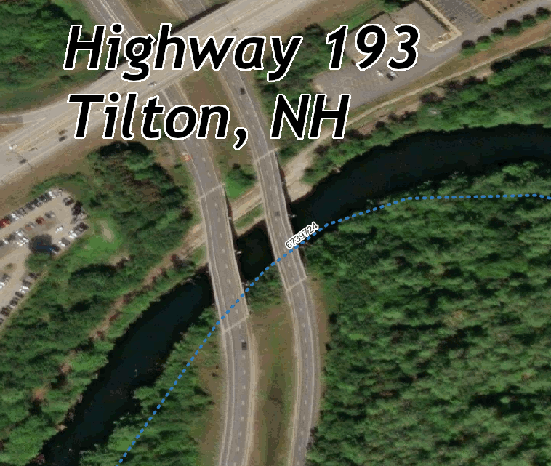
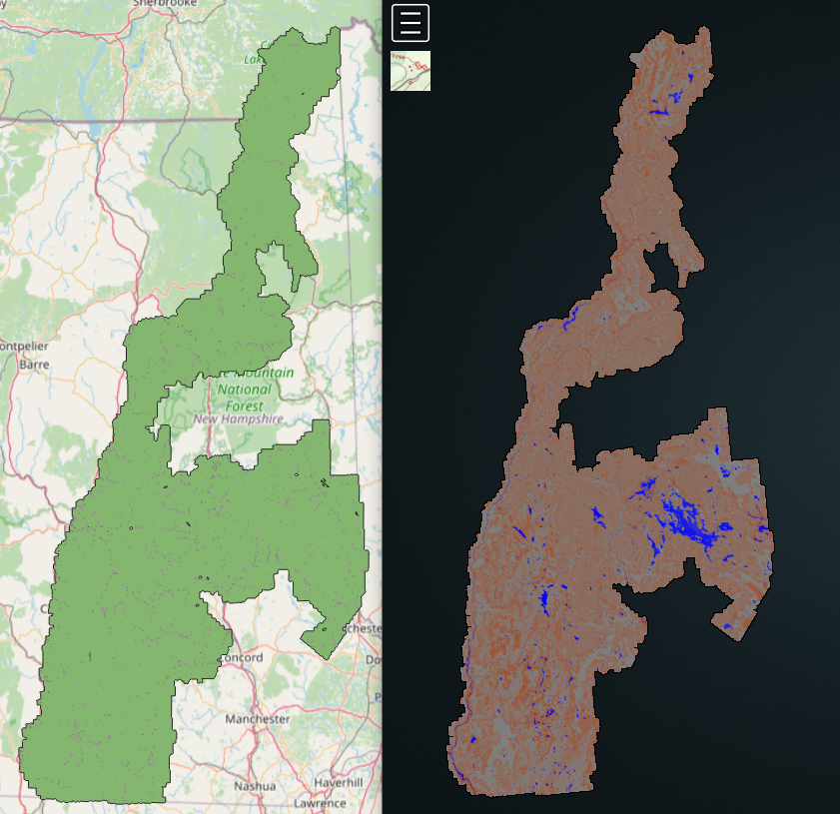
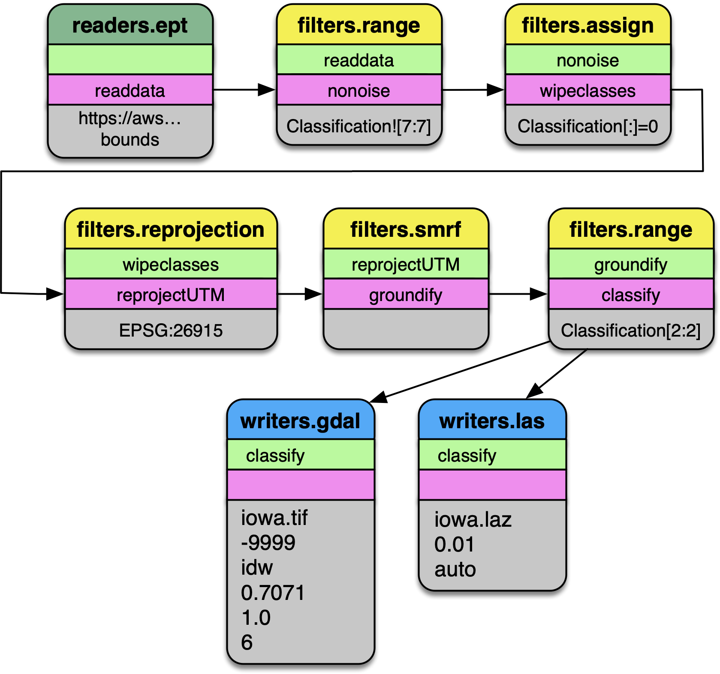
Bulk Classified LIDAR Healing
NBI informed and PDAL classified
3

Slide 10
Flood Organizing Group Flood Inundation Mapping Subcommittee (FLOG/FIM)
Andy Carter, PE
Senior Engineering Scientist, The University of Texas at Austin
RAS2FIM-2D

Slide 11
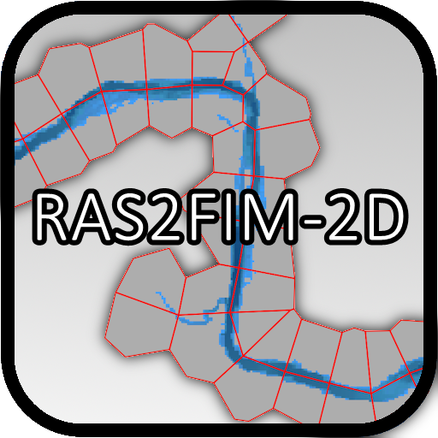
Flood Mapping Suite
2019-2021
2022-2023
2023-2024+

Slide 12
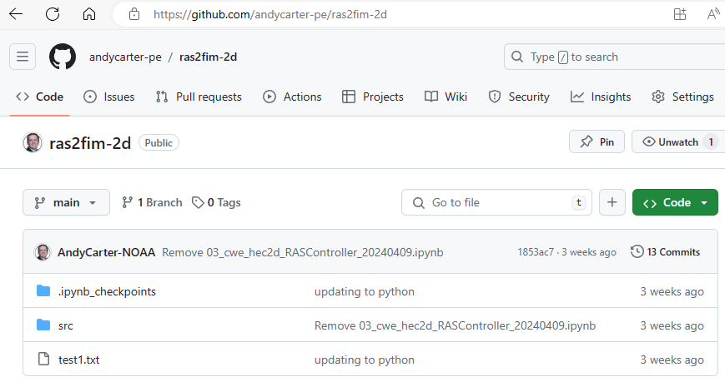
What is RAS2FIM-2D
GOAL: Utilize HEC-RAS 2-dimensional computational grid meshes to develop flood inundation products and corresponding synthetic rating curves for use in the National Water Prediction Service (NWPS)
Pair these data with the National Water Model for real-time flood warning and prediction.

Slide 13
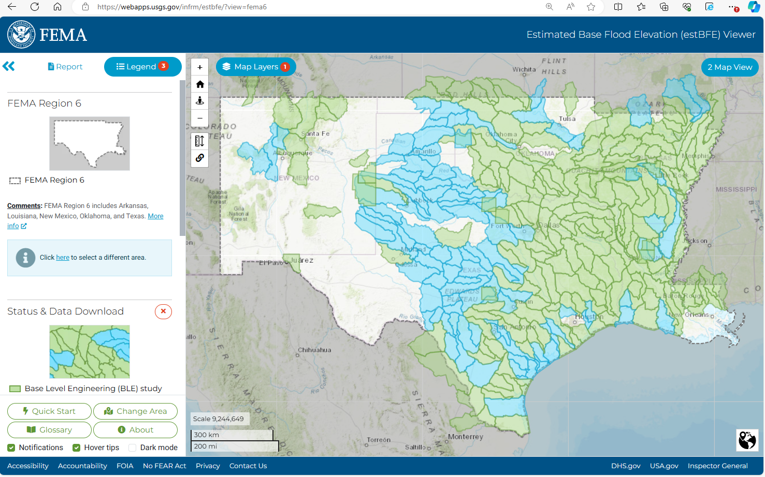
RAS2FIM-2D – $$ Millions $$ in Modeling

Slide 14
Needed Inputs
Global Inputs:
(1) NOAA’s NextGEN Hydrofrabic (geopackage)
(2) Method for determining peak discharge as function of drainage area (csv?)
Model Specific Inputs:
(3) HEC-RAS plan HDF with a 2D computational area
(4) HEC-RAS files used to “spawn” a run
- geometry file
- unsteady flow file
- unsteady plan file
(5) Terrain used to create HEC-RAS computational grid mesh

Slide 15
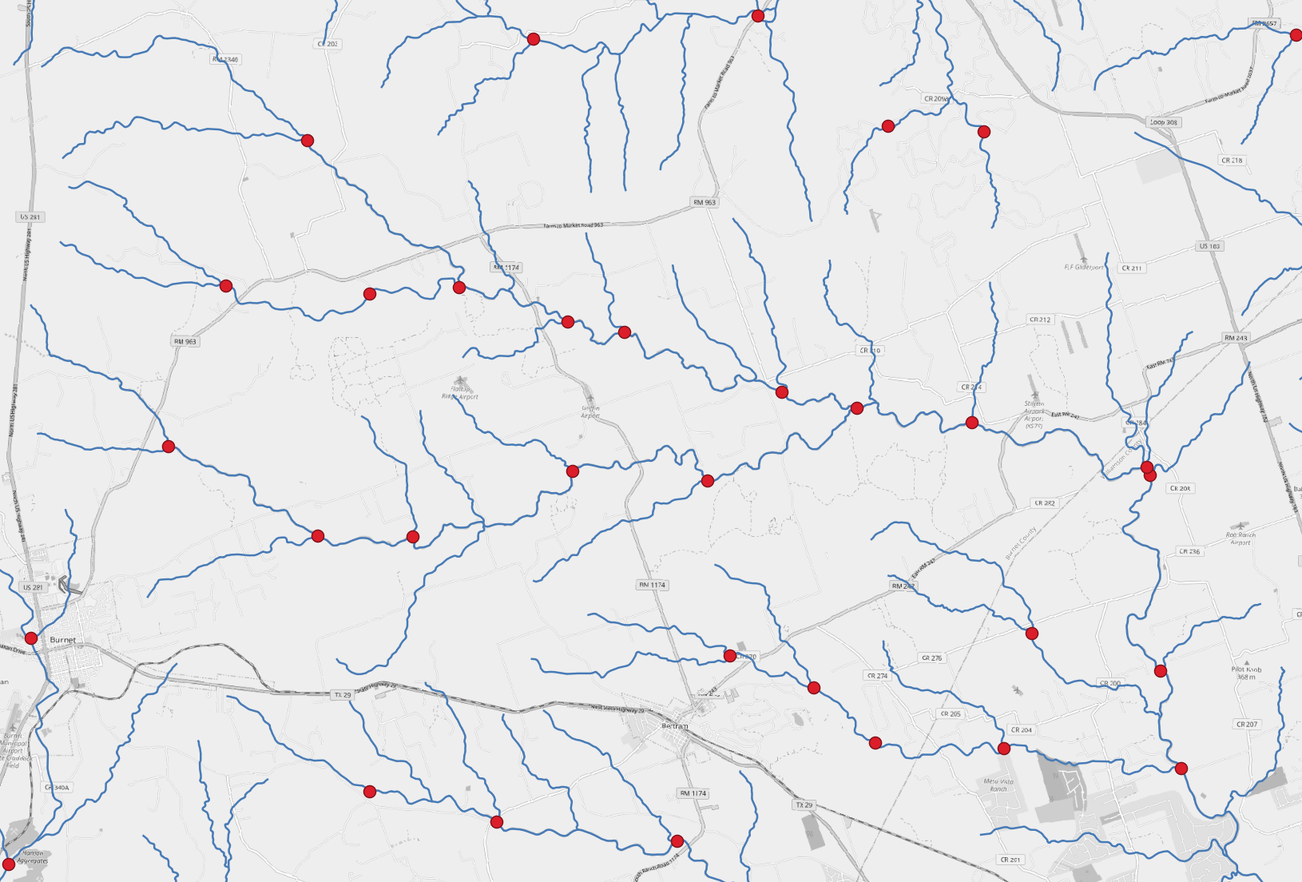
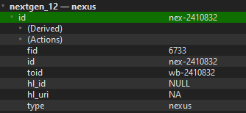
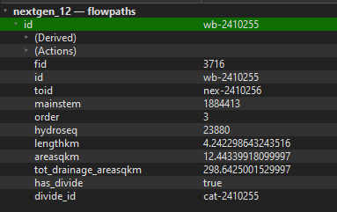
NextGEN Hydrofabric – Global Input (1)
Nexus Points
Flowpath Lines
https://lynker-spatial.s3-us-west-2.amazonaws.com/hydrofabric/v20.1/gpkg/nextgen_12.gpkg

Slide 16
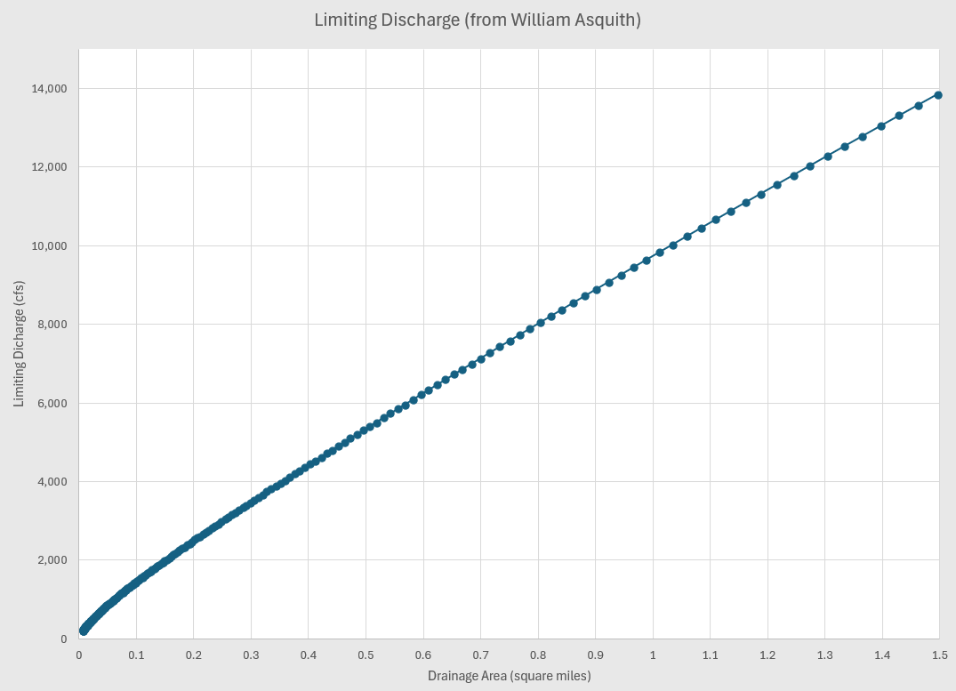
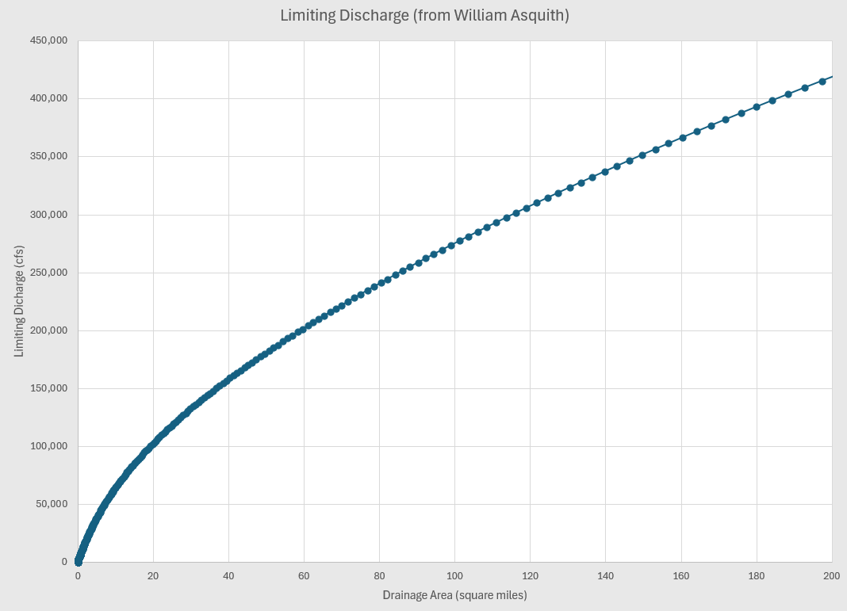
Limiting Discharge – Global Input (2)
Limiting Discharge (from William Asquith)
https://www.caee.utexas.edu/prof/maidment/StreamflowII/Data/LimitingDischarge.csv

Slide 17
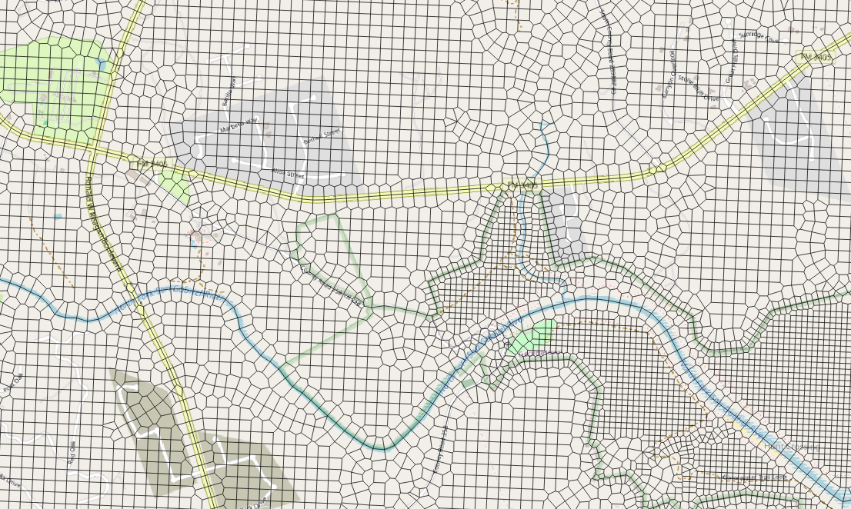
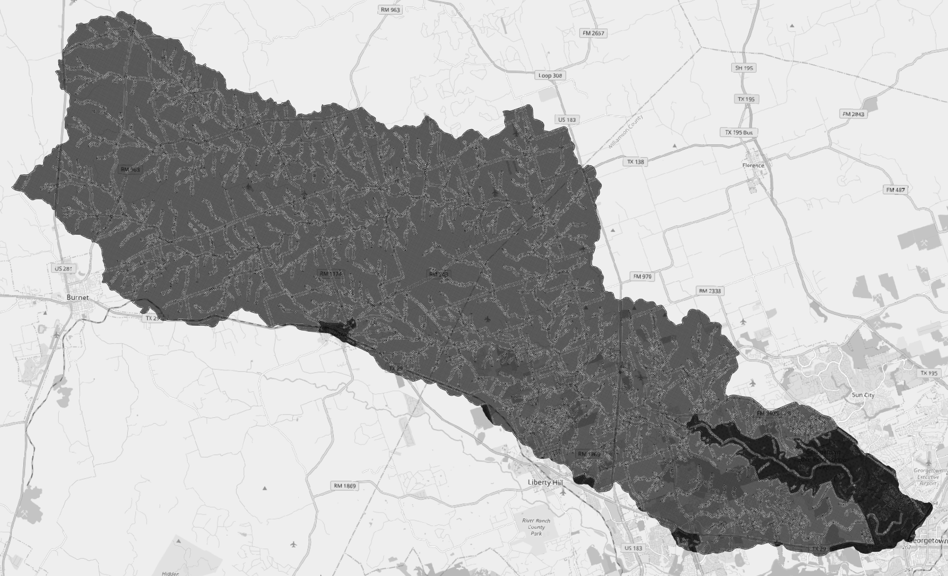
HEC-RAS Plan (HDF)– Local Input (3)
Example: HUC-10 from Base Level Engineering
- 200 foot cells with 100 foot cells in “urban areas”
- computational breaklines on road and rivers
- Mannings per NLCD
E:\HECRAS_2D_12070205\BLE_12070205_Engineering_Models\Engineering Models\Hydraulic Models\RAS_Submittal\LBSG_501\Input\BLE_LBSG_501.p02.hdf

Slide 18
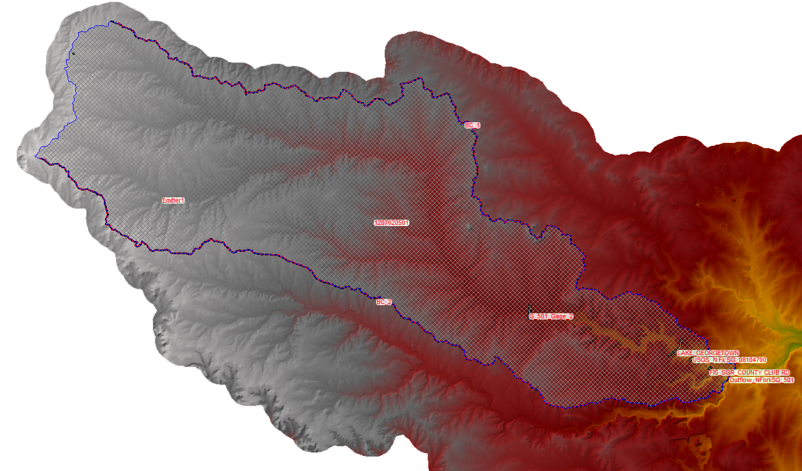
HEC-RAS Model - Local Inputs (4) & (5)
Geometry
gXX
Unsteady
Flow
uXX
Plan
pXX
Project (prj)
Model terrain
Remove the “Precipitation”
boundary condition and
any other “Inflows”
Create an Internal Boundary Condition (BC) Line
Anywhere within the 2D mesh… name it “Emitter”

Slide 19
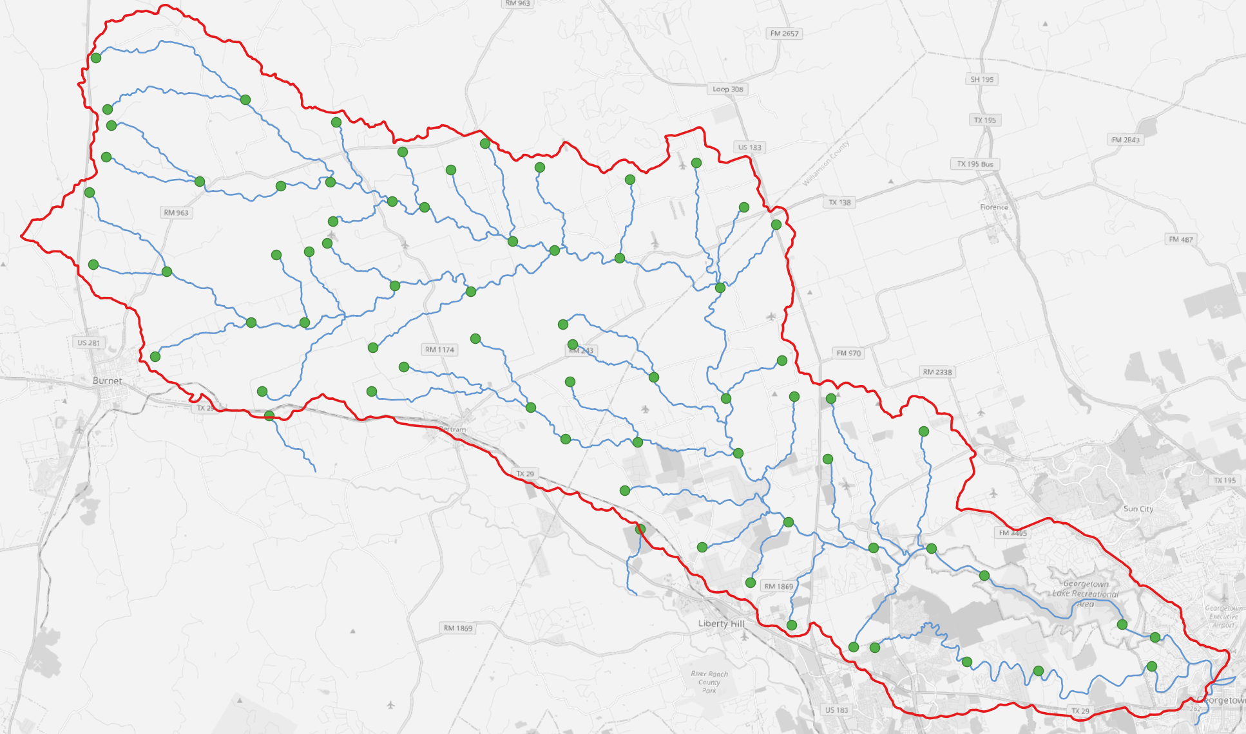
RAS2FIM-2D Steps - Determine NextGEN streams in 2D area
Nexus moved to upstream of “wb” stream.
Only network of streams moving through outflow boundary conditions are evaluated.
E:\ras2fim-2d-presentation\ras2fim_2d_prelim_20240425\model_hydrofabric.gpkg

Slide 20
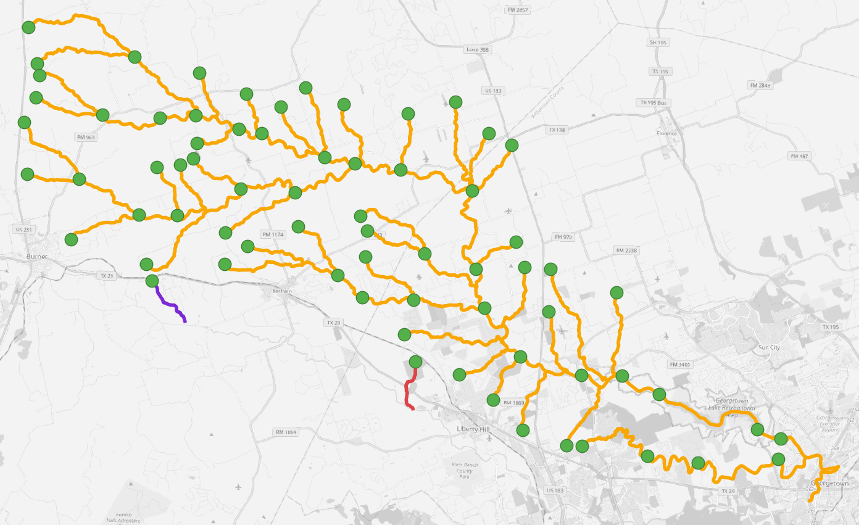
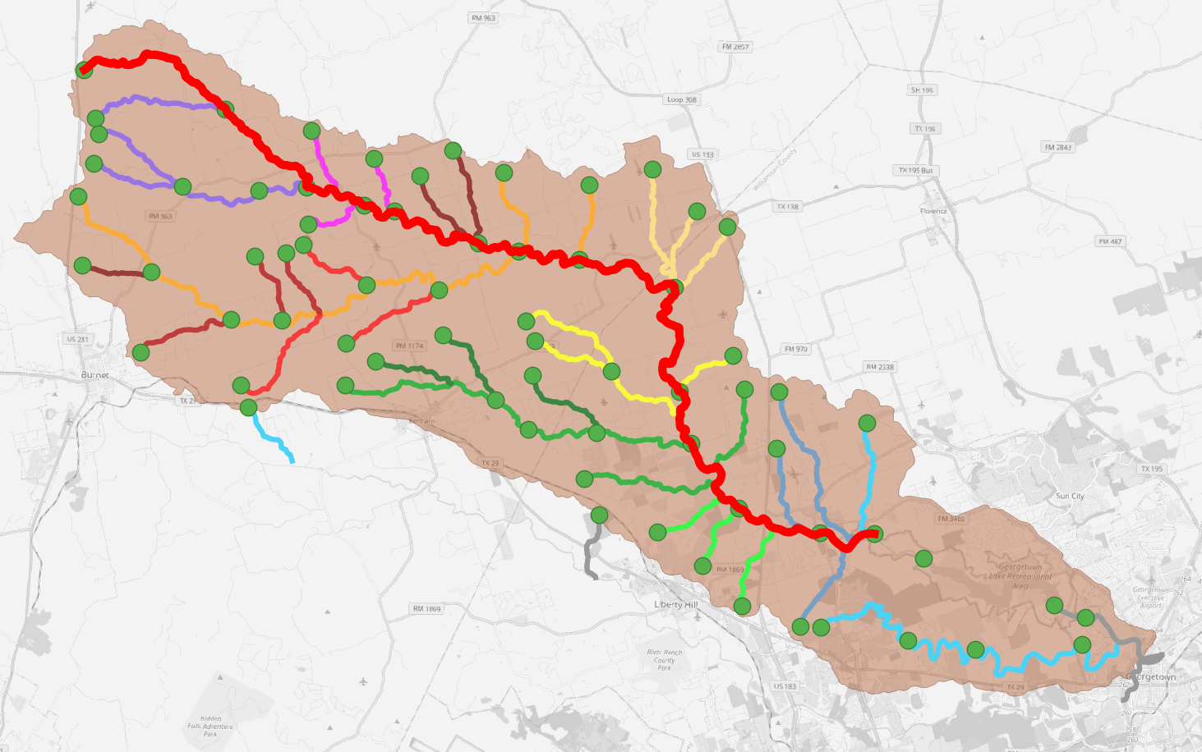
RAS2FIM-2D Steps - Mianstems
3 network groupings… does this network flow out of a boundary condition?
43 – mainstems
73 - flowpaths
Example shown is mainstem “184413”

Slide 21
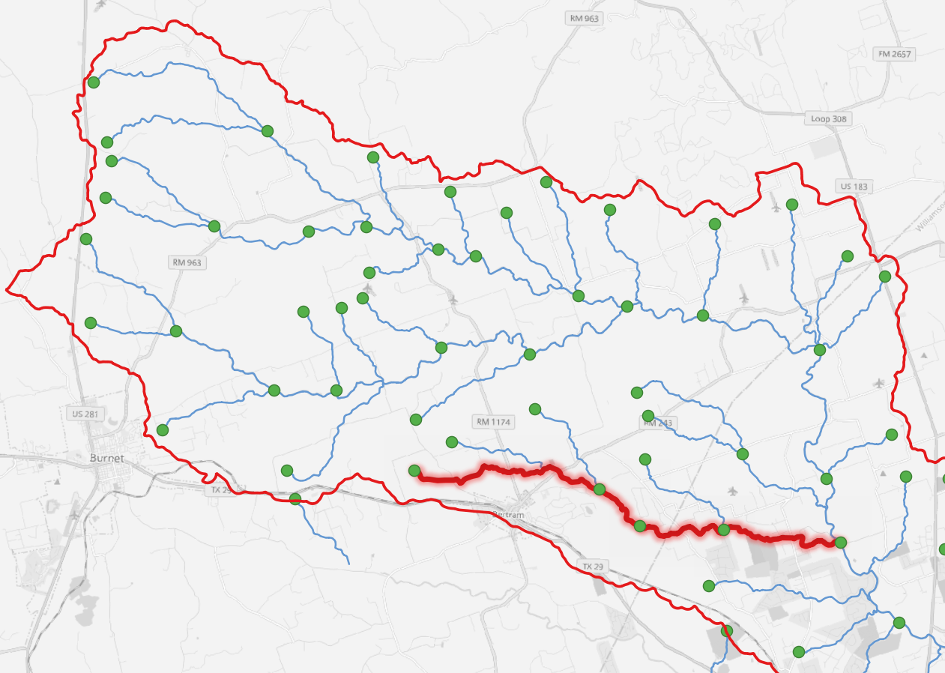
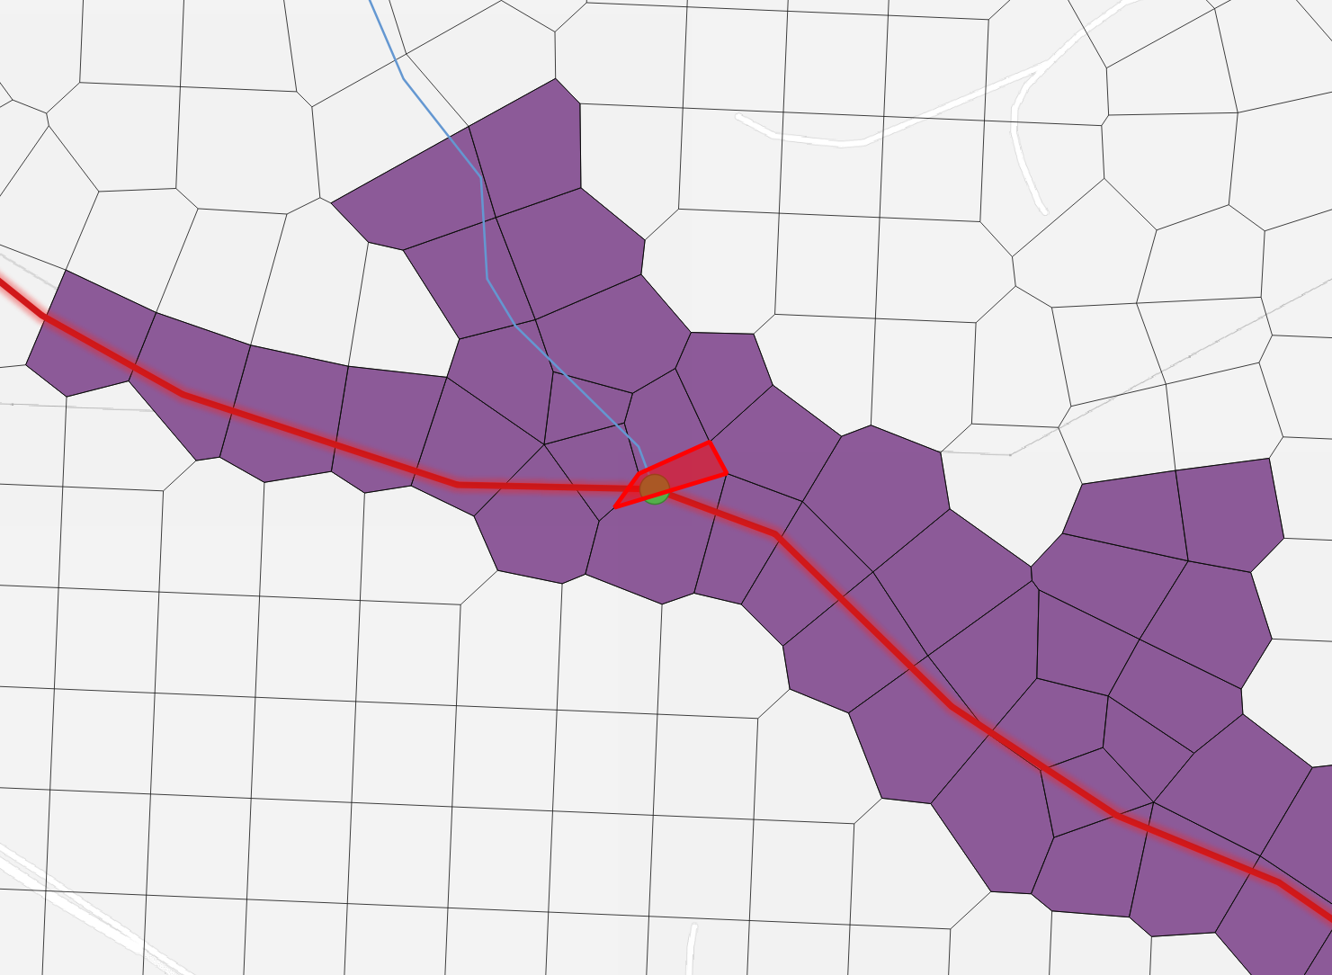
RAS2FIM-2D Steps - Determine NextGEN streams in 2D area
Mainstem “1884864” – starting at “wb-2410538”
This is cell “191552” within the HEC-RAS model
E:\ras2fim-2d-presentation\ras2fim_2d_prelim_20240425\model_hydrofabric.gpkg

Slide 22
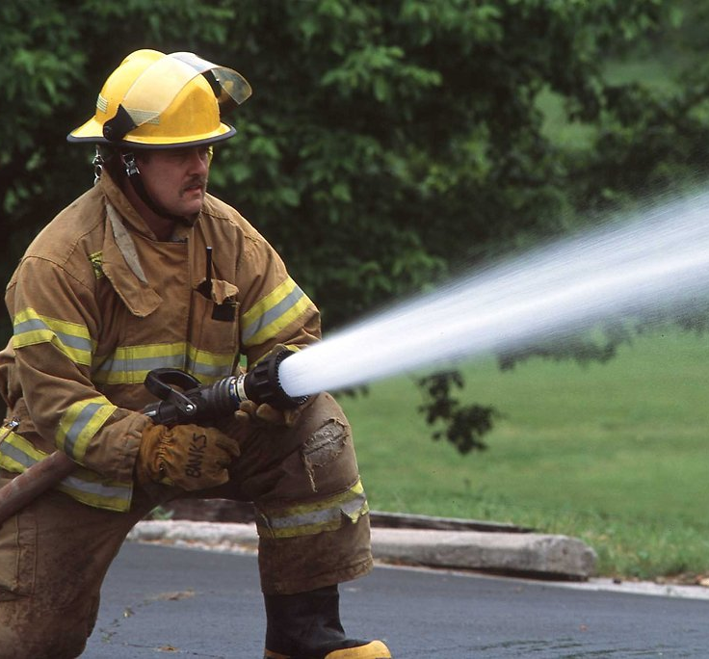
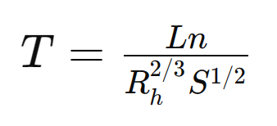
RAS2FIM-2D – How much flow? How Long?
Maximum Flow:
~ 15 square miles... on “wb-2410538”
Estimated Peak Flow:
Asquith limiting discharge is 85,000 cfs… so 30% is 25,500 cfs
Minimum Flow … say 500 cfs
How long for water to flow from “emitter” to outlet of mainstem?
About 7 miles
1

Slide 23
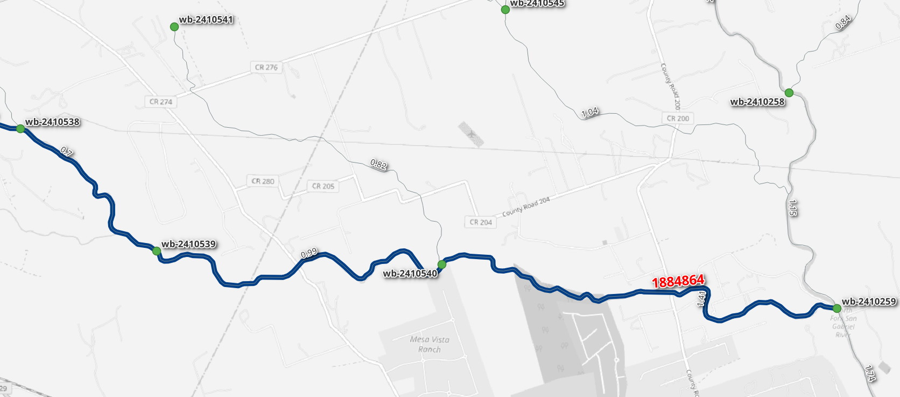
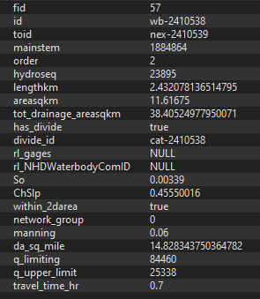
Low Flow Travel Time Estimate: Example
1
“wb-2410538”
L = 2.43 km
n = 0.060
S = 0.00339 (0.33%)
T = 2,504 sec
T = 0.7 hr
“wb-2410539”
L = 4.21 km
n = 0.060
S = 0.00503 (0.50%)
T = 3,561 sec
T = 0.99 hr
“wb-2410540”
L = 5.59 km
n = 0.060
S = 0.00432 (0.43%)
T = 5,103 sec
T = 1.41 hr
Estimated low flow travel time=
0.7 + 0.99 + 1.41 =
3.1 hr

Slide 24
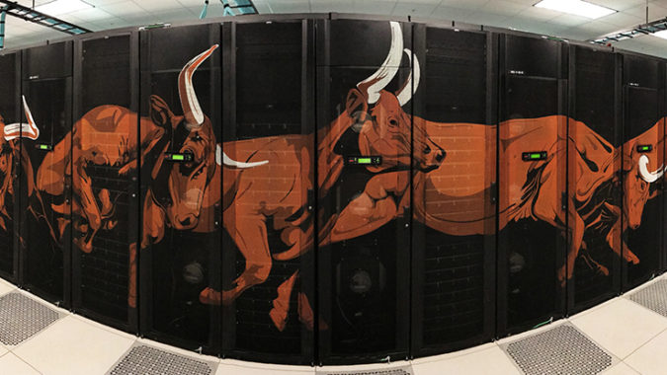
RAS2FIM-2D – Running the Model
Working Plan Name:
1884413_wb-2410249_wb-2410261_30-hr_500-cfs_to_3000-cfs_step_600-cfs_plan
Geometry
gXX
Unsteady
Flow
uXX
Plan
pXX
Stampede3
HEC-RAS Windows API to create cXX and bXX for the run
(in blocking model)
Run this configuration on Linux version of HEC-RAS (v6.1)
bXX (text file tied to plan)?
cXX (binary file tied to geometry)?
HEC-RAS Plan HDF5 file

Slide 25
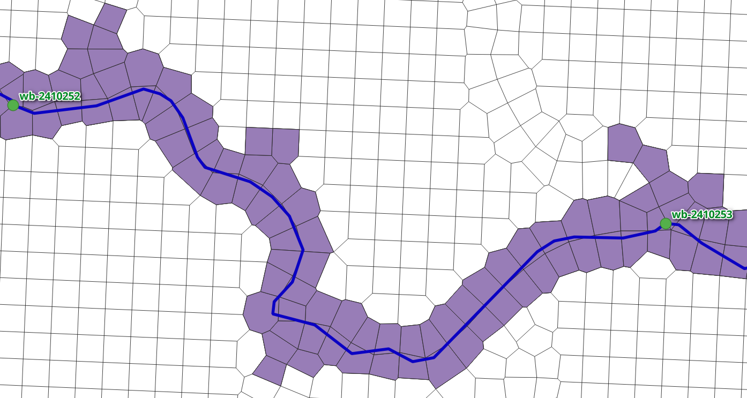
RAS2FIM-2D – Wet Cells
Working Plan Name:
1884413_wb-2410249_wb-2410261_30-hr_500-cfs_to_3000-cfs_step_600-cfs_plan
HEC-RAS Plan HDF5 file
If WSEL > Minimum elevation … cell in grid mesh is “wet”
E:\HECRAS_2D_12070205\base_model_20240414_copy\BLE_LBSG_501.p23.hdf
/Results/Unsteady/Output/Output Blocks/Base Output/Unsteady Time Series/2D Flow Areas/1207020501/Water Surface
180 hours x 220,317 cells (39.6 million values)
/Geometry/2D Flow Areas/1207020501/Cells Minimum Elevation
220,317 cells

Slide 26
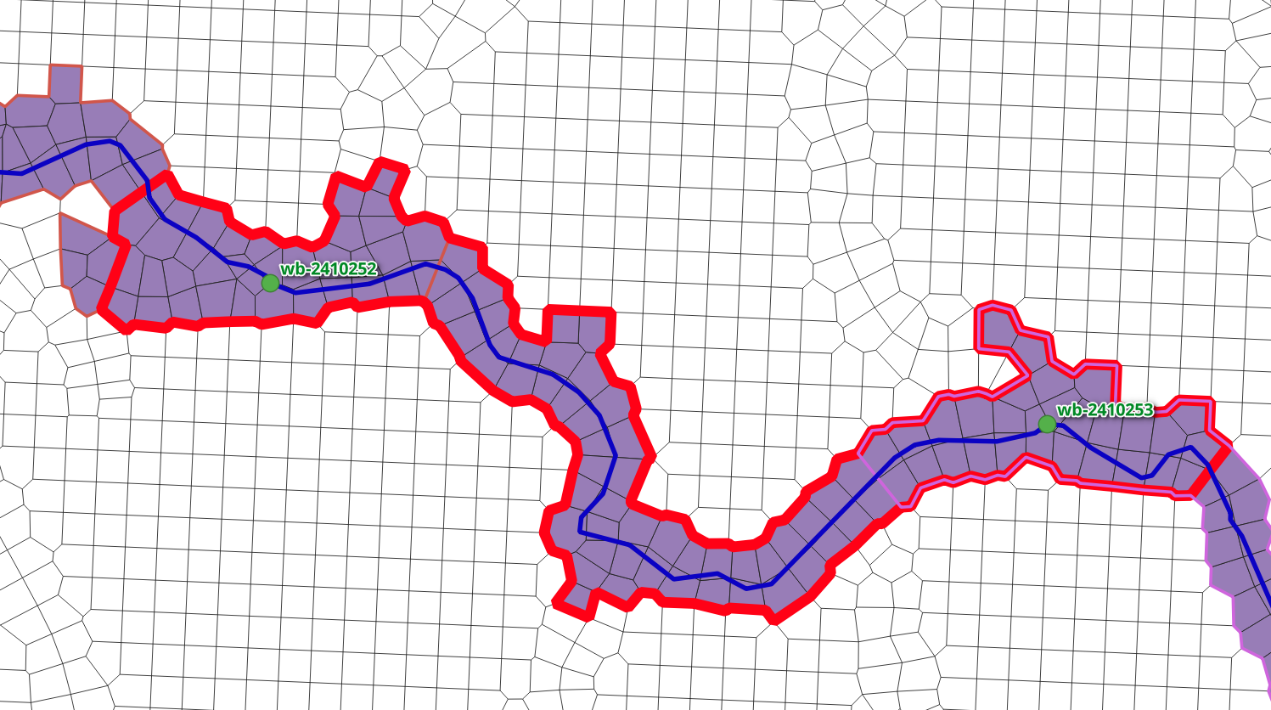
RAS2FIM-2D – Grouping Wet Cells
For each “wet” cell in a mainstem run, determine the nearest ‘flowpath’. Buffer these groupings {5} cells
5
4
3
2
1
1
2
3
4
5

Slide 27
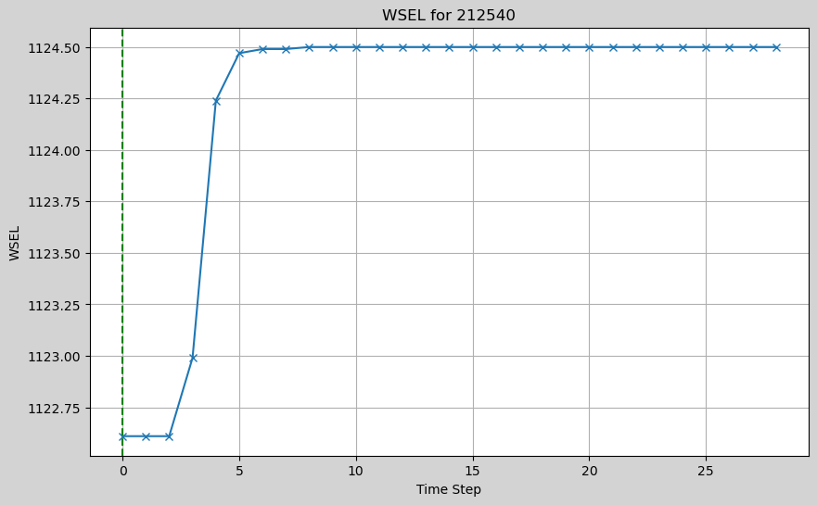
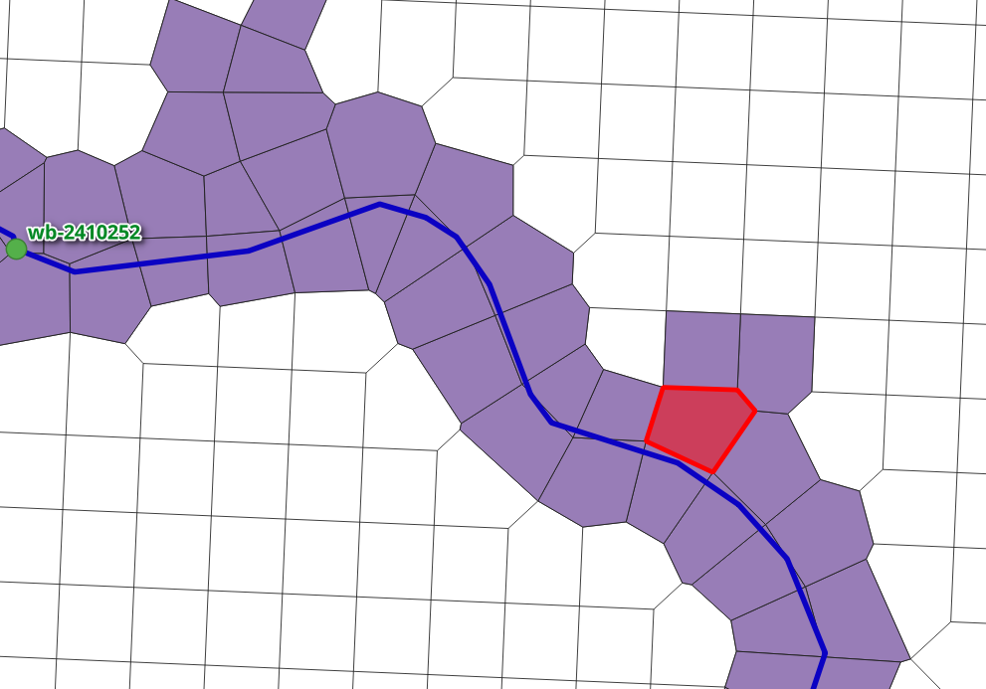
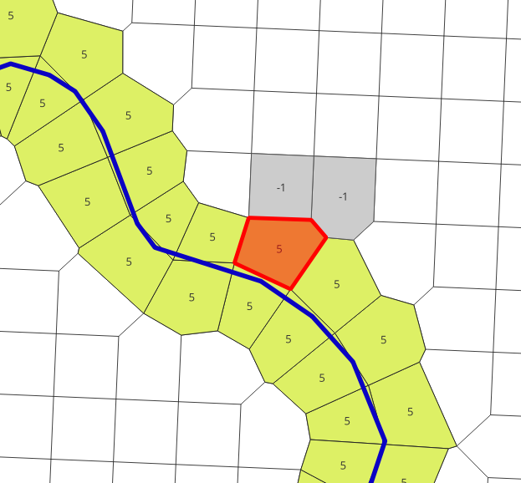
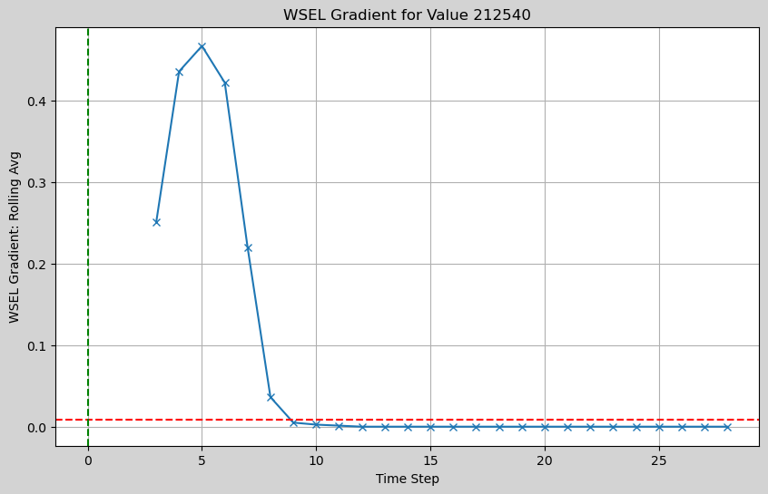
RAS2FIM-2D – Determine “Stable” cells
Water Surface Elevation of
cell for 30 hours
212540
Stable at hour 9
(9-{4}) = 5 hr to stable
Rolling Average Gradient
{4} hours
Minimum passable gradient = 0.009

Slide 28
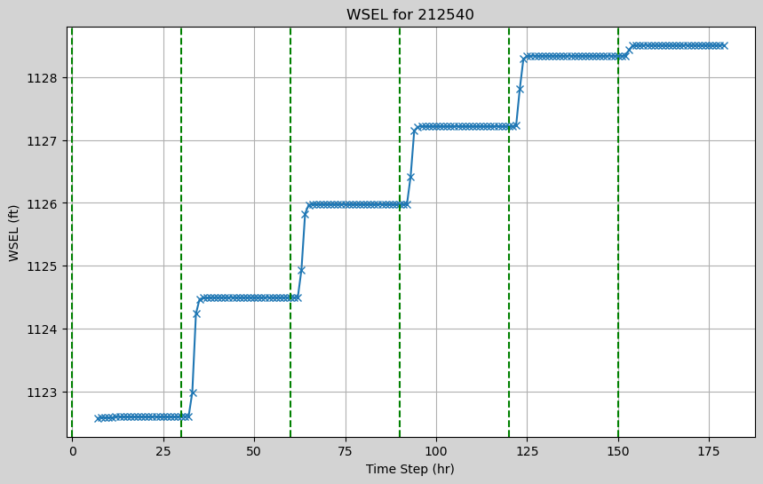
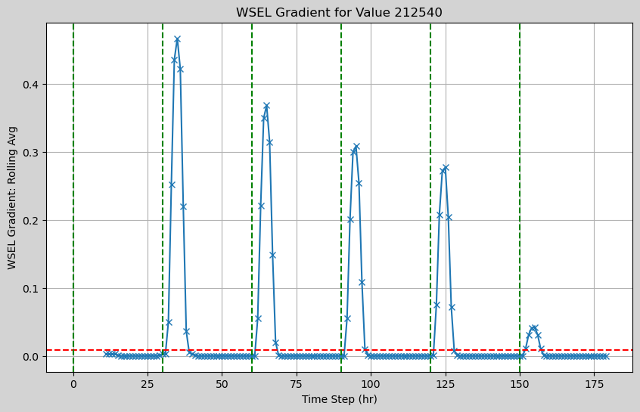
RAS2FIM-2D – Stepped Firehose
500 cfs
1100 cfs
1700 cfs
2300 cfs
2900 cfs
3000 cfs
About 12 miles downstream of “Emitter”
Water Surface Elevation of
cell for 30 hours (6 steps)
212540
First “wet” hour = 7
Rolling Average Gradient
{4} hours
Working Plan Name:
1884413_wb-2410249_wb-2410261_30-hr_500-cfs_to_3000-cfs_step_600-cfs_plan
Flows: 500,1100,1700,2300,2900,3000 (cfs)
Computed Low Flow Travel Speed = ~2.5 ft/sec
Minimum passable gradient = 0.009

Slide 29
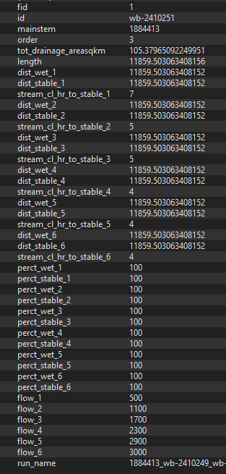
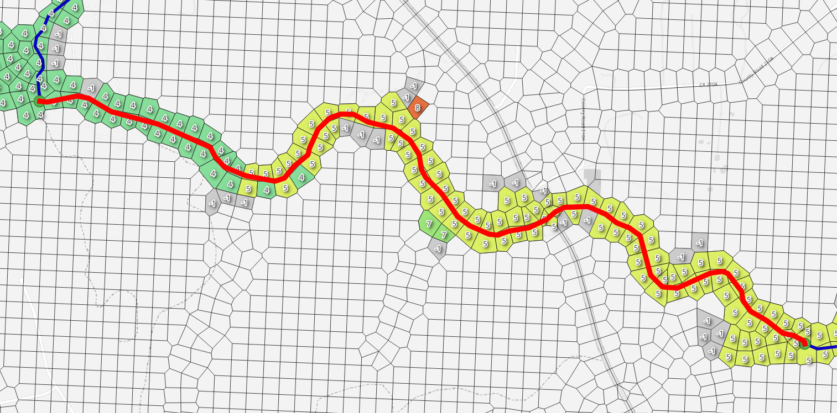
RAS2FIM-2D – Stream Analysis per flow in a “run”
NextGEN id = “wb-2410251
Mainstem = 1884413
Step on firehose = 2
Flow = 1100 cfs
Numbers in cell reflect hours to stable for that flow
Working Plan Name:
1884413_wb-2410249_wb-2410261_30-hr_500-cfs_to_3000-cfs_step_600-cfs_plan

Slide 30
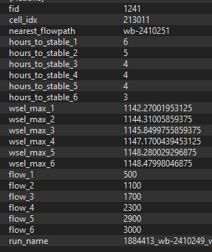
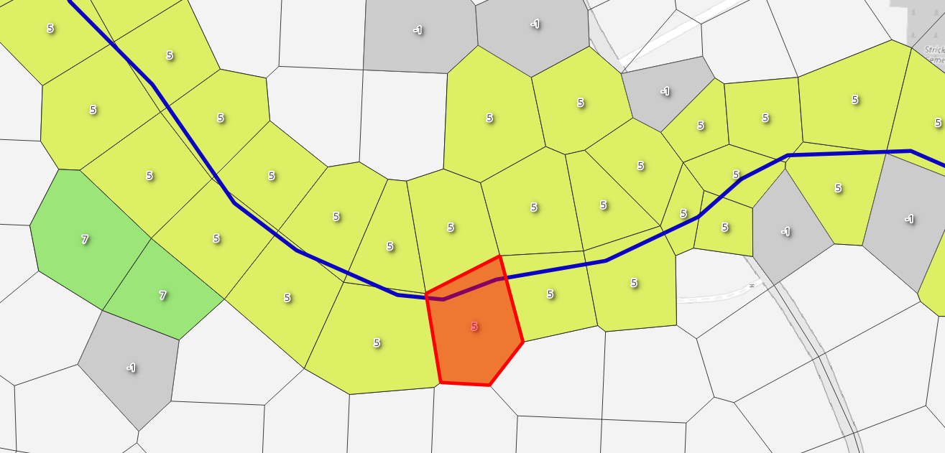
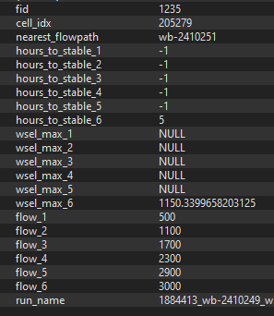
RAS2FIM-2D – Cell values per run
NextGEN id = “wb-2410251
Mainstem = 1884413
Step on firehose = 2
Flow = 1100 cfs
Numbers in cell reflect hours to stable for that flow
Working Plan Name:
1884413_wb-2410249_wb-2410261_30-hr_500-cfs_to_3000-cfs_step_600-cfs_plan

Slide 31
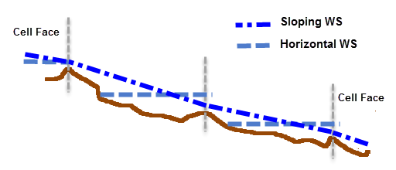
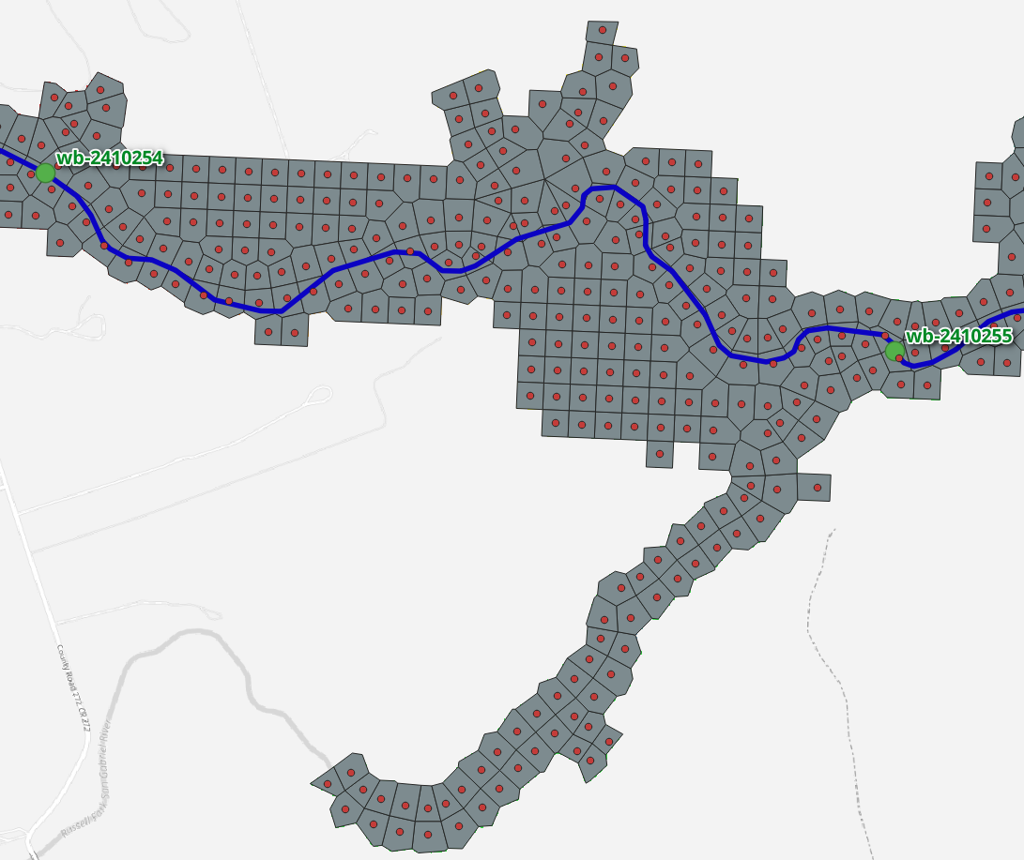
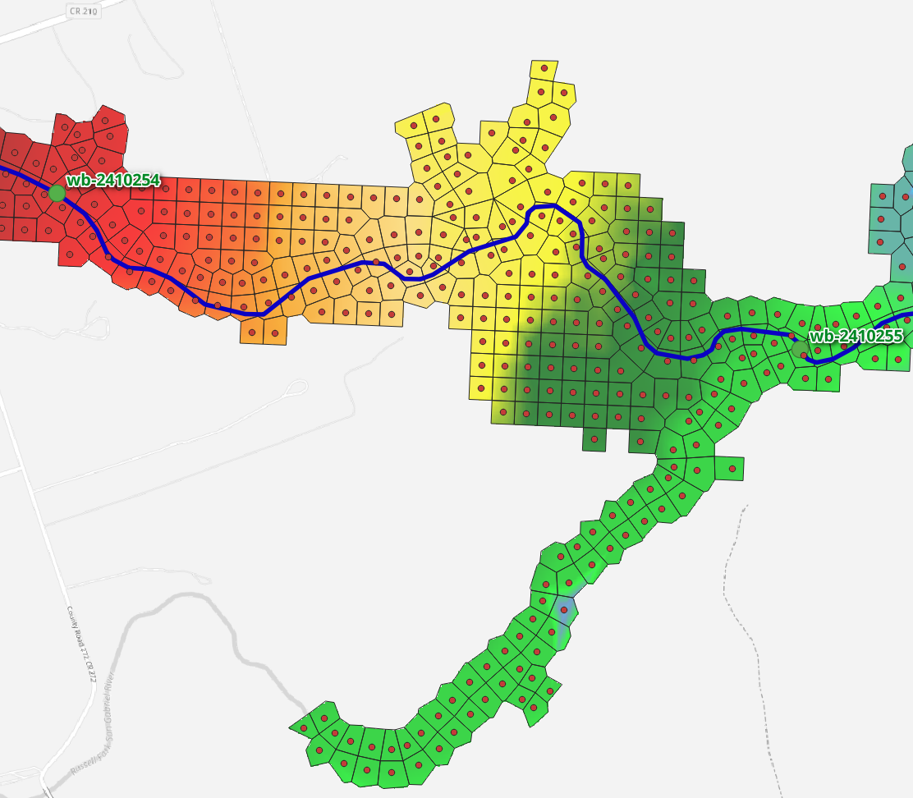
RAS2FIM-2D – Raster Engine
In Plan HDF:
/Geometry/2D Flow Areas/1207020501/Cells Center Coordinate
Each “wet” cell has a WSEL assigned to the cells “center coordinate”
WSEL raster (bi-linear interpolation) … masked to “wet” cells
WSEL Raster is aligned to Terrain DEM (same resolution)
Working Plan Name:
1884413_wb-2410249_wb-2410261_29-hr_14100-cfs_plan

Slide 32
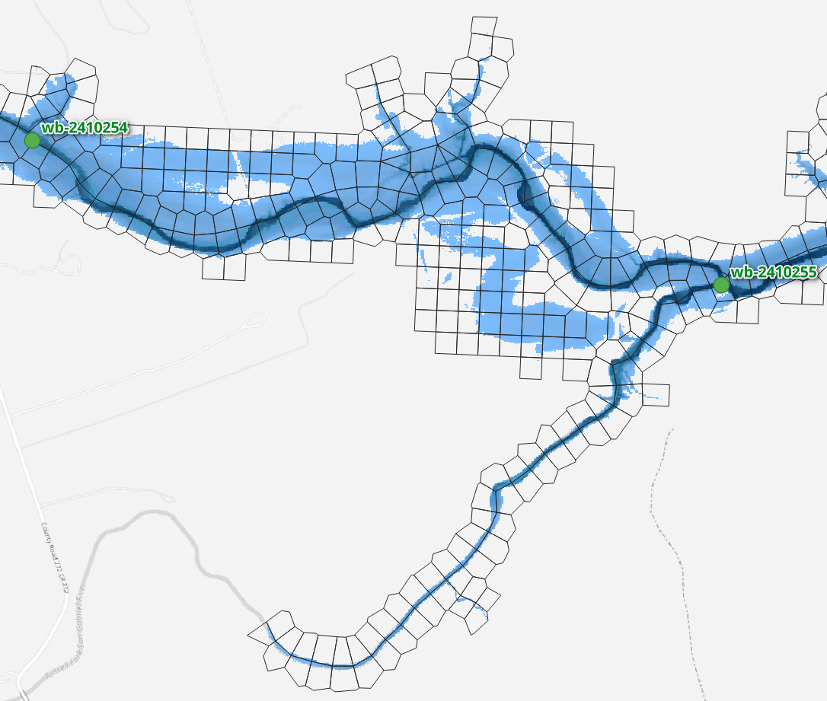
RAS2FIM-2D – Depth and WSEL Rasters
“High Resolution Subgrid Model”
WSEL raster (bi-linear interpolation) … masked to “wet” cells
WSEL Raster is aligned to Terrain DEM (same resolution)
Depth and WSEL Rasters
Working Plan Name:
1884413_wb-2410249_wb-2410261_29-hr_14100-cfs_plan

Slide 33
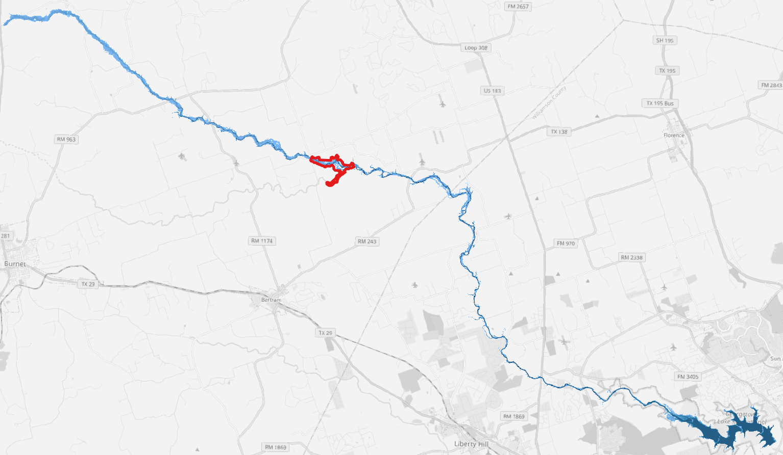
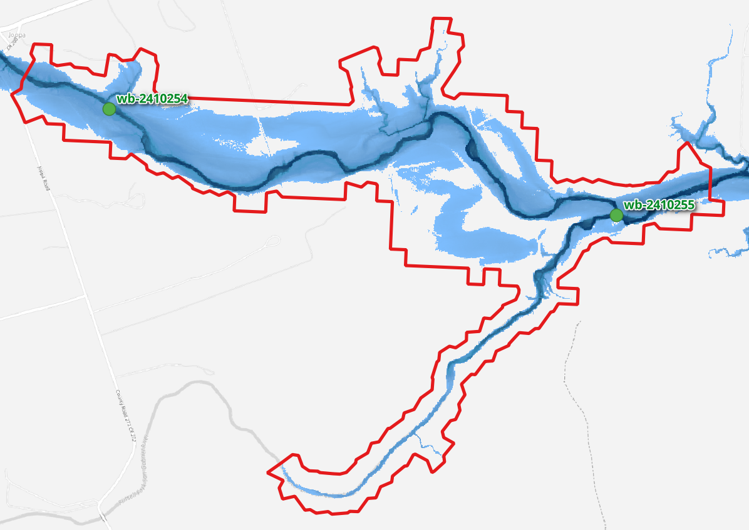
RAS2FIM-2D – Depth and WSEL Rasters
18 “flowpaths” in this mainstem run
~40 mile run
29 hour “firehose”
Mainstem = 1884413
Emitter at “wb-241029”
Wet cell grouping polygon for flowpath “wb-2410254” @ 14,100 cfs
Working Plan Name:
1884413_wb-2410249_wb-2410261_29-hr_14100-cfs_plan

Slide 34
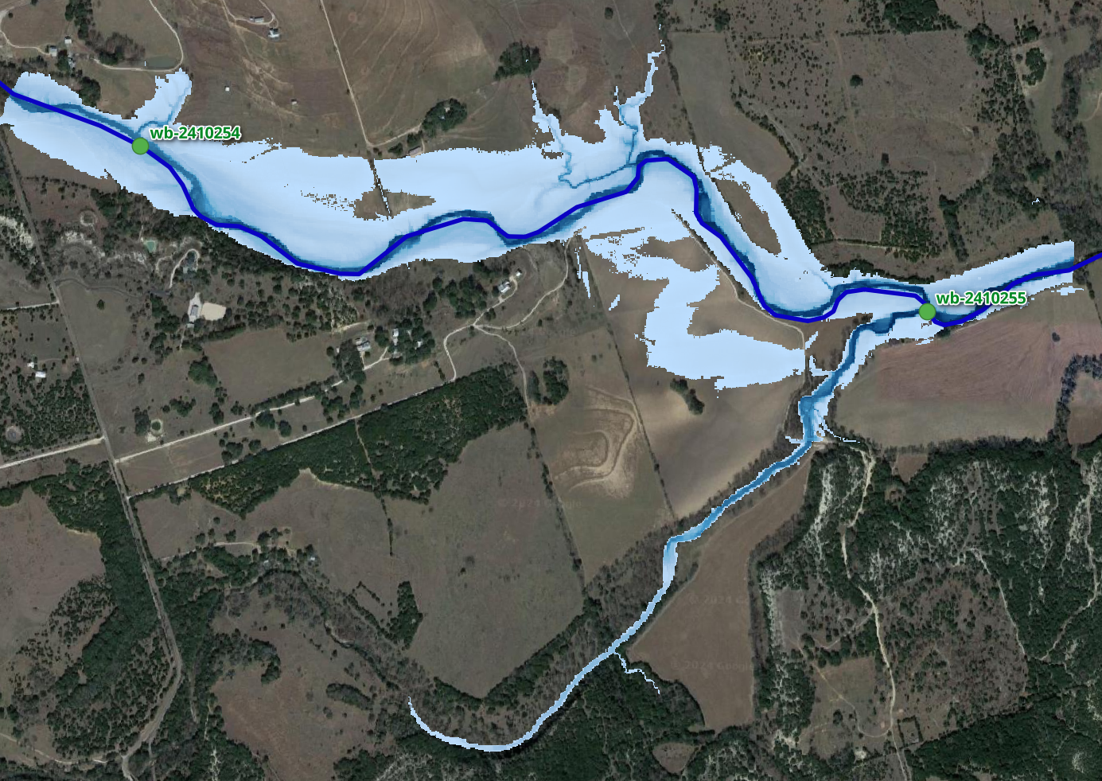
RAS2FIM-2D – Depth and WSEL Rasters
Example Pixel:
WSEL = 10465 = 1,046.5 ft
Depth = 79 = 7.9 ft
For Q = 14,100 cfs
Depth:
Unsigned 16-bit Integer
3m x 3m grid
EPSG:3857
148 KB
“depth_wb-2410254_14100.tif”
WSEL:
Signed 32-bit Integer
3m x 3m grid
EPSG:3857
325 KB
“wsel_wb-2410254_14100.tif”
Working Plan Name:
1884413_wb-2410249_wb-2410261_29-hr_14100-cfs_plan

Slide 35
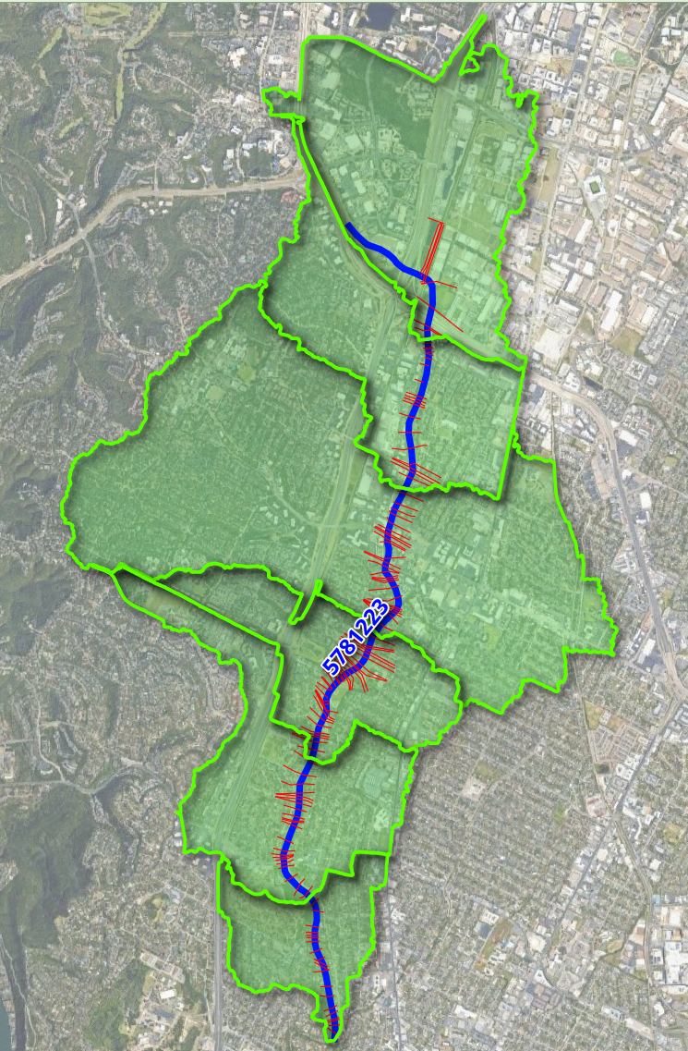
RAS2FIM - Overestimating Stream Order 1 Floodplains
For headwater streams characterized by a Strahler stream order of 1, flood inundation mapping is traditionally generated using a constant flow down the entire reach.
This approach tends to overestimate flooding at the upstream end.
% of Total
Flow to Emit
Drainage Area = 1.55 sq mi
(1.55/8.27) = 19%
19%
Drainage Area = 2.67 sq mi
(2.67/8.27) = 32%
Using the 30m “Flow Accumulation Grid” for CONUS, determine multiple “Emitters” locations and ratio rates.
13%
Drainage Area = 5.88 sq mi
(5.88/8.27) = 71%
39%
Drainage Area = 6.67 sq mi
(6.67/8.27) = 81%
10%
Drainage Area = 7.77 sq mi
(7.77/8.27) = 94%
13%
Drainage Area = 8.27 sq mi
(8.27/8.27) = 100%
6%
Total = 100%
National Water Model flow forecast point

Slide 36
Output

Slide 37
Output
From multiple “runs” with a range of “stable” flows, a synthetic rating curve can be extracted at either a HEC-RAS 2D “cell” or a FIM pixel
Depth and WSEL Rasters as geotiff

Slide 38
Summary Workflow
Get HEC-RAS model with 2D Area
Determine streams within network:
Calculate peak flows and estimated travel times
Prepare HEC-RAS model:
Remove precipitation and add “Emitter(s)”
Create and Run HEC-RAS Mainstem Models
Low Flow Model to determine travel times
Create and Run HEC-RAS “Stepped Firehose” Models
At each nexus on mainstem run to peak discharge
Map floodplain (Depth and WSEL)
And generate “run” output geopackage
Aggregate “run” data
Spatial database of Rating curves and FIM Rasters

