Slide 1



Developing Future Rainfall Frequency Grids for the State of Texas: TxRAIN
John Nielsen-Gammon and William Baule – Texas A&M University, College Station
James Doss-Gollin and Yuchen Lu – Rice University
Srikanth Koka, Rewati Niraula and Saul Nuccitelli – (TWDB)* -
But not responsible for the content of this presentation

Slide 2
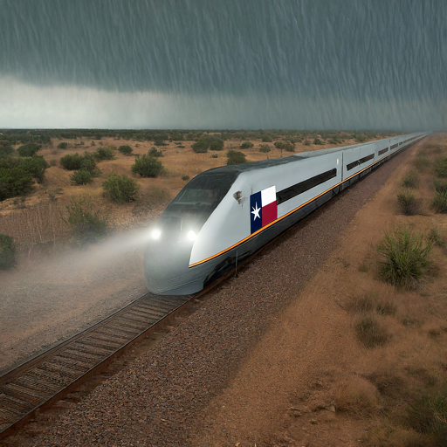
Project Overview
Develop projected future rainfall frequency grids for Texas by incorporating information from historic trends and climate model projections.
Improvements to existing NOAA Atlas 14 data.
Gap filler between Altas 14 and Atlas 15.
Alternative approach to Atlas 15.
Products can be utilized for future flood
mapping, planning, hydraulic infrastructure
design projects, and flood mitigation efforts.

Slide 3
Coming: NOAA Atlas 15
Volume 1: Regional Frequency Analysis including nonstationarity
Volume 2: Projections
Issues with NOAA Atlas 15:
  RFA includes same spatial footprint for all moments
    Higher-order moments require larger sample size
  Separate treatment of historical trends and future projection
    Observed trends inform our knowledge of future trends (are models accurate?)
    Model projections inform our knowledge of current trends (is history noisy?)

Slide 4
Coming Sooner: TxRAIN
(Texas Rainfall Analysis Incorporating Nonstationarity)
Sponsor: Texas Water Development Board
Foundation: NOAA Atlas 14 data
Additional data
  Longer period of record, shorter durations
Spatial statistics
  No regionalization; automatic consistency across durations
Climate model projections
Merged analysis of nonstationarity
Techniques and results may improve NOAA Atlas 15

Slide 5
Project Team
Core Research Team | Research Review Panel Members | TWDB Project Team
John Nielsen-Gammon Texas A&M University | Andy Yung Walter P Moore | Saul Nuccitelli*
James Doss-Gollin Rice University | Blake C. Kronkosky StateTech Engineering | Srikanth Koka
William J Baule Texas A&M University | Todd Ward Harris County Flood Control District | Rewati Niraula**
Yuchen Lu Rice University
*Leaving team **Left team
Additional review from subject matter experts from federal agencies like NOAA, USGS and USACE will be requested and addressed before the final report and data is shared for public use.

Slide 6
Project Timeline
Project Initiation: Fall 2022
Project Draft Report: Fall/Winter, 2024
Final Report and Data Dissemination: Spring/Summer 2025

Slide 7
Data
NOAA Atlas 14
Global Historical Climatology Network – Daily
United States Climate Reference Network – 5-minute
Cooperative Network – Hourly
Automated Surface Observing System – 5-minute
Jefferson County Drainage District 6 – 5-minute
Harris County Flood Control Network – 5-minute
Oklahoma Mesonet – 5-minute
West Texas Mesonet – 5-minute

Slide 8
Quality Control
Outlandishly small numbers
Outlandishly large numbers
Statistically weird storms

Slide 9
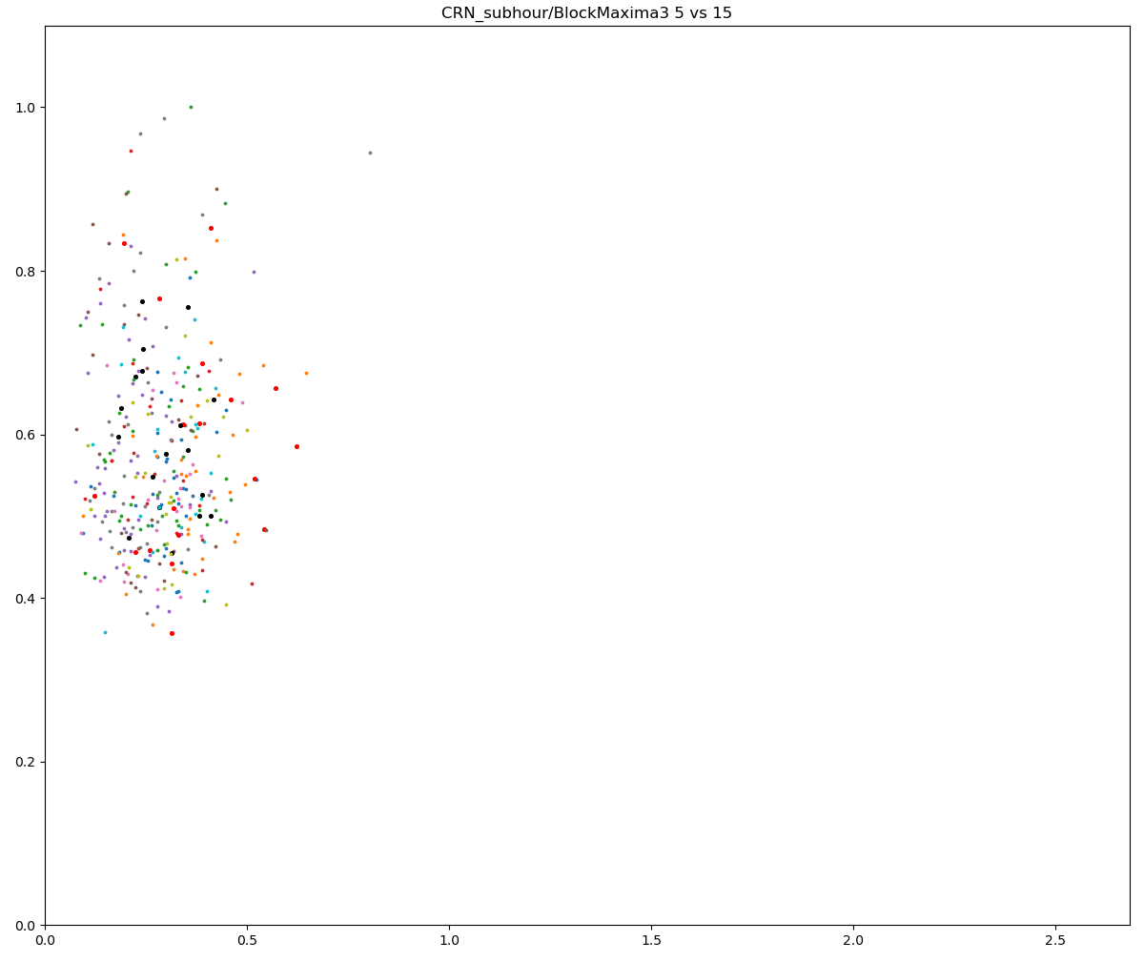
1.0
0.8
0.6
0.4
CRN: 5min/15min
0.2
0.0
0.0”
0.5”
1.0”
1.5”

Slide 10
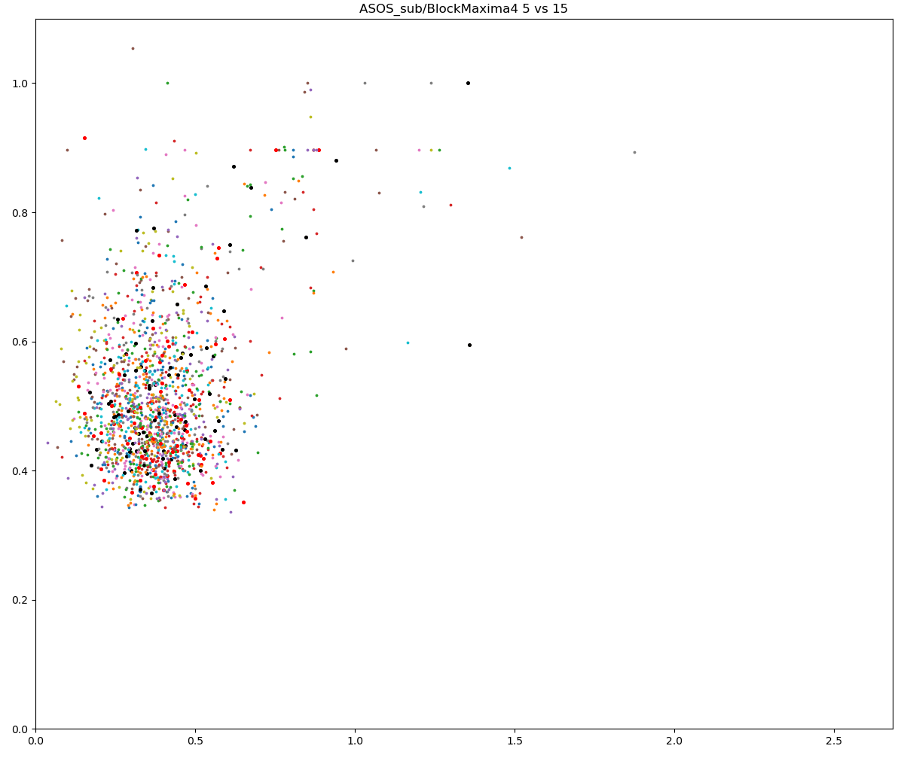
1.0
1.0
0.8
0.8
0.6
0.6
0.4
0.4
CRN: 5min/15min
ASOS sub-hourly: 5min/15min (raw)
0.2
0.2
0.0
0.0
0.0”
0.5”
1.0”
1.5”
0.0”
0.5”
1.0”
1.5”
2.0”
2.5”
10

Slide 11

1.0
1.0
0.8
0.8
0.6
0.6
0.4
0.4
CRN: 5min/15min
ASOS sub-hourly: 5min/15min (QC)
0.2
0.2
0.0
0.0
0.0”
0.5”
1.0”
1.5”
0.0”
0.5”
1.0”
1.5”
2.0”
2.5”
11

Slide 12
Data
NOAA Atlas 14
Global Historical Climatology Network – Daily
United States Climate Reference Network – 5-minute
Cooperative Network – Hourly
Automated Surface Observing System – 5-minute
Jefferson County Drainage District 6 – 5-minute
Harris County Flood Control Network – 5-minute
Oklahoma Mesonet – 5-minute
West Texas Mesonet – 5-minute

Slide 13
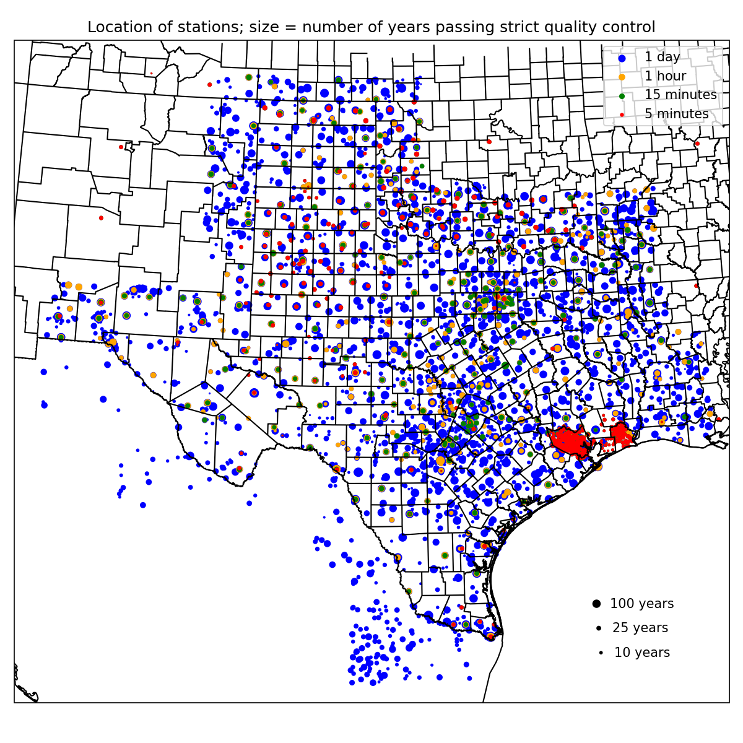
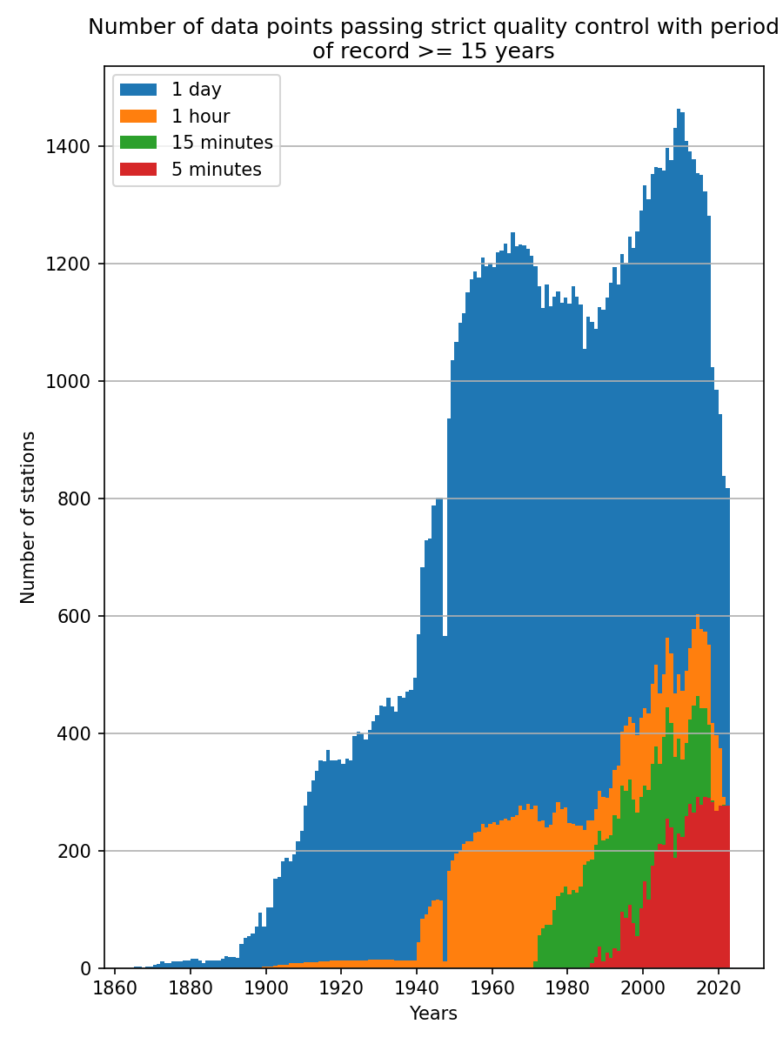

Slide 14
Over to you, James and Yuchen…

Slide 15
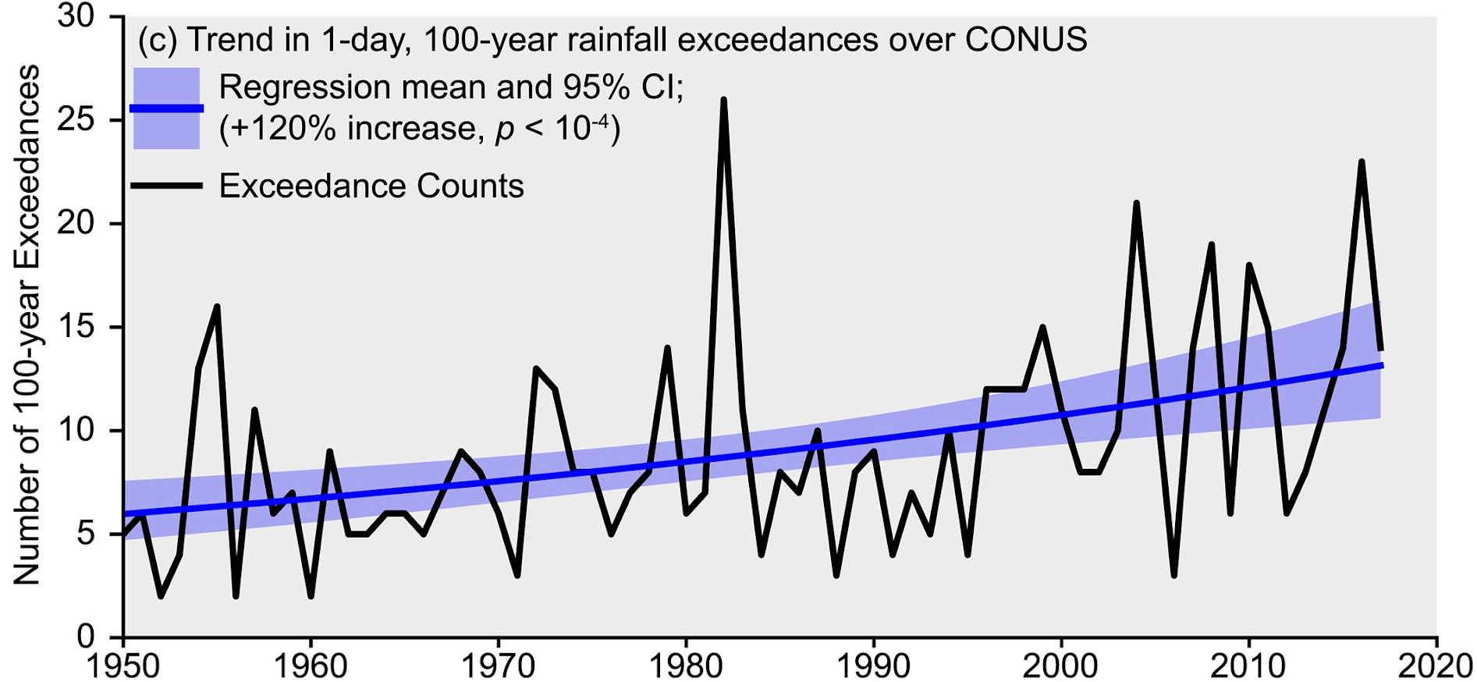
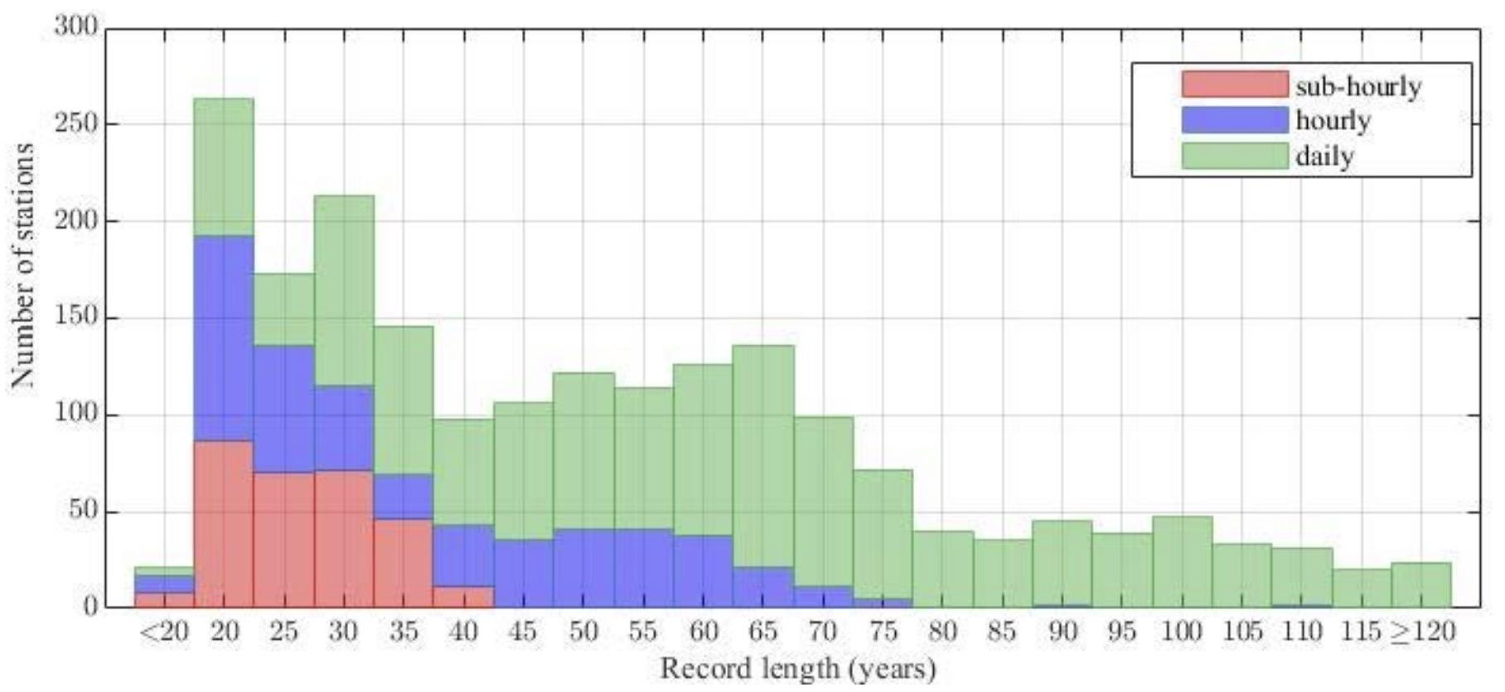
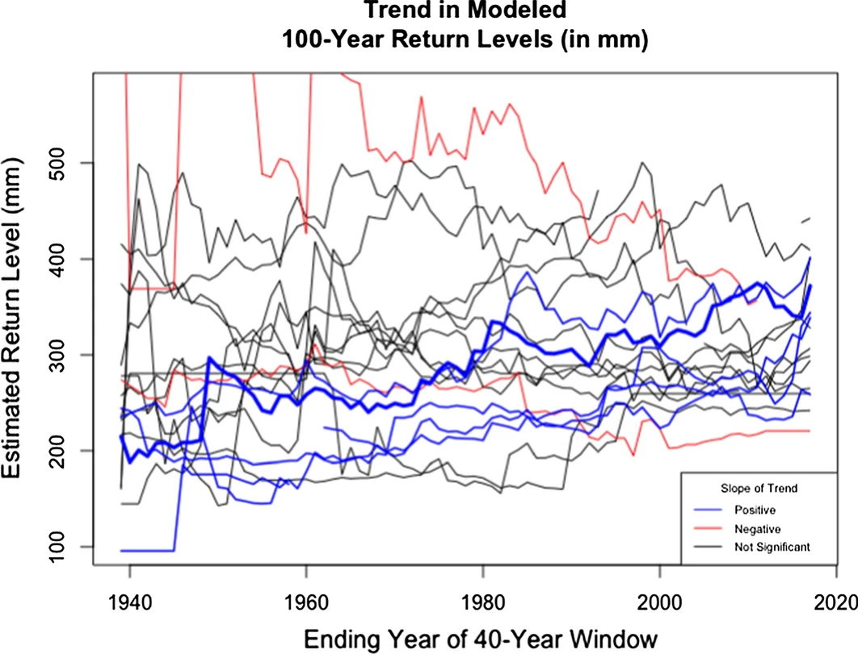
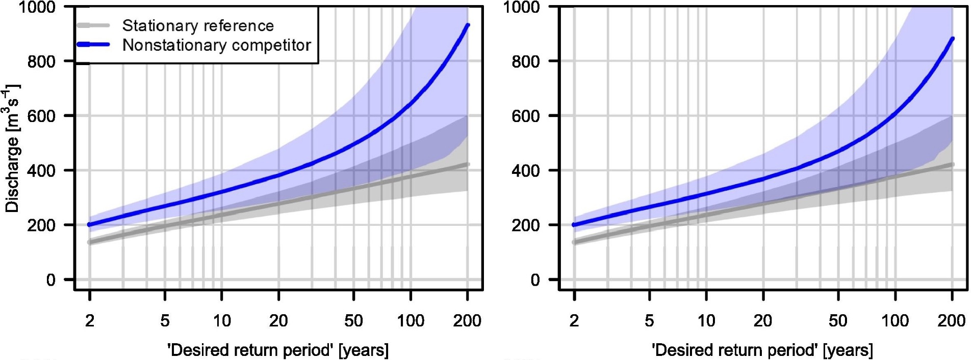
Nonstationarity
Limited Observations
Return levels ⬆️
(Wright et al., 2019)
Short durations with limited records
(Perica et al., 2018)
Parametric Uncertainty
Sampling Variability
Nonstationarity ➡️ More parameters ➡️ Uncertainty ⬆️ (Serinaldi and Kilsby, 2015)
Different trend estimates at nearby stations (Fagnant et al., 2020)
Notes:
[James]

Slide 16
Spatially Varying and Duration Dependent Covariates Model
Bayesian Hierarchical Model:
year
y(s, t, d)~GEV(μ(s, t, d), σ(s, t, d), ξ(d))
station
duration
1. Nonstationarity: parameters conditioned on time-varying covariates
2. Spatially varying parameters: latent spatial fields
3. Duration-dependent GEV distributions (dGEV): learn equations that describe GEV parameters for all durations simultaneously
Notes:
[James]

Slide 17
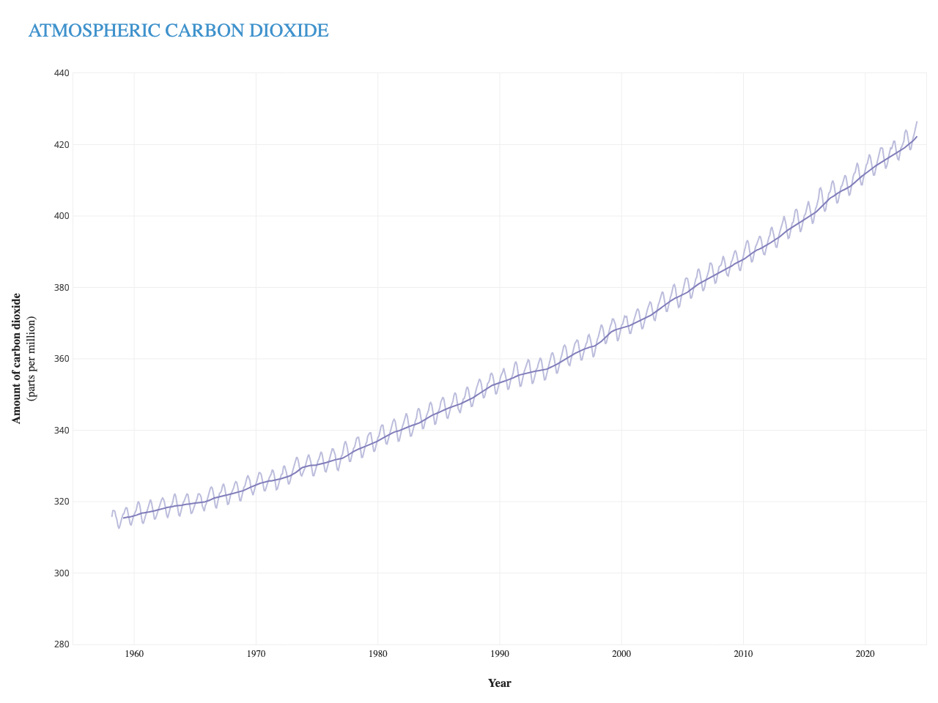
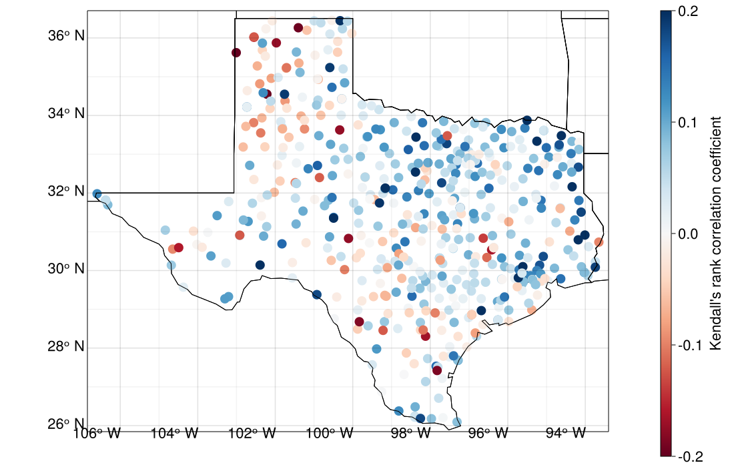
Spatially Varying and Duration Dependent Covariates Model
Process-informed nonstationary models condition GEV parameters 𝜙(s,t) on time-varying covariates x(t)
𝜙(s, t)=α+β(s)x(t)
CO2 concentration recorded at Mauna Loa Observatory in Hawaii (NOAA)
Correlation between logCO2 and 1d annual maximum series
Notes:
[Yuchen]

Slide 18
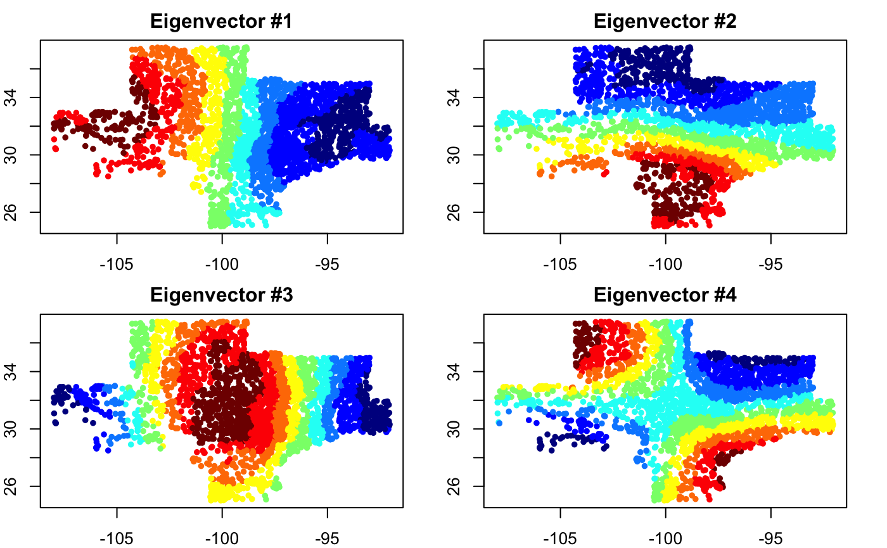
Spatially Varying and Duration Dependent Covariates Model
Spatially varying parameters are described with latent spatial fields (Moran basis functions)
Example basis functions for the study area – a total of 100 basis functions are used
Notes:
[Yuchen]

Slide 19
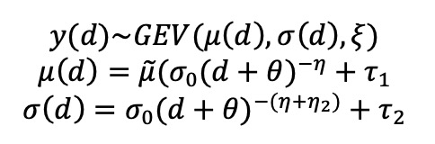
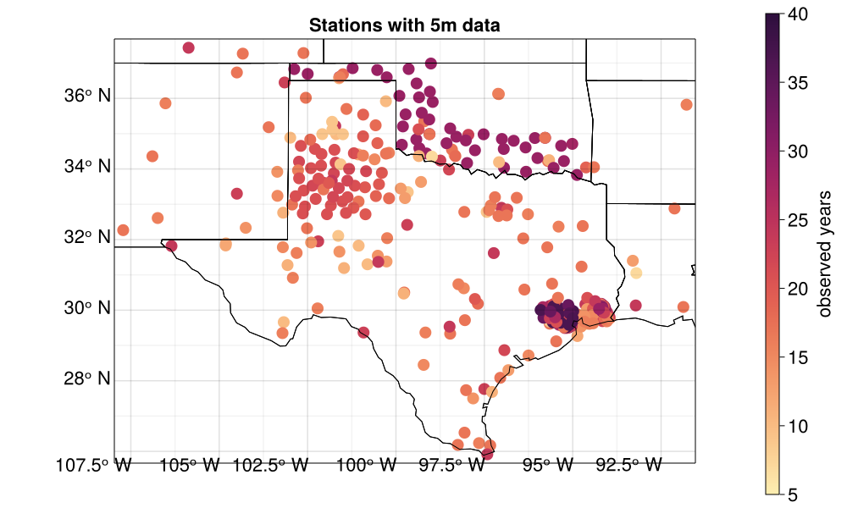
Spatially Varying and Duration Dependent Covariates Model
Duration-dependent GEV (dGEV) equations describe GEV parameters at all durations simultaneously from a few hyper-parameters
Shorter durations have fewer recorded observations
Notes:
[Yuchen]

Slide 20
 | Atlas 14 | Atlas 15 | TRAIN model
Notes:
[James]

Slide 21
 | Atlas 14 | Atlas 15 | TRAIN model
Stationarity | Stationary | Process-informed nonstationary | Process-informed nonstationary
Notes:
[James]

Slide 22
 | Atlas 14 | Atlas 15 | TRAIN model
Stationarity | Stationary | Process-informed nonstationary | Process-informed nonstationary
Regionalization | Region of influence | Region of influence | Latent spatial fields (Moran basis functions)
Notes:
[James]

Slide 23
 | Atlas 14 | Atlas 15 | TRAIN model
Stationarity | Stationary | Process-informed nonstationary | Process-informed nonstationary
Regionalization | Region of influence | Region of influence | Latent spatial fields (Moran basis functions)
Consistency across durations | Smoothing of quantiles | N/A | Duration-dependent GEV
Notes:
[James]

Slide 24
 | Atlas 14 | Atlas 15 | TRAIN model
Stationarity | Stationary | Process-informed nonstationary | Process-informed nonstationary
Regionalization | Region of influence | Region of influence | Latent spatial fields (Moran basis functions)
Consistency across durations | Smoothing of quantiles | N/A | Duration-dependent GEV
Estimation | L-moments; separate for each station | Maximum likelihood; separate for each station | Maximum a posteriori; all stations simultaneously
Notes:
[James]

Slide 25
 | Atlas 14 | Atlas 15 | TRAIN model
Stationarity | Stationary | Process-informed nonstationary | Process-informed nonstationary
Regionalization | Region of influence | Region of influence | Latent spatial fields (Moran basis functions)
Consistency across durations | Smoothing of quantiles | N/A | Duration-dependent GEV
Estimation | L-moments; separate for each station | Maximum likelihood; separate for each station | Maximum a posteriori; all stations simultaneously
Gridding | Interpolate | Interpolate | Explicitly spatial
Notes:
[James]

Slide 26
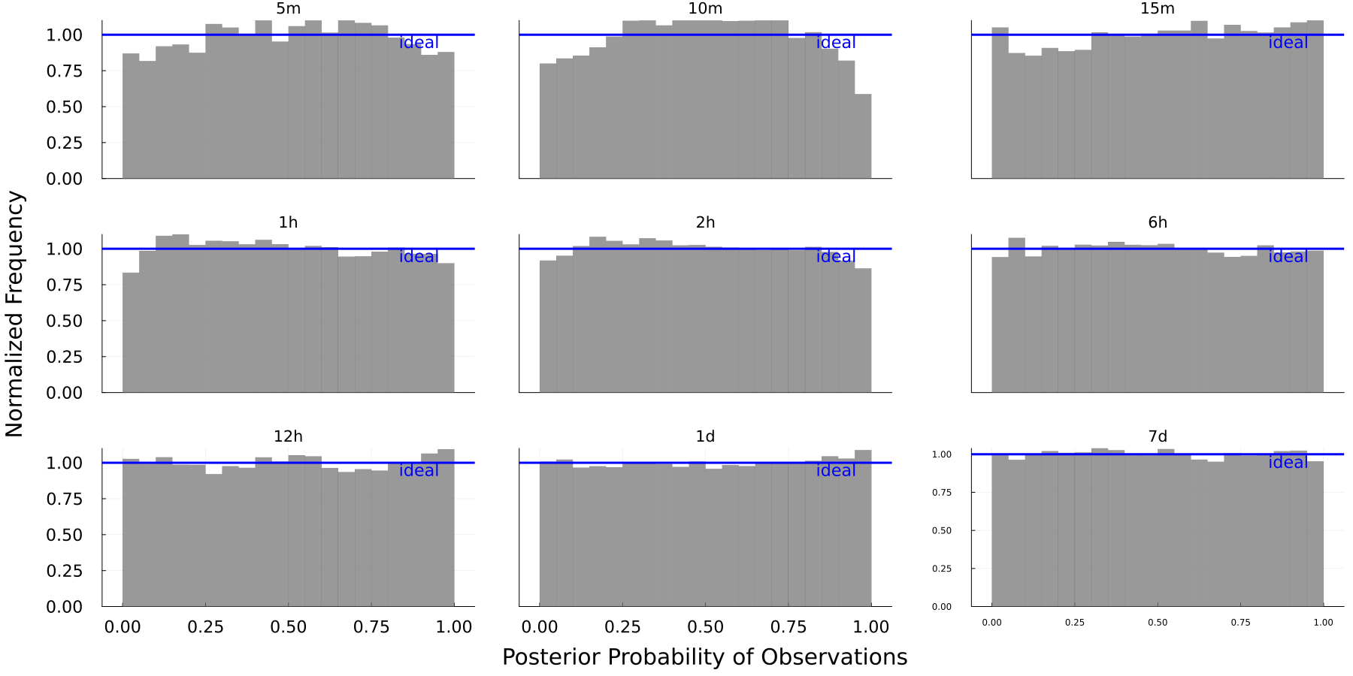
Observational inferences are well-calibrated
Quantile plots show the histograms for observation quantiles based on the simulated distributions. Ideally, these histograms resemble uniform distributions. Preliminary results.
Notes:
[James]

Slide 27
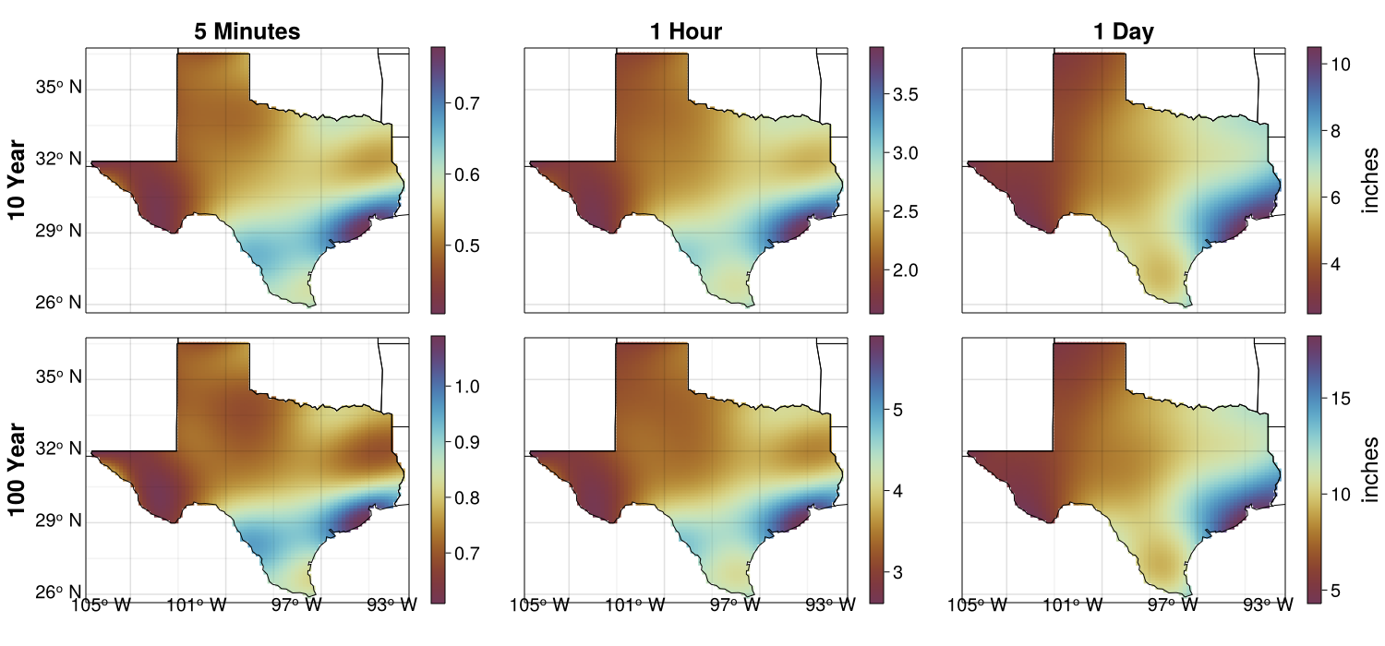
Spatially coherent return level estimates
(T) 10 and (B) 100 year return level estimates in 2022 at (L) 5 minute (M) 1 hour (R) 1 day extreme precipitation. Preliminary results.
Notes:
[Yuchen]

Slide 28
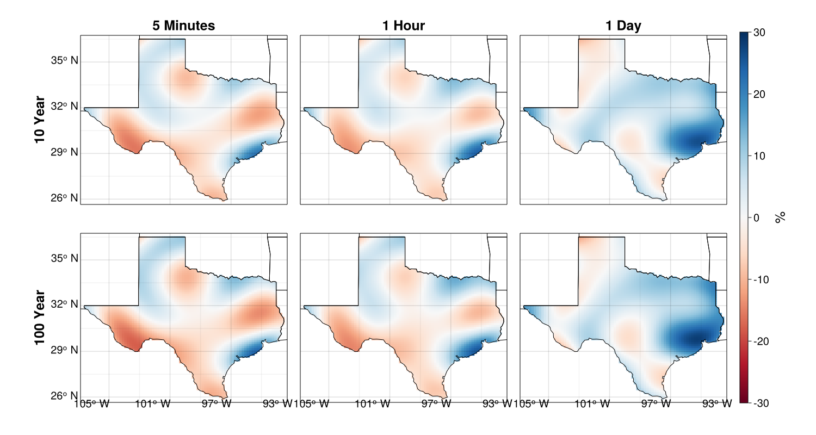
Return levels increase more for longer durations
Percentage change for (T) 10 and (B) 100 year return level estimates from 1980 to 2022 at (L) 5 minute (M) 1 hour (R) 1 day extreme precipitation. Preliminary results.
Notes:
[Yuchen]

Slide 29
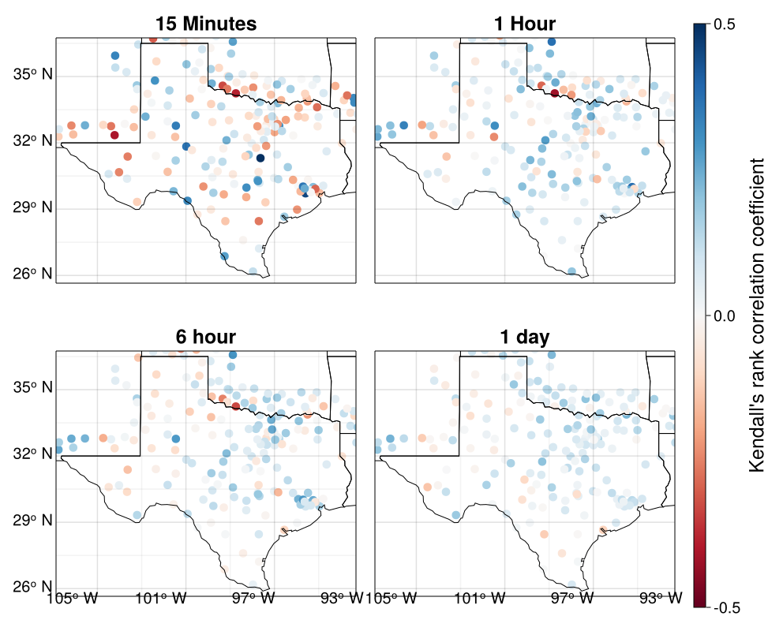
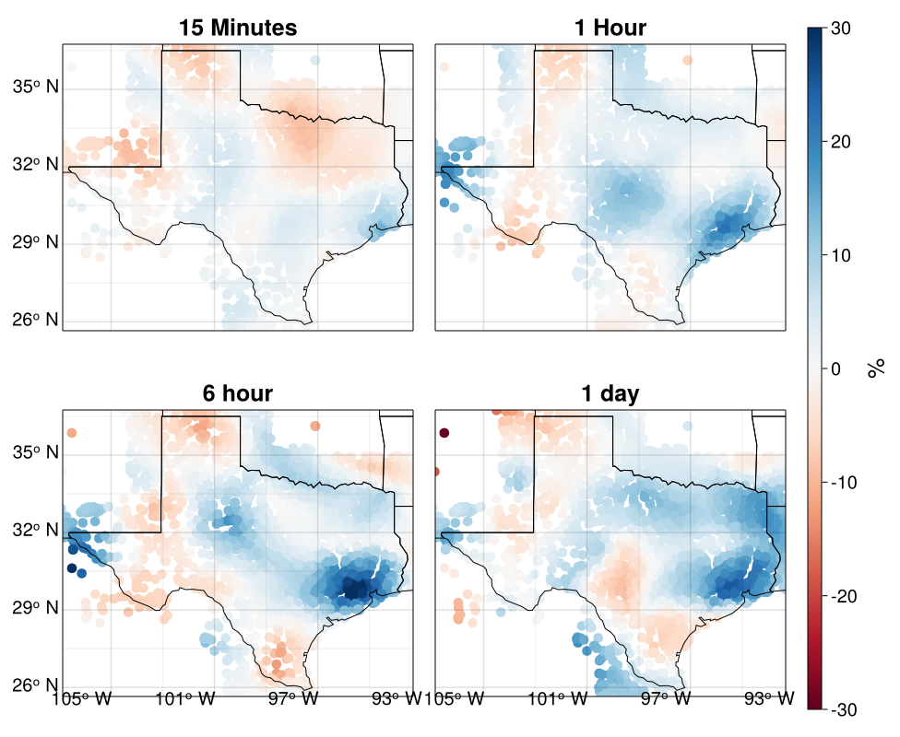
Appendix – Historical trend justifications
More stations exhibit positive relationships with year at longer durations
Estimates for individual durations show more increases in daily rainfall
This figure shows the Kendall’s rank correlation coefficients between annual maximum time series and year. Blue (red) indicates a positive (negative) relationship.
This figure shows the percentage change in extreme rainfall probability estimates from 1980 to 2022. Blue (red)

Slide 30
Future Conditions
NEX-GDDP-CMIP6 input data
  “NASA Earth Exchange Global Daily Downscaled Projections”
  Bias-Correction Spatial Disaggregation downscaling
  0.25 degree (~26 km) spatial resolution
LOCA2-CMIP6 input data
  “Localized Constructed Analogs” downscaling
  1/16 degree (~6 km) spatial resolution
Perform nonstationary GEV analysis
“Planar Fits”: fit trend components to linear spatial variation

Slide 31
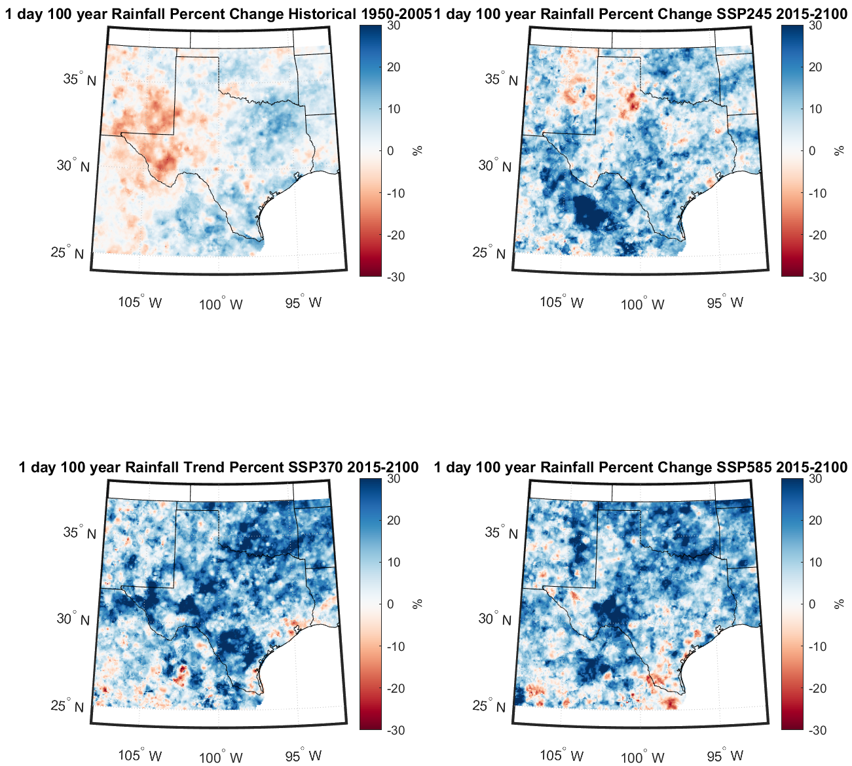
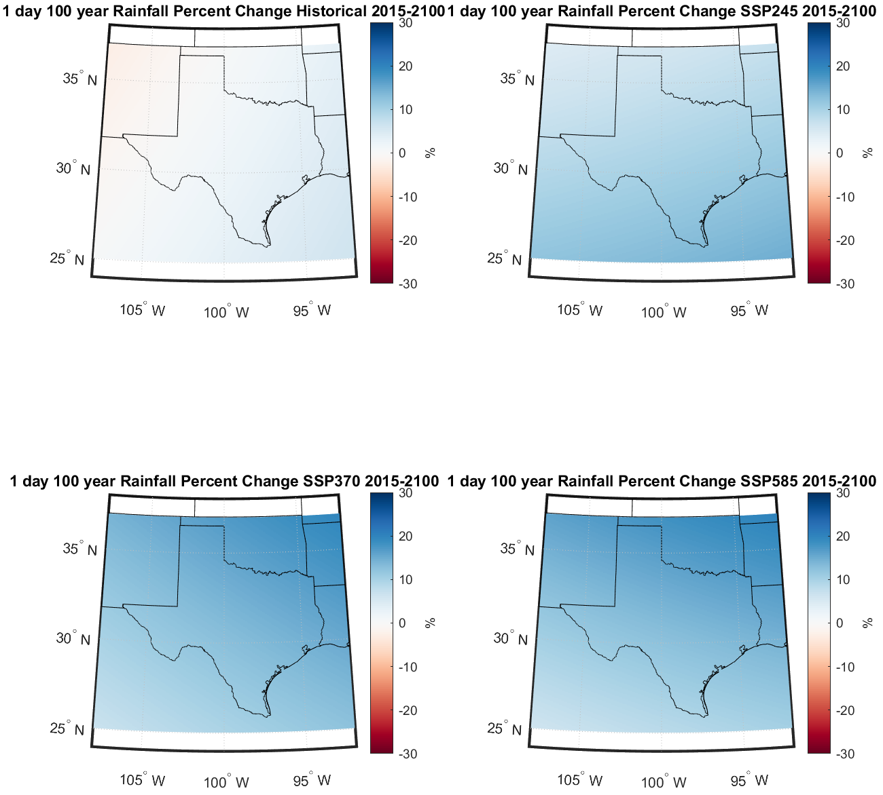
Ensemble-mean trends in downscaled simulations
Planar fits to ensemble-mean trends

Slide 32
Final Steps (big picture)
Merge historical observed and future modeled trends
  Use spatially smooth trend estimates
  Relative weights depend on quantified uncertainty magnitudes and (for models) deep uncertainty
    Observations: Historic trend as estimate of combined historic-future trend
      Natural variability component estimated from observations
      Full estimate of uncertainty available from climate models
    Models: Projected trend as estimate of future trend
      Natural variability reduced by ensemble averaging
      Model structural uncertainty sampled, but poorly
      Requires estimate of shared biases

Slide 33
Final Steps (big picture)
Redo historical analysis with assumed trends
  Will perform (and may deliver) output using multiple versions of obs-model weights
Provide output and documentation
  Gridded fields at time/temperature/CO2 snapshots
  Information necessary to compute values for any year or covariate change
  Example use cases and recommended procedures
Review and release

Slide 34
Possible tweaks in the meantime…
More (challenging) mesonets
Debug(?) weaker trend at shorter durations
PRISM Mean Annual Maximum as spatial first guess (to improve product and harmonize with Atlas 15)
Projected global mean surface temperatures as covariate

Slide 35
Summary of Differences from Atlas 15
Spatial and durational coherency built into statistical analysis
5-minute and 10-minute return values estimated directly
Trends assumed to be smoother than return values
Merged historical-future trends combining information from observations and projections
  Affects present-day return values as well as future return values
We only have to do Texas

Slide 36
Contact Us
John Nielsen-Gammon: n-g@tamu.edu
James Doss-Gollin: jdossgollin@rice.edu
Srikanth Koka: Srikanth.Koka@twdb.texas.gov

