Slide 1
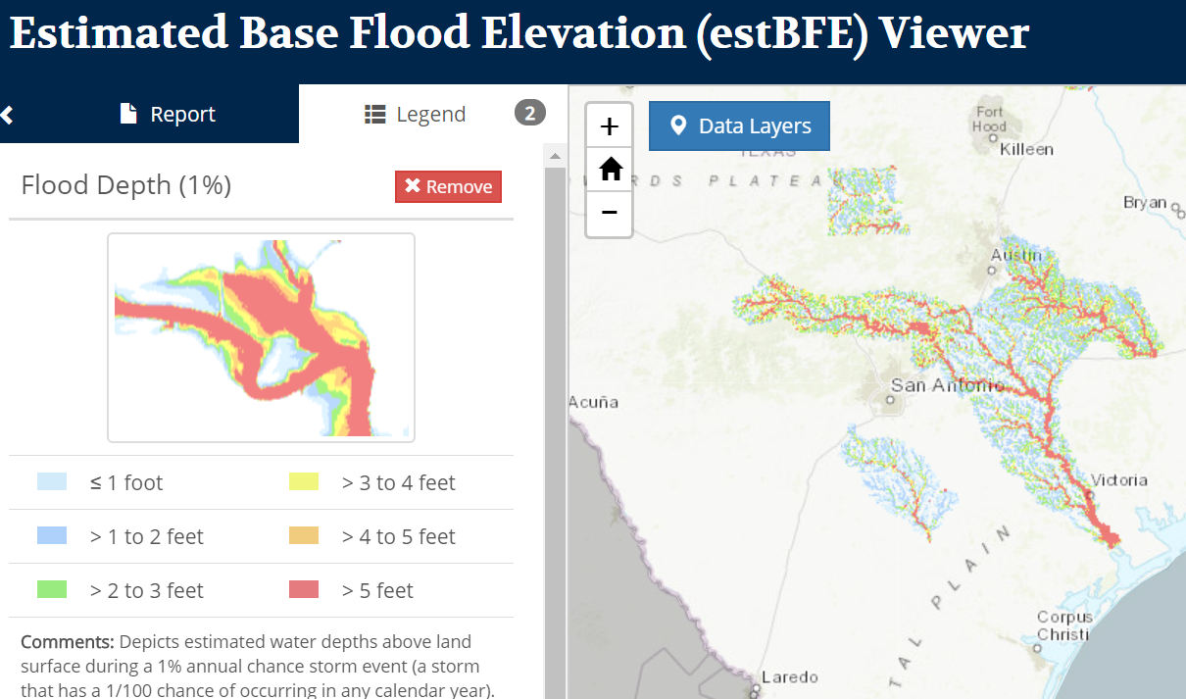
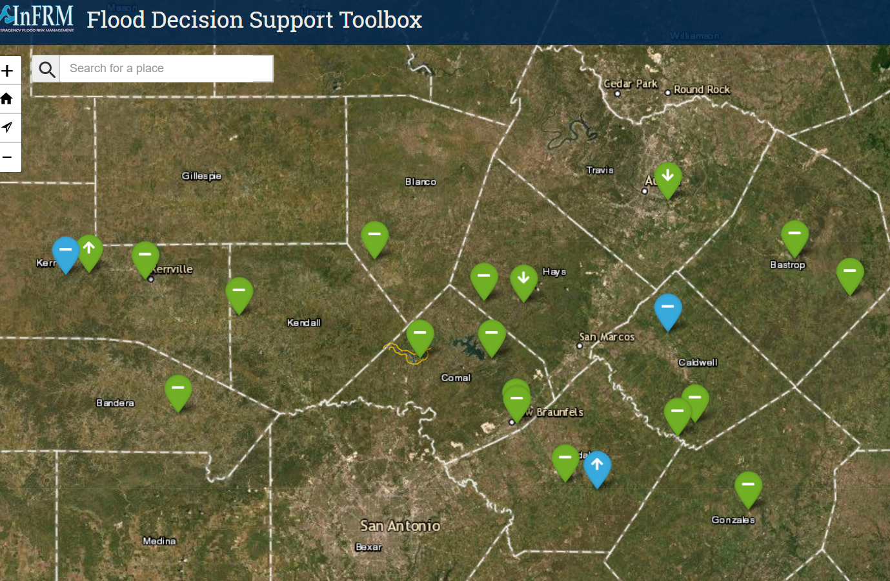
Inundation Mapping from BLE Models at River Basin Scale
Prepared by Andy Carter and David Maidment
How to extend flood inundation mapping from gage locations to the whole basin?
Base Flood Engineering Models on River Basins
Inundation Maps at USGS Gages
Flood Decision Support Toolbox prepared by Interagency Flood Risk Management (InFRM)
https://webapps.usgs.gov/infrm/
Presentation for NOAA National Weather Service, 15 September 2020

Slide 2
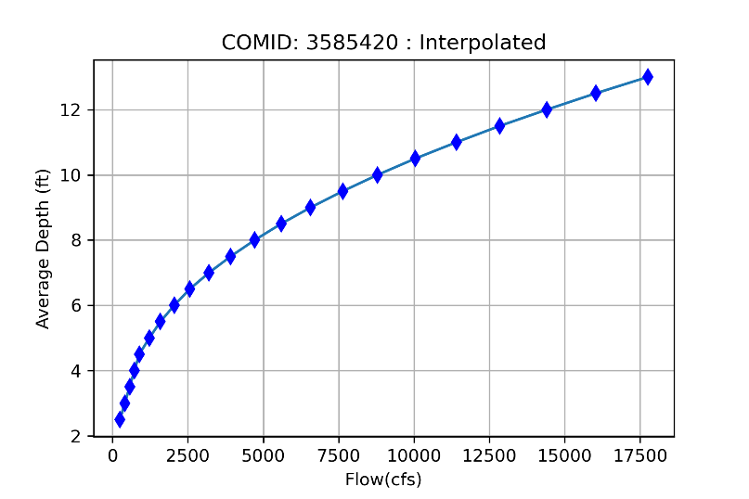
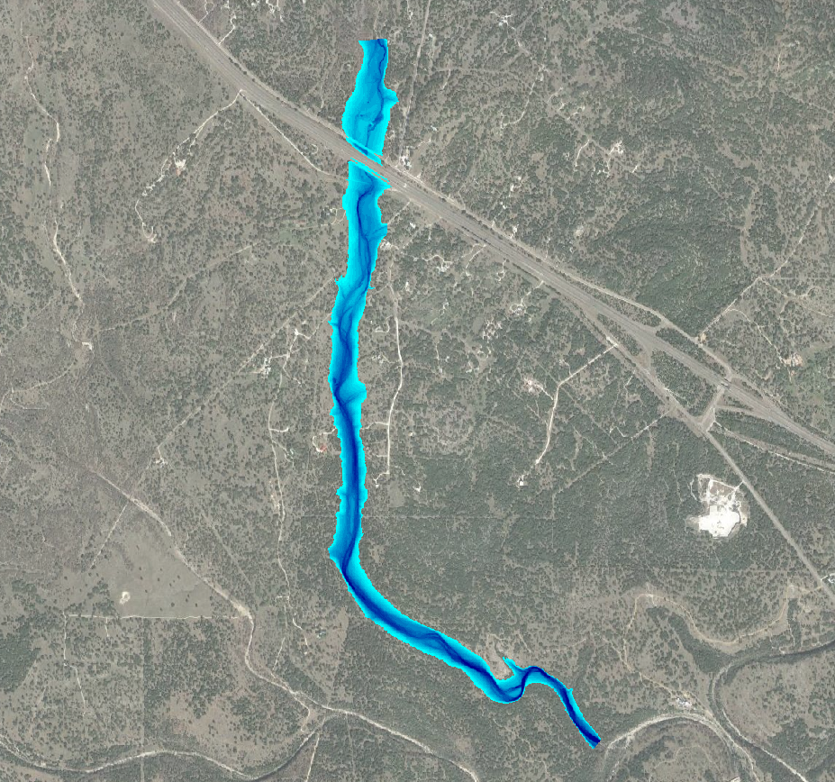
Inundation Mapping from BLE Models at River Basin Scale
National Weather Service Flood Inundation Mapping (FIM) Services for Texas
Process for Base Level Engineering (BLE) to FIM for 1-D HEC-RAS Models
Example of 2-D HEC-RAS Model to FIM
Next Steps
Flood Discharge Forecast
from the National Water Model
or WGRFC Model
Average
Stream Depth
Rating
Curve
Inundation
Map
Flow Rate

Slide 3
Inundation Mapping from BLE Models at River Basin Scale
National Weather Service Flood Inundation Mapping (FIM) Services for Texas
Process for Base Level Engineering (BLE) to FIM for 1-D HEC-RAS Models
Example of 2-D HEC-RAS Model to FIM
Next Steps
Flood Discharge Forecast
from the National Water Model
or WGRFC Model
Average
Stream Depth
Rating
Curve
Inundation
Map
Flow Rate

Slide 4
National Water Model
Version 2.0
Deployed: June 2019
Domains: CONUS and Hawaii
CONUS Configurations:
3-Hour and 28-Hour Analysis and Assimilation (Hourly and Daily)
18-Hour Short Range Forecast (Hourly)
10-Day Medium Range Forecast (6-Hourly)
30-Day Long Range Forecast (Daily)
Hawaii Configurations:
3-Hour Analysis and Assimilation (Hourly)
60-Hour Short Range Forecast (6-Hourly)

Slide 5
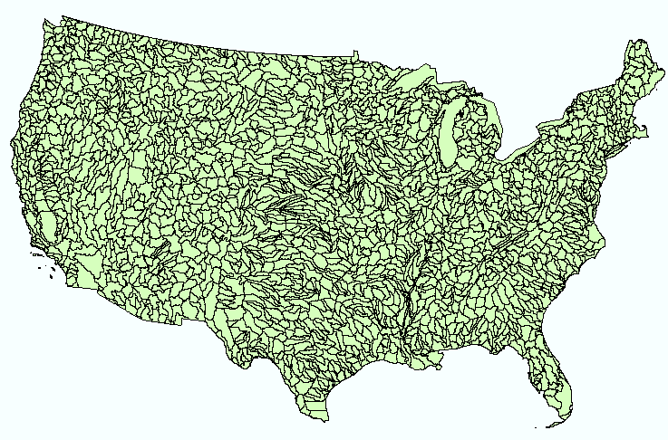
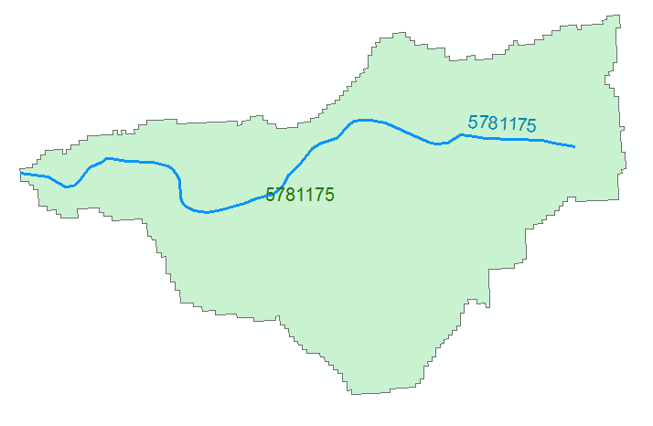
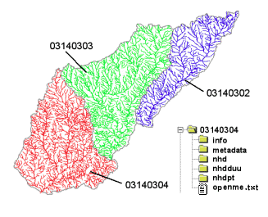
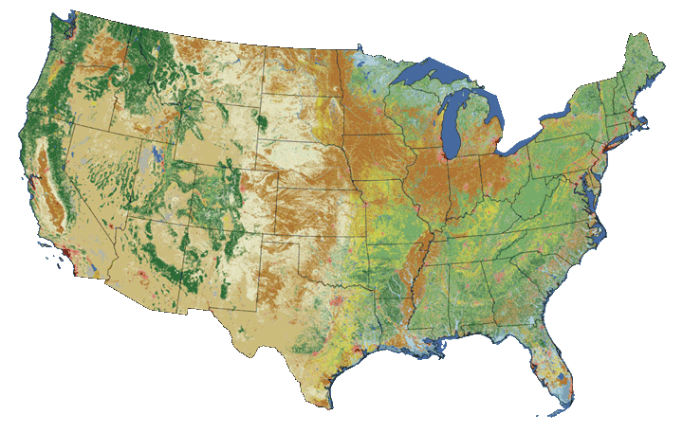
NHDPlus: One reach = one catchment for US
Geospatial Foundation for the National Water Model
NHDPlus
2.7 million reach catchments in US
average area 3 km²
reach length 2 km
Uniquely labelled
National Elevation Dataset
Watershed Boundary Dataset
National Hydrography Dataset
National Land Cover Dataset

Slide 6
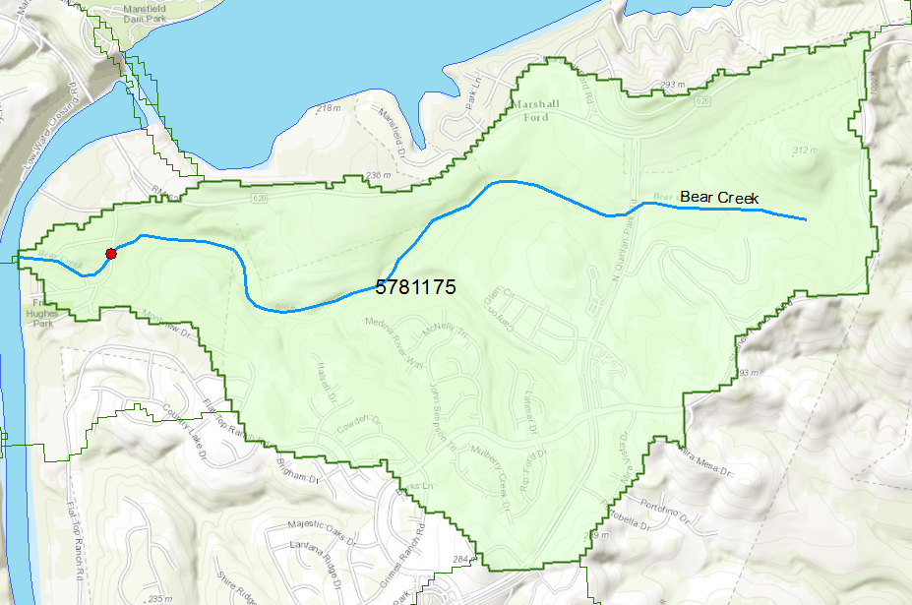
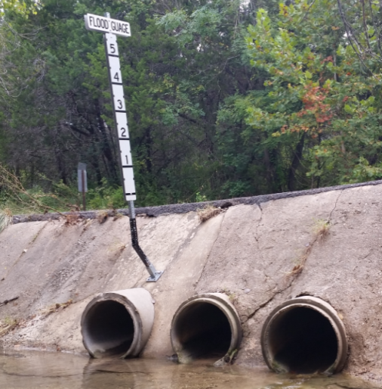
Flood Information for one NHDPlus Catchment
National Hydrography Dataset Plus
catchment for Bear Creek
(area = 5.71 km2)
Deputy Jessica Hollis
19 September 2014
Low water crossing at
3400 Fritz Hughes Park Rd

Slide 7
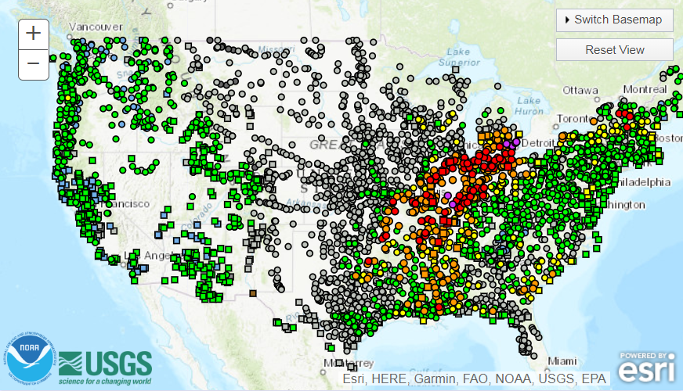
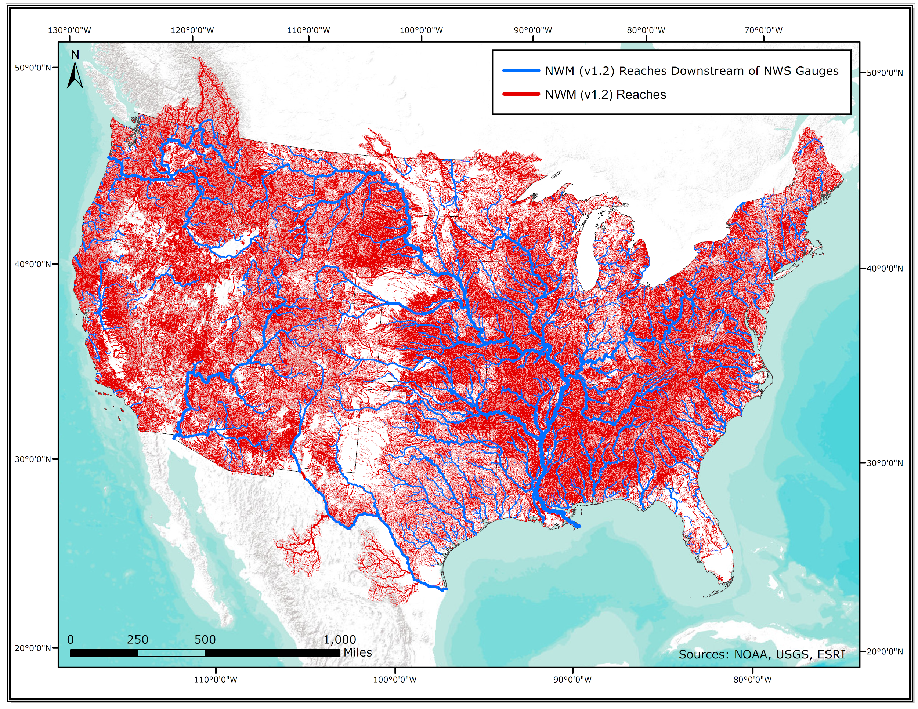
Complementary Hydrologic Prediction Systems
Advanced Hydrologic
Prediction Service
Route
Replace
and
1 forecast point for every 1,000 river miles
National Water Model

Slide 8
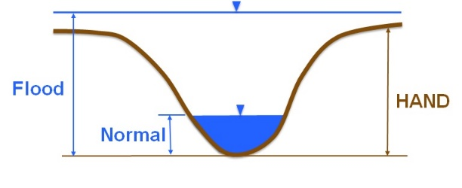
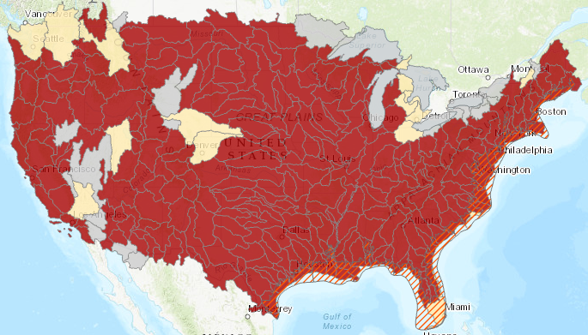
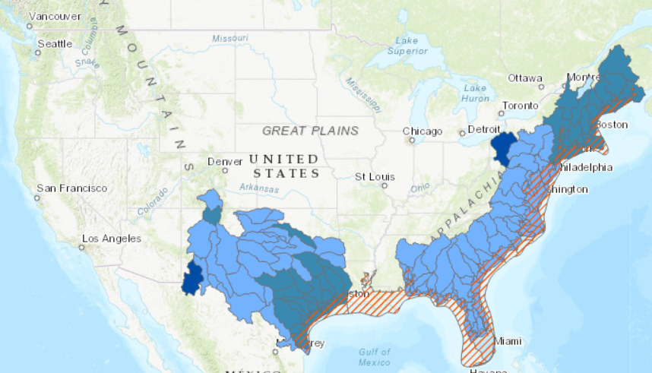
NWC FIM Services
All this mapping is based
on the Height Above
Nearest Drainage
(HAND) method
Replace and Route FIM Services
National Water Model FIM Services
Note: Replace and Route FIM only available downstream of RFC forecast points.
Note: National Water Model FIM available along all modeled river segments..
FIM v2.X MS
FIM v2.Xc
FIM v2.X MS
None
FIM v1.0 FR
FIM v1.0c
None

Slide 9
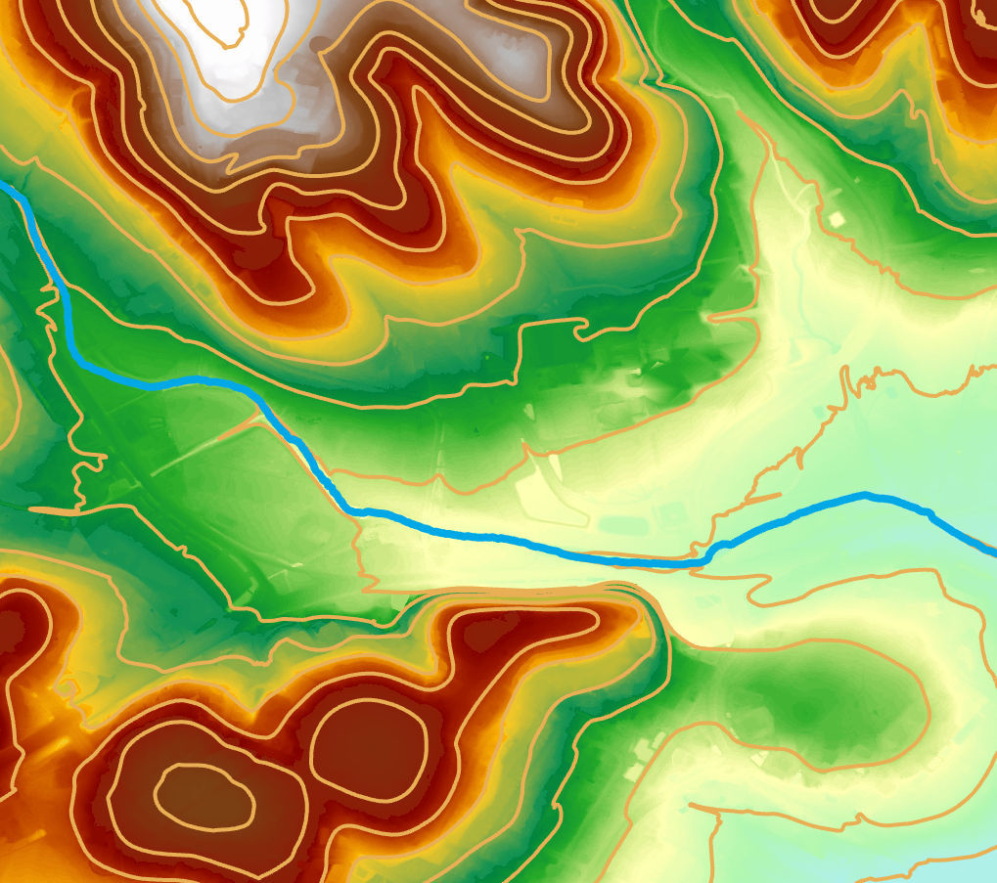
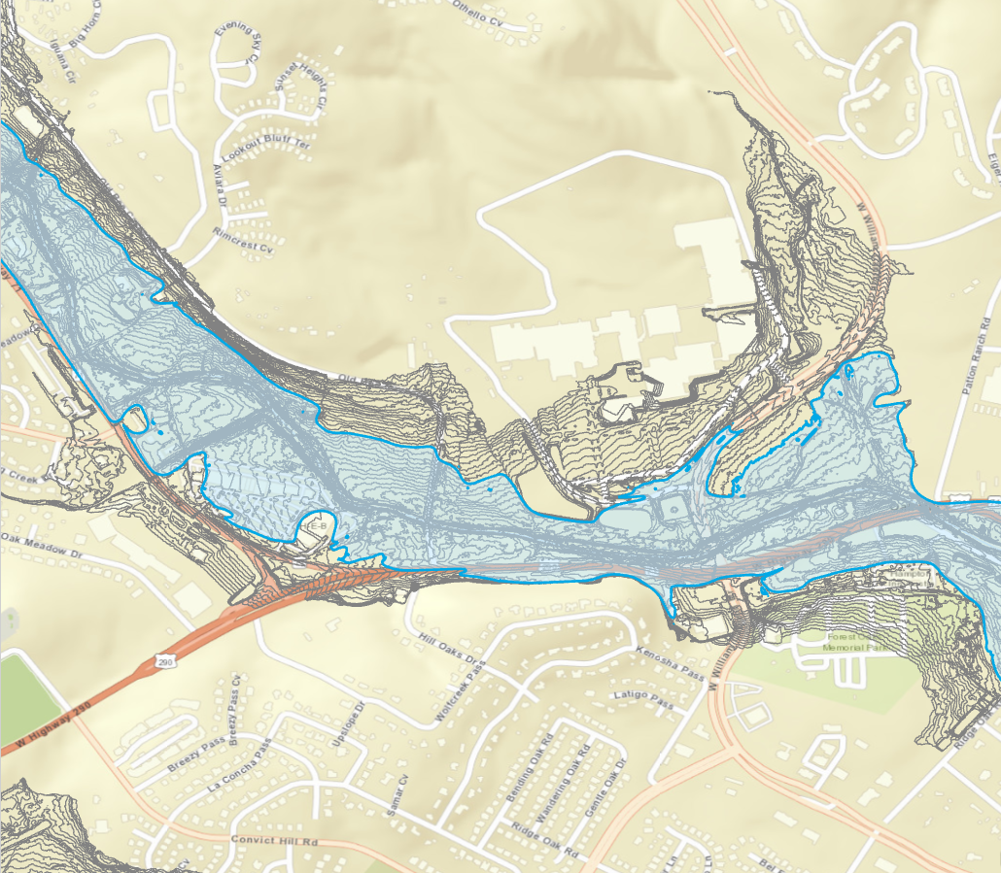
HAND: Relative Elevation above Creek Bed
Williamson Creek
Williamson Creek
1 foot HAND contours
Elevation of Land Surface
Elevation above Creek Bed

Slide 10
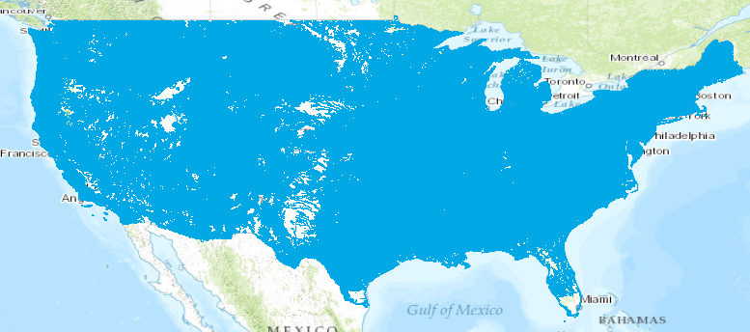
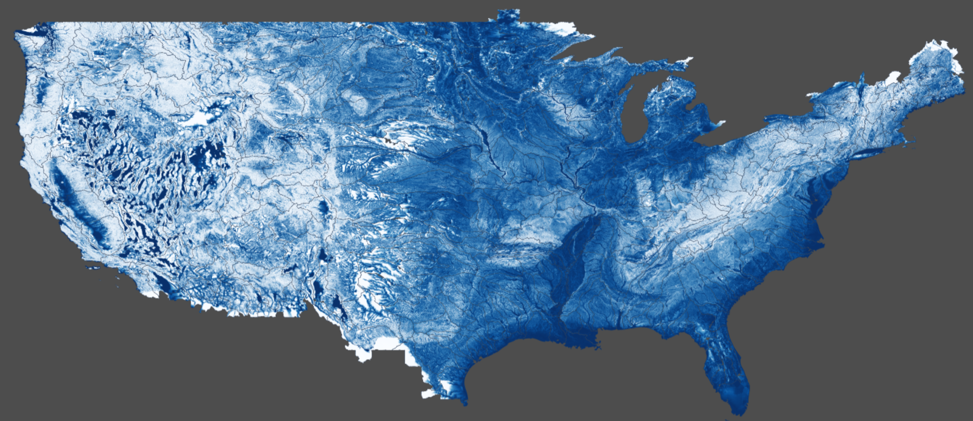
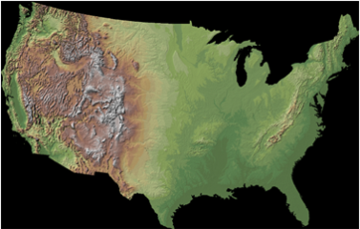
HAND at Continental Scale
National Hydrography Dataset
HAND
10m National Elevation Dataset
Supercomputer

Slide 11
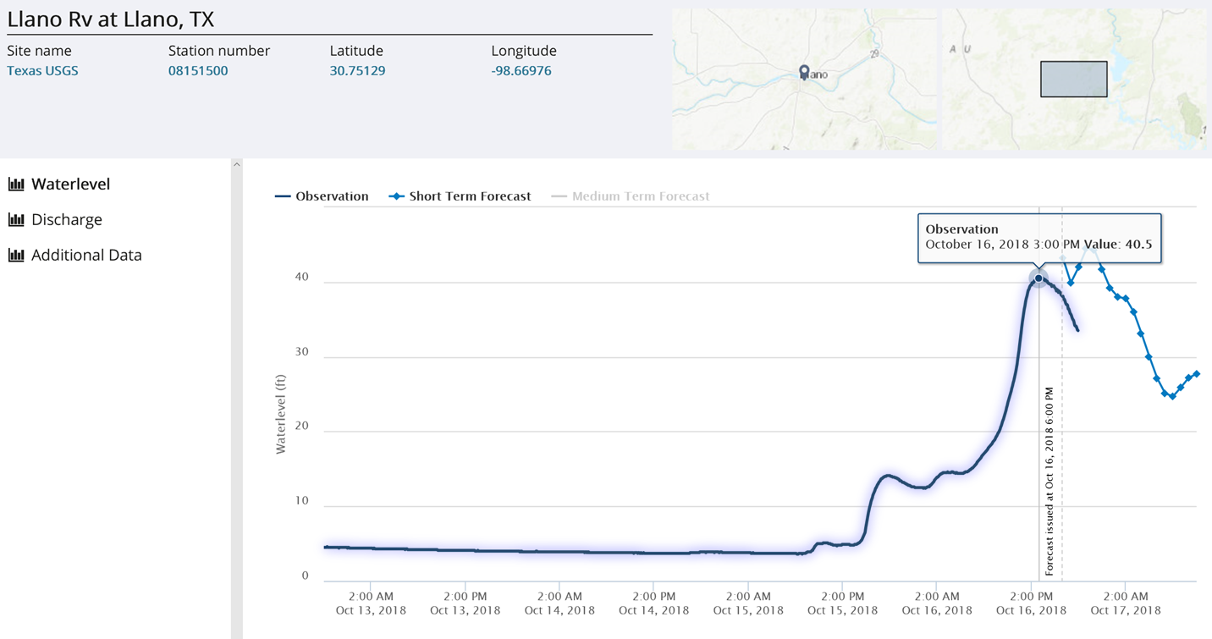
Example: Llano Flood, 16 October 2018
HAND method assumes
Uniform flow
Velocity, depth, area
constant along reach
Llano River at Llano
Real-time snapshot
from TxDOT Flood
Portal
40
30
Water Level (ft)
USGS Observation
20
National Water Model forecast
and HAND-based rating curve
10
0
Largest flood on Llano River since 1939

Slide 12
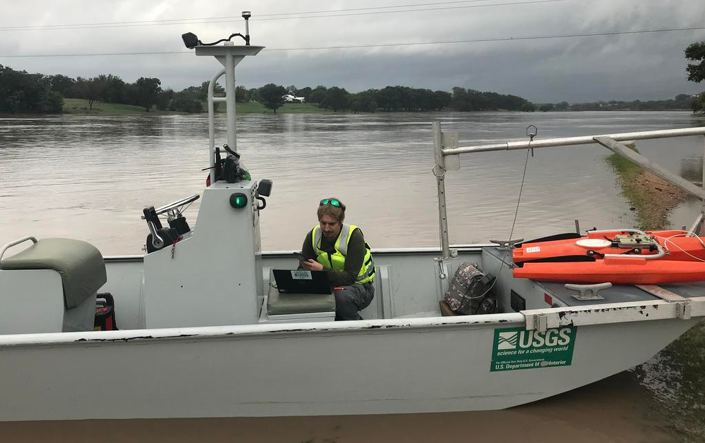
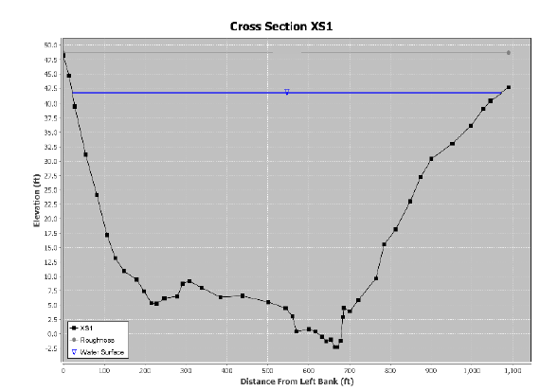
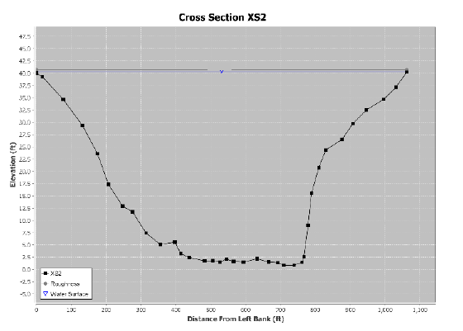
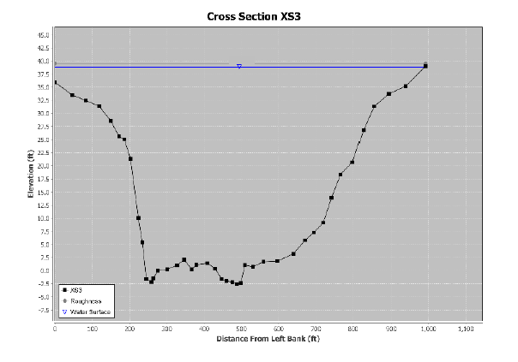
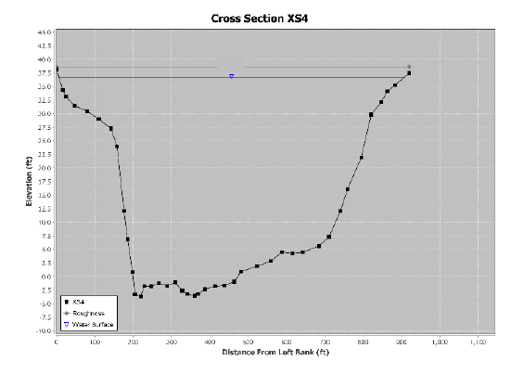
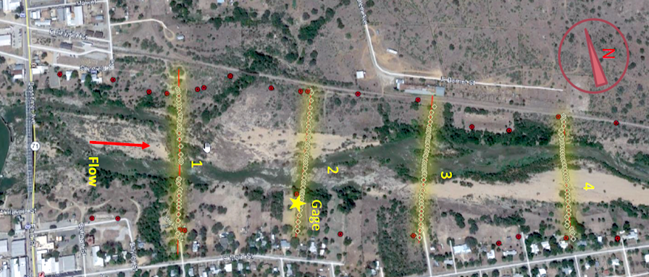
Indirect Measurement of Flow at Llano Gage (Scott Grzyb, USGS)
Q = 282,000 cfs, Gage Height = 40.18 ft
V = 9.9 ft/s
A = 28,500 ft²
BLE models assume
Nonuniform flow
Velocity, depth, area
vary along reach
Flow
V = 11.1 ft/s
A = 25,500 ft²
V = 12.0 ft/s
A = 23,500 ft²
V = 12.3 ft/s
A = 22,900 ft²
Reach Length = 2900 ft (0.55 miles); Bed Slope = 0.18%

Slide 13
Inundation Mapping from BLE Models at River Basin Scale
National Weather Service Flood Inundation Mapping (FIM) Services for Texas
Process for Base Level Engineering (BLE) to FIM for 1-D HEC-RAS Models
Example of 2-D HEC-RAS Model to FIM
Next Steps
Flood Discharge Forecast
from the National Water Model
or WGRFC Model
Average
Stream Depth
Rating
Curve
Inundation
Map
Flow Rate

Slide 14
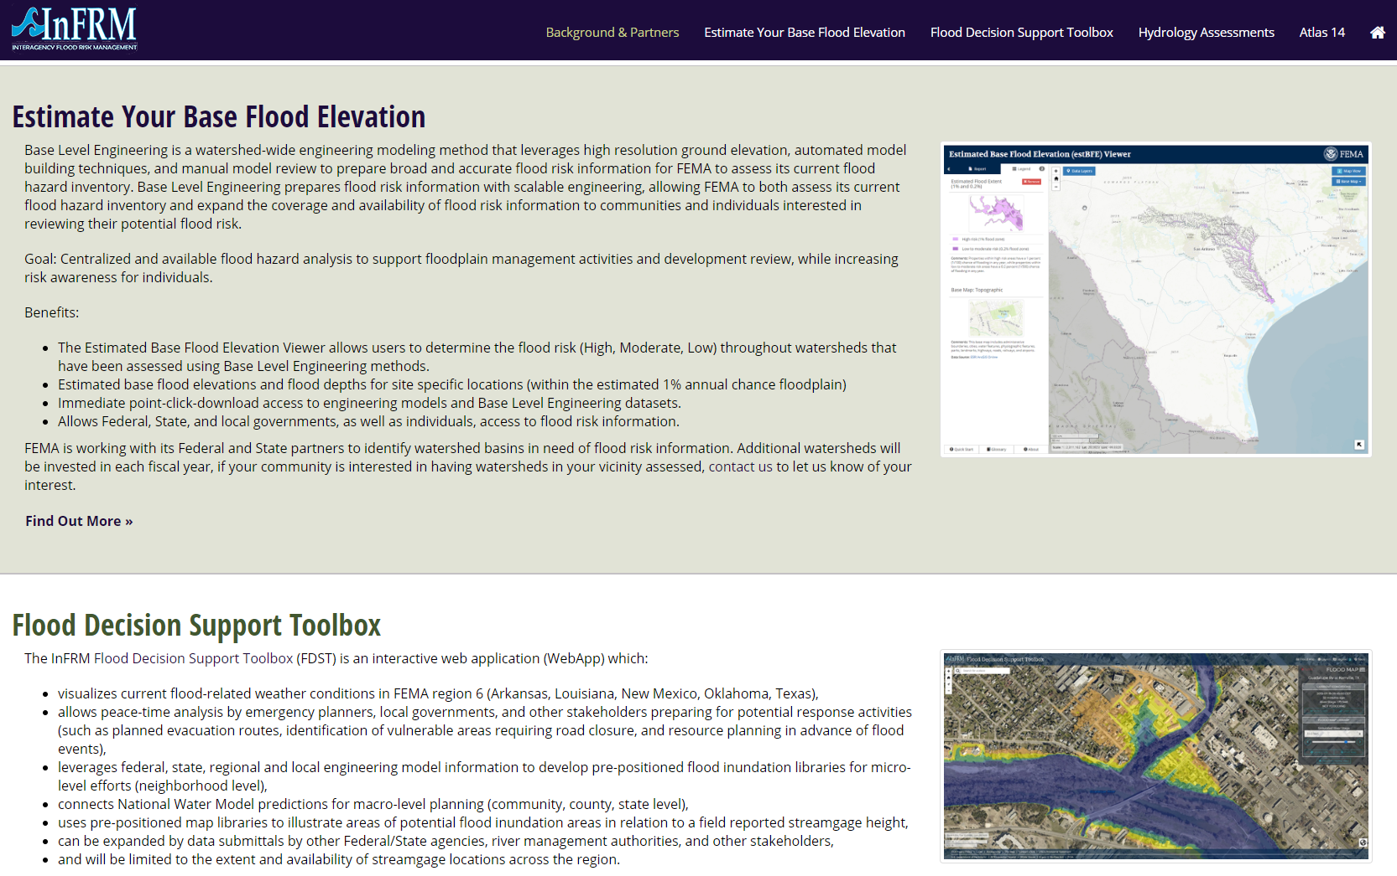
Question: Can Equivalent Mapping be developed from BLE Models?
InFRM – Interagency Flood Risk Management (FEMA Region 6)
https://webapps.usgs.gov/infrm/
Base Level Engineering Models
Base Level
Engineering Models
InFRM flood map specifications
InFRM Flood
Inundation Maps

Slide 15
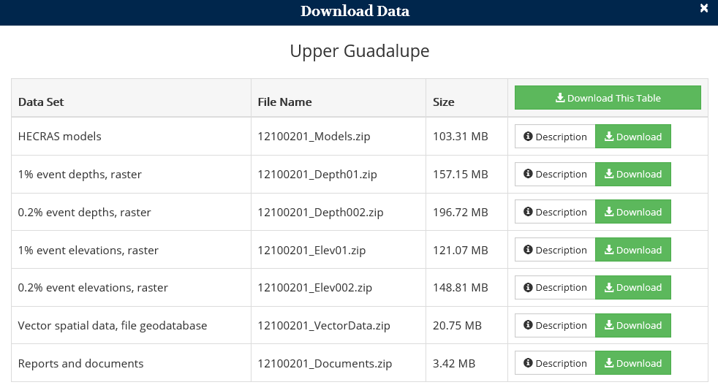
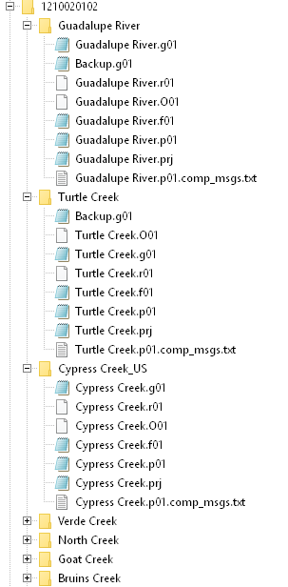
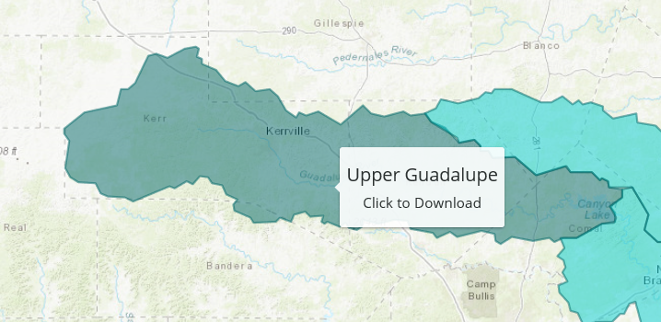
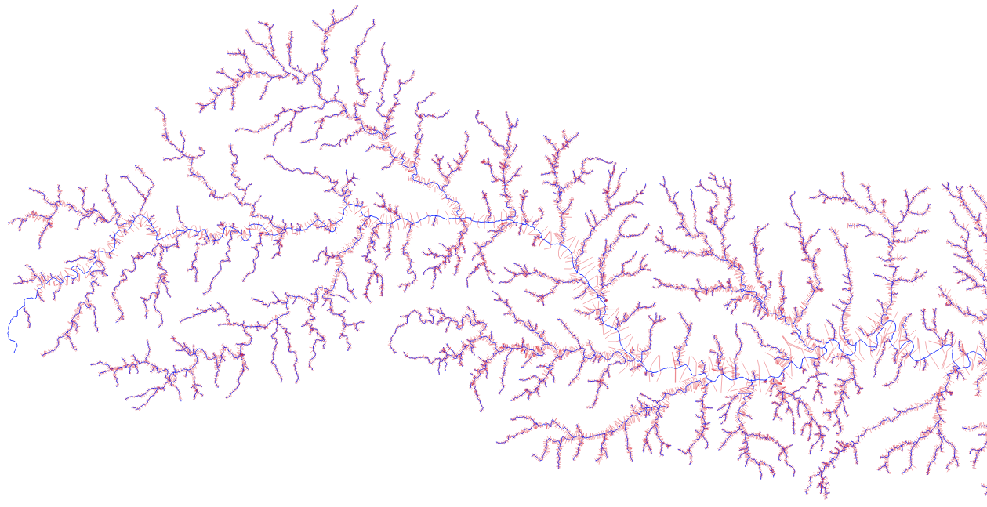
BLE Input Data Req’d
https://webapps.usgs.gov/infrm/estBFE/
12100201_UpperGuadalupe.gdb
Needed Feature Classes
XS = “Cross Sections”
WTR_LN = “HEC-RAS stream centerlines”
XS Attributes Needed:
WTR_NM = “HEC-RAS Model Name –matched to .PRJ”
XS_LN_ID = “Station of Cross section in model”
E_Q_0_2PCT = “500 year peak flow”
WTR_LN Attributes Needed:
WTR_NM = “HEC-RAS Model Name –matched to .PRJ”

Slide 16
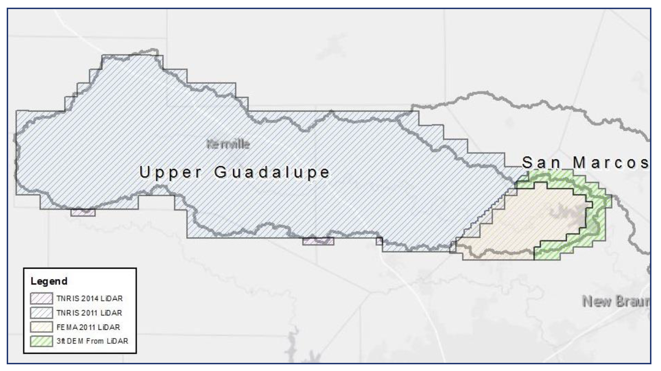
BLE Surface Data Utilized
BLE report provides documentation of LiDAR utilized for HEC-RAS models
Create a GeoTIFF DEM (1m resolution) for each HUC-12 using the same terrain datasets.
Convert each HUC-12 DEM to the BLE coordinate reference zone
Adjust the vertical units if necessary
Convert the GeoTIFF into a HEC-RAS Terrain file (HDF5) using RAS_Mapper

Slide 17
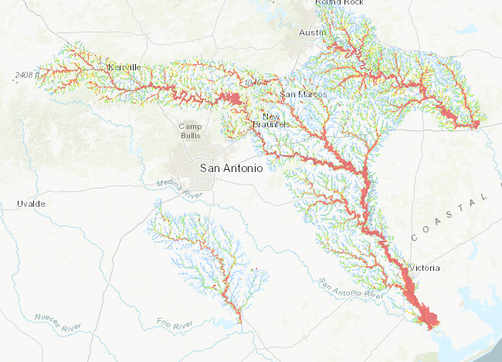
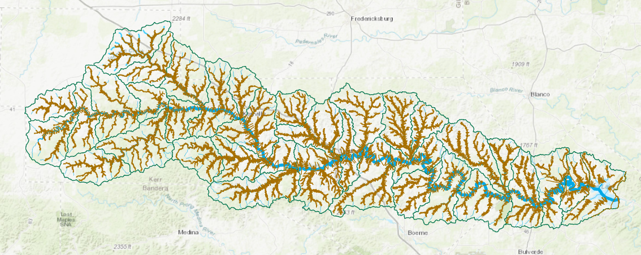
HEC-RAS Cross-Sections from BLE Modeling

Slide 18
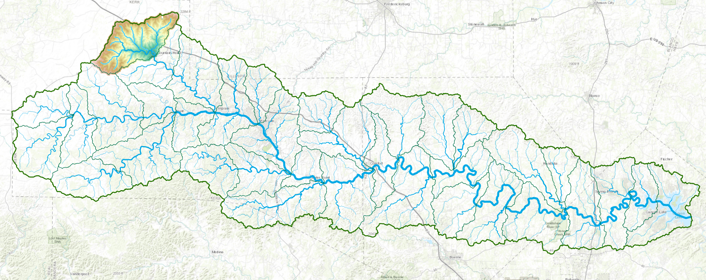
Upper Guadalupe Basin, HUC8 = 12100201
Upper Johnson Creek, HUC12 = 121002010109
21 NHDPlus Reaches
36 HUC12 Subwatersheds
775 NHPlus Reaches
5 USGS Gages

Slide 19
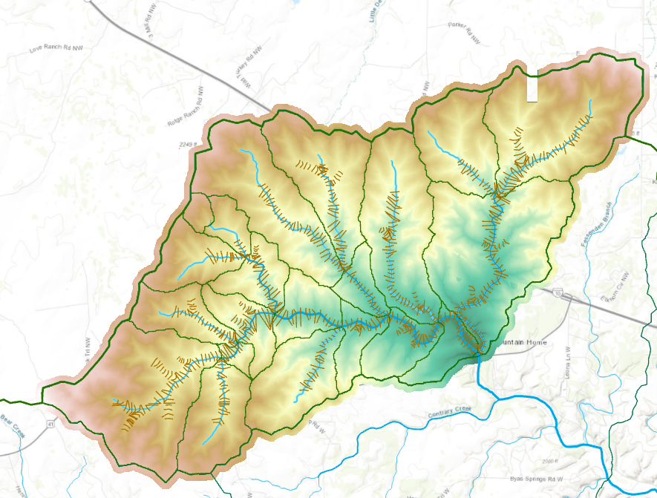
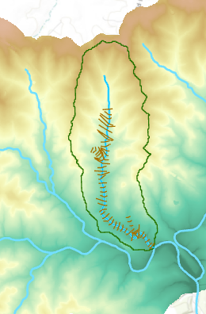
Upper Johnson Creek, 21 NHDPlus Catchments and Reaches indexed by COMID
COMID = 3585420

Slide 20
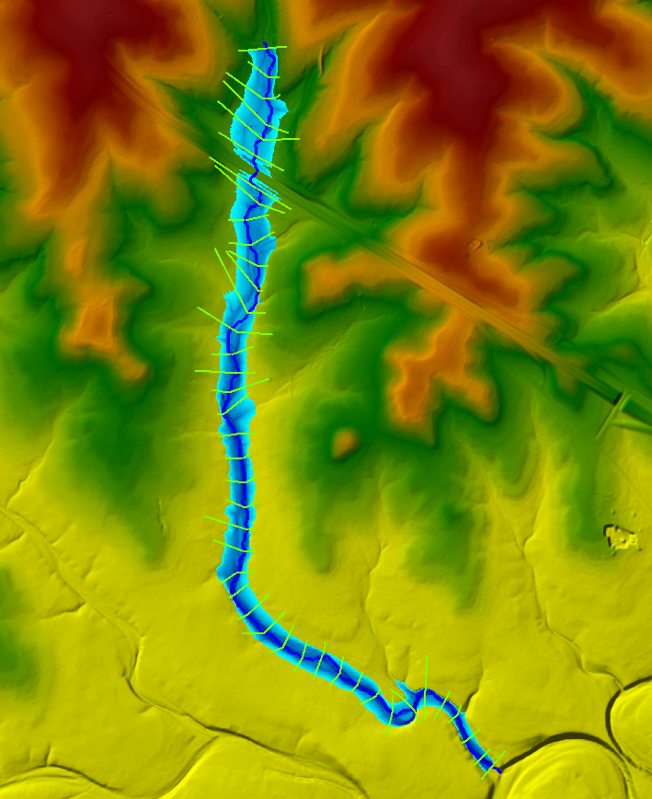
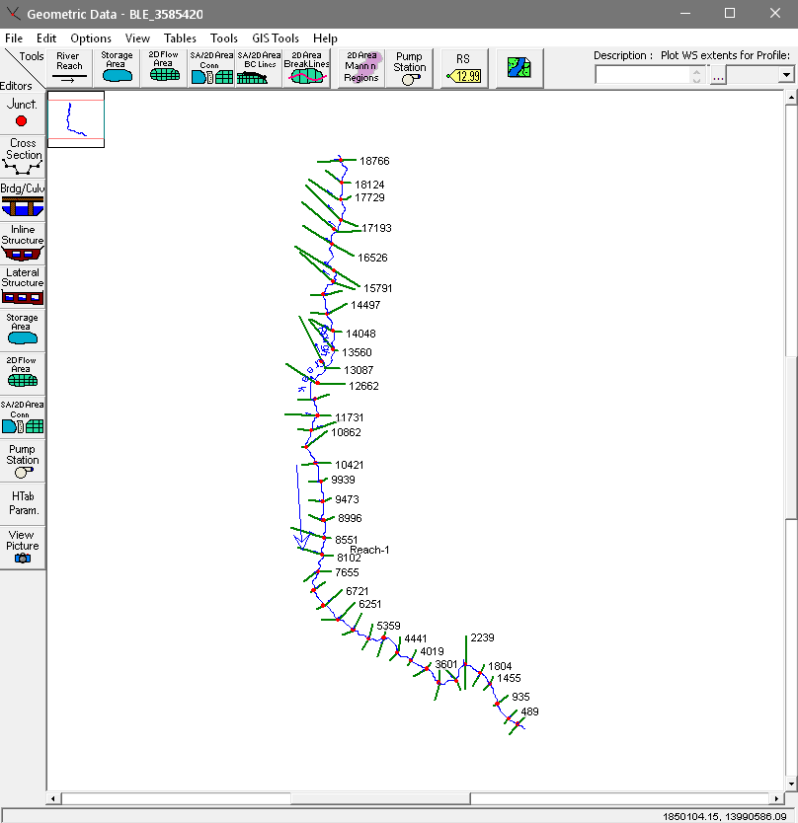
HEC-RAS Model from Base Level Engineering
Produces a flood inundation map

Slide 21
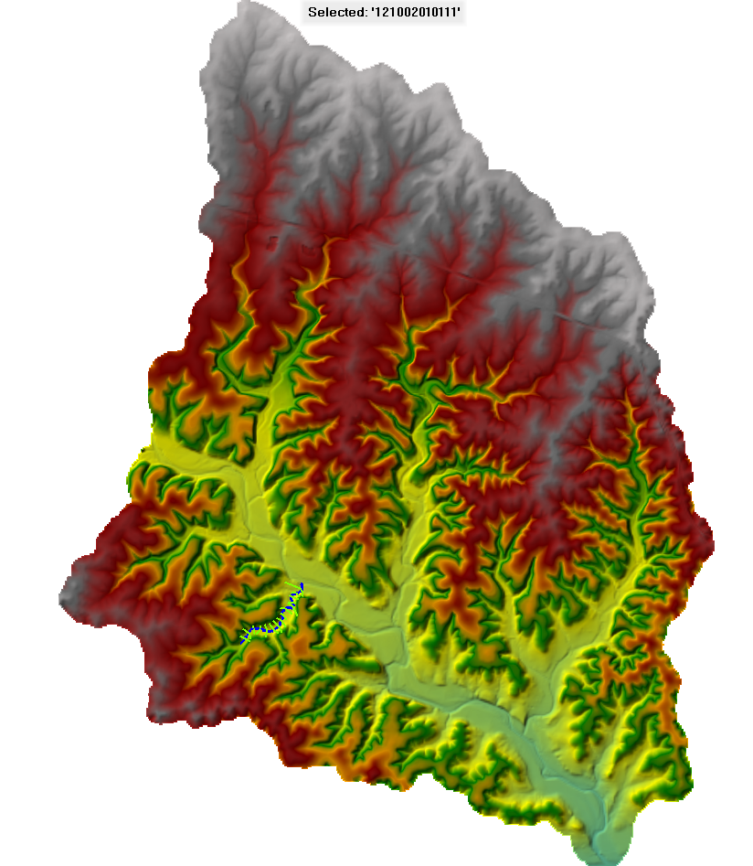
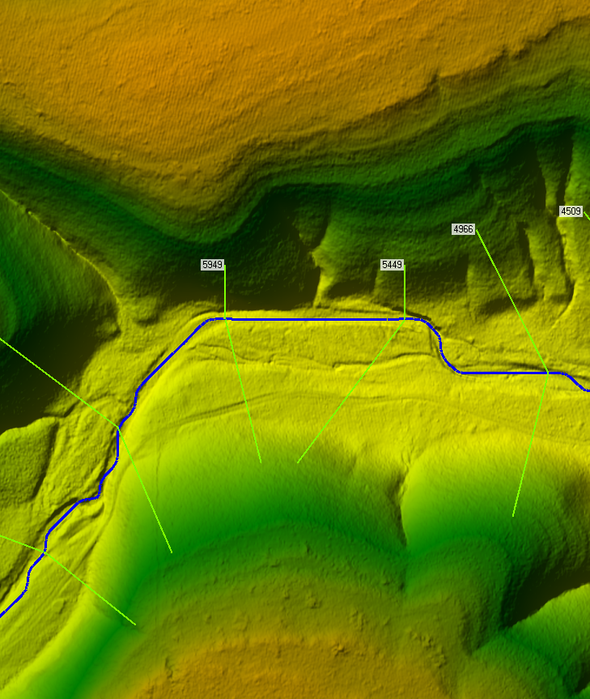
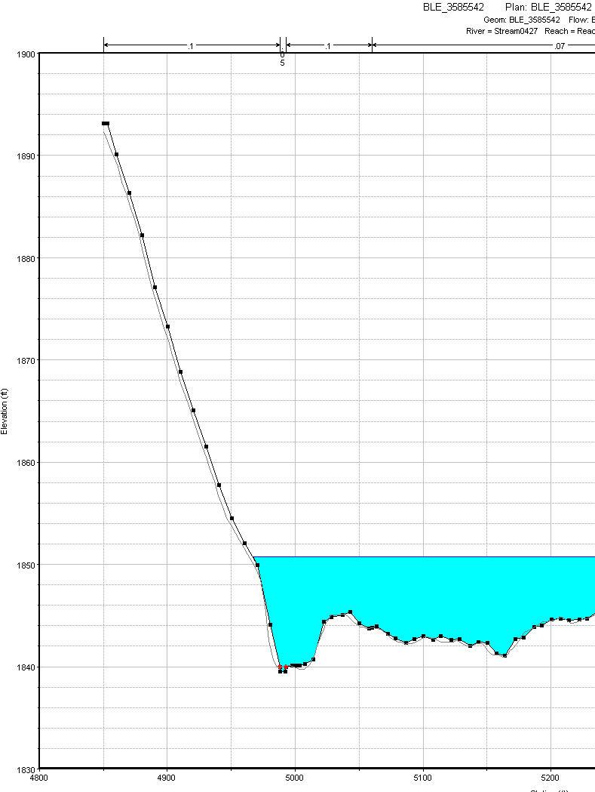
Verify BLE HEC-RAS model to HEC-RAS Terrain File
HEC-RAS HDF5 Terrain
Vs
BLE HEC-RAS Model
Note that HEC-RAS surfaces are created via script using DEM grids served by TNRIS using the Amazon Web service
https://s3.amazonaws.com/data.tnris.org/

Slide 22
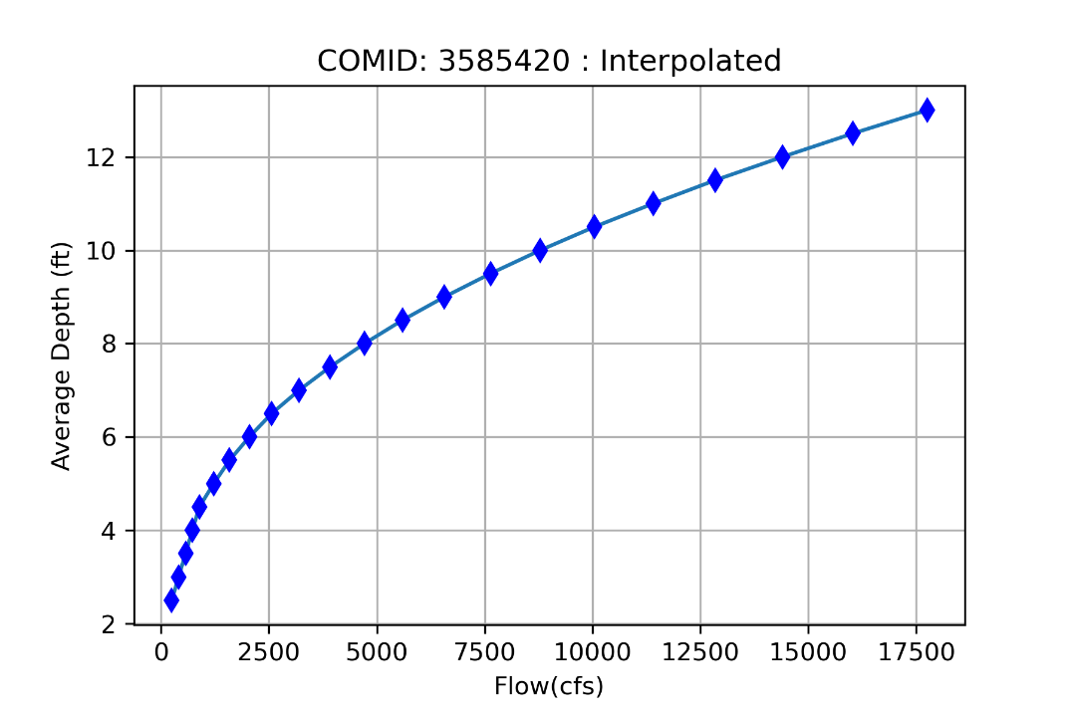
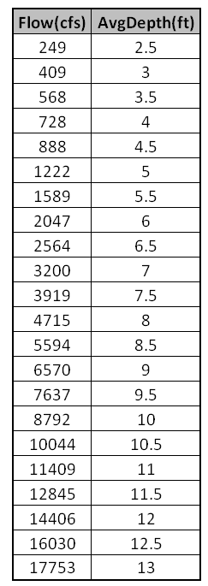
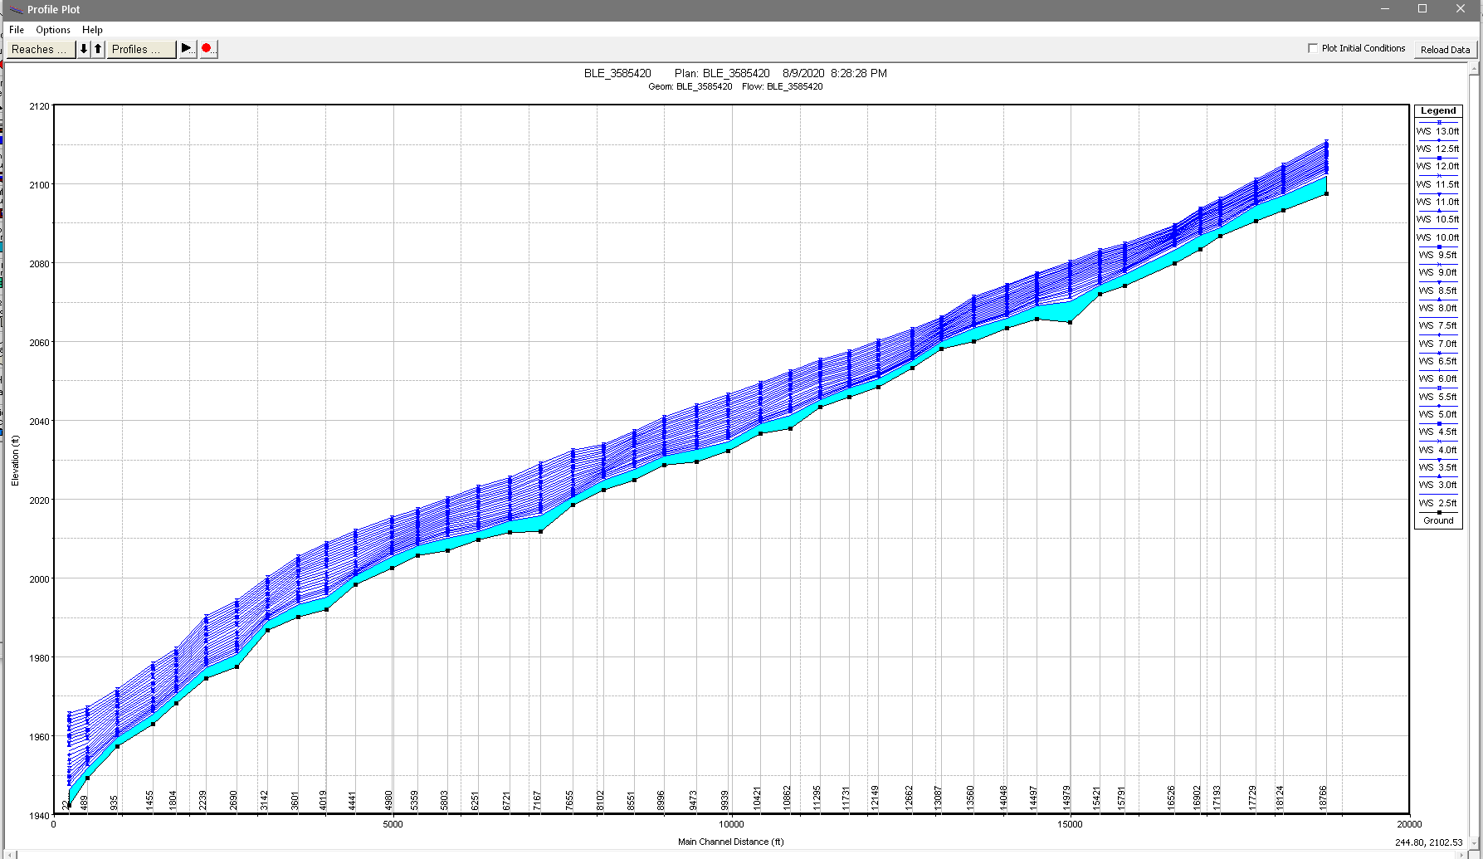
HEC-RAS Model from Base Level Engineering
Average Depth Rating Curve

Slide 23
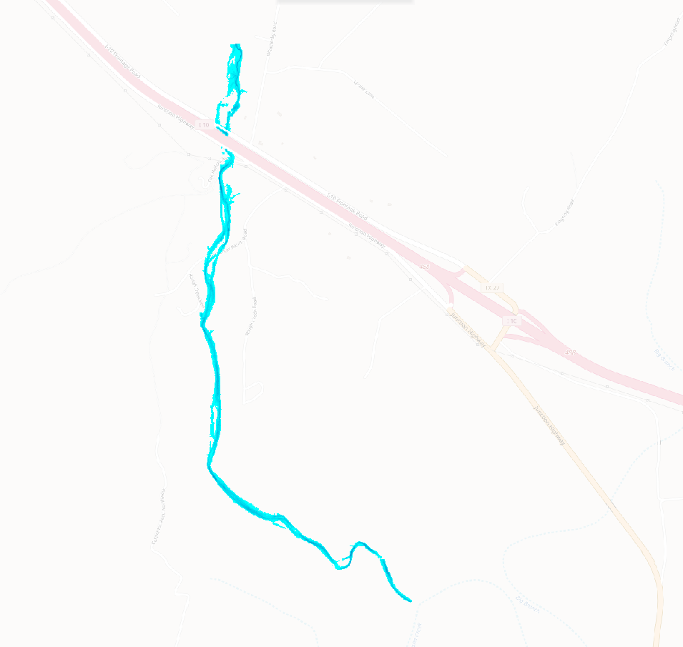
Flood Inundation Map Library
Avg Stream
Depth 4 ft
Avg Stream
Depth 13 ft

Slide 24
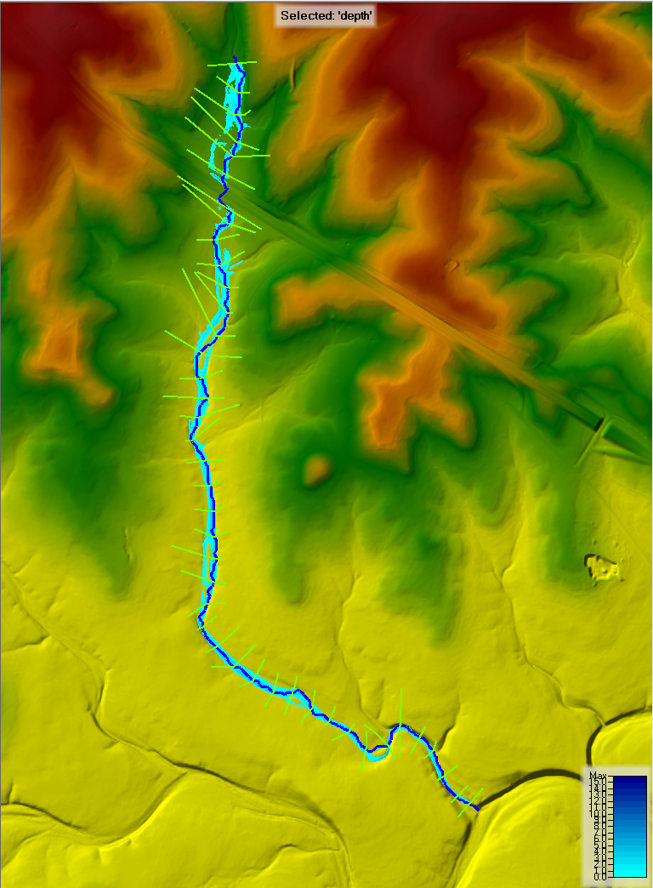
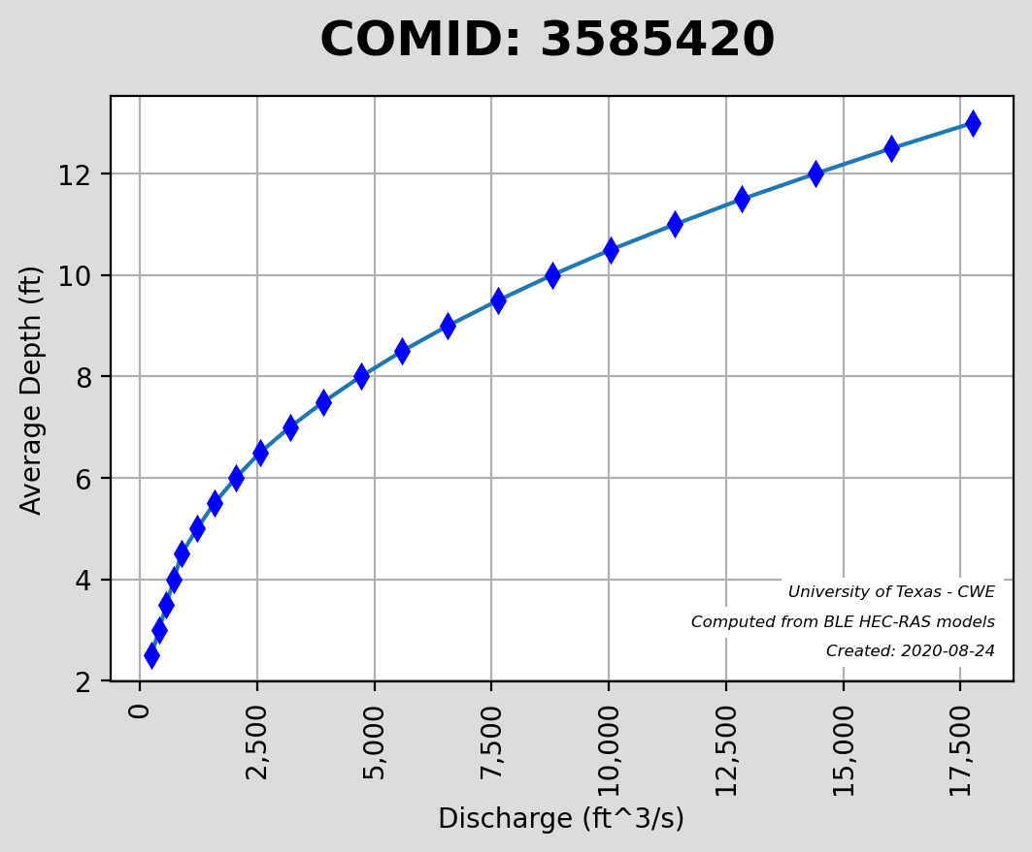
Flood Inundation Map Library
Stream
Depth 4 ft

Slide 25
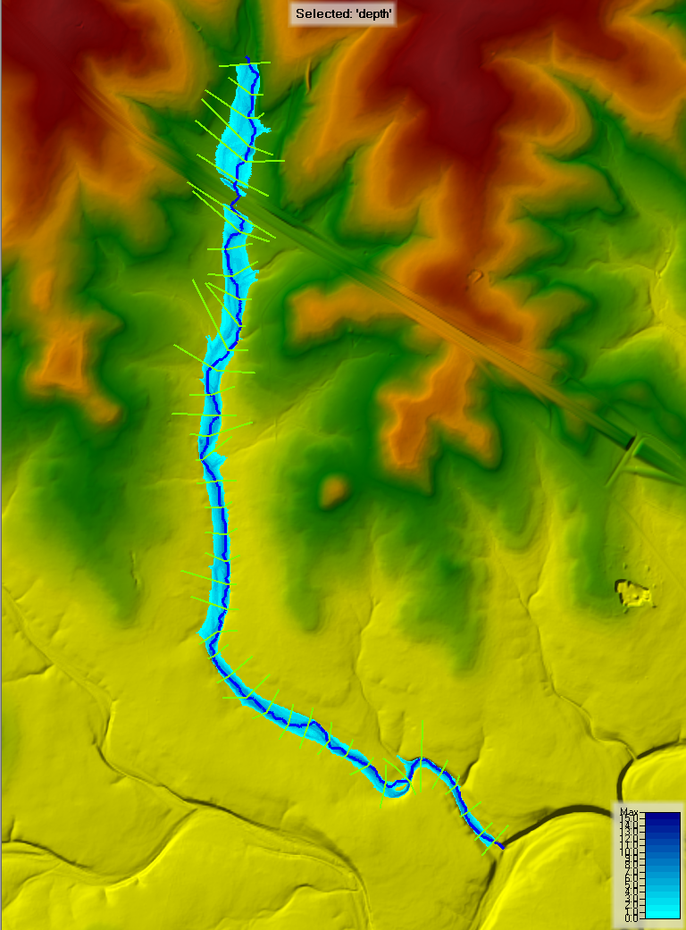
Flood Inundation Map Library
Stream
Depth 6 ft

Slide 26
Flood Inundation Map Library
Stream
Depth 8 ft
Stream
Depth 8 ft

Slide 27
Flood Inundation Map Library
Stream
Depth 10 ft

Slide 28
Flood Inundation Map Library
Stream
Depth 12 ft

Slide 29
Flood Inundation Map Library
Stream
Depth 13 ft

Slide 30
Flood Inundation Map Library from BLE Procedure
Step 1: Acquire Input Data
Step 2: Conflate BLE Streams to NHD-MR Streams
Create a ‘cross-walk’ that identifies which BLE model corresponds to particular NHD-MR stream reach
National Hydrography Dataset
(Medium Resolution)
Base Level Engineering:
HEC-RAS Models
Vector Spatial Data
Vector Spatial Data [streams]
Step 3: Determine modeling limits & peak flows for each stream in NHD-MR
Step 4: Get the terrain data (1m resolution) for the subject watershed
For each COMID, determine the upstream and downstream cross section for the BLE within the limits of the COMID. Get maximum flow in these sections (500 yr) from BLE
Download and composite a ground elevation data (1m resolution derived from LiDAR). Convert for use with HEC-RAS (Terrain HDF). Convert to same coordinate reference system (CRS) as the BLE models. Convert vertical units to feet if necessary.

Slide 31
Flood Inundation Map Library from BLE Procedure
Step 5: Create HEC-RAS Model for each COMID
Step 6: Compute HEC-RAS Average Depths on reach
Clip BLE HEC-RAS model to limits of cross sections from step 3. Create corresponding steady flow and plan file for truncated model
Up to the 500yr flow, iterate multiple flows down the 1D reach and determine the average reach stream depth for each flow.
Step 7: Interpolate rating curve to even depth intervals
Step 8: Compute and export grids for the specified intervals
Interpolate the flow that generates depth at a specified interval (0.5 ft). Save the rating curve data. Revise the HEC-RAS input flow data and re-simulate the model.
Extract the flood depth grid (GeoTIFF) of each of the computed depth interval. Automatically generated using HEC-RAS Mapper.

Slide 32
Flood Inundation Map Library from BLE Procedure
Step 9: Convert grids and supporting data to InFRM FDST compliant data
Step 10: Upload flood libraries to REST service
Convert data (shapefiles, grids and metadata to Interagency Flood Risk Management (InFRM) Flood Decision Support Toolbox (FDST) compliant format and projections
The flood libraries can be paired with the predictive reach flow to determine mapped limits of estimated flooding.
Graphic derived from InFRM Flood Decision Support Toolbox
Executive Summary and Submittal Guidance (August 13, 2019)
Flood Discharge Forecast
from the National Water Model
or WGRFC Model
Average
Stream Depth
Rating
Curve
Inundation
Map
Flow Rate

Slide 33
InFRM Deliverables

Slide 34
InFRM Deliverables

Slide 35
InFRM Inundation Map Documentation

Slide 36
Flood Inundation Mapping, Guadalupe River at Spring Branch
https://webapps.usgs.gov/infrm/fdst/

Slide 37
NHD-MR vs. Base Level Engineering(Stream Cardinality)
Turtle Creek BLE HEC-RAS Model
27 Stream Miles
Turtle Creek:
NHD-MR to BLE
16:1
Turtle Creek –
One HEC-RAS model in BLE =
16 COMID’s in NHD-MR

Slide 38
NHD-MR vs. Base Level Engineering
#1 BLE HEC-RAS model
Is shorter than the NHD-MR
stream
#2 Stream studied in
BLE but not in the
NHD-MR dataset
#3 NHD-MR
has no corresponding
BLE model

Slide 39
Limited Domain of Inundation Limits
Inundation limits for COMID
#3587586 stops at limits of
BLE ‘Stream1332’ HEC-RAS
COMID #3587672 has no
BLE model to which it
conflates

Slide 40
Five Gage Flood Map Datasets in Flood Decision Support Toolbox
Transformed to 2020 Km or 1250 miles of river mapping in
600+ reach flood map datasets in BLE to FIM library

Slide 41
Inundation Mapping from BLE Models at River Basin Scale
National Weather Service Flood Inundation Mapping (FIM) Services for Texas
Process for Base Level Engineering (BLE) to FIM for 1-D HEC-RAS Models
Example of 2-D HEC-RAS Model to FIM
Next Steps
Flood Discharge Forecast
from the National Water Model
or WGRFC Model
Average
Stream Depth
Rating
Curve
Inundation
Map
Flow Rate

Slide 42
2D Analysis: West Navidad River at I-10

Slide 43
HEC-RAS 2D Model for the NWM Catchment at Bridge
Credit: Cam Ackerman, USACE Hydrologic Engineering Center; Andy Carter, UT Austin

Slide 44
Mean Water Depths for Water Surface Profile along Stream
71,868 cfs
48,151 cfs
20,425 cfs
8,520 cfs
1,705 cfs
I-10 bridge

Slide 45
Rating Curves for Stream Reach and Bridge

Slide 46
Inundation Mapping from BLE Models at River Basin Scale
National Weather Service Flood Inundation Mapping (FIM) Services for Texas
Process for Base Level Engineering (BLE) to FIM for 1-D HEC-RAS Models
Example of 2-D HEC-RAS Model to FIM
Next Steps
Flood Discharge Forecast
from the National Water Model
or WGRFC Model
Average
Stream Depth
Rating
Curve
Inundation
Map
Flow Rate

Slide 47
Next Steps
Base Level Engineering to Flood Inundation Mapping
What we have now:
Solid foundation for state-wide flood forecasting
WGRFC Model for main stems and National Water Model for tributaries
Operational state-wide flood inundation mapping services
Built using HAND on 10m National Elevation Dataset
Build flood inundation map services on LIDAR
Use BLE models where available
Use HAND for the rest
What is needed:
Elevation data on 1m grid
Build BLE to FIM into a production system

Slide 48
Implement BLE to FIM for Main Stem Rivers? Support Replace and Route with HEC-RAS inundation mapping
Many HEC-RAS models
available for these rivers

