Slide 1
Streamflow Measurement at TxDOT Bridges
Closeout Presentation
TxDOT Project #5-9054-01
David Arctur
Leah Huling
Matt Ables
Brandon Azvedo
Kisters North America, Sacramento, CA
Barney Austin
Annabeth McCall
Aqua Strategies,
Dripping Springs, TX
Courtney Gallagher
Brian Footen
EarthViews,
Wimberley, TX
David Maidment
Paola Passalacqua
Harry Evans
Center for Water and the Environment,
University of Texas at Austin
Texas Department of Transportation, 21 October 2019
Acknowledgements: Chris Glancy, Project Manager, Saul Nuccitelli, TxDOT Chief Hydraulics Engineer, Kenneth Mora, Director, Design Divn;
TxDOT Project Team: Abderrahmane Maamar-Tayeb, Sean Yoon, Adam Jack, Brian Dodge, Jennifer Lyons, Kathleen Newton.
Xing Zheng, Christine Thies, Center for Water and Environment; Peter Ward, Hydrological Services America; Dirk Schwanenberg, Kisters;
Jim Navarro, Air-Sea Systems; Scott Gallagher, EarthViews; Tim Osting, Aqua Strategies; Andy Carter, LandDev;
Cam Ackerman, Hydrologic Engineering Center; Andy Rooke, AR Consults; Gert Van Maren ESRI; Meghan Roussel, Milton Sunvison, USGS.
Notes:
How do we answer the question of how many people are going to be impacted, especially if large areas of the state are not covered by LIDAR or National Flood Hazard Layer? The researchers developed a process called Height Above Nearest Drainage or HAND.

Slide 2
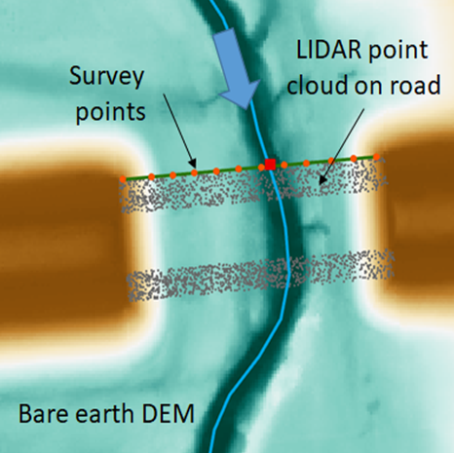
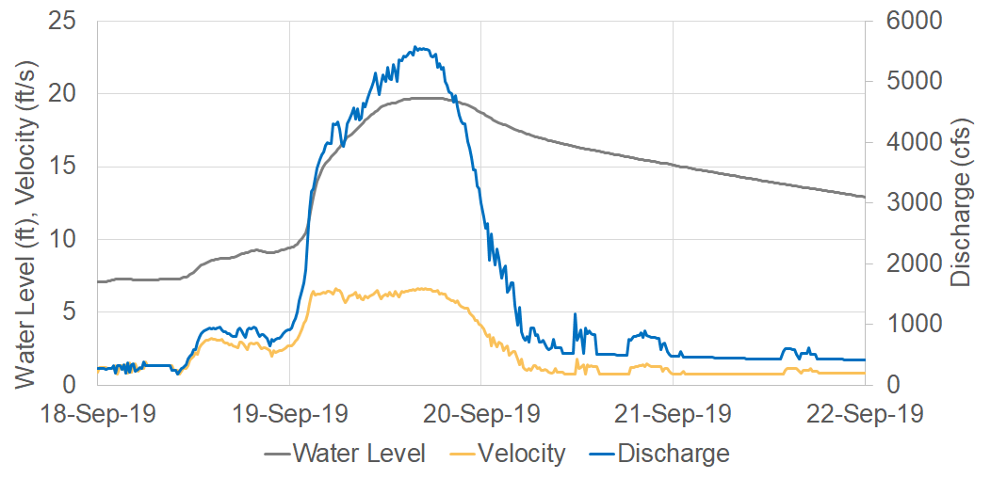
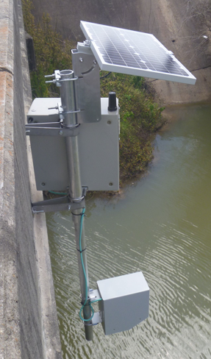
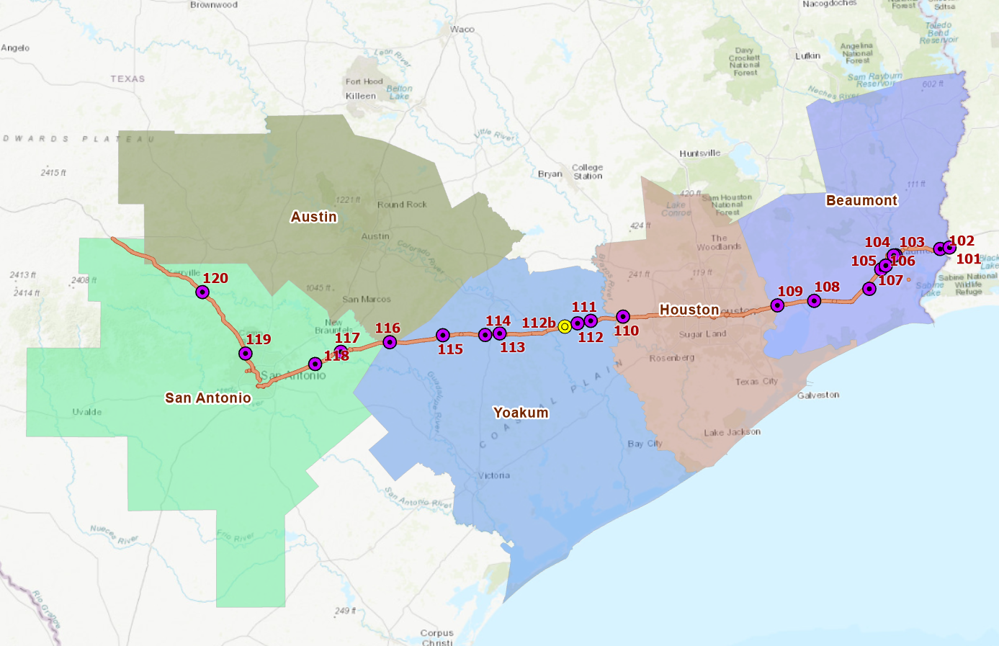
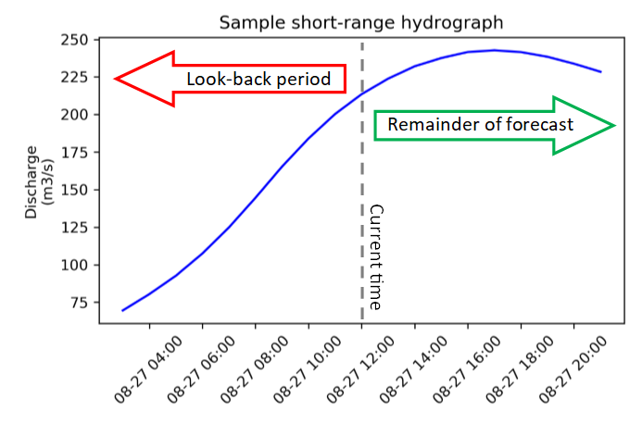
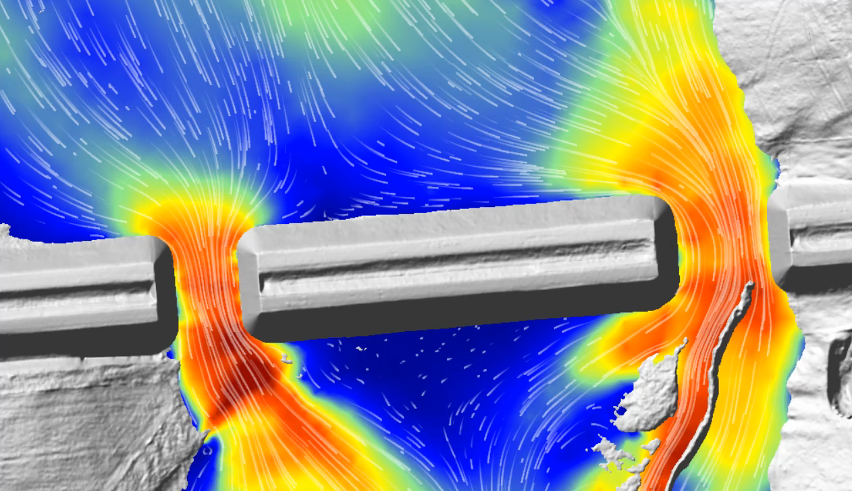
Streamflow Measurement at TxDOT Bridges
Gage
LIDAR
Results
Transect
Correlation
Modeling

Slide 3
Transect of Gages on I-10 Flood security of a highway
Notes:
In order to see where we are going we have to understand the past.
Lets look at a brief history of flood mapping during an emergency response.

Slide 4
National Water Model
Spatially Continuous Water Prediction Forecasts
Operational hydrologic forecast model running 24/7 on Weather and Climate Operational Supercomputing System (WCOSS)
Streamflow forecasts for 2.7M river reaches depicted in National Hydrography Dataset-Plus (NHDPlus)
National Water Center started operations on 1 October 2019.
Tuscaloosa, Alabama
Slide: adapted from Fernando Salas, NWS
Notes:
NWM V2.0 Configurations
CONUS
Analysis and Short-Range (each hour)
Extended Analysis (daily)
Ensemble Medium-Range (synoptic)
Ensemble Long-Range (daily, time-lagged)
Hawaii
Analysis and Short-Range (synoptic)

Slide 5
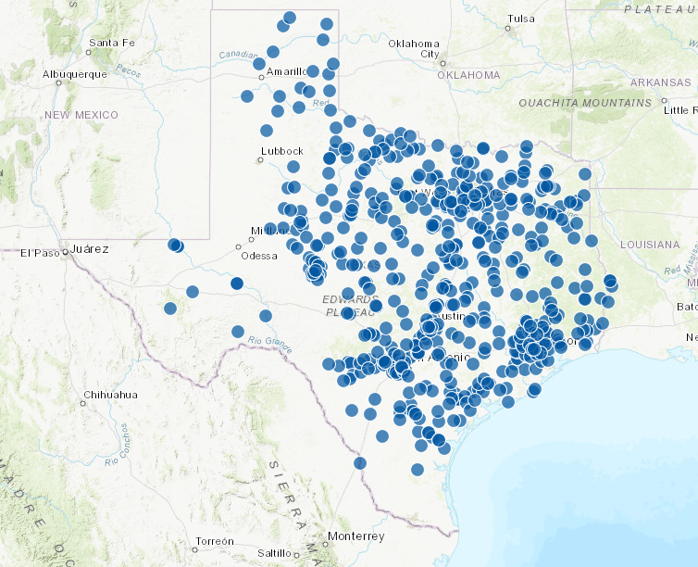
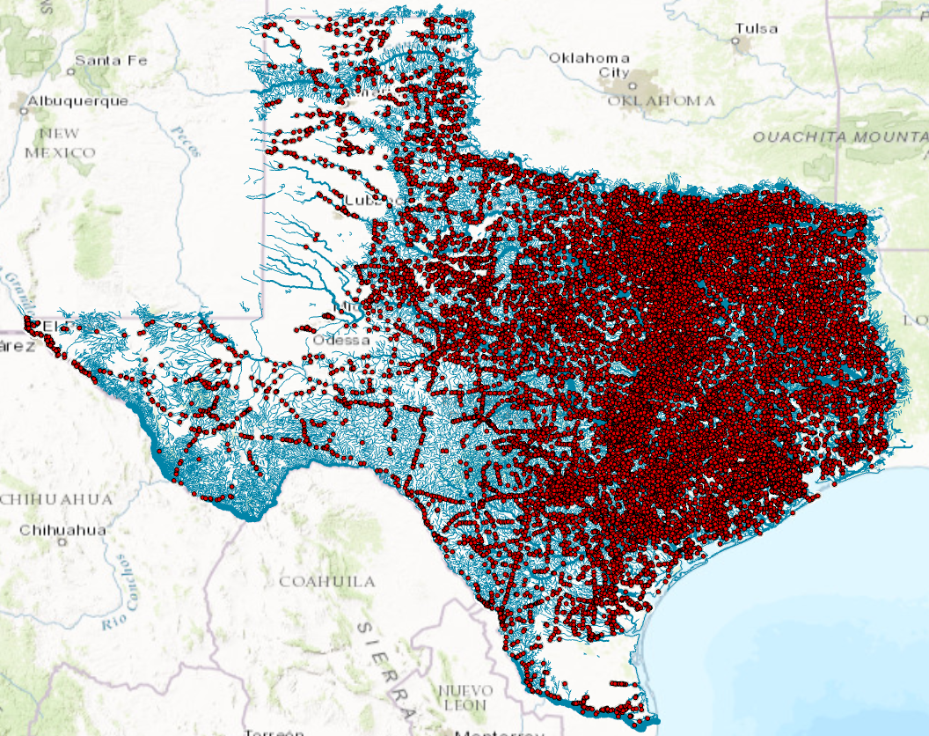
Water Measurement Sites
550 USGS Streamflow Gages
(data presently used in NWM)
27,000 TxDOT Bridges on 15,700 NWM reaches
(potential additional measurement sites)

Slide 6
Transect of 20 Measurement Sites on I-10
Site | Location
101 | Sabine River at I-10
102 | Adams Bayou at I-10
103 | Bairds Bayou at I-10
104 | Neches River at I-10
105 | Hillebrandt Bayou at TX-124
106 | Willow Marsh Bayou at I-10
107 | North Fork Taylor Bayou at I-10
108 | Turtle Bayou at I-10
109 | Cedar Bayou at I-10
110 | Bessies Creek at I-10
111 | East Bernard Creek at I-10
112 | San Bernard at I-10 (moved to Church Creek at I-10)
113 | East Bernard River at US-90
114 | West Navidad River at I-10
115 | Peach Creek at I-10
116 | Plum Creek at I-10
117 | Geronimo Creek at I-10
118 | Santa Clara Creek at I-10
119 | Leon Creek at I-10
120 | Guadalupe River at US-87
Credit: Harry Evans, CWE; Matt Ables and Brandon Azvedo, Kisters; Jim Navarro, Air-Sea Systems;

Slide 7
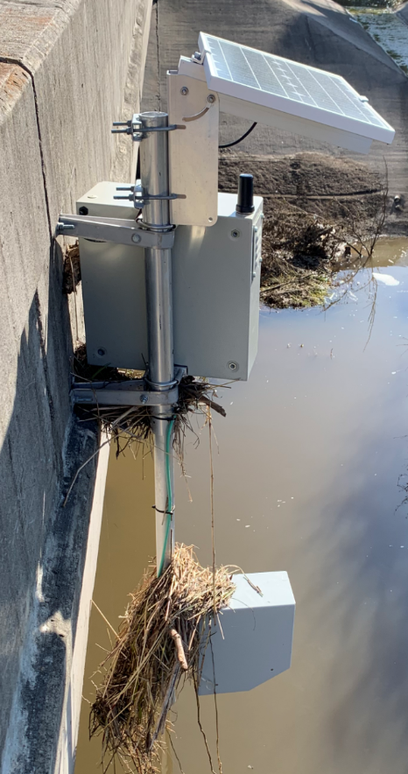
Findings and Recommendation: Radar Bridge Sensors
Idea of an autonomous bridge streamflow sensor worked
Self contained, solar power, cell phone communication
Measuring both water level and velocity is valuable
Cost $15,000
Installation time ~ 3 hours
Reliable and low maintenance
If bridge overflows, gage overflows
Recommendation:
Need to consider elevating gages
Site 106: Willow Marsh Bayou,
Beaumont, after TS Imelda

Slide 8
Findings and Recommendation: Transect of Gages on I-10
Concept of a transect of gages along a highway is innovative
Largest set of radar streamflow measurement sites in the US
Many gages already installed in Harris County so no need to gage there
9 gages in Beaumont District
Recommendation:
Consider additional transects
above and below I-10 especially
in South-East Texas
(4 Presidentially Declared flood
disasters in the last 5 years)

Slide 9
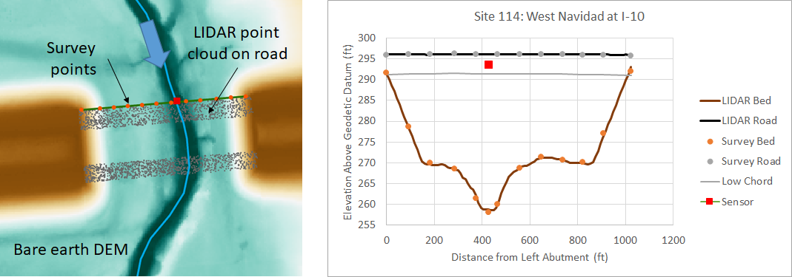
LIDAR for Site Characterization Measuring stream cross-section
Notes:
In order to see where we are going we have to understand the past.
Lets look at a brief history of flood mapping during an emergency response.

Slide 10
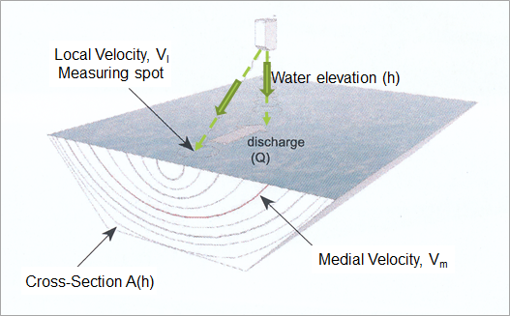
Measurement of Water Elevation and Velocity using Radar
Wolfram &
Christoph
Sommer
Peter
Ward

Slide 11
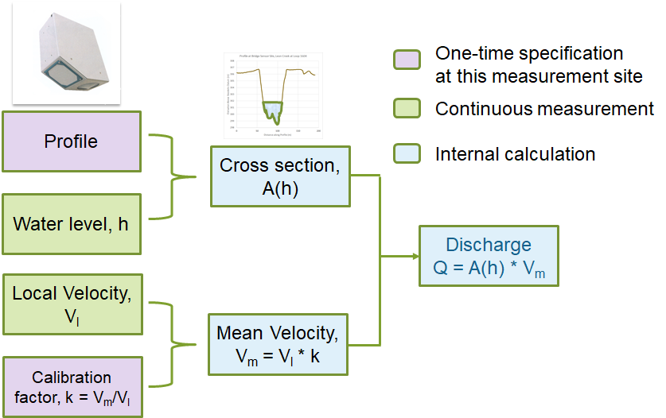
Procedure for Computing Discharge
Specified at installation
Measured by gage
Computed in Kisters cloud
Credit: Matt Ables, Kisters

Slide 12
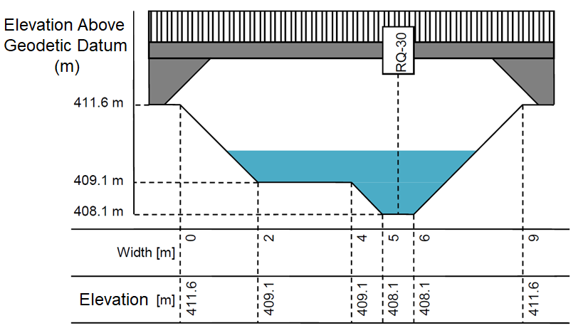
Specification of River Cross-Section

Slide 13
LIDAR DEM, and LIDAR Point Cloud on Bridge Used to characterize cross-section profiles at site
Very close agreement between LIDAR and GPS surveying

Slide 14
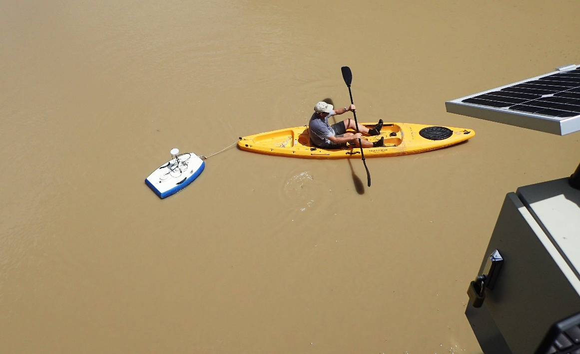
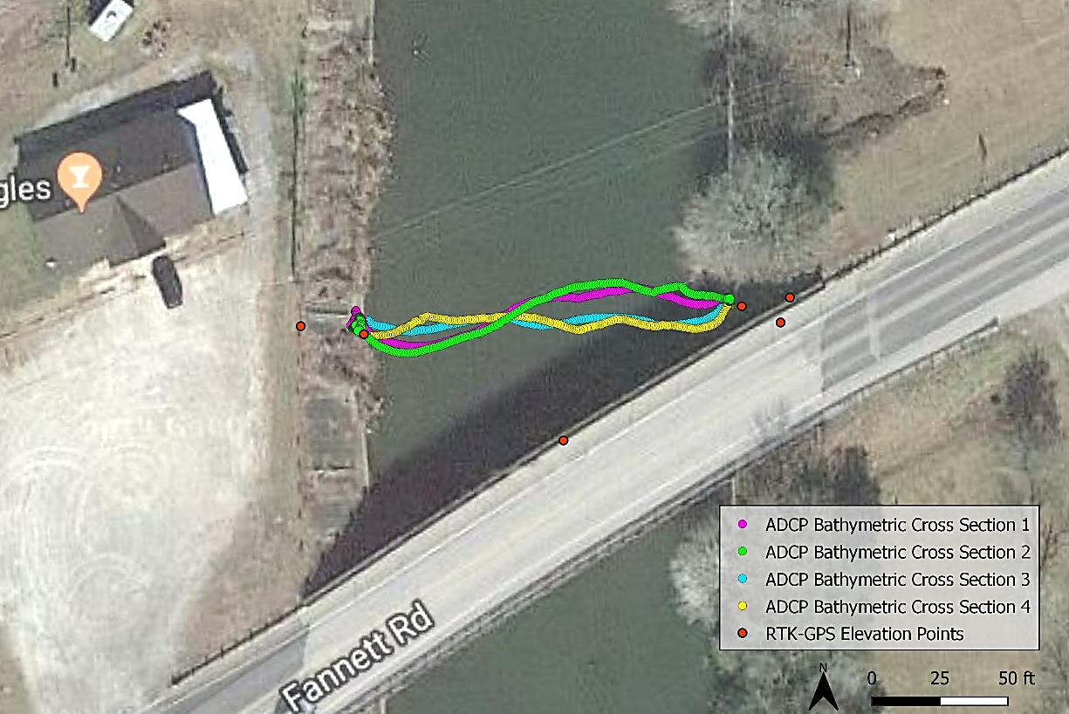
Acoustic Doppler Profiler Measurement For Rivers with Permanent Water: All Sites on I-10 East of Houston
Credit: Barney Austin, Annabeth McCall, Tim Osting, Aqua Strategies
Measures Depth
and Velocity

Slide 15
Stream Cross-Section and Road Profile Developed from LIDAR and sonar measurement
LIDAR
Standing water at sea level
Sonar (ADCP)

Slide 16
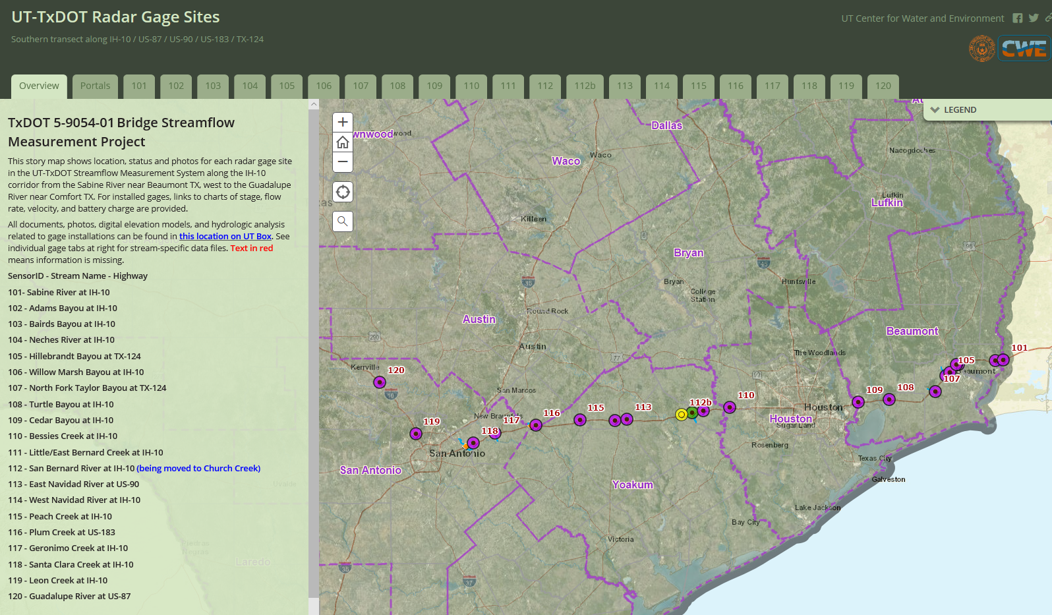
ArcGIS StoryMap for Site Characterization
https://arcg.is/0WqTS0
Credit: David Arctur, CWE

Slide 17
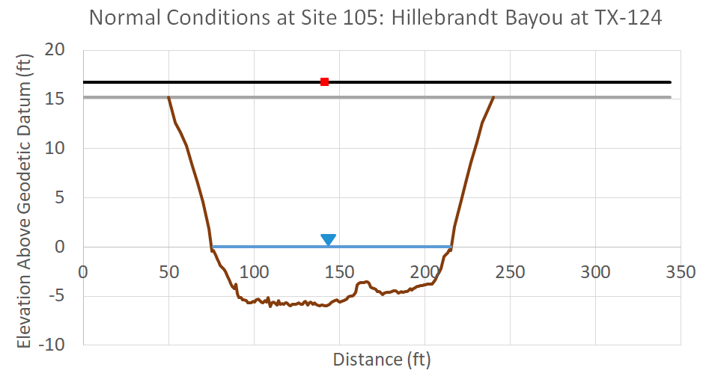
Findings and Recommendation: LIDAR for Site Characterization
Texas new 1m LIDAR data are very accurate
Can be used for 3D characterization of road and stream profiles
GPS Survey of gage location in (x,y,z) is critical
All gages east of Houston on I-10 have stream bed below sea level
Supplement LIDAR with ADCP
Recommendation:
Consider measurement of
stream bathymetry all along rivers

Slide 18
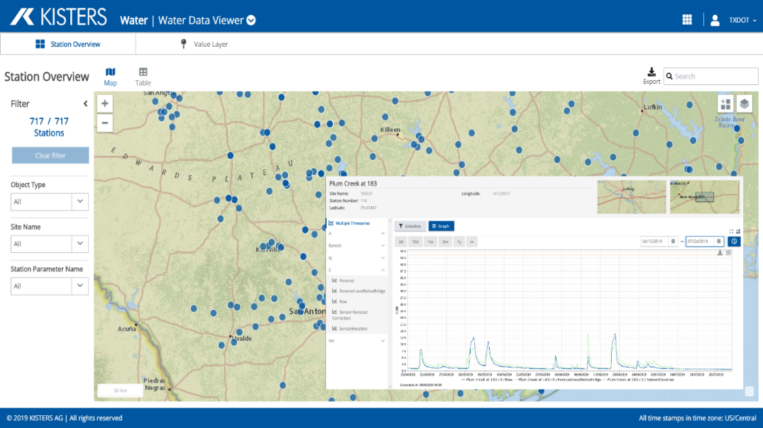
Data Processing and Results Kisters Big Data System in the cloud
Notes:
In order to see where we are going we have to understand the past.
Lets look at a brief history of flood mapping during an emergency response.

Slide 19
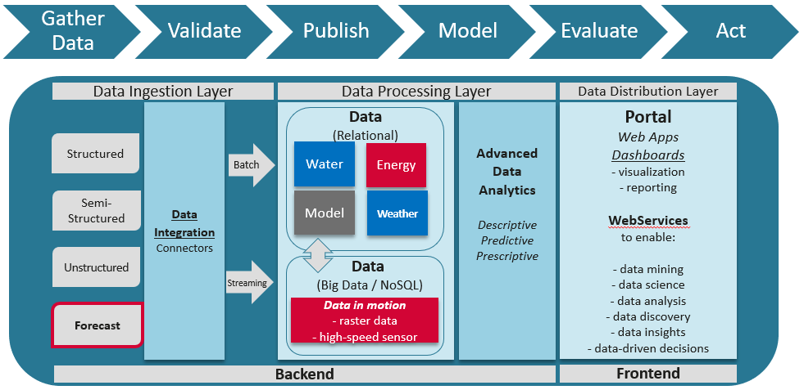
Kisters Big Data System
(located in Aachen, Germany)
Kisters is the largest water data management company in the world

Slide 20
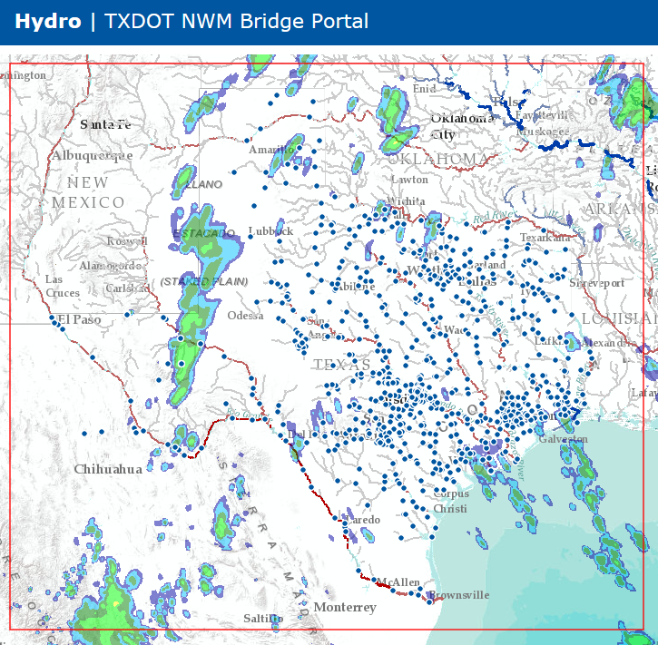
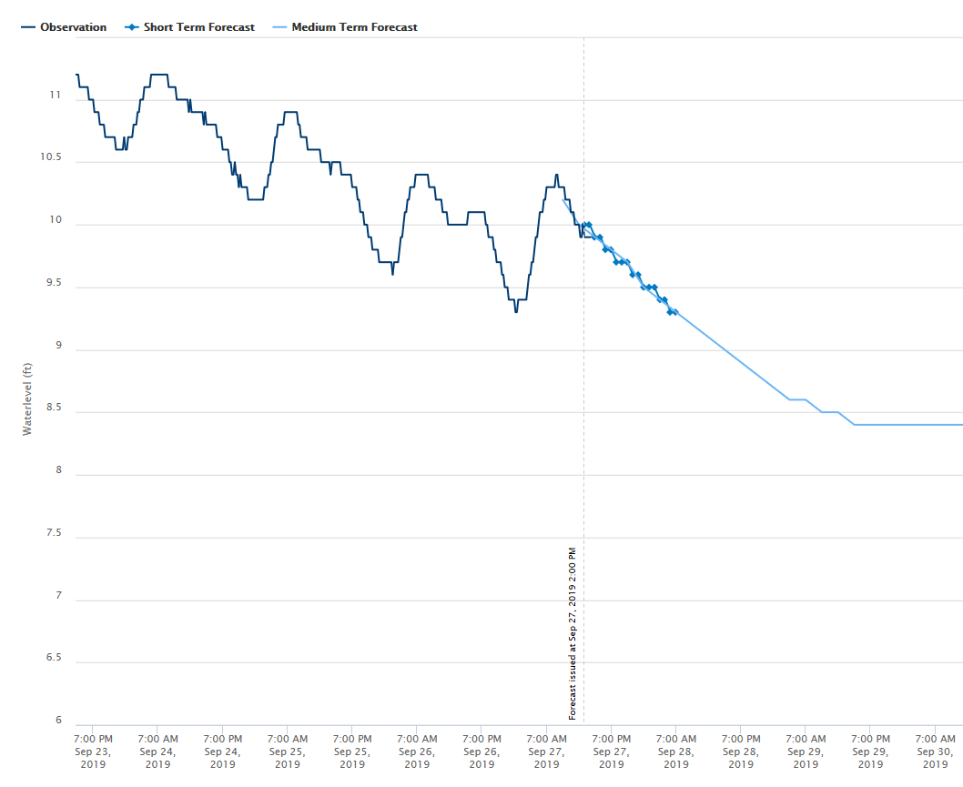
TxDOT National Water Model Bridge Portal
Credit: Matt Ables, Brandon Azvedo, Kisters North America
TxDOT
Measurement
NWM
Forecast
Water Level (ft)
Neches River
during TS Imelda
Present
Provides state-wide coverage of National Water Model forecasts for Texas
(102,000 river reaches covering 190,000 miles of streams and rivers)

Slide 21
TxDOT Water Data Viewer (details of individual sites)
Enables retrospective view of observed water data at individual sites for chosen time periods

Slide 22
Radar Streamflow Measurement during TS Imelda Gage simultaneously measures water level and surface velocity, then computes discharge

Slide 23
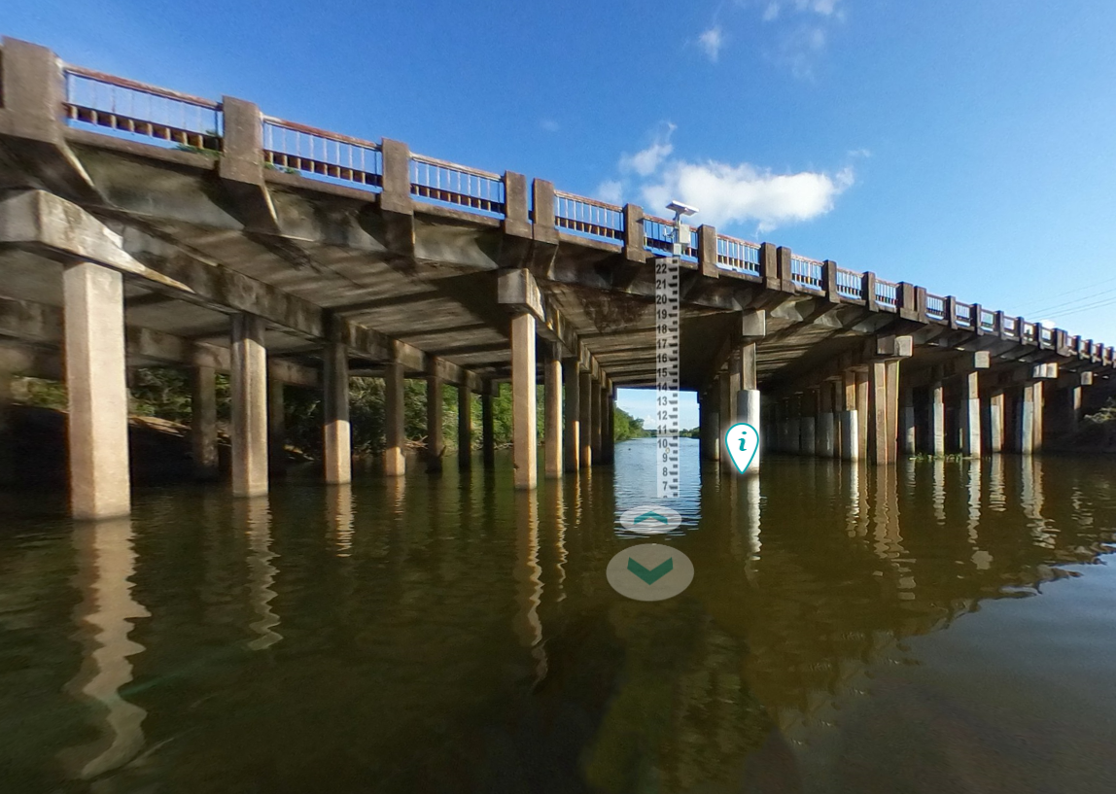
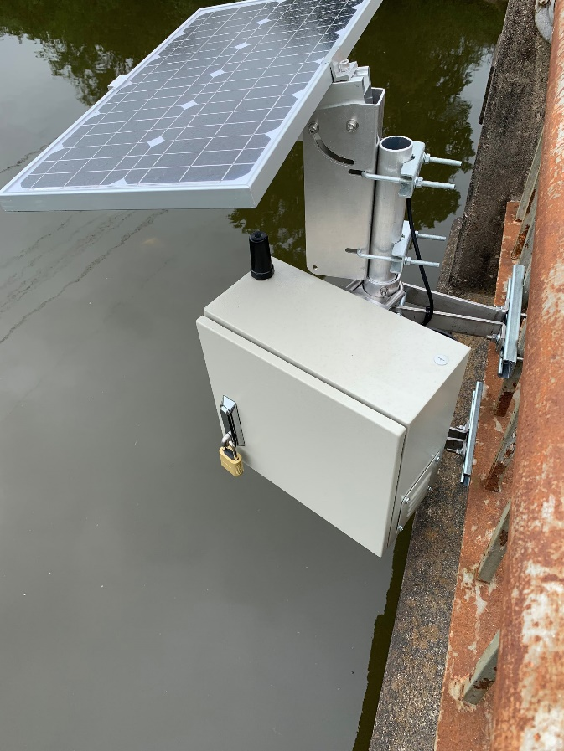
EarthViews 360°Imagery at Hillebrandt Bayou
https://arcgis.earthviews.com/public/105-hillerbrandt-bayou#22
Radar Sensor
Virtual Staff Gage
Credit: Courtney Gallagher and Brian Footen, EarthViews

Slide 24
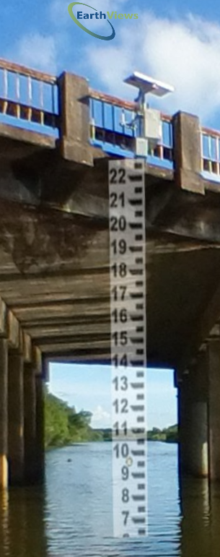
Water Level on Virtual Staff Gage
Peak water level 19.7 feet
above stream bed

Slide 25
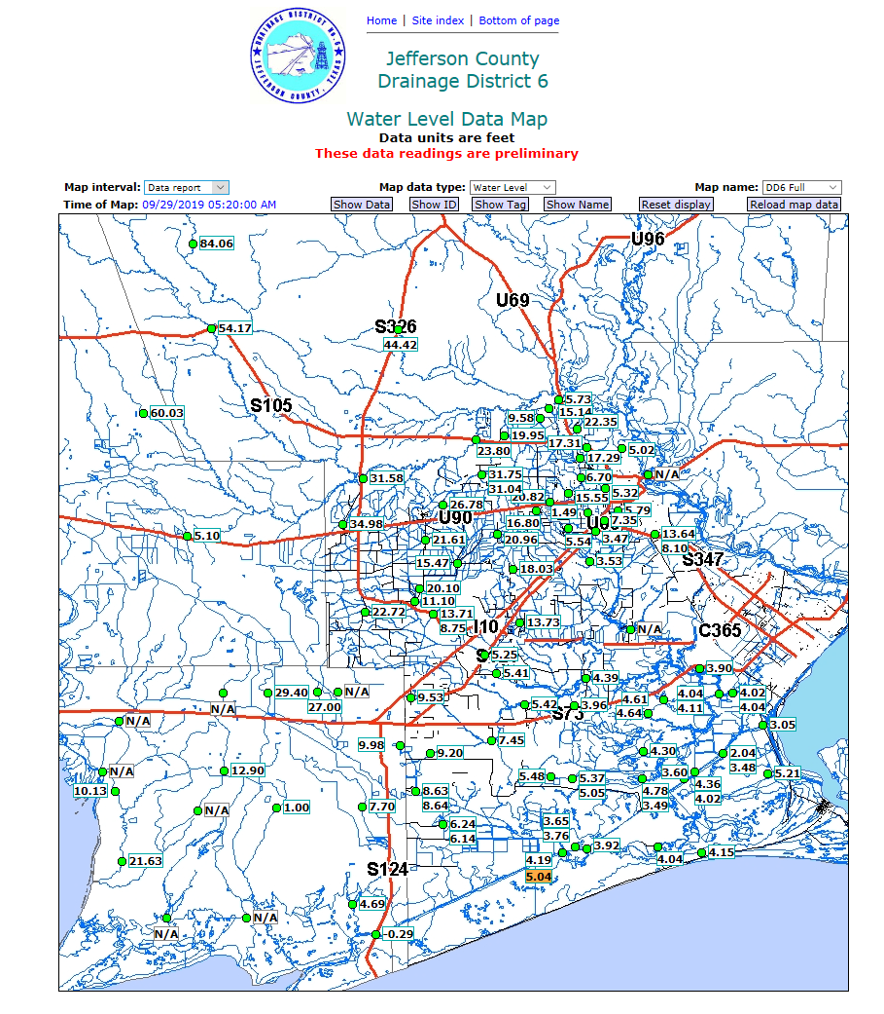
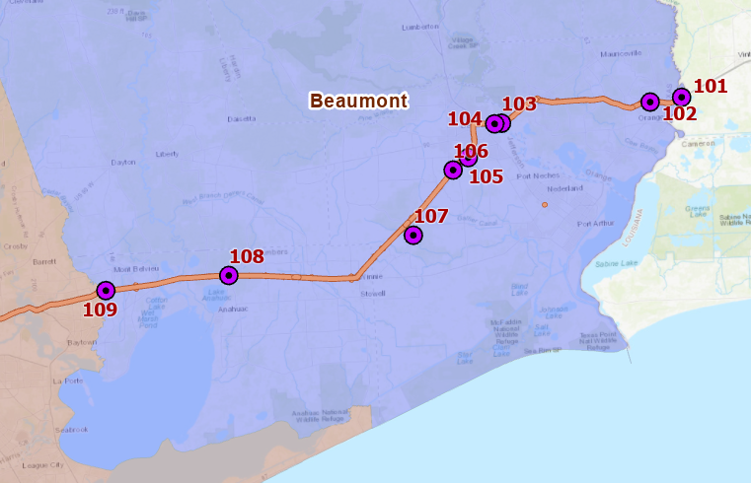
Local Observation Network in Beaumont Area
Jefferson County
Drainage District No. 6

Slide 26
Summary and Findings: Data Processing and Results
Kisters Big Data System is a reliable repository for large scale data
Various viewers and services for data output
Handles large scale data from National Water Model effortlessly
Processes data from radar sites
Can provide alerts
Recommendation:
Add more local networks
LCRA, Houston, Jefferson County DD6

Slide 27
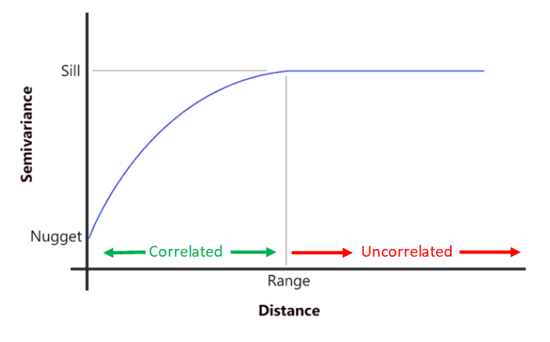
Statistical Analysis Correlation along streams and along I-10
Notes:
In order to see where we are going we have to understand the past.
Lets look at a brief history of flood mapping during an emergency response.

Slide 28
Data Assimilation Application in West Navidad Basin
(Correlation along the streams)

Slide 29
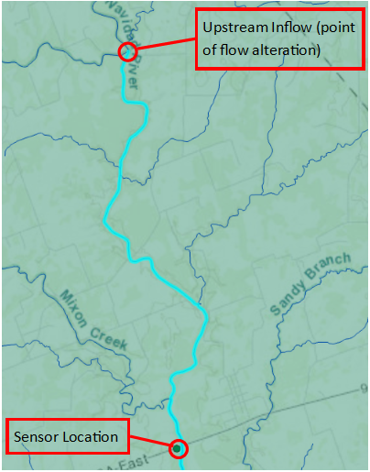
Proof of Concept: Upstream Alteration

Slide 30
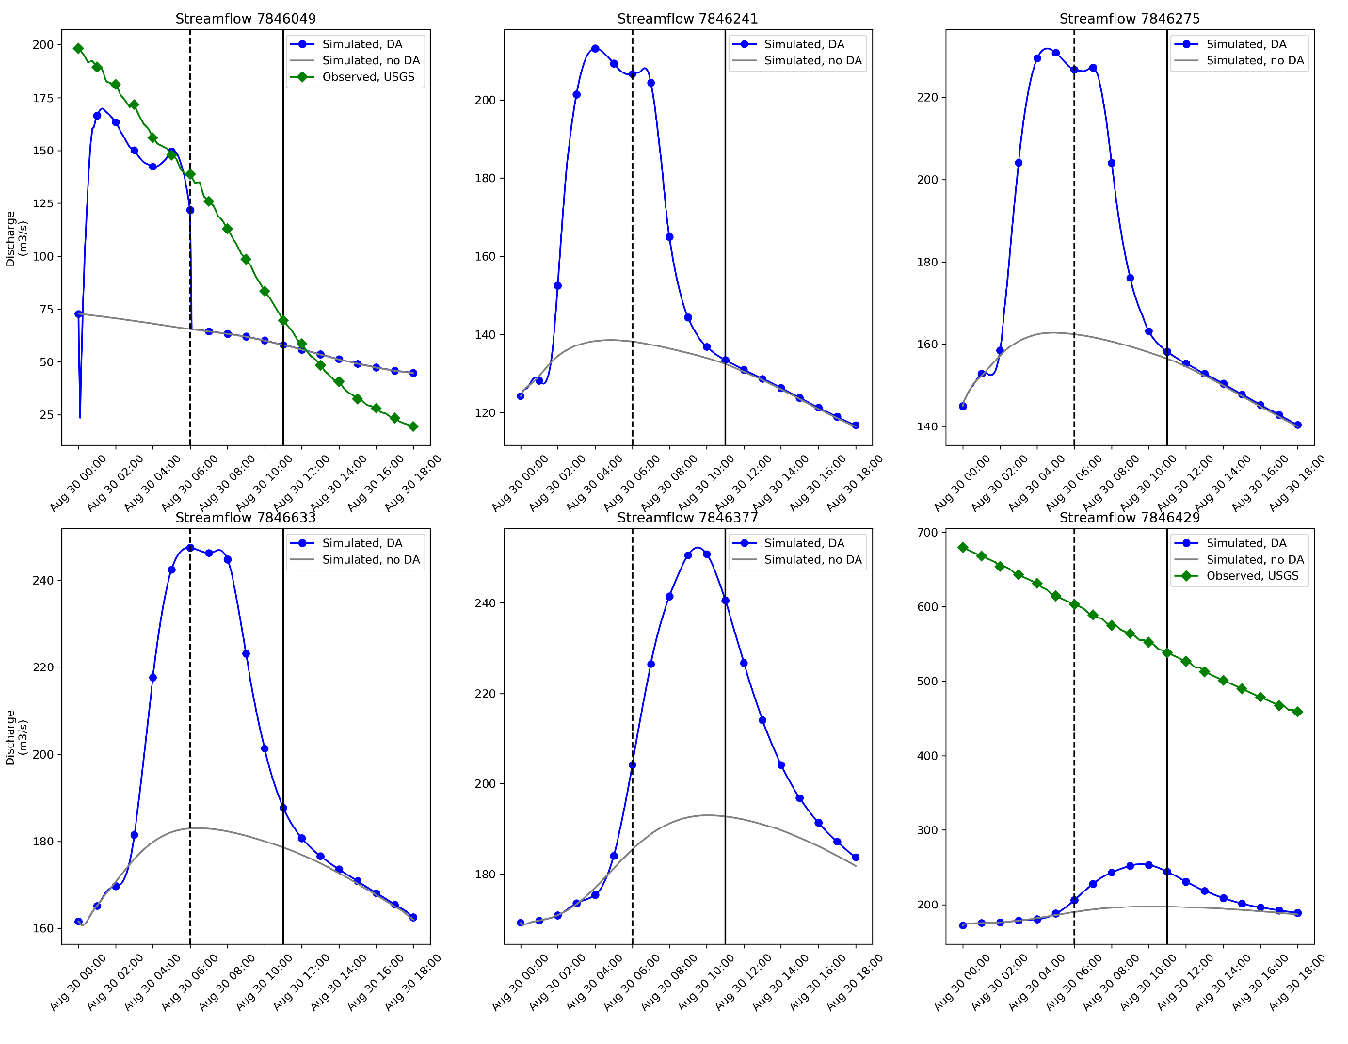
Proof of Concept: Downstream Propagation

Slide 31
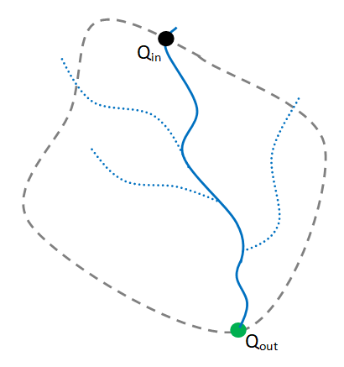
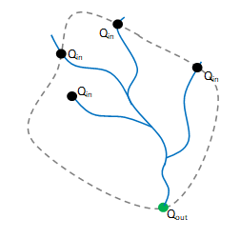
Next Steps - Single Channel v. Branched Network
Single Channel Network
Branched Network
Study Area Boundary
Contributing stream segment
Missed stream segment
Credit: Leah Huling and Paola Passalacqua, UT Austin, Dirk Schwanenberg, Kisters

Slide 32
Extent of Longitudinal Correlation along Streams
15 miles
upstream
30 miles
downstream

Slide 33
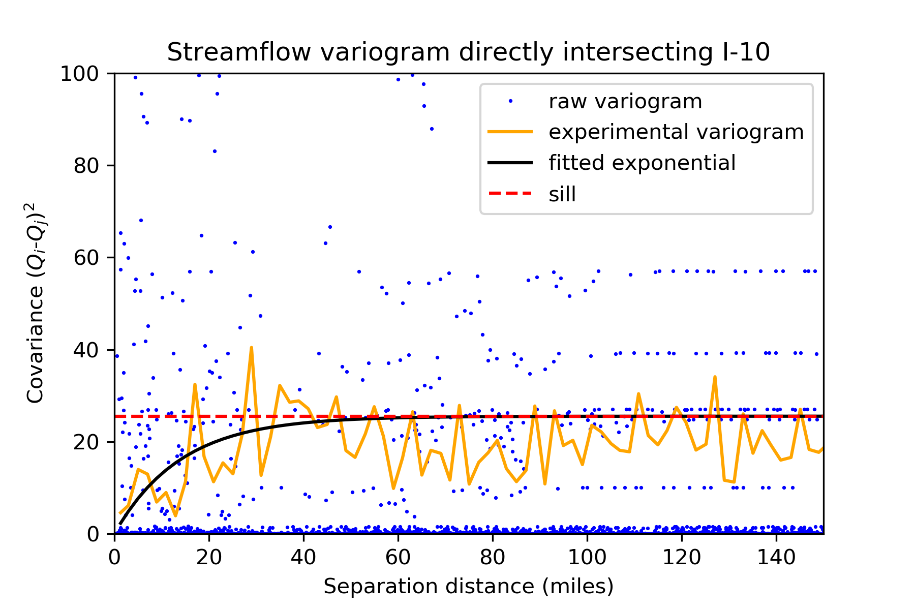
Correlation of Flows in Streams Crossing I-10 during TS Imelda
(Correlation along I-10)
Variogram meets sill at about 50 miles – Extent of lateral correlation along I-10

Slide 34
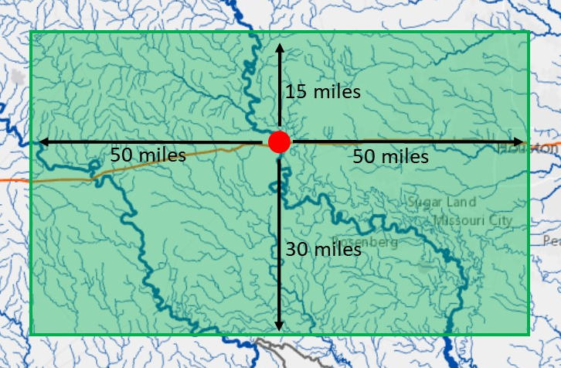
Summary: Correlation along Streams and Along I-10
I-10
Streams
Current gage spacing ~ 1 gage per 20 miles on I-10 West of Houston,1 gage per 10 miles on I-10 in Beaumont

Slide 35
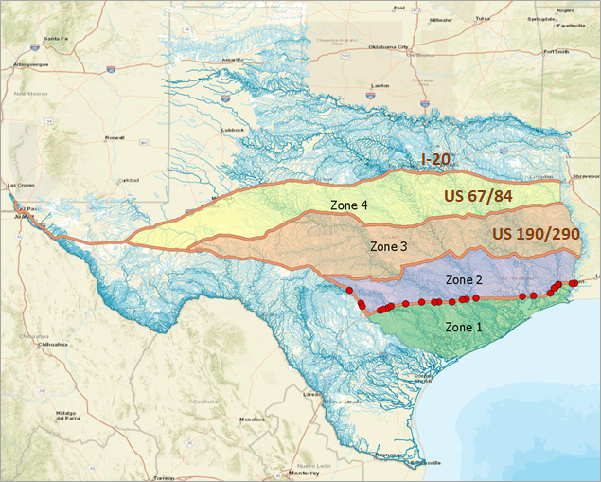
Possible Future Transects
Transects are about 70 miles apart
Probably need to be about half
this distance

Slide 36
Findings and Recommendation: Statistical Analysis
Flows are correlated laterally along I-10 and longitudinally along streams
Correlation on the order of 40-50 miles
Current gage spacing is 10-20 miles
This is dense enough to avoid gaps
Results are preliminary
Recommendation:
More detailed study of TxDOT and USGS
data coupled with National Water Model

Slide 37
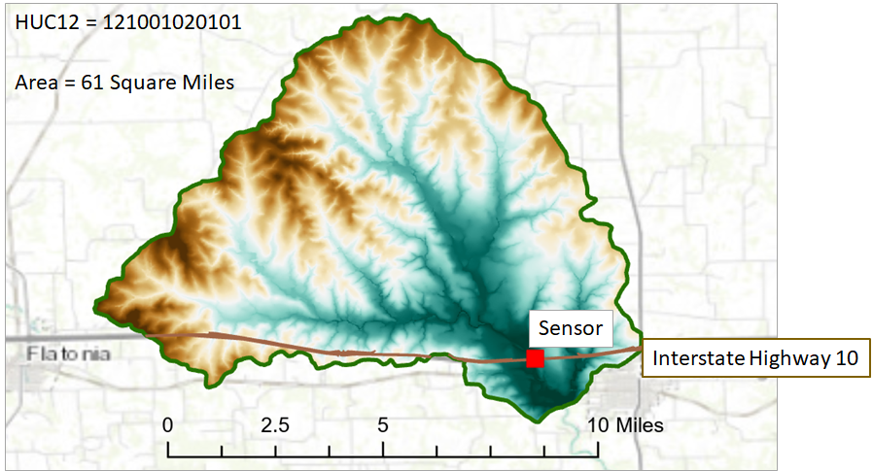
Flow Modeling at Bridges Details of depth and velocity
Notes:
In order to see where we are going we have to understand the past.
Lets look at a brief history of flood mapping during an emergency response.

Slide 38
Watershed of Gage on West Navidad River at I-10

Slide 39
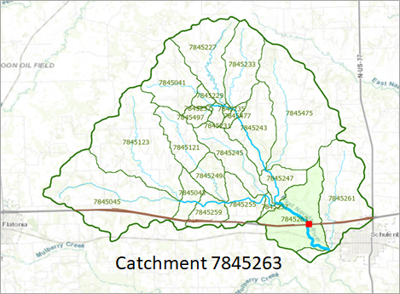
Representation in the National Water Model as 23 Reach Catchments

Slide 40
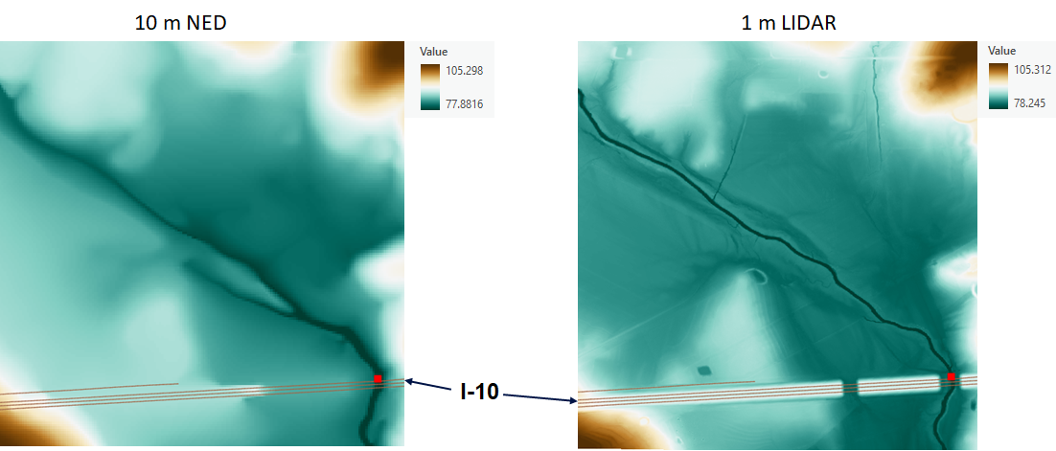
Terrain Data Near I-10
10m x 10m cells
1m x 1m cells

Slide 41
Elevation Profiles along I-10
LIDAR measures road profile accurately

Slide 42
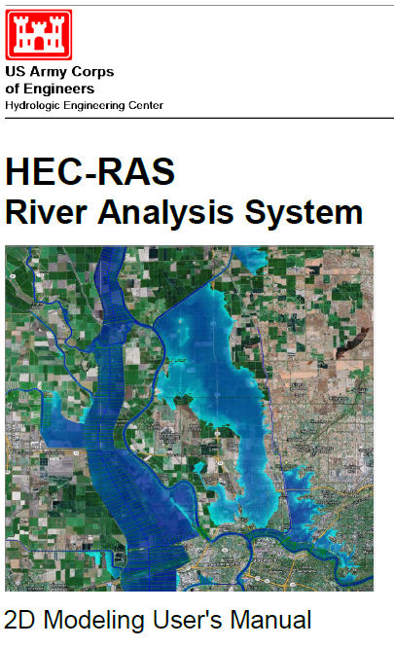
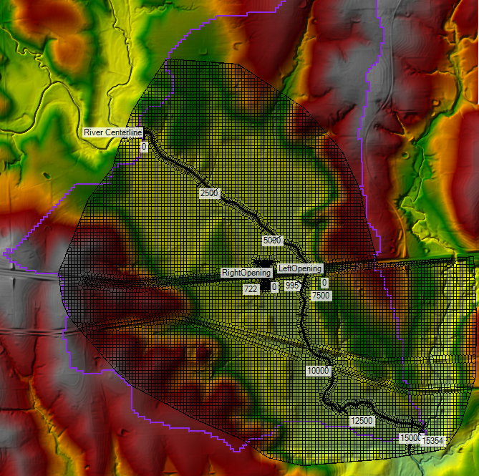
HEC-RAS 2D Model for Catchment of this Gage
Credit: Cam Ackerman, USACE Hydrologic Engineering Center; Andy Carter, LandDev

Slide 43
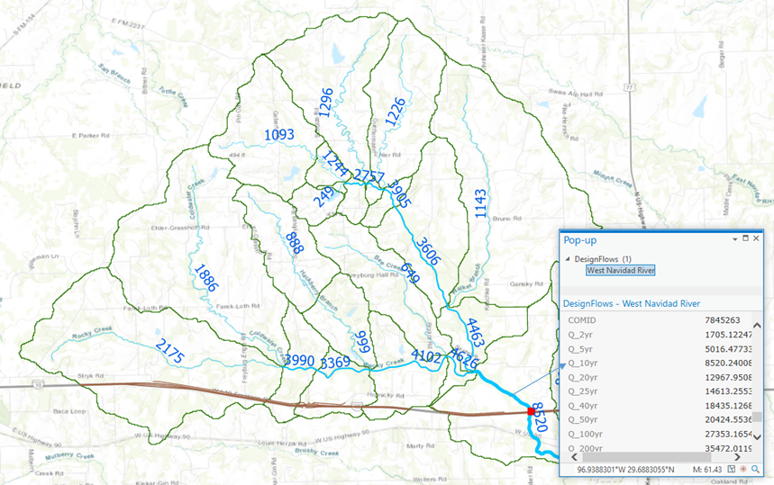
Flood Frequency from National Water Model Reanalysis (1993-2018)
Credit: Xing Zheng, CWE

Slide 44
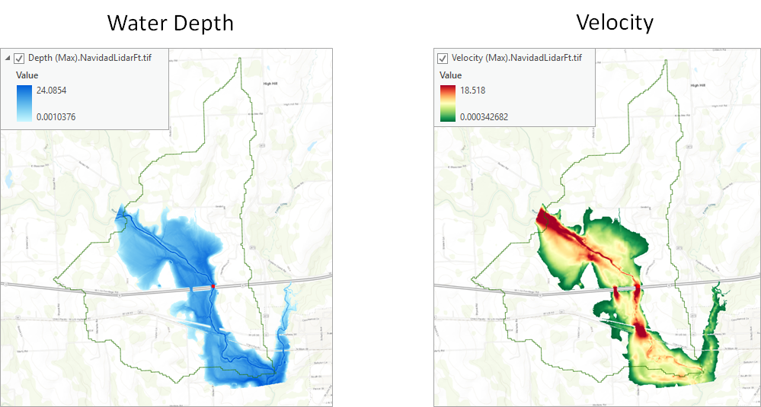
Maps of Water Depth and Velocity (produce flood inundation map library by varying discharge)

Slide 45
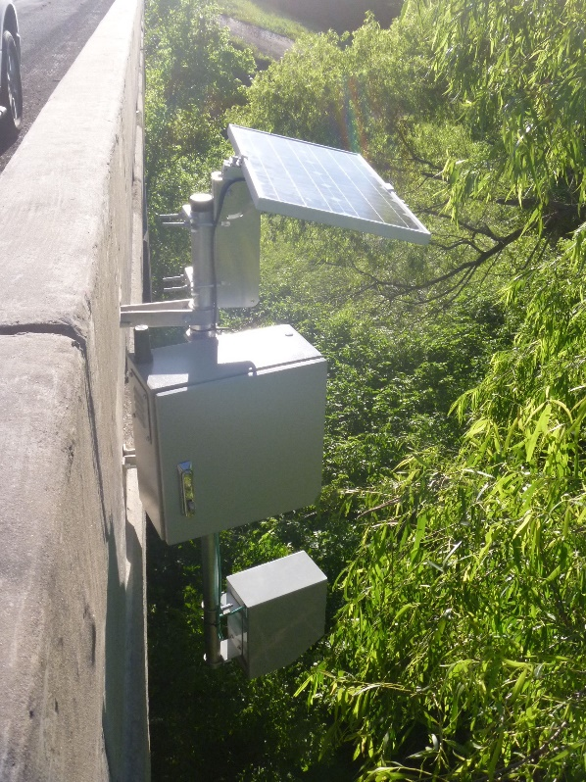
Flow through the Bridges (30% on left, 70% on right)
Gage at Site 116

Slide 46
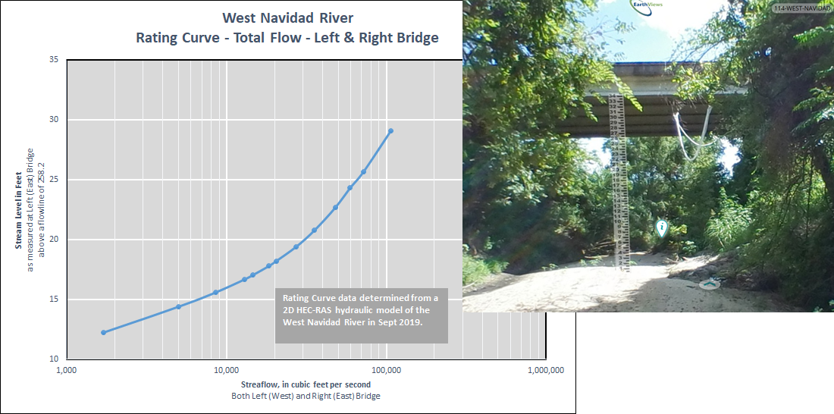
Rating Curve at Bridge: West Navidad River at I-10
Water Level (ft)
Discharge (cfs)

Slide 47
Findings and Recommendations: Flow Modeling at Bridges (this component was not part of the original project scope)
2D flow modeling on 1m LIDAR gives good engineering scale results
Enables flood risk at bridge to be reliably estimated
Can be used with National Water Model reanalysis
Produces rating curve at bridge
Recommendations:
Do this modeling at all
bridge streamflow sites
Define a methodology for
flood security of I-10

Slide 48
Project Assessment What was achieved, where to now?
Notes:
In order to see where we are going we have to understand the past.
Lets look at a brief history of flood mapping during an emergency response.

Slide 49
What was achieved?
Installation of 20 Gages along I-10
Beaumont, Houston, Yoakum, and San Antonio Districts
Gages record water level, velocity, and discharge
A unique new system of radar streamflow measurement along a highway transect
Creation of forecast portal
Provides access to TxDOT observed data and National Water Model forecasts
Topographic-bathymetric survey
GPS survey at 11 sites west of Houston, GPS and sonar bathymetry survey at 9 sites East of Houston
Statistical Analysis
Correlation of data along streams and along I-10
Flow Modeling at a Bridge
Detailed maps of flow velocity and depth

Slide 50
This was a large project …
4 TxDOT Districts
11 members of project team
11 additional contributors
5 commercial firms as subcontractors
(Kisters, EarthViews, Aqua Strategies, Sea-Air Systems, AR Consults)
4 additional commercial firms supplied or rented equipment
… that required a wide variety of technical skills
Hydrological fieldwork for gage installation
GPS Surveying
Sonar Bathymetry measurement
360º photography
Terrain analysis using GIS
Big Data System in the cloud
Statistical analysis of large data volumes
Engineering scale modeling at bridges

Slide 51
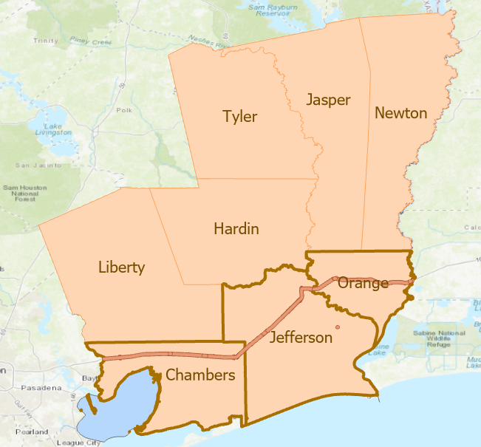
How to Sustain this Long Term?
Continue to use Kisters data system
for data maintenance and processing
Engage US Geological Survey
for gage maintenance and installation of additional transects
Imbed Data in District Flood Operations
Case Study in Beaumont District
Focus on Chambers, Jefferson
and Orange Counties
Collaborate with Lamar University
Develop methodology for highway
flood risk assessment on I-10
In real-time as floods occur
As a planning tool for flood security
Extend to other highways later

