Slide 1
Arc Hydro River Plan
David Maidment
University of Texas at Austin
Arc Hydro on the Web
---- Five Layers
Arc Hydro River
---- Model, Toolset, Book
Multiscale, 3D Hydrography
Arc Hydro River Workshop, Austin, Texas, December 3, 2010

Slide 2
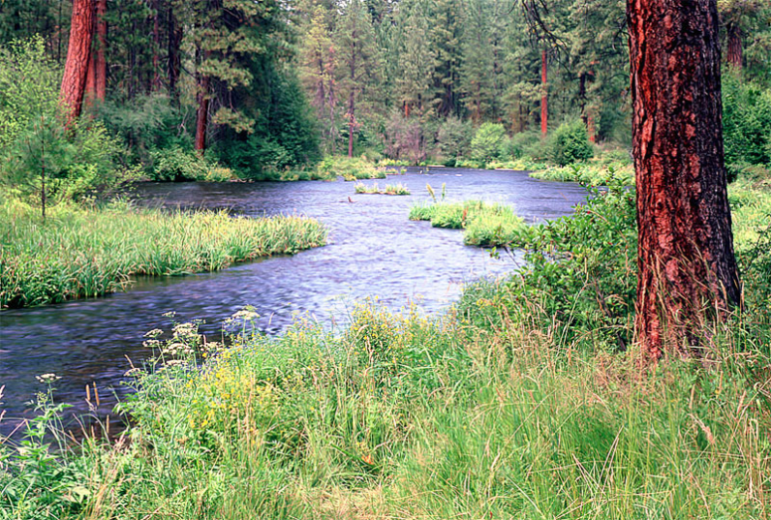
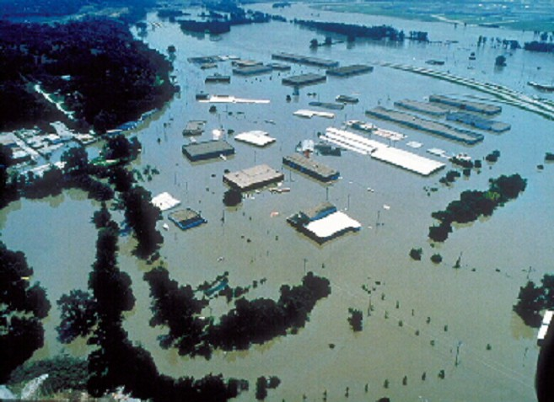
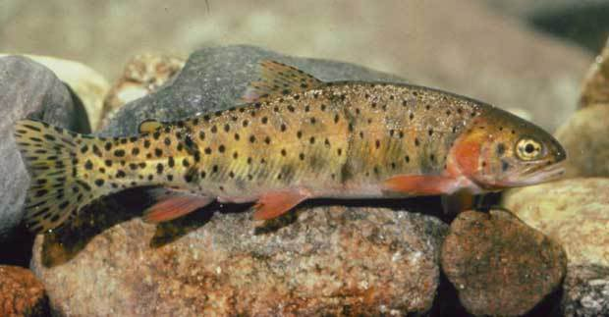
Arc Hydro River
Here is what I was thinking at the start of this meeting
River Network
Channel Shape
Geography
Flooding
Aquatic Biology
Applications

Slide 3



Is Global Geospatial Consciousness Possible?
We’ve discussed this a lot over the past couple of days
Billions
Society
Millions
Application
Users
100’s of Thousands
GIS Professionals
Thousands
Research
There are lots of things that could be done ……
……. we need a thoughtful plan

Slide 4
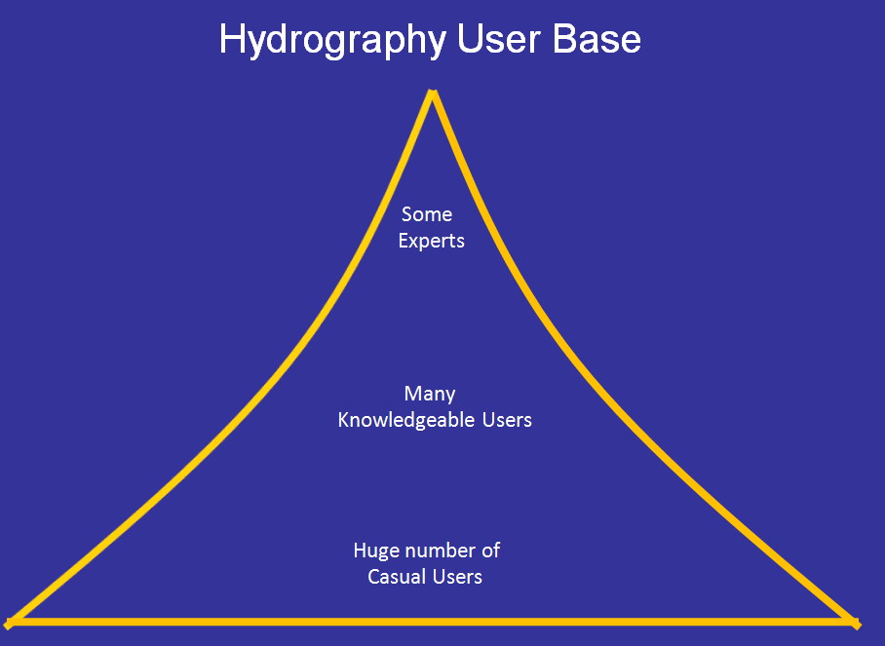
Slide: Jeff Simley, USGS

Slide 5
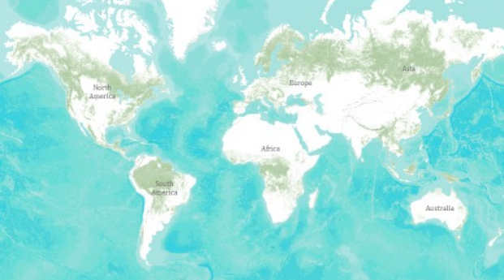
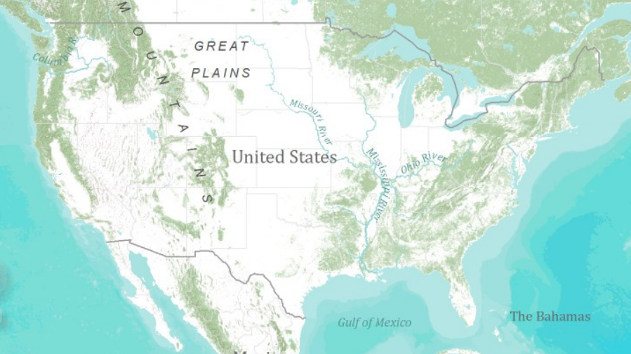
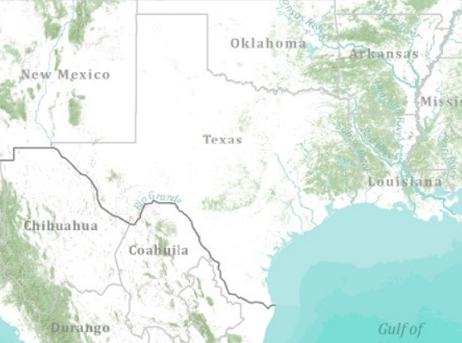
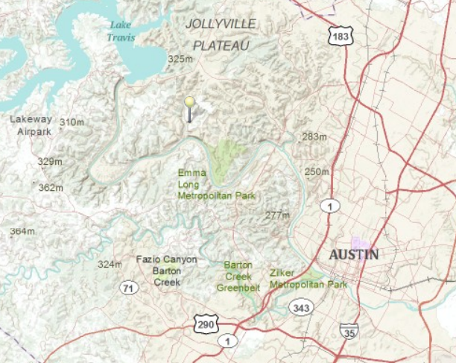
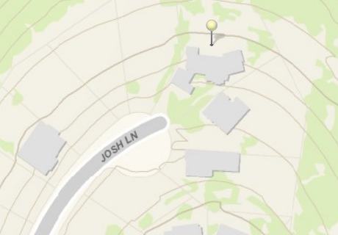
Global Topographic Basemap in ArcGIS.com
Tiled base map synthesizing information across map scales
World
United States
Texas
Austin
Home
How do we do this for hydro?

Slide 6
Arc Hydro on the Web
A vision has emerged at this meeting …..
Modeling Layers
Descriptive Layers
Observations Layers
Operational Layer
(Key Hydro Functions)
Display Layer
(Base Map)

Slide 7
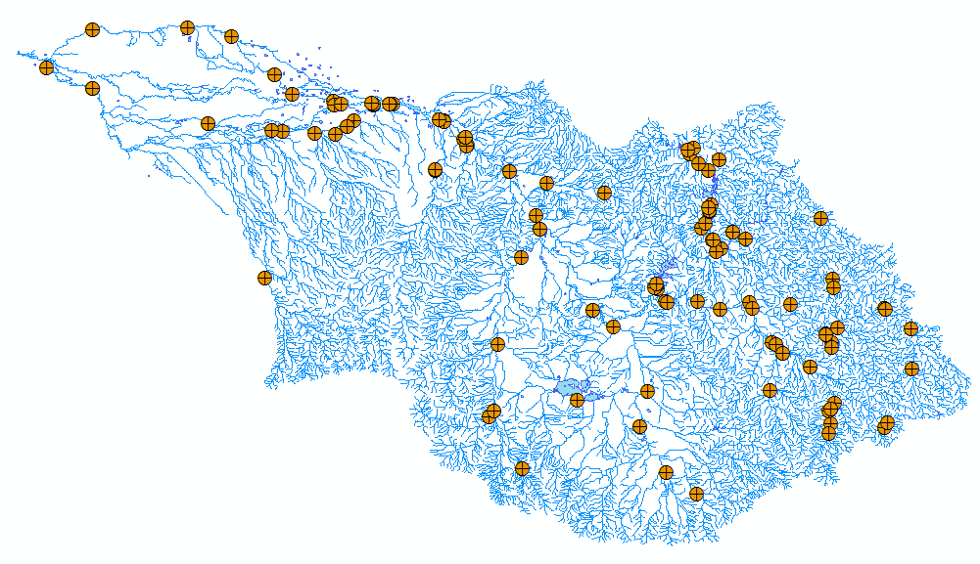
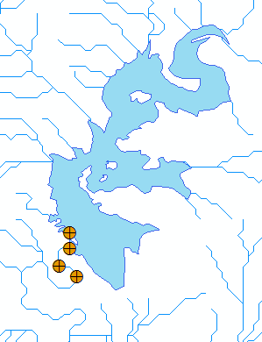

Hydro BaseMap Display Layer
The Hydrography or “blue line” component of a topographic map

Slide 8
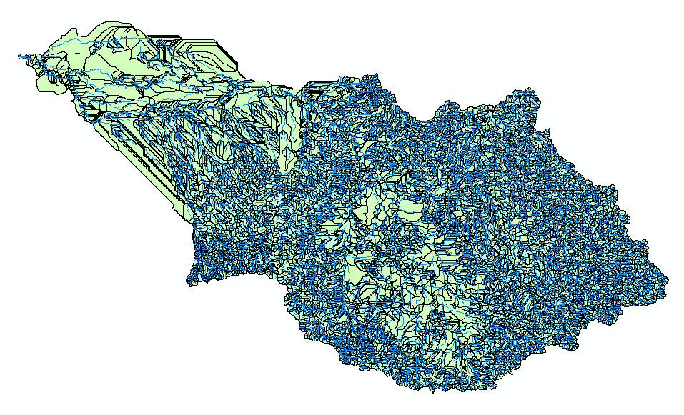
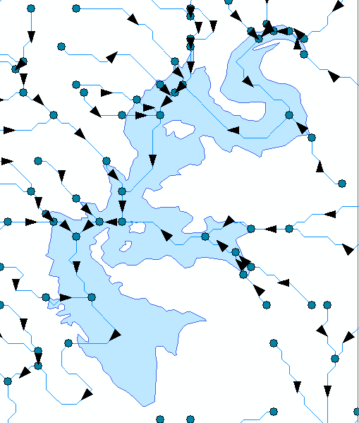

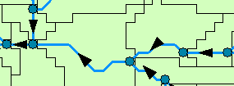
Hydro Operational Layer
A geometric network with a local catchment for each network edge

Slide 9
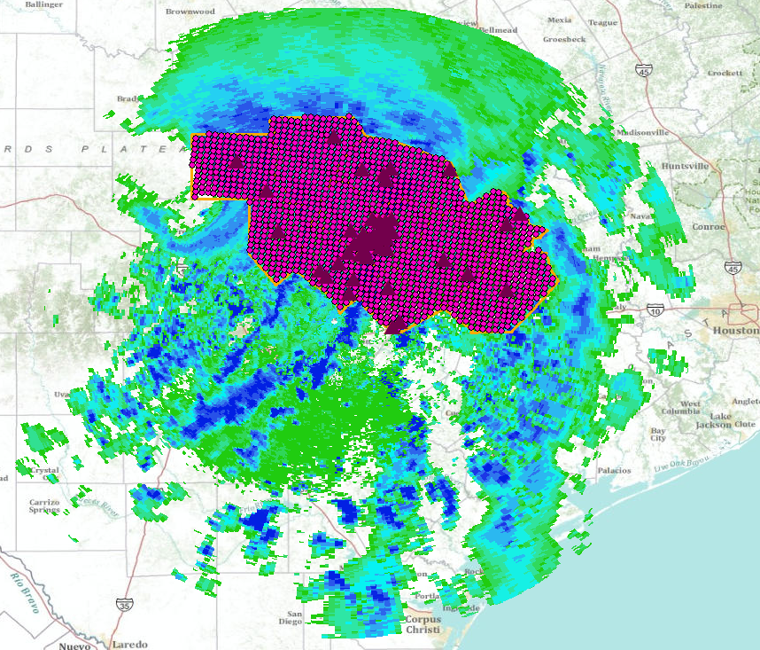
Hydro Observation Layers
Time-enabled feature layers of observations data

Slide 10
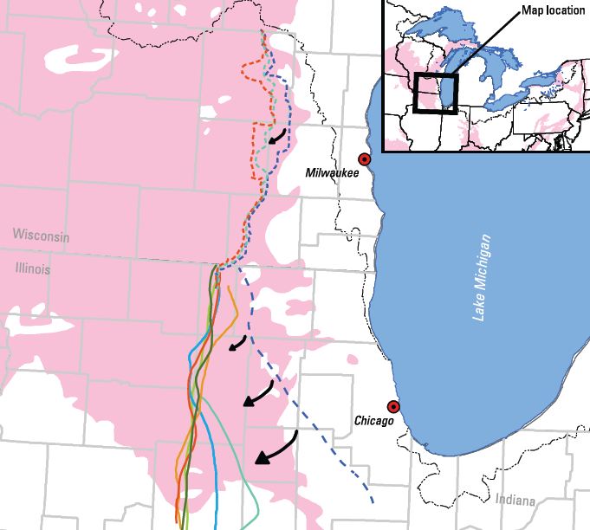
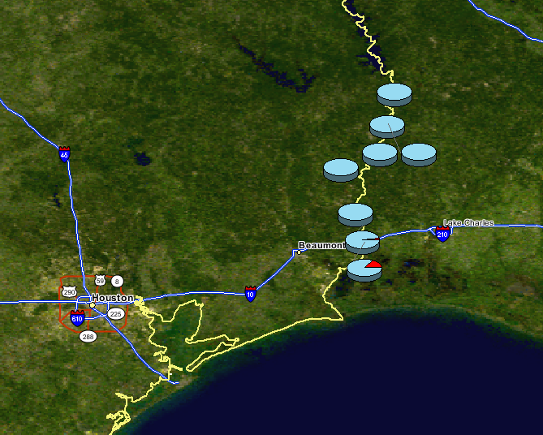
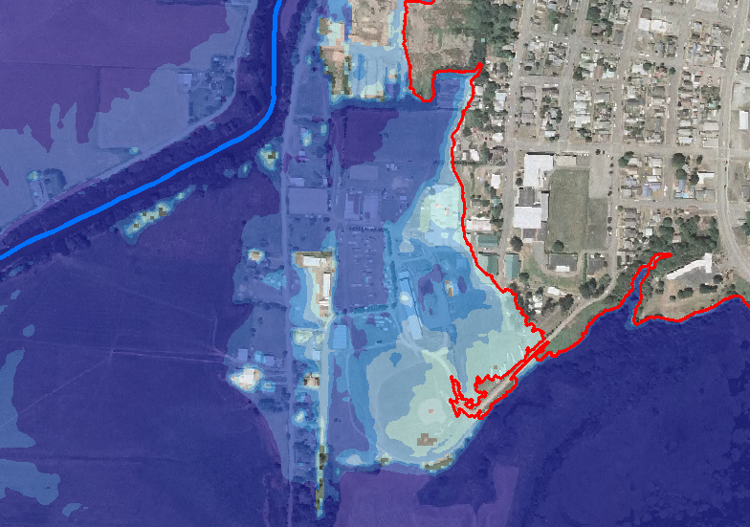

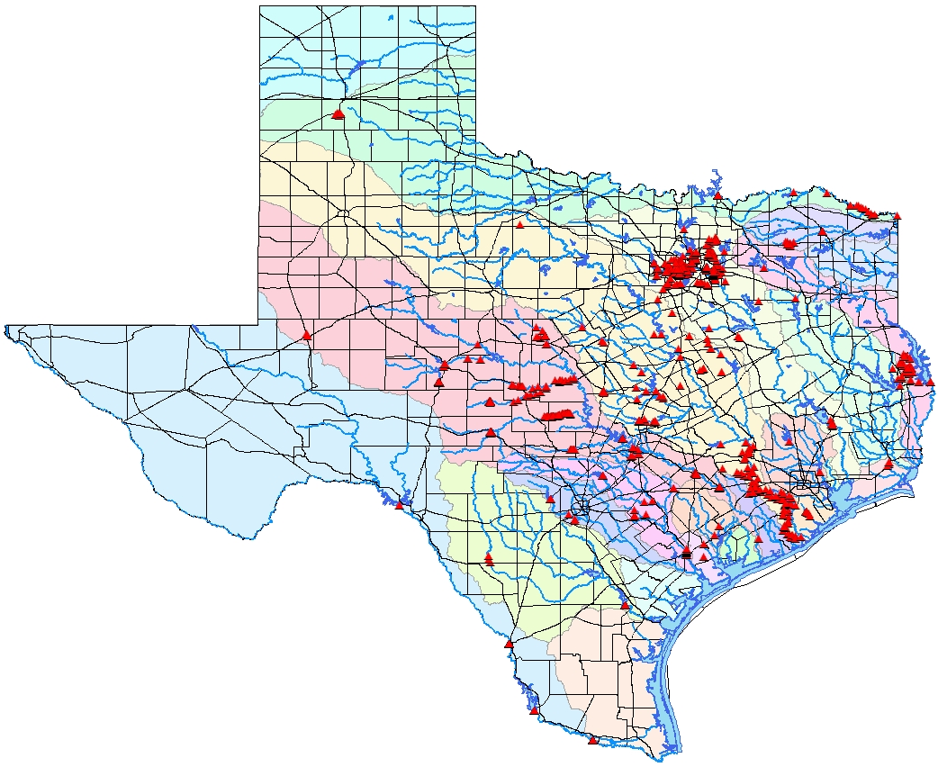
Hydro Descriptive Layers
Static information about hydro features
Watershed divide
Groundwater divides
Groundwater divide
Fish species distributions
100 year flood depth
High Water Marks
……Linked to the Operational Layer by “Virtual Referencing”

Slide 11
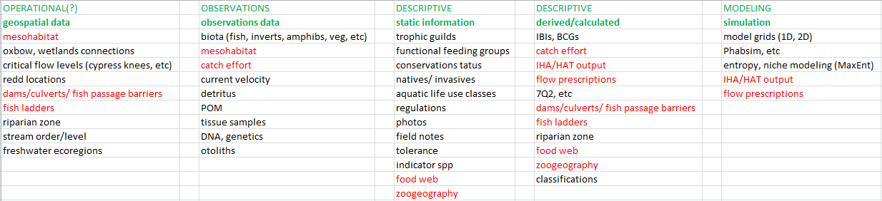
River Ecology

Slide 12
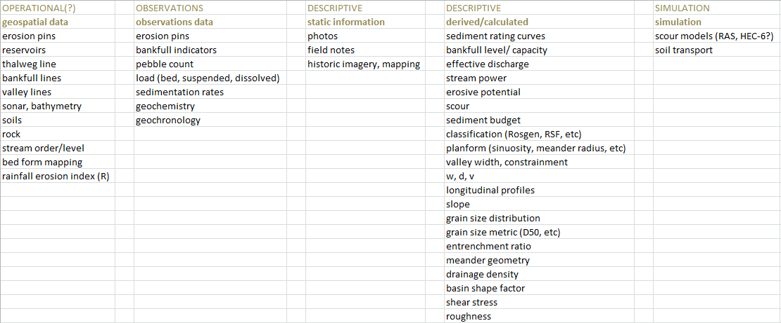
Geomorphology

Slide 13
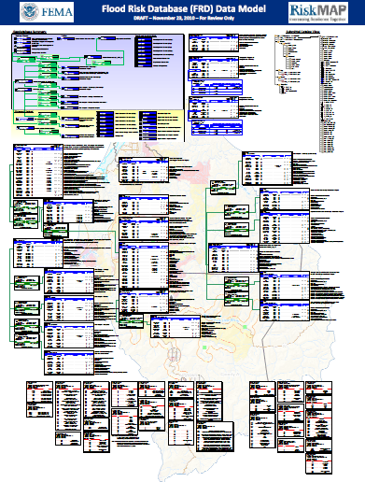
Use Existing Geodatabase Designs for Descriptive Layers

Slide 14
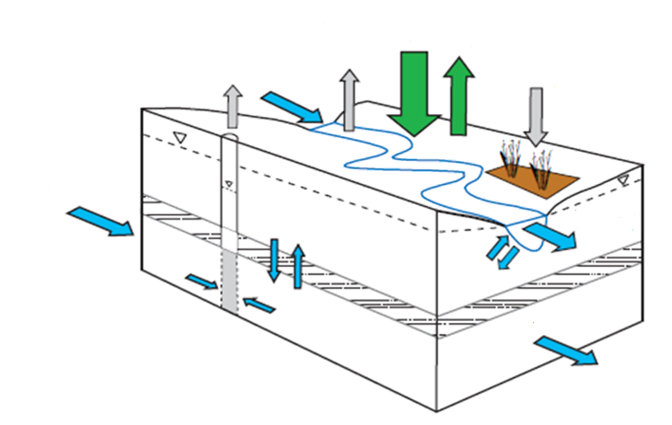
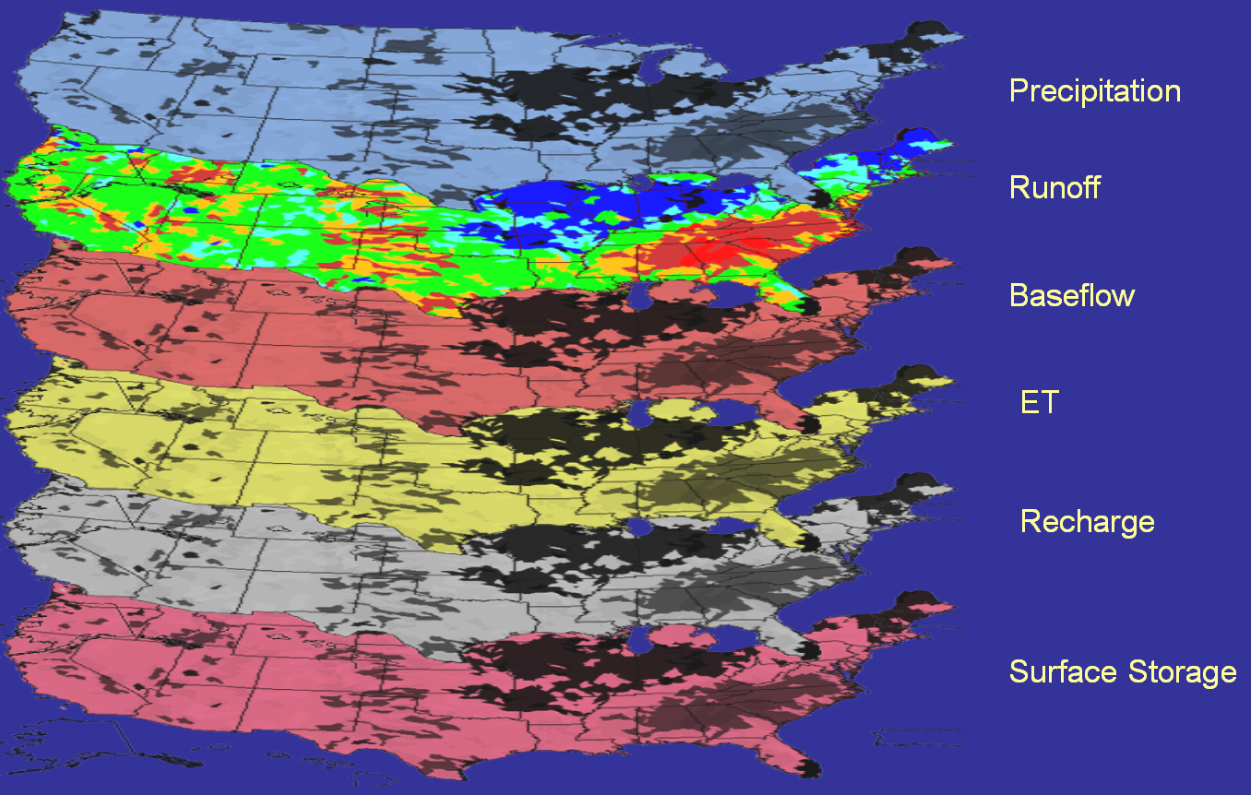
Hydro Modeling Layers
Models that connect maps
Source: USGS Water Census

Slide 15
Delivering web-based
hydro map display and network-based discovery and analysis
Start Here
International
view
Its got to work in Botswana!
Hydro Network
Catalog
Containers
HUCs
Catchments
Events
National
view
HUCs
MRB
HUC2
HUC4
HUC6
HUC8
HUC10
HUC12
Linked Data
Attributes
(raw data and
analytical results)
Esri hydro base map
(15+ layers)
HUC
Attributes
Catchments
100k view
(Med res)
Drainage Areas
(watersheds)
Catchment
Attributes
Events
24k or better view
(High res)
Event
Attributes
Source: Tommy Dewald, EPA

Slide 16
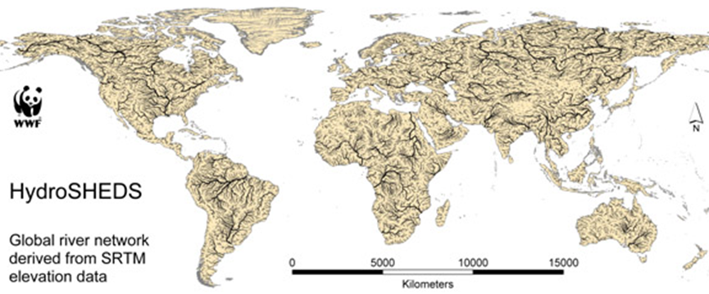
Global HydroBase Map and Operational Layer
Build from HydroSheds
Start Global and use this to define the template

Slide 17
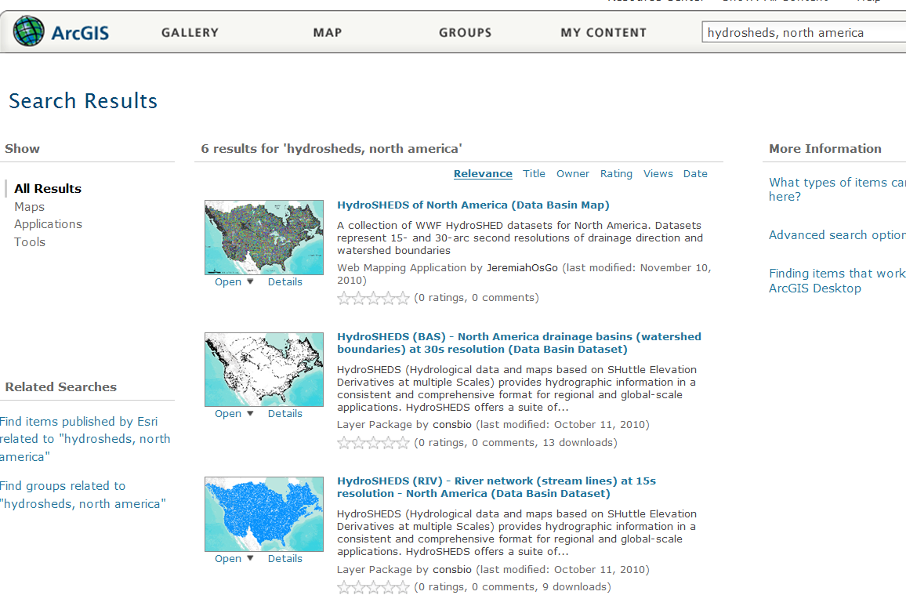
HydroSheds for the World
The data is already presented in ArcGIS.com

Slide 18

http://www.caee.utexas.edu/prof/maidment/giswr2010/Dec2/Gutierrez.pptx

Slide 19
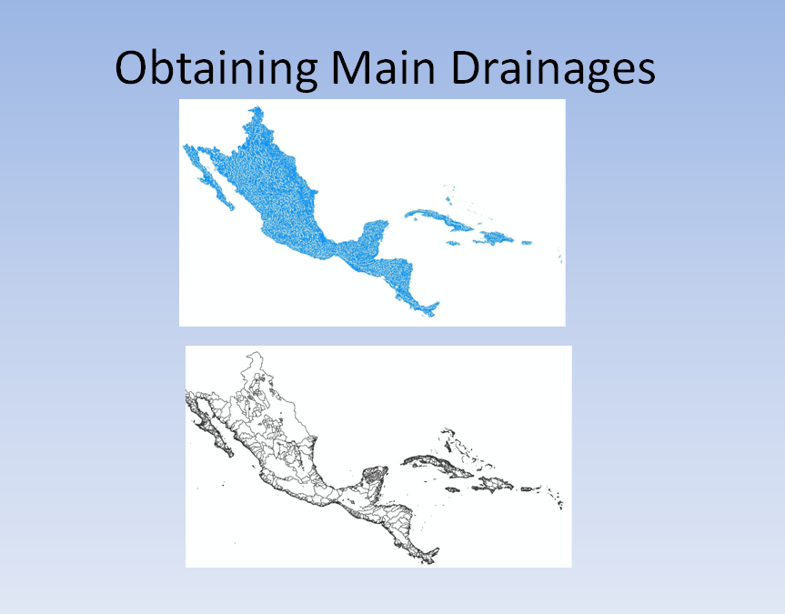
HydroSheds from ArcGIS.com

Slide 20
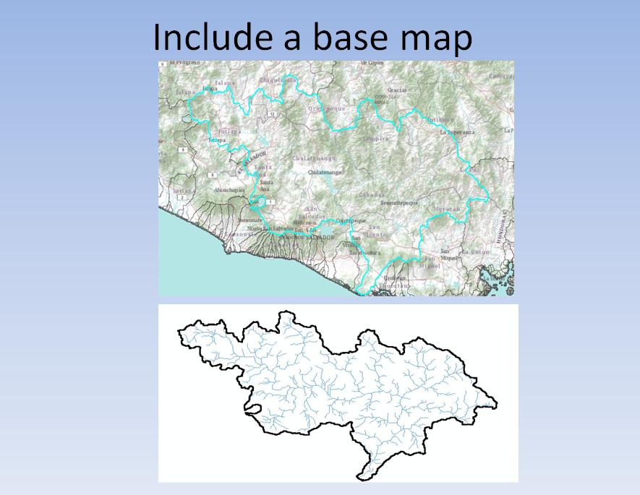
ESRI Global Topographic Map used for reference

Slide 21
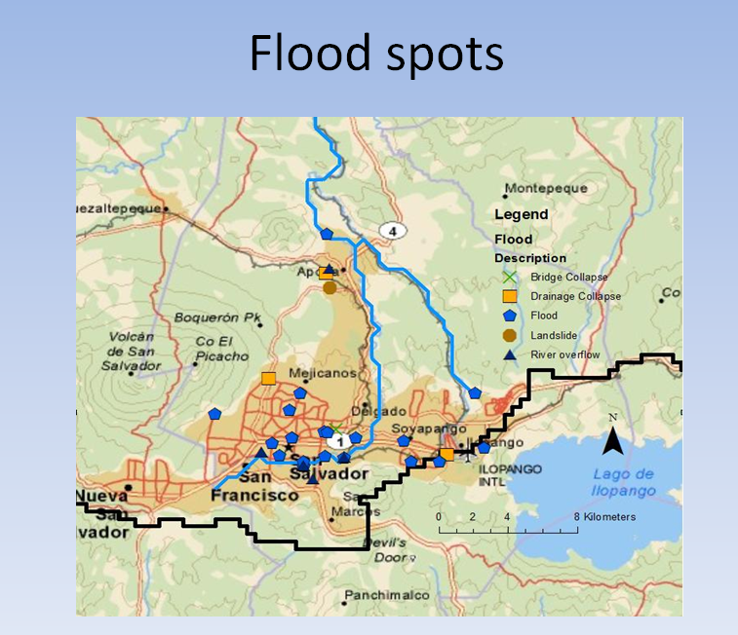
Base Map with a Flood Descriptive Layer

Slide 22
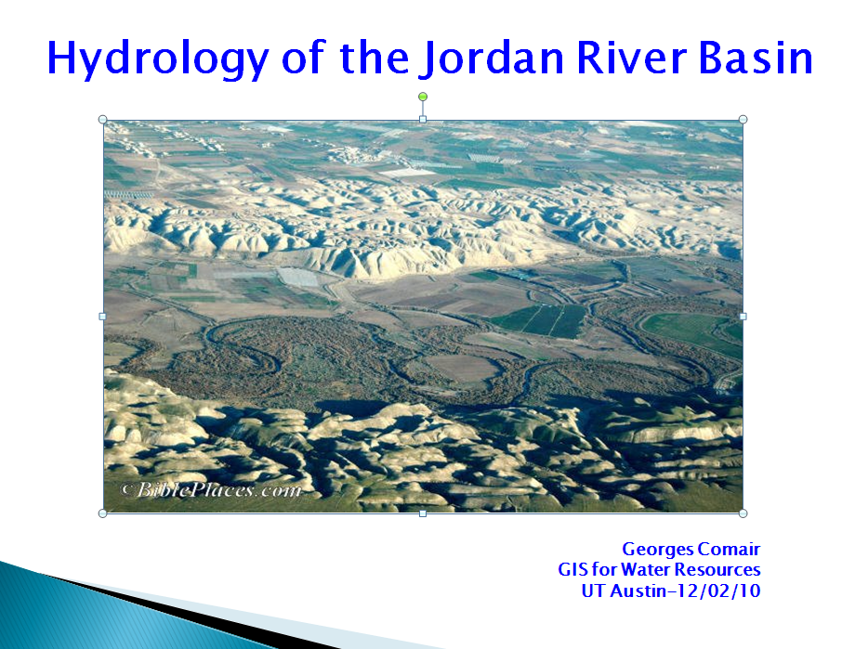
http://www.caee.utexas.edu/prof/maidment/giswr2010/Dec2/Comair.pptx

Slide 23
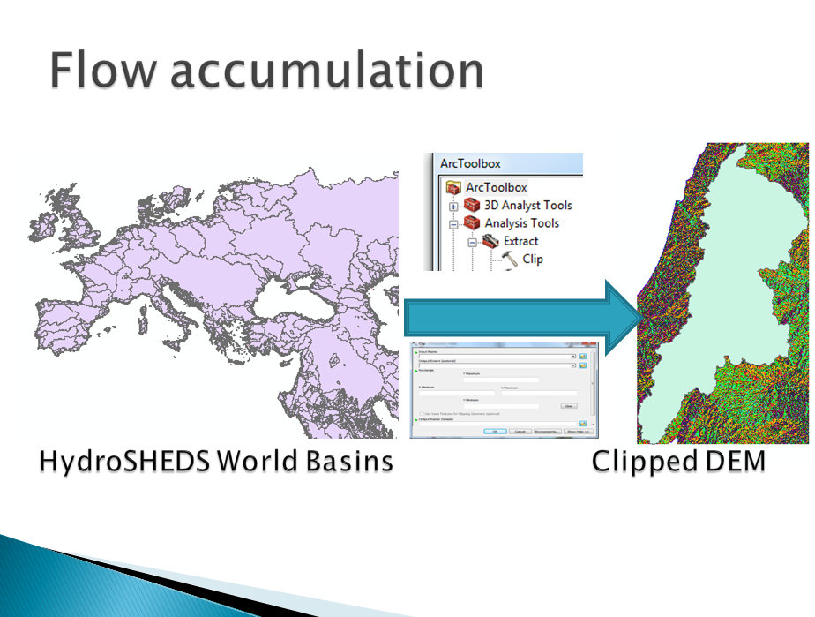
Operational Layer

Slide 24
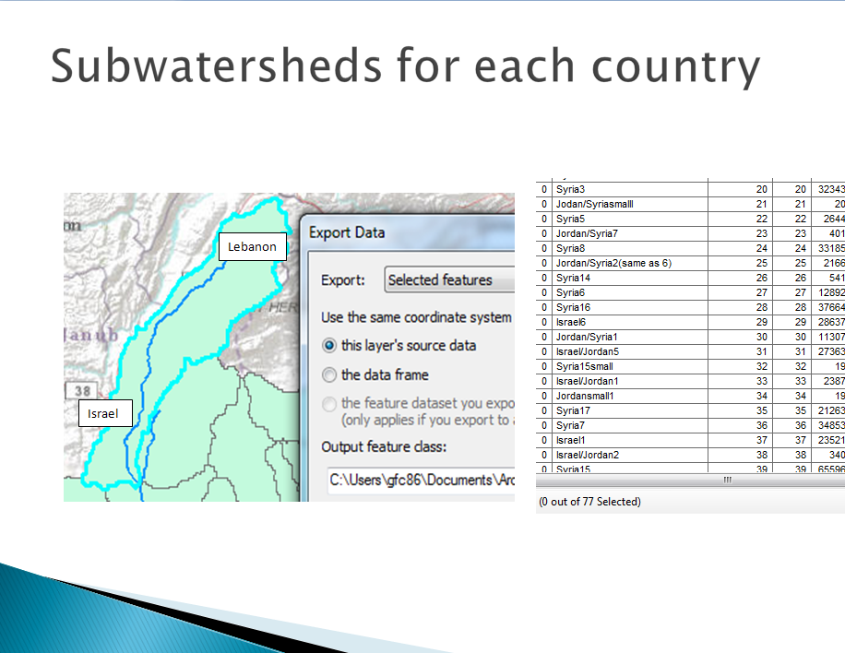

Slide 25
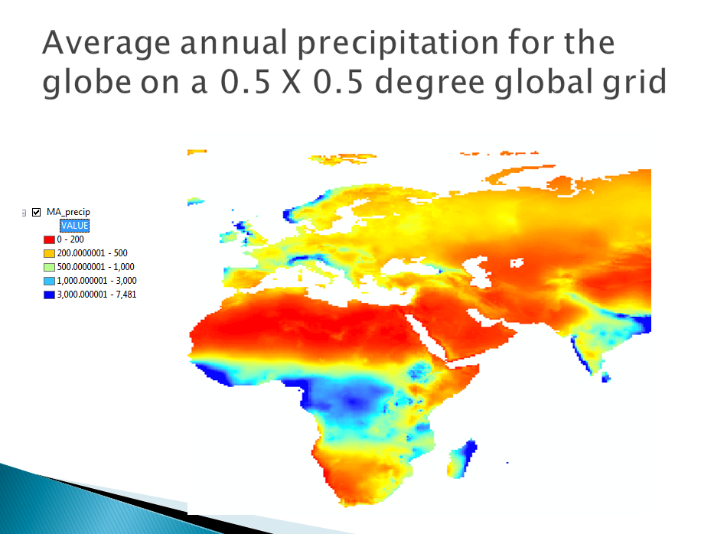
Observation Layer

Slide 26
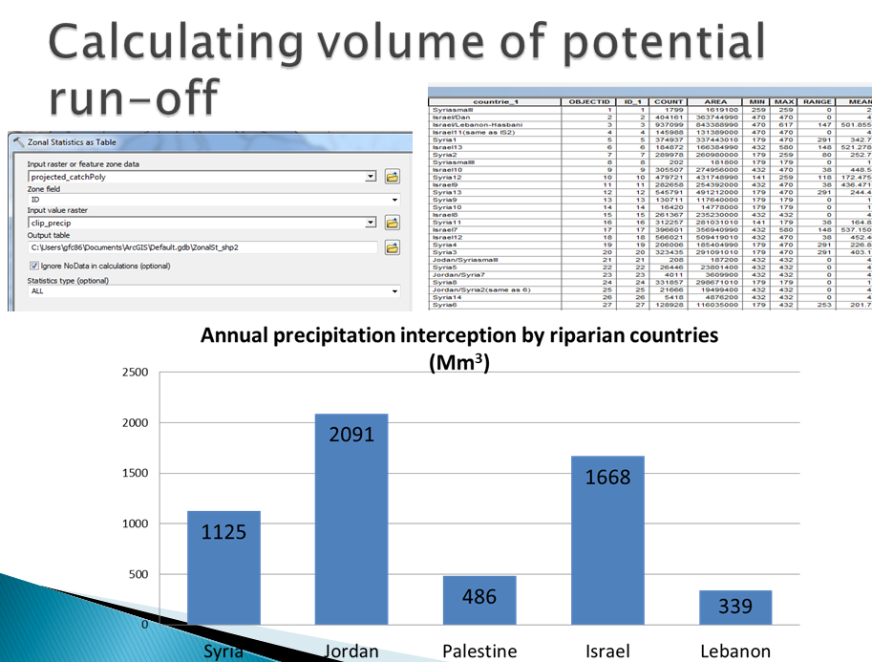

Slide 27
Arc Hydro on the Web
Conclusion: Start at the international level and work downwards….
Modeling Layers
Descriptive Layers
Observations Layer
(Precipitation)
Operational Layer
(Watershed delineation)
Display Layer
(HydroSheds)
……one base data source, one operational function, one observation layer

Slide 28
Arc Hydro on the Web
Within the US, lets explore a “Map Sandwich” as a stack of services
Modeling Layer Services
Descriptive Layer Services
Observations Layer Services
Operational Layer Services
(Key Hydro Functions)
Display Layer Services
(Base Map)

Slide 29
Arc Hydro River Plan
David Maidment
University of Texas at Austin
Arc Hydro on the Web
---- Five Layers
Arc Hydro River
---- Model, Toolset, Book
Multiscale, 3D Hydrography
Arc Hydro River Workshop, Austin, Texas, December 3, 2010

Slide 30
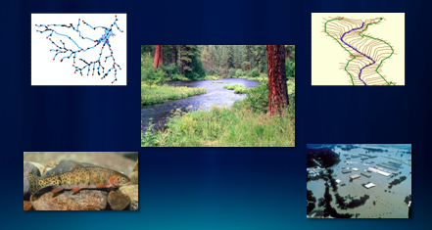
Milestones for Arc Hydro River
Build this in the Arc Hydro Resource Center
Year 1 – Arc Hydro River data model defined
Year 2 – Arc Hydro River toolsets developed
Year 3 – Arc Hydro River book published by ESRI Press
Start with the design of a Channel Profile Model, Toolset, and Workflows for Implementation
Develop templates for Descriptive Layers

Slide 31
Arc Hydro River
We need some core GIS research….
River Network
Multiscale 3D Hydrography
Channel Shape
…..Can we combine networks and terrains to get 3D Hydrography?

Slide 32
Arc Hydro River Plan
David Maidment
University of Texas at Austin
Arc Hydro on the Web
---- Five Layers
Arc Hydro River
---- Model, Toolset, Book
Multiscale, 3D Hydrography
Arc Hydro River Workshop, Austin, Texas, December 3, 2010

Slide 33
Is Global Geospatial Consciousness Possible?
How to make this work for Hydro
Next 7 slides from Steve Kopp, ESRI
Billions
Society
Millions
Application
Users
Dream
Big
100’s of Thousands
GIS Professionals
Key Expansion
Thousands
Research
Arc Hydro Today
Make geospatial understanding of water relevant by making it accessible and easy.
Think of the questions people might want of ask of the data.

Slide 34
Transforming Technologies
Wealth of high resolution terrain and bathymetry.
IT Evolution will continue, GIS and modeling will be there
  More complex solutions in a shorter amount of time
  Think of interactive design elements
Hosted data services and analytic services lower the bar to get started and make it easier for everyone to do better, more consistent work.
  Easy packaging and publishing via ArcGIS.com
Like Word docs and Google docs, geospatial data can be hosted, and edited collaboratively.
  National datasets
  Field data collection

Slide 35
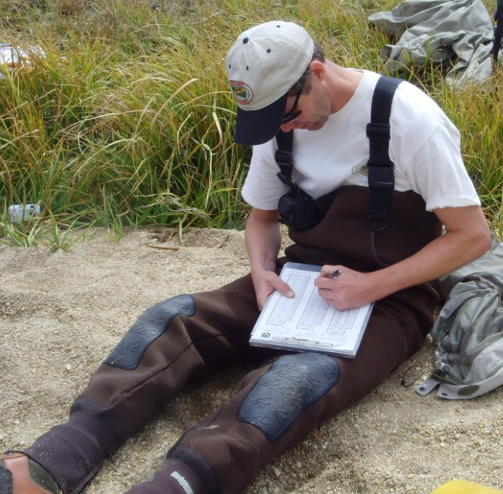
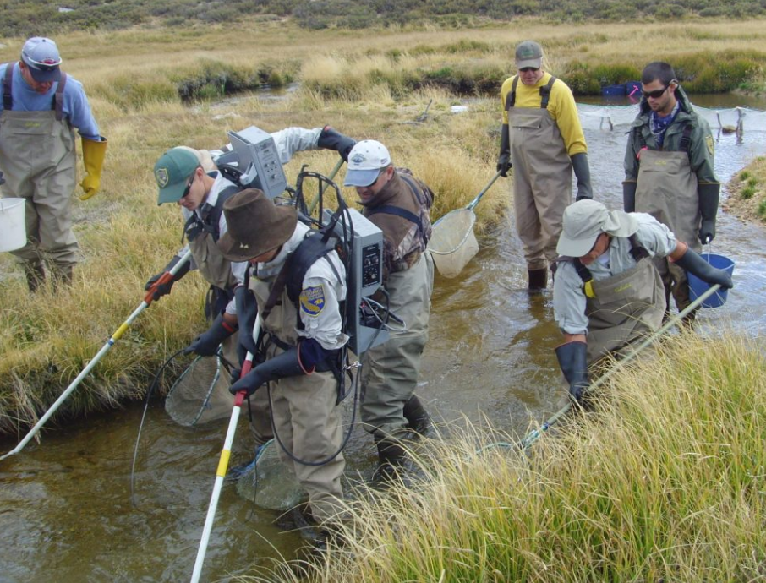
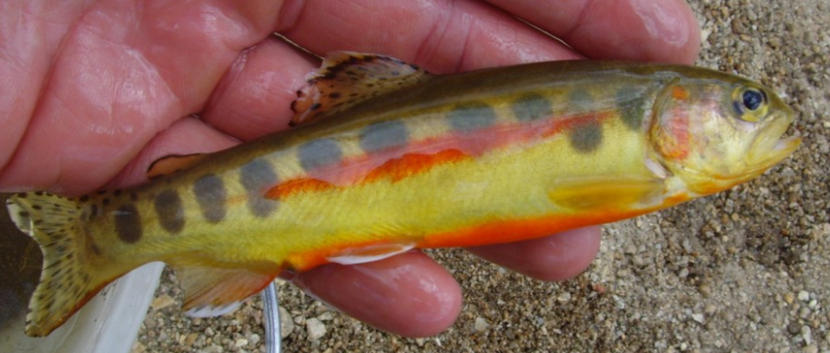
Time for a technology transformation
Someone get this guy an iPad
Improve data accuracy
Timely access to information
Broader availability
Digital archive for comparison

Slide 36
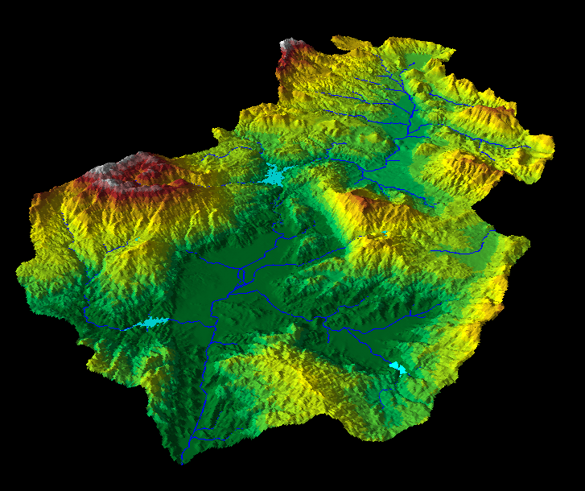
Community Basemap Efforts
Currently compiling Topographic, Streets, and Imagery
  Best available
  Authoritative
  Multiscale
Elevation will begin soon…
http://resources.arcgis.com/content/community-basemap

Slide 37
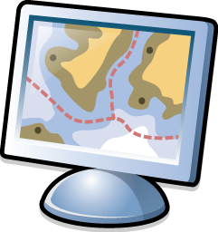


New LiDAR Workflow
Direct use of LAS files
  On the fly mosaicking and rendering (hillshade, slope, etc)
  Input to analytic tools as a raster or terrain
  Editing
Research hydrologic derivatives from
high resolution triangulated elevation
LAS
LAS
LAS
LAS
LAS
LAS
LAS
LAS
LAS
LAS
LAS
LAS
LAS
LAS

Slide 38
Divergent flow
Divergent flow it not modeled well in the current D8 implementation.
  Encoded in flow direction raster, but not used in analysis
Handling of other non-D8 approaches requires consideration of other tools relying upon the flow direction raster.
What do we want to know besides direction?
  Proportion of flow per branch?
  A stage at which it becomes divergent?
What should be derived from and stored with the raster, and what with the vector network?
How much manual effort is involved in
building data with proper divergent flow
and loops?
?

Slide 39
Looking past initial implementation…
Some blue sky ideas of possible future
Seamless, worldwide, multiresolution elevation
Accessible from any computing device, anywhere
Dynamic interactive real time flood mapping and flood forecasting
  2 hrs from now the water depth at this location will be 6 feet and velocity 10 m/s
Field surveys of biota and cross sections collected through simple mobile applications directly uploaded to accessible digital database.
Hydrology/hydraulics impact models of future climate or landcover scenarios accessible to other disciplines through simple web services (urban planning, forestry, etc).

Slide 40
Conclusions
This has been a very creative meeting …..
We need to form some study teams and work through the issues systematically
Break the big problems down into smaller problems and solve them one by one
Thanks to Kernell Reis for the suggesting this meeting and to Erika Boghici (ESRI) and Sharon Bernard (and CRWR Staff) for organizing it!
….. perhaps the best Arc Hydro event that we’ve ever had

