Slide 1
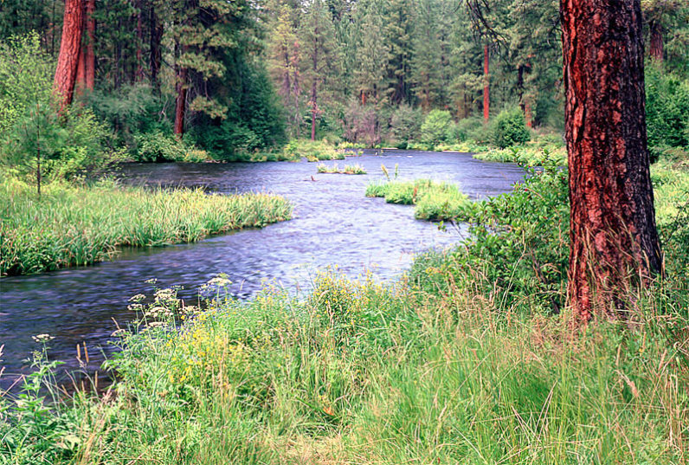
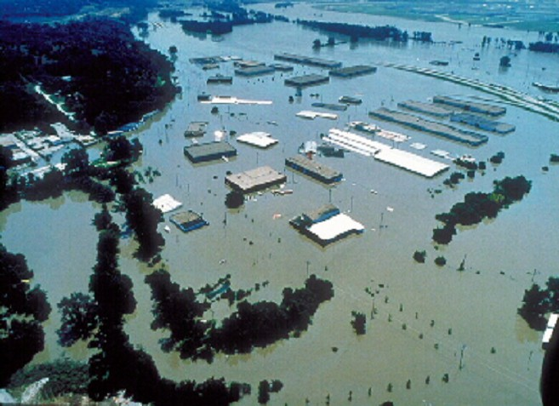
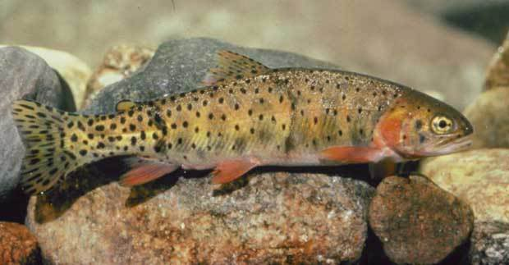
Arc Hydro River
River Network
Multiscale 3D Hydrography
Channel Shape
Flooding
Aquatic Biology
Applications

Slide 2
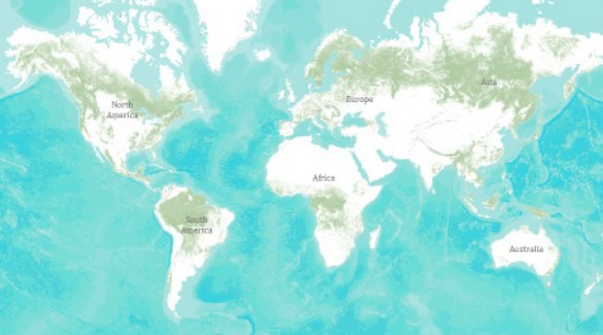
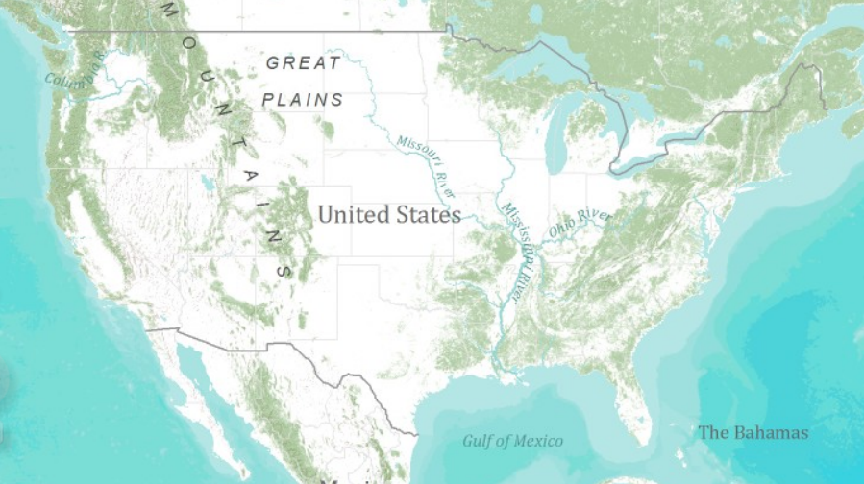
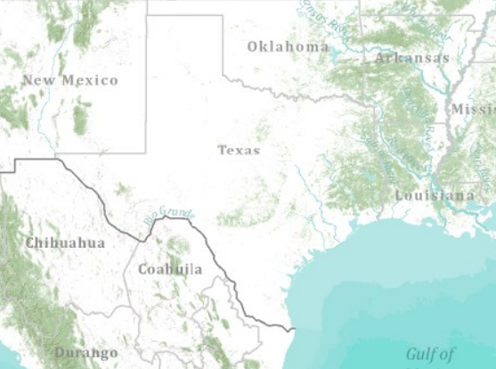
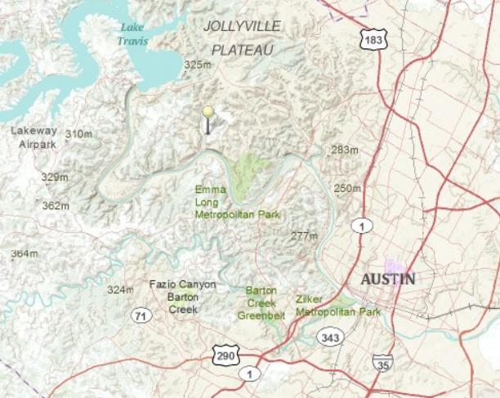
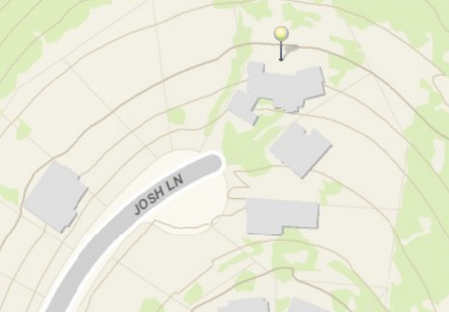
Global Topographic Basemap in ArcGIS.com
Tiled base map synthesizing information across map scales
World
United States
Texas
Austin
Home
How do we do this for hydro?

Slide 3
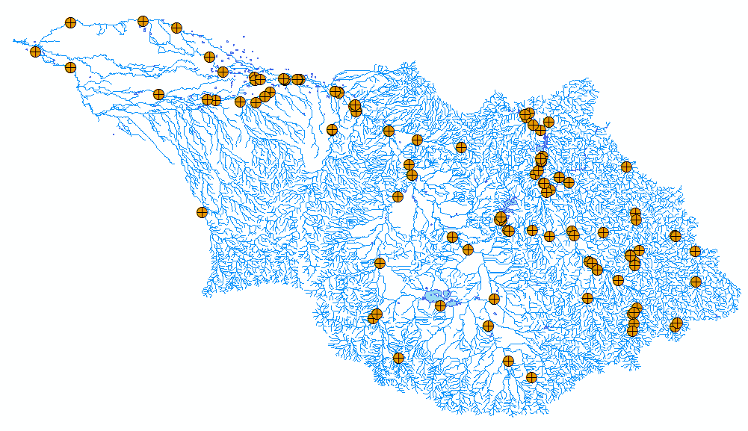
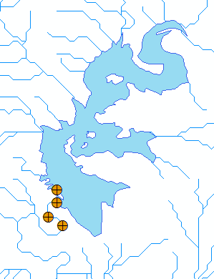
Hydro BaseMap Display Layer
The Hydrography or “blue line” component of a topographic map

Slide 4
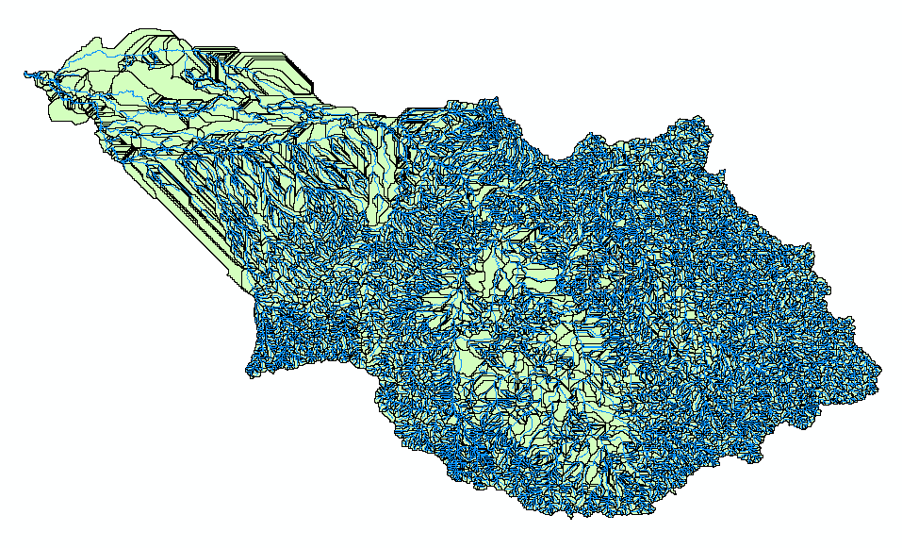
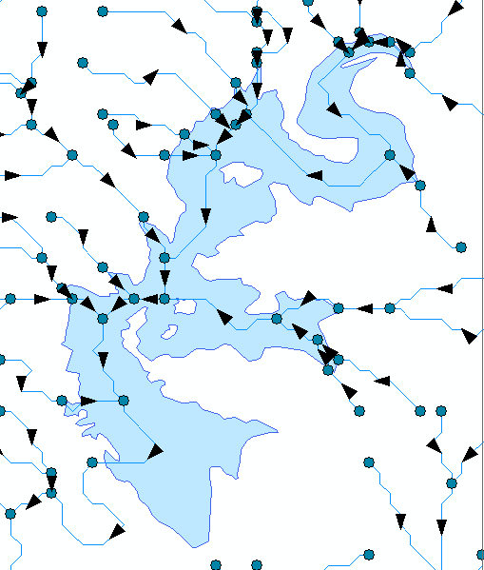
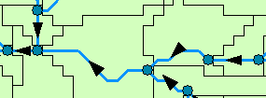
Hydro BaseMap Operational Layer
A geometric network with a local catchment for each network edge

Slide 5
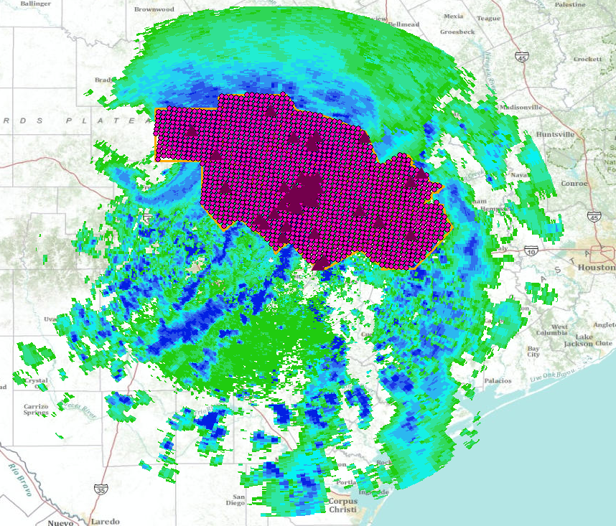
Hydro BaseMap Observation Layers
Time-enabled feature layers of observations data

Slide 6
Some Implementation Principles
Work with high resolution Lidar point data and breakline data
Better integration of vector geometry and networks with the elevation data (e.g. WBD, NHD, NED)
Have a better solution for multiscale visualization and analysis
Operational layer has the same seamless behavior across scales as does the display layer
There are base-level original data. At all higher, less resolved scales, the features displayed are a selected set from the base level original dataset.

