Slide 1
Arc Hydro River Vision
David Maidment
University of Texas at Austin
Goals
Community Hydrobase map
Space-time observations layers
Arc Hydro River
Arc Hydro River Workshop, Austin, Texas, December 1, 2010

Slide 2
Linking GIS and Water Resources
This is the diagram that I have always used in the past
Water
Resources
GIS

Slide 3
Water in GIS
Could we transition to this vision?
GIS
Water

Slide 4
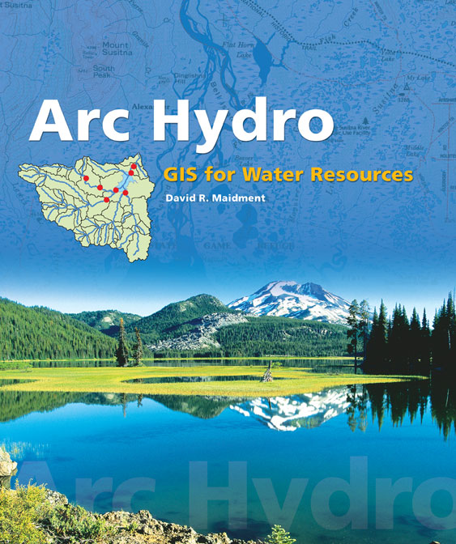
Arc Hydro: GIS for Water Resources
Published in 2002, now in revision for Arc Hydro II
Arc Hydro
An ArcGIS data model for water resources
Arc Hydro toolset for implementation
Framework for linking hydrologic simulation models
The most comprehensive terrain analysis and watershed toolset available
Work of Dean Djokic and his team at ESRI Water Resources Applications
Notes:
Notes:
Industrial partners: ESRI, Danish Hydraulic Institute, Camp,Dresser and McKee, Dodson and Associates
Government partners:
Federal: EPA, USGS, Corps of Engineers (Hydrologic Engineering Center)
State: Texas Natural Resource Conservation Commission, Texas Water Development Board
Local: Lower Colorado River Authority, City of Austin, Dept of Watershed Protection
Academic Partners: University of Texas, Brigham Young University, Utah State University

Slide 5
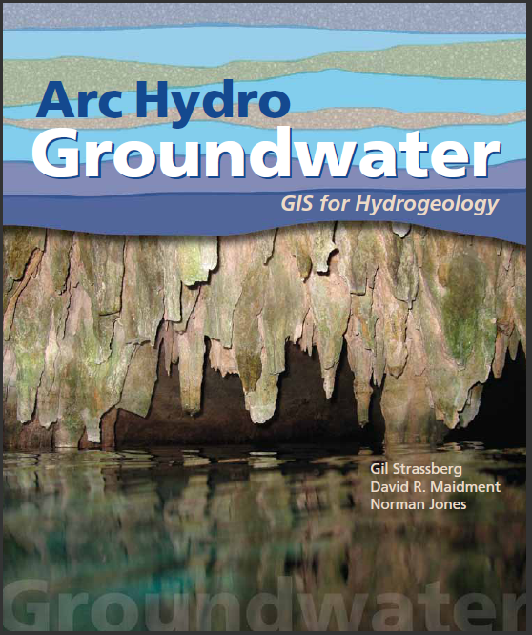
Arc Hydro Groundwater: GIS For Hydrogeology
Describes the data model – public domain
Toolset and data model available now from Aquaveo
Book from ESRI Press in Fall 2010
Adapted for a National Groundwater Information System for Australia
Notes:
Notes:
Industrial partners: ESRI, Danish Hydraulic Institute, Camp,Dresser and McKee, Dodson and Associates
Government partners:
Federal: EPA, USGS, Corps of Engineers (Hydrologic Engineering Center)
State: Texas Natural Resource Conservation Commission, Texas Water Development Board
Local: Lower Colorado River Authority, City of Austin, Dept of Watershed Protection
Academic Partners: University of Texas, Brigham Young University, Utah State University

Slide 9
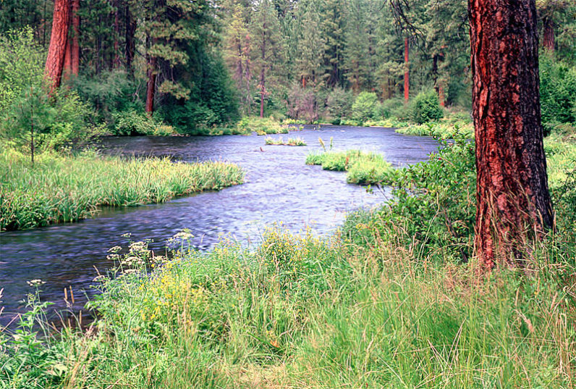
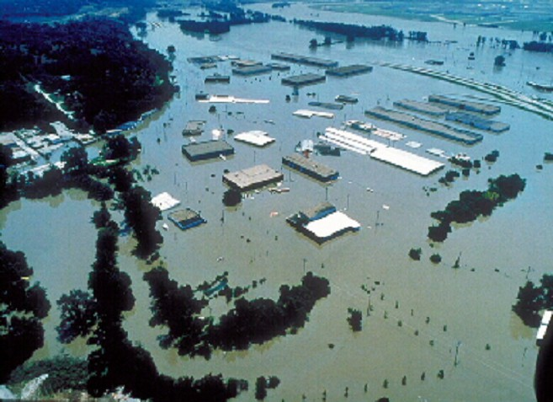
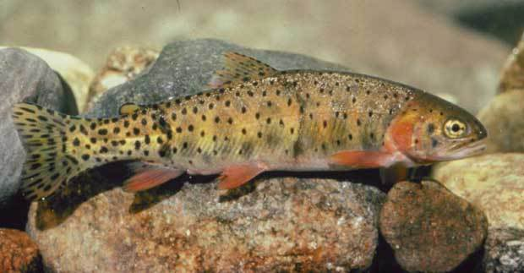
Arc Hydro River
GIS for River Morphology and Modeling
River Network
Channel Shape
Geography
Flooding
Aquatic Biology
Applications

Slide 10
Is Global Geospatial Consciousness Possible?
How to make this work for Hydro
Billions
Society
Millions
Application
Users
100’s of Thousands
GIS Professionals
Thousands
Research
Slide from Jack Dangermond’s Plenary Presentation at 2010 ESRI User Conference

Slide 11
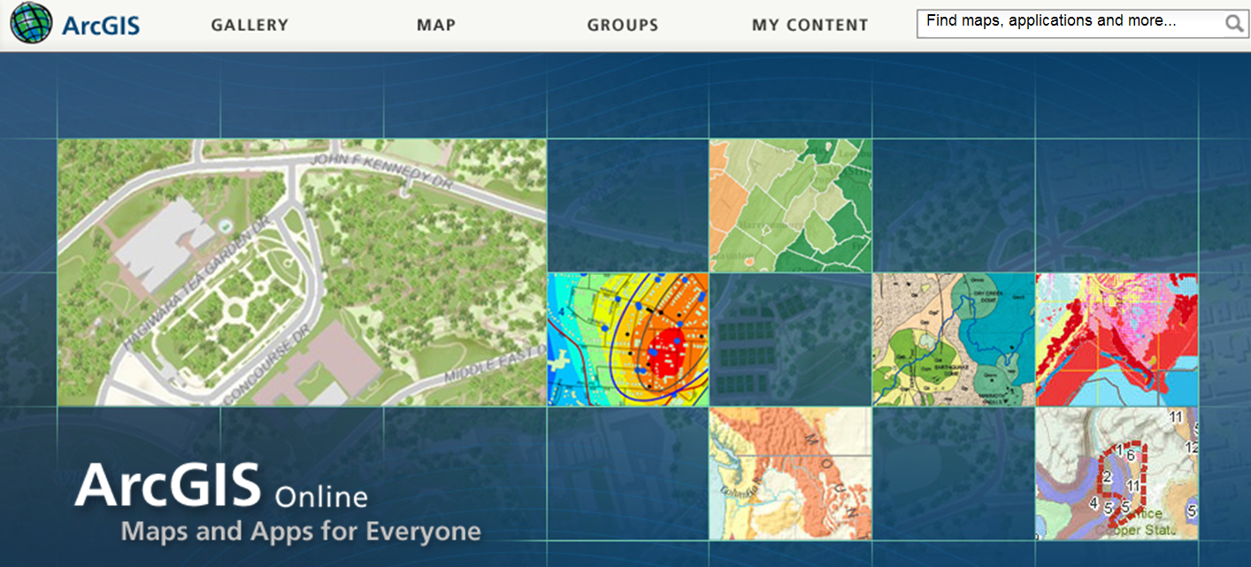
ArcGIS Online
http://www.ArcGIS.com
Arc Hydro River datasets and models stored in ArcGIS Online

Slide 12
The Context of this Workshop
A paradigm shift is happing in GIS ….
Think of rivers as a unique class of geographic features
How do we describe them?
How do we design their data model?
How do we build applications for them?
What advancements in ESRI core technology are needed?
What application toolsets are needed?
Who will build them?
How do we move to web GIS?
….Synthesis and integration of information through the web

Slide 13
Goals for this Workshop
We have a rich heritage of past work ….
Define a set of requirements for Arc Hydro River
Take the paper that Clint Brown and I have started and lets complete that to define what needs to be done
….lets do some “blue sky” thinking about the future

Slide 14
Inspiration from Clint Brown
Jack Dangermond asserts that GIS is undergoing a modality shift…..
“At the heart of this vision is the large and rich collection of geographic and scientific information that is collected and maintained by hundreds of organizations. These organizations have built this critical, authoritative, and trusted geographic information within their own institutions. They also recognize the value of their data and are increasingly representing and sharing their geographic information as web map and GIS services because they want their information to be leveraged and used to make a difference. An online GIS infrastructure brings all of this information together on the Web. Individual content from many organizations will be mashed up and combined in this new Web world. Geographic location will be used to integrate information across many organizations and disciplines. This vision for global integration of geographic information provides real synergy.”

Slide 15
Milestones for Arc Hydro River
Year 1 – Arc Hydro River data model defined
Year 2 – Arc Hydro River toolsets developed
Year 3 – Arc Hydro River book published by ESRI Press

Slide 16
Arc Hydro River Vision
David Maidment
University of Texas at Austin
Goals
Community Hydrobase map
Space-time observations layers
Arc Hydro River
Arc Hydro River Workshop, Austin, Texas, December 1, 2010

Slide 17
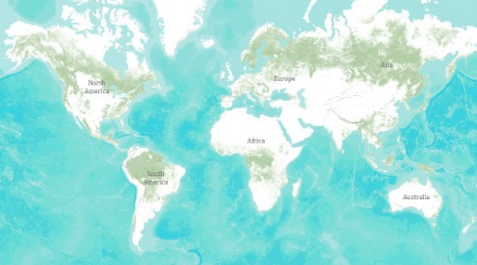
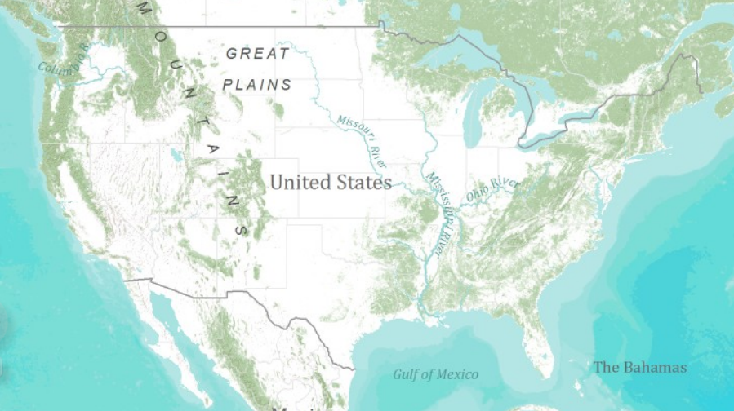
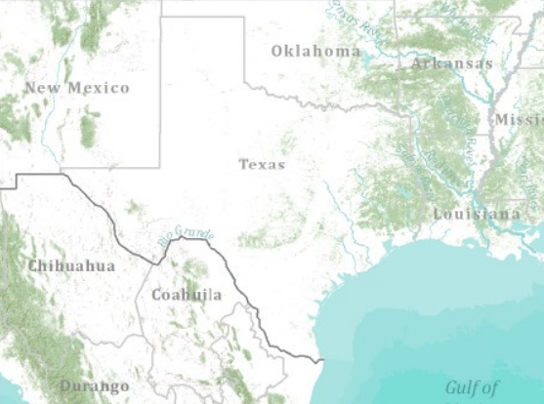
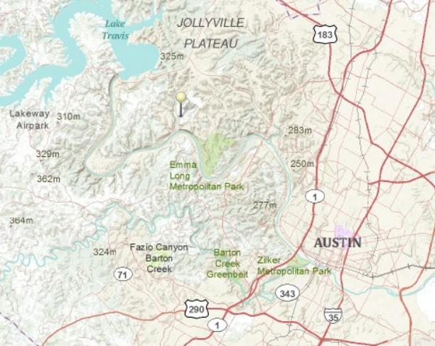
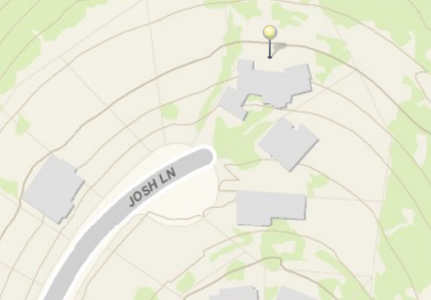
Global Topographic Basemap in ArcGIS.com
Tiled base map synthesizing information across map scales
World
United States
Texas
Austin
Home
How do we do this for hydro?

Slide 18
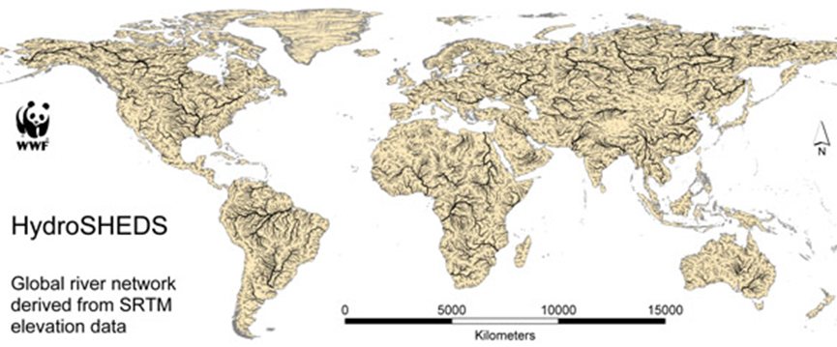
Global HydroBase Map
Build from HydroSheds
Global coverage from 60 ºS to 60 ºN

Slide 19
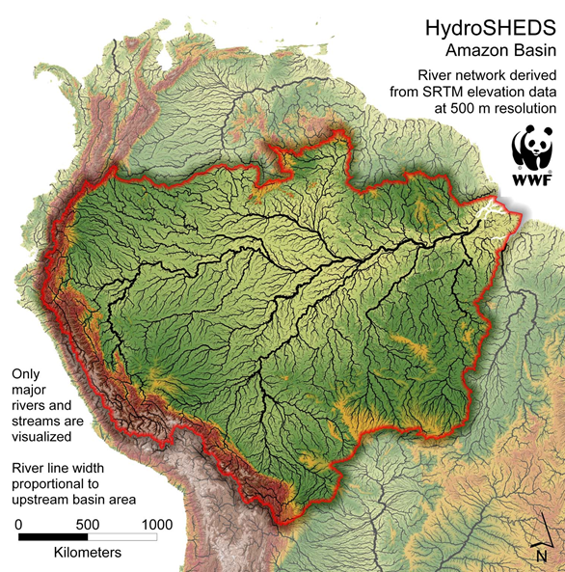

Slide 20
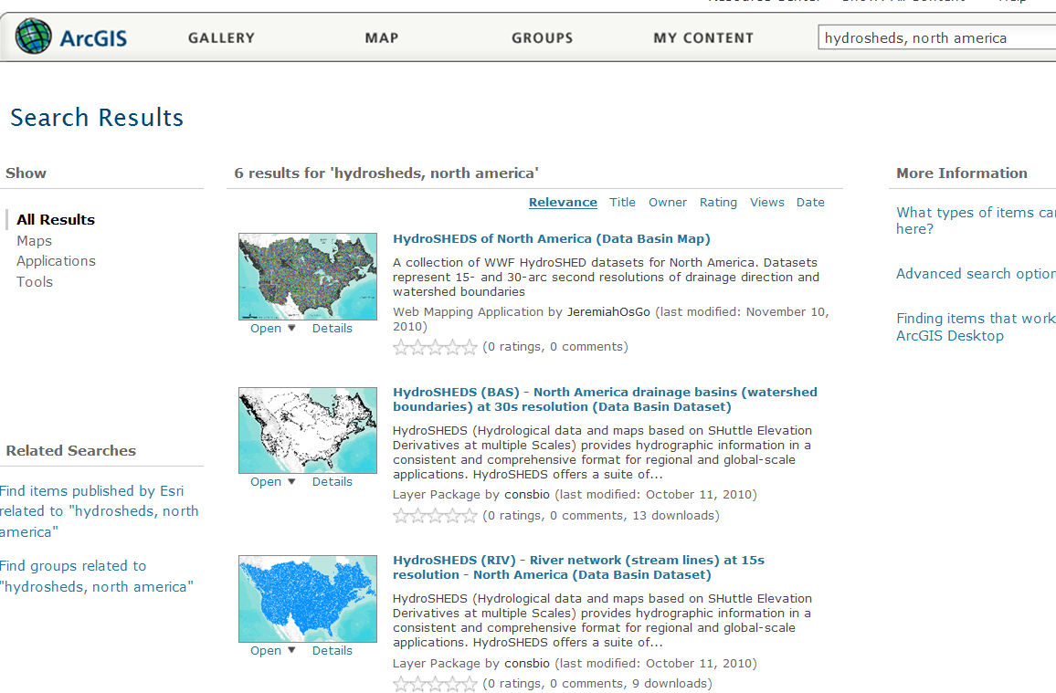
HydroSheds for the World
Much of the data is already presented in ArcGIS.com

Slide 21
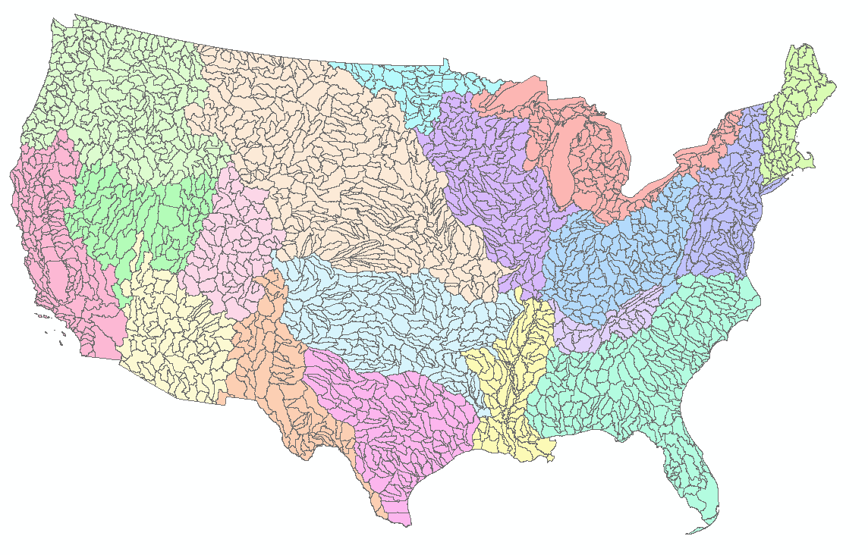
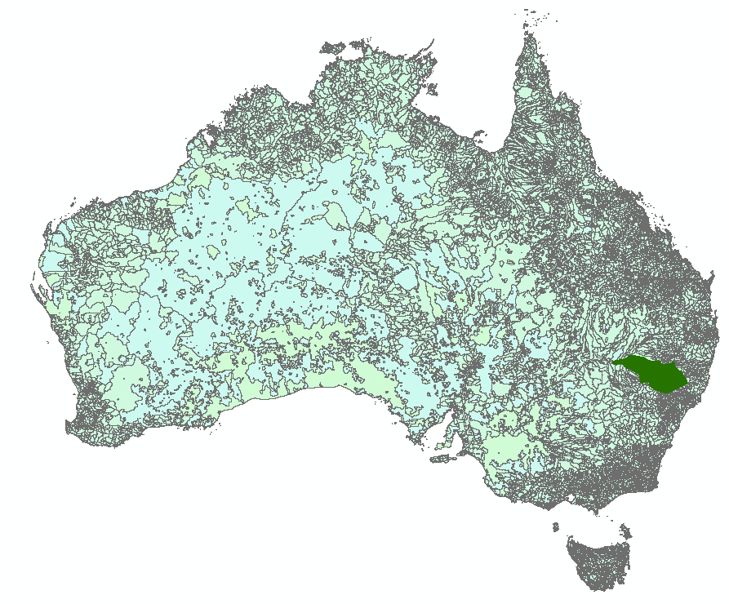
Add Detailed Content for Regions
NHDand NHDPlus – USGS and EPA
Geofabric - Bureau of Meteorology, Geoscience Australia, ANU and CSIRO'

Slide 22
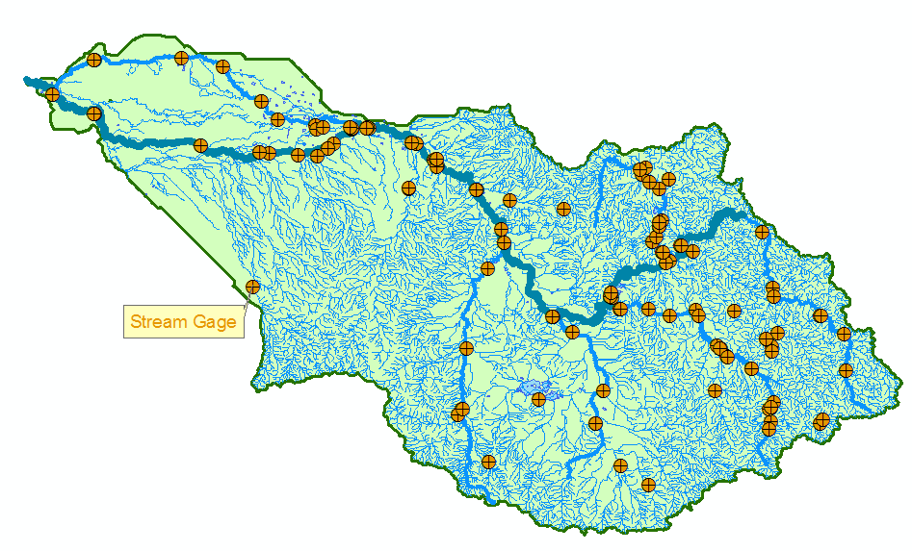
Namoi Basin from Australian Geofabric
Looped stream networks

Slide 23
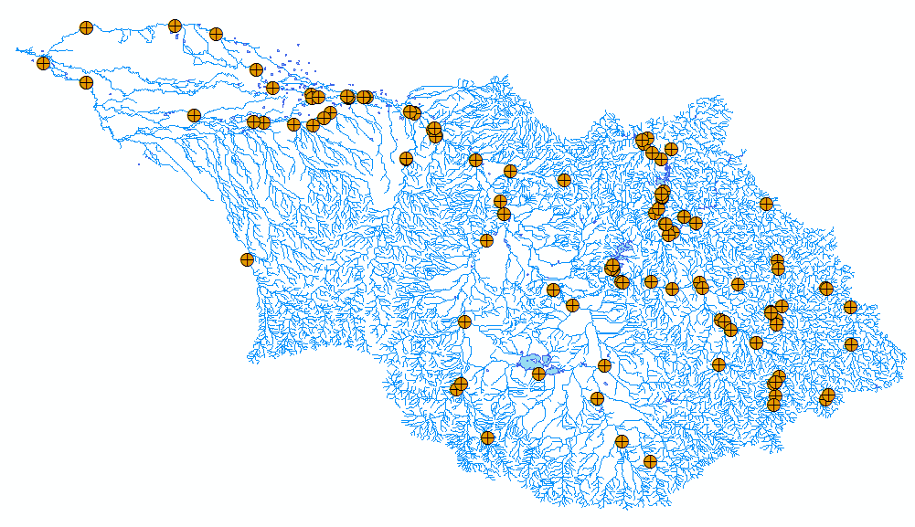
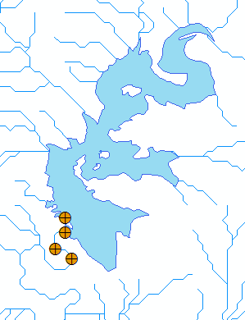
HydroBaseMap Display Layer
The Hydrography or “blue line” component of a topographic map

Slide 24
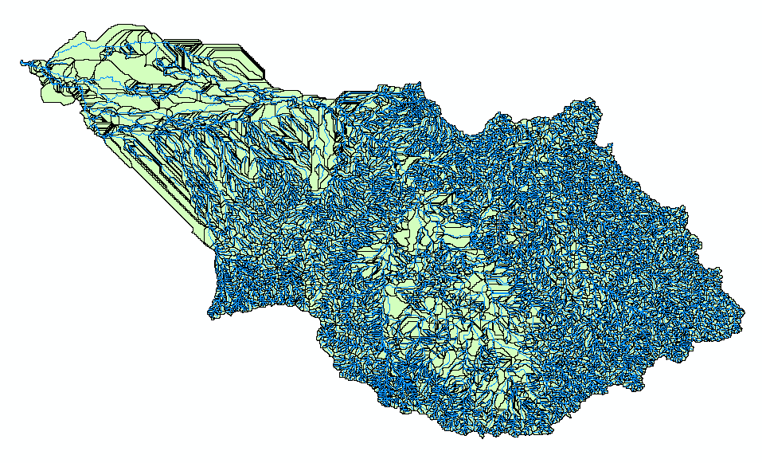
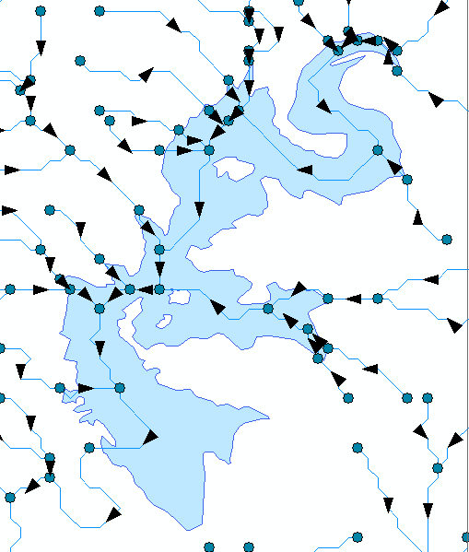
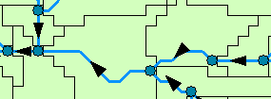
HydroBaseMap Operational Layer
A geometric network with a local catchment for each network edge
What functionality should this layer have?

Slide 25
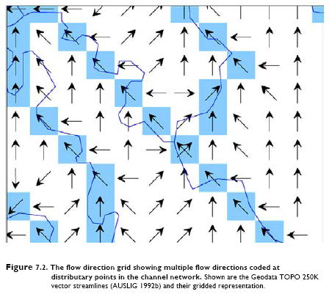
Multiple Flow Directions at a Cell
This is now part of ANU DEM
From: Ecohydrological regionalisation of Australia: a tool for management and science by Brad Pusey, Fran Sheldon, Mark Kennard, Mike Hutchinson
Looped stream networks
http://lwa.gov.au/products/pn22591
…Is there a need for updating the core hydrology functions of ArcGIS ?

Slide 26
Arc Hydro River Vision
David Maidment
University of Texas at Austin
Goals
Community Hydrobase map
Space-time observations layers
Arc Hydro River
Arc Hydro River Workshop, Austin, Texas, December 1, 2010

Slide 27
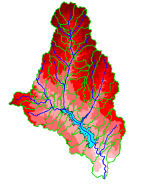
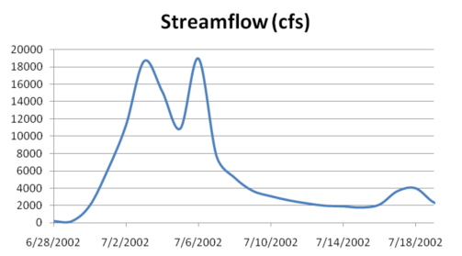
The Key Challenge
Integrating GIS and Water Resources Observations Data
Geography and GIS provide the Framework
Time Series Data
GIS
Water Environment
(Watersheds, streams, gages, sampling points)
The Water Itself
(Flow, water level concentraton)
. . . Relevant at all Scales

Slide 28
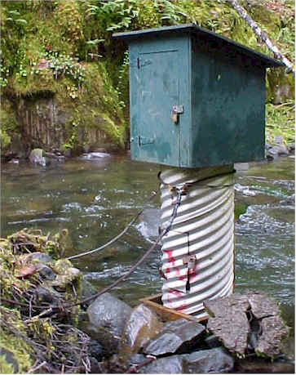
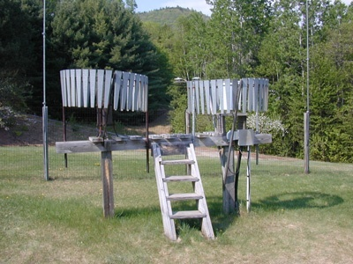
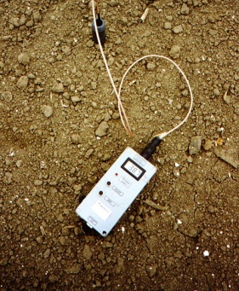
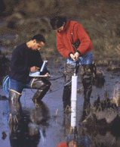
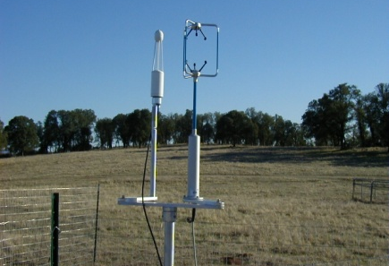
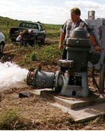
This System Integrates Many Types of Water Observations Data
Water quantity
Rainfall
Soil water
Water quality
Meteorology
Groundwater

Slide 29
This is Enabled by WaterML
a Web Language for Water Observations Data
GetValues Response in WaterML
. . .Adopted by USGS, and other agencies for Publishing Some of their Data

Slide 30
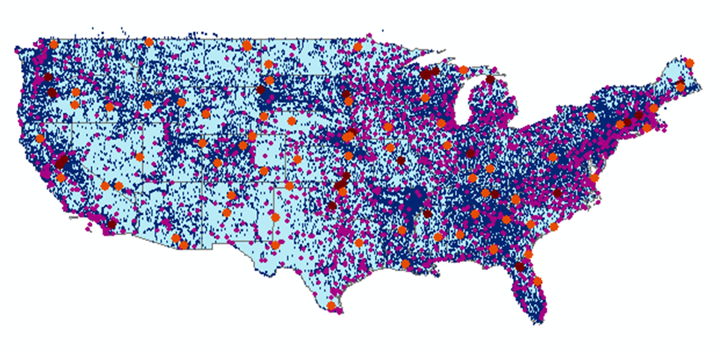
The CUAHSI Data Catalog Integrates
Multi Source Water Data Services
Map Integrating NWIS, STORET, & Climatic Sites
47 services
15,000 variables
1.8 million sites
9 million series
4.3 billion data Values
. . . The Worlds Largest Water Data Catalog

Slide 31
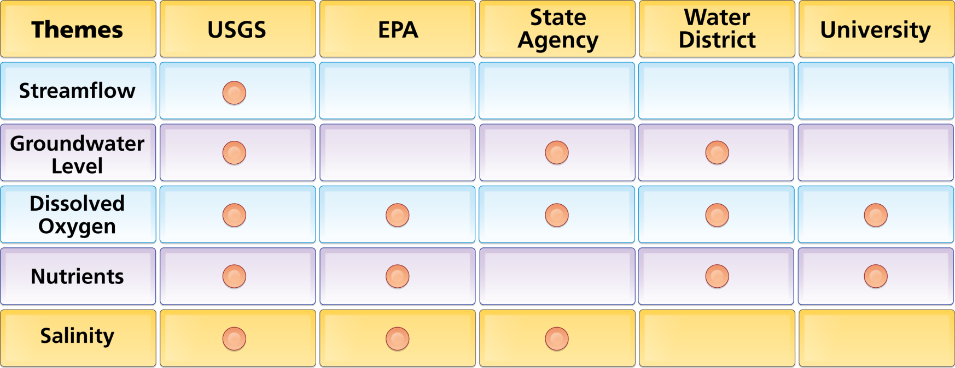
Data Carts Organize Water Data Into “Themes”
Integrating Water Data Services From Multiple Agencies
WaterML
WaterML
WaterML
WaterML
WaterML
. . . Across a Group of Organizations

Slide 32
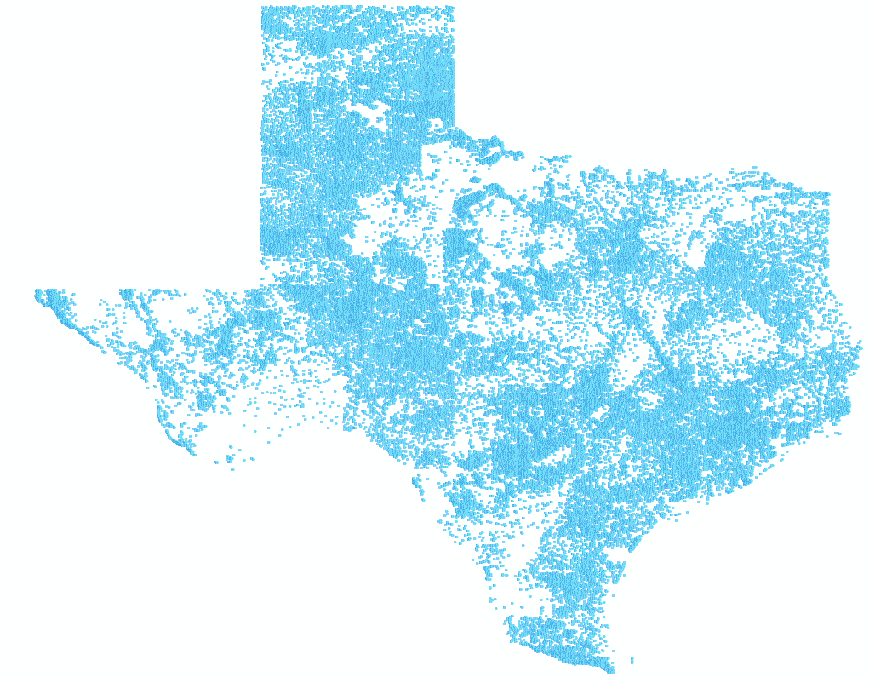
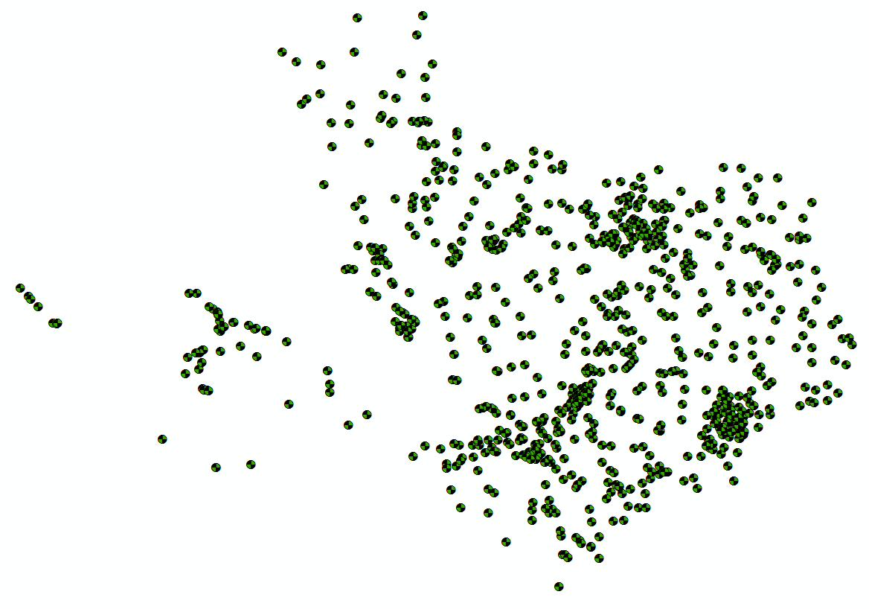
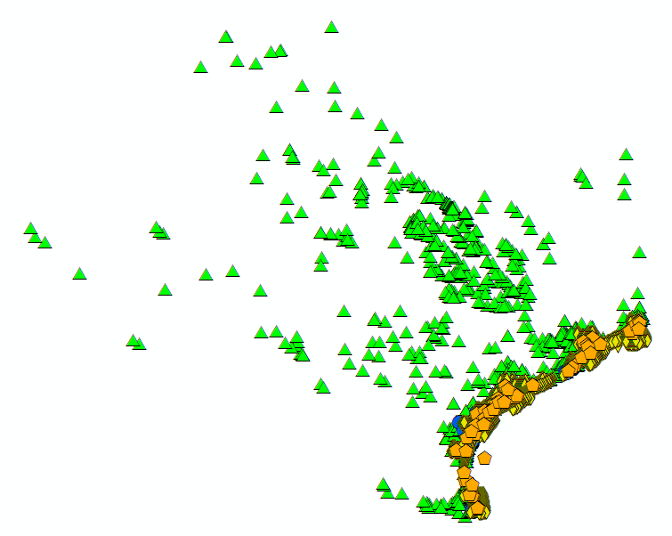
Bringing Water Into GIS Thematic Maps of Water Observations as GIS Layers
Groundwater
Streamflow
Salinity
Unified access to water data in Texas ….

Slide 33
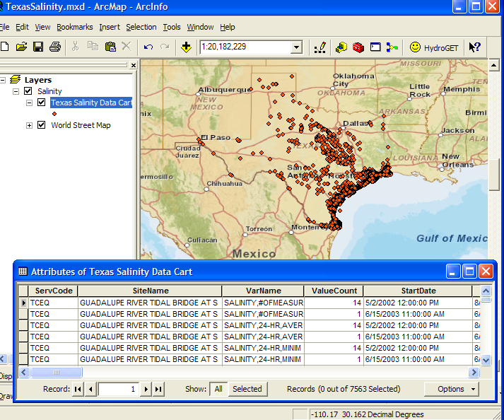
This System Organizes Water Information Using “Data Carts”
Metadata Records, for Each Time Series
Indexing water observations . . .
. . . including reference to its WaterML data service

Slide 34
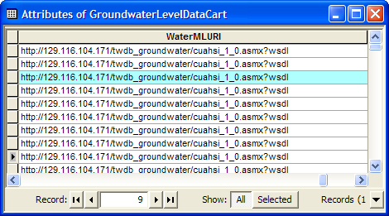
WaterML Web Service Delivers Data
Same format for all water observations data sources

Slide 35
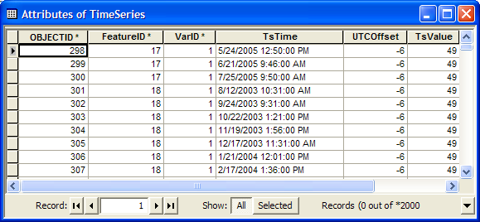
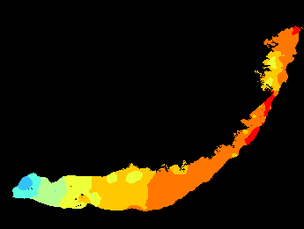
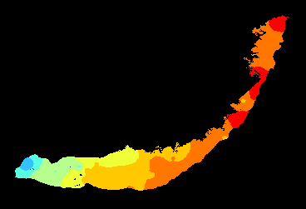
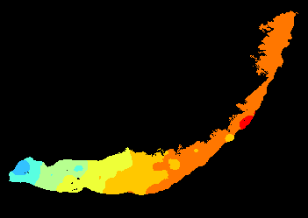
Ingest Data into Arc Hydro Time Series
2005
Transform them into time-varying maps
2006
2007

Slide 36
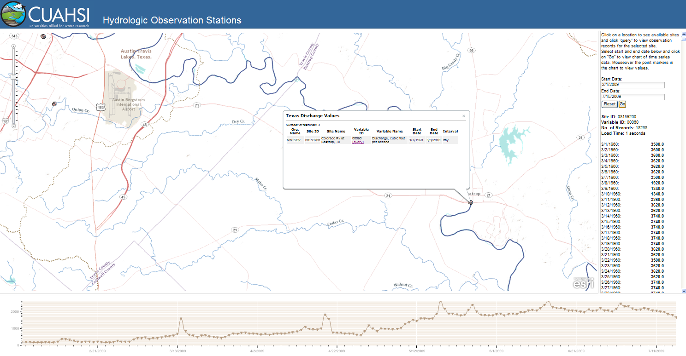
Publish space-time map services in ArcGIS 10
http://hydro_bm.esri.com/TxDischarge/TxDischarge.html
Query and visualize the data through the web

Slide 37
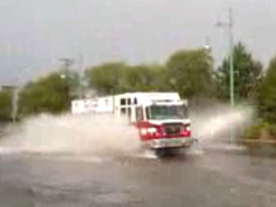
Real-Time Situational Awareness
Routing fire trucks during a flood
Requires a real-time flood water level map

Slide 38
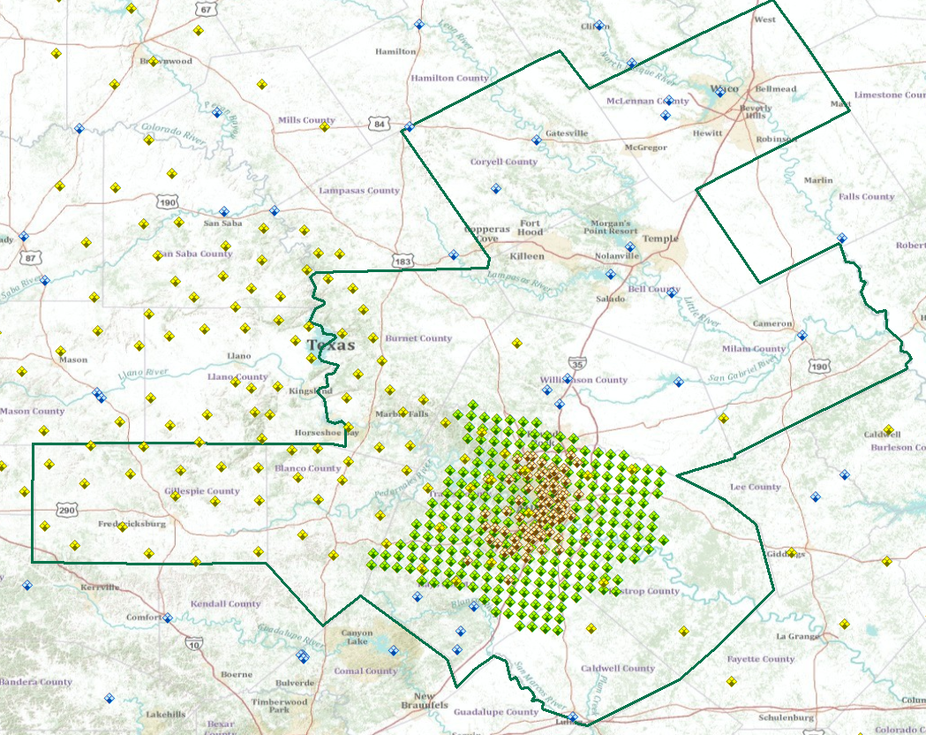
Real-time Observations Layer for Austin, Texas
WaterML web services for precipitation and water level
….provided by multiple agencies

Slide 40
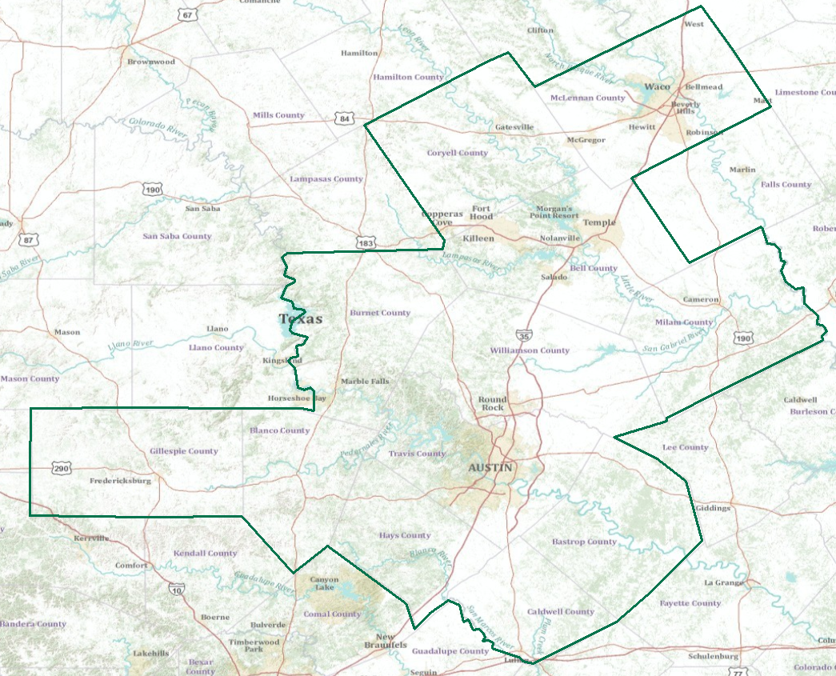
Real-Time Flood Information for Television
Maureen McCann, Meteorologist with News8 Austin
Develop a prototype of space-time mapping for television meteorologists

Slide 41
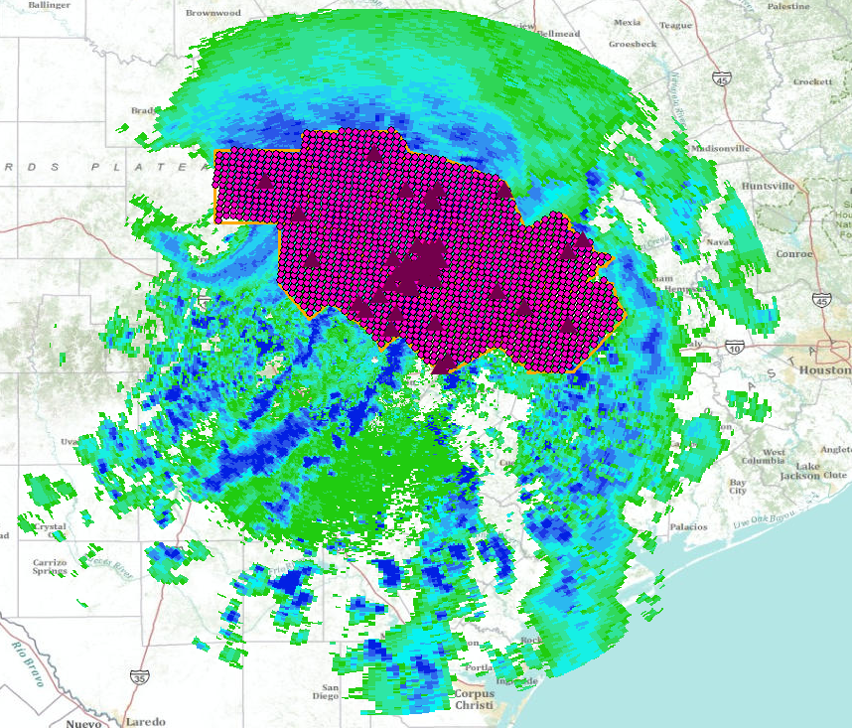
Tropical Storm Hermine, 8 Sept 2010
An ArcGIS map service in space
Tropical Storm Hermine CRWR Map service
Tropical Storm Hermine CRWR Layer Package

Slide 42
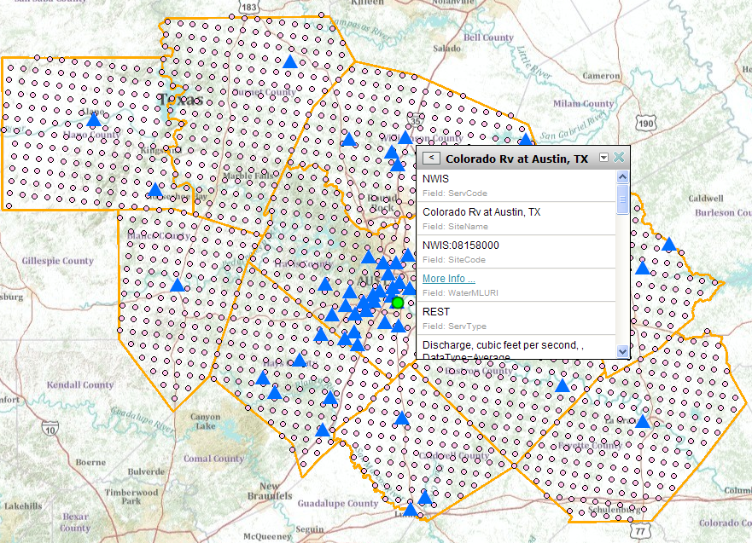
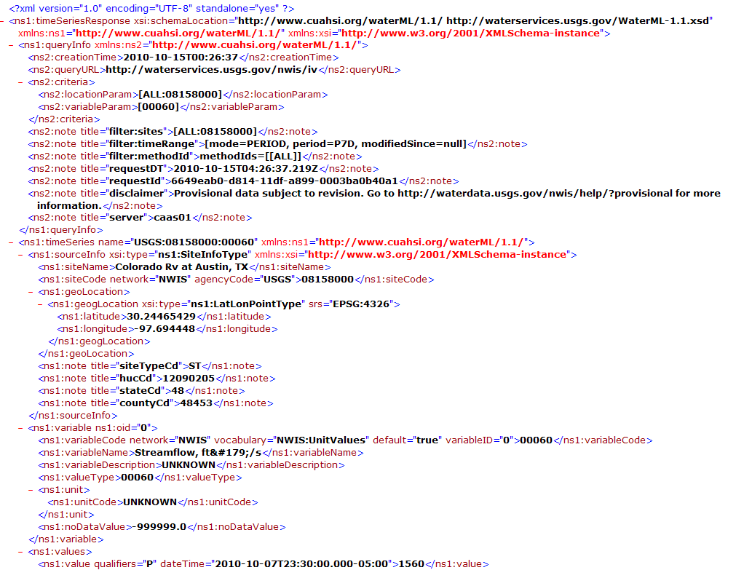
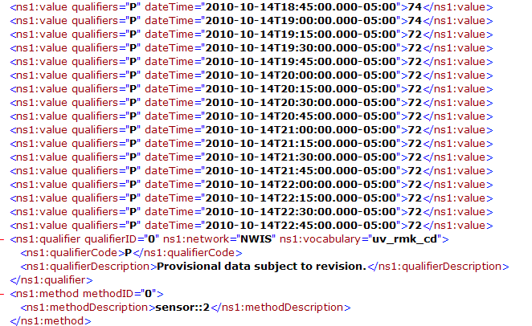
USGS REST service
http://waterservices.usgs.gov/nwis/iv?sites=08158000&period=P7D&parameterCd=00060
A WaterML observations service in time

Slide 43
Observations Data Layers for Precipitation, Streamflow and Water Level
Not just a pretty map but rich observations data layers for which you can create new displays and drill down into for geospatial analysis

Slide 44
Types of Observations Data (Scott Morehouse)
Telemetry from sensors
Information interchange between agencies
Collections in repositories
Derived information products for consumers
Information synthesized across repositories and flowing to consumers (CUAHSI)
ESRI focuses on:

Slide 45
Arc Hydro River Vision
David Maidment
University of Texas at Austin
Goals
Community Hydrobase map
Space-time observations layers
Arc Hydro River
Arc Hydro River Workshop, Austin, Texas, December 1, 2010

Slide 46
Arc Hydro River
GIS for River Morphology and Modeling
River Network
Channel Shape
Geography
Flooding
Aquatic Biology
Applications

Slide 47
Why Arc Hydro River?
National Hydrography Dataset and NHDPlus have been completed for the United States
A river is a lot more than a blue line
LIDAR data acquisition has blossomed in recent years
Floodplain mapping has become an industry
Environmental flows require characterization of river biology and habitat
Sediment transport is a key function of rivers

Slide 48
River Network
National Hydrography Dataset for the United States
Geometric model for the (x, y) of river location
Logical model for connecting river reaches in flow sequence
Addressing model for specifying a point location on a river
Can we publish networks directly in ArcGIS.com?

Slide 49
A Core “Network-Catchment” Model?
The vector version of the connected set of DEM cells
….. PhD dissertation work of Clark Siler

Slide 50
LIDAR Land Elevation Mapping
Image: Roberto Gutierrez, UT Center for Space Research

Slide 51
Elevation for the Nation
National coverage of high accuracy terrain data
20% of the US is covered with LIDAR data
FEMA is now investing $20 million per year in terrain data acquisition …… and processing around rivers

Slide 52
River Morphology
3D model of river channel shape and properties
LIDAR data for 3D description of land surface terrain
Profile lines and Cross-Sections for channel geometry
Bed sediment (ripples, dunes, antidunes)
Needs Triangulated Integrated Network
and 3D Analyst

Slide 53
National River Morphology Dataset
A proposal being initiated at this time
Initiated by John Gray, USGS Office of Surface Water, within the scope of the ACWI Subcommittee on Sedimentation
Collaboration from Wisconsin Water Science Center and University of Texas at Austin
Data Components
Study locations – Watersheds, Reaches, Transects, Gages
Raw data – Survey (GPS), pebble counts, bank characteristics and erosion, sediment lab reports
Calculated data – Cross-sections and profiles, morphological characteristics of river and watershed, sediment size distribution
Additional data – photographs, analysis files, experimental methods,
A repository for data from river morphology field studies

Slide 54
River Bottom Bathymetry
Sand waves on the bed of the Hudson River estuary up to 3 meters in height
Source: http://www.magazine.noaa.gov/stories/images/hudson_bathymetry.jpg

Slide 55
Aquatic Biology
River habitat and species
Biological data for fish and macroinvertebrates
Sediment data describing river bed material sizes
Geomorphic information about pools, riffles, bars
Needs relational data tables

Slide 56
Environmental Flows
http://efis.crwr.utexas.edu
….. PhD dissertation work of Eric Hersh

Slide 57
Flooding
Flood modeling and mapping
Hydraulic modeling of flood water elevation (HEC-RAS)
Floodplain mapping using intersection of terrain and flood elevation surfaces
Economic analysis of flood damage
Needs links to flood models (HEC-GeoRAS)

Slide 58
River Hydraulic Modeling
Rivers with > 2000 km² drainage area
Flat slope < 1 ft/mile (Dynamic wave)
Mild Slope 1-10 ft/mile (Diffusion wave)
Steep Slope > 10 ft/mile (Kinematic wave)
NWS Hydraulic models
From: Reed, S. (2010), “Lessons Learned from Transitioning NWS Operational Hydraulic Models to HEC-RAS”, Proceedings of AWRA GIS in Water Resources Specialty Conference, Orlando, FL

Slide 59
LIDAR for Floodplain Mapping
High precision data for terrain and water surface elevation
Flood water surface elevation, 2008 Iowa floods
Source: University of Iowa and National
Center for Airborne Laser Mapping
National Academies study of FEMA Floodplain Mapping

Slide 60
Mapping Differential Risk of Flooding
New Orleans

Slide 61
Arc Hydro River in ArcGIS Online
http://resources.esri.com/arcHydro/
Documentation of draft data model designs , discussion and meetings for Arc Hydro River

Slide 62
Arc Hydro River is a Proposal
We welcome your contribution and guidance
Questions?
Suggestions?
Who should be involved?

