Slide 1
Processing Terrain Data in the River Proximity
Arc Hydro River Workshop
December 1, 2010
Erin Atkinson, PE, CFM, GISP
Halff Associates, Inc.

Slide 2
Terrain Processing Overview
Terrain Data Models
Terrain for Hydraulics (GeoRAS)
Terrain Acquisition and LIDAR
ESRI Terrain Dataset
Hydraulics and LIDAR Case Studies

Slide 3
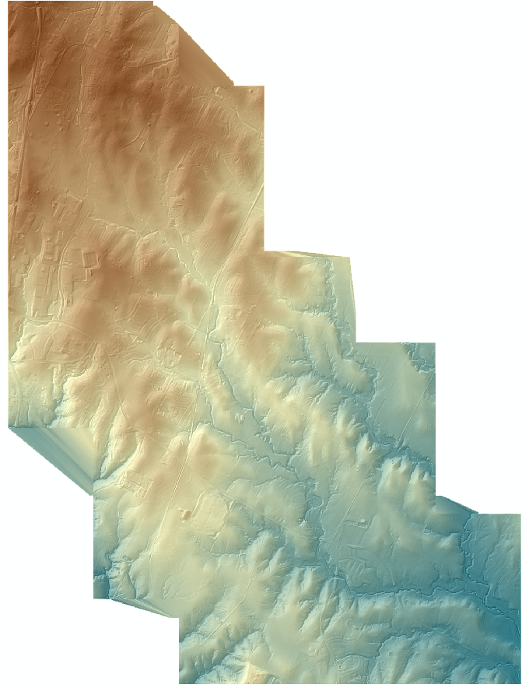
Terrain for H&H Modeling
Terrain is the most important piece of data for automated H&H
Always start with source data (when possible)
Mass points
Breaklines
Contours and DEMs are typically derivative datasets
Don’t overlap data from different sources

Slide 4
Supported Terrain Data Models in GIS
Vector – Points, Breaklines, & Contours
Vector features representing elevation with x,y,z coordinates
DEM – Digital Elevation Model
Raster features representing terrain with cells
TIN – Triangulated Irregular Network
Nodes and edges forming triangles
ESRI Terrain Dataset

Slide 5
Terrain for Hydraulics
Geoprocessing tools for hydraulics usually work with TINs, but rasters are also supported
TINs allow for more detail in channel area, less in overbanks
TINs for hydraulics should be limited to the floodplain
A TIN for an entire subbasin is a waste of space and processing
Cross sections and other hydraulic features get elevation values at:
Intersection of triangle edge in a TIN
Crossing a cell in a raster

Slide 6
GeoRAS Elevation Dataset Requirements
GeoRAS currently supports two DTM types
TINs
GRIDs
DTM should cover channel and overbank areas
i.e. Spatial extent of DTM must cover cross sections
Terrain datasets are currently not supported by GeoRAS
GeoRAS does support the use of multiple DTMs for modeling long reaches

Slide 7
GeoRAS Elevation Dataset
TINs are recommended for use with GeoRAS
Linear features can be enforced
Channel banks
Hydraulic structures
Roads
Density of data can be varied (channel vs. overbank)
Survey information can be retained

Slide 8
Terrain Acquisition Methods
Remote sensing technologies are collecting data at very fine resolutions
LIDAR = 1.4 m, 0.7 m, even 0.25 m
Radar (IFSAR) = 5 m
ACS (Auto Correlated Surface) = 8 ft
Example
Avg 1.4 m spacing for a 1,000 sq mi county
1,320,000,000 – elevation points

Slide 9
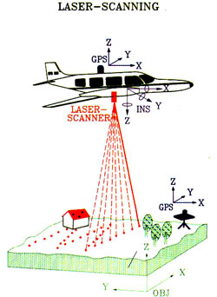
LIDAR
Light Detection and Ranging
Light pulse (laser) mounted on fixed wing aircraft or helicopter
Multi-return technology
Multiple measurements per pulse
“Penetrating” ability
Average spacing, 1.4m to 0.25m

Slide 10
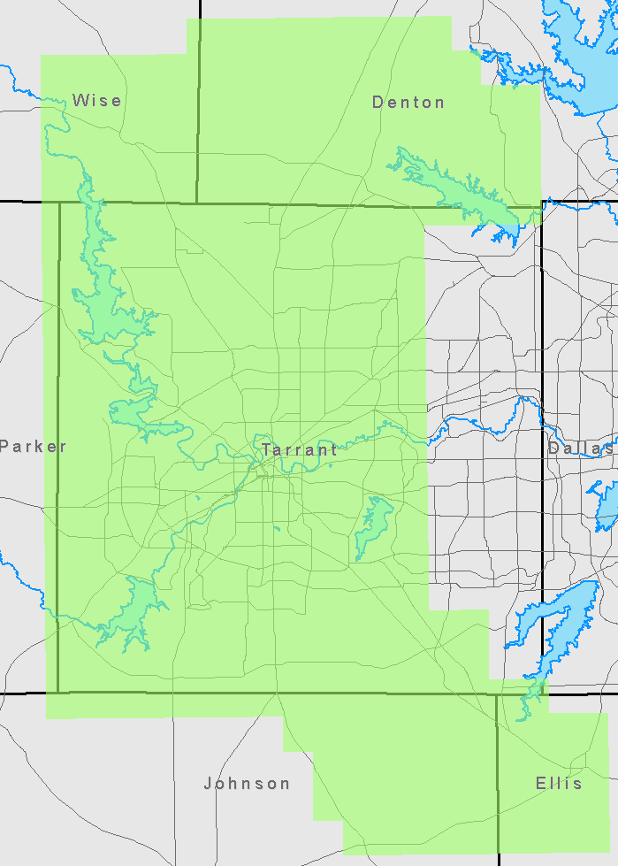
TNRIS 2009 LIDAR
Acquisition area
1,300 sq mi
Average point spacing
Full resolution = 2 ft
Bare earth = 3 ft
Total point count
Full resolution = 11.6 billion
Bare earth = 4.2 billion

Slide 11
Great Data, But How Do I Use It?
Problem
Too much data
How should it be stored
How can it be viewed
Solution
ESRI Terrain dataset
New data type introduced with ArcGIS 9.2

Slide 12
Basic Issue with LIDAR for TINs and DEMs
Realistic size limit of a TIN = 10 million nodes
1.4 m LIDAR ~ average point spacing is 4.6 feet
10 million nodes is approximately 7.6 square miles
Possible to go as high as 15-20 million nodes
DEM (GRID format) = 400 million cells
1.4 m LIDAR ~ raster cell size is 4.6 feet
400 million cells is approximately 300 square miles
Optimal processing size 25 million cells or less

Slide 13
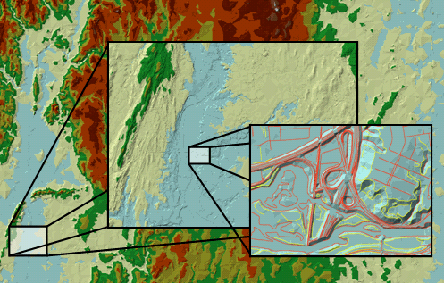
ESRI Terrain Dataset
Multi resolution dataset
Continuous surface
Designed to hold lots of data (LIDAR)
Works with multiple feature types
Fast display – uses pyramid concept
On the fly “TINing”
Editable and Expandable
*Graphic from ArcGIS Desktop Help

Slide 14
Terrain Dataset Basics
Exists in a geodatabase (all types)
Can read multiple feature classes
Point, Polyline, or Polygon (2D or 3D)
Treats each feature class independently
Displays as a TIN surface
Triangulates on the fly
Can be converted to a DEM or TIN
Supports versioning with SDE

Slide 15
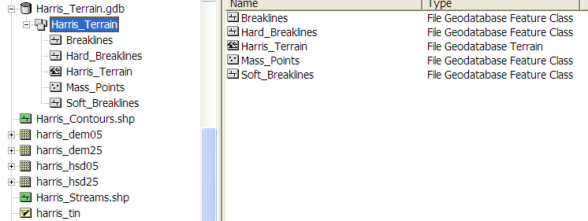
Geodatabase Terrain Data

Slide 16
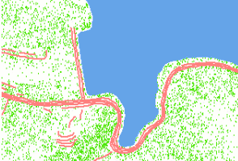
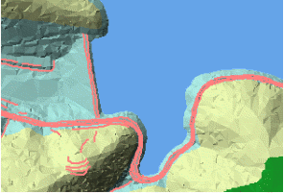
Terrain Surface Feature Types
Same options as a TIN
Surface feature type defines how the feature class will be treated by the terrain
SFTypes
Mass points
Breaklines
Clip polygons
Erase polygons
Replace polygons
Value fill polygons
*Graphics from ArcGIS Desktop Help

Slide 17
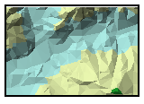
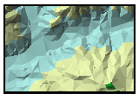
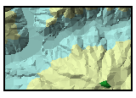
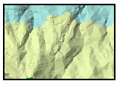
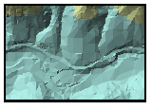
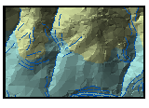
Terrain Pyramids
Pyramids are used to represent multiple levels of resolution
Pyramid levels are based on a map scale range
More points are displayed as the user zooms in
User defined
Number of pyramids along with map scale
Two options
Z-tolerance
Window size
*Graphics from ArcGIS Desktop Help

Slide 18
Pyramids Options
Z-Tolerance
Vertical approximation of the pyramid level to full resolution
Example: Scale threshold = 6,000 and Z-tolerance = 1ft
Result: Triangulated surface is within +/- 1.0’ of full resolution
Window Size
Pyramid resolution is defined by the window size
Elevation points are thinned out based on partitions of equal area, aka Windows
One or two points are selected for each window based on z min, z max, z min and max, or mean z value
*Graphics from ArcGIS Desktop Help

Slide 19
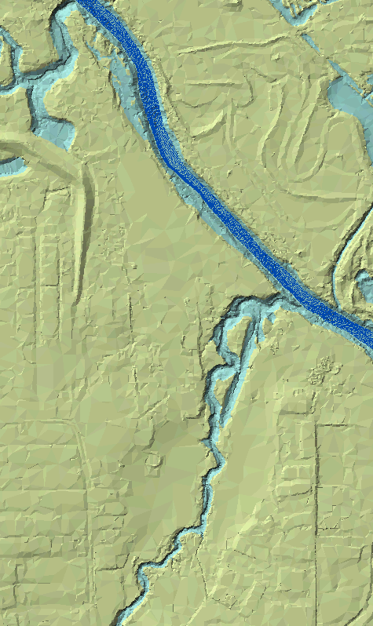
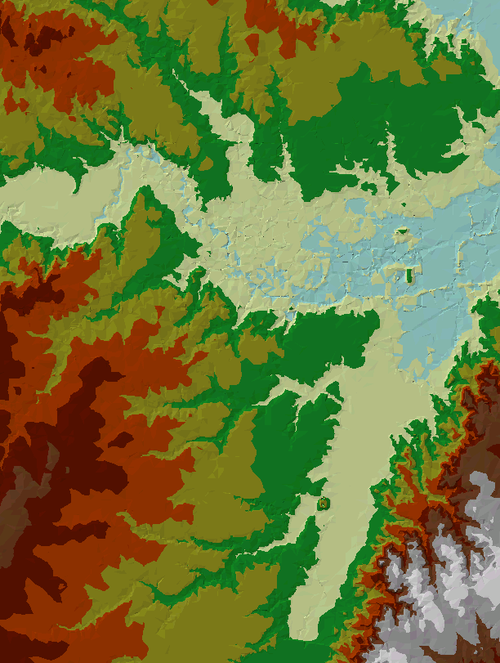
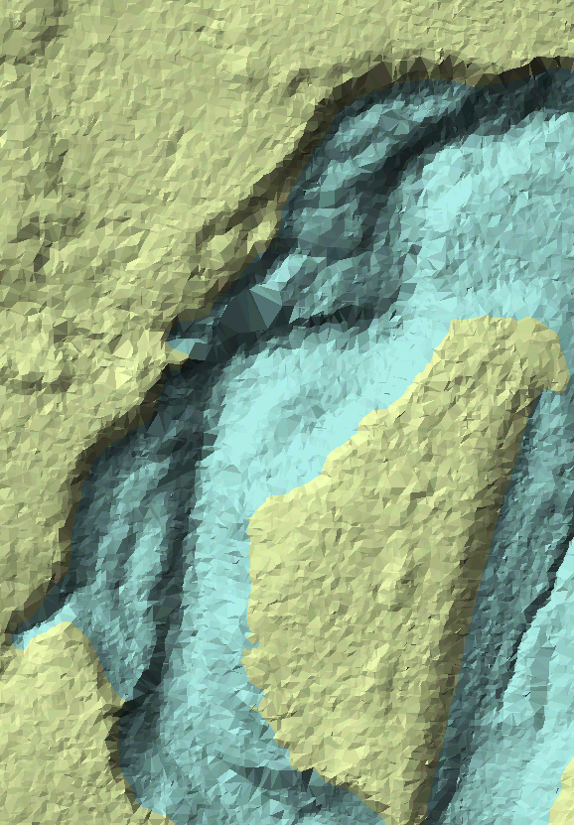
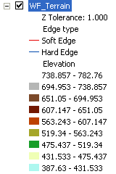
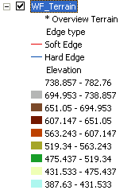
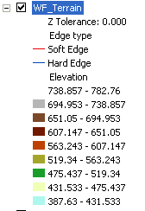
Terrain Display Based on Z Tolerance

Slide 20
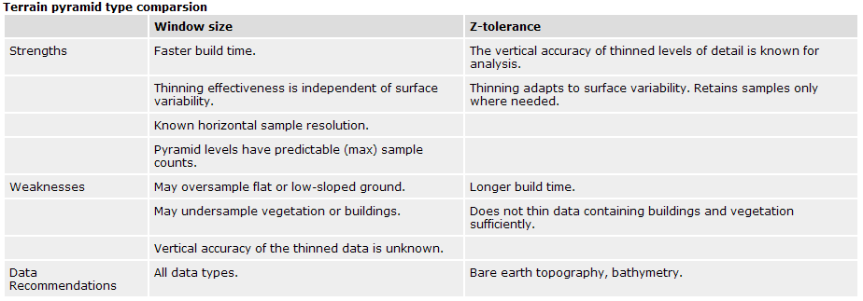
Terrain Pyramid Type Comparison
*Table from ArcGIS Desktop Help

Slide 21
Exporting Terrains: DEM vs. TIN
Terrain export geoprocessing tools allow the user to select the pyramid level to export from
Changing the DEM cell size averages the point elevation values within the cell area
Related to horizontal tolerance
TINs created from a terrain are based on vertical tolerances
Elevations within a user specified value (pyramids)
Larger z-tolerances allow for TINs with larger spatial extents

Slide 22
Hydraulics and LIDAR Case Studies
New technology sometimes generates more data than a TIN dataset can hold (especially LIDAR)
More data than necessary to define surface
Flat area represented by 100’s or millions of points
Low vegetation and automated LIDAR “cleaning” algorithms can leave surface appearring “noisy”
User and computer resources can get overloaded
Processing time
Storage space
Ability to QC all the data

Slide 23
Case Study 1 – Coastal Floodplain
Relatively flat floodplains required long cross sections
Inordinate number of stat/elev points in XS cut lines
1,000+, HEC-RAS has a maximum of 500
Needed a way to maintain accuracy while reducing the number of points and processing time
Topographic data for study area stored in a Terrain
1.2 billion elevation points

Slide 24
Terrain Data Models and Stream Hydraulics
Currently cross sections can not be cut directly from Terrains in all applications (i.e. GeoRAS)
Option to use either a TIN or GRID
XS station/elevation locations
Raster – 1 sta/elev pt each time the XS line crosses a cell
TIN – 1 sta/elev pt each time the XS line crosses a triangle edge

Slide 25
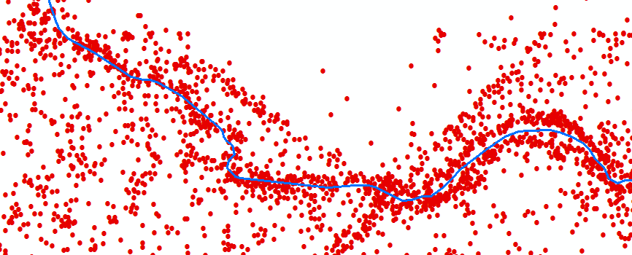
LIDAR vs Area
1.4 m LIDAR, average point spacing
Average of 1 elevation point per 21 sq ft
1 sq mi = 1,321,422 LIDAR points

Slide 26
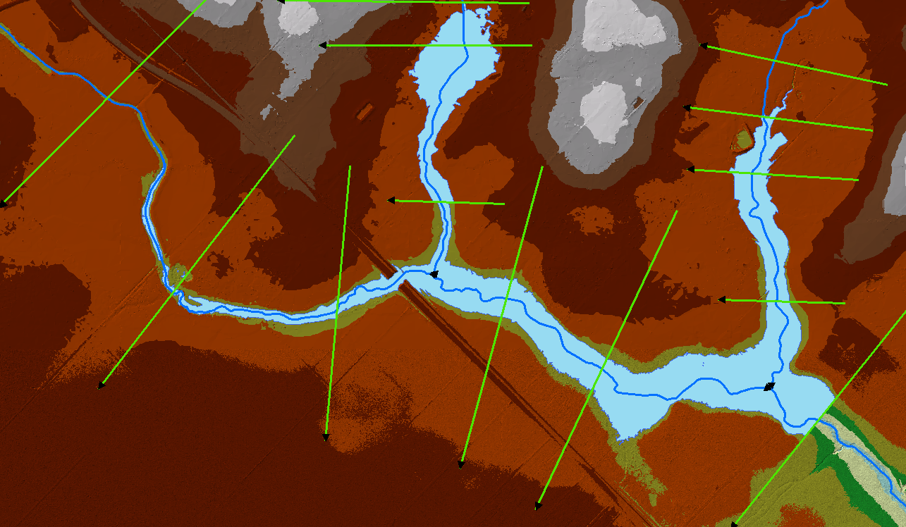
Case Study 1 Project Area
XS 8441

Slide 27
Node Count of TINs Exported from a Terrain
Project area = 2.9 square miles
0.00’ Z-Tolerance = 4,094,000 nodes
0.25’ Z-Tolerance = 442,000 nodes
0.50’ Z-Tolerance = 111,000 nodes
0.75’ Z-Tolerance = 45,000 nodes
1.00’ Z-Tolerance = 24,000 nodes

Slide 28
TINs based on Z-tolerance
Z-tol = 0.00’
Sta/Elev = 1792
Z-tol = 0.25’
Sta/Elev = 541
Z-tol = 0.50’
Sta/Elev = 223
Z-tol = 0.75’
Sta/Elev = 156
Z-tol = 1.00’
Sta/Elev = 110

Slide 29
Profile Comparisons

Slide 30
Reduce LIDAR “Noise”

Slide 31
Profile Comparison

Slide 32
Hydraulics based on Z-Tolerance
Z-Tol | Top Width | XS Area | Hydraulic Radius | WS Elev | Sta/Elev Pts
0.00' | 1051.8 | 4247.7 | 4.0 | 120.3 | 1792
0.25' | 1045.7 | 4246.7 | 4.1 | 120.3 | 541
0.50' | 998.2 | 4150.4 | 4.2 | 120.2 | 223
0.75' | 1153.0 | 4827.4 | 4.2 | 120.7 | 156
1.00' | 1178.2 | 4842.1 | 4.1 | 120.8 | 110
Max Diff | 126.4 | 594.4 | 0.1 | 0.5 | 1692
Max % Diff | 12.0% | 13.9% | 3.7% | 0.5% | 93.9%

Slide 33
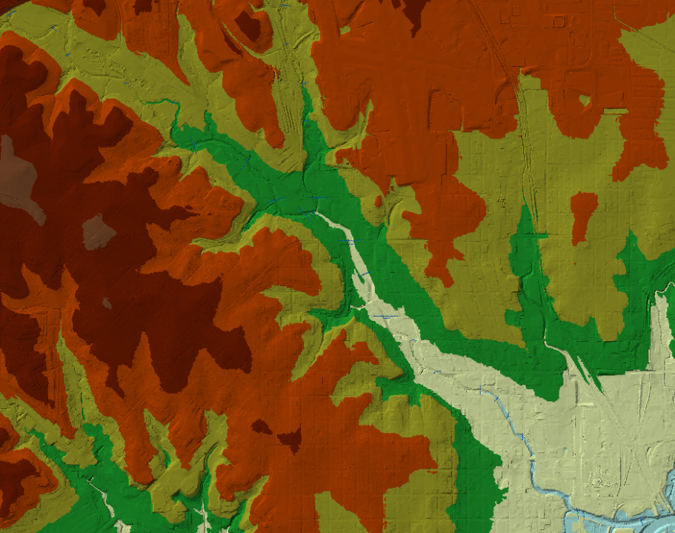
Case Study 2 – Marine Creek (Tarrant Co.)
Marine Creek watershed, Ft. Worth, TX
2009 TNRIS LIDAR
Average spacing 3-ft
Terrain contains 196 million nodes
Compared 10 cross sections

Slide 34
Marine Creek XS Comparison
Average difference of 10 cross sections
Water surface elevations based on normal depth calculations
Z-Tolerance | % Reduction in Sta/Elev Pairs | Water Surface Elevation Difference
Full resolution | 0% | 0.00 ft
0.1 ft | 43% | -0.01 ft
0.2 ft | 67% | -0.03 ft
0.3 ft | 76% | -0.05 ft
0.4 ft | 81% | -0.07 ft
0.5 ft | 84% | -0.10 ft

Slide 35
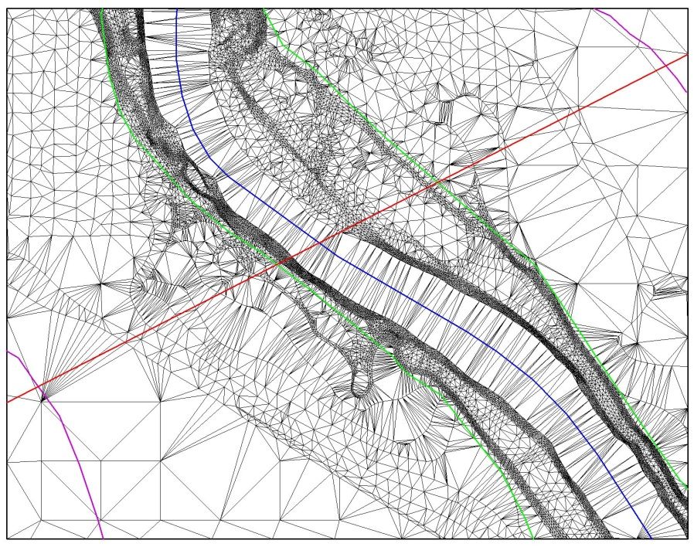
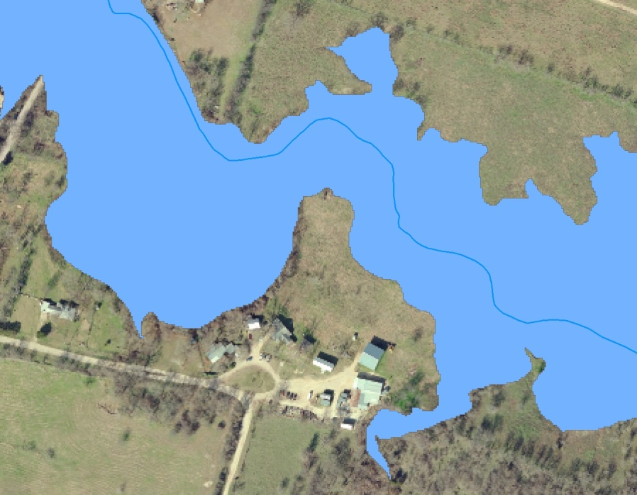
Questions?

