Slide 1
Overview of FEMA’s Risk MAP Program & Taming the Terrain Beast
Arc Hydro River Workshop
Gray Minton & Andy Bonner, AECOM
December 2, 2010
Notes:
Presentation will touch upon the new products and datasets being produced as part of each Risk MAP project, and then very briefly FEMA’s plans as they relate to the use and collection of new/updated topo

Slide 2

Agenda
  FEMA’s Risk MAP Program
    Watershed vs. Countywide
    New Risk MAP Datasets & Products
    FEMA’s Elevation Strategy
  Taming the Terrain Beast
    Challenges and Custom Solutions
    The Virtual Office
  Q&A

Slide 3
FEMA’s Risk MAP Program
Notes:
Will spend most time on the flood depth & analysis grids

Slide 4
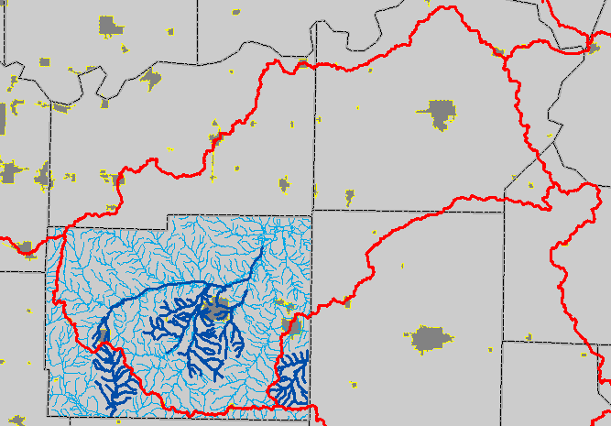
Countywide Studies
Jurisdictionally-based
County 2
County 1
New/Updated
Studies
County 3
County 5
County 4

Slide 5
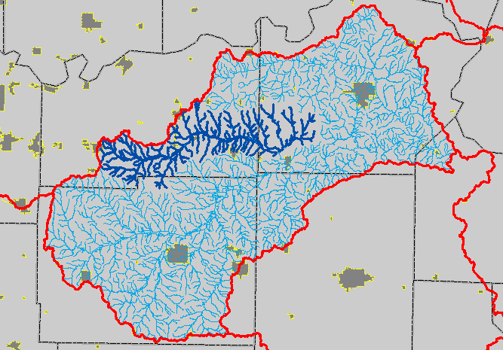
Watershed Studies
Not limited by corporate limits anymore
County 2
New/Updated
Studies
County 1
County 3
County 5
County 4

Slide 6
Flood Risk Products & Datasets
Notes:
Will spend most time on the flood depth & analysis grids

Slide 7
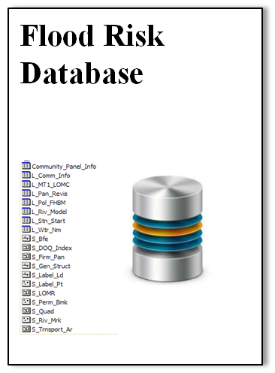
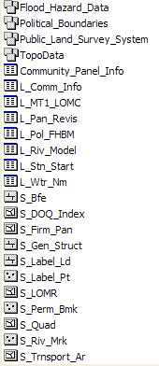
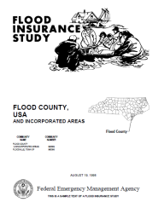
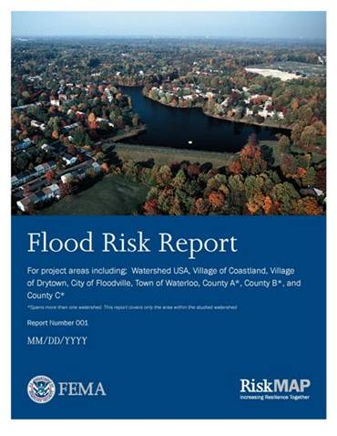
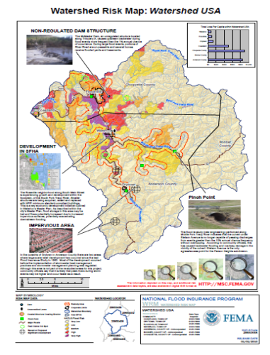
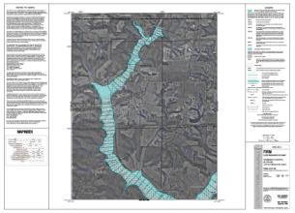
Program Product Comparisons
Traditional Regulatory Products
Non-Regulatory Products
DFIRM Database
Traditional products are regulatory and subject to statutory due-process requirements
Risk MAP products are non-regulatory and are not subject to statutory due-process requirements
Notes:
Floodplain mapping pre-Risk MAP generated 3 main types of products that all familiar with the DFIRM process have come to know and understand
DFIRM Database
FIS Report
DFIRMs
Risk MAP does not seek to replace the FIRM flagship products (FIRM DB, FIS report, and the map itself) – those will still be produced for each study. However, we want to align our new datasets/products with an existing structure and follow the same general model.

Slide 8
Flood Risk Datasets
Changes Since Last FIRM
Flood Depth & Analysis Grids
Flood Risk Assessment Data
Areas of Mitigation Interest (Enhanced)
Notes:
Will spend most time on the flood depth & analysis grids

Slide 9
Flood Depth & Analysis Grids
Summary Table of Grids (☑) vs. Enhanced Grids ()
* Note that the delivery of water surface elevation grids is an enhancement
Grid(s) | Riverine | Coastal | Levee
Depth: 10%, 4%, 2%, 0.2% Annual Chance | ☑ | ✴ | ✴
Depth: 1% (100-yr) Annual Chance | ☑ | ☑ | ☑
Depth: Additional Flood Frequencies (e.g. 50%, 20%, 0.5%, 1%+, etc.) | ✴ | ✴ | ✴
Percent Annual Chance of Flooding | ☑ | ✴ | ✴
Percent Chance of Flooding over a 30-yr Period | ☑ | ✴ | ✴
Water Surface Elevation*: 50%, 20%, 10%, 4%, 2%, 1%, 1%+, 0.5%, 0.2% | ✴ | ✴ | ✴
Velocity | ✴ | ✴ | ✴
Water Surface Elevation Change | ✴ | ✴ | ✴
Depth: Annualized | ✴ | ✴ | ✴
Top & Toe of Levee | N/A | N/A | ✴
Notes:
We will be discussing in more detail the grids in bold – others will not be discussed due to time constraints

Slide 10
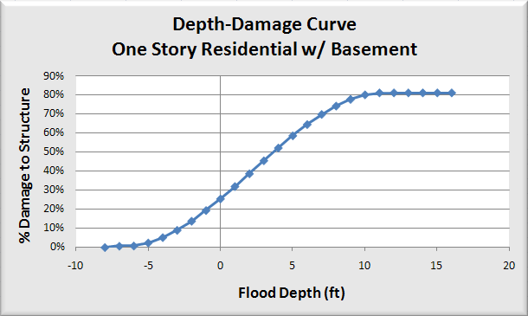
Flood Depth Grids
Definition
  Digital dataset showing the flood depth at various location within the floodplain
Purpose
  Communication of flood hazard in terms of depth (i.e. 4 feet of water means more to most people than a Base Flood Elevation of 734’)
  Key Input into Flood Risk Assessment tools (e.g. HAZUS, etc.)
Source: USACE, Economic Guidance Memo #04-01, October 2003

Slide 11
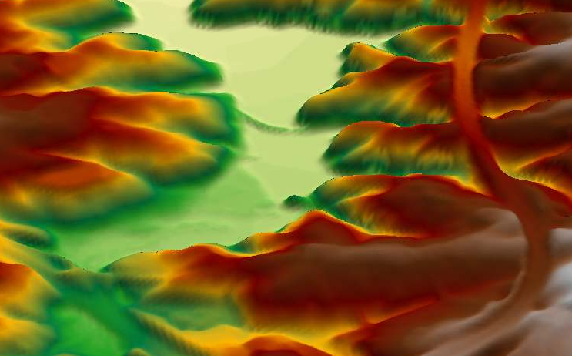
Flood Depth Grid Development
Terrain Developed and Cross-Sections Placed
XS
XS

Slide 12
Flood Depth Grid Development
Hydraulic Models Created
XS
XS

Slide 13
Flood Depth Grid Development
Water Surface Elevations (WSE) Calculated and WSE Grid Produced
XS
XS
WSE
Notes:
Make point that WSE grids will be developed as part of the process to produce depth grids, but will not be delivered unless specifically requested as an enhancement

Slide 14
Flood Depth Grid Development
Depth Grid Calculated as Difference between WSE and Ground
XS
XS
Depth

Slide 15

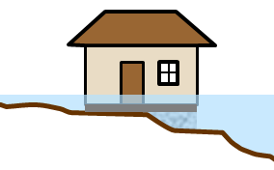
Flood Depth & Analysis Grids
Awareness when using at specific buildings/structures
Finished Floor
Elevation
Notes:
Pause to make sure people understand this graphic – when using this data in relation to specific buildings or structures, everyone needs to understand that the depths are based on the topographic data, which should reflect the natural ground. So awareness is needed when looking at a specific structure that the depth that would be reflected by the depth grade may not be the depth inside the home (unless the structure’s finished floor elevation is at grade). However, in this example, the foundation is still exposed to flood waters. This is an example of where having the water surface elevation grids comes in handy if depths at specific structures is desired.

Slide 16
Percent Chance of Flooding Grids
Definition
  Digital datasets showing the percent chance of flooding at various locations within the mapped floodplain
Purpose
  Communication that the likelihood of flooding for someone living within the mapped floodplain may actually be higher than a “1% annual chance”, and that the flood hazard (and by extension, risk) varies within the mapped floodplain

Slide 17
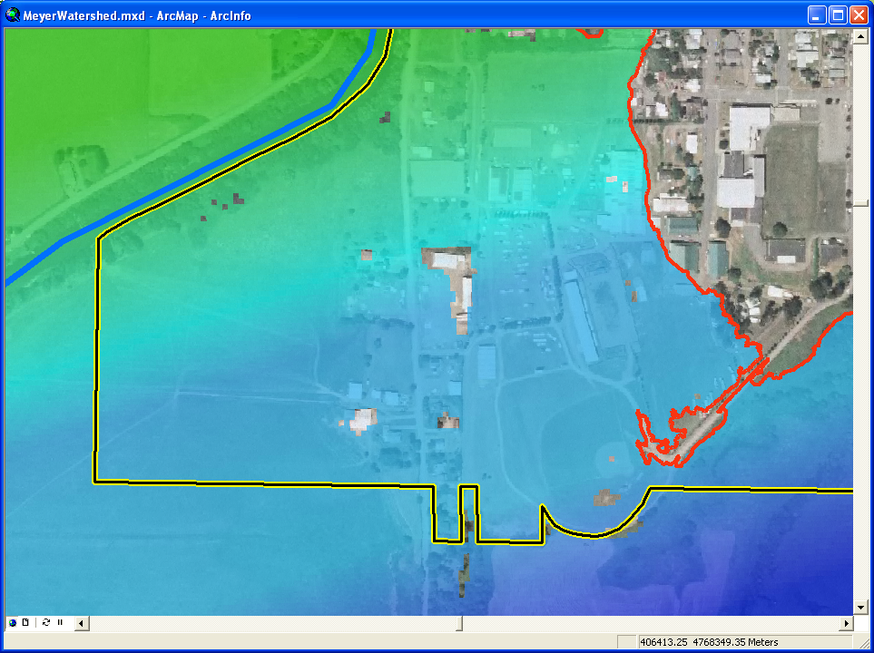
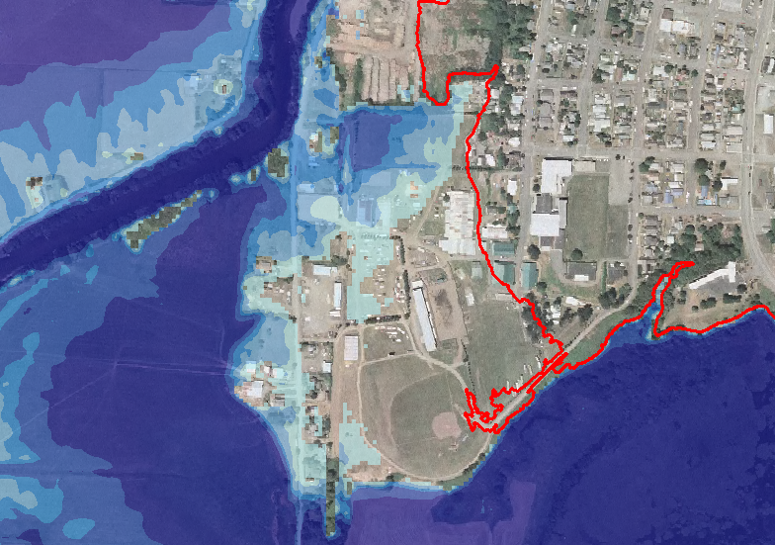
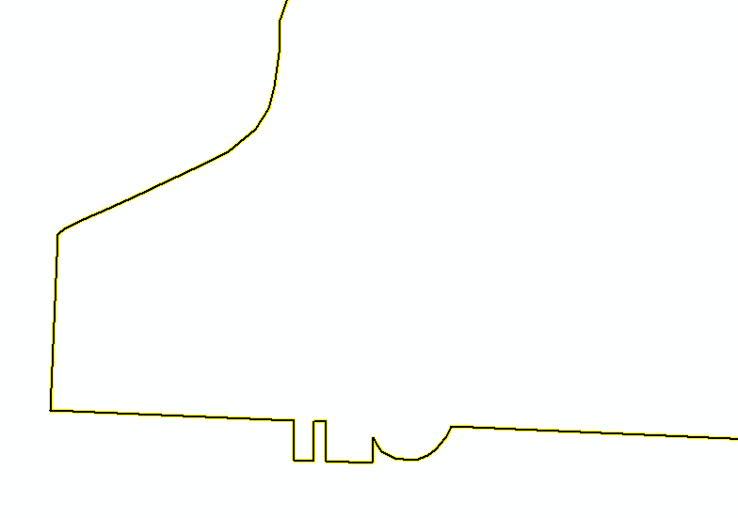

10% Depth
(10-Year)
1% Annual Chance
Floodplain Boundary
1.5 ft
0.0 ft
0.0 ft
Notes:
Red line is the mapped 1% annual chance floodplain boundary
Depth of flooding is an important factor in determining the consequences of flooding, and thus assists in better estimating one’s flood risk
Point A is not only within the 100-yr floodplain, but also the 10-year floodplain

Slide 18
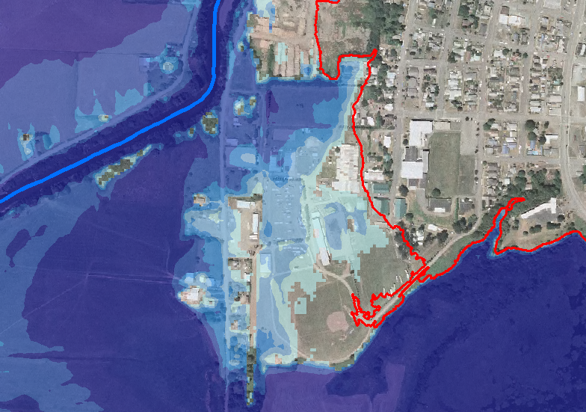
4% Depth
(25-Year)
2.8 ft
0.0 ft
0.0 ft

Slide 19
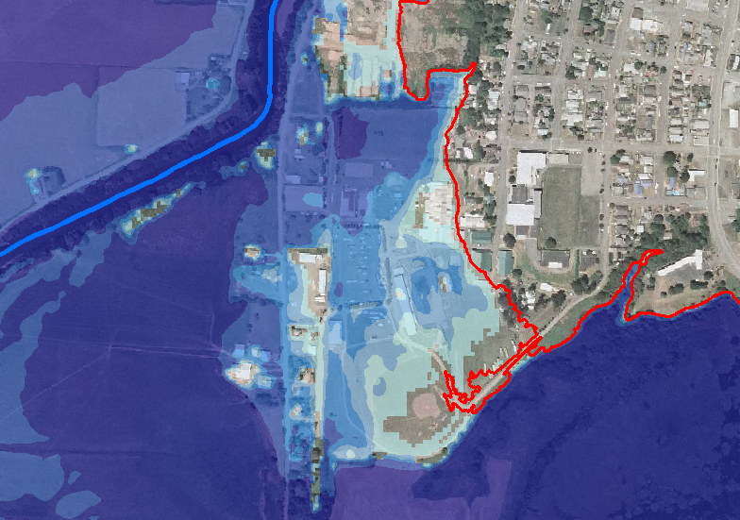
2% Depth
(50-Year)
3.8 ft
0.0 ft
0.0 ft

Slide 20
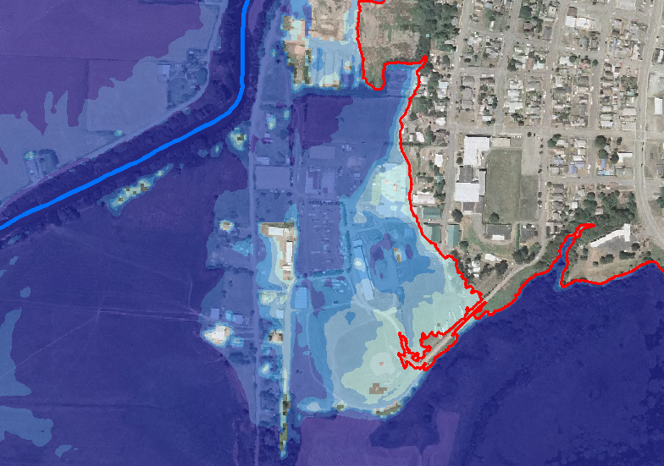
1% Depth
(100-Year)
4.7 ft
0.0 ft
0.1 ft
Notes:
Point B falls just within the 1% annual chance floodplain. These depth grids help illustrate the fact that, although often referred to as the “1% annual chance floodplain”, the likelihood of flooding for lower-lying areas within the FEMA-defined floodplain is actually greater than a 1% annual chance of occurrence

Slide 21
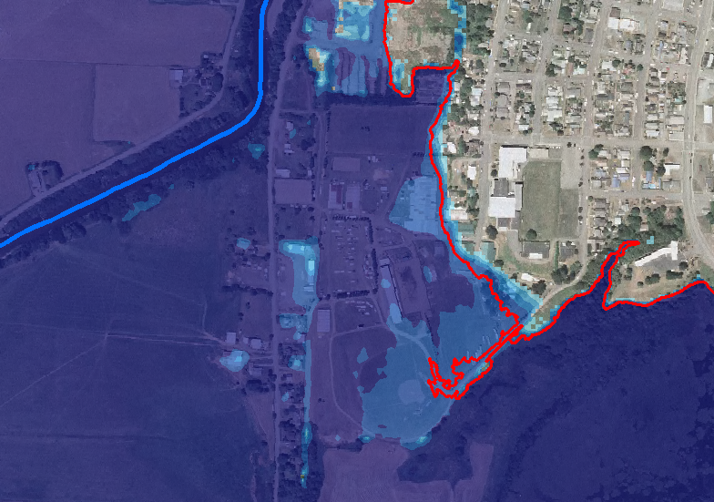
0.2% Depth
(500-Year)
8.9 ft
1.7 ft
4.3 ft
Notes:
Depth grid uses/benefits:
Mapping – better delineation of AO zones for shallow flooding areas (1, 2, 3ft)
Overlay against building footprints, critical facilities, or other site-specific structure (superfund sites, above/below ground storage containers) information to estimate potential risk
Incorporation into Risk Assessment tools, such as HAZUS
BCA screening and project planning
Encourage Flood Insurance purchase outside of 100 year flood boundary

Slide 22
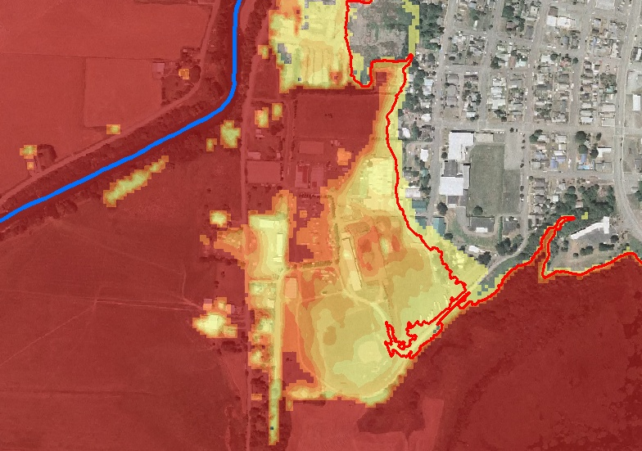

Percent Annual Chance of Flooding
10% +
0.4%
1%
Notes:
From the results of the multi-frequency analyses, the percent annual chance of flooding can be estimated, which can be used for multiple purposes.

Slide 23
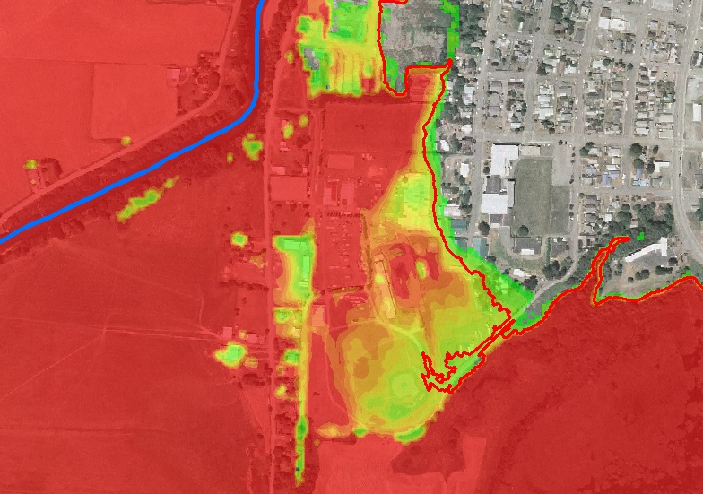
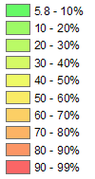
Percent Chance of Flooding over a 30-yr Period
96% +
11%
26%
Notes:
For insurance or communication purposes, we can even use this information to communicate percent chance of flooding during a 30-yr period of time
A grid dataset created to show the estimated likelihood of flooding at least once within a 30-year period for all locations within the extent of the 0.2% annual chance floodplain

Slide 24
Elevation Data Acquisition

Slide 25
Risk MAP Elevation Data Strategy
Program plan is to spend $20M annually
Reuse existing LiDAR where available
Stratify requirements by risk and terrain
  Only the very flattest areas will require very high accuracy
  Most of the need will be medium or low accuracy LiDAR (relative to typical LiDAR standards)
  Very lowest risk areas might use existing data
Cost share for overall collection and initial processing
Cost share separately for targeted post-processing of floodplain areas

Slide 26
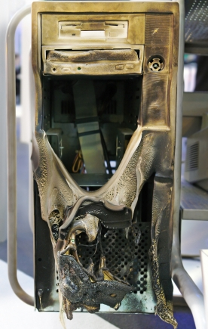

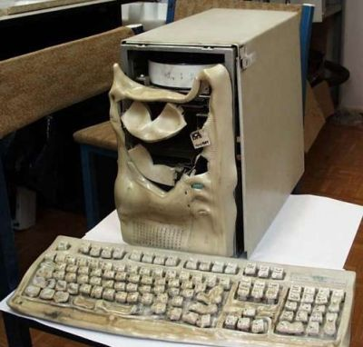

Taming the Terrain Beast
LiDAR is great, but…
  More points = more data to store
  More points = more data to process
  Point spacing keeps getting closer and no end is in sight

Slide 27
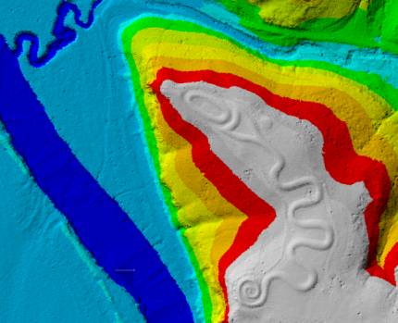
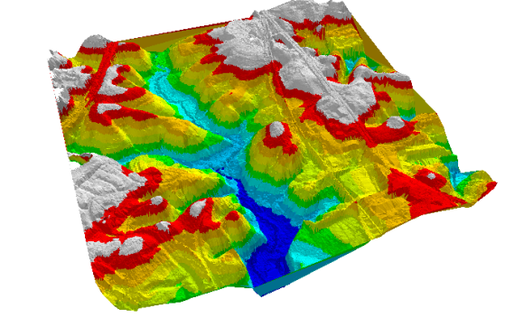
Internal lessons learned:
Custom tool development:
  We developed the core of our existing terrain solution around 1997 for a countywide non-LiDAR study.
  Since then, the tool has evolved to handle LiDAR studies ranging in size from a small watershed to an entire state (or larger if needed).
Virtual office:
  Our staff is dispersed over many states, and need access to the same data at the same time.
  We have been using CITRIX for all data access and processing.

Slide 28
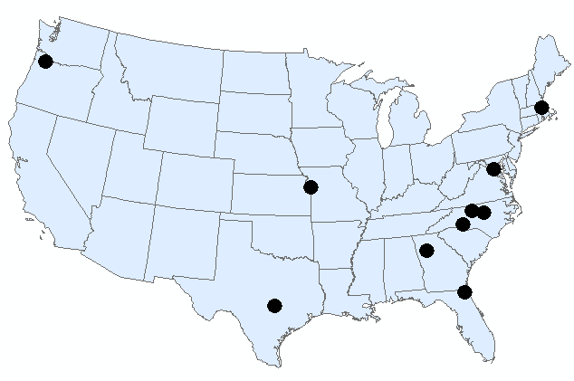
The Virtual Office: The cloud before the cloud was cool?
Citrix Application Servers create a “Virtual Office” environment that allows for 24/7 access to production data from anywhere in the world.
  Coupled with Geodatabase = Powerful Production
  Data, Storage, Processing & Licensing Centralization
  Basically, an internal cloud
CITRIX
Application Servers
ArcSDE Server

Slide 29
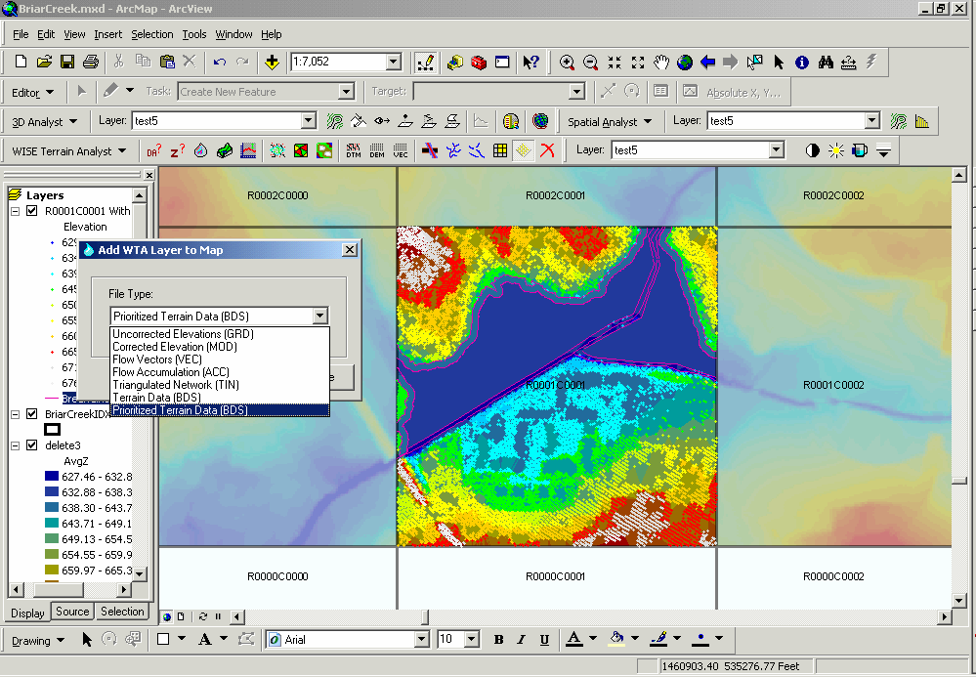
Custom Tool Development
WISE Terrain Analyst:
  Was not originally planned; was developed out of necessity due to magnitude of project topographic data
  Extremely scalable
  Multi-user access to data through one access point
  Rapid access to all data regardless of study size
  Custom additions for versioning, data prioritization, hydrocorrection, etc.
  Foundation for all tools
Arc Hydro River Workshop
December 2, 2010
Notes:
Rod – first module to move to ArcObjects. Drawing XS across NC – seconds.

Slide 30
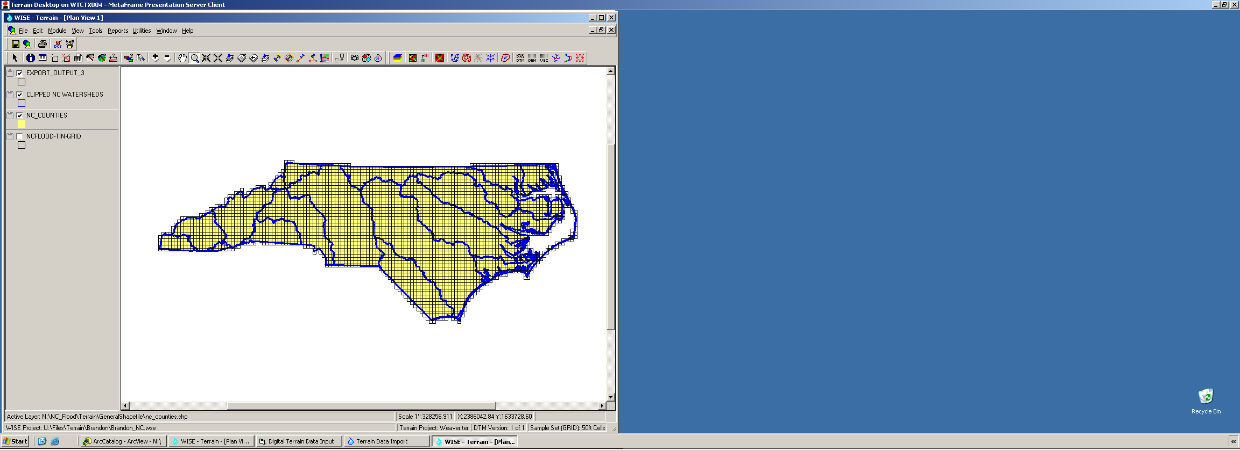
WISE currently stores complete TIN and DEMs from LIDAR for the entire state of North Carolina in one seamless project
(50,000 square miles, billions of points)

Slide 31
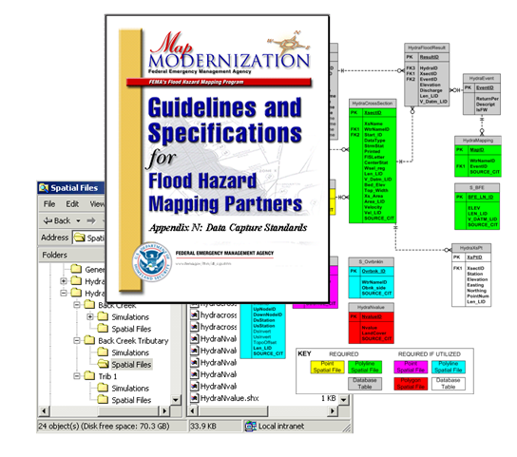
Ideas to take away for Arc Hydro River:
Talk to agencies who warehouse data early, take advantage of existing efforts, and incorporate standardized hooks into future data models for easier retrieval

Slide 32
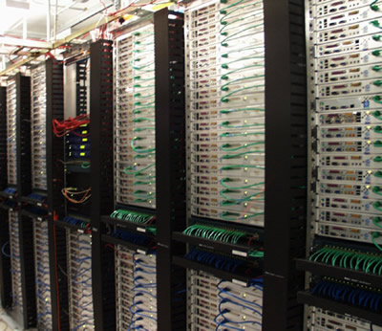
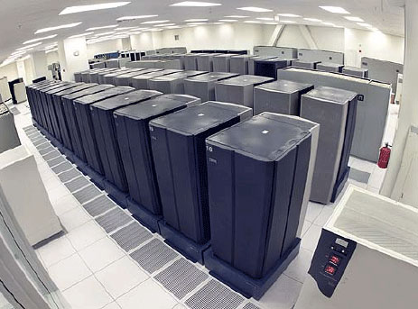


Ideas to take away for Arc Hydro River:
Design needs to be scalable
Users expect rapid access to data and fast calculations, so pre-process/cache any data that may be needed more than once
Design tools for both simple and advanced users
Stock up on storage space!!

Slide 33
Q&A?
Andy Bonner
Gray Minton

