Slide 1


A National Water Census
* Part of the Initiative
U.S. Department of the Interior
U.S. Geological Survey

Slide 2

How do the National Water Census and WaterSMART Interrelate?
The National Water Census
is a Department of the Interior initiative on water conservation. It includes activities in:
Bureau of Reclamation
U.S. Geological Survey
Office of the Ass’t. Sec. for Water and Sci.
is an integral part of the U.S. Geological Survey’s Science Strategy to conduct an ongoing assessment of the Nation’s water resources
The Water Availability and Use Assessment proposed in the 2011 budget is part of WaterSMART and the National Water Census
Notes:
Use slide to briefly describe how the National Water Census and WaterSMART relate to each other.

Slide 3
Our objective for the Water Census:
To place technical information and tools in the hands of stakeholders, allowing them to answer two primary questions about water availability:
Does the Nation have enough freshwater to meet both human and ecological needs?
Will this water be present to meet future needs?
Notes:
Emphasize this objective and the questions to be answered

Slide 4
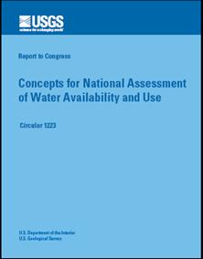
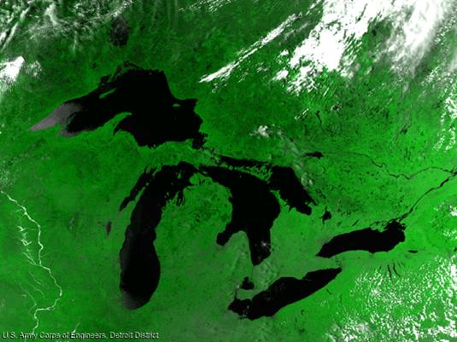
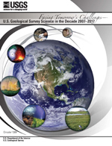
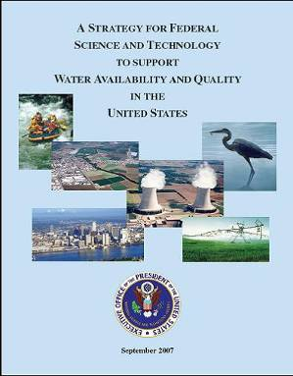
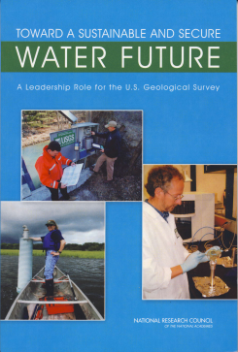
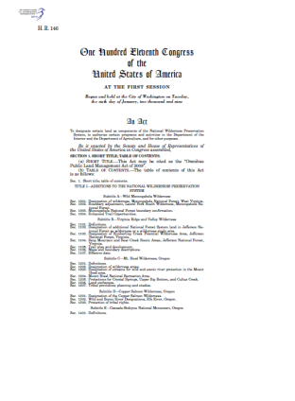
How did we get to where we are today?
2002
Great Lakes
Pilot Study
2005
2011
2007
Water Availability and Use Assessment
2007
SECURE Water Act
2009
2009
Notes:
This slide is animated to bring up a year as you click through and explain how each report or effort has lead towards, or called for, the Water Census (WaterSMART Initiative). The reports are: Circular 1223 – our report to Congress on the framework for a national assessment of water availability and use; the Great Lakes Pilot Study from 2005 – 2009 – which Congress gave us money to do; the USGS Strategic Science Plan; the SWAQ document (Subcommittee on water availablity and use – part of OSTP); the SECURE Water Act; the 2009 report from the NRC about the future of the Water Discipline; and thennnnn The WaterSMART Initiative.

Slide 5
P.L. 111-11 Subtitle F (SECURE Water Act as signed by the President March 30, 2009)
Section 9501: Findings
Section 9502: Definitions
Section 9503: Reclamation Climate Change and Water Program
Section 9504: Water Management Improvement
Section 9505: Hydroelectric Power Assessment
Section 9506: Climate Change and Water Intergovernmental Panel
Section 9507: Water Data Enhancement by United States Geological Survey Full National Streamflow Information Program. Creates a National Groundwater Resources Monitoring Program and a Brackish Groundwater Assessment.
Section 9508: Water Availability Assessments Creates a national program to study water quality and quantity. Requires first report in 2012 and every 5 years thereafter. Grants are available to assist state agencies in developing and integrating state water use data.
Section 9509: Research Agreement Authority
Section 9510: Effect
Notes:
Emphasize Section 9507 – the Brackish Groundwater Study
Emphasize Section 9508 as the core of the Water Census – the National Assessment of Water Availability and Use

Slide 6
Report to Congress - Every 5 years thereafter:
  The current availability of water resources in the United States,
  Significant trends affecting water availability, including documented or projected impacts as a result of global climate change,
  The withdrawal and use of surface water and groundwater by various sectors,
  Significant trends relating to each water use sector, including significant changes in water use due to the development of new energy supplies,
  Significant water use conflicts or shortages that have occurred or are occurring,
  Each factor that has caused, or is causing, a conflict or shortage.
Notes:
Run through the six reporting objectives with emphasis on the last two.

Slide 7
USGS Implementation Team
Water Use Ecological Flow Groundwater
Water Quality Biology Geography
Geology Climate Change Pilot Studies
Surface Water Information Technology
Program
Integration
Water
Use
Ecological
Flows
Availability
Indicators
Products,
Info Mgmt,
Decision
Support
Notes:
The USGS has formed an internal implementation team, with expertise from each discipline area you see in the large box. The team has been working on position papers in the areas of program integration, water use science, ecological flows, general water availability indicators, and product delivery – information management. The papers will be used to initiate discussions external stakeholders on how an overall water census could be planned.

Slide 8
Stakeholders on ad hoc committee
Organization | Acronym
Association of American State Geologists | AASG
Association of Fish and Wildlife Agencies | AFWA
Association of Metropolitan Water Agencies | AMWA
Association of State Drinking Water Administrators | ASDWA
American Water Resources Association | AWRA
American Water Works Association | AWWA
Interstate Council on Water Policy | ICWP
National Ground Water Association | NGWA
National Tribal Water Council | NTWC
The Nature Conservancy | TNC
Water Systems Council | WSC
Western States Water Council | WSWC
Bureau of Reclamation | BOR
National Aeronautics and Space Administration | NASA
US Fish and Wildlife Service | USFWS
US Dept. of Energy - Energy Information Administration | DOE - EIA
NOAA National Weather Service | NOAA-NWS
US Army Corps of Engineers | USACE
US Dept. of Agriculture - Economic Research Service | USDA - ERS
US Dept. of Agriculture – Forest Service | USDA - FS
US Dept. of Agriculture - NASS | USDA - NASS
US Dept. of Agriculture - NRCS | USDA - NRCS
US Environmental Protection Agency | USEPA
Notes:
The ad hoc committee will be made up of the stakeholders represented on this list.

Slide 9
Charge to the ad hoc committee
The ad hoc committee will work with the Implementation Team to improve the concepts, efforts, and products proposed for inclusion in the Water Census so that they best meet stakeholders needs.
The output from the committee will be brief report to the Associate Director for Water, USGS, on the concensus reached for the Water Census.
The timeframe for this effort is February – August, 2010.
Notes:
The following charge will be delivered to the ad hoc committee.

Slide 10
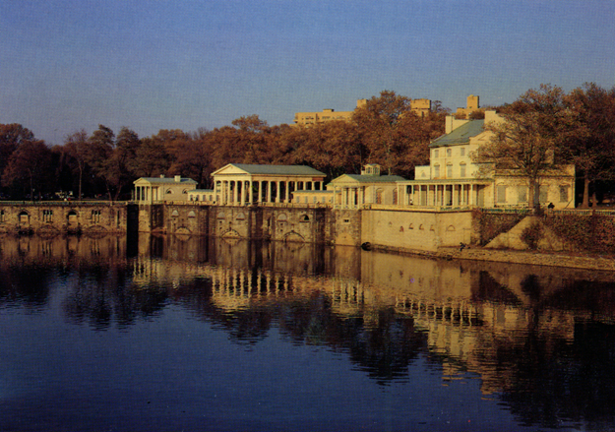
Integration of programs around the
Theme of Water Availability
Notes:
Vision: that the Water Census can provide USGS with the "glue" to integrate our efforts on groundwater, surface water, water quality, ecology, and climate variability relative to answering the key questions about water availability.
The Water Census works with the Climate Change, NAWQA, Toxics, Ecosystems, GWRP, NWUIP, NSIP, GAM, and Geology programs to fulfill the joint mission of the other programs where they all touch on water availability. Plan together for deliberate outcomes that we jointly work to achieve.
Set complimentary goals with other programs. Joint planning and program execution needs to be careful mapped out, intersections of work identified, and agreements verified.

Slide 11
How will we apply the 2011 funds?
Total Initiative $9.0 M
Notes:
This slide shows the overall budget and how it is distributed among the top-level budget line items.

Slide 12
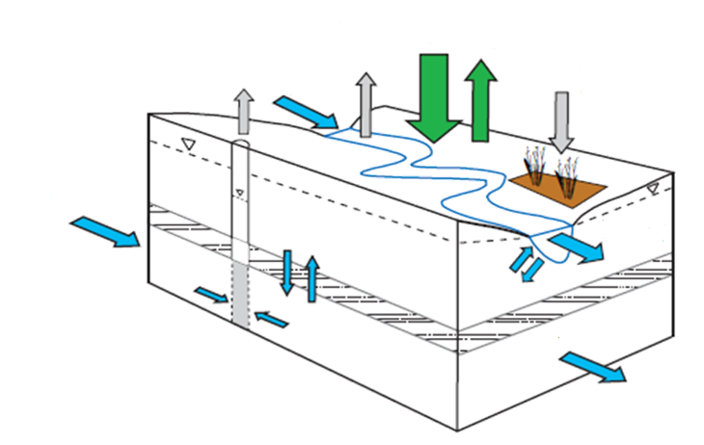
Account for water with a “budget”
Notes:
How do we account for water availability? We start with a water budget. Similar to your financial budget, it counts the inputs, withdrawals, and changes in amount of water in each component of the water cycle. In this simple diagram, green arrows represent exchanges with the atmosphere – precipitation and evapotranspiration , gray arrows represent human withdrawals and return flows, and blue arrows represent movement of water within and between components of the watershed – the aquifers and the stream. Each arrow represents a “flux” or movement of water from one component to another.

Slide 13
A Nationwide System to deliver water accounting information addressing
Precipitation
Evapotranspiration
Storage in Reservoirs, Lakes, Snow and Ice
Surface Water
Groundwater
  Recharge rates
  Water level in aquifers
Ecological Needs
Water Withdrawals
Return Flows
Consumptive Uses
Run-of-the-River Uses
Notes:
One of the primary new capabilities would be a nationwide system to deliver information about the key water availability indicators that every manager needs to know when dealing with availability questions. How much of our water does reside in each one of these components as we move across the nation and throughout the seasons? We plan to answer that question through the Water Census.

Slide 14
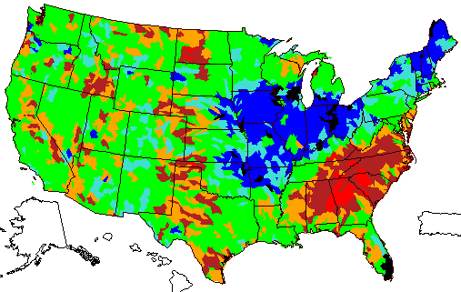

Generating and delivering information for water accounting
Envision a seamless coverage of information for
a water accounting component
Notes:
How will this information be delivered? Envision a seamless coverage of data about one of those water budget components. It might look like this. The map you see is computed stream runoff for year 2008 for 2,264 watershed units across the lower 48 states. This information is currently available on a monthly, quarterly and annual basis from the USGS WaterWatch website. Stream runoff is key water budget component.

Slide 15
And if you could get that info for all accounting components
Precipitation
Runoff
Baseflow
ET
Recharge
Surface Storage
Notes:
Now let’s envision USGS providing the same kind of coverage for all the water budget components. And we will deliver this information through a web-based tool that will allow stakeholders to access the information at scales from small watersheds to multistate river basins, construct their own water budgets, and access information about trends. This effort will involve cooperation across a variety of agencies like Reclamation, Army Corps, NOAA, and Agriculture, just to name a few. We work together to provide answers to water questions.

Slide 16
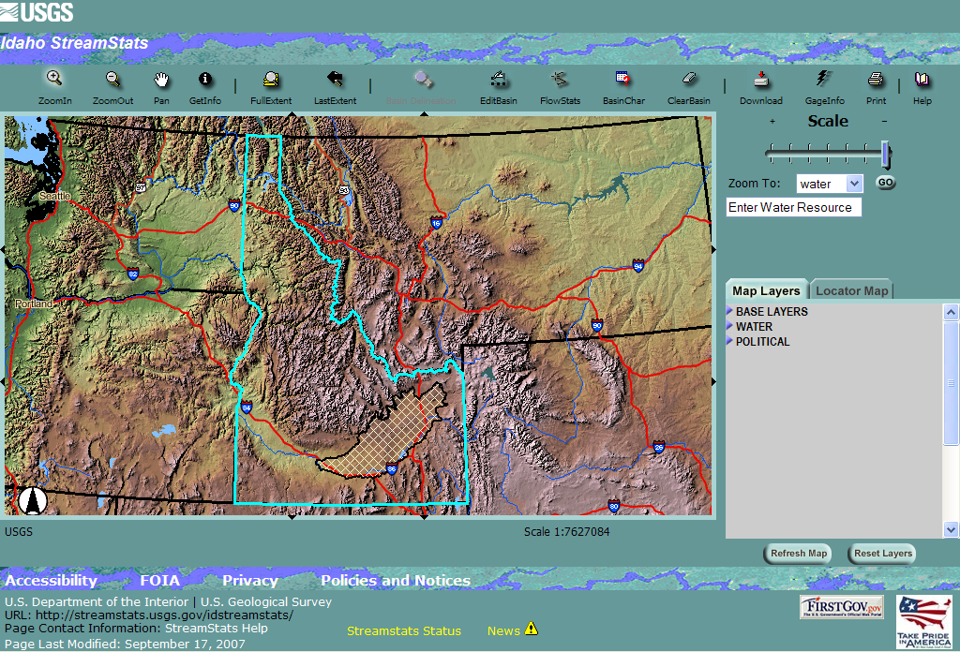
Information Delivery
A web application for delivering water availability information at scales that are relevant to the user
Select the area of interest.
Generate information on
water accounting components
Work with the online tool to construct your water budget
Access trend information
Notes:
We want to provide a standard way of analyzing and presenting water availability information.
We intend to deliver this information through a web-based application that allows the user to select from very local to multi-state scales. Our current thinking is to work through the platform of our StreamStats application.
Water managers would be able to select a basin, generate the information on water accounting components, construct their own water budget, and access trend information.

Slide 17
How will we apply the 2011 funds?
Nationwide Analysis System $1.6 M
Water Use $3.0 M
Ecological Flow $1.3 M
Groundwater and Brackish Studies $1.6 M
Focus Area Studies $1.5 M
Total $9.0 M
Notes:
This slide shows the overall budget and how it is distributed among the top-level budget line items.

Slide 18
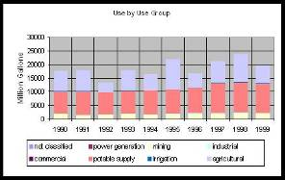
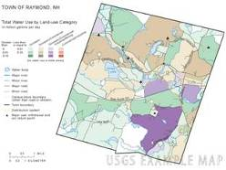
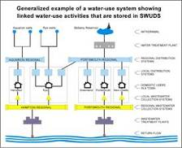
Enhancing the Nation’s Water Use Information
Use New Methods to Estimate Water Use
  Stratified Random Sampling
  Regression Models
Develop models of water use based on land use
Ability to track water from
point of withdrawal thru to
return of flow.
Notes:
We want to invest significantly in the science of water use – to develop better means of estimating water use as recommended by the National Research Council. We will make a significant investment in reinstituting estimates of consumptive use. Our ultimate objective will be to track the drop of water from where it is withdrawn, to how it is used and consumed, and ultimate how its flow is returned to the environment.

Slide 19
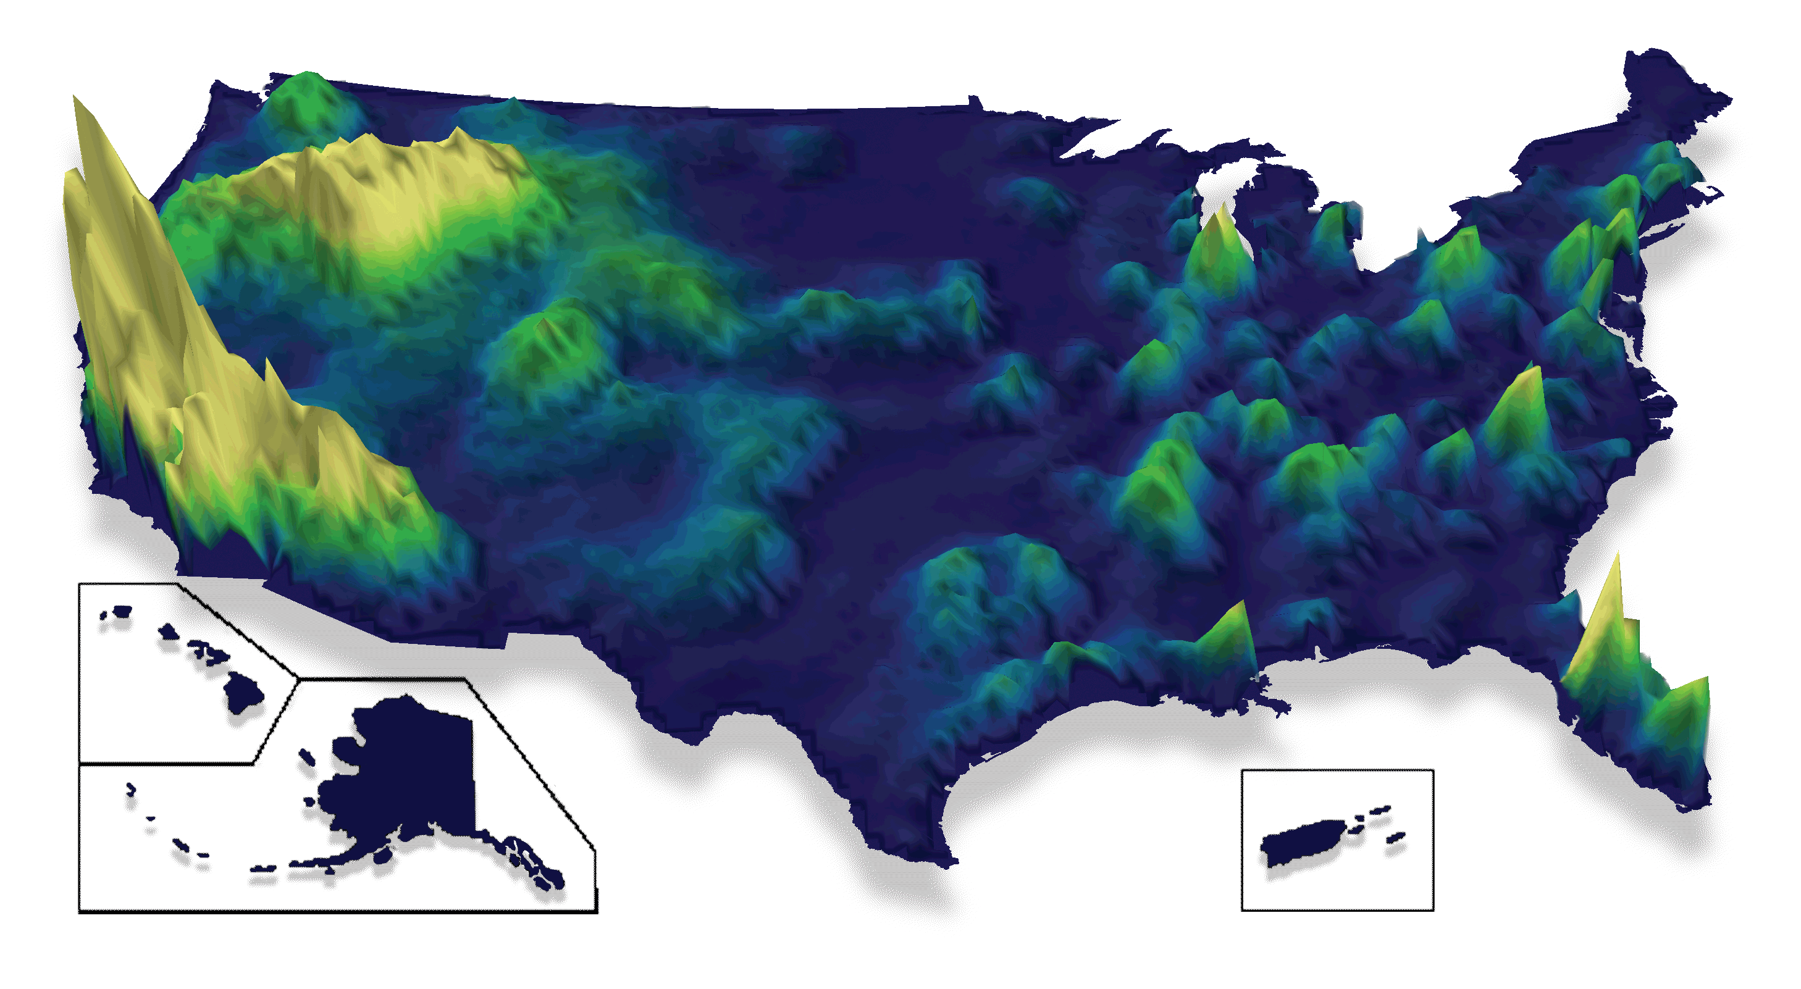
New Authority: Water Use Grants to States
Notes:
The map you see shown depicts the intensity of total water withdrawals and how that varies across the country through the “contours” or elevated areas on the map. The USGS investment in water use science will include a program of grants to state water resource agencies to assist them with critical work on their water use databases. This information is vital to our understanding of the current and historical trends in water demand. This is a new authority under the SECURE Water Act, which allows each State to receive up to $250K in grants for improvements to their water use data.

Slide 20
How will we apply the 2011 funds?
Nationwide Analysis System $1.6 M
Water Use $3.0 M
Ecological Flow $1.3 M
Groundwater and Brackish Studies $1.6 M
Focus Area Studies $1.5 M
Total $9.0 M
Notes:
This slide shows the overall budget and how it is distributed among the top-level budget line items.

Slide 21
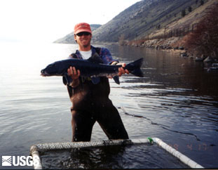
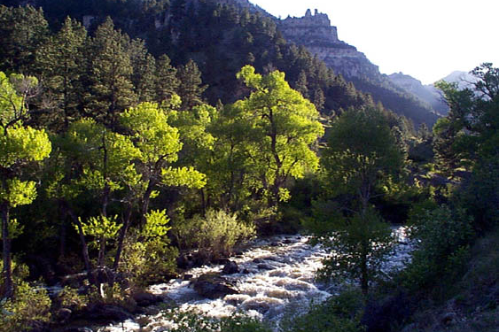
Flows Needs for Wildlife and Habitat
Assist classifying water bodies for their hydro-ecological type
Provide tools and data to systematically assess the ecological affects of hydrologic alteration
Assist users to develop flow or water level alteration – ecological response relationships by type of water body
Notes:
Can our water sustain important habitats? Once again, we don’t know. Only through new scientific applications can we provide the answer to this question.
Water managers, in places like the Klamath River Basin, need help with this issue.
The Klamath River Basin is experiencing a water conflict between salmon and endangered fish species habitats and agricultural uses. A water census will help land managers make informed decisions about maintaining a balance between healthy habitats and agricultural use.
We will invest in the science of ecological flows to classify our streams for analysis, systematically examine the ecological effects of flow alteration, and from this, develop a relationship between flow alteration and ecological response for each class of stream. From this information, state water managers can establish ecological flow goals in their respective states.

Slide 22
How will we apply the 2011 funds?
Nationwide Analysis System $1.6 M
Water Use $3.0 M
Ecological Flow $1.3 M
Groundwater and Brackish Studies $1.6 M
Focus Area Studies $1.5 M
Total $9.0 M
Notes:
This slide shows the overall budget and how it is distributed among the top-level budget line items.

Slide 23
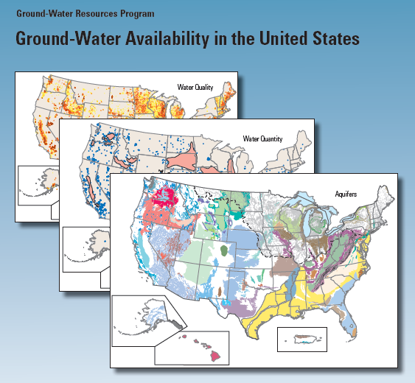
Assess Groundwater’s role in Water Availability
Use the strength of and
enhance the resources
within this program to provide
the information on:
Recharge
GW yields
Changes in storage.
Saltwater Intrusion
Trends in GW Indices
Artificial Recharge
GW/SW Interactions
Notes:
We will invest resources in expanding our work through the Survey’s Groundwater Resources Program. This program assesses groundwater availability through studies of principal aquifer systems. We will concentrate on those systems that account for the greatest groundwater use. The new resources planned in the initiative will give us the ability to double the number of studies starting in 2011. From these studies, we will obtain the information we need about recharge, yields, changes in storage, etc. for the Water Census.

Slide 24
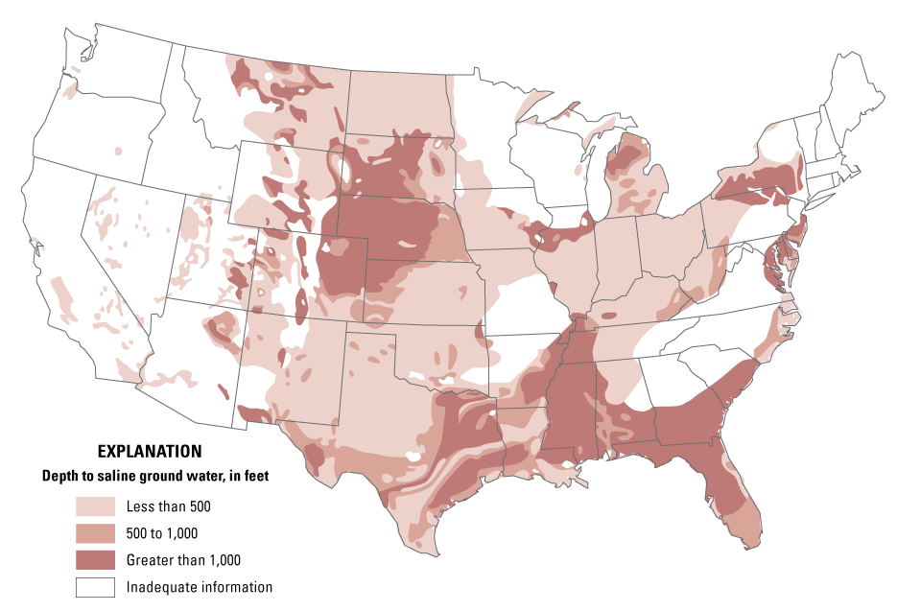
Assess the Nation’s Brackish Resources
Continue and strengthen the effort begun under the Challenge Projects RFP for 2010
Locations of the res.
Hydrologic properties
Water quality properties
Current uses
Notes:
We will use some of the resources of this initiative to continue and complete an analysis of the Nation’s brackish aquifer systems. This analysis is a priority under the SECURE Water Act and the USGS began this effort in 2010 with the initiation of three regional studies on brackish aquifers. The initiative will give us the ability to double our efforts in this area.

Slide 25
How will we apply the 2011 funds?
Nationwide Analysis System $1.6 M
Water Use $3.0 M
Ecological Flow $1.3 M
Groundwater and Brackish Studies $1.6 M
Focus Area Studies $1.5 M
Total $9.0 M
Notes:
This slide shows the overall budget and how it is distributed among the top-level budget line items.

Slide 26
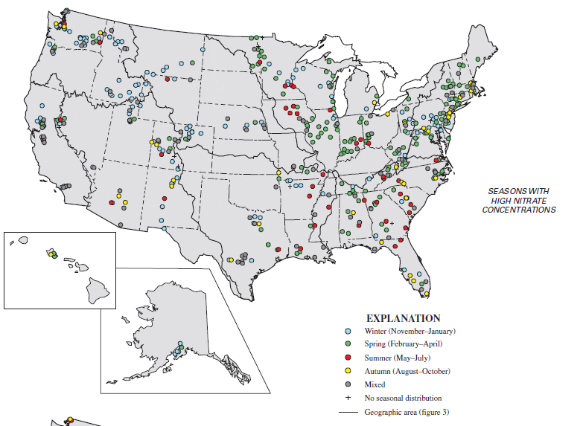
Assess Water Quality’s role in Water Availability
Use the strength of the
NAWQA Program and tools
like SPARROW to:
Demonstrate the degree
of water quality impairment
that limits water availability
Define the main compounds
of importance.
Relate to water use
and return
Trends
Notes:
It is critical to assess water availability from the perspective of water quantity and quality. The quality aspects of this assessment will be accomplished through collaborative work with the water quality programs of the USGS. Primarily concentrating on the NAWQA Program, but including activities in the Toxics Substances Hydrology and NASQAN programs, the USGS will bring the necessary tools together to demonstrate the degree of water quality impairment that limits water availability. We will define the main compounds of importance and relate water quality to water use and return flows.

Slide 27
Finally, three studies focused on selected watersheds: the Colorado River, the Delaware River, and the ACF Rivers - where there is significant competition over water resources. Here, the USGS will work collaboratively with stakeholders to comprehensively assess the technical aspects of water availability.

Slide 28
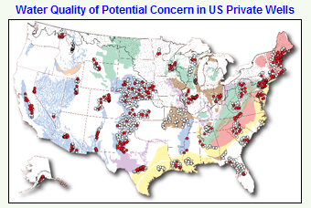




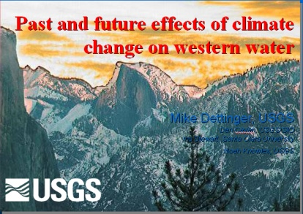
Focused Water Availability Assessments
Water Quality
Groundwater
Resources
Water Use
SW Trends,
Precipitation, etc
State, Local, Regional
Stakeholder Involvement
Eco Flows
Global Change
Defined Technical Questions to
be Answered
Notes:
Within the focus area studies, the USGS will work with stakeholders to define the technical questions to which we can contribute meaningful information and then bring all of the Survey’s tools to bear on those technical issues. These studies will be conducted over a three year period of time and each study will be funded at $1.5M over the three year period. We strongly encourage looking for areas where collaborations can occur with other activities in these basins, such as the Bureau of Reclamation’s River Basin Supply and Demand Studies and the various climate science efforts.

Slide 29
How will we apply the 2011 funds?
Nationwide Analysis System $1.6 M
Water Use $3.0 M
Ecological Flow $1.3 M
Groundwater and Brackish Studies $1.6 M
Focus Area Studies $1.5 M
Total $9.0 M
Notes:
This slide shows the overall budget and how it is distributed among the top-level budget line items.

Slide 30
The objective is to place the information and tools into stakeholders hands to answer the questions they are facing.
Notes:
To close, I want to once again emphasize that our objective is to place the information and tools into stakeholders hands to answer the questions they are facing about water availability.

Slide 31
GREAT LAKES BASIN PILOT PROJECT
http://water.usgs.gov/wateravailability/greatlakes
Notes:
If you have time, introduce the work we did on the Great Lakes Basin, under a special appropriation from Congress from 2005 - 2009

Slide 32
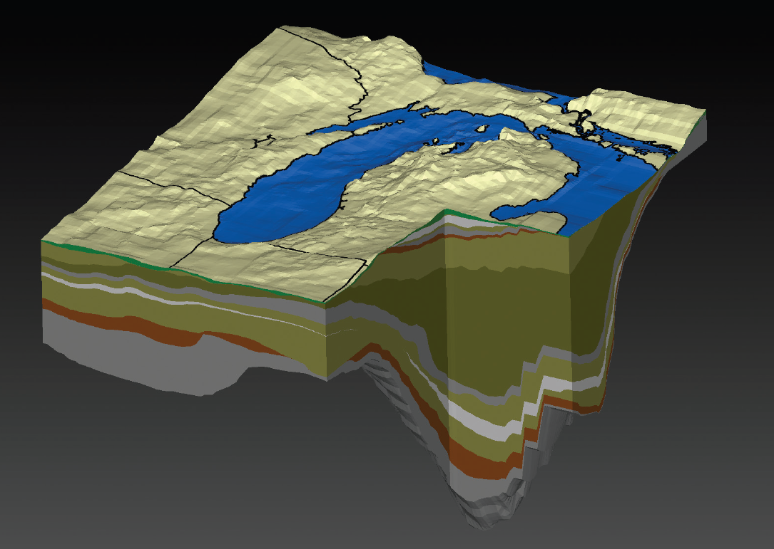
National Emphasis—Regional Focus
Develop methods applicable to national program
Respond to Great Lakes issues—Compact
Notes:
Two areas of emphasis in Great Lakes Pilot
1—Explore and develop methods potentially applicable to national program
2--Respond to regional issues
Regional issues for this pilot primarily focused on information needs for implementation of the GL-St Lawrence River Basin Compact
A key feature of the Pilot was to use available data; new data were not collected
However new methods were employed to understand these data
For instance the figure shows hydrostratigraphy for the Lake Michigan area—that is the layering of rocks and their hydrologic characteristics. This hydrostratigraphy was derived from state well-log databases—water and oil&gas. And served as the basis for a 3-dimensional model of groundwater flow in the Lake Michigan region.

Slide 33
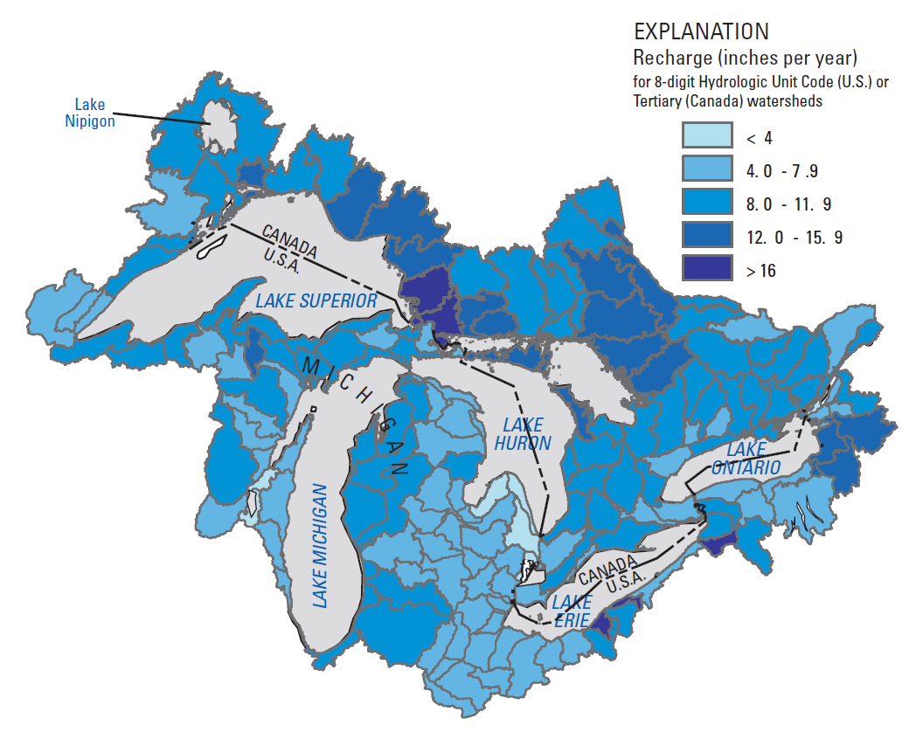
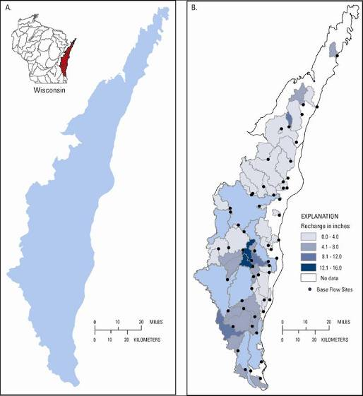
Regional Recharge
Notes:
Products of Great Lakes Pilot vary in geographic extent scope—The one shown here is for entire GL Basin
It shows the variability in annual recharge across the watershed
Recharge—Water entering storage in shallow groundwater
This was a binational study with Dr. Andrew Piggott at Environment Canada (NWRI) and they provided their own funding
The recharge is a derivative product of USGS and Water Survey of Canada streamgage data

Slide 34
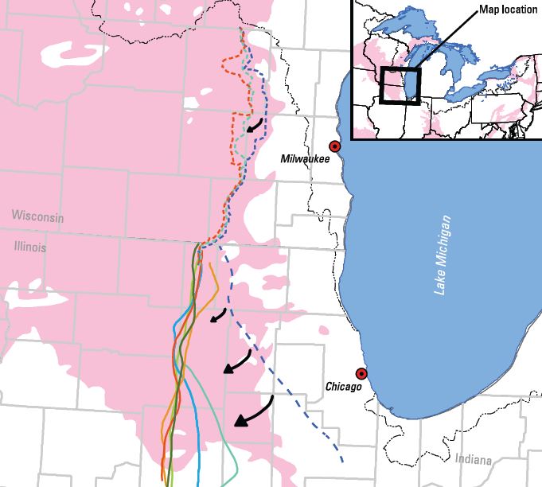
Groundwater Divides
Watershed divide
Groundwater divide
Notes:
Groundwater is defined as part of “Waters of the Great Lakes” in Compact, because groundwater flows to surface water—lakes, streams, and wetlands
One product looks at Groundwater divides on U.S. side of GL Basin
Two noteworthy features of groundwater divides:
(1) not the same locations as watershed divide (squiggly line near Lake Michigan—dashed blue line is groundwater divide)
(2) Groundwater divide moves in response to pumping (dashed blue line is before pumping began; colored lines to west represent more recent locations of divide
This analysis was used in the Compact development decision making process to determine what groundwater to include as “Waters of the Great Lakes for Compact implementation purposes.

Slide 35
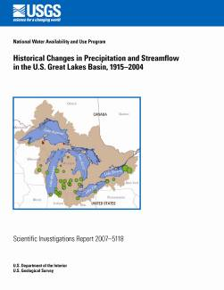
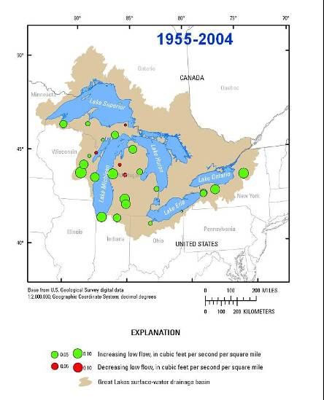
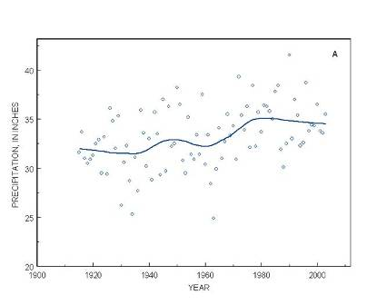
HISTORICAL CHANGES IN
PRECIP. AND STREAMFLOW
Notes:
We have produced a report on trends in streamflow in the basin. At many gages, low flow statistics of streamflow have shown an increase, and we feel this is sensing climate change, with more precipitation falling on unfrozen ground and contributing to baseflow.

Slide 36
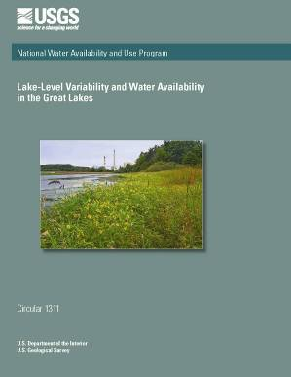
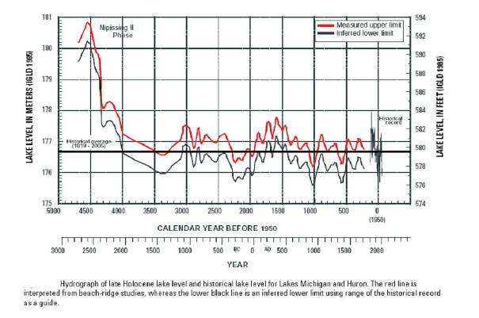
LAKE-LEVEL VARIABILITY
Notes:
Finally, we have put together a 5000 year paleo-record of changes in the water level of the Great Lakes. This puts the recent records that man has measured over the last 150 years into context of the variability that has been observed over five millenia.

Slide 37
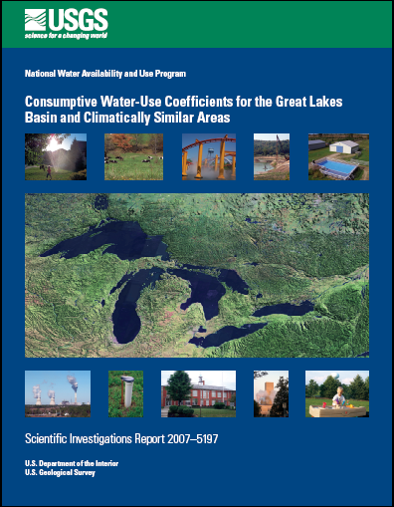
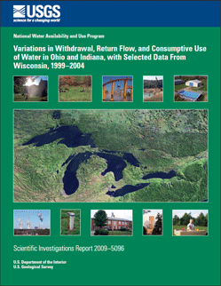
WATER-USE PRODUCTS
Consumptive water-use coefficients
for the Great Lakes Basin and
climatically similar areas.
Seasonal and monthly water use and
consumptive use for selected water-
use categories and water-use types.
Estimated use of water in the Great Lakes Basin by hydrologic unit code (HUC 8) in 2005
Notes:
We have produced a report on consumptive water use coefficients throughout the Great lakes basin and climatically similar areas from around the world. This has been an extremely popular report and one that was first on the list of requests from water supply managers throughout the Great Lakes. Two other water use and consumptive use reports are planned for release.

Slide 38
Groundwater equals another Great Lake
Annual flow out of GL is
1 percent of water in storage
Water use is 65,000 cfs
Consumptive use is
3000 cfs
Notes:
There’s a lot of info on this figure, but it summarizes the major flows and storage for GL Basin.
I’m only going to make a few points about it
Huge amount of water stored in Great Lakes as you know—around 10,000 billion cubic feet in each lake
Groundwater stored in aquifers in U.S. side Great Lakes basin is about the same amount as water in another Great Lake
Annual flow out of Great Lakes thru St Lawrence is about 1 percent of the amount of water stored in the Lakes
Major natural flows in Great Lakes are all about the same size—rain on GL, river flow to GL, evap from GL—all range in 1000s of cubic feet per second
Total water use is in the same range/order of magnitude as natrual flows—65,000 cubic feet per second.
But almost all of this is returned to storage in Great Lakes or groundwater
The amount lost from the basin—consumptive use—is another order of magnitude smaller—about 3000 cfs—this is less than any of the major diversions in or out of Great Lakes

Slide 39
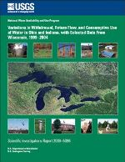
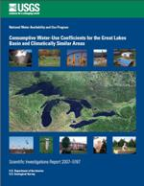
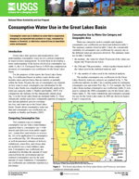
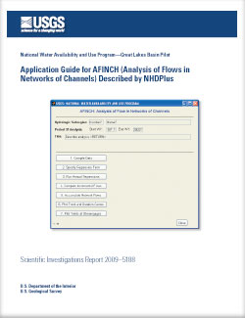
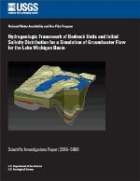
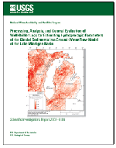
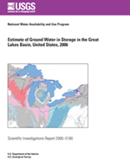
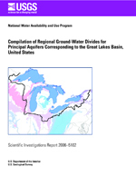
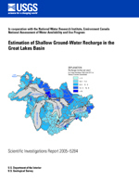
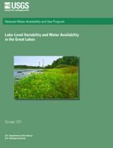
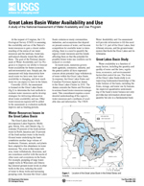
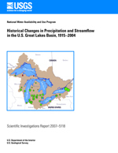
http://water.usgs.gov/wateravailability/greatlakes
Notes:
USGS has many reports published as part of Great Lakes Pilot
Summary report, which synthesizes all of the work is being finalized
All reports are available on-line at the URL shown—or google USGS water availability great lakes—our site will be at the top

Slide 40
Eric J Evenson
Water Census Coordinator
U.S. Geological Survey
810 Bear Tavern Road, Suite 206
Trenton, New Jersey 08628
609-771-3904 eevenson@usgs.gov
U.S. Department of the Interior
U.S. Geological Survey

