Slide 1
ArcGIS 10 and Beyond
Steve Kopp
Esri
Arc Hydro River Workshop, Austin, Texas, December 1, 2010

Slide 2



Is Global Geospatial Consciousness Possible?
How to make this work for Hydro
Billions
Society
Millions
Application
Users
Dream
Big
100’s of Thousands
GIS Professionals
Key Expansion
Thousands
Research
Arc Hydro Today
Make geospatial understanding of water relevant by making it accessible and easy.
Think of the questions people might want o ask of the data.

Slide 3
Transforming Technologies
Wealth of high resolution terrain and bathymetry.
IT Evolution will continue, GIS and modeling will be there
  More complex solutions in a shorter amount of time
  Think of interactive design elements
Hosted data services and analytic services lower the bar to get started and make it easier for everyone to do better, more consistent work.
  Easy packaging and publishing via ArcGIS.com
Like Word docs and Google docs, geospatial data can be hosted, and edited collaboratively.
  National datasets
  Field data collection

Slide 4
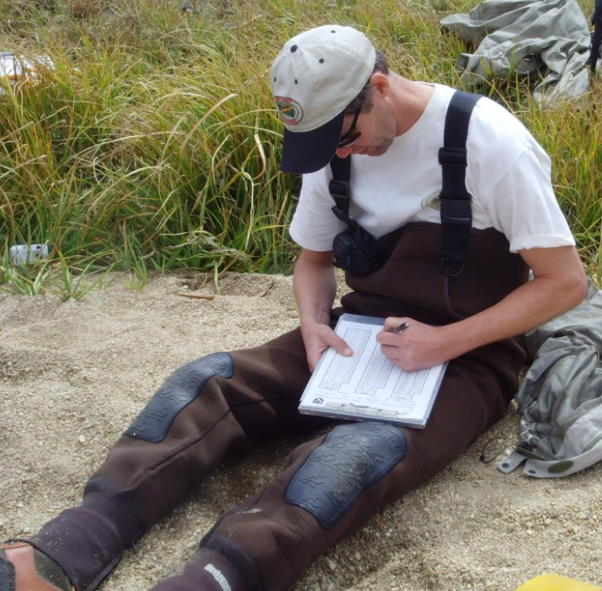
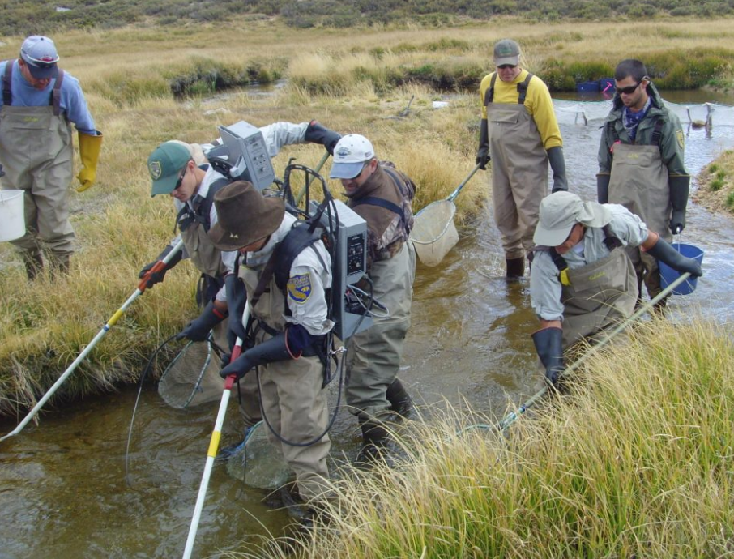
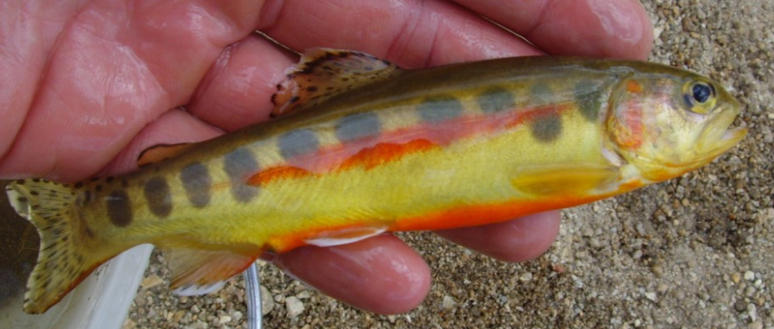
Time for a technology transformation
Someone get this guy an iPad
Improve data accuracy
Timely access to information
Broader availability
Digital archive for comparison

Slide 5
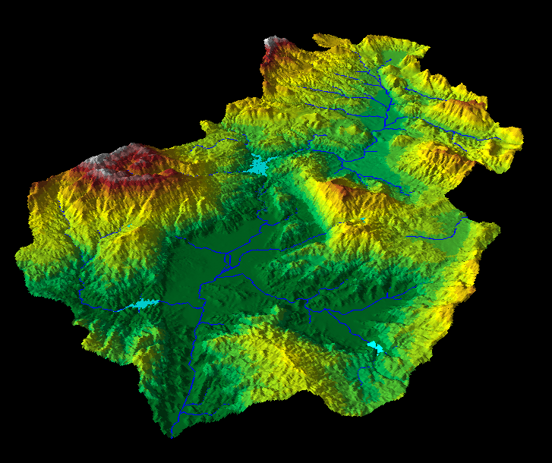
Community Basemap Efforts
Currently compiling Topographic, Streets, and Imagery
  Best available
  Authoritative
  Multiscale
Elevation will begin soon…
http://resources.arcgis.com/content/community-basemap

Slide 6
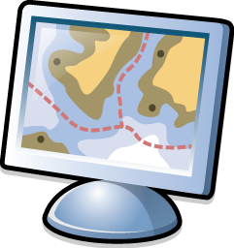
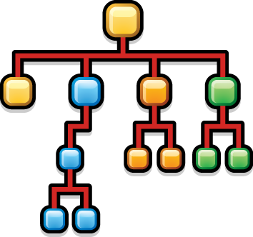

New LiDAR Workflow
Direct use of LAS files
  On the fly mosaicking and rendering (hillshade, slope, etc)
  Input to analytic tools as a raster or terrain
  Editing
Research hydrologic derivatives from
high resolution triangulated elevation
LAS
LAS
LAS
LAS
LAS
LAS
LAS
LAS
LAS
LAS
LAS
LAS
LAS
LAS

Slide 7
Divergent flow
Divergent flow it not modeled well in the current D8 implementation.
  Encoded in flow direction raster, but not used in analysis
Handling of other non-D8 approaches requires consideration of other tools relying upon the flow direction raster.
What do we want to know besides direction?
  Proportion of flow per branch?
  A stage at which it becomes divergent?
What should be derived from and stored with the raster, and what with the vector network?
How much manual effort is involved in
building data with proper divergent flow
and loops?
?

Slide 8
Looking past initial implementation…

Slide 9
Looking past initial implementation…
Some blue sky ideas of possible future
Seamless, worldwide, multiresolution elevation
Accessible from any computing device, anywhere
Dynamic interactive real time flood mapping and flood forecasting
  2 hrs from now the water depth at this location will be 6 feet and velocity 10 m/s
Field surveys of biota and cross sections collected through simple mobile applications directly uploaded to accessible digital database.
Hydrology/hydraulics impact models of future climate or landcover scenarios accessible to other disciplines through simple web services (urban planning, forestry, etc).

