Slide 1
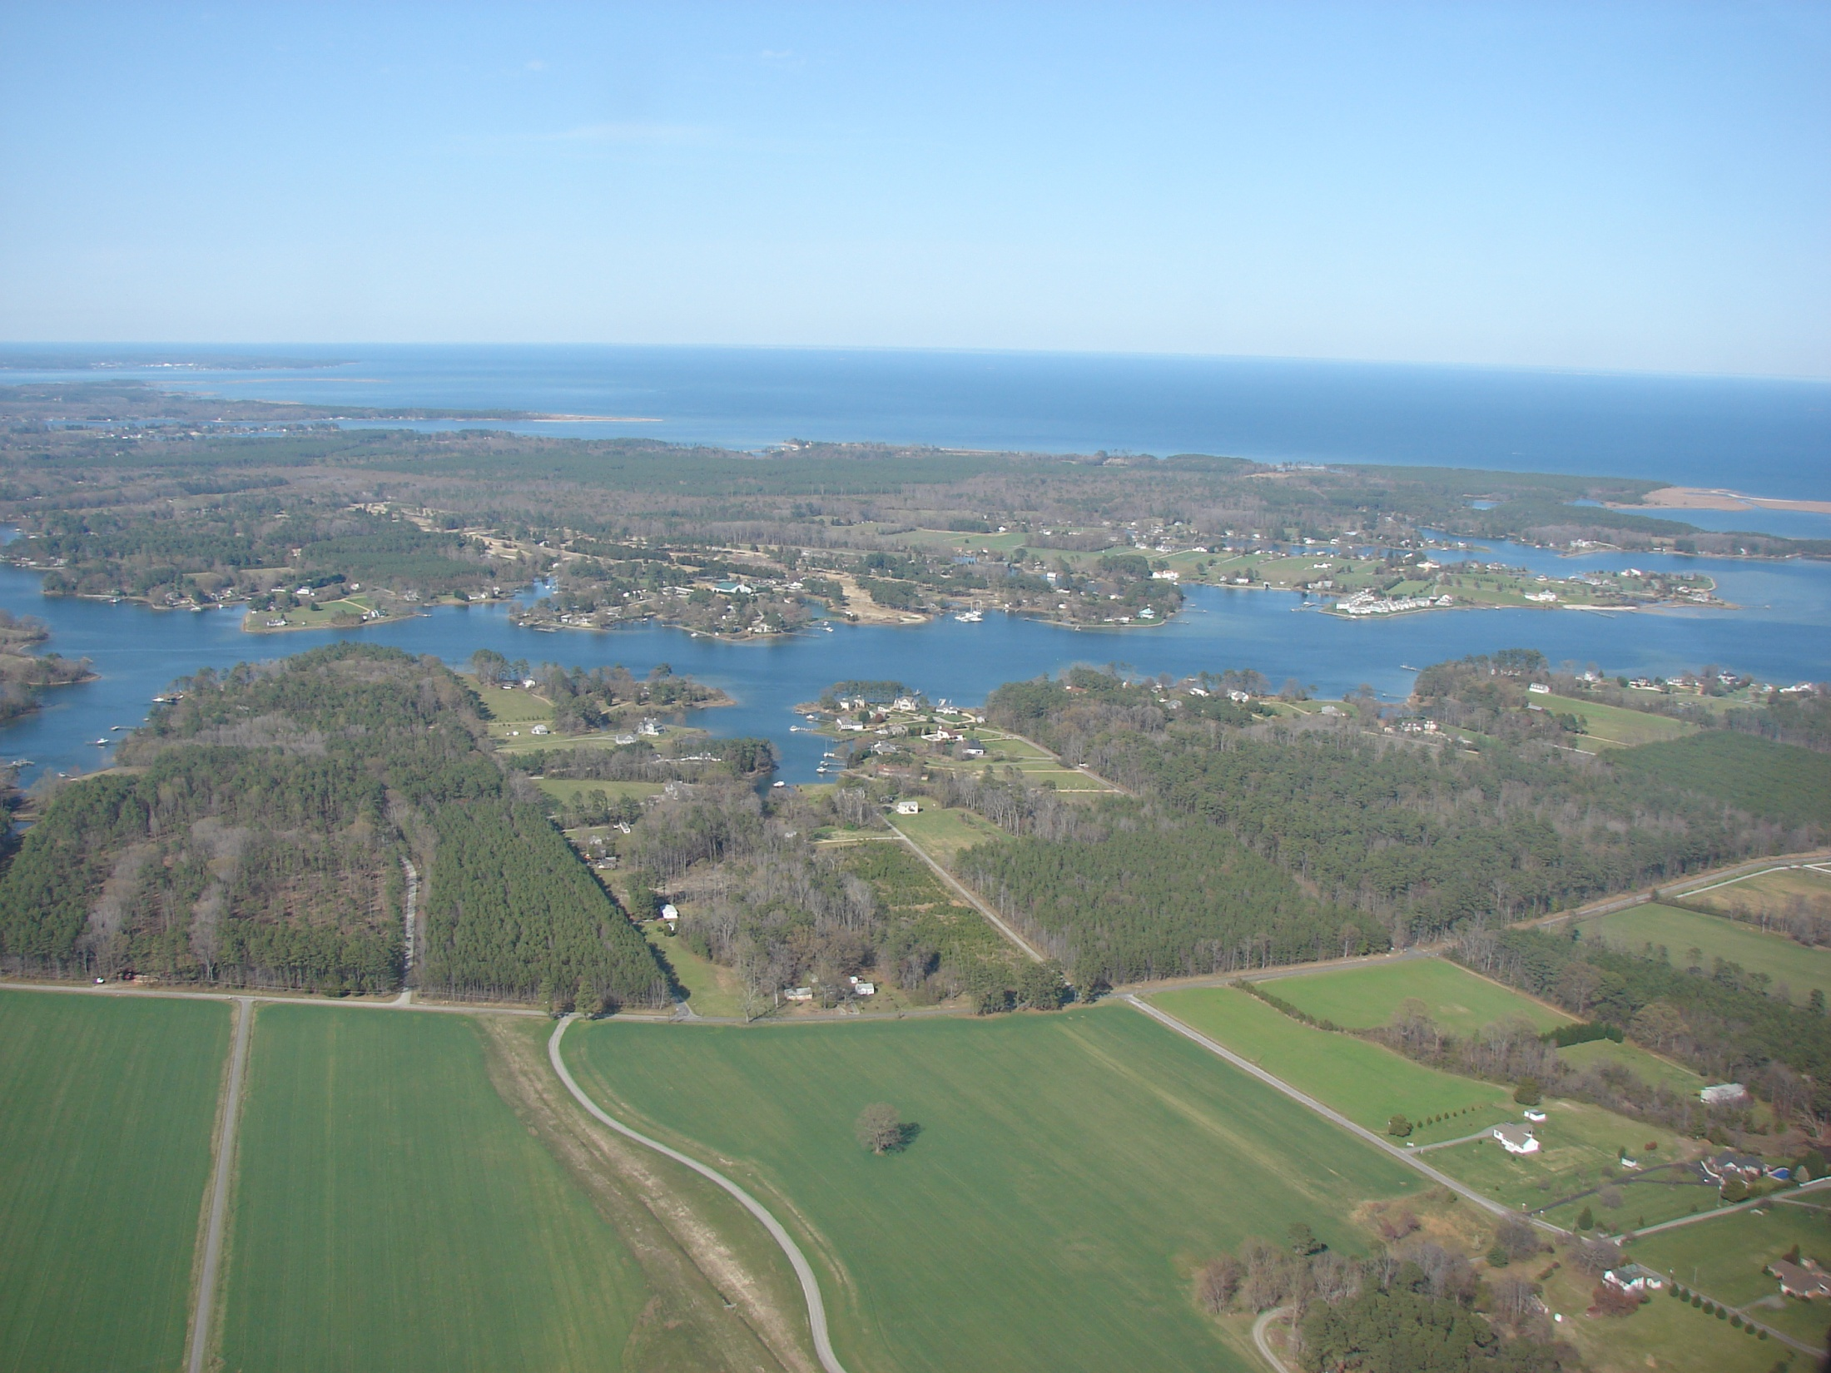
Introduction
National Hydrography Dataset Plus
(NHDPlus)
Version 2

Slide 2

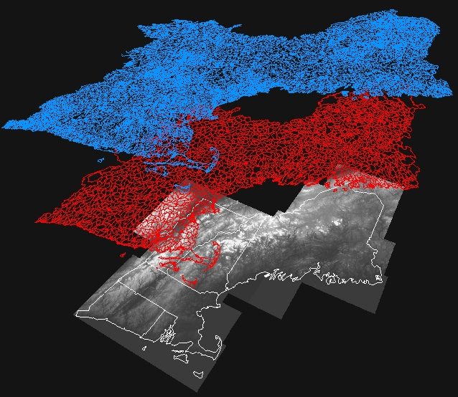
NHDPlus Concepts: Integration of NHD, WBD, and NED
National
Hydrography
Dataset (NHD)
Watershed
Boundary
Dataset (WBD)
National
Elevation
Dataset (NED)

Slide 3
NHDPlus Concepts: Integration of NHD, WBD, and NED
WBD Boundary
“walled”
Into Elevation
NHD Streams
“burned”
Into Elevation

Slide 4
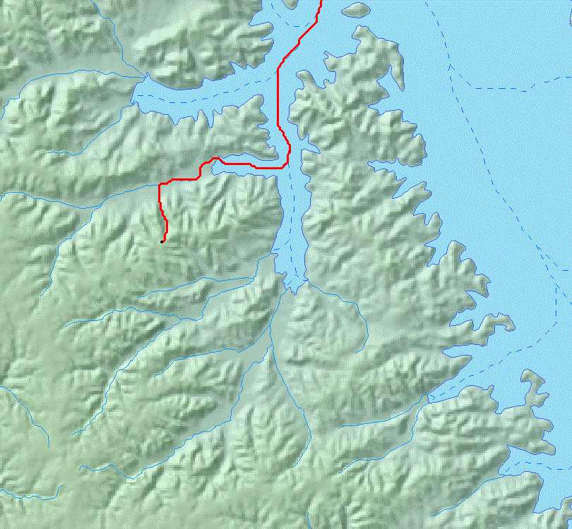
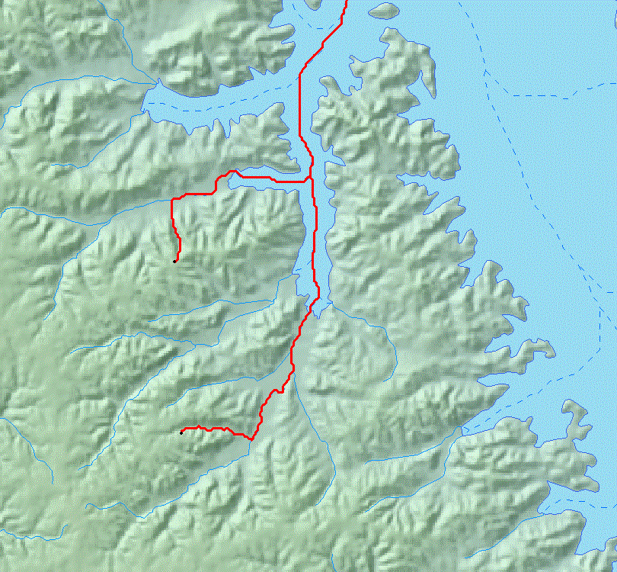
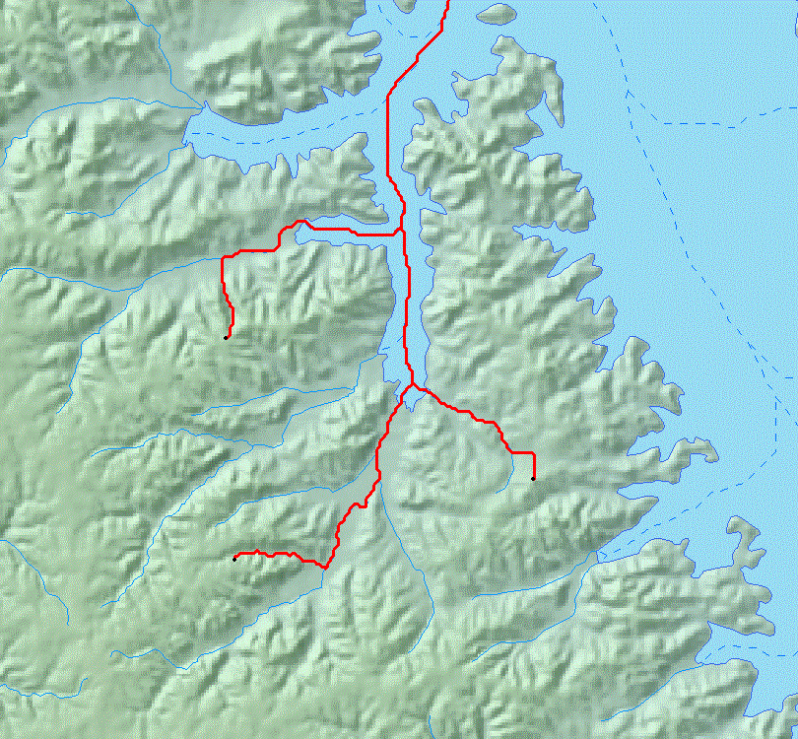
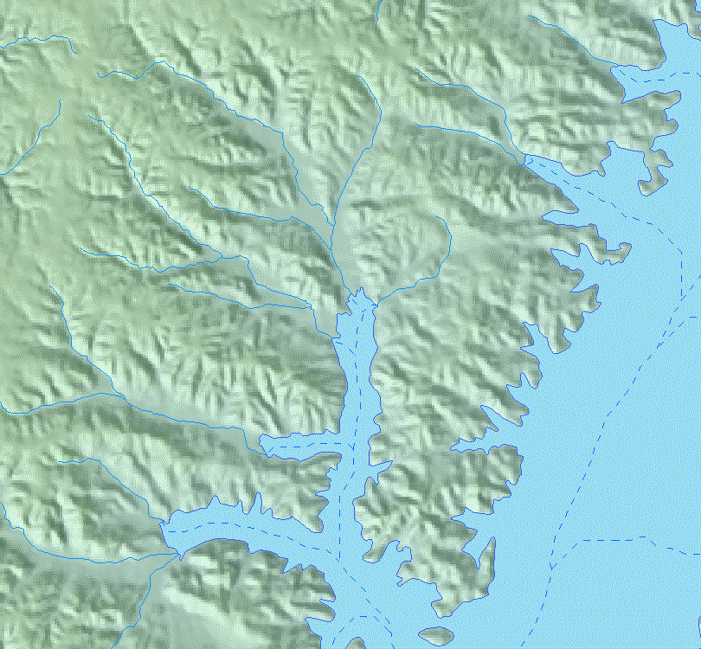

NHDPlus Concepts: Link the Landscape to the Mapped Stream Network
NHDPlus Elevation Derivatives: Flow Direction Grid to perform “raindrop” transport

Slide 5
NHDPlus Concepts: Link the Landscape to the Mapped Stream Network
NHDPlus Catchments: Define the land surface that drains to each stream segment.

Slide 6
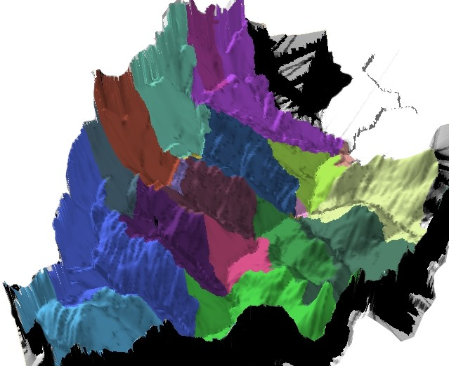
NHDPlus Concepts: Link the Landscape to the Mapped Stream Network
NHDPlus Catchments in 3D

Slide 7
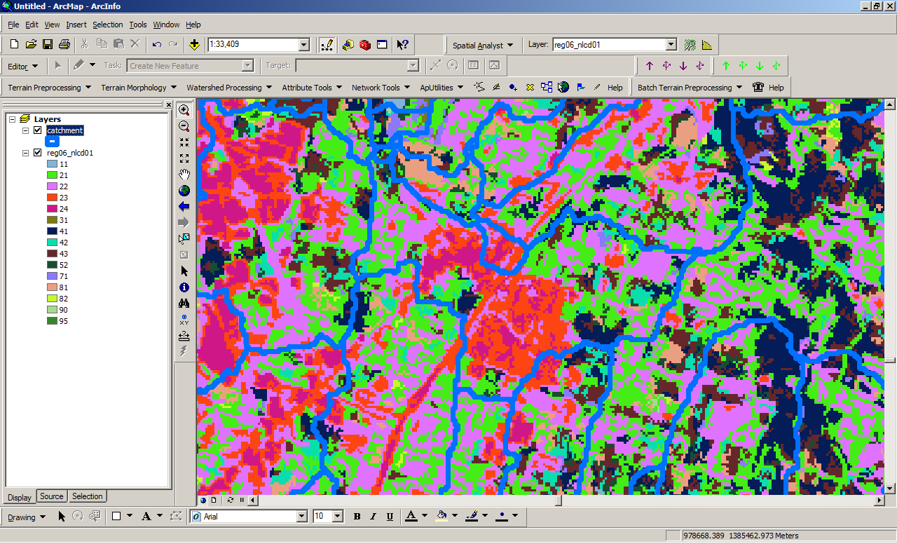
NHDPlus Concepts: Link Landscape Characteristics to the Stream Network

Slide 8
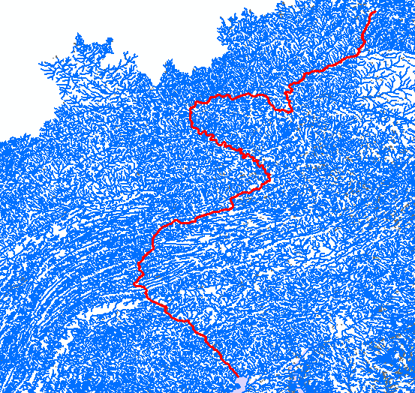
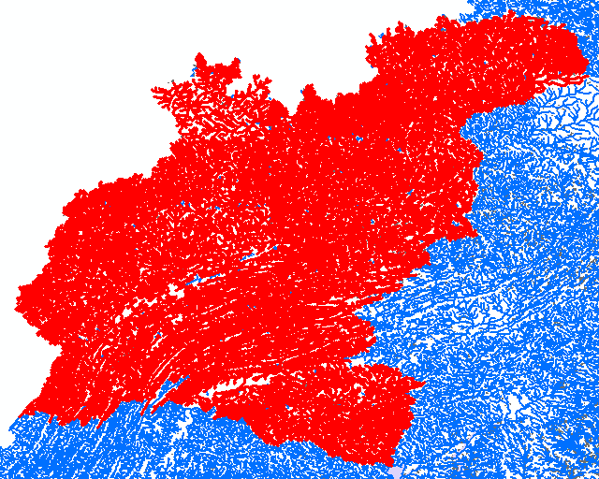
NHDPlus Concepts: Navigation of the Linear Surface Water Network
Susquehanna River
Drainage Basin
Susquehanna River
Main Stem

Slide 9
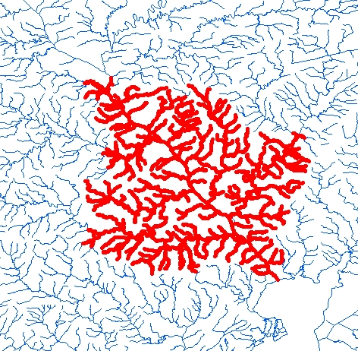
NHDPlus Concepts: Navigation of the Linear Surface Water Network
Stream Drainage Within 50 Miles of the
Mouth of the Susquehanna River

Slide 10
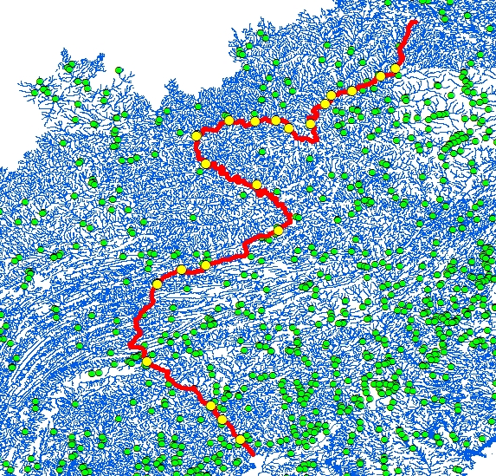
NHDPlus Concepts: Network Analysis
All Gages on the Susquehanna River

Slide 11
NHDPlus Concepts: Network Analysis
Find the nearest Permitted Discharge.
How long will it take to transport this toxic spill to the nearest downstream drinking water intake?
If we remove this dam, how much usable upstream habitat can the fish access?
NHDPlus makes these analyses possible.
NHDPlus make them fast and easy to implement.

Slide 12
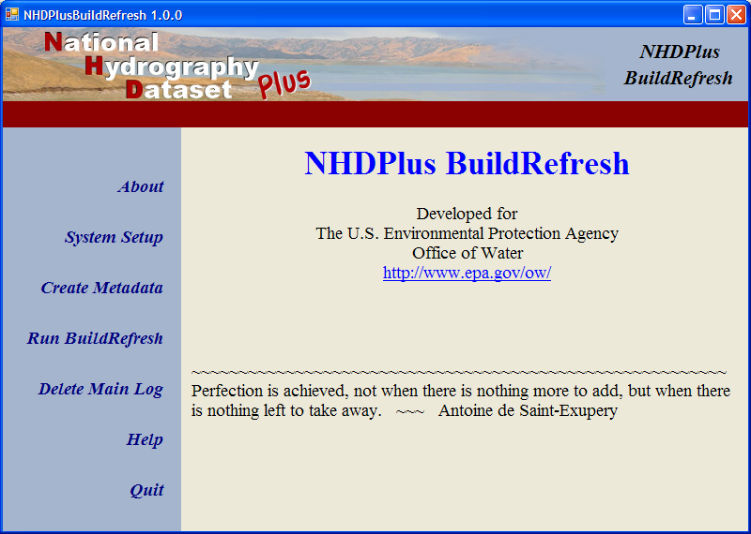
NHDPlus Ver 2.0: Build\Refresh Tools

Slide 13
NHDPlus Ver 2.0: Content
NHD Snapshot
  More Names
  More Lakes
  More than 7500 Isolated Networks Connected
NED Snapshot
  Nearly Wall-to-Wall 10 Meter Source Data
WBD Snapshot
  Nationally Complete

Slide 14
NHDPlus Ver 2.0: Content
USGS NWIS Streamflow Gage Network Locations – 23,000 in V01 – 30,000 in V02
Major Divergence Fractions - % of flow down divergent paths
Major Water Flow Additions, Removals & Inter-basin Transfers
TBD – NID Dam Network Locations

Slide 15
NHDPlus Ver 2.0: Content
2001 National Land Cover
  Land Cover
  Impervious Surface
  Canopy
  1992-2001 Change
PRISM – Temperature (1971-2000)
PRISM – Precipitation (1971-2000)
Annual and Monthly Runoff

Slide 16
NHDPlus Ver 2.0: Tools
(Enhanced and New)
Network Navigators
Basin Delineator
Catchment Attribute Allocation and Accumulation
Network/Catchment/Attribute Generalization

Slide 17
NHDPlus Ver 2.0: Flow Estimation
Version 2.0 – Mean Flows - Monthly & Annual
    Divergence Fraction
    Runoff Estimate
    Flow Additions and Removals
    Evapotranspiration
    Streamflow Gage Adjustments

Slide 18
NHDPlus Ver 2.0:
Questions?
LDM@Horizon-Systems.com
NHDPlus@hscnet.com

