Slide 1

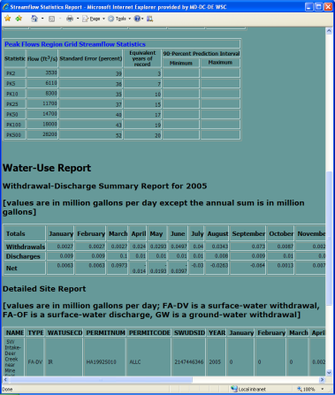
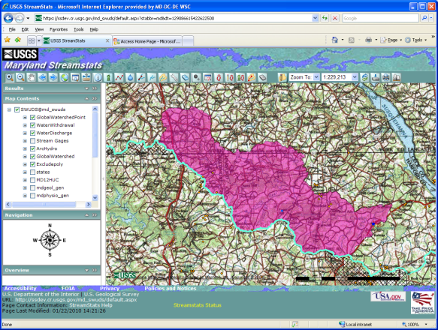
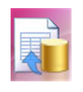
Linkage Between StreamStats and Water-Use Database
SWUDS Water-Use Database (UNIX/
Ingres)
Output
StreamStats
Web service request
Data
Ware-
house (Windows/
Access)
Water-use data sent

Slide 2

Example of Water Tracking
GW withdrawal
SW withdrawal
Wastewater discharge
Water conveyance
Irrigated land
Developed land - sewered
Developed land - unsewered
Ungaged site

Slide 3
Water Budgeting Requires
Estimate of natural flow
Sum of withdrawals
Sum of direct returns through WWTPs
Adjustments for
  Returns to GW in non-sewered areas
  Consumptive losses for irrigation and other uses within basin
  Infiltration and Inflow

Slide 4
Data Needs
Ungaged site
  Estimates of natural flow statistics or time series
Conveyances
  Time series (need to disaggregate from monthly to daily time step?)
  Estimates of unaccounted losses
Agricultural areas
  Estimates of ET and infiltration rates
Unsewered developed areas
  Estimates of consumptive losses
Sewered areas
  Quantification of I & I
Industries
  Consumptive losses

Slide 5
Integration with NHD and NHDPlus
NHD and NHDPlus can handle surface-water diversions and returns
What is the best way to integrate this functionality with SWUDS and Arc Hydro River for water budgeting?
How should groundwater withdrawals be handled in the context of NHD and NHDPlus?

Slide 6
Groundwater Issues
How do we deal with
  Time lag between GW withdrawal and effects on streamflow?
      STRMDEPL08* – stream depletion model?
      Arc Hydro Groundwater?
      Other types of models?
      Spatial datasets needed to parameterize models?
  Withdrawals from confined aquifers?
  Discharges to groundwater?
*Reeves, H.W., 2008, STRMDEPL08—An extended version of STRMDEPL with additional analytical solutions to calculate streamflow depletion by nearby pumping wells: U.S. Geological Survey Open-File Report 2008–1166, 22 p. Date Posted: June 16, 2008: [http://pubs.water.usgs.gov/ofr20081166/]

Slide 7
Reservoir Issues
Water withdrawals from reservoirs do not have an immediate effect on streamflow below the reservoirs because the water is taken mostly from storage
How can withdrawals from storage be handled in the context of SWUDS and Arc Hydro River?
Possibly use time series of prescribed releases as the basis for downstream flows?

